Slide 1

AWAKE
Daniel Ruiz under tutelage of Marlene Turner
May 6

Slide 2
Correlations.
Charge, Energy, Energy spread against
Proton Bunch Length / Intensity
Laser Energy
BPM

Slide 3
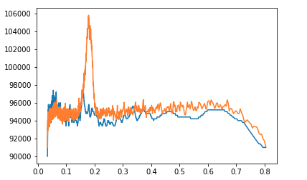
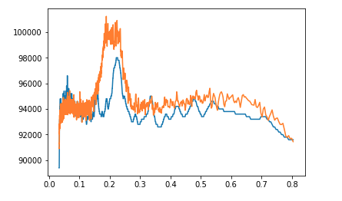
Lack of findings due to background

Slide 4
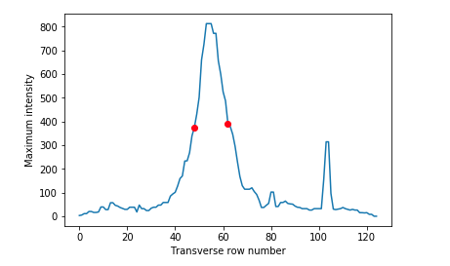
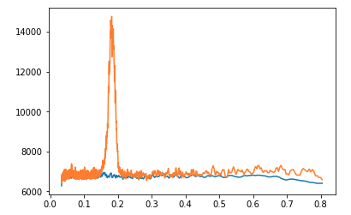
Reworking Algorithm
Transverse maximums

Slide 5
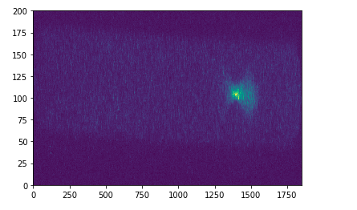
Screen Rotation necessary

Slide 6
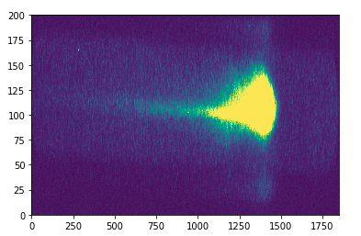
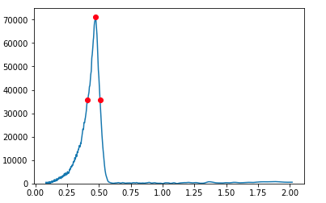
Charge Conversion
And Calibration
93 pC

