Slide 1


Plasma Wakefield Acceleration and the AWAKE Experiment
CAS@ ESI: Basics of Accelerator Physics and Technology
7 – 11 October 2019, Archamps, France
Edda Gschwendtner, CERN

Slide 2
Outline
Motivation
Introduction to Plasma Wakefield Acceleration
State of the Art
The AWAKE Experiment

Slide 3
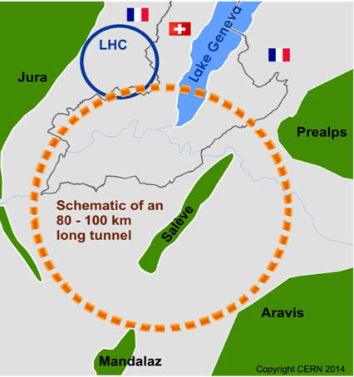

Discover New Physics
Accelerate particles to even higher energies
→ Bigger accelerators: circular colliders
Future Circular Collider: FCC
Limitations of conventional circular accelerators:
For hadron colliders, the limitation is magnet strength. Ambitious plans like the FCC call for 16 T magnets in a 100 km tunnel to reach 100 TeV proton-proton collision energy.
For electron-positron colliders: Circular machines are limited by synchrotron radiation in the case of positron colliders. These machines are unfeasible for collision energies beyond ~350 GeV.

Slide 4
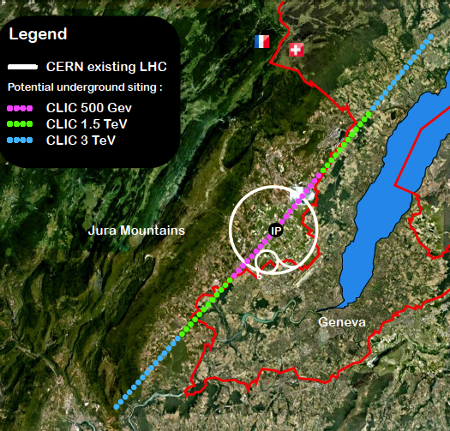
Discover New Physics
Linear colliders are favorable for acceleration of low mass particles to high energies.
CLIC, electron-positron collider with 3 TeV energy
→ 48 km
Limitations of linear colliders:
Linear machines accelerate particles in a single pass. The amount of acceleration achieved in a given distance is the accelerating gradient. This number is limited to 100 MV/m for conventional copper cavities.

Slide 5
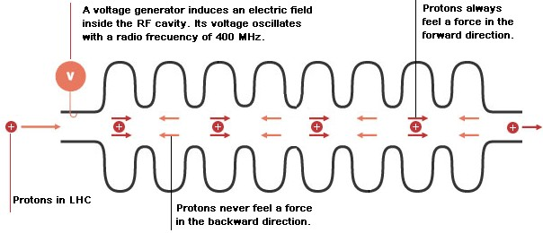
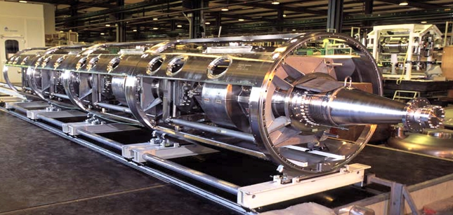
Conventional Acceleration Technology
Radiofrequency Cavities
LHC Cavity
  (invention of Gustav Ising 1924 and Rolf Wideroe 1927)

Slide 6
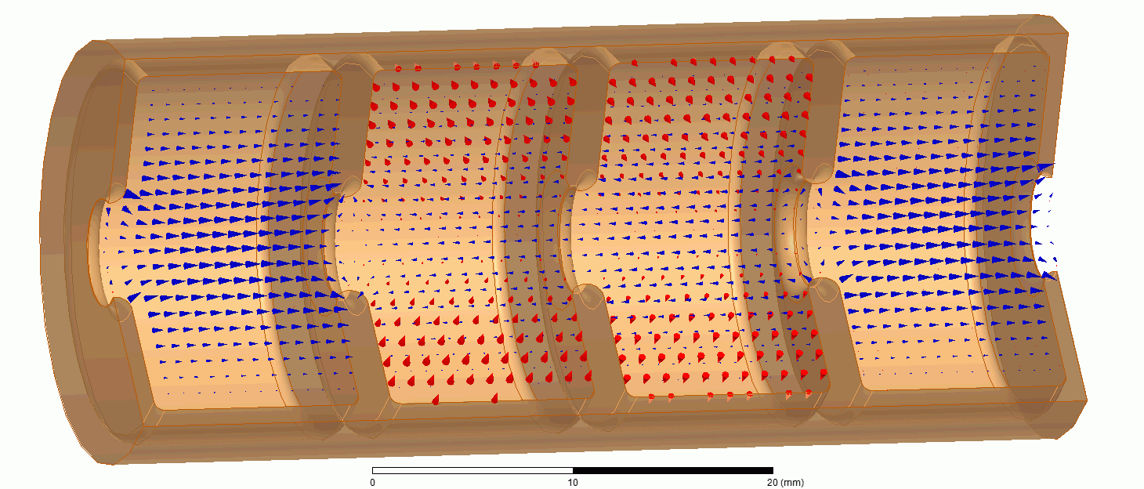
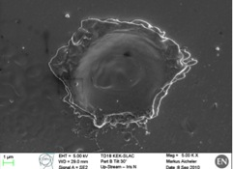
Conventional Accelerating Technology
Today’s RF cavities or microwave technology:
Very successfully used in all accelerators (hospitals, scientific labs,…) in the last 100 years.
Typical gradients:
  LHC: 5 MV/m
  ILC: 35 MV/m
  CLIC: 100 MV/m
However:
accelerating fields are limited to <100 MV/m
  In metallic structures, a too high field level leads to break down of surfaces, creating electric discharge.
  Fields cannot be sustained, structures might be damaged.
several tens of kilometers for future linear colliders

Slide 7
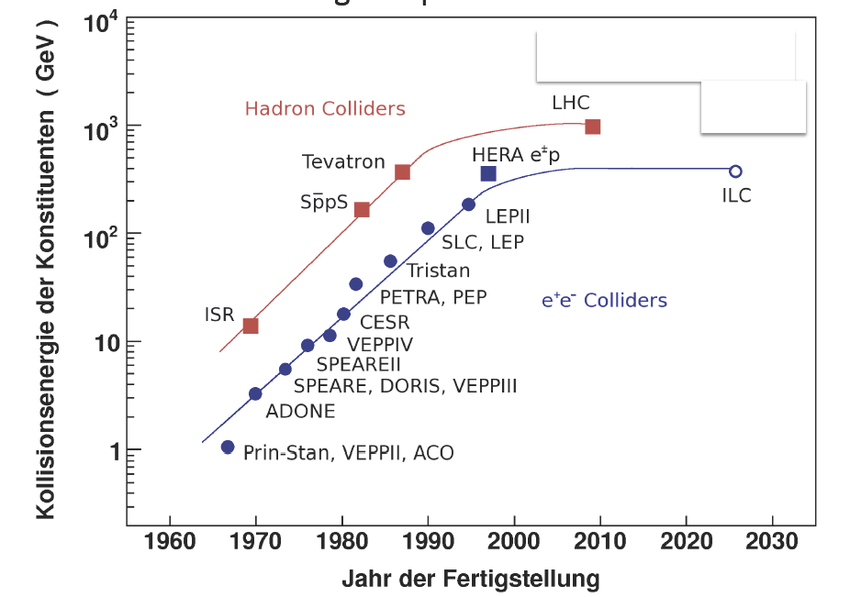
Saturation at Energy Frontier for Accelerators
Livingston plot
➔ Project size and cost increase with energy

Slide 8
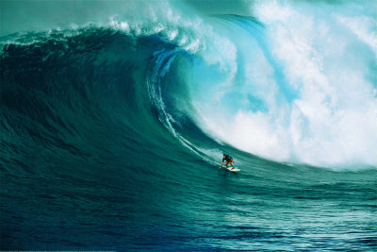
Plasma Wakefield Acceleration
➔Acceleration technology, which obtains ~1000 factor stronger acceleration than conventional technology.

Slide 9
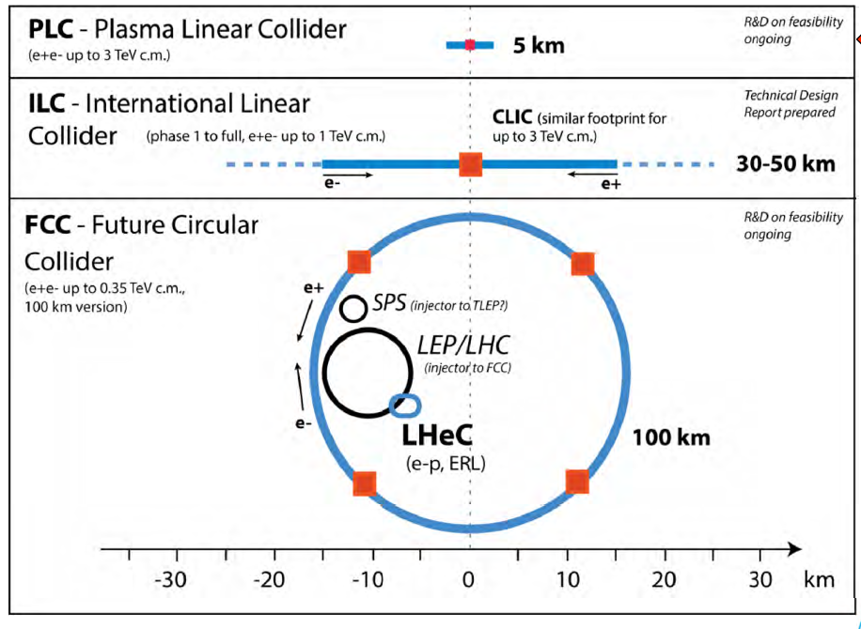
Conventional vs. Plasma

Slide 10
Outline
Motivation
Introduction to Plasma Wakefield Acceleration
State of the Art
The AWAKE Experiment

Slide 11
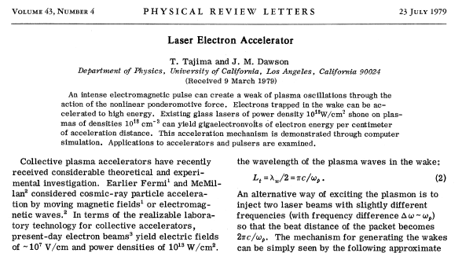
Seminal Paper 1979, T. Tajima, J. Dawson
Use a plasma to convert the transverse space charge force of a beam driver into a longitudinal electrical field in the plasma

Slide 12

Plasma Wakefield
What is a plasma?
Rb⁺
e
Quasi-neutrality: the overall charge of a plasma is about zero.
Collective effects: Charged particles must be close enough together
that each particle influences many nearby charged particles.
Electrostatic interactions dominate over collisions or ordinary gas kinetics.
Rb⁺
e
Rb⁺
Rb⁺
e
Rb⁺
e
e
e
e
e
Rb⁺
e
Rb⁺
Rb⁺
Rb⁺
e
Rb⁺
Example: Single ionized rubidium plasma
What is a plasma wakefield?
e
e
e
e
e
e
Rb⁺
e
e
e
e
Rb⁺
e
e
Rb⁺
e
e
e
e
e
e
e
e
Rb⁺
e
e
e
Rb⁺
e
e
e
Fields created by collective motion of plasma particles are called
plasma wakefields.
e
e
e
e
e
Rb⁺
e
Rb⁺
Rb⁺
Rb⁺
Rb⁺
e
e
e
e
e
e
e
e
e
e
e
e
e
e
e
e

Slide 13
Plasma Baseline Parameters
A plasma of density n_{pe} is characterized by the plasma frequency
n_{pe} e²
c
ω_{pe}
ω_{pe}
=
➔
k_{pe} =
√
m_{e} ε₀
ω_{pe}
… unit of plasma [m]
c
c
= 0.2mm ➔ k_{pe} = 5 mm⁻¹
Example: n_{pe} = 7x10¹⁴ cm⁻³ (AWAKE) ➔ ω_{pe} = 1.25x10¹² rad/s ➔
ω_{pe}
This translates into a wavelength of the plasma oscillation
c
10¹⁵ cm⁻³
λ_{pe}
=
2π
λ_{pe}
≈
1 mm
ω_{pe}
➔
√
n_{pe}
λ_{pe} = 1.2 mm
→ Produce cavities with mm size!

Slide 14

How to Create a Plasma Wakefield?
surfer
boat
Analogy:
water → plasma
Boat → particle beam (drive beam)
Surfer → accelerated particle beam (witness beam)
water

Slide 15
How to Create a Plasma Wakefield?
What we want:
Longitudinal electric field to accelerate charged particles.
e⁻ acceleration
e⁻
Our Tool:
e
Rb⁺
e
Rb⁺
Rb⁺
Rb⁺
e
drive-beam
Rb⁺
e
e
e
e
e
Rb⁺
e
Rb⁺
Rb⁺
Rb⁺
e
Rb⁺
Single ionized rubidium plasma
Using plasma to convert the transverse electric field of the
drive bunch into a longitudinal electric field in the plasma.
The more energy is available, the longer (distance-wise) these
plasma wakefields can be driven.
Charged particle bunches carry almost purely transverse Electric Fields.

Slide 16
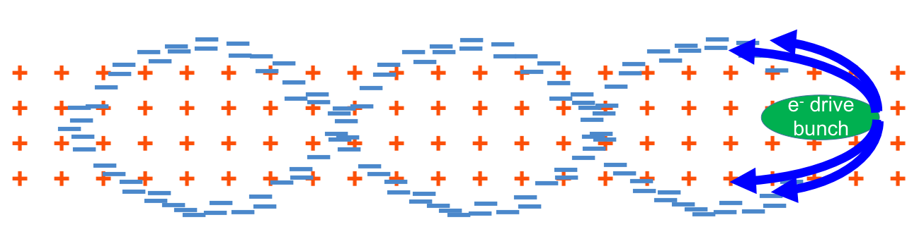
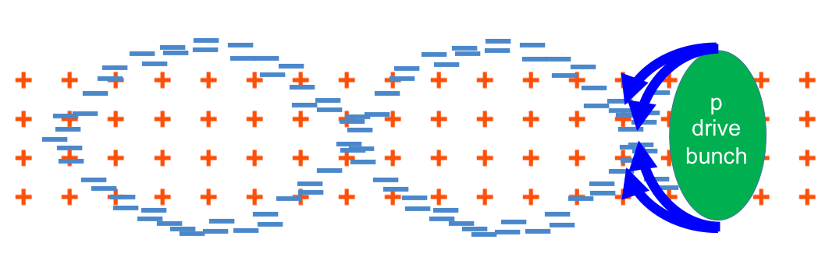
Principle of Plasma Wakefield Acceleration
Laser drive beam
  ➔ Ponderomotive force
Charged particle drive beam
  ➔ Transverse space charge field
  Reverses sign for negatively (blow-out) or positively (suck-in) charged beam
Plasma wave/wake excited by relativistic particle bunch
Plasma e⁻ are expelled by space charge force
Plasma e⁻ rush back on axis
Ultra-relativistic driver – ultra-relativistic wake → no dephasing
Acceleration physics identical for LWFA, PWFA
plasma wavelength λ_{pe}

Slide 17
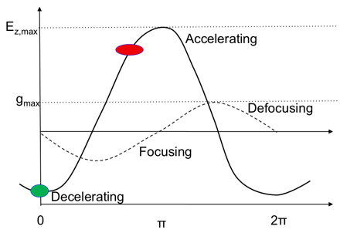
Where to Place the Witness Beam (Surfer)?
Accelerating for e⁻
Decelerating for e⁻
e⁻
Focusing for e⁻
Defocusing for e⁻

Slide 18
Wakefields
Accelerating for e⁻
Decelerating for e⁻
e⁻
Focusing for e⁻
Defocusing for e⁻
How strong can the fields be?
The plasma oscillation leads to a longitudinal accelerating field. The maximum accelerating field (wave-breaking field) is:
The ion channel left on-axis, where the beam passes, induces an ultra-strong focusing field:
n_{pe}
T
V
n_{pe}
g = 960 π
e E_{WB} =
96
10¹⁴ cm⁻³
m
m
√
cm⁻³
Example: n_{pe} = 7x10¹⁴ cm⁻³ (AWAKE) ➔ eE_{WB} = 2.5 GV/m ➔ g = 21kT/m
Example: n_{pe} = 7x10¹⁷ cm⁻³ ➔ eE_{WB} = 80 GV/m ➔ g = 21MT/m

Slide 19

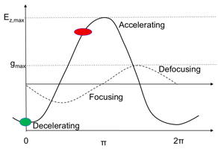
Plasma Wakefield, Linear Theory
(R. D. Ruth, P. Chen, SLAC-PUB-3906, 1986)
When drive beam density is smaller than plasma density (n_{b} << n_{p}) → linear theory.
Peak accelerating field in plasma resulting from drive beam with Gaussian distribution:
➔ eE_{z} ≈ N/σ_{z}²
B.E. Blue 2003
Wakefield excited by bunch oscillates sinusoidally with frequency determined by plasma density
Accelerating gradient increases linearly with N/σ_{z}
Fields excited by electrons and protons/positrons are equal in magnitude but opposite in phase
The accelerating field is maximized for a value of
k_{pe} σ_{z} ≈ √2
k_{pe} σ_{r} ≤ 1
Example: n_{pe} = 7x10¹⁴ cm⁻³ (AWAKE), k_{pe} = 5 mm⁻¹ ➔ drive beam: σ_{z} = 300µm, σ_{r} = 200µm

Slide 20
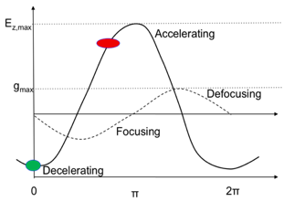
Plasma Wakefield, Linear Theory
Accelerating for e⁻
Decelerating for e⁻
Focusing for e⁻
e⁻
Defocusing for e⁻
Linear Theory: Maximum accelerating electric field reached with drive beam of N and σ_{z}:
MV
N/(2 x 10¹⁰)
← Driver must be short compared to plasma wavelength, easy for laser and electron bunches.
E_{acc}=
110
m
(σ_{z} / 0.6mm)²
Examples of accelerating fields for different beam parameters and plasma parameters fields:
N = 3x10¹⁰, σ_{z} = 300µm, n_{pe}= 7x10¹⁴ cm⁻³ ➔ E_{acc} = 600 MV/m
N = 3x10¹⁰, σ_{z} = 20µm, n_{pe}= 2x10¹⁷ cm⁻³ ➔ E_{acc} = 15 GV/m

Slide 21
Outline
Motivation
Introduction to Plasma Wakefield Acceleration
State of the Art
The AWAKE Experiment

Slide 22
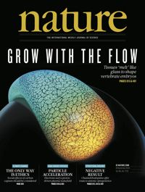
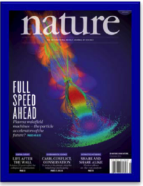

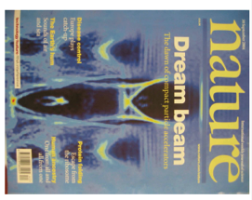
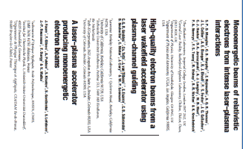
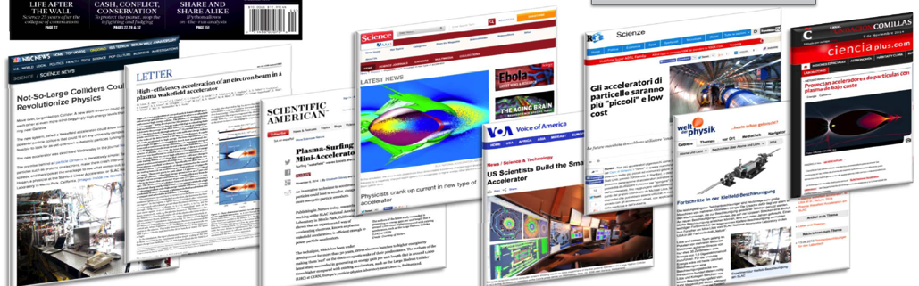
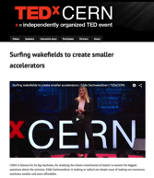
Many, Many Electron and Laser Driven Plasma Wakefield Experiments…!
Now first Proton Driven Plasma Wakefield Experiment

Slide 23

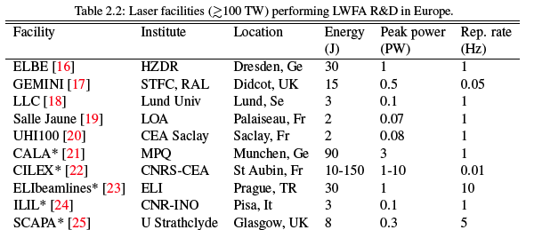
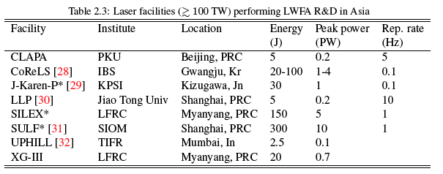
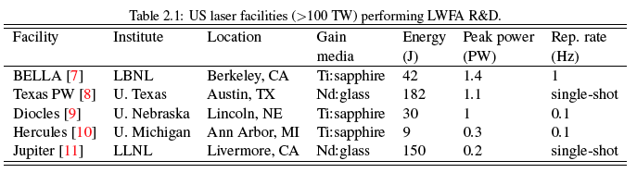
Laser-Driven Plasma Acceleration Facilities
ANGUS
DESY
Hamburg, Ge
5
0.2
5

Slide 24
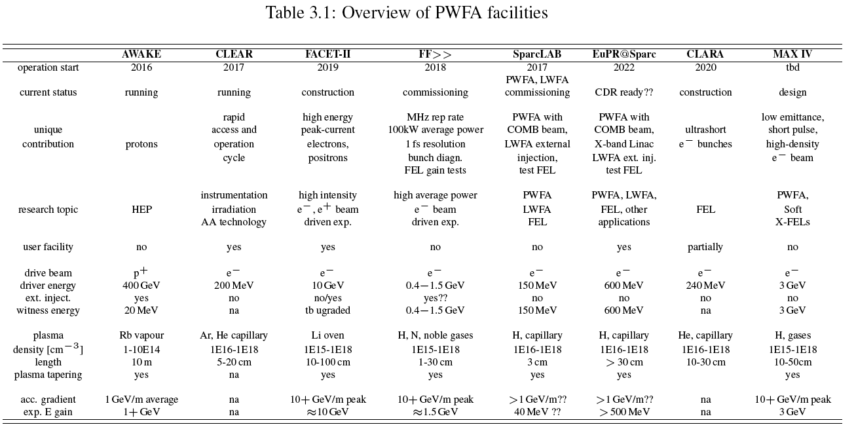
Beam-Driven Plasma Acceleration Facilities

Slide 25










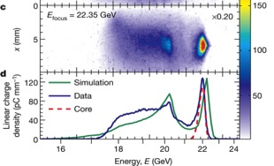
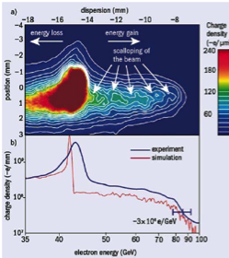
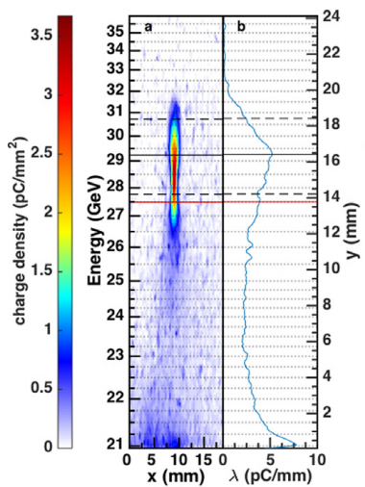

FACET, SLAC, US – Electrons as Driver
Premier R&D facility for PWFA: Only facility capable of e⁺ acceleration
Timeline:
  Commissioning (2011)
  Experimental program (2012-2016)
Key PWFA Milestones:
  Mono-energetic e⁻ acceleration
  High efficiency e⁻ acceleration
  First high-gradient e⁺ PWFA
  Demonstrate required emittance, energy spread
Energy doubling of 42 GeV electrons in a metre-scale plasma wakefield accelerator
I. Blumenfeld et al, Nature 455, p 741 (2007)
High-Efficiency acceleration of an electron beam in a plasmas wakefield accelerator, 2014
M. Litos et al., doi, Nature, 6 Nov 2014, 10.1038/nature 13882
Initial energy
9 GeV energy gain in a beam-driven plasma wakefield accelerator
→ gradient of 52 GV/m
Accelerated witness beam
M Litos et al 2016 Plasma Phys. Control. Fusion 58 034017
70 pC of charge accelerated, 2 GeV energy gain, 5 GeV/m gradient ➔ Up to 30% transfer efficiency, ~2% energy spread

Slide 26
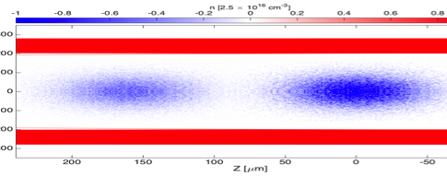
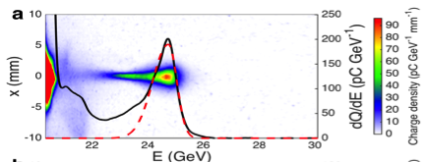
Positron Acceleration, FACET
  Positrons for high energy linear colliders: high energy, high charge, low emittance.
First demonstration of positron acceleration in plasma (FFTB)
Hollow plasma channel: positron propagation, wake excitation, acceleration in 30 cm channel.
S. Gessner et. al. Nat. Comm. 7, 11785 (2016)
B.E. Blue et al., Phys. Rev. Lett. 90, 214801 (2003)
M. J. Hogan et. al. Phys. Rev. Lett. 90 205002 (2003).
  Energy gain of 5 GeV. Energy spread can be as low as 1.8% (r.m.s.).
  S. Corde et al., Nature 524, 442 (2015)
Plasma
Vacuum
Witness Beam e⁺
𝜀 = 1
Drive Beam e⁺
𝜀 < 0
Measurement of transverse wakefields in a hollow plasma channel due to off-axis drive bunch propagation.
C. A. Lindstrøm et. al. Phys. Rev. Lett. 120 124802 (2018).
  High-density, compressed positron beam for non-linear PWFA experiments. Energy transfer from the front to the back part of the bunch.
Two-bunch positron beam: First demonstration of controlled beam in positron-driven wake
S. Doche et al., Nat. Sci. Rep. 7, 14180 (2017)
➔ Emittance blow-up is an issue! → Use hollow-channel, so no plasma on-axis, no complicated forces from plasma electrons streaming through the plasma → but then strong transverse wakefields when beams are misaligned.
Notes:
Now consider the case of a positron beam-driven wake. Instead of expelling electrons from the beam volume, plasma electrons are sucked into the beam volume, where they perform tight oscillations around the beam centroid, leading to an on-axis spike in plasma electron density.
The effect of this spike is twofold.
First, the plasma electron density profile matches, or attempts to match, the positron beam density profile. This results in a quasi-Gaussian plasma electron radial distribution resulting in a non-linear focusing field profile.
Second, the focused plasma electrons act back on the positron drive bunch, further focusing the beam and modifying its transverse distribution.
This implies that the beam emittance is spoiled due to the nonlinear focusing effects and that the exact focusing fields are difficult or impossible to predict analytically, due to their nonlinear nature.

Slide 27

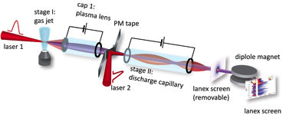
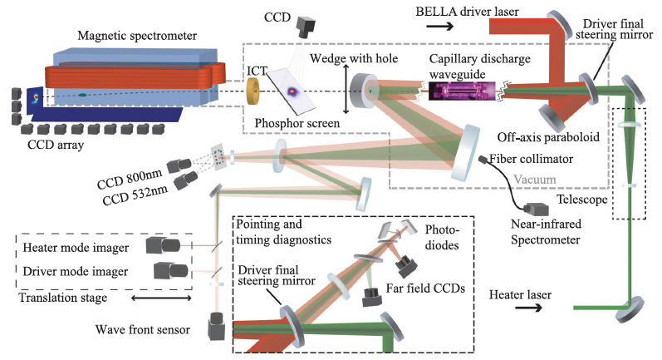
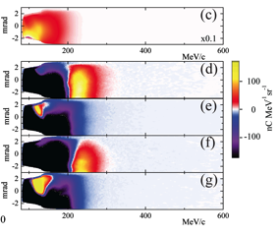
BELLA, Berkeley Lab, US– Laser as Driver
Laser Driven Plasma Wakefield Acceleration Facility: Today: PW laser!
Multistage coupling of independent laser-plasma accelerators
S. Steinke, Nature 530, 190 (2016)
Petawatt laser guiding and electron beam acceleration to 8 GeV in a laser-heated capillary discharge waveguide
A.J.Gonsalves et al., Phys.Rev.Lett. 122, 084801 (2019)
Laser heater added to capillary
Staging demonstrated at 100MeVs level.
→ path to 10 GeV with continued improvement of guiding in progress
Notes:
The Berkeley Lab Laser Accelerator (BELLA) Center focuses on the development and application of laser-plasma accelerators (LPAs). LPAs produce ultrahigh accelerating fields (1-100 GV/m) and may provide a compact technology for a variety of applications that include accelerators for high energy physics and drivers for high energy photon sources.
They preform the plasma waveguides in such a way that they mitigate the laser diffraction of the focused laser pulses and the associated reduction in the laser intensity.
Like that they increase the acceleration length and consequently the energy of the accelerated electrons.
Preforming the plasma channel, where the laser density is lower on axis, which creates a refractive index profile that is peaked on axis.
Heat the plasma along the capillary axis with a laser pulse of nanosecond length.
Guiding of relativistically intense laser pulses with peak power of 0.85 PW over 15 diffraction lengths was demonstrated by increasing the focusing strength of a capillary discharge waveguide using laser inverse bremsstrahlung heating. This allowed for the production of electron beams with quasimonoenergetic peaks up to 7.8 GeV, double the energy that was previously demonstrated. Charge was 5 pC at 7.8 GeV and up to 62 pC in 6 GeV peaks, and typical beam divergence was 0.2 mrad

Slide 28
What about a proton beam as a driver?

Slide 29
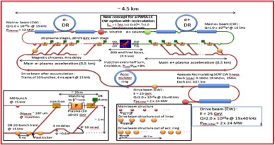
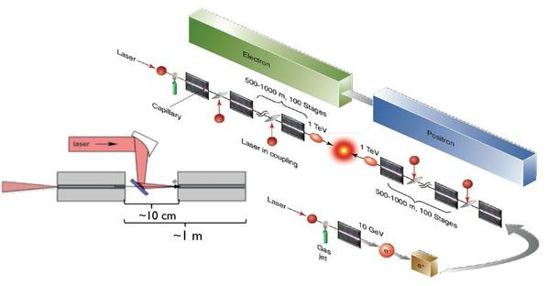
Energy Budget for High Energy Plasma Wakefield Accelerators
Drive beams:
Lasers: ~40 J/pulse
Electron drive beam: 30 J/bunch
Proton drive beam: SPS 19kJ/pulse, LHC 300kJ/bunch
Witness beams:
Electrons: 10¹⁰ particles @ 1 TeV ~few kJ
To reach TeV scale:
Electron/laser driven PWA: need several stages, and challenging wrt to relative timing, tolerances, matching, etc…
  effective gradient reduced because of long sections between accelerating elements….
Plasma cell
Plasma cell
Plasma cell
Plasma cell
Plasma cell
Plasma cell
Witness beam
Drive beam: electron/laser
E. Adli et. al.,arXiv:1308.1145 [physics.acc-ph]
C. B. Schroeder et. al. Phys. Rev. ST Accel. Beams 13, 101301

Slide 30
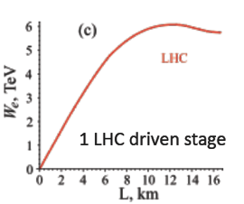
Energy Budget for High Energy Plasma Wakefield Accelerators
Drive beams:
Lasers: ~40 J/pulse
Electron drive beam: 30 J/bunch
Proton drive beam: SPS 19kJ/pulse, LHC 300kJ/bunch
Witness beams:
Electrons: 10¹⁰ particles @ 1 TeV ~few kJ
Proton drivers: large energy content in proton bunches → allows to consider single stage acceleration:
  A single SPS/LHC bunch could produce an ILC bunch in a single PDWA stage.
Plasma cell
Witness beam
Drive beam: protons
Dephasing:
SPS: ~70 m
LHC: ~few km
FCC: ~ ∞

Slide 31
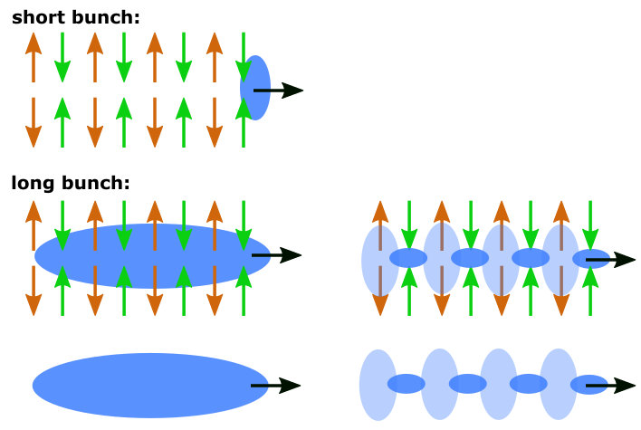
Seeded Self-Modulation of the Proton Beam
  In order to create plasma wakefields efficiently, the drive bunch length has to be in the order of the plasma wavelength.
  CERN SPS proton bunch: very long! (σ_{z} = 12 cm) → much longer than plasma wavelength (λ = 1mm)
N. Kumar, A. Pukhov, K. Lotov,
PRL 104, 255003 (2010)
Self-Modulation:
Bunch drives wakefields at the initial seed value when entering plasma.
  Initial wakefields act back on the proton bunch itself. → On-axis density is modulated. → Contribution to the wakefields is ∝ n_{b} .
Density modulation on-axis → micro-bunches.
  Micro-bunches separated by plasma wavelength λ_{pe}.
  drive wakefields resonantly.

Slide 32
AWAKE at CERN
Advanced WAKEfield Experiment
Proof-of-Principle Accelerator R&D experiment at CERN to study proton driven plasma wakefield acceleration.
Final Goal: Design high quality & high energy electron accelerator based on acquired knowledge.
Approved in August 2013
First proton beam sent to plasma end 2016
First electron acceleration in 2018

Slide 33

AWAKE
AWAKE Collaboration: 22 institutes world-wide:
University of Oslo, Oslo, Norway
CERN, Geneva, Switzerland
University of Manchester, Manchester, UK
Cockcroft Institute, Daresbury, UK
Lancaster University, Lancaster, UK
Oxford University, UK
Max Planck Institute for Physics, Munich, Germany
Max Planck Institute for Plasma Physics, Greifswald, Germany
UCL, London, UK
UNIST, Ulsan, Republic of Korea
Philipps-Universität Marburg, Marburg, Germany
Heinrich-Heine-University of Düsseldorf, Düsseldorf, Germany
University of Liverpool, Liverpool, UK
ISCTE - Instituto Universitéario de Lisboa, Portugal
Budker Institute of Nuclear Physics SB RAS, Novosibirsk, Russia
Novosibirsk State University, Novosibirsk, Russia
GoLP/Instituto de Plasmas e Fusão Nuclear, Instituto Superior Técnico, Universidade de Lisboa, Lisbon, Portugal
TRIUMF, Vancouver, Canada
Ludwig-Maximilians-Universität, Munich, Germany
University of Wisconsin, Madison, US
Wigner Institute, Budapest
Swiss Plasma Center group of EPFL, Lausanne, Switzerland
Novosibirsk
Korea
Vancouver
Glasgow
Madison
Oslo
Manchester
London
Hamburg, Greifswald
Dusseldorf
Budapest
Munich
Lausanne
CERN
Lisbon

Slide 34



AWAKE Timeline
 | 2013 | 2014 | 2015 | 2016 | 2017 | 2018 | 2019 | 2020 | 2021 | 2022/23/24
Proton and laser beam-line
Experimental area
e⁻ source and beam-line
Study, Design,
Procurement, Component preparation
Installation
Data taking
Data taking
AWAKE RUN 1
Long Shutdown 2
24 months
Commissioning
AWAKE RUN 2
AWAKE++: After Run 2: kick-off particle physics driven applications
Modification, Civil Engineering and installation
Study, Design,
Procurement, Component preparation
Phase 1
Studies, design
Fabrication
Installation
Commissioning
Phase 2
AWAKE Run 1: Proof-of Concept
2016/17: Seeded Self-Modulation of proton beam in plasma
2018: Electron acceleration in plasma
AWAKE Run 2: proposed for after LS2:
achieve high-charge bunches of electrons accelerated to high energy, about 10 GeV, while maintaining beam quality through the plasma and showing that the process is scalable.

Slide 35
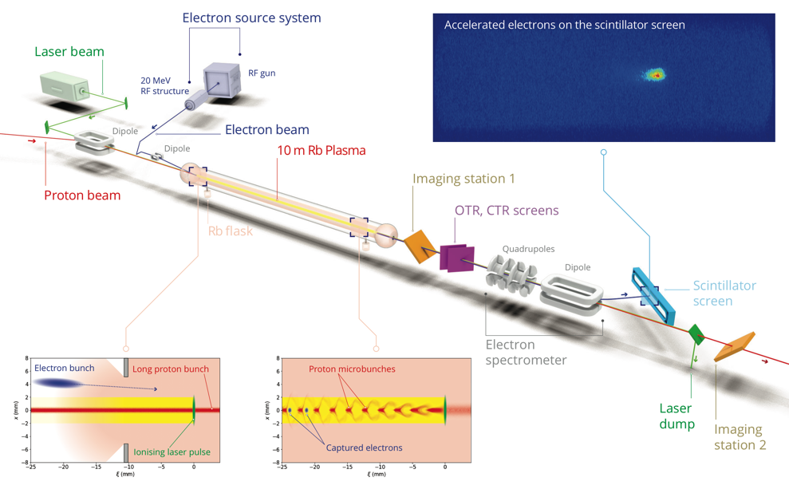
AWAKE Experiment

Slide 36
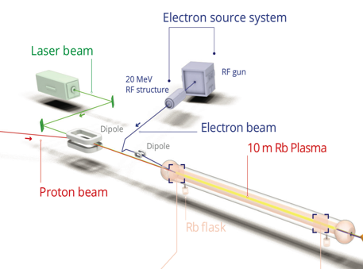
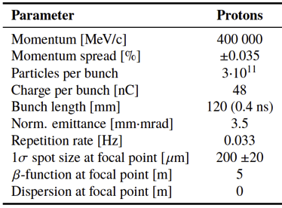
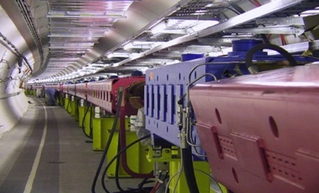
AWAKE Proton Beam Line
Plasma linear theory: k_{pe} σ_{r} ≤ 1
With σ_{r} = 200 µm
k_{pe} = ω_{pe} /c = 5 mm⁻¹
➔ n_{pe} = 7x10¹⁴ cm⁻³
The AWAKE beamline is designed to deliver a high-quality beam to the experiment. The proton beam must be steered around a mirror which couples a terawatt class laser into the beamline.
Further downstream, the witness electron beam will injected into the same beamline.
750m proton beam line

Slide 37
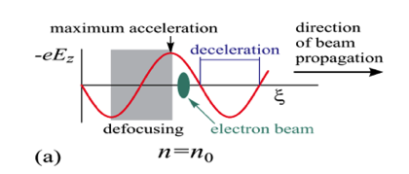
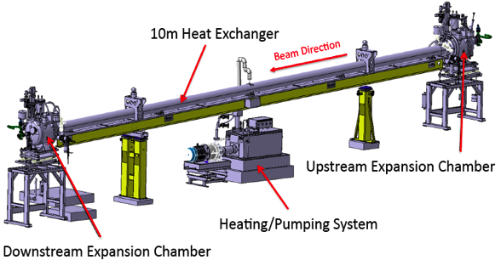
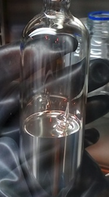
AWAKE Plasma Cell
10 m long, 4 cm diameter
Rubidium vapor, field ionization threshold ~10¹² W/cm²
Density adjustable from 10¹⁴ – 10¹⁵ cm⁻³ ➔ 7x 10¹⁴ cm⁻³
Requirements:
  density uniformity better than 0.2%
    Fluid-heated system (˜220 deg)
    Complex control system: 79 Temperature probes, valves
  Transition between plasma and vacuum as sharp as possible
Plasma density profile
few cm
10 m
few cm
Plasma density
Circulation of Galden HT270 at 210 [°C] in plasma cell

Slide 38
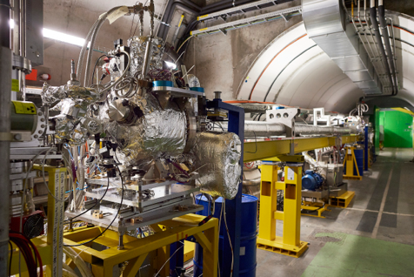
AWAKE Plasma Cell
Plasma cell in AWAKE tunnel
Notes:
.

Slide 39
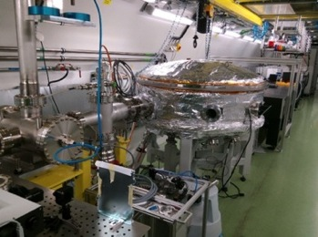
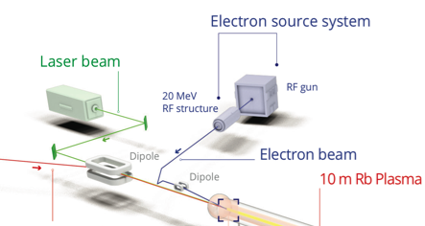
Laser and Laser Line
AWAKE uses a short-pulse Titanium:Sapphire laser to ionize the rubidium source.
→ Seeding of the self-modulation with the ionization front.
The laser can deliver up to 500 mJ in a 120 fs pulse envelope.
Laser beam
e-source laser
Diagnostic laser
Laser, compressor in laser room

Slide 40
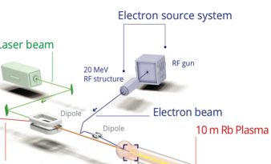
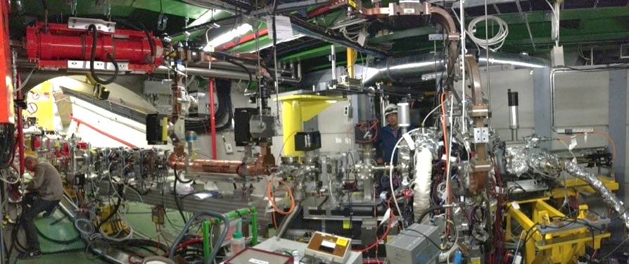
Electron Beam System
Laser beam
e-source laser
Laser line
Transfer line
Diagnostics and booster structure
Electron source
A Photo-injector originally built for a CLIC test facility is now used as electron source for AWAKE producing short electron bunches at an energy of ~20 MeV/c.
A completely new 12 m long electron beam line was designed and built to connect the electrons from the e-source with the plasma cell.
Challenge: cross the electron beam with the proton beam inside the plasma at a precision of ~100 µm.
Notes:
19 MeV
14mm mrad
650 pC at source
FWHM = 5.2 ps.

Slide 41
Outline
Introduction to Plasma Wakefield Acceleration
AWAKE, The Advanced Wakefield Experiments
AWAKE Results
What’s Next

Slide 42
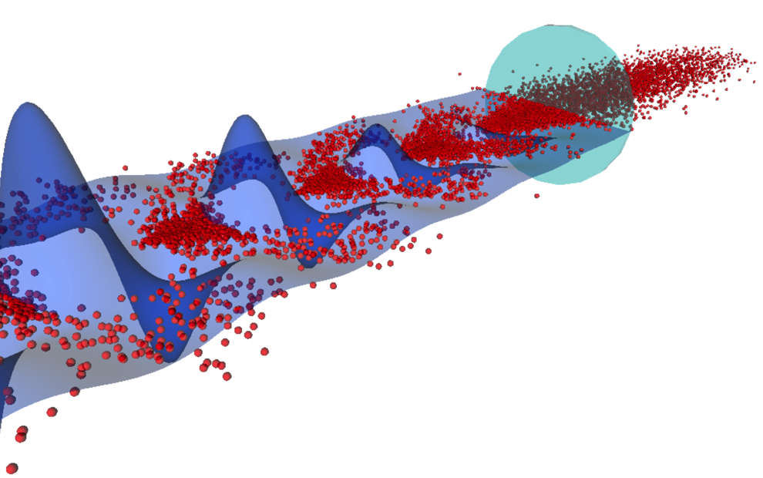
Seeded Self-Modulation Results
Short laser pulse
No plasma
Wake potential
protons
λ_{p} = 1.2 mm
Second half of the proton bunch sees plasma
A. Petrenko, CERN

Slide 43


Diagnostics for Seeded Self-Modulation
Direct SSM Measurement:
Measure longitudinal structure of self-modulated proton bunch.
→ Image OTR light onto the slit of a streak camera.
→ Time resolved measurement.
Streak Camera
OTR screen
/ OTR
/ OTR

Slide 44



Results: Direct Seeded Self-Modulation Measurement
Laser
Plasma
Vapor
p⁺
AWAKE preliminary
AWAKE
collaboration
Effect starts at laser timing → SM seeding
Density modulation at the ps-scale visible
Micro-bunches present over long time scale from seed point
Reproducibility of the µ-bunch process against bunch parameters variation
Phase stability essential for e⁻ external injection.
→ 1st AWAKE Milestone reached
AWAKE Collaboration, ‘Experimental observation of proton bunch modulation in a plasma, at varying plasma densities’. Phys. Rev. Lett. 122, 054802 (2019).

Slide 45


Electron Acceleration Results 2018
Electron acceleration after 10m:
What we expect with the AWAKE Run 1 setup:
with baseline parameters: ~1.6 GeV
protons
electrons
Beams are co-propagating in this direction close to the speed of light
A. Petrenko, CERN
A. Caldwell et al., AWAKE Coll., Nucl. Instrum. A 829 (2016) 3

Slide 46


Electron Acceleration Diagnostics
camera
scintillator screen Lanex, 1m x 6cm
Spectrometer:
Dipole: B = 0.1 - 1.5 T, Magnetic length = 1m
→ detect electrons with energies ranging from 30MeV - 8.5 GeV
Electrons will be accelerated in the plasma. To measure the energy the electrons pass through a dipole spectrometer and the dispersed electron impact on the scintillator screen.
The resulting light is collected with an intensified CCD camera.

Slide 47

Electron Acceleration Results
Event at n_{pe} =1.8 x 10¹⁴ cm⁻³ with 5%/10m density gradient.
Acceleration to 800 MeV.
E. Adli et al. (AWAKE Collaboration), Nature, doi:10.1038/s41586-018-0485-4 (2018)

Slide 48

Electron Acceleration Results
Acceleration up to 2 GeV has been achieved.
Charge capture up to 20%.
E. Adli et al. (AWAKE Collaboration), Nature, doi:10.1038/s41586-018-0485-4 (2018)

Slide 49
Outline
Introduction to Plasma Wakefield Acceleration
AWAKE, The Advanced Wakefield Experiments
AWAKE Results
What’s Next

Slide 50

AWAKE Run 2
Goal:
Accelerate an electron beam to high energy (gradient of 0.5-1GV/m)
Preserve electron beam quality as well as possible (emittance preservation at 10 mm mrad level)
Demonstrate scalable plasma source technology (e.g. helicon prototype)
Freeze the modulation with density step in first plasma cell
For emittance control: need to work in blow-out regime and do beam-loading
R&D on different plasma source technologies
2013
2014
2015
2016
2017
2018
2019
2020
2021
2022
2023
2024
2025
2026
2027
LS2
LS2
LS3
Run 1
Preparation
Run 1
Run 2
Preparation
Run 2
First application

Slide 51




AWAKE Run 2
X-band electron source
Accelerating plasma cell
Helicon plasma cell

Slide 52

Applications with AWAKE-Like Scheme
➔ Requirements on emittance are moderate for fixed target experiments and e/p collider experiments, so first experiments in not-too far future!
First Application:
Fixed target test facility: Use bunches from SPS with 3.5 E11 protons every ~5sec, → electron beam of up to O (50GeV), 3 orders of magnitude increase in electrons (compared to NA64)
deep inelastic scattering, non-linear QED, search for dark photons a la NA64
50 m: 33 GeV/c e, ∆E/E = 2%, ~100 pC.
100 m: 53 GeV/c e, ∆E/E=2%, ~130 pC.
Notes:
parameter space of the mass of the dark photon, mA0 , and
the dimensionless coupling to Standard Model particles, in decays to e+e􀀀.

Slide 53
Applications with AWAKE-Like Scheme
➔ Requirements on emittance are moderate for fixed target experiments and e/p collider experiments, so first experiments in not-too far future!
Using the SPS or the LHC beam as a driver, TeV electron beams are possible → Electron/Proton or Electron/Ion Collider
  PEPIC: LHeC like collider: E_{e} up to O (70 GeV), colliding with LHC protons → exceeds HERA centre-of-mass energy
  VHEeP: choose E_{e} = 3 TeV as a baseline and with E_{P} = 7 TeV yields √s = 9 TeV. → CM ~30 higher than HERA. Luminosity ~ 10²⁸ − 10²⁹ cm⁻² s⁻¹ gives ~ 1 pb⁻¹/yr.

Slide 54
Summary and Outlook
Many encouraging results in the plasma wakefield acceleration technology. Plasma wakefield acceleration is an exciting and growing field with a huge potential.
AWAKE: Proton-driven plasma wakefield acceleration interesting because of large energy content of driver. Modulation process means existing proton machines can be used.
AWAKE has for the first time demonstrated proton driven plasma wakefield acceleration of externally injected electrons to GeV levels. Next step is to accelerate high quality, high energy electrons.
Outlook:
Near-term goals: the laser/electron-based plasma wakefield acceleration could provide near term solutions for FELs, medical applications, etc.
Mid-term goal: the AWAKE technology could provide particle physics applications.
Long-term goal: design of a high energy electron/positron/gamma linear collider based on plasma wakefield acceleration.

Slide 55
Extra Slides

Slide 56
Status of Today and Goals for Collider Application
 | Current | Goal
Charge (nC) | 0.1 | 1
Energy (GeV) | 9 | 10
Energy spread (%) | 2 | 0.1
Emittance (um) | >50-100 (PWFA), 0.1 (LFWA) | <10⁻¹
Staging | single, two | multiple
Efficiency (%) | 20 | 40
Rep Rate (Hz) | 1-10 | 10³⁻⁴
Acc. Distance (m)/stage | 1 | 1-5
Positron acceleration | acceleration | emittance preservation
Proton drivers | SSM, acceleration | emittance control
Plasma cell (p-driver) | 10 m | 100s m
Simulations | days | improvements by 10⁷

Slide 57
Outlook
Short term perspective of PWFA (< 10 years):
  Compact FEL based: 5 – 10 GeV energy range
  Compact X-ray sources: electron accelerated in strong transverse field of plasma emit betatron radiation
  applications in medicine, radiobiology, material science
Long term perspective of PWFA (>20 years):
  High energy physics applications: Plasma-based high energy linear collider
  ➔ depends strongly on progress in many fields.
The most demanding application of plasma wakefield acceleration is to build a compact, efficient, Plasma-Based Linear Collider.

