Slide 1
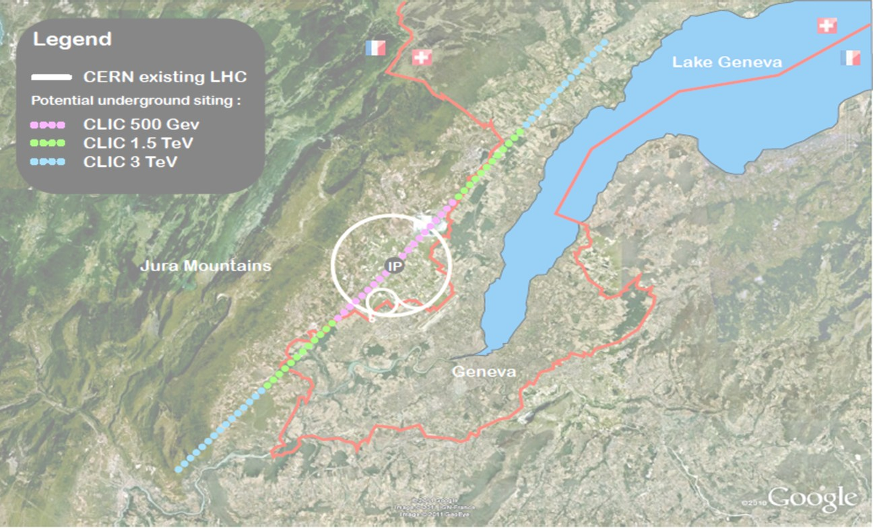
CLIC
Many slides courtesy of Daniel Schulte (CERN) and Frank Tecker (CERN)
Hermann Schmickler, CERN CAS@ESI Archamps 2019

Slide 2
Outline
Overview future (and past) high energy colliders
CLIC := Compact Linear (e+e-) Collider
- Why e+e-? → precision physics
- Why linear? → no synchrotron radiation
- how compact? → 100 MV/m with NC RF
Basic Parameters of CLIC…Comparison with ILC
Focus on two aspects:
- Nanometer Size Beams at IP: Why and how?
- RF Powering through a second particle beam: Why and how?

Slide 3
Past/Existing High Energy Frontier Colliders
Only referring to the highest energy
Lepton colliders:
LEP (Large Electron Positron Colliders)
  Z₀ factory at 90GeV electron-positron cms energy
  W⁺W⁻ factory at 160GeV
  Maximum 209 GeV cms energy for higgs search
  (bad luck: e+e- → Z⁰H needs about 250 GeV)
  Closed in the year 2000
SLC (Standford Linear Collider)
  Z₀ factory at 90GeV electron-positron cms energy
Hadron colliders
LHC (Large Hadron Collider):
  Proton-proton with 13TeV
  Ion-ion operation

Slide 4
Considered Future High Energy Frontier Colliders
Circular colliders:
FCC (Future Circular Collider)
  FCC-hh: 100TeV proton-proton cms energy, ion operation possible
  FCC-ee: Potential intermediate step 90-350 GeV lepton collider
  FCC-he: Lepton-hadron option
CEPC / SppC (Circular Electron-positron Collider/Super Proton-proton Collider)
  CepC : e⁺e⁻ 240GeV cms
  SppC : pp 70TeV cms
Linear colliders
ILC (International Linear Collider): e⁺e⁻, 500 GeV cms energy, Japan considers hosting project
CLIC (Compact Linear Collider): e⁺e⁻, 380GeV-3TeV cms energy, CERN hosts collaboration
Others
Muon collider, has been supported mainly in the US but effort has stopped
Plasma wakefield acceleration in linear collider…not yet ready
Photon-photon collider
LHeC

Slide 5
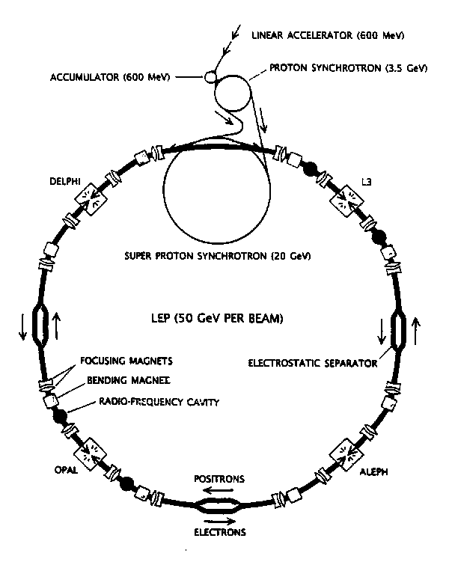
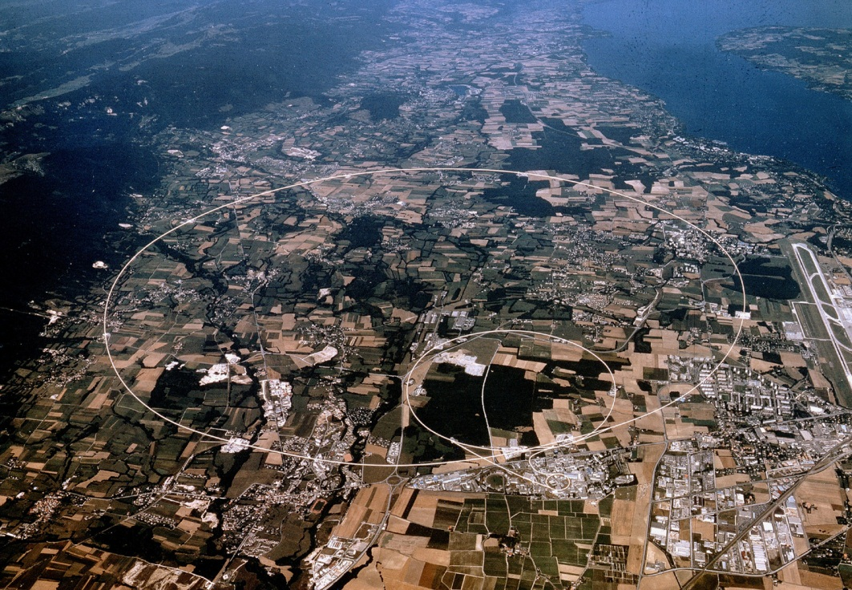
LEP (at CERN)
27km circumference
Electron-positron collider
4 experiments: ALEPH, DELPHI, L3, OPAL
CMS energy: 90GeV (LEP I) - 209GeV (LEP II)
Peak Luminosity: 10³²cm⁻²s⁻¹
Operation: 1989-2000
Highest particle speed in any accelerator

Slide 6
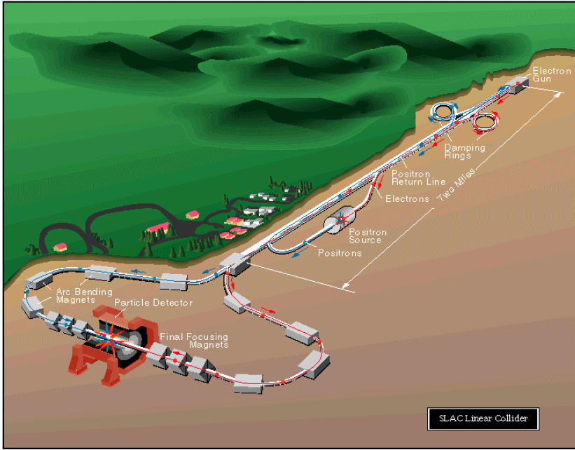
SLC (at SLAC)
Electron-positron linear collider
2 experiments: first MARK II, then SLD
CMS energy: 92GeV
Peak Luminosity: 2x10³⁰cm⁻²s⁻¹
Operation: 1989-1998
The only linear collider sofar

Slide 7
The LHC (at CERN)
27km circumference (well, the LEP tunnel)
4 main experiments
Nominal CMS energy: 14TeV
Peak Luminosity: 10³⁴cm⁻²s⁻¹
Operation: 2009-today
Highest particle energy in any accelerator

Slide 8
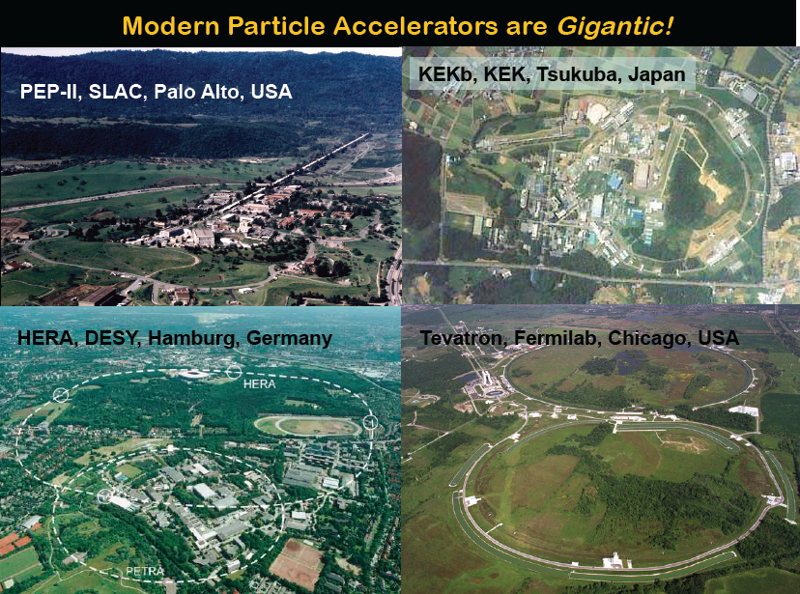
Other Colliders

Slide 9
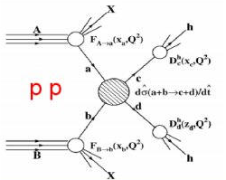
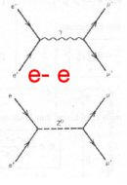
Collider Choices
Hadron collisions: compound particles
  Mix of quarks, anti-quarks and gluons: variety of processes
  Parton energy spread
  QCD processes large background sources
  total cross section increases with log s;
  “interesting cross sections” decrease with s
  Hadron collisions ⇒ large discovery range
Lepton collisions: elementary particles
  Collision process known
  Well defined energy
  Other physics background limited
  Lepton collisions ⇒ precision measurements
  All cross sections decrease with s
Lepton-hadron is also possible

Slide 10
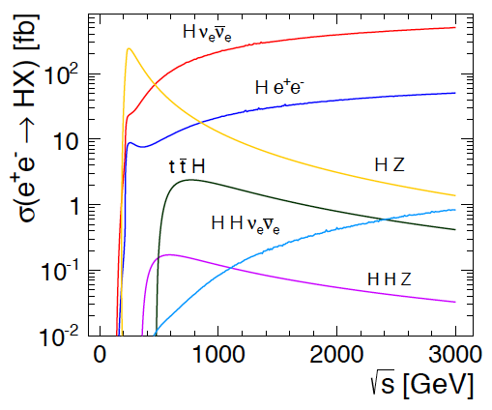
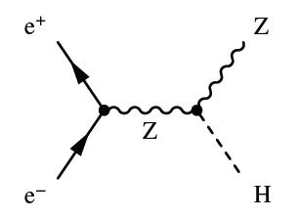
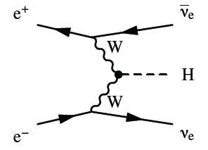
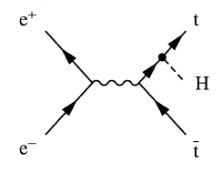
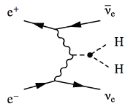

Higgs Physics in e+e- Collisions
Precision Higgs measurements
Model-independent
  Higgs couplings
  Higgs mass
Large energy span of linear colliders allows to collect a maximum of information:
  ILC: 500 GeV (1 TeV)
  CLIC: ~350 GeV – 3 TeV

Slide 11
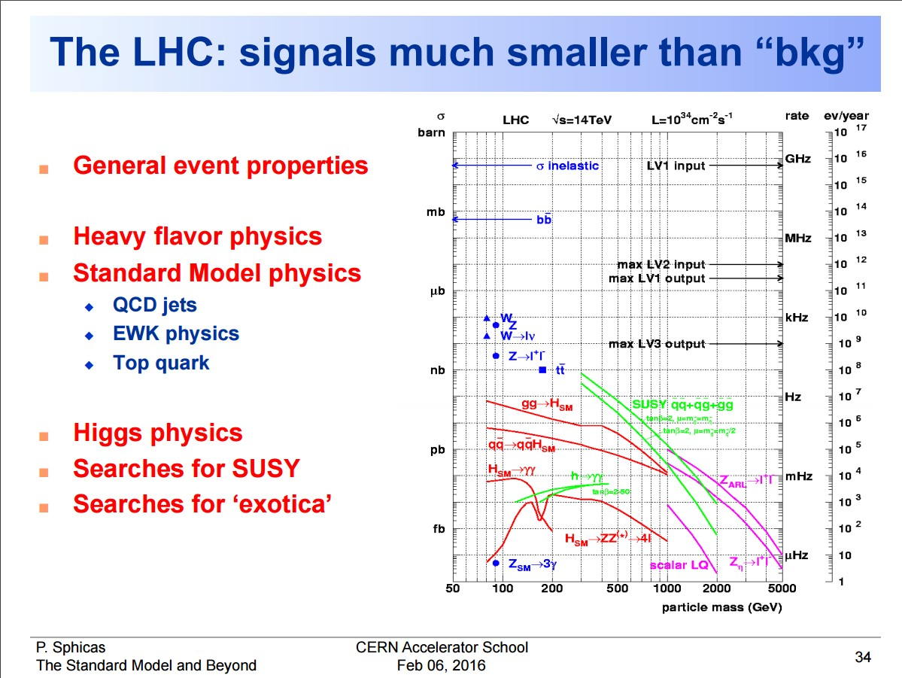

Slide 12
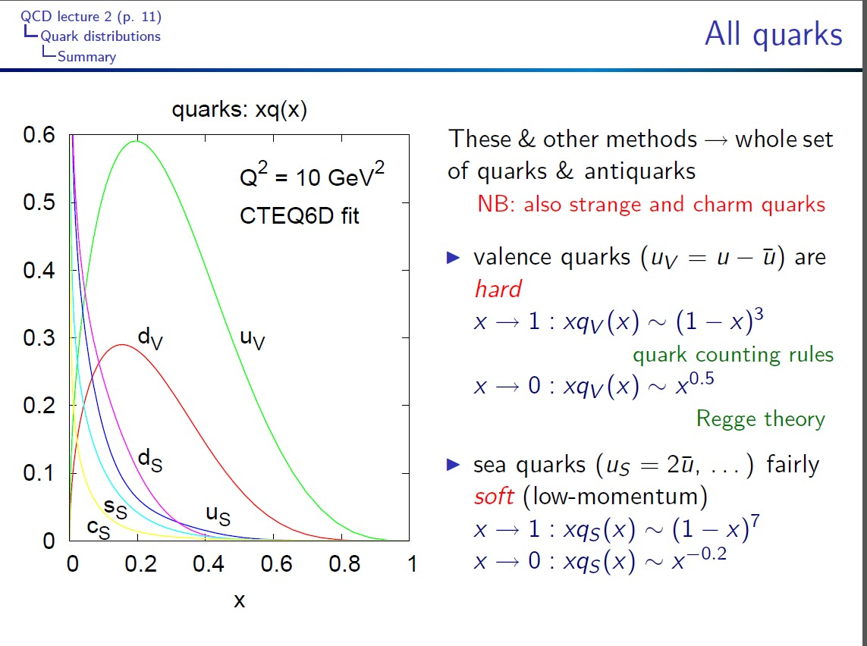

Slide 13
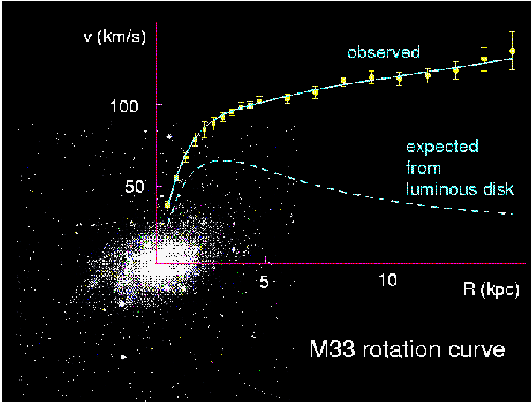
Physics Beyond the Standard Model (BSM)
Example: Dark Matter
The outer region of galaxies rotate faster than expected from visible matter
Corbelli & Salucci (2000); Bergstrom (2000)
Dark matter would explain this
Other observations exist
But all through gravity
What is it?
One explanation is supersymmetry

Slide 14
Supersymmetry
Supersymmetric
Partner
~
~
~
~
~
u
c
t
γ
H
u
c
t
γ
H
~
~
~
~
~
d
s
b
g
H
d
s
b
g
H
ν_{e}
ν_{μ}
ν_{τ}
~
~
~
~
W
ν_{e}
ν_{μ}
ν_{τ}
W
~
~
~
~
e
μ
τ
Z
e
μ
τ
Z
Spin
1/2
Spin
1
Spin
0
Spin
0
Spin
1/2
Spin
1/2

Slide 15
Example of Potential SUSY Scenario
350GeV
Consistent with current LHC results

Slide 16
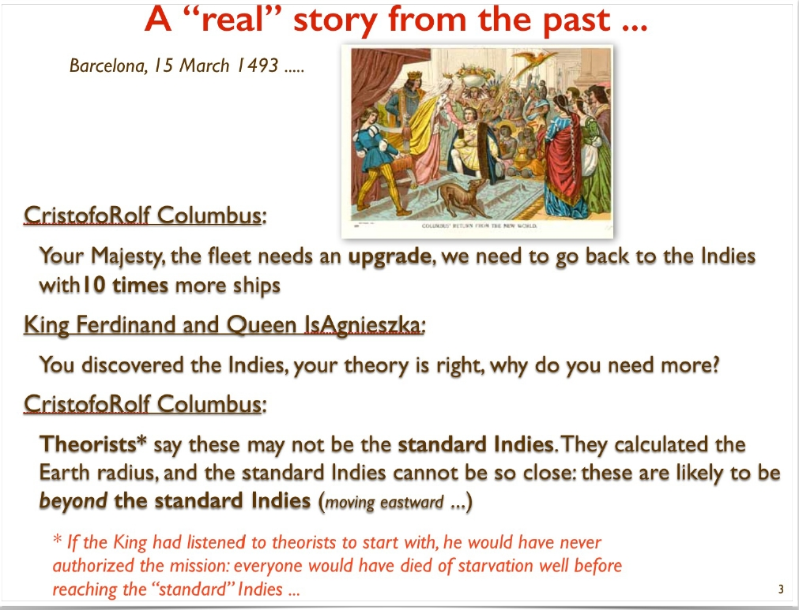

Slide 17
Lepton Collider Options
Three main approaches
Big LEP-type collider ring
  FCC-ee, CepC
  Later a proton collider in the same tunnel
Linear collider
  ILC, CLIC
  The focus of this course
Muon collider

Slide 18
Ring Collider Energy Limitation
Beam can be used many times
Lepton beam energy is below LHC
-> magnets are not a problem
accelerating cavities
N
N
But synchrotron radiation is:
At LEP2 lost 2.75GeV/turn for E=105GeV
Pay for installed voltage (ΔE) and size (R),
so scale as:
S
S
-> use heavier particles, e.g. muons
-> or linear collider
(-> or try to push a bit harder on cost)

Slide 19
Linear Collider Energy Limitation
source
main linac
Hardly any synchrotron radiation
Beam can only be used only once
-> strong beam-beam effects
Acceleration gradient is an important issue

Slide 20
Simplified Cost Scaling Comparison
Linac:
Ring:
Power consumption behaves similar to cost for constant luminosity
There will always be an energy where linear colliders are better

Slide 21
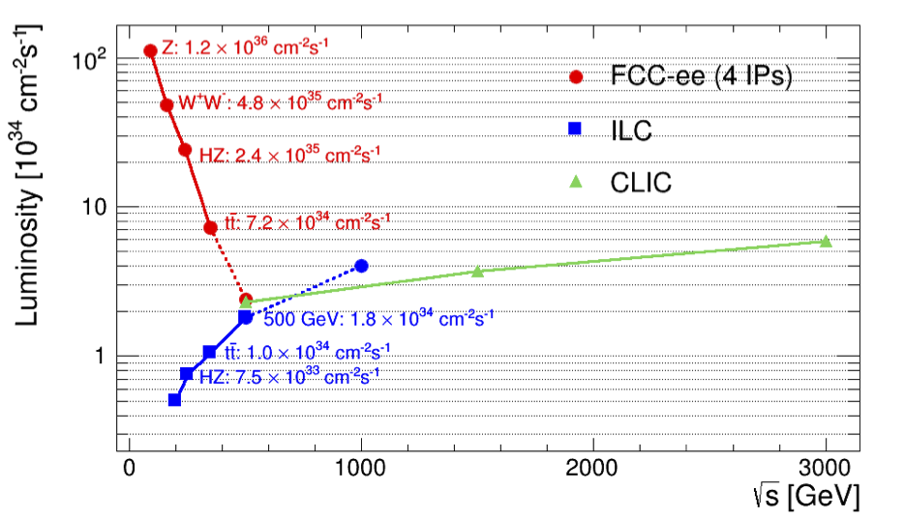
Circular vs. Linear Colliders
Circular,
adding four experiments
F. Gianotti
Modified from original version:
http://arxiv.org/pdf/1308.6176v3.pdf
CepC (2 IPs)
China prepares a project similar to FCC-ee
Linear

Slide 22
Generic Linear Collider
The main linac provides the energy of the beam
Issue 1: the gradient

Slide 23
Generic Linear Collider
But little luminosity, since beams collider only once
Need very small σ_{x} and σ_{y}

Slide 24
Generic Linear Collider
The damping rings reduce the phase space (emittance ε_{x,y}) of the beam
The RTML (ring-to-main linac transport) reduces the bunch length

Slide 25
Generic Linear Collider
The beam delivery system (BDS) squeezes the beam as much as possible, i.e. reduces β_{x,y}

Slide 26
ILC Layout

Slide 27
CLIC – layout for 380 GeV
only one DB complex (with 2x RF pulse length compared to 2 DB complexes)
drive beam time delay line
(1st half of pulse sent there)
shorter main linac
Drive Beam Generation Complex
Drive beam
Main beam
Main Beam Generation Complex

Slide 28
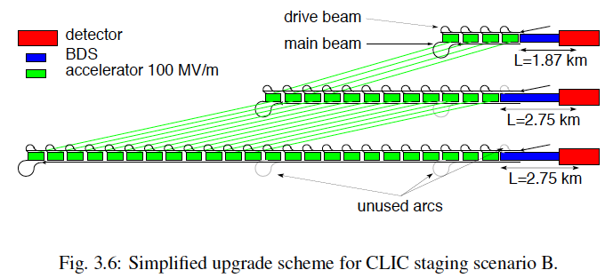
CLIC Staged Design
380 GeV
1.5 TeV
3 TeV
Staged design for CLIC to optimise physics and funding profile:
First stage: E_{cms}=380 GeV, L=1.5x10³⁴cm⁻²s⁻¹, L_{0.01}/L>0.6
Second stage: E_{cms}=O(1.5 TeV)
Final stage: E_{cms}=3 TeV, L_{0.01}=2x10³⁴cm⁻²s⁻¹, L_{0.01}/L>0.3

Slide 29
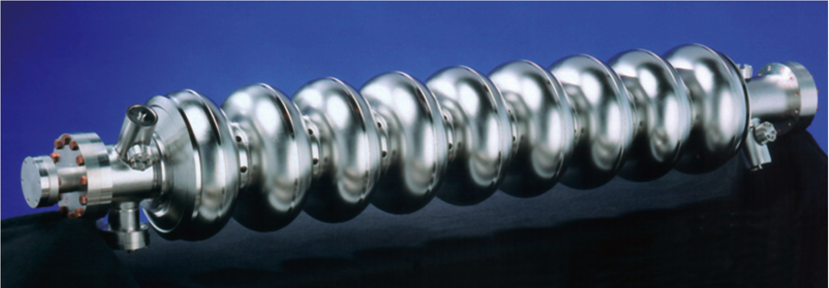
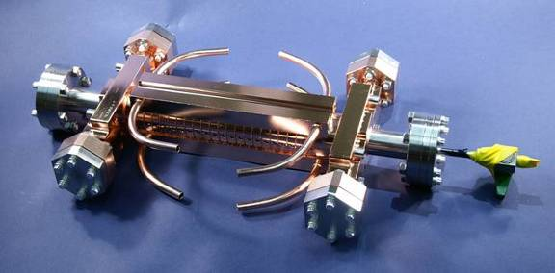
Cavity/Accelerating Structure
ILC cavity
1.3 GHz, superconducting
Target effective operational 31.5MV/m
Target gradient 35MV/m
Q₀≈10¹⁰
CLIC accelerating structure
12 GHz, normal conducting
Target loaded gradient 100MV/m
Target unloaded gradient 120MV/m
Q₀≈6 10³

Slide 30
Warm vs Cold RF Collider
Normal Conducting
High gradient => short linac ☺
High rep. rate => ground motion
suppression ☺
Small structures => strong wakefields ☹
Generation of high peak RF power ☹
Superconducting
long pulse => low peak power ☺
large structure dimensions => low WF ☺
very long pulse train => feedback within train ☺
SC structures => high efficiency ☺
Gradient limited <40 MV/m => longer linac ☹
(SC material limit ~ 55 MV/m)
Large number of e+ per pulse ☹
very large DR ☹

Slide 31
ILC and CLIC Main Parameters
Parameter | Symbol [unit] | SLC | ILC | CLIC
Centre of mass energy | E_{cm} [GeV] | 92 | 500 | 3000
luminosity | L [10³⁴cm⁻²s⁻¹] | 0.0003 | 1.8 | 6
Luminosity in peak | L_{0.01} [10³⁴cm⁻²s⁻¹] | 0.0003 | 1 | 2
Gradient | G [MV/m] | 20 | 31.5 | 100
Particles per bunch | N [10⁹] | 37 | 20 | 3.72
Bunch length | σ_{z} [μm] | 1000 | 300 | 44
Collision beam size | σ_{x,y} [nm/nm] | 1700/600 | 474/5.9 | 40/1
Vertical emittance | ε_{x,y} [nm] | 3000 | 35 | 20
Bunches per pulse | n_{b} | 1 | 1312 | 312
Distance between bunches | Δz [mm] | - | 554 | 0.5
Repetition rate | f_{r} [Hz] | 120 | 5 | 50
ILC has parameter sets from 250 GeV to 1TeV
CLIC has parameter sets from 250 GeV to 3TeV

Slide 32
Let us look at two main aspects:
Why does CLIC need so small vertical beam sizes?
(6 times smaller than ILC)
→ and what does this imply for the technical systems
Why “two beam acceleration”?
- usually we have already problems enough with one beam….

Slide 33
Luminosity and Parameter Drivers
Can re-write normal luminosity formula
Beam power
Luminosity
spectrum
Luminosity
Need to ensure that we can achieve each parameter

Slide 34

Small (vertical) beam sizes
NC RF <-> SC RF
Only Normal conducting RF enables accelerating gradients of 100 MV/m
In the present CLIC RF structure (23 cm long) some 50 MW peak power are needed to produce a 100 MV/m accelerating field
Large RF Power
With 50 Hz repetition rate beam pulse is as short as 156 ns; i.e. duty cycle 8 * 10-6!!!
Still 300 MW electrical power only for the RF acceleration in case of the 3 TeV accelerator
Also important:
BDR – pulse-length gradient scaling
Pulsed operation
Highest bunch density
Max. Rf frequency in damping rings:
2 GHz (presently 1 GHz): 312 bunches/pulse
← wake fields in accelerating structure
Max. bunch charge
4 * 10⁹ particles/bunch
Flat beams for minimum energy spread in luminosity spectrum; need to get high luminosity from small vertical beam size
Flat beams

Slide 35
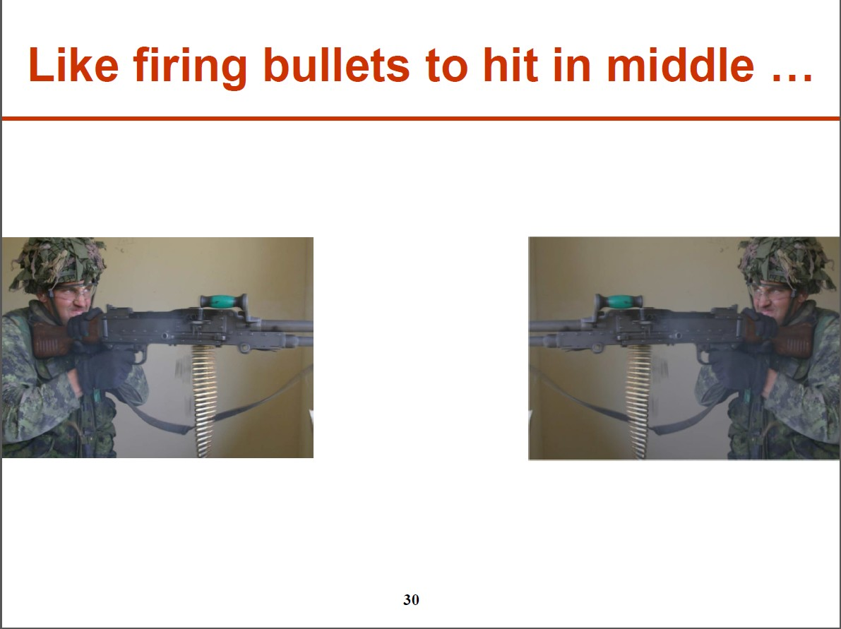

Slide 36
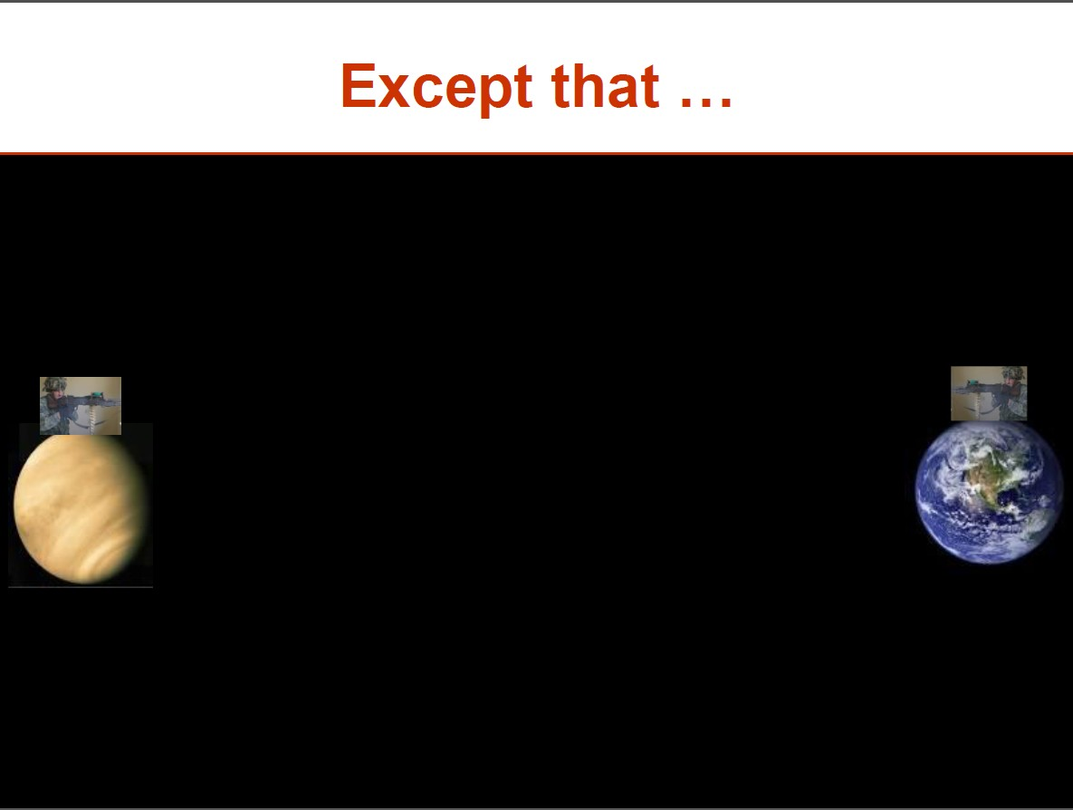

Slide 37
Whole list of requirements for colliding small beams
Generate small vertical emittance in high performance damping rings
Extract from damping rings with low ripple kickers (10-4)
Transport beams over 24 km without emittance growth
- through hundreds of quadrupoles
→ active stabilisation against ground motion
- through thousands of acceleration cavities
→ 10 um alignment to avoid wakefields
Beam delivery system with highest gradient quadrupoles
Feedbacks….feedbacks….feedbacks

Slide 38
Let us look at two main aspects:
Why does CLIC need so small vertical beam sizes?
(6 times smaller than ILC)
→ and what does this imply for the technical systems
Why “two beam acceleration”?
- usually we have already problems enough with one beam….
→ Mainly a consequence of the very short beam pulse

Slide 39
Why not using klystrons as RF powersource?
Electron
Gun
Reminder: Klystron
  narrow-band vacuum-tube amplifier at microwave frequencies
  (an electron-beam device).
  low-power signal at the design frequency excites input cavity
  Velocity modulation becomes time modulation in the drift tube
  Bunched beam excites output cavity
We need: - high power for high fields
- very short pulses (remember: 200 ns!)
We need also: Many klystrons
  ILC: 560 10 MW, 1.6 ms
  NLC: 4000 75 MW, 1.6 µs
  CLIC: would need many more klystrons with extremely short pulses
  Avoid another critical set of components: RF pulse compression schemes
→Drive beam like beam of a gigantic klystron
Input
Cavity
Drift
Tube
Output
Cavity
Collector

Slide 40
CLIC – layout for 380 GeV
only one DB complex (with 2x RF pulse length compared to 2 DB complexes)
drive beam time delay line
(1st half of pulse sent there)
shorter main linac
Drive Beam Generation Complex
Drive beam
Main beam
Main Beam Generation Complex

Slide 41
Two-beam acceleration
Counter propagation from central complex
Instead of using a single drive beam pulse for the whole main linac, several (N_{S} = 24) short drive beam pulses are used
Each one feed a ~880 m long sector of two-beam acceleration (TBA)
decelerator sector
main linac
1
2
3
main beam
pulse
pulse 2
pulse 1
From central
complex
R.Corsini
Counter flow distribution allows to power different sectors of the main linac
with different time bins of a single long electron drive beam pulse
The distance between the pulses is 2 L_{s} = 2 L_{main}/N_{S} (L_{main}= single side linac length)
The initial drive beam pulse length t_{DB} is given by twice the time of flight through one single linac
so t_{DB} = 2 L_{main} / c, 140 µs for the 3 TeV CLIC
This is the required RF pulse length of the drive beam klystrons.

Slide 42

Drive beam time structure
2904 bunches
83 ps (12 GHz)
240 ns
5.8μs
140μs, 24 trains
Bunch charge: 8.4 nC, Current in train: 100 A

Slide 43
CLIC Drive Beam Scheme
Very high gradients possible with NC accelerating structures at high RF frequencies (12 GHz)
Extract required high RF power from an intense e- “drive beam”
Generate efficiently long beam pulse and
compress it (in power + frequency)
‘few’ Klystrons
Low frequency
High efficiency
Power stored in
electron beam
Power extracted from beam
in resonant structures
Accelerating Structures
High Frequency – High field
Long RF Pulses
P₀ , ν₀ , τ₀
Electron beam manipulation
Power compression
Frequency multiplication
Short RF Pulses
P_{A} = P₀ x N₁
τ_{A} = τ₀ / N₂
ν_{A} = ν₀ x N₃

Slide 44
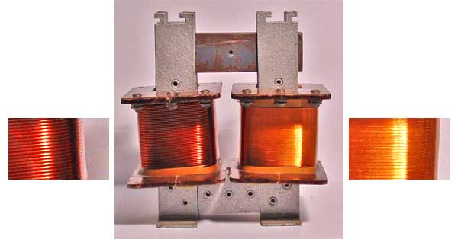
More on drive beam generation
Again a big transformer:
→ But now in time domain
Input: Long beam pulse train
low current
low bunch frequency
Output: Short beam pulse trains
high current
high bunch frequency
=> high beam power
Drive beam time structure - initial
Drive beam time structure - final
240 ns
240 ns
5.8 μs
140 μs train length – 24 x 24 sub-pulses
4.2 A - 2.4 GeV – 60 cm between bunches
24 pulses – 101 A – 2.5 cm between bunches

Slide 45

Lemmings Drive Beam
Alexandra
Andersson

Slide 46
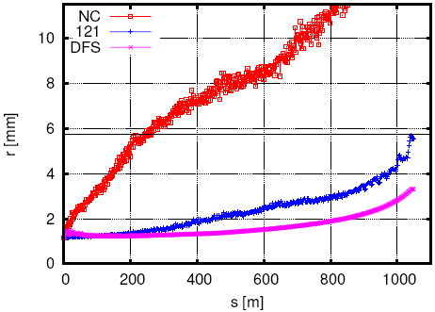
CLIC decelerator
Goal: transport particles of all energies through the decelerator sector:
in the presence of huge energy spread (90%)
Tight FODO focusing (large energy acceptance, low beta)
Lowest energy particles ideally see constant FODO phase-advance μ~90º, higher energy particles see phase-advance varying from μ~90º to μ~10º
Good quad alignment needed (20µm)
Good BPM accuracy (20µm)
Orbit correction essential
  1-to-1 steering to BPM centres
  DFS (Dispersion Free Steering)
  gives almost ideal case

Slide 47
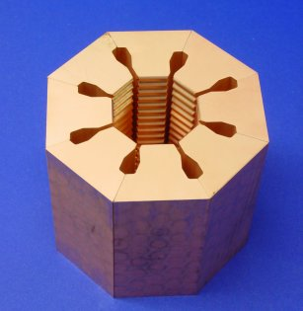
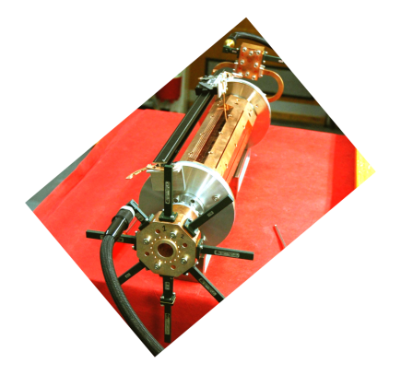
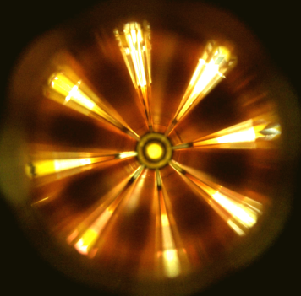
Power extraction structure PETS
must extract efficiently >100 MW power from high current drive beam
passive microwave device in which bunches of the drive beam interact with the impedance of the periodically loaded waveguide and generate RF power
periodically corrugated structure with low impedance (big a/λ)
ON/OFF
mechanism
The power produced by the bunched (ω₀) beam in a constant impedance structure:
Design input parameters
PETS design
Beam eye
view
P – RF power, determined by the accelerating structure needs and the module layout.
I – Drive beam current
L – Active length of the PETS
F_{b} – single bunch form factor (≈ 1)

Slide 48
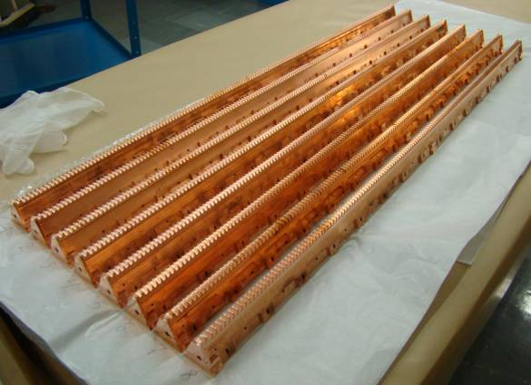
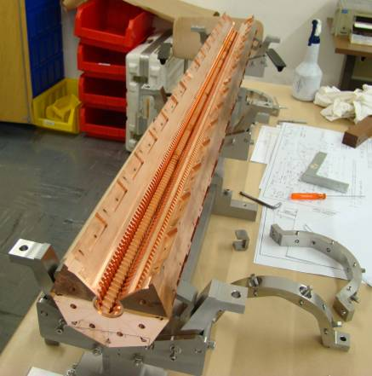
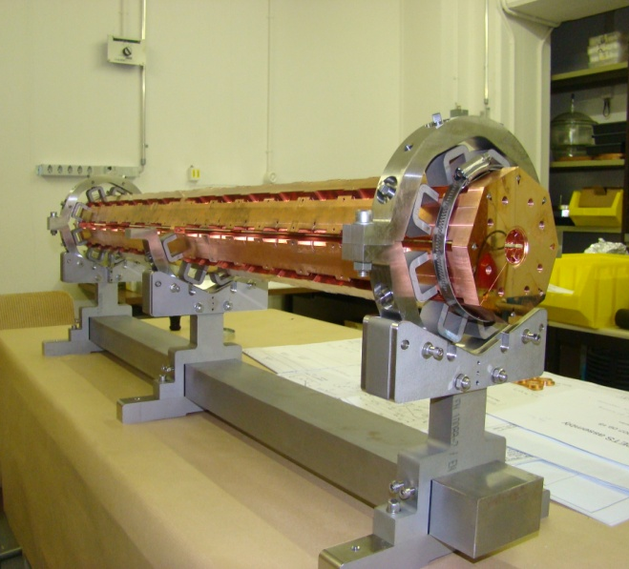
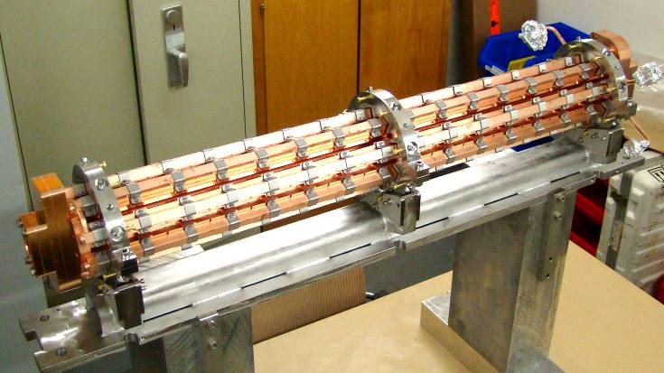
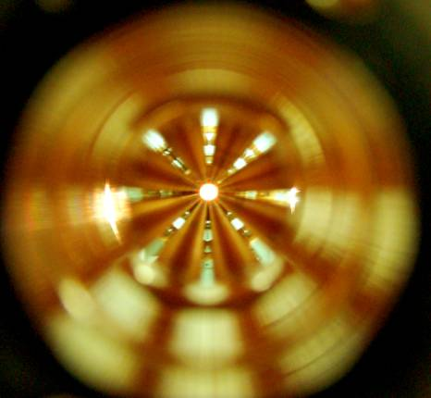
12 GHz PETS assembly
8 bars, as received from VDL
PETS octants assembly
I. Syratchev

Slide 49
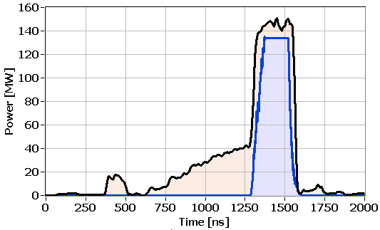
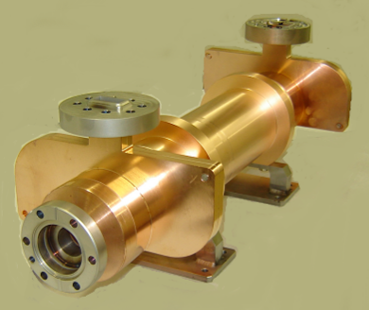
Present PETS status (12 GHz)
Typical RF pulse shape in ASTA during the last 125h of operation
achieved 150 MW @ 266ns
in RF driven test at SLAC
up to >250 MW peak power beam driven
at CTF3 (recirculation)
model well understood
CLIC target pulse
Measured (current)
Measured (power)
Model (power)
MW
CLIC target pulse
ns

Slide 50
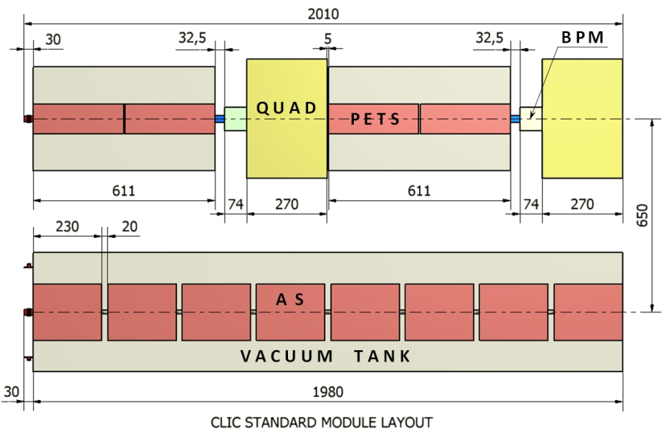
CLIC two-beam Module layout
Standard module
Total per module
8 accelerating structures
8 wakefield monitors
4 PETS
2 DB quadrupoles
2 DB BPM
Total per linac
8374 standard modules
Other modules have 2,4,6 or 8 acc.structures replaced by a quadrupole
(depending on main beam optics)
Total 10462 modules, 71406 acc. structures, 35703 PETS

Slide 51
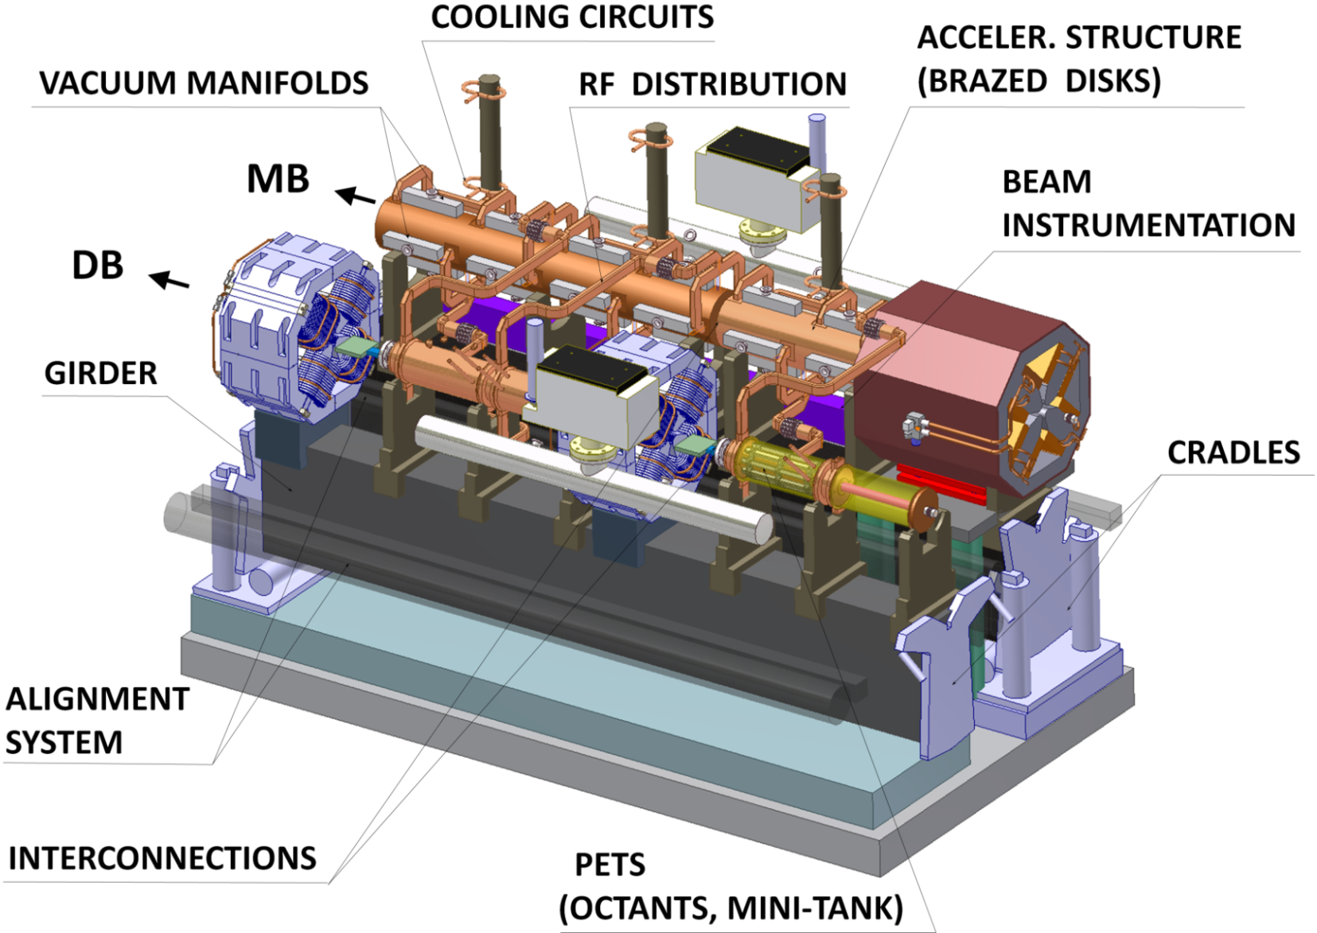
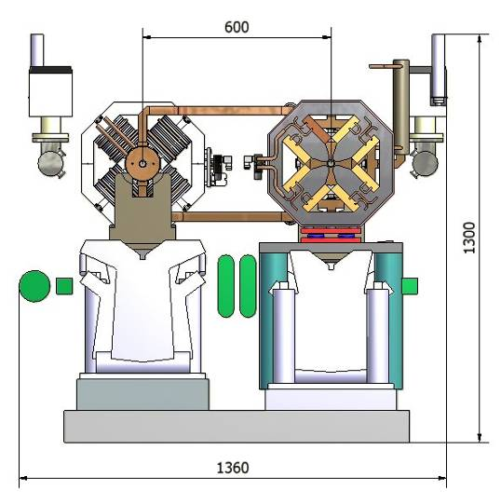
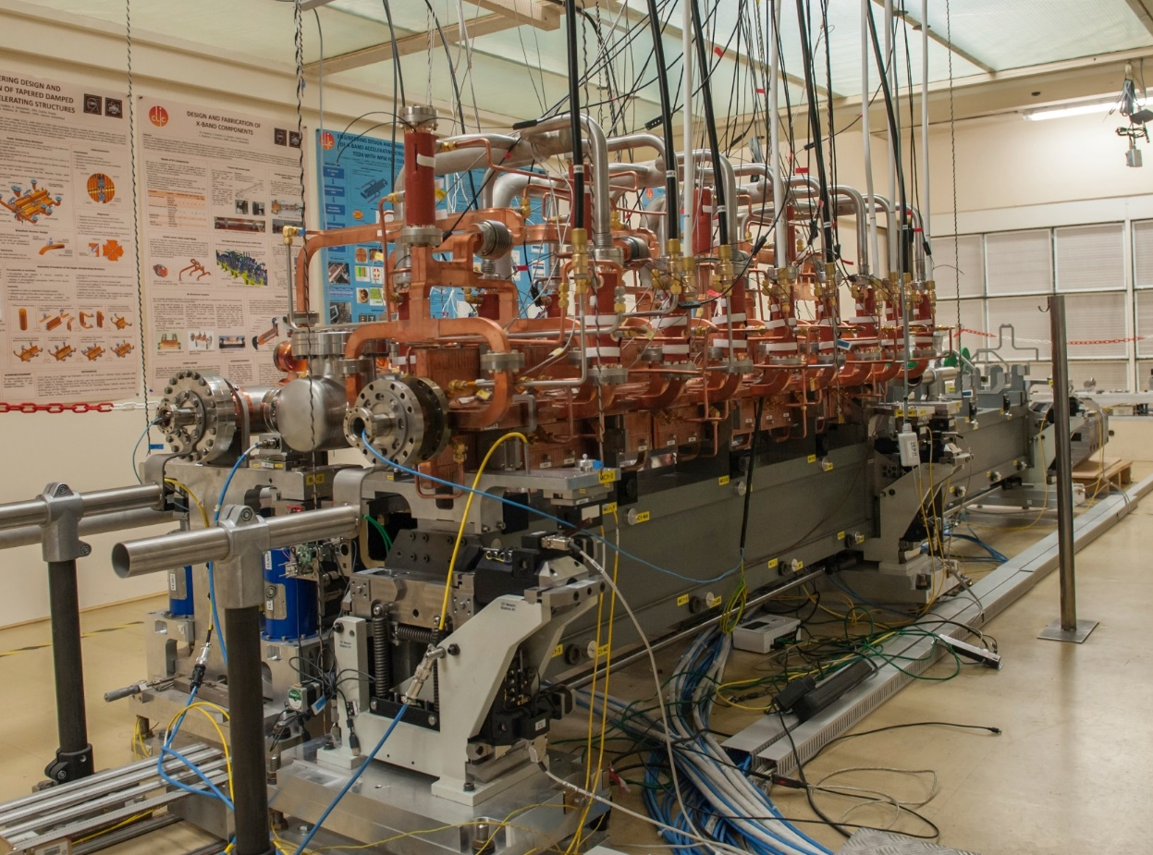
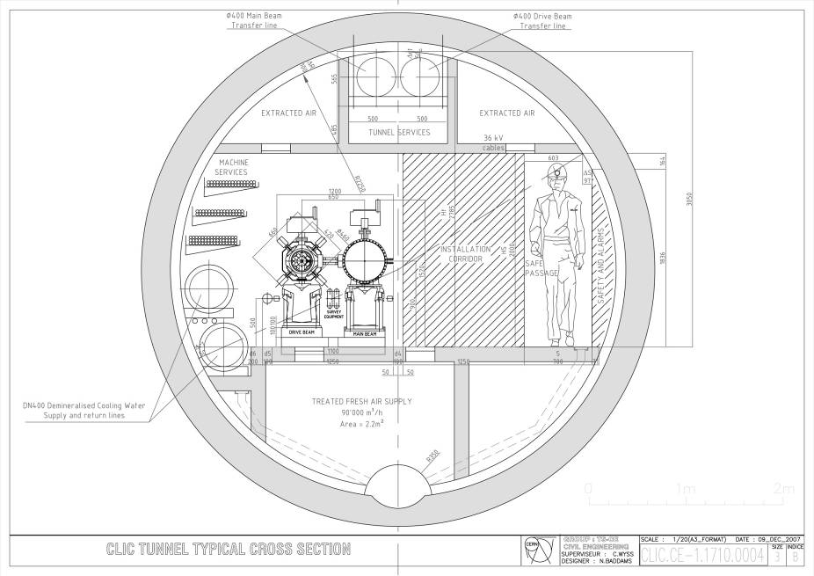
CLIC two-beam Module
Transfer lines
Drive Beam
Main Beam
Alignment system, beam instrumentation, cooling integrated in design
G.Riddone

Slide 52
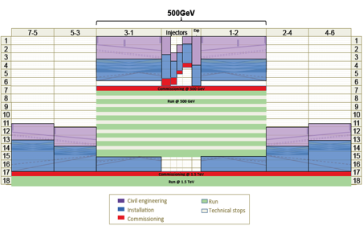
CLIC - Future Milestones
2013-18 Development Phase
Develop a Project Plan for a staged implementation in agreement with LHC findings; further technical developments with industry, performance studies for accelerator parts and systems, as well as for detectors.
Construction Phase
Stage 1 construction of CLIC, in parallel with detector construction.
Preparation for implementation of further stages.
4-5 year Preparation Phase
Finalise implementation parameters, Drive Beam Facility and other system verifications, site authorisation and preparation for industrial procurement.
Prepare detailed Technical Proposals for the detector-systems.
2018-19 Decisions
On the basis of LHC data
and Project Plans (for CLIC and other potential projects as FCC), take decisions about next project(s) at the Energy Frontier.
Commissioning
Becoming ready for data-taking as the LHC programme reaches completion.
2024-25 Construction Start
Ready for full construction
and main tunnel excavation.

Slide 53
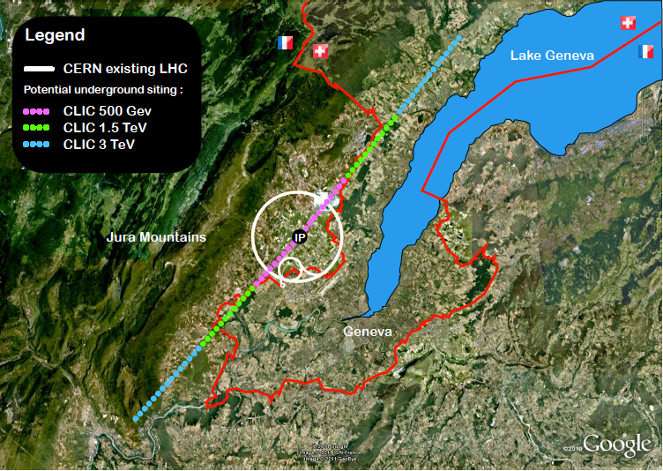
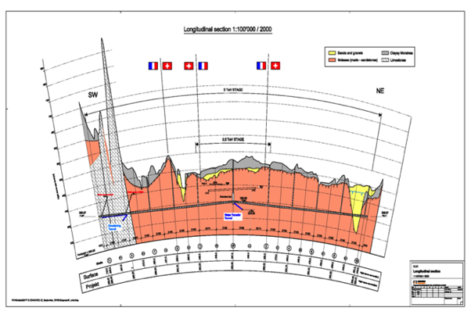
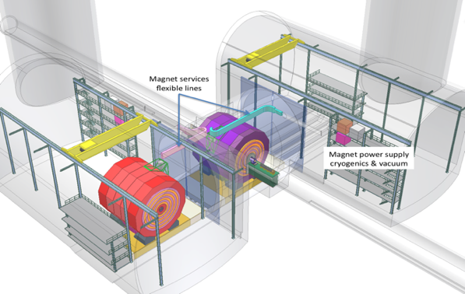
CLIC near CERN
Tunnel implementations (laser straight)
Central MDI & Interaction Region

Slide 54
CLIC Documentation - CDRs
Vol 1: The CLIC accelerator and site facilities (H.Schmickler)
- CLIC concept with exploration over multi-TeV energy range up to 3 TeV
- Feasibility study of CLIC parameters optimized at 3 TeV (most demanding)
- Consider also 500 GeV, and intermediate energy range
- Complete, presented in SPC in March 2011, in print: https://edms.cern.ch/document/1234244/
Vol 2: Physics and detectors at CLIC (L.Linssen)
- Physics at a multi-TeV CLIC machine can be measured with high precision, despite challenging background conditions
- External review procedure in October 2011
- Completed and printed, presented in SPC in December 2011 http://arxiv.org/pdf/1202.5940v1
Vol 3: “CLIC study summary” (S.Stapnes)
- Summary and available for the European Strategy process, including possible implementation stages for a CLIC machine as well as costing and cost-drives
- Proposing objectives and work plan of post CDR phase (2012-16)
- Completed and printed, submitted for the European Strategy Open Meeting
in September http://arxiv.org/pdf/1209.2543v1
In addition a shorter overview document was submitted as input to the European Strategy update, available at:
http://arxiv.org/pdf/1208.1402v1

Slide 55
Slides for detailed explanation of small vertical emittances all slides get called from within the talk

Slide 56
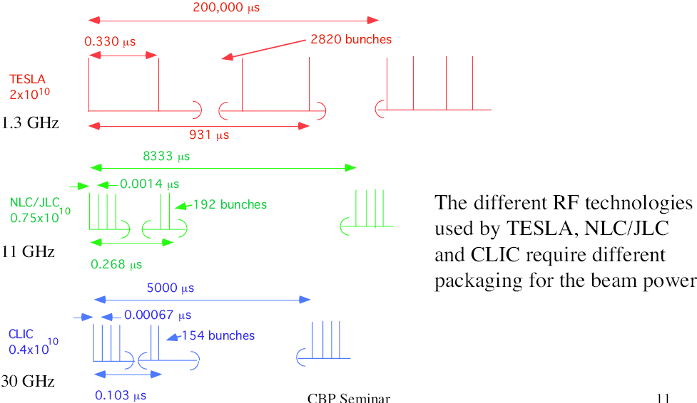
Bunch structure
SC allows long pulse, NC needs short pulse with smaller bunch charge
0.370
2625
ILC
970
ILC
20000
0.0005
312
12
0.156

Slide 57
Beam-beam Effect
Bunches are squeezed strongly to maximise luminosity
Electron magnetic fields are very strong
Beam particles travel on curved trajectories
They emit photons (O(1)) (beamstrahlung)
They collide with less than nominal energy

Slide 58
Beamstrahlung Optimisation
For low energies (classical regime) number of emitted photons
For CLIC at 3TeV (quantum regime)
Hence use
Total luminosity grows for smaller beams
CLIC parameter choice
But luminosity in peak starts to decrease again

Slide 59
Breakdown-rate vs gradient
Higher breakdown rate for higher gradient
Strong function of the field (~E^{~30})
=> small decrease of field lowers BDR significantly
C. Adolphsen /SLAC

Slide 60
Breakdown-rate vs pulse length
Higher breakdown rate for longer RF pulses
10
1
10
0
Breakdown rate
10
-1
SLAC 70 MV/m
-2
SLAC 65 MV/m
10
SLAC 60 MV/m
KEK 65 MV/m
-3
exp. fit
10
100
200
300
400
500
600
700
800
900
Pulse length (ns)
experimental scaling: BDR ˜ (pulselength) ⁶ * (gradient) ³⁰

Slide 61
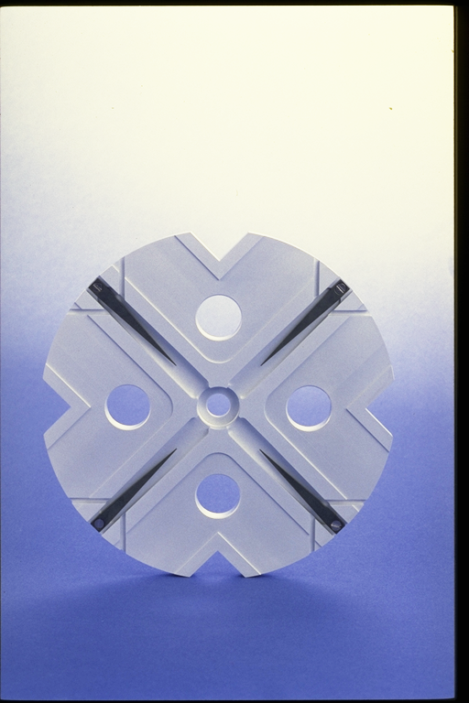
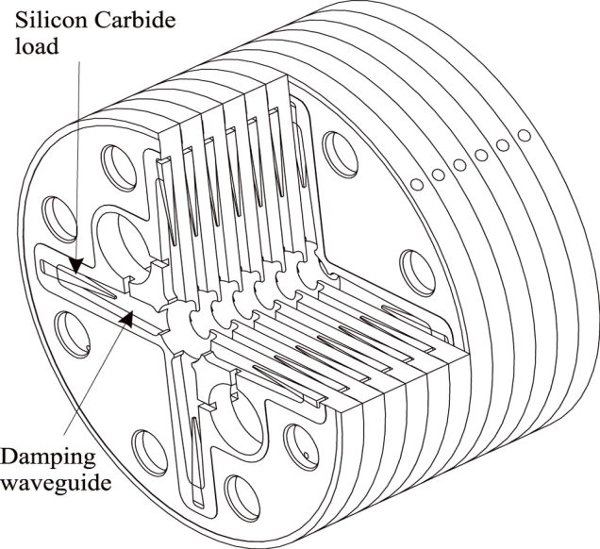
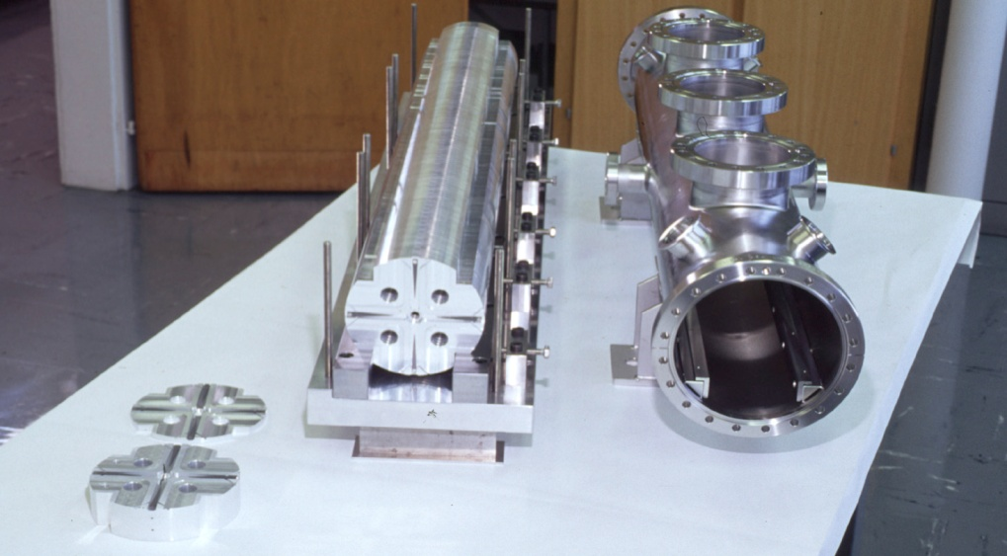
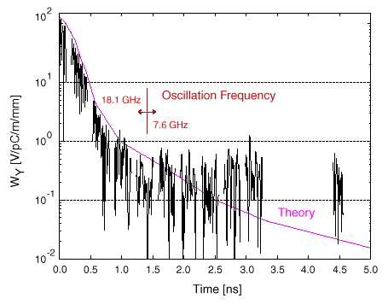
Accelerating structure developments
Structures built from discs
Each cell damped by 4 radial WGs
terminated by SiC RF loads
Higher order modes (HOM)
enter WG
Long-range wakefields
efficiently damped
Time of next bunch

Slide 62
Limitations of NC Gradient E_{acc}
Surface magnetic field
  Pulsed surface heating => material fatigue => cracks
Field emission due to surface electric field
  RF break downs
  Break down rate => Operation efficiency
  Local plasma triggered by field emission => Erosion of surface
  Dark current capture
  => Efficiency reduction, activation, detector backgrounds
RF power flow
  RF power flow and/or iris aperture apparently have a strong impact on
  achievable E_{acc} and on surface erosion. Mechanism not fully understood

Slide 63
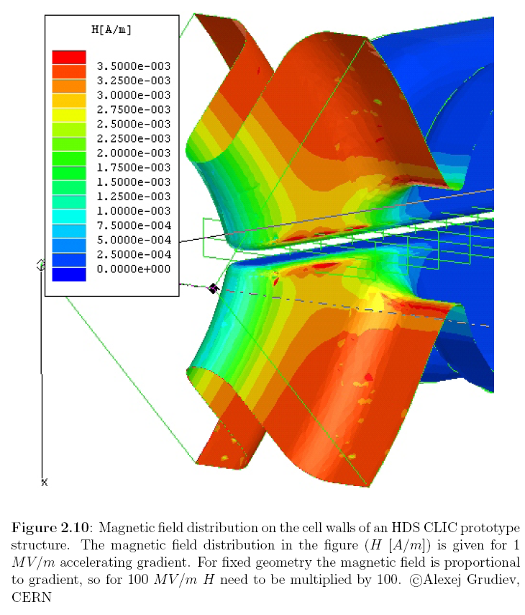
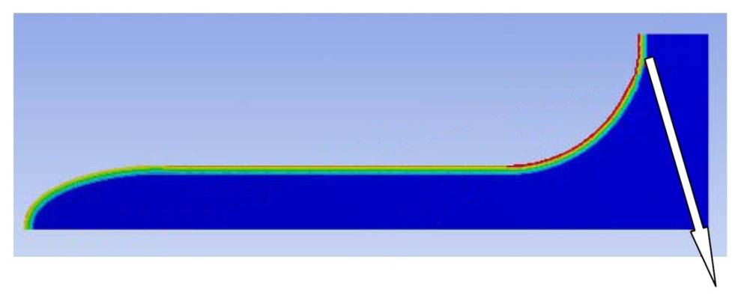

Pulsed surface heating - Fatigue
Cyclic compressive stresses
Magnetic RF field heats up cavity wall
Extension causes compressive stress
Can lead to fatigue
Hpeak
↕
ΔT
↕
σ
Failure
High number of cycles limits to smaller stresses
20 years operation => ~10¹⁰ cycles!
Limits maximum ΔT and
peak magnetic field
Steels, Mo, Ti, …
Cu, Al, …
No Failure

Slide 64
Pulsed surface heating
Pulsed surface heating proportional to
  Square root of pulse length
  Square of peak magnetic field
Field reduced only by geometry,
but high field needed for high gradient
Limits the maximum pulse length
=> short pulses (~few 100ns)

