Slide 1
1-D ChDR Point Spread Function (3)
A. Potylitsyn, D. Shkitov, S. Gogolev
Outline
KEK ATF experiment
Simulations of the ChDR PSF
Conclusion

Slide 2
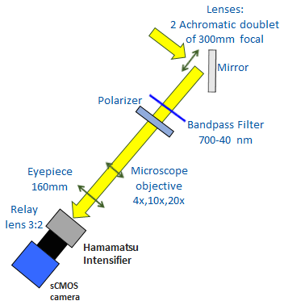
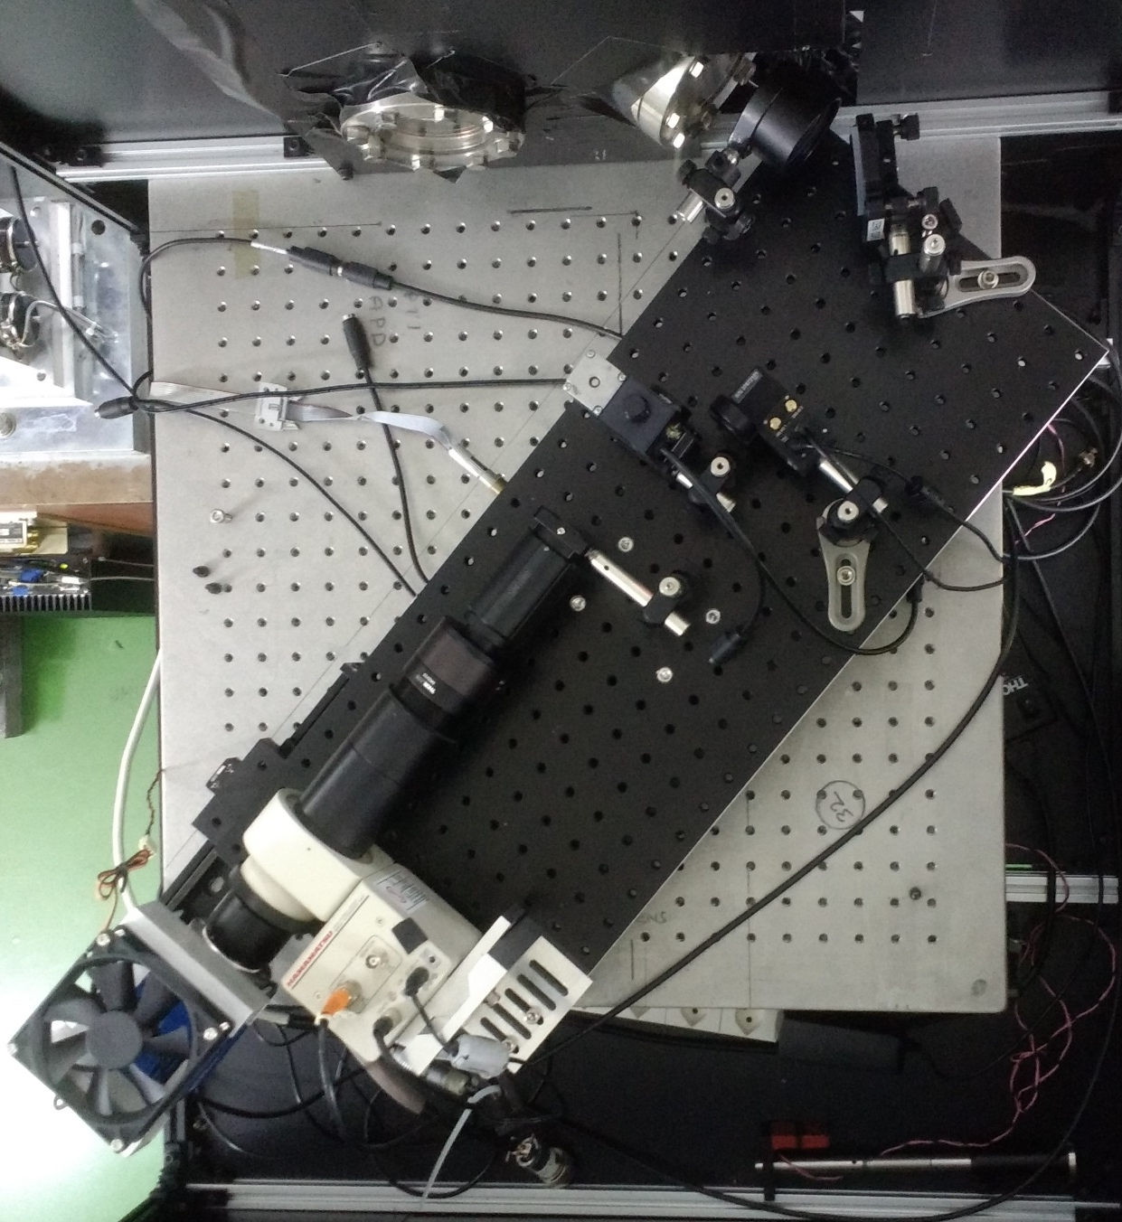
Optical line installation
d_{lens} = 2 inch
L = 30 cm
d/2L = 0.085 ≈ 211γ⁻¹

Slide 3
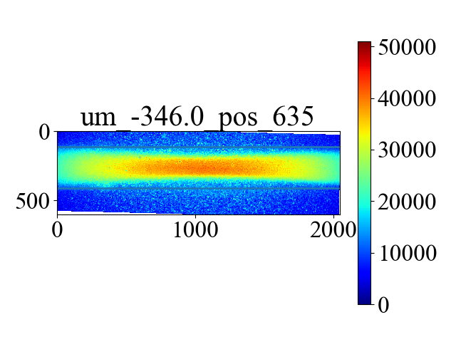
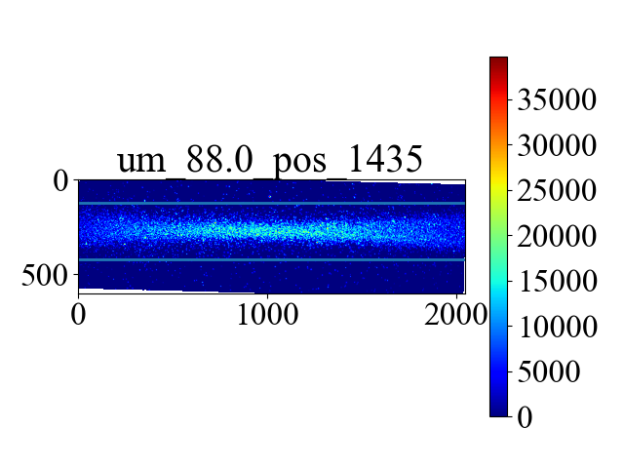
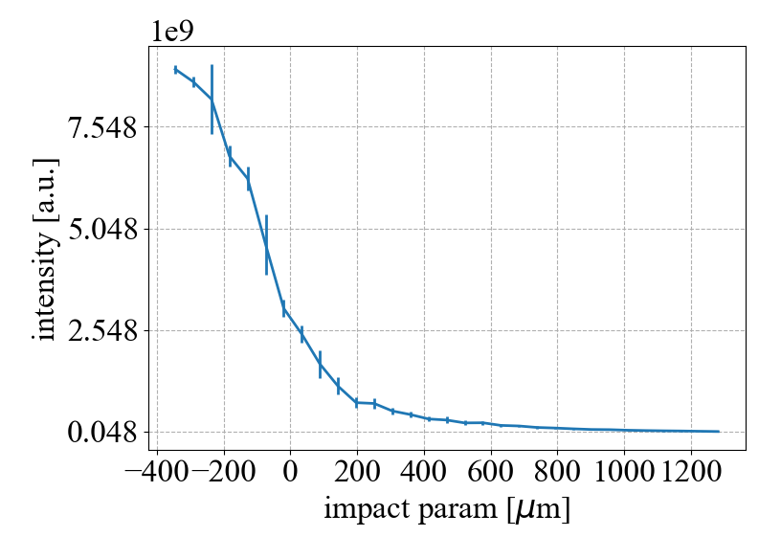
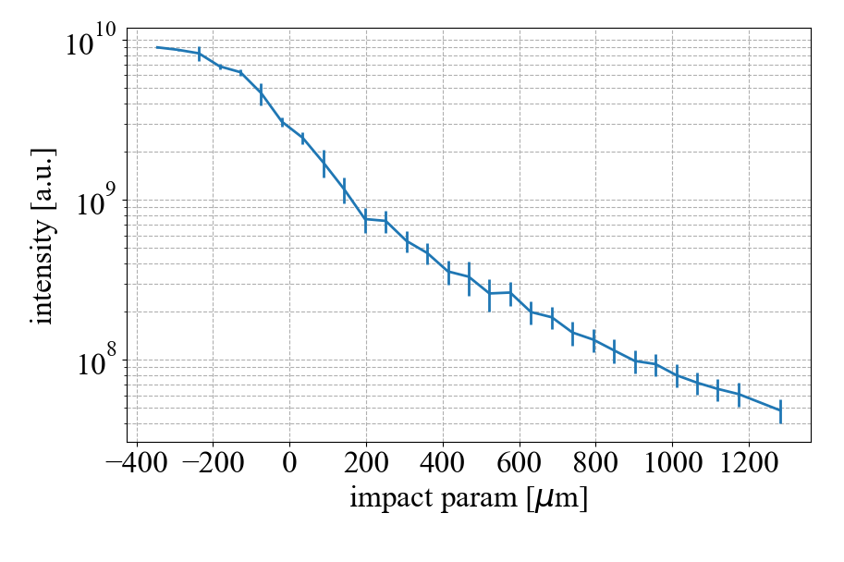
Impact parameter scan
Total intensity linear scale
Total intensity log scale

Slide 4
Simulation of 1-D ChDR PSF
Assumptions:
Cross-section of the LSF at the fixed position of the trajectory trace is considered as one-dimensional PSF;
Both polarization components of the ChDR field are simulated using the polarization currents method neglecting by refraction and attenuation effects;
ChDR fields are simulated for far field zone;
Unit magnification of the optical system.

Slide 5
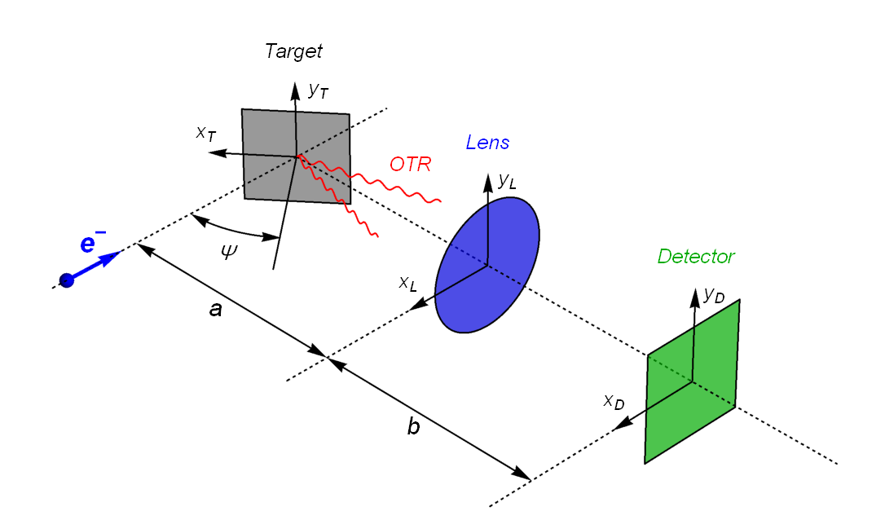
OTR PSF calculations
Here and are the coordinates of target surface and lens plane, is the target surface area, is the MacDonald function of the first order, and
It’s the Fourier transformation from momentum presentation into space presentation X_{D} – Y_{D}.

Slide 6
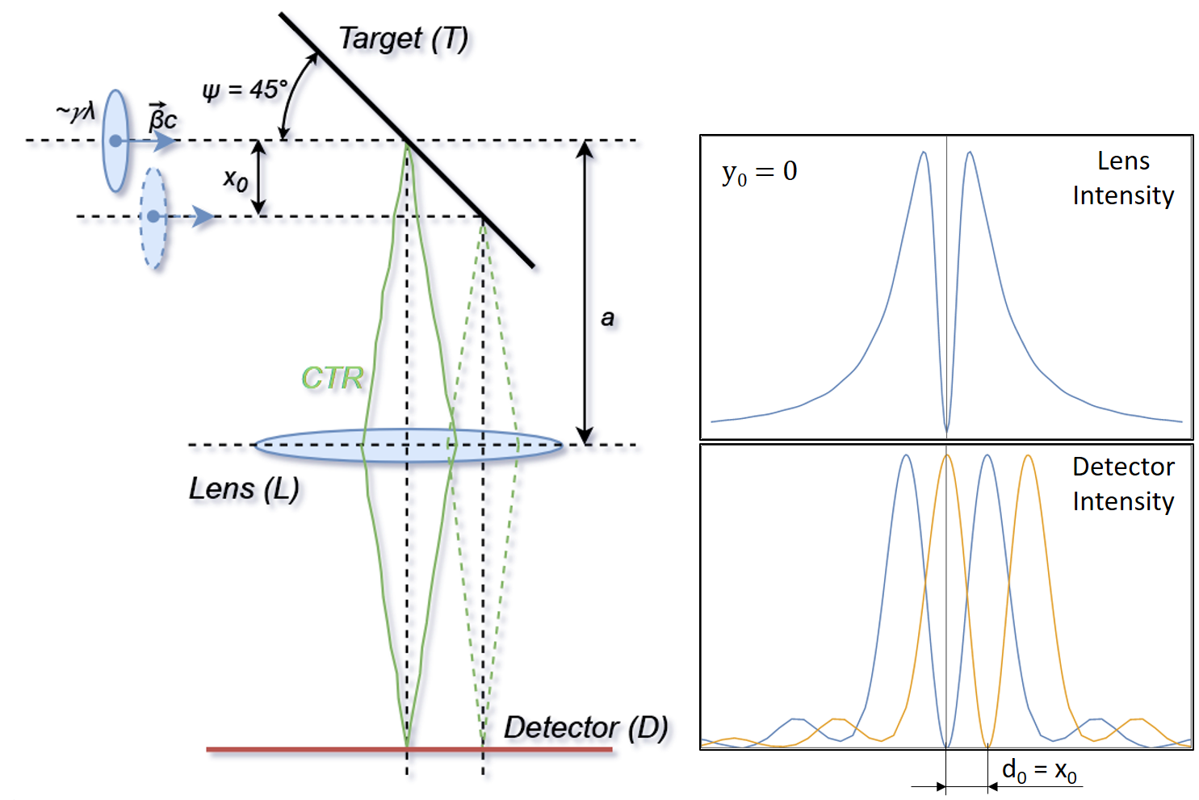
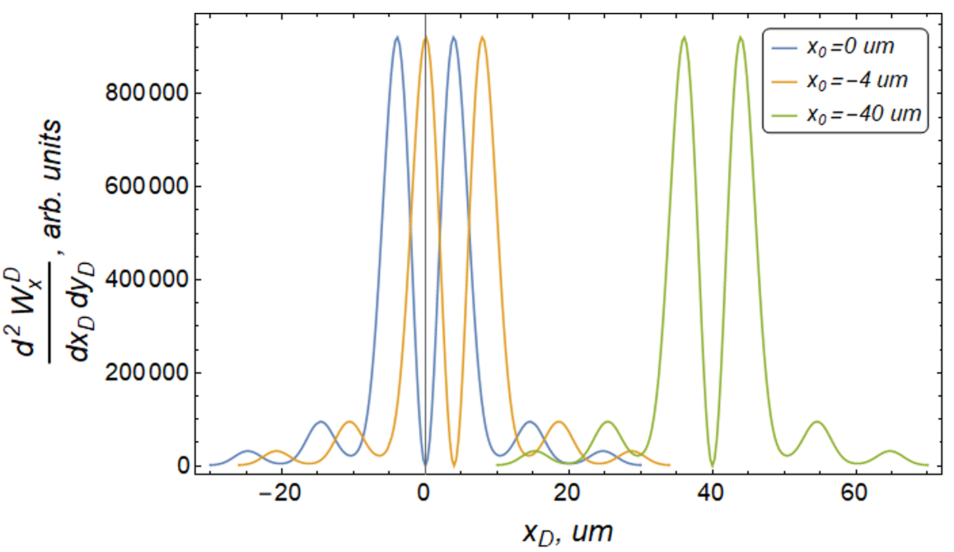
OTR PSF

Slide 7
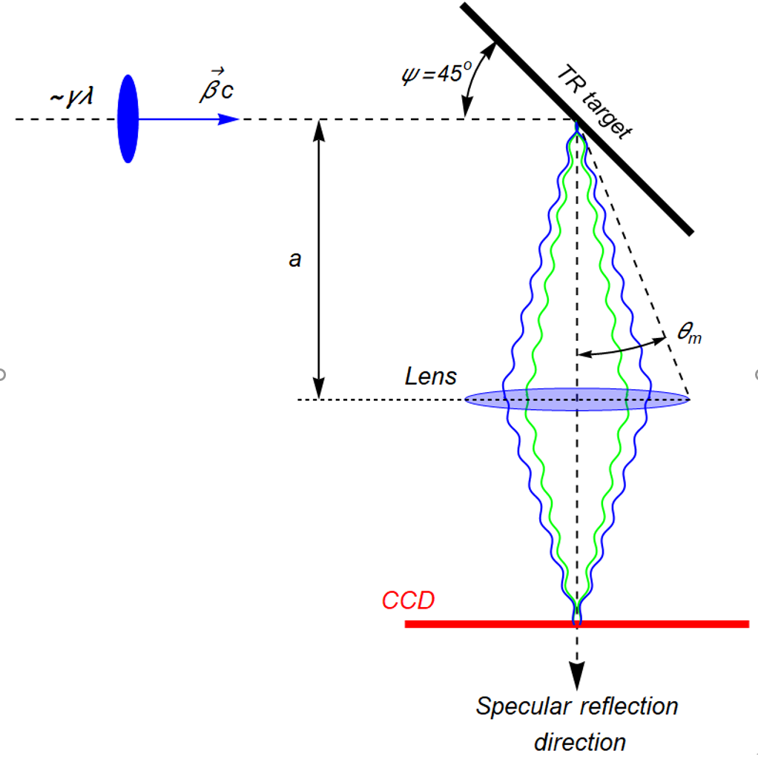
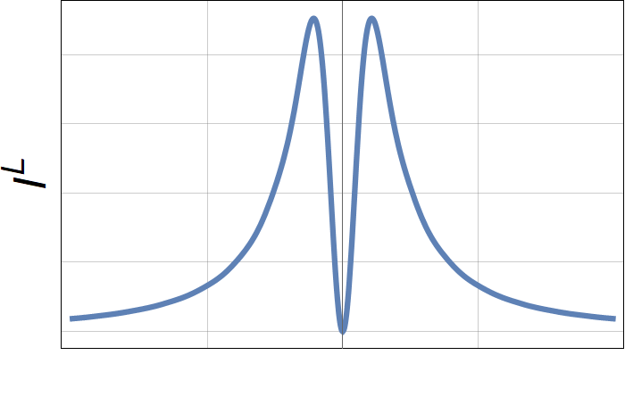
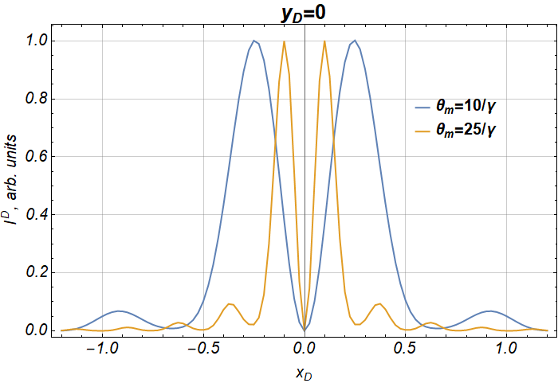
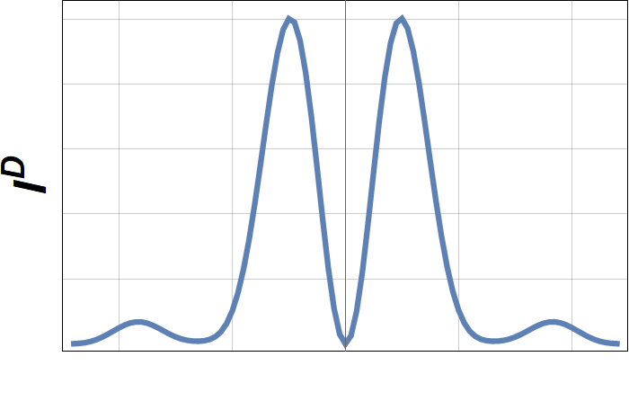
OTR profile monitor
θ_{m} >> 1/γ
Lens Aperture
CCD

Slide 8
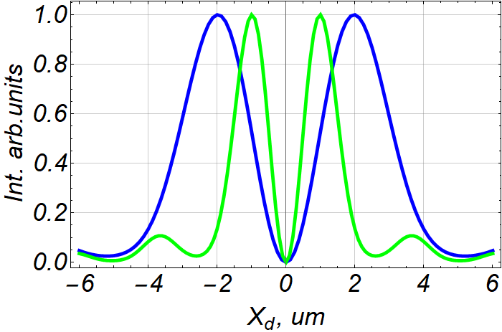
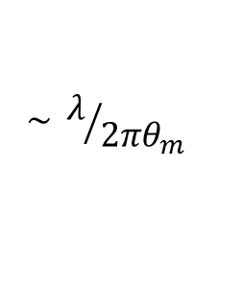
OTR PSF
Spatial resolution
$$\sim λ/{2πθ_{m}}$$

Slide 9
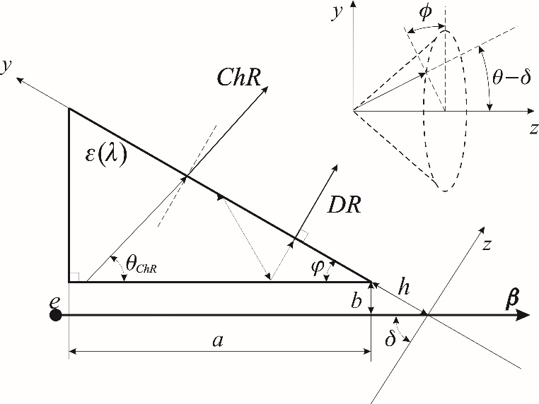
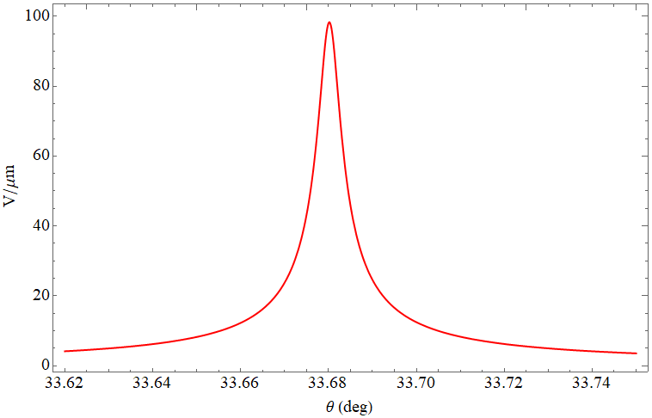


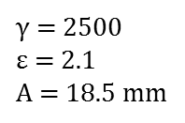

ChDR in a vacuum
Polarization currents model in the far field zone
$γ$ = 2500
$ε$ = 2.1
A = 18.5 mm
$θ_{Ch}^{max}$ = 33.68 deg
$I$ (arb. units)
A
$θ$ (deg)
Scheme of the generation of polarization radiation
ChDR angular distribution

Slide 10
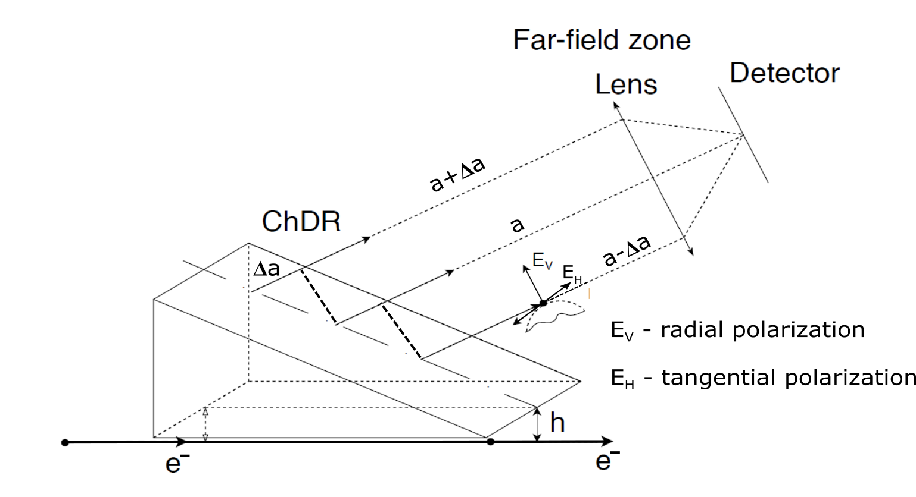
ChDR generation scheme
Trajectory image
There is defocusing effect due to Δa ≠ 0

Slide 11
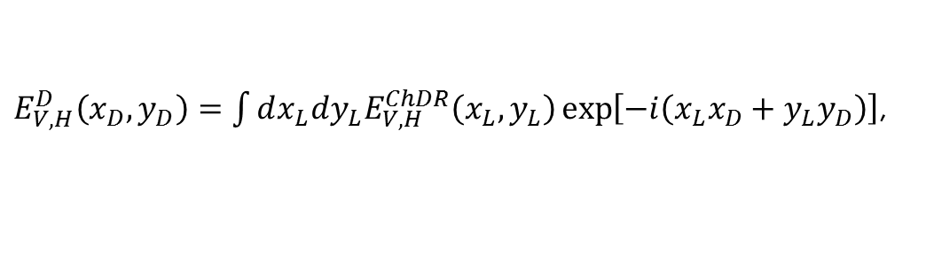


1-D PSF simulation.
Dimensionless variables
$E_{V,H}^{D}\left(x_{D},y_{D}\right)=\int{dx_{L}dy_{L}E_{V,H}^{ChDR}\left(x_{L},y_{L}\right)}\exp\left[−i\left(x_{L}x_{D}+y_{L}y_{D}\right)\right]$,
lens
aperture
where
$x_{L}=\frac{γ}{a}X_{L}$,
$x_{D}=\frac{2π}{γλ}X_{D}$,
here $X_{L,D}$ – in micrometers, a is the distance between a source and a lens.
$W_{V,H}^{D}\left(x_{D},0\right)={\left|E_{V,H}^{D}\left(x_{D},0\right)\right|}^{2}={\left|{ReE}_{V,H}^{D}\left(x_{D},0\right)\right|}^{2}+{\left|E_{V,H}^{D}\left(x_{D},0\right)\right|}^{2}$.
Image from a single charge: ${PSF}_{V,H}{⇒ W}_{V,H}^{D}\left(x_{D},0\right)$.
10

Slide 12


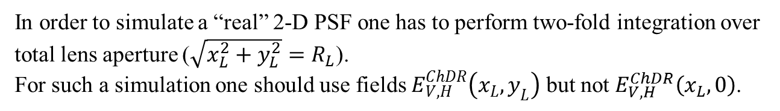
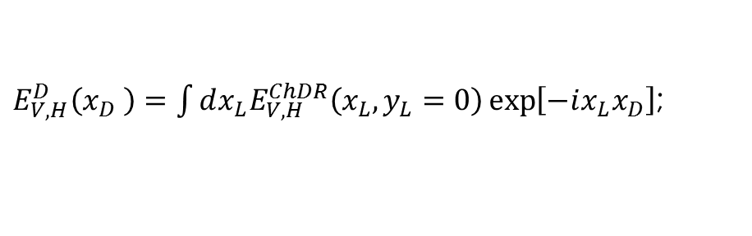
1-D PSF distribution
$X_{L}=aφ$;
Dimensionless variable
$x_{L}=\frac{γ}{a}X_{L}=γφ$;
It is approximation only
$E_{V,H}^{D}\left(x_{D} \right)=\int{dx_{L}E_{V,H}^{ChDR}\left(x_{L},y_{L}=0\right)}\exp\left[−ix_{L}x_{D}\right]$;
lens
aperture
In order to simulate a “real” 2-D PSF one has to perform two-fold integration over total lens aperture ($\sqrt{x_{L}^{2}+y_{L}^{2}}=R_{L}$).
For such a simulation one should use fields $E_{V,H}^{ChDR}\left(x_{L},y_{L}\right)$ but not $E_{V,H}^{ChDR}\left(x_{L},0\right)$.

Slide 13
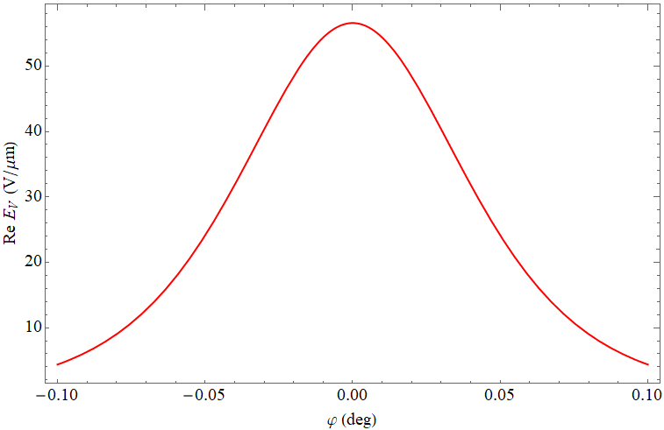
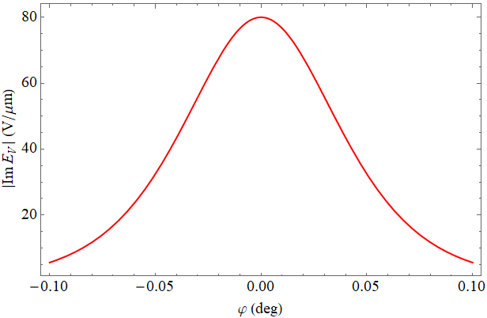



Azimuthal distribution of the ChDR for $E_{V}$
Real and imaginary part of electric field vertical component taken in absolute value at the maximum of ChDR
${ |Re E}_{V}$|
${ |Im E}_{V}$|
Impact parameter 500 um

Slide 14
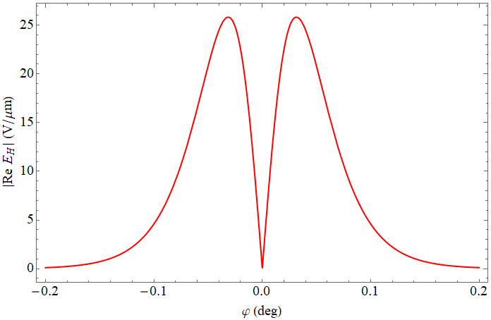
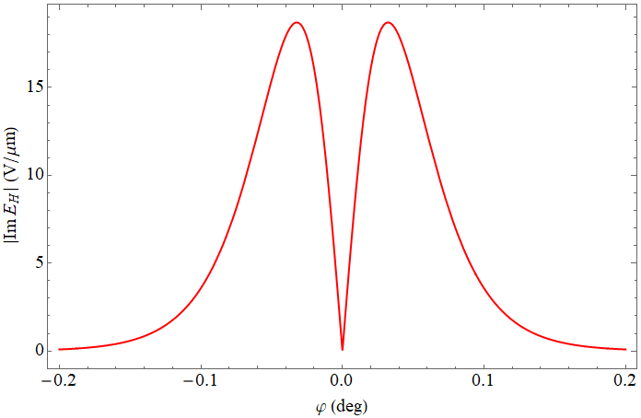



Azimuthal distribution of the ChDR for $E_{H}$
Real and imaginary part of electric field horizontal component taken in absolute value at the maximum of ChDR
${ |Re E}_{H}$|
${ |Im E}_{H}$|
Impact parameter 500 um

Slide 15
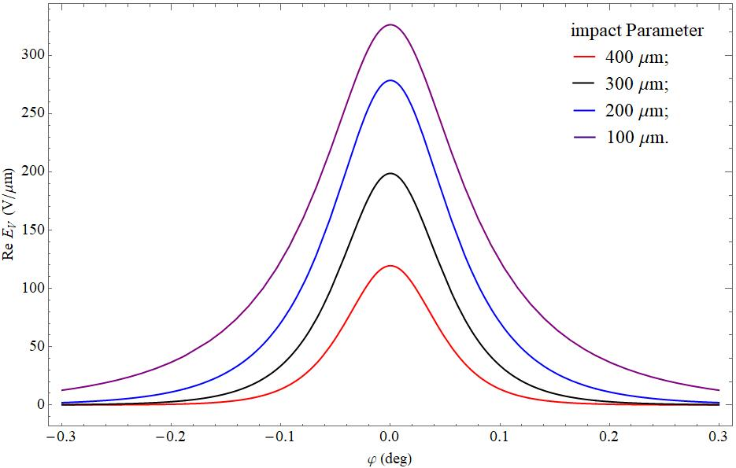
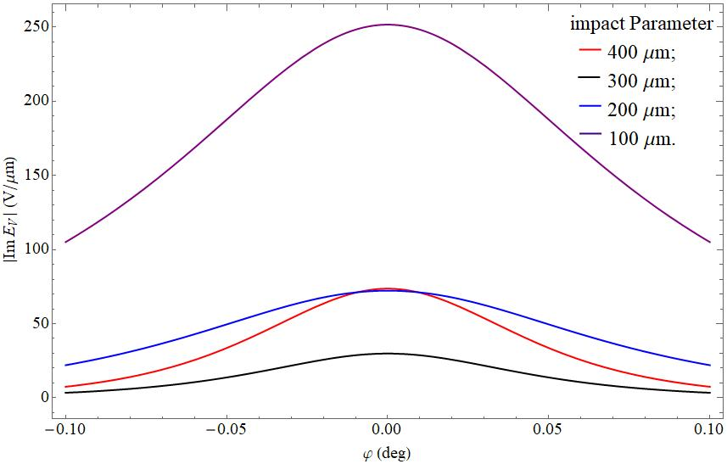

Azimuthal distribution of the ChDR for $E_{V}$
Real and imaginary part of electric field vertical component taken in absolute value at the maximum of ChDR
${ |Re E}_{V}$|
${ |Im E}_{V}$|

Slide 16
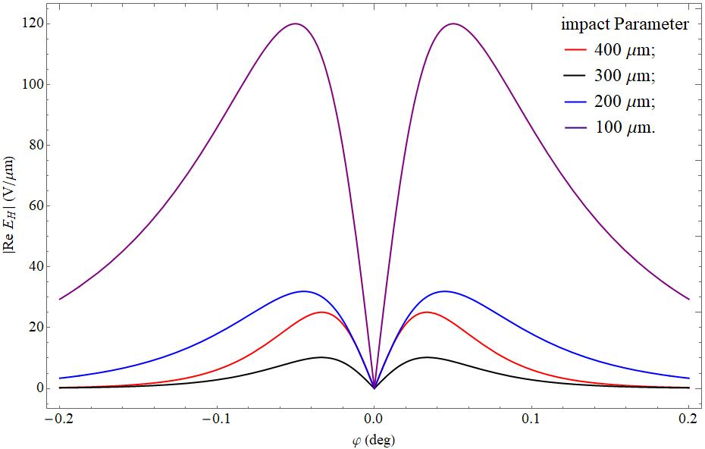
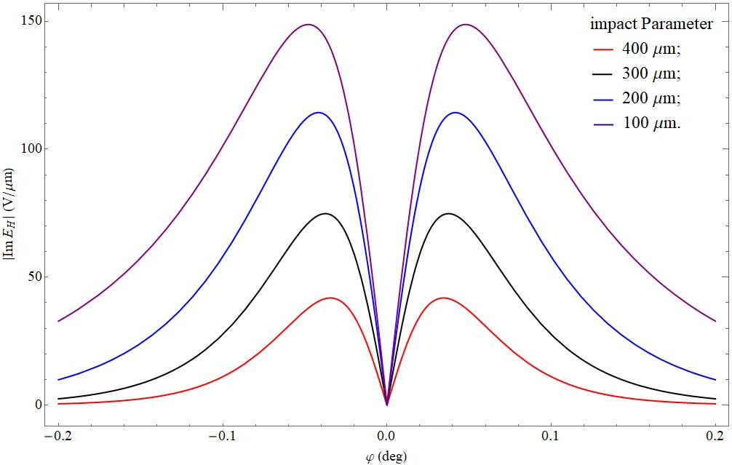
Azimuthal distribution of the ChDR for $E_{H}$
Real and imaginary part of electric field horizontal component taken in absolute value at the maximum of ChDR
${ |Re E}_{H}$|
${ |Im E}_{H}$|

Slide 17


1-D ChDR PSF (vertical polarization)
In order to simplify simulation, real and imaginary parts of the vertical component for different impact parameters were approximated by gaussians with parameters (dimensionless values):
${Re E}_{V}$ → $σ_{x}^{R}$
100 um
1200 um
$$\left\{\text{3.05734,} \text{2.50146,} \text{2.1772,} \text{2.03823,} \text{1.62502,} \text{1.33967,} \text{1.23405,} \text{1.14141}\right\}$$
${Im E}_{V}$ → $σ_{x}^{I}$
$$\left\{\text{3.33528,} \text{2.7794,} \text{1.81032,} \text{1.81032,} \text{1.57499,} \text{1.36005,} \text{1.29705,} \text{1.11176}\right\}$$
FWHMs of distributions do not depend on the lens aperture (100/γ, 200/γ and 4000/γ were checked).

Slide 18
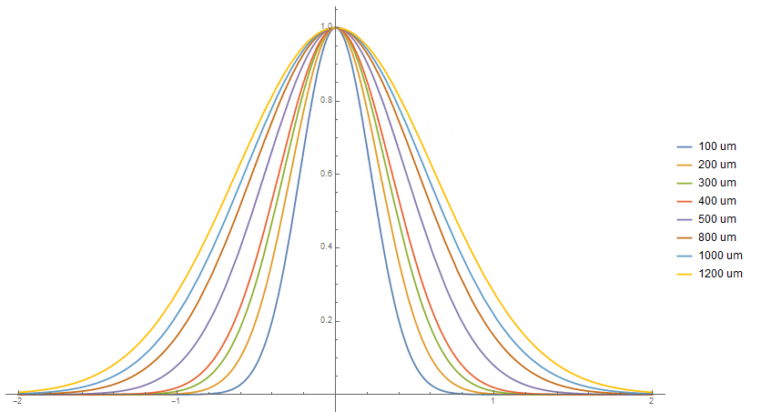


1-D ChDR PSF (vertical polarization)
PSF for vertical component
$I$ (arb. units)
γ = 2500
λ = 0.7 um
No dependence on lens aperture if aperture >> γ⁻¹
(in other words, angular distribution of the ChDR decreases exponentially with angle rise but not power decreasing as for OTR)
1200 um
100 um
$$x_{D}$$
x_{D} = 1 (dimensionless) --> X_{D} = γλ/2π = 280 um

Slide 19
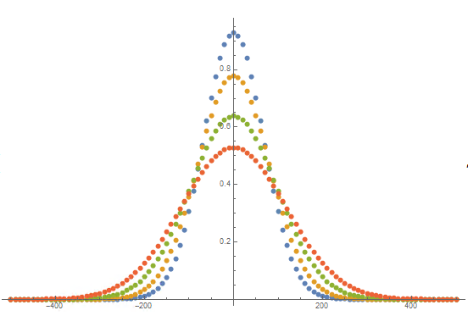
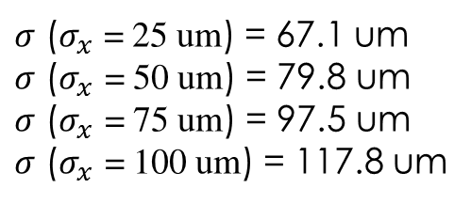

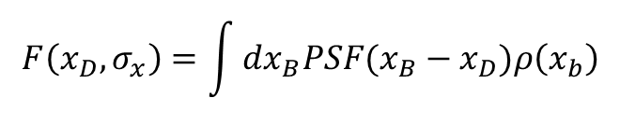
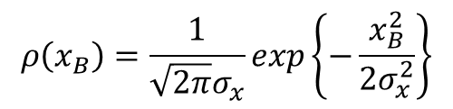
Beam profile imaging simulation
Gaussian beam:
vertical
lens aperture 400/γ
impact parameter 100 um
$$ρ\left(x_{B}\right)=\frac{1}{\sqrt{2π}σ_{x}}exp\left\{−\frac{x_{B}^{2}}{2σ_{x}^{2}}\right\}$$
$I$ (arb. units)
PSF transforms beam profile to the measured intensity distribution on the image plane (detector plane):
25 um
50 um
$$F\left(x_{D},σ_{x}\right)=\int{dx_{B}PSF(x_{B}−x_{D})ρ\left(x_{b}\right)}$$
75 um
100 um
RMS size:
$σ$ ($σ_{x}$ = 25 um) = 67.1 um
$σ$ ($σ_{x}$ = 50 um) = 79.8 um
$σ$ ($σ_{x}$ = 75 um) = 97.5 um
$σ$ ($σ_{x}$ = 100 um) = 117.8 um
$x_{D}$ (um)

Slide 20
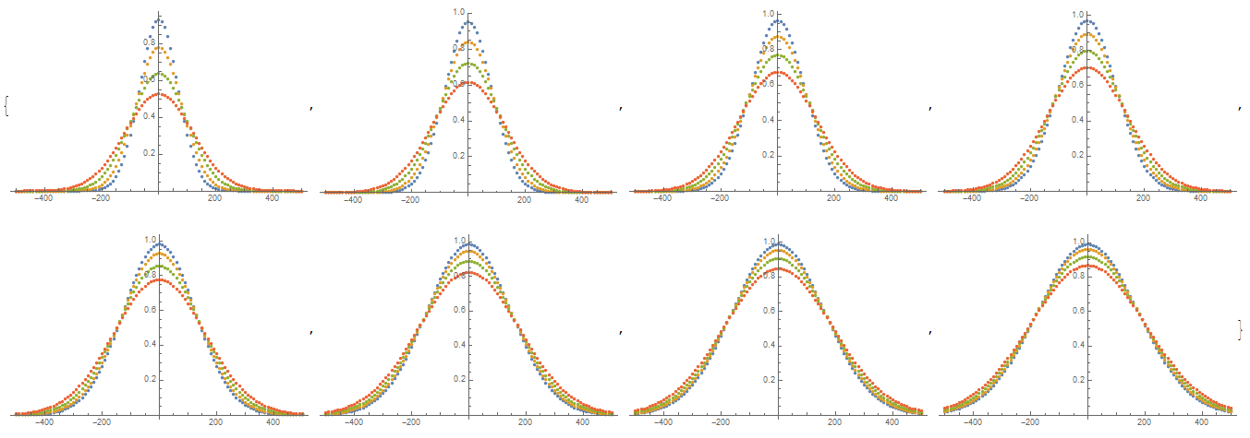
Beam profile imaging simulation for different impact parameters
σ_{x} =
25 um
h = 100 200 300 400
500 800 1000 1200 um
lens aperture 400/γ
100 um

Slide 21
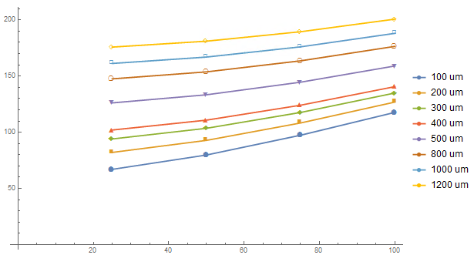
Dependence of the image RMS size on σ_{x} (vertical polarization)
σ (um)
σ_{x} (um)

Slide 22
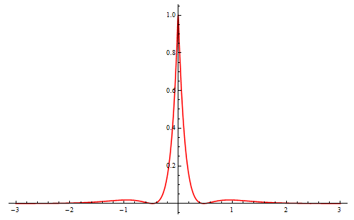
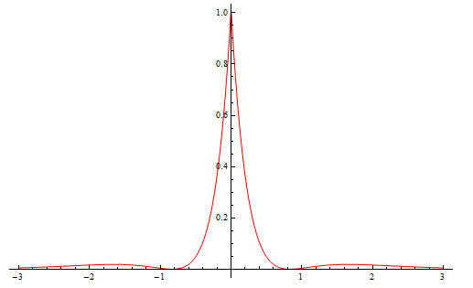



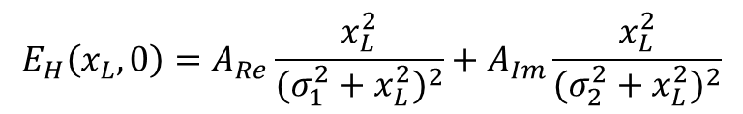
1-D ChDR PSF (horizontal polarization)
$$E_{H}\left(x_{L},0\right)=A_{Re}\frac{x_{L}^{2}}{{(σ_{1}^{2}+x_{L}^{2})}^{2}}+A_{Im}\frac{x_{L}^{2}}{{(σ_{2}^{2}+x_{L}^{2})}^{2}}$$
Approximation of the field $E_{H}$
$I$ (arb. units)
PSF distributions
$I$ (arb. units)
h = 100 um
h = 800 um
$$x_{D}$$
$$x_{D}$$
x_{D} = 1 (dimensionless) --> X_{D} = 280 um

Slide 23
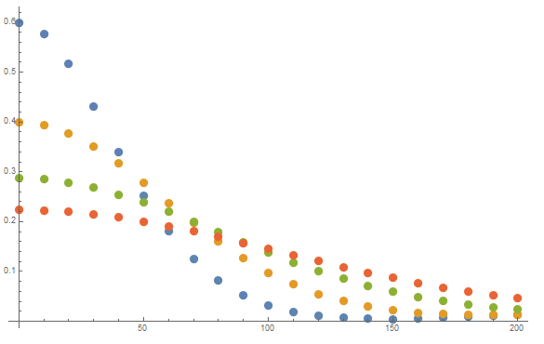
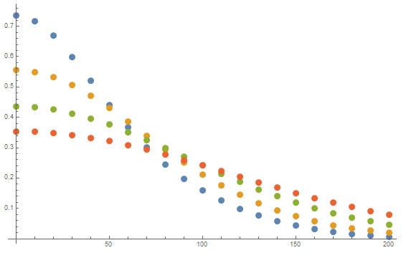



Beam profile imaging simulation
horizontal polarization
lens aperture 200/γ
impact parameter 100 um
horizontal polarization
lens aperture 200/γ
impact parameter 800 um
$I$ (arb. units)
$I$ (arb. units)
25 um
25 um
50 um
50 um
75 um
75 um
100 um
100 um
$x_{D}$ (um)
$x_{D}$ (um)

Slide 24
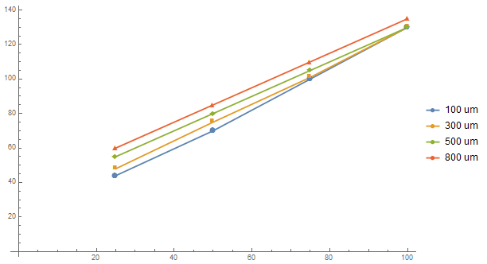
Dependence of the image RMS size on σ_{x} (horizontal polarization)
σ (um)
σ_{x} (um)

Slide 25
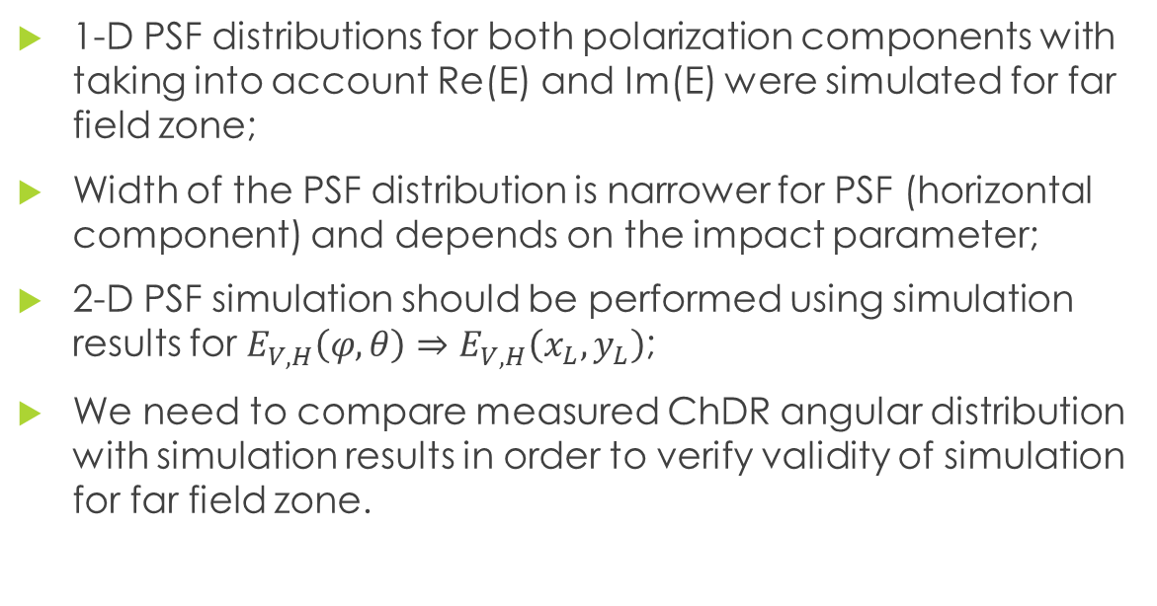
Conclusions
1-D PSF distributions for both polarization components with taking into account Re(E) and Im(E) were simulated for far field zone;
Width of the PSF distribution is narrower for PSF (horizontal component) and depends on the impact parameter;
2-D PSF simulation should be performed using simulation results for $E_{V,H}^{}\left(φ,θ\right)⇒E_{V,H}^{}\left(x_{L},y_{L}\right)$;
We need to compare measured ChDR angular distribution with simulation results in order to verify validity of simulation for far field zone.

