Slide 1
Optical System Design
- D Harryman, L Bobb

Slide 2
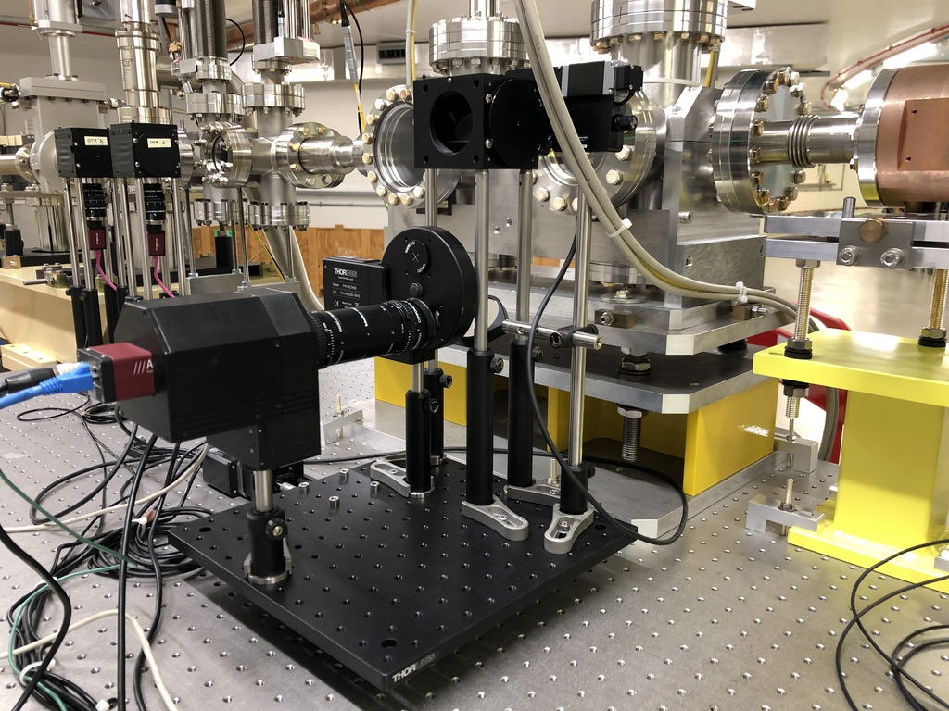
Current Optical System

Slide 3
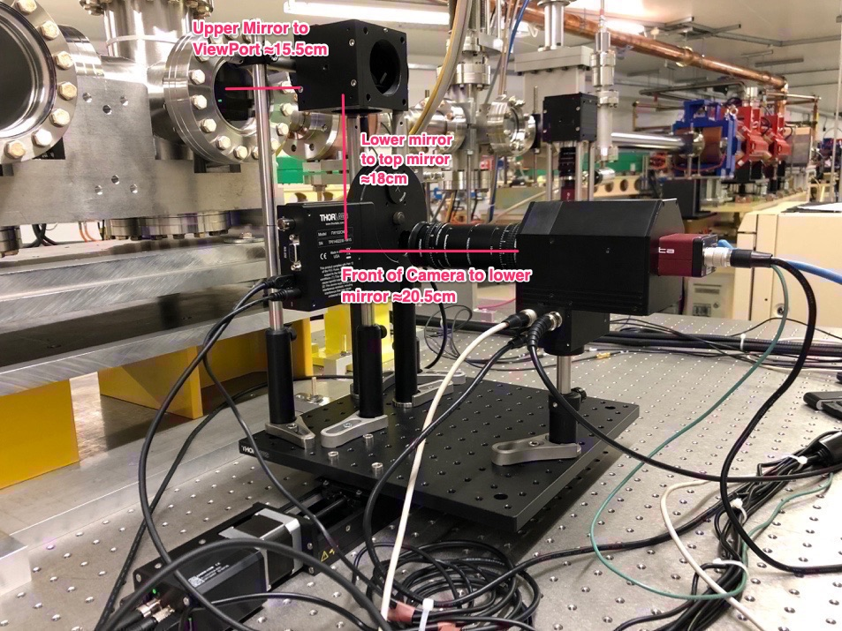
Current Optical System

Slide 4
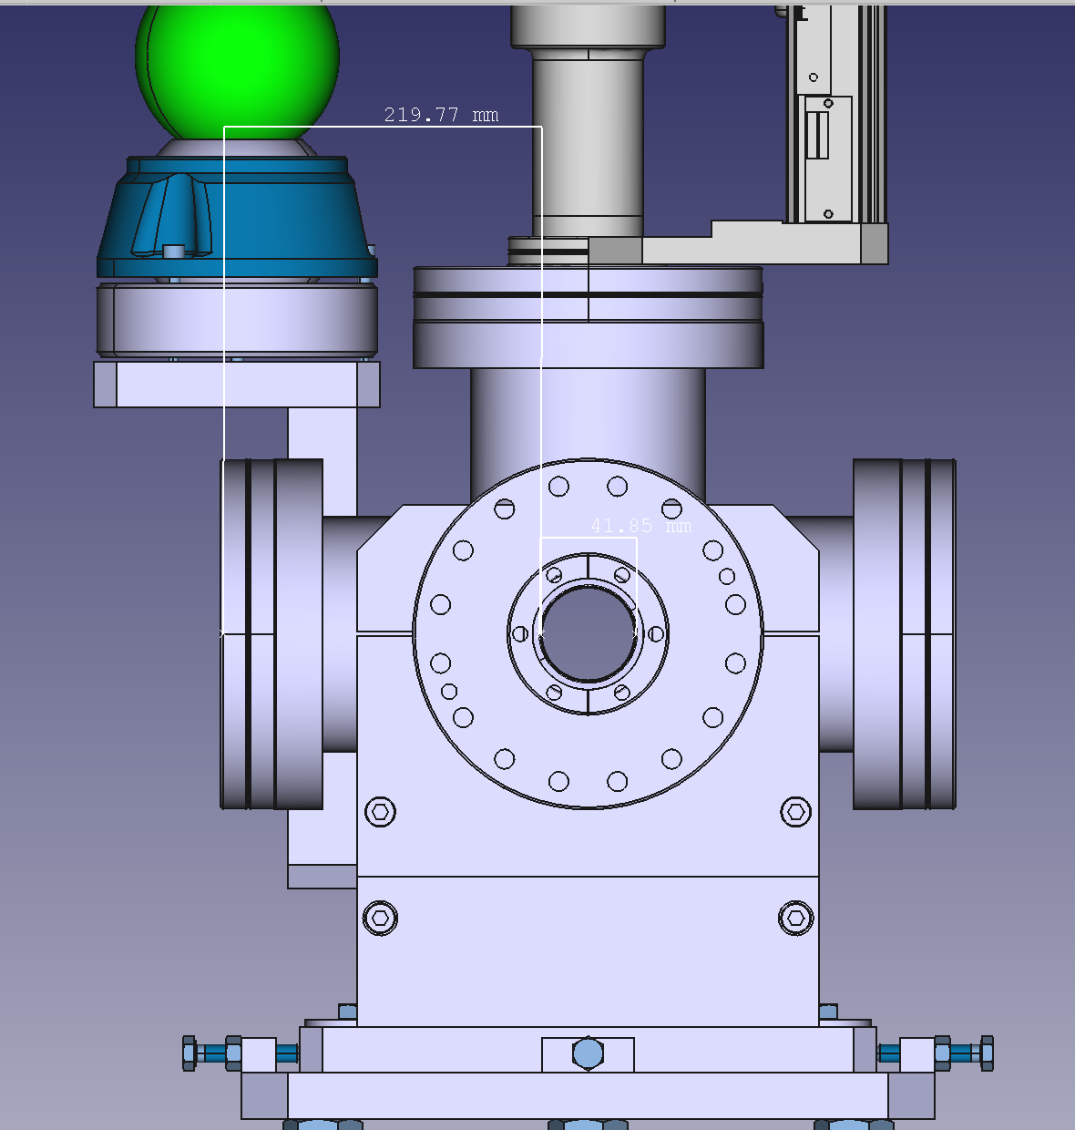
Current Optical System

Slide 5
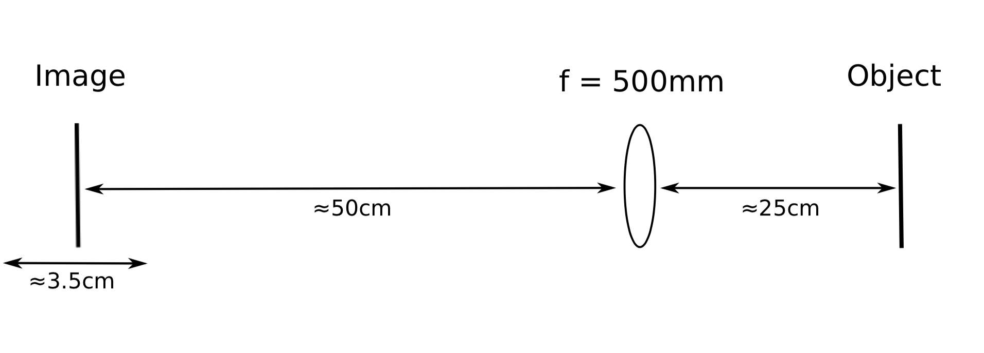
Proposed Optical System

Slide 6

Proposed Optical System
Gamma = 5900 => Lens Acceptance > 0.17mRad
For 10 pixels across:
500mm lens results in ≈ 8 pixels across 1/Gamma

Slide 7
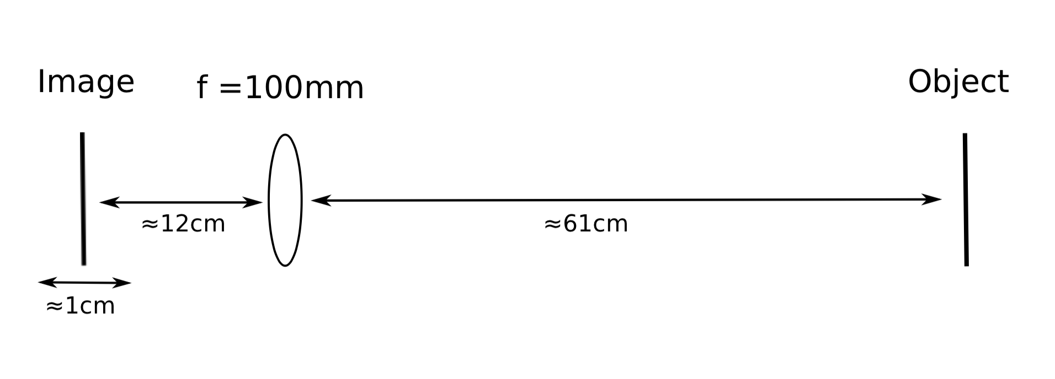
Proposed Optical System
Magnification = 0.2

Slide 8
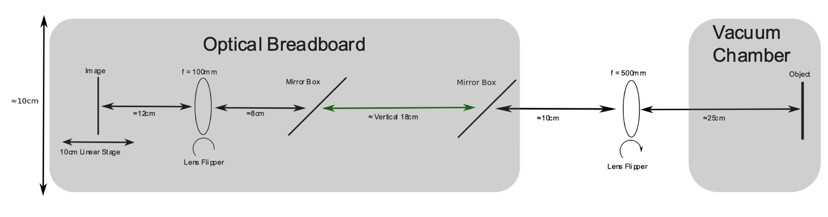
Proposed Optical System

Slide 9
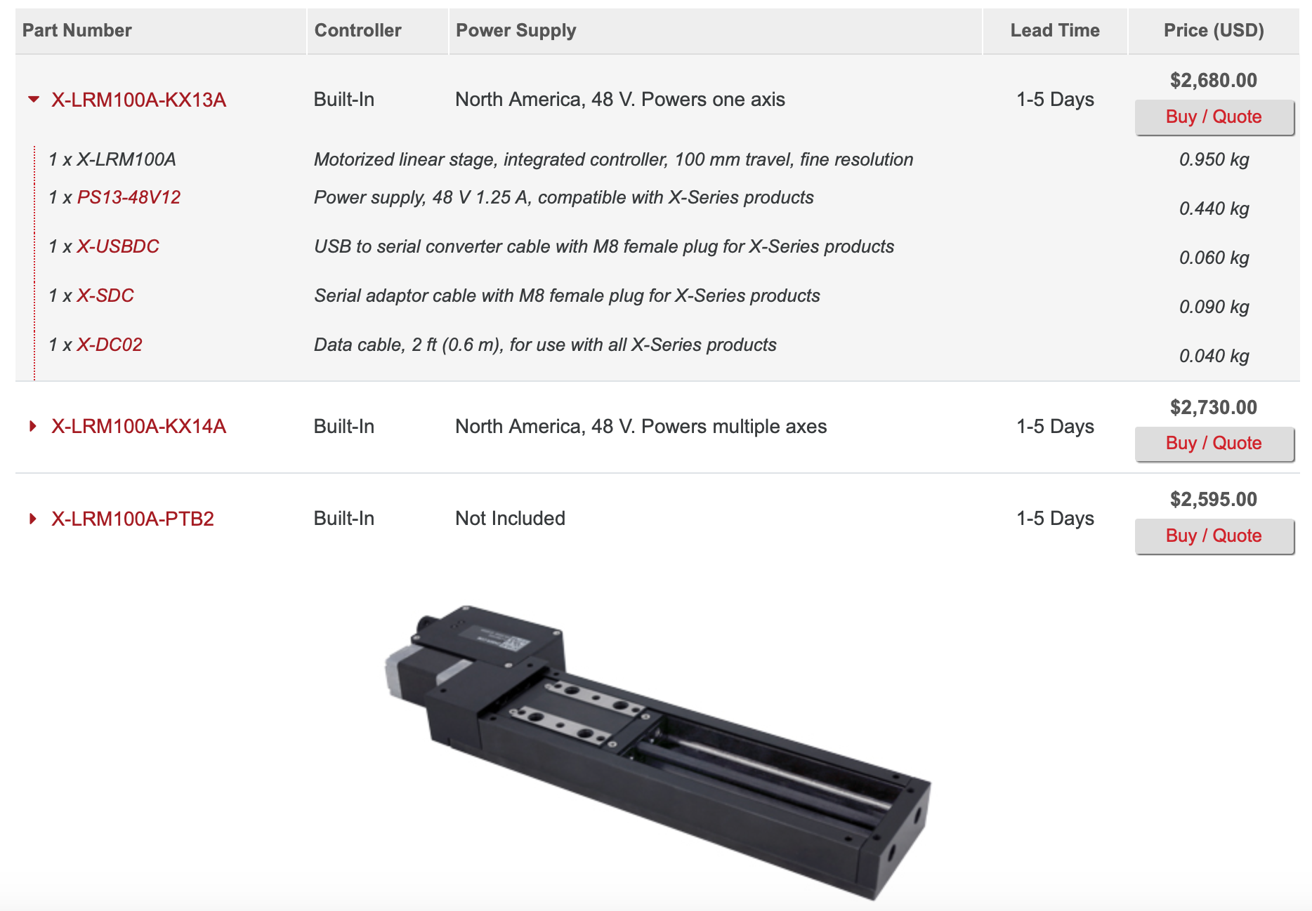
Proposed Optical System

Slide 10
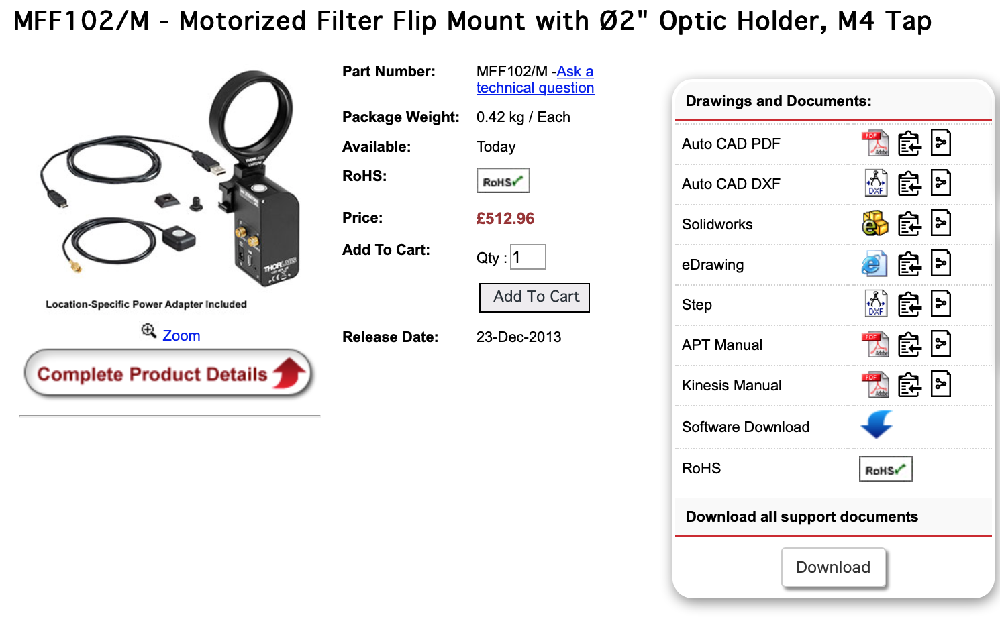
Proposed Optical System

Slide 11
Proposed Optical System
Angular Lens
AC508-500-AB - f = 500.0 mm, Ø50.8 mm Achromatic Doublet, ARC: 400 - 1100 nm
https://www.thorlabs.com/thorproduct.cfm?partnumber=AC508-500-AB
£112.50
Imaging Lens
AC254-100-AB - f = 100.0 mm, Ø1" Achromatic Doublet, ARC: 400 - 1100 nm
https://www.thorlabs.com/thorproduct.cfm?partnumber=AC254-100-AB
£75.00

