Slide 1
DIRAC
OAuth2 authorization

Slide 2
OAuth2
OAuth 2 is the industry-standard protocol for authorization, provides several "grant types" for different use cases. In our project we use Authorization Code flow.
The Authorization Code grant type is used by confidential and public clients to exchange an authorization code for an access token.
The user is directed to the authorization endpoint of the Oauth2 identity provider, e.g. EGI Check-In
After the flow returns to the client via the redirect URL (to the DIRAC Oauth2 API), the application will get the authorization code from the URL and use it to request an access and refresh tokens.
After that we can get user profile, where we can find unique ID and some other information.

Slide 3
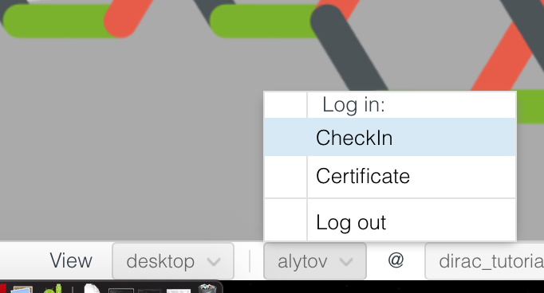
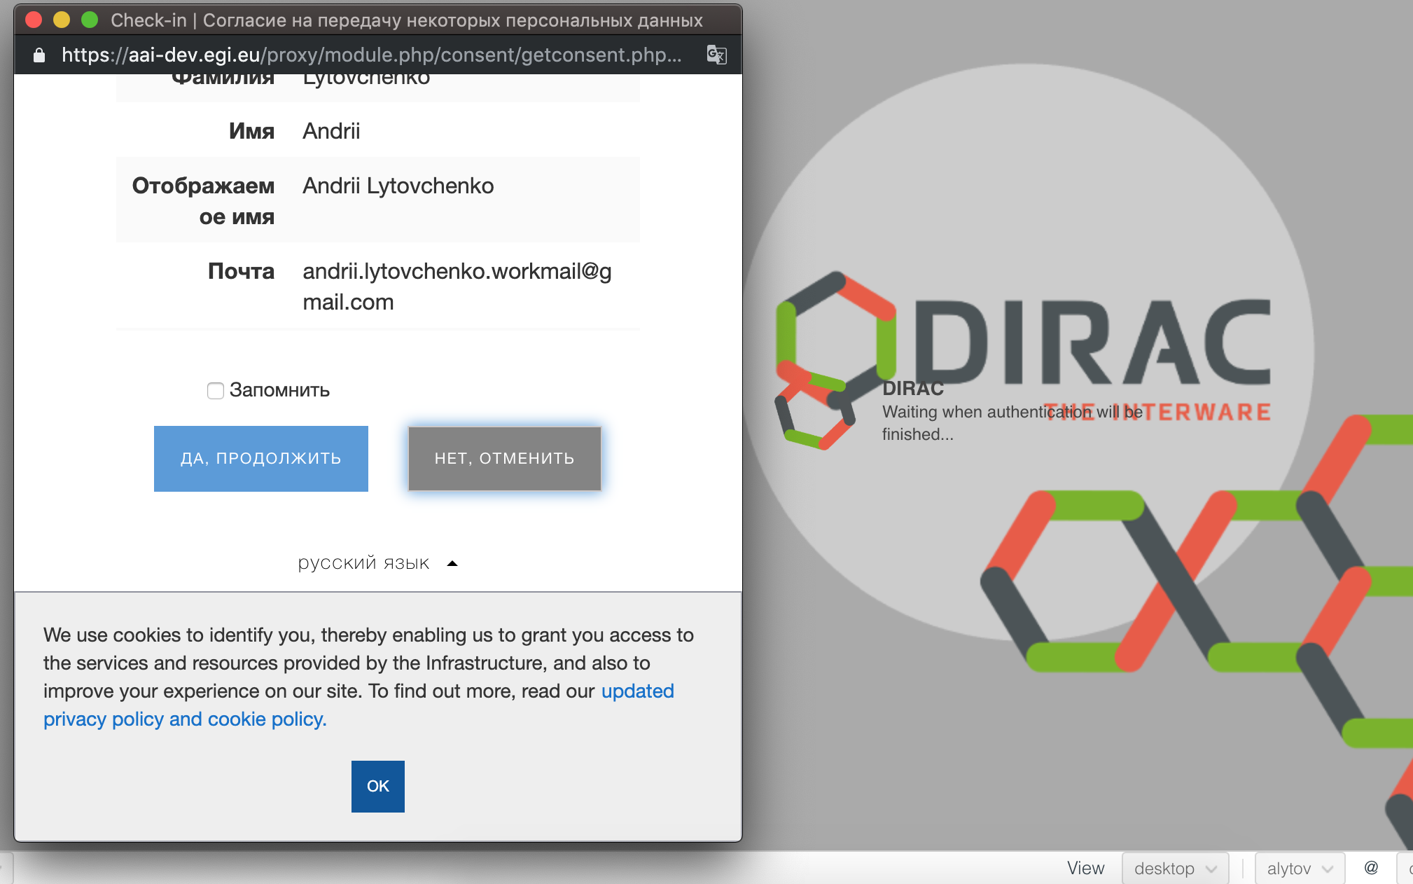
Portal

Slide 4
Portal
HTTP
OAuth2Service
click login button
ask authorization url
create url
DB
user
open url
return url
save session
authorization
authorization request
return authorization code
closed?
begin authorization
read session record
closed?
ask full info
web portal
oauth2 API
handler
class
token request
profile request
return tokens
closed?
return profile
closed?
save it to session
authorization pop-up window
for oauth2 proxy provider
begin new oauth2 circle
ask DN
for other proxy providers
closed?
closed?
modify/create new dirac user
print result / close
return registration result
oauth2 provider
proxyManager
closed!
ask session status
set cookies reload page
return state of session
ask session info
authentication done

Slide 5
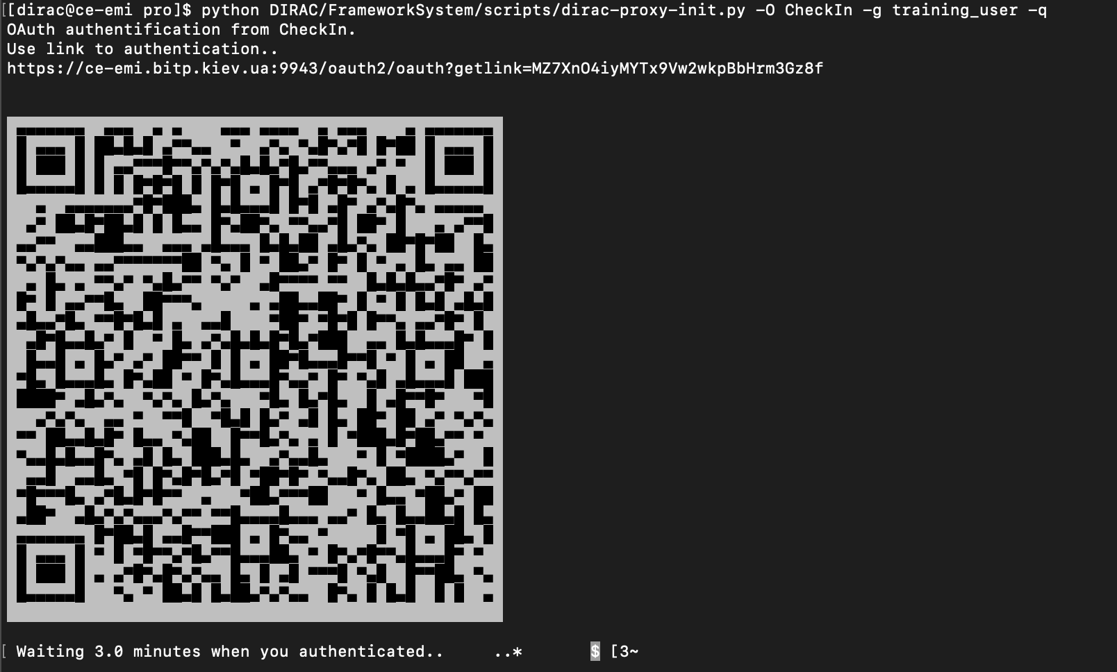
Command line client

Slide 6
Command line client
HTTP
OAuth2Service
dirac-proxy-init
ask oauth2 endpoint
user
ask session state
create url
return state
save session
proxyDB
DB
oauth2 provider
create short url for authorization
proxyManager
open url
wait proxy
wait result
ask authorization status
redirect
get long authorization url
authorization
authorization request
return authorization code
begin authorization
read session record
terminal
ask full info
oauth2 API
class
token request
handler
profile request
return tokens
save it to session
return profile
authorization window
configuration API
for oauth2 proxy provider
begin new oauth2 circle
ask DN
for other proxy providers
ask authorization status
modify/create new dirac user
print result / close
return registration result
ask authorization status
return state of session
get proxy
write proxy to file
add group and return proxy
save clean proxy

Slide 7
Software
Add base code from WebApp to get the ability to realisation the http API for some services, for example OAuth2 authentication service or Configuration service.
/WebAppDIRAC/ [Core, Lib, scripts] --> /DIRAC/Core/HTTP/
To use APIs we need also add APIs software of service to system directory, create configuration file(http.cfg for example).
/DIRAC/SomeSystem/API/ServicenameHandler.py
And run script:
dirac-webapp-run http.cfg -o RootURL=/ -S DIRAC. SomeSystem.API
PR #4032
PR #4037

Slide 8
Software
OAuth2 authentication provided by OAuth2 DIRAC service. It will use OAuthDB to store authentication session, where are recorded tokens, state number, user ID, profile(email, name, etc) and ProxyDB to store clean proxy, without any dirac extentionals.
Also ProxyManager has new opportunity to work with clean proxies and with proxy providers to generate proxy on the fly.
PR #4037

Slide 9
Configuration
Resources
IdProviders
{
CheckIn
{
method = oAuth2
issuer = https://aai-dev.egi.eu/oidc
client_id = 2C7823B4-wqenknsadljdas2-E5D06D955809
client_secret = 732h9d0dn-23dos983_CRcUf6paEMejjojAqQz5A
Syntax
{
VOMS
{
claim = edu_person_entitlements
vo = ^urn:mace:egi.eu:(group:registry|group):<VALUE>[:#].*
role = ^urn:mace:egi.eu:group:.*:role=<VALUE>[#:].*
}
}
proxy_provider = CheckInProxy
}
IdProviders
{
Google
{
method = oAuth2
issuer = https://accounts.google.com
client_id = 123987.googleusercontent.com
client_secret = S0tiJUqweoiiouesSH1advt
proxy_provider = DIRAC_EOSC_CA
dirac_groups = dirac_tutorial
}
}
dirac.cfg

Slide 10
Configuration
Resources
ProxyProviders
{
CheckInProxy
{
method = oAuth2
issuer = https://masterportal-pilot.aai.egi.eu/mp-oa2-server
client_id = myproxy:949241khkhkhk358d4981d
client_secret = ISh-Q32bkXRf-1_97qoxWmAQ1ylExh2pQc7rAlBqGVcQVNMf
max_proxylifetime = 864000
proxy_endpoint = https://masterportal-pilot.aai.egi.eu/mp-oa2-server/getproxy
}
ProxyProviders
{
DIRAC_EOSC_CA
{
max_proxylifetime = 31536000
method = DIRACCA
CAConfigFile = /opt/dirac/pro/etc/m2.cfg
}
PUSP
{
method = PUSP
}
}
dirac.cfg

Slide 11
Configuration
Framework
{
Production
{
Services
{
OAuth
{
Port = 9244
}
URLs
{
OAuth = dips://ce-emi.bitp.kiev.ua:9244/Framework/OAuth
OAuthAPI = https://ce-emi.bitp.kiev.ua:9943/oauth2
}
}
}
dirac.cfg

Slide 12
Configuration
WebApp
{
Balancer = none
HTTPS
{
Enabled = True
Port = 9943
}
HTTP
{
Port = 8099
}
AdminsEmails = atsareg@cppm.in2p3.fr, lytovchenko@cppm.in2p3.fr
}
http.cfg

Slide 13
Configuration
LocalInstallation
{
ConfigurationServerAPI = https://ce-emi.bitp.kiev.ua:9943/configuration
}
defaults-DIRAC.cfg

Slide 14
END
Thanks for your attention

