Slide 1
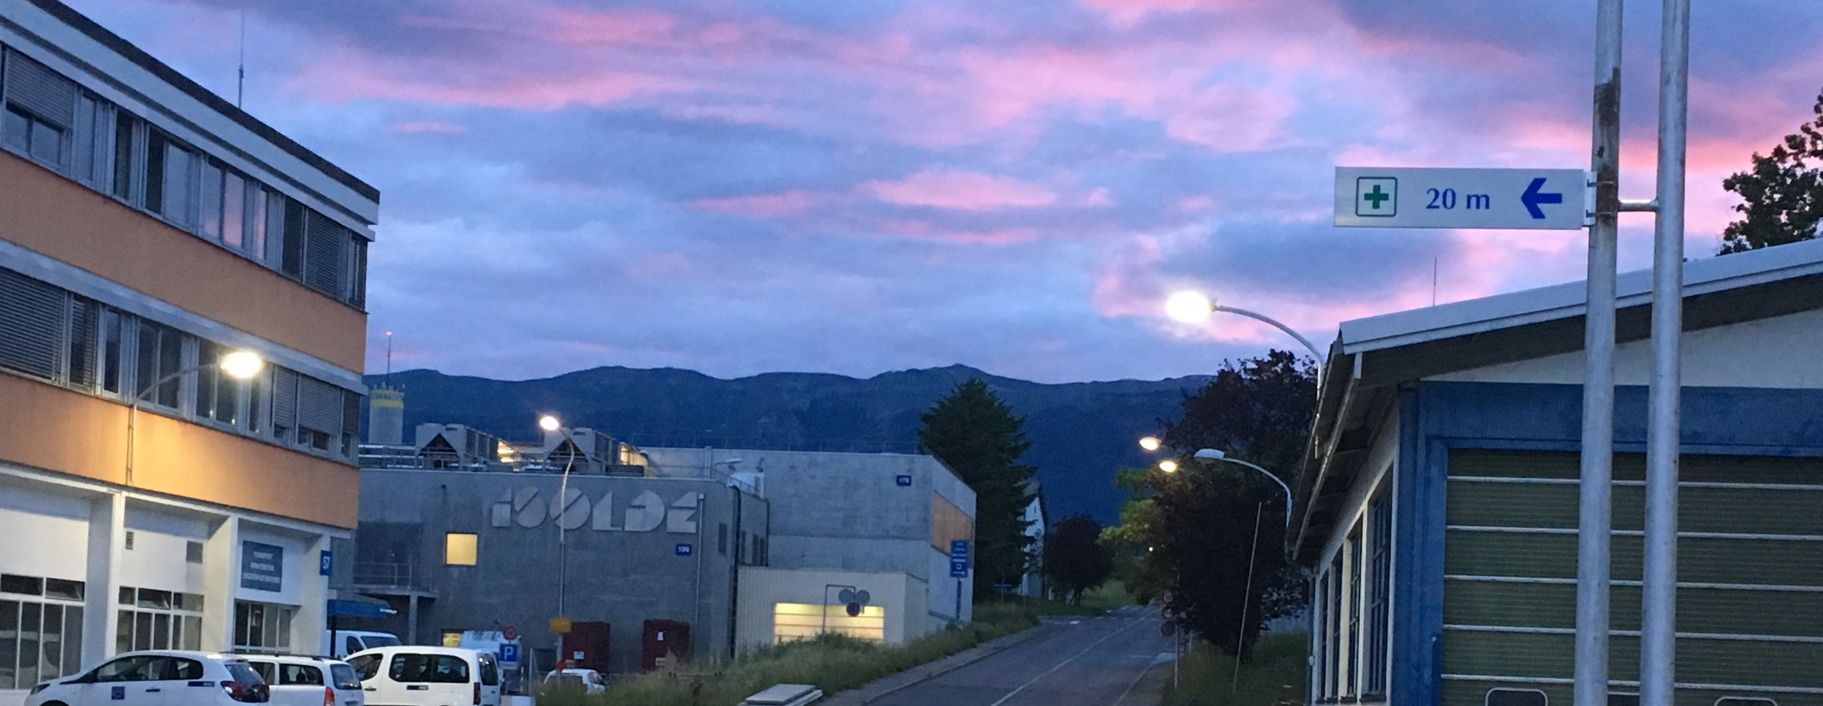


(Nuclear) Physics at ISOLDE-CERN (2/2)
Hanne Heylen
hanne.heylen@cern.ch
CERN, Experimental Physics department
on behalf of the ISOLDE-CERN group

Slide 2
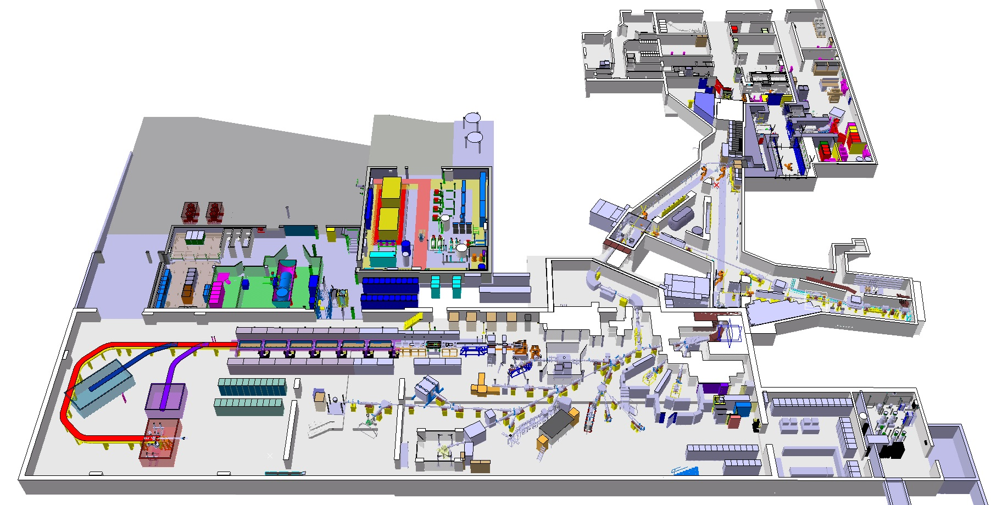



The ISOLDE facility - recap
Radioactive laboratory
Class A
MEDICIS
HRS
High Resolution Separator
Route Democrite
High Energy RIB
Target area
Route Einstein
Low energy RIB
GPS
General Purpose Separator

Slide 3
Homework
What factors determine ion beam intensity in your set-up?
ISOLDE
1.4 GeV protons
2 uA maximal proton intensity
Isol facility

Slide 4

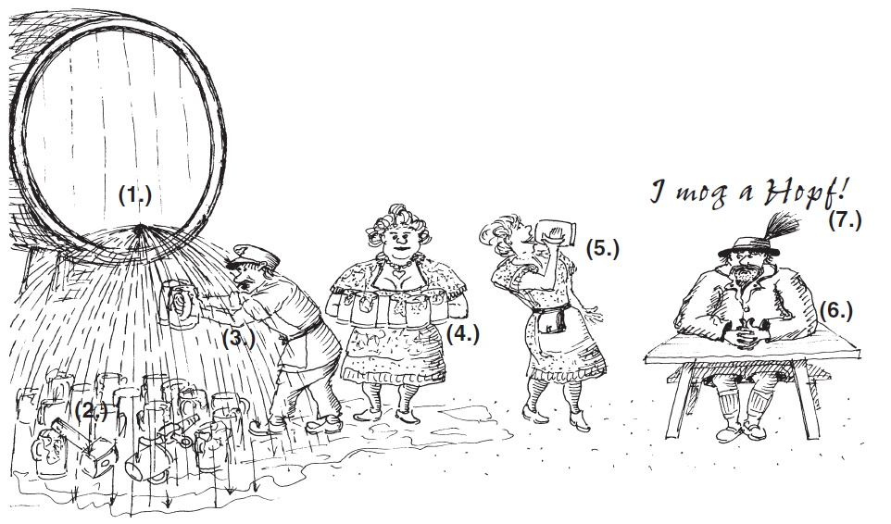
Homework
Number of extracted ions (yield) is governed by:
primary particle flux x reaction cross section x number of target particles x efficiencies
ISOLDE
Energy loss of protons in thick target (σ(E))
Secondary reactions in target
Selectivity <> loss in yield
Effusion/Diffusion out of target
Release from target <> half-life
How much time do we spend on optimizing (gain in intensity <> available beam time)
...

Slide 5
Outline
Lecture 1: ISOLDE-CERN: radioactive ion beam production
Lecture 2: Nuclear Physics and Applications at ISOLDE
Visit to the ISOLDE facility
  Tuesday 30/07, Thursday 01/08, Wednesday 07/08
  https://indico.cern.ch/event/834871/
  Meeting point: b. 508
  Safety information: closed and flat shoes!
  Don’t forget to cancel if you cannot make it, there is a long waiting list!

Slide 6
Research at ISOLDE
Research ON radioactive isotopes (80%)
  Nuclear physics
  Nuclear astrophysics
  Symmetries and fundamental interactions
Research WITH radioactive isotopes (20%)
  Solid state physics
  Biophysics
ISOLDE pie 2017

Slide 7
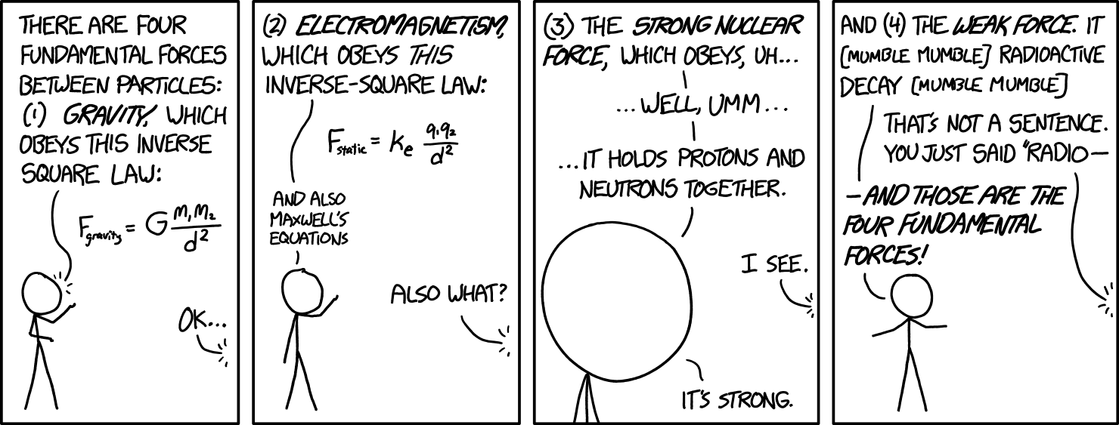
1. Nuclear physics
https://xkcd.com/1489/

Slide 8
The nuclear physics problem
Understand the fundamental properties of nuclei starting from their building blocks, the protons and neutrons
The atomic nucleus = system of A interacting nucleons
Solving the quantum many-body problem
Mean field approaches
Ab-initio (limited number of A)
Details of the nuclear force within the nuclear medium
Effective nucleon-nucleon interaction no derivation from QCD
Theory
Major computational and conceptual advances in last decade
Experiment
Test predictive power of nuclear models when going to the extremes
Notes:
While QCD is well tested at high energies,
where the strong coupling constant is sufficiently
small for perturbation theory to apply, it becomes
a strongly coupled theory in the low energy regime
where many aspects await a better understanding

Slide 9
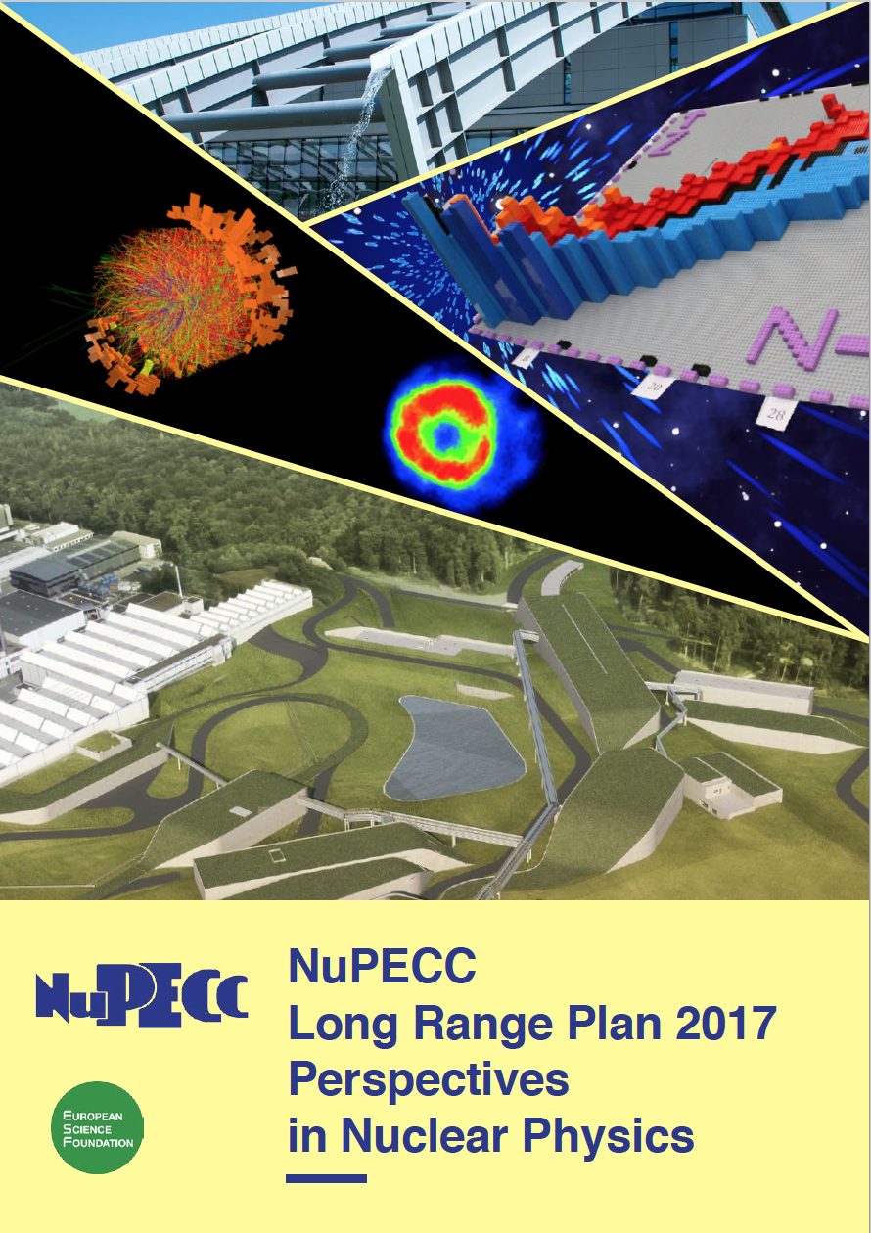
Some key questions
What are the limits of nuclear existence?
What are the nuclear processes that drive the evolution of stars, galaxies and the universe?
How do simple and regular patterns emerge in complex nuclei?

Slide 10
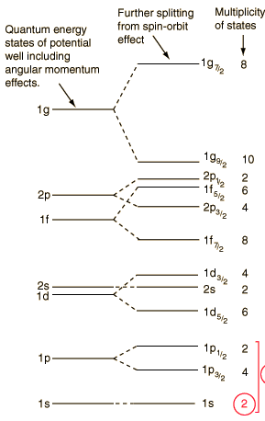
Shell structure in nuclei
How do simple and regular patterns emerge in complex nuclei?
Energy of first excited 2⁺ state
50
TE Cocolios
20
Filled proton or neutrons shells
  Magic numbers: 8, 20, 28, 50, 82, 126
  Increased stability
  → Backbone of nuclear physics
8
2

Slide 11
Shell structure in nuclei
How do simple and regular patterns emerge in complex nuclei?
Energy of first excited 2⁺ state
50
  Do magic numbers change in exotic nuclei?
TE Cocolios
20
Filled proton or neutrons shells
  Magic numbers: 8, 20, 28, 50, 82, 126
  Increased stability
  → Backbone of nuclear physics
8
2

Slide 12
ISOLDE – focus on exotic nuclei
Exotic nuclei have a different neutron-to-proton ratio than stable nuclei
  New structures
  New decay modes (e.g. proton decay)
  Challenging for state-of-the-art models
Example: shell structure evolution
  Do magic numbers change in exotic nuclei?

Slide 13
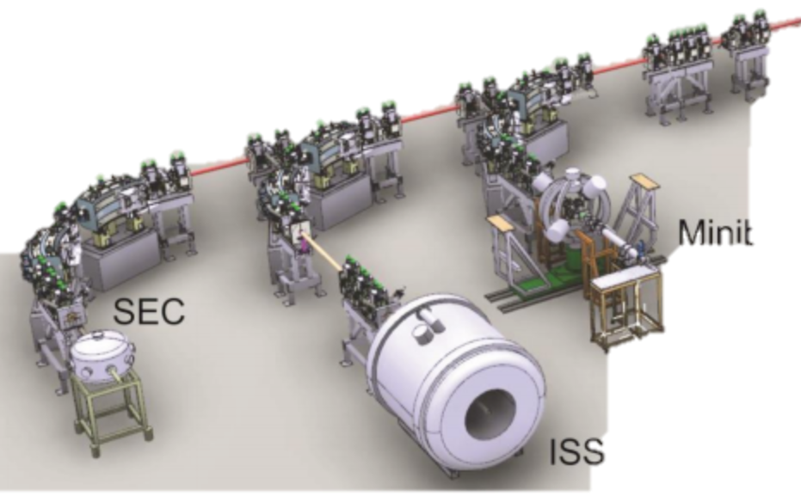
Experiments to probe nuclear structure
Focus on Exotic Beams at ISOLDE: A Laboratory Portrait
J. Phys. G: Nucl. Part. Phys. 44 (2017)
TAS
REX-ISOLDE
WISARD
HIE-ISOLDE
VITO
Scattering
Chamber
MINIBALL
IDS
NICOLE
CRIS
ISOLTRAP
COLLAPS
ISS
Travelling setups
Low energy experiments
High energy experiments

Slide 14
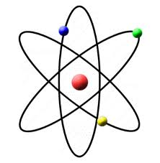
2a. Research on radioactive isotopes:
Low energy nuclear physics
Energy
Ground state properties
  Mass spectrometry
  Laser spectroscopy
Decay spectroscopy
Weak interaction and fundamental symmetries studies
T_{1/2}
I^{π}
^{A}Y
Radioactive decay
(α, β, γ, n, p, fission)
Isomeric state
t_{1/2}, angular correlations
Mass spectroscopy
(binding energy)
Ground state
Laser spectroscopy
(spin, size, shape)
^{A}X

Slide 15
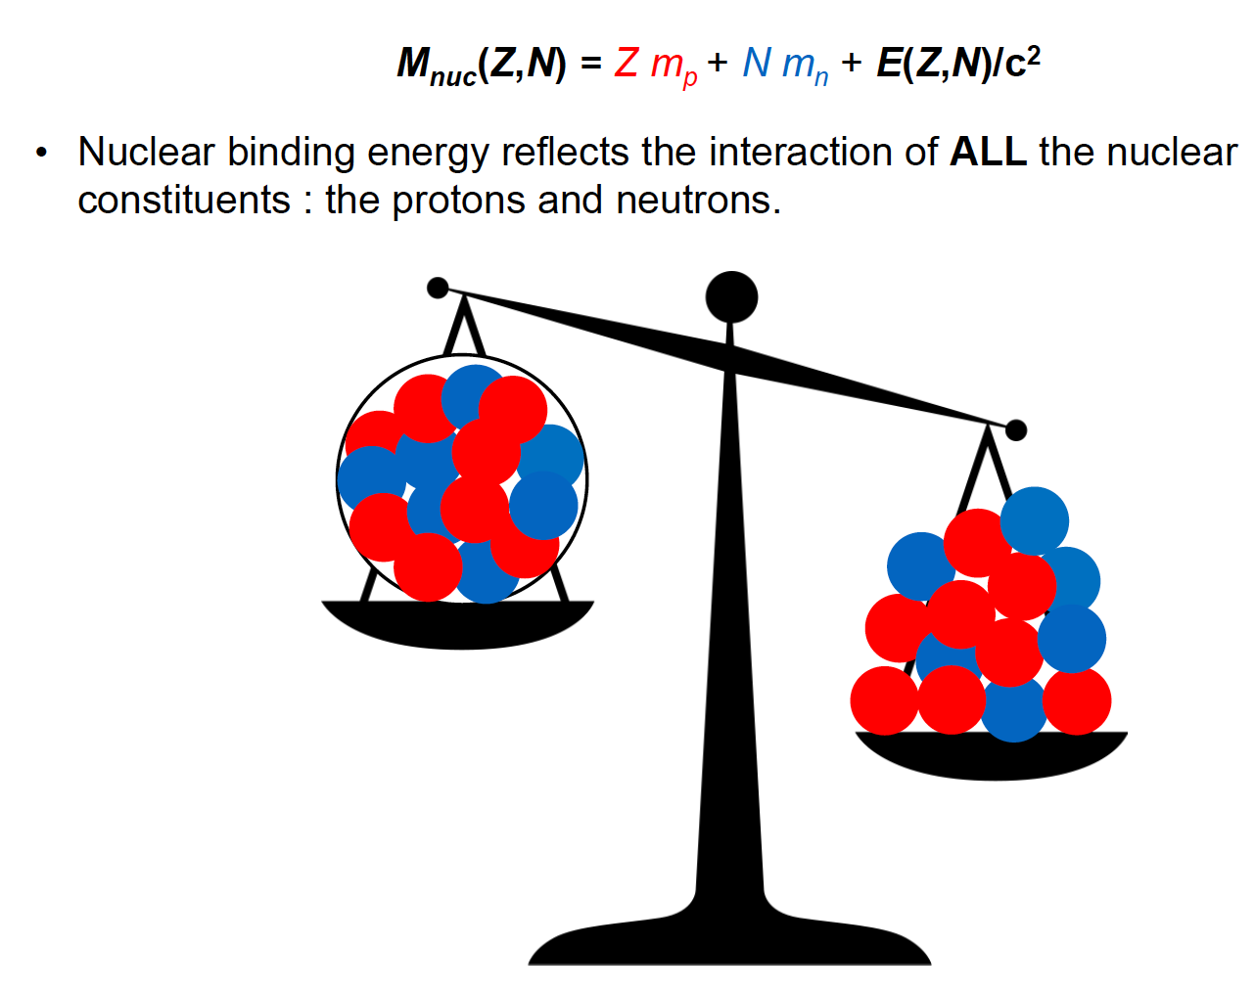
ISOLTRAP mass spectrometer
maxime.mougeot@cern.ch
High-precision mass measurements
Why?
Nuclear structure: shell closure
Input for astrophysics
Test of Standard Model
Relative precision of
Δm/m ~ 10⁻⁸ to 10⁻⁹

Slide 16
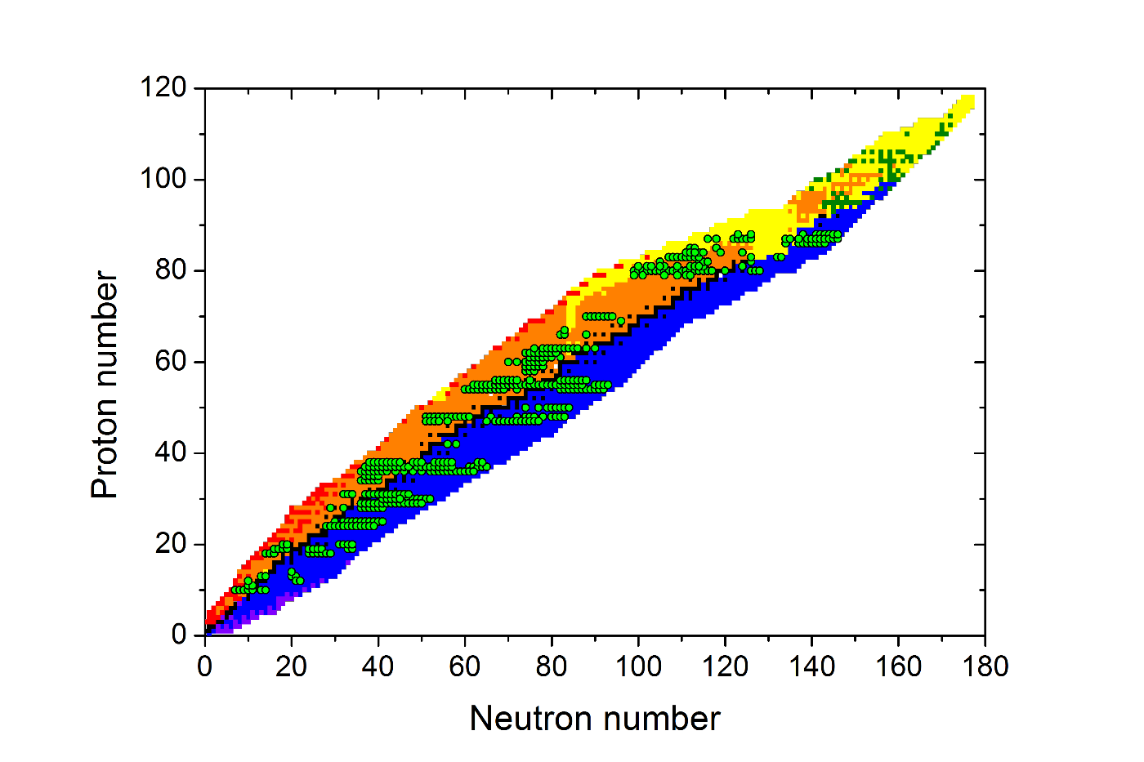
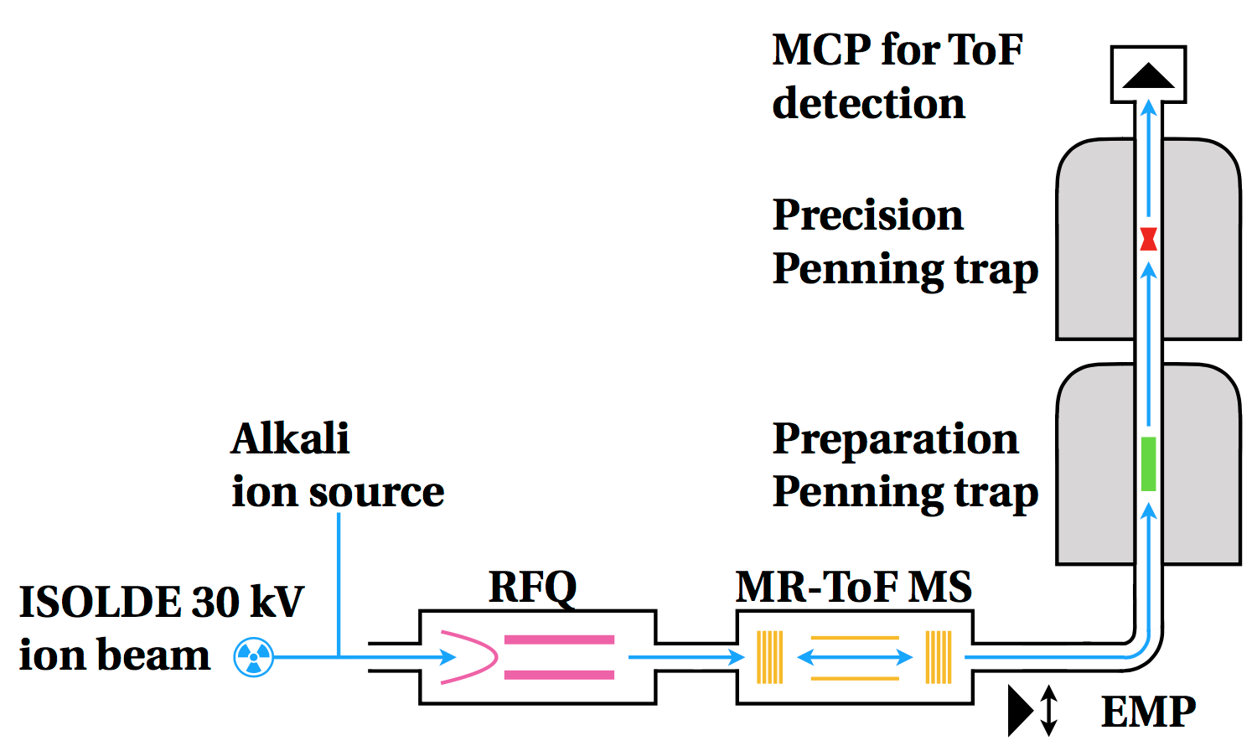
ISOLTRAP mass spectrometer
maxime.mougeot@cern.ch
Measured by ISOLTRAP
J. Karthein et al. PRC 100, 015502 (2019)

Slide 17
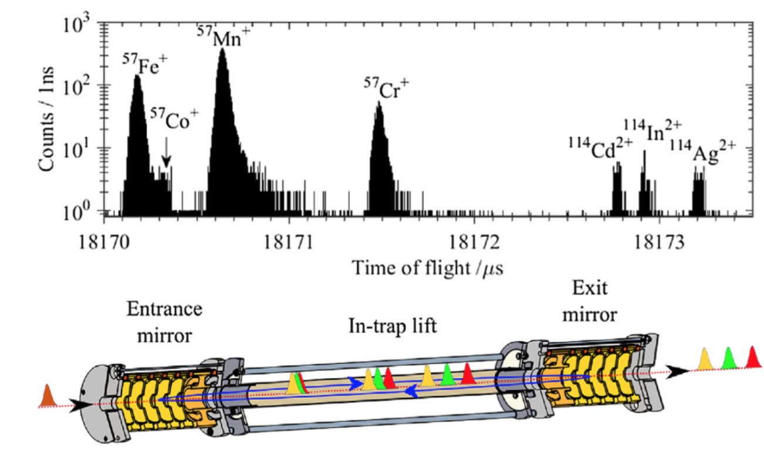
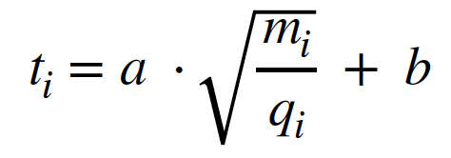
ISOLTRAP mass spectrometer
maxime.mougeot@cern.ch
Multi-reflection Time-of-Flight (MR-ToF)
Fold 1000s m of flight-path in device of ~1m
Limitation
  < 1 pps
  10 ms half-life
Resolving power
  10⁵ in ~20 ms
F. Wienholtz et al., Int. J. Mass Spectrom. 421, 285-293 (2017)

Slide 18
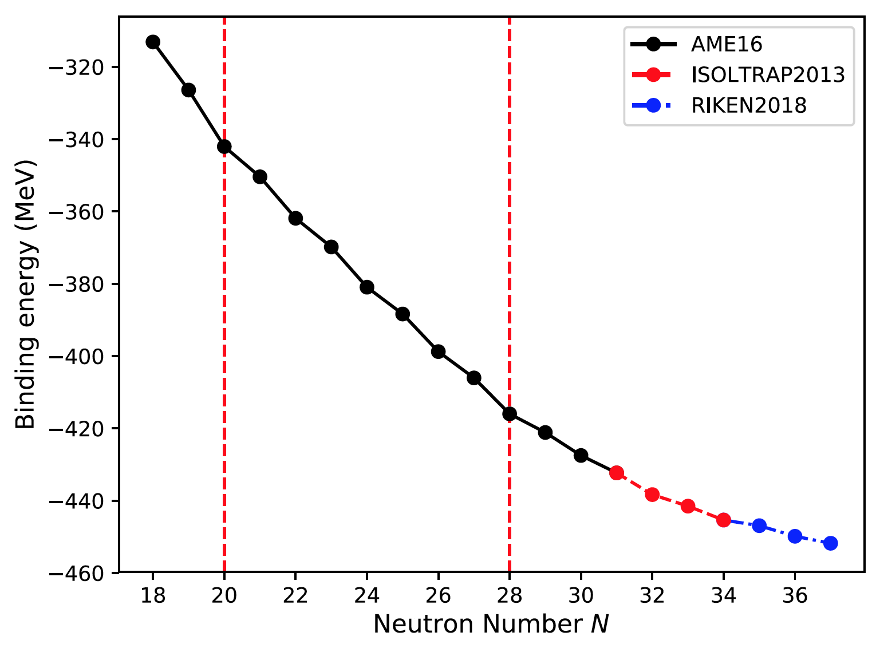
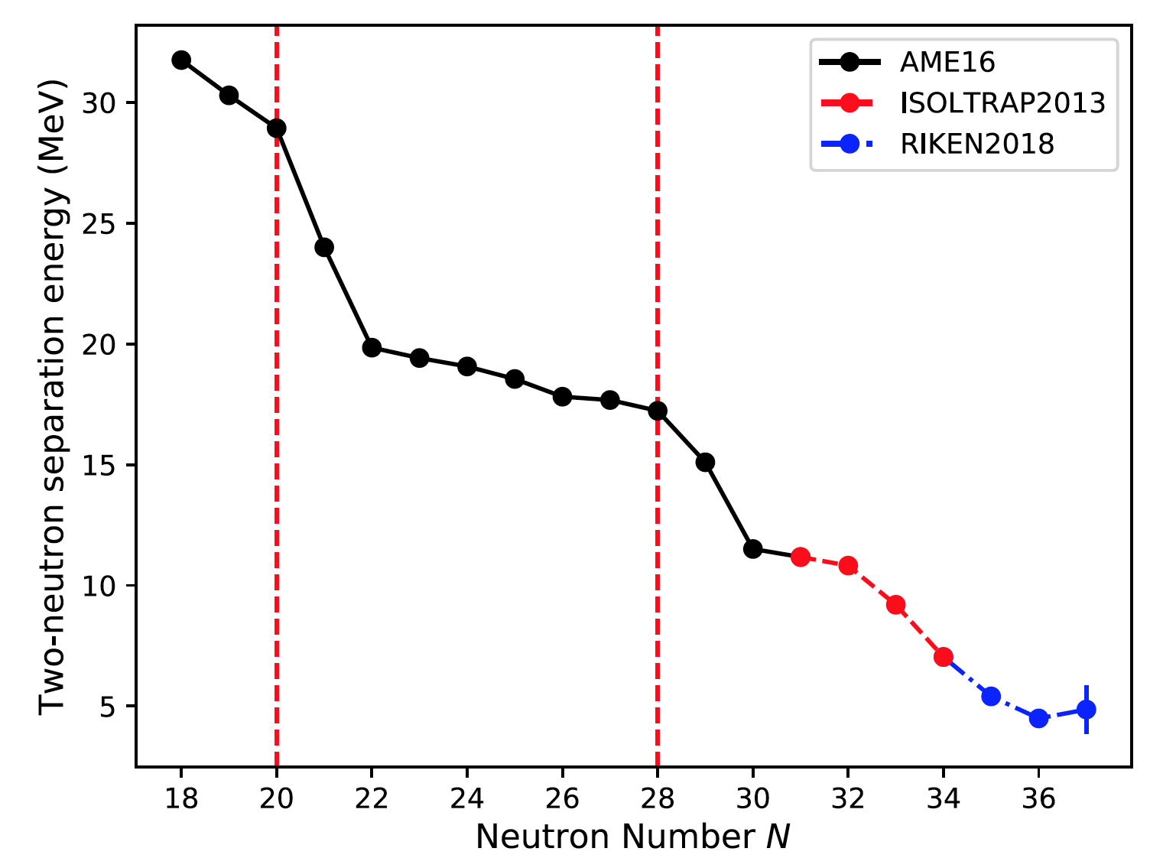

ISOLTRAP mass spectrometer
maxime.mougeot@cern.ch
Ca-isotopes
  Z = 20 closed shell: benchmark for nuclear models
  New magic numbers at N = 32 and N = 34?

Slide 19

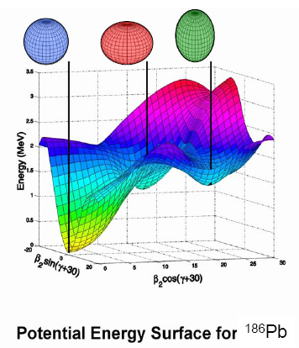
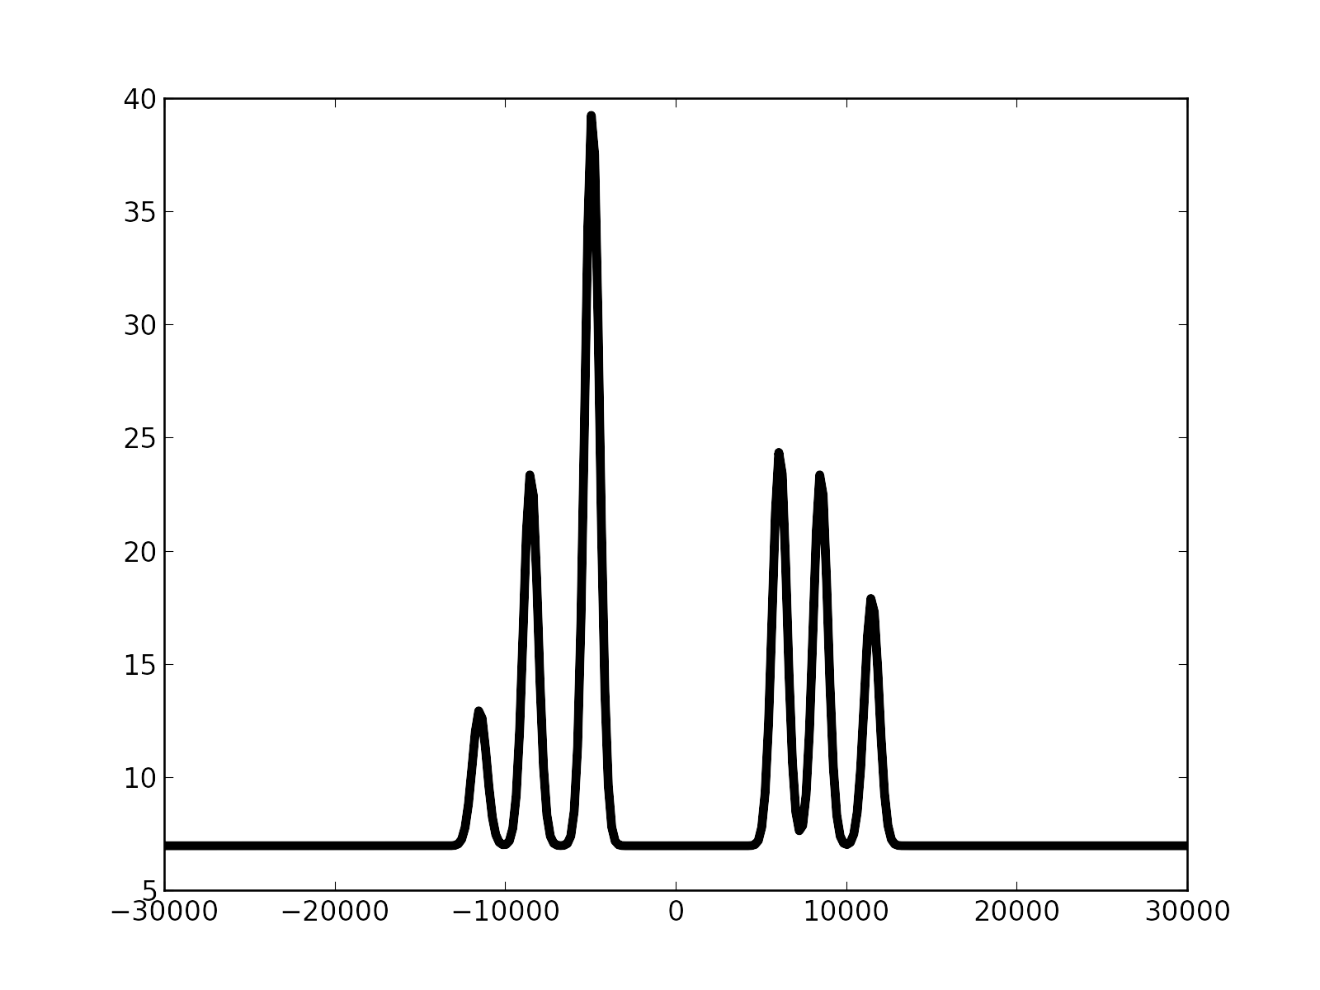
Laser spectroscopy
liss.vazquez@cern.ch
ronald.fernando.garcia.ruiz@cern.ch
Spin I
Magnetic dipole
moment μ
Electric Quadrupole moment Q_{s}
Charge radius δ⟨r²⟩
Nuclear information from probing atomic structure
Isotope shifts
Hyperfine structure
Atomic excited state
Atomic ground state

Slide 20
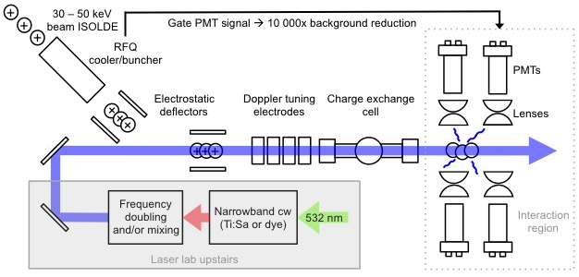
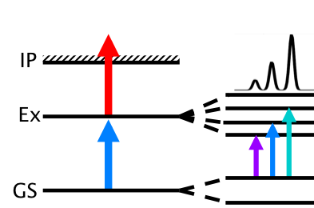
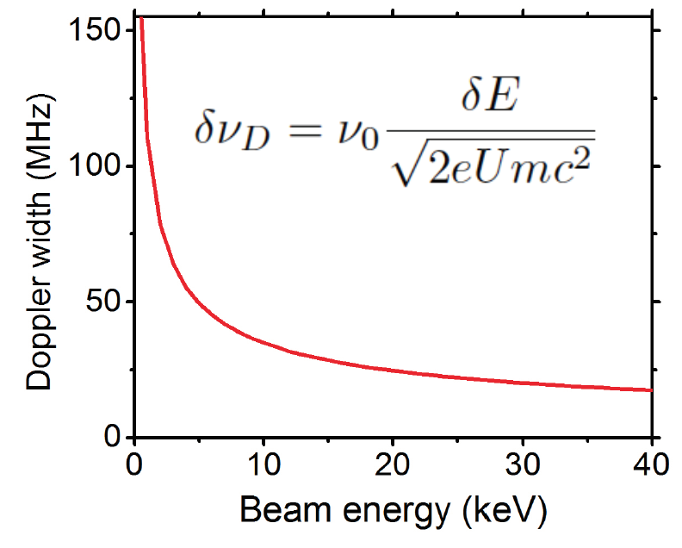
Laser spectroscopy
liss.vazquez@cern.ch
ronald.fernando.garcia.ruiz@cern.ch
Collinear overlap of laser and ion beam
Fast beam: high resolution
Detection
  Fluorescence detection (COLLAPS)
  Resonance ionization spectroscopy (CRIS)

Slide 21
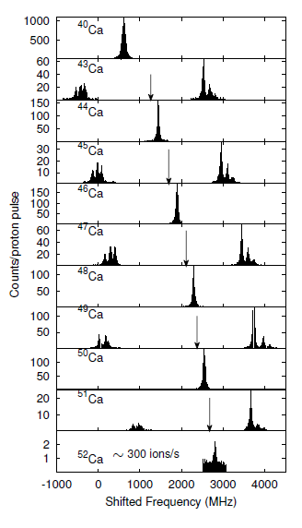
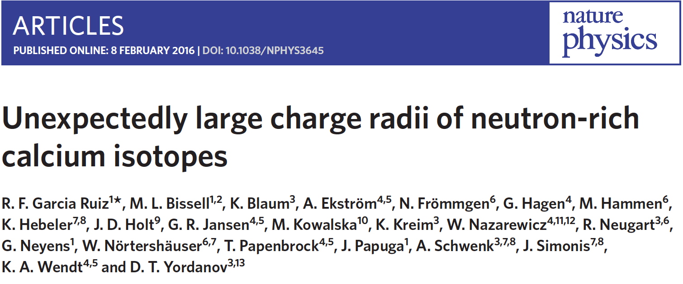
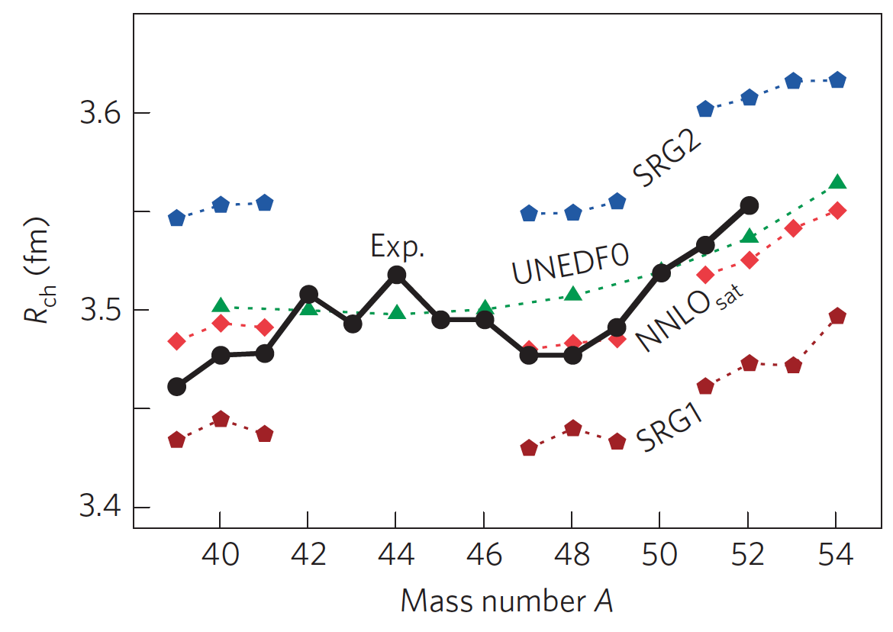
Laser spectroscopy
liss.vazquez@cern.ch
ronald.fernando.garcia.ruiz@cern.ch
N = 20
N = 28
N = 32

Slide 22
2b. Research on radioactive isotopes: post-accelerated beams
Energy
Reactions
Gamma spectroscopy
(excitation schemes)
Few-nucleon transfer
5-10 MeV/u
(probe quantum orbits)
^{A-1}X (d,p)
Isomeric state
Coulomb excitation
3-4 MeV/u
(probe collectivity)
Ground state
^{A}X

Slide 23
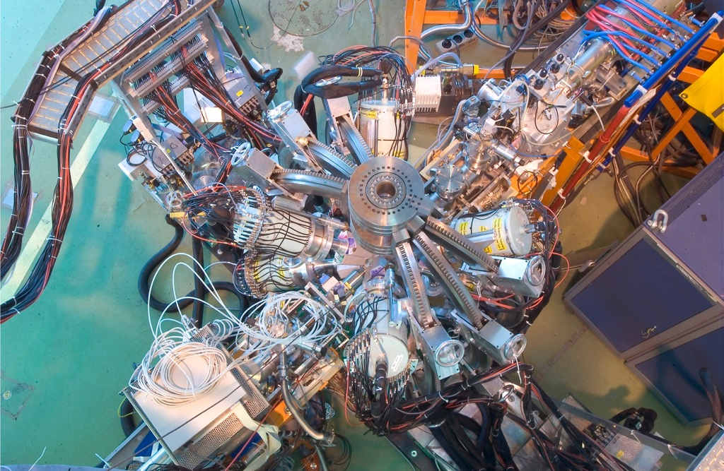
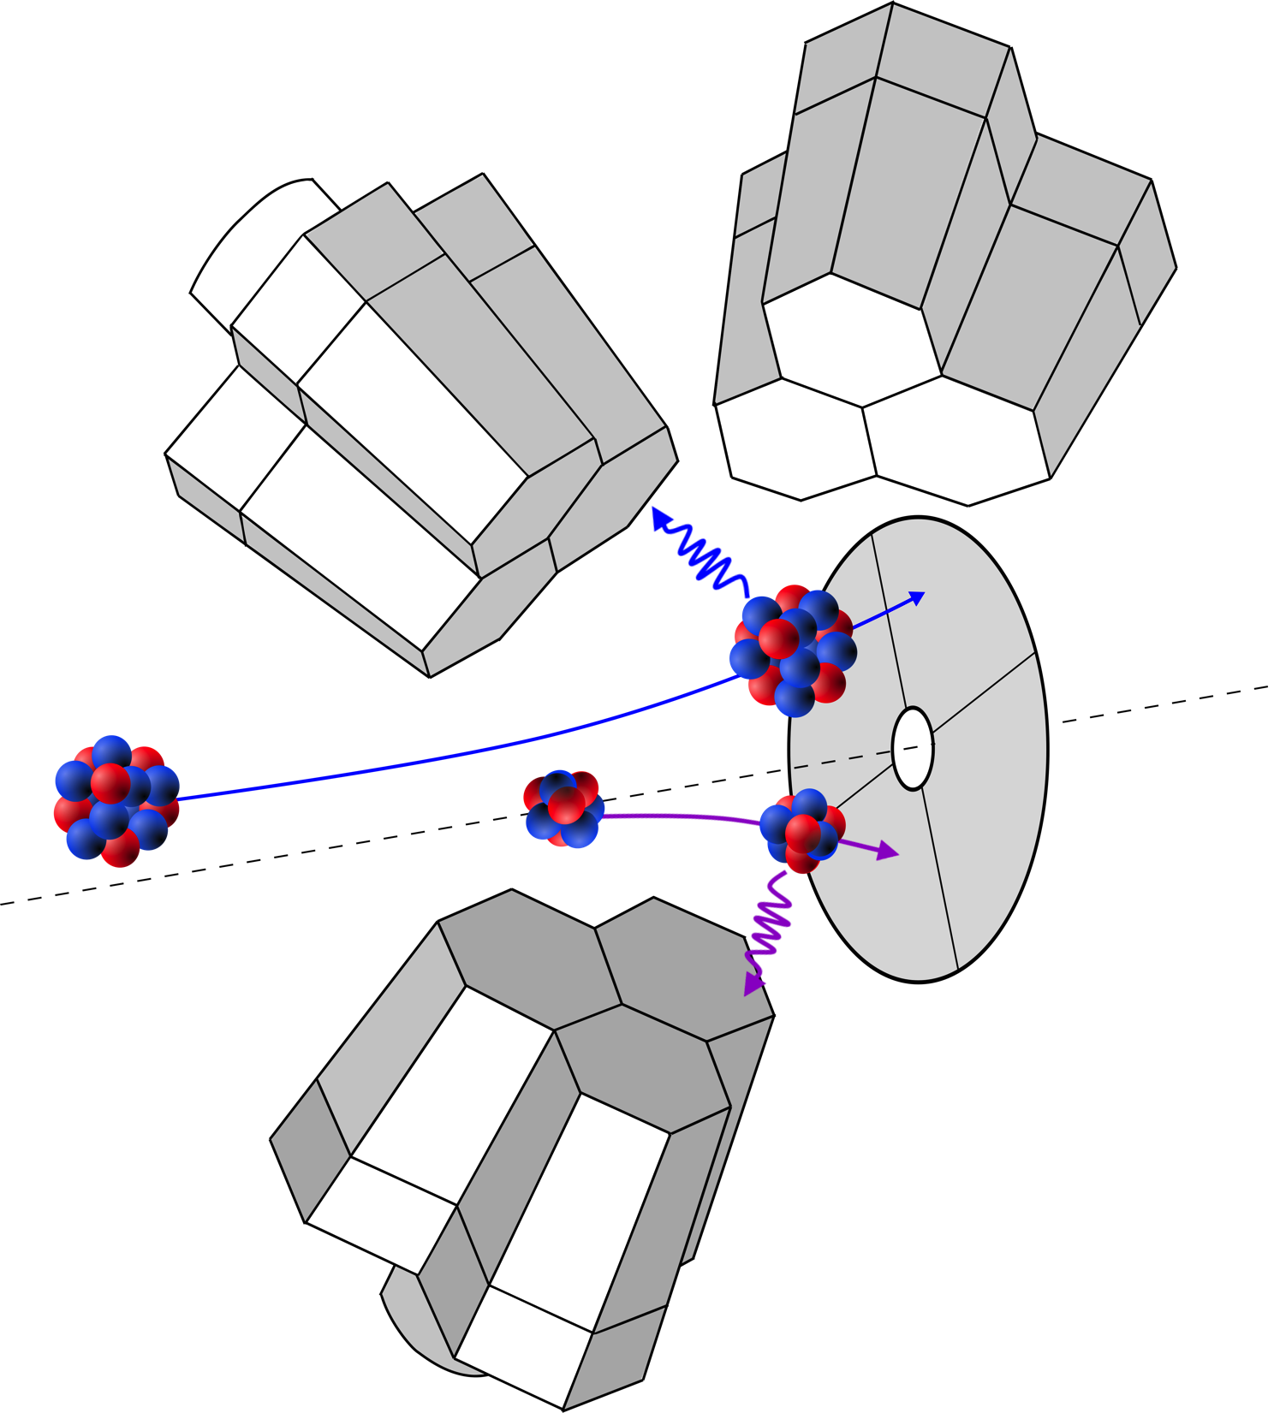
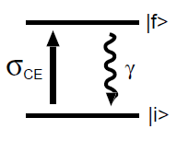
Miniball: Coulomb excitation
Joonas.konki@cern.ch
Coulomb excitation
  Inelastic scattering of nuclei with electromagnetic force only
  Nuclei never collide
Observables
  Gamma-decay energies
  Probability to excite to final state

Slide 24
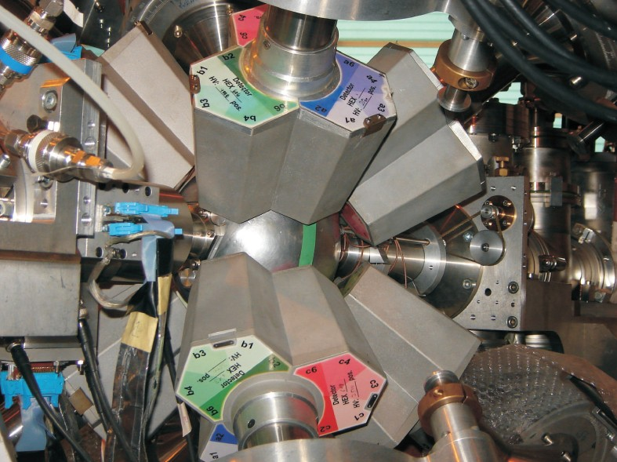
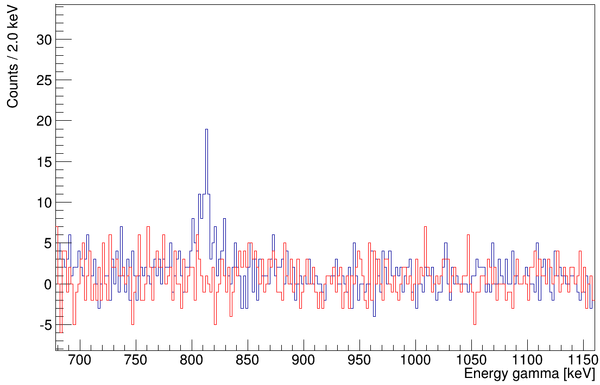
Miniball: Coulomb excitation
Joonas.konki@cern.ch
Detect scattered beam particle velocity and direction
→ Doppler correction
⁷⁴Zn
4.0 MeV/A (~ 5 hours)
Miniball set-up
  Si detectors for particle identification
  Ge detectors for efficient γ-ray detection
    Compact and high-solid angle coverage
    Segmented: position sensitive
2.8 MeV/A (~ 16 hours)
→ HIE-ISOLDE advantage

Slide 25
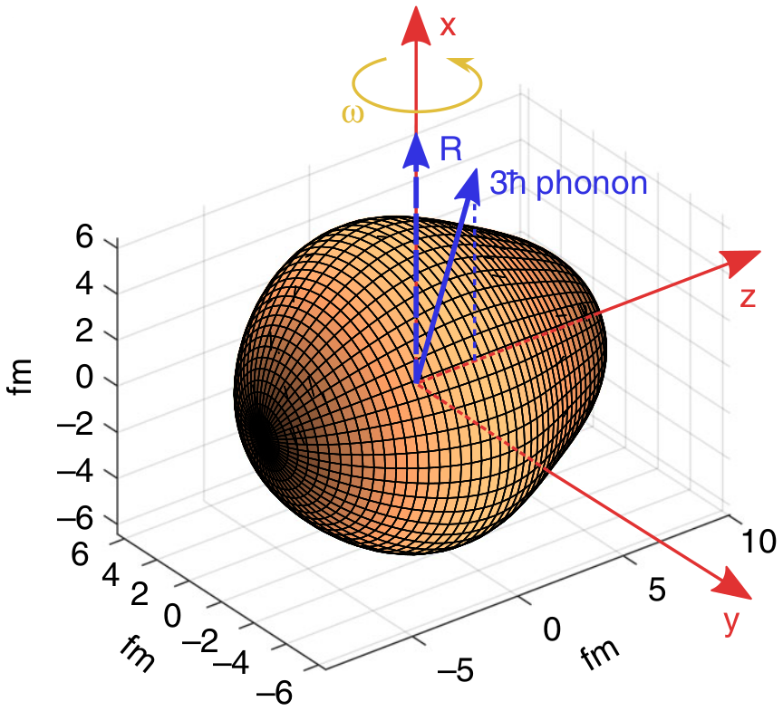
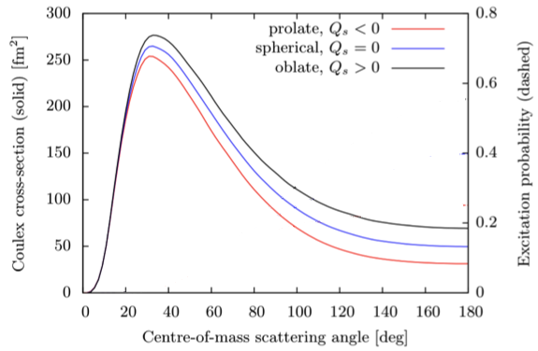
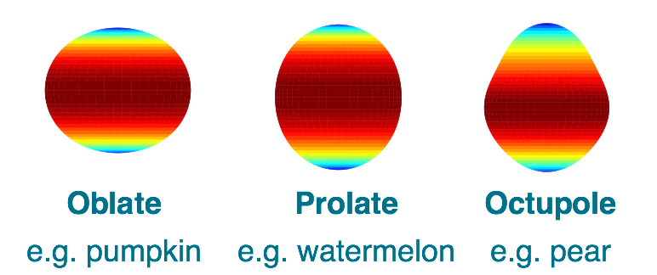
Coulomb excitation
Joonas.konki@cern.ch
Observation of vibrating pear-shapes in radon nuclei
P.A. Butler et al., Nature Comm. 10 (2019) 2473
Information
  Level scheme
  Nuclear shape of excited states
Oblate
e.g. pumpkin
Prolate
e.g. watermelon

Slide 26
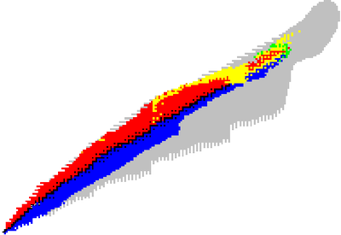
Summary
Ion traps
Decay
spectroscopy
Laser
spectroscopy
decay pattern
mass
Transition probability
Spin, parity
e-m moments
half-life
radius
Nucleon-transfer reactions
Beta-detected NMR
Coulomb excitation

Slide 27
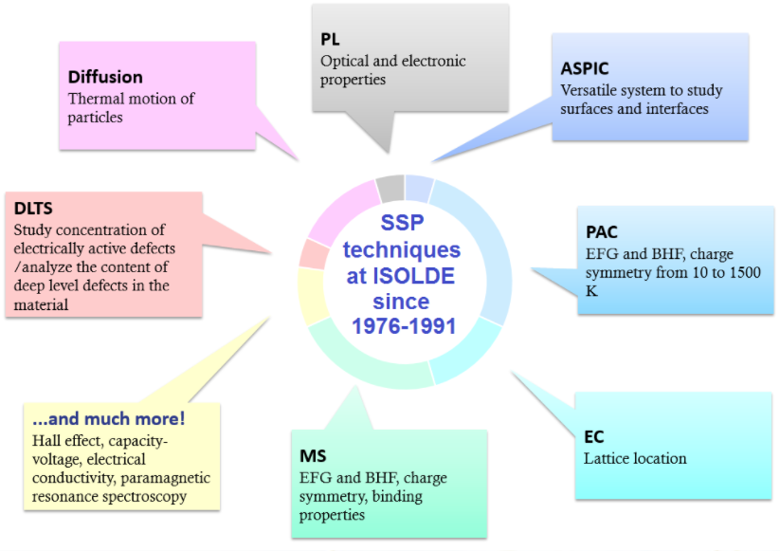
3. Research with radioactive isotopes

Slide 28

Materials research with RIBs
juliana.schell@cern.ch
Use radioactive ion as probe to characterise different materials
  Solid state physics
  Biophysics
Advantages from radionuclides
  Wide variety of isotopes with different half-lives and decay properties
  High detection efficiency for radiation
  Low quantities need to be implanted (no interference with host)
More info: J. Phys. G: Nucl. Part. Phys. 44 (2017) 104001

Slide 29
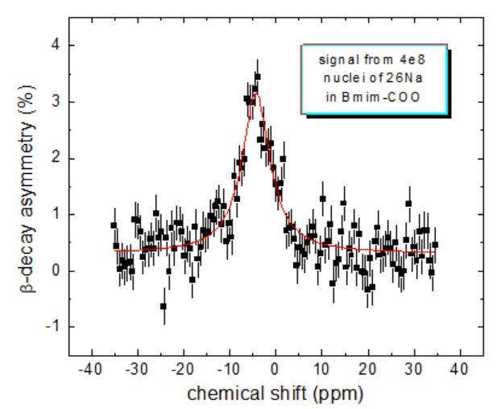

Beta-NMR at ISOLDE
Magdalena.kowalska@cern.ch
Metal ions in living organisms (Na, Mg, Cu, Zn …)
  Right concentration crucial for correct functioning of cells
  Very important but not very abundant
  Difficult to study with techniques on stable isotopes (e.g. NMR)
beta-NMR
  Asymmetry in beta decay in space (due to parity non-conservation by weak interaction)
  Up to 10¹⁰ more sensitive than conventional NMR
  Structure and dynamic of the interaction of metal ions with biomolecules
1st Na beta-NMR signal in a liquid
26Na (t1/2=1.1 s)
B = 0.5 T
Meas. time 5min

Slide 30
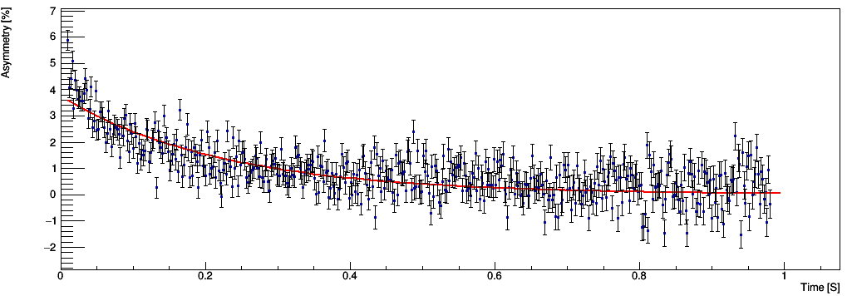
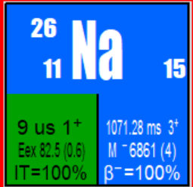
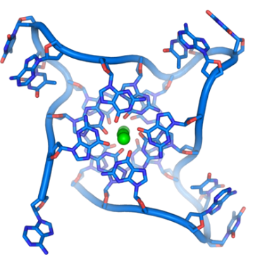
Beta-NMR at ISOLDE
Magdalena.kowalska@cern.ch
T = 0.5 T
Meas. time, ca 5min
T1 = ca 150 ms
Asymmetry relaxation of
²⁶Na in folded in DNA
M. Kowalska et al., J. Phys. G: Nucl. Part. Phys. 44 (2017) 084005
W. Gins et al., Nucl. Instr. and Meth. A (2019)

Slide 31
Summary
ISOLDE is the world’s first ISOL-type facility and is still a reference for radioactive ion beam production over 50 years later
The upgrade of HIE-ISOLDE provides high-energy beams of up to 10 MeV/u
ISOLDE is host to a dozen permanent experiments (and many travelling setups) studying:
  Nuclear physics
  Nuclear astrophysics
  Solid state physics
  Bio-physics
  Fundamental physics
The new facility MEDICIS produces radioactive isotopes dedicated to medical applications

Slide 32
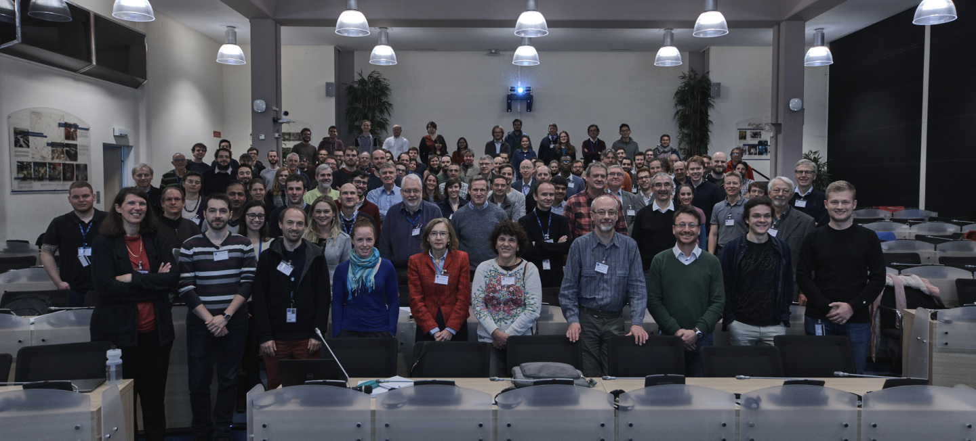
Questions?
ISOLDE workshop and users meeting 2018

Slide 33
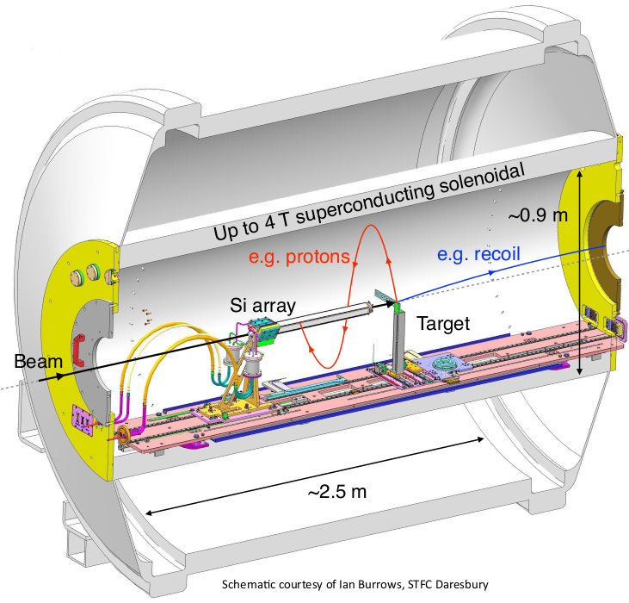
ISOLDE Solenoidal Spectrometer (ISS)
Based on the HELIOS concept from Argonne National Lab (ANL)
using a MRI magnet
Improves energy resolution by the solenoidal field that makes a linear relation between energy and z thus removing kinematic compression issues
Utilised Si array and DAQ from ANL in 2018
First two successful experiments in 2018 !
IS621 - ²⁸Mg(d,p)²⁹Mg
IS631 - ²⁰⁶Hg(d,p)²⁰⁷Hg

Slide 34
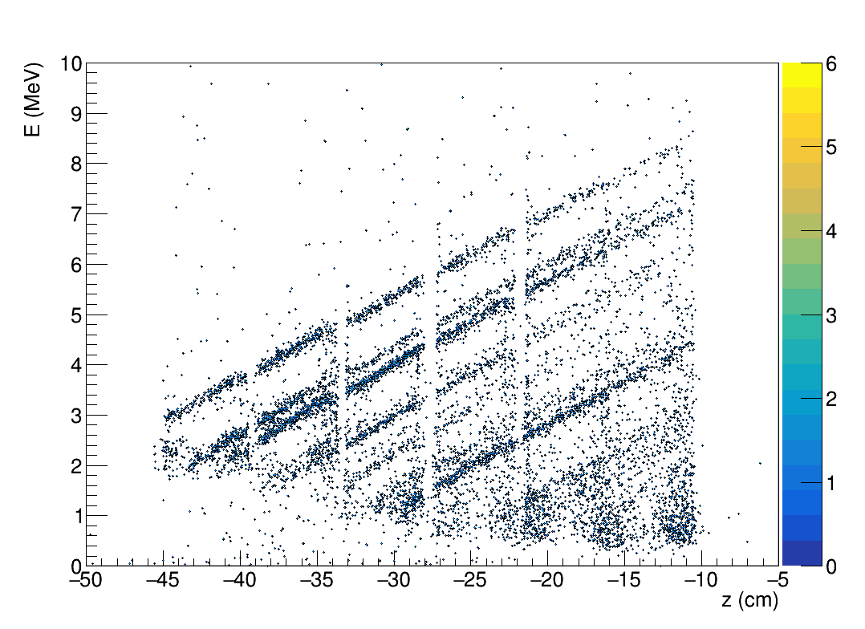
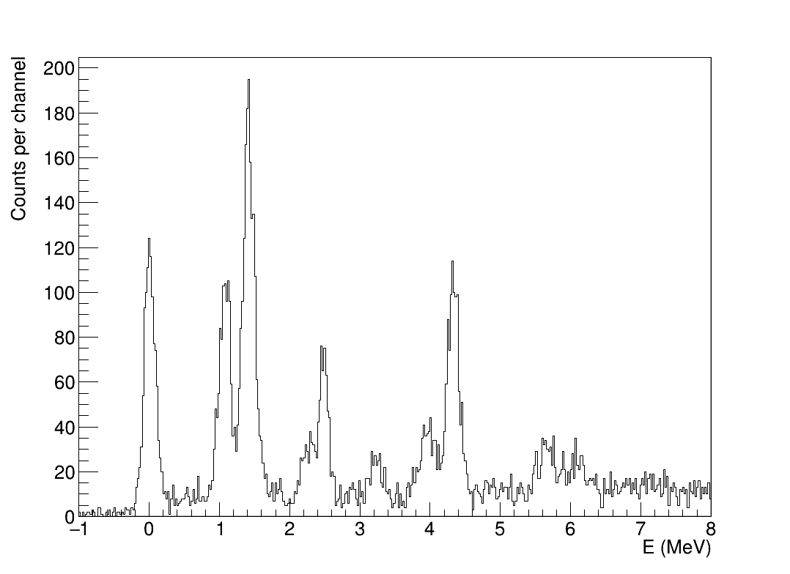
ISS : ²⁸Mg(d,p)²⁹Mg in 2018
Probing single-particle properties near Island of Inversion.
D.K. Sharp et al.
First experiment with ISOLDE Solenoidal Spectrometer
²⁸Mg @ 9.473 MeV/u beam, dE/E = 0.3%
FWHM at target position <1.5 mm
Maximum beam intensity 10⁶ pps
ISS set to a B-field of 2.5 T
PRELIMINARY
PRELIMINARY
Measured properties E_{p}, z, recoil dE/E.
Preliminary excitation energy spectrum – states populated up to ~6 MeV. 12º<θ_{cm}<40º.
Resolution ~100 keV – able to resolve majority of states of interest. No need for γ-ray detection.
Can probe single-particle properties of both bound and unbound states in ²⁹Mg.

Slide 35
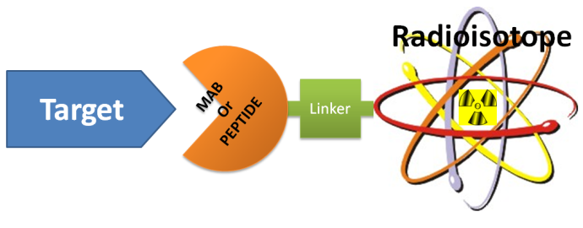

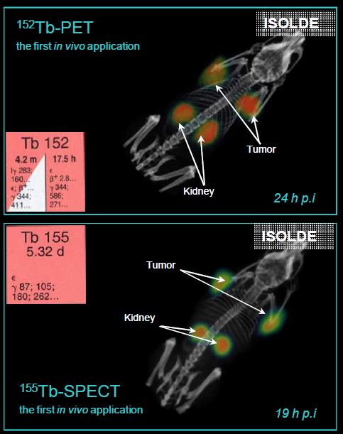

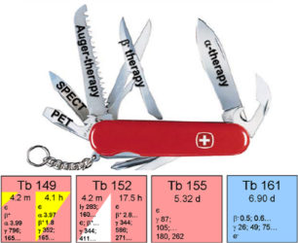

Theranostics
DiagNOSTICS
THERApy
β⁺-emissions
α-emitter
PET E(γ) = 511 keV
High LET, short distance in human tissue
γ-emissions
β-emitter
SPECT
100keV<E(γ)<200keV
Low LET, long distance in human tissue
Receptor-targeted radiopharmaceuticals:
Radionuclide attached to a carrier that selectively delivers it to tumour cells

Slide 36
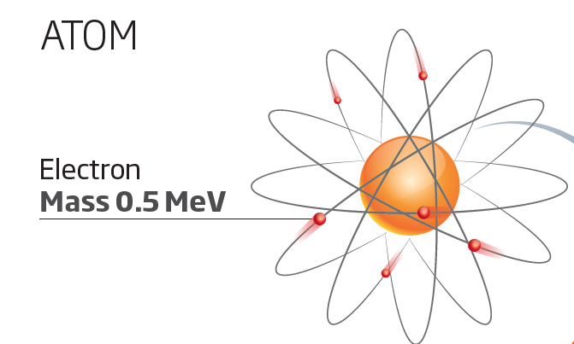
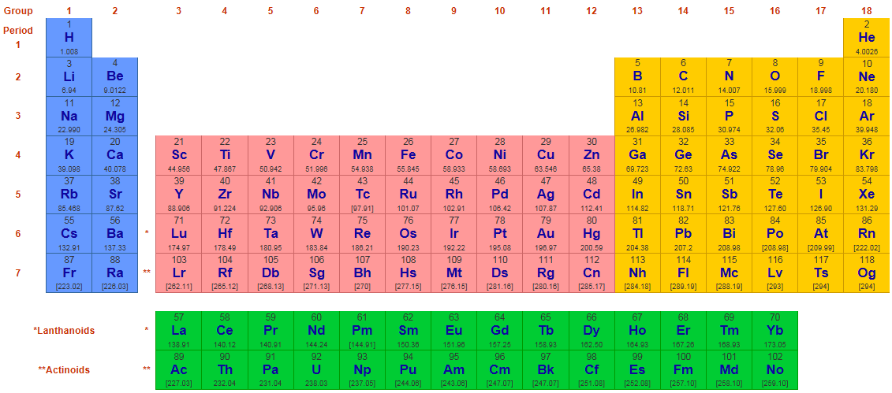
Periodic table of elements
Ordered by proton number Z
118 chemical elements known to date
More than 20 of them made only in a lab
Named in June 2016
36

Slide 37
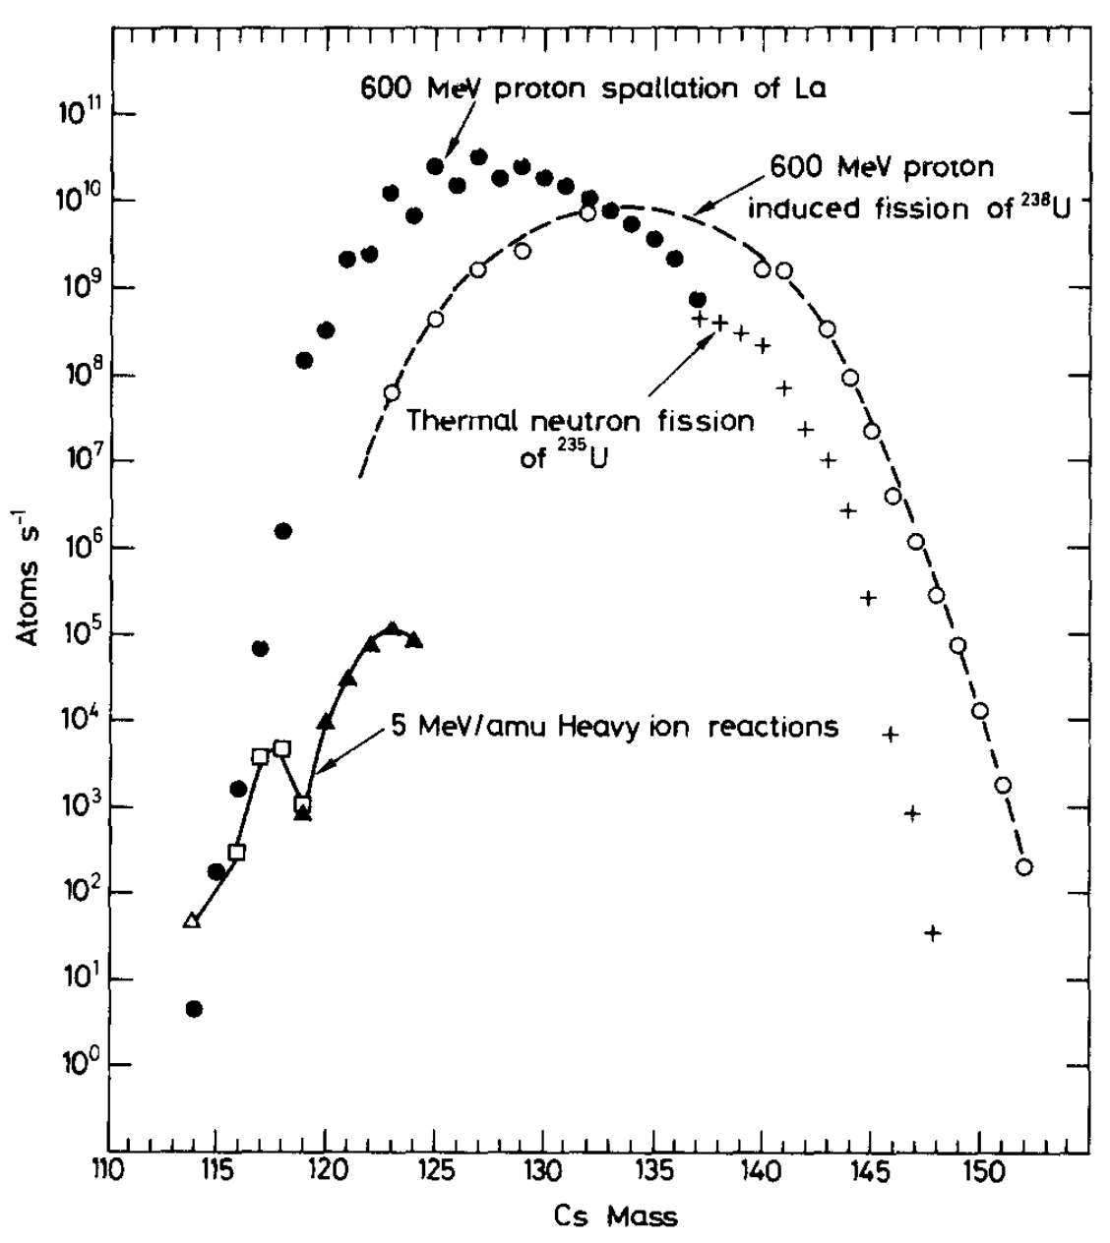
Production: nuclear reactions
https://www.sciencedirect.com/science/article/pii/0370157379900450

Slide 38
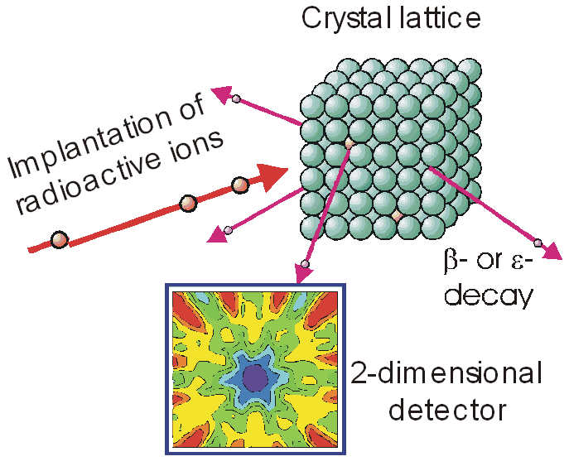
Emission channeling
Information on:
  Probe atom lattice site location as function of implantation/annealing temperature
  Diffusion of probe atom
  Annealing of implantation defects
WHY?
Examples of recent results?
38
Emission channelling pattern

Slide 39
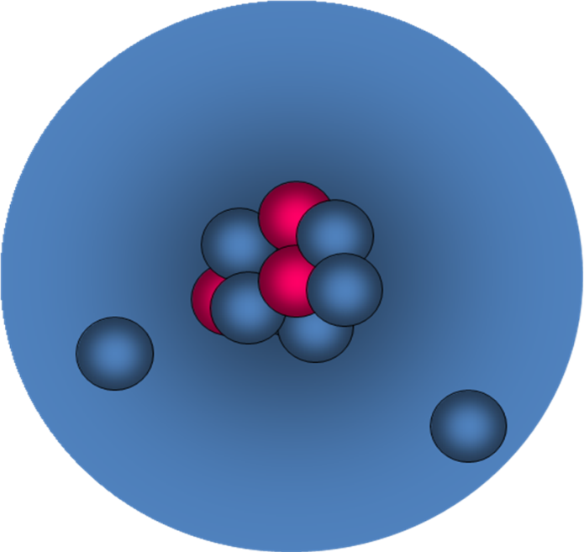
ISOLDE – focus on exotic nuclei
Exotic nuclei have a different neutron-to-proton ratio than stable nuclei
  New structures
  New decay modes (e.g. proton decay)
  Challenging for state-of-the-art models
Example: halo nuclei such as ¹¹Li (1985)
  Radius of ¹¹Li is similar to that of ²⁰⁸Pb
  Explanation: ⁹Li core + two loosely bound neutrons
  When taking away 1 neutron, the other is not bound any more (¹⁰Li is not bound)
Example: shell structure evolution
  Do magic numbers change in exotic nuclei?

Slide 40
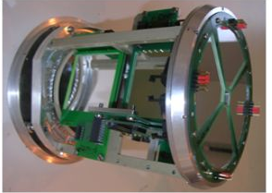

Transfer reactions
Joonas.konki@cern.ch
p
γ-decay
Accelerated RIB
(5-10 MeV/A)
d
Miniball + T-REX set-up: Si-detector barrel
Observables
  Energy and angular distribution of emitted particles and emitted RIB
  γ-rays
  Reaction probability
Information
  Similarity of initial and final state wave functions
  Spin and parity from angular distribution
Two-neutron transfer: ⁶⁶Ni + ³H -> ⁶⁸Ni + p
F. Flavigny, PRC 99, 054332 (2019)

