Slide 1
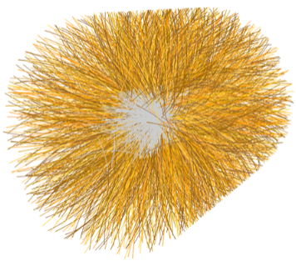
Introduction to Heavy-Ion Physics
Part III
Jan Fiete Grosse-Oetringhaus, CERN
Francesca Bellini*, CERN
Summer Student Lectures 2019

Slide 2
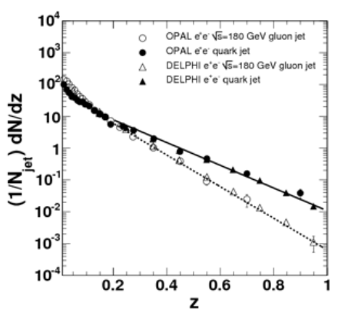
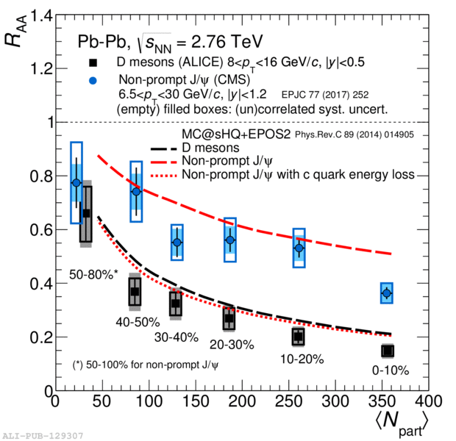
Recap Lecture II
Energy loss in the medium by elastic and inelastic processes
Quark-mass dependence expected
  Fragmentation needs to be considered
  Harder fragmentation of quark over gluon
R_{AA} of D and B mesons
  Analysis complex due to small S/B ratio
  Mass dependence of energy loss
q
g

Slide 3
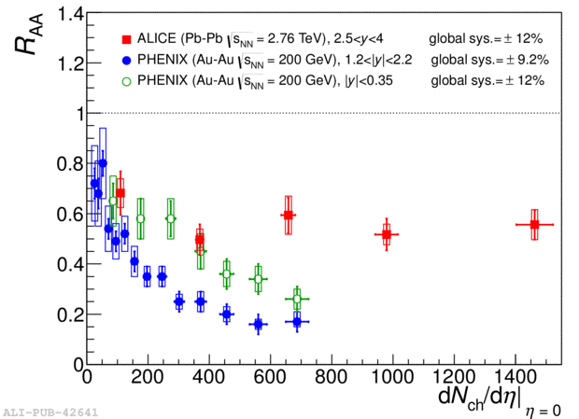
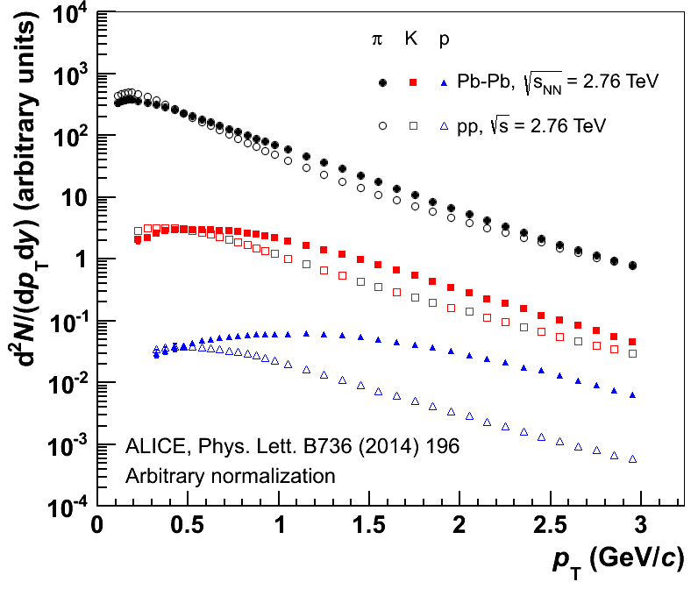
Recap Lecture II
Quarkonia (c-cbar, b-bar) “melt” due to color screening in the QGP
  J/ψ suppression
  Abundance of c at LHC so large
  that J/ψ regenerate statistically
  States with lower binding energy are more suppressed
Hadron yields described by statistical models for √s_{NN} = 2-2760 GeV
  Matter created in HI collisions is in local thermal equilibrium
Expansion of QGP changes momenta of particles
  Radial flow
  (dependent on particle mass)

Slide 4
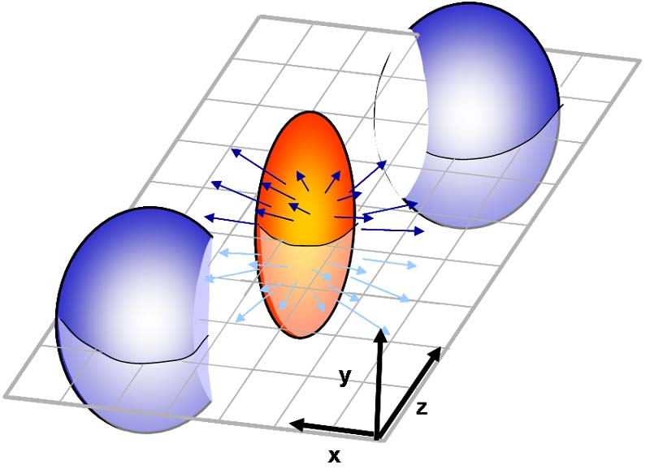
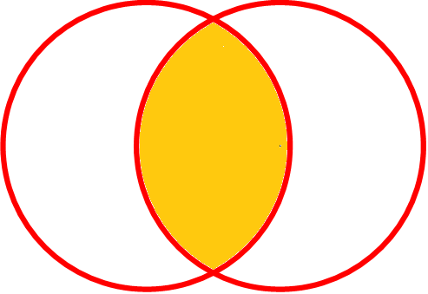

Elliptic Flow
Overlap of colliding nuclei not isotropic in non-central collisions
out of plane
in plane
y
x
4
→ Pressure gradients
dependent on direction
Defines reaction plane Ψ_{RP}
(spanned by beam axis
and impact parameter vector)

Slide 5

Elliptic Flow (2)
Spatial anisotropy (almond shape)
  Quantified by eccentricity ε
Pressure gradient larger in-plane
Pressure pushes partons
  More in in-plane than out-of-plane
Spatial anisotropy converts into momentum-space anisotropy
  “Faster” particles in-plane
  Measurable in the final state!
Coordinate
space
Momentum
space
y
p_{y}
x
p_{x}
Time
p_{y}
p_{x}

Slide 6
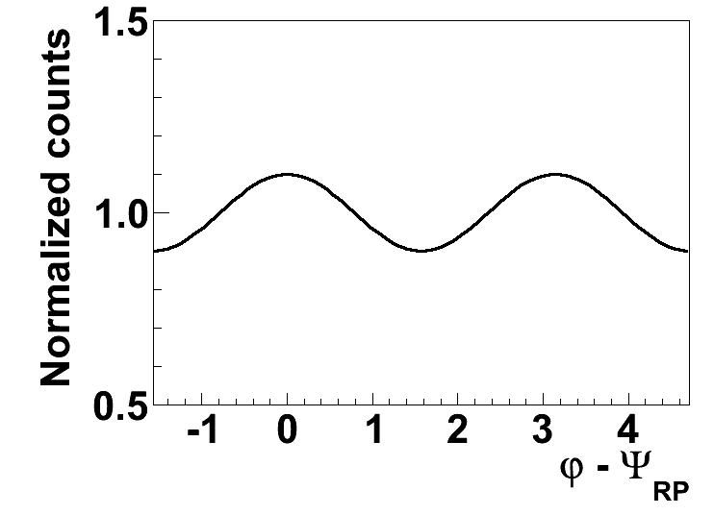
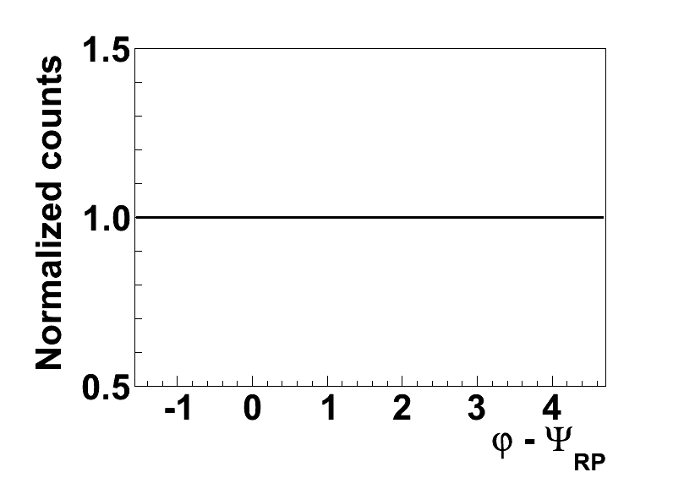
Elliptic Flow (3)
Particles as a function of ϕ - Ψ_{RP}
Define v₂ = < cos 2 (ϕ - Ψ_{RP}) >
  Second coefficient of Fourier expansion
Ψ_{RP} common symmetry plane
(for all particles)
What if there were no
correlations with Ψ_{RP}?
ϕ
p_{y}
Ψ_{RP}
p_{x}

Slide 7
Measuring Elliptic Flow
v₂ = < cos 2 (ϕ – Ψ_{RP}) >
Measure tracks
Measure reaction-plane angle
Reaction plane angle
  From the particles themselves
  Ψ_{RP} approximates true reaction-plane angle (called event plane)
Calculation of integrated v₂ = < cos 2 (ϕ - Ψ_{RP}) >
v₂(p_{T}) by considering only particles at given p_{T}
Called event plane method, denoted v₂{EP}
weight w

Slide 8
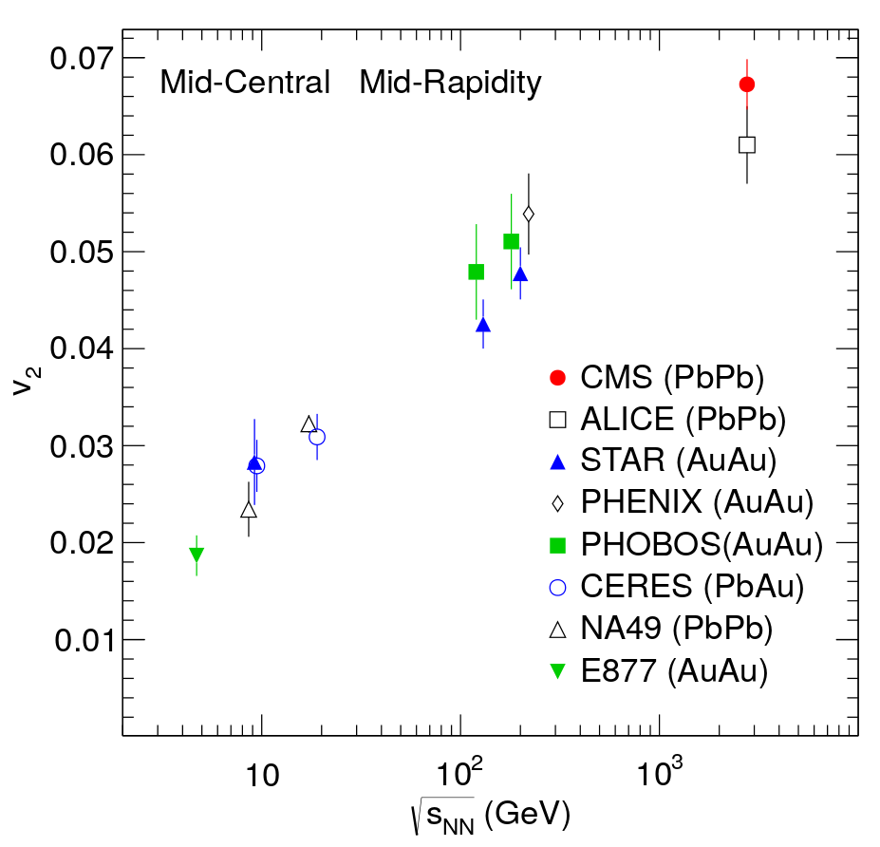
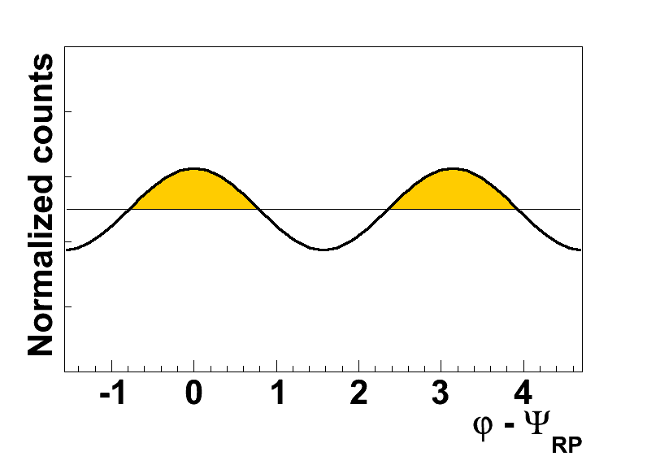
√s_{NN} Dependence
Increases with √s_{NN}
At LHC v₂ ~ 0.06
  What does that mean?
  2v₂ = 12% of particles “move”
  from out-of-plane to in-plane
v₂ vs. √s_{NN}
CMS, PRC 87(2013) 014902

Slide 9
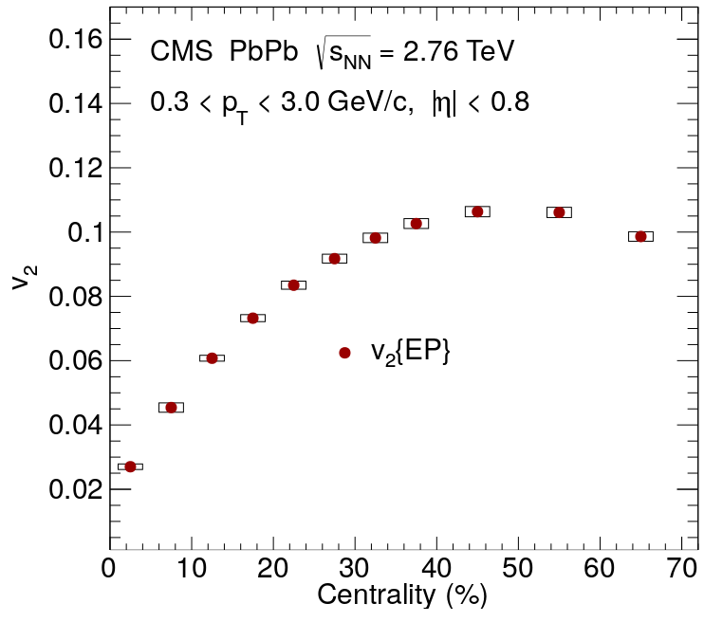
Centrality Dependence
Strong centrality dependence
v₂ largest for 40-50%
Spatial anisotropy very small in central collisions
Largest anisotropy in mid-central collisions
Small overlap region in peripheral collisions
v₂ vs. Centrality
CMS, PRC 87(2013) 014902

Slide 10
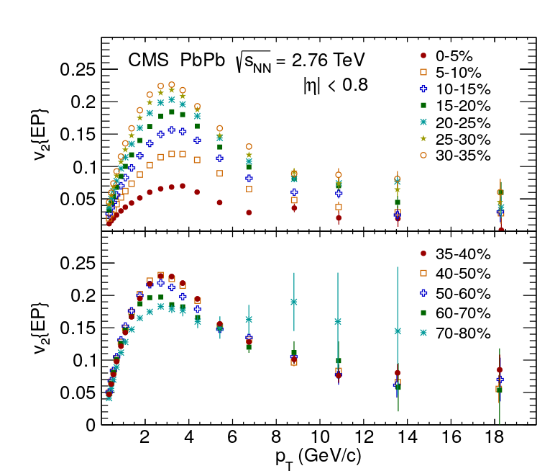
p_{T} Dependence
Centrality dependence independent of p_{T}
Largest v₂ for
p_{T} ~ 3 GeV/c
Low and intermediate p_{T}, v₂ caused by collective expansion
Large p_{T}, v₂ caused by length-dependent jet quenching
  Longer path length out of plane than in plane
v₂ vs. p_{T}
out of plane
in plane
CMS, PRC 87(2013) 014902

Slide 11
Recap
Pressure in dense medium affects momenta
Isotropic expansion effect called radial flow
Overlap of colliding nuclei causes spatial anisotropy
Converted into momentum-space anisotropy in medium evolution
Modulation of observed particles
Quantified by v₂ = < cos 2 (ϕ - Ψ_{RP}) >
What other methods exist to measure v₂?
What effect do jet-related particles have on v₂?

Slide 12
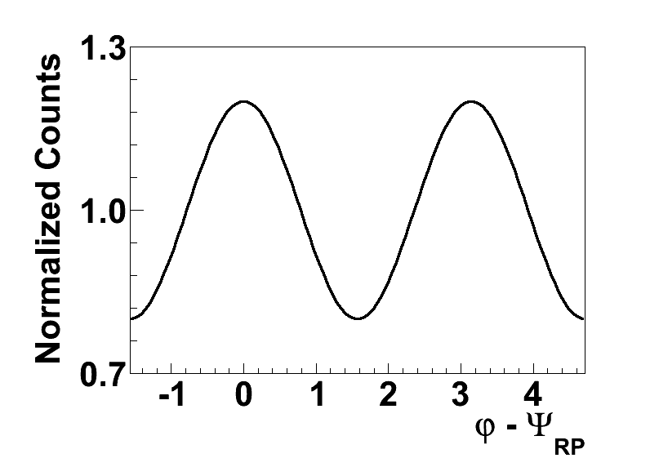
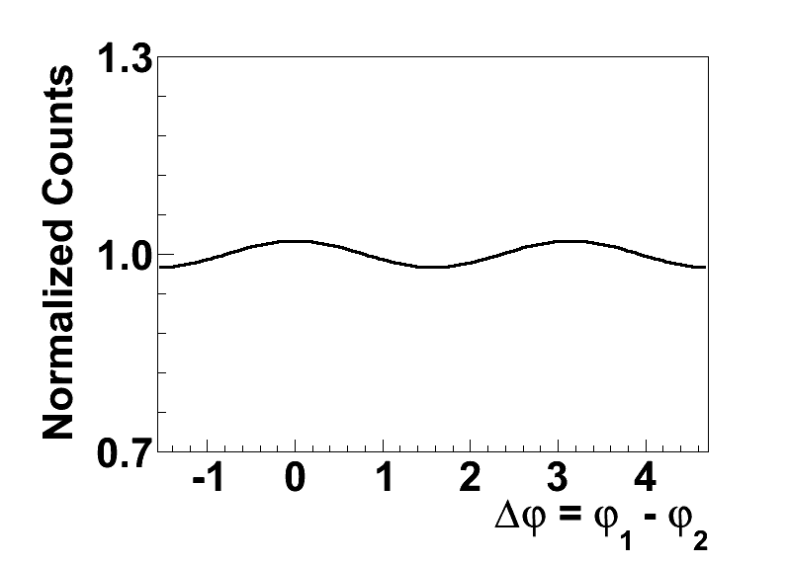
Two-Particle Correlations
Reaction-plane estimation can be experimentally tricky
Rewrite as
v₂ can also be measured from 2-particle correlations
ϕ₁
p_{y}
ϕ₂
p_{x}
Modulation smaller due to v₂ → (v₂)² but statistical power similar

Slide 13
Higher-Order Correlations
Trivial extension to 4-particles (and higher-orders)
  NB. sign is arbitrary as long as same amount of positive and negative angles
  → rotational symmetry

Slide 14
Cumulants
Cumulants extract genuine n-particle correlations
For 2-particle correlations
Rewrite (trivially)
For 3-particle correlations
measured
correlation
lower order
“correlations”
genuine 2-particle
correlations
ϕ dependence only from detector acceptance
Higher-order cumulants zero → no genuine multi-particle correlation ! No matter what multi particles correlations (i.e. not cumulants) show

Slide 15
Cumulants for Elliptic Flow
For uniform detector acceptance,
cumulants of 2nd and 4th order:
c₂{4} is genuine 4-particle correlations
  I.e. if only pairs of particles are correlated → c₂{4} = 0
identical to two-particle correlation
lower orders are removed

Slide 16

Flow Methods
Now we have tons of methods to measure flow
  Event plane
  2-particle and 4-particle correlations, …
  2-particle and 4-particle cumulants, …
They all estimate v₂, so what?
Let’s have a look, what spoils the flow measurement…

Slide 17
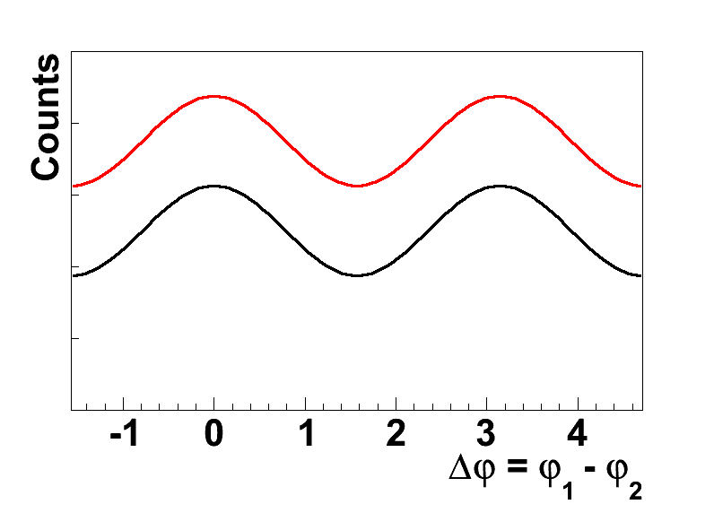
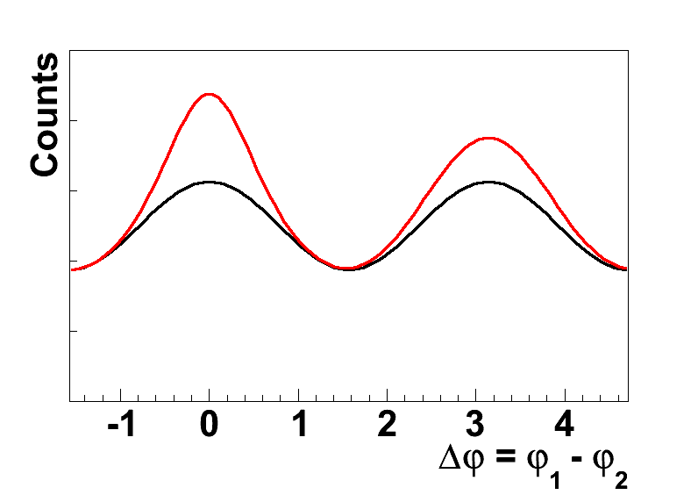
Non-Flow
Counts vs. Δϕ
Particles are correlated through reaction plane Ψ_{RP}
Additional isotropically distributed particles
  Add to baseline, reduce cos 2Δϕ magnitude, but don’t distort shape
Jets
  Particles which exhibit correlations close in angle (within the same jet) and at Δϕ = π (back-to-back jet)
  Distort Ψ_{RP} estimate
  Distorts shape in 2 particle correlations
A pure jet-signal results in v₂ > 0 (e.g. Pythia)

Slide 18
Non-Flow (2)
Different effect on different flow methods
2-particle correlations / cumulants
4-particle correlations
4-particle cumulants
non-flow
contribution
Second order non-flow dropped out !

Slide 19
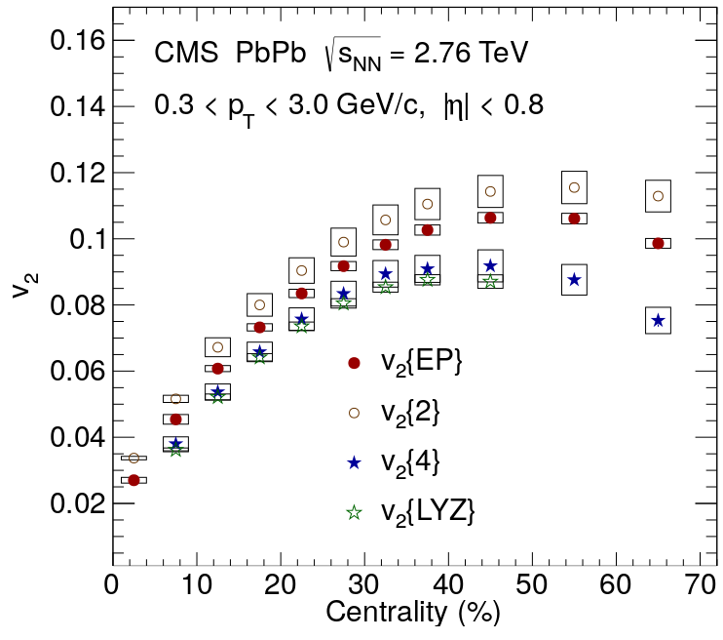
Experiment
v₂ vs. Centrality
Larger non-flow influence* for v₂{2} than v₂{4}
* neglects fluctuations, see backup
PRC 87(2013) 014902

Slide 20
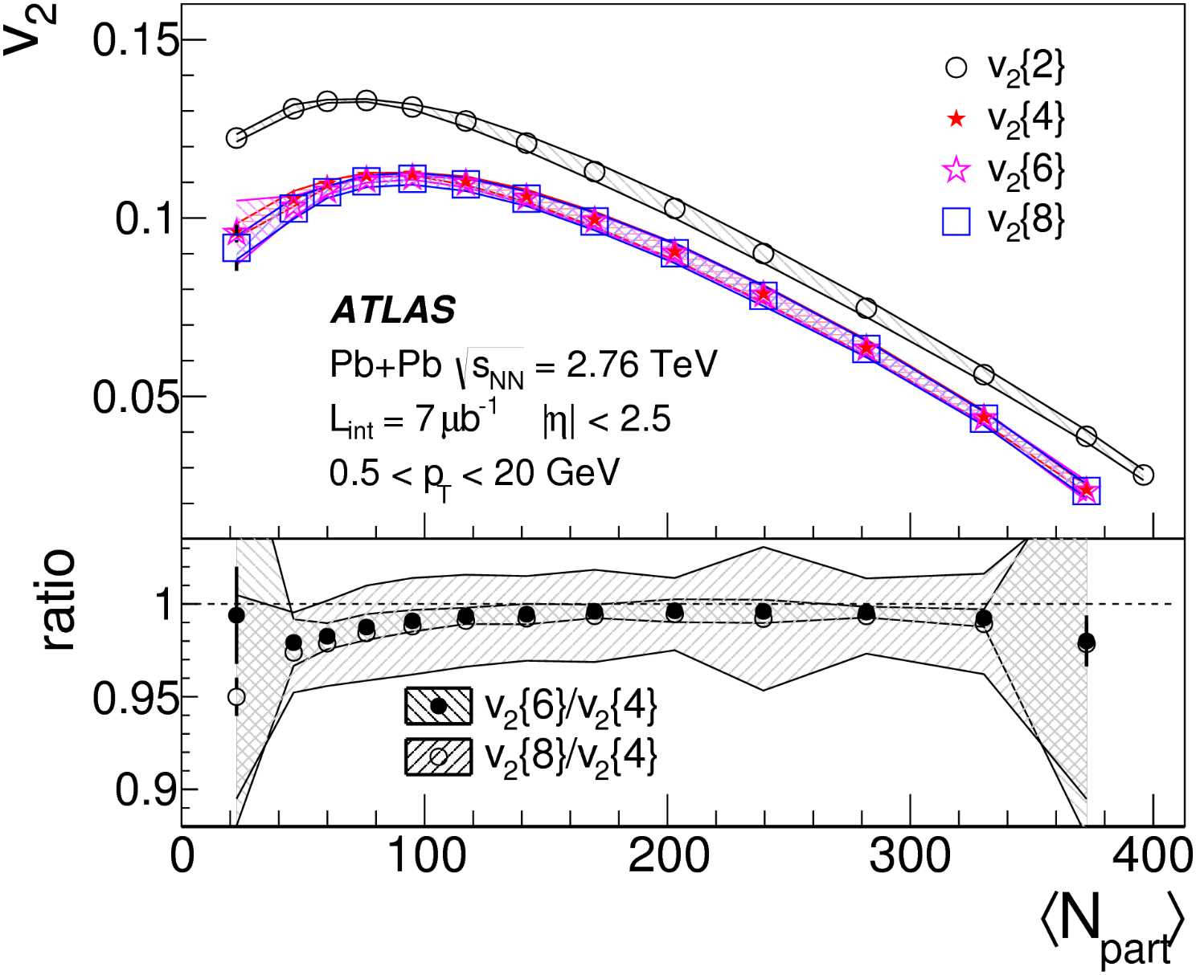
Up to 8 Particles…
v₂ vs. N_{part}
v₂{4} ~ v₂{6} ~ v₂{8}
→ influence of non-flow (and fluctuations) small for >= 4 particles
EPJC (2014) 74: 3157

Slide 21
Recap
Elliptic flow can be measured with different methods
Cumulants of n^{th} order measure genuine n-particle correlations – not reducible to lower orders
Mini(jets) and resonances distort the v₂ measurement
Non-flow influence is different for different methods
  The higher the order of the cumulant, the smaller the influence
For now we have discussed elliptic flow v₂ – is that all?

Slide 22
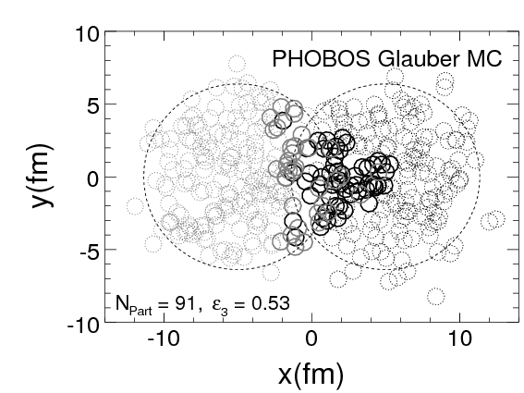
Higher-Order Flow
Geometrical picture
→ 2nd order modulation (v₂)
In practice interacting nucleons
need to be considered
  E.g. estimated with Glauber MC
  Initial state density fluctuations
These produce all kinds of shapes
  Elliptic, triangular, quadruple, …
  And mixtures of those
nucl-ex/0701025, PRC81 (2010) 054905

Slide 23
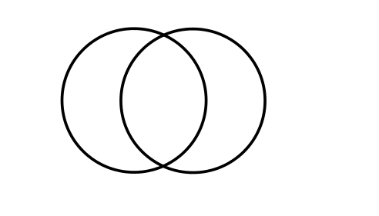
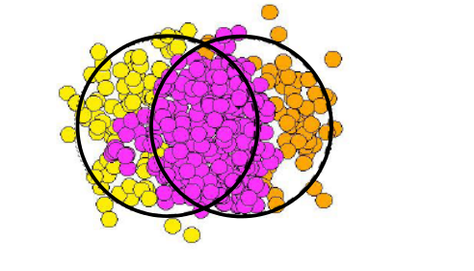
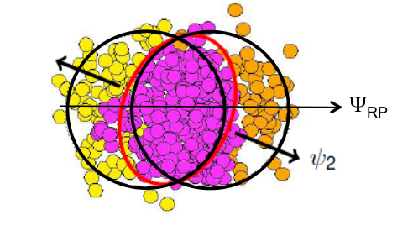
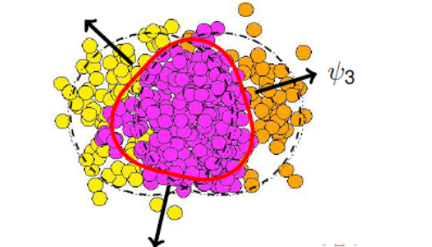
Higher-Order Flow (2)
  Reaction plane Ψ_{RP} → n^{th} order participant plane Ψ_{n}
Formalism can be trivially extended from v₂ to v_{n}
E.g.
PRC81 (2010) 054905

Slide 24
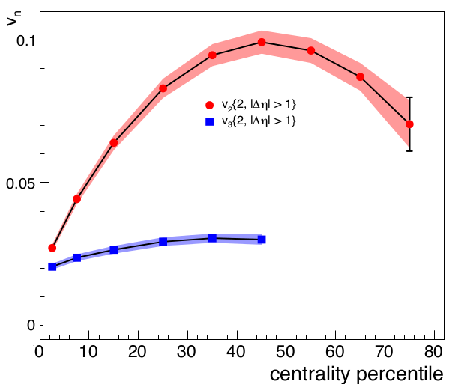
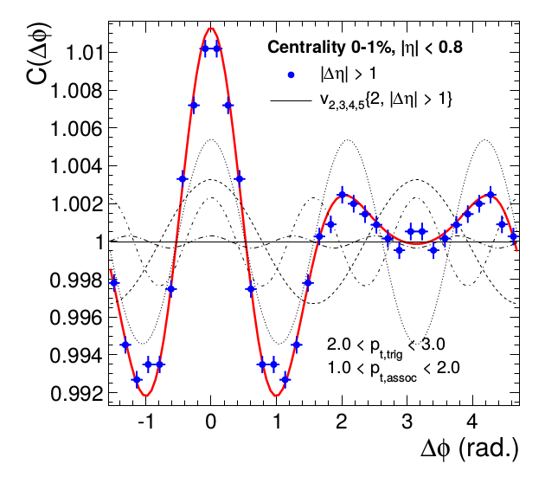
Experiment
v_{n} vs. Centrality
C(Δϕ) vs. Δϕ
v₂{2}
v₃{2}
v₃ sizable
v₃ ~ ½ v₂
Weaker centrality dependence
Two-particle correlations can be fully described by v₂ … v₅
PRL107, 032301 (2011)
Notes:
my school 2009

Slide 25
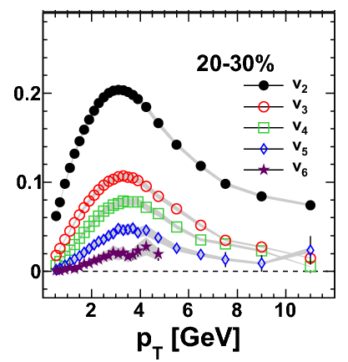
And even higher orders…
V_{nΔ} = (v_{n})² vs. n
v_{n} vs. p_{T}
Significant up to 6 orders
ATLAS-CONF-2011-074
PLB708 (2012) 249

Slide 26
Recap
Geometry of overlapping nuclei → elliptic flow
Initial-state density fluctuations lead to different ‘shapes’ of overlap region → flow at higher orders
Flow measured up to 6th order
What does a medium need for collective effects?
What can we learn from these results?

Slide 27
Hydrodynamics
Calculating space-time evolution of QGP from first principles (QCD Lagrangian) is too complex (non-abelian, strong coupling, many-body system, …)
Expanding medium can be described macroscopically with hydrodynamical models
  Conservation of energy-momentum
  Conservation of charges, mainly baryon number
  Local thermodynamical equilibrium
Needed input
  Initial conditions
  Equation of State (EoS), from lattice QCD
  Relativistic fluid dynamics
    Perfect or dissipative (→ transport coefficients)

Slide 28
Hydrodynamics (2)
Once dynamics well described, hydrodynamic “output” can be used in other calculations: jet quenching, J/ψ melting, etc.
Flow observables:
Initial-state anisotropies → final-state anisotropies
  Translate from initial-state eccentricity ε_{n} to final-state flow v_{n}
Deduce conclusions on initial conditions, EoS and transport coefficients by data comparison

Slide 29
Shear Viscosity
Shear viscosity washes out initial-state anisotropies
  Expressed as η/s (shear viscosity over entropy)
  Ideal hydrodynamics : η/s = 0
  Viscous hydrodynamics : η/s > 0
  Large influence on higher-order flow
not to confuse with ideal (free streaming) gas
→ no interactions
Density in collision region (x vs. y)
Initial conditions
η/s = 0
η/s = 0.16
Water: η/s ~ 30 | Olive oil η/s ~ 240
MUSIC, Sangyong Jeon

Slide 30
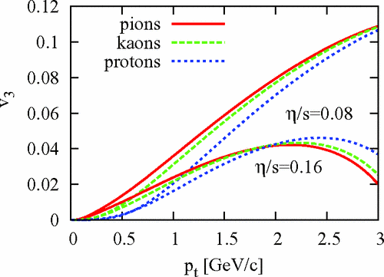
Example: Shear Viscosity
v₃ vs. p_{T}
η/s = 0.08
Larger η/s
reduces flow
η/s = 0.16
Shear viscosity hampers the build-up of flow !
PRC 82, 034913 (2010)

Slide 31
Hydro vs. Data
MC-KLN Initial conditions MC-Glauber
Range of η/s
Eccentricity-scaled v₂
Multiplicity per overlap area
Multiplicity per overlap area
MC-KLN with η/s = 0.16 or MC-Glauber with η/s = 0.08
Water: η/s ~ 30 | Olive oil η/s ~ 240
Annu.Rev.Nucl.Part.Sci. 63 (2013) 123 (Data: STAR 200 GeV)

Slide 32
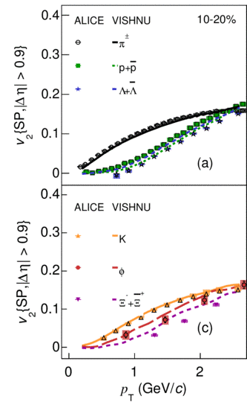
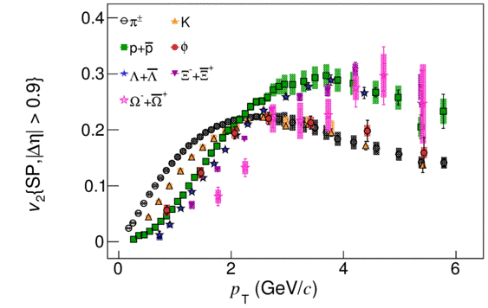
Hydro vs. Data (2)
v₂ vs. p_{T}
  v₂ measured for 7 different species
Strong species dependence
  Different masses and quark content
Stringent test for hydro
  Very good agreement with VISHNU (hydro + hadronic cascade model (UrQMD),
  initial conditions MC-KLN, η/s ~ 0.16)
v₂ vs. p_{T}
30-40%
π p Λ
π K p φ Λ Ξ Ω
K φ Ξ
JHEP 06 (2015) 190
Notes:
VISHNU: PRL106 (2011) 192301

Slide 33
Summary
Collective Flow & Hydrodynamics
Quark-gluon plasma expands rapidly (up to ~0.65c)
Spatial anisotropy of collision region causes anisotropic flow quantified as Fourier coefficients v_{n}
  Measured up to 6th order
  Initial-state fluctuations influence v_{n}
Well described by viscous hydrodynamics with a very low shear viscosity (η/s ~ 0.08 – 0.16) “perfect liquid”
Matter created in HI collisions is in local thermal equilibrium
Hydrodynamical models describe collective flow

Slide 34
Collectivity in
Small Systems
Some surprises…

Slide 35
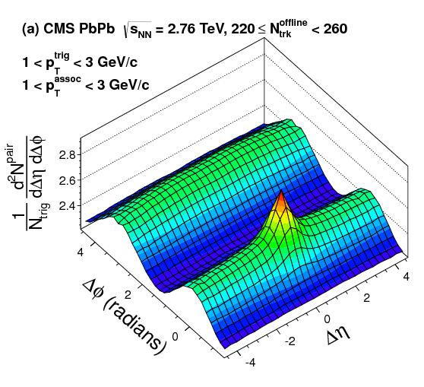
Recap Two-Particle Correlations
For v_{n} measurement, we discussed contribution from flow and non-flow ((mini)jets)
This can also be looked at in two dimensions
  Azimuth Δϕ and pseudorapidity Δη
ϕ₁
p_{y}
ϕ₂
p_{x}
Yield vs. Δϕ vs. Δη
flow modulation
+ (mini)jet

Slide 36
Typical Two-Particle Correlation
Away-side jet + flow
(Δϕ ~ π, elongated in Δη)
Near-side jet
+ resonances, ...
(Δϕ ~ 0, Δη ~ 0)
Near-side flow ridge
(Δϕ ~ 0, elongated in Δη)

Slide 37
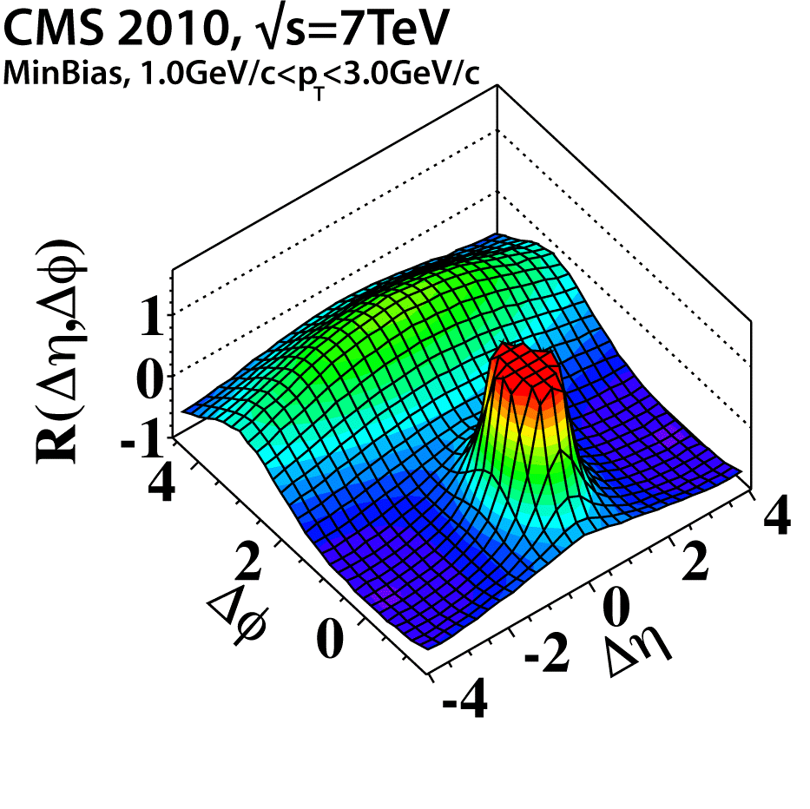
Pb-Pb vs. pp
Pb-Pb
pp
Near-side ridge (flow) only in Pb-Pb
at least everyone thought so for a long time…

Slide 38
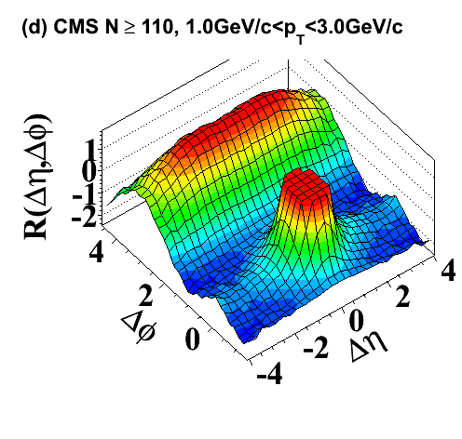
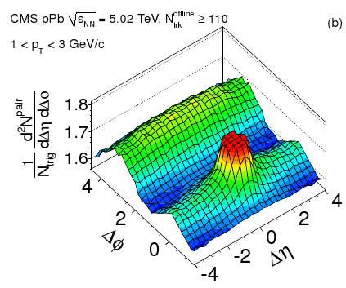
Near-Side Ridge
here: η = η_{lab}
0.005% of MB
…observed in very high-multiplicity pp collisions
  0.005% events with highest multiplicity
…observed in high multiplicity p-Pb collisions
  ~40% events with highest multiplicity
  Surprisingly large magnitude
pp
CMS, JHEP09(2010)091
N_{offline,trk} > 110
p-Pb
CMS, PLB718 (2013) 795
3.1% of MB

Slide 39
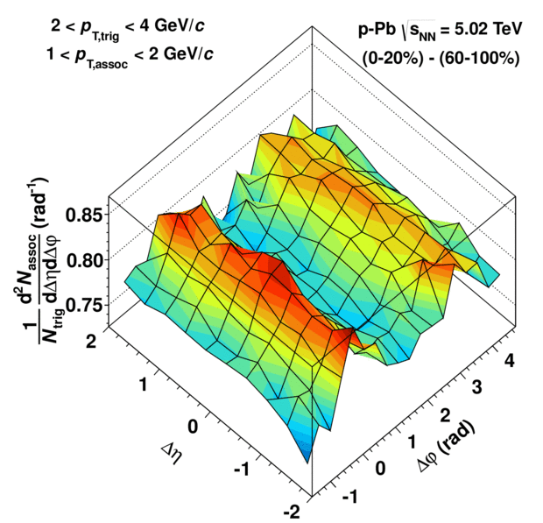
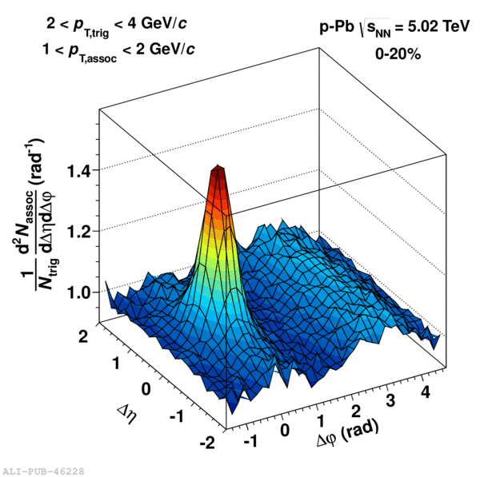
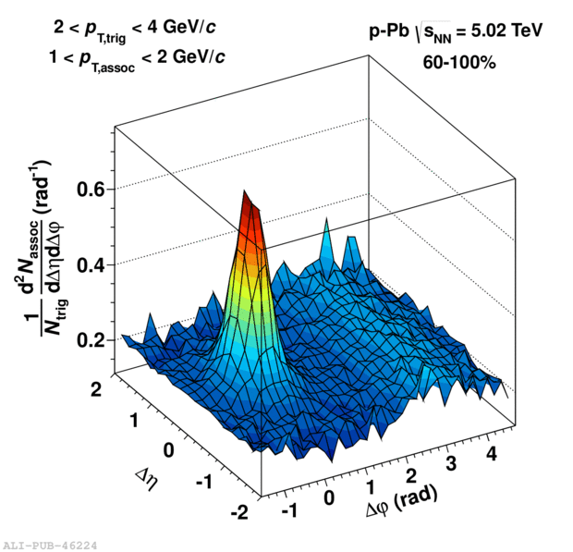
The Double Ridge
here: η = η_{lab}
Subtraction procedure to “isolate” ridge contribution from jet correlations
  No ridge seen in 60-100% and similar to pp
0-20%
60-100%
–
=
Δη
Δη
Δϕ (rad)
Δϕ (rad)
Δη
Δϕ (rad)
Two ridges !
ALICE, PLB719 (2013) 29

Slide 40
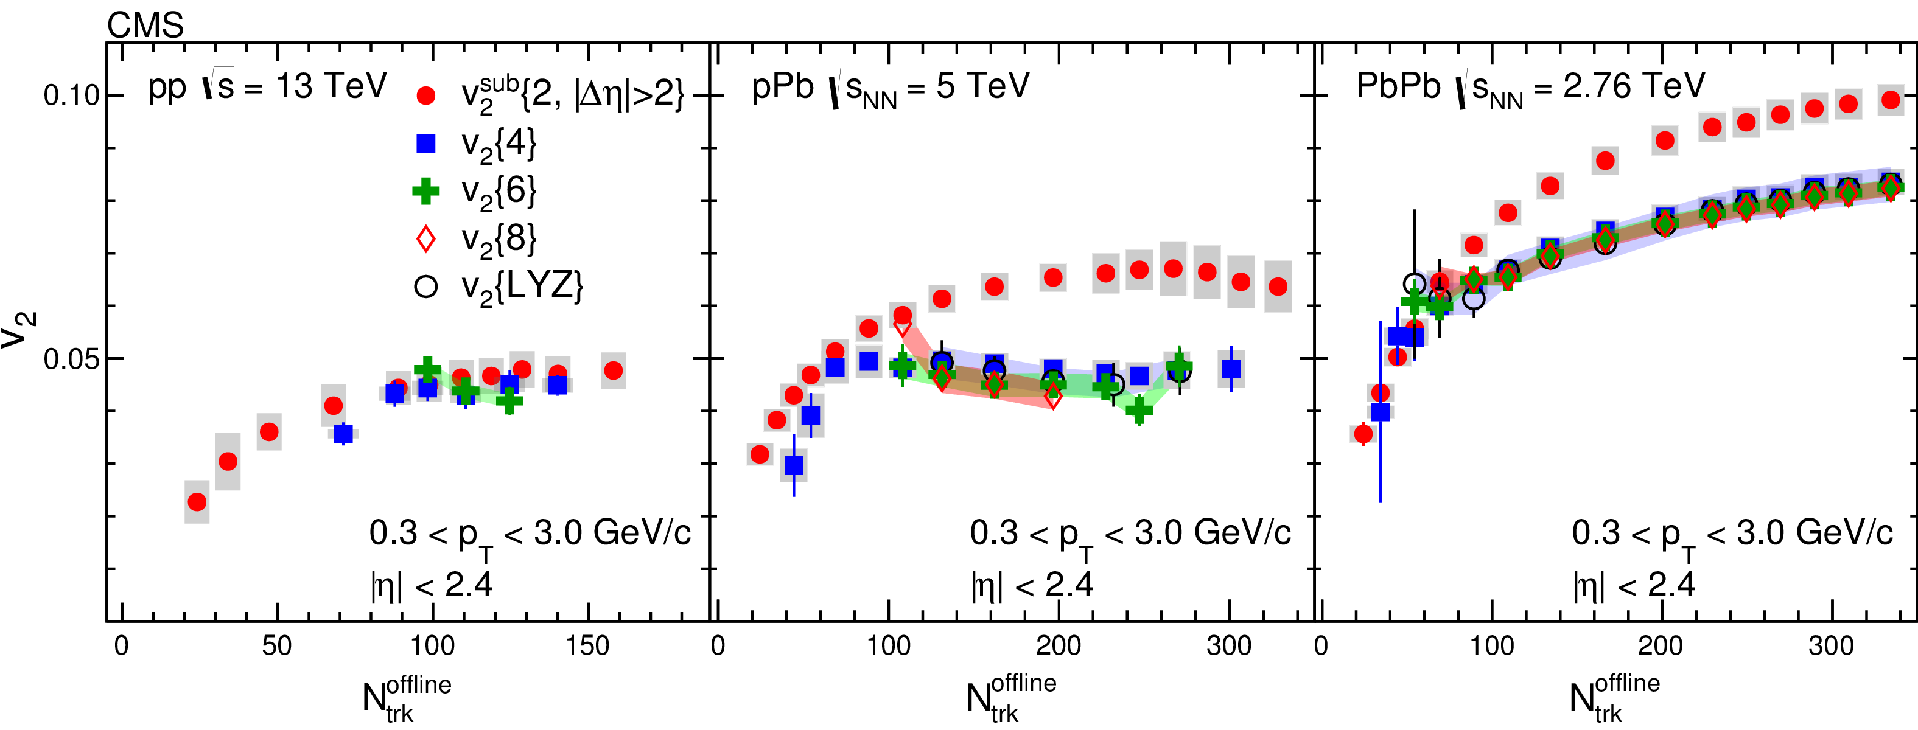
Today’s Understanding
Various “HI observables” in p-Pb and high-multiplicity pp
  v₂, v₃, …
  Multi-particle correlation v₂{4} = v₂{6} = v₂{8}
  Mass ordering of particle species E.g. v₂{p} < v₂{π} for p_{T} < 2 GeV/c
v₂ vs. Multiplicity
pp
p-Pb
Pb-Pb
PLB 765 (2017) 193

Slide 41
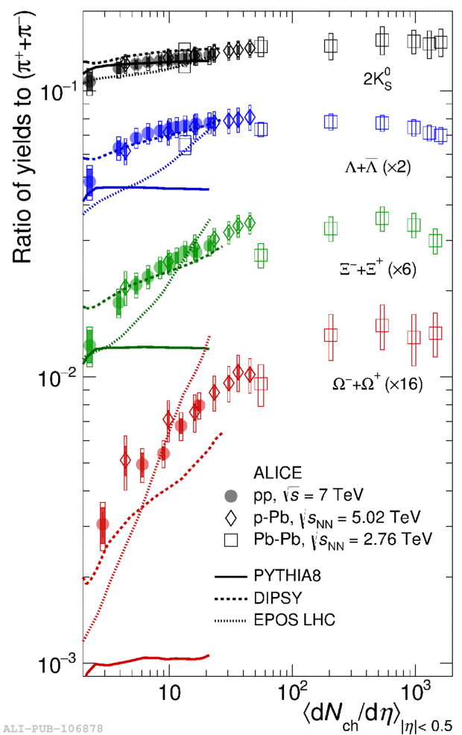
Today’s Understanding (2)
Strange / π ratio vs. N_{ch}
  Particle ratios and strangeness
  Smooth increase of strange baryon
  production
  From pp, over p-Pb to Pb-Pb
  Multiplicity dependence not reproduced by MC generators
But: No sign of parton energy loss
K⁰/π
Λ/π
Ξ/π
p-Pb
Ω/π
Pb-Pb
pp
Pythia
Nature Phys. 13 (2017) 535

Slide 42
Summary Collectivity in Small Systems
Typical Pb-Pb collision effects observed in pp and p-Pb
Paradigm shift in interpretation of small systems
Many hints that (mini) QGP is created in high-multiplicity p-Pb collisions (and pp collisions?)
Debate on influence of the initial state effect as opposed to a collective approach (rescattering)
For LHC | pp | p-Pb | Pb-Pb
Size collision region (fm²) | 2 | 12 | 150
Volume at freeze-out (fm³) | 25 | 160 | 5000
Energy density (GeV/fm³) | ? | 3 (?) | 10
more info
Topic of ongoing exciting research – Stay tuned… or even better: join in!

Slide 43
What Next?
Observations challenge two paradigms at once
  For how small systems does the HI “standard model” remain valid?
  Can the standard tools for pp physics remain standard?
Run 1 + 2 (2009-2018)
Discovery of heavy-ion like phenomena in small systems
Characterization of multi-particle correlations and strangeness enhancement
2021-2029
Non-flow-free correlation measurements
→ nature of higher-order correlations
Run
3 + 4
Thermal radiation
→ isotropization / equilibration
Energy-loss signals
→ role of final-state interactions
Strangeness enhancement
→ insight into baryon production
Chance to find unified description of underlying dynamics across system size

Slide 44
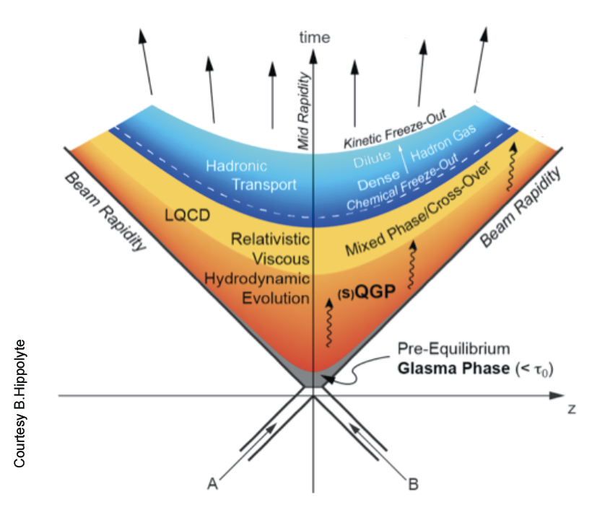
Summary
Medium Evolution
dN_{ch}/dη ~ 1600 particles
Kinetical
freeze-out
~ 90 MeV
Large pressure
↓
collective flow
Chemical freeze-out
~ 155 MeV
Dense medium
↓
Energy loss, Quarkonia melting
Viscous hydrodynamics
η/s ~ 0.08 – 0.16
Initial temperature*
~ 300 MeV
Density fluctuations
↓
spatial anisotropies
Values for central √s_{NN} = 2.76 TeV collisions (LHC)
* from direct photons (not discussed)

Slide 45
Take-Home Messages
Dense colored strongly coupling medium is produced in heavy-ion collisions (the Quark-Gluon Plasma)
  Particle production is strongly suppressed
Created matter is in local thermal equilibrium
  Particle production described by statistical models
  Expansion described by viscous hydrodynamics “perfect liquid”
Recent discoveries and observations in p-Pb collisions hint at collective “QGP-like” effects in small systems
  Universal description across system size?
Many thanks for useful discussions and inspiring previous lectures to Federico Antinori, Davide Caffarri, Leticia Cunqueiro, Andrea Dainese, Michele Floris, Alexander Kalweit, Andreas Morsch, Raimond Snellings, Alberica Toia
Thank you for
your attention

Slide 46
Backup

Slide 47

Fluctuations
Initial-state density fluctuations cause higher-order flow
For a given order
  Value is not the same event by event
  Usually we look at averages
  However we look for
without fluctuations
Deviates with fluctuations
means actually
etc.
non-flow not shown for simplicity
for
fluctuation
average

Slide 48
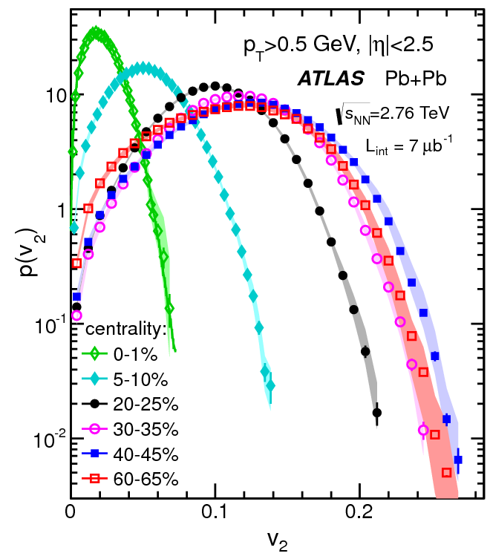
Fluctuations (2)
P(v₂) vs v₂
v₂ distribution is broad
Influence of fluctuations significant
Estimate of fluctuations
for
JHEP11(2013)183

Slide 49
Interpretation
Hydro?
Observed effects associated to hydrodynamical evolution in Pb-Pb collisions
Hydrodynamics in p-Pb
collisions?
  Number of interactions?
  Sufficient time for
  constituents to see
  each other?
Hydrodynamics in p-Pb
collisions reproduces
measurements
  Assuming 0.2-0.6 fm/c for beginning of hydro evolution
v₂: Hydro vs. Data
arXiv:1304.3044

Slide 50
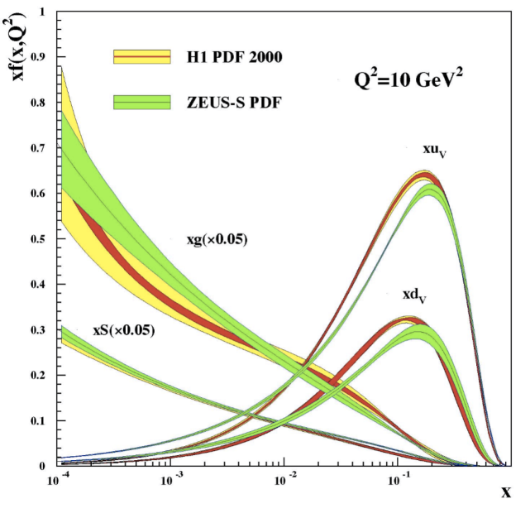
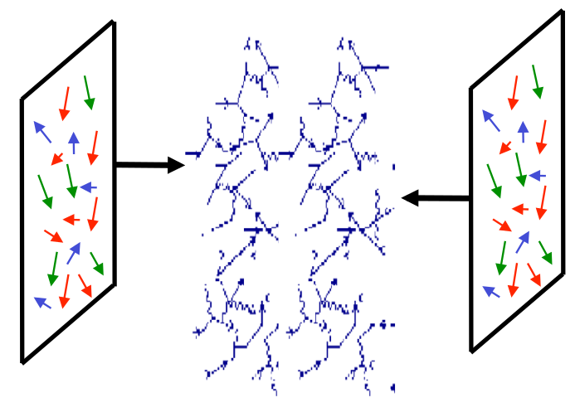
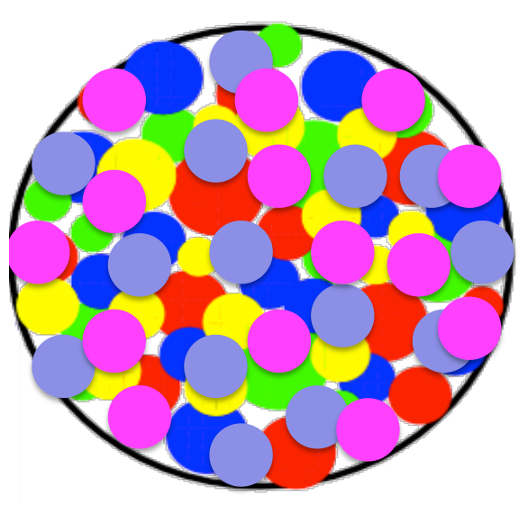
Interpretation
Initial-state effect?
q/g densities vs. x
At low x, gluon density rises
In nucleus density increases by A^{1/3} ~ 6
→ saturation
Model of Color Glass Condensate
Gluons (suppressed by factor 20)
Color: gluon color charge
Glass: solid on short time scale, liquid on large time scales
Condensate: high density

Slide 51
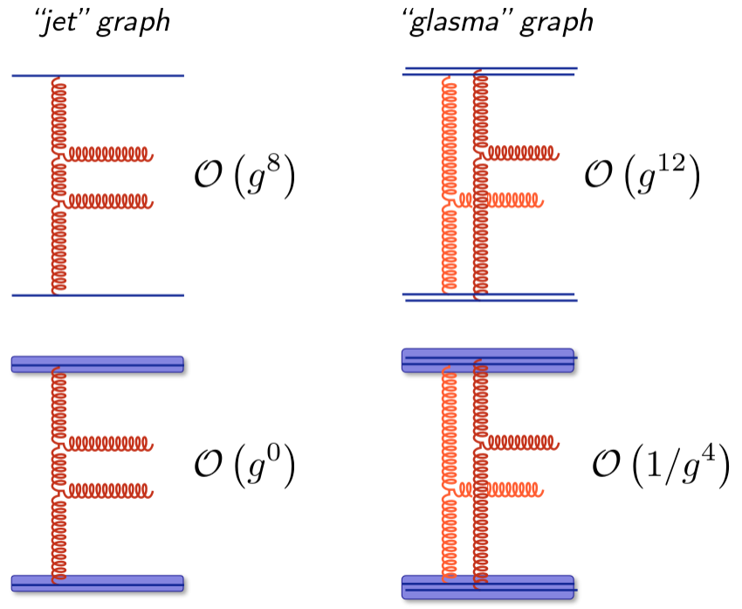
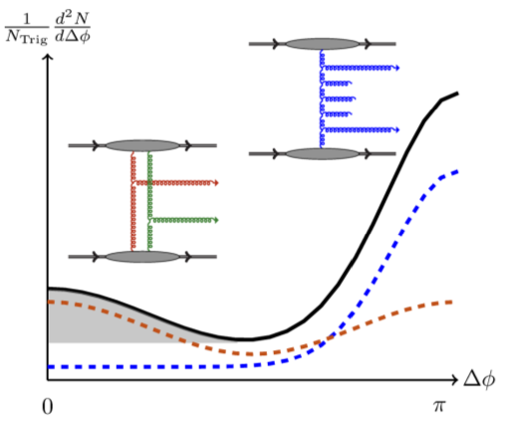
Interpretation (2)
Initial-state effect?
Saturation enhances certain graphs by orders of α_{S}
  Glasma graph enhanced by twice the order of magnitudes than jet graph
Low color density
x10⁸
x10¹⁶
High color density
Within these models, ridge can be calculated quantitatively
Then there are lots of other qualitative ideas…
PRD 87, 094034 (2013)
Notes:
TODO IS ideas, see slides from Bjoern

