Slide 1

Workshop Report from ERL2019 at HZB
Peter McIntosh, STFC Daresbury Laboratory
TESLA Technology Collaboration Meeting
CERN, 4th – 7th February 2020

Slide 2
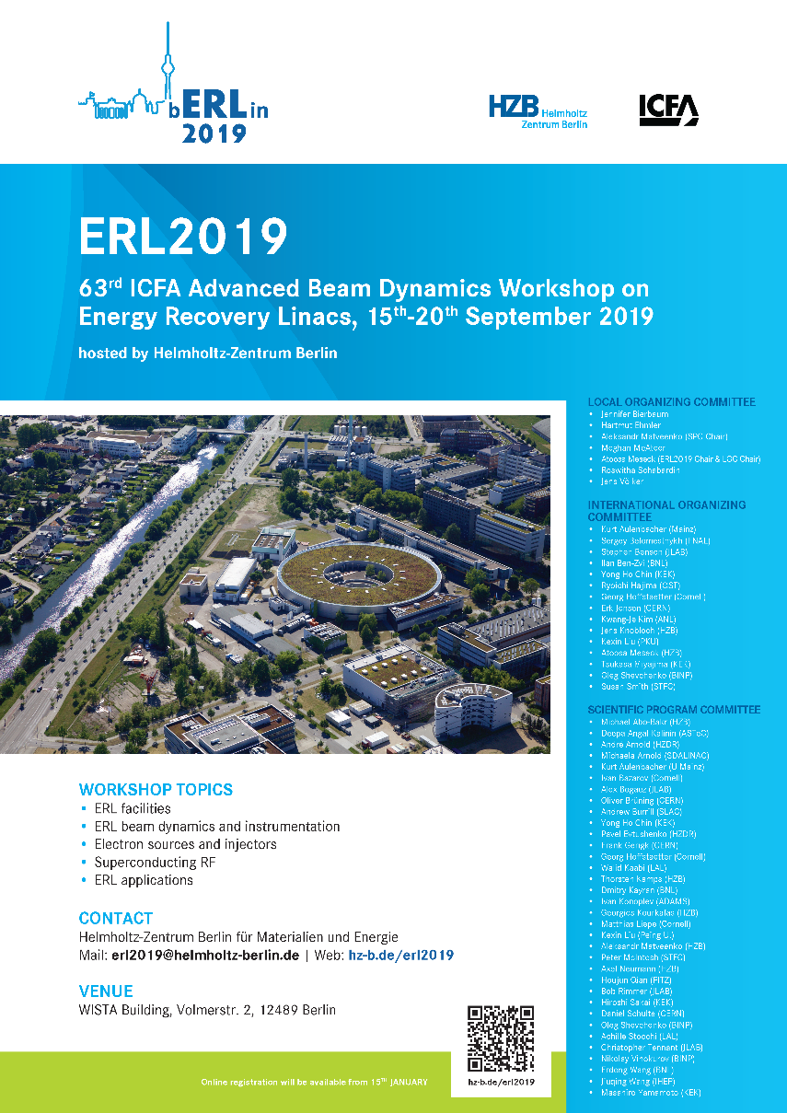
63rd ICFA Advanced Beam Dynamics Workshop Energy Recovery Linacs
ERL2019 Helmholz Zentrum Berlin (HZB)
15 – 20 Sept 2019
Workshop Topics:
ERL Facilities
  Michael Abo-Bakr (HZB)
  Michaela Arnold (S-DALINAC)
Beam Dynamics & Instrumentation
  Alex Bogacz (Jlab)
  Georg Hoffstaetter (Cornell Univ)
  Pavel Evtushenko (HZDR)
  Thorsten Kamps (HZB)
Electron sources and Injectors
  Luca Cultrera (Cornell Univ)
  Erdong Wang (BNL)
Superconducting RF
  Frank Gerigk (CERN)
  Peter McIntosh (STFC)
ERL Applications
  Deepa Angal-Kalinin (STFC)
  Oleg Shevchenko (BINP)
100 participants:
  61 Europe
  27 N America
  12 Asia
https://erl2019.vrws.de/
https://www.helmholtz-berlin.de/events/erl19/index_en.html

Slide 3
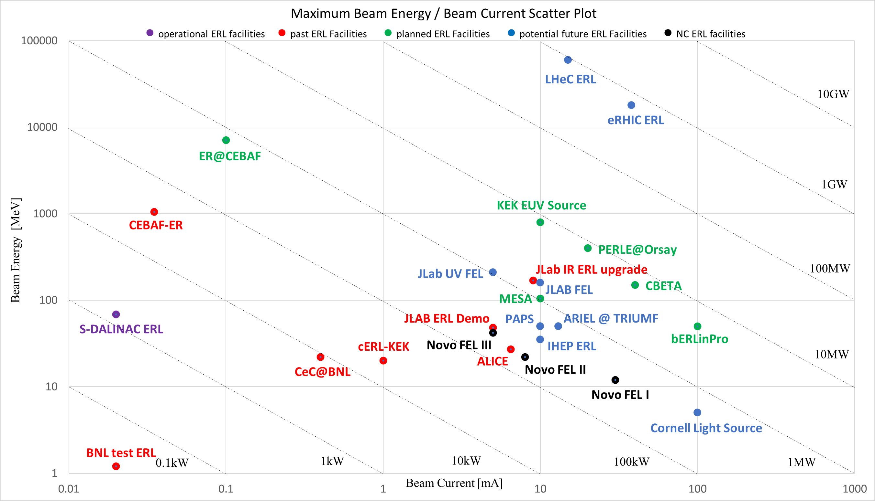
Global ERL Facilities

Slide 4
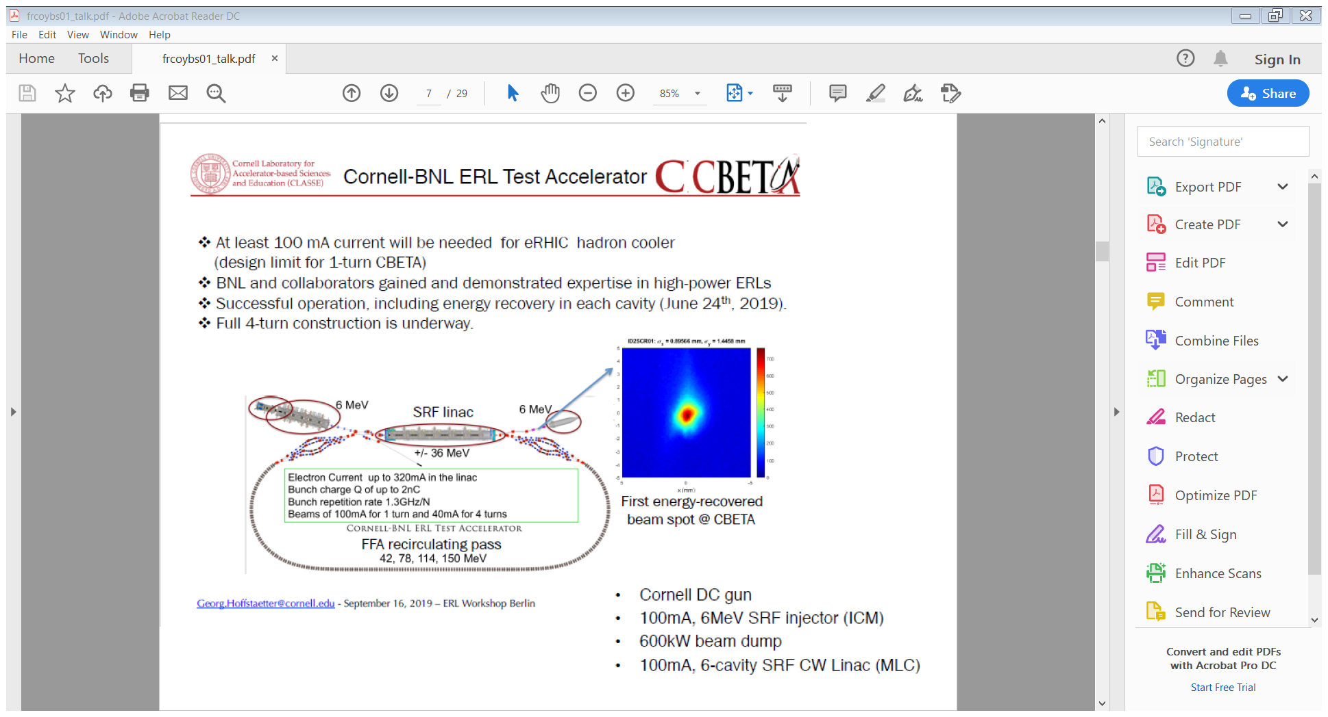
CBETA at Cornell/BNL
Georg Hoffstaetter, Cornell University

Slide 5
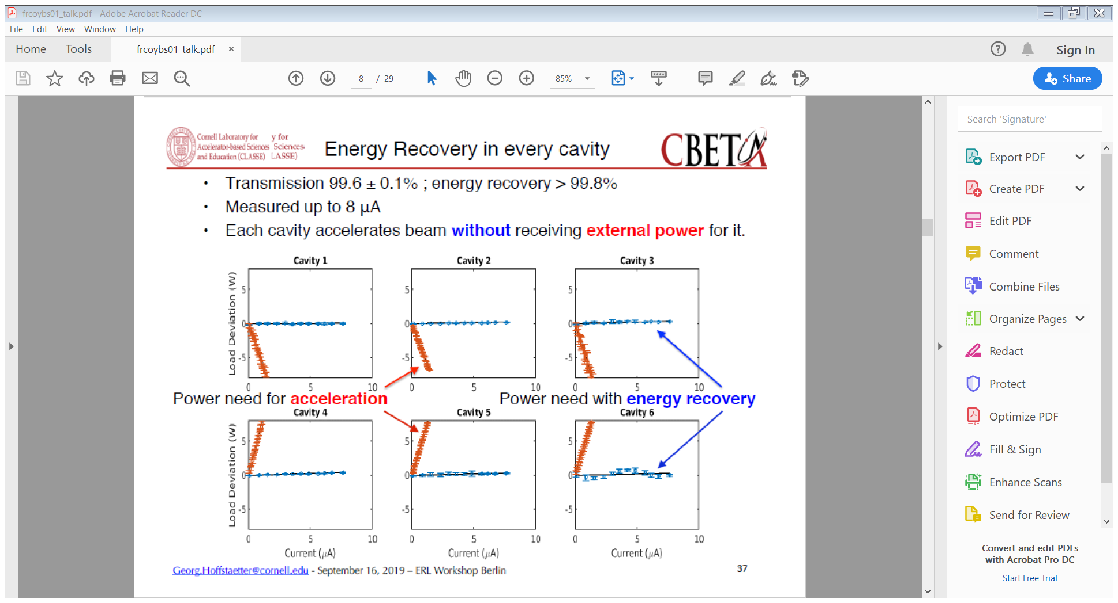
CBETA Energy Recovery
Georg Hoffstaetter, Cornell University

Slide 6
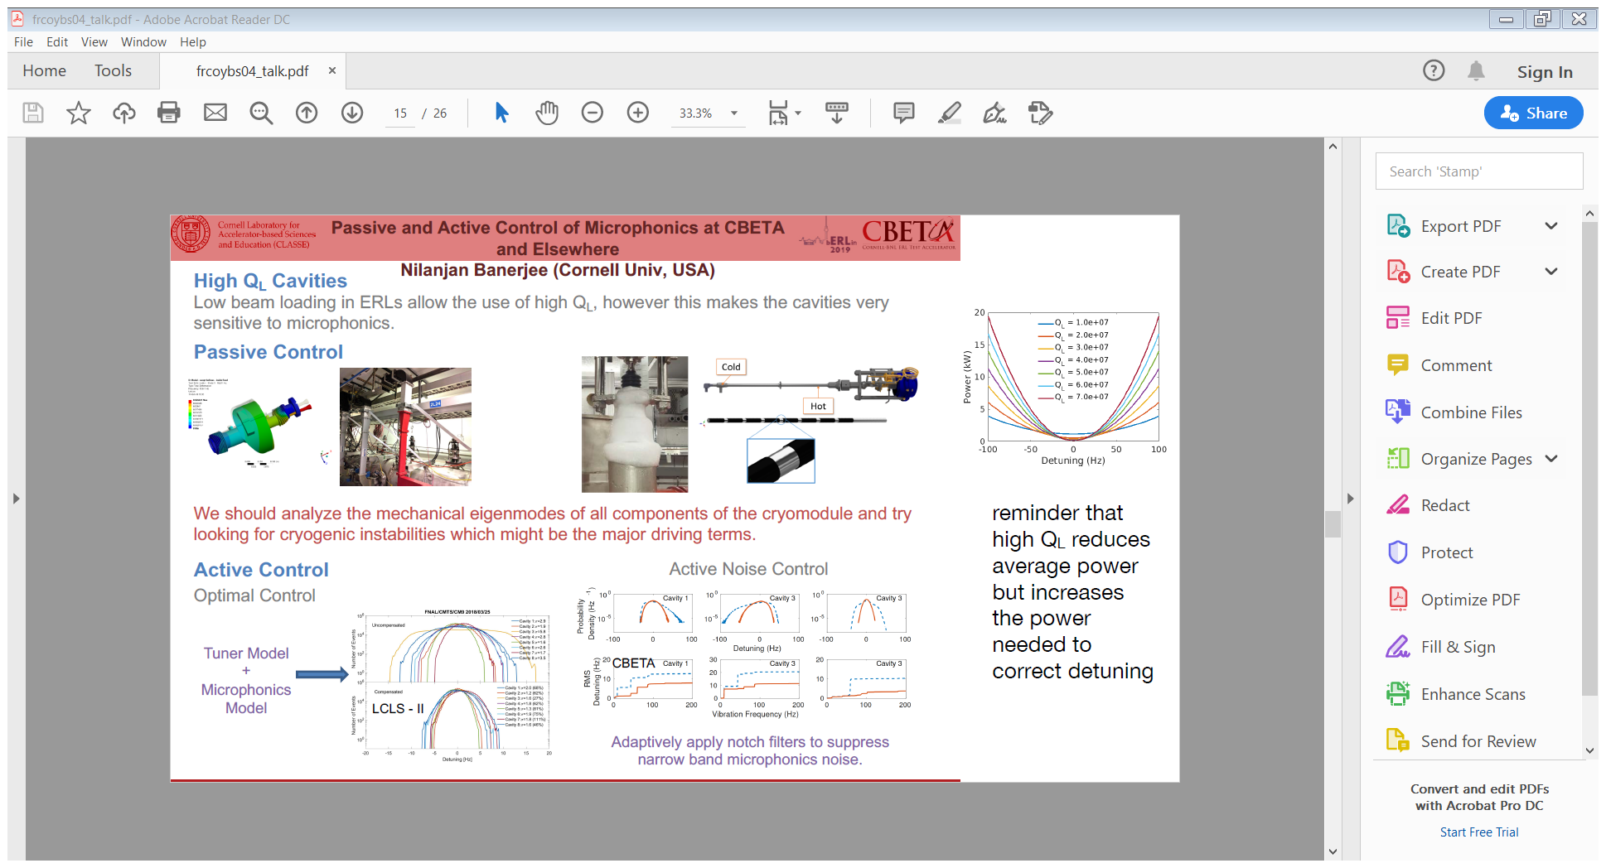
CBETA RF Control
Nilanjan Banerjee, Cornell University

Slide 7
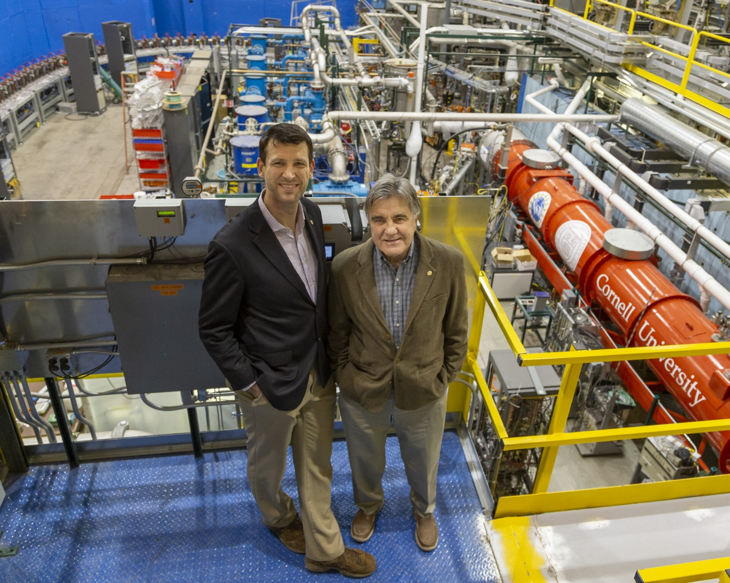
CBETA 8-Turn Success in Jan 2020!!!
Scientists from Cornell University and the U.S. Department of Energy's (DOE) Brookhaven National Laboratory (BNL) have successfully demonstrated the world's first capture and reuse of energy in a multi-turn particle accelerator, where electrons are accelerated and decelerated in multiple stages and transported at different energies through a single beamline.
This advance paves the way for ultra-bright particle accelerators that use far less energy than today's machines.
Not presented at the workshop!
4 Up and 4 Down ER demonstrated:
42, 78, 114, and 150 MeV in four passes through the ERL
Press release: 21st January 2020 - https://phys.org/news/2020-01-green-world-pass-full-energy.html

Slide 8
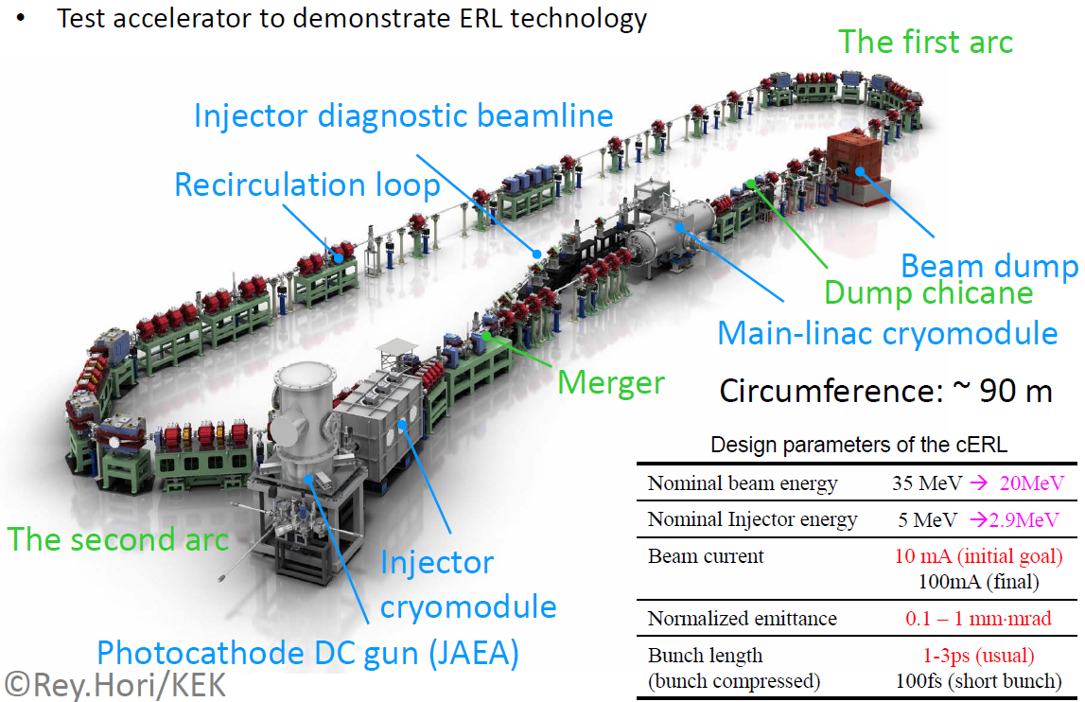
Compact ERL (cERL) at KEK
Tsukasa Miyajima, KEK

Slide 9
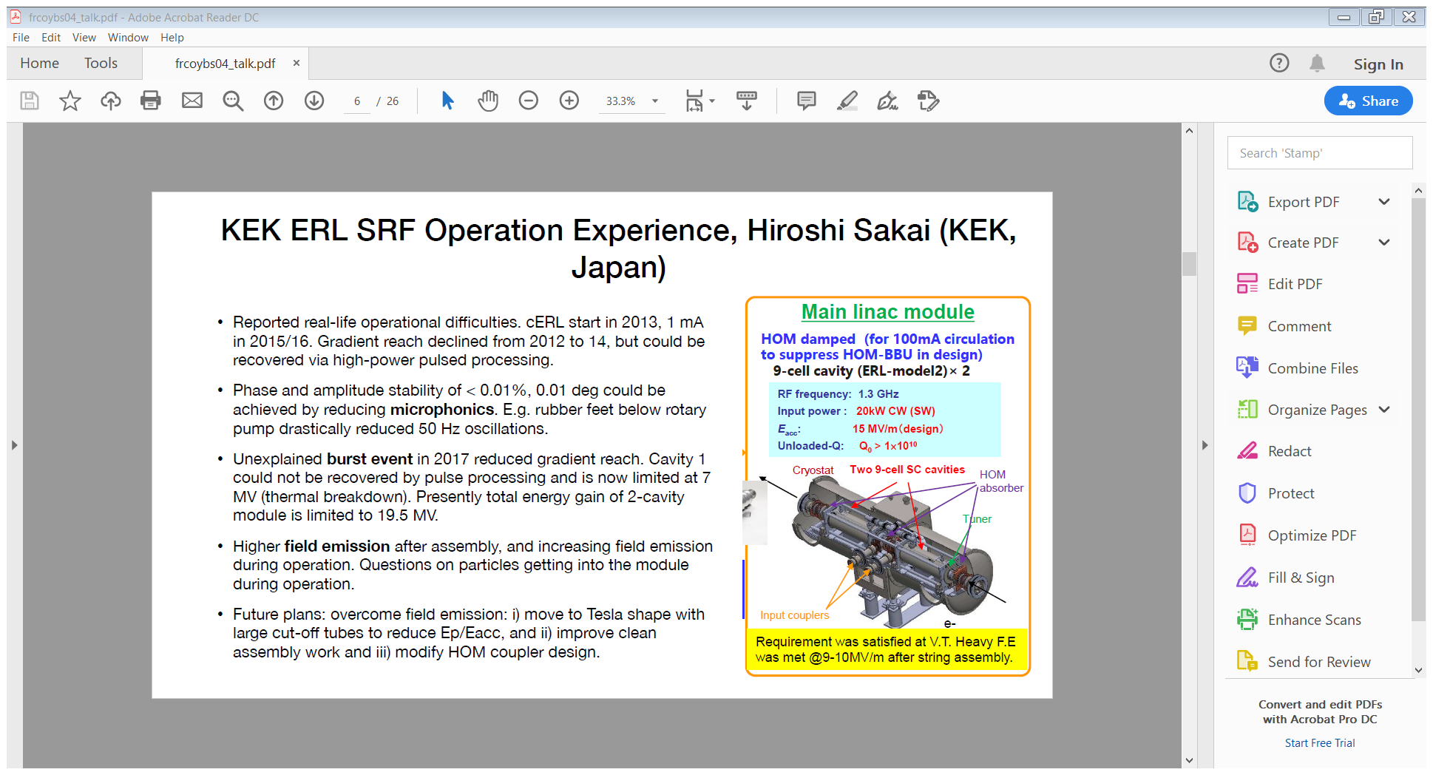
cERL Operational Experience
Hiroshi Sakai, KEK

Slide 10
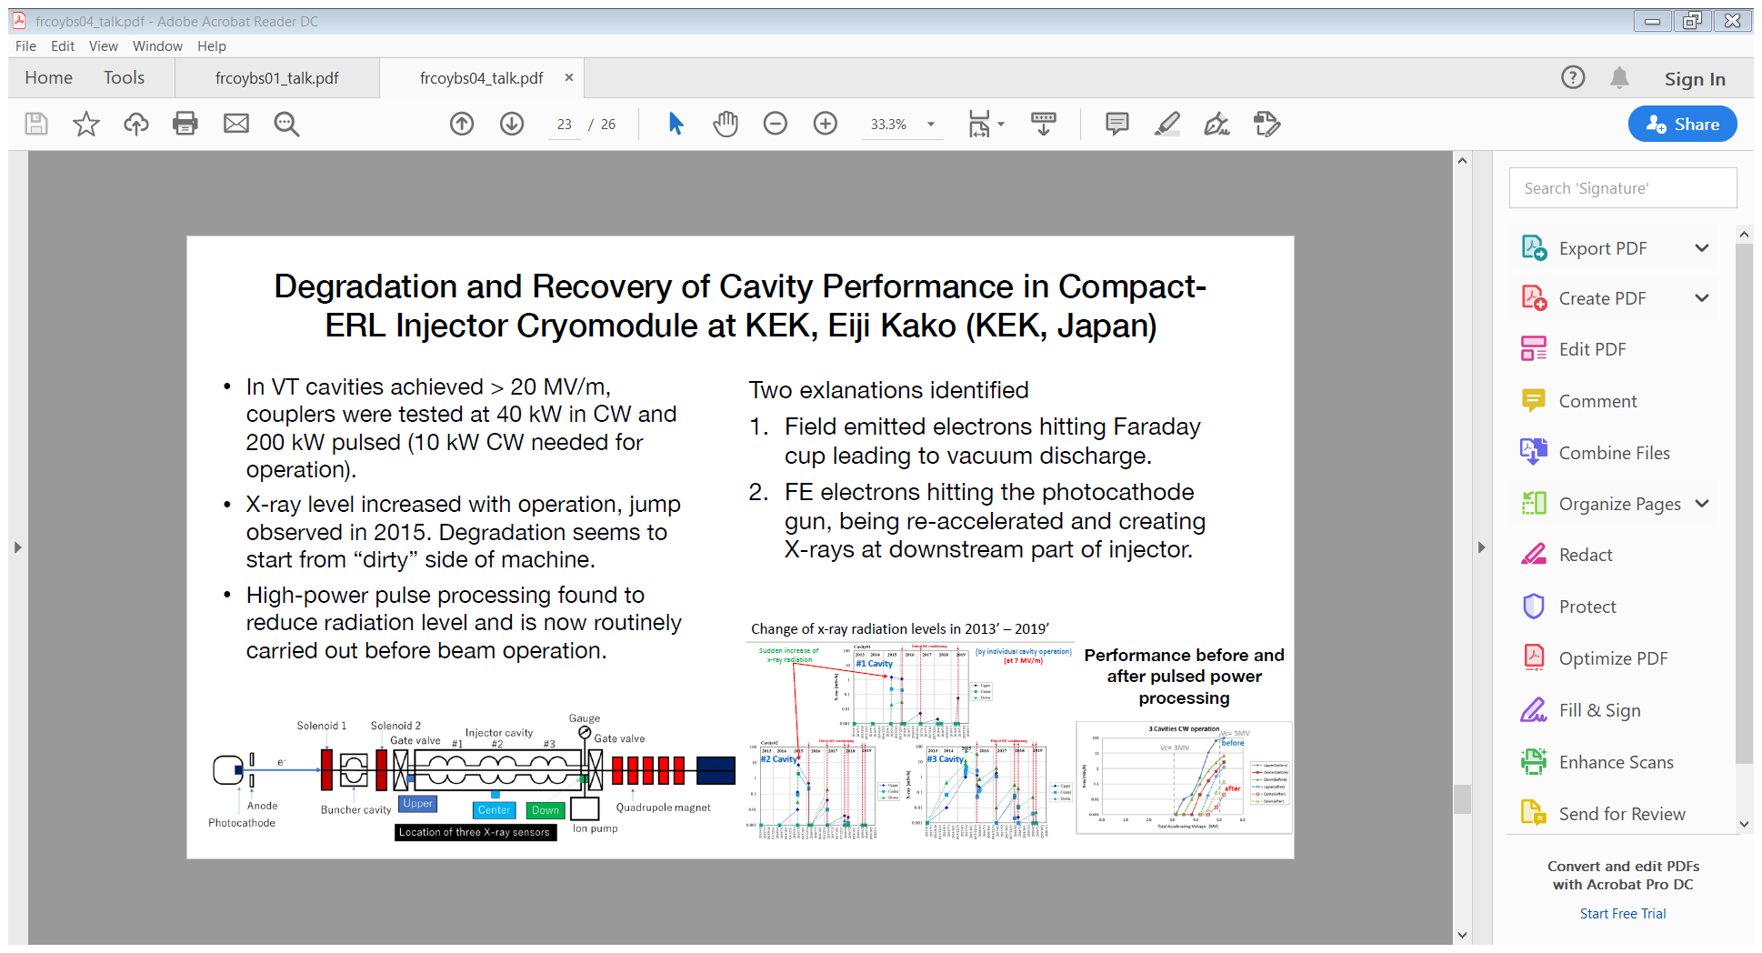
cERL Injector Cryomodule
Eĳi Kako, KEK

Slide 11
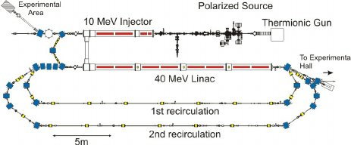
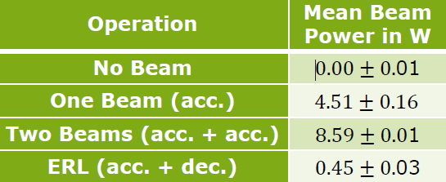
S-DALINAC at TU Darmstadt
Operating its recirculating linac since 1991.
ERL upgrade completed in 2015/16 for the S-DALINAC (3 GHz).
Lattice capable of a once (34 MeV) or twice-recirculating ERL operation (68 MeV).
Important aspect is the effect of phase slippage and its influence on the quality of the decelerated beam.
Diagnostic systems are great importance, especially for the twice-recirculating ERL, 2 beams of same energy transported through the same beam line.
Commissioning of different ERL modes started in 2017, continued during upcoming beam times.
Michaela Arnold, TU Darmstadt

Slide 12
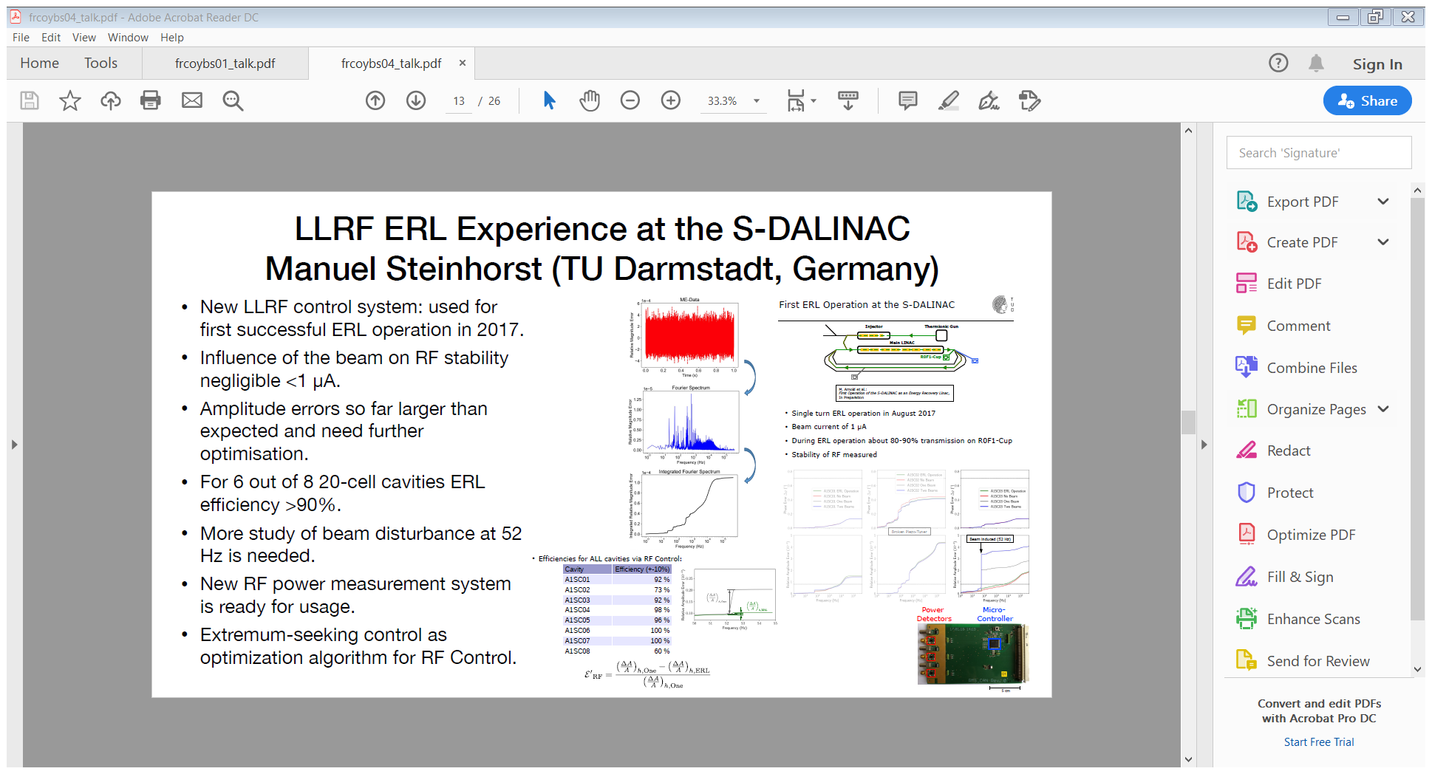
S-DALINAC RF Control for ERL
Manuel Steinhorst, TU Darmstadt

Slide 13
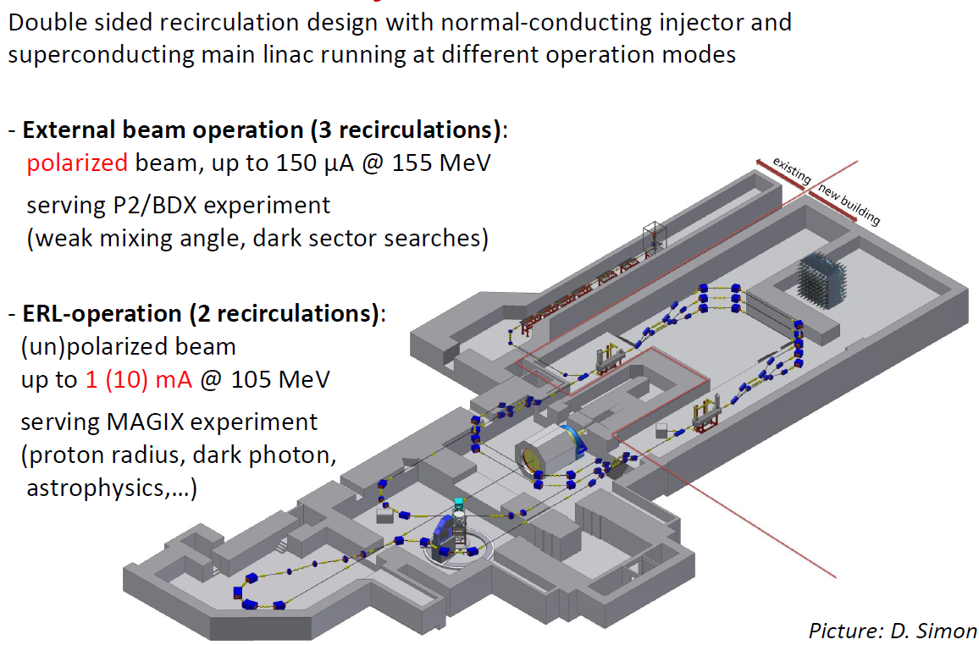
MESA at Mainz University
Mainz Energy-Recovering Superconducting Accelerator
Florian Hug, Mainz University

Slide 14
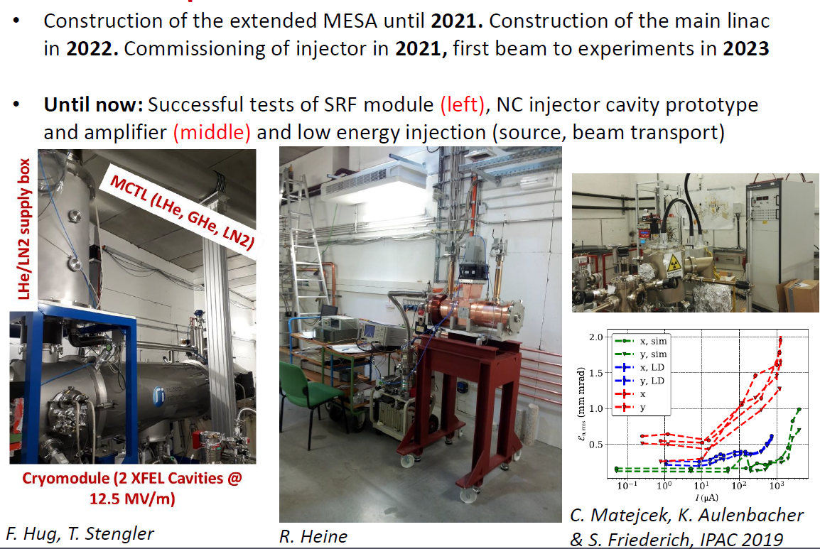
MESA Accelerator Status

Slide 15
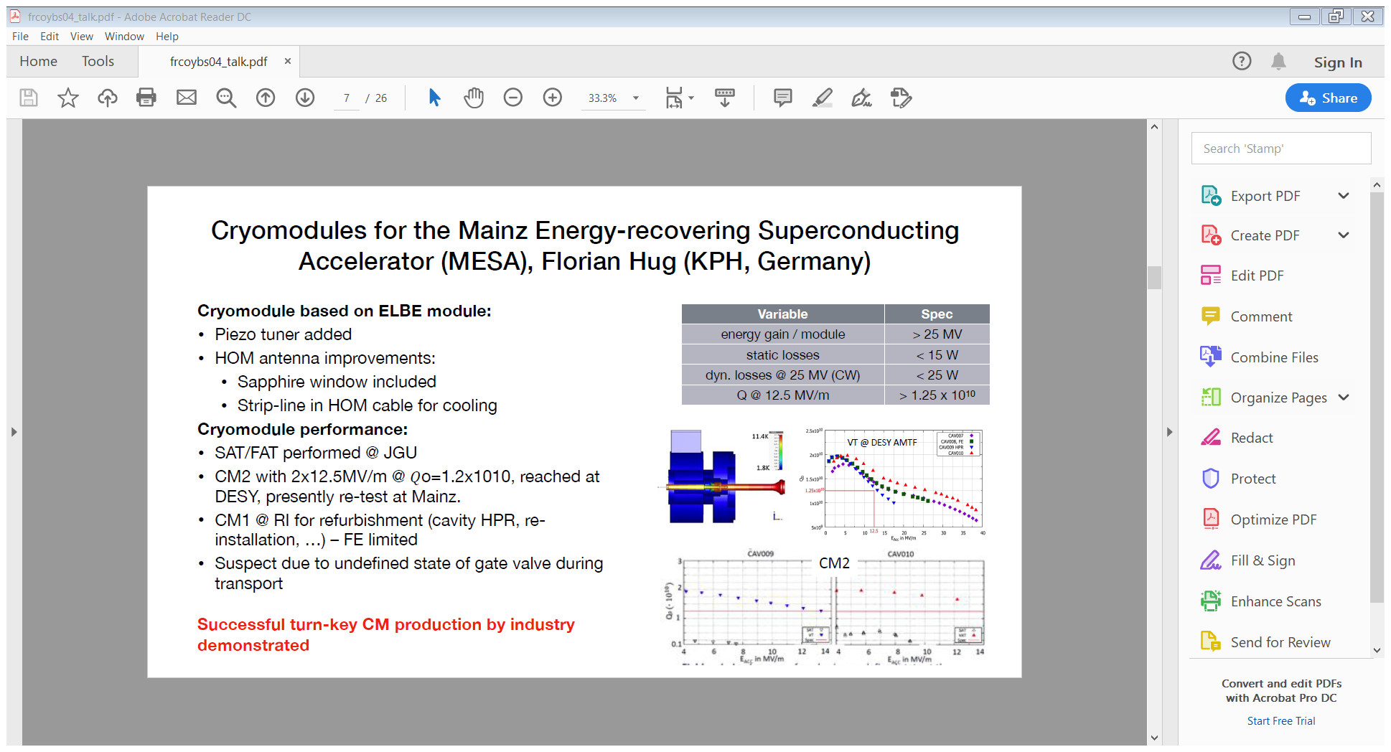
MESA Cryomodule Tests
CM
Florian Hug, Mainz University

Slide 16
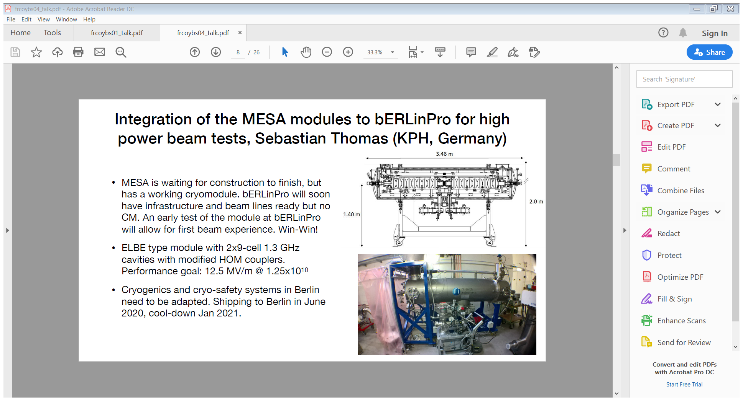
bERLinPro MESA Module Integration
Sebastian Thomas, Mainz University

Slide 17
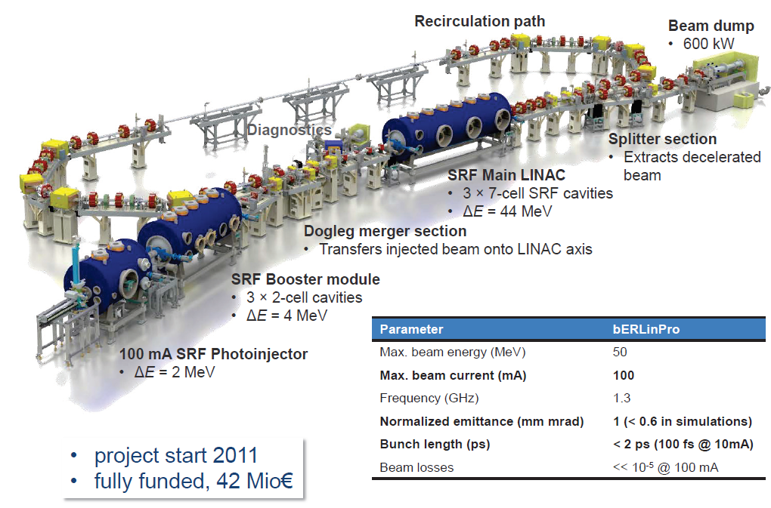
bERLinPro at HZB
Andreas Jankowiak, HZB

Slide 18
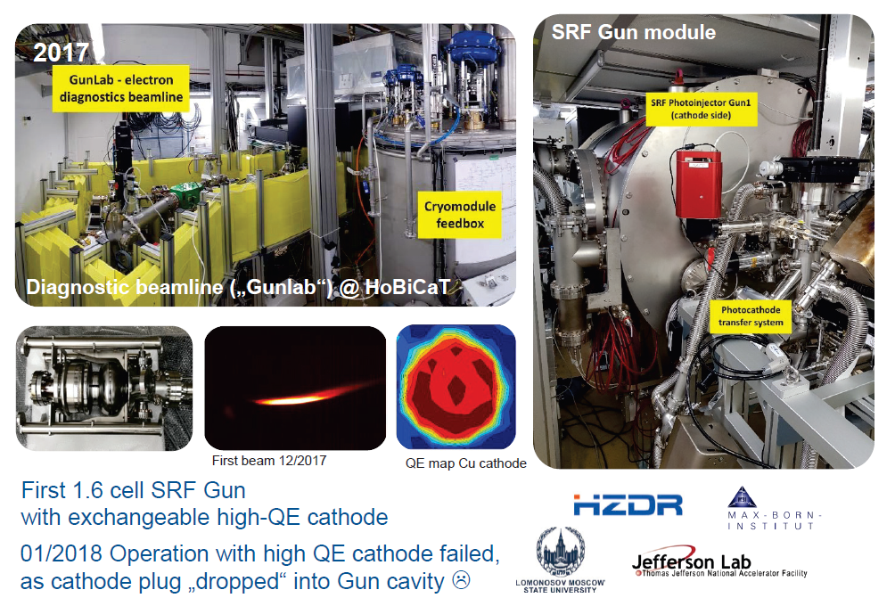
bERLinPro SRF Photo-Injector
Andreas Jankowiak, HZB

Slide 19
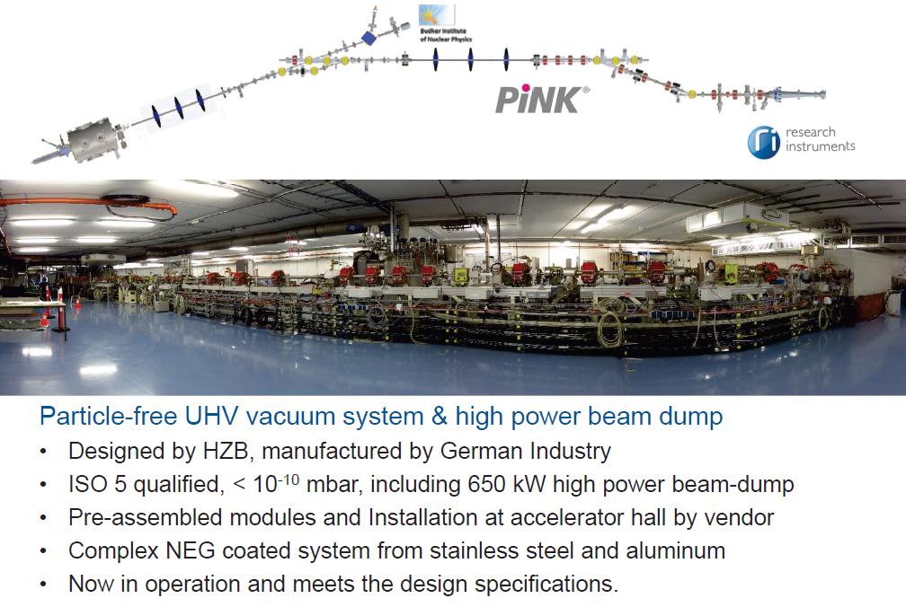
bERLinPro ‘SRF Ready’ Particle Free UHV System
Andreas Jankowiak, HZB

Slide 20
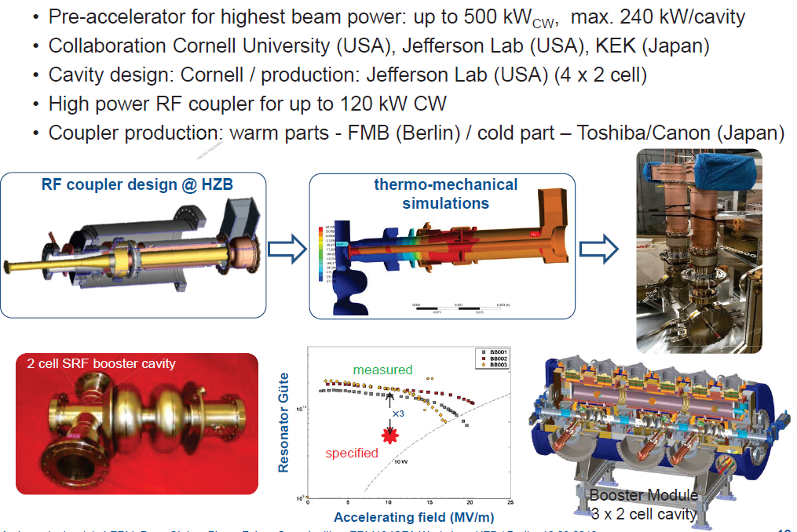
bERLinPro High Current Booster
Andreas Jankowiak, HZB

Slide 21
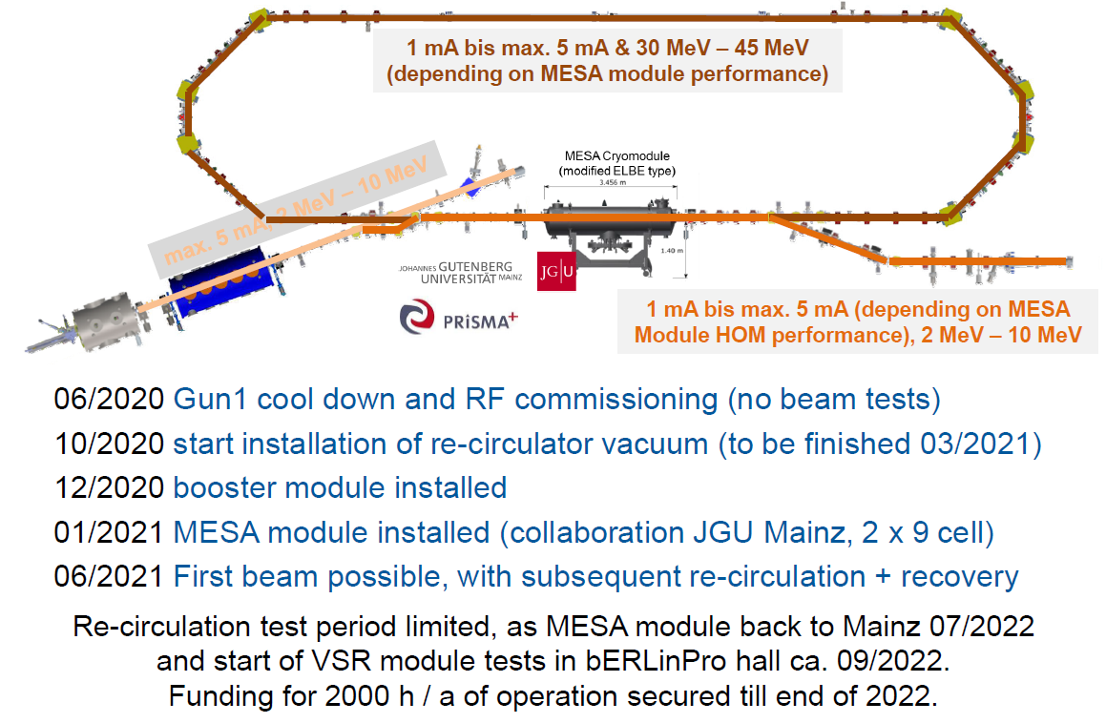
bERLinPro Operational Readiness
Andreas Jankowiak, HZB

Slide 22
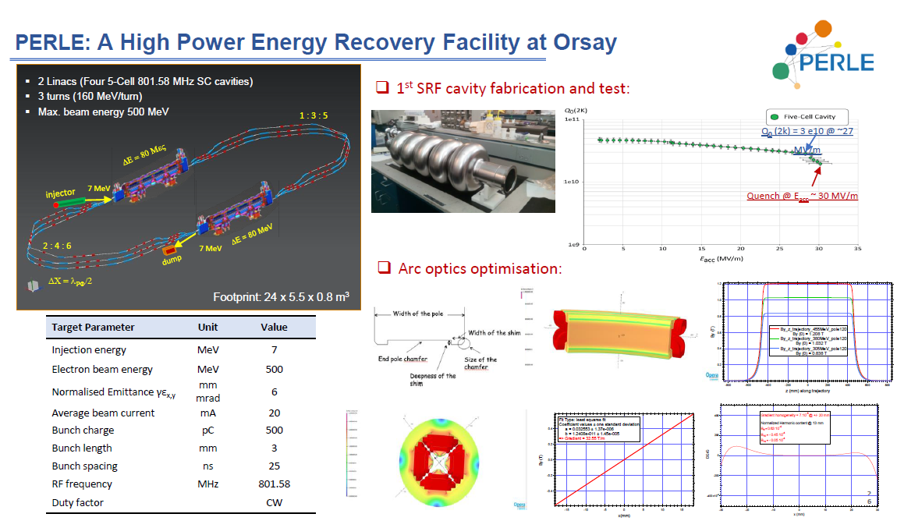
PERLE at Orsay
Powerful Energy Recovery Linac for Experiments
Walid Kaabi, LAL-CNRS
Proposed ERL technology demonstrator for LHeC at CERN

Slide 23
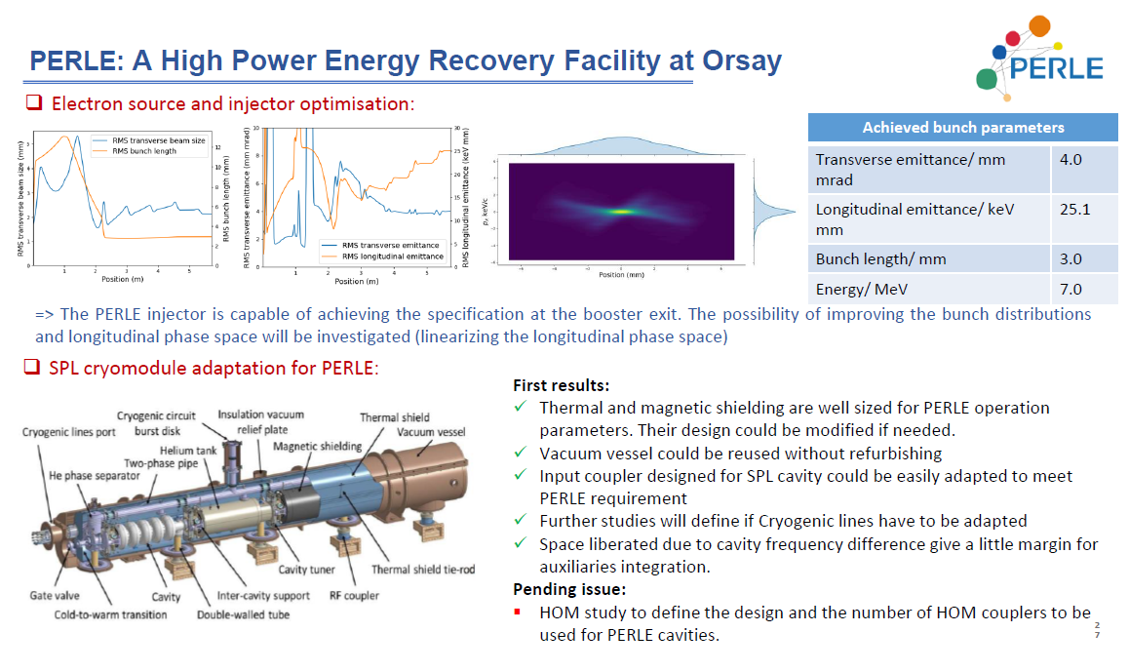
PERLE Injector and Accelerator
Walid Kaabi, LAL-CNRS

Slide 24
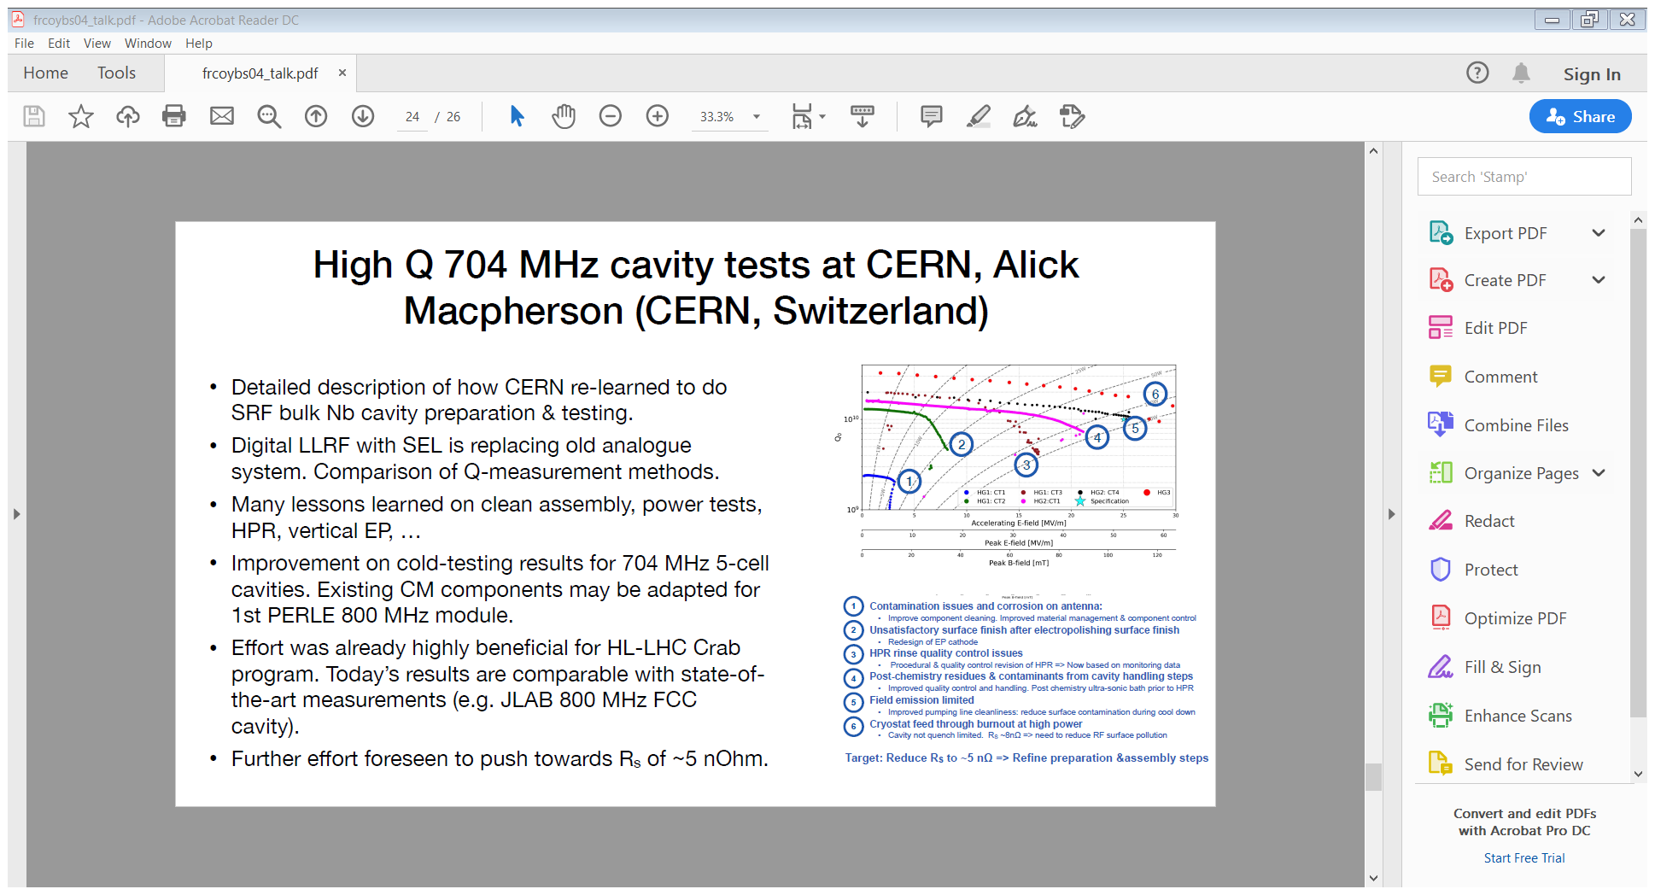
PERLE Adapting from SPL
Alick Macpherson, CERN

Slide 25
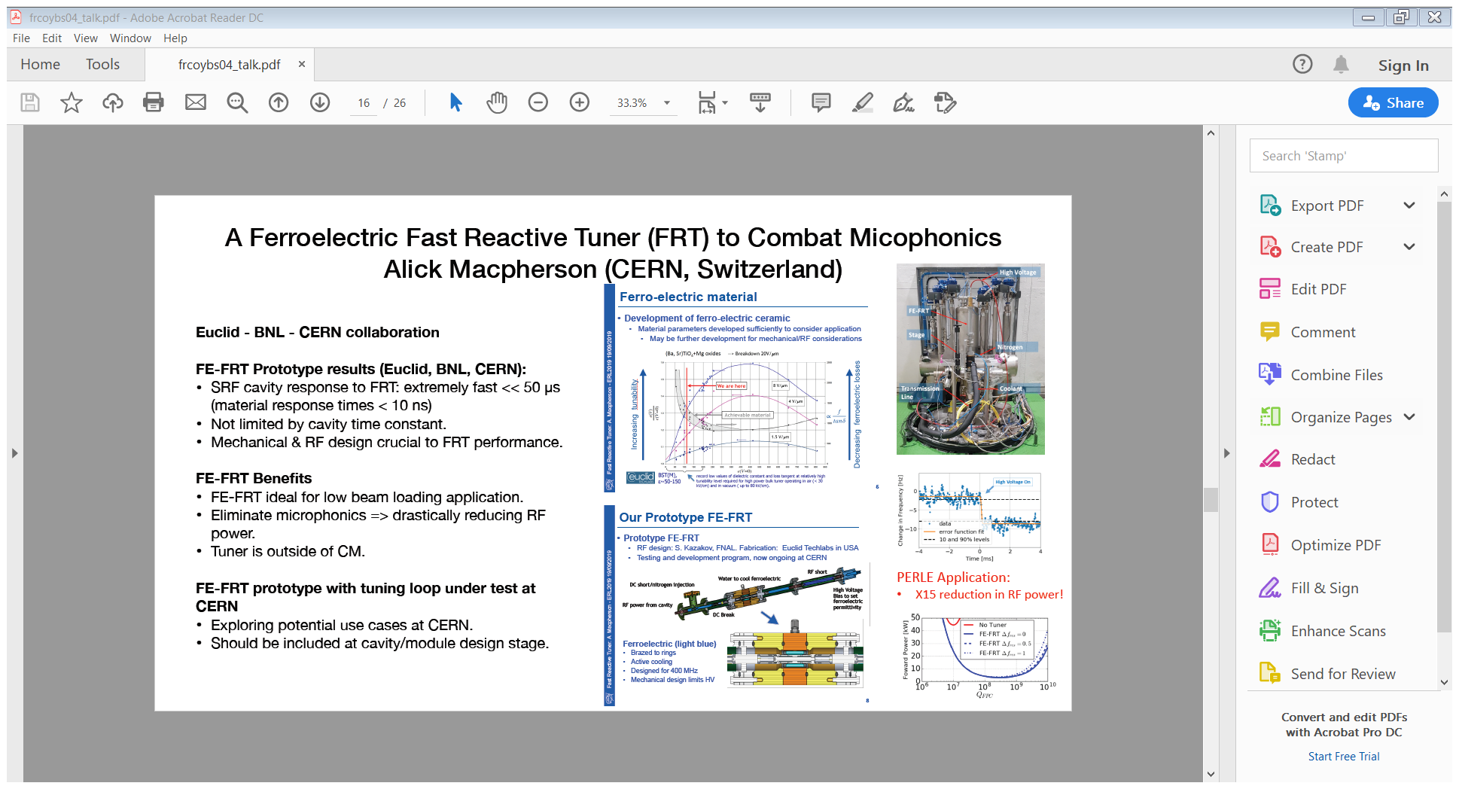
PERLE FE-FRT
Ferro-Electric Fast Reactive Tuner
Alick Macpherson, CERN

Slide 26
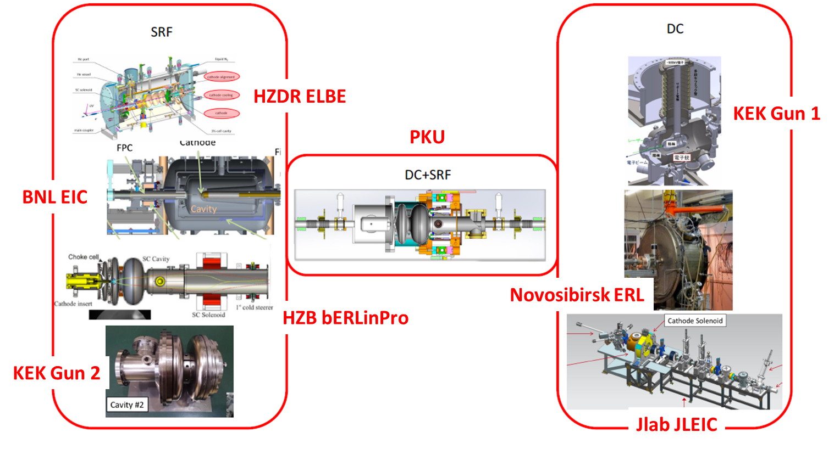
ERL Injectors

Slide 27
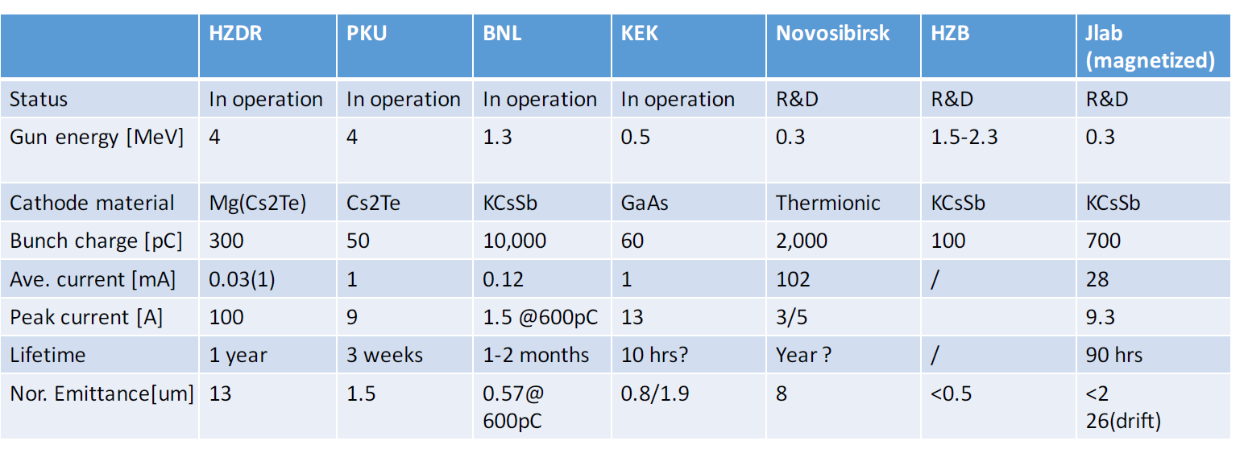
Challenges Injectors/Photocathodes
Photocathodes for high power:
Alkali antimonides up to 65 mA;
Available at several labs;
Ps time response time;
Few days operational lifetime;
Halo from transverse laser profiles;
Microbunching instability;
Thermionic cathodes can deliver 100mA required for coolers.
Photocathodes for spin polarized beams:
GaAs based SL are the only real choice;
Distributed Bragg Reflector yields improved QE;
Lifetime is still limited;
Halo from tails (transverse and longitudinal);
R&D community focusing on ”new applications”
Time resolved microscopy;
High brightness for utra-fast diffraction;
Dielectric acceleration;

Slide 28
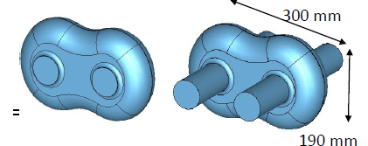
ERL SRF Technology Developments
Cavities
Asymmetric SRF dual axis cavities for ERLs
Aim to surpass existing ERL electron beam handling capabilities & footprint, provide high current for Compton light source, FEL, THz and EUV applications.
Design 2: 1.5 GHz Jlab/ODU
Aim 15 MV/m at 1497 MHz. Designed for: easy cleaning, max. beam pipe separation, avoid MP,
Cavity 1 reached 23 MV/m at 7x10⁹, cavity 2 only 5 MV/m (welding defect), no MP.
Fabrication more straight forward than anticipated.
Chemistry and cleanliness can be handled.
Design 1: 1.3 GHz JAI/MePhI
Proof of concept/optimisation of 7-cell aluminium and 11-cell copper dual axis asymmetric cavities with preliminary studies of HOMs conducted.
Yaroslav Shashkov, MEPhI
HyeKoung Park, JLab

Slide 29
ERL Applications
  Wide range of applications of ERLs covered:
  Radiation sources
    FELs: Far-IR, IR, EUV, hard X-rays,...
    Intense THz (via coherent resonant diffraction radiation)
    Gamma source (LCS, ICS)
  High resolution X-ray imaging
  Security and medical isotope manufacturing
  Particle Physics
    LHeC & PERLE
  Nuclear Physics:
    Cooler for high energy heavy ions in EIC (JELIC/eRHIC)
  Photonics (nuclear, surface plasmons,…)
  Spectroscopy (ultra-fast, pump-probe, ….)
  Nuclear astrophysics

Slide 30
Industrial Applications of cERL
Several important industrial High current (~10mA) applications:
High resolution X-ray imaging device for medical use
Nuclear security system (gamma-ray by LCS)
Near Future:
Manufacturing facility for nuclear medical examination.
Intense THz light generation.
Design concept for high repetition, high current EUV-FEL for Future Lithography industrial application – operational experience with high current is being studied in cERL at KEK.
Hiroshi Sakai, KEK

Slide 31
ERL19 Summary
Global ERL activity is growing extensively ‘once again’!
A number of planned ERL facilities under construction or development:
  CBETA at Cornell
  bERLinPro at HZB
  MESA at Mainz
  PERLE at Orsay
ERL microphonics control shows that LLRF systems need a specific effort and a ‘practical approach’:
  Mechanical damping of everything that can vibrate or induce vibrations.
  Final compensation with LLRF.
Enhanced ERL injector performance enabling large beam currents (10’s mA) and long lifetimes (months).
ERL applications continue to be realised:
  FELs, THz, Gamma, imaging, isotope production, particle and nuclear physics, photonics and spectroscopy ……. And growing!
}
Directly using 1.3 GHz TESLA technology
ERL technology and applications look very bright!

Slide 32

Many Thanks
https://erl2019.vrws.de/
https://www.helmholtz-berlin.de/events/erl19/index_en.html

