Slide 1
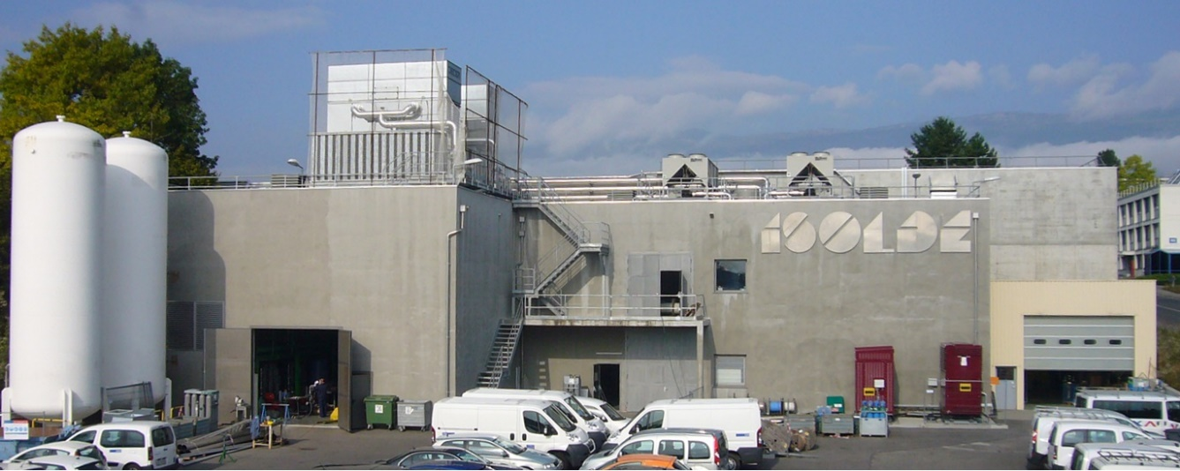
Nuclear reaction studies with accelerated radioactive ion beams at HIE-ISOLDE
Gerda Neyens
ISOLDE Collaboration Spokesperson
CERN (Switzerland) and KU Leuven (Belgium)

Slide 2
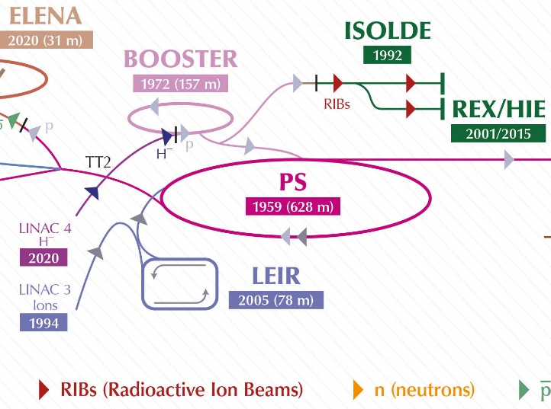
ISOLDE
= a Radioactive Ion Beam (RIB) facility at CERN
> 50% of Booster protons are sent to ISOLDE
ISOLDE = Isotope Separation On-Line Device
→ ISOL is a method to produce and select
short-lived radioactive isotopes
(t_{1/2} down to few milliseconds)

Slide 3
Production of RIB’s at ISOLDE
Unique worldwide: high energy (1.4 GeV) protons on variety of thick targets
The high impact energy splits the (heavy) target nucleus in smaller nuclei through
  Fission
  Fragmentation
  Spallation
²³⁸U
Spallation
➔ ‘exotic’ isotopes from light to heavy
Fission
Fragmentation
Proton beam
hits the target

Slide 4
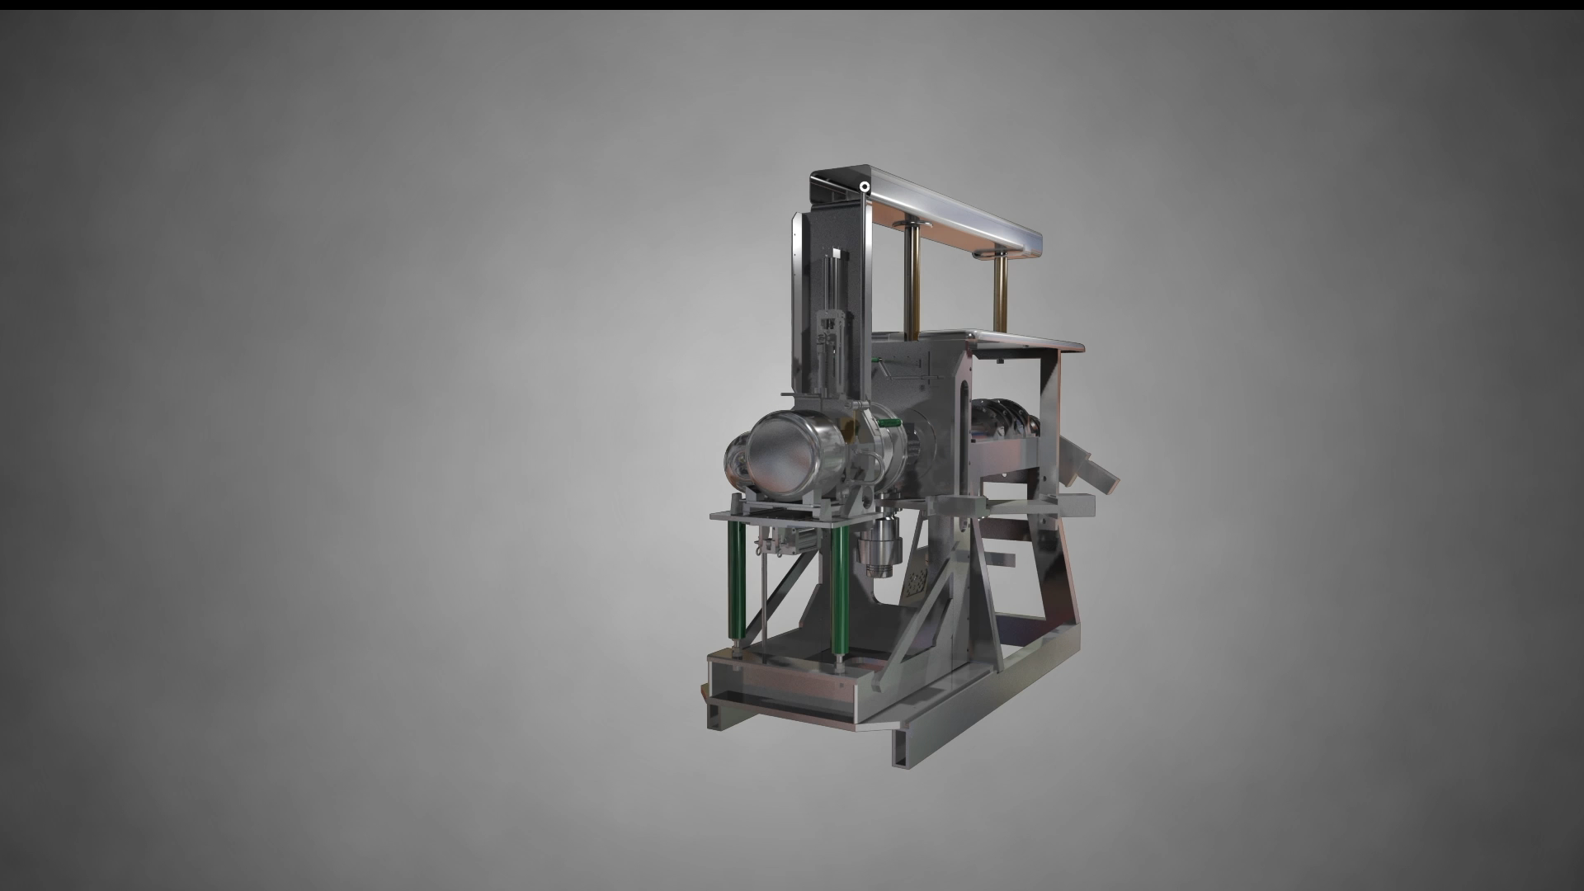
ISOL method
Isotope Separation On-Line method
= isotopes come out of the target in few ms
(diffusion/effusion from heated target at ~2000 degrees)
+ selection of (ideally) 1 specific isotope in microseconds to seconds (element dependent)

Slide 5

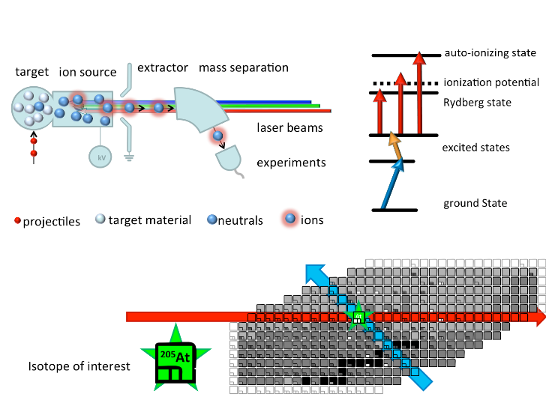
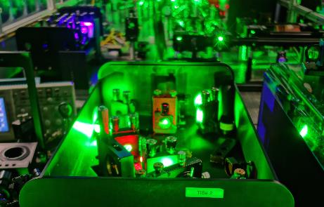

Selection 1 isotope out of hundreds
Resonance Ionization Laser Ion Source (since 1994)
Selective and efficient ionization of one particular element (e.g. Tin)
Mass separation
Proton beam
Isotope Mass (A=Z+N) selection with dipole magnets
Isotope Element selection with lasers

Slide 6
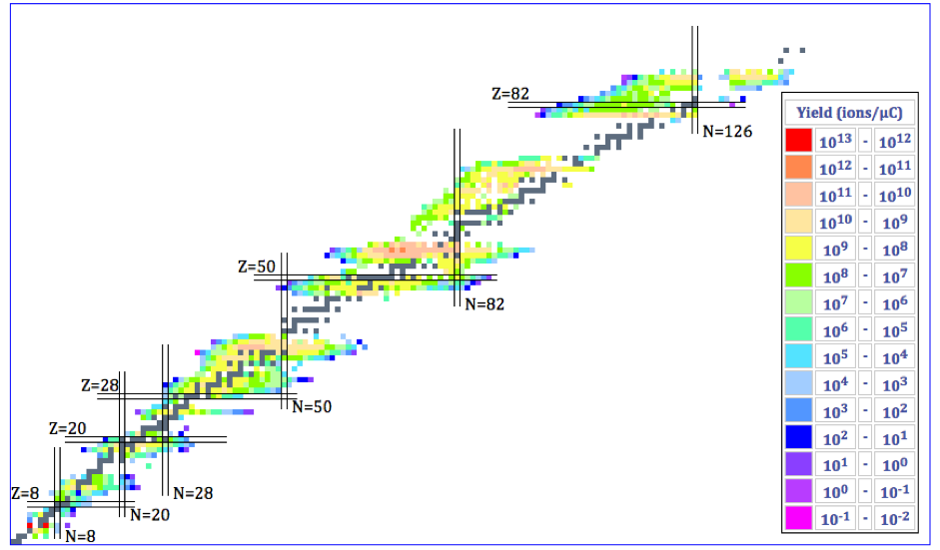
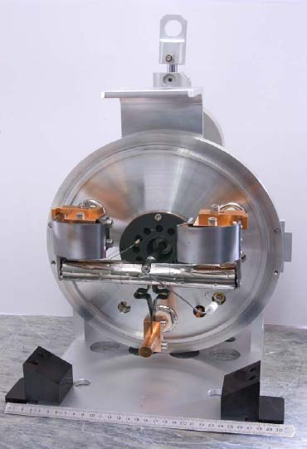
Produced Nuclei: 50 y experience
Over 20 target materials (carbides, oxides, solid metals, molten metals and molten salts) operated at high temperature
3 types of Ion-sources:
  Surface, Plasma, Laser
> 1300 isotopes of 75 chemical elements

Slide 7
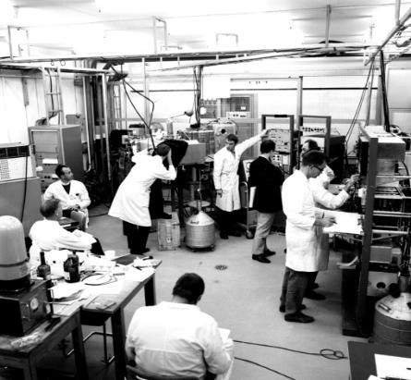
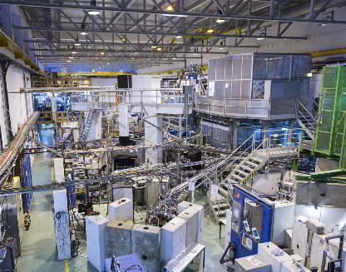
A short history of ISOLDE
> 50 years of experience !
The first ISOL-type facility worldwide
ISOLDE project accepted Dec 1964
First radioactive beam October 1967
Upgrades 1974 and 1988
New facility 1992 at PSB
Longest running CERN experiment
Extension in 2000 to host a NC Linac (REX)
Extension in 2013 to host a SC Linac (HIE-ISOLDE)

Slide 8
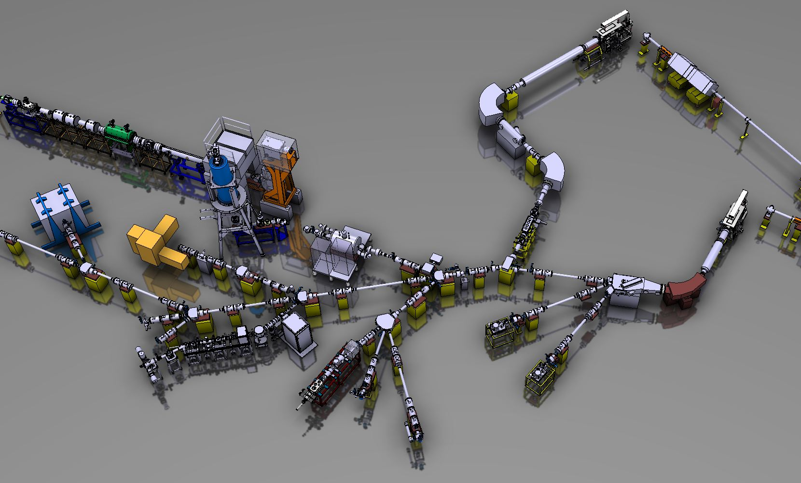
The ISOLDE facility today
Proton driver: 1.4 GeV, 2 μA (future: 2 GeV / 4 μA)
Two target stations (partially in parallel)
Ion cooler-buncher (μs bunches, user-defined repetition rate)
Target station 1
p
Post-accelerated beams ~ 10 MeV/u
Target station 2
Low-energy beams 40-60 keV
p

Slide 9
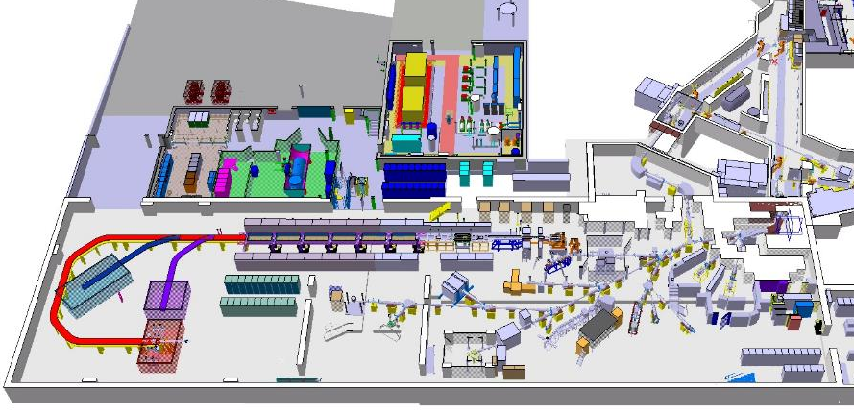
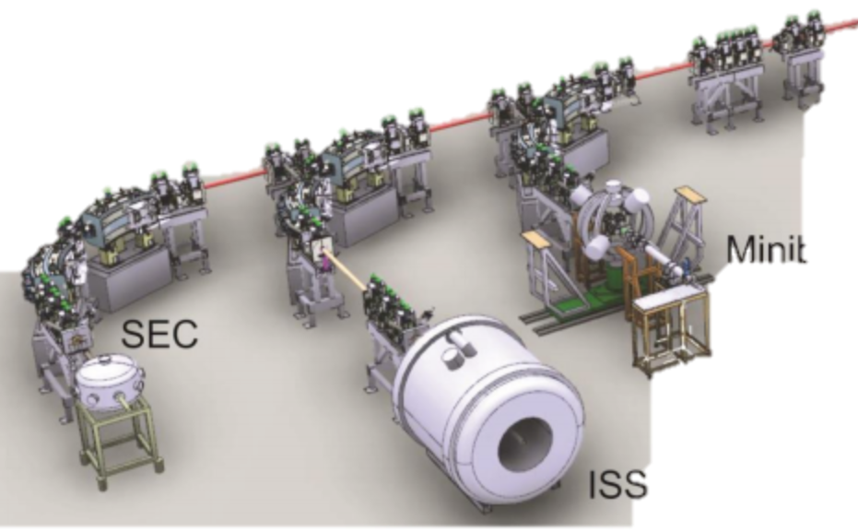
The ISOLDE facility today
Proton driver: 1.4 GeV, 2 μA (future: 2 GeV / 4 μA)
Two target stations (partially in parallel)
Ion cooler-buncher (μs bunches, user-defined repetition rate)
production
GPS
Target 2
HRS
Target 1
RIB production
TAS
+RILIS
WISARD
proton beam
VITO
IDS
CRIS
Solid State Physics
NICOLE
ISOLTRAP
COLLAPS
Low energy experiments
(~ 60 keV)
Travelling setups

Slide 10
The ISOLDE facility today
production
GPS
Target 2
RIB production
HRS
Target 1
REX-ISOLDE
RIB accelerator
Since 2001
3 MeV/u
TAS
+RILIS
HIE-ISOLDE RIB accelerator
2014-2018
Gradual increase to 10 MeV/u
WISARD
proton beam
VITO
Scattering
Chamber
MINIBALL
IDS
Solid State Physics
NICOLE
CRIS
ISOLTRAP
COLLAPS
ISS
Low energy experiments
(~ 60 keV)
Travelling setups
High energy experiments

Slide 11
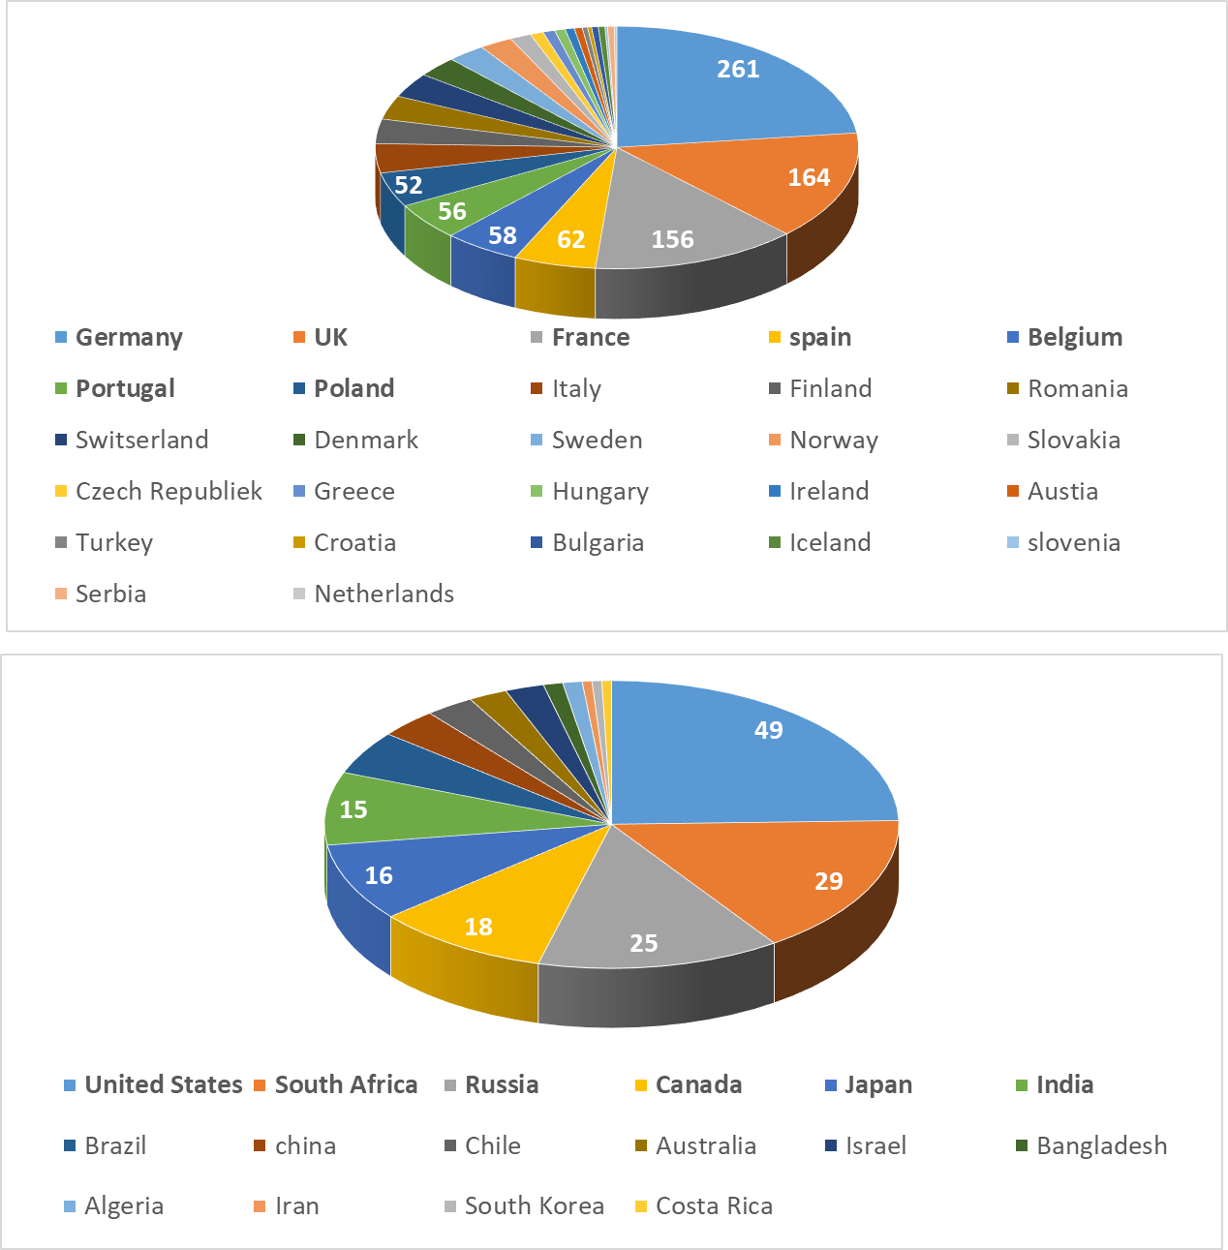
The ISOLDE users community
European Countries
Since post-accelerated beams became available: continuously expanding users community !
ISOLDE USERS:
In pre-REX/HIE-ISOLDE era:
  400-500 users
Today: more than 1000 !
  From 43 countries
  From > 200 institutions
  From all around the world
Other Countries

Slide 12
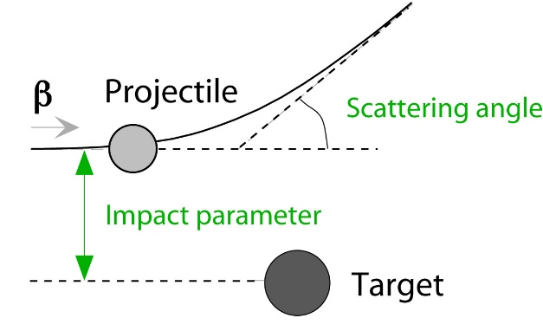
Accelerated beams: study reactions with RIB’s
Goal: measure precise cross sections of reactions with RIB’s
Beam energy and impact parameter defines type of reaction
Detect: scattered target and projectile nuclei, emitted particles (β,α) and gamma-decay
Radioactive
Coulomb excitation (RIB energies 2.5 – 5.5 MeV/nucleon)
  First studies at REX-ISOLDE / much better at HIE-ISOLDE !
  Study the vibrations and rotational behavior of nuclei
  Discovery of nuclei with ‘static’ pear shapes !
Scattering experiments (RIB energies from 3 – 7 MeV/u)
  Study exotic reaction channels or reactions relevant for astrophysics
Transfer reactions (RIB energies from 5 - 10 MeV/nucleon)
  Ideal with HIE-ISOLDE beams !
  First measurements in 2016 – first PRL just published !
➔ Get information about the structure of and reactions with exotic nuclei

Slide 13
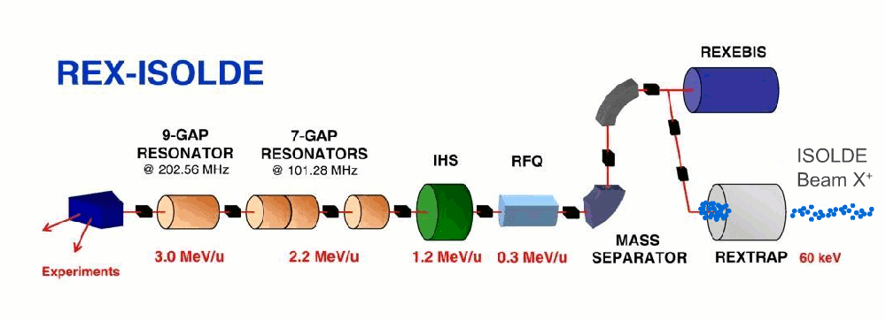
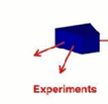
1st accelerator: REX-ISOLDE
Approved in 1994 as an experiment: “Radioactive beam EXperiment…”
Normal conducting RF-cavities built @ different Universities
First beams @ 2.2 MeV/u in Oct 2001
Upgrade to 3.1 MeV/u completed in 2004
REX Universal post-accelerator from He (A=4) to Ra (A=224)
> 100 different beams accelerated until 2012 for Coulomb Excitation studies
More than 110 papers, many high-impact !
ISOLDE
1⁺ to A/Q = 2 – 4.5
Primary
target
Protons
from PS
Stockholm
Mainz
Heidelberg + GSI, Darmstadt
Notes:
Ions are cold in the large aceptance rex-trap to effectively enter in the Electron beam ion source that produce a charge breeding between 3 al 4.5. last year the A/Q ratio 2 was successfully proved.
The 4-rod-RFQ is designed to accelerate radioactive ions with a charge-to-mass ratio larger than 1/4.5 from 5 keV/u to 300 keV/u . The RF Quadrupole field provides transverse focusing for the low energy ions while a modulation of the four rods performs a smooth bunching and acceleration of the injected 100 µs bunch.
The IH-Structure (IHS) [8] is a compact cavity containing separated regions of acceleration and focusing, including a triplet of quadrupoles and a section of drift tubes operating as a re-buncher, boosting the beam from 0.3 MeV/u to an energy value between 1.1 and 1.2 MeV/u, by providing an effective voltage of up to 4.2 MV. The whole structure has 20 gaps and a total length of 1.5 m.

Slide 14
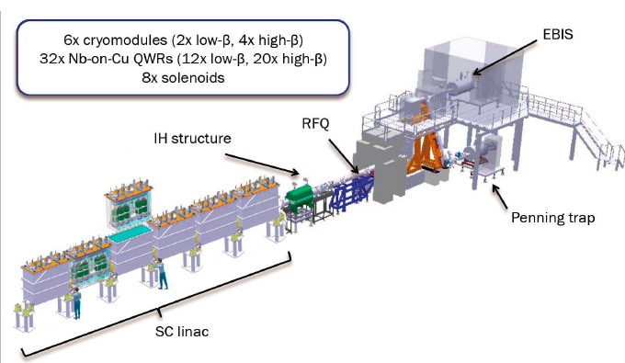
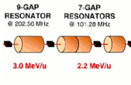
After LS2: increase RIB energy !
From 3.1 MeV/nucleon to 10 MeV/nucleon
add compact superconducting RF-cavities (SC-LINAC)
  4 cryomodules, each containing 5 RF cavities
a staged approach allows to have continued operation !
Realized by several CERN teams !
A/q =2.5 - 4.5
REX
4.3 MeV/u
A/Q = 4.3
2015 → first beam Oct. 2015
5.5 MeV/u
A/Q = 4.3
2016 → beams from sept. for physics
9.5 MeV/u
A/Q = 4.3
7.8 MeV/u
A/Q = 4.3
2017 → beams from july onwards
2018

Slide 15
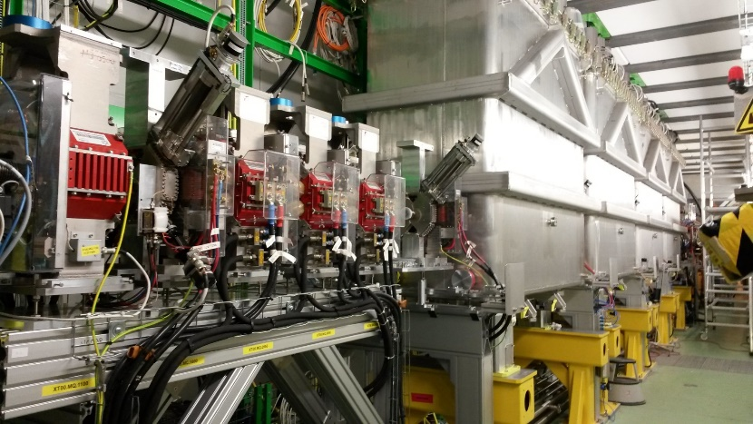
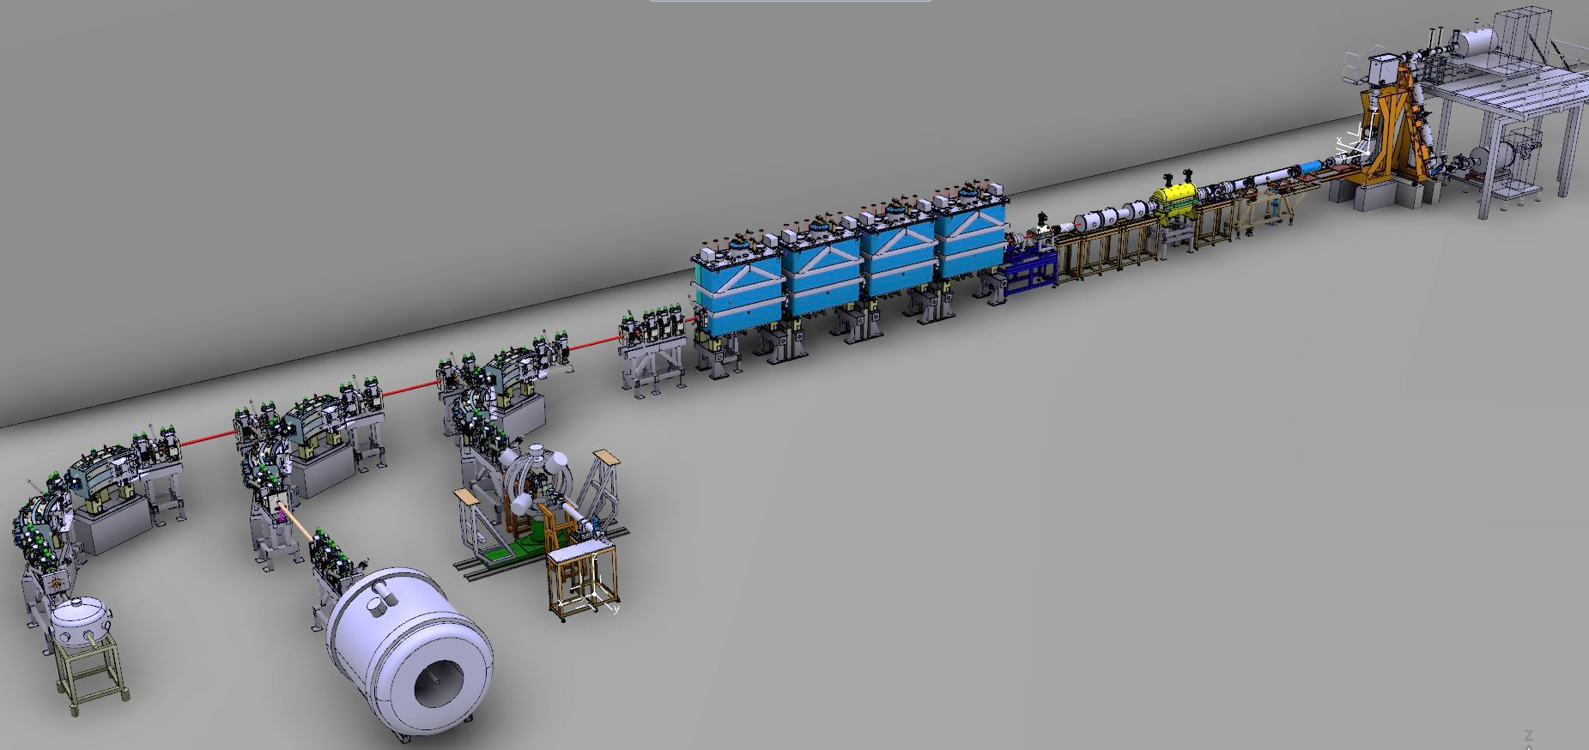
HIE-ISOLDE completed 2018
40-60 keV
RIB from ISOLDE
5 RF-cavities per cryomodule
REX TRAP & EBIS
1+ ➔ N+
REX NC LINAC
< 3.1 MeV/u
(2001-2012)
HIE SC LINAC
Miniball
(HPGe segmented detectors)
Added spring 2017
Added spring 2018
ISOLDE Solenoidal Spectrometer (ISS)
SEC +
movable
set-ups

Slide 16
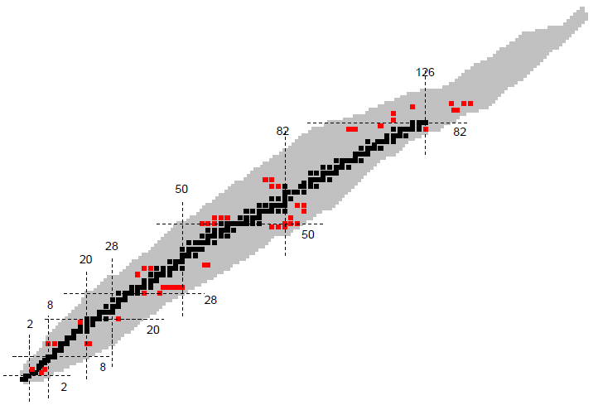
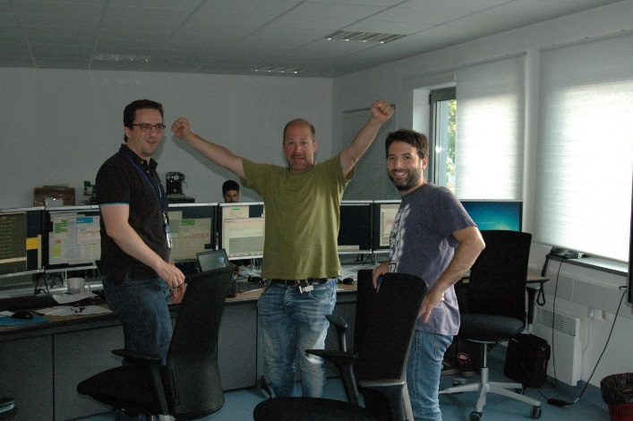
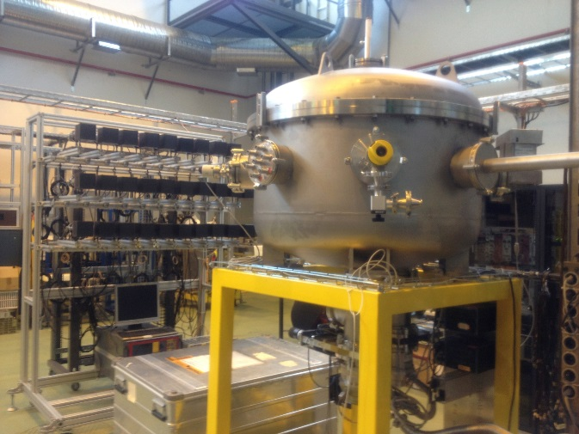
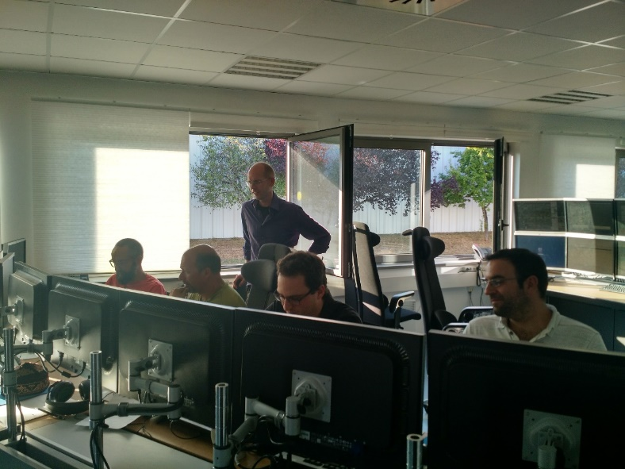
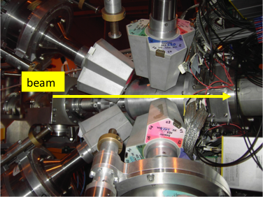

Radioactive beam physics after LS1
First radioactive beams on 9 September 2016 → ¹¹⁰Sn
Coulomb excitation of ⁷⁸Zn, ¹¹⁰Sn, ¹³²Sn, ¹⁴²Xe @ 5.5 MeV/u
Transfer reaction with ⁹Li beam @ 6.8 MeV/u
9 September 2016
SEC
MINIBALL
mgb@cern.ch
mgb@cern.ch
16

Slide 17
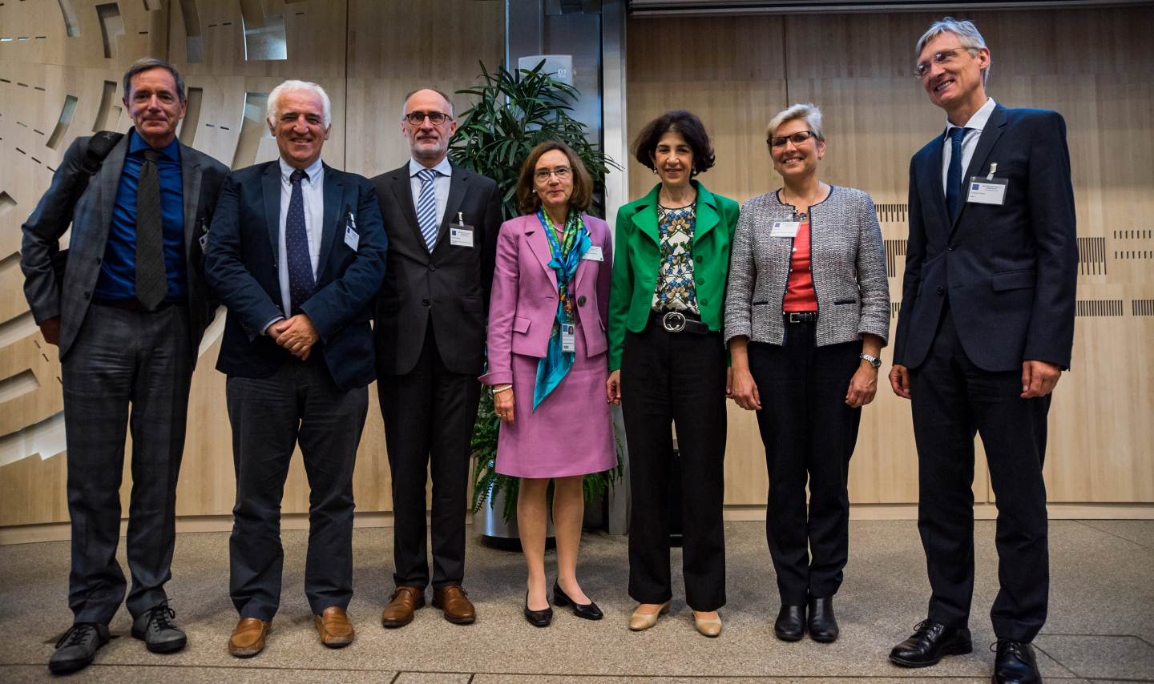
Radioactive beams @ 5.5 MeV/u
Celebration 28 September 2016

Slide 18
Operational situation in 2018
SRF cavity gradients operational during the 2018 campaign at 75 % of the nominal
Beam energies at 75% of nominal value
Reachable energies for beams with different A/q
J.A. Rodriguez – ISOLDE Workshop and Users Meeting – Dec. 7th 2018

Slide 19
Beam energies as function of isotope mass
Maximum energies for the 2018 accelerated beams
¹⁰⁶Sn²⁶⁺
¹³²Sn³¹⁺
²⁸Mg⁹⁺
²⁰⁶Hg⁴⁶⁺
Maximum energy for heavy beams limited to 7.4 MeV/u
Depends on charge state that can be produced in EBIS charge breeder
AFTER LS2 (repair of CM4 cavities): 8.2 MeV/u

Slide 20
Physics from REX-ISOLDE
2001-2012

Slide 21
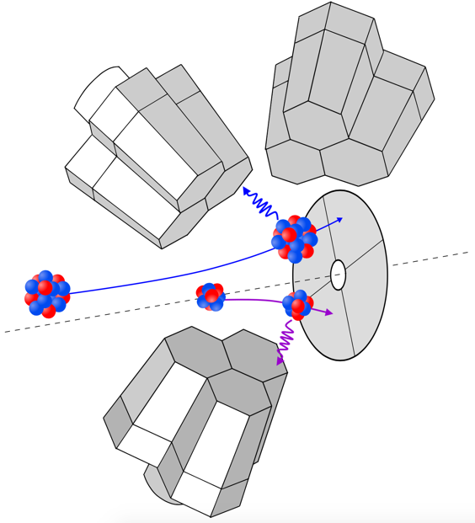
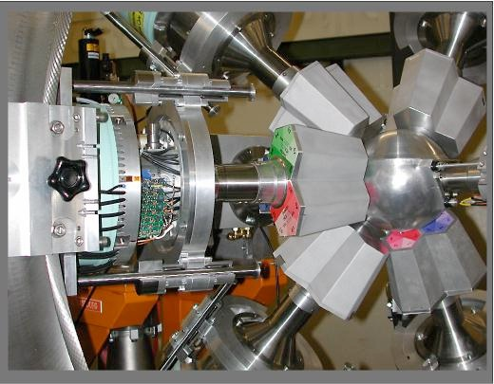
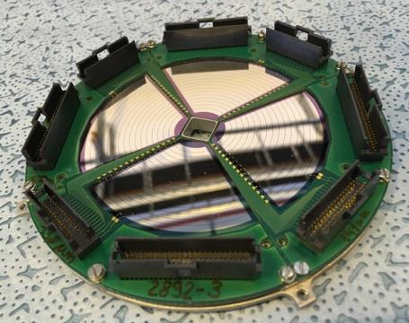
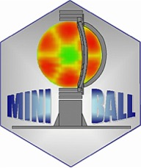
Experimental set-up: MINIBALL
(collaboration initiated 1998)
γ-detection:
Array of 8 HPGe triple clusters
6-fold electronic segmentation
ε > 7% for 1.3MeV γ-rays
+ 0˚ gas-Si ionisation chamber
Particle detection:
Particle ID in a Double-Sided Si Strip Detector (DSSSD).
Event-by-event Doppler correction of γ-energy
~20˚ < θlab < ~60˚
N. Warr et al., EPJ 49 (2013)

Slide 22
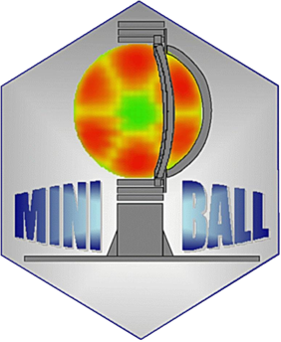
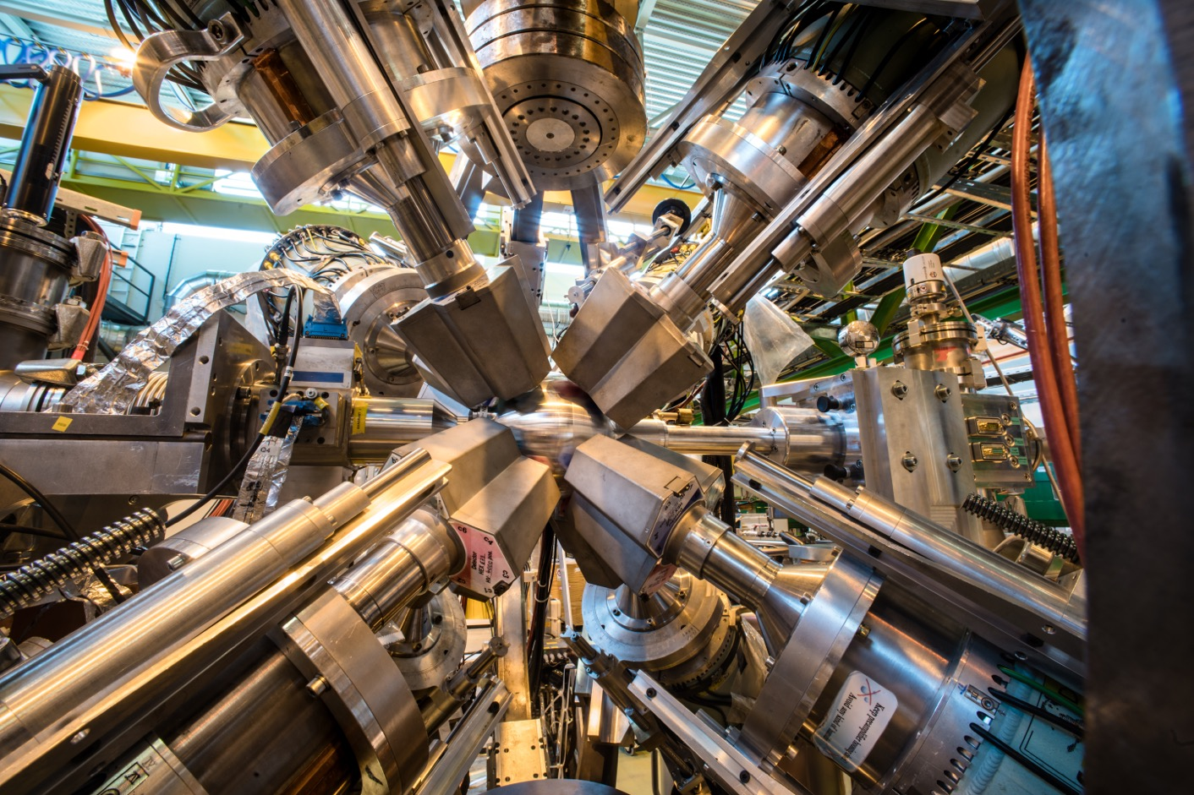

Miniball @ REX and HIE-ISOLDE

Slide 23
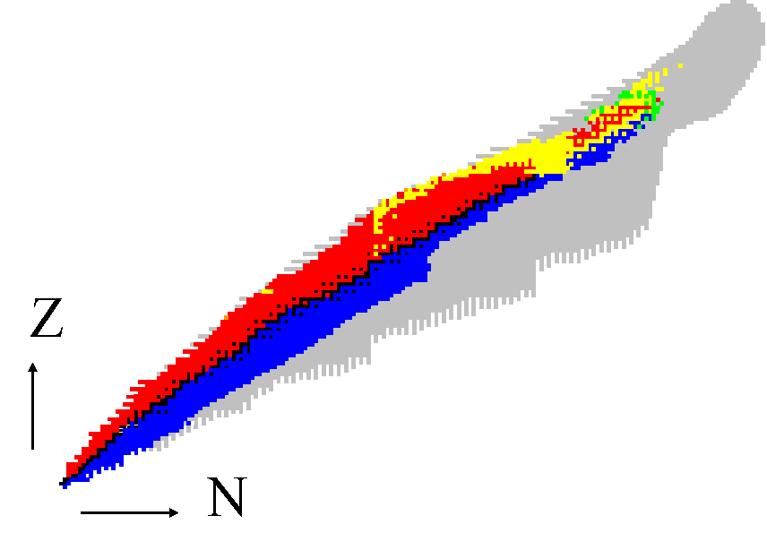
Coulomb excitation with beam up to 3.1 MeV/nucleon
A selection of publications and physics cases
^{184,186,188}Hg; Bree PRL (2014)
¹⁹⁶⁻²⁰²Po; Kesteloot PRC (2015)
^{202,204}Rn; Gaffney PRC (2015)
Probing shape coexistence
126
^{222,224}Ra^{; 220,222}Rn
Probing Pear Shape
Gaffney Nature 2013
82
¹¹⁰Sn; Cederkäll PRL 2007
^{106,108}Sn, Ekstrom PRL 2008
50
^{96,98}Sr, ⁸⁸Kr, ⁹²Kr Albers PRL 2012
Clement PRL 2016
50
^{122,124,126}Cd
^{138,140,142,144}Xe
^{140,148,150}Ba
20
28
Evolution of collectivity around ¹³² Sn
8
⁷⁰Se Hurst PRL 2007, Shape coexistence
28
^{74,76,78,80}Zn Probing large scale shell model, Van de Walle, PRL 2007
20
8
^{67,69,71,73}Cu, Stefanescu PRL 2008
^{68,70}Cu, Isomeric ⁶⁸Cu, Stefanescu PRL 2007
^{30,31,32}Mg, Niedermaier PRL2005
Island of inversion
NEED UP TO 5 MeV/u TO BE MORE SENSITIVE

Slide 24
Search for pear-shaped nuclei
Octupole deformation
λ=2
➔ Look for enhanced Octupole Excitation probability
λ=2

Slide 25

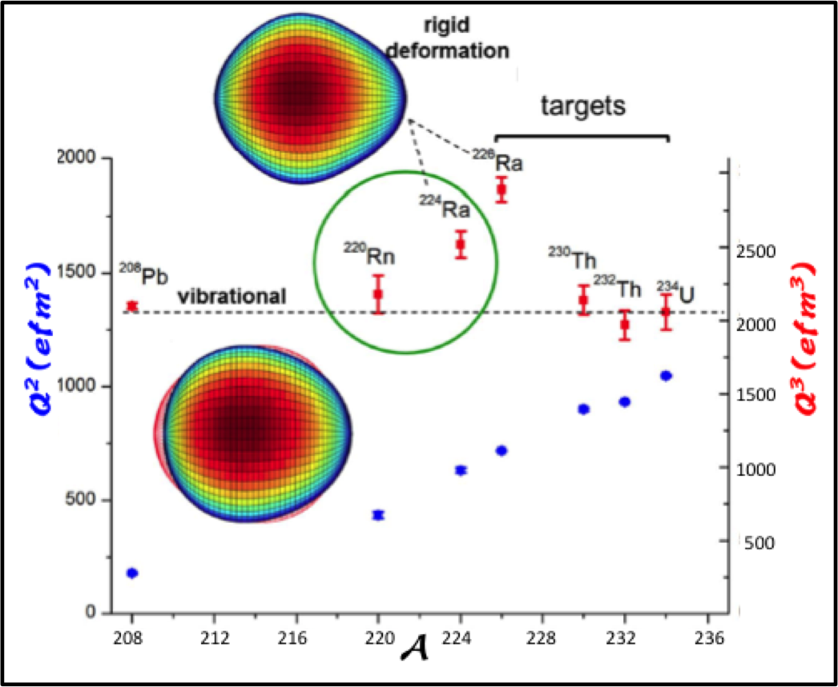
Search for pear-shaped nuclei
L. P. Gaffney, et al. (2013). Nature, 497(7448), 199–204.
Octupole deformation
λ = 2
²²⁴Ra and ²²⁶Ra are octupole deformed (=pear shaped)
→ Ideal nuclei to search for Physics Beyond Standard Model
λ = 2

Slide 26
Coulomb excitation of ‘isomeric’ beams
Physical Review Letters 98, 122701 (2007)
Unique at ISOLDE: RILIS + REX ➔produce pure beams of different long-lived states in nuclei
Two ⁶⁸Cu beams (1+ and 6-) at 2.83 MeV/nucleon
Study structure and collectivity of different long-lived states independently

Slide 27
Physics from HIE-ISOLDE
(2016-2018)
The new energy window (up to 9.5 MeV/nucleon) gives the opportunity to address new physics questions
35 Experiments approved during LS1
Isospin symmetry
Magic numbers far from stability
Collectivity versus Single Particle
Shape Coexistence
Quadrupole and Octupole degrees of freedom
Reaction for nucleosynthesis studies

Slide 28
First Radioactive beam in 2015 @ 4 MeV/u
Repeat Coulomb excitation of ⁷⁴Zn at higher energy.
4⁺
Factor of more than 3 gain in sensitivity !
Excitation to higher energies more probable !
816 keV
2⁺
602 keV
0⁺
⁷⁴Zn
HIE – 5 hours
REX – 16 hours

Slide 29
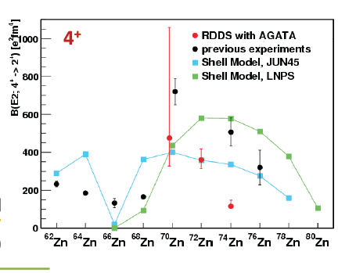
First HIE-ISOLDE beams in 2015 @ 4 MeV/u
Repeat Coulomb excitation of ⁷⁴Zn and ⁷⁶Zn studied at higher energy.
(REX)
Large disagreement for ⁷⁴Zn B(E2) between lifetime measurements (Legnaro) and Coulomb excitation (REX-ISOLDE)
→ Van de Walle PRC79 (2009) 014309 (REX)
→ Louchart PRC87 (2013) 054302 (AGATA)

Slide 30
Status in 2017
Coulomb excitation measurements confirmed (REX and HIE-ISOLDE)!
Lifetime measurements using AGATA also confirmed (Legnaro and GANIL)
Lifetime measurements and Coulomb Excitation give different results
➔ Still under investigation !

Slide 31
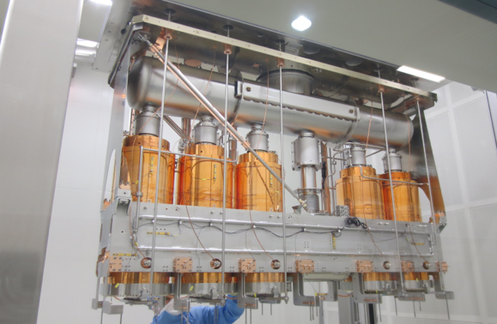
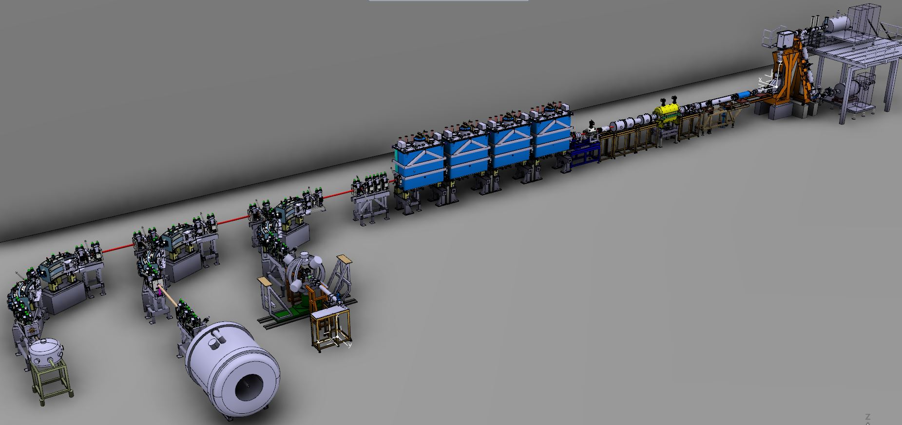

HIE-ISOLDE Phase 1 (2016)
5.4 MeV/u
X
X
Phase 1 - 2015/16
Coulomb excitation:
^{74,76,78}Zn (KU Leuven)
¹⁴²Xe (Darmstadt)
¹¹⁰Sn (Lund)
¹³²Sn (Köln)
Miniball
X
Reactions:
⁶⁶Ni(d,p) (Oslo/iThemba)
⁹Li(t,p) (Aarhus) @ SEC
Moveable Setups (SEC)
31

Slide 32

HIE-ISOLDE Phase 2a (2017)
Reactions:
⁹⁴Rb(²⁰⁸Pb) MNT (Legnaro/Zagreb)
¹⁵C(²⁰⁸Pb) Elastic (Huelva)
⁹Li(t,p) (Aarhus)
⁵⁹Cu(p,α) (Edinburgh)
X
Commissioning:
¹⁴N to ISS
Phase 2a – 2017
Coulomb excitation:
⁷²Se (Surrey)
⁷⁰Se/⁶⁶Ge (Western Cape)
^{142,144}Ba (Paisley/Liverpool)
¹⁴⁰Sm (Oslo)
¹⁴⁰Nd (Darmstadt/Sofia)
¹⁰⁸Sn (Lund)
²⁰⁶Hg (Surrey)
Miniball
Moveable Setups (SEC)
Moments:
²⁸Mg g-factor (Orsay)
32

Slide 33
HIE-ISOLDE Phase 2b (2018)
Coulomb excitation (Miniball):
⁹⁶Kr @ 5.325 MeV/u
²¹²Rn @ 4.355 MeV/u
    @ 3.824 MeV/u
²²²Ra @ 4.305 MeV/u
²²⁸Ra @ 4.310 MeV/u
¹⁴²Ba @ 4.190 MeV/u
²²²Rn @ 4.230 MeV/u
^{224,226}Rn @ 5.080 MeV/u
¹⁰⁶Sn @ 4.404 MeV/u
Phase 2b – 2018
Reactions:
⁸B(⁶⁴Zn) @ 4.900 MeV/u (SEC)
⁷Be(d,p) @ 5.000 MeV/u (SEC)
⁹Li(t,p) @ 8.000 MeV/u (SEC)
¹¹Be(decay) @ 7.498 MeV/u (SEC-TPC)
^{132,134}Sn(d,p) @ 7.200 MeV/u (Miniball+T-REX)
²⁸Mg(t,p) @ 9.473 MeV/u (Miniball+T-REX)
²⁸Mg(d,p) @ 9.473 MeV/u (ISS)
²⁰⁶Hg(d,p) @ 7.380 MeV/u (ISS)
Miniball
Moveable Setups (SEC)
33

Slide 34
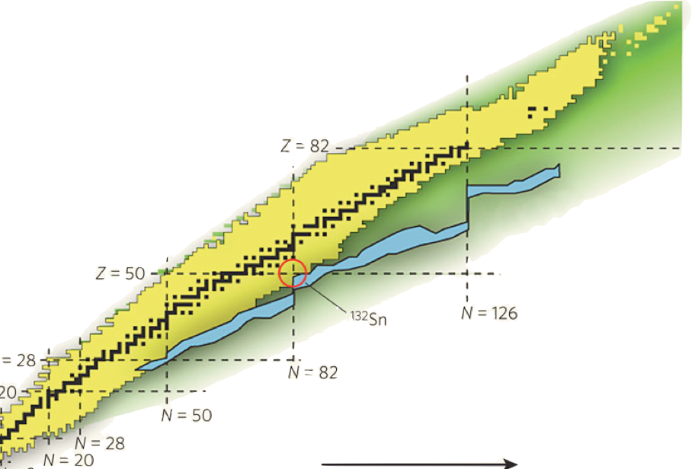



A selection of physics (2016-2018)
¹³²Sn – IS551
r-process /
doubly-magic nuclei
²²⁰Ra – ²²⁸Ra
²²²⁻²²⁴Rn
Octupole collectivity and pear shapes
²⁸Mg(t,p) – IS651/IS628
Island of Inversion
²⁰⁶Hg(d,p) – IS631
²⁰⁶Hg – IS547
terra incognita
Doubly-magic nuclei
A very small sample for today
⁹⁶Kr – IS644
Shape coexistence

Slide 35
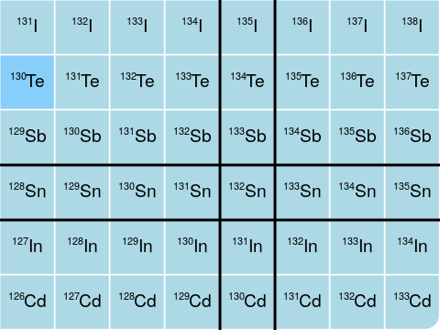

1st HIE-ISOLDE publication: ¹³²Sn
D. Rosiak et al., Phys. Rev. Lett. 121, 252501 (2018).
132Sn: a doubly-magic nucleus on the r-process path ?
Z=50, N=82
Single-particle properties:
G. Bocchi et al.
PLB 760
(2016) 273-278
R. L. Kozub et al.
PRL 109, 172-177
(October 2012)
K. L. Jones et al.
Nature 465, 430-431
(27 May 2010)
M. Gorska et al.
PLB 672,
(2009) 313-316,
Coulomb excitation of ¹³²Sn:
How easily can it be excited ??

Slide 36

Excitation probability of ¹³²Sn
Molecular ISOLDE beam: ¹³²Sn³⁴S⁺, 50 keV
HIE-ISOLDE beam: ¹³²Sn³¹⁺ @ 5.49 MeV/u
Total RIB intensity: ~3.0 x 10⁵ ions/s
‘safe’ scattering angles: lab = 17.8 - 41.5°
Beam composition: ¹³²Sn, ¹³²Sb, ¹³²Ba, ¹⁶⁶Yb
γ-counts
keV
¹³²Sn
First high-precision measurements of excitation probability !
¹³²Sn is doubly magic and spherical
D. Rosiak et al., Phys. Rev. Lett. 121, 252501 (2018).

Slide 37
Terra Incognita investigated with ISS
Study excited states in ²⁰⁷Hg for the first time using Transfer Reaction
Beam: ²⁰⁶Hg, 7.4 MeV/nucleon (max available)
208Pb

Slide 38

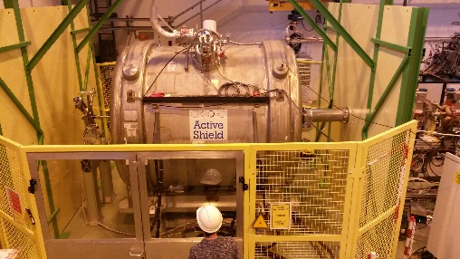
ISOLDE Solenoidal Spectrometer
4T superconducting (former MRI) solenoid from UQ hospital, Brisbane to ISOLDE in 2017
Helical orbit spectrometer principle
Target on the field axis + array of Si detectors.
MEASURE: position z, cyclotron period T_{cyc} and energy E_{p} of emitted protons from transfer reaction
Suffers no kinematic compression of the Q-value spectrum.
Linear relationship between E_{cm} and E_{lab}
4T solenoid

Slide 39
How strong is the neutron bound to ²⁰⁶Hg ?
B. Kay et al., Physical Review Letters (2020)
²⁰⁶Hg (1.52 GeV) + d → ²⁰⁷Hg + p
(d,p)
Excited levels in ²⁰⁷Hg
²⁰⁶Hg
(3/2⁺)
Proton counts
(5/2⁺)
9/2⁺
N=126
νg_{9/2}
(1/2⁺)
(7/2⁺)
Proton Energy (MeV)
The first excited state is seen at 1.2 MeV
But: a state around 700 keV is expected (11/2+)
Need 10 MeV/u (2.06 GeV) to populate this level !

Slide 40
Ben Kay et al.
Paper accepted in Physical Review Letters
5.10⁵ ²⁰⁶Hg/s
7.4 MeV/u
(purity > 98 %)
30 deuterated polyethylene targets (165 mg/cm2)
(to deal with target degradation)
Special target ladder (automatic moving)

Slide 41
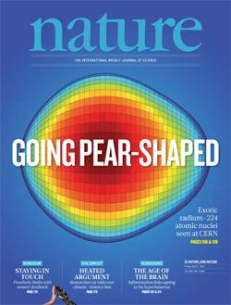
Pear shapes and vibrating pears
REX-ISOLDE, 3.1 MeV/u
^{224,226}Ra
L.P. Gaffney, P.A. Butler et al.
Nature 479, May 2013
HIE-ISOLDE, 5 MeV/u
P.A. Butler, L.P. Gaffney et al.
Nature Communications, June 2019
Butler, Gaffney et al.,
Phys. Rev. Lett. 124, 042503 (2020)
Static octupole deformation:
Δi_{x} = 0 ➔ ^{222,224,226}Ra isotopes !
Octupole vibrators:
Δi_{x} =3 ➔ ^{218,220,222,224}Rn isotopes !

Slide 42
Outlook to the future

Slide 43
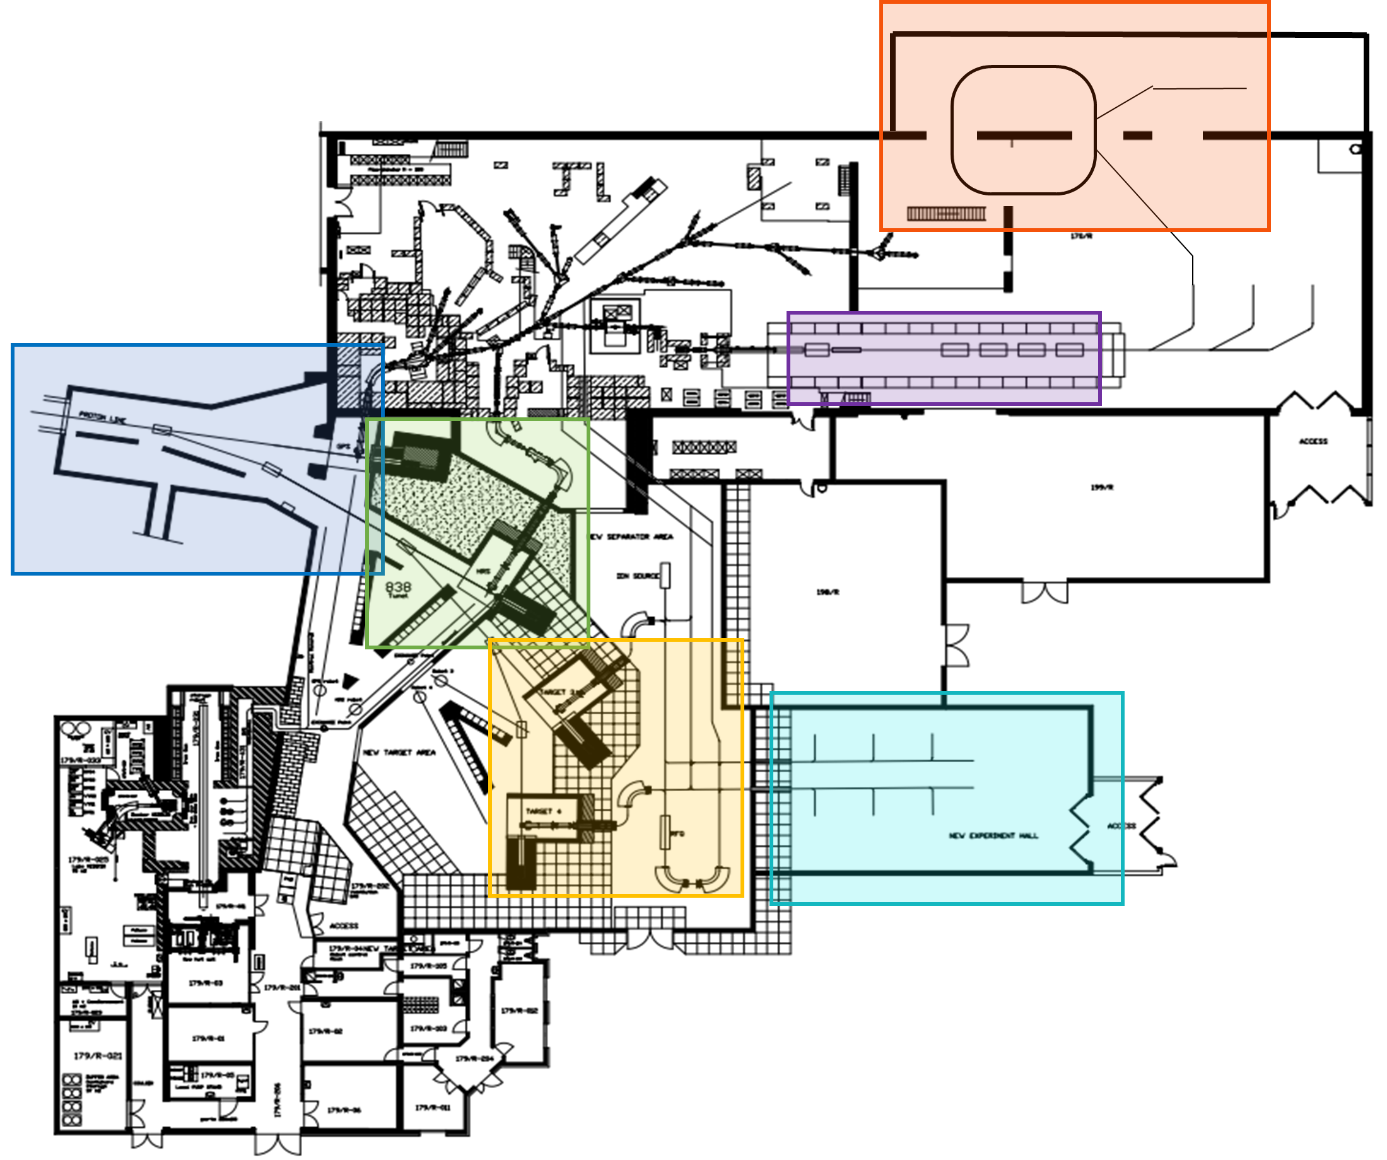
The EPIC Project: Exploiting the Potential of ISOLDE at CERN
Layout of an extended ISOLDE (colors are new/upgrades) :
protons
The EPIC project comprises of 6 key upgrades (in no particular order):
The addition of two new target stations and a high resolution mass separator
Improvement of the existing beam dumps
Provide 2 GeV protons to ISOLDE
The addition of a second experimental hall
Installation of a storage ring beyond the HIE-ISOLDE post accelerator
An upgrade of the non-superconducting part of HIE-ISOLDE (REX-part)

Slide 44
New opportunities with EPIC@CERN
for the (European) (Nuclear) Physics Community
Upgrade of the HIE-ISOLDE pre-accelerator (REX)
  higher A/Q (up to 5.5) so more intense heavy beams, with a variable time structure and up to 10 MeV/u also for those around Pb.
Higher RIB beam intensities (gain factor 2 to 50)
  thanks to the LHC intensity upgrades (LIU) at CERN
    Higher proton beam intensity from booster (from 2 → 4 μA)
    Higher proton beam energy (from 1.4 → 2 GeV) from booster
Two new (additional) target stations + a new low-energy hall
  Have multiple simultaneous RIB’s for users (low/high energy)
Improved mass separation capabilities
  Purer beams are better for efficient reacceleration
A new storage ring for short-lived, light and heavy ions
  New perspectives for precision studies in nuclear, atomic and astrophysics

Slide 45
Conclusions
ISOLDE now provides slow and accelerated RIB’s (up to ~ 9.5 MeV/u) for more than a dozen permanent experiments
(and a few travelling setups) for studying:
  Nuclear physics
  Nuclear astrophysics
  Solid state physics
  Bio-physics
  Fundamental interactions and symmetries
Future upgrades are under discussion in the framework of
the EPIC Project (Exploiting the Potential of ISOLDE @ CERN)

Slide 46



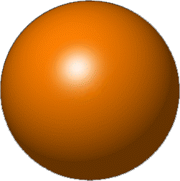
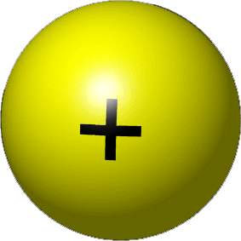


Why to study exotic nuclei ?
the nucleus = interplay between 3 of the 4 basic forces in nature
* electromagnetic force (charged protons repel each other)
* strong force (keeps protons and neutrons bound in the nucleus,
determines the nuclear properties)
* weak force (responsible for radioactive decay)
THE STANDARD MODEL: Unification of Electromagnetic, Strong and Weak force
→ 25 elementary particles (quarks, leptons, intermediate bosons, …) !
→ describes very well the sub-nuclear world!
→ quark-gluon, protons, neutrons, …
NUCLEAR MODELS
to go from the interaction between two nucleons
to interactions between several (up to few hundred) of nucleons
→ a universal model does not (yet) exist !!!

Slide 47
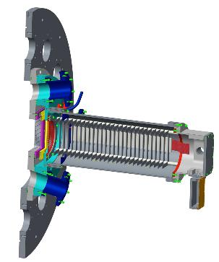
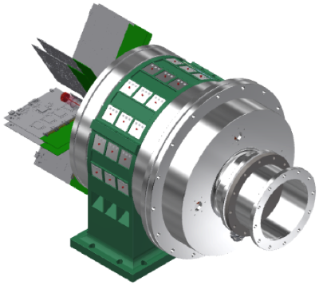
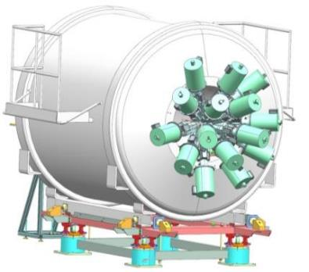
Future ISS developments
University of Manchester
New array (Liverpool)
New fast-counting ionisation chamber to be constructed at The University of Manchester 2019/20.
  Up to 100 kHz counting.
  Segmented with digital readout
  Sample dE/dx along track of recoils.
SpecMat – time projection chamber with gamma-ray detection.
Germanium spectrometer tests in the solenoid field. Design full array at back of ISS.
KU Leuven
University of Padova

Slide 48
Nuclear astrophysics – IS607
⁵⁹Cu(p,α) – Implications for nucleosynthesis in core collapse supernovae
Key importance for light curve from X-ray bursts.
  T-dependence
  Competition with ⁵⁹Cu(p,γ)
Thanks to Claudia Lederer-Woods and Ruchi Garg

