Slide 1
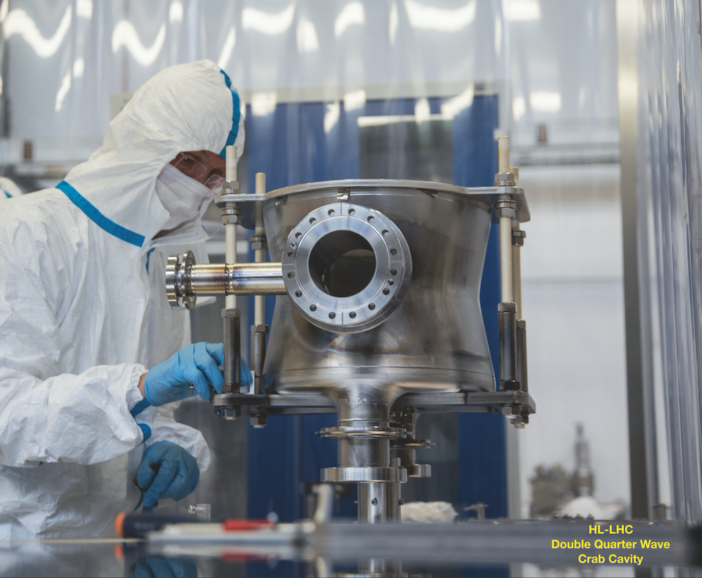

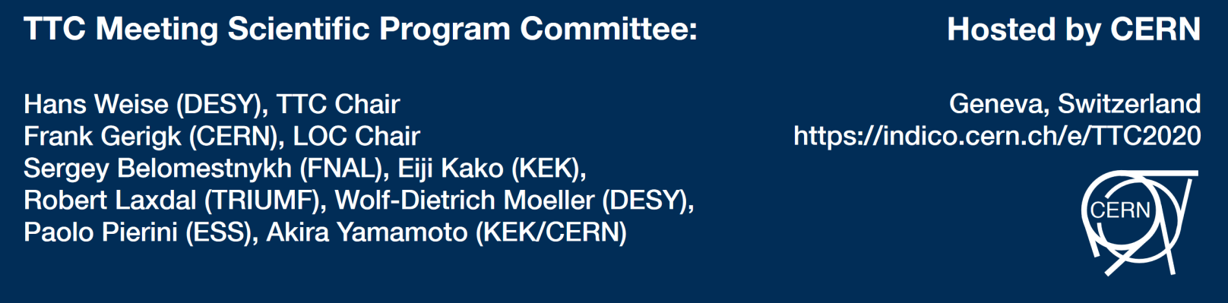

Collaboration Board – Short Report
Hans Weise, DESY
February 7th, 2020
Notes:
How to edit the title slide
Upper area: Title of your talk, max. 2 rows of the defined size (55 pt)
Lower area (subtitle): Conference/meeting/workshop, location, date,
your name and affiliation,
max. 4 rows of the defined size (32 pt)
Change the partner logos or add others in the last row.

Slide 2
The mission of the TESLA Technology Collaboration
The mission of the TESLA Technology Collaboration is
to advance SRF technology R&D and related accelerator studies across the broad diversity of scientific applications, and
to keep open and provide a bridge for communication and sharing of ideas, developments, and testing across associated projects.
To this end the Collaboration supports and encourages free and open exchange of scientific and technical knowledge, expertise, engineering designs, and equipment.
The TTC organizes regular collaboration meetings where new developments are reported, recent findings are discussed and technical issues are concluded. This time, TTC meeting is hosted by CERN on 04 - 07 February 2020.

Slide 3
Agenda
Approval of the minutes of the Vancouver CB meeting
Short Reports on TTC WGs and esp. topical meetings
The procedure for selecting the TTC Chair was meanwhile documented with the help of the chair of the last selection procedure. The CB and its Chair will act accordingly. The next selection process requires CB actions in summer 2020.
We appreciated the application of QST/Rokkasho for TTC Membership. Keitaro Kondo-san described the lab in a short presentation. There was unanimous agreement during voting. We welcome QST / Rokkasho.
Rokkasho was picked as the TTC Workshop host for summer 2020. We confirmed the meeting in Aomori, Japan, June 30 til July 3, 2020.
The First International TESLA Workshop was held July 23 – 26, 1990 at Cornell. This summer we can celebrate the success of the TESLA Technology based on 30 years of workshops of the TESLA (Technology) Collaboration.

Slide 4
Short Reports on TTC WGs and esp. topical meetings
  High Q / High G – Ari summarized the progress since the last meeting – in general the working group is useful but more engagement from labs outside the USA would make the WG more effective. JLAB and FNAL are the most active presently.
  Thin films – there was a discussion on whether we need to specifically promote this technology since it is already a conference series – Frank Gerigk will reinitialize a call for a TTC lead communication forum to gauge the interest.
  Topical meetings
    LLRF – this is already covered under the LLRF global series
    Cornell is hosting a Nb3Sn topical workshop in early 2020 – we will aim for a report at the next TTC
    TTC Topical Workshop on SRF Linac Operation, Experience and Improvements

Slide 5
TTC Topical Workshop on SRF Linac Operation, Experience and Improvements
Early November, 2020 – hosted by Jefferson Lab, Newport News, VA, USA - Duration: Three days
Objective
Bring operational experts, scientists and engineers together to discuss existing issues with installed SRF linacs. Characterize SRF system operation limiting factors and its interlay with other systems such as cryogenic system and vacuum system etc. Exchange experiences in SRF linac performance optimization and up-time improvement. Identify opportunities in SRF system design advancement for high RAMI performance of next SRF linacs.
Topics
Design gradient margins and preservation of initial installed gradients
In situ processing techniques for cavity gradient and Q0 recovery
Gradient maintenance methodology and techniques (spares or re-furbish)
Low particulate cryomodule beamline interface installation
Operational feedback for new cryomodule/cavity designs
Maintaining vacuum integrity around high gradient CMs
Beamline vacuum incident, impact, recovery and prevention
Field emission turn on, prevention and recovery.
Cool down/Warm up speed and durations.
Vacuum seals

Slide 6
Agenda
Approval of the minutes of the Vancouver CB meeting
Short Reports on TTC WGs and esp. topical meetings
The procedure for selecting the TTC Chair was meanwhile documented with the help of the chair of the last selection procedure. The CB and its Chair will act accordingly. The next selection process requires CB actions in summer 2020.
We appreciated the application of QST/Rokkasho for TTC Membership. Keitaro Kondo-san described the lab in a short presentation. There was unanimous agreement during voting. We welcome QST / Rokkasho.
Rokkasho was picked as the TTC Workshop host for summer 2020. We confirmed the meeting in Aomori, Japan, June 30 til July 3, 2020.
The First International TESLA Workshop was held July 23 – 26, 1990 at Cornell. This summer we can celebrate the success of the TESLA Technology based on 30 years of workshops of the TESLA (Technology) Collaboration.

Slide 7
Agenda
Approval of the minutes of the Vancouver CB meeting
Short Reports on TTC WGs and esp. topical meetings
The procedure for selecting the TTC Chair was meanwhile documented with the help of the chair of the last selection procedure. The CB and its Chair will act accordingly. The next selection process requires CB actions in summer 2020.
We appreciated the application of QST/Rokkasho for TTC Membership. Keitaro Kondo-san described the lab in a short presentation. There was unanimous agreement during voting. We welcome QST / Rokkasho.
Rokkasho was picked as the TTC Workshop host for summer 2020. We confirmed the meeting in Aomori, Japan, June 30 til July 3, 2020.
The First International TESLA Workshop was held July 23 – 26, 1990 at Cornell. This summer we can celebrate the success of the TESLA Technology based on 30 years of workshops of the TESLA (Technology) Collaboration.

Slide 8
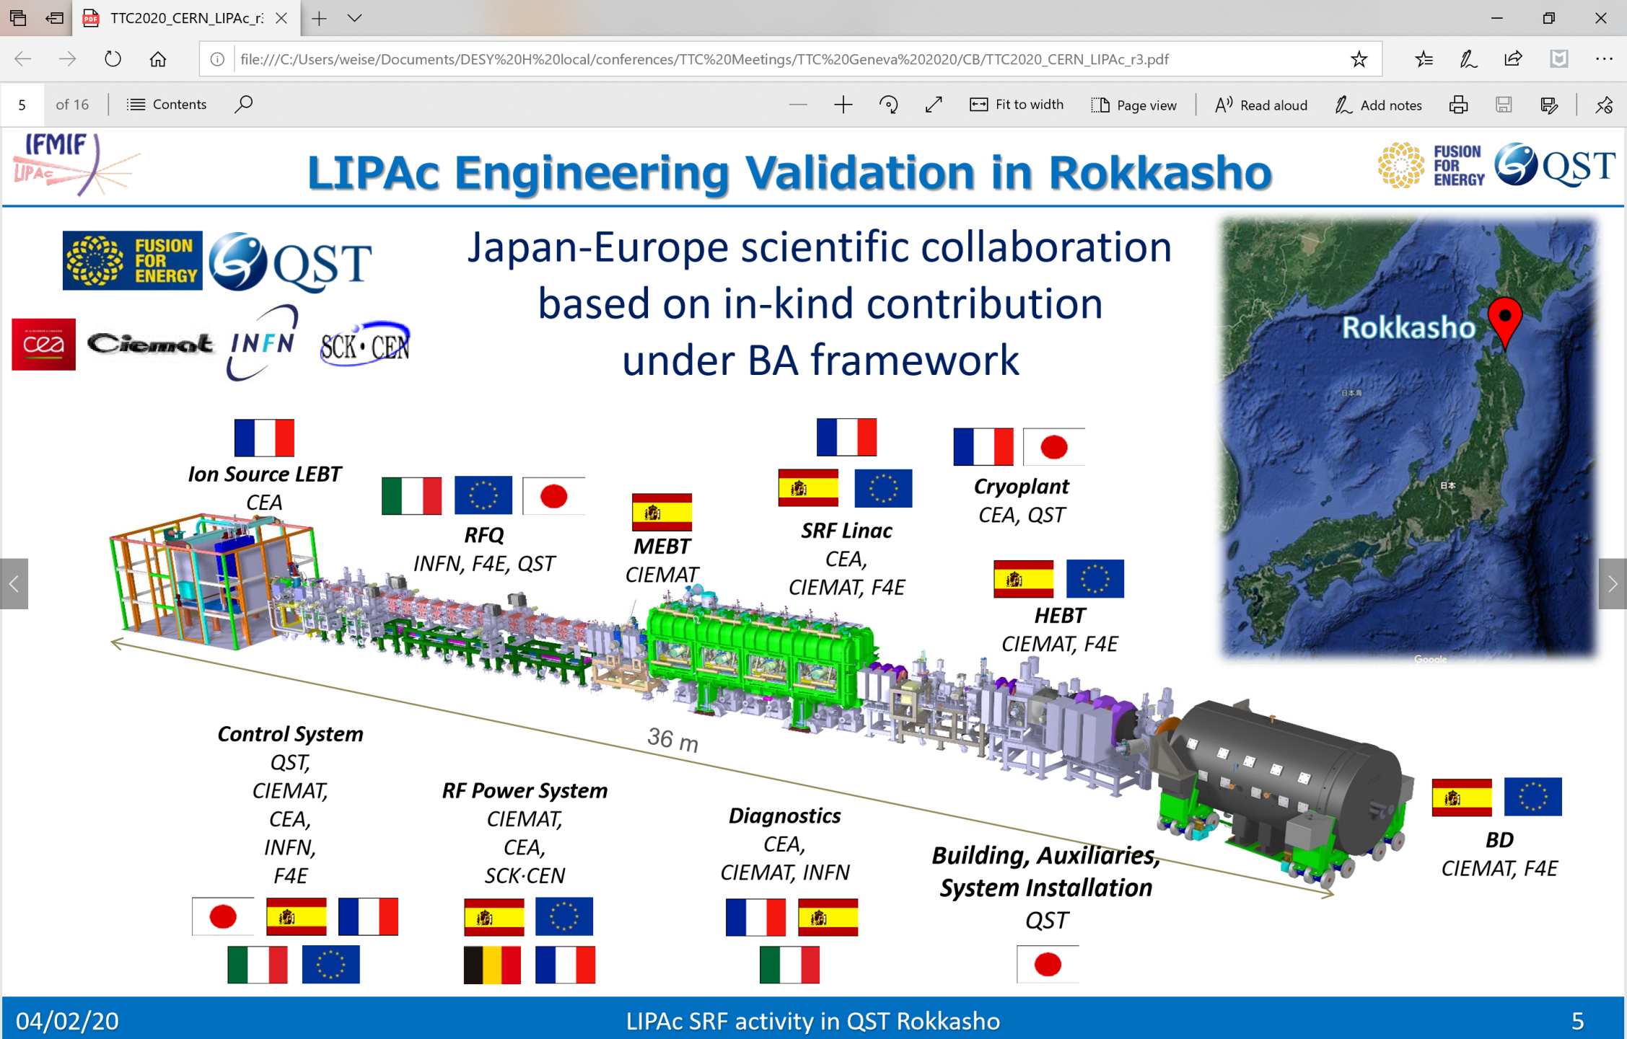

Slide 9
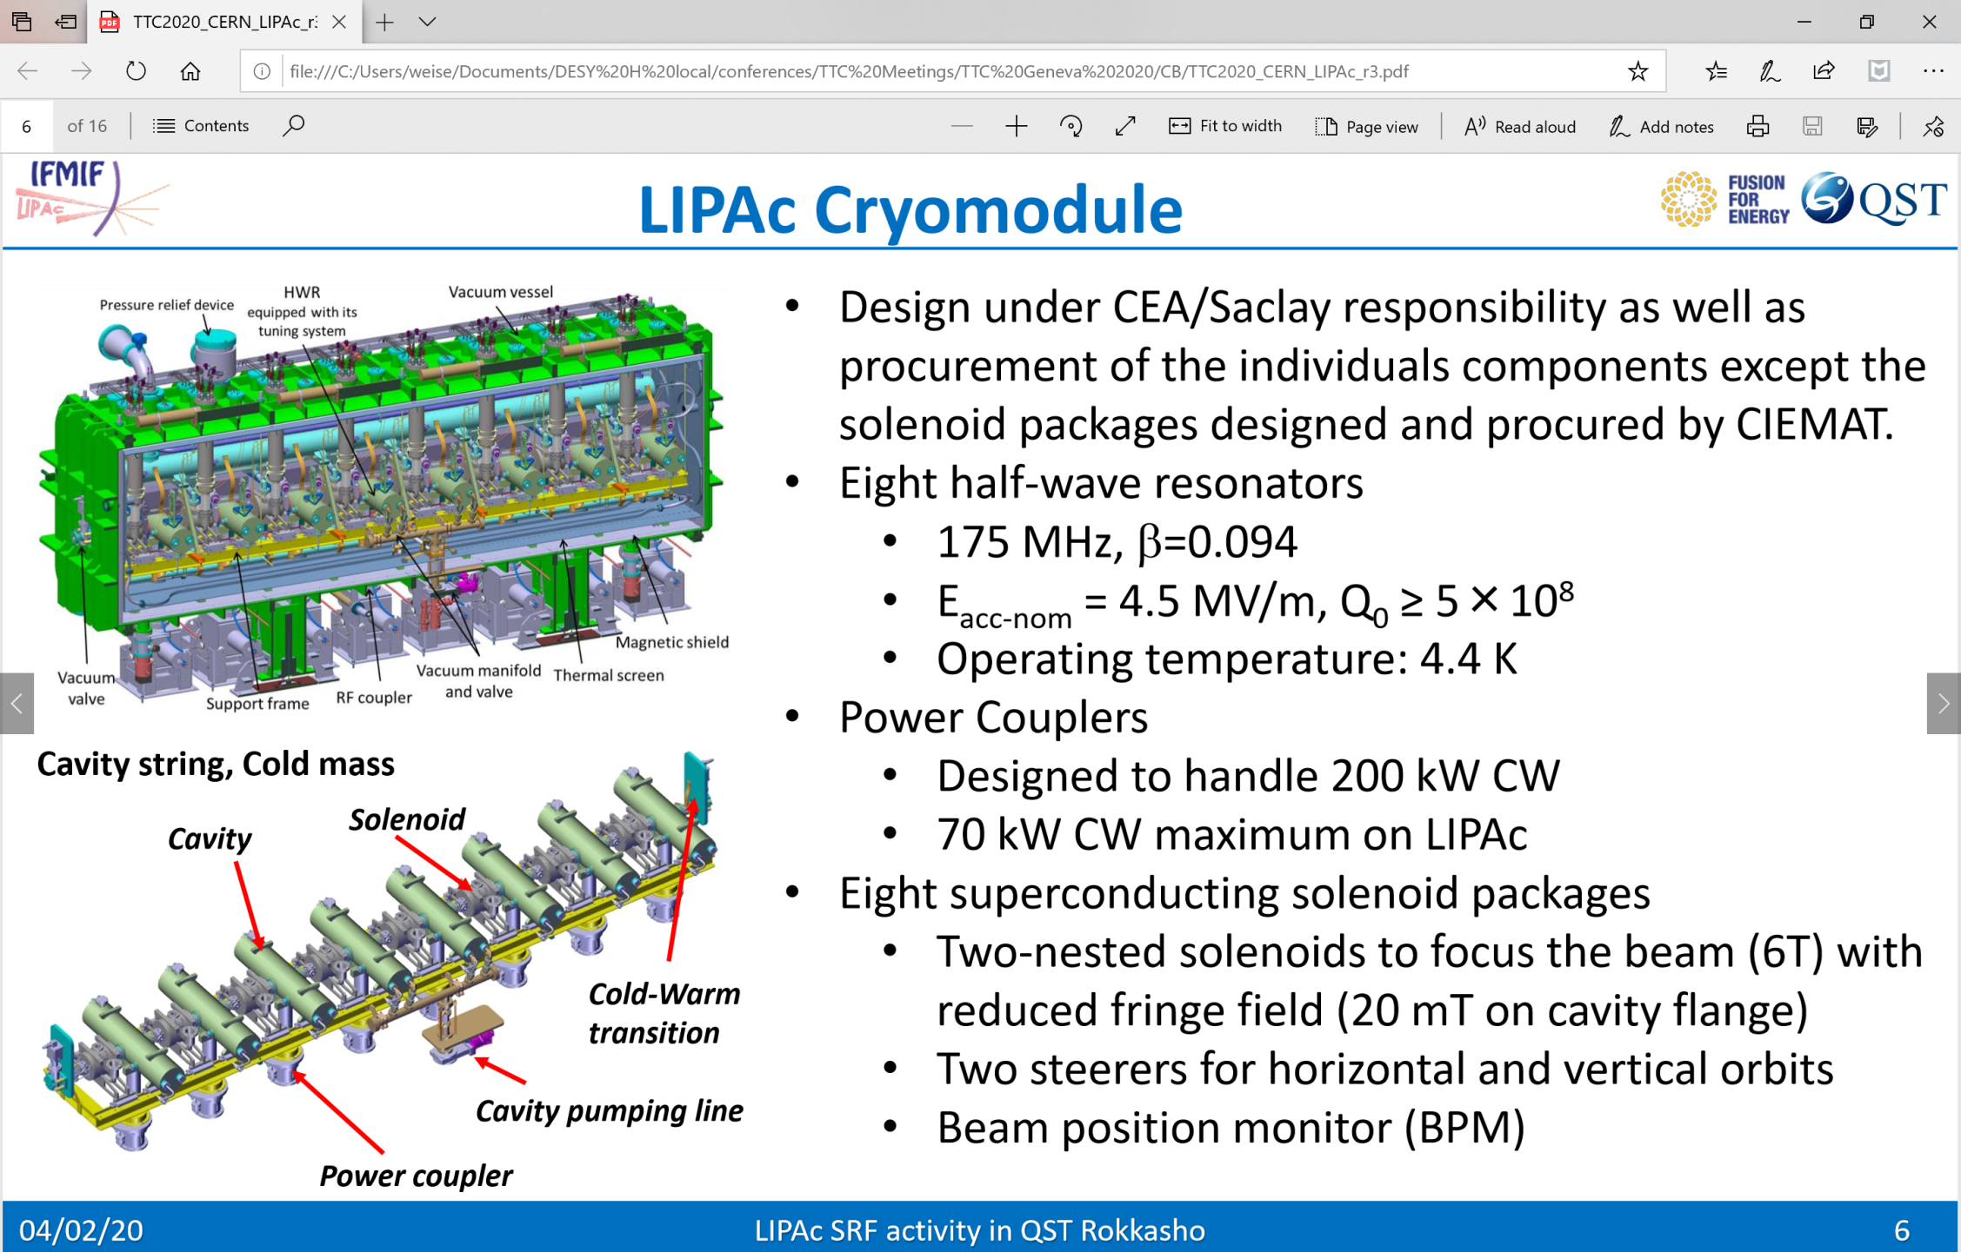

Slide 10
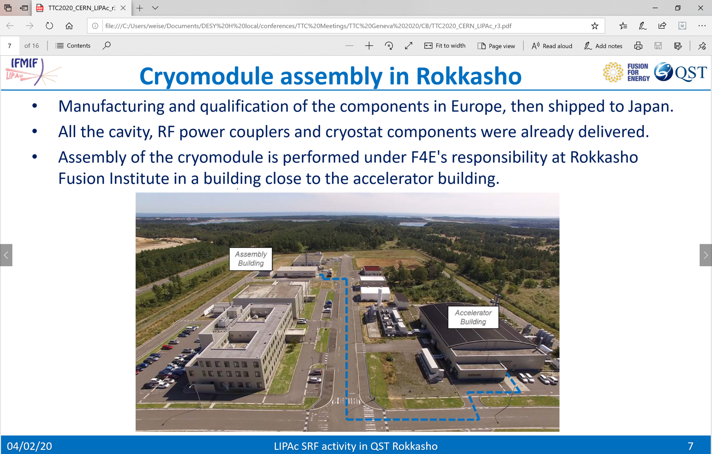

Slide 11
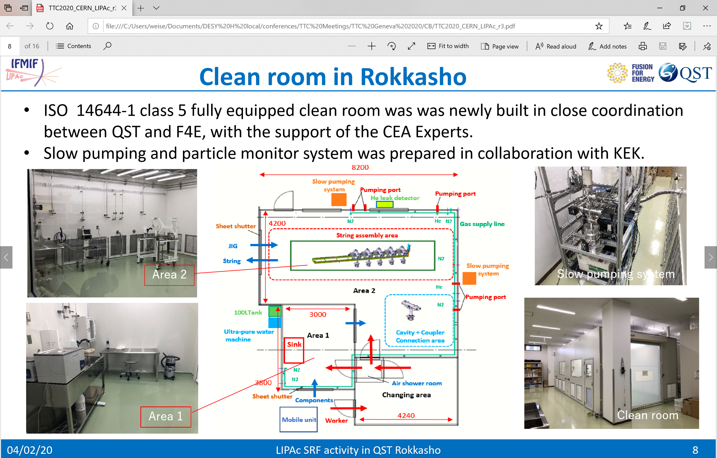

Slide 12
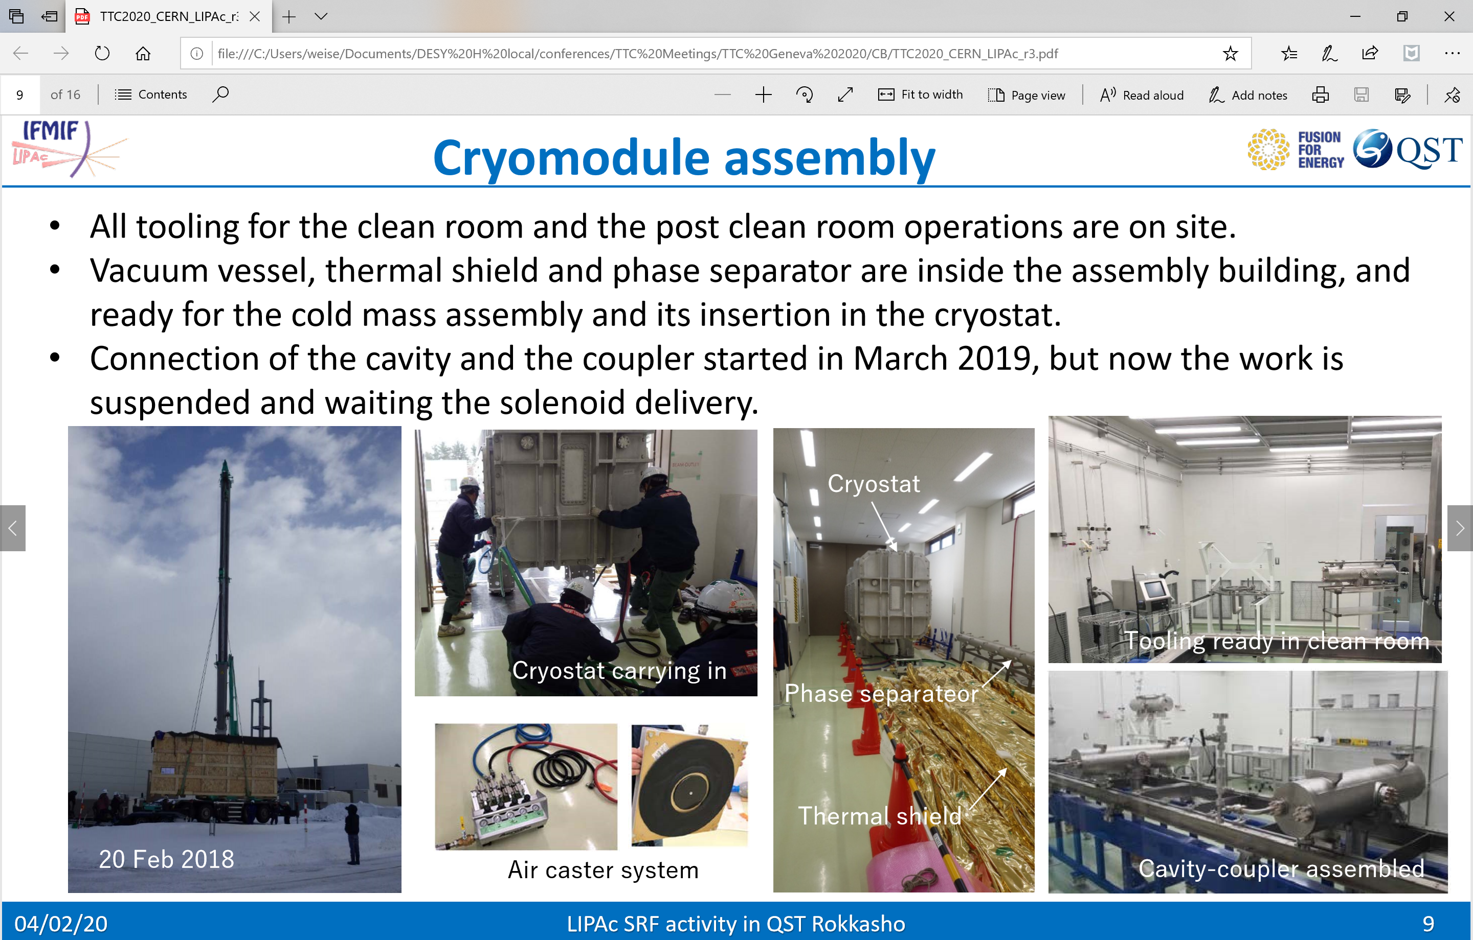

Slide 13
Agenda
Approval of the minutes of the Vancouver CB meeting
Short Reports on TTC WGs and esp. topical meetings
The procedure for selecting the TTC Chair was meanwhile documented with the help of the chair of the last selection procedure. The CB and its Chair will act accordingly. The next selection process requires CB actions in summer 2020.
We appreciated the application of QST/Rokkasho for TTC Membership. Keitaro Kondo-san described the lab in a short presentation. There was unanimous agreement during voting. We welcome QST / Rokkasho.
Rokkasho was picked as the TTC Workshop host for summer 2020. We confirmed the meeting in Aomori, Japan, June 30 til July 3, 2020.
The First International TESLA Workshop was held July 23 – 26, 1990 at Cornell. This summer we can celebrate the success of the TESLA Technology based on 30 years of workshops of the TESLA (Technology) Collaboration.

Slide 14
Agenda
Approval of the minutes of the Vancouver CB meeting
Short Reports on TTC WGs and esp. topical meetings
The procedure for selecting the TTC Chair was meanwhile documented with the help of the chair of the last selection procedure. The CB and its Chair will act accordingly. The next selection process requires CB actions in summer 2020.
We appreciated the application of QST/Rokkasho for TTC Membership. Keitaro Kondo-san described the lab in a short presentation. There was unanimous agreement during voting. We welcome QST / Rokkasho.
Rokkasho was picked as the TTC Workshop host for summer 2020. We confirmed the meeting in Aomori, Japan, June 30 til July 3, 2020.
The First International TESLA Workshop was held July 23 – 26, 1990 at Cornell. This summer we can celebrate the success of the TESLA Technology based on 30 years of workshops of the TESLA (Technology) Collaboration.

Slide 15
30 years of TESLA / TTC Meetings
  The First International TESLA Workshop was held July 23 – 26, 1990 at Cornell. This summer we can celebrate the success of the TESLA Technology based on 30 years of workshops of the TESLA (Technology) Collaboration.
    we celebrate the gains in the community over the last 30 years
    we co-author a one page report for the CERN Courier with authors representing the three global regions
    We can use the two special seminar slots and a plenary talk as reflective talks from the past 30 years and invite appropriate speakers (former TTC Chairs)

Slide 16
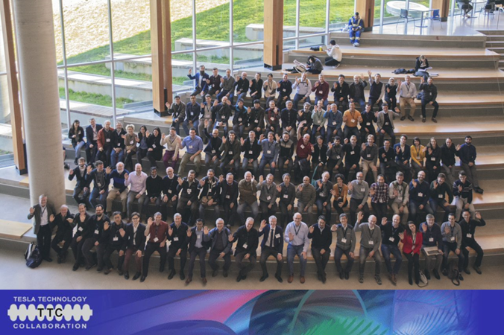
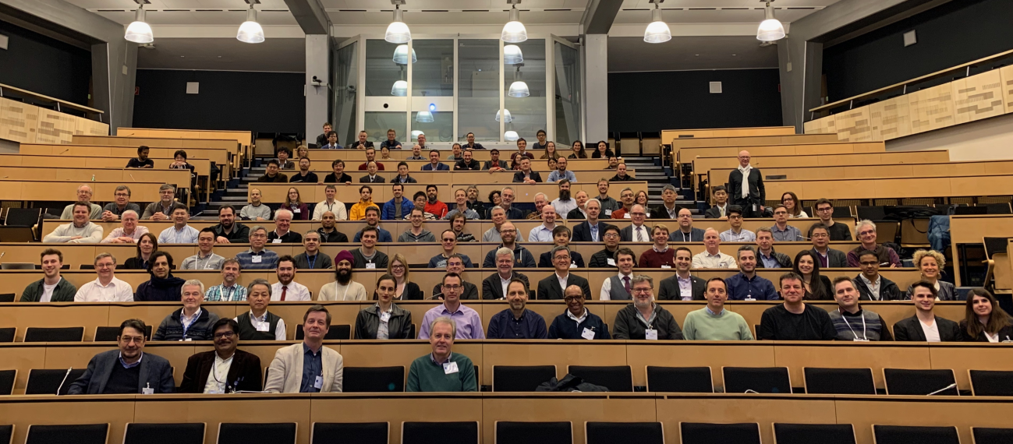
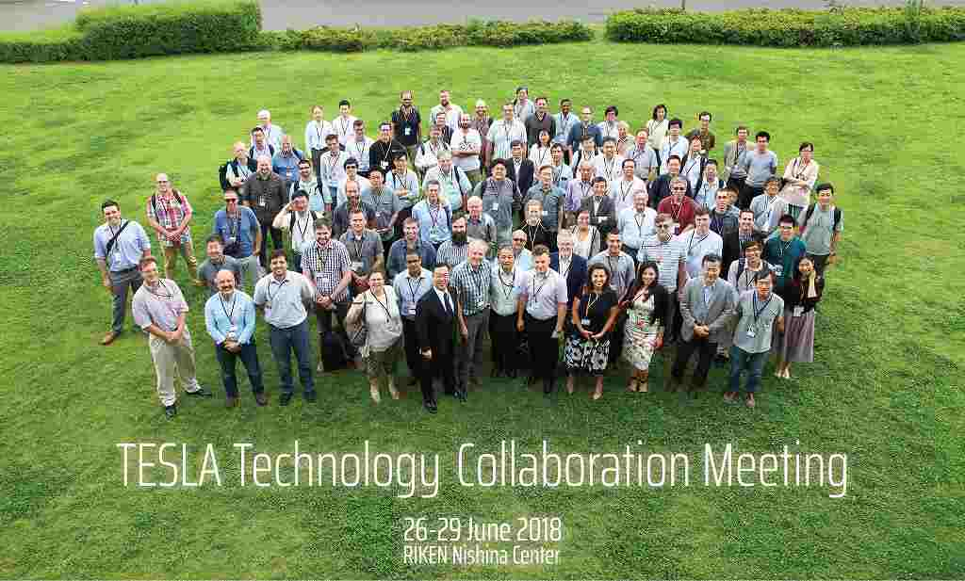
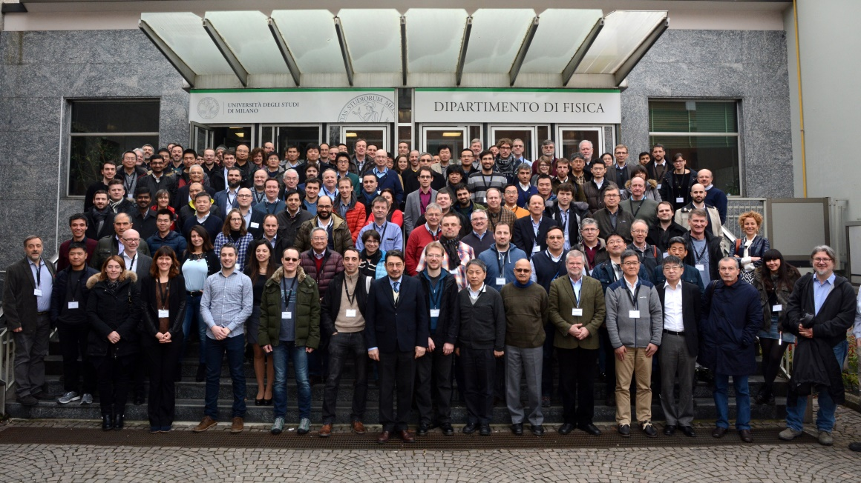
30 years of TESLA / TTC Meetings

