Slide 1
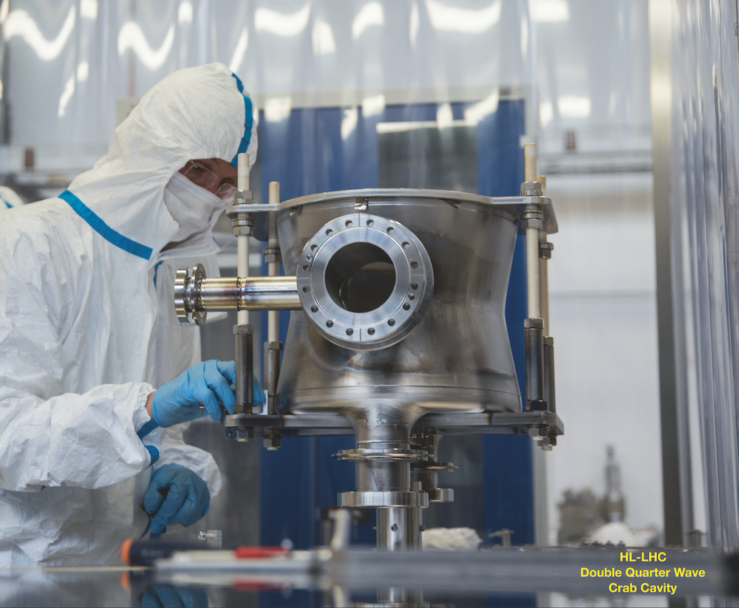

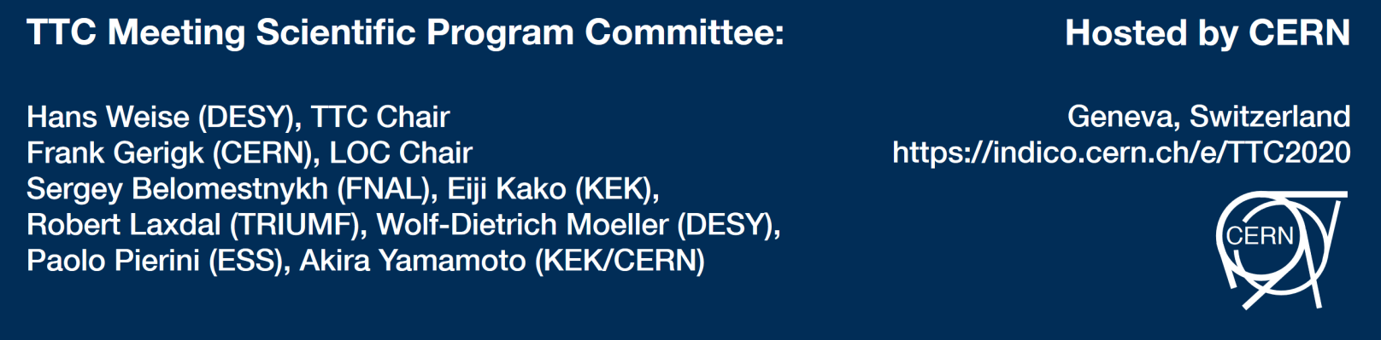

Welcome & Introduction
Hans Weise, DESY
February 4th, 2020
Notes:
How to edit the title slide
Upper area: Title of your talk, max. 2 rows of the defined size (55 pt)
Lower area (subtitle): Conference/meeting/workshop, location, date,
your name and affiliation,
max. 4 rows of the defined size (32 pt)
Change the partner logos or add others in the last row.

Slide 2
The mission of the TESLA Technology Collaboration
The mission of the TESLA Technology Collaboration is
to advance SRF technology R&D and related accelerator studies across the broad diversity of scientific applications, and
to keep open and provide a bridge for communication and sharing of ideas, developments, and testing across associated projects.
To this end the Collaboration supports and encourages free and open exchange of scientific and technical knowledge, expertise, engineering designs, and equipment.
The TTC organizes regular collaboration meetings where new developments are reported, recent findings are discussed and technical issues are concluded. This time, TTC meeting is hosted by CERN on 04 - 07 February 2020.

Slide 3
The list of work packages chosen in the Scientific Program Committee includes:
WG-1: Progress on high Q and high gradient
WG-2: Couplers and auxiliaries
WG-3: Coating techniques thin films and new materials
WG-4: New techniques for fabrication of SRF components & CM assembly and design
Hot Topic: Processing and testing of large elliptical cavities (<1 GHz) for hadron linacs
Gerda Neyens (CERN)
Nuclear Reactions Studies with Radioactive Ion Beams at HIE-ISOLDE
Serhan Tufanli (Yale)
Physics and technology overview of LBNF Dune

Slide 4
The actual TTC Meeting was prepared in an enthusiastic way and with great care…
(11 SPC Video Meetings!!!)
Frank Gerigk (CERN), and his team namely Eleanor Sylvaine Davies and Patricia Clerc
with some support by Katrin Lando / DESY
and the
TTC Meeting Scientific Program Committee chaired by Eiji Kako (KEK) & Wolf-Dietrich Moeller (DESY)
SPC | WP Leaders
Hans Weise (DESY), TTC-chair Frank Gerigk (CERN) Bob Laxdal (TRIUMF) Eiji Kako (KEK) Wolf-Dietrich Moeller (DESY) Sergey Belomestnykh (FNAL) Akira Yamamoto (KEK/CERN) Paolo Pierini (ESS) | Ari Palczewski (JLAB) Kensei Umemori (KEK) Marc Wenskat (DESY) Eric Montesinos (CERN) Naruhiko Sakamoto (RIKEN) Sang Hoon Kim (FRIB) Guillaume Jonathan Rosaz (CERN) Teng Tan (IMP CAS) Tobias Junginger (UBC / TRIUMF) | Hiroshi Sakai (KEK) Stéphane BERRY (CEA-Saclay) Tug Arkan (FNAL) Grivory Eremeev (FNAL) Paolo Pierini (ESS) Sha Peng (IHEP)
THANK YOU!!!

Slide 5
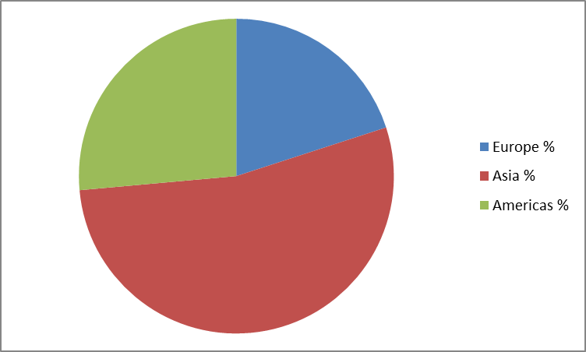
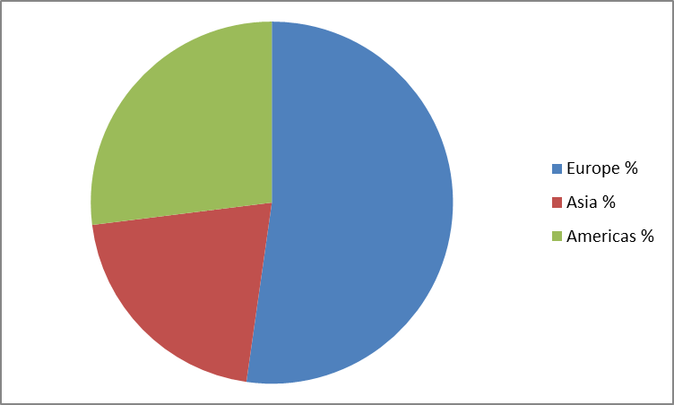
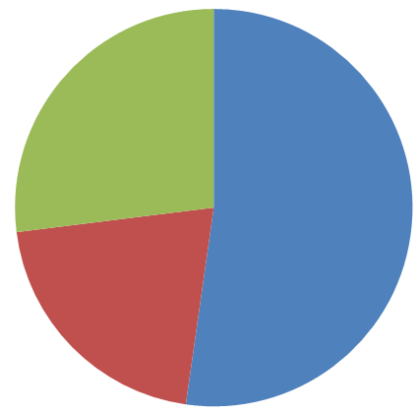
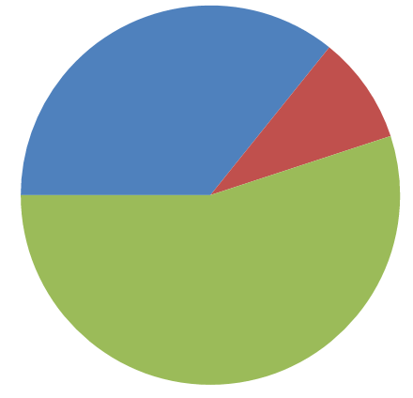
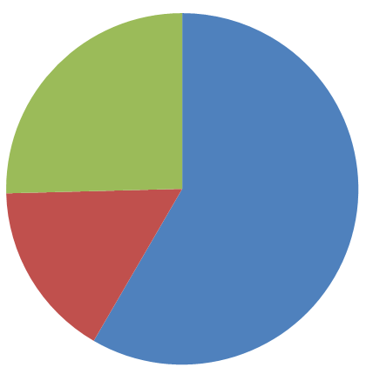
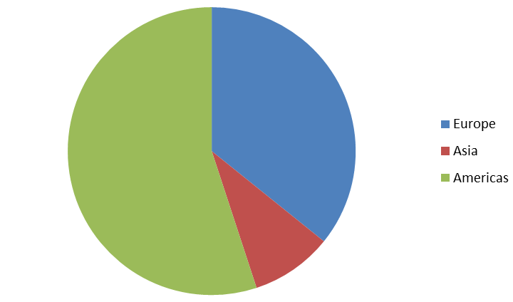
Number of TTC Meeting Participants
RIKEN
6/2018
MILANO
2/2018
143 participants
22% from industry
178 participants
TRIUMF
2/2019
Geneva
2/2020
109 participants
4% from industry
188 participants
5% from industry

Slide 6
WG-1: Progress on High-Q and High Gradient
Marc Wenskat (DESY), Ari Palczewski (JLAB), Kensei Umemori (KEK)
discuss the most recent results
material evolution under established but also newly developed heat treatments such as N-Infusion, N-Doping, Low-T Bake and Mid-T Bake
differences and advantages of low-temperature EP compared with conventional EP
current results on flux-expulsion studies
Is there a single reason or mechanism for the Q improvement? Independent of the chosen heat treatments? Or are we using different knobs to impact the material? Is the evolution of the surface understood or do we miss something?

Slide 7
WG-2: Couplers and auxiliaries
Eric Montesinos (CERN), Naruhiko Sakamoto (RIKEN), Sang Hoon Kim (FRIB)
Superconducting accelerator modules require more than just cavities.
exchange knowledge and ideas related to recent developments in the field of
  fundamental power and HOM couplers
  feedroughs
  frequency tuners, usually operated at cold
What are the most recent designs?
High Q cavities, require sufficient magnetic hygiene; this holds not only for testing condition but also in the real accelerator environment. Recent developments should be reported.

Slide 8
WG-3: Coating techniques thin films and new materials
Tobias Junginger (University of Victoria/TRIUMF), Guillaume Rosaz (CERN), Teng Tan (IMP)
The SRF community is pushing the limits of bulk niobium.
Thin films of Nb on Cu may offer an alternative to bulk niobium for certain applications to reduce costs of the cavities and/or cryomodules while still achieving high performance.
New materials like Nb3Sn and MgB2 with higher Tc and Hsh are being developed to allow operation at higher temperatures and/or enhanced gradient.
Thin films of complex multi-layers over bulk-Nb are also being pursued as a way to push bulk Nb to reach higher peak fields. These new films/materials are being pursued through advanced coating techniques with quality determined through sample study and/or cavity characterization. Samples can be characterized with DC methods or with characterization in custom built rf resonators.
Recent developments, new methods, lessons learned and progress should be reported.

Slide 9
WG-4: New techniques for fabrication of SRF components & CM assembly and design
Hiroshi Sakai (KEK), Stephane Berry (CEA), Tug Arkan (FNAL)
Standard cavity manufacture involves forming or machining RRR Nb parts and then electron beam welding them into subassemblies to be then EB welded into final assemblies.
Cryomodule assembly is done in a clean room with well trained technicians following accepted protocols.
New fabrication methods are being pursued to improve the cost and or quality of cavities or cavity parts including laser welding, internal welding, hydroforming, electro-hydroforming, electro-deposition of Cu to make seamless cavities and 3-D printing.
Cavity processing, cavity string assembly or cryomodule assembly may benefit in terms of quality and reproducibility, especially for mass production, through the incorporation of robotic techniques. Finally new cryomodules that are being developed for industrial applications are providing an alternative to helium refrigerators by incorporating cryocoolers and conduction cooling.
Recent developments in non-standard fabrication, design and assembly concepts should be reported.

Slide 10
Hot Topic: Processing and testing of large elliptical cavities (<1 GHz) for hadron linacs
Grigory Eremeev (FNAL), Paolo Pierini (ESS), Sha Peng (IHEP)
Several upcoming accelerator projects (ESS, PIP-II, SNS upgrade, FRIB upgrade, eRHIC/JLEIC, FCC, CEPC, …) utilize multi-cell elliptical cavities operating at sub-GHz frequencies and medium accelerating gradients. While the community strives to reach the “golden standard” of 1.3-GHz cavities, there are still several technological challenges remaining, from design to the cavity performance in an accelerator.
The hot topic discussion should concentrate on these challenges, among which are: cavity design (high Lorentz Force Detuning, helium vessel integration, …); fabrication and handling due to size/weight; processing to achieve high Q and FE-free cavities; challenges during bare and dressed cavity testing; etc. It is important for the community to start collecting and analyze data and develop performance indicators.

Slide 11
The mission of the TESLA Technology Collaboration
The TESLA Technology Collaboration supports and encourages free and open exchange of scientific and technical knowledge, expertise, engineering designs, and equipment. Therefore:
We aim for exchange between many projects, in all phases
Scientific exchange is of utmost importance
We profit from common and shared knowledge of many collaborators
  we like IP sharing more than IP protection BUT
  industry needs the right to protect their little tricks
  IP should be respected in the sense that knowledge transfer is nice and a great goal but should always be done in mutual agreement
  we like knowledge transfer as part of collaborative work
Message from dual-use workshop discussions: a clear separation of peaceful and military / defense research & mission & funding helps a lot when promoting free and open scientific exchange

Slide 12
Sustainable SRF Component Production is a MUST
The spread-out use of SRF technology helps to
  sustain and further develop technology
  keeps industry active
  supports sustainable operation of infrastructure
We need to
  carefully balance between all teammates – collaboration, support, qualification, health
  invest in education
  address the question of technology transfer between all partners … in an appropriate and optimum way
Let’s start and enjoy the meeting!!!

