Slide 1
Status of Infusion Studies at Jlab
Pashupati Dhakal

Slide 2
Summary, TTC 2019, Feb 5-8 2019
Earlier “Infusion” were reproducible when gas injected at higher temperature.
~75C hold for 4 hours during 120 C baking didn’t appear to be beneficial over the conventional 120C bake (statistics of 2 rf test).
Furnace itself appeared to be clean after the recent upgrade evident from the rf (single cavity) test.
First infusion run after furnace upgrade wasn’t as expected, probably due leak/contamination to gas injection line
Work in progress to prepare some baseline cavities and infusion run once the furnace issue resolved.

Slide 3
Summary, SRF 2019, June 30-July 5, 2019
High Q, high E_{acc} results are reproducible when gas injected at higher temperature (250-290 C).
~75C hold for 4 hours during 120 C baking didn’t appear to be beneficial over the conventional 120C bake (statistics of 2 rf test).
The influence of furnace contamination, cavity preparations before heat treatment plays significant role in the outcome of the cavity performance.
Sample studies shows that the dirtier rf surface with NbN_{1-x}O_{x} phase underneath the topmost Nb₂O₅ layer may be responsible for Q-rise.
Explorations of several parameters such as the duration of bake time, optimal temperature and partial pressure of nitrogen is ongoing.

Slide 4
Varying N2 Injection Temperature
Cavity Surface Temperature
Hold (800C/3hrs)
N₂ Inject to furnace
at different temperature
during ramp down (YYY °C)
Temperature
Ramp Up
Hold (120-200 ° C/24, 48hrs)
Time

Slide 5
RDT-06, 1.3 GHz
Baseline EP limited by HFQ slope at 30 MV/m

Slide 6
RDT-06, 1.3 GHz
N₂ In | Hold T | Time | Q@40 MV/m
155 C | 155 C | 48hrs | 7x10⁹

Slide 7
RDT-06, 1.3 GHz
20 μm
EP
N₂ In | Hold T | Time | Q@40 MV/m
155 C | 155 C | 48hrs | 7x10⁹
250 C | 175 C | 48hrs | 1.7x10¹⁰

Slide 8
RDT-06, 1.3 GHz
20 μm
EP
N₂ In | Hold T | Time | Q@40 MV/m
155 C | 155 C | 48hrs | 7x10⁹
250 C | 175 C | 48hrs | 1.7x10¹⁰
300 C | 175 C | 48hrs | 1.2x10¹⁰

Slide 9
RDT-06, 1.3 GHz
20 μm
EP
N₂ In | Hold T | Time | Q@40 MV/m
155 C | 155 C | 48hrs | 7x10⁹
250 C | 175 C | 48hrs | 1.7x10¹⁰
300 C | 175 C | 48hrs | 1.2x10¹⁰
300 C | 175 C | 24hrs | 2.0x10¹⁰

Slide 10
RDL-0, 1.5 GHz
Higher Residual resistance, however the Q-rise was observed with 175 C/48hrs hold recipe when N₂ injected at 250 C and 300 C

Slide 11
FH3C, 3 GHz
2x10¹⁰@ 17.5 MV/m

Slide 12
Frequency Dependence
Recipe:
800C/3hrs+175 C/48hrs with N2 in at 300C

Slide 13
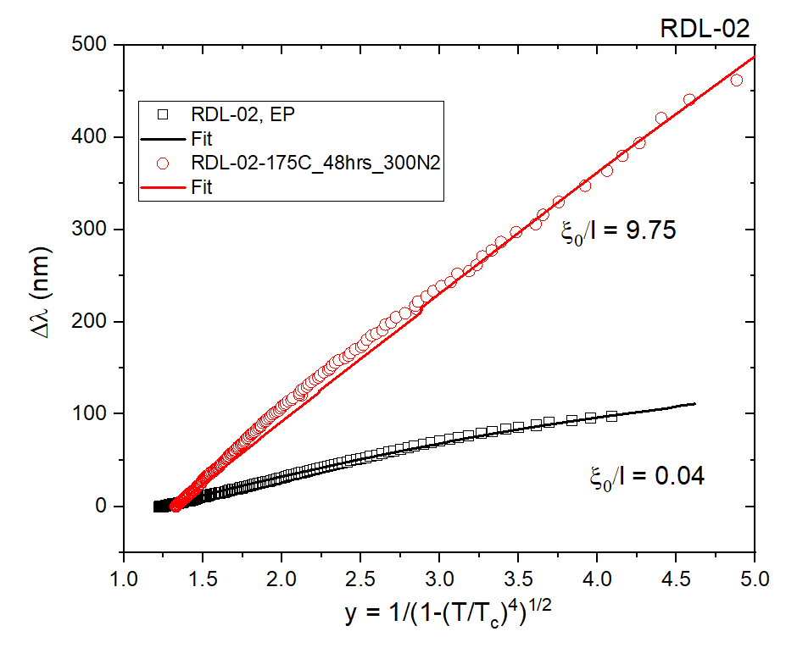
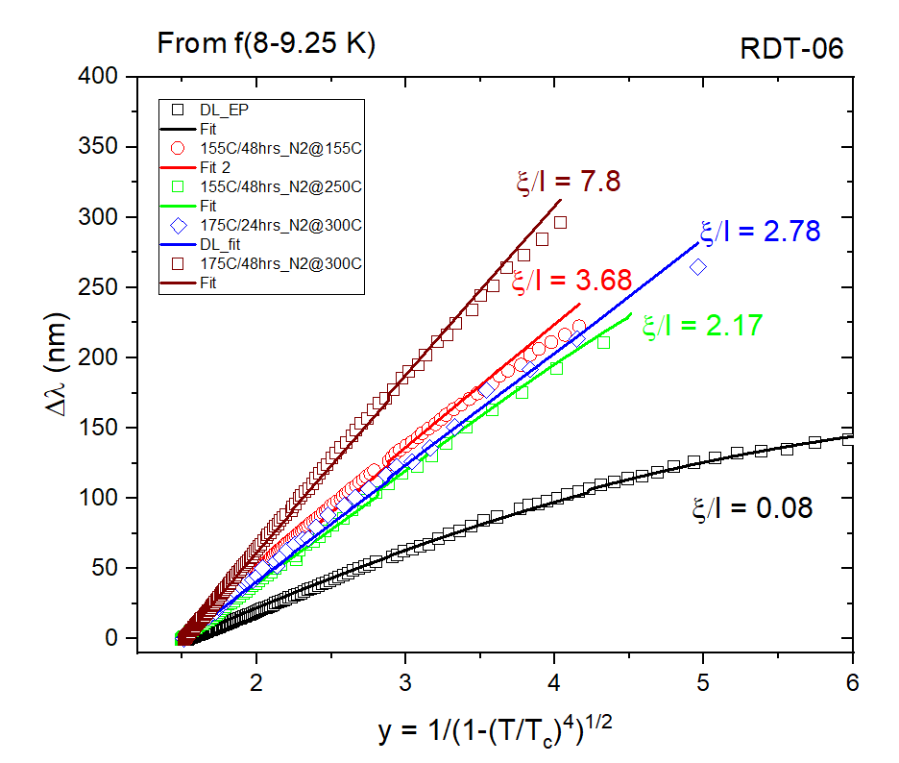
Mean free path from f vs T data
Resonant frequency was tracked during the cavity warm up. The change in penetration
depth with temperature was fitted with BCS theory in the temperature range (8-9.25K).
T_{c}, λ₀, ξ₀ was fixed as material parameters and Δ/K_{B}T_{c}= 1.85 in some cases, when wasn’t available from Rs(T) fits
dirty limit
Tuning of mfp
clean→ dirty
clean limit

Slide 14
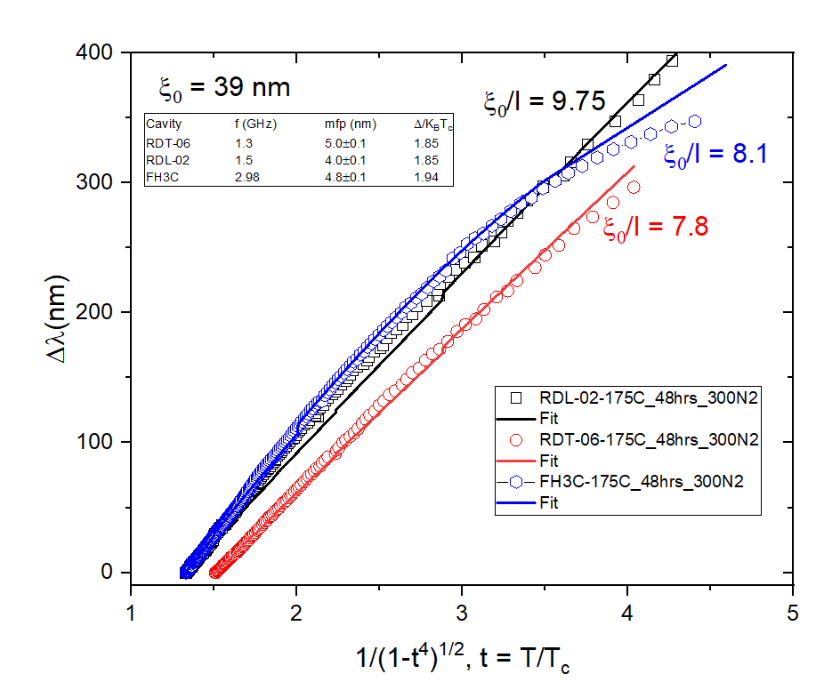
Mean free path via f vs T data

Slide 15
Summary
RF performance of SRF cavity was tuned depending on the gas injection temperature, hold temperature and time.
The same recipe applied to three different cavities with different frequency, showing the similar Q(E) dependence.
The recipe will be applied to multi-cell cavities to reproduce the single cell results.

Slide 16


