Slide 1
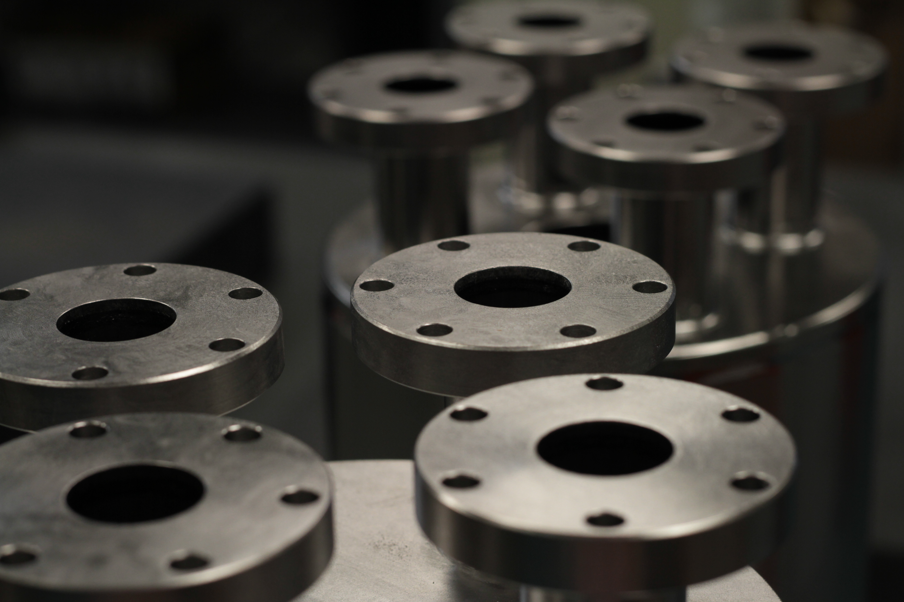
Test Results from the TRIUMF Multi-Mode Coaxial Resonators
TTC Meeting Feb 2020
Philipp Kolb,
Robert Laxdal, Zhongyuan Yao, Tobias Junginger (U of Victoria)
Combined results from QWR and HWR cooldowns with a first N2 infusion test on the QWR
Philipp Kolb

Slide 2
Outline
Motivation
Cavities
HWR after degassing + flash BCP combined with QWR data
  Frequency dependence of resistance parameters.
QWR N2 infusion (+mag field expulsion)
Notes:
I’ll be talking about what motivated this study and the cavities we’re using. Then I’ll be going into the latest results from the halfwave cavity and combine this with the quarterwave data to show you some results of the frequency dependence of the resistance parameters. To finish up, I’ll show some results of the first Nitrogen infusion test of the our quarterwave cavity.

Slide 3
Motivation
Great improvements on Q₀ and E_{acc} in recent years
  N2 doping & infusion, two-step “magic” baking, Nb3Sn…
But research is focused on 1.3GHz, elliptical cavities for big projects like LCLS-II, ILC… operating around 2.0K.
What about low frequency, TEM cavities? What exactly is the frequency dependence of the surface resistance? Are they useful at 4.2K? Are these new treatments useful for heavy ion accelerators that use QWR/HWR cavities at 80-400MHz?

Slide 4
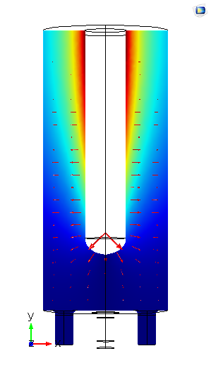
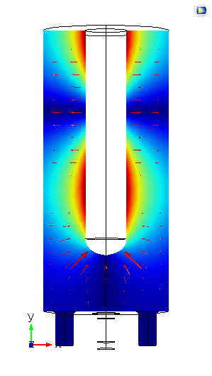
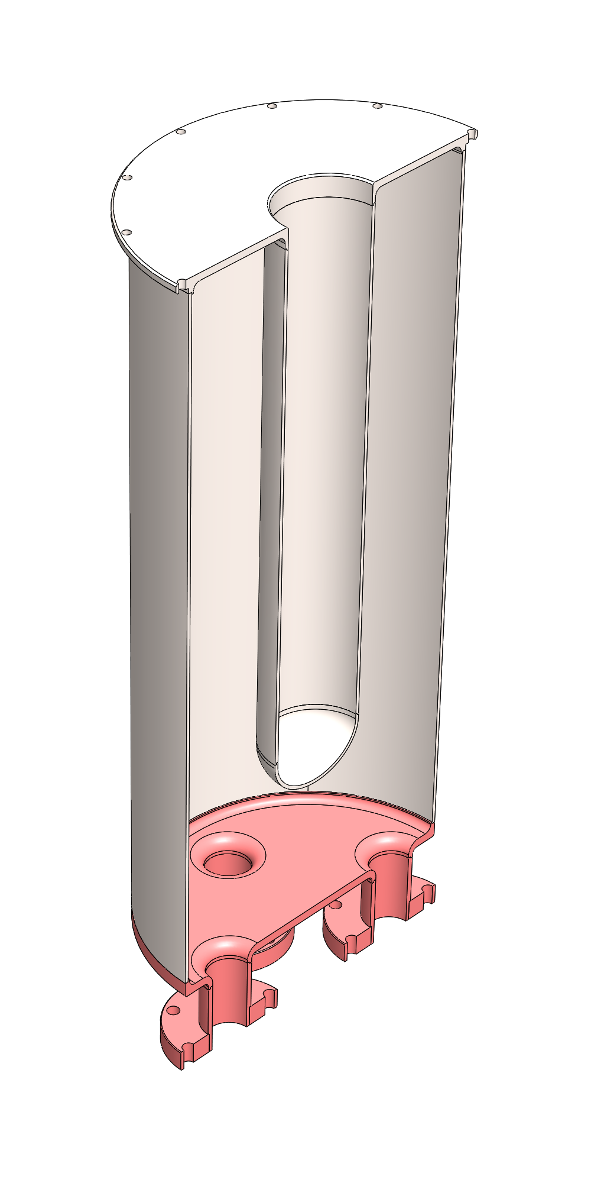
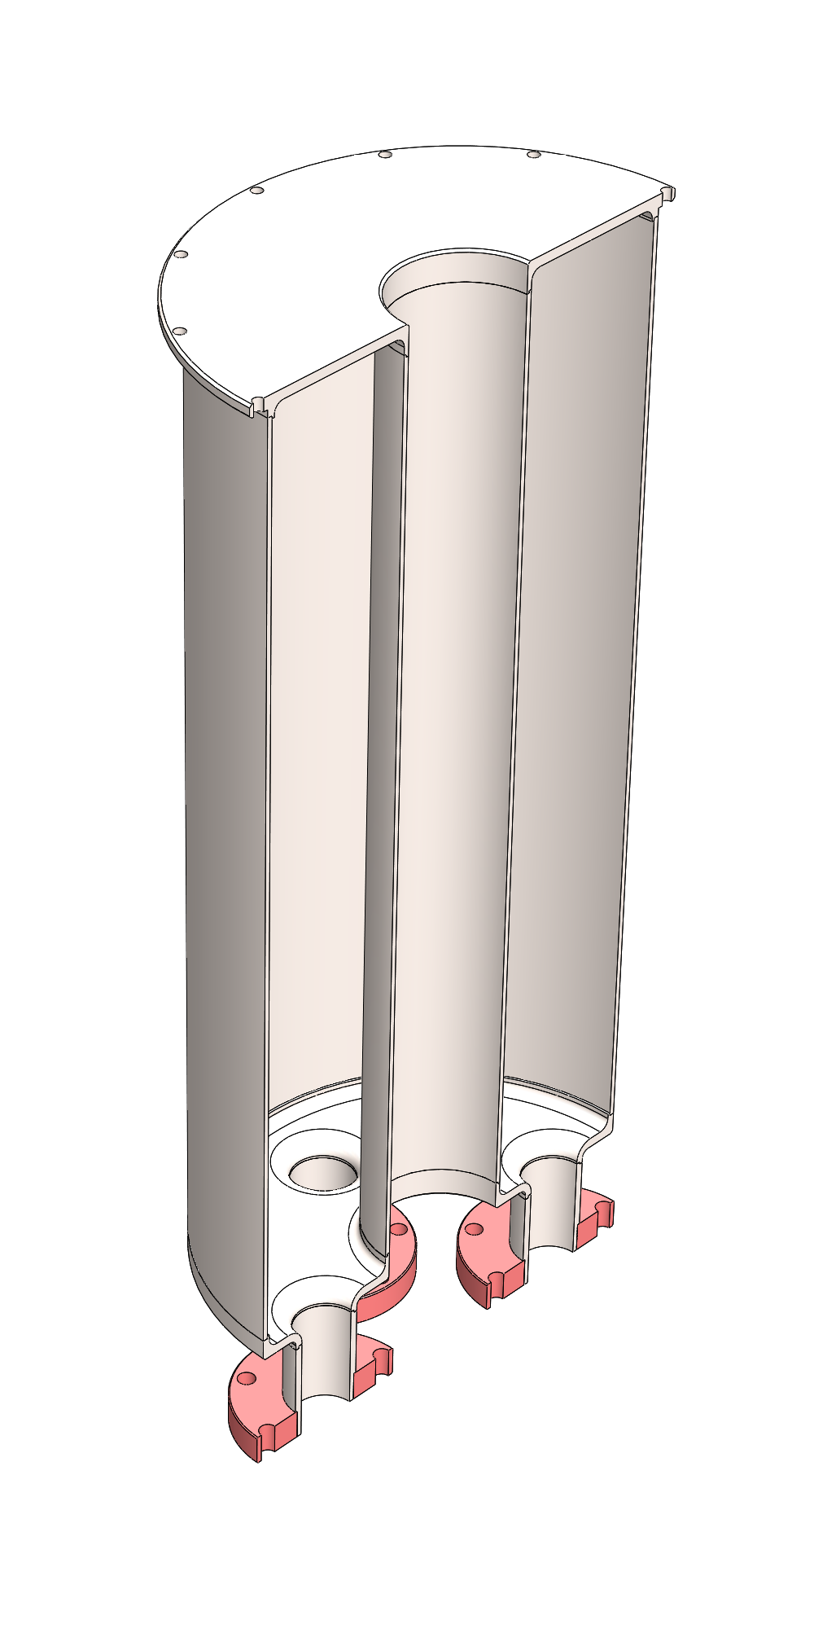
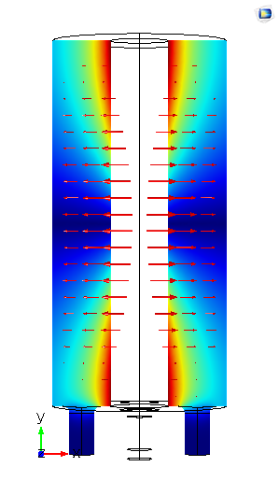
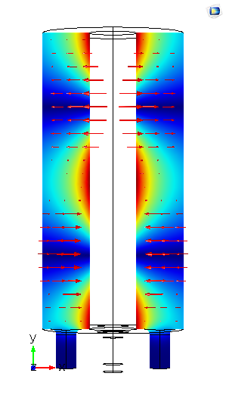
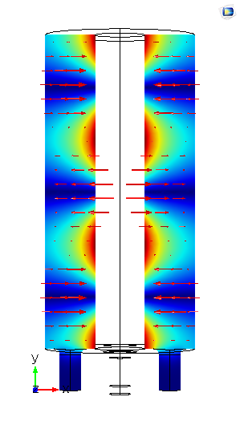
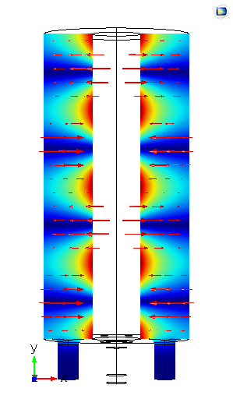
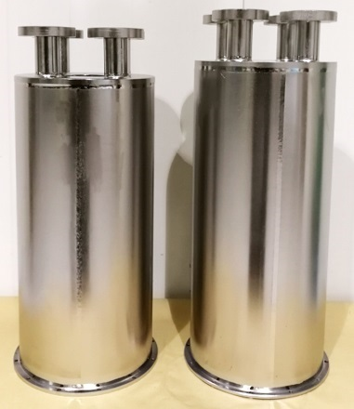
Coax Test Cavities
Designed and build two coax cavities, QWR and HWR, with a similar purpose & size as a 1.3GHz single cell cavity.
No beam ports on cavity, simplifying geometry.
RRR grade Nb for cavity walls, reactor grade for ports/bottom plate (QWR),
No NbTi -> less sources of contamination.
QWR | Simu. /MHz | Meas. /MHz | Geo. Factor /Ohm
TEM | 217 | 217.4 | 37.47
TEM | 647 | 647.3 | 113.7
TE111 | 892 | –
TEM | 1055 | 1054.2
TE112 | 1103 | 1100.8/1103.5
HWR | Simu. /MHz | Meas. /MHz
TEM | 389 | 388.6 | 60.39
TEM | 778 | 777.4 | 120.77
TE111 | 905 | 901.9/906.6
TE112 | 1128 | 1125.4/1129.1
TEM | 1166 | 1166.1 | 181.08
TE113 | 1424 | 1421.9/1424.8
TEM | 1555 | 1554.8 | 241.24
TE211 | 1602 | 1600.7
40cm
Program began with the QWR. HWR is catching up now. Data of the two cavities with same surface treatments will be combined to give a large frequency range and extract frequency dependence of R_{S} parameters.
20cm
Notes:
To answer these questions we designed two coaxial cavities. One quarter-wave, one halfwave. Roughly same size as a 1.3GHz elliptical cavity and their purpose is similar to a single cell cavity as a test cavity for new treatments. We test them in these TEM resonant modes to get the frequency dependence. We started with the QWR, but now the HWR is catching up and we’ll get a large dataset of surface resistance data at different frequencies.

Slide 5
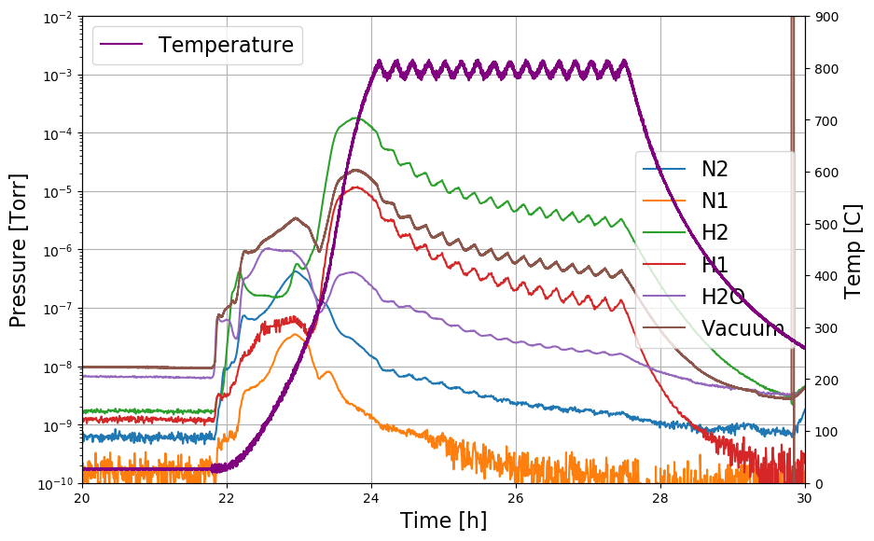
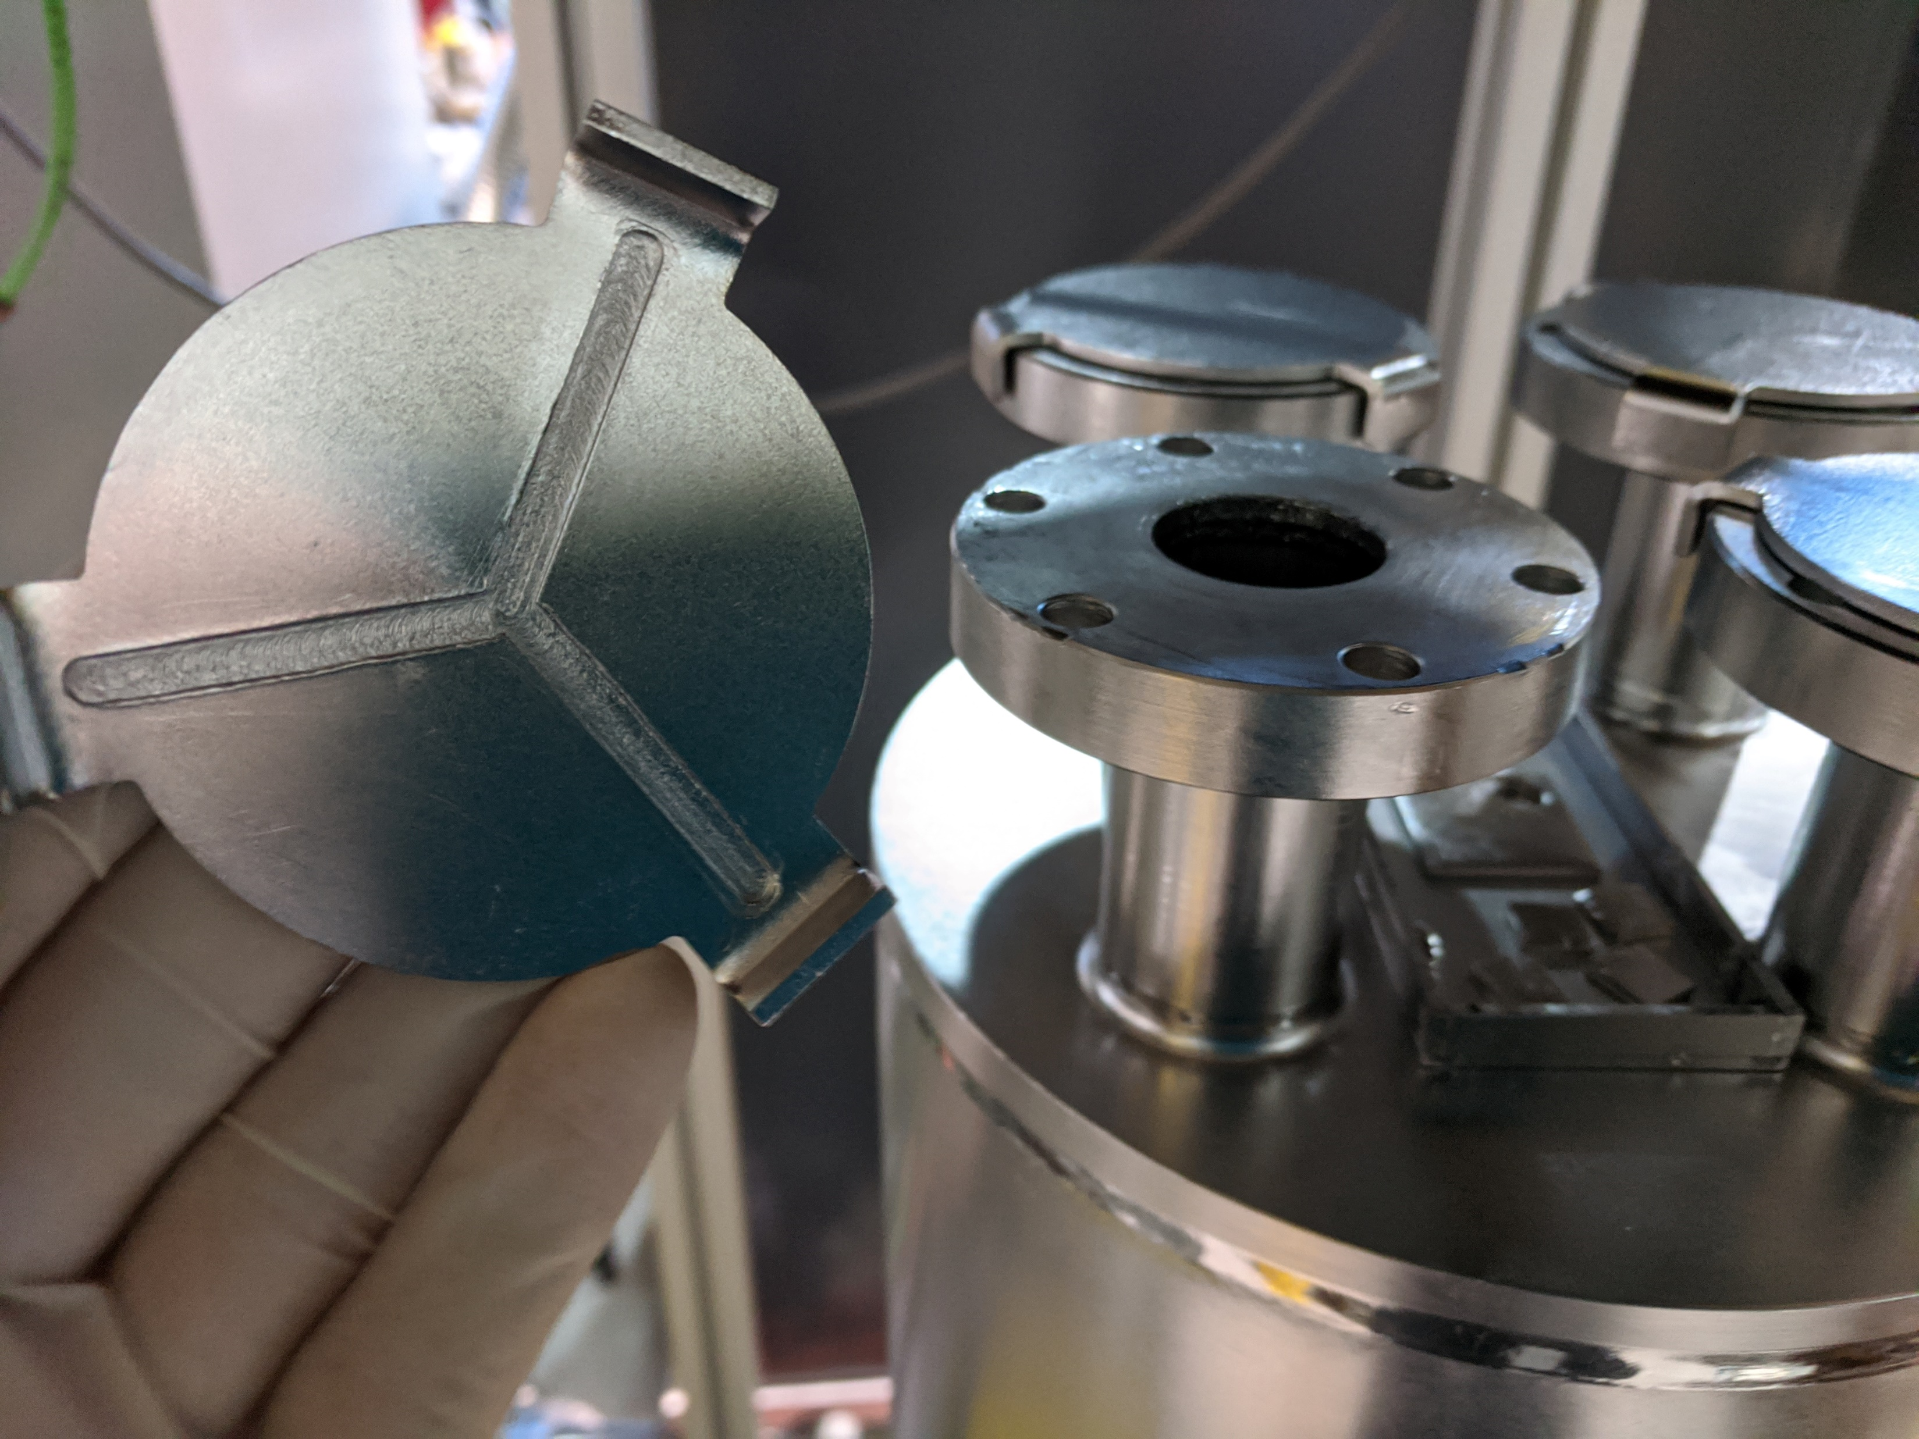
Degassing of the HWR in induction furnace
3.5h at 800C
  H2 decreased from 10⁻⁴ to 10⁻⁶ Torr
Followed by 15min of BCP at ~1um/min @ 12-13 C
No low temp bake
Using Nb caps on ports with defined and reproduceable leak.
Notes:
Latest surface treatment of the HWR is shown here. Degassing at 800C followed by 15um flash BCP. Here is a photo of our Nb caps used during heat treatment with a defined and reproduceable leak.

Slide 6
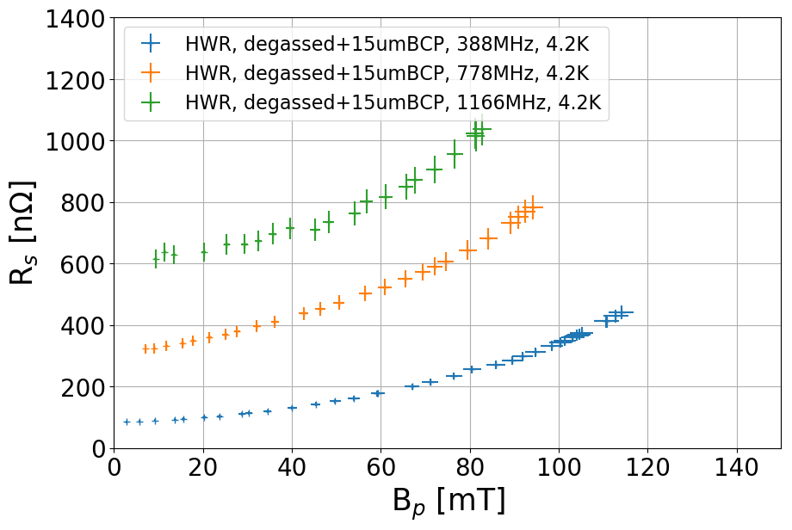
HWR: R_{S} at 4.2K
Surface resistances are NOT corrected for field distribution. Correction factors are all very similar and would only make a difference once compared to elliptical cavities which is not done here, hence no correction necessary.
After degassing and 15um BCP
Clean curves without field emissions or MP.
388MHz: limited by quench at 115mT
  Pulsed up to 120mT
778MHz: cw quench at 94mT
  No pulsed measurement of quench field possible due to high P_{fwd}
1166MHz: amplifier limit reached at B_{P} = 83mT (P_{amplifier} = 350W), no pulse measurement
Notes:
4K results are shown here, limitations are quench at 390 and 780MHz and amplifier power at 1166MHz. Clean curves without field emmissions.

Slide 7
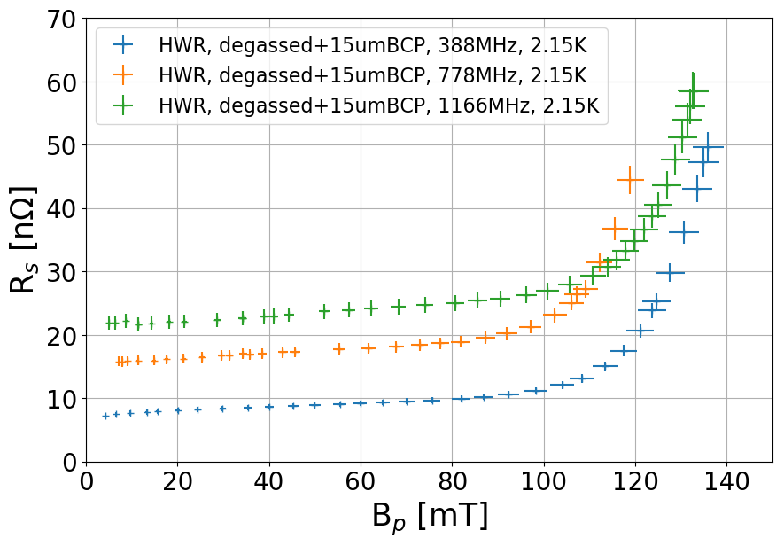
HWR: R_{S} at 2.15K
Surface resistances are NOT corrected for field distribution. Correction factors are all very similar and would only make a difference once compared to elliptical cavities which is not done here, hence no correction necessary.
After degassing and 15um BCP
Clean curves at first three modes
No pulsed measurement due to limited coupler movement – mechanical issue
388MHz:quench at 136mT, no x rays around cryostat -> high field Q slope!
778MHz: quench at 121mT, no xrays around cryostat -> high field Q slope!
1166MHz: 133mT, 5uSv/h around cryostat at cavity height.
  Very low amount and should barely make a difference in Q₀ -> high field Q slope
Notes:
And here are the 2K results. Again clean curves without field emissions. So what we are seeing her at high field is actually high field Q slope.

Slide 8
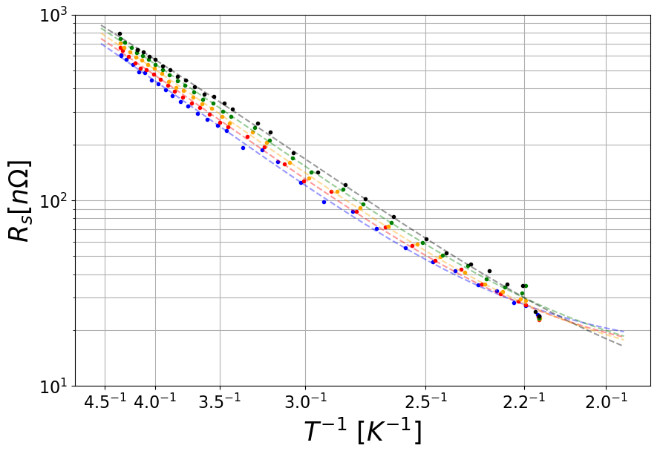
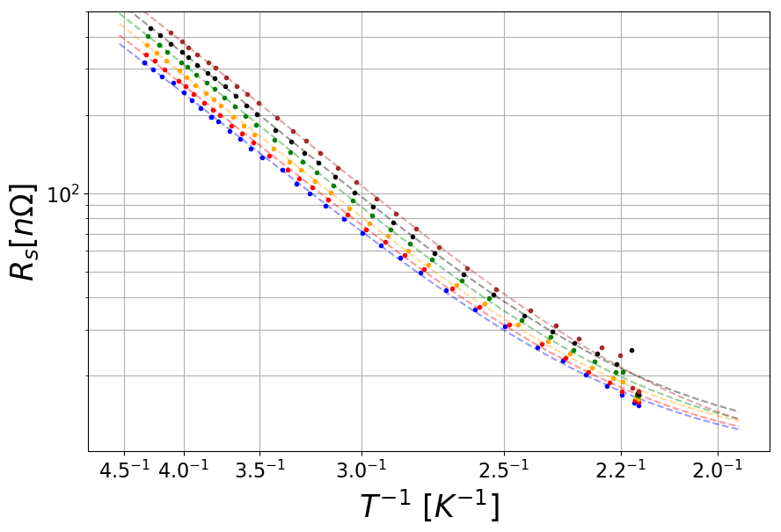
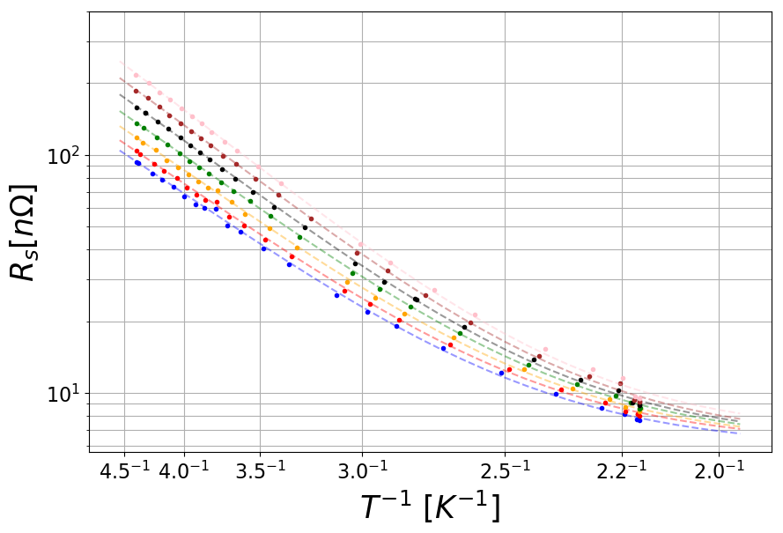

Cooldown data fit
1166MHz
778MHz
These data sets will now be combined with datasets from the QWR with the same surface treatment.
388MHz
$$R_{S}^{ } (B,T)=\frac{A\left(B_{p}, ω\right)}{T}\exp\left(−\frac{C\left(B_{p}, ω\right)}{T}\right)+R_{Ti}(B_{p}, ω)$$
With A, C, R_{Ti} as independent fit parameters.
Notes:
During the cooldown to 2K we collect data at fixed field amplitudes, fit that to this equation to extract the temperature dependence of the surface resistance. And now we combine this with data from a QWR cooldown with the same surface treatment.

Slide 9
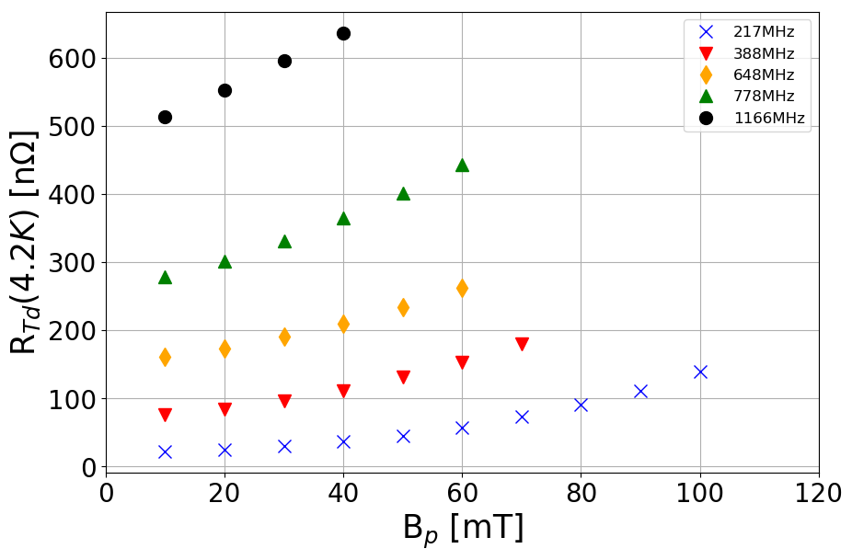
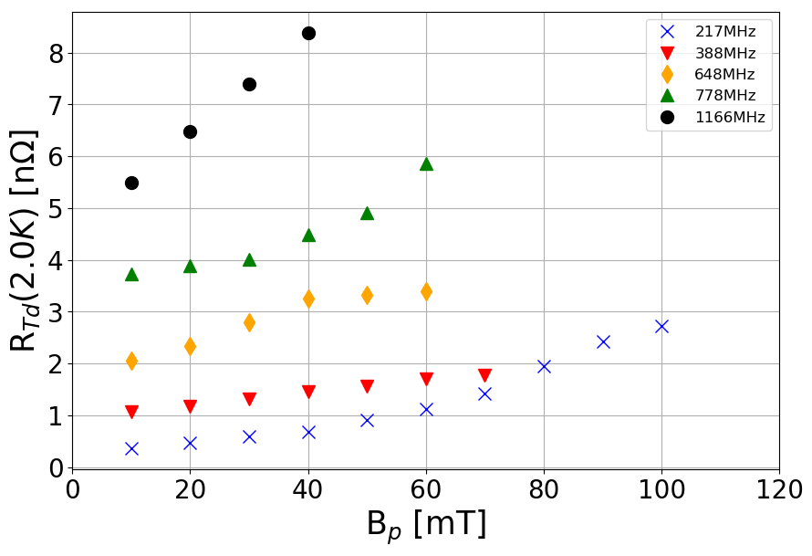

Field dependence:
R_{T(emperature)d(ependent)}
$$R_{S}^{ } (B,T)=\frac{A\left(B_{p}, ω\right)}{T}\exp\left(−\frac{C\left(B_{p}, ω\right)}{T}\right)+R_{Ti}(B_{p}, ω)$$
Clear upwards trends with increasing field amplitude and with increasing frequency.
Notes:
First, here is the temperature dependent part of the surface resistance at 4.2K and at 2.0K as a function of peak surface field. As you can see we’ve got clear upwards trends with increasing field and increasing frequency, with a bit of a stronger field dependence in higher frequencies. Trends seem to be the same at both temperatures.

Slide 10
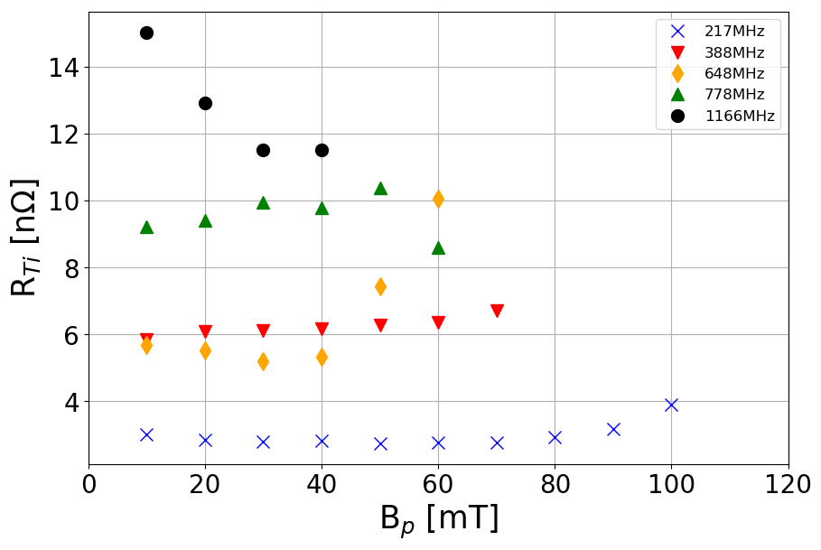

Field dependence:
R_{T(emperature)i(ndependent)}
$$R_{S}^{ } (B,T)=\frac{A\left(B_{p}, ω\right)}{T}\exp\left(−\frac{C\left(B_{p}, ω\right)}{T}\right)+R_{Ti}(B_{p}, ω)$$
Generally an increase with frequency is observed.
Not a clear trend with increasing B_{p} for the different modes, some modes decrease, some are increasing or have practically zero slope.
Notes:
And here is the temperature independent part. As you can see there is not really a clear trend with increasing field, some modes decrease, some increase.

Slide 11
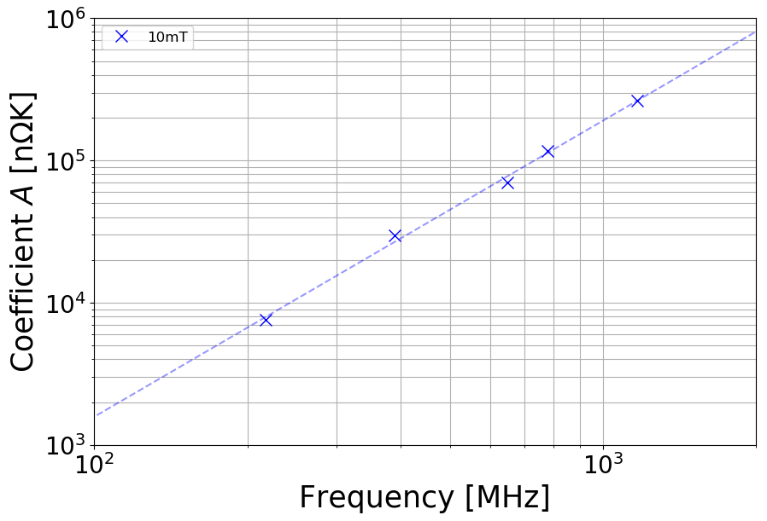
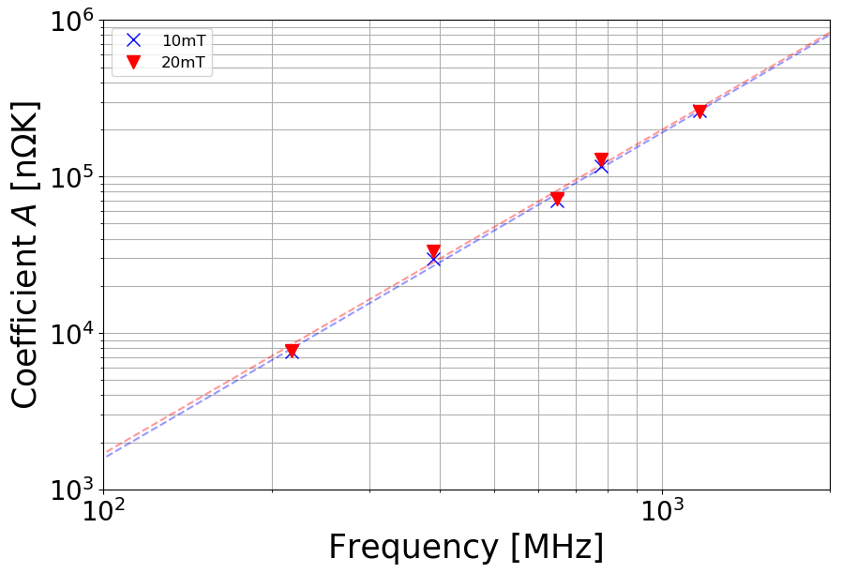
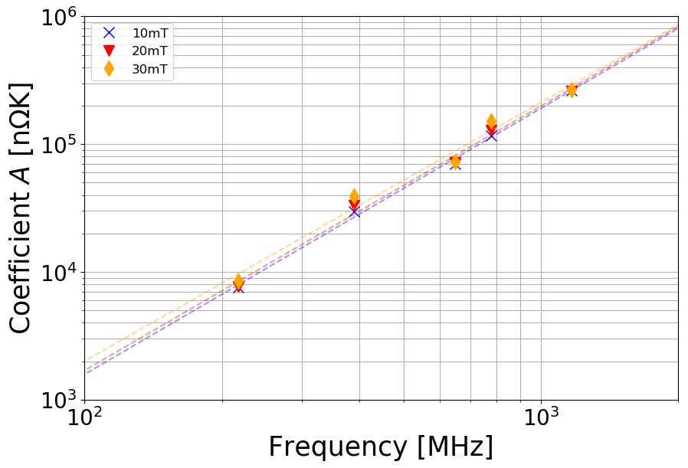
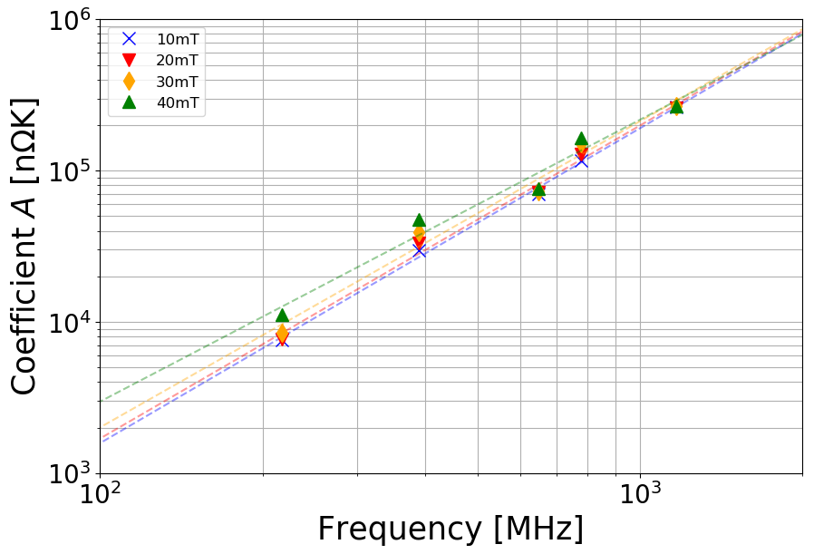
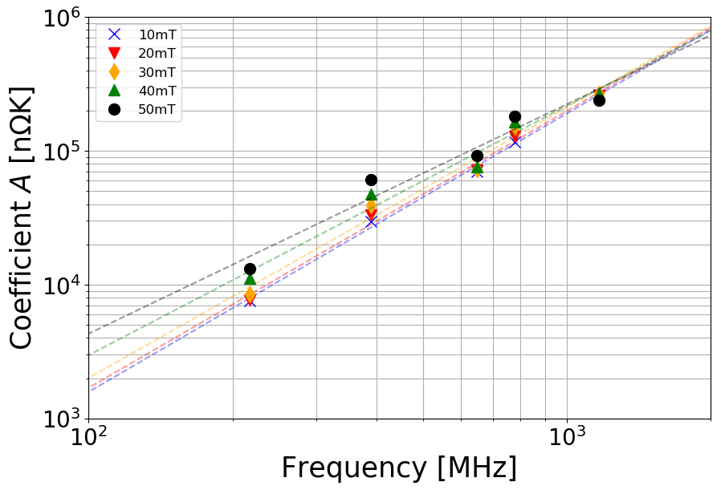
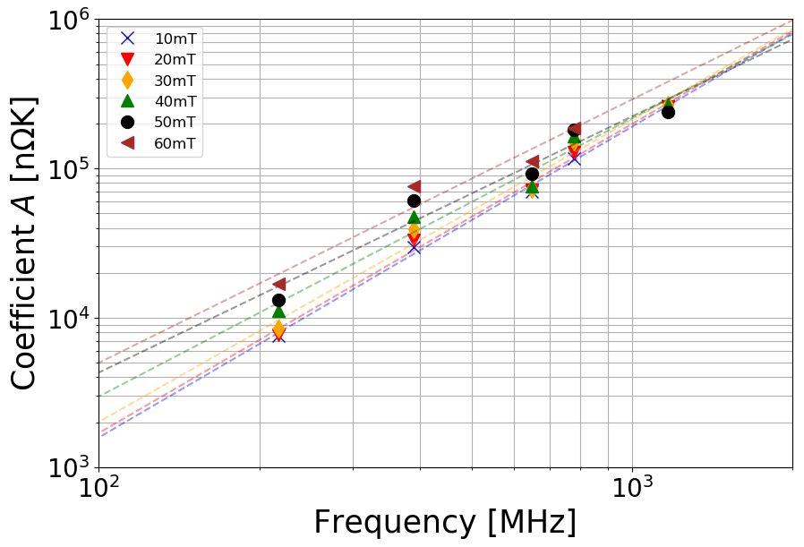


Frequency dependence:
Coefficient A
$$R_{S}^{ } (B,T)=\frac{A\left(B_{p}, ω\right)}{T}\exp\left(−\frac{C\left(B_{p}, ω\right)}{T}\right)+R_{Ti}(B_{p}, ω)$$
Fitted as a function of resonant frequency
$$A=A_{0}f^{x}$$
Bp [mT] | exponent
10 | 2.08 ± 0.22
20 | 2.06 ± 0.34
30 | 2.02 ± 0.53
40 | 1.86 ± 0.58
50 | 1.71 ± 0.71
60 | 1.76 ± 1.24
Bp [mT] | exponent
10 | 2.08 ± 0.22
20 | 2.06 ± 0.34
30 | 2.02 ± 0.53
40 | 1.86 ± 0.58
Bp [mT] | exponent
10 | 2.08 ± 0.22
Bp [mT] | exponent
10 | 2.08 ± 0.22
20 | 2.06 ± 0.34
Bp [mT] | exponent
10 | 2.08 ± 0.22
20 | 2.06 ± 0.34
30 | 2.02 ± 0.53
40 | 1.86 ± 0.58
50 | 1.71 ± 0.71
Bp [mT] | Exponent x
10 | 2.08 ± 0.22
20 | 2.06 ± 0.34
30 | 2.02 ± 0.53
Uncertainty given by 95% confidence bounds from fit.
Notes:
Coming to the frequency dependence of the fit parameters. First off here is the coefficient A as a function of frequency at 10 mT peak surface field. All points fit fairly neatly on this fit line, which gives us this exponent around 2.1. The same analysis is done for the remaining field amplitudes and again we get exponents around 2. There seems to be some downwards trend with increasing field, but the fits become less certain.

Slide 12
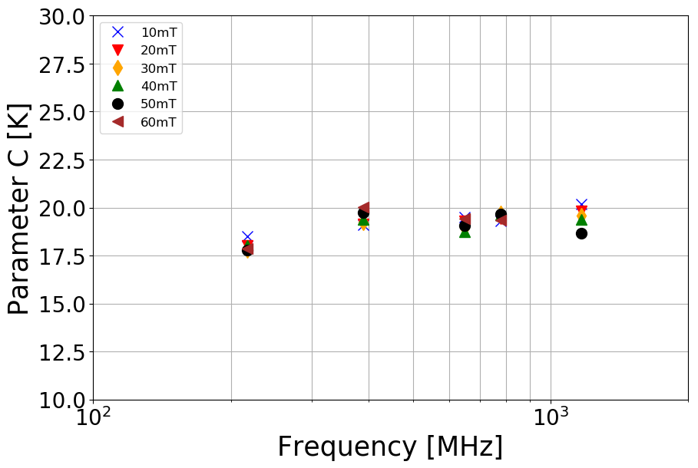

Frequency dependence:
“Energy gap” Parameter C
$$R_{S}^{ } (B,T)=\frac{A\left(B_{p}, ω\right)}{T}\exp\left(−\frac{C\left(B_{p}, ω\right)}{T}\right)+R_{Ti}(B_{p}, ω)$$
No strong frequency or field dependence.
Candidate for shared fit between field & frequency data sets. Work in progress.
Notes:
Here is the same plot for the fit parameter C. Overall I don’t see a particular field of frequency dependence in this data. This leads us to the believe that this might be the same value for all and we’re looking into shared fit parameter between the datasets.

Slide 13
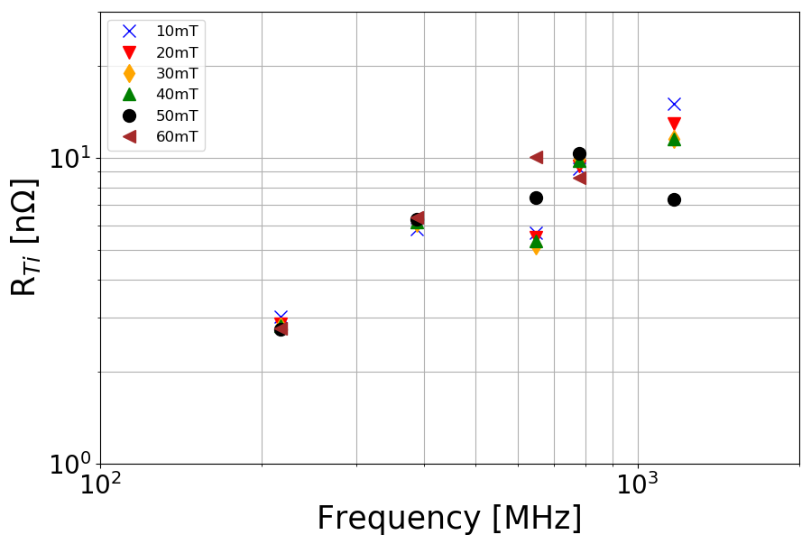
Frequency dependence:
R_{Ti}
$$R_{S}^{ } (B,T)=\frac{A\left(B_{p}, ω\right)}{T}\exp\left(−\frac{C\left(B_{p}, ω\right)}{T}\right)+R_{Ti}(B_{p}, ω)$$
Unclear dependence of R_{Ti} on frequency.
There seems to be a lot of scatter happening at higher frequencies.
Notes:
Now for Rti, there seems to be a increasing trend with increasing frequency, but there is a lot of scatter at higher frequencies. This makes it difficult to define a clear trend.

Slide 14
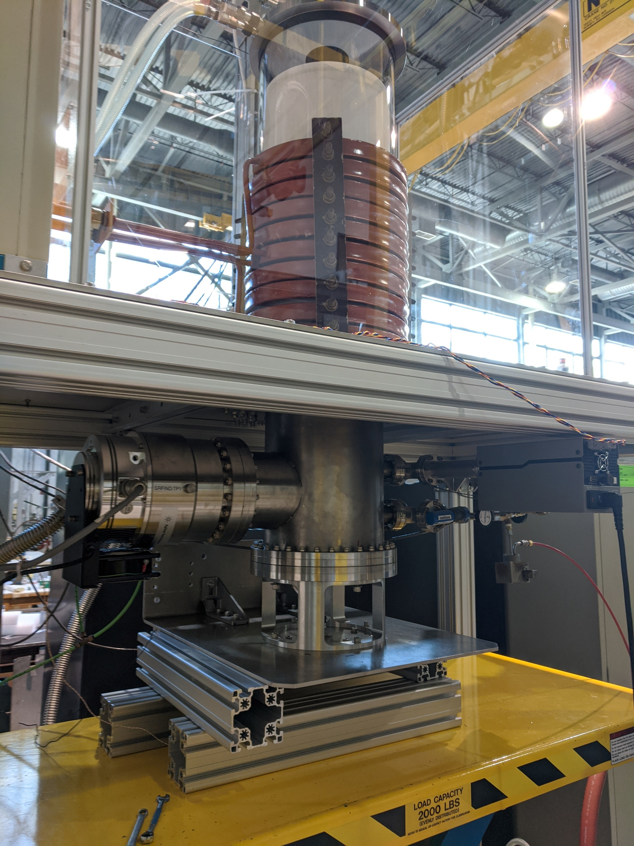
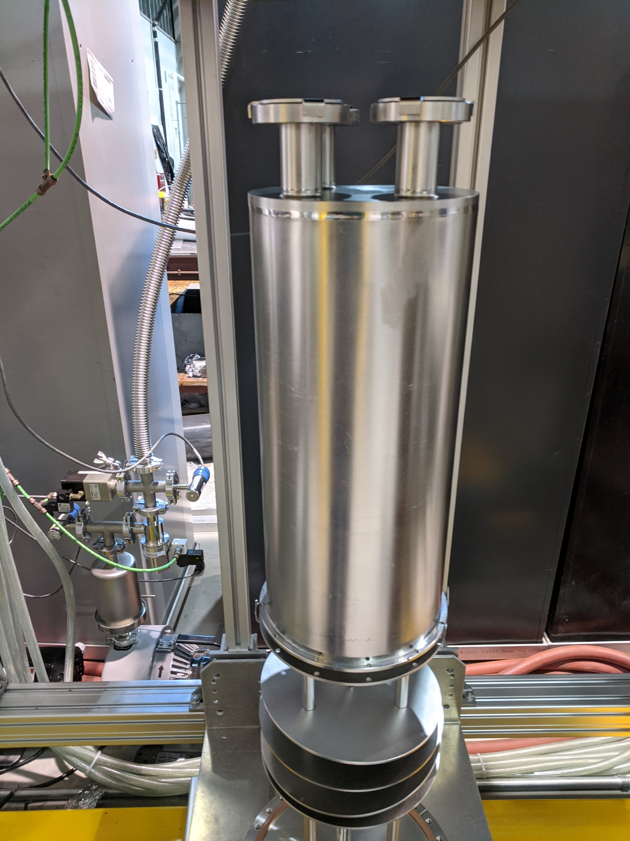
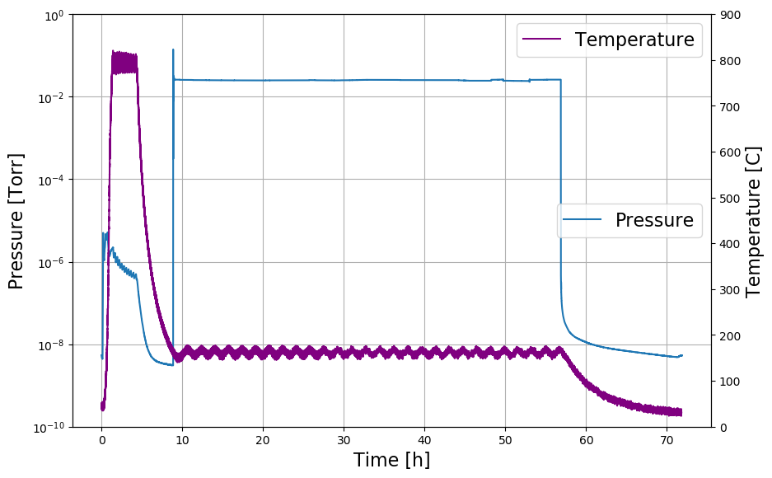
QWR infusion
3h @ 800C + 48h @ 160C with 25mTorr N2 injected into hot zone.
Slotted caps provide line of sight cover for RF surface and defined & reproduceable leak for gas flow.
Notes:
Now I’d like to move to the latest results from the quarterwave. We did an 160C nitrogen infusion treatment, here you can see the temperature and pressure profile. Again we use these slotted Nb caps to provide line-of-sight cover with a reproduceable gas leak.

Slide 15
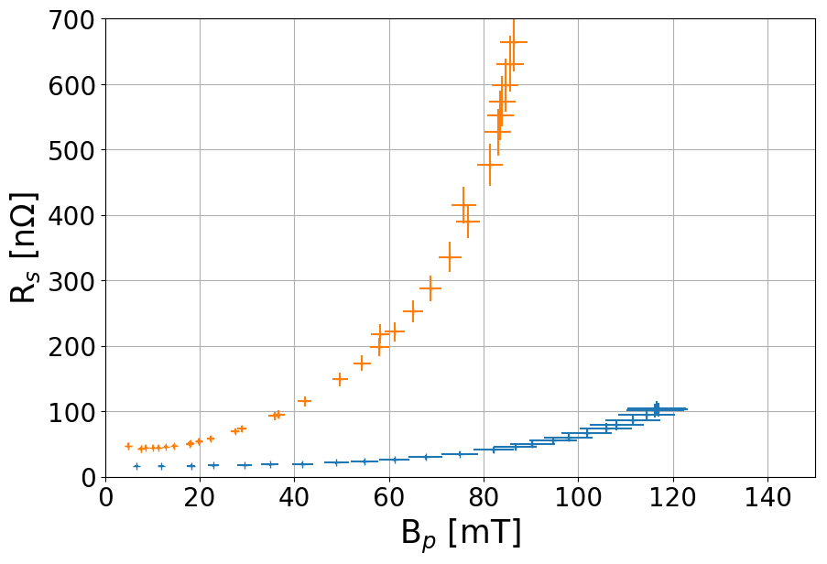
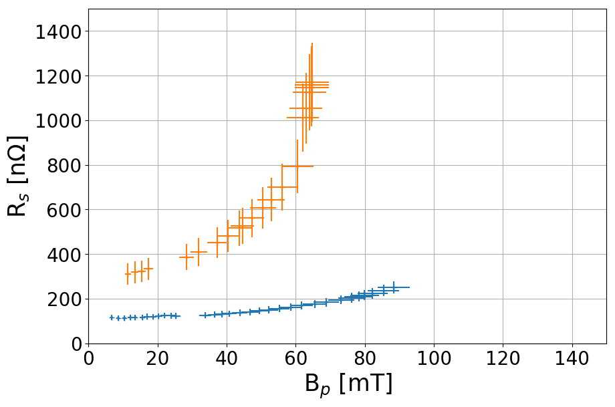
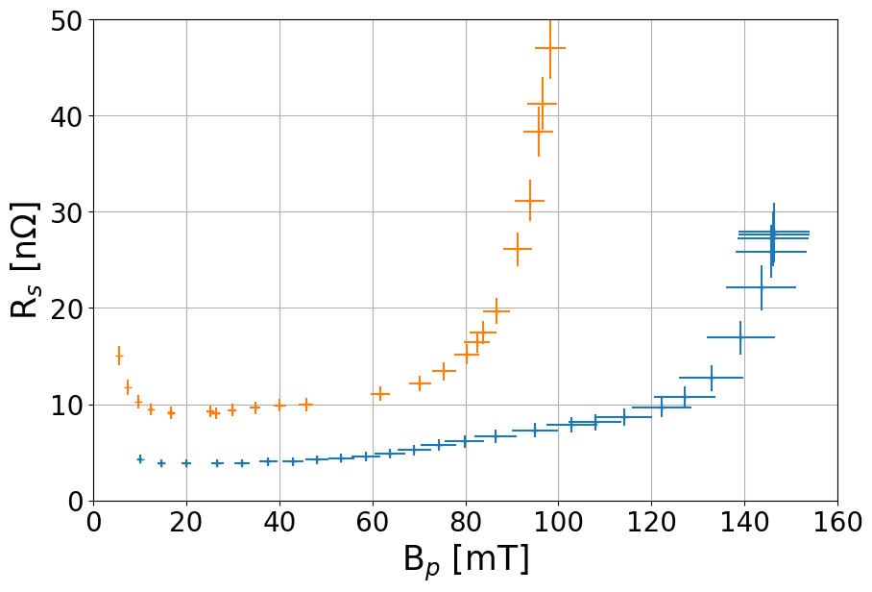
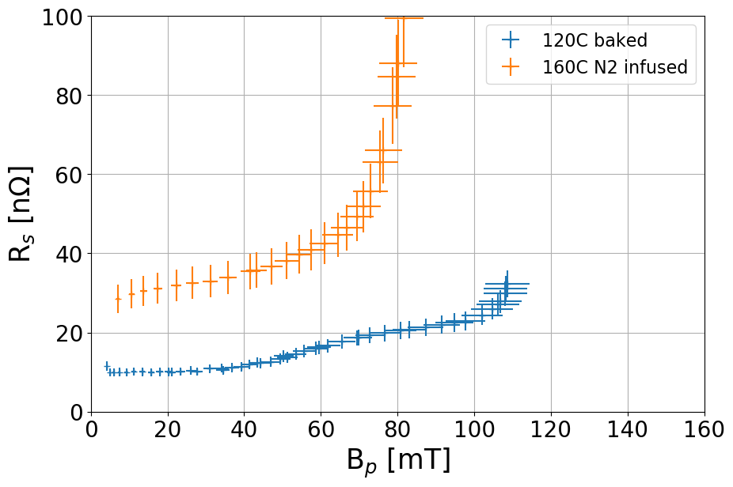
QWR infusion results
Surface resistances are NOT corrected for field distribution. Correction factors are all very similar and would only make a difference once compared to elliptical cavities which is not done here, hence no correction necessary.
217MHz
648MHz
Added additional surface resistance to the cavity, made it overall worse in both Rs and quench field. Gradient limited by field emissions.
Potential causes for low performance:
Used low purity nitrogen source, higher purity N2 gas will be used in future.
Cavity cleanliness before installation in furnace can be improved.
4.2K
2.1K
Notes:
And here are the fixed temperature results in orange, compared to the previous 120C baked results, in blue. As you can see the performance is worse across the board. Higher resistance, lower quench field in all cases. We did have field emissions in there, so the assembly was not as clean as it could be but that’s not responsible for the low field performance. Potential causes for the poor performance that we already identified are a low purity nitrogen source and we can improve on the cavity cleanliness before installation in our furnace.

Slide 16
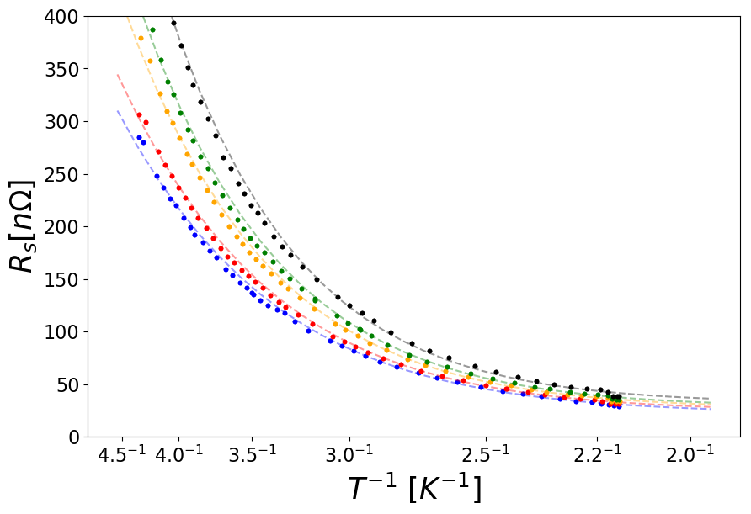
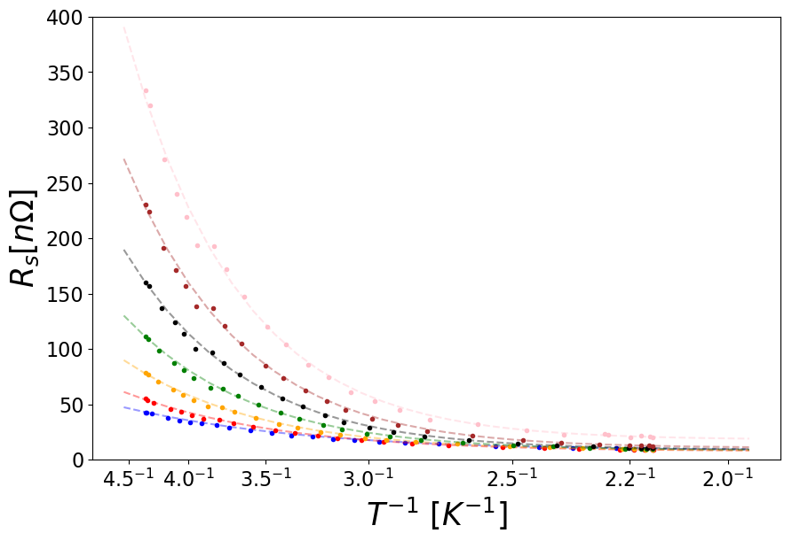
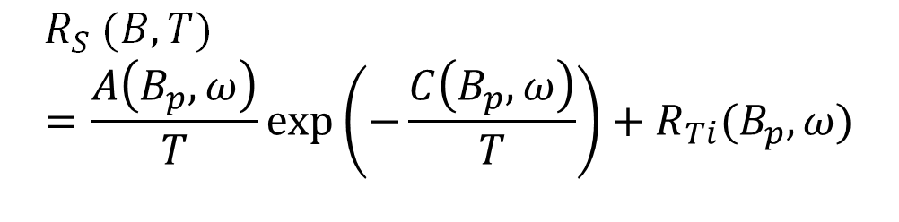
Cooldown data
648MHz
To extract temperature depended and independent parts as function of peak surface magnetic field
217MHz
Fitting function:
$$R_{S}^{ } (B,T)=\frac{A\left(B_{p}, ω\right)}{T}\exp\left(−\frac{C\left(B_{p}, ω\right)}{T}\right)+R_{Ti}(B_{p}, ω)$$
With A, C, R_{Ti} as fit parameters.
Notes:
Again, we’re taking data during the cooldown to extract temperature dependence.

Slide 17
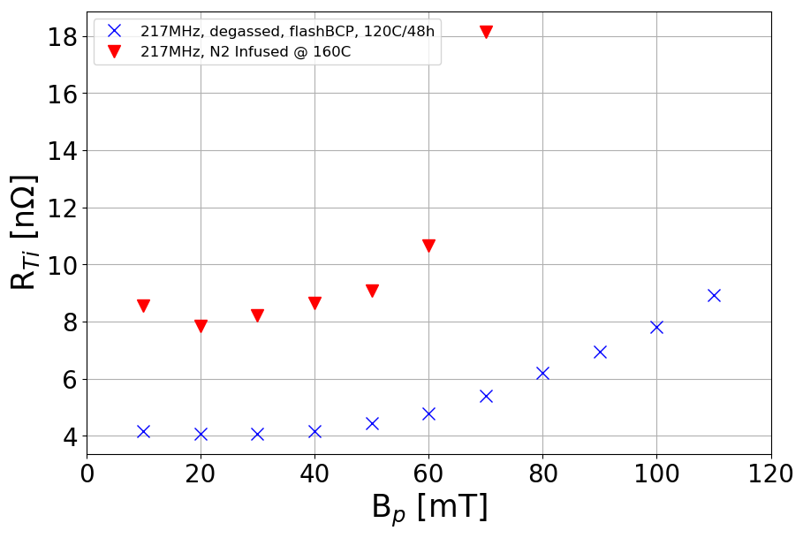
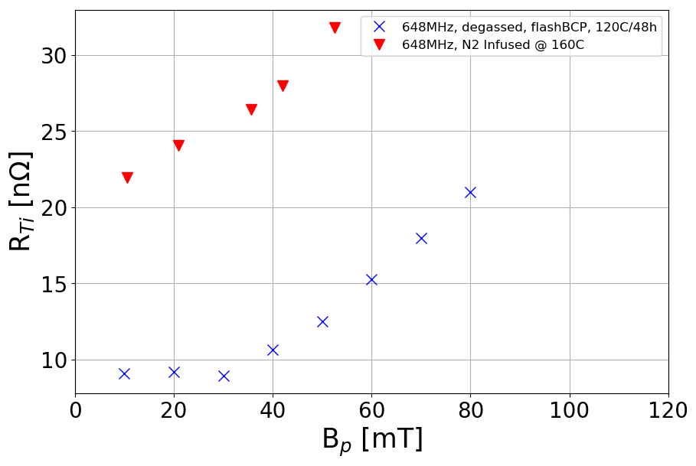

R_{Ti} after infusion
$$R_{S}^{ } (B,T)=\frac{A\left(B_{p}, ω\right)}{T}\exp\left(−\frac{C\left(B_{p}, ω\right)}{T}\right)+R_{Ti}(B_{p}, ω)$$
217MHz
648MHz
Increased R_{Ti} compared to degas/flashBCP/120C
Similar trends
Notes:
Looking at Rti, we got a sizable increase here but with overall similar trends, leading to the suspicion that the surface is somewhat contaminated with something undesirable.

Slide 18
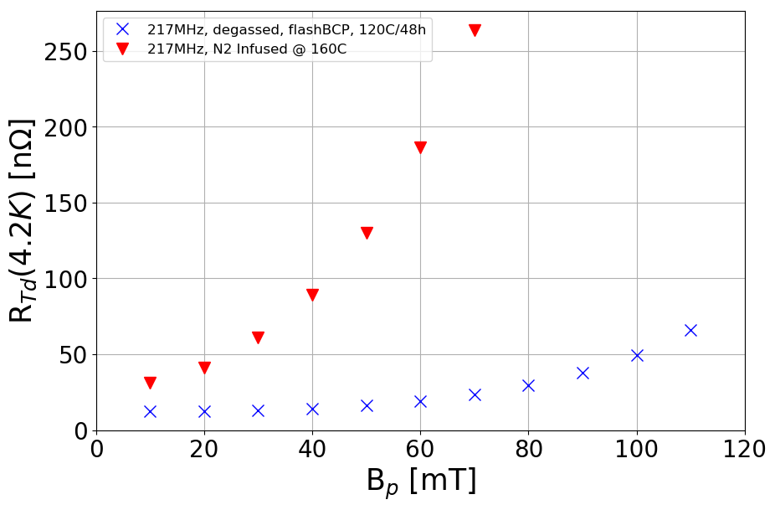
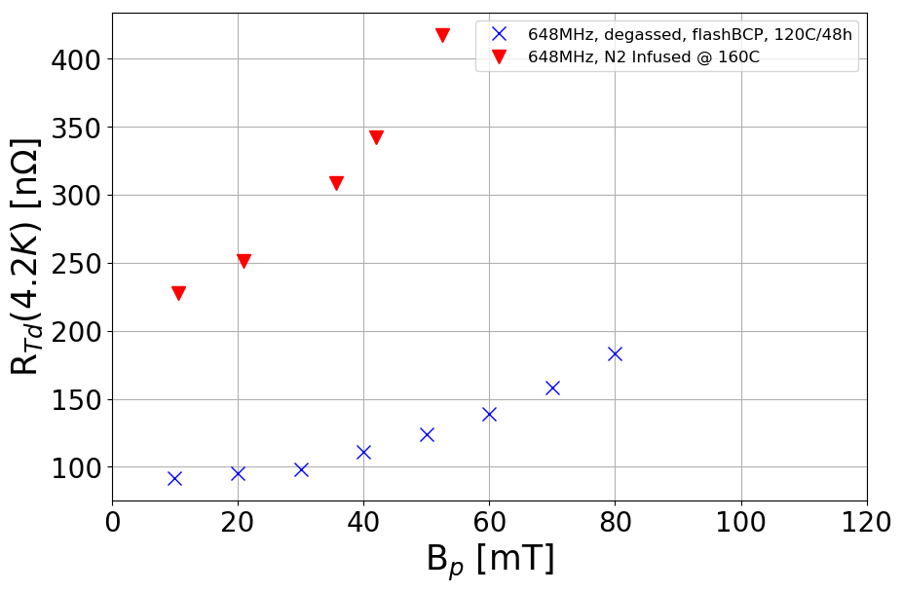
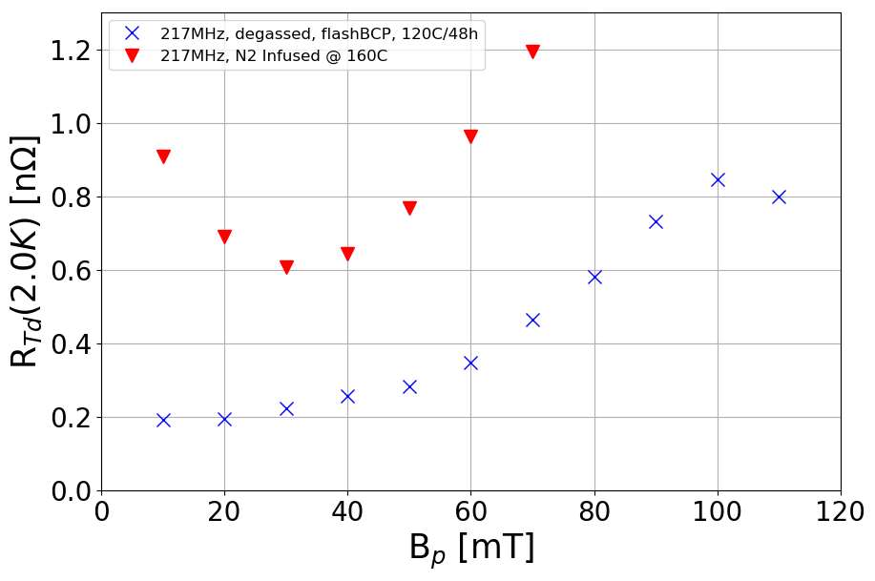
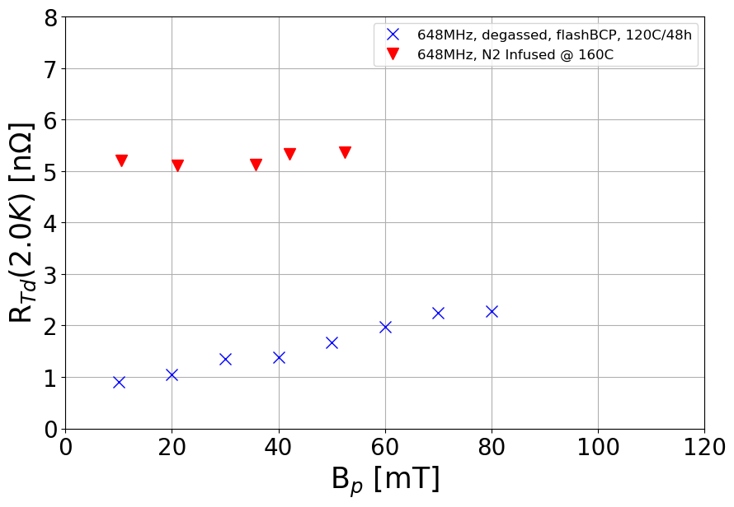

R_{Td} after infusion
$$R_{S}^{ } (B,T)=\frac{A\left(B_{p}, ω\right)}{T}\exp\left(−\frac{C\left(B_{p}, ω\right)}{T}\right)+R_{Ti}(B_{p}, ω)$$
217MHz
648MHz
R_{Td} minimum appears at around Bp = 30mT at 217MHz.
Overall increased R_{Td} and increased field dependence.
Notes:
We also see an increase in RTd, this time not just in amplitude but also in field dependence as you can see in these 4.2K plots. At 2.0K we actually see something interesting besides the increased resistance. There appears to be a minimum resistance right around 30mT, This could be an indication of the positive Q slope that has been seen in elliptical cavities.

Slide 19
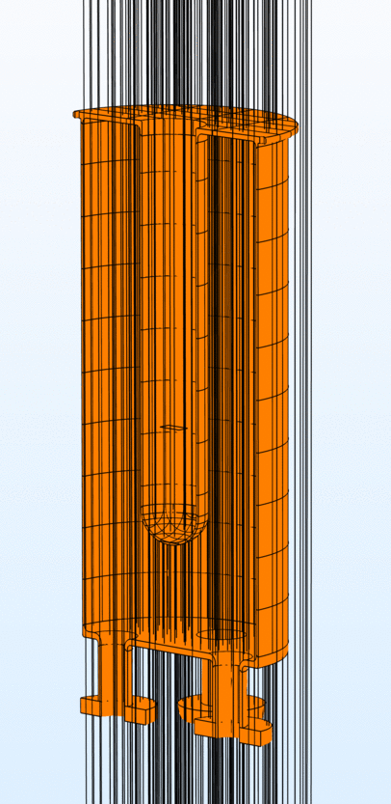
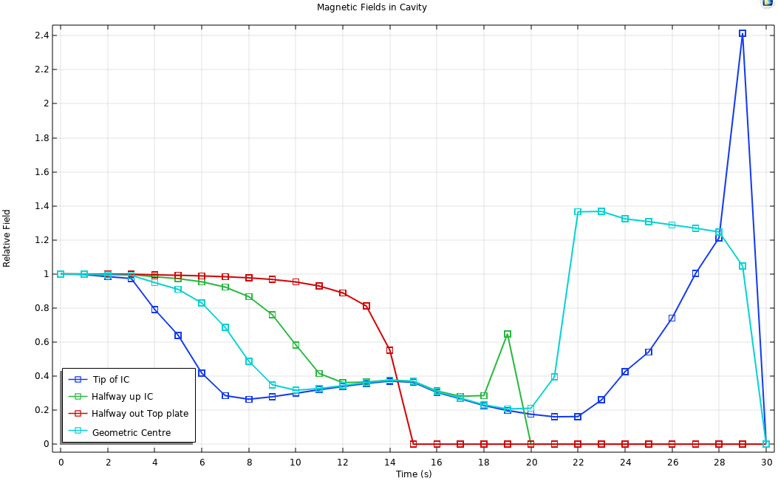
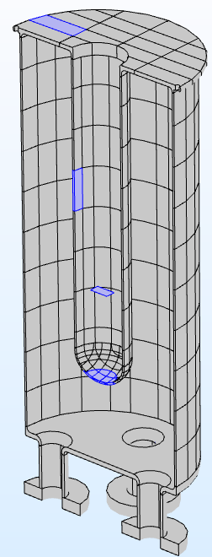
QWR : Magnetic Expulsion Simulation
Halfway Up IC
Halfway Top Plate
Arb. Timesteps
Geo. Center
Tip of IC
Last time step in simulation when tip becomes sc seems unphysical, presumably flux gets trapped and frozen in there.
Notes:
One more topic of studies with these cavities is magnetic flux expulsion during cooldown. We’ve done some simulation on how we thing this might look and here is an animation of the quarterwave transitioning and expelling flux when gets into the Meissner state. In this plot is the magnetic field plotted at different spots along the cavity. I’d like to focus on the geometric center as that’s where my probes are. You can see first this dip in amplitude and then this rise above the applied field as the inner conductor becomes superconducting and flux is focused through the tip of the inner conductor.

Slide 20
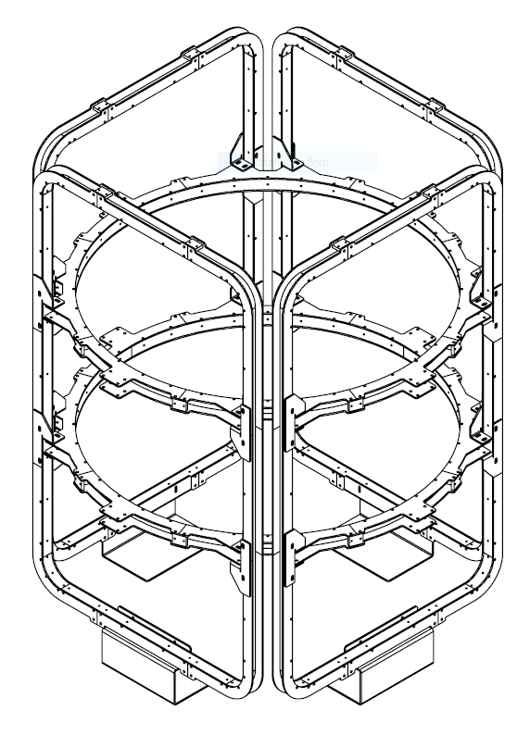
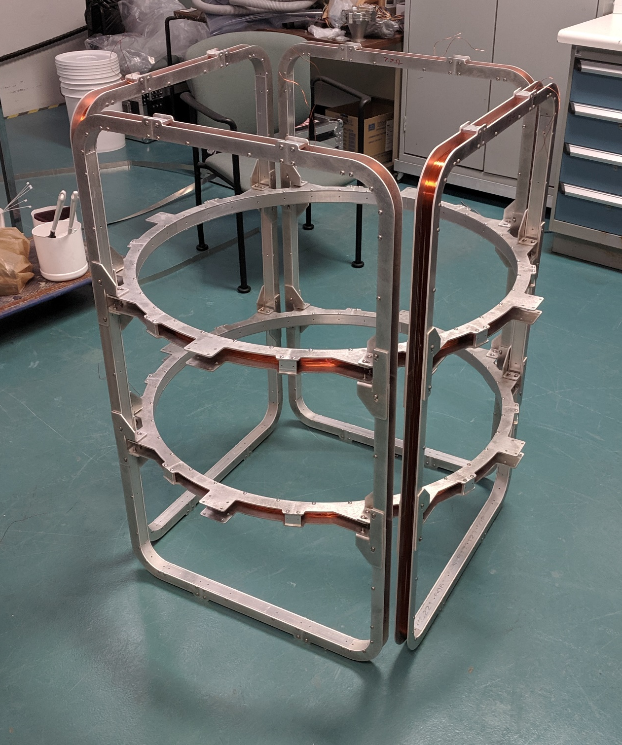
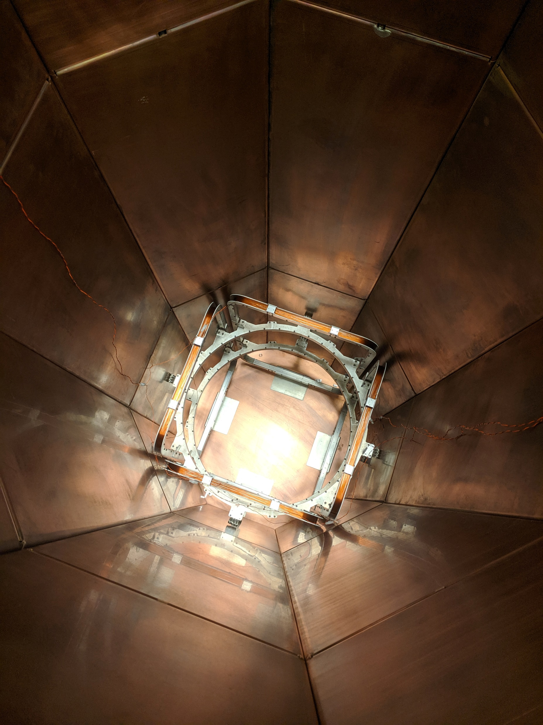
3D Helmholtz coils
Mech. Drawing
During assembly
Installed in cryostat
B field measurement using 3 Bartington fluxgate probes located in center of cavity\HH coils to measure vertical and horizontal fields.
Notes:
To control the magnetic field we designed and build a set of 3D Helmholtz coils and installed them in the cryostat, between the nitrogen shield and the helium vessel. We have three fluxgate probes installed in the geometric center of the coils which is also the geometric center of the cavity.

Slide 21

Transition through T_{C}
Loc. of T sensor
Geo. Center
Arb. Timesteps
Measured at geometric center of cavity + Helmholtz Coils
Notes:
And here in this right hand plot is what we measure as we cool down. Again first a dip and then an increased in field magnitude, so the simulations are reasonable. We did three cooldowns, first with a compensated background field, then 10 and 20 uT in the vertical direction.

Slide 22






External Magnetic Field Expulsion Studies
Cavity thermally cycled through T_{C} with 0, 10 and 20 μT external magnetic background field in vertical direction.
217MHz
648MHz
4.2K no changes visible, all Curves are on top of each other.
Notes:
And here are the surface resistance plots at 2K for the two resonant modes. First here for the compensated field, then here 10 and here 20 uT cooled. As you can see there is a clear increase in resistance with the applied field.

Slide 23


External magnetic field contributions
217MHz
648MHz
0.5 nΩ/μT at 217MHz
1.2-1.7 nΩ/μT at 648MHz, some field dependence
Notes:
And we see this increase in resistance mainly in Rti with about 0.5nOhm per uT at 217MHz and about 1.5nOHm per uT at 648MHz,

Slide 24


Next steps
Huge parameter space to explore with these cavities
HWR:
  120C/48h bake
  Exploring external magnetic field influence
  N2 infusion once optimized on QWR
QWR:
  Optimization of infusion technique
  Development of Electropolishing for N2 doping
  Further exploration of external magnetic field influence
  Cooldown studies
    Cooldown from outside/inside/both
Improved fitting routine
  Shared fit parameters between B_{p}, ω
Looking into T & H mapping for more diagnostics
Notes:
Finally, I hope to have shown you that we have a huge parameter space to explore with these cavities and a lot of interesting work can be done with them. In the near future we’ll go forward with a low temperature bake of the HWR while exploring the external magnetic field influence. And once optimized well go for an infusion treatment.
Speaking of optimized infusion, that’s our goal for the QWR. In parallel we’re working on getting EP ready for these cavities so that we can also do EP studies and doping. There’s some more that we can explore on external magnetic field and how the cooldown changes things in terms of flux expulsion.
At the same time we’re working on implementing shared parameter fitting and T & H mapping.

Slide 25
Some references
Cavity design: Z. Yao: SRF2017 TUPB065, LINAC2018
First QWR cold test results: P. Kolb: TTC 2019 Vancouver
Further QWR test results: P. Kolb, SRF2019: TUP046
Field Distribution correction: J. Delayen: Phys. Rev. Accel. Beams 21, 122001
T & H mapping: B. Schmitz: Rev. Sci. Inst. 89, 054706

Slide 26
Thanks!
Thanks go to the people who make things happen in the background:
  Bhalwinder Waraich, James Keir, Devon Lang, David Kishi, Johnson Cheung, Bryan Dury, Melissa Biaocci, Marc Vanderbanck …
And you for your attention!

Slide 27
QWR cooldown scenarios
LHe supply
LHe supply
LHe supply
Cooldown from out- and inside the inner conductor:
Currently done in ISAC-II accelerator, potential to push magnetic field to top plate and trapping it in high H field area.
Outside cooldown:
Currently done, tip of inner conductor (high E field) transitions last, trapping magnetic flux there.
Inside cooldown:
Tip of inner conductor transitions first, pushing magnetic flux towards bottom plate into low field area.

Slide 28



N2 Infusion Fit Parameters
Zero field cooled data
$$R_{S}^{ } (B,T)=\frac{A\left(B_{p}, ω\right)}{T}\exp\left(−\frac{C\left(B_{p}, ω\right)}{T}\right)+R_{Ti}(B_{p}, ω)$$

