Slide 1
Sebastian Keckert
Overview Multilayers – RF Results
TTC Meeting
5 Feb 2020, CERN

Slide 2
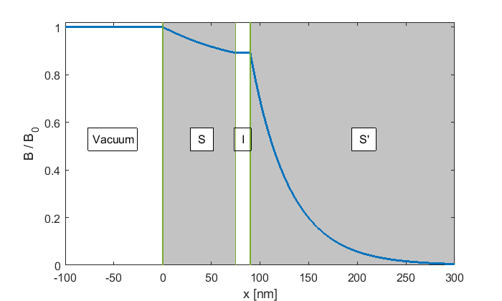
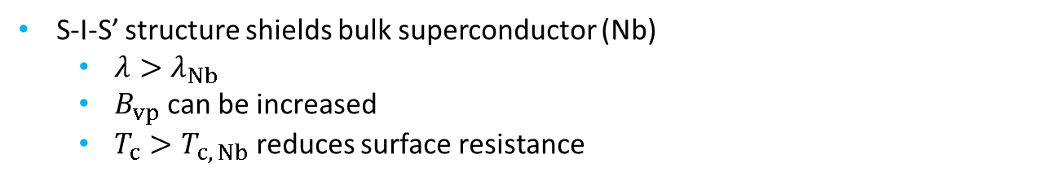
Motivation
[A. Gurevich, Appl. Phys. Lett. 88, 012511, 2006]
On the way towards high gradient
[T. Kubo, Sc. Sci. Technol. 30, 023001, 2017]
S-I-S’ structure shields bulk superconductor (Nb)
  $λ>λ_{Nb}$
  $B_{vp}$ can be increased
  $T_{c}>T_{c, Nb}$ reduces surface resistance

Slide 3
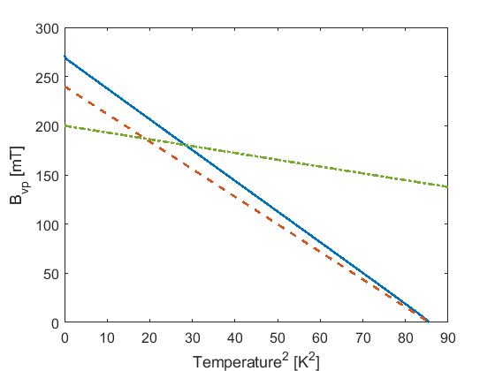
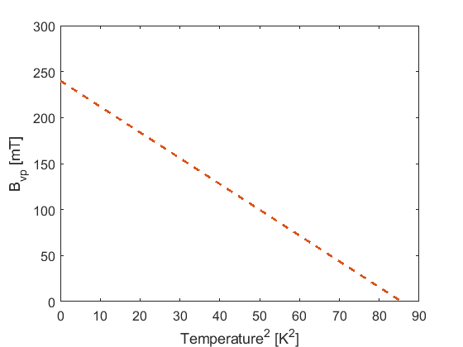
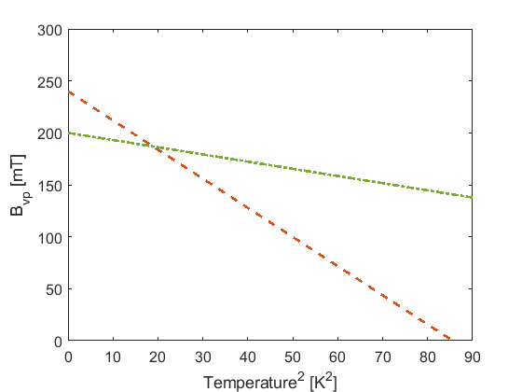
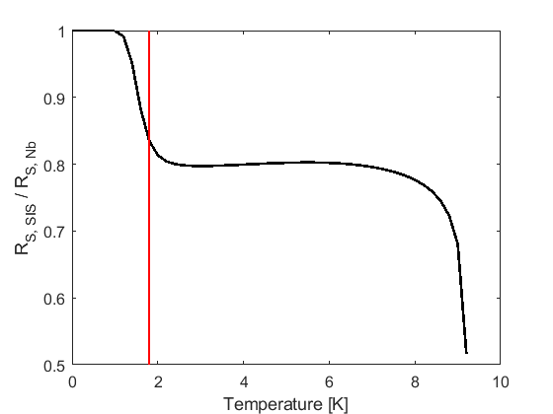
Motivation
[A. Gurevich, Appl. Phys. Lett. 88, 012511, 2006]
On the way towards high gradient
[T. Kubo, Sc. Sci. Technol. 30, 023001, 2017]
S-I-S’ structure promises high B_{max}
More stable w.r.t. early vortex penetration?
Moderate decrease of R_{S}
  Thick films needed for higher operating temperature !
1.8 K
S-I-S´: B_{max}=273 mT
NbTiN: B_{sh}=200 mT
Nb: B_{sh}=240 mT
Notes:
Right: Assuming the same residual resistance for Nb and NbTiN

Slide 4
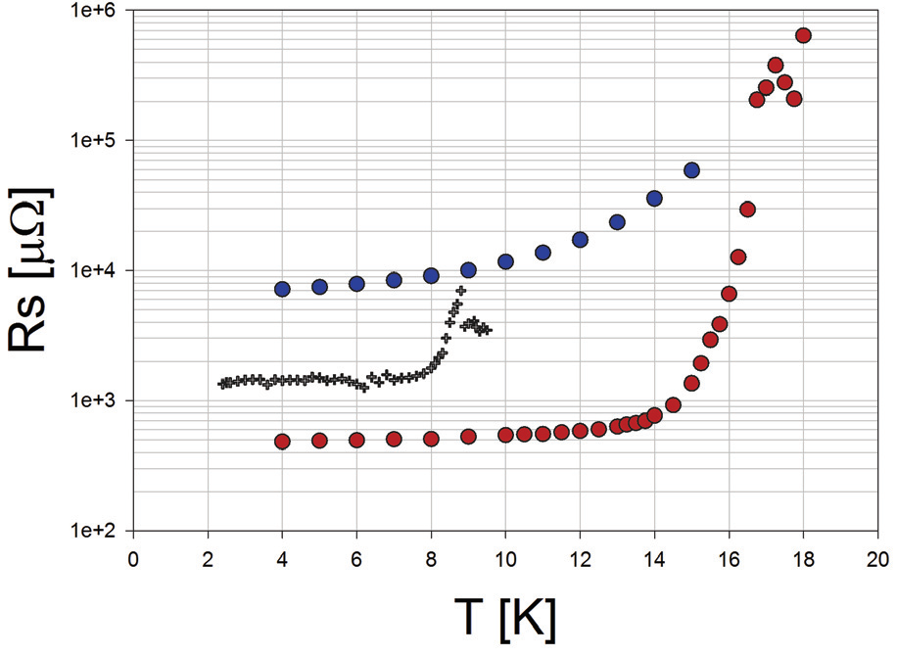
Overview: Multilayer at SRF conferences
Nb₃Sn / Al₂O₃ / Nb @ 7.5 GHz
TE011 sapphire loaded cavity 50mm disk sample
50nm Nb₃Sn / Al₂O₃ / Nb
bulk Nb
100nm Nb₃Sn / Al₂O₃ / Nb
[S. Sosa-Guitron, SRF’15]

Slide 5
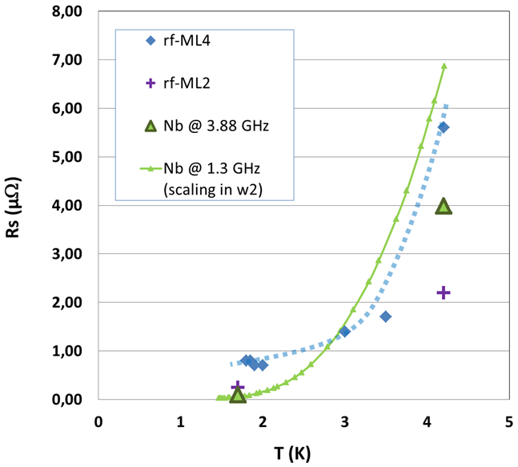
Overview: Multilayer at SRF conferences
100nm NbN @ 3.88 GHz, 1 mT
TE011 cavity
130mm disk sample
4x 25nm NbN / 14nm MgO
+ 5nm MgO top layer
Substrate: rough PC Nb
2x 50nm NbN / 14nm MgO
+ 5nm MgO top layer
Substrate: smooth LG Nb
[C. Baumier, SRF’13]

Slide 6
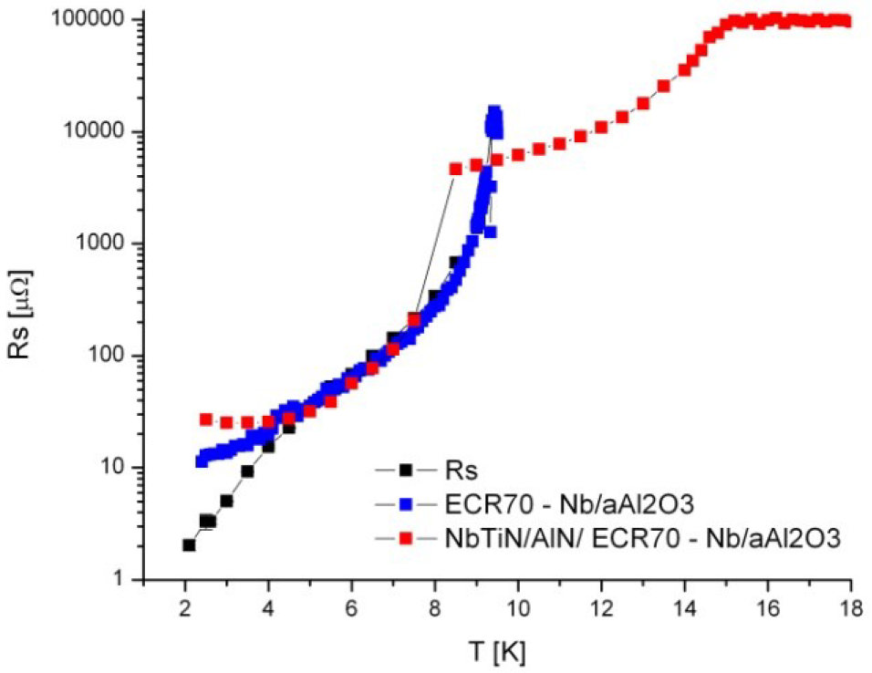
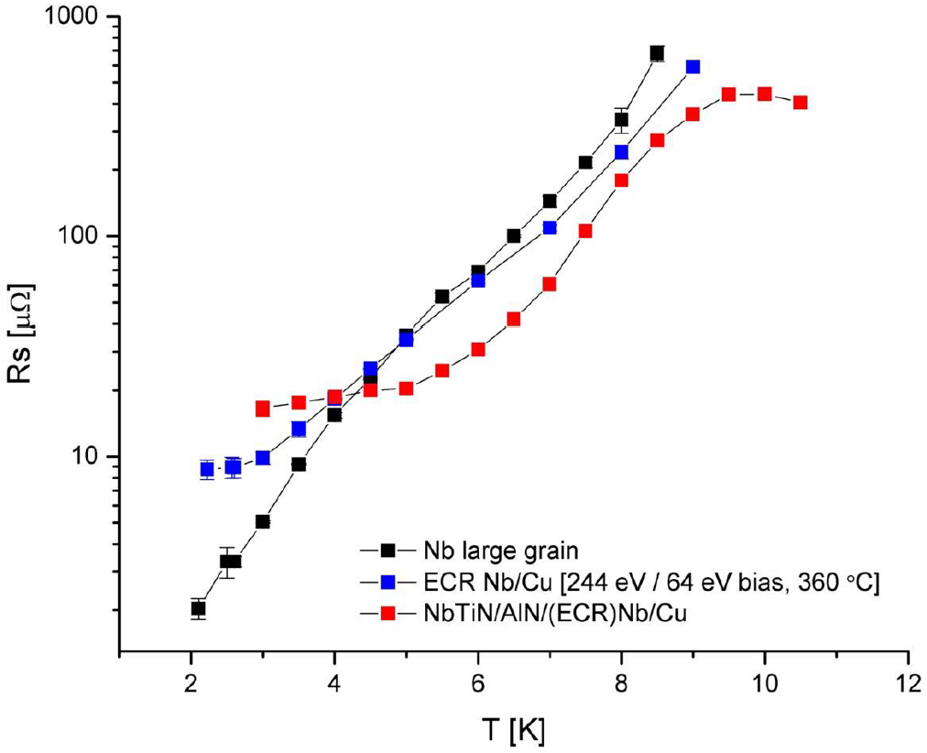
Overview: Multilayer at SRF conferences
NbTiN / AlN / Nb @ 7.5 GHz
TE011 sapphire loaded cavity
50mm disk sample
[A.-M. Valente-Feliciano, SRF’13]
[A.-M. Valente-Feliciano, SRF’15]

Slide 7
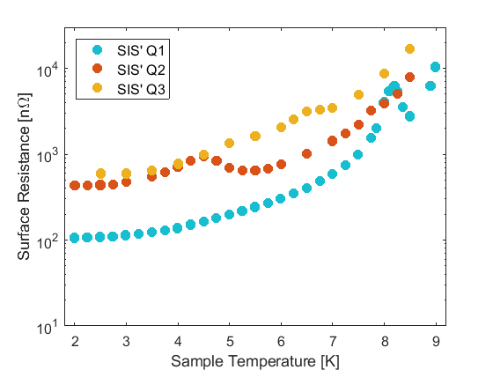
Overview: Multilayer at SRF conferences
75nm NbTiN / 15nm AlN / Nb @ 10 mT
HZB QPR, 75mm disk sample
1286 MHz
845 MHz
414 MHz
[S. Keckert, SRF’19]

Slide 8
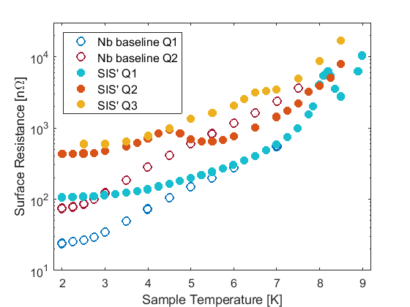
Overview: Multilayer at SRF conferences
75nm NbTiN / 15nm AlN / Nb @ 10 mT
HZB QPR, 75mm disk sample
1286 MHz
845 MHz
414 MHz
[S. Keckert, SRF’19]

Slide 9
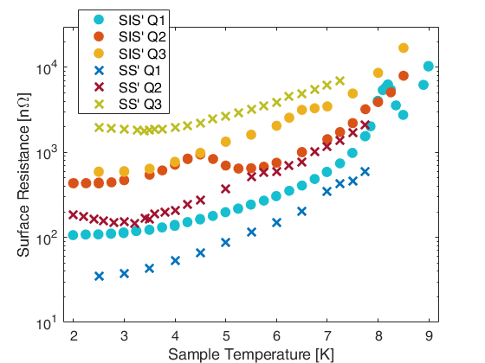
Overview: Multilayer at SRF conferences
S-I-S´ : 75nm NbTiN / 15nm AlN / Nb
S-S´ : 70nm NbTiN / Nb
HZB QPR, 75mm disk sample
1286 MHz
845 MHz
414 MHz
[D. Tikhonov, SRF19]
[S. Keckert, SRF’19]

Slide 10
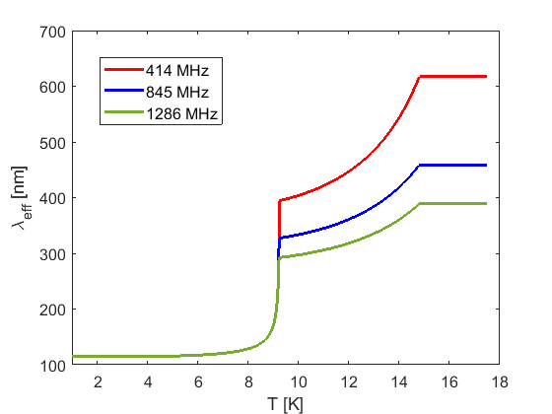
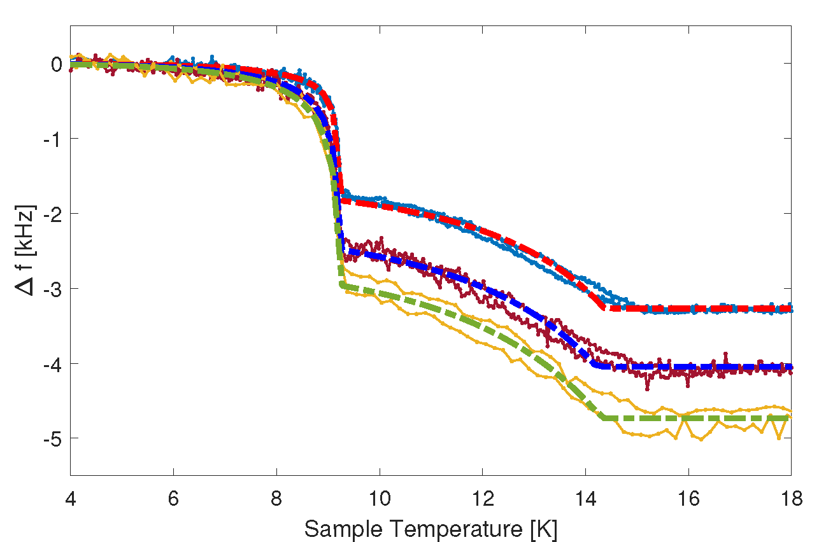

S-I-S´ penetration depth
75nm NbTiN / 15nm AlN / Nb
HZB QPR, 75mm disk sample
414 MHz, 845 MHz, 1286 MHz
14.3 K
9.25 K
Dashed lines:
Fits using S-I-S´
multilayer theory
$Δf∝f$

Slide 11
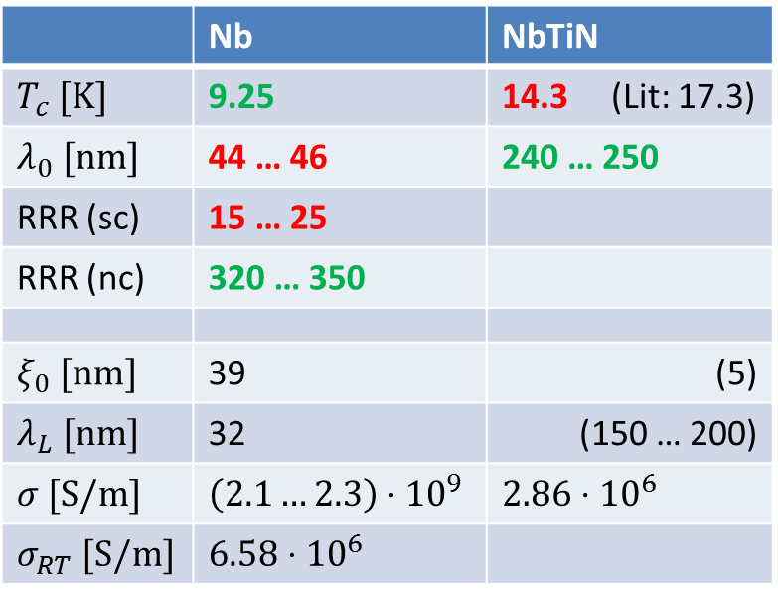
S-I-S´ penetration depth
 | Nb | NbTiN
$T_{c} [K]$ | 9.25 | 14.3 (Lit: 17.3)
$λ_{0} [nm]$ | 44 … 46 | 240 … 250
RRR (sc) | 15 … 25
RRR (nc) | 320 … 350
$ξ_{0} [nm]$ | 39 | (5)
$λ_{L} [nm]$ | 32 | (150 … 200)
$σ [S/m]$ | $\left(2.1…2.3\right)⋅{10}^{9}$ | $2.86⋅{10}^{6}$
$σ_{RT} [S/m]$ | $6.58⋅{10}^{6}$
75nm NbTiN / 15nm AlN / Nb
HZB QPR, 75mm disk sample
414 MHz, 845 MHz, 1286 MHz
9.25 K
Dashed lines: Fits using
S-I-S´ multilayer theory
14.3 K

Slide 12
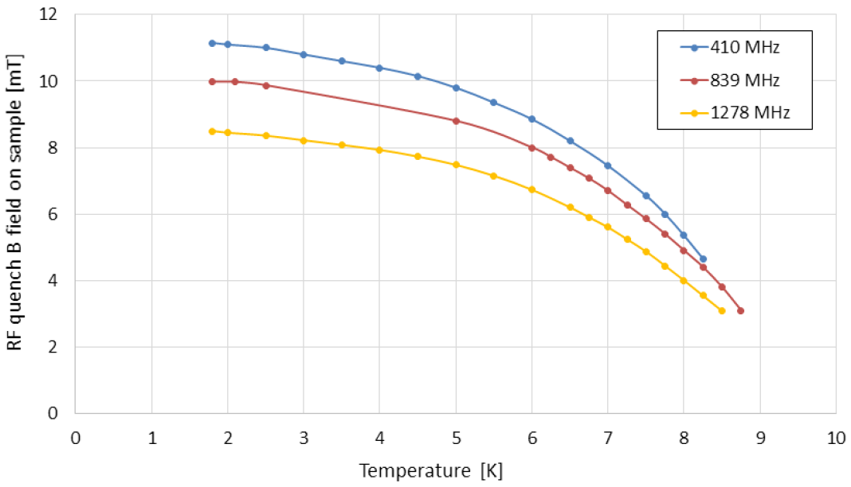
S-S´ RF quench field
70nm NbTiN / Nb
No insulator
HZB QPR, 75mm disk sample
[D. Tikhonov, SRF19]

Slide 13
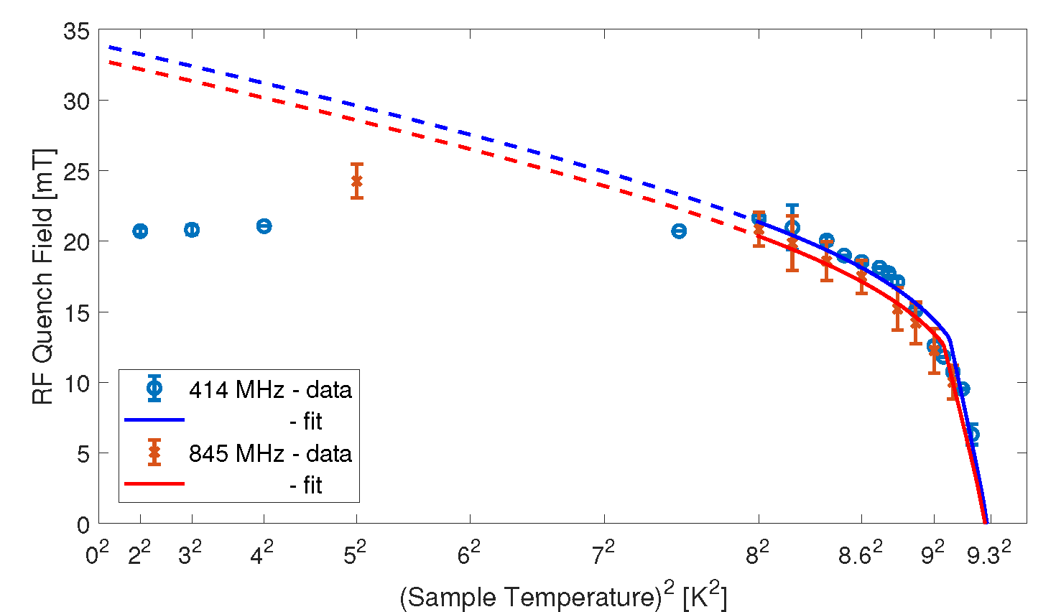
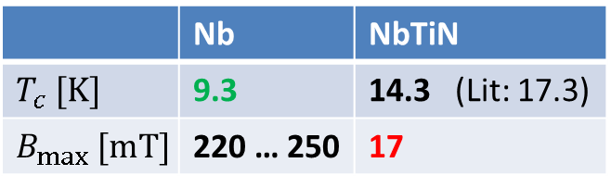
S-I-S´ RF Quench field
Hard magnetic quench limit at 20-25 mT
Fit according to S-I-S´ multilayer theory
S-I-S´ allows increase of bulk limit
 | Nb | NbTiN
$T_{c} [K]$ | 9.3 | 14.3 (Lit: 17.3)
$B_{max} [mT]$ | 220 … 250 | 17
Solid lines: S-I-S´ Fit
Dashed: Extrapolation

Slide 14
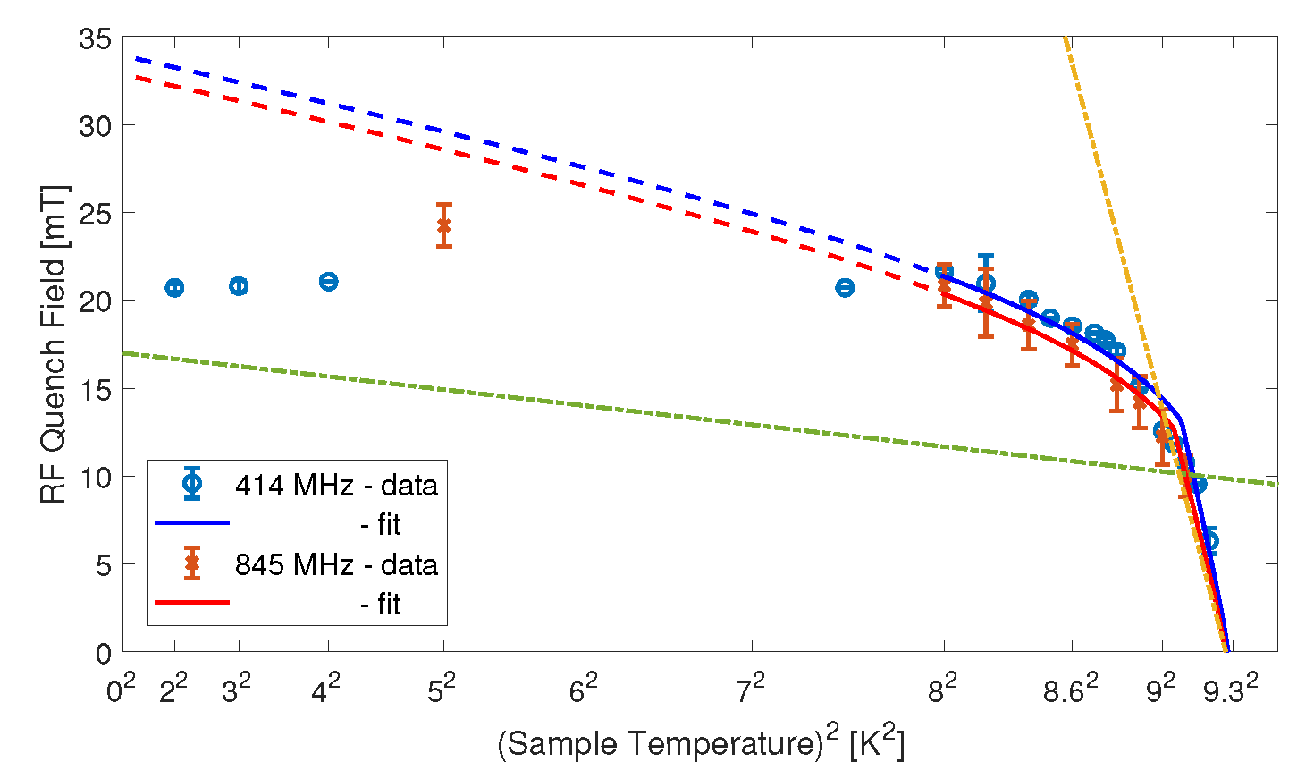
S-I-S´ RF Quench field
Hard magnetic quench limit at 20-25 mT
Fit according to S-I-S´ multilayer theory
S-I-S´ allows increase of bulk limit
 | Nb | NbTiN
$T_{c} [K]$ | 9.3 | 14.3 (Lit: 17.3)
$B_{max} [mT]$ | 220 … 250 | 17
Nb: 240 mT
NbTiN: 17 mT

Slide 15
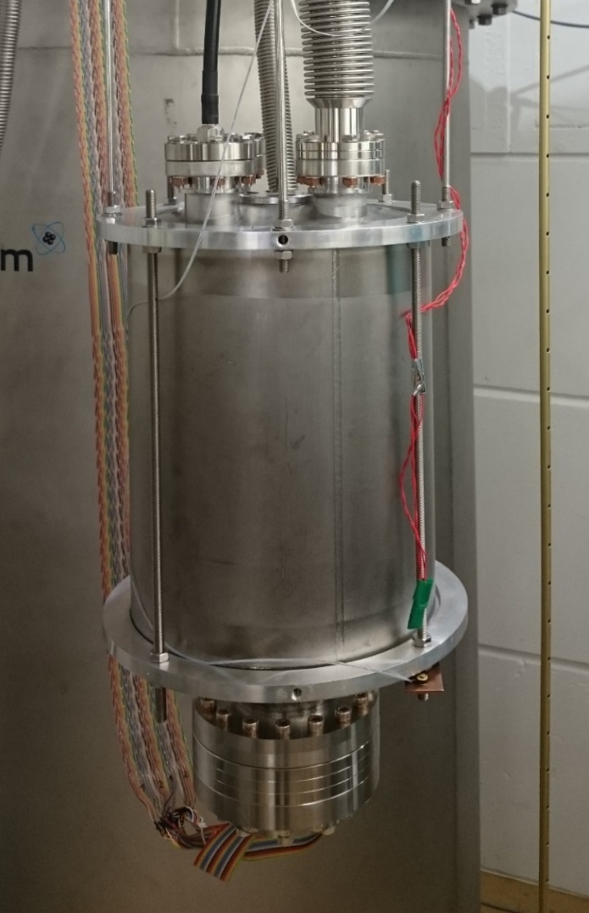
Conclusion
SRF characterization of multilayer structures with sample test cavities
So far: Mostly surface resistance data
at high frequency and low field
Consistently: Lower R_{S} than for Nb at higher temperature
So far: Severe limitations by residual resistance
Penetration depth measurement
agrees with S-I-S´ multilayer theory
First RF critical field measurements of S-I-S´ and
S-S´ structures show low-field quenches
We need more data on the RF quench field !
Thank you for your attention!

Slide 17
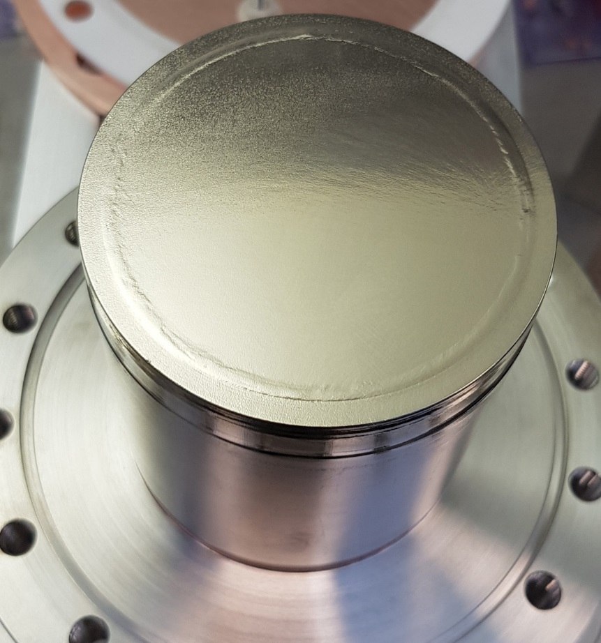
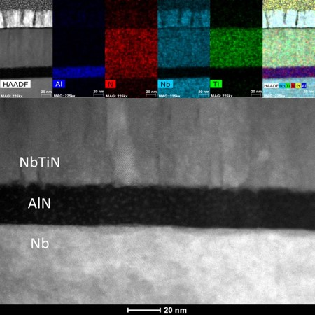
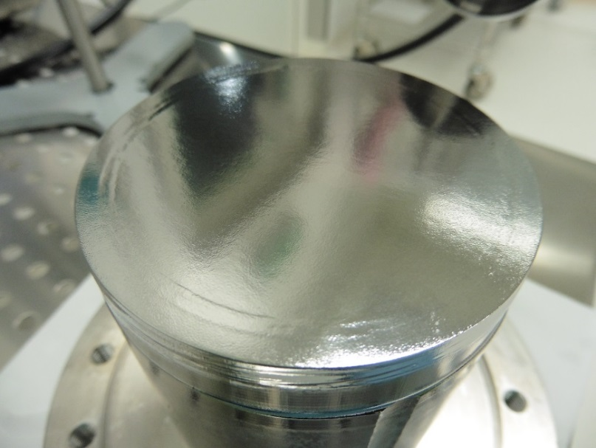
S-I-S´ Sample
75 nm NbTiN – 15 nm AlN – bulk Nb
[Courtesy of Anne-Marie Valente-Feliciano]

Slide 18
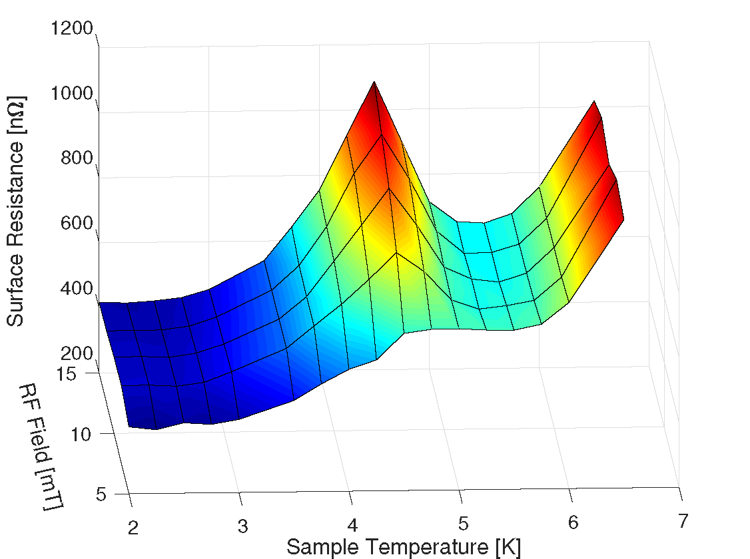
S-I-S´ – R(T,B) – 845 MHz

