Slide 1
Correlations between Tunneling
Spectroscopy and SRF cavity perfomances
Thomas Proslier
TTC – CERN - 05/02/220
Notes:
Saisir les champs « Titre », « P. Nom » et « Date.
Laisser ou retirer le bandeau.

Slide 2
Team:
Technician: A. Four, E. Fayet, G. Jullien, C. Servouin
Scientist: S. Berry, C. Antoine, E. Cenni, G. Devanz, F. Eozenou, T. Proslier
Ph.D.: Sarra Bira (IPNO/CEA), Y. Kalboussi (CEA)
Internship: R. Dubroeucq, S. Habhab
Collaborations:
KEK: T. Saeki, T. kubo, Marui. (thin films, theory, electropolishing)
IPNO: D. Longuevergne, M. Fouaidy, T. Pépin-donat
HZB: O. Kugeler (characterization, thin films)
DESY: M. Wenskat (characterization, thin films)
CERN: G. Rosaz, S. Calatroni (thin films)
STFC: R. Valizadeh (thin films, Nb3Sn)
INFN: C. Pira (thin films)
JLAB: A-M. Valente, G. Ciovati, D. Patshupati (Bulk Nb, thin films)
FNAL: S. Posen, A. Romanenko, A. Grassellino, M. Chechin (Bulk Nb, Nb3Sn)
ANL: A. Glatz – Theory (theory simulations)
IIT: J. Zasadzinski
TRIUMPH: T. Junginger (characterization)
Cornell: D. Hall, M. Liepe (Nb3Sn)

Slide 3
Correlations between Tunneling
Spectroscopy and SRF cavity perfomances
Point Contact Tunneling spectroscopy
Bulk Nb treatments
Nb3Sn/Nb
  Summary and future

Slide 4
Correlations between Tunneling
Spectroscopy and SRF cavity perfomances
Point Contact Tunneling spectroscopy
Bulk Nb treatments
Nb3Sn/Nb
  Summary and future

Slide 5
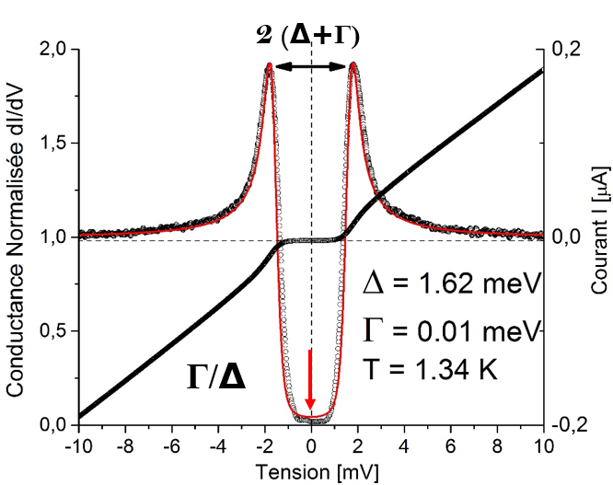
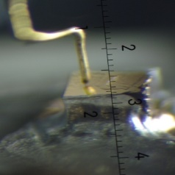
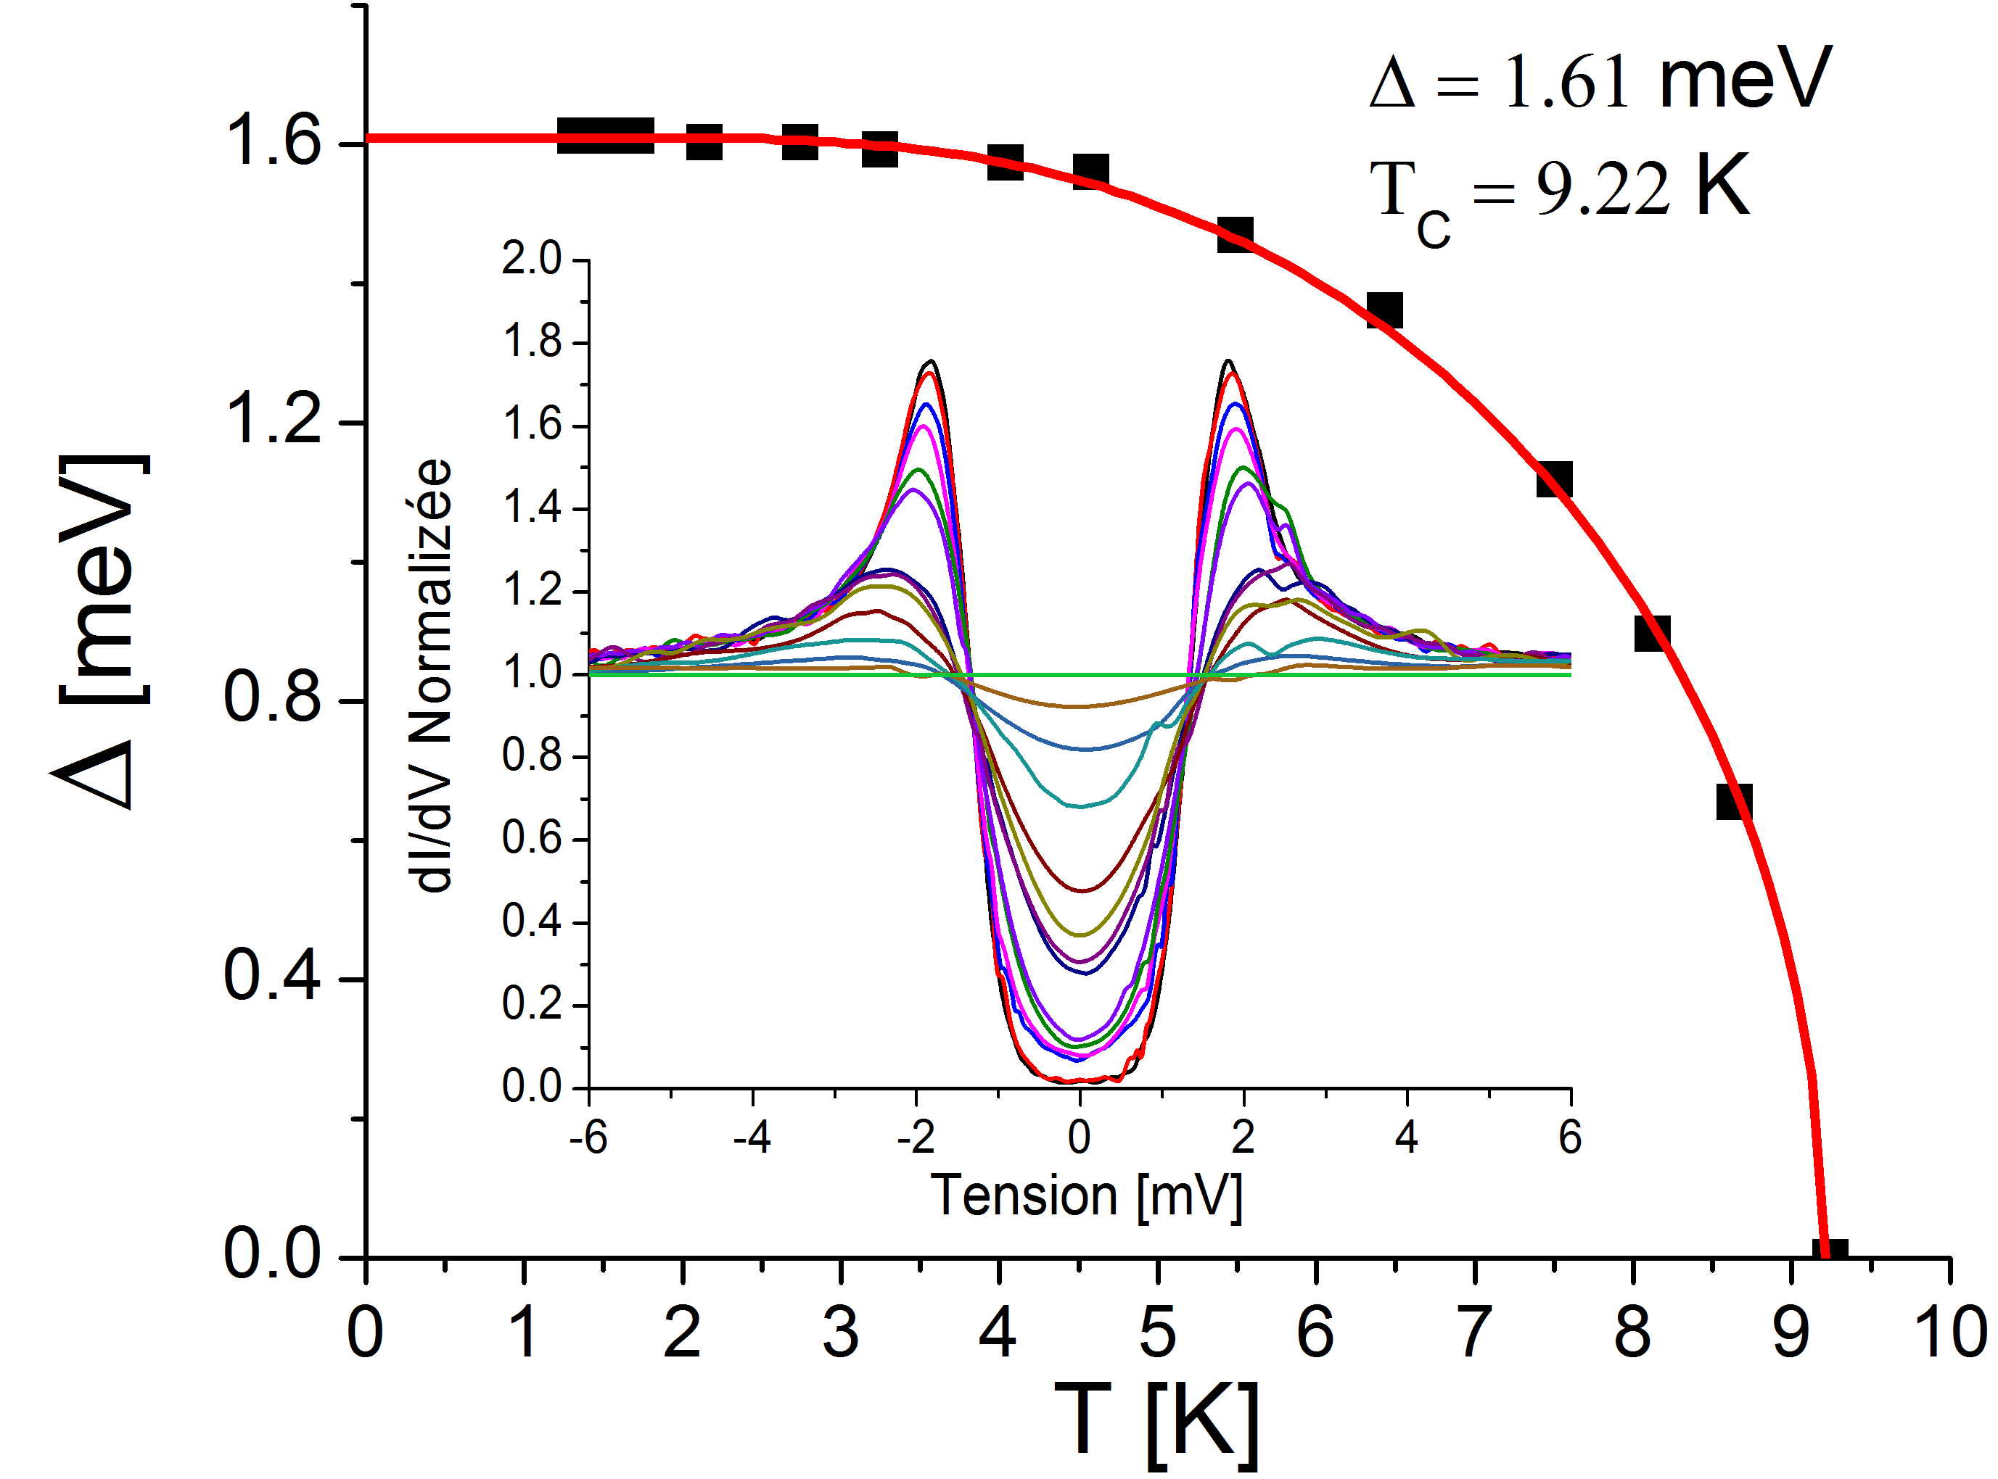
Tunneling spectroscopy: what do we measure and why?
principle
measure
Tc
Measure the fundamental superconducting parameters:
Δ, T_{C}, H_{C2}
Measure non-ideal signature: Γ.
Shape of the DOS give clues to microscopic origins:
Proximity effect, magnetic impurties, deleterious phases.
Direct correlation to SRF cavity performances.
Cartography.
Notes:
Cliquez sur Insertion puis En-tête/Pied pour saisir les champs « Evènement – Date » et « Service » ; puis cliquer sur Appliquer partout.

Slide 6
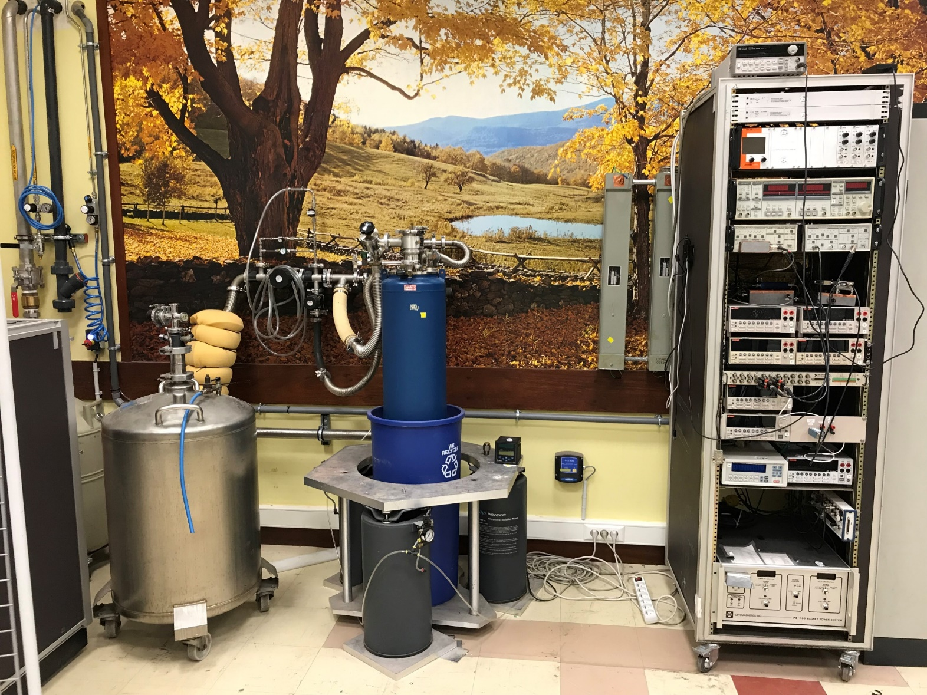
The Point Contact system at CEA
Gaz and Vacuum
Lines
Electronics
Cryostat
Pneumatic foot
Temp: 1,4 K
Magnetic field: 6 T
Cartography: 10 µm – 1 mm
Sample size: 10x10 mm
Fast measurements: 100-300 jonctions/5hrs
Transport (RRR, Tc vs H applied...)
Hall Effect
Used for Nb/Cu, bulk Nb doping, Nb3Sn, mutlilayers etc…

Slide 7
Correlations between Tunneling
Spectroscopy and SRF cavity perfomances
Point Contact Tunneling spectroscopy
Bulk Nb treatments
Nb3Sn/Nb
  Summary and future

Slide 8
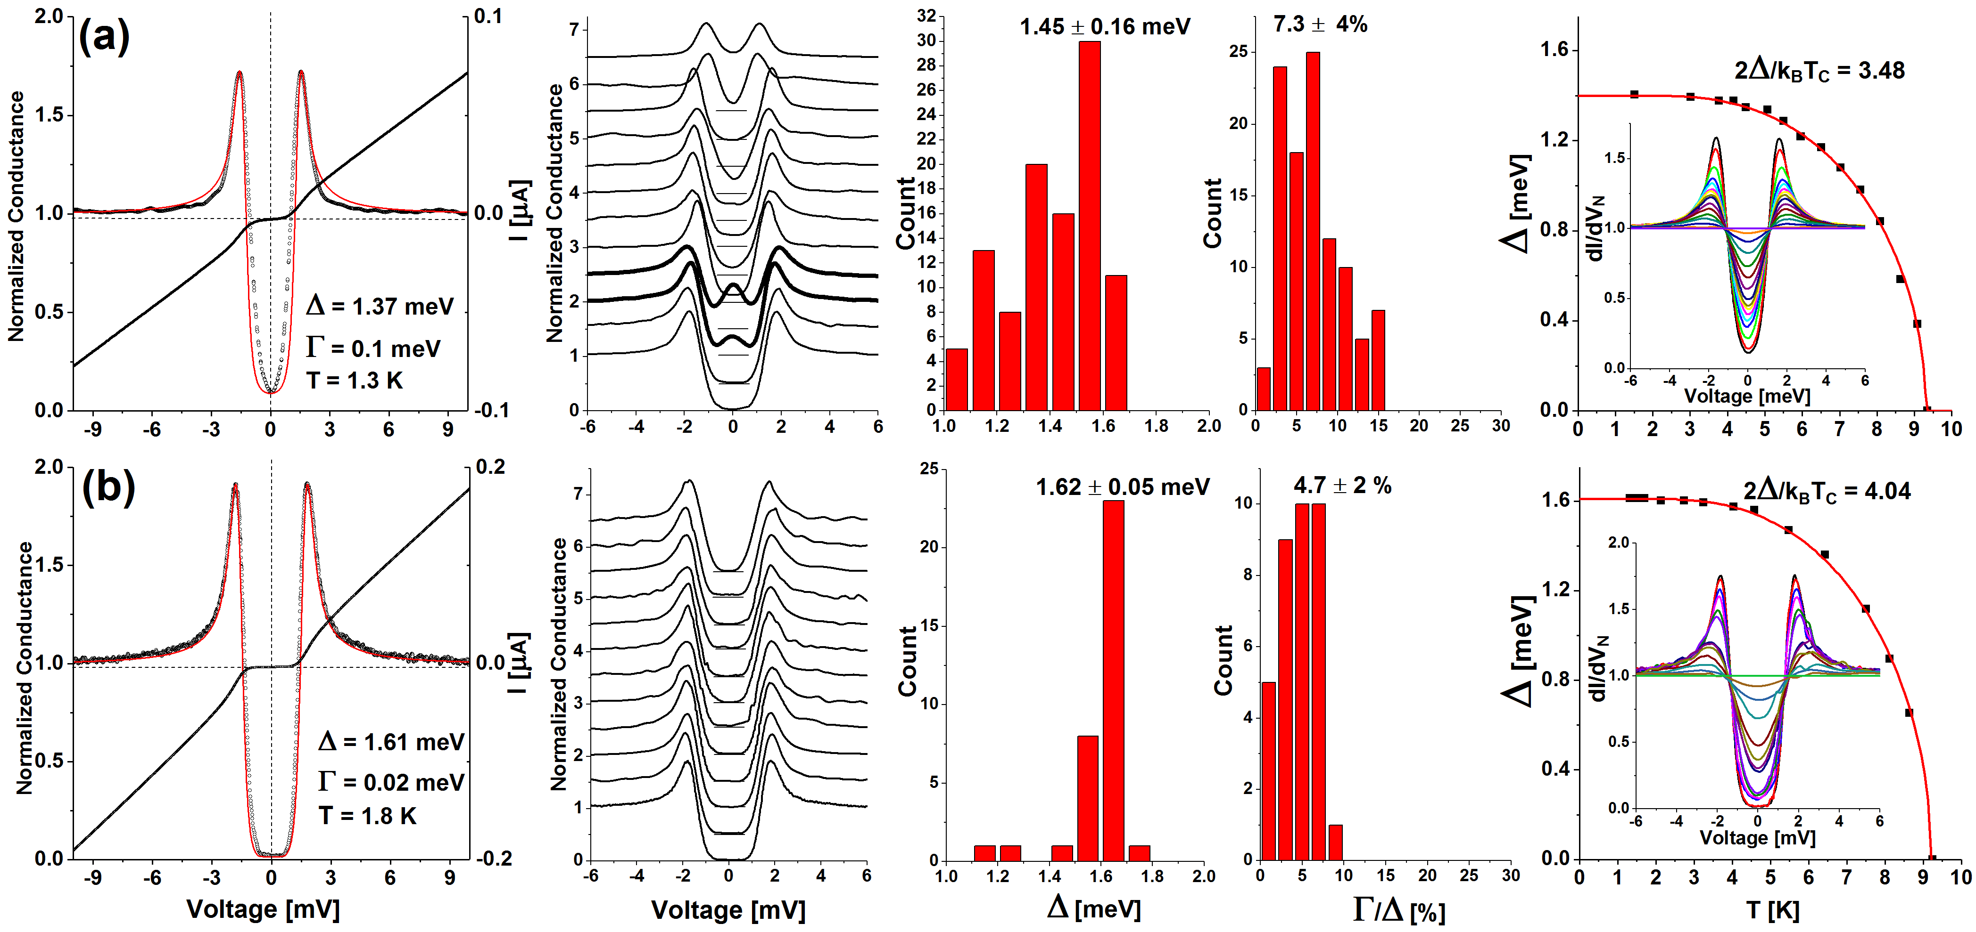
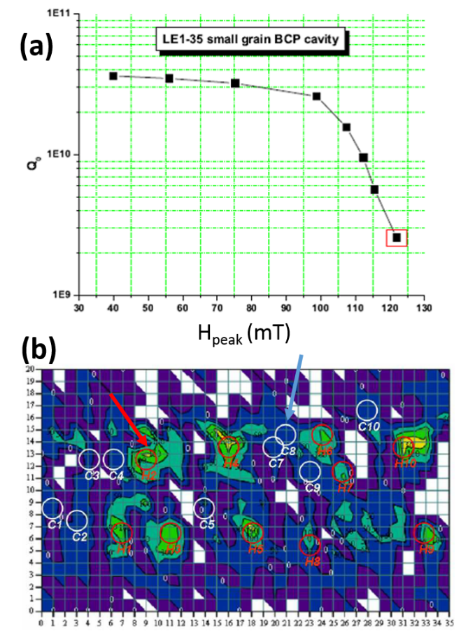
Tunneling spectroscopy: Bulk Nb HFQS
BCP Nb – small grain Nb
Hot Spots:
spread of gap values as low as 1 meV
Inelastic scattering parameters Γ
Zero Bias Peaks
Cold Spots:
Narrow gap distibution 1.6 meV
Lower Inelastic scattering parameters Γ
No zero bias peaks

Slide 9
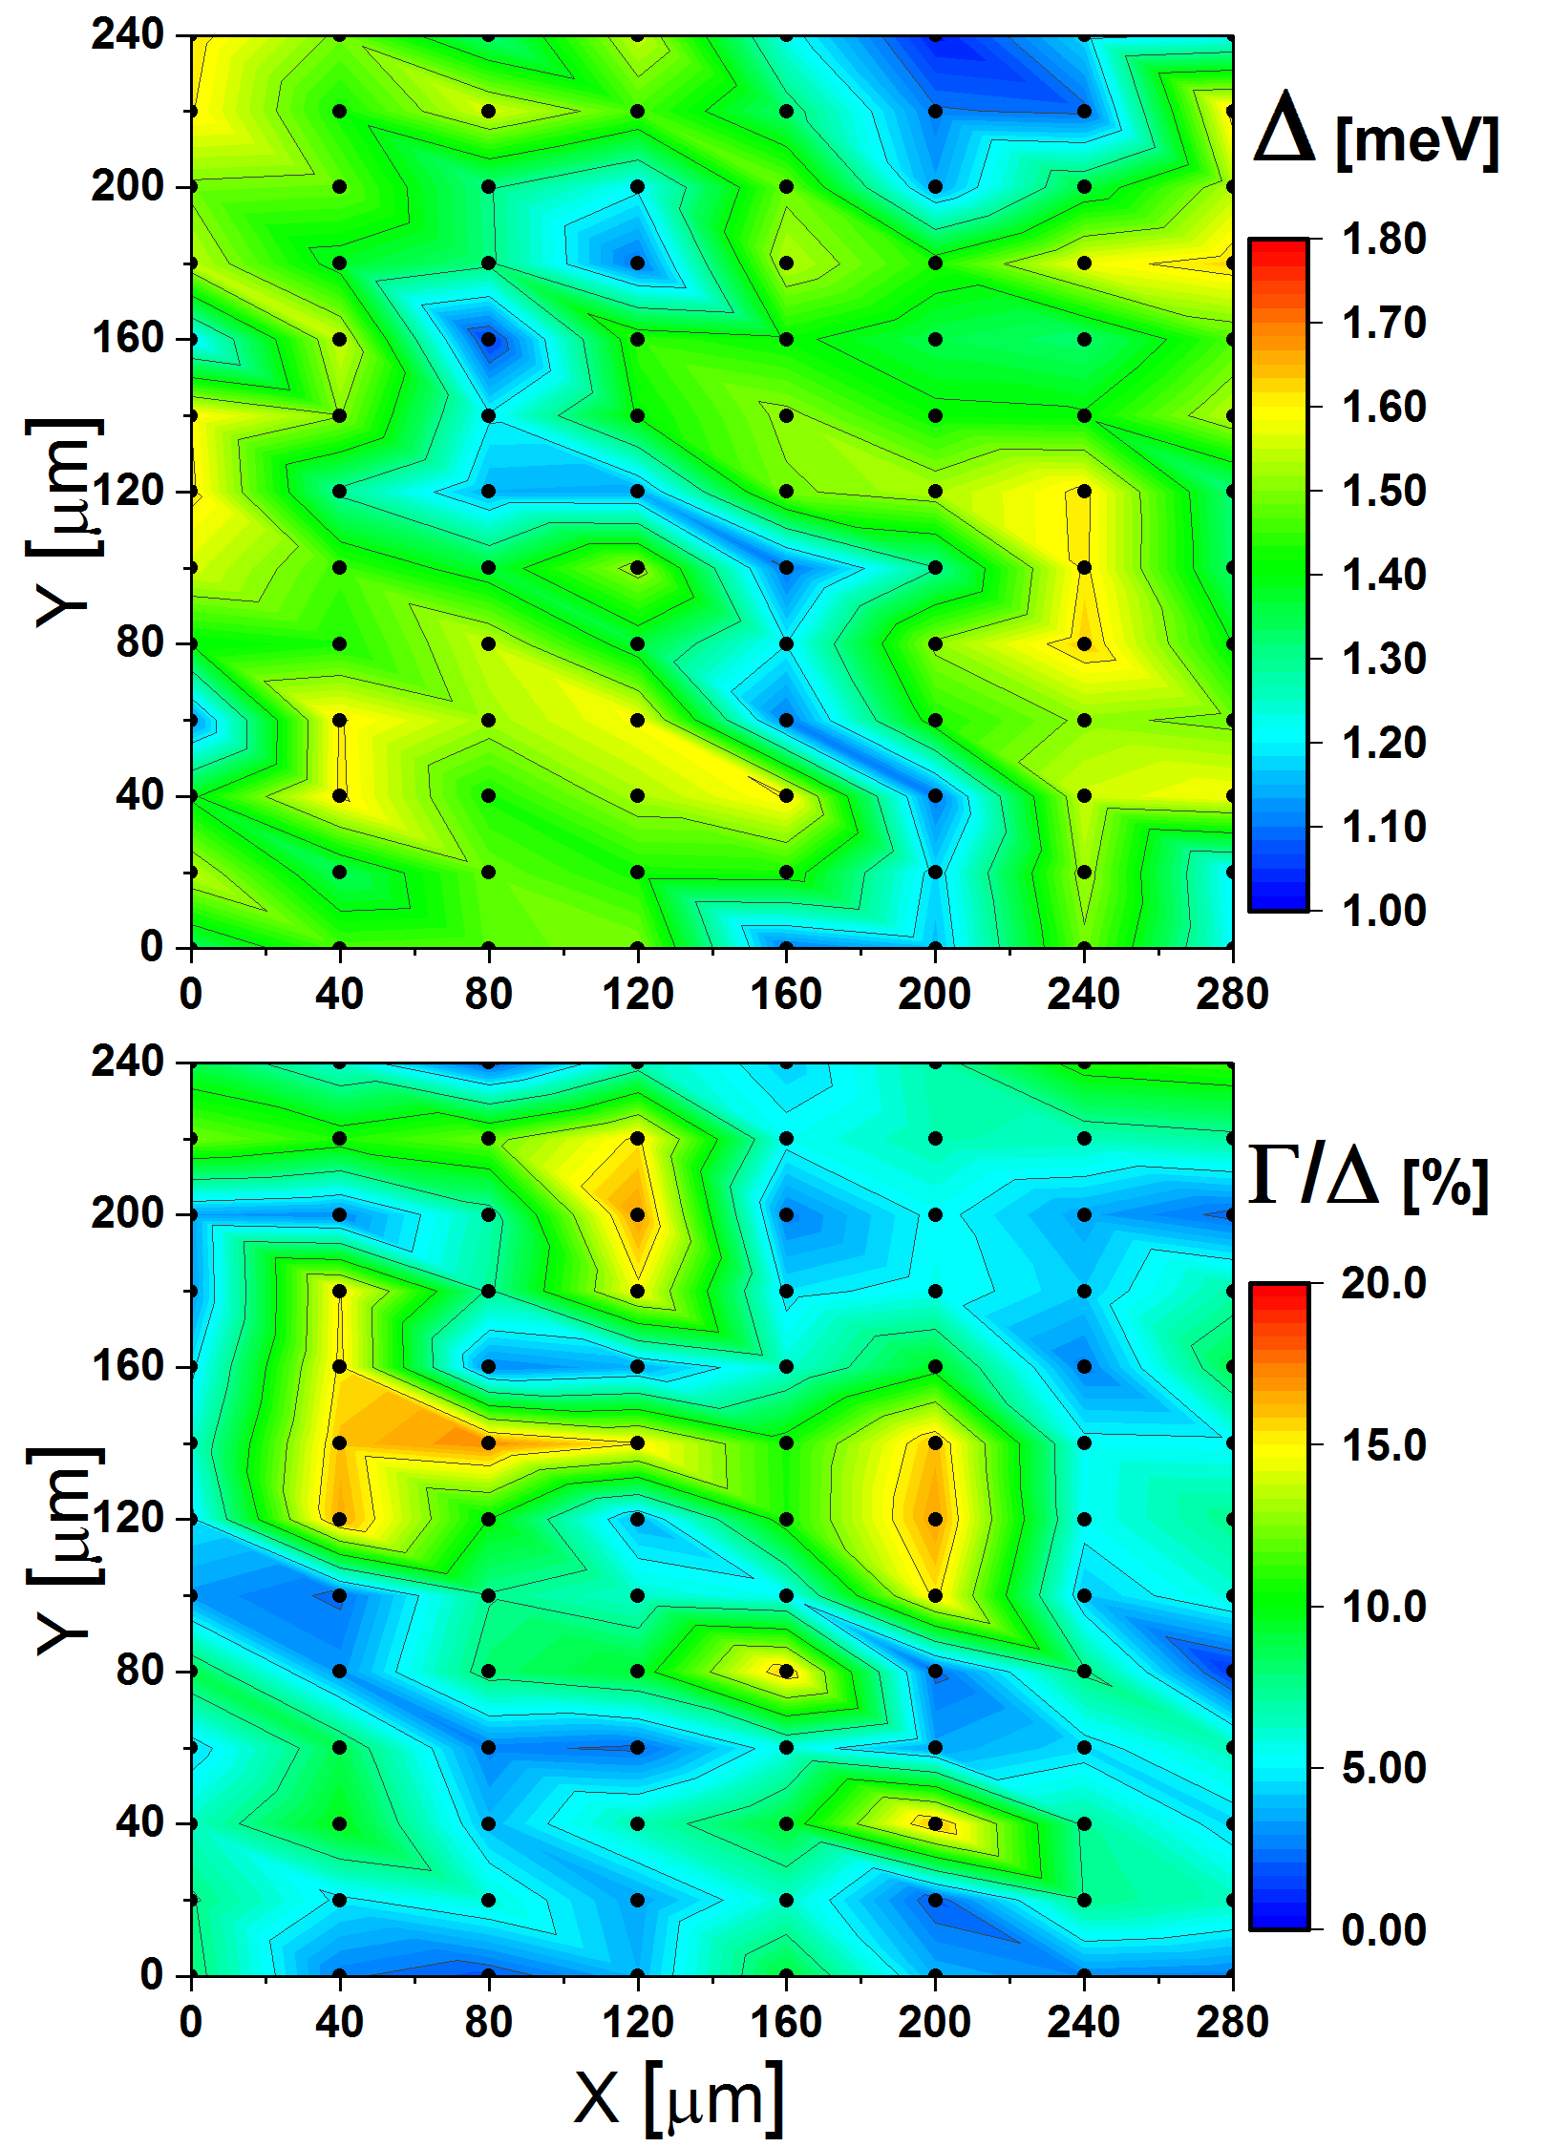
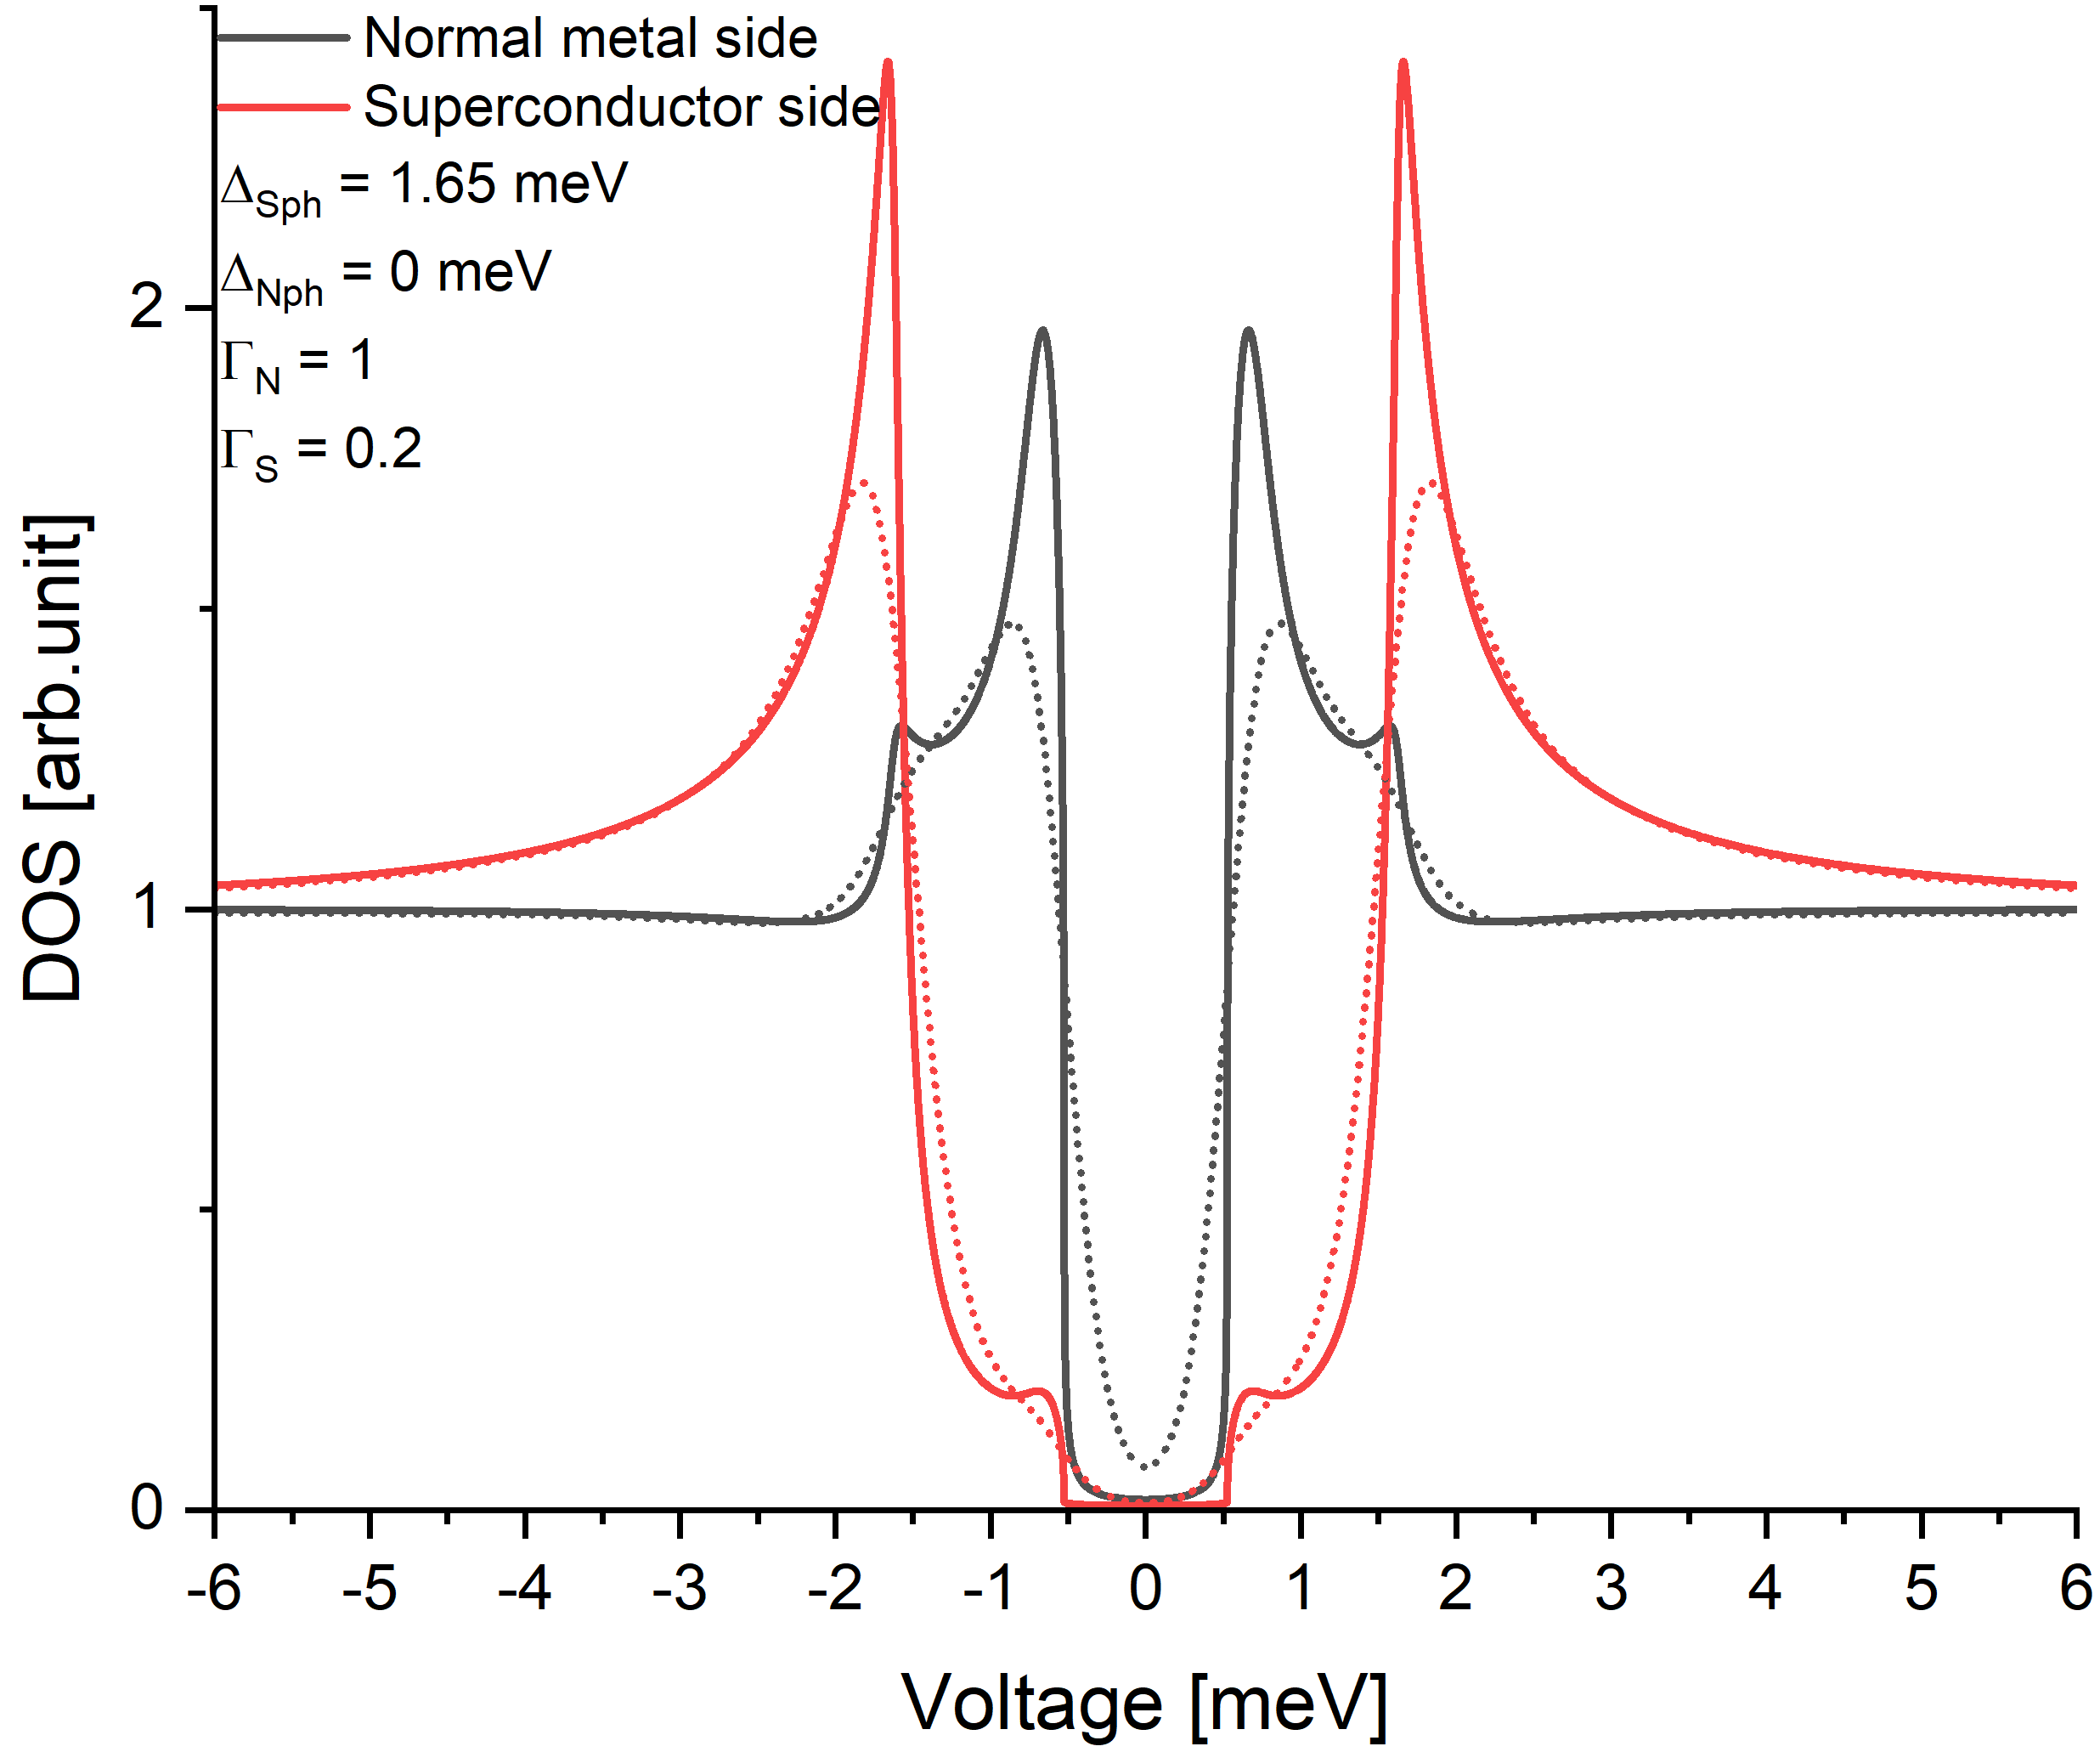
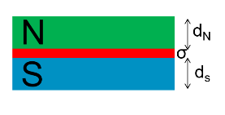
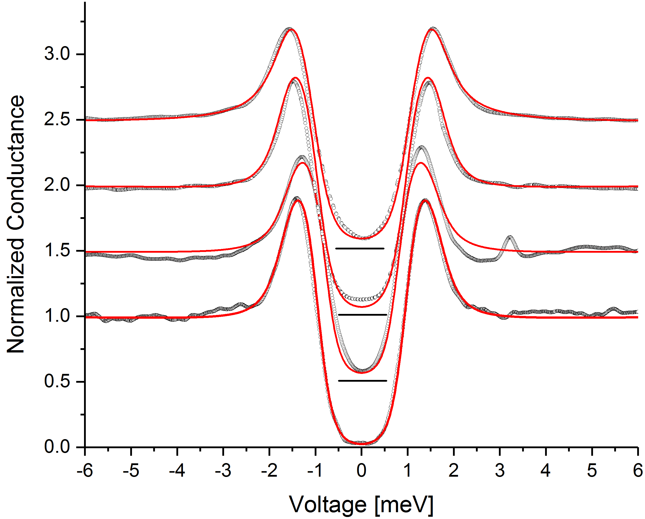
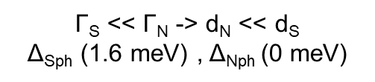
Tunneling spectroscopy: bulk Nb - Why small gaps?
Proximity effects: MacMillan Model
Any Temperature.
Diffusive scattering
Low transparency interface (σ=0.1).
No spatial dependence
Γ_{S}, Γ_{N}, Δ_{Sph} , Δ_{Nph}
Γ_{N/S} =ħ.V_{FN/S}.σ/(2.B.d_{N/S})
Distinguish btw buried and surface normal metal phases
Presence of normal metal regions: 10 nm < d_{N} < 15 nm -> reduce the quench field of SRF cavities: H_{B} ~ Φ₀ / (6 λ_{N} d_{N}) Onset at 100 mT -> d_{N} ≤ 20 nm consistent with PTC.
Transparent at low fields (Q0) but revealed at « higher » accelerating gradients.
Candidates: Nb Hydride phases at the surface (XRD at 90 K no sign of NbH_{X} phases)

Slide 10
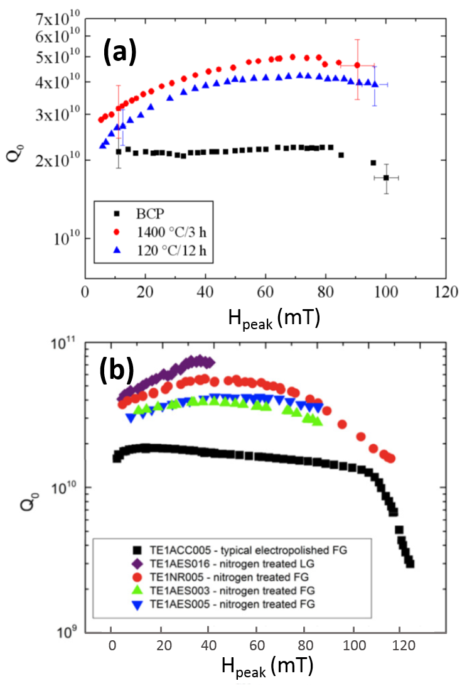
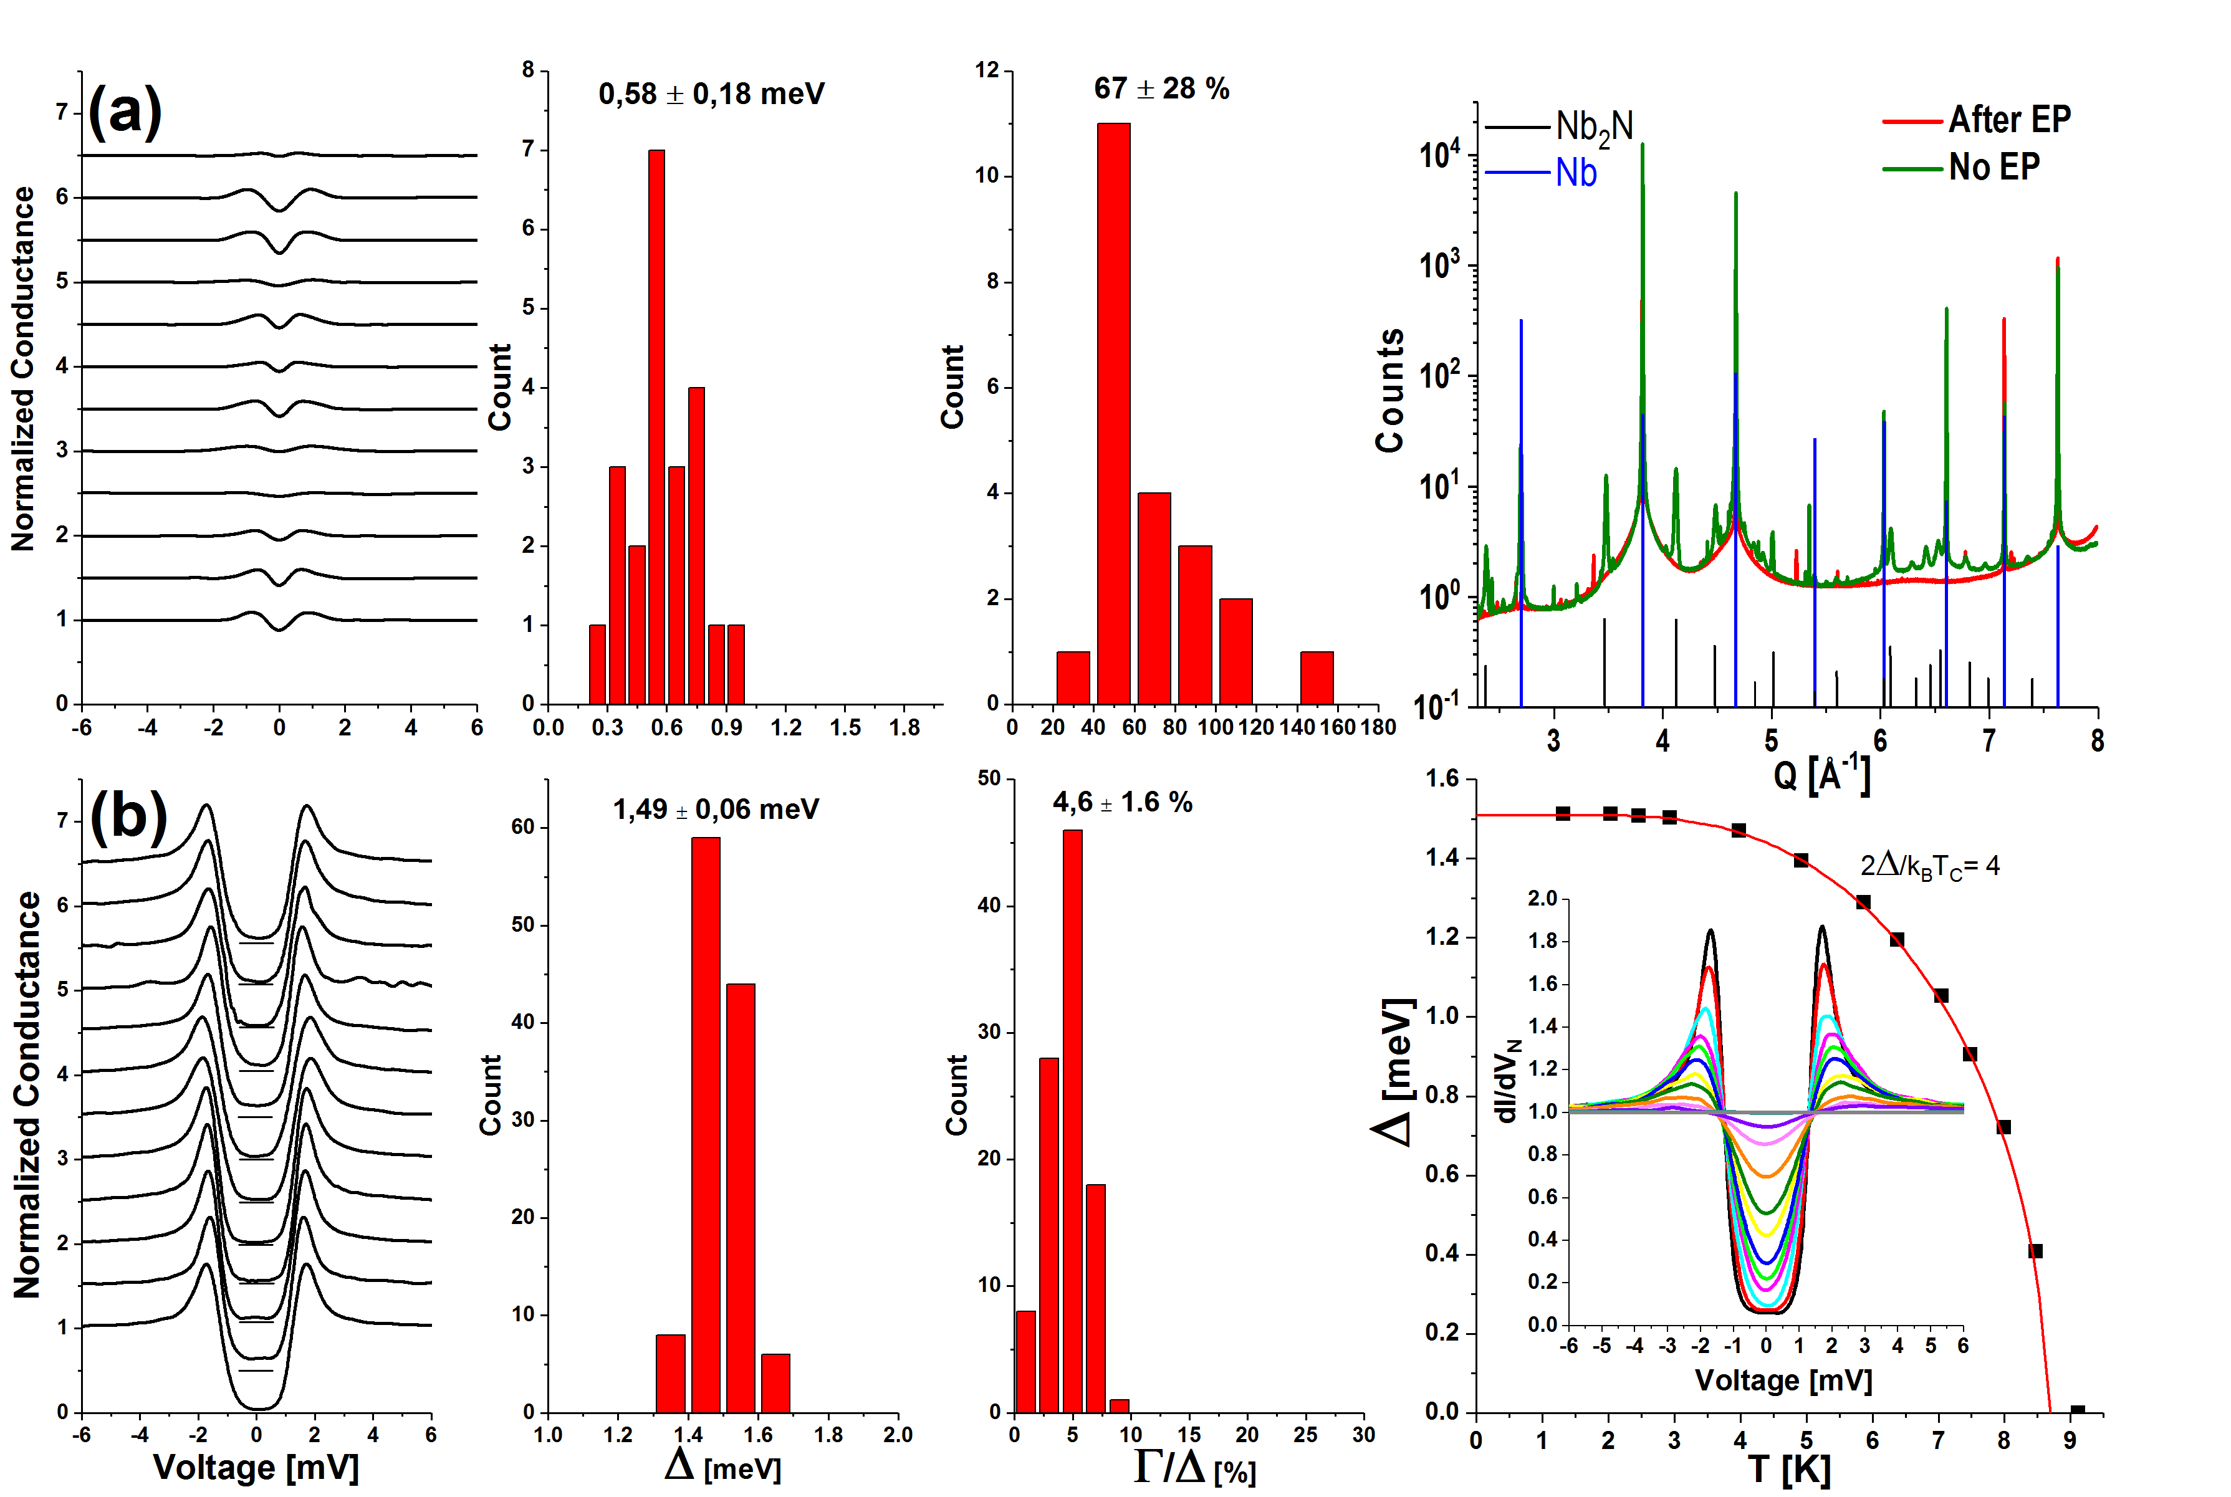
Tunneling spectroscopy: Nb Doping: N and Ti
N / Ti Doping:
Narrow gap distribution
Very low Inelastic scattering Γ values
Near ideal DOS
No Zero Bias Peaks
But:
Gap values a bit lower (1.48 meV) than bulk Nb (1.6 meV)
Tc (8.7 K) < Bulk Nb Tc (9.2)
Ratio 2Δ/kTc = 4 (similar to this cavity)

Slide 11
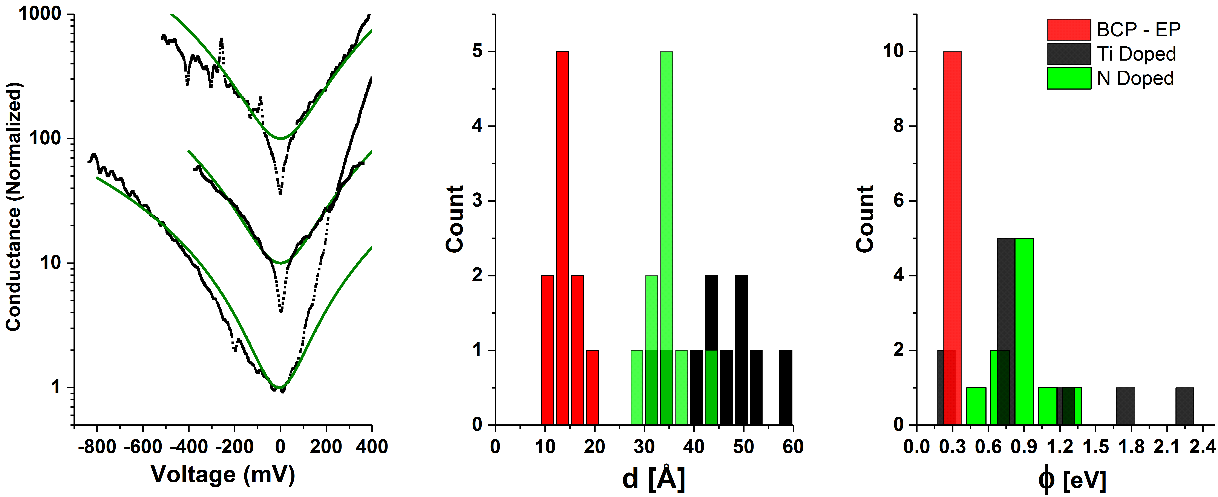
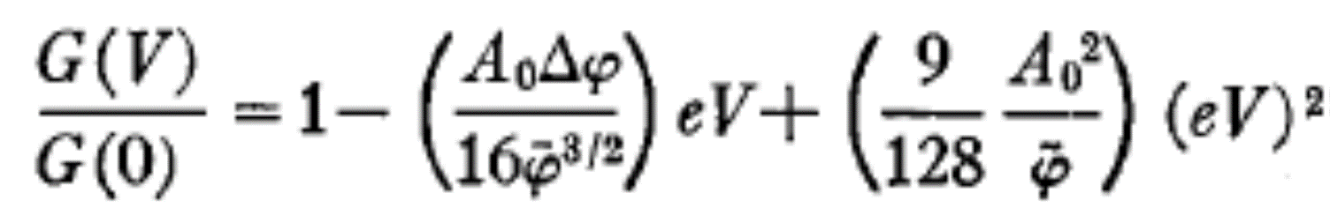
Tunneling spectroscopy: Nb
High Bias region
d, thickness of the oxide
Φ, work function of the oxide
Φ_{TIP}, work function of the tip
Undoped: reduced barrier height and thickness
Doped (Ti or N): higher barrier height and thickness
Points towards defects in the oxide mitigated by addition of dopants:
TLS – Hydrogen relationship and ZBP as signature
Qbits : magnetic impurities, H + O(?) as a source of it
Low fields measurements

Slide 12
Correlations between Tunneling
Spectroscopy and SRF cavity perfomances
Point Contact Tunneling spectroscopy
Bulk Nb treatments
Nb3Sn/Nb
  Summary and future

Slide 13
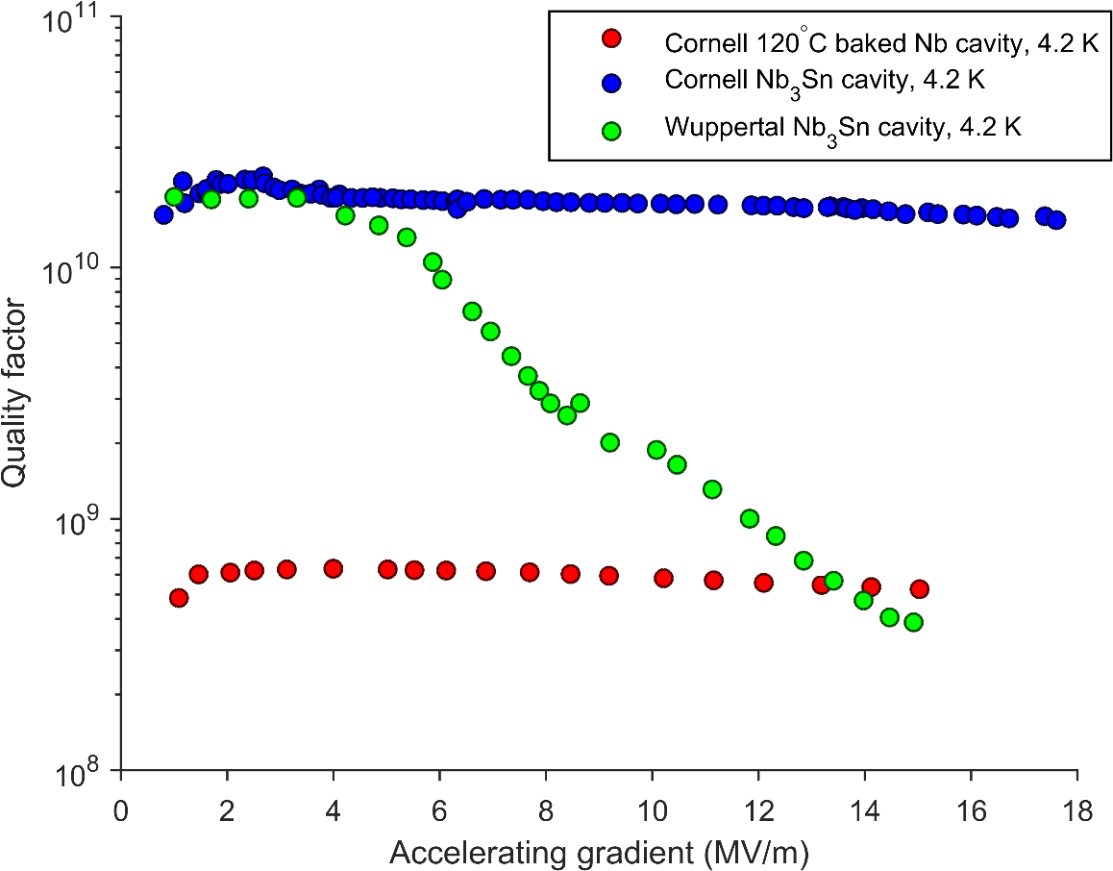
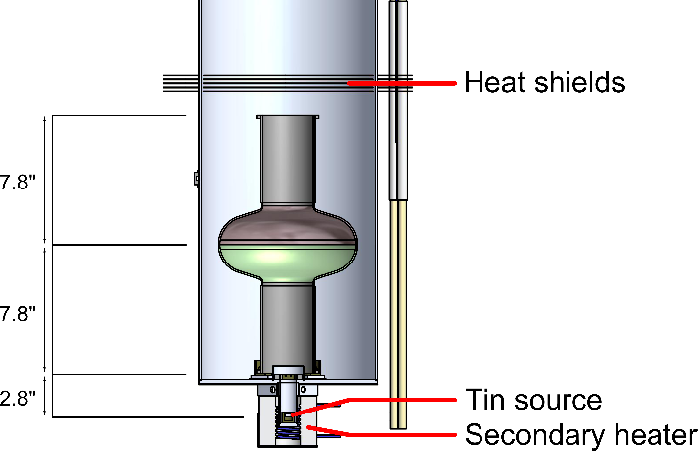
Nb₃Sn/Nb (Cornell)
Sample position
Wupperthal method: diffusion of Sn in a Nb cavity
Nb₃Sn Q₀ at 4,2K ~ Nb Q₀ at 2K
Moderate increase of Q₀ between 4K to 2K -> Non-BCS
Q₀ decrease at ~ 6K
Have we reached the limits of Nb₃Sn ?

Slide 14
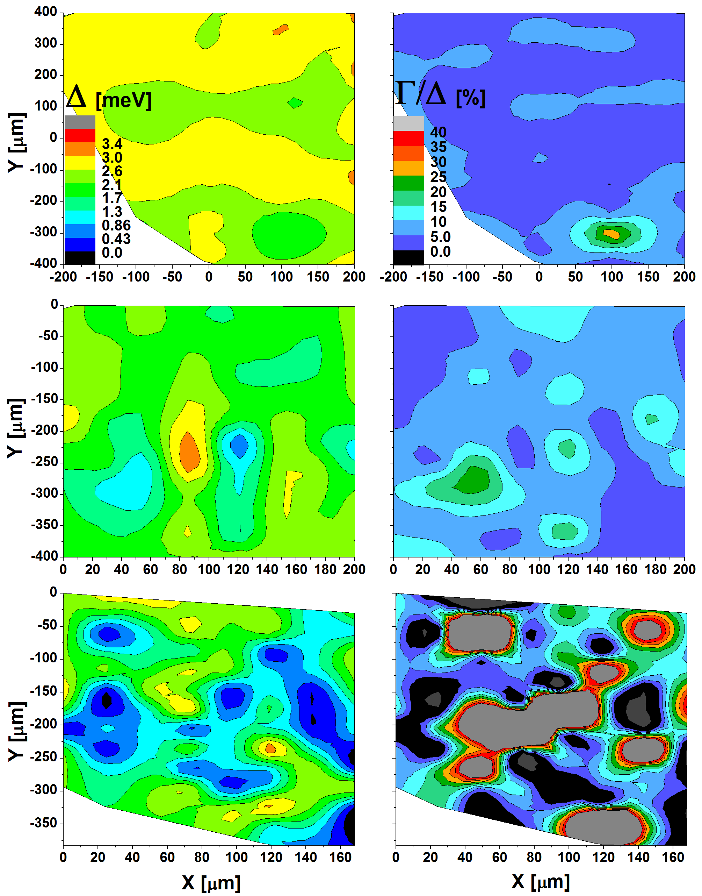
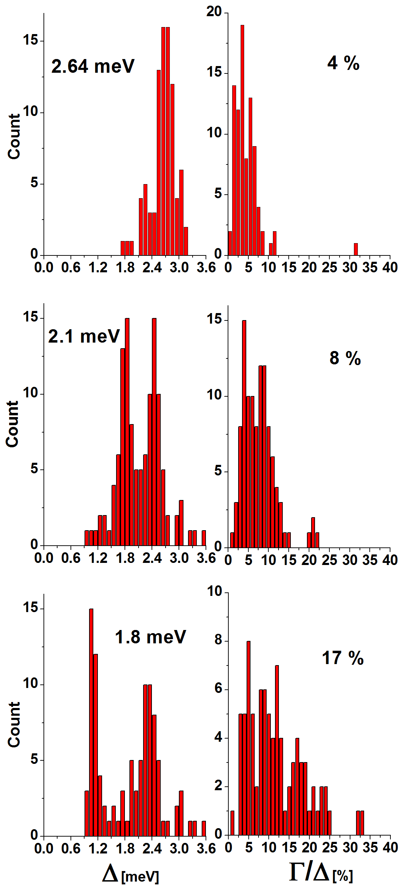
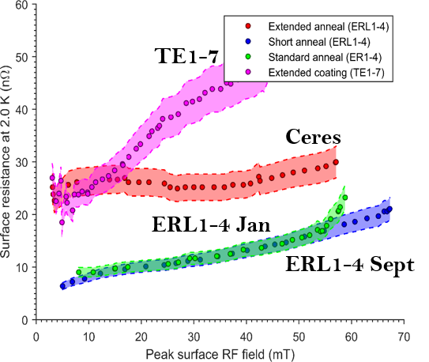
Nb₃Sn/Nb (Cornell) - PCT
PCTS measurements
Nb3Sn cavity RF tests
ERL1-4 jan
CERES
TE1-7
Δ > Nb and Γ/ Δ is small
-> Quality factor @ 4K is ~ Nb @ 2K
But pockets of Nb rich phases:
- Lower Tc and Δ
- Carbon contamination

Slide 15
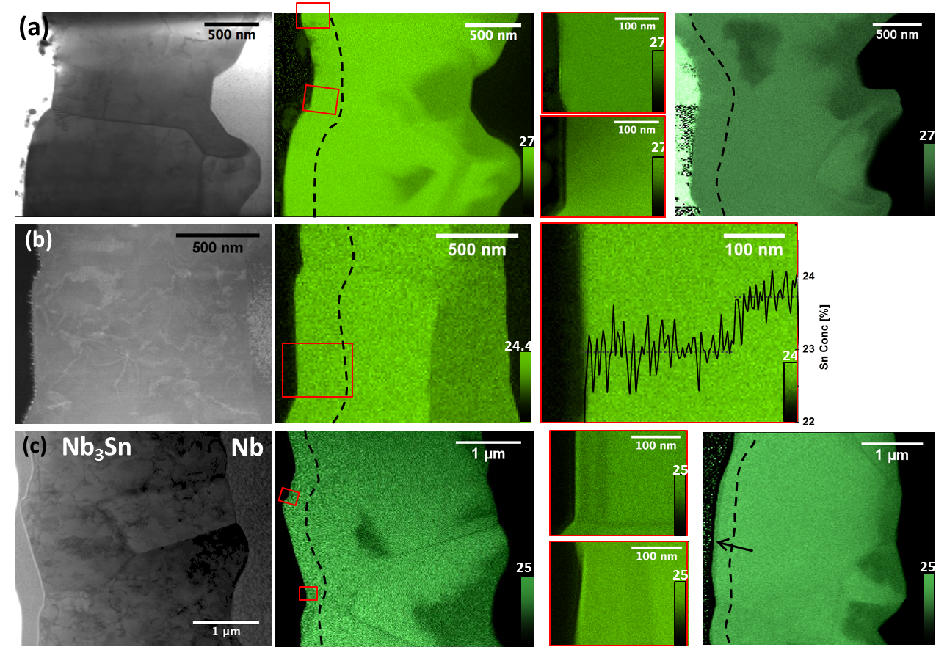
Nb₃Sn/Nb (Cornell) – TEM
ERL1-4 Jan
CERES
TE1-7
phase riche Nb ~ 17.5 - 23%
Interface Nb-Nb₃Sn , grain boundaries
Pockets near the surface
Crystallites ~ 100 - 200 nm (XRD)

Slide 16
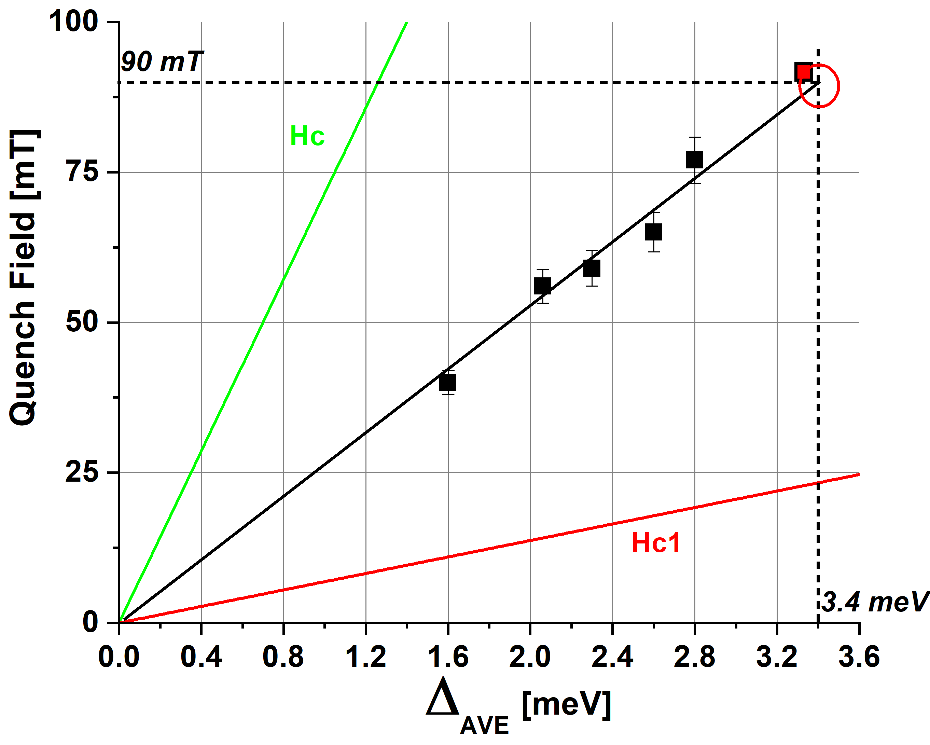



Nb₃Sn/Nb (Cornell - FNAL) – PCT
Quench field vs Average Gap
For large κ (λ/ξ = 24)
$$H_{C}=\sqrt{\frac{N_{0}}{μ_{0}}}. Δ.e$$
$H_{SH}=26 ±2.5 Δ [\frac{mT}{meV}]$
Bulk Δ for Nb3Sn is 3.4 to 3.5 meV
Max expected Quench field is ~ 91 ± 2 mT = 22 MV/m
$$H_{C1}=\frac{1}{\sqrt{2}κ}\left(Ln\left[κ\right]+0.08\right) H_{C}$$
Linear dependence of Emax on the average surface gap (~300x300 µm)
H_{SH}~3.5 times the H_{C1} but why this gap dependence? Roughness, effective penetration depth?
A15 compounds (V₃Si, Nb₃Sn, Nb₃Al…) are good for Q₀ and higher operation temp. (4,2 K)
But what about E_{MAX} ? How to increase E_{MAX} ?

Slide 17
Correlations between Tunneling
Spectroscopy and SRF cavity perfomances
Point Contact Tunneling spectroscopy
Bulk Nb treatments
Nb3Sn/Nb
  Summary and future

Slide 18
Summary:
Enable testing surface treatments/heterostructures on coupons prior to cavity tests
Faster turner over and phase space exploration of growth parameters etc…
Measurement of Nb₃Sn sample from FNAL
Nb3Sn : linear dependence of Emax and the superconducting gap.
Nb: à déterminer.
Future:
Faraday Cage to improve noise (ordered) ~ 3 months.
Measure of infusion in bulk Nb and Nb3Sn thin films from DESY, Jlab, STFC.
Bulk Nb: Correlation between inhomogeneous properties and samples measurements
Smaller scan areas < 1 μm.

Slide 19
Thanks you
The END

Slide 20




Summary
Funding Sources

Slide 21
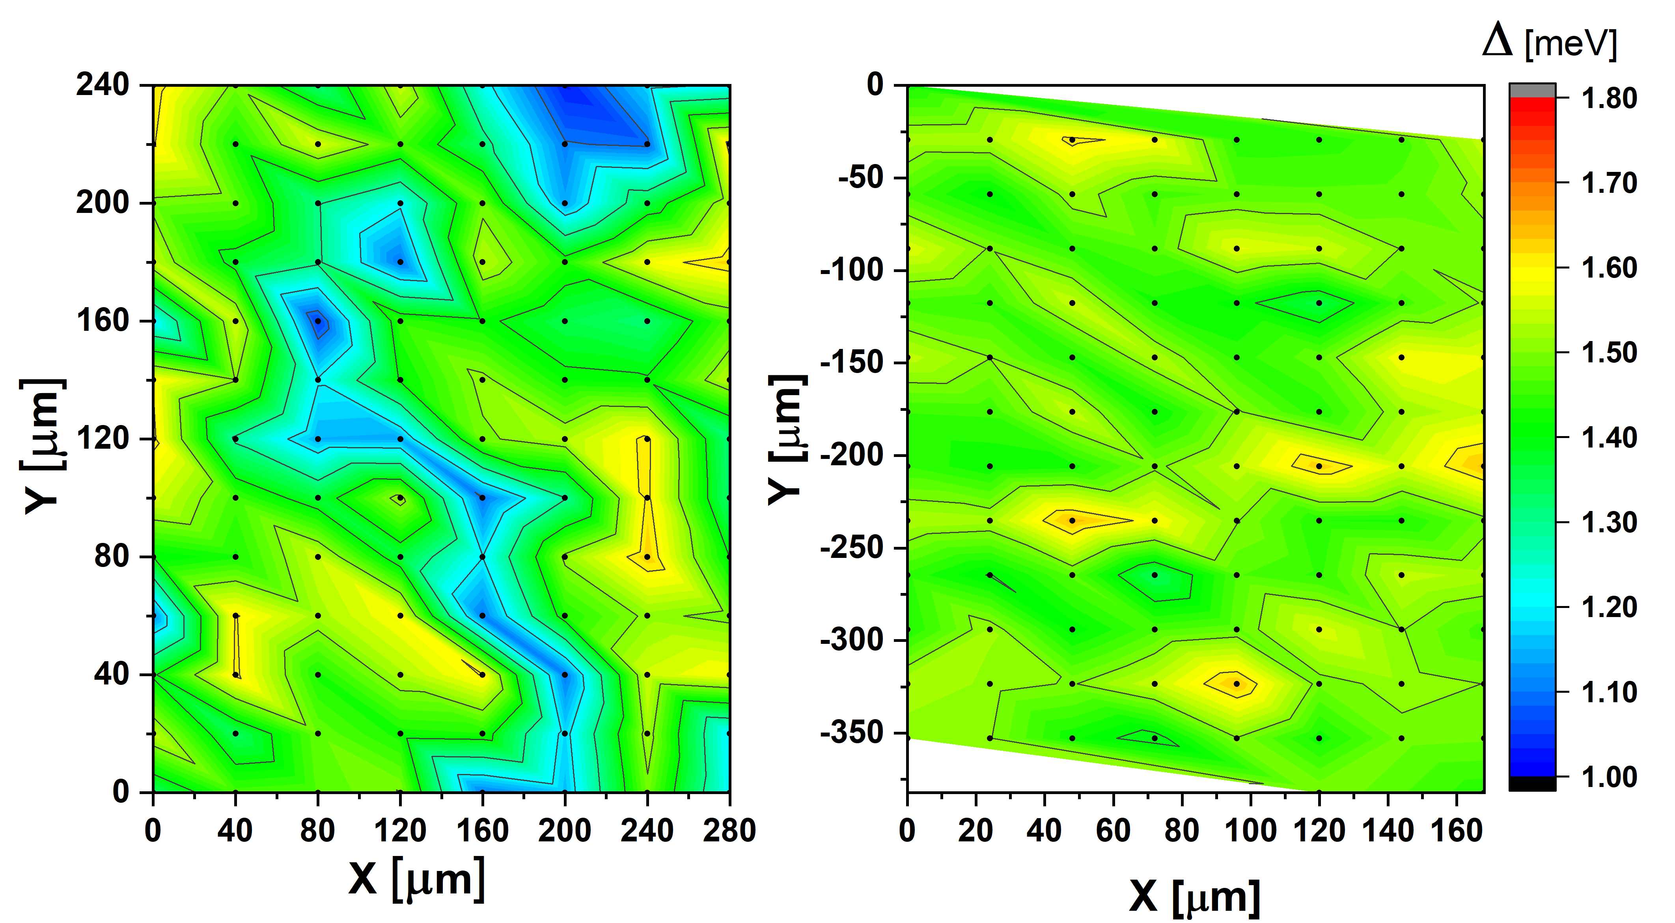
Tunneling spectroscopy: Nb
Cartography
Hot Spot Nb
N Doped Nb
N doping: Homogeneous bulk Nb gap values on the surface
Hot spot: Regions with low superconducting gap values that can be fitted with normal metal regions
on the surface (presumably hydrides)

Slide 22
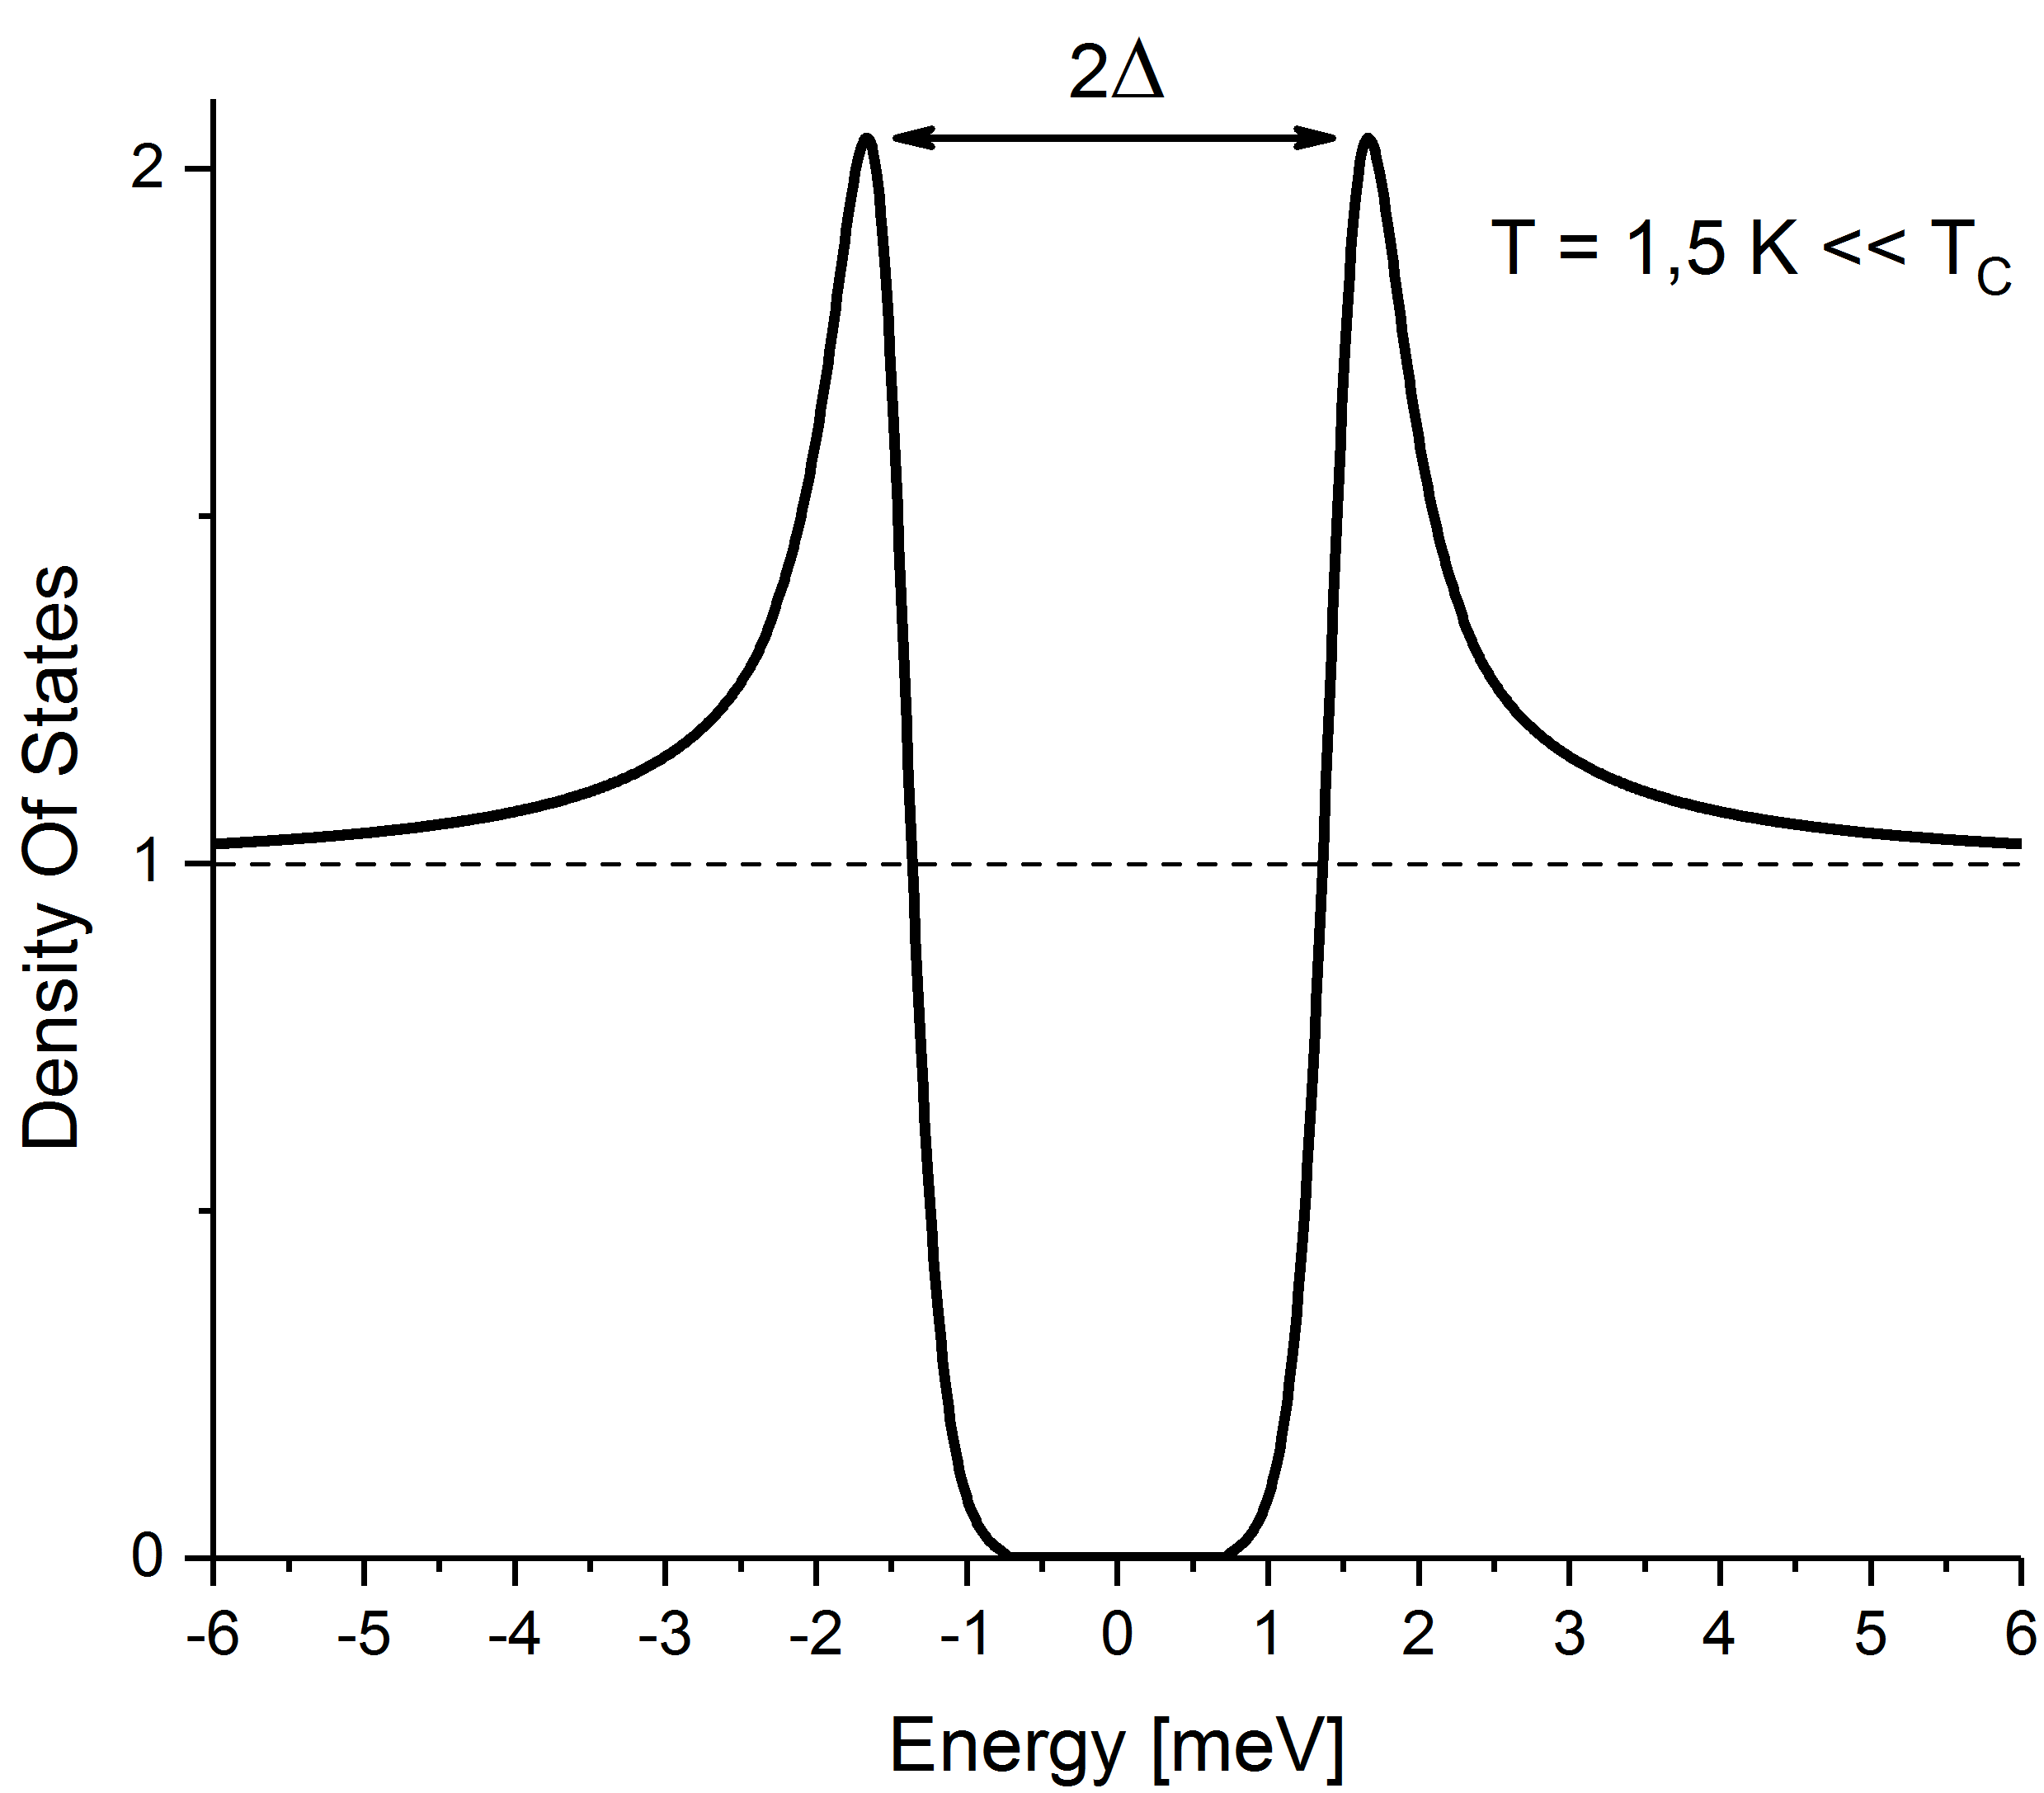
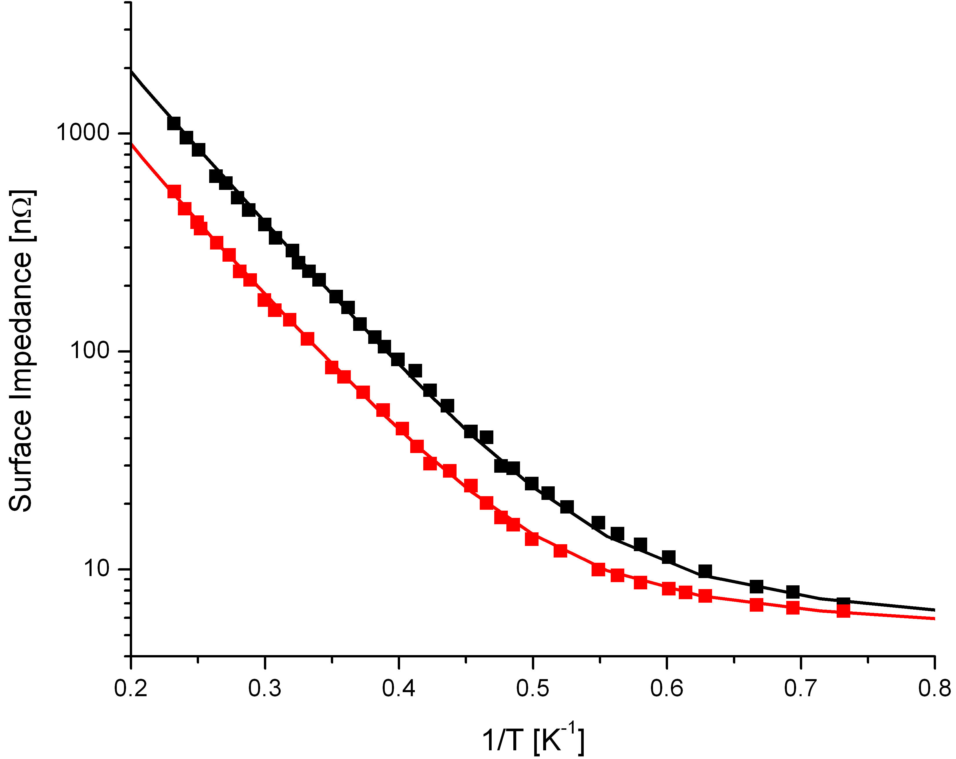
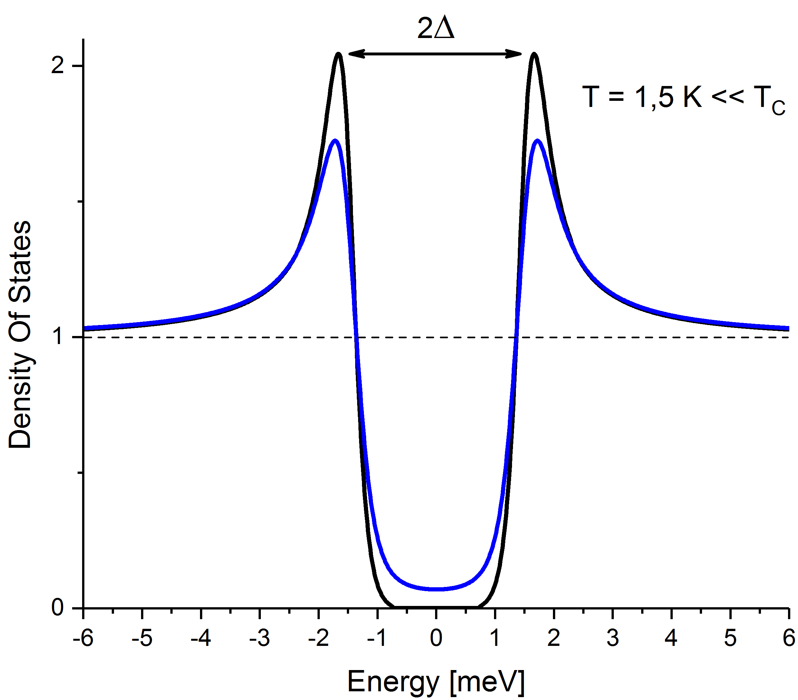
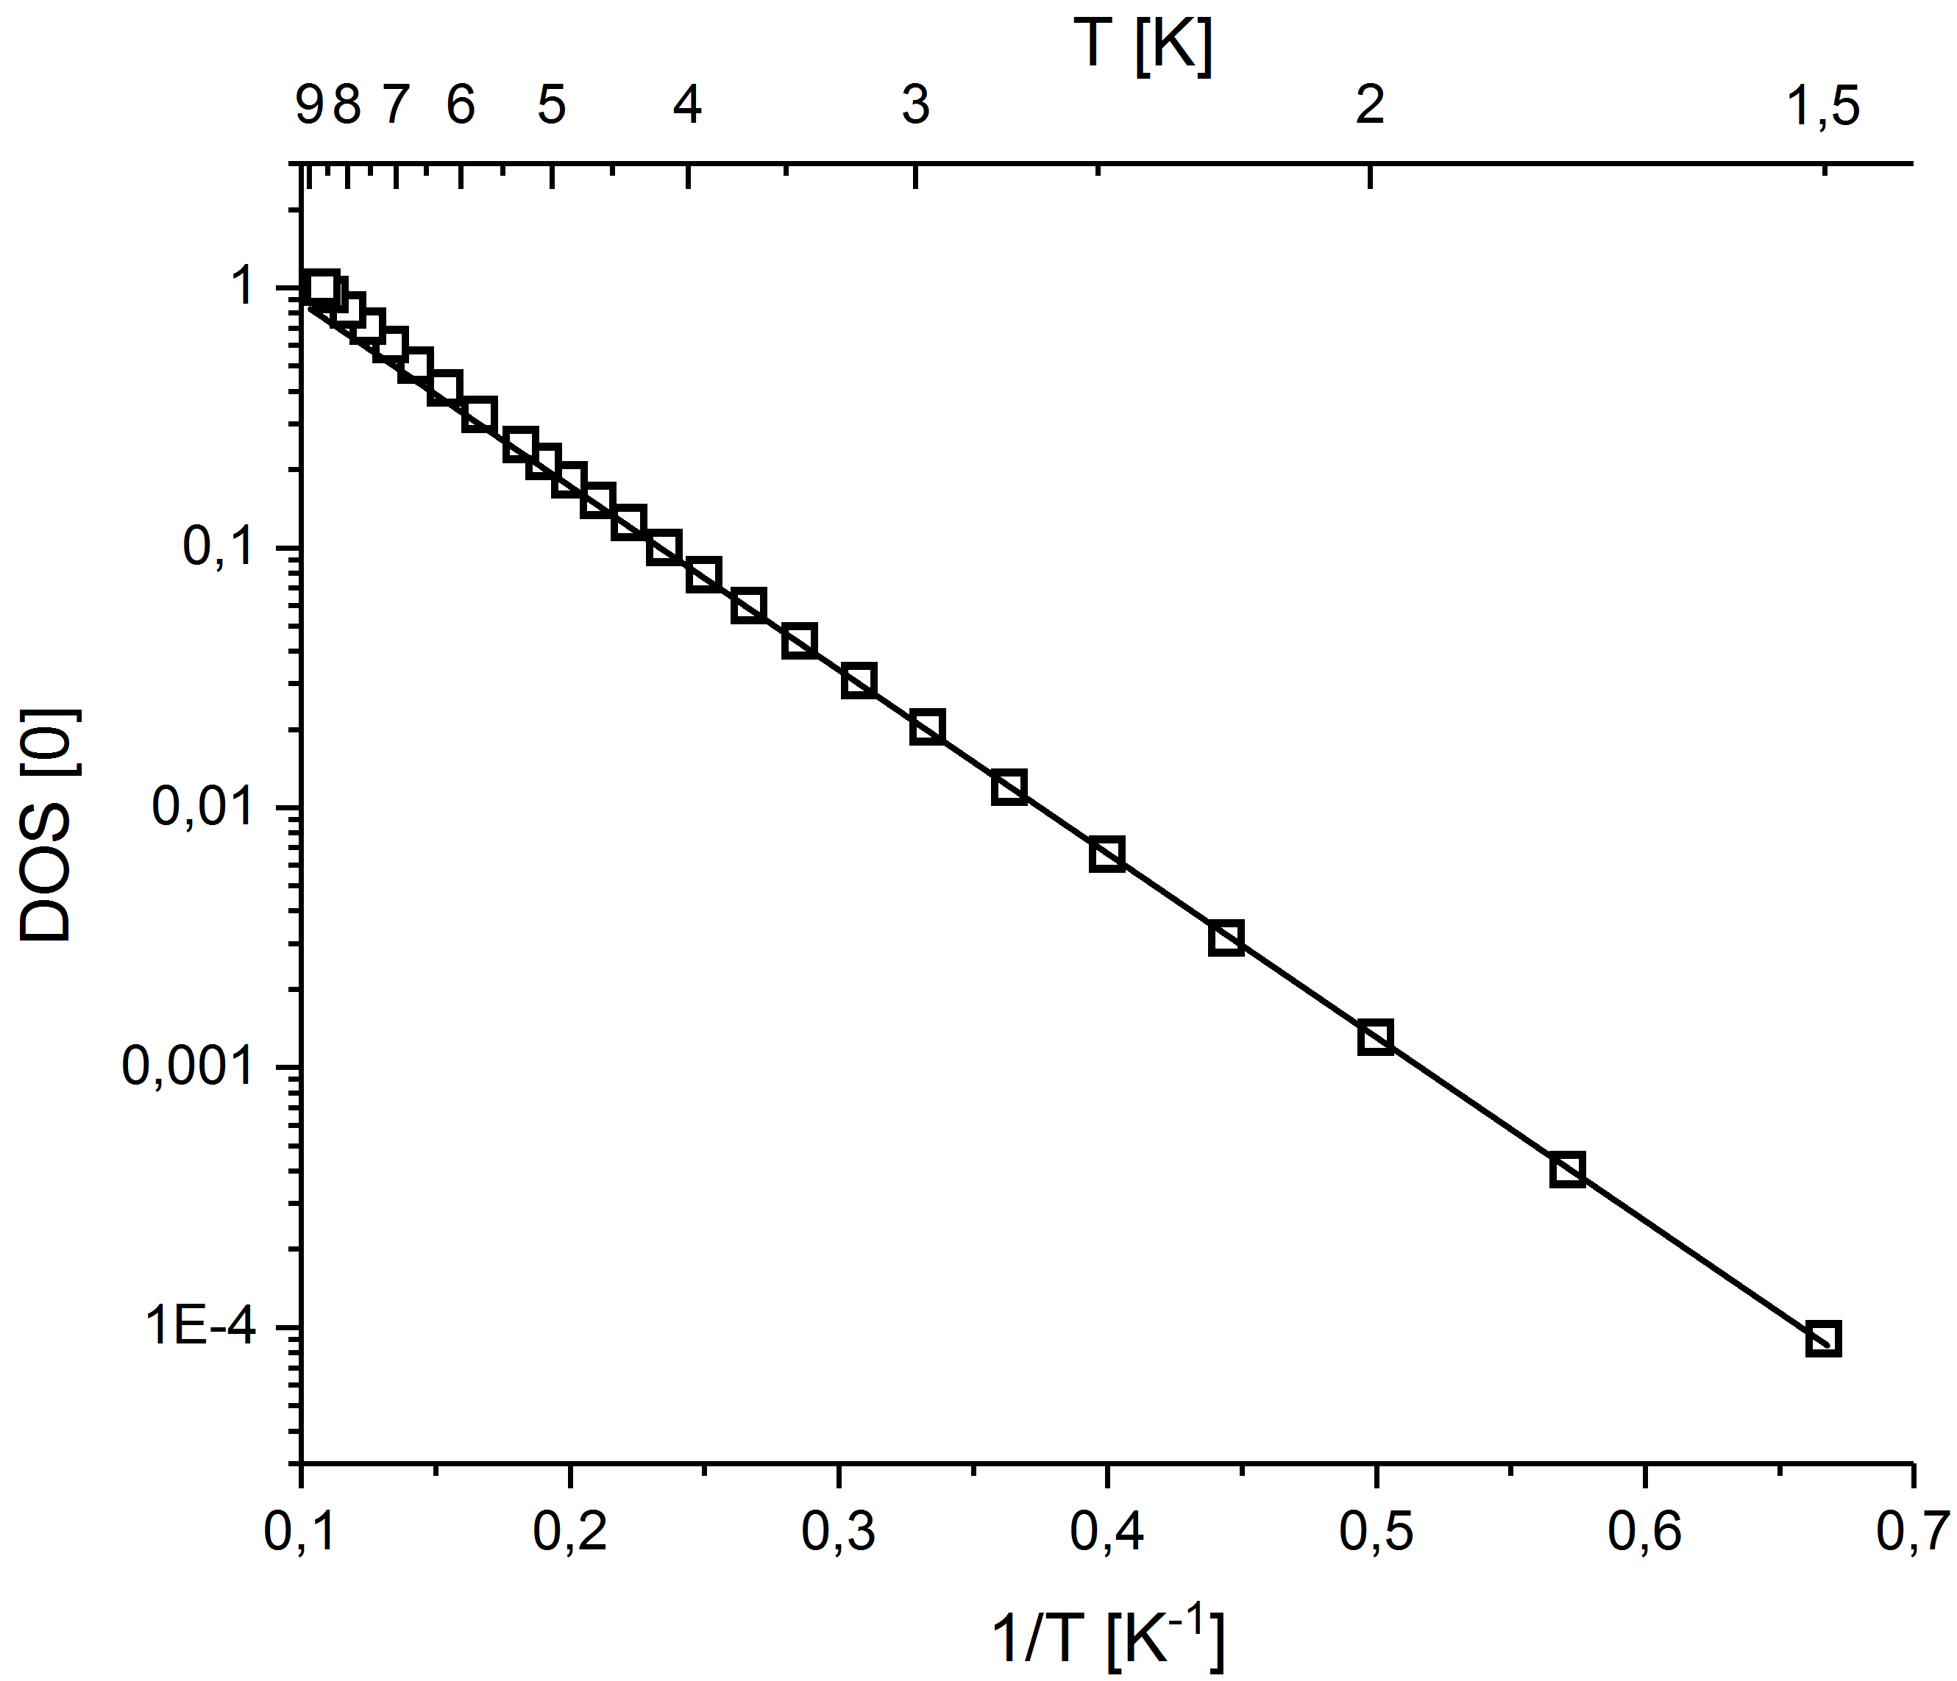
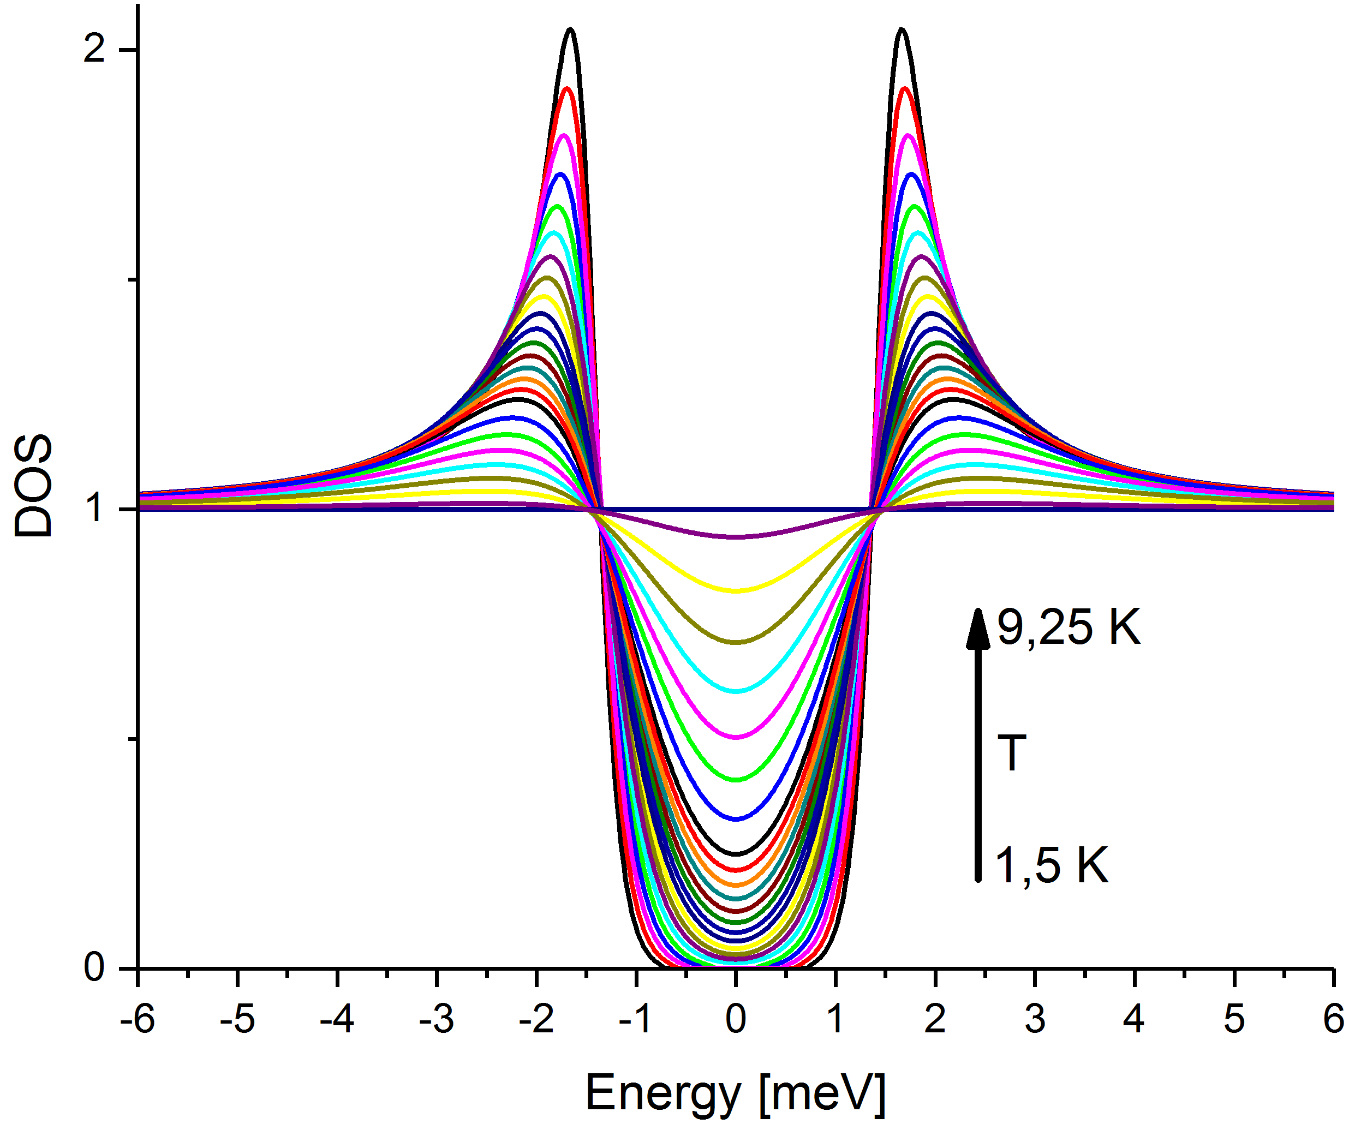




Tunneling spectroscopy: what do we measure and why?
Density of states
$R_{S}=$ $R_{BCS}+ R_{Res}$
$$R_{BCS}=Cλ^{4}ω^{2}l e^{−Δ/k_{B}T}$$
$$DOS\left(E_{f}\right)∝ e^{−Δ/k_{B}T}$$
$$Γ/Δ$$
Rs depends on DOS(E_{F}). DOS(E_{F}) (B, T, Δ, r)
DOS (E_{F}) ≠ 0 -> dissipation @ T=0 K
DOS(E_{F}) (B, T, Δ, r), R_{S} = <DOS(E_{F}) (B, T, Δ)>_{r}
Saturation mechanisms of the DOS? -> Inelastic scattering (Γ)
Higher Gap (Δ) -> Higher Q

Slide 23
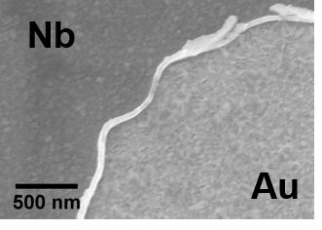
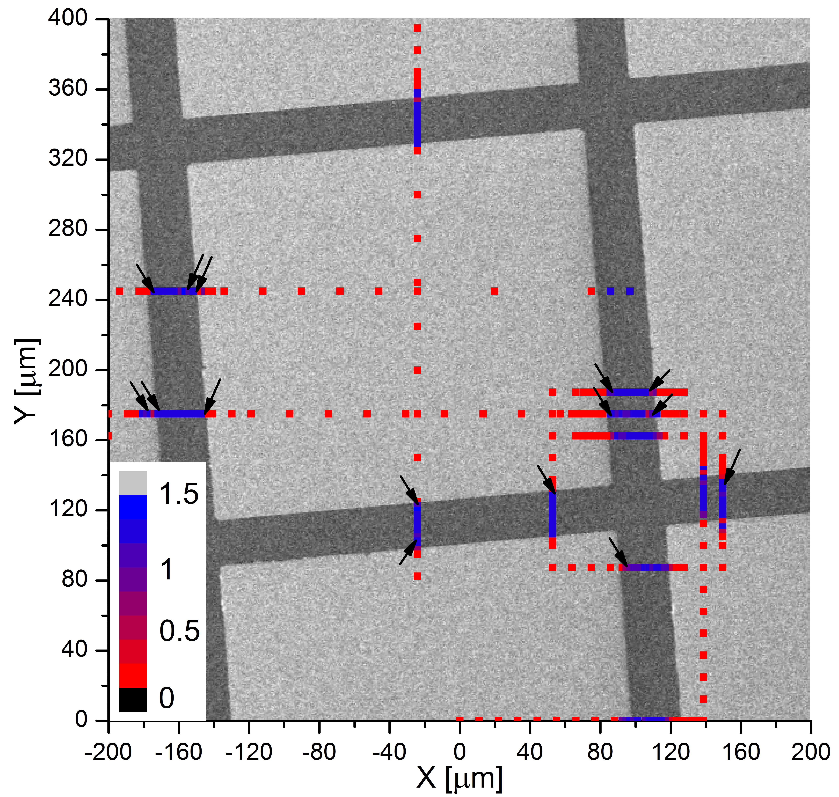
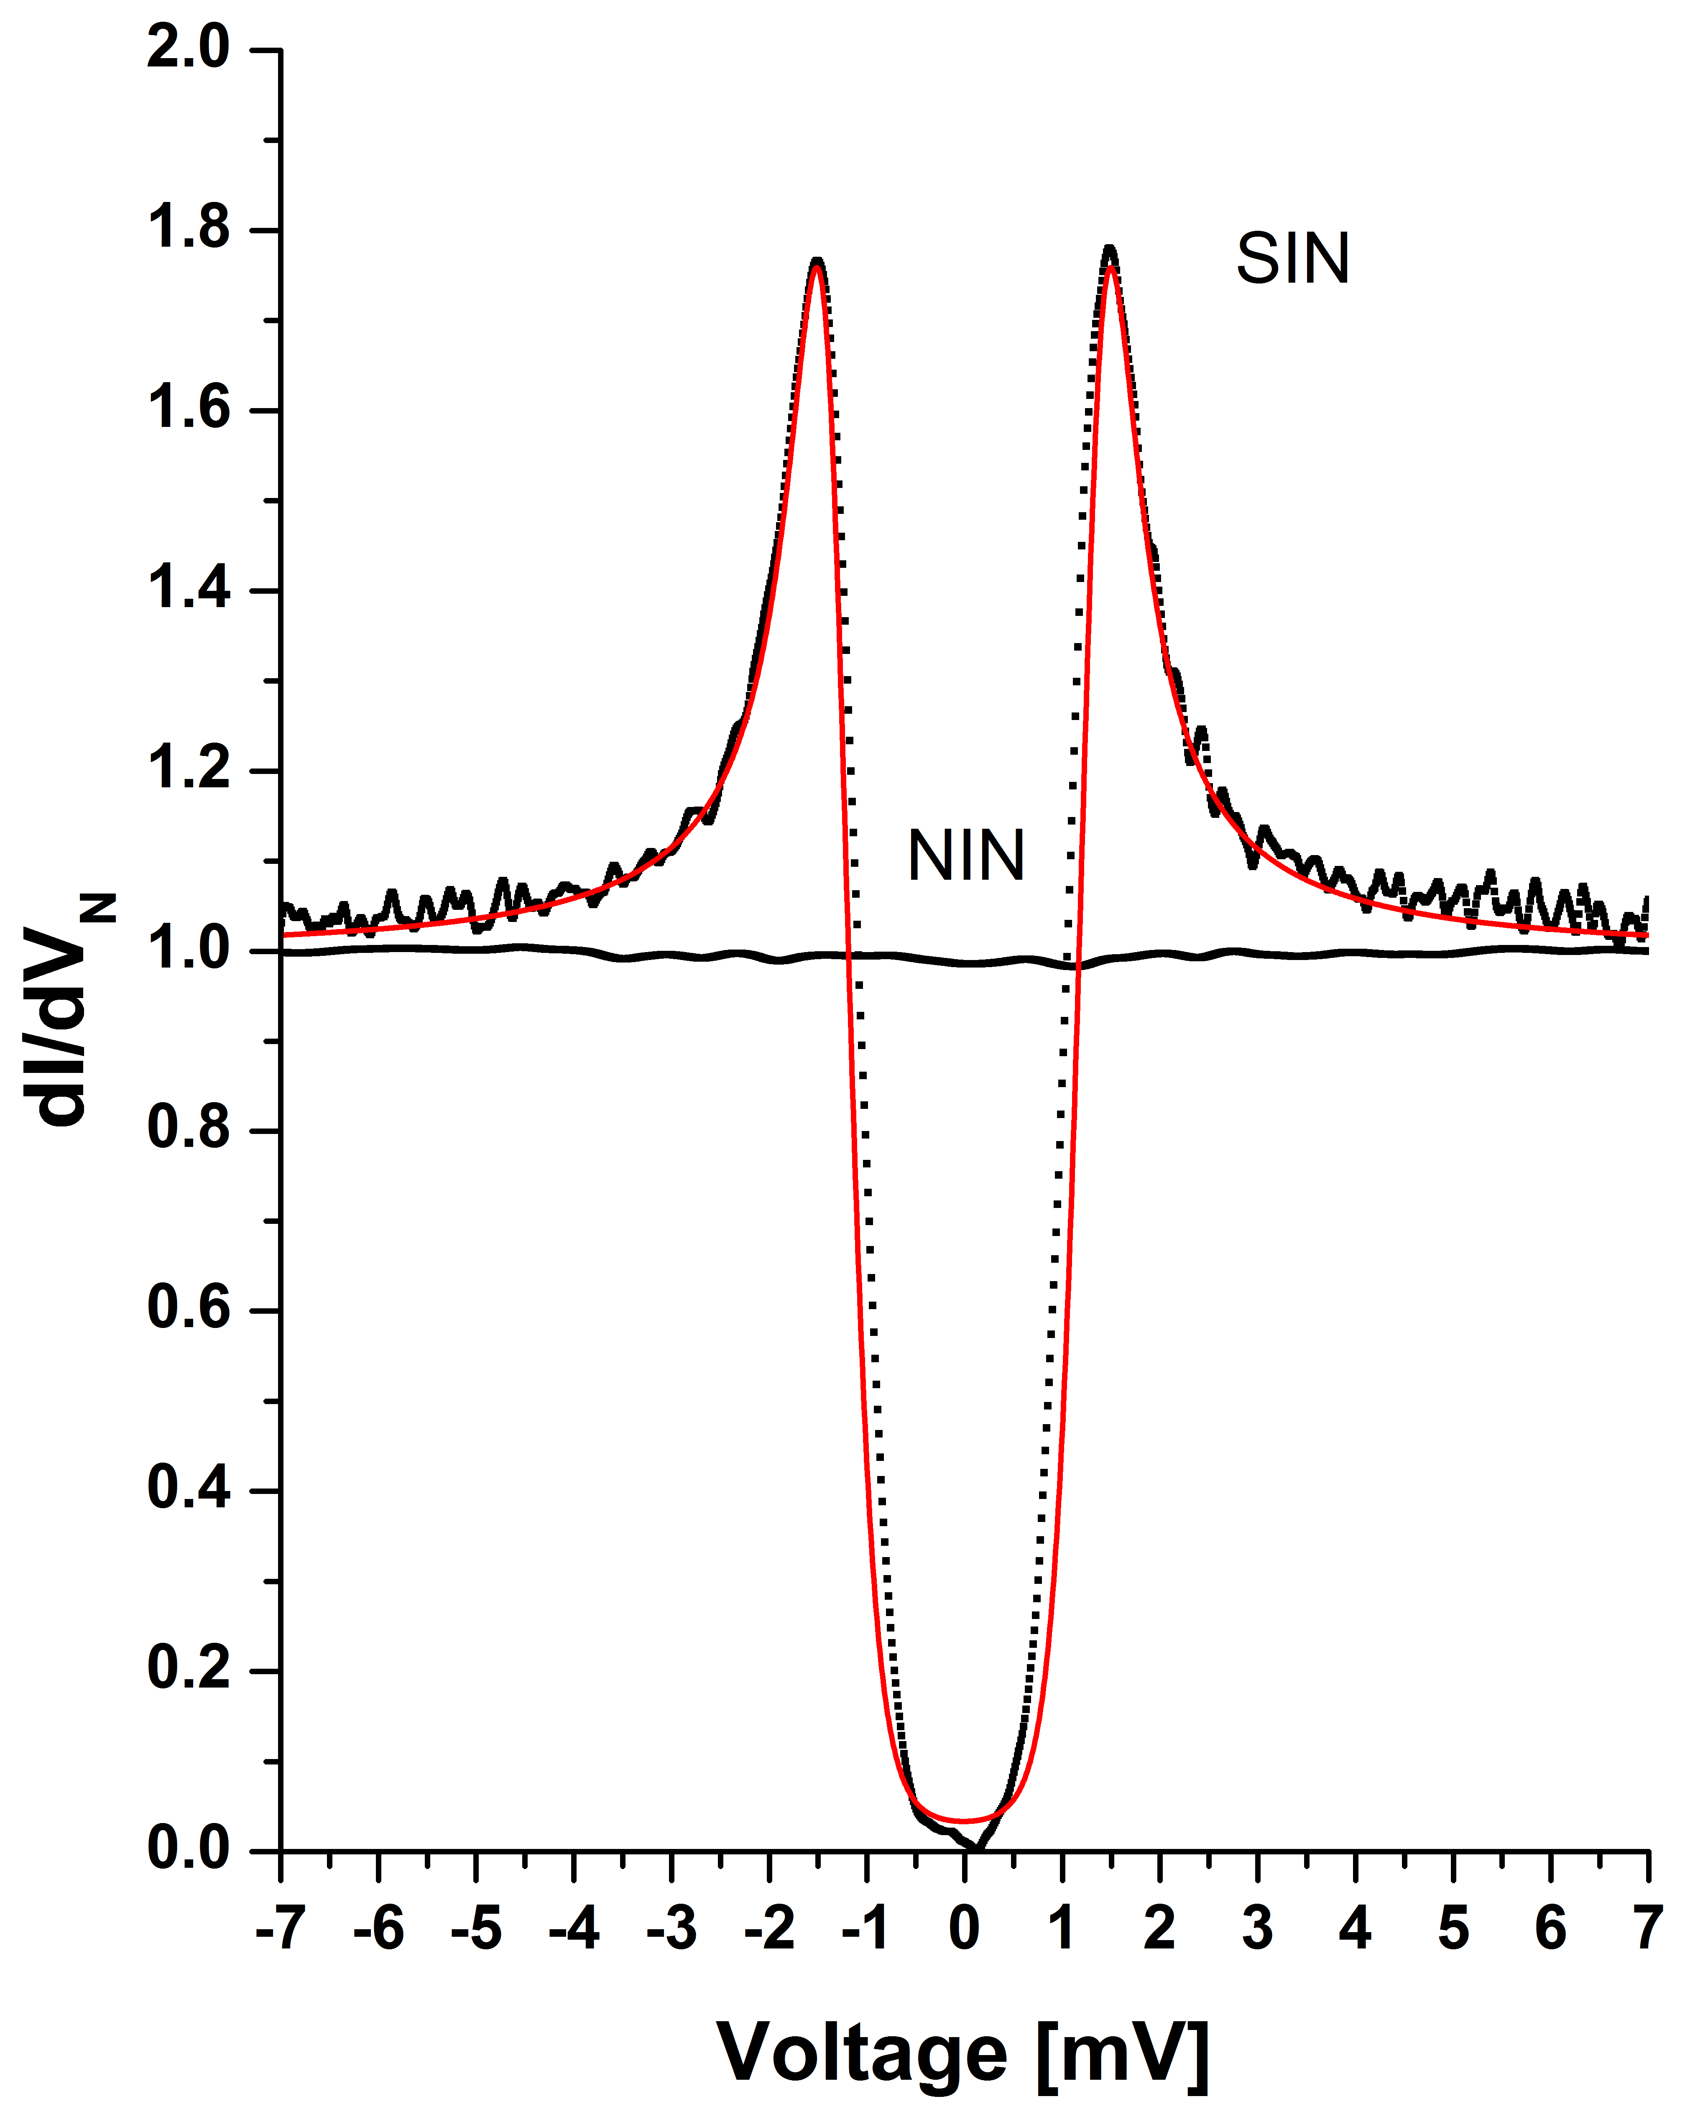
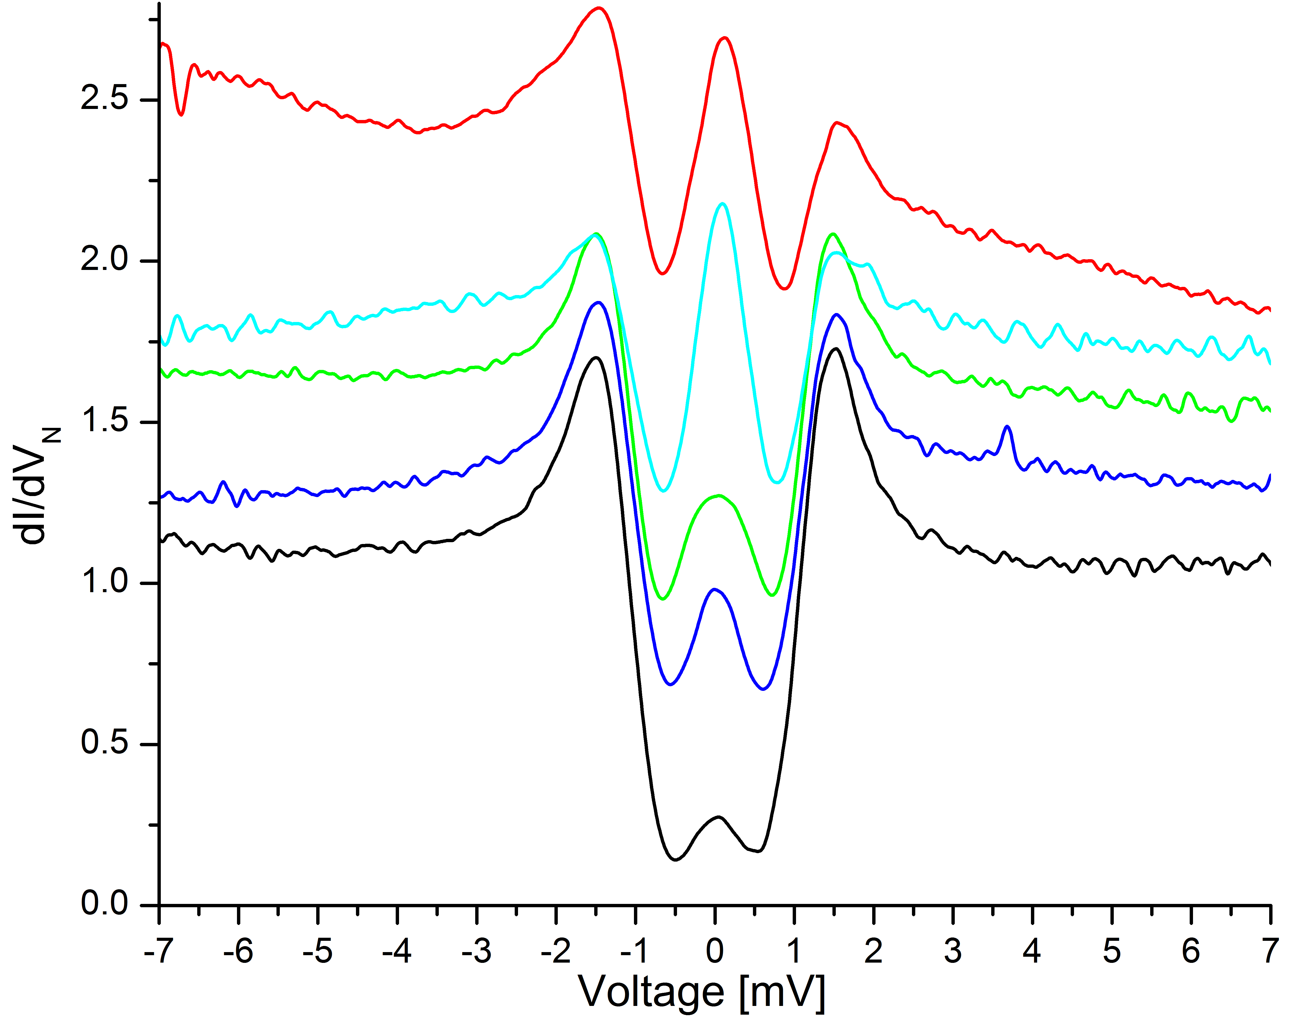

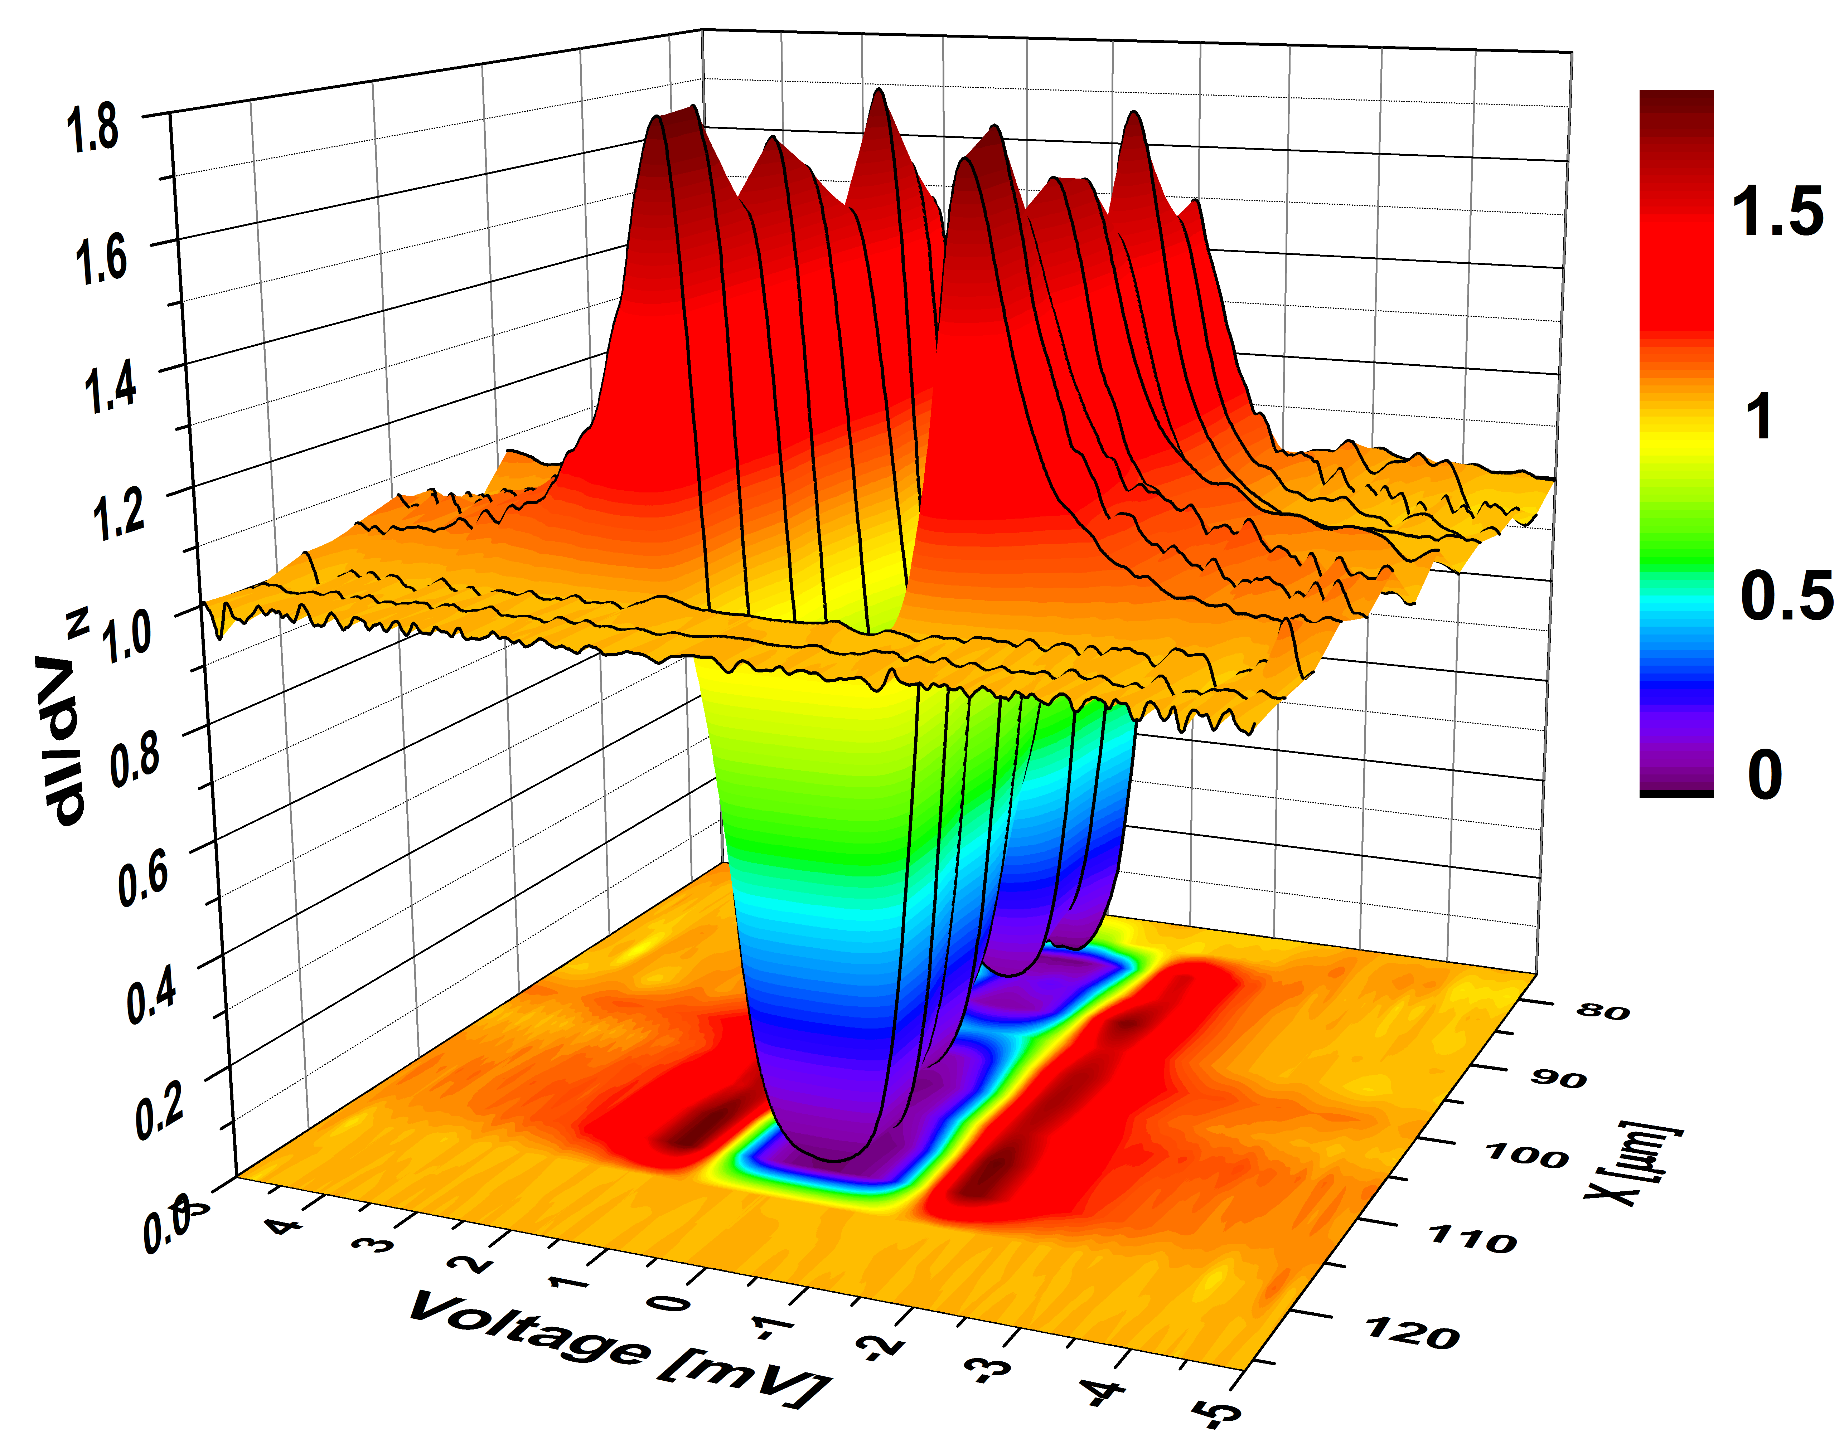
Cartography: calibration
Standard:
Lignes de Al(6 nm)/Nb (80 nm) sur Au (200 nm)
Calibration: X = 4,1 nm/V
Y = 4,9 nm/V
Détails la DOS

Slide 24
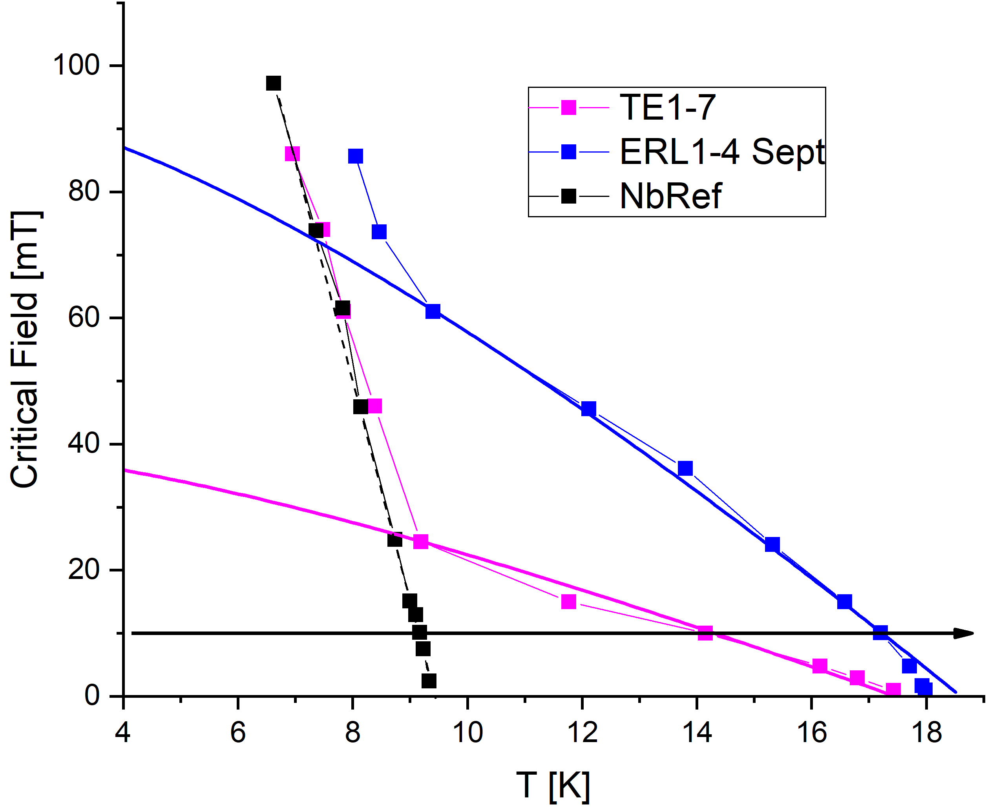
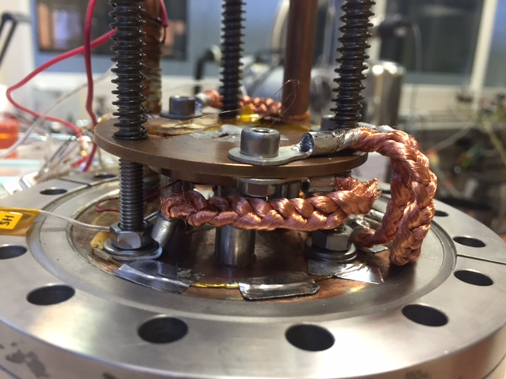
Nb₃Sn/Nb (Cornell) - Magnetometry
RF tests
Measure critical penetration field In Bulk and thin films samples
Sample size: > 1 inch
4.2 K and 120 mT
The critical field measured by Magnetometry correlates with RF tests Quench fields

Slide 25
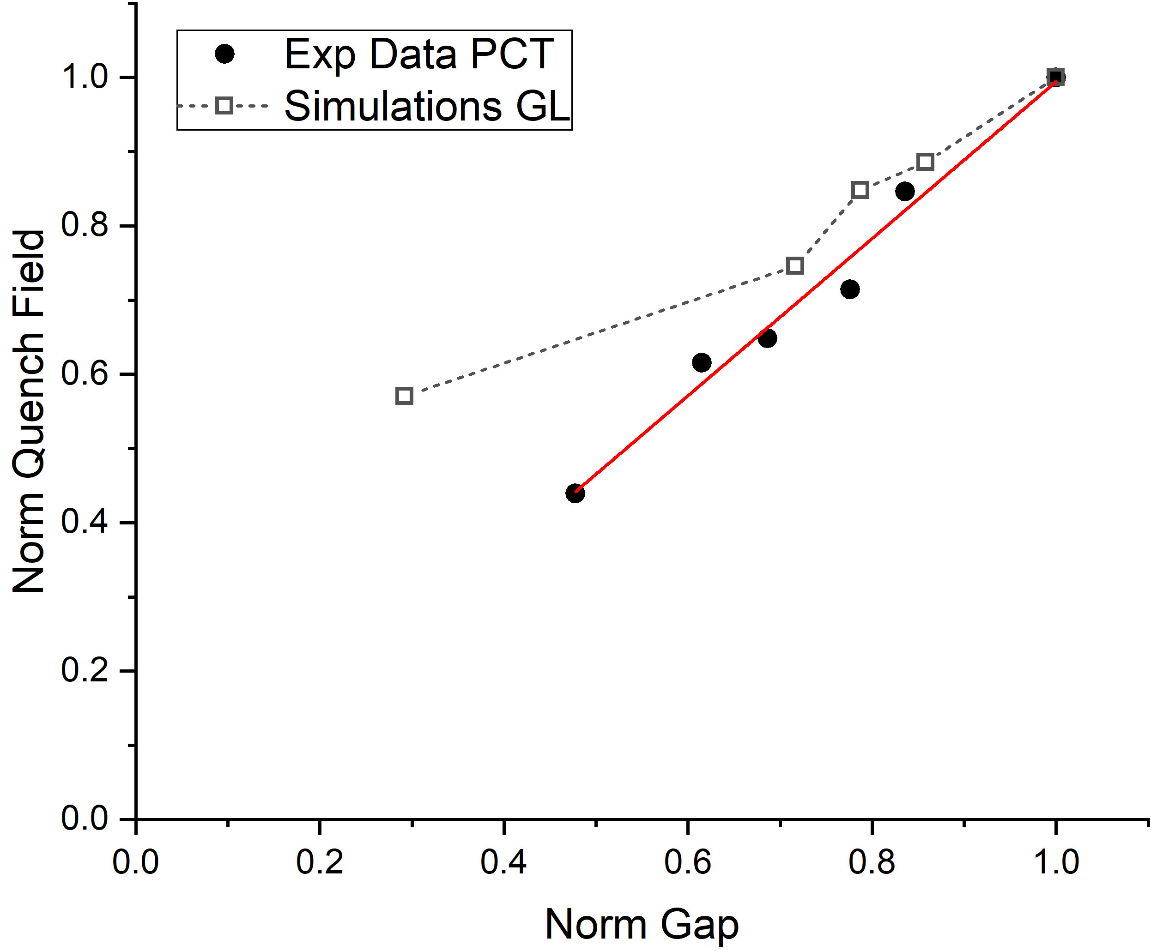
Nb₃Sn/Nb
Comparaison Theory - experiments
Qualitative agreement between GL simul and PCT data
To be continued

Slide 26
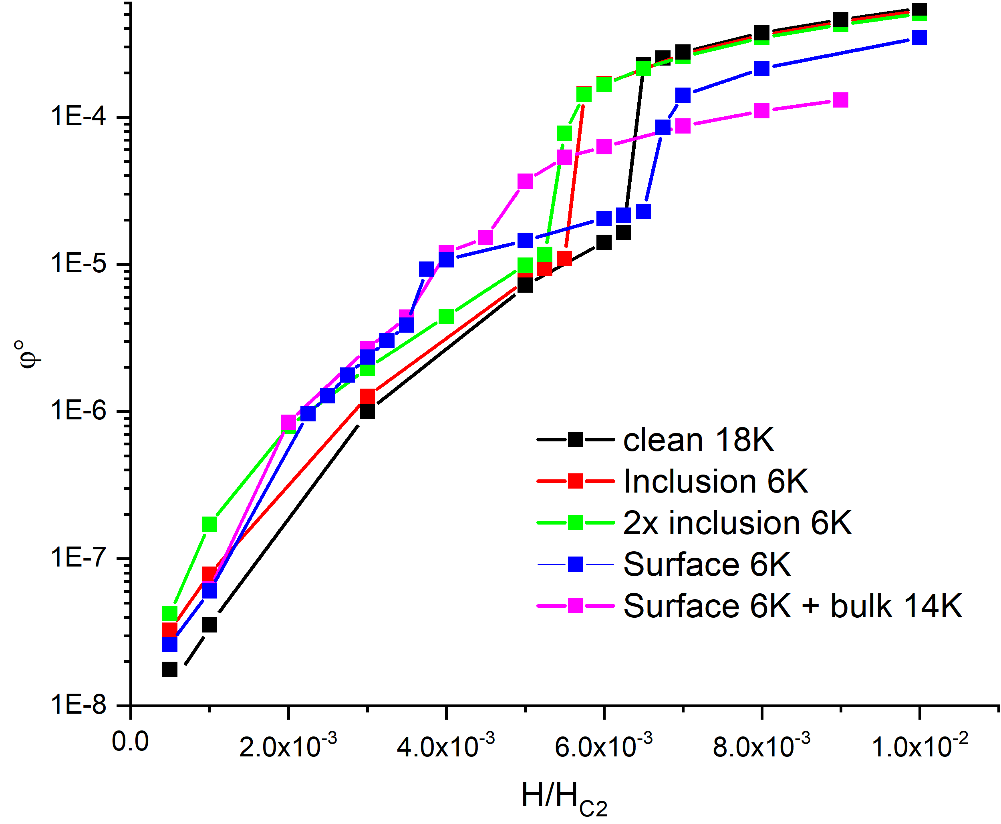

Nb₃Sn/Nb - simulation
Case of surface layer Low Tc 6K + lower bulk Tc 14K
18 K
W$=\left\langle {\left|∂_{t}ψ\right|}^{2}\right\rangle$
14 K
6 K
Lower bulk Tc also lead to lower penetration field.

