Slide 1


Q studies for the higher power 1.5 GHz couplers for BESSY VSR
Emmy Sharples
04.02.2020
FG-ISRF, Helmholtz-Zentrum Berlin / BESSY II
TESLA technical collaboration meeting, CERN, February 4-7, 2020.

Slide 2
Outline
BESSY VSR coupler a brief intro
  VSR requirements
  Finalised coupler design
Q studies
  Q range limits
  Determining the optimal Q range for stable operation
Tolerance studies
  Module stresses and the coupler port
  Displacement studies
Outlook

Slide 3
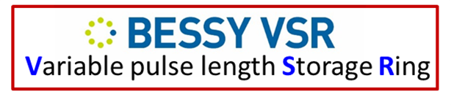
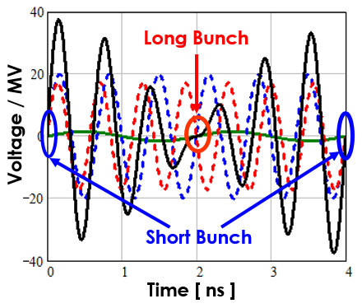
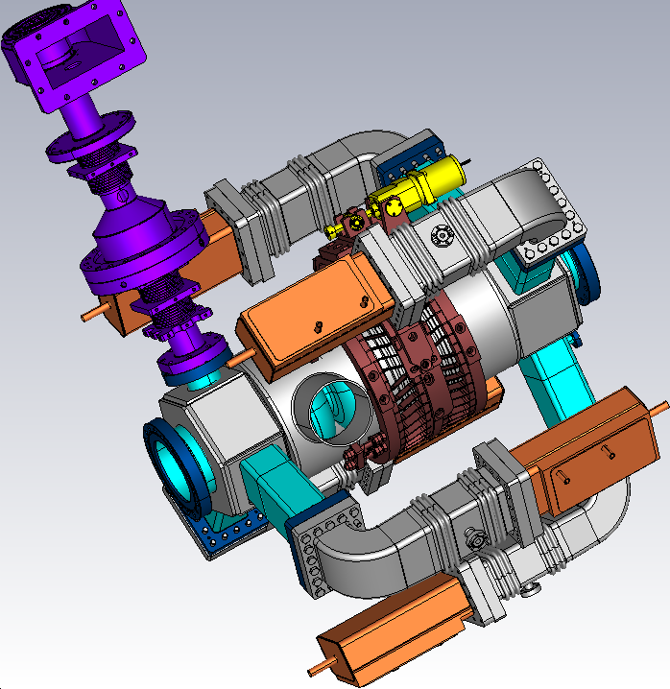
BESSY VSR Requirements
Initial parameters as laid out in the TDS for BESSY VSR VSR
Parameter | Value
Central Freq (f_{c}) | 1.498 GHz
Power level | 16 kW CW
Q_{ext} range | 6x10⁶ to 6x10⁷
Q_{loaded} | 5x10⁷
S₁₁ @f_{c} | ≤-30 dB
S₁₁ @f_{c} ± 5MHz | ≤-20 dB
Upgrading the existing ring with SRF 1.5 GHz and 1.75 GHz SRF cavities
RF beating allows for simultaneously long and short bunches
Dressed 1.5 GHz cavity
Fundamental coupler design
Adjustable coaxial coupler based on Cornell cERL injector coupler: Lower coupling level and lower power but higher frequency
Unique challenges of VSR
Complex cavity design → Higher order mode propagation
High power, high fields, small scale → heating issues
Smaller scales → Mechanical challenges
Module integration → dimensional constraints
High gradients and SRF → Field emission + multipacting must be avoided

Slide 4
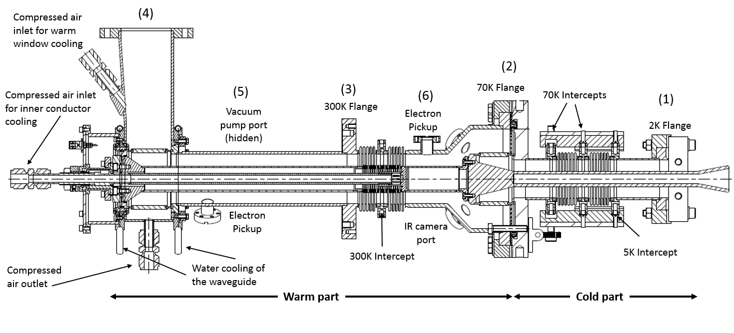
Final design
Small cold coax dimensions
20 mm inner and 49 mm outer coax diameter
Reduces the chance of HOM propagating up the coupler and damaging the cold window
DC Bias system
Kapton foil capacitor located around the waveguide to coax transition.
Reduce the chance of multipacting
Warm coax dimensions
33mm inner and 64 mm outer coax diameter
Increased diameter to allow for better cooling of the inner conductor.
Tip design
Simple conical shape to fit with the required coupling
Hollow to reduce the weight and the stress on the cold window.
Open to allow for cleaning

Slide 5
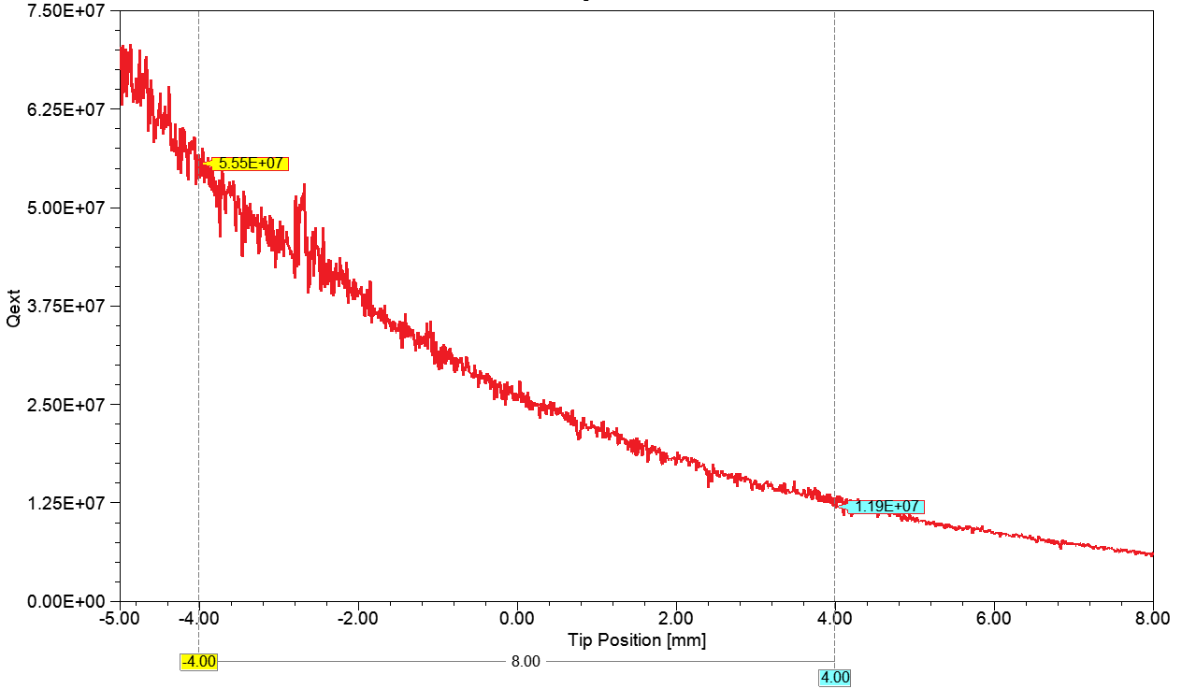
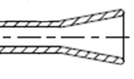
Q limitations
Desired Q_{ext} range 6x10⁶ to 6x10⁷
Range of movement achievable with coupler ± 4 mm
Resultant Q_{ext} range 1.19x10⁷ to 5.5x10⁷
Is there a better range?
Limiting factors

Slide 6
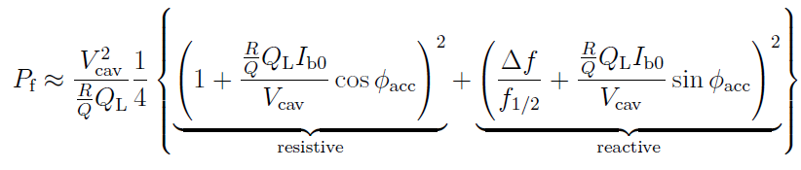
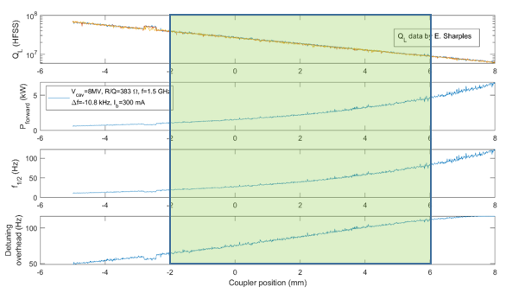
Optimal Q range
→ Aim for Q for stable operation: Achieve as much tuning overhead
as possible while maintaining acceptable average power level
Parameters:
l_{acc}=4*0.1m, f=1.5 GHz
R/Q= 383 W
V_{cav}= 8 MV, i.e. E_{acc}=20 MV/m
P_{max} at coupler 13 kW
=1
Compensated by proper tuning
Chosen range:
-2 to +6 mm of original
coupler range:
3.9.10⁷≤Q_{L}≤9.1.10⁶
→ 250 ≤b_{c} ≤1100
Curve flattens here
Courtesy of A. Neumann

Slide 7
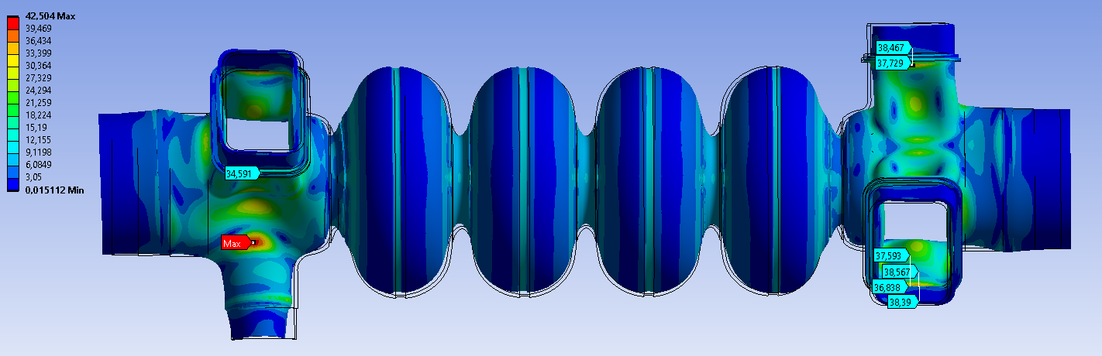
Mitigation of mechanical stress
When cavity @ max pressure peak stress @ coupler port is 42 MPa
Stress > yield strength of Nb → deformation
Stress limits for the warm cavity
Pressure | Operation | Yield strength – Nb 38 MPa after baking | Safety factor
1.5 bara | Warmup/ cool down | 22 MPa | 1.7
3.5 bara (max) | Safety valve | 38 MPa | 1.0
Coupler port blending radius: 15 mm
Increasing radius in critical region reduces the peak stress
Space limitations → cannot apply a larger radius in the full region.
Solutions: a variable radius, with a fixed R15 mm in horizontal plane (wrt installation orientation) and increased value in peak stress region.
Courtesy of Nora Wunderer
Notes:
Changes of the 1.5GHz VSR Cavity vessel lead to increased stress values when the cavity is pressurized with the max. value of p = 3.5bar(a), a peak stress of 42 MPa where the coupler port joins the cavity end group. The max. yield strength of Niobium @ room temp is 38MPa, so the design has to be adapted such that this value is not exceeded.

Slide 8
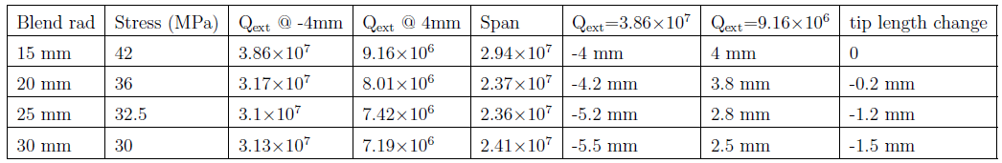
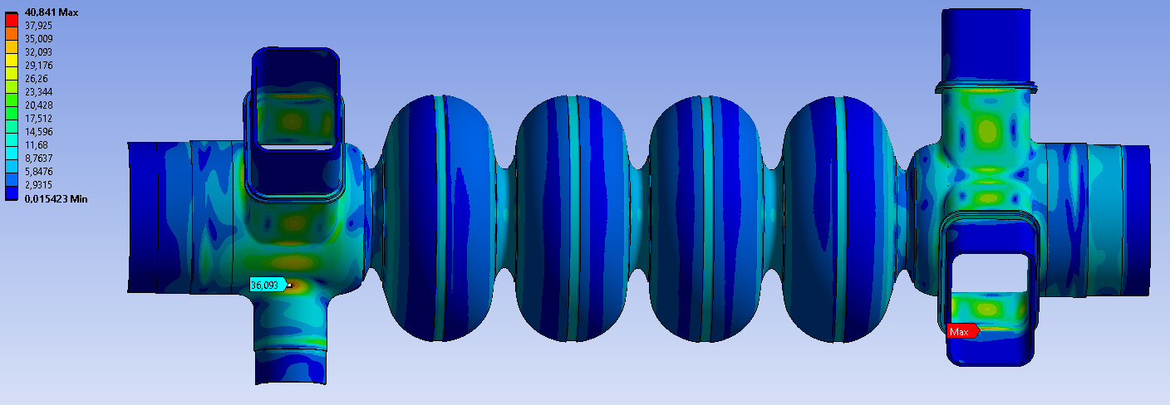
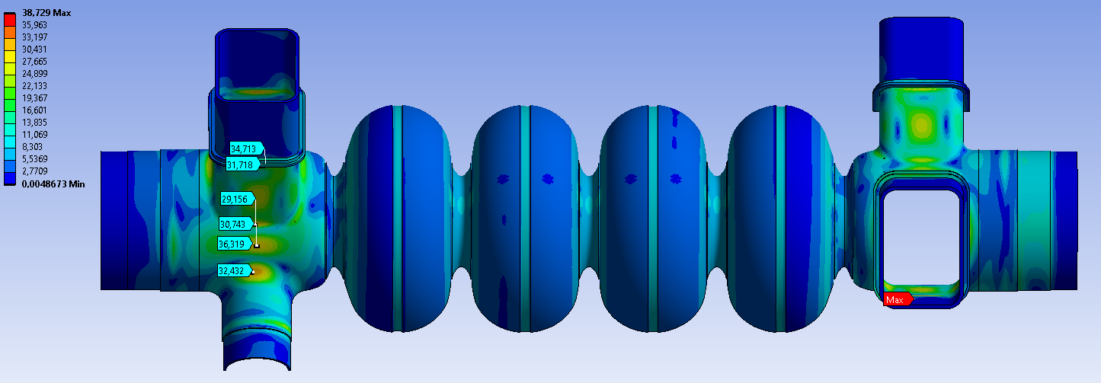
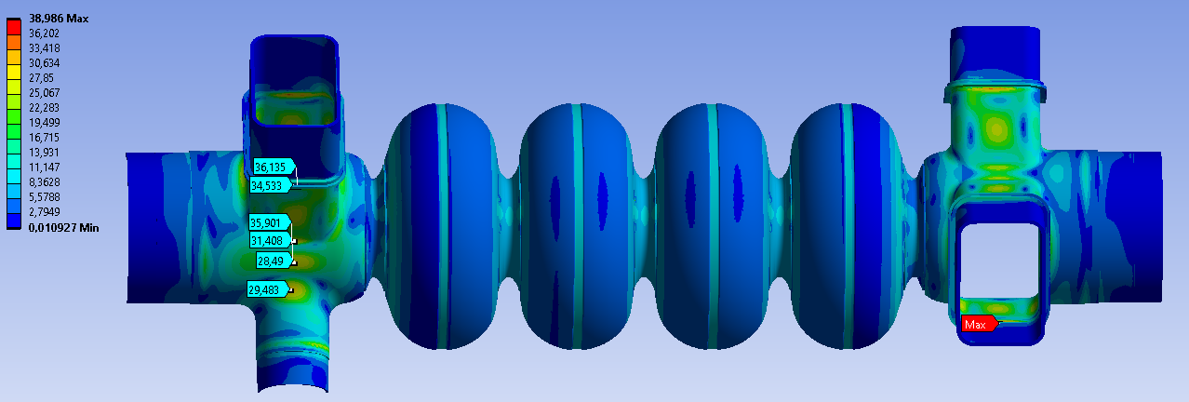
Mitigation of mechanical stress
Blending radius 20 mm
Stress: 36 MPa
Best option: lower stress, shorter tip, good coupling range
Blending radius 25 mm
Stress: 32.5 MPa
Blending radius 30 mm
Stress: 30 MPa
Courtesy of Nora Wunderer

Slide 9
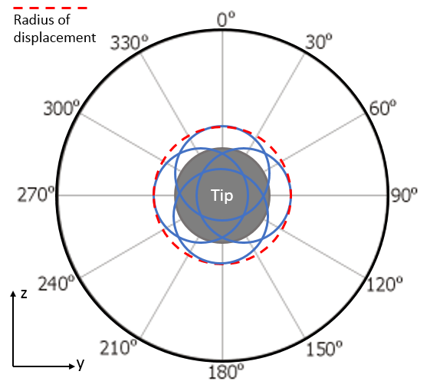
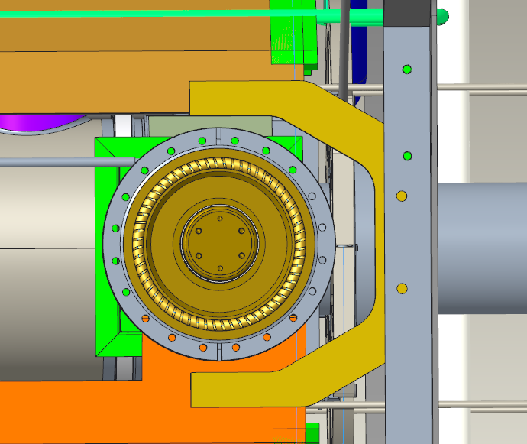
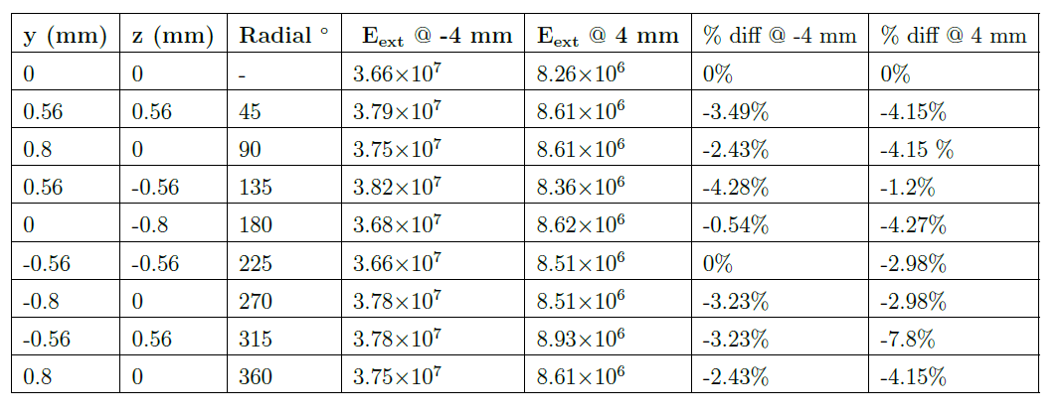
Displacement analysis
Fixed at the 70 K flange
The coupler is a fixed point within the module.
→ during cooldown, displacement of the coupler tip can be expected.
Notes:
the red dashed line shows the 0.8 mm radius of displacement and the blue circles represent possible tip displacements.
Relates to axial support of the cavity

Slide 10
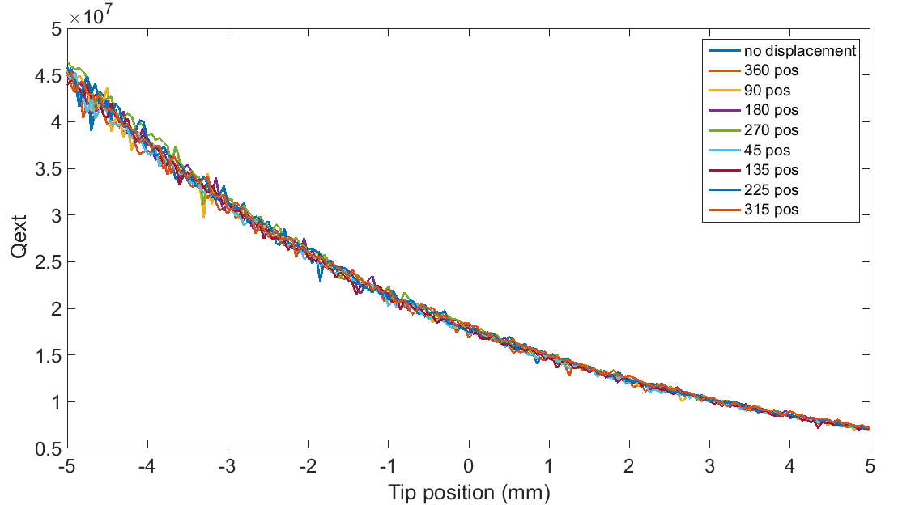
Displacement analysis
Minimal change < 5% in Q for all displacements
Further studies to see how the fields are affected are required

Slide 11

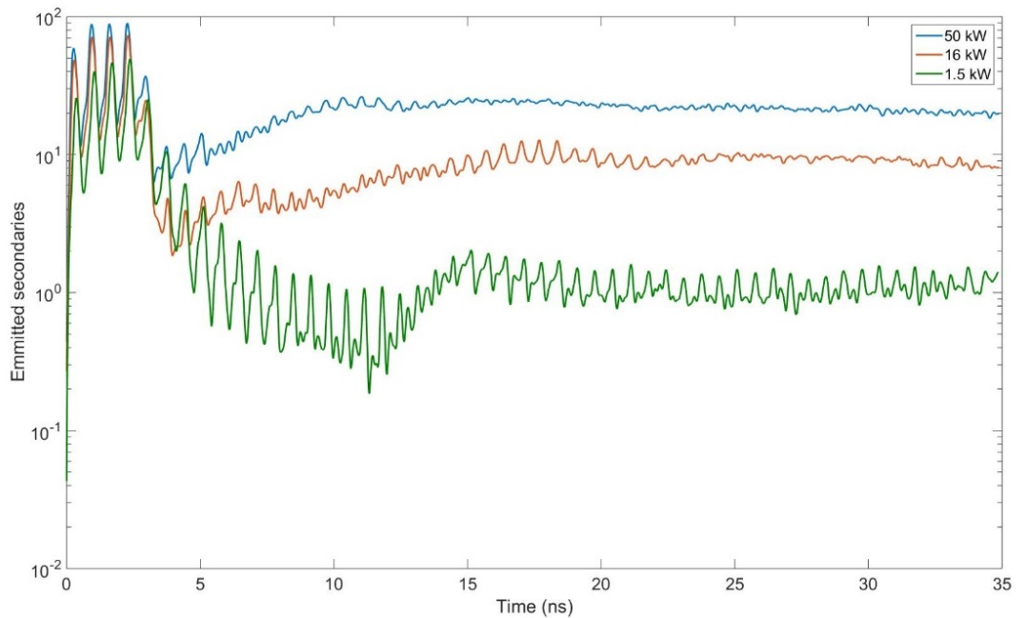
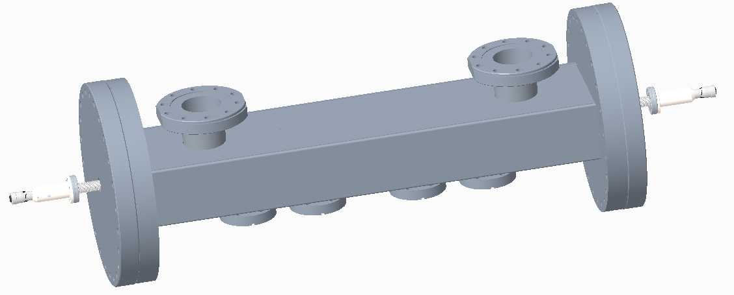
Outlook
Emitted particles vs time at different power levels
Design finalised
Multipacting studies performed and no multipacting found
Further field studies required for tolerance and blending studies
Thermal concerns still present around warm bellow but solution being sought
Testbox development almost complete
Coated ceramic: SEY=1.5
Current coupler status: Tender awarded, kick off meeting scheduled for the next month
Prototype Delivery: Expected November 2020
Series delivery: Expected August 2021

Slide 12
Thank you for your attention
Any Questions?

Slide 13
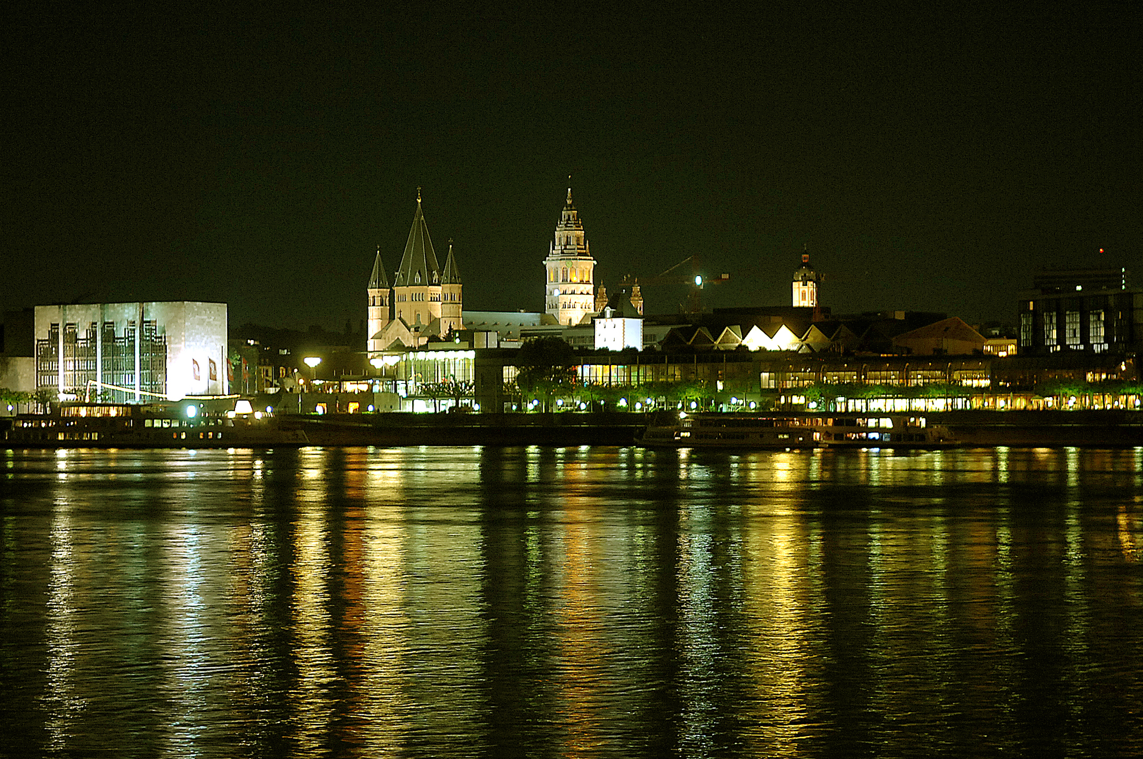




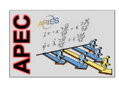
2nd Workshop on Operating SRF Systems Reliably in a "Dirty" Machine
November 10th - 12th, 2020
Helmholtz Institute
Mainz, Germany
https://indico.him.uni-mainz.de/event/63/
dirtySRF@uni-mainz.de
TOPICS:
Controlling contamination of SRF cavities during accelerator operation
Elimination of accelerator contamination
Experience in long term operation and degradation
Gas targets at the experimental sites:
possible issues and safety measures for SRF installations
Local organizing committee:
  Florian Hug
  Miriam Jäger
  Thorsten Kürzeder
  Tanja Schwerdt
  Timo Stengler
Copyright: Bildnummer: PAN12 @ Landeshauptstadt Mainz
Notes:
We do not have a scientific counsil yet, we are working on it
We are working on the indico page and add some unseful information about the workshop, accelerators in Mainz and Darmstadt, and of course tourist information about the wonderful city of Mainz.
At the moment we check if we can arrange the workshop without a workshop fee
We are already blocking some rooms in nearby hotels
After the TTC Hanse Weise will send an invitation email
We, ourselves, will also send invitation emails, also to Institutes which are perhaps not on the TTC list.

Slide 14
Operating SRF in A dirty machine: Workshop 2

Slide 15
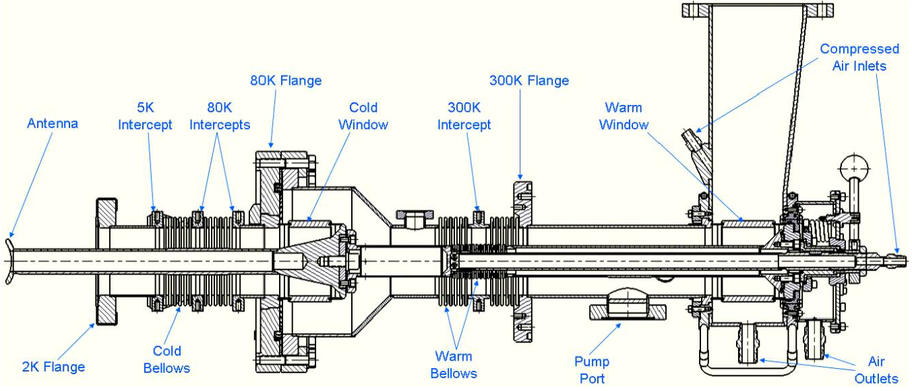
VSR Requirements
Initial parameters as laid out in the TDS for BESSY VSR VSR
Fundamental coupler Design
Adjustable coaxial coupler based on Cornell cERL injector coupler: Lower coupling level and lower power but higher frequency
Parameter | Value
Central Frequency (f_{c}) | 1.498 GHz
Power level | 16 kW CW
Q_{ext} range | 6x10⁶ to 6x10⁷
Q_{loaded} | 5x10⁷
S₁₁ @f_{c} | ≤-30 dB
S₁₁ @f_{c} ± 5MHz | ≤-20 dB
Cornell cERL injector coupler
Dressed 1.5 GHz cavity
Unique challenges of VSR
Complex cavity design → Higher order mode propagation
High power, high fields, small scale → heating issues
Smaller scales → Mechanical challenges
Module integration → dimensional constraints
High gradients and SRF → Field emission + multipacting must be avoided

Slide 16
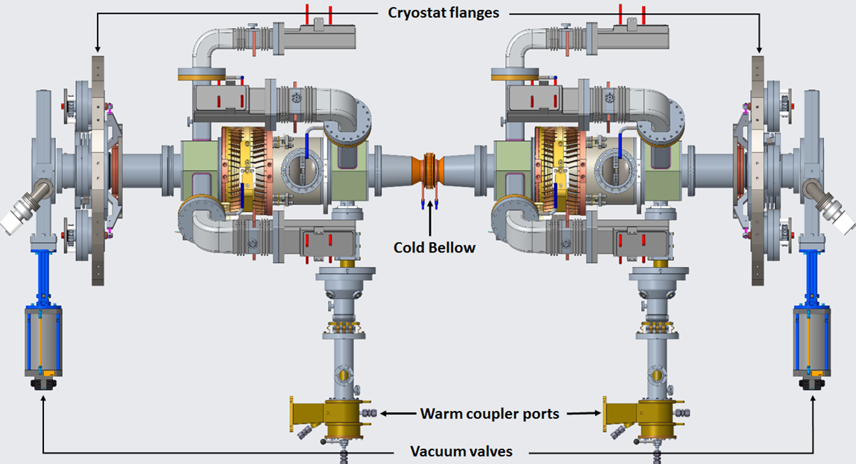
  Cryo Module – Preparatory Phase
Restricted space for tuner & is more critical for 1.75 GHz cavities.
Optional: one of the 1.5GHz cavities can be replaced by 5-cell 1.75GHz one, without big modifications.

Slide 17
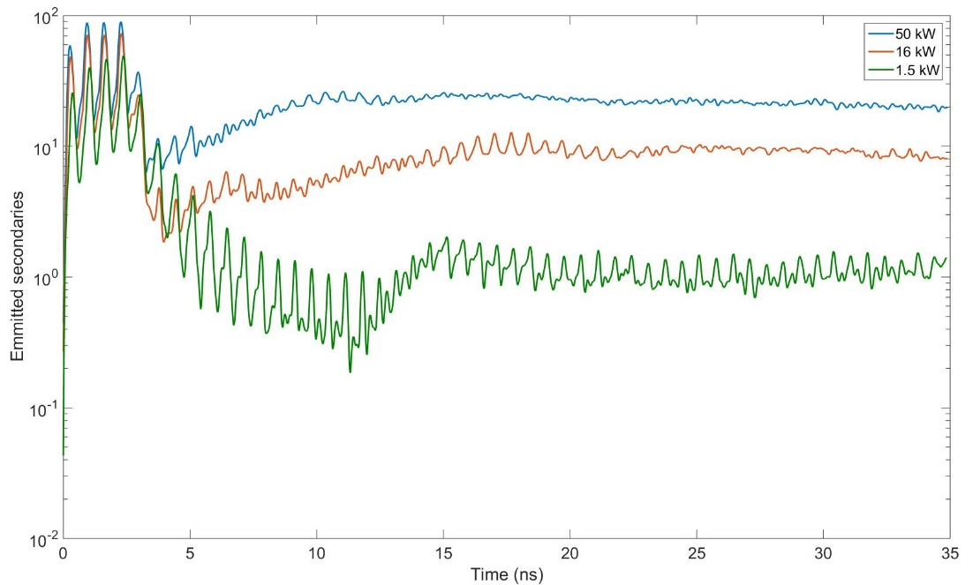
Multipacting
Emitted particles vs time at different power levels
Coated ceramic: SEY=1.5

