Slide 1


Remote handling of ultra-high vacuum beam pipe connections in high-radiation zones
Lukasz Krzempek, Cedric Garion
TTC CERN 06.02.2020

Slide 2
Outline
Introduction to flanges with knife for ultra-high vacuum applications;
Present applications of ‘Quick chain clamps’;
HL-LHC connection concept for VAX;
Summary.
TTC CERN 06.02.2020

Slide 3
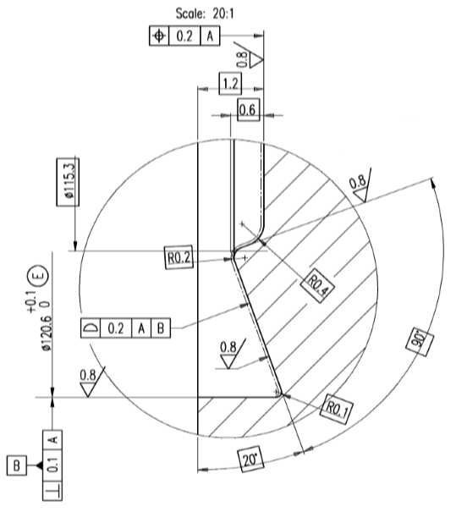
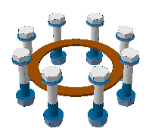
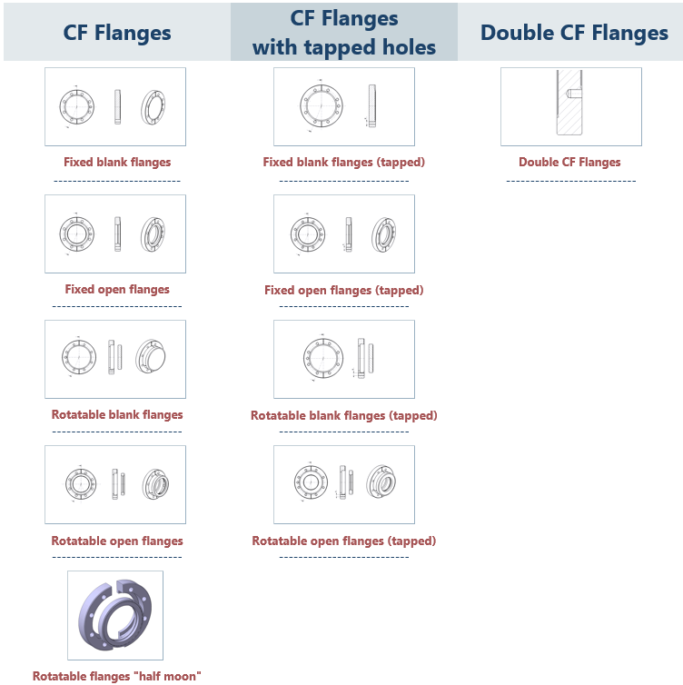
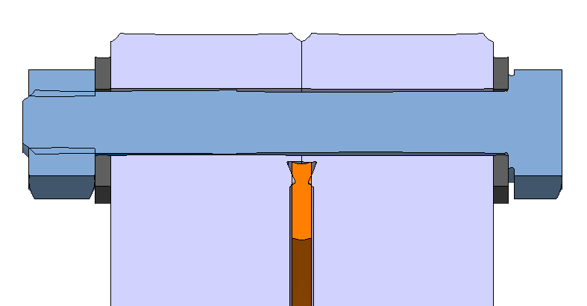
ConFlat (CF) flanges for Ultra High Vacuum (UHV)
CF knife
Bolts + silver coated gasket OFS
Accelerators (LHC, LEIR,…)
Compatible with bake out
Bolts + standard gasket OFHC
Leak tests
Laboratory use
Not compatible with bake out
350N/mm – force acting on gasket
Cross section of a typical assembly
Typical tightening torque – 33Nm (M8 screws for DN100)
TTC CERN 06.02.2020

Slide 4
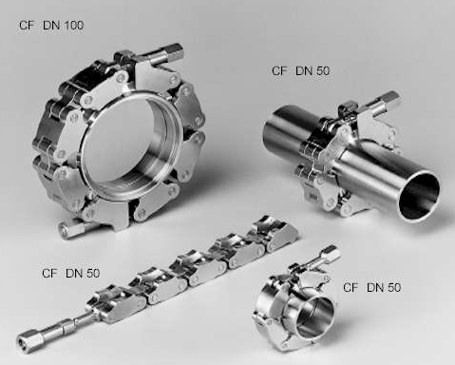
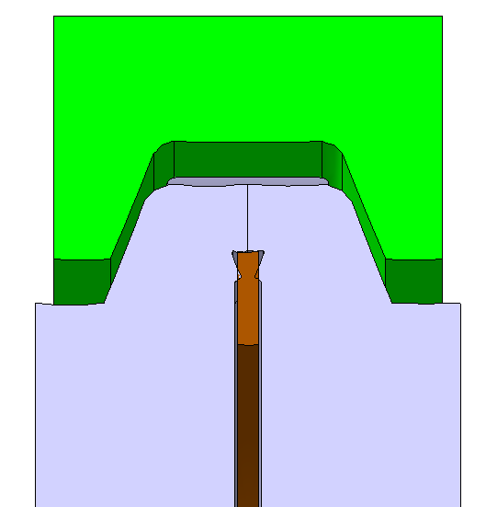
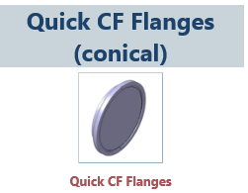
ConFlat (CF) quick flanges for Ultra High Vacuum (UHV)
Tightening screw
Chain clamp segment
CF knives
Courtesy of MKT Tschann
Cross section of a typical chain clamp assembly
Overview chain clamps CF
Material | Stainless steel 1.4435
Temperature range | -200 to +350°C
Tightening torque | Depends on clamp size (30Nm for DN100 chain clamp) and coating conditions
UHV | 10^-12mbar
Available sizes | DN16 – DN250
TTC CERN 06.02.2020

Slide 5
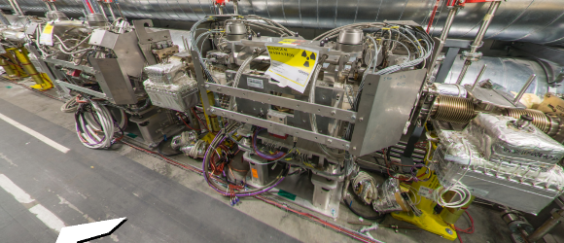
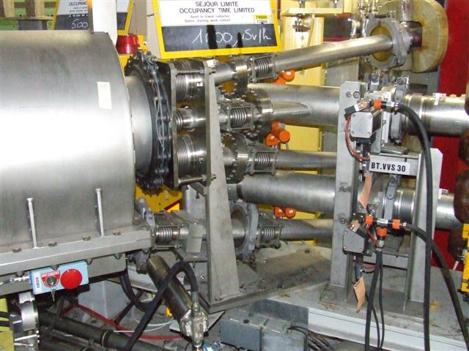
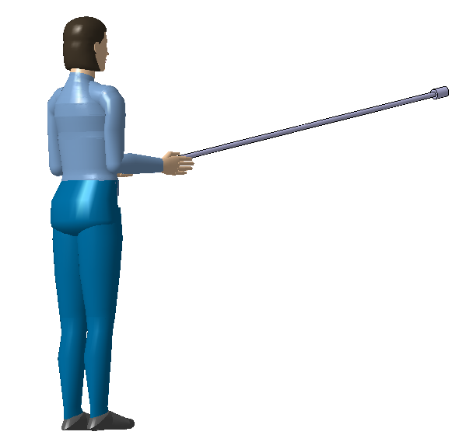
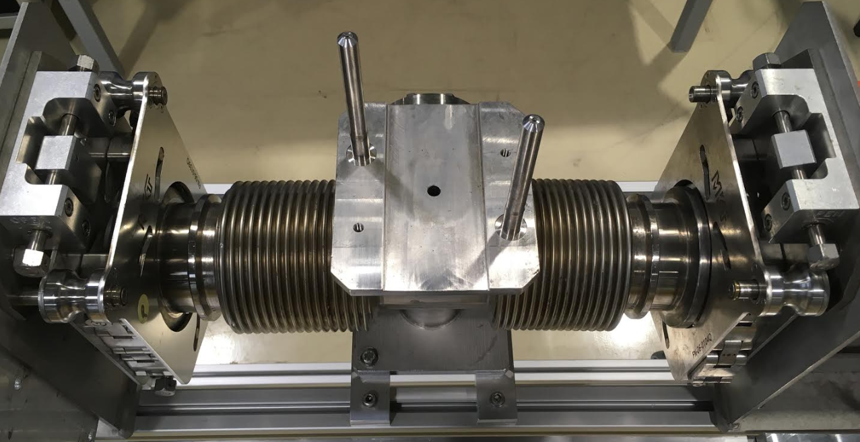
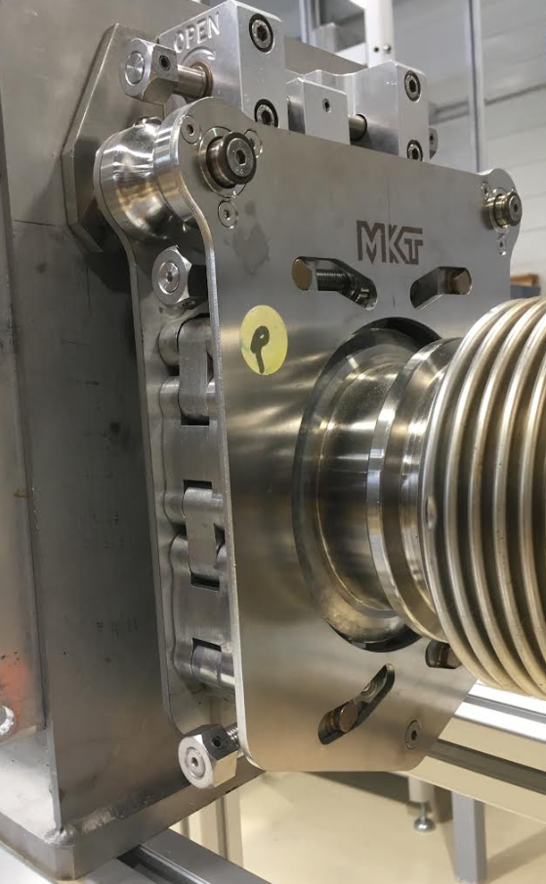
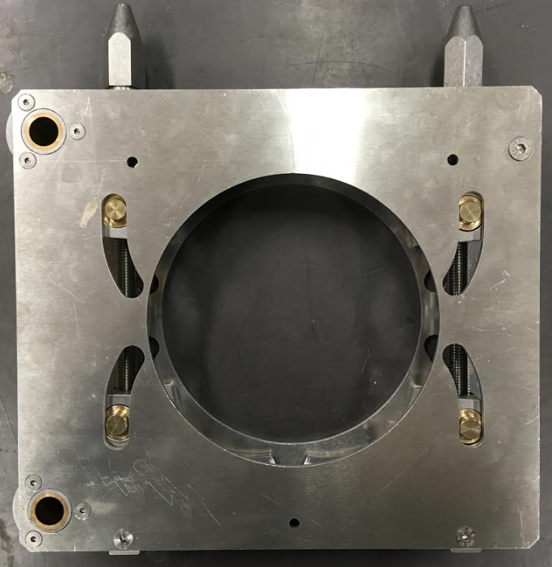
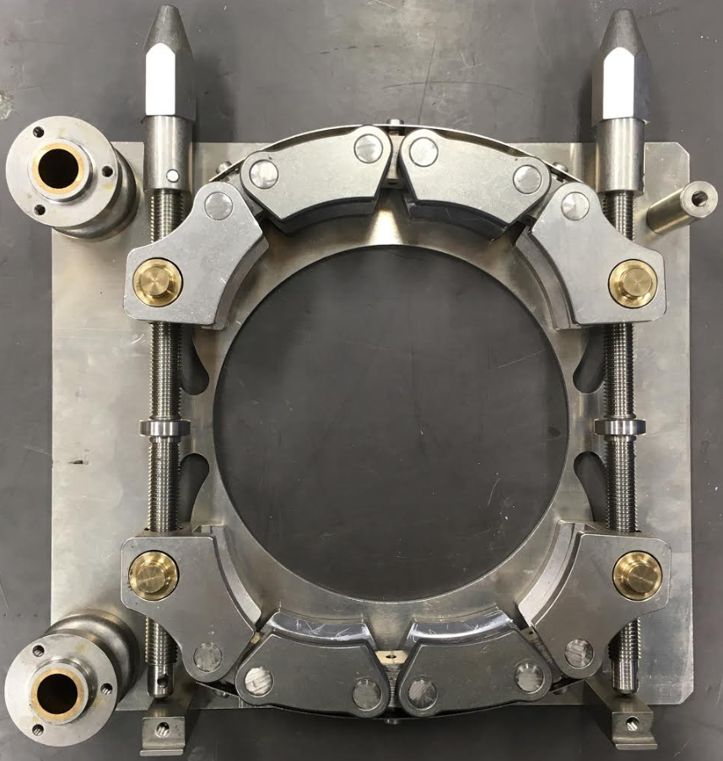
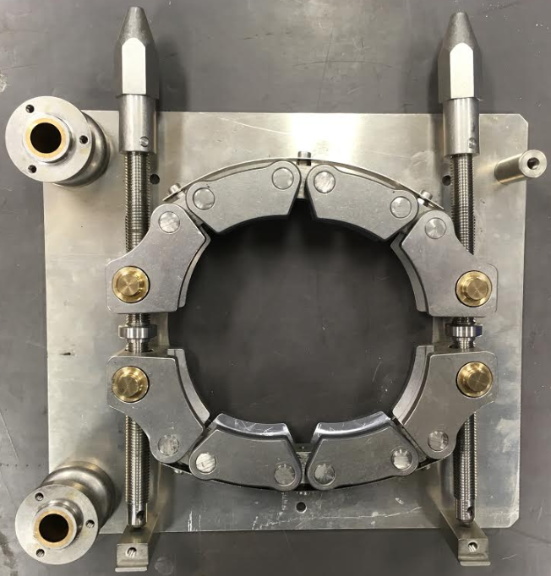
Examples of present applications – chain clamps and chain clamp assemblies
LHC
Booster
*
Preparation (drawings, pictures, simulations)
Dose mapping;
Work planning (where and how long);
Mock-ups and training;
Tooling (electrical wrenches, extension rods, etc.)
*
*
*
*
[1]
[2]
Manual handling with optimized intervention tooling
Guiding grooves
Combination of chain clamp and bellows compression tool
Chain clamp in open position
Chain clamp in close position
Horizontal actuation of tightening screws
TTC CERN 06.02.2020

Slide 6
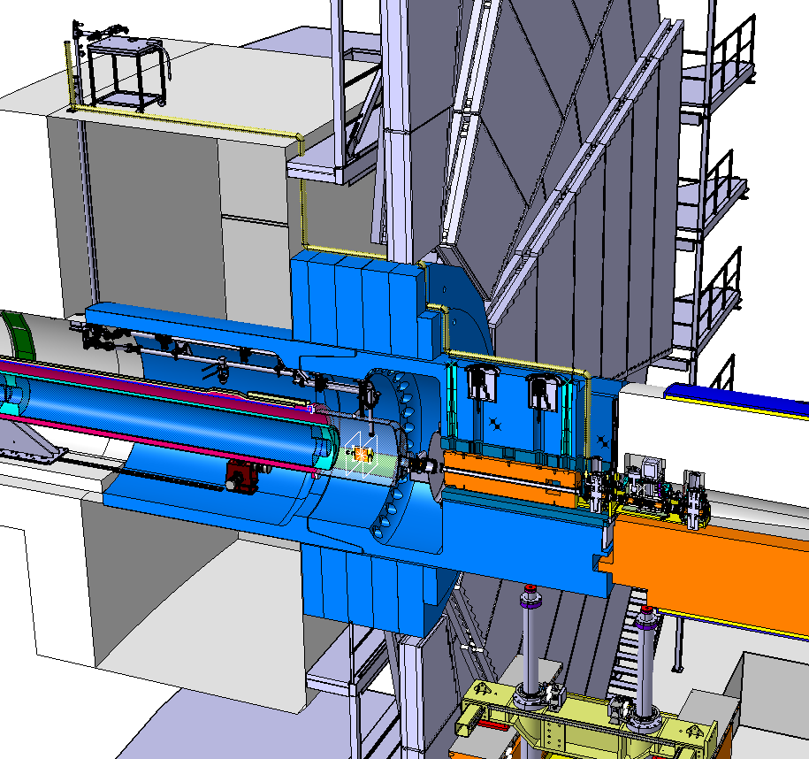
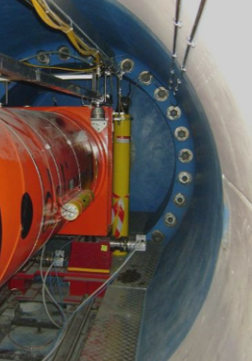
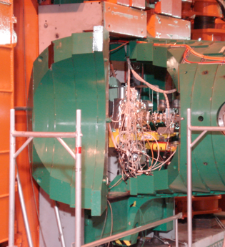
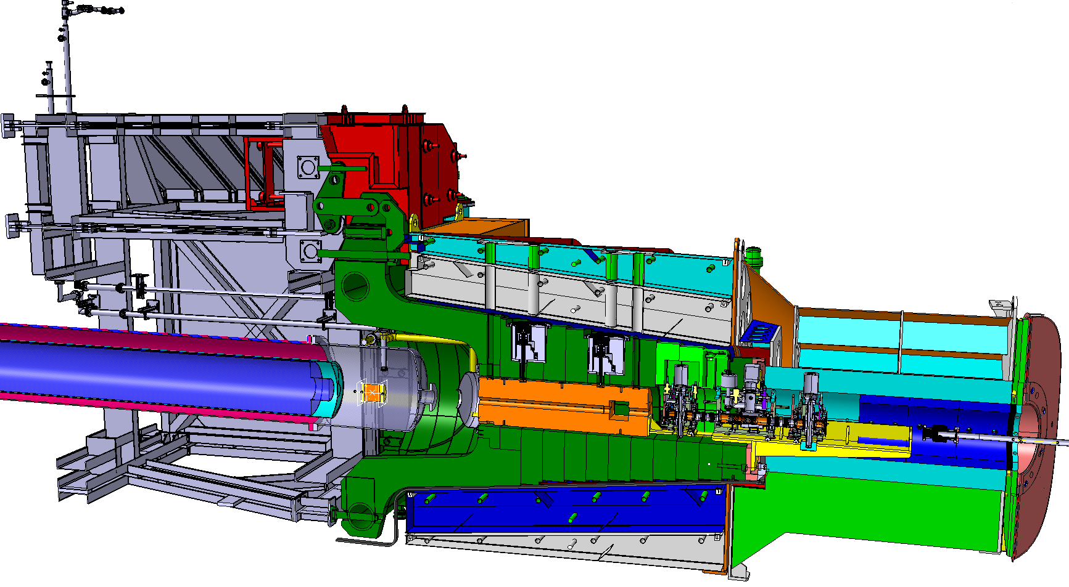
Vacuum Assembly for eXperimental areas (VAX) in HL-LHC phase
ATLAS
VAX relocation into experimental area
Access to VAX equipment at Point 1 (on the left) and Point 5 (on the right)
CMS
VAX relocation into experimental area
Priority to radiation transparent aluminium;
Transparent to a strong external magnetic field;
Robust equipment ensuring long term system reliability;
Quick, standard and unified connection between the VAX components;
Vertical remote handling maintenance.
TTC CERN 06.02.2020

Slide 7
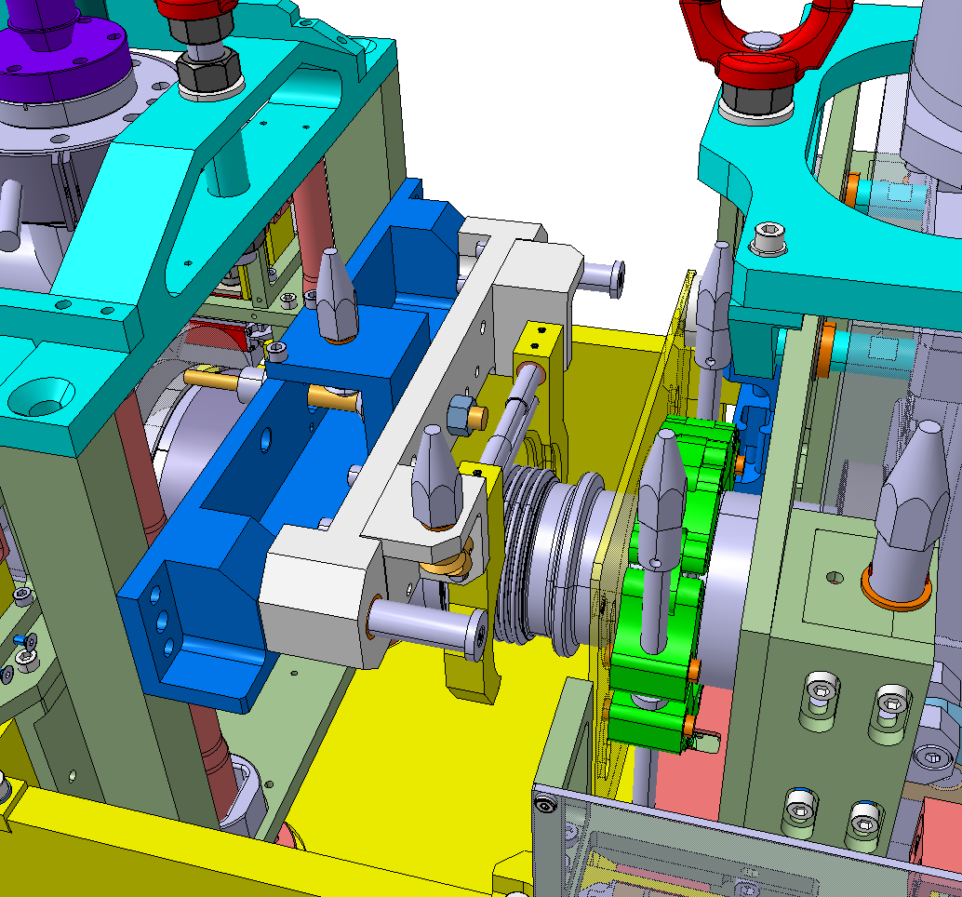
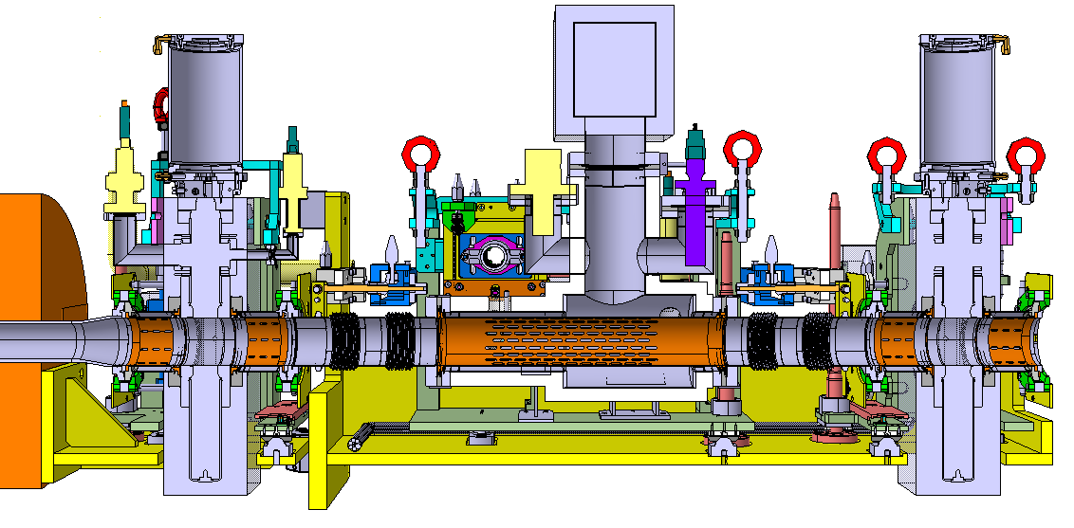
Vacuum Assembly for eXperimental areas (VAX) in HL-LHC phase
Combination of chain clamp and bellows compression tool
MODULE 1:
Vacuum sector valve
DN100 chain clamp assemblies
MODULE 2:
Instrumentation to pump down and control vacuum
MODULE 3:
Vacuum sector valve
DN100 chain clamp assemblies
Tunnel
Point 1 IP
TTC CERN 06.02.2020

Slide 8
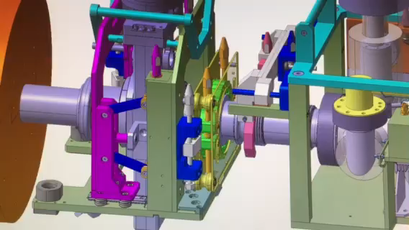
VAX Module 1 maintenance - DN100 chain clamp
Bellow compression tool arrive to its position;
Jaws grab the collar of bellows;
First tightening screw of chain clamp DN100 is wound out to its maximum;
Second tightening screw of chain clamp DN100 is wound out to its maximum;
Chain clamp DN100 assembly is pivoted backwards to free some space;
Bellows is compressed by compression tool;
(Chain clamp DN100 assembly on the opposite side of Module 1 is opened by the same 3 screws (2x tightening screw and 1x pivoting screw). However, the chain clamp is hidden for the purpose of this video);
The equipment in VAX Module 1 is shifted backwards and Module 1 is ready for transport.
TTC CERN 06.02.2020

Slide 9
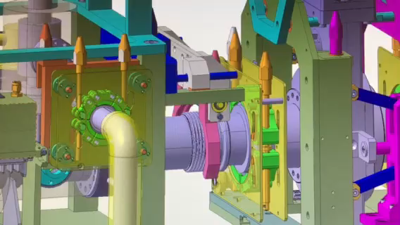
VAX maintenance – DN40 chain clamp
Bellow compression tool arrive to its position;
Jaws grab the collar of bellows;
First tightening screw of chain clamp DN100 is wound out to its maximum;
Second tightening screw of chain clamp DN100 is wound out to its maximum;
Chain clamp DN100 assembly is pivoted backwards to free some space;
Bellows is compressed by compression tool;
(Chain clamp DN100 on the opposite side of Module 2 is opened in the same sequence. It is skipped for the purpose of this video)
First tightening screw of DN40 chain clamp is wound out to its maximum;
Second tightening screw of DN40 chain clamp is wound out to its maximum;
Chain clamp DN40 assembly is shifted backwards to free some space and Module 2 is ready for transport.
TTC CERN 06.02.2020

Slide 10
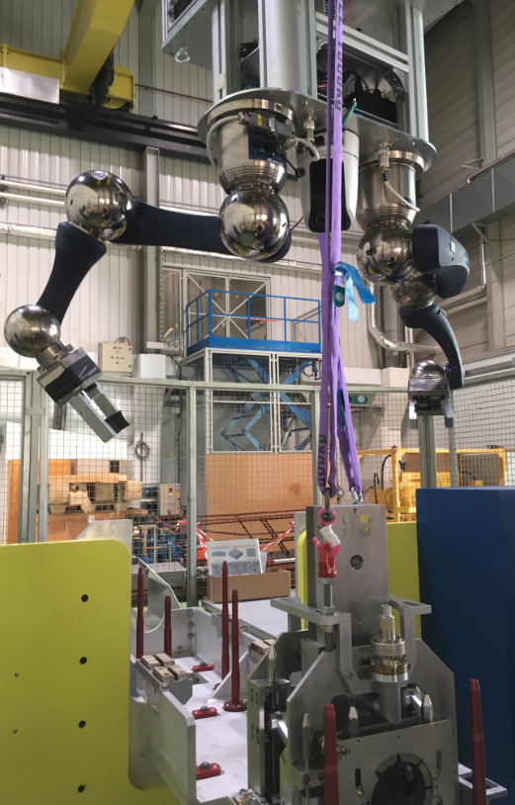
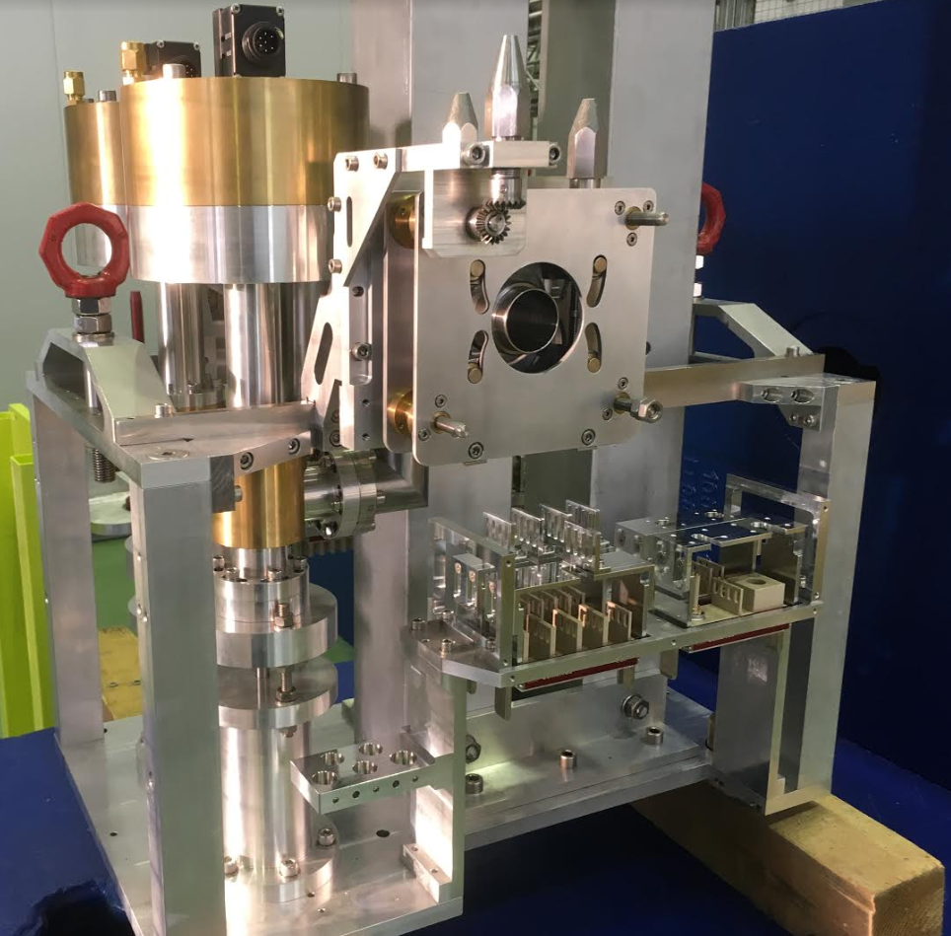
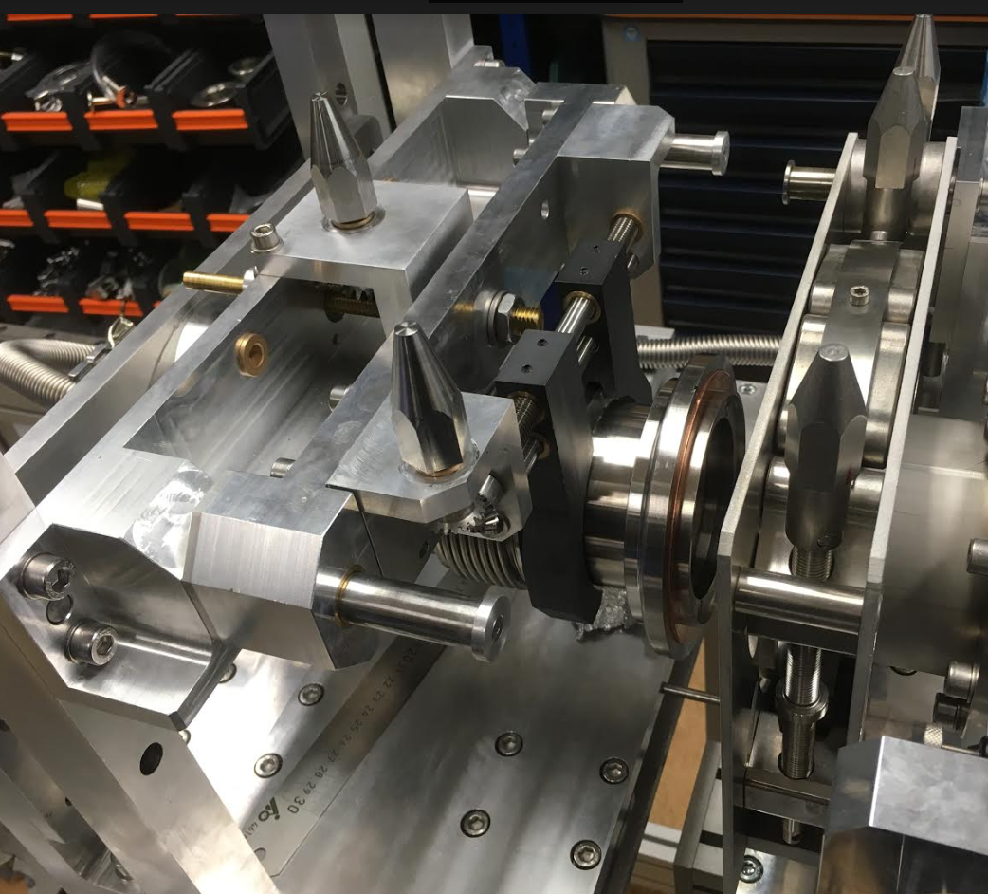
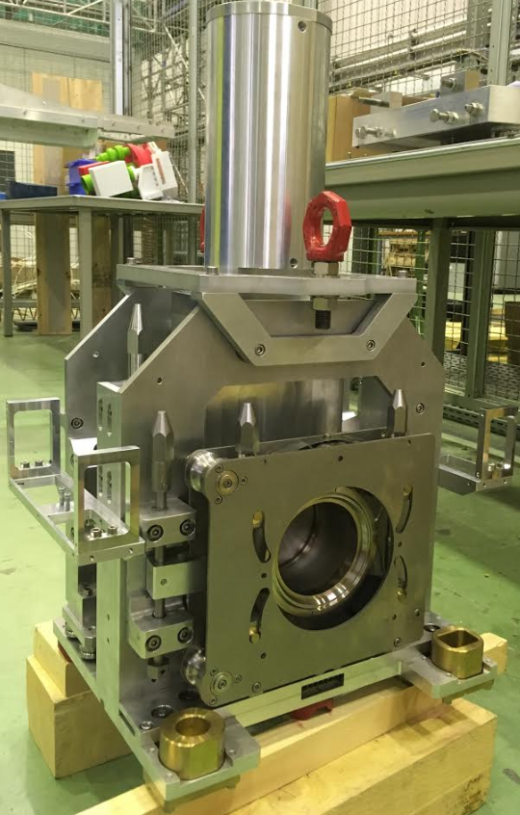
VAX prototype and tests
VAX chain clamps:
Torque control;
Tightening screw’s turns control;
Robot friendly interface;
Minimum number of steps for the robot to operate the tightening (locking) screws;
Chain clamp size determines number of segments (chain links) so that working conditions potentially could be affected by the gravity.
VAX Module 2 – chain clamp DN40
VAX Module interconnection – chain clamp DN100 in b.112
VAX Module 3 – chain clamp DN100 in b.186
VAX remote operation:
intervention of robot (gripper or gripper with extension tool);
Intervention of personnel from ‘safe’ area using extension tool.
VAX Module 1 – remote handling in b.186
TTC CERN 06.02.2020

Slide 11
Summary
Chain clamp connection assembly:
Quick solution to ‘bolted’ connections in terms of remote handling;
Simple and robust solution;
Design depends on:
  maintenance scenario;
  available space (space required for the surrounding mechanical system);
  Accessibility;
Disadvantage to grease the clamp.
Remote handling:
Cost;
Accessibility;
Time consuming;
  To remove 1 chain clamp at 5mSv/h
  Robot: 15-30 min (0µS);
  Torque wrench: 3 minutes (250µS);
No dose to personnel;
Robot vs. human leverage to be always considered.
[3]
TTC CERN 06.02.2020

Slide 12
Thank you
lukasz.piotr.krzempek@cern.ch
+41 22 76 62101
CERN 112/1-015
TTC CERN 06.02.2020

Slide 13
References
[1] J. Chauré - Intégration de blindages mobiles en LSS7 pour YETS et Long Shutdown 10th October 2018;
[2] J. Hansen – LIU PSB Work package description&Project status 18th June 2012;
[3] J. A. Ferreira – CERN experience: Vacuum design, interventions and operation in radioactive environment 22nd-24th November 2017
TTC CERN 06.02.2020

