Slide 1

cern.ch/STEAM
STEAM Architecture
Workshop 13-14 June 2019
Michał Maciejewski
on behalf of the STEAM team

Slide 2
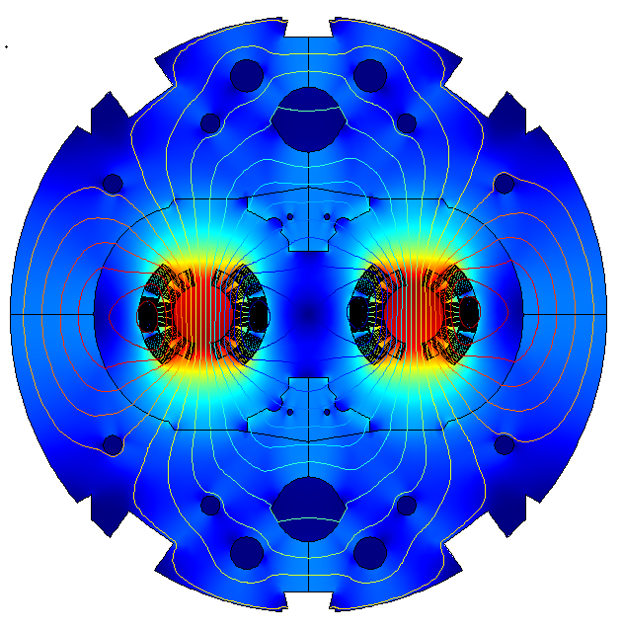




Superconducting Accelerator Circuits
– Numerical Challenges
Field/network model of a magnet
Partial differential equations
Varying time constants
~10us (quench) - ~10ms (losses)
Varying geometric scales
~10 um (filaments) - ~10 m (magnet)
~10 k degrees of freedom
Highly non-linear material properties
and equations
$$\vec{B }$$
Controller Model
$$\vec{F }$$
Differential-algebraic equations
Fixed frequency of operation
10-100 elements
Non-linear behaviour
$$\vec{v }$$
Network model of a circuit
I_{ref}
+
PI
M154
Differential-algebraic equations
Varying time constants
~1 ms (switch) - ~10 min (circuit discharge)
Varying geometric scales
~10 cm (diode) - ~10 km (circuit)
~10 k elements
Non-linear behaviour
-
M2
U
A
R
Busbar Model
Partial differential equations
Varying time constants
Adaptive mesh refinement
~1k elements
Non-linear behaviour
Multi-Domain, Multi-Physics, Multi-Rate and Multi-Scale Problem

Slide 3
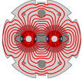


Simulation of Transient Effects in Accelerator Magnets
- Our Solution
Multi-domain – dedicated, domain-specific numerical tools
Multi-physics – strong coupling in single model, weak coupling of independent models
Multi-rate – interaction, coupling of two or more models
Multi-scale – interaction, coupling of two or more models
We use our models for performance evaluation of SC magnets and circuits for
LHC
No free lunch theorem – One tool can not simulate it all!

Slide 4

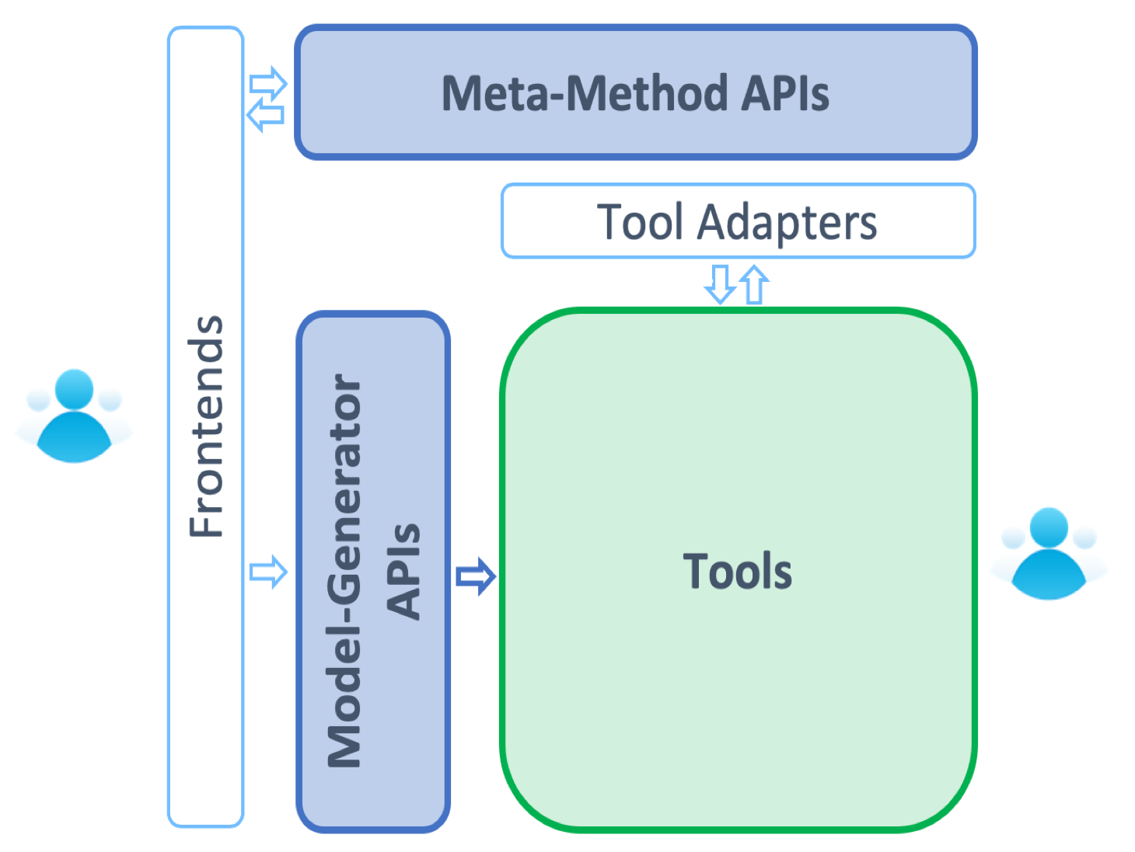
STEAM Overview
4. Meta-Methods
(Co-simulation, optimization)
STEAM is a simulation framework to study transient effects in SC magnets.
STEAM consists of five pillars:
Numerical tools
→ standalone, co-simulation
Model generation API
Tool adapter API
Meta-Methods
→co-simulation, optimization
Front-end to interact with APIs
3. Tool Adapter APIs
5. Frontends (Jupyter, Matlab)
1. Tools
(BBQ, ProteCCT, LEDET, ANSYS, COMSOL, PSIM, PSpice, LTSpice, QLASA)
2. Model-Generator
APIs
We believe that with STEAM there is place for everything
and everything is in place

Slide 5
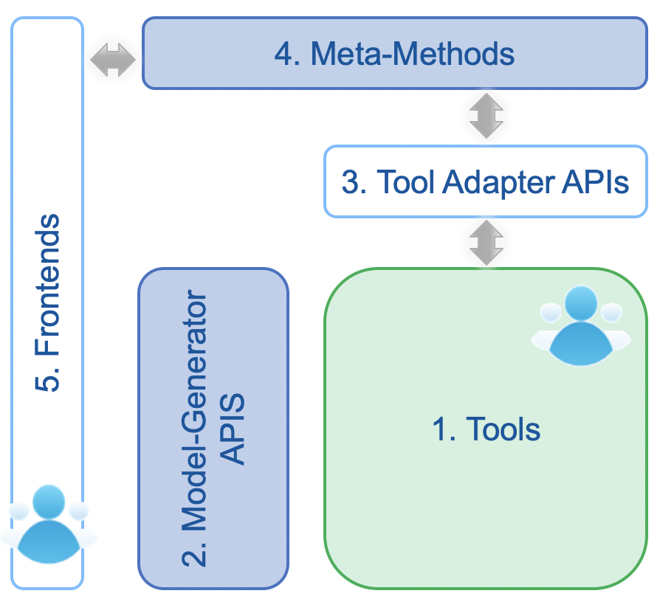
Presentation Outline
Introduction - Challenges
STEAM Architecture
STEAM Tools
STEAM Model-Generator APIs
STEAM Tool Adapter APIs
STEAM Meta-methods: Co-simulation
STEAM Frontends: Notebooks
Conclusion

Slide 6
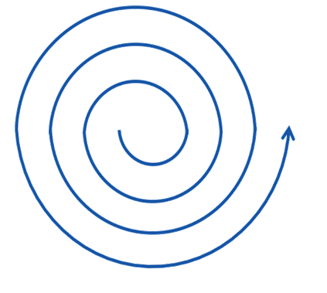
1. Model Completeness
Considering thermal models:
Computation time
3D FEM + Analytical
2D FEM
1D
Model
completeness
0D
2D network
3D Analytical
3D FEM
Model completeness

Slide 7
1. Qualities of good models
High Fidelity
Model Credibility
Linked to Decision Support
Understandable and Well-Organized
Well formed for Optimization
Clear Scope
Internally Consistent
Elegant
Analyzable and Traceable
Data Extrapolation
Availability of Interfaces
Reusable
Course on Architecture and Systems Engineering: Models and Methods to Manage Complex Systems, MIT Professional Education

Slide 8
1. Available Tools
 | Power Converter Controller | Superconducting Circuit | Superconducting Busbar | Superconducting Magnet
Equation type | Differential-algebraic | Differential-algebraic | Partial-differential | Differential-algebraic (network) Partial-differential (field)
Time-stepping | Fixed | Adaptive | Adaptive | Fixed Adaptive
# DOF | ~10 | ~10-10k | ~1k | ~1k-10k
Dimension | 0D | 0D | 1+1D | 0D, 1D, 2D
Physical Domains | - | Electric | Thermal | Magnetoquasistatic Thermal Mechanical
Models are subject to continuous verification and validation

Slide 9
1. Available Tools
 | Power Converter Controller | Superconducting Circuit | Superconducting Busbar | Superconducting Magnet
Equation type | Differential-algebraic | Differential-algebraic | Partial-differential | Differential-algebraic (network) Partial-differential (field)
Time-stepping | Fixed | Adaptive | Adaptive | Fixed Adaptive
# DOF | ~10 | ~10-10k | ~1k | ~1k-10k
Dimension | 0D | 0D | 1+1D | 0D, 1D, 2D
Physical Domains | - | Electric | Thermal | Magnetoquasistatic Thermal Mechanical
Proprietary
LEDET
QLASA
In-house
ProteCCT
We use proprietary tools for the sake of their verification and long-term support.
We use in-house tools due to their efficient implementation of custom physics.
Models are subject to continuous verification and validation

Slide 10
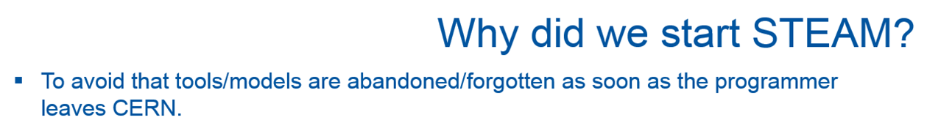
2. Model-Generator APIs
- Single source of truth
- A. Verweij, project owner
Inevitably models reflects engineer’s style → How to standardize them?
Differences in GUI models are difficult to capture → How to compare them?
In-house tools typically developed by a single person → How to maintain them?
In-house tools typically implement own equations, solver, etc → How to verify them?
Our goal is to provide a tool-independent, versionable model description.

Slide 11
2. Model-Generator APIs
- Single source of truth
Circuit modelling
PSpice GUI difficult to version
GUI models difficult to interpret
No API for GUI models
Netlist – scripted circuit description
Reusability of static libraries
Automatic generation of models and post-processing
Magnet modelling
Excel files difficult to version (can contain math)
Difficult to visualize geometry
Dependency on ROXIE field maps
Scripted geometry and parameters
Automatic generation of models
COMSOL open for modifications
STEAM-SING
STEAM-SIGMA
STEAM-LEDET
Input model parameters are separated from the tool itself.
(WYSIWYG approach)

Slide 12
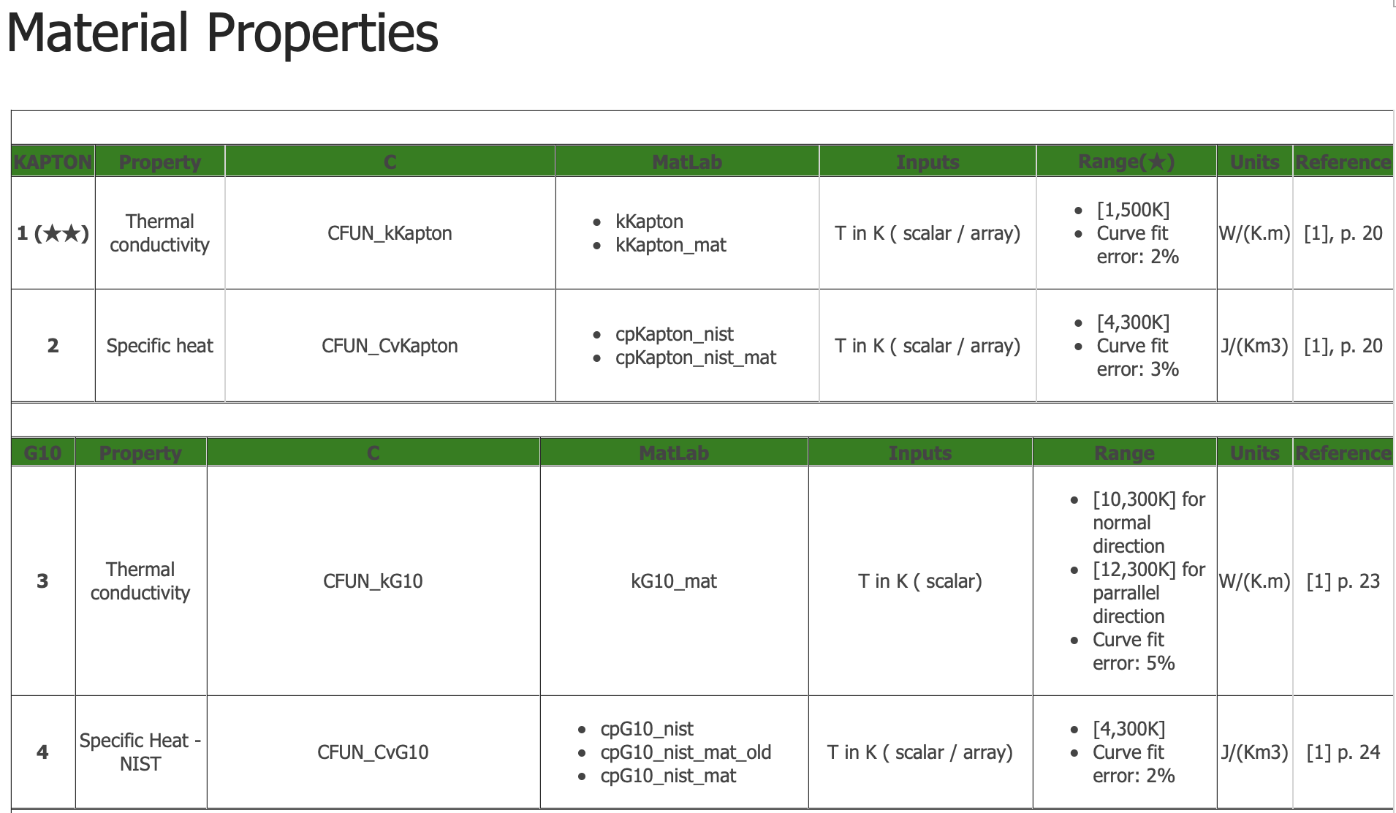
2. Library of Material Properties
Repository of material properties in:
  C
  MATLAB
Automated testing routine
References to existing measurements
https://gitlab.cern.ch/steam/steam-material-library
Input model parameters include also a subset of material properties.

Slide 13
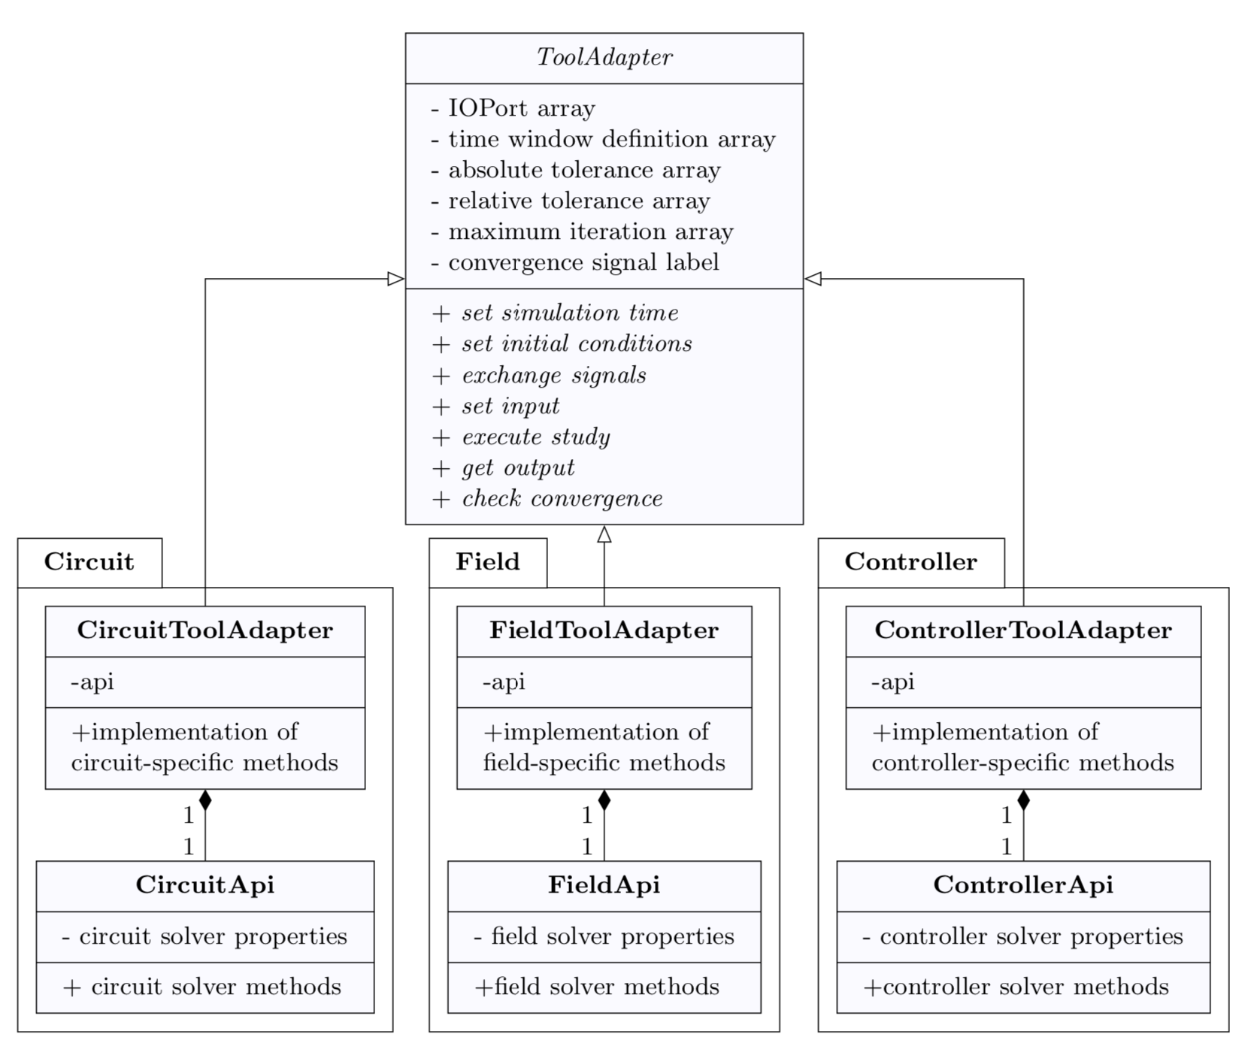
3. Tool Adapter API
Tool Adapter is a model-independent interface for simulation tools capable of
Setting/getting parameters
Controlling simulation time
Writing input
Reading output
Such an interface can be used for:
Cooperative simulations
Parametric studies
Optimization

Slide 14
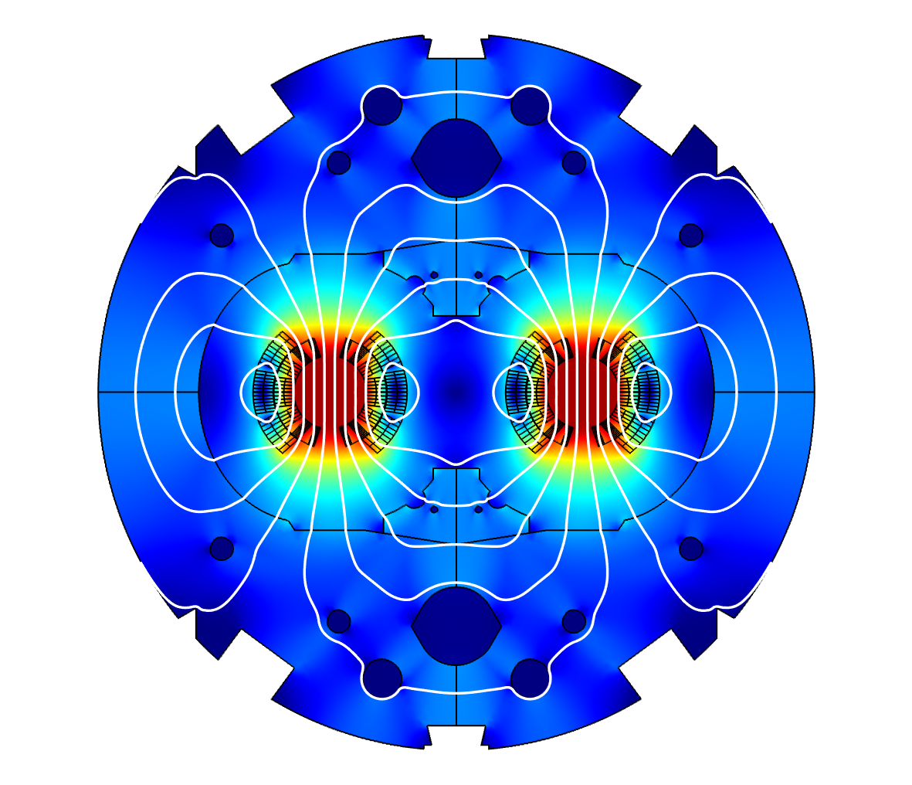
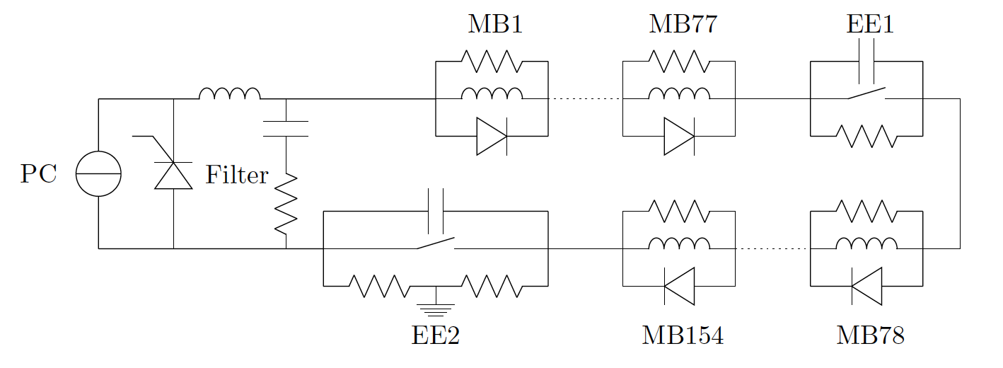



4. Cooperative Simulation - Motivation
Suitable to study interaction of models characterized by different
dynamical behavior: fast vs slow, fixed vs adaptive time stepping
mathematical formulation: ordinary vs partial differential equations
geometrical scales: phenomena occurring at micro vs macro scales, different mesh
physical phenomena: migration between tools can be time consuming
$$I_{circuit}^{k}$$
$$U_{FEM}^{k−1}$$
$$R_{quench}^{k−1}$$
Iteration until convergence is reached

Slide 15

4. Cooperative Simulation: STEAM CoSim
Co-simulation
Scenario
Supported tool adapters:
PSIM
LTspice
PSpice
COMSOL: SIGMA&BBQ
ANSYS
LEDET
ProteCCT
QLASA
Supported co-simulation methods:
One-way coupling
Weak coupling
Strong coupling
Waveform relaxation
List of Tool Adapters
Time Window
Definition
Hierarchical
Co-simulation
TA1
API
Ports
TA2
API
Ports
TAn
API
Ports
t
1
2
T₁
T₂
T_{w}
Co-simulation time and iteration loops
t
T₁
T₂
T₃
…
T_{w}

Slide 16


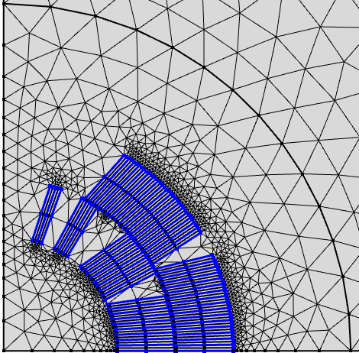

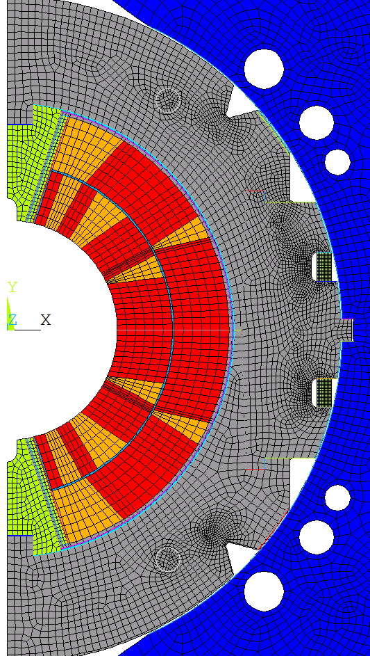


4. Cooperative Simulation: Mesh-Based Interpolation
Magneto-thermal models are solved with COMSOL and problem-specific mesh
Mechanical models are solved with ANSYS and problem-specific mesh
Magneto-thermal load on the magnet during the energy discharge is relevant for Nb₃Sn superconductors
Magneto-thermal model
Mesh-based interpolation
Coupling Environment
Mechanical model
$$T$$
$${\vec{F}}_{L}$$
$$\hat{T}$$
$$\hat{{\vec{F}}_{L}}$$
Mesh-based interpolation
M. Maciejewski, et al., "Coupling of Magnetothermal and Mechanical Superconducting Magnet Models by Means of Mesh-Based Interpolation", IEEE Transactions on Applied Superconductivity
MpCCI supports many other numerical codes: JMAG, Flux, Abaqus, MSC, …

Slide 17
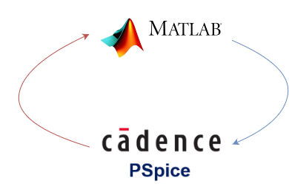
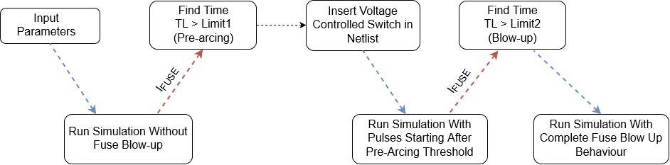
4. Simulation Scheme for Intermittent Short Analysis
MATLAB: - Main Loop Interface
- Numerical Integration
PSpice: Solves Netlist Provided by MATLAB (3 simulations in total)
- Simulation data exchange using STEAM PSpice Manager
Courtesy A. Liakopoulou

Slide 18

5. STEAM Frontend Notebooks
- Models as repositories of data
Models
A typical modelling work includes
creation of model,
running some simulations
post-processing results
summarizing results
(paper, report, presentation)
Analysis scripts
Results
Often times the link between the model, its results and report is broken.
With the use of APIs and scripts, part of this process can be integrated into a notebook.
This way model becomes a repository of data queried to provide relevant information.
Especially important while working for future magnets when we only have models

Slide 19
Presentation Outline
Introduction - Challenges
STEAM Architecture
STEAM Tools
STEAM Model-Generator APIs
STEAM Tool Adapter APIs
STEAM Meta-methods: Co-simulation
STEAM Frontends: Notebooks
Conclusion
STEAM Code Conventions
STEAM Continuous Integration Pipeline
STEAM Application – FCC Design

Slide 20

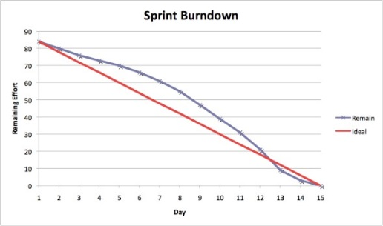

STEAM Code Convention - Implementation
Our naming convention:
https://espace.cern.ch/steam/_layouts/15/start.aspx#/SitePages/Naming%20conventions.aspx
Stand-up meetings @10AM
Shared coding convention became a language for the team work and discussion with experts
9 c 2015, Clean code development workshop, jointly with MPE-MS
13 Aug 2015, Object-oriented programming workshop, jointly with MPE-MS

Slide 21






STEAM Continuous Integration Pipeline – Implementation*
External
dependencies
Frontends
dependencies
model inputs
STEAM APIs
Code
analysis
Project
development
fatJar
uploadArchives
git commit
build_job
sonarqube
Testing
Project
versioning
Internal
dependencies
build image
*Strong cooperation with TE-MPE/MS (K. Król, JC. Garnier)
The pipeline automatically executes project build, testing, sharing, and analysis.
This ensures the maintainability of the project.

Slide 22
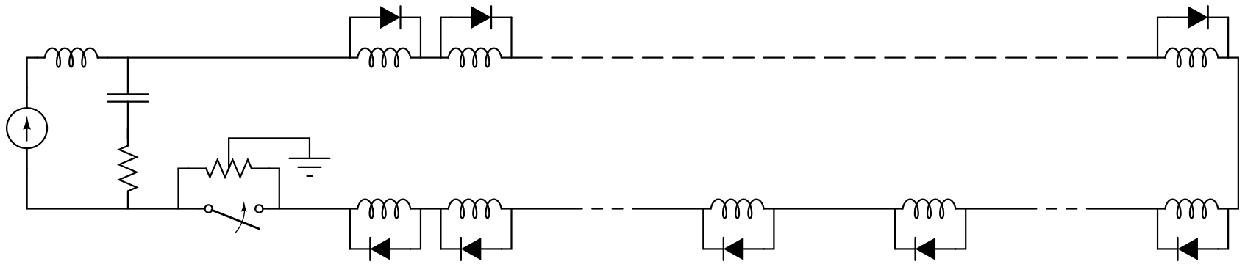



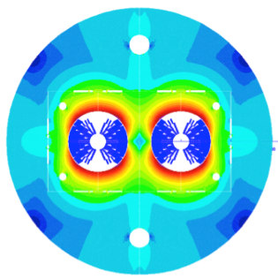

STEAM Application
– FCC Main Dipole Circuit Layout and Protection Design
L_{filt}
Circuit model
2800 components
PSpice
CLIQ
QDS
C_{filt}
M₁
M₂
M₂₂
PC
R_{EE}
R_{filt}
M₄₄
M₄₃
M_{n+1}
M_{n}
M₂₃
Electro-thermal
magnet model
400 turns
Models: PSpice, COMSOL, LEDET, ANSYS
Model generator API: SING, SIGMA
Meta-methods: CoSim, mesh-based interpolation
Frontends: PSpice Manager, CoSim viewer
Courtesy
M. Prioli
Quenching magnet:
CLIQ simulation
Neighbouring magnet:
Simulation of voltage response
FCC Week 2018: https://indico.cern.ch/event/656491/

Slide 23



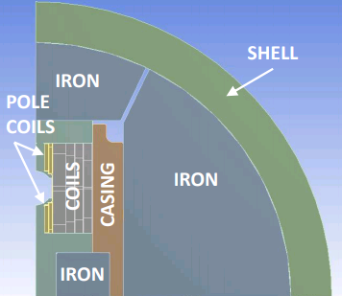
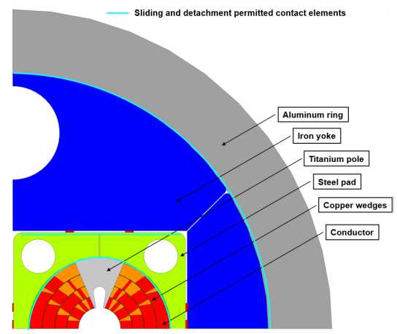
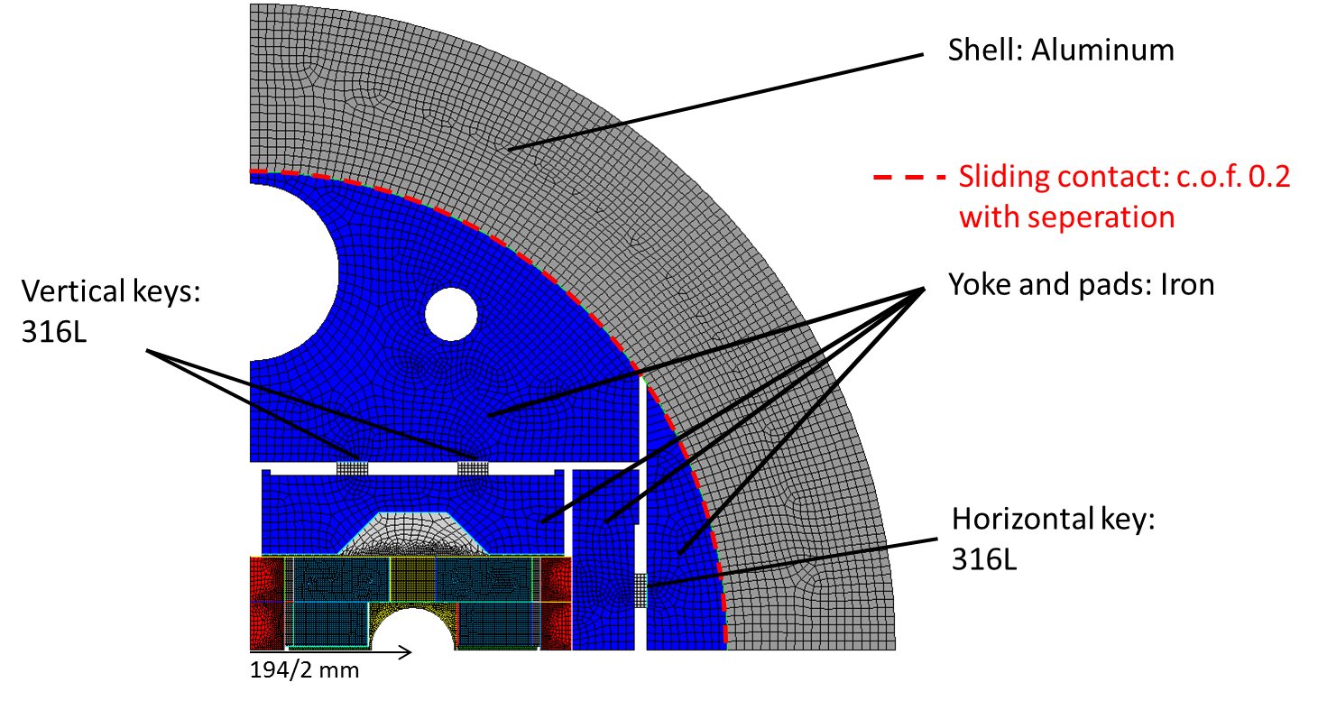
STEAM Application
– FCC Main Dipole Circuit Layout and Protection Design
  Cos-theta
  Block coil
  Common coil
Courtesy
M. Prioli
Protection design involved, among others, T. Salmi, B. Auchmann
FCC Week 2018: https://indico.cern.ch/event/656491/

Slide 24
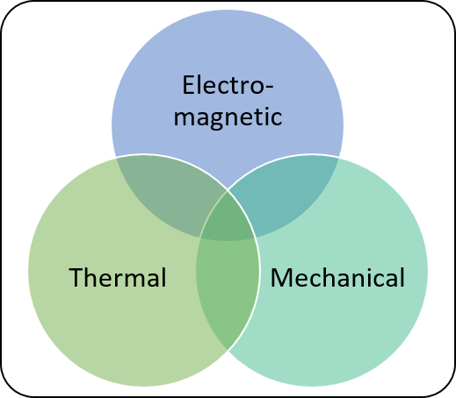
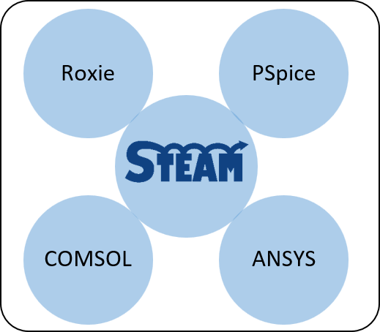
Design phases for the FCC dipole magnets
Electromagnetic design
Final
Magnet
Design
Objectives:
Peak field
Field quality
Physical
Domains
Electro-magnetic
Simulation
Tools
Roxie
Courtesy
M. Prioli
LEDET

Slide 25
Design phases for the FCC dipole magnets
Electromagnetic design
Mechanical design
Final
Magnet
Design
Objectives:
Peak field
Field quality
Objectives:
Peak stress during various phases (assembly, cool-down, powering)
Physical
Domains
Simulation
Tools
Mechanical
ANSYS
Courtesy
M. Prioli
LEDET

Slide 26

Design phases for the FCC dipole magnets
Electromagnetic design
Mechanical design
Quench protection design (CLIQ)
Final
Magnet
Design
Objectives:
Peak field
Field quality
Objectives:
Peak stress during various phases (assembly, cool-down, powering)
Objectives:
Hot-spot temperature
Peak voltage to ground
Physical
Domains
Electro-magnetic
Simulation
Tools
Thermal
COMSOL
Courtesy
M. Prioli
LEDET

Slide 27
Design phases for the FCC dipole magnets
Electromagnetic design
Mechanical design
Quench protection design (CLIQ)
Final
Magnet
Design
Objectives:
Peak field
Field quality
Objectives:
Peak stress during various phases (assembly, cool-down, powering)
Circuit design
Objectives:
Hot-spot temperature
Peak voltage to ground
Objectives:
Discharge time
Peak voltage to ground
Physical
Domains
Electro-magnetic
Simulation
Tools
PSpice
Thermal
COMSOL
Courtesy
M. Prioli
LEDET
M. Prioli et al.: “The CLIQ quench protection system applied to the 16 T FCC-hh dipole magnets”, IEEE Transactions on Applied Superconductivity, accepted for publication

Slide 28
Design phases for the FCC dipole magnets
Electromagnetic design
Mechanical design
Quench protection design (CLIQ)
Final
Magnet
Design
Objectives:
Peak field
Field quality
Objectives:
Peak stress during various phases (assembly, cool-down, powering)
Circuit design
Objectives:
Hot-spot temperature
Peak voltage to ground
Quench mechanics
Objectives:
Discharge time
Peak voltage to ground
Objectives:
Peak stress during quench protection
Physical
Domains
Electro-magnetic
Simulation
Tools
Thermal
Mechanical
COMSOL
ANSYS
LEDET
M. Prioli et al.: “The CLIQ quench protection system applied to the 16 T FCC-hh dipole magnets”, IEEE Transactions on Applied Superconductivity, submitted for publication

Slide 29
Conclusion
A solid base of the STEAM framework is now established and ready to be used for all kinds of simulations on SC circuits for actual and future accelerators.
STEAM has already been used for many studies, especially:
    Fault scenario’s in the LHC
    HiLumi triplet circuit
    FCC magnet and circuit protection
    “RB+11T” circuit
We have acquired a lot of competence in the MPE-PE section in co-simulation and individual tools

