Slide 1

STEAM-BBQ
(BusBar Quench)
1st STEAM Workshop 13-14 June 2019
cern.ch/STEAM
Matthias Mentink
on behalf of the STEAM team

Slide 2
Overview
Motivation

Slide 3
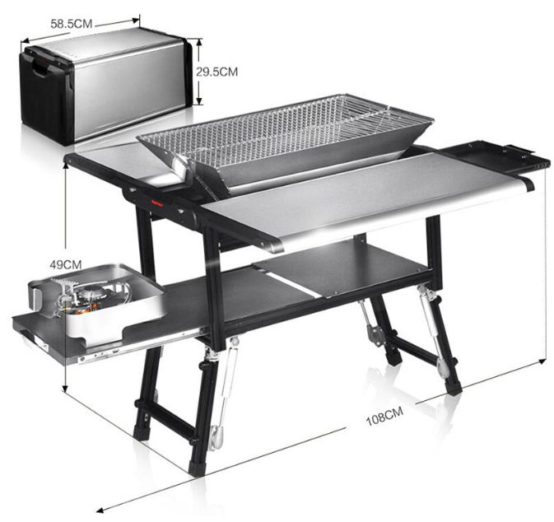
Motivation for STEAM-BusBarQuench (BBQ)
For a circuit with a known discharge quench integral:
What is the time required to detect and validate a quench?
What is the total quench integral that the superconducting conductors see?
What are implications of cooling to the helium bath?
How long does it take for a normal zone to traverse a given conductor length, also considering local field variations, joints, inhomogeneous cooling conditions etc.?
What is the hotspot temperature of a conductor quenching at a given circuit current?
→ STEAM-BBQ
Multi-functional barbecue grill

Slide 4
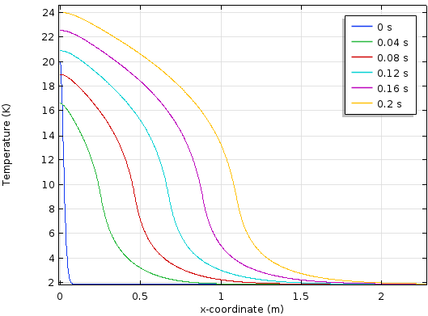
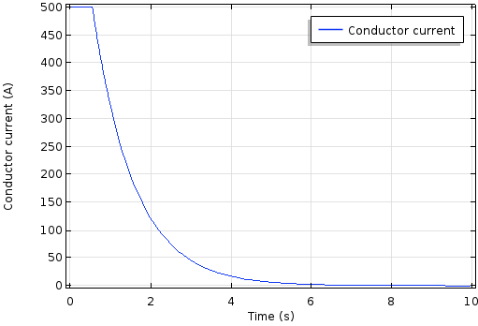
Some tool basics
STEAM-BBQ [1]: FEM-based Comsol simulation tool for calculating the quench-related properties of individual conductors such as superconducting busbars, with inspiration from previously developed 1D quench propagation tool [2]
Calculation of quench-related conductor properties:
  Quench propagation velocity v_{Q}
  Development of voltage after quench origination for quench detection
  Hotspot temperature as a function of quench integral
For circuit with known discharge quench integral:
  Time-dependent current (Exponential decay after quench detected)
  Time-dependent hotspot temperature
Hotspot temperature at
t = 0.2 s
v_{Q}
Temperature-development along length of conductor
[1] M. Mentink and M. Maciejewski, “STEAM-BBQ User manual”, EDMS nr. 2159478, (2019)
[2] D. Paudel, CERN thesis 2015-090, June 30th (2015)
Circuit current discharge

Slide 5
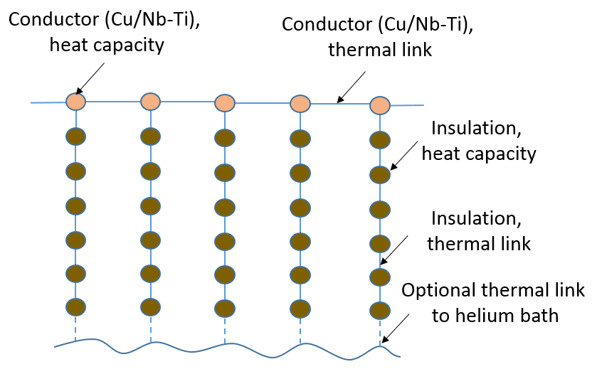
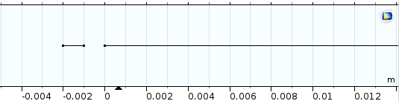
Thermal aspects
Tool dimensionality: 1+1D
  Longitudinal heat transfer along length of conductive busbar (For example: Cu / Nb-Ti conductor)
  Transverse heat transfer from conductive center to six insulation layers
  Optional heat transfer to helium bath, Kapitza cooling + film boiling
Tool simultaneously calculates the busbar hotspot temperature in two ways:
  ‘Adiabatic hotspot temperature’: No longitudinal heat propagation, perfect transverse heat propagation without cooling to bath
  Regular hotspot temperature, with longitudinal heat propagation and transverse heat propagation
Uses STEAM material library for user-selected material properties (with cross-checked temperature and magnetic-field dependence)
Thermal layout: 1+1D dimensionality
Adiabatic
Regular
Axial layout: Adiabatic region (left) + regular busbar with axial + transverse heat propagation

Slide 6
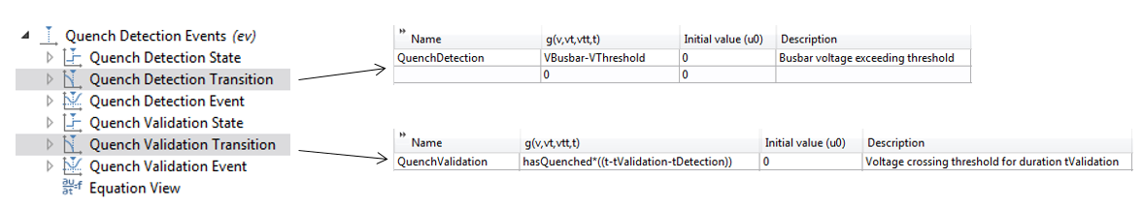
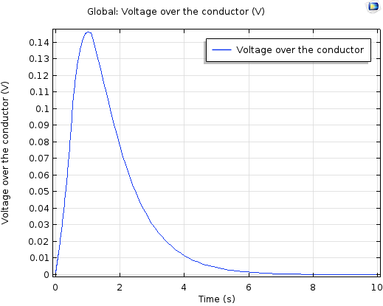
Model states
All model equations are visible to the user, to allow user to understand underlying physics and give high tool flexibility
Model state with Comsol ev module: Module switches from constant current to discharge upon meeting condition
Here: Circuit discharge once total voltage exceeds VThreshold for duration tValidation
Flexible feature for switching model states. Here: Circuit discharge once VThreshold is exceeded for duration tValidation
Voltage over conductor
Circuit discharge

Slide 7
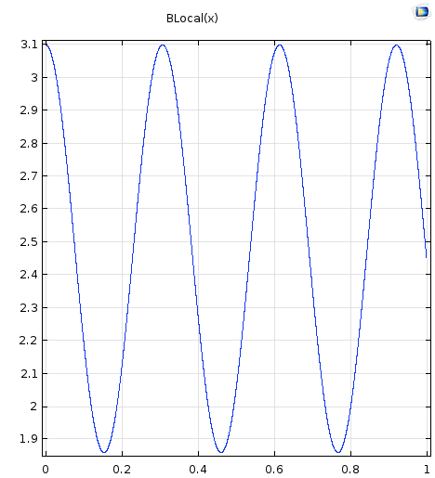
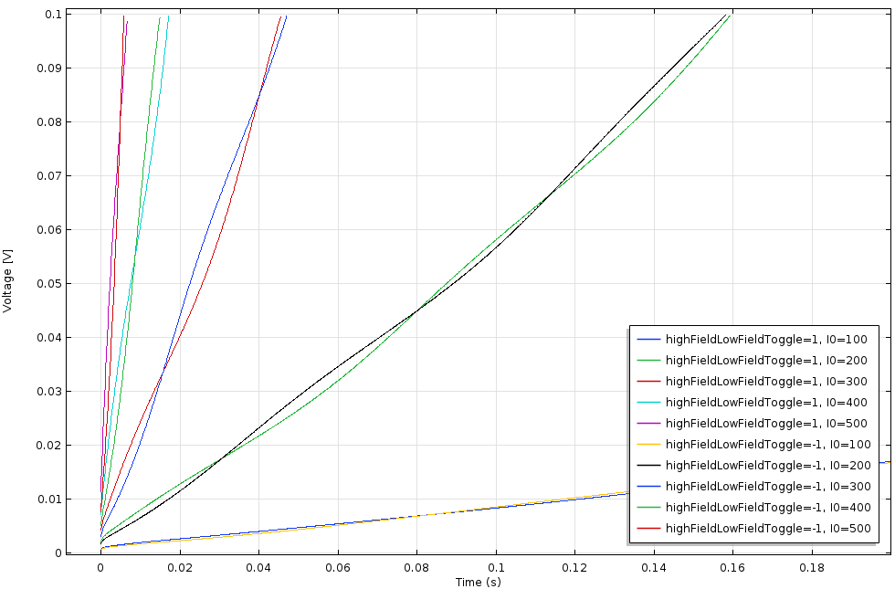
Example: Calculation of initial voltage development in MCBRD
500 A 400 A 300 A 200 A
Magnetic field B [T]
100 A
Position x [m]
Text to be added

Slide 8
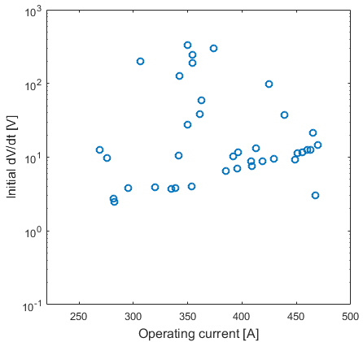
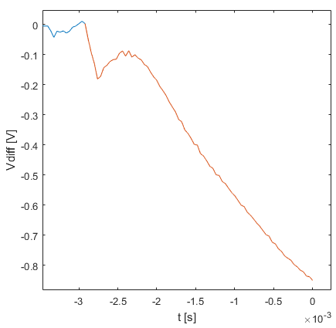
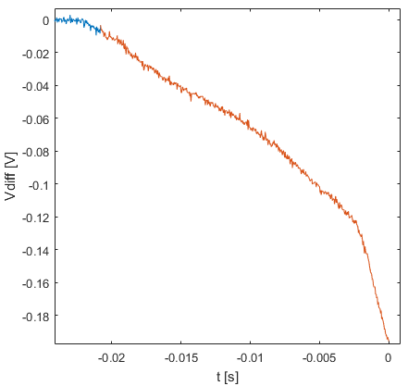
Experimental observations on MCBRD
300 V/s
7 V/s
Symmetric quench
Fast voltage development
Slow voltage development
Experimentally observed initial dV/dt for training quenches on MCBRDp1
Text to be added

Slide 9
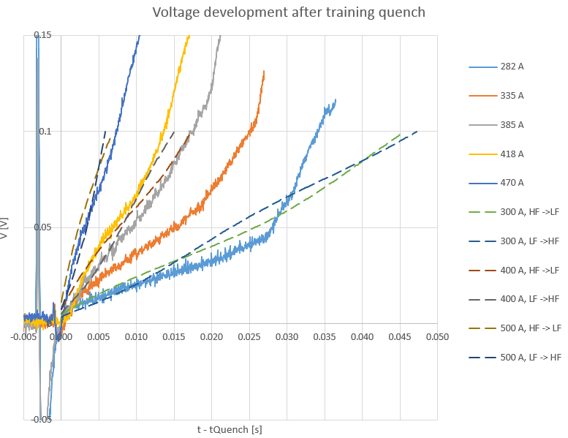
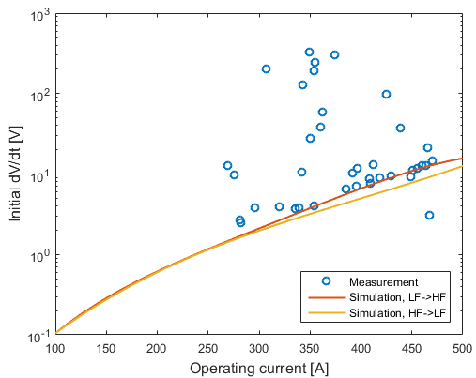
Comparison, simulations vs. experimental results
Measurement: Propagation to neighbouring strand
Symmetric quench
Text to be added

Slide 10
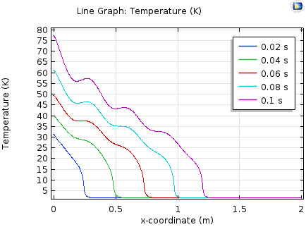
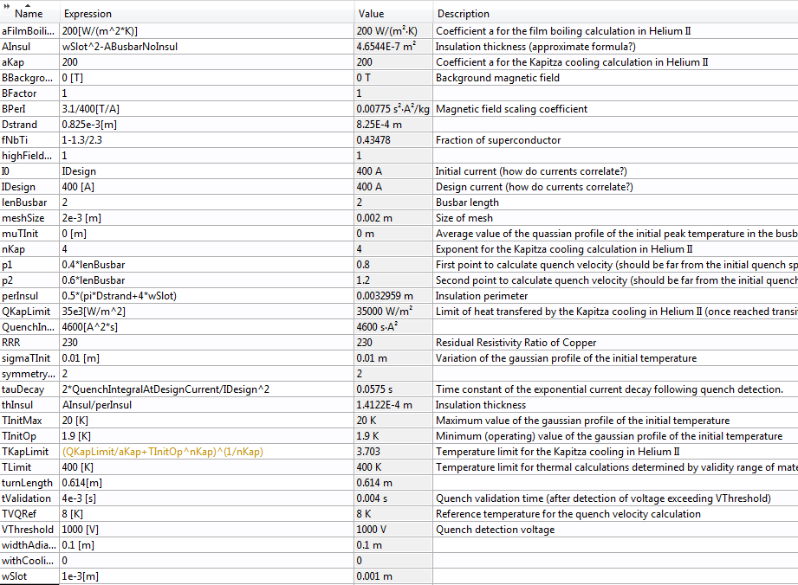
User interface
Temperature as a function of position
Comsol user interface
Text to be added

Slide 11
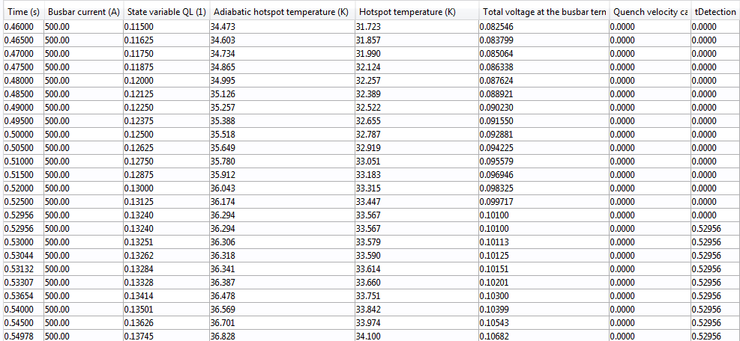
Demonstration
Text to be added

Slide 12
Summary
Text to be added

