Slide 1

LEDET https://cern.ch/STEAM/LEDET
1st STEAM Workshop 13-14 June 2019
cern.ch/STEAM
Emmanuele Ravaioli
on behalf of the STEAM team

Slide 2
LEDET in a nutshell
Why bothering with coupling currents?
Effect of coupling currents on quench protection
LEDET validation and past use
How to run LEDET – Demo
LEDET future development

Slide 3
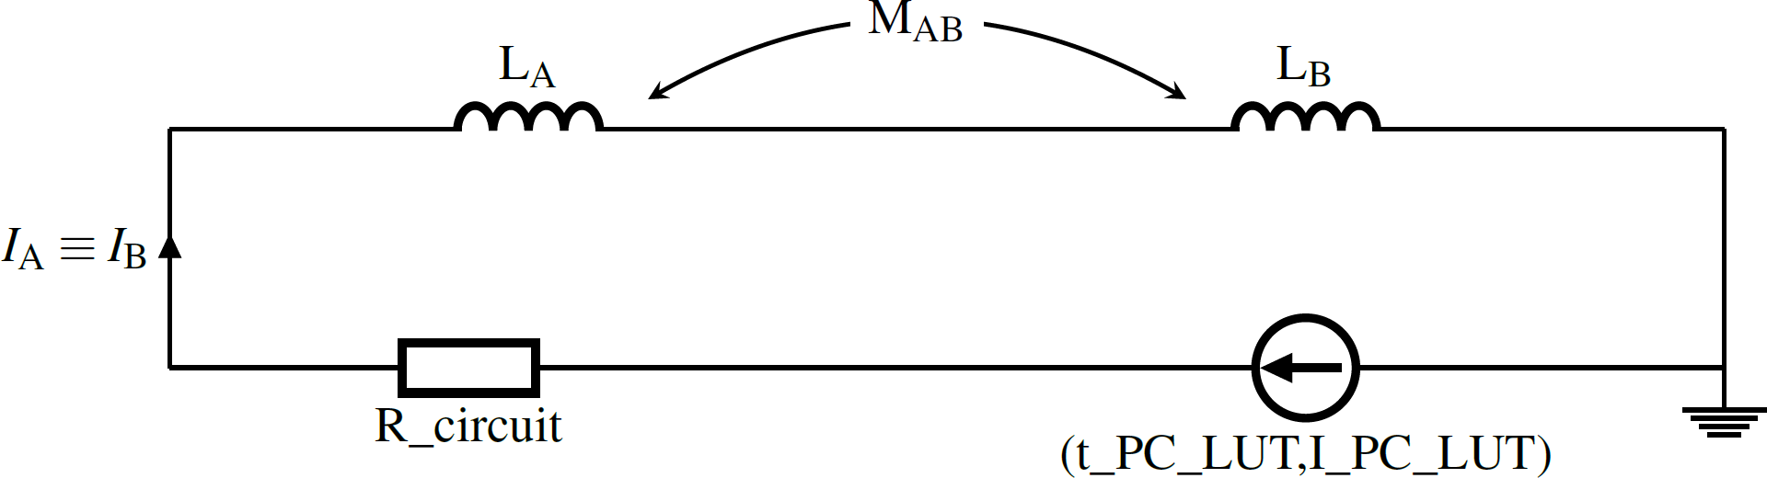
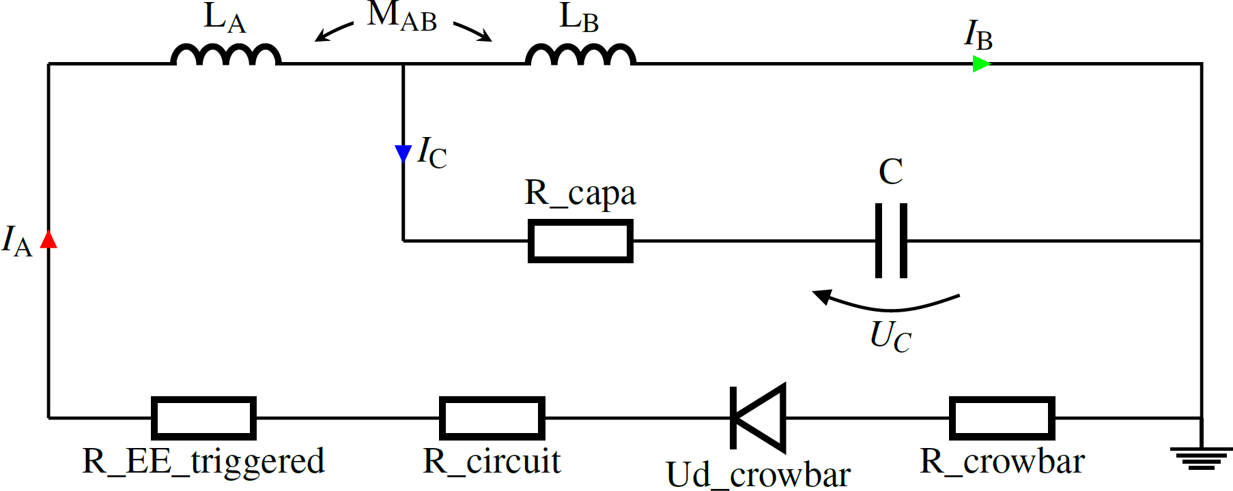
LEDET in a nutshell
Fast and accurate tool to simulate electro-magnetic and thermal transients in superconducting magnets.
2D magnet model + very simplified electrical circuit
Magnetic field maps calculated externally (usually with ROXIE)
Inter-filament and inter-strand coupling currents included
Turn-to-turn heat exchange, simplified helium cooling included
Energy-extraction, quench heaters, CLIQ transients simulated
Comes as a .exe file. A typical simulation runs in ~2 minutes.
Full manual and tutorial available:
https://edms.cern.ch/document/2046824

Slide 4
LEDET in a nutshell
Why bothering with coupling currents?
Effect of coupling currents on quench protection
LEDET validation and past use
How to run LEDET – Demo
LEDET future development

Slide 5
Transitory losses in the conductor
When wires and cables are subject to magnetic field change, transitory losses develop in the conductor
Inter-filament coupling loss in wires/strands
Inter-strand coupling loss in cables
Hysteresis in the superconductor (Magnetization)
Eddy currents in metallic materials
…
Main effects during the magnet discharge
Generated loss is heat deposited in the conductor, which can induce a transition to the normal state (quench)
Generated currents change the local magnetic field, hence influencing the magnet differential inductance

Slide 6
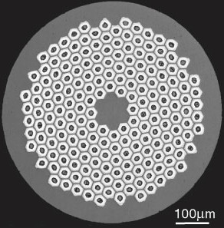
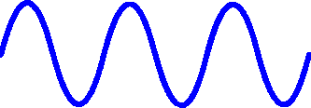
Inter-filament coupling currents
.
.
.
B
B
B
Characteristic time constant in the order of ms or tens of ms
Generation of local heat in the strand
(due to losses)
Induction of local magnetic field
(due to currents)
SC
Cu

Slide 7
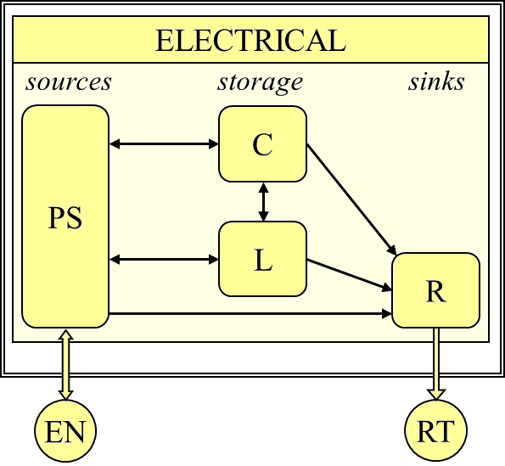
Energy exchanges in an electrical model

Slide 8
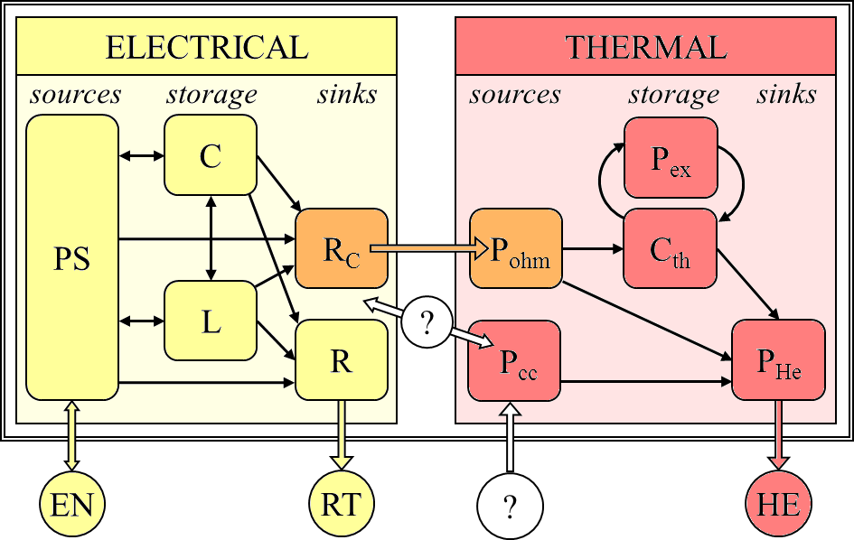
Energy exchanges in many traditional Electro-Thermal models
What is the effect of coupling currents on the electrical circuit?
Where is the energy deposited as coupling loss coming from?

Slide 9
Coupling effects
What is the effect of coupling currents on the electrical circuit?
Where is the energy deposited as coupling loss coming from?
The generation of local heat and the reduction of magnet differential inductance are one and the same effect (coupling currents/losses).
  The same energy that is deposited as loss in the conductor is also subtracted from the magnet’s stored energy
  The differential inductance is the derivative of the magnetic flux versus current
  L_{diff} = dΦ/dI = U/ (dI/dt)
  The presence of inter-filament and inter-strand coupling currents change the local magnetic field linked in the coil
  A part of magnetic flux is lost into millions of tiny dissipative LR loops (at the level of the filament and strand twist-pitch)

Slide 10
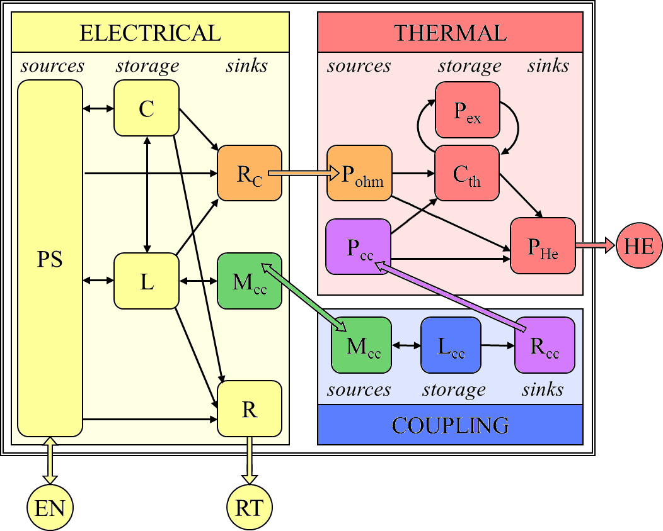
Electro-Thermal and Coupling modeling
How to implement this coupling mechanism?

Slide 11
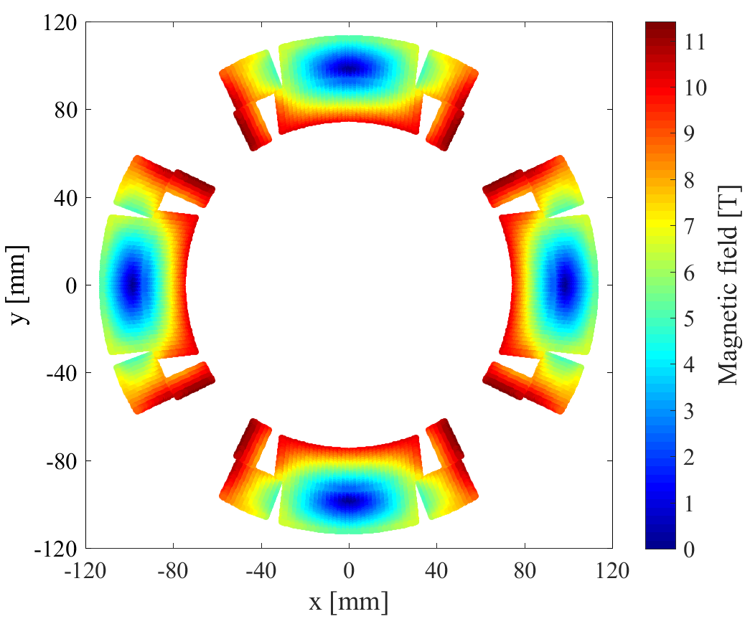
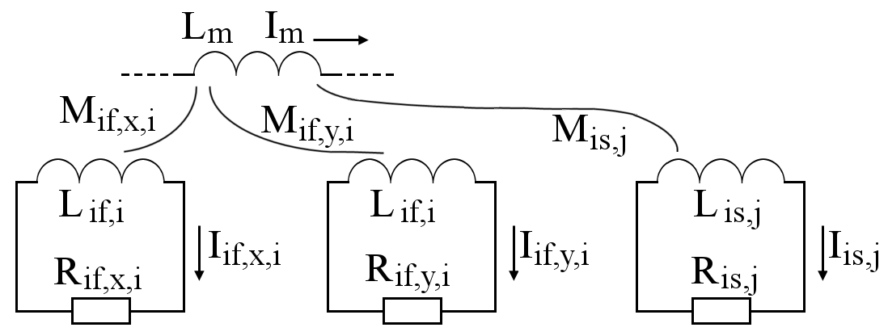
LEDET model
The interaction between the superconducting magnet and the local coupling currents is modeled with an array of RL dissipative loops mutually coupled with the magnet self-inductance
All simulations presented today are performed with the LEDET 2D model
(Lumped-Element Dynamic Electro-Thermal)
Example: HL-LHC 12 T Nb₃Sn quadrupole magnet (MQXF)
2x 16000 IFCL loops
400 ISCL loops
Inter-filament coupling currents
Inter-strand coupling currents
[1] E. Ravaioli, “CLIQ”, PhD thesis, 2015
[2] E. Ravaioli et al., Cryogenics 2016

Slide 12
LEDET in a nutshell
Why bothering with coupling currents?
Effect of coupling currents on quench protection
LEDET validation and past use
How to run LEDET – Demo
LEDET future development

Slide 13
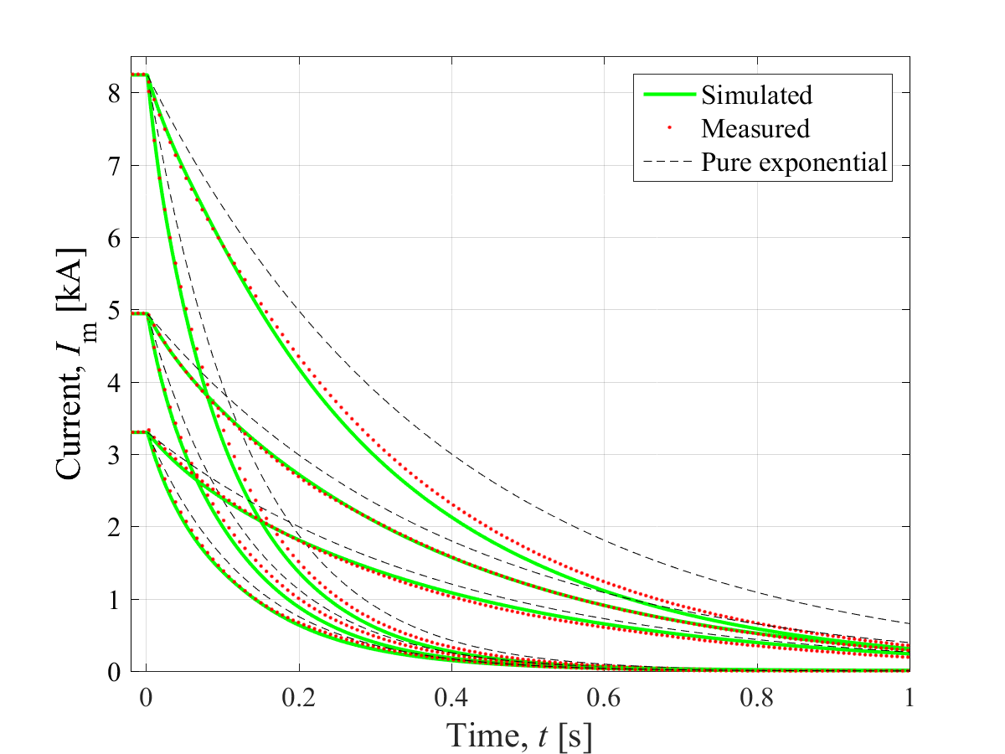
Example 1: Magnet protected by energy-extraction -1
Experimental discharges much faster than pure exponential
LEDET simulations in very good agreement
Experimental data from
G. Chlachidze, S. Stoynev (FNAL)
HL-LHC 12 T Nb₃Sn quadrupole model magnet (MQXFS1, 1.2 m)
E. Ravaioli et al., IEEE Trans. on Supercon., 2017, https://ieeexplore.ieee.org/document/7776818

Slide 14
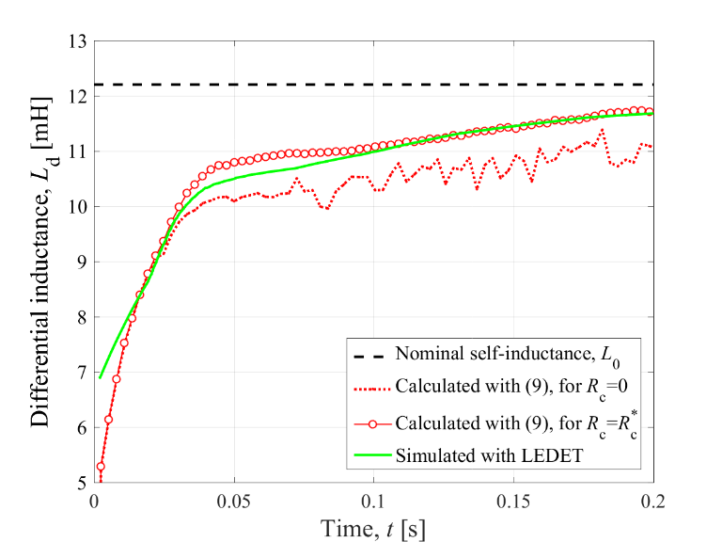
Example 1: Magnet protected by energy-extraction -2
Differential inductance reduced by 50-60% due to coupling
This reduction can be calculated analytically! (see paper)
E. Ravaioli et al., IEEE Trans. on Supercon., 2017, https://ieeexplore.ieee.org/document/7776818

Slide 15
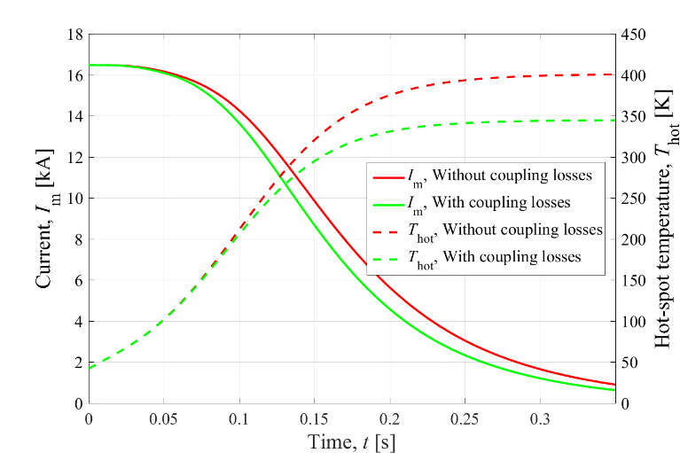
Example 2: Magnet protected by quench heaters
Note: Effect of iron-yoke saturation included in both simulations
HL-LHC 12 T Nb₃Sn quadrupole magnet (MQXF, 7.15 m)
Significant but not determinant contribution of coupling losses to quench protection

Slide 16
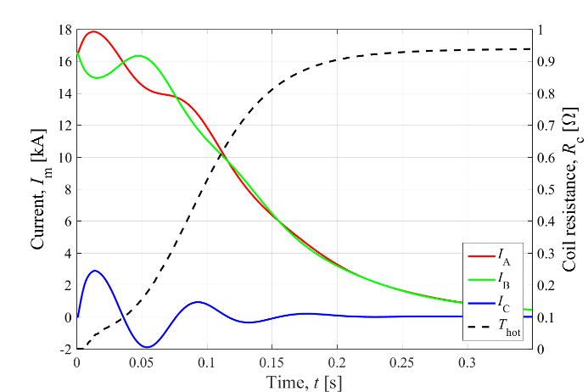
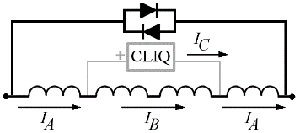
Example 3: Magnet protected by CLIQ
CLIQ relies on coupling loss to transfer the coil to the normal state

Slide 17
Effect of coupling currents on quench protection
Short summary. Coupling currents have a double effect: they generate local heat (and potentially quench-back) and they reduce the magnet differential inductance.
In many practical cases the differential inductance is reduced by >50% due to inter-filament coupling currents.
This effect is immediate (as soon as magnet current starts changing) and lasts as long as coupling currents are developing or decaying (tens-hundreds of ms).
Every case is different, but in general:
Energy-extraction system: Immediate differential inductance reduction and possibly quench due to heat deposition
Quench heaters: Differential inductance reduction occurs when the circuit resistance is ~0, not very important. Quench due to heat deposition helps protection due to the faster coil resistance increase
CLIQ: Fully relies on coupling loss to quench the magnet. Differential inductance reduction has strong impact on oscillation frequency. Both effects need to be correctly modelled in order to reproduce experimental results

Slide 18
LEDET in a nutshell
Why bothering with coupling currents?
Effect of coupling currents on quench protection
LEDET validation and past use
How to run LEDET – Demo
LEDET future development

Slide 19
LEDET validation and past use
Project | Magnet | Studies | Notes | Validation
LHC | MQXA | Quench protection, Co-sim | Helium, Heaters | Partial
LHC | MQXB | Quench protection, Co-sim | Helium, Heaters | Partial
LHC | MQ | Quench protection, Co-sim | Helium, Heaters, initial hot-spot | Yes
HL-LHC | MQXF | Q. protection, Co-sim, Failure cases, Short-circuit |  | Yes
HL-LHC | 11 T dipole | Q. protection, Co-sim, Failure cases |  | Yes
FCC | Cos-θ | Quench protection, Co-sim |  | No data available
FCC | Block-coil | Quench protection, Co-sim |  | No data available
FCC | Common-coil | Quench protection, Co-sim |  | No data available
Other | FECR sextupole | Quench protection | Sextupole | No data available
Other | FECR solenoids | Quench protection | Solenoids | No data available
Other | PYPUP magnets | Quench protection | Bi-2212, Solenoids | No data available
Other | HEPdipo | Quench protection |  | No data available
Other | 16T common-coil | Quench protection, Co-sim | Insert/Outsert | No data available
Other | HEPdipo | Quench protection |  | No data available
Other | RC series | Quench protection | Bi-2212, Current-sharing | Partial
Other | LBL common-coil | Quench protection | Bi-2212, Current-sharing | No data available
Other | 15 T dipole | Quench protection |  | No data available
Other | *** | Quench protection | New quench protection ideas | No data available
Quench protection design
Quench protection design

Slide 20
LEDET in a nutshell
Why bothering with coupling currents?
Effect of coupling currents on quench protection
LEDET validation and past use
How to run LEDET – Demo
LEDET future development

Slide 21
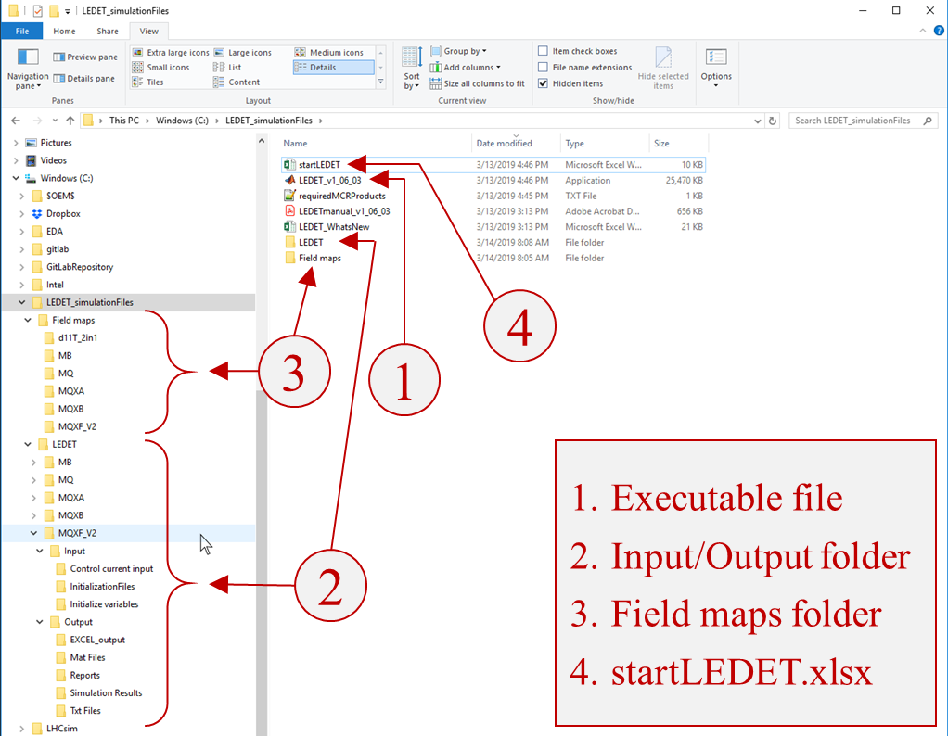
LEDET folder structure

Slide 22
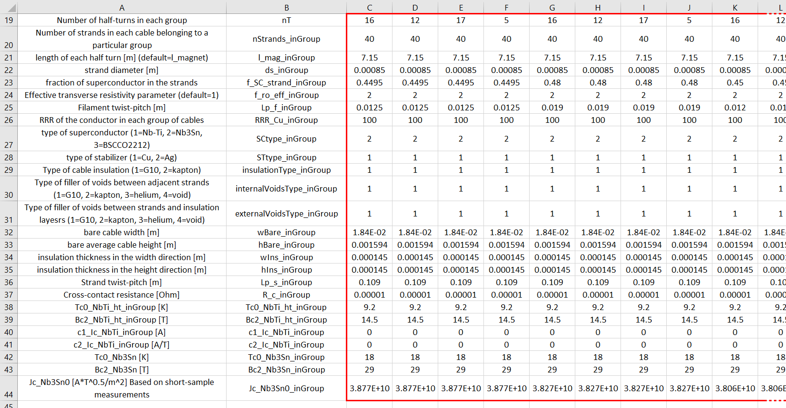
LEDET input file

Slide 23
Demo: Run a LEDET simulation
See what a startLEDET file looks like
See what a LEDET input looks like
Run LEDET
Show the generated report
Change input parameters in the input file
Change the startLEDET file
Re-run LEDET
Show the new generated report

Slide 24
LEDET outputs
Plots
Animated GIF’s
Report
Txt files
Assign Lorentz forces and temperatures to a mesh

Slide 25
LEDET in a nutshell
Why bothering with coupling currents?
Effect of coupling currents on quench protection
LEDET validation and past use
How to run LEDET – Demo
LEDET future development

Slide 26
LEDET new features
Continuous development of new features thanks to the feedback (and sometimes the help) of many users: THANKS!
Examples of newest released features:
Turn self-mutual inductance calculation (thanks Lucas Brouwer, LBNL)
Automatic report generation (thanks Michał Maciejewski, CERN)
Decay of inter-filament coupling currents after quench
Examples of beta features tested by a few users:
Resistive voltage in the hot-spot (thanks Dimitri Pracht, CERN)
Bi-2212 current-sharing regime (thanks Daniel Davis, FSU/LBNL)
Examples of soon-to-be-available features:
More flexible quench heater inputs and improved heat-exchange model
Develop even simpler apps for specific magnets (example: MQXF)
Ways to contribute:
Use the software, Gives us feedback, Ask for new features, Help us develop new features ( so far special thanks to Lucas Brouwer and Daniel Davis!)

Slide 27
Questions?

Slide 28
Annex

Slide 29
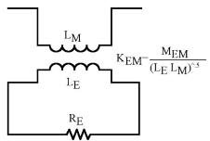
LEDET – Equivalent model of coupling effects -1
Local balance of magnetic field change
dBt/dt = dBa/dt + dBcc/dt
(total magnetic field change is the sum between applied magnetic field Ba, due to magnet currents), and magnetic field induced by the presence of coupling currents Bcc)
The applied magnetic field change is proportional to the magnet current change
  dBa/dt = MTF * dIm/dt
For any “magnetization volume” (strand for IFCC, or cable for ISCC)
  Coupling Current Bcc = gamma * Icc → dBcc/dt = gamma * dIcc/dt
  Induced Field Bcc = -tau * dBt/dt → dBt/dt = -gamma/tau * Icc
  Coupling Loss Pcc = beta * Volume * ( dBt/dt )^2
We can rewrite the local balance of magnetic field change as
dBt/dt = dBa/dt + dBcc/dt
-gamma/tau * Icc = MTF * dIm/dt + gamma * dIcc/dt
-Rcc * Icc = Mcc * dIm/dt + Lcc * dIcc/dt
This is the equation of an RL loop mutually coupled with the magnet inductance!

Slide 30
LEDET – Equivalent model of coupling effects -2
dBt/dt = dBa/dt + dBcc/dt
-gamma/tau * Icc = MTF * dIm/dt + gamma * dIcc/dt
-Rcc * Icc = Mcc * dIm/dt + Lcc * dIcc/dt
This is the equation of an RL loop mutually coupled with the magnet inductance!
The ohmic loss in the resistor Rcc must equal the coupling loss
  Pcc = Rcc * Icc^2 = beta * Volume * ( dBt/dt )^2
→Rcc = beta * Volume / gamma^2
The characteristic time constant of the coupling currents is
→tau=Lcc/Rcc
The other lumped-element parameters follow
Rcc = beta * Volume / gamma^2
Lcc = tau * Lcc = beta * Volume / gamma^2
Mcc = beta * Volume / gamma * MTF
beta, gamma, tau depend on the strand/cable parameters and partly on the current level, Rcc=f(I) (due to magneto-resistivity)
MTF depends on the magnet geometry and partly on the current level, MTF=f(I) (due to iron saturation)
A more rigorous derivation is available, but too long to present here.

Slide 31
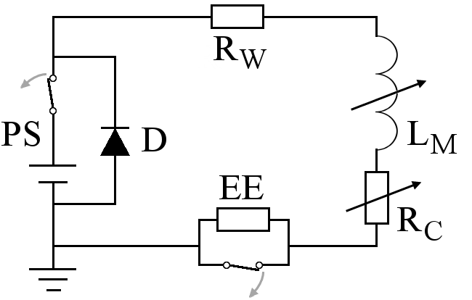
Energy-extraction protection
(t)
(t)
Both the magnet differential inductance and the coil resistance change with time

Slide 32
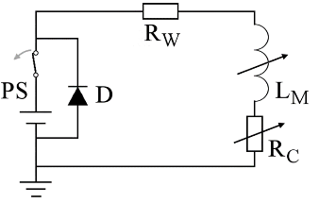
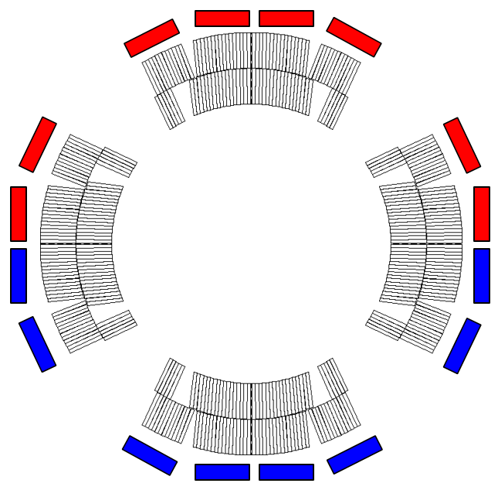


Quench heater protection
Quench heaters are μm-thin strips glued to the coil, which heat the turns by thermal diffusion
No external energy extraction
Example:
HL-LHC 12 T Nb₃Sn quadrupole model magnet (MQXFS1, 1.2 m)

Slide 33
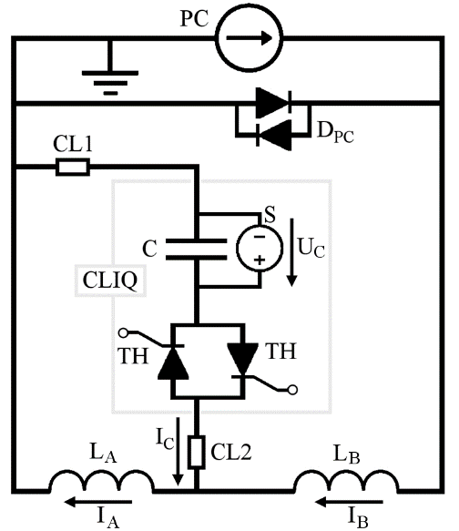



CLIQ – Coupling-Loss Induced Quench
Current change
Patent EP13174323.9
Magnetic field change
Coupling losses (Heat)
Temperature rise
QUENCH

