Slide 1

cern.ch/STEAM
STEAM-SIGMA
Workshop 13-14 June 2019
Michał Maciejewski, Carmelo Barbagallo, Barakat-Ullah Bokhraie
on behalf of the STEAM team
Notes:
Truly inspiring intellectual journey

Slide 2
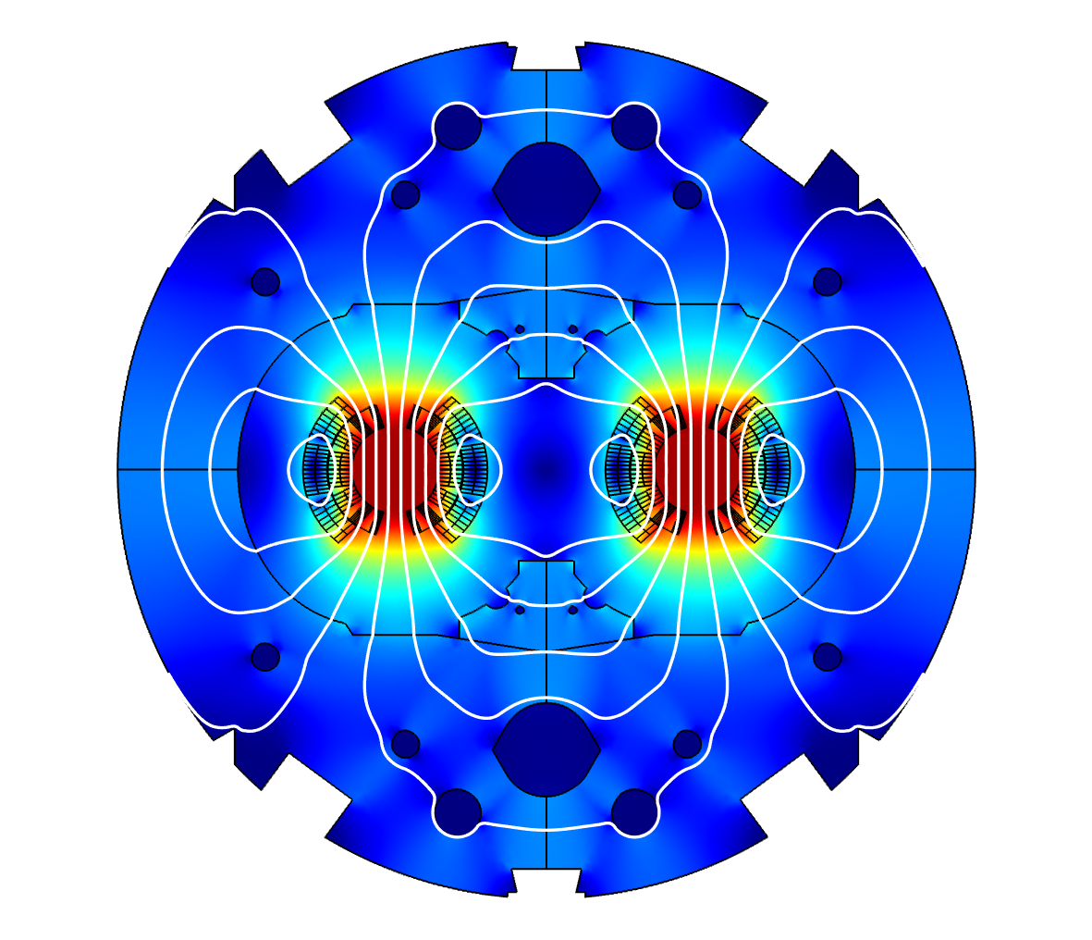
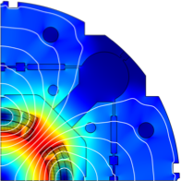
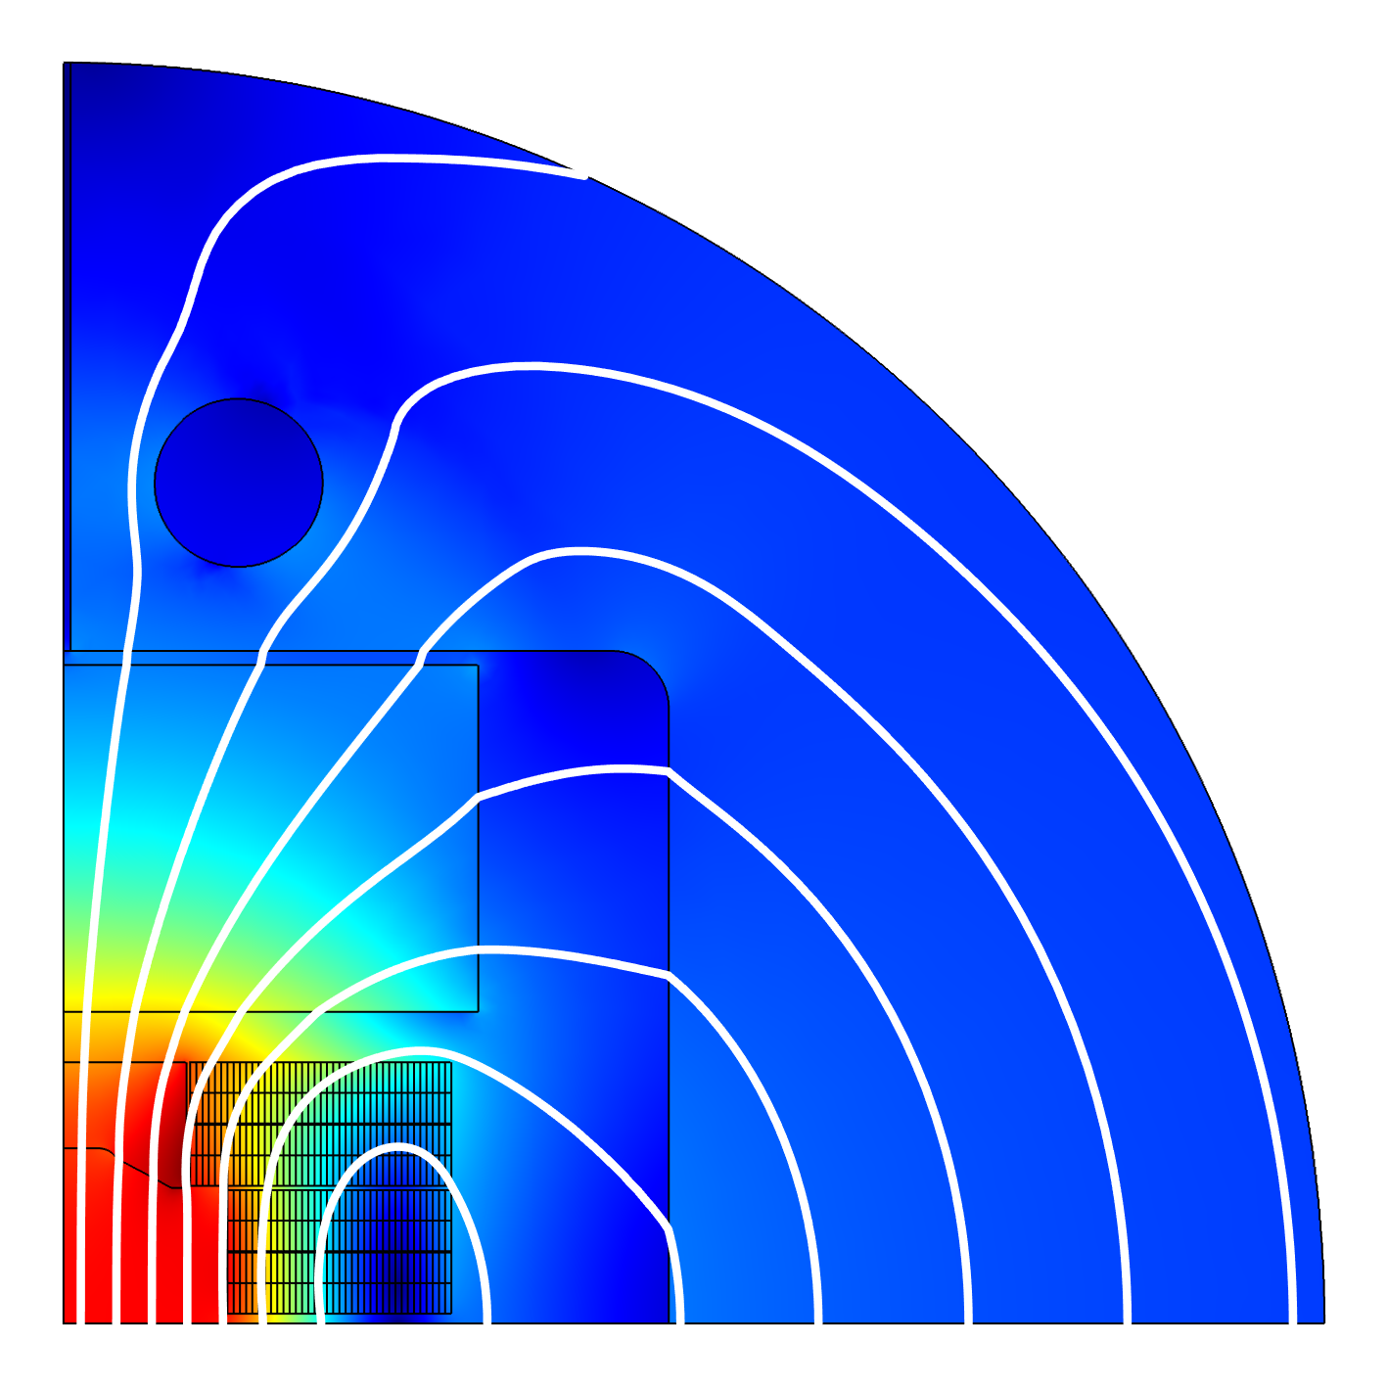
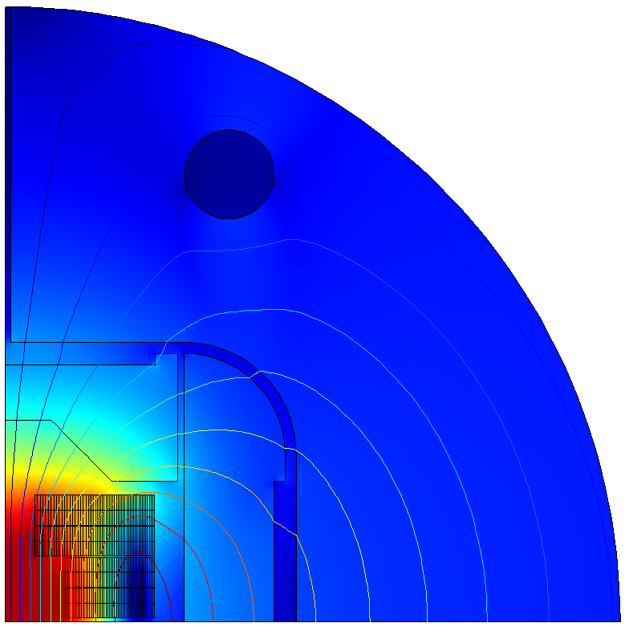
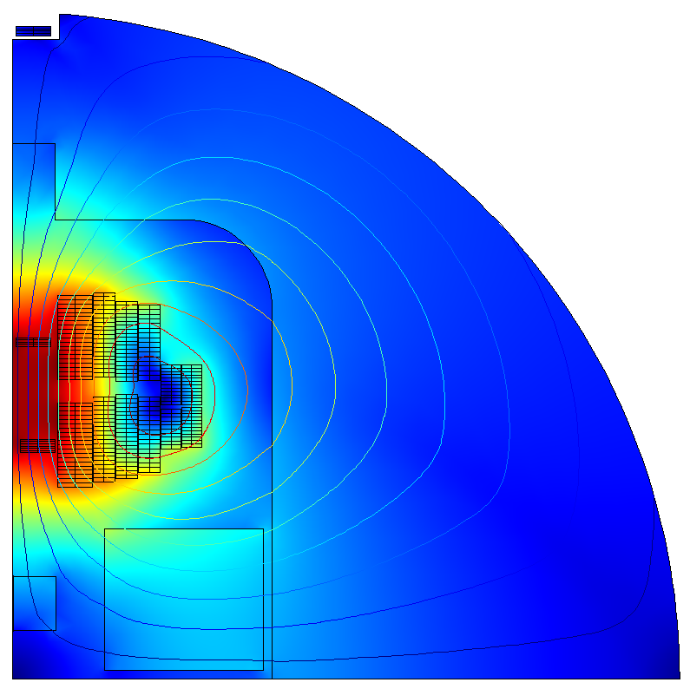


STEAM Integrated Generator of Magnets for Accelerators
Need for automatic model generation
Many different magnet types
Implementation of custom equations requires model updates
Manual model creation prone to errors
Magnet designs for new magnets under continuous modifications
LHC – MB
Hi-Lumi – MQXF
Test station – FRESCA2
FCC – Cos$θ$
FCC – Block coil
FCC – Common coil
Other models: 11 Tesla, D1, … and many more!
Magneto-thermal 2D models provide a good approximation of magnet behavior during transients.

Slide 3
Outline
Introduction
Physics
Architecture
User input
Conclusion
LHC – MB
Hi-Lumi – MQXF
Test station – FRESCA2
FCC – Cos$θ$
FCC – Block coil
FCC – Common coil
Other models: 11 Tesla, D1, … and many more!

Slide 4






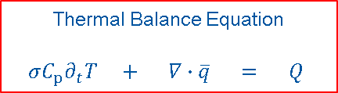

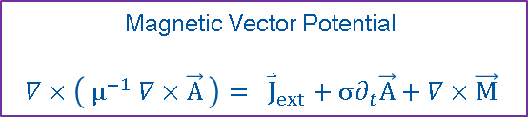

STEAM-SIGMA – Physics Overview
COMSOL models generated with STEAM-SIGMA implement strongly coupled magnetoquasistatic, thermal and network equations.
Models provide an interface for co-simulation in a current- and voltage-driven modes.
Magnetic Vector Potential
$$∇×\left( μ^{−1} ∇×\vec{A} \right)= {\overset{⃑}{J}}_{ext}+σ∂_{t}\vec{A}+∇×\vec{M}$$
Thermal Balance Equation
$$σC_{p}∂_{t}T + ∇∙\overline{q} = Q$$
$$ρ_{quench}$$
$$\overline{B}(\overline{H})$$
$$C_{p}(T,B,..)$$
$$k(T,B,..)$$
$$Q_{Ohm}$$
$$Q_{IFCL}$$
Helium
Heaters
$$Q_{ISCL}$$
ISCC
IFCC
$$Q_{Eddy}$$
Eddy
CLIQ

Slide 5
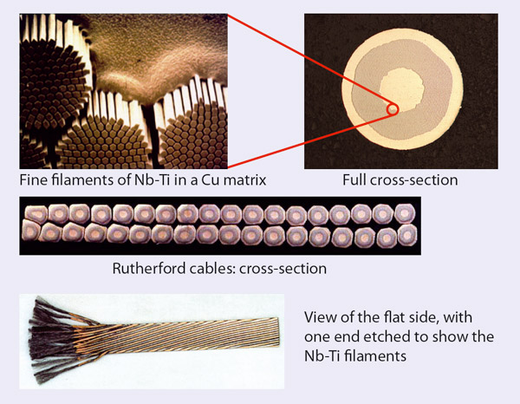





STEAM-SIGMA – Physics: Inter-Filament Coupling Currents
How to discretize a superconducting cable?
Wilson / Verweij equivalent magnetization
Formulation
Equivalent Tau formulation
Constitutive law
Ampere-Maxwell Law
~100 um
$$μ_{0}μ_{r} {\vec{M}}_{IFCC}=− τ_{eq}∂_{t}\vec{B}$$
$$τ_{eq}= \frac{μ_{0}μ_{r}}{ρ_{eff}}{\left(\frac{l_{f}}{2π}\right)}^{2}$$
CERNcourier.com
$$\vec{B}=μ_{0}μ_{r} \left( \vec{H}+ {\vec{M}}_{IFCC} \right)$$
If the eddy-currents paths are known a priori, the equivalent magnetization effect can be directly related to the change of magnetic flux density
Faraday-Lenz + Ampere-Maxwell
$$σ\frac{∂\vec{A}}{∂t}$$
Currents’ paths
don’t have to be
resolved anymore!
$∇× {\vec{M} }_{IFCC}$
We found an issue in this formulation.
Suitable for external field without imposed current
See next slides.

Slide 6
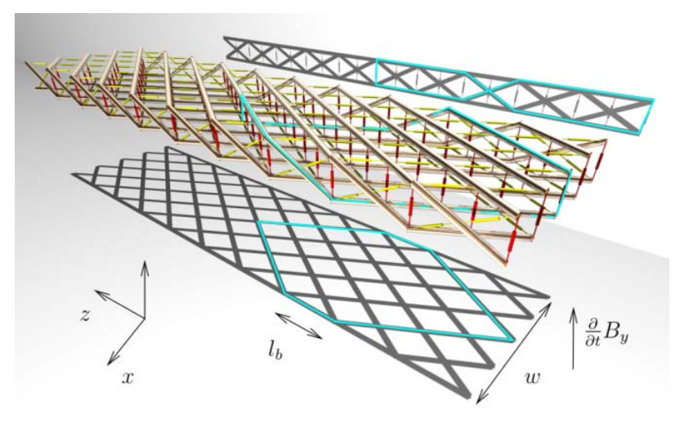
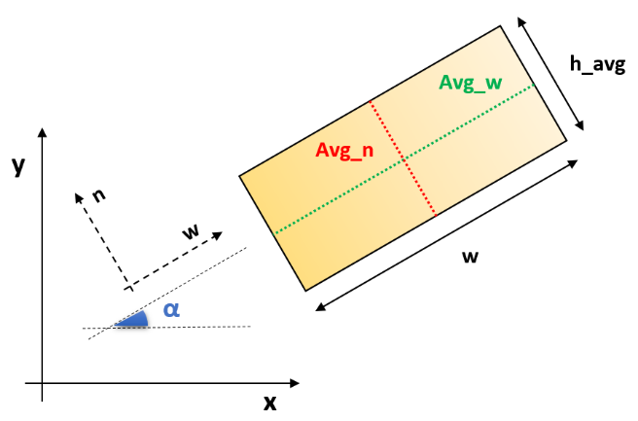
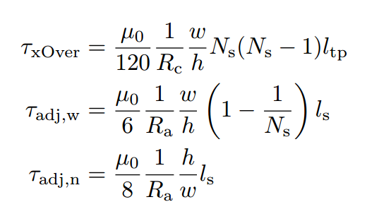

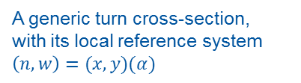



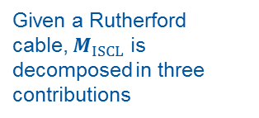
STEAM-SIGMA – Physics: Inter-Strand Coupling Currents
Given a Rutherford cable, $M_{ISCL}$ is decomposed in three contributions
The three contributions are formulated as
$${μ_{0}μ_{r}M}_{Xover}^{⊥}=− τ_{Xover}{ \left\langle ∂_{t}B^{⊥}\right\rangle }_{Avg_w}$$
$M_{Xover}^{⊥}$ $M_{adj_w}^{⊥}$ $M_{adj_n}^{∥}$
$${μ_{0}μ_{r}M}_{adj_w}^{⊥}=− τ_{{adj}_{w}} {\left\langle ∂_{t}B^{⊥}\right\rangle }_{Avg_w}$$
$${μ_{0}μ_{r}M}_{adj_n}^{∥}=− τ_{adj_n}∗{\left\langle ∂_{t}B^{∥}\right\rangle }_{Avg_n}$$
The symbol ${ \left\langle X\right\rangle }_{y}$ indicates the average of $X$ along $y$
The equivalent tau are in first approximation function only of the cable parameters, and they are given as
A generic turn cross-section,
with its local reference system $\left(n,w\right)=(x,y)(α)$
Notes:
Focus on LHC scale (Mt. Blanc, Airport)

Slide 7
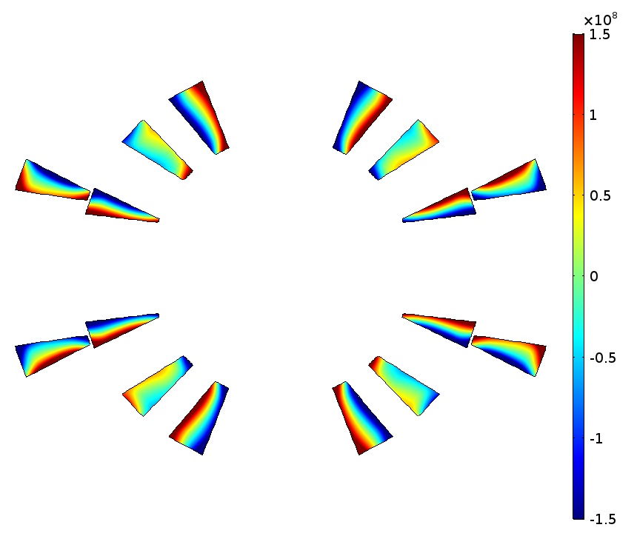
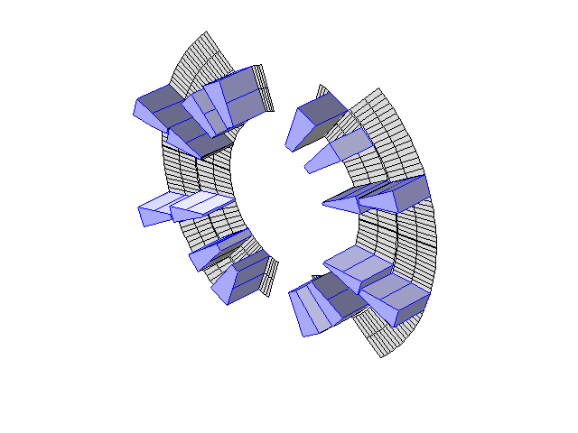


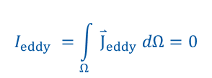

STEAM-SIGMA – Physics: Eddy Currents
The iron yoke is laminated
Only the structural copper wedges are considered
Wedges do not form a closed loop.
A constraint is necessary, to prevent a net current.
The Coil feature is stable
The figure shows the eddy currents patters during a CLIQ discharge in an MB magnet
$${\overset{⃑}{J}}_{eddy}=σ_{wedge}\frac{∂\vec{A}}{∂t}$$
$$I_{wedge}=I_{ext} {+ I}_{eddy}=0$$
$$I_{ext}=0$$
$$I_{eddy} =\int_{Ω}{{\overset{⃑}{J}}_{eddy} dΩ}=0$$
COMSOL in-built Coil feature

Slide 8
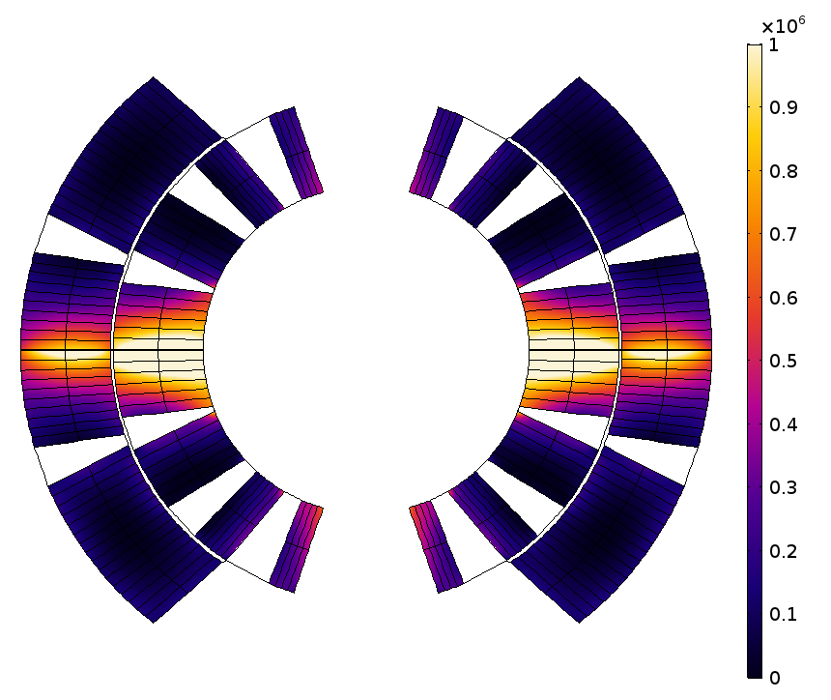
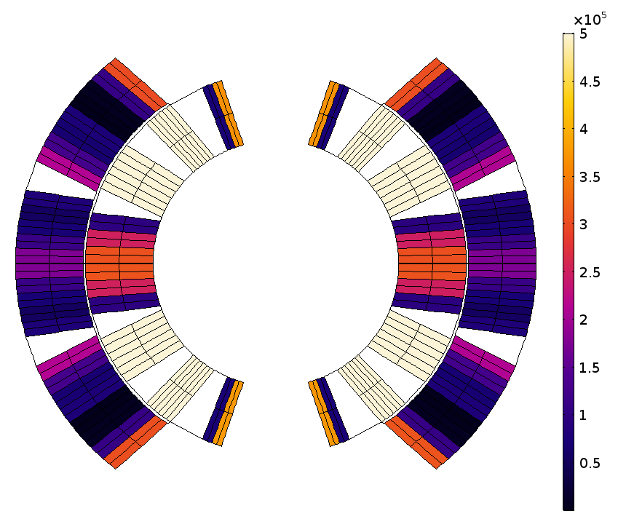
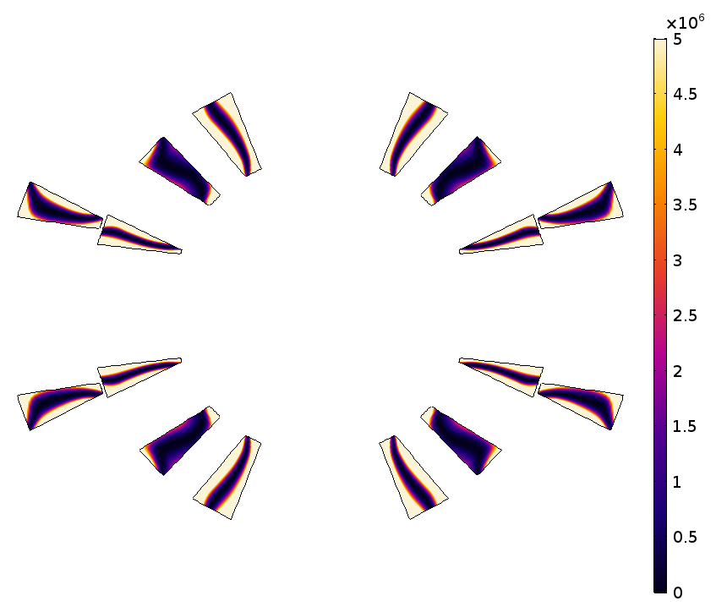




STEAM-SIGMA – Physics: Electromagnetic Losses
Inter-filament and inter-strand coupling losses are associated to the magnetic energy density function
Losses in wedges are calculated using the Joule’ Law
$${ ∂}_{t}W=M{ ∂}_{t}B [W/m^{3}]$$
$${ ∂}_{t}W= ρj_{eddy}^{2}$$
$${ ∂}_{t}W= τ_{eq}{\left({ ∂}_{t}\vec{B} \right)}^{2}$$
$${ ∂}_{t}W= τ_{eq}{\left( \left\langle ∂_{t}\vec{B}\right\rangle \right)}^{2}$$
CLIQ discharge

Slide 9
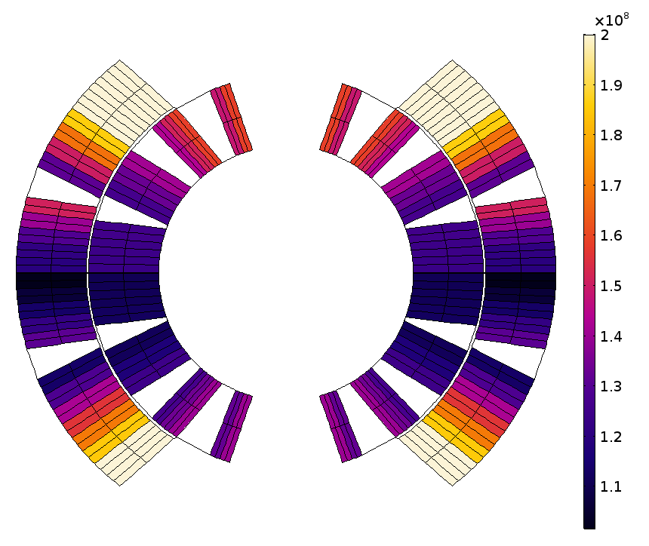
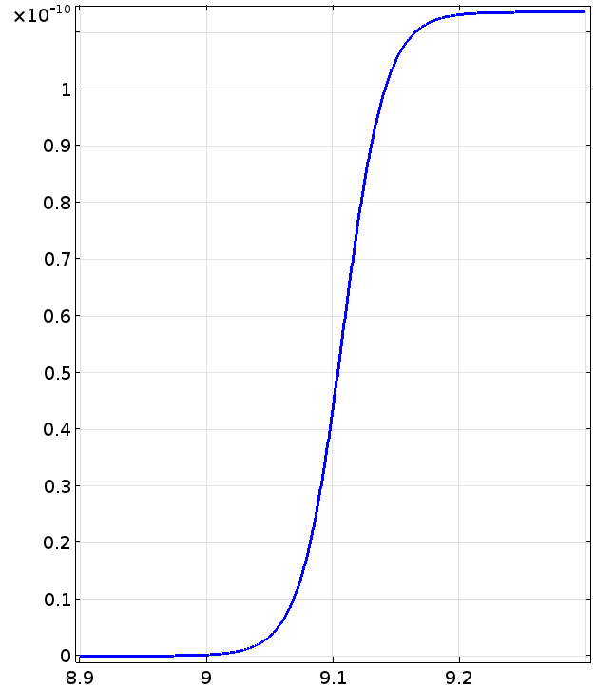
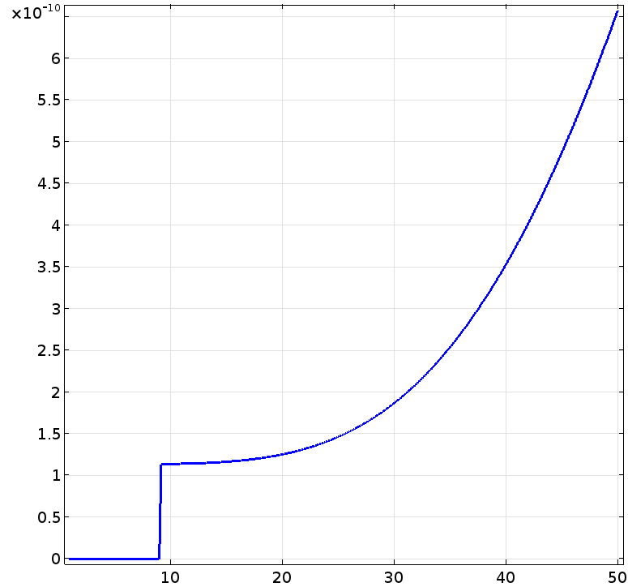

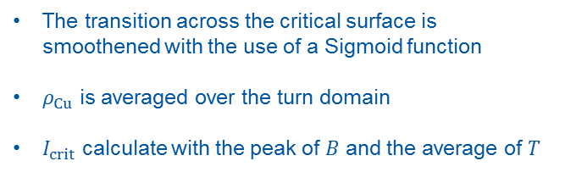





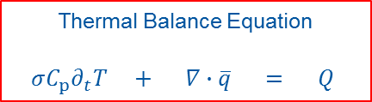
$${ ∂}_{t}W=M{ ∂}_{t}B [W/m^{3}]$$
$${ ∂}_{t}W= τ_{eq}{\left({ ∂}_{t}\vec{B} \right)}^{2}$$
$${ ∂}_{t}W= τ_{eq}{\left( \left\langle ∂_{t}\vec{B}\right\rangle \right)}^{2}$$
(y0*exp(xc*r0)+y1*exp(r0*x))/(exp(xc*r0)+exp(r0*x));
STEAM-SIGMA – Physics: Heat Balance Equation
Thermal Balance Equation
$$σC_{p}∂_{t}T + ∇∙\overline{q} = Q$$
The transition across the critical surface is smoothened with the use of a Sigmoid function
$ρ_{Cu}$ is averaged over the turn domain
$I_{crit}$ calculate with the peak of $B$ and the average of $T$
$$σ_{s}= \frac{y_{0}e^{x_{c}} + y_{1}e^{r_{0}x}}{e^{r_{0}x_{c}} +{ e}^{r_{0}x}}$$
Losses are calculated using
the Joule’ Law
$${ ∂}_{t}W= ρj_{eddy}^{2}$$
$${\left\langle ρ\right\rangle }_{t}= ρ_{Cu}\left({\left\langle T\right\rangle }_{t},{\left\langle B\right\rangle }_{t}\right)∙σ_{s}\left(\frac{I_{t}}{I_{crit}\left({\hat{B}}_{t},{\left\langle T\right\rangle }_{t}\right)}\right)$$
Current
sharing
[Ωm]
[K]
[9] Russenschuck, Stephan. Field computation for accelerator magnets: analytical and numerical methods for electromagnetic design and optimization. John Wiley & Sons, 2011.

Slide 10
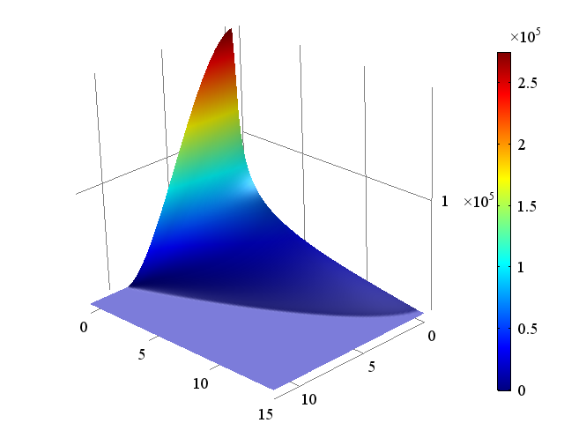



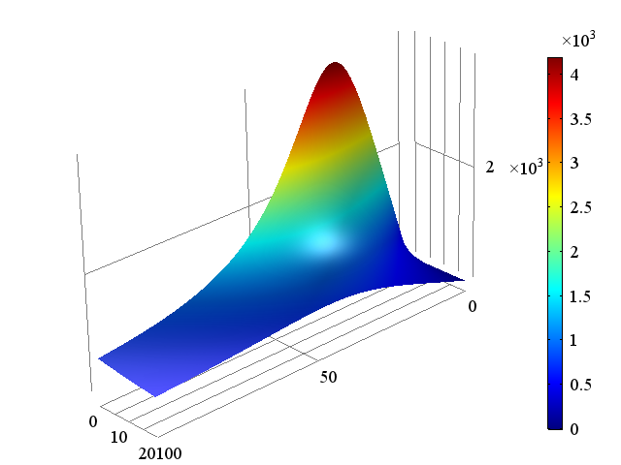
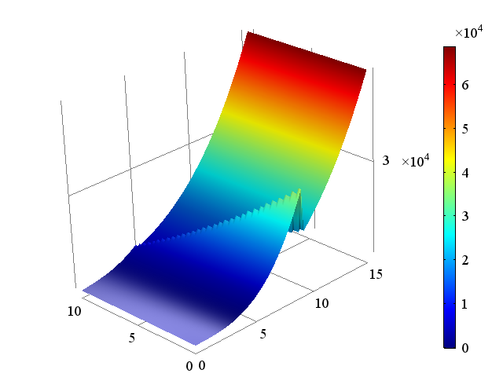




STEAM-SIGMA – Physics: Nonlinear Materials
Materials C library (versioning, storage)
J [A/mm²]
C compiler:
Visual C++ Build Tools
T [K]
B [T]
$$J_{c Nb−Ti}$$
Dynamic Link Library
(immutability)
COMSOL external function
Cp [J/kg/K]
k [W/m/K]
$$k_{Cu}$$
T [K]
B [T]
$$C_{p Nb−Ti}$$
T [K]
B [T]

Slide 11
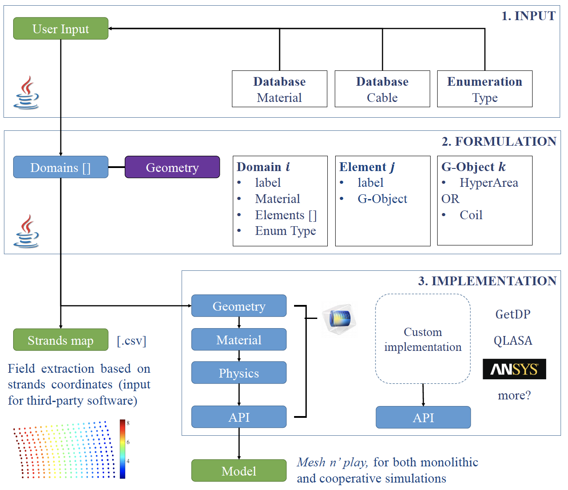
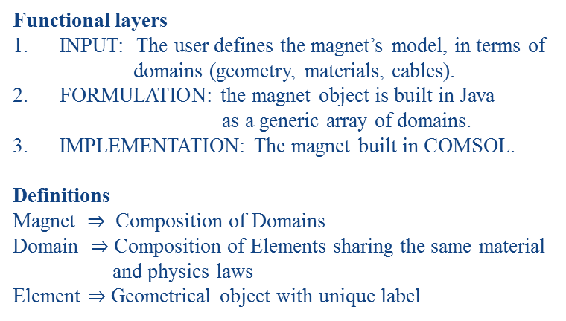
STEAM-SIGMA - Architecture
Functional layers
INPUT: The user defines the magnet’s model, in terms of
domains (geometry, materials, cables).
FORMULATION: the magnet object is built in Java
as a generic array of domains.
IMPLEMENTATION: The magnet built in COMSOL.
Definitions
Magnet $⇒$ Composition of Domains
Domain $⇒$ Composition of Elements sharing the same material
and physics laws
Element $⇒$ Geometrical object with unique label

Slide 12
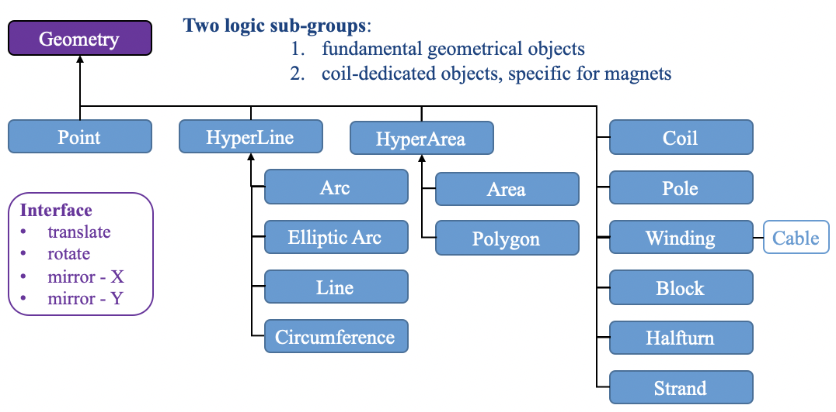
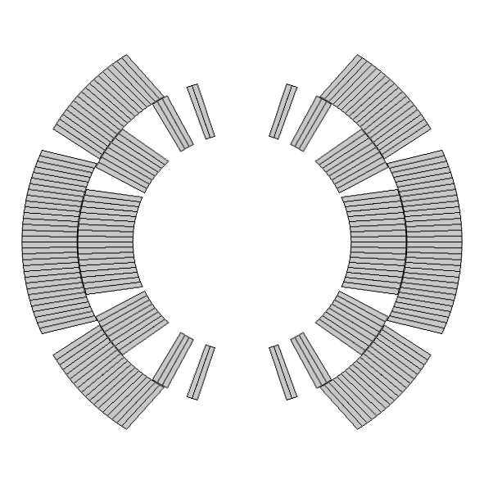
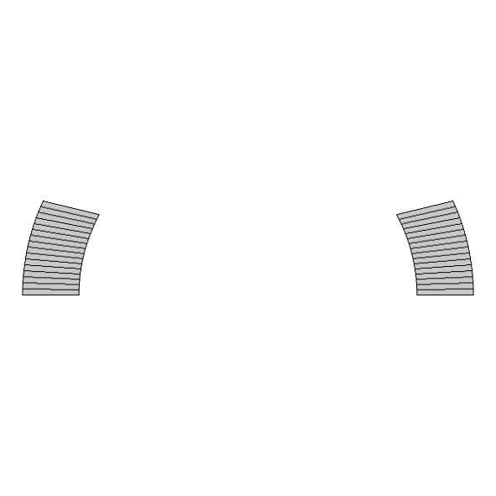
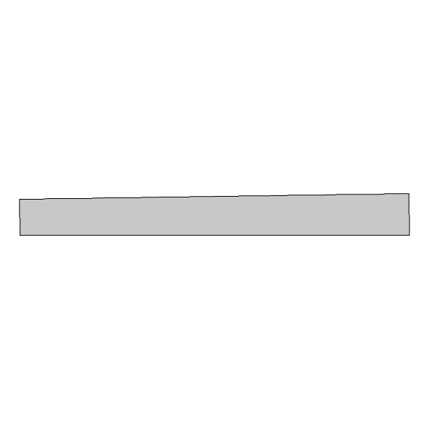
STEAM-SIGMA – Geometry Module
Geometry module
Pillars
Interface
Immutability
Encapsulation
Getters
Two logic sub-groups:
  fundamental geometrical objects
  coil-dedicated objects, specific for magnets
Geometry
Point
HyperLine
HyperArea
Coil
Arc
Area
Pole
Interface
translate
rotate
mirror - X
mirror - Y
Elliptic Arc
Polygon
Winding
Cable
Line
Block
Circumference
Halfturn
Strand
Element
label
HyperArea
made of
HyperLines []
Points []
coil
Winding
Halfturn
Pole
Block
Strands

Slide 13
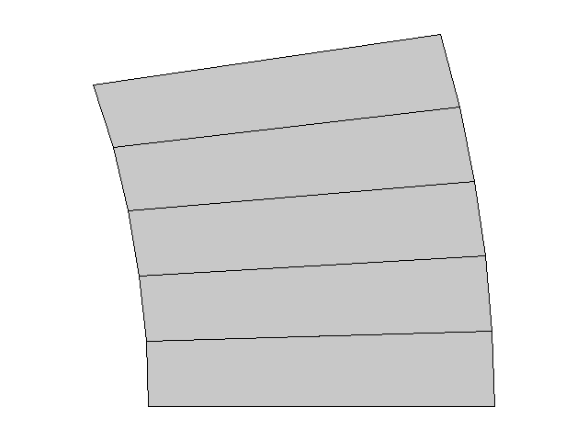
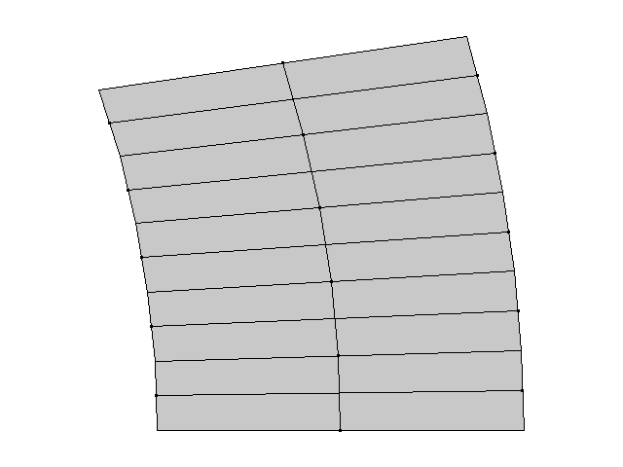
STEAM-SIGMA – Geometry Module
Handling
Geometry is automatically handled via the FEM workflow.
Geometrical objects are defined in Java, then implemented via the API
no Of Turns
User
Entities
The elementary entity is a turn cross-section
Turns implemented as polygons

Slide 14
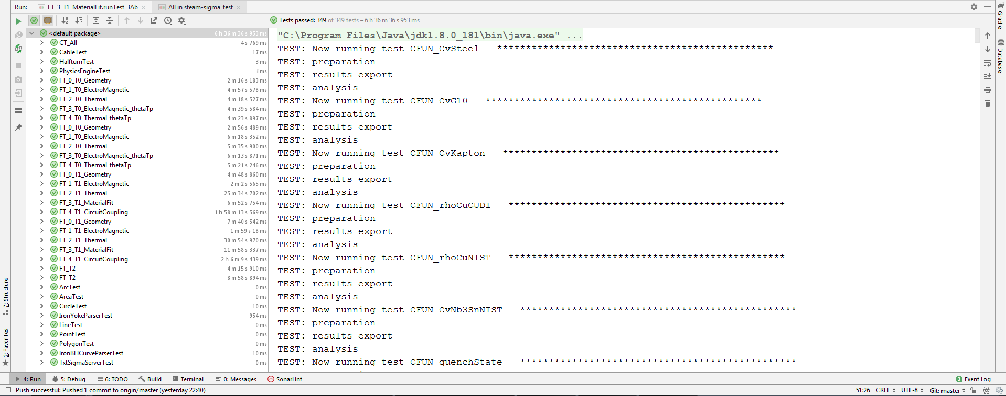
STEAM-SIGMA – Verification

Slide 15
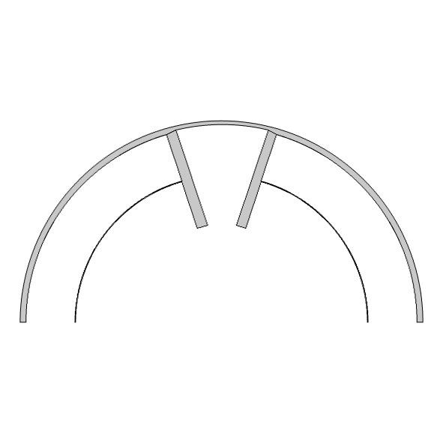
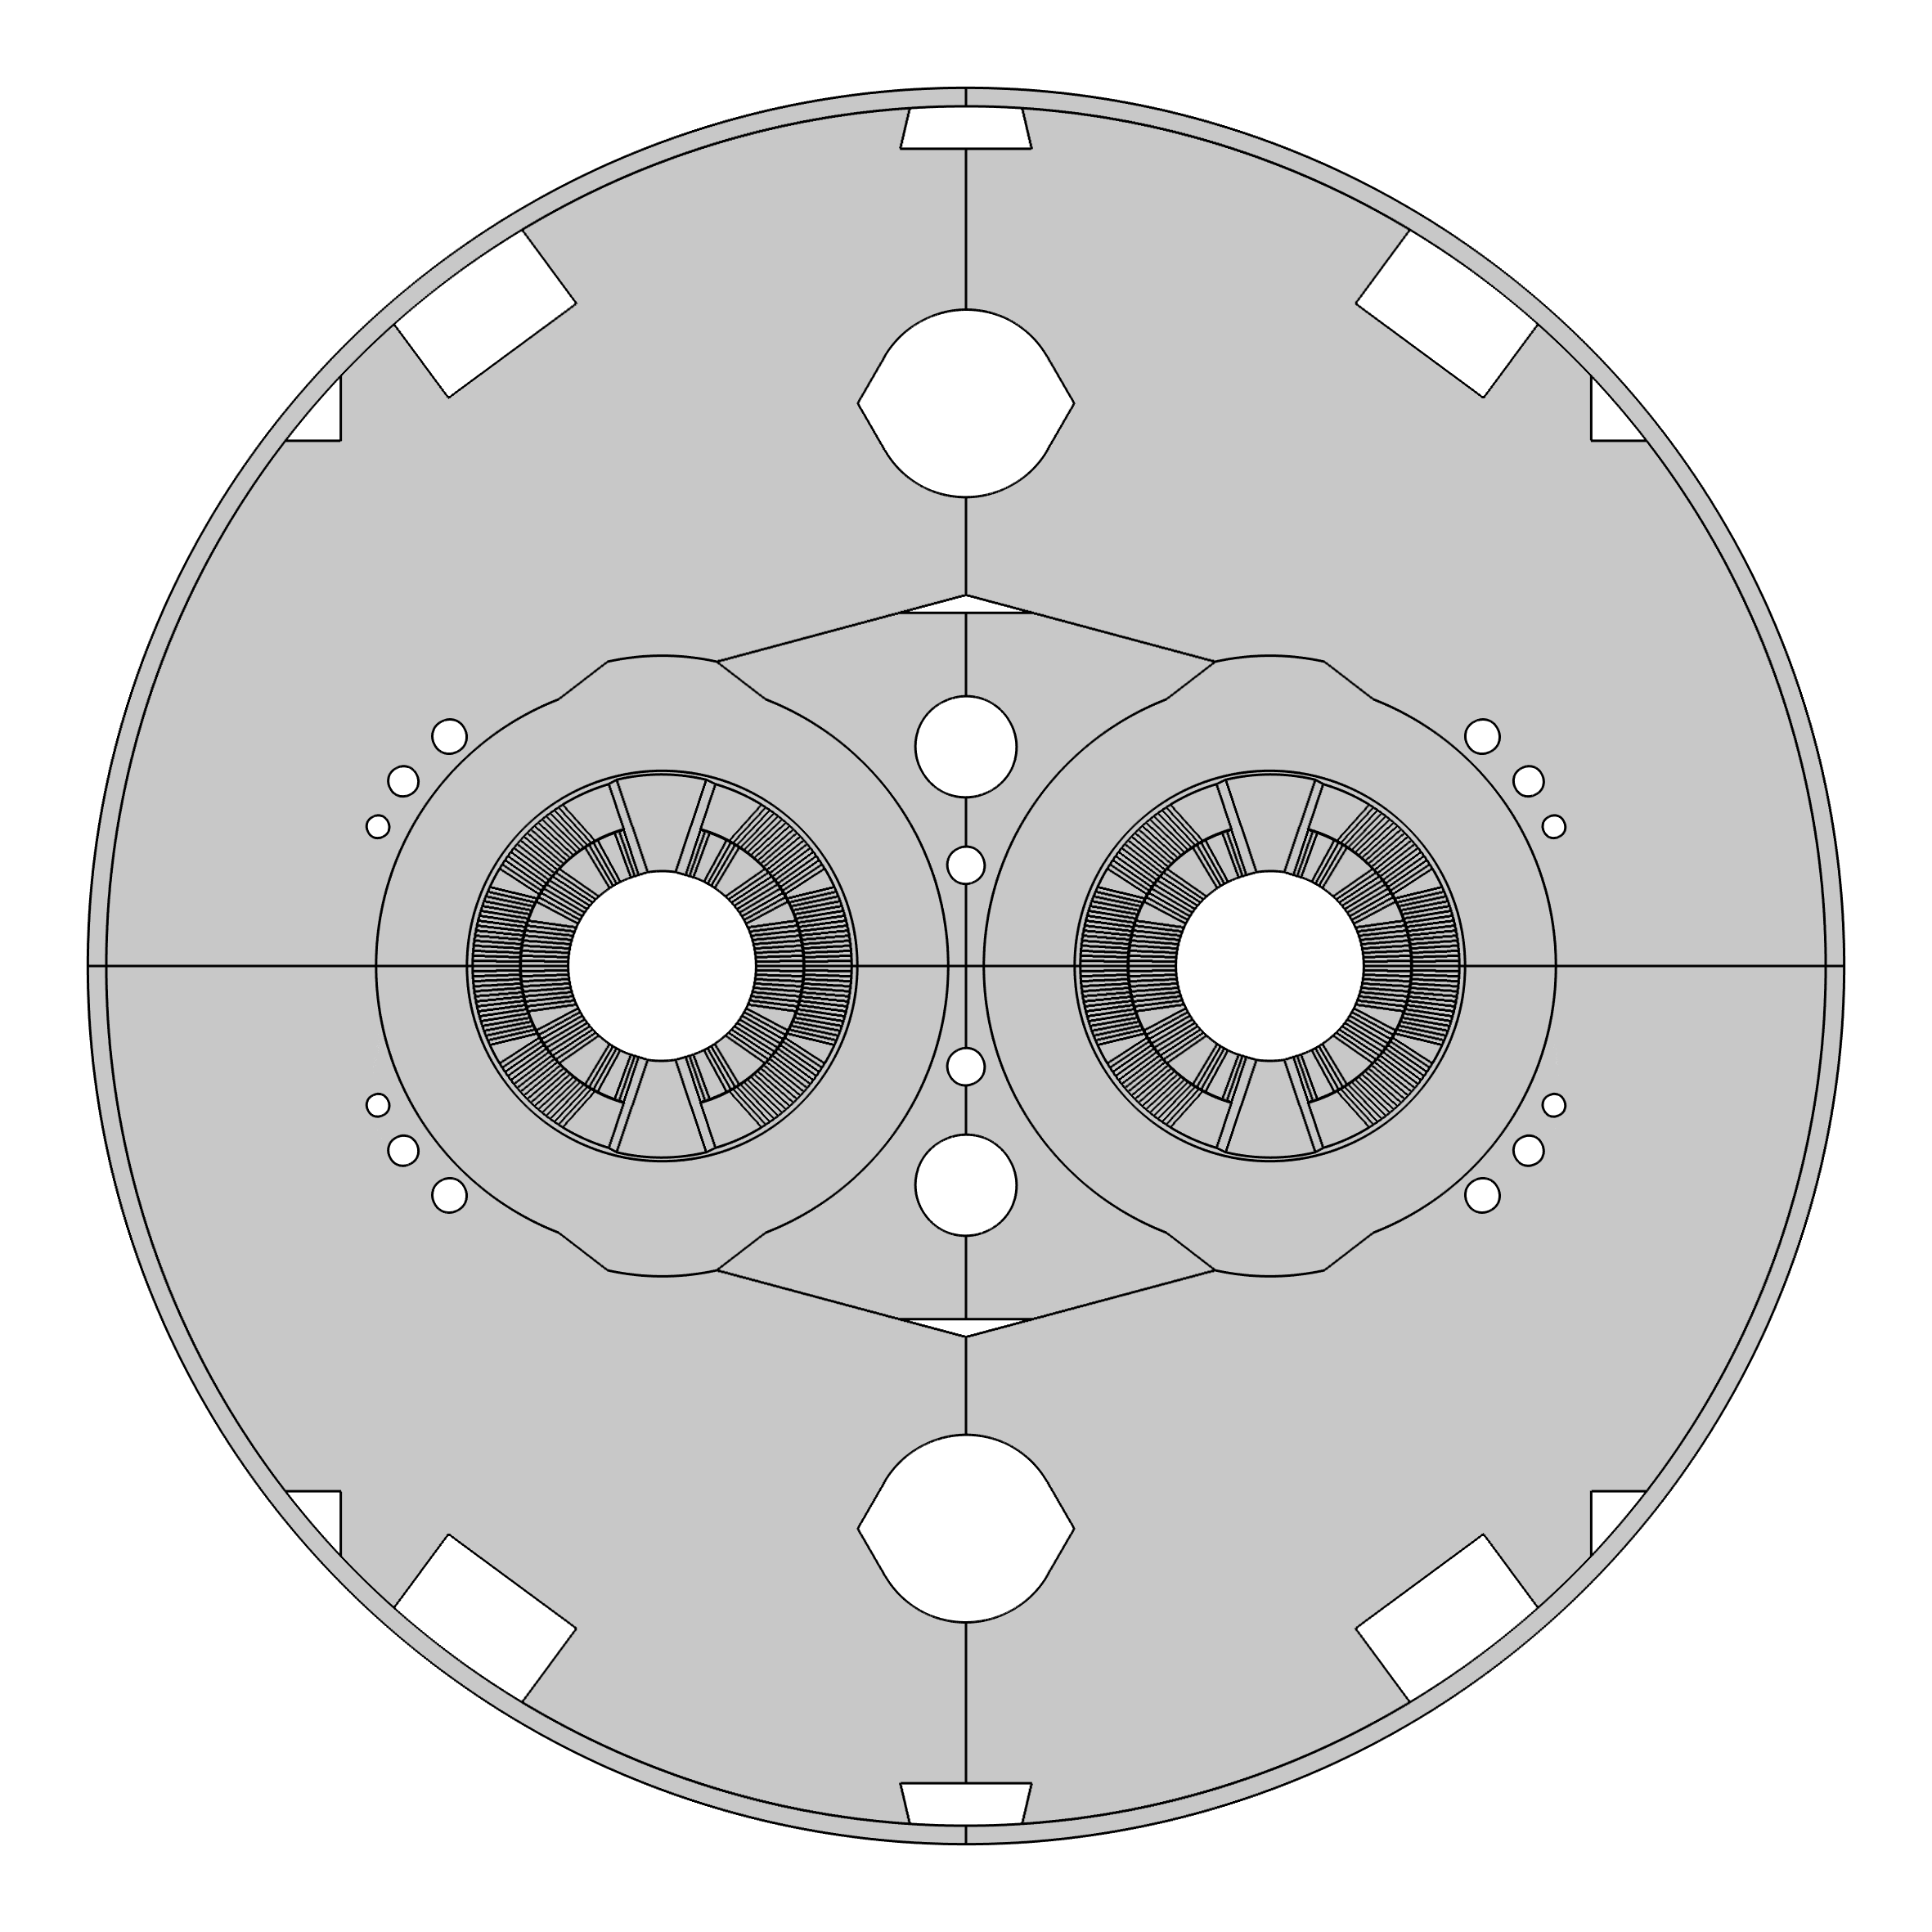

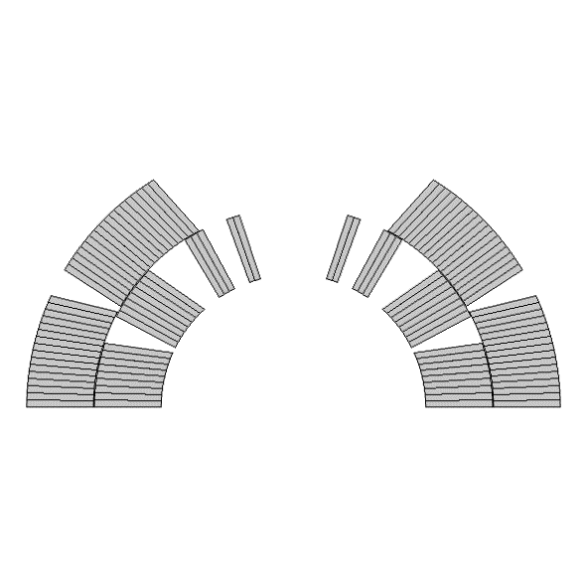
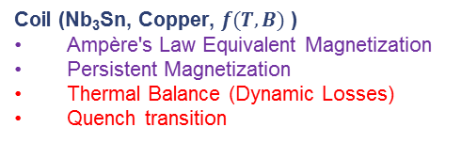
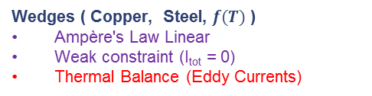
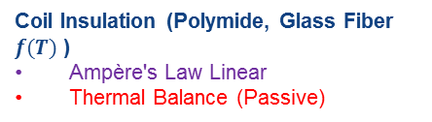
Construction of a High-Field Dipole Magnet
- Geometry, Materials, Physics
Coil Insulation (Polymide, Glass Fiber $f(T)$ )
Ampère's Law Linear
Thermal Balance (Passive)
Wedges ( Copper, Steel, $f(T)$ )
Ampère's Law Linear
Weak constraint (I_{tot} = 0)
Thermal Balance (Eddy Currents)
Coil (Nb₃Sn, Copper, $f(T,B)$ )
Ampère's Law Equivalent Magnetization
Persistent Magnetization
Thermal Balance (Dynamic Losses)
Quench transition

Slide 16
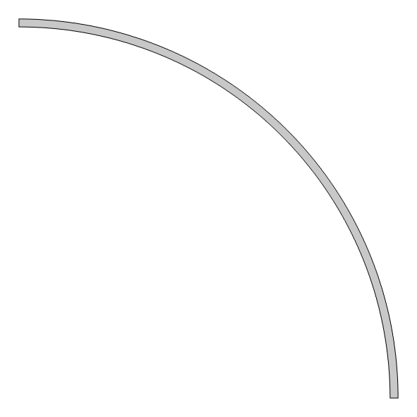
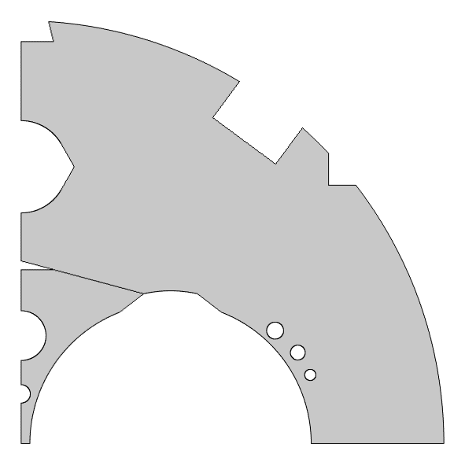
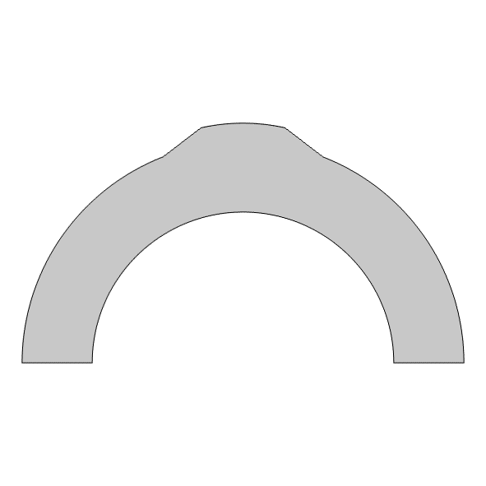
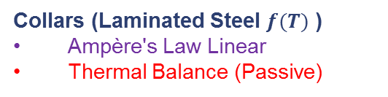
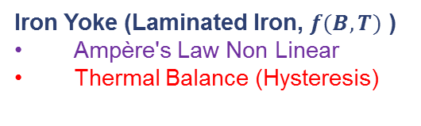
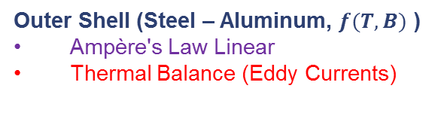
Construction of a High-Field Dipole Magnet
- Geometry, Materials, Physics
Outer Shell (Steel – Aluminum, $f(T,B)$ )
Ampère's Law Linear
Thermal Balance (Eddy Currents)
Iron Yoke (Laminated Iron, $f(B,T)$ )
Ampère's Law Non Linear
Thermal Balance (Hysteresis)
Collars (Laminated Steel $f(T)$ )
Ampère's Law Linear
Thermal Balance (Passive)

Slide 17
Validation of a High-Field Dipole Magnet

Slide 18
Validation of a High-Field Dipole Magnet

Slide 19
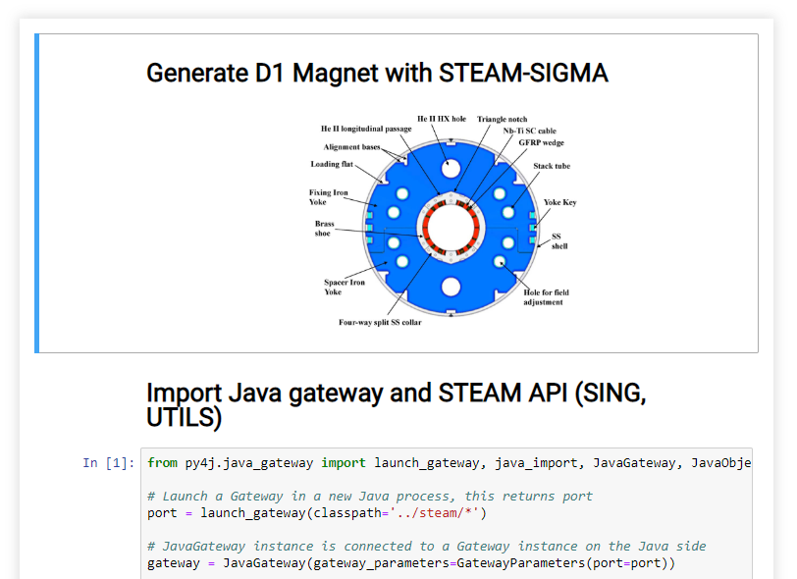
Model Construction with SWAN - demo

Slide 20
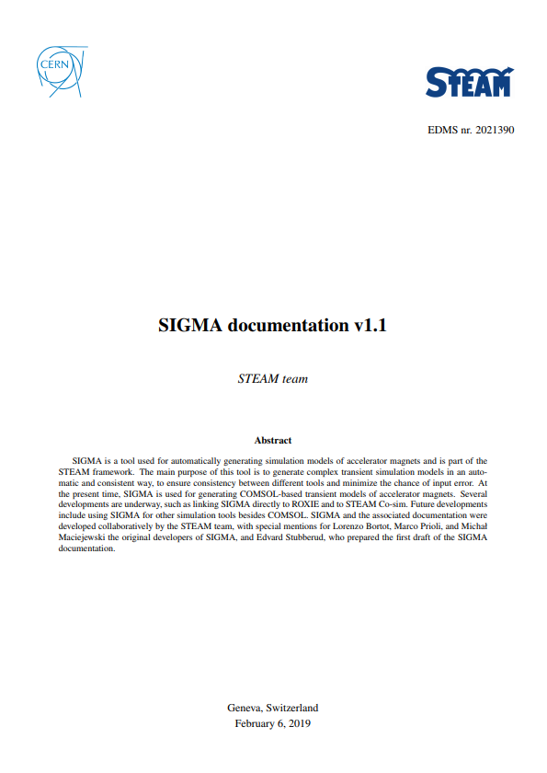

STEAM-SIGMA – Documentation
Minor updates
Documentation of the public API (demo)

Slide 21
New features
Enhanced Automation of Model Generation - Barakat-Ullah Bokharaie
Inter-Filament Coupling Currents Modelling – Carmelo Barbagallo

Slide 22
Enhanced Automation of Model Generation
Author: Barakat-Ullah Bokharaie
Supervisors: Matthias Mentink
STEAM workshop, 13th June 2019

Slide 23

Revision of STEAM’s SIGMA Tool
Purpose of revision:
  Reduction of computation times
  Increased usability
    Automatic definition of Quench Heaters
    Automatic creation of correct study settings
    Automatic creation of mesh
Reduction of computation times:
  General:
    ↑ Complexity → ↑ Variables → ↑ Time
  Global description rather than individual
  Results:
    Reduction by a factor of up to 15

Slide 24


Increased usability
Automatic definition of Quench Heaters
Geometry
Materials
Thermal properties
Low-field Quench Heaters =
High-field Quench Heaters =
MQXF magnet model for High-Lumi LHC

Slide 25




Increased usability
Automatic creation of correct study settings and mesh
Correct study settings:
  Stationary study
  Time dependant study
  Relevant physics
  Solver settings
Mesh settings:
  Mapped
  Triangular
Meshed MQXF magnet model
25

Slide 26
Inter-Filament Coupling Currents Modelling
Author: Carmelo Barbagallo
Supervisors: Matthias Mentink and Arjan Verweij
STEAM workshop, 13th June 2019

Slide 27




Introduction
Inter-filament coupling currents (IFCCs) in the strands of a superconducting cable are modelled by using an additional magnetization term ${\vec{M}}_{IFCC}$ (in Am⁻¹):
$${\vec{M}}_{IFCC}=−ντ_{IFCC}\frac{∂\vec{B}}{∂t}$$
Rutherford cable (real image)
Strand magnetization
${\vec{M}}_{IFCC}$ is due to small closed current-carrying loops;
The magnetizing current ${\vec{J}}_{m}=∇×{\vec{M}}_{IFCC}$ is divergence-free.
$$∇×\left(ν∇×\vec{A}\right)+σ\frac{∂\vec{A}}{∂t}={\vec{J}}_{s}+∇×{\vec{M}}_{IFCC}$$
Magnetoquasistatic (MQS) PDE
Finite Element Method is used to solve the following MQS equation for individual strands:
$$∇×\left(ν∇×\vec{A}\right)+∇×\left(ντ_{IFCC}∇×\frac{∂\vec{A}}{∂t}\right)={\vec{J}}_{s}$$
Aim of the study: how does homogenization affect IFCCs behavior on superconducting cables and magnets.

Slide 28






Stack of four Rutherford cables – Homogeneous vs Multi-strand model
Homogenised model
Multi-strand model
$${\vec{M}}_{IFCC}=−k_{ht}ντ_{IFCC}\frac{∂\vec{B}}{∂t}$$
$${\vec{M}}_{IFCC}=−ντ_{IFCC}\frac{∂\vec{B}}{∂t}$$
Stack of four Rutherford cables submitted to an external varying magnetic field;
D_{strand}=0.9 mm, $τ_{IFCC}=10 ms$;
Homogenisation density factor $k_{ht}=\frac{\left|Ω_{st}\right|}{\left|Ω_{ht}\right|}=0.55$ to compensate discretization error in the homogenised model;
Multi-strand model: same field amplitude but lower time constant than the homogenised model.

Slide 29















Future studies for IFCCs modelling on superconducting magnets
Modified Homogenisation Formulation
Equivalent Resistivity Formulation
$$t_{h}$$
COMSOL coil feature:
$I_{coil}=0$ (coil excitation);
Strand border electrical conductivity applied to the conductive border of thickness $t_{h}=\frac{R_{s}}{2}$:
$${\vec{M}}_{IFCC}=−\frac{2τ_{IFCC}}{μ_{0}}\frac{∂\vec{B}}{∂t}$$
equivalent
$$\frac{d{\vec{M}}_{IFCC}}{dt}=\left(−\frac{1}{2τ_{IFCC}}\right){\vec{M}}_{IFCC}−(1)\frac{d\vec{H}}{dt}$$
$$Γ$$
→
because $\vec{B}=μ_{0}\left(\vec{H}+\vec{M}\right)$
Decay term
Driving term
$$y$$
$$\frac{d{\vec{M}}_{IFCC}}{dt}={k_{ht}}^{−0.5}\left(−\frac{1}{2τ}\right){\vec{M}}_{IFCC}−{k_{ht}}^{0.5}\frac{d\vec{H}}{dt}$$
$$x$$
$$z$$
$σ_{Γ}=\frac{1}{ρ_{Γ}}=\frac{{4τ}_{IFCC}}{R_{s}^{2}μ_{0}}$ (in S/m)
where$ρ_{Γ}$ is the resistivity of the border and R_{s} the strand radius.
Equations were implemented in COMSOL by using Dode (Domain ODEs and DAEs) module;
Same field amplitude and time constant for homogenised and multi-strand model.
Field amplitude and time constant in accordance with expectations;
The implementation on cable stacks is under study.

Slide 30





Magneto-thermal analysis with CLIQ protection system for FRESCA2 magnet
FRESCA2 Nb₃Sn dipole magnet
(developed within a collaboration between CERN and CEA Saclay)
Homogenised model
(based FRESCA2 model created by L. Bortot)
Multi-strand model
Image: G. Willering
Magnetic field: 13 T;
Block coil design with 4 double pancake coils: 42 turns outer layer, 36 turns inner layer;
Cable: 40 strands of 1 mm;
Bladder and key concept for loading;
Magnetic flux density is in agreement with expectations;
IFCCs losses are different in the two models.

Slide 31






Magneto-thermal analysis with CLIQ: Homogenised model vs Multi-strand model
$${\left({\left.\frac{dI_{mag}}{dt}\right|}_{t=0}\right)}_{Homo.}$$
$${\left({\left.\frac{dI_{mag}}{dt}\right|}_{t=0}\right)}_{Strands}$$
The slope${ \left.\left(\frac{dI_{mag}}{dt}\right)\right|}_{t=0}$is 35% lower in the multi-strand model. Furthermore, after the initial fluctuation, the discharge in the two models is similar. This outcome explains why we have noticed so far a higher $\frac{dI_{mag}}{dt}$ than expected in all homogenised models of magnets;
Losses due to IFCCs are, as consequence, lower of a factor two in the multi-strand model than in the homogenised one;
Results are encouraging, however further studies are required to understand the differences noticed between the two models.

Slide 32
Conclusion
We can automatically generate COMSOL models
We are extending this approach to build LEDET and ANSYS models
We are enhancing automatic model generation capabilities
We identified an issue with equivalent magnetization and work on a solution
We used STEAM-SIGMA for LHC, HL-LHC and FCC magnet studies

Slide 34

STEAM-SIGMA – Code Quality
Feature | 26.09.18 | 05.02.19
Bugs | 117 | 0
Vulnerabilities | 97 | 2
Code smells | 8.2 k | 36
Tech. debt | 85 d | 3 d
LoC (code+doc) | 15 k | 15 k
Most frequent issues:
No documentation
Coding conventions violated
Logic errors
Code duplications
Missing and failing tests

