Slide 1

STEAM-ProteCCT
(Protection of Canted-Cosine-Theta-type Magnets)
1st STEAM Workshop 13-14 June 2019
cern.ch/STEAM
Matthias Mentink,
On behalf of the STEAM team

Slide 2
Overview
Motivation
Thermal aspects
Internal circuit / Co-simulation
User interface
Complexities + correction factors:
  Oversimplified model of eddy currents in the formers → Correction factor fLoopFactor
  Additional helium present between the (non-bonded) formers and outer cylinder → Correction factor addedHeCpFrac
Simulation vs. experimental observations
Running the model
Demonstration
Summary

Slide 3
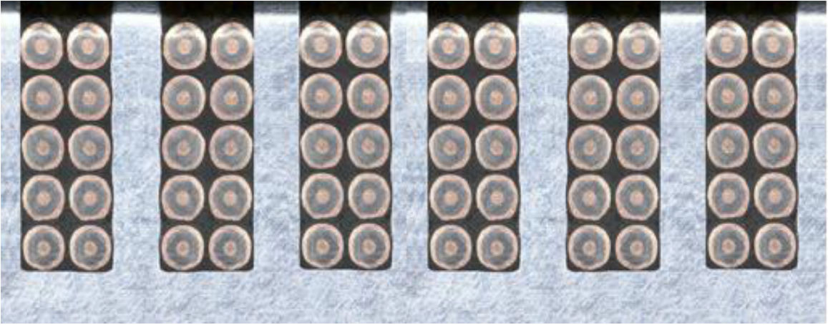
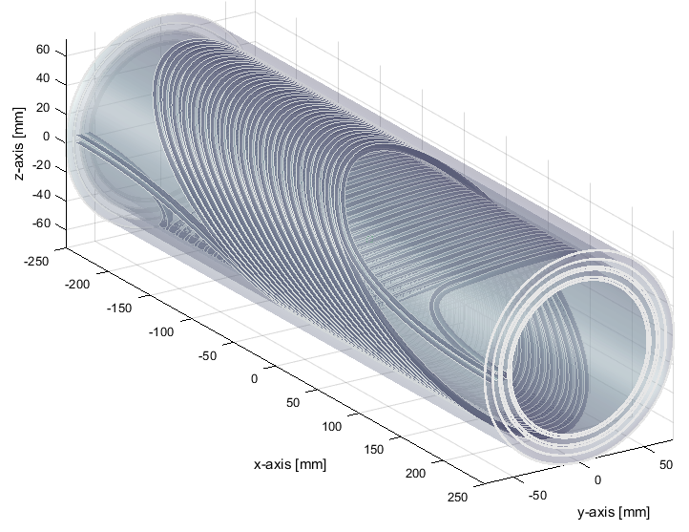
Motivation
Insulated
Nb-Ti/Cu strand
Why STEAM-ProteCCT?
Canted Cosine Theta Magnets:
  Concentric superconducting coils held in place by conductive aluminum formers
  Cost-effective and may be used for any higher-order field (dipole, quadrupole, etc.)
Quench protection of MCBRD Twin Aperture Orbit Correctors for HL-LHC upgrade
  Magnet is discharged over energy extractor
  Eddy currents in the conductive formers → Heating in formers → Fast development of normal zone throughout superconducting coils (Quench-back)
  Complex three-dimensional geometry
→ Quench simulation with STEAM-ProteCCT
Aluminum former
Canted-Cosine-Theta (CCT) magnets: superconducting strand inside slots in conductive former [1]
CCT coils
Formers
Eddy currents in the formers
Eddy currents in formers surrounding CCT coils during discharge
[1] G. Kirby et al. IEEE Trans. on Appl. Supercond. 28, p. 4002205 (2018)

Slide 4
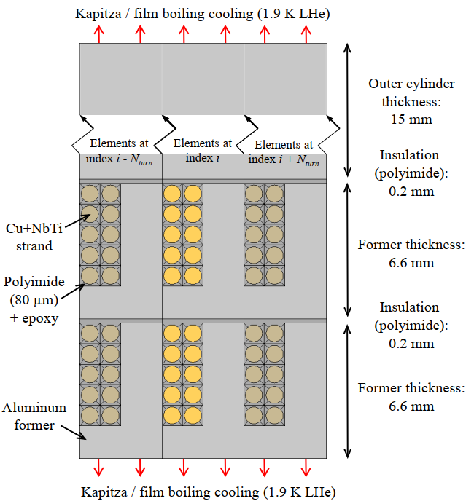
Thermal aspects
Turn-to-turn periodic boundary condition
Three-dimensional thermal propagation in simplified geometry [1]
Longitudinal heat propagation along length of strands, insulation, and formers
Transverse heat propagation
  Individual thermal elements for strands, insulation, formers, former insulation
  Heat flow to the bath: Kapitza + film boiling cooling for 1.9 K, Nuclear + film boiling for 4.5 K
  Since each turn sees the same magnetic field and eddy currents (neglecting edges of the magnet): Periodic boundary condition
Non-linear magnetic-field- and temperature-dependent properties taken from STEAM library and LEDET material database
Thermal layout [1]
[2] M. Mentink et al. IEEE Trans. on Appl. Supercond. 28, p. 4004806 (2018)

Slide 5
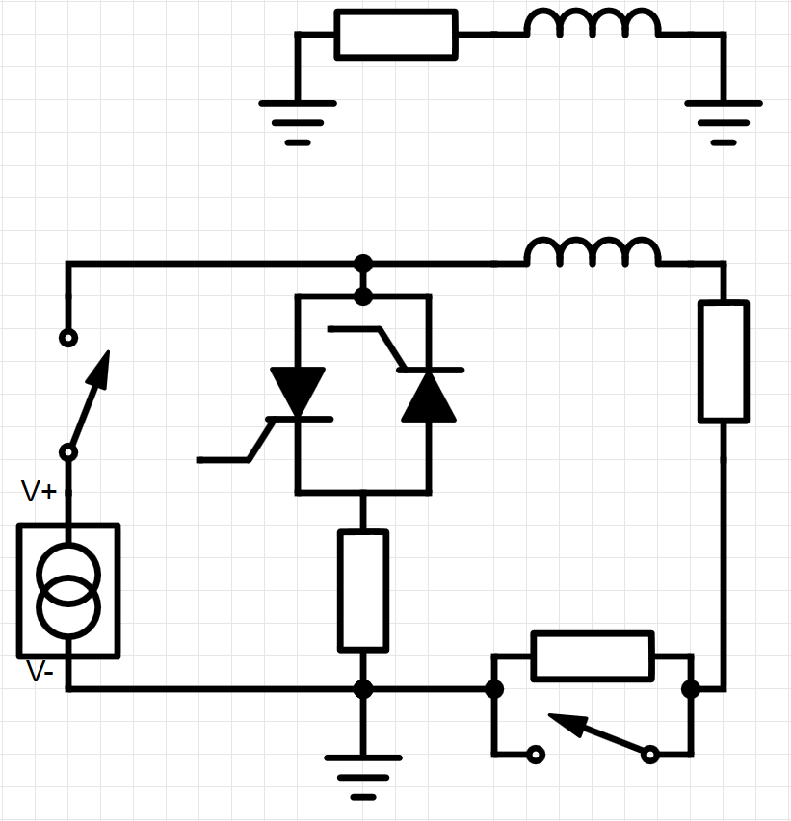
Internal circuit / Co-simulation
Internal circuit:
  At each iteration: Calculation of internal resistance, considering superconducting properties, temperature magneto-resistivity, etcetera
  Coupling matrix for coupling between coils, formers, and outer cylinder
  Adaptive time-stepping (constraints on maximum dT/dt, maximum dI/dt in formers, user-specified dt)
Co-simulation:
  Tested with STEAM co-simulation framework (ProteCCTToolAdapter)
  Accepting external current waveform, and return resistance + inductive voltage waveforms
  Adaptive time-stepping in between co-sim-requested steps
Eddy current heating in two formers and outer support cylinder
3x
M
Superconducting coil,
L = 970 mH
Power supply, deactivated at t = 0
NbTi/Cu
strands, R(t)
Energy extractor,
1.4 Ω / Metrosil, activated after 10 ms
Crowbar,
R = 0.055 Ω
Internal circuit

Slide 6
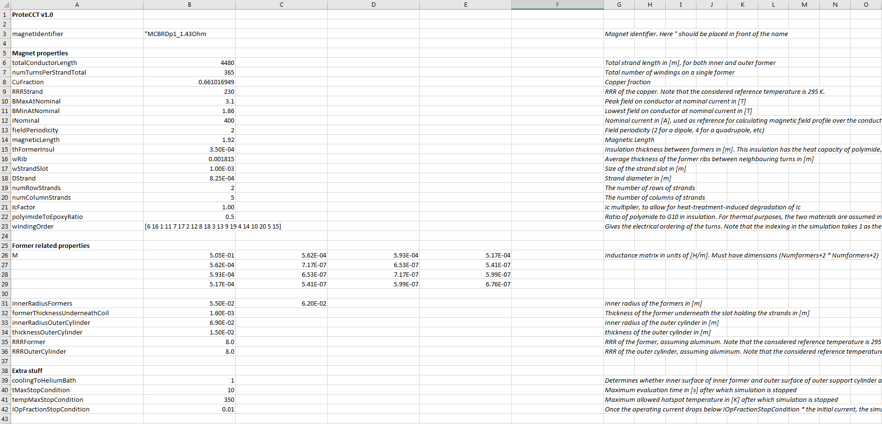
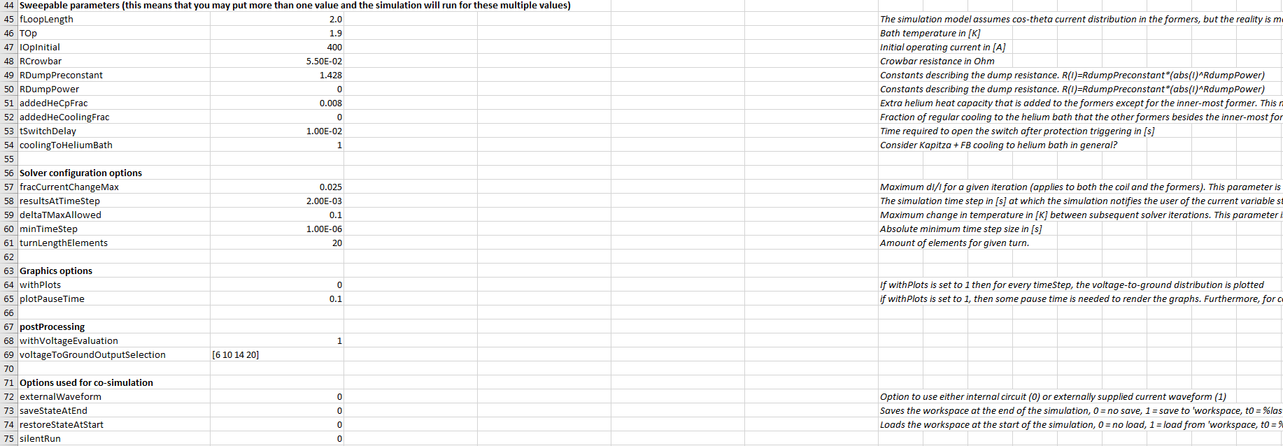
User interface
ProteCCT user manual [3]
User input:
  Internal circuit: Similar to LEDET, all user input is taken from a single Excel file
  Co-simulation: Single Excel file + txt file for external current waveform
For the most part, easy-to-understand parameters (Conductor RRR, Operating current, etc.)
Model input: Excel file
[3] M. Mentink, “STEAM-ProteCCT User manual”, EDMS nr. 2160020, (2019)

Slide 7
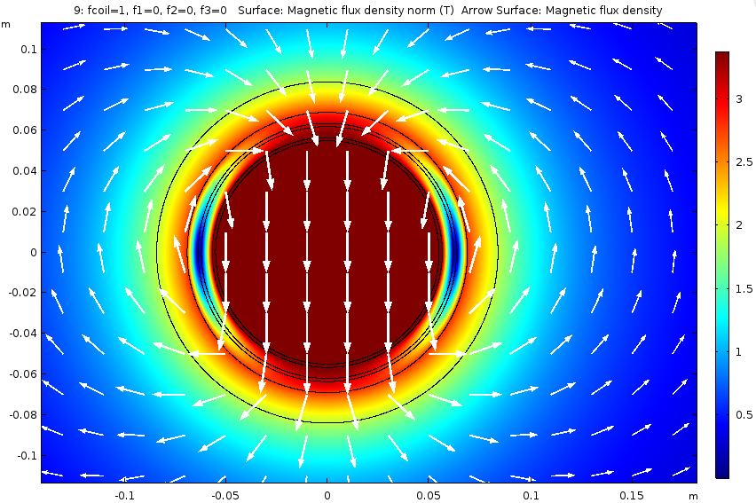
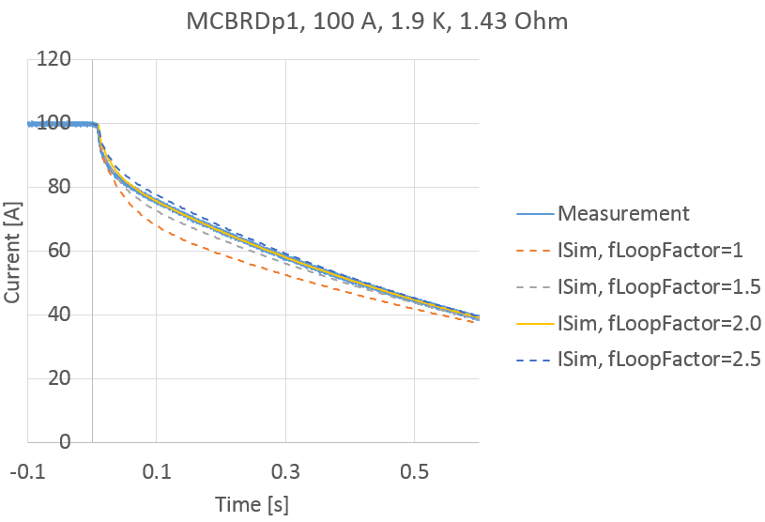
Complexity & correction factor #1: fLoopFactor
Coupling-matrix calculated in Comsol, assuming simplified 2D geometry with cos-θ current distribution
Determination of fLoopFactor by matching to experimentally observed low-current discharge (no quench-back)
Coupling matrix: Calculated in Comsol, assuming simplified 2D geometry with cos-θ current distribution in the coils, formers, and outer cylinder [3]
Assumption: Eddy current flows axially through formers
Reality: Eddy current model is oversimplified, so global correction factor fLoopFactor needed that augments the effective path lengths of the eddy currents
fLoopFactor determined by matching discharge to experimental result at low current without quench-back
[3] M. Mentink, “STEAM-ProteCCT User manual”, EDMS nr. 2160020, (2019)

Slide 8
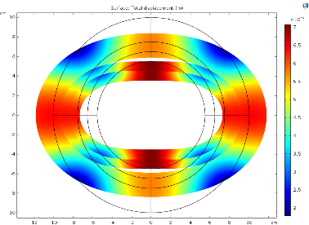
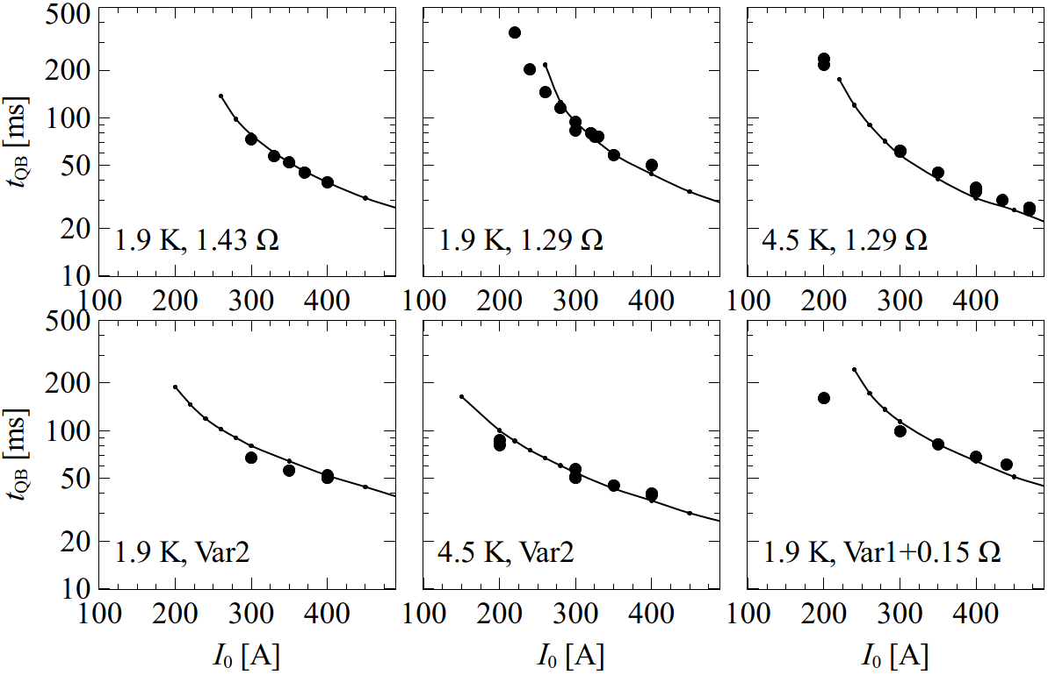
Complexity & correction factor #2: addedHeCpFrac
Liquid helium between formers
Sliding and deformation of formers during powering (Courtesy Martin Novak)
Simulated vs. Observed onset of Quench back (Measurement data: Courtesy F. Mangiarotti)
In addition to helium to bath cooling: Additional liquid helium present between non-bonded formers and outer cylinder → Slows down quench-back onset
Extra helium heat capacity: 0.13 MPa liquid + gas, with inclusion helium gas enthalpy
Added as global correction factor addedHeCpFrac → Additional heat capacity in formers (~0.8%)
Determination of correction factor by matching quench back onset t_{QB} at I₀ = 400 A, 1.9 K, 1.43 Ω → Used as a global parameter

Slide 9
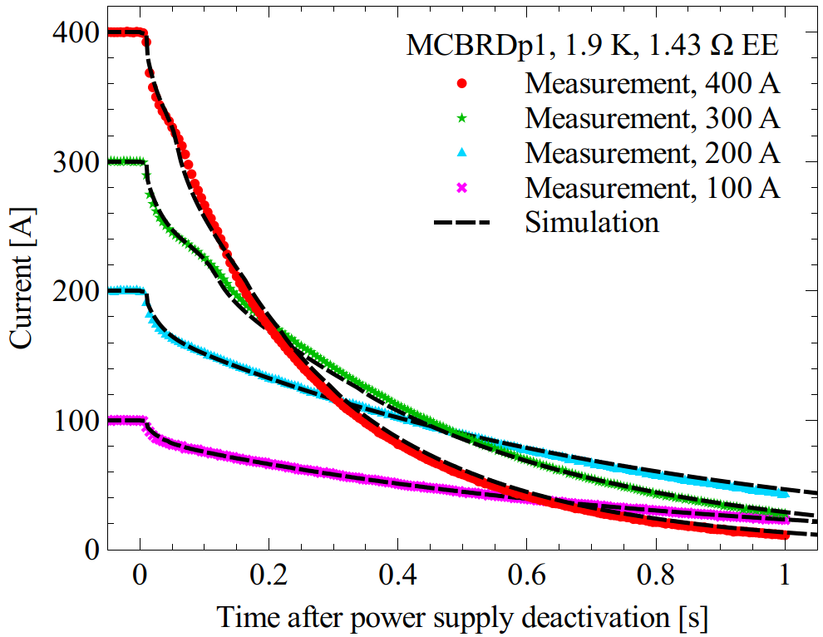
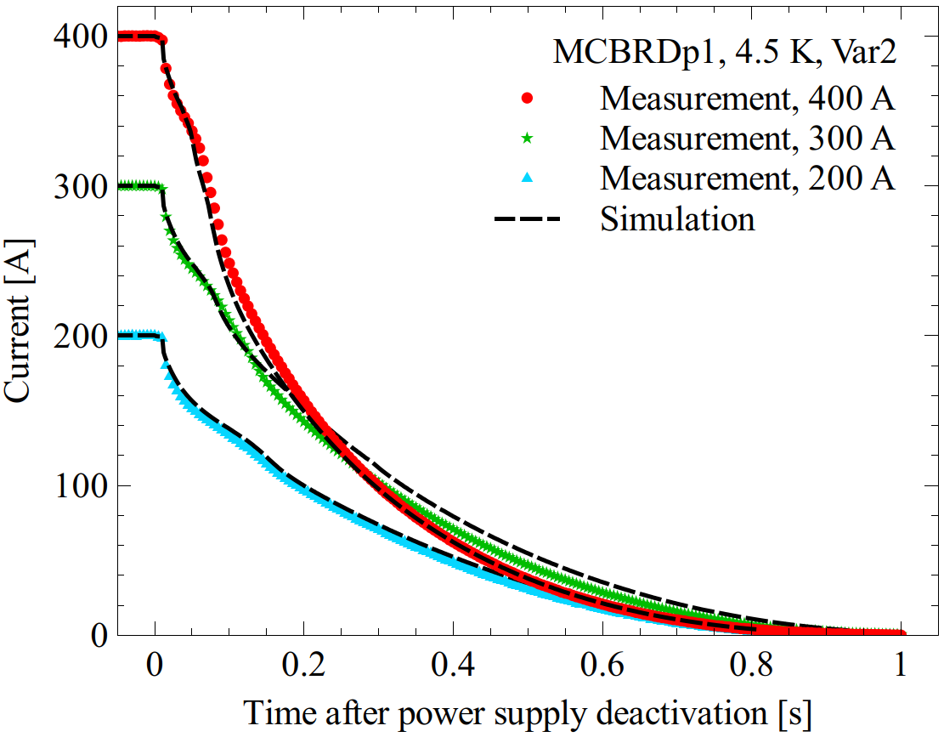
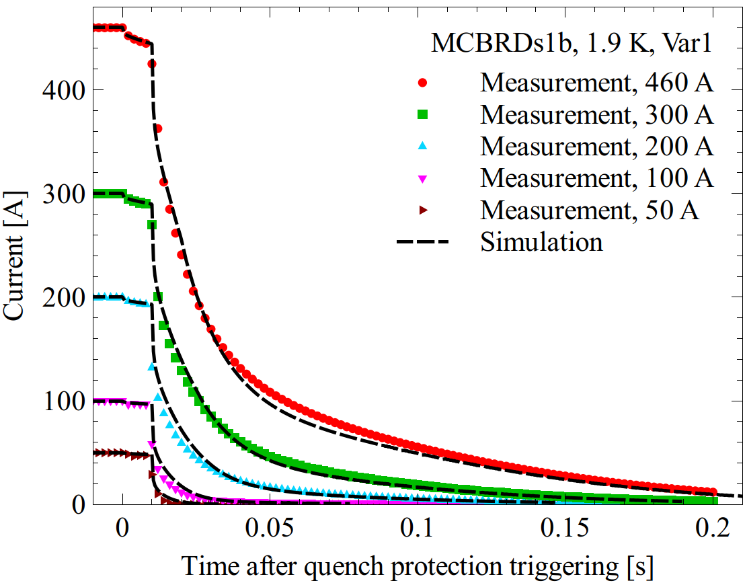
Simulation vs. Experimental observation
MCBRDp1 prototype, discharge over 1.43 Ω dump resistor
MCBRDp1 prototype, discharge over Metrosil varistor
MCBRDs1b short model, discharge over Metrosil varistor
Comparison between simulation and experimental (MCBRD prototype apertures and short models):
High degree of consistency between simulations and experimental observations
Different magnetic lengths, former material types, operating temperatures, varying dump resistors + Metrosil varistors, operating currents
Two identical global correction parameters fLoopFactor and addedHeCpFrac for all cases

Slide 10
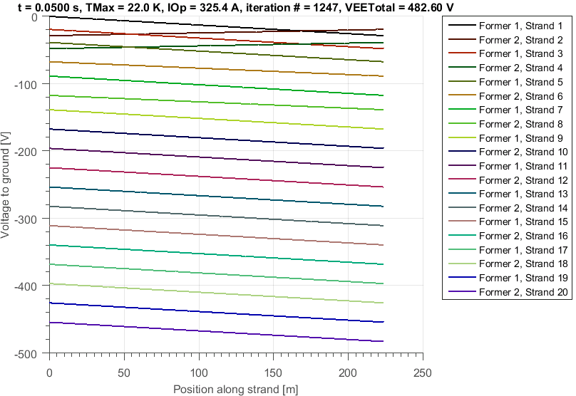
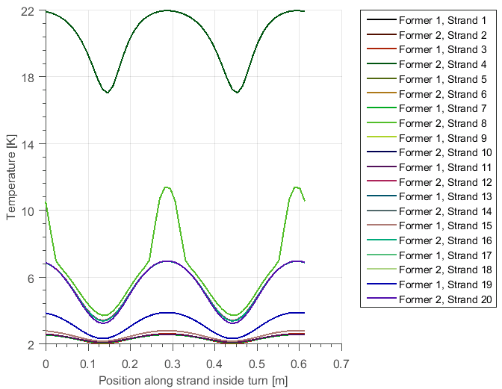
Running the simulation
Voltage-to-ground calculation
(During simulation, t = 50 ms)
Strand temperature development
(During simulation, t = 50 ms)
Very fast: Typical run-time on the order of a minute
Free-to-use standalone executable, no license required
During simulation: Optional plotting of voltage-to-ground and strand temperature for each time-step
Simulation output written to excel file:
  Time-dependent Current, hot-spot temperature, voltage-to-ground of selected turns

Slide 11
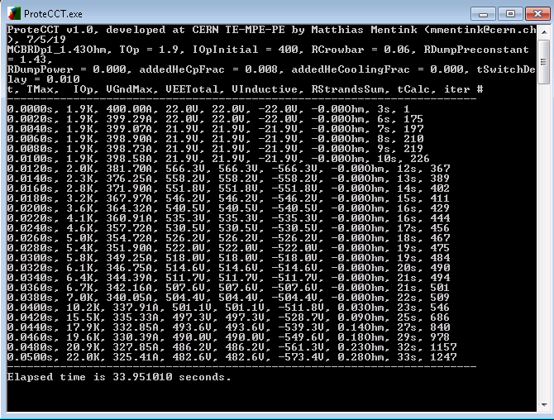
Demonstration
Strand temperature development
(During simulation, t = 50 ms)
Demonstration

Slide 12
Summary
CCT coils
Formers
STEAM-ProteCCT
Simulation tool for evaluating discharge of CCT-type magnets (With quench-back from conductive formers)
Very fast, standalone executable, free to use
User-interface: Input from Excel, output to Excel (plus optional plotting during execution)
Available on STEAM website (cern.ch/steam)
Eddy currents in the formers

