Slide 1
CERN Resources Planning, Budgeting and Control overview
Kasia Pokorska
Financial Publication and Narrative Reporting Forum
24 June 2019

Slide 2
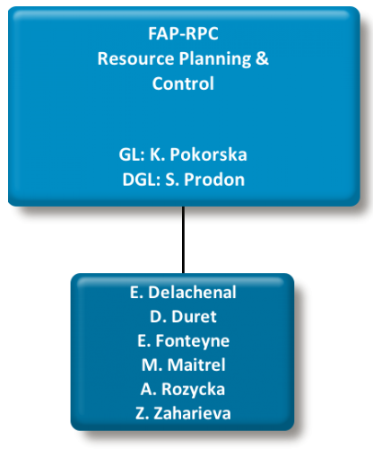
Presentation of the central planning unit
Group Resources Planning and Control in the Finance and Administrative Processes Department: FAP-RPC

Slide 3
Overview of the CERN planning cycle (1) – core planning documents: MTP and Final Budget
Medium Term Plan (MTP) including Draft Budget
  Overall underlining strategy (objectives) for the next 5 years
  Draft Budget for next year in the current prices
  Targets for next budget year (to be measured against these)
  Submitted to the approval by the Council
  E.g. MTP 2019: covers planning period 2020-2024 and introduces Draft Budget for the year 2020
Final Budget
  Implements
    The approved indexation to the expenses and revenues budget
    The allowed transfers of unspent budget between years (carry forward, carry back, reprofilings)
  Includes the information on the Probable Revenues and Expenses
  For information only, no formal vote required from the Council
Long Term Plan (LTP)
  More general and concise
  Key strategic objectives
  Time-frame 10 years
    last time proposed in June 2007: 2007-2016 at the end of the LHC construction

Slide 4
Overview of the CERN planning cycle (2) – core reporting document: APR
Annual Progress Report (APR)
  Quantitative aspect:
    Compares the actual amounts (budget out-turn) with the budgeted values by activity, showing the achievements
    Report on budget carry over
    KPIs
  Qualitative aspect:
    Explains the numerical variations
    “Narrative” reporting on the targets / objectives set in the Final Budget
  Joint effort of multiple actors
    Accounting for the actual amounts
    DHs, DPOs, Project Leaders for explanations
Revised Budget
  Part of the MTP
    eg. MTP 2019 contains Revised 2019 Budget
  Published as a separate document occasionally (e.g. in 2009 as a result of the LHC incident in September 2008)

Slide 5
Overview of the CERN planning cycle (3) – auxiliary documents: CVI and “Scale”
Cost Variation Index (CVI)
  Voted in December
  Personnel part: to protect basic salaries and stipends from the erosion of purchasing power resulting from the increase in the cost of living
    No “negative” indexation but keep the memory
      Currently no memory left
  Materials part: to align the expenses budget to the inflation / deflation tendency, corrected by the variation in exchange rate between national currencies and Swiss franc
  Revenues part, only MS contributions are indexed, the “corridor” principle
Scale of Member States’ Contributions
  Voted in June
    The contributions are expressed in the current year prices
  Indexation applied in December
    Corridor principle: Member States’ contribution are indexed in between 0% and 2%

Slide 6
Overview of the CERN planning cycle (4) - timeline
Scale of contribution N+1
CVI N+1
N
N-1
N+1
N+2
N+3
N+4
N+5
June N
Dec. N
Medium Term Plan N+1 -> N+5
Annual Progress Report N-1
Revised Budget N
Draft Budget N+1
Planning
Reporting
Probable Revenues and Expenses N
Final Budget N+1

Slide 7
Resources planning @CERN (1) - Principles
Financial Rules and Regulations
  Document approved by Council
  Last revision 19/06/2013: CERN/FC/5305/Rev.
  Stipulate (Article 15):
CERN’s accounts shall be drawn up in accordance with the International Public Sector Accounting Standards (IPSAS).
These standards and the way in which they are implemented shall be explained in the notes attached to the annual accounts of each financial year.
  Planning and budget: Article 5 to 9
IPSAS implementation
  Since 2007

Slide 8
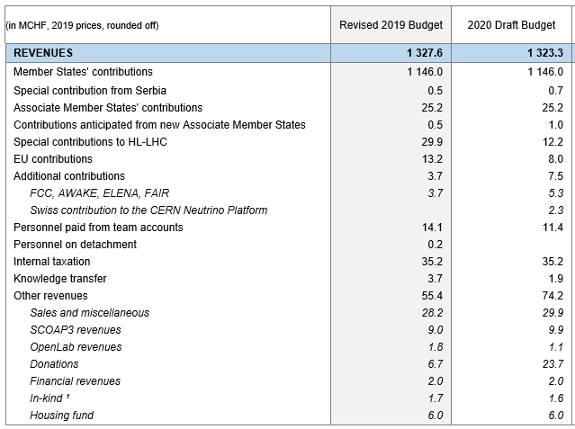
Resources planning @CERN (2) - Revenues
Member States’ contribution
  90% of the whole revenues
Contributions from Associate Member States
  Transition phase, a percentage of the full amount, minimum 1 MCHF
  Ramping up to 100% over a few years
Participation in EU projects
In-kind and cash contributions to specific projects and facilities, from
  Countries (e.g. NEUTPLAT)
  Institutes (e.g. ITER)
  Private Industry (e.g. Siemens, Intel, HP, Oracle for OpenLab project)
  Donations (e.g. Science Gateway)

Slide 9
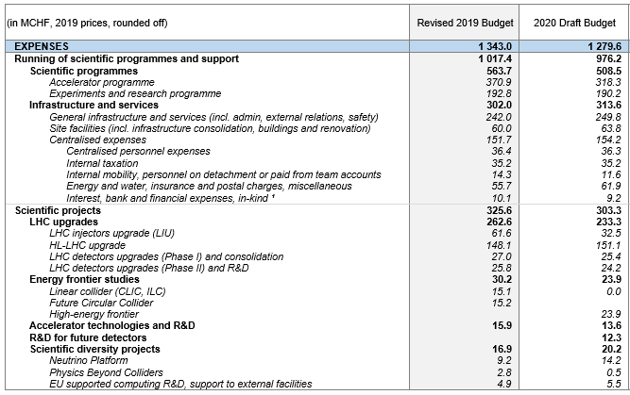
Resources planning @CERN (3) – Expenses in general
Expenses are broken down by
  Activity / Project
  Organic Unit (Department)
  Funding
  Nature / Account
=> Impact IPSAS
  Accrual accounting
  The expenses are recognized when an actual / physical delivery takes place and not the payment!

Slide 10
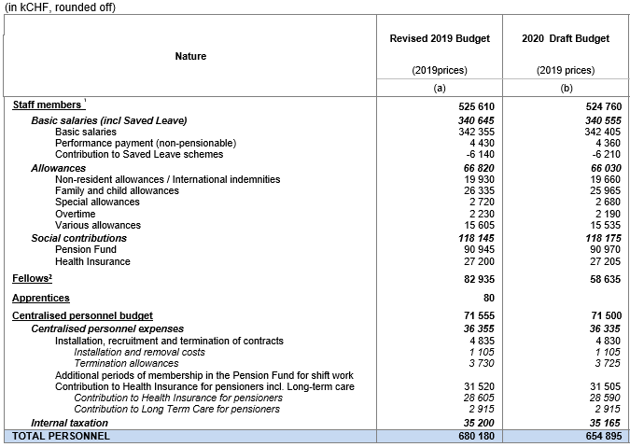
Resources planning @CERN (4) – Personnel
Employed Member of Personnel (MPE)
  Staff
  Fellows
Budgeted at standard cost
  An overhead factor calculated at the beginning of each year
Carry-forward
  Unspent budget can be carried to the next year only to cover the existing commitments
Limit on Full Time Active (FTA)
  2250 +/- 5% Staff paid by Member States’ contributions
Conversion from Limited Duration contract to Indefinite Contract (LD->IC)
  Impact on the budget
Advancement exercise
  Built in the budget, 1.5 % per year
  Compensated by expensive departures

Slide 11
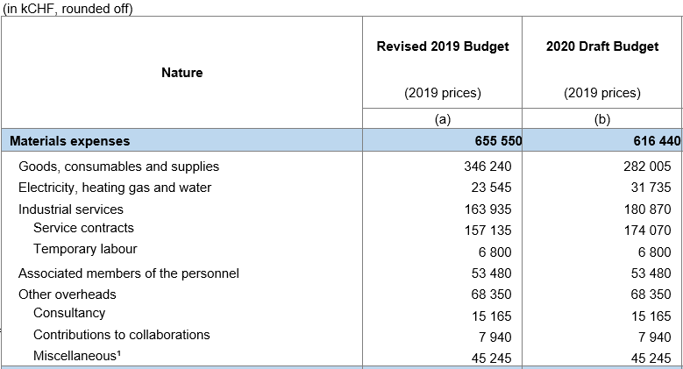
Resources planning @CERN (5) – Materials
Various categories, including manpower
  Associated Members of Personnel (MPA)
  Industrial services
Carry forward
  Recurrent activities – NONE, only in the limit of committed amounts
  Projects
    Unspent budget can be carried forward to the next year without limits
    If project is advancing faster, funds can be also carried back from future years without limits.
But also possible to do M to P transfers

Slide 12
Resources controlling @CERN (1) - Personnel
Staff
  For each post opening for limited duration contract
    Verification whether within FTAs limit
    Check the implication on cost
  LD to IC exercise
    Budgetary consequences
  Advancement exercise
    Control of the cost – within 1.5% limit?
Real cost versus standard
  Follow-up on monthly basis
  Readjustment if needed
Fellows
  Follow up of the commitments (in kCHF) versus budget
  Regular reports on the recruitment margin
  Follow-up of M to P transfers

Slide 13
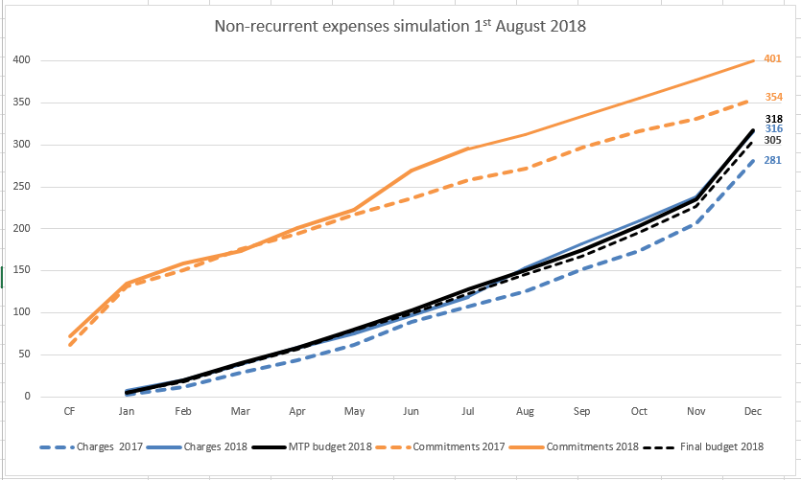
Resources controlling @CERN (2) - Materials
Sophisticated budget control structure set up in Qualiac
  Different criteria
    Per department / project / recurrent activity
  All extra commitments / expenses exceeding allocated budget are coming to DG-RPC for approval
Main scientific/construction projects
use EVM
Internal monthly reports forecasting
expenses and comparing to the budget

Slide 14
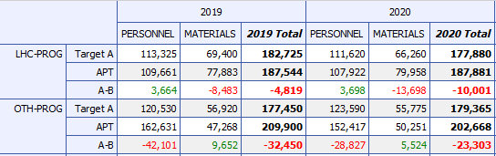
Tools (1) – planning: Activity Planning Tool APT
Top-down approach:
  Management decision
  Implemented in budget / target figures
Bottom-up approach
  Group / Project leader requests (“APT”)
  Consolidated into departmental proposals
Arbitration and approval during MTP preparation
Built-in EVM module

Slide 15
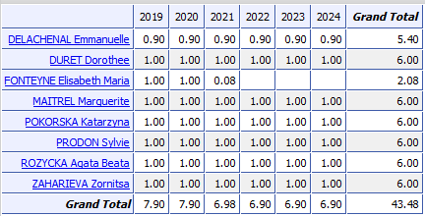
Tools (2) – personnel forecast: Staff Monitoring Tool SMT
SMT allows to
  Simulate number of FTAs
  Calculate the corresponding cost
Deterministic tool
  All events are expressed with a probability
Using different scenarios and hypothesis
  All LD leave
  All LD stay
  Various retirements / advancement / replacement models
  Different LD to IC ratio
  Etc.

Slide 16
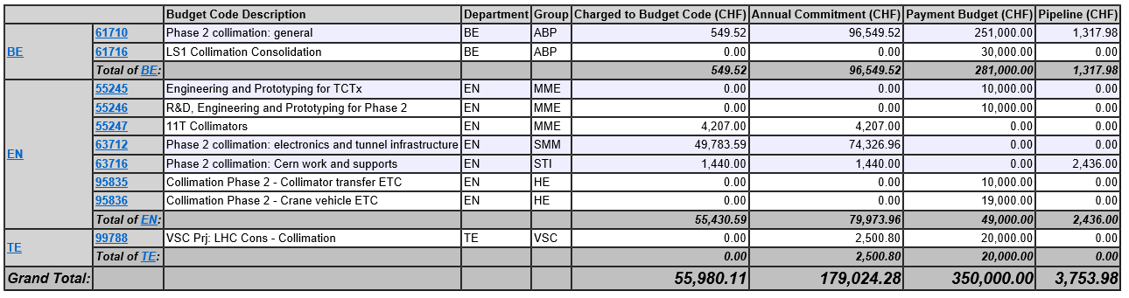
Tools (3) – controlling and reporting: CERN Expenses Tracking CET (Qualiac)

Slide 17
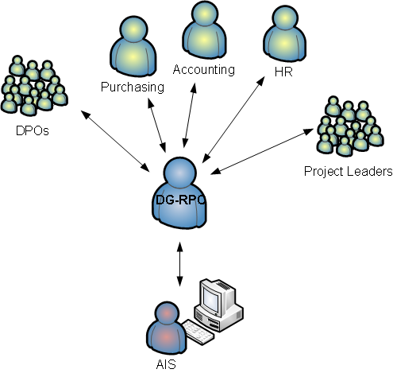
Interactions with other services
Departmental planning officers and Project Leaders
  Consolidation of bottom-up budgetary requests
  Implementation of top-down budget decision
General and Personnel Accounting
  Close collaboration on the Annual Progress Report
  Establishing of the common processes, understanding, interpretation of accounting rules and standards
Purchasing
  Budget control
  Estimation of Industrial Services
Human Resources
  Openings and extensions of posts within FTA limit
  Budgetary impact of the LD to IC exercise
  Advancement exercise
Business Computing group
  Interface to administrative tools: APT, SMT, CET / Qualiac, HRT, EDH
  Working groups on possible enhancements to the existing applications
BC

