Slide 1


Welcome
Fundamental Research
Technology & Innovation
Education
Collaboration
TO
Accelerating Science and Innovation
Finance Forum
Financial Publication and Narrative Reporting
CERN, 24.06.2019
Zory Zaharieva (FAP-RPC)
Notes:
1

Slide 2
Speaker’s presentation
Education
  MEng Industrial Engineering, specialization in robotics and control systems
  MSc Computing – Information and Communication technologies
Work experience
  2 years - AMCI Inc. - Industrial controls R&D
  15 years – CERN Accelerators Controls
    service manager, project leader, lead developer and architect of Accelerators Controls and Operation systems
    Accelerators & Technology Sector – QA engineer
  2 years – CERN RPC team
    financial analyst responsible for the Research and Computing Sector in terms of resources planning and budget control
Passionate supporter of STEM outreach
  lecturer and organizer of programs for physics and engineering high school teachers at CERN as well as for high school students

Slide 3
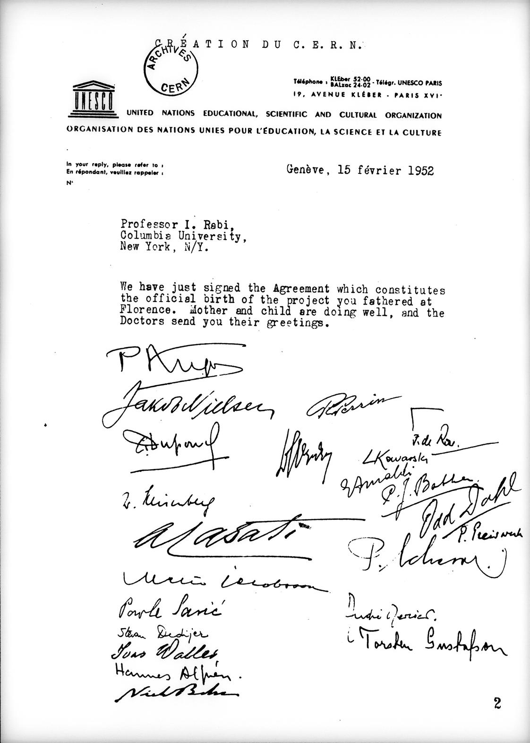
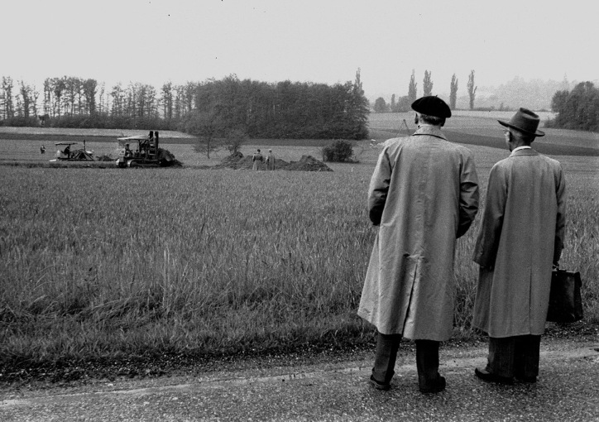
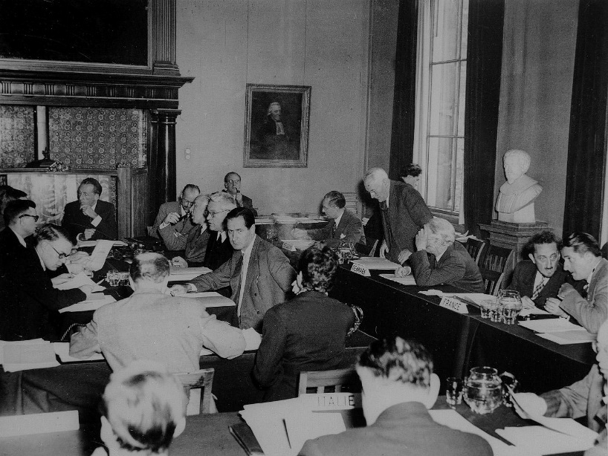
CERN – The Beginning ...
Aim...
When...
Founders...
Where...
The name...
To unite the efforts of European countries in physics research ‘Science for Peace’
1954 (1952)
12 European countries
next to Geneva
CERN - Conseil Européen pour
la Recherche Nucléaire
Notes:
3

Slide 4
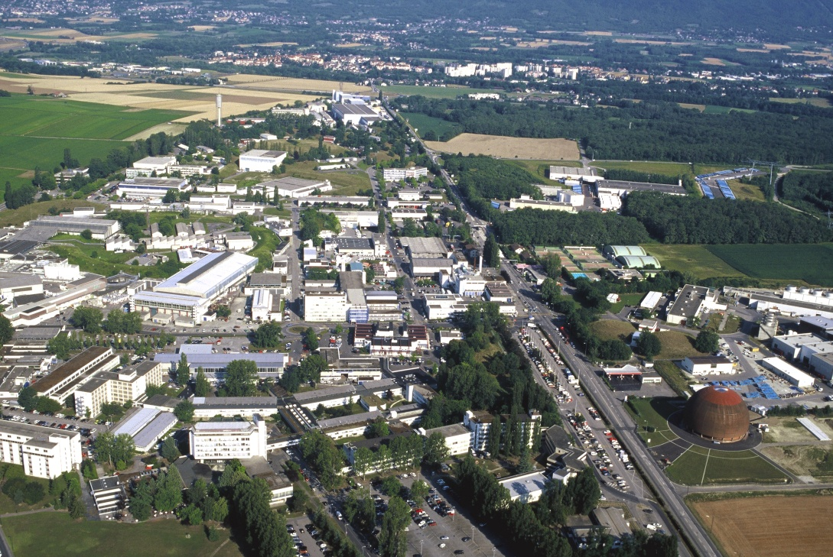
CERN – Today
The world’s largest particle physics research laboratory

Slide 5
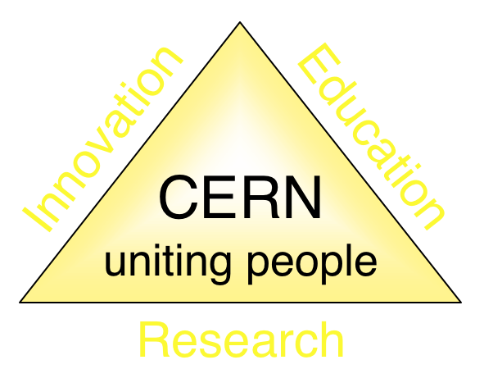
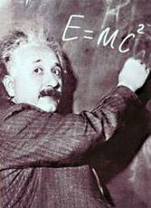
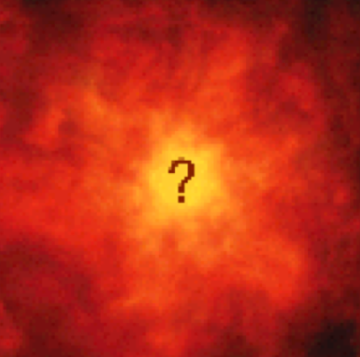


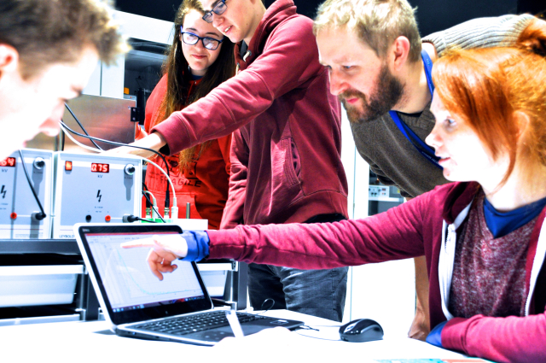
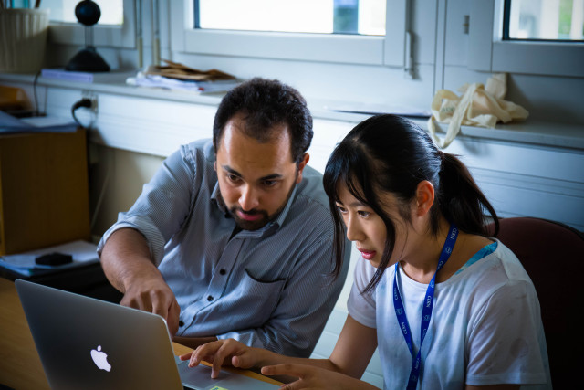
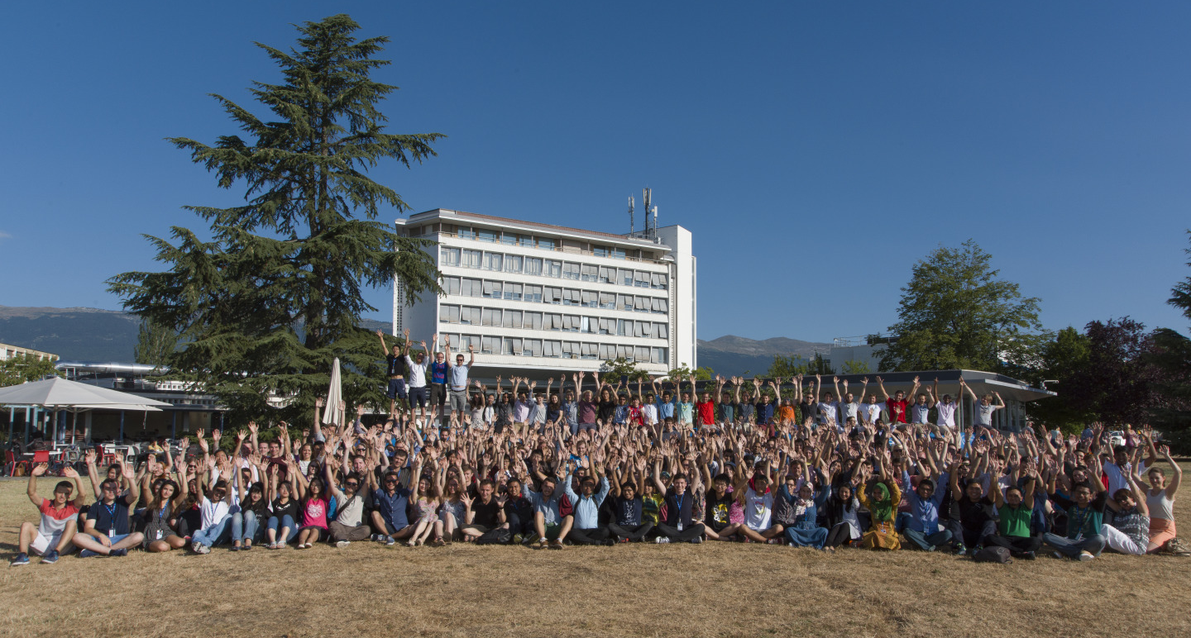
The Mission of CERN
Push back the frontiers of knowledge
E.g. the secrets of the Big Bang …what was the matter like within the first moments of the Universe’s existence?
What is 96% of our Universe made of?
Matter-antimatter asymmetry problem ...
Develop new technologies for accelerators and detectors
Information technology - the Web and the GRID
Medicine – diagnosis (e.g. PET scanners) and
therapy (e.g. cancer treatment)
Train scientists and engineers of tomorrow
Unite people from different countries
and cultures
Notes:
5

Slide 6
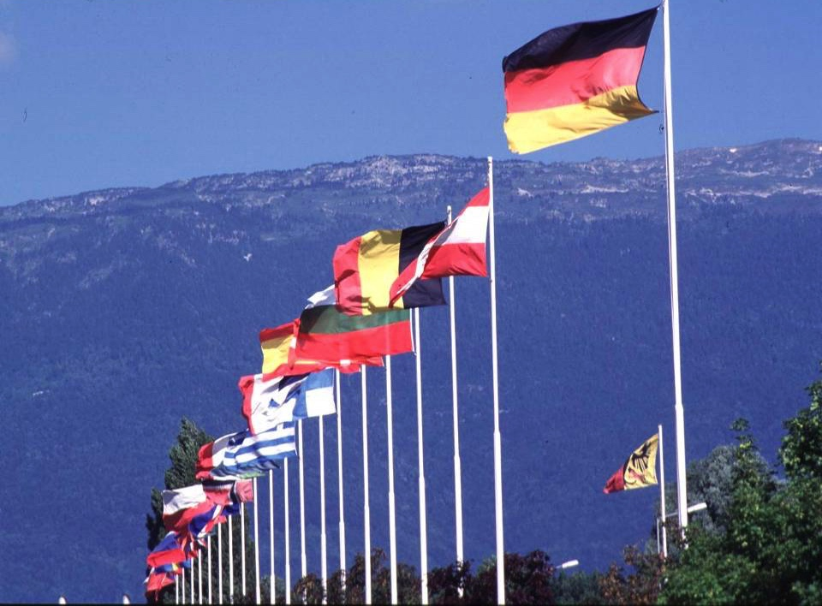

CERN founded in 1954 - 12 European States
“Science for Peace”
Today: 23 Member States
~ 2 600 staff
~ 1 800 other paid personnel
~ 14 000 scientific users
Budget (2019) ~ 1 200 MCHF
Member States: Austria, Belgium, Bulgaria, Czech Republic, Denmark, Finland, France, Germany, Greece, Hungary, Israel, Italy, Netherlands, Norway, Poland, Portugal, Romania, Serbia, Slovak Republic, Spain, Sweden, Switzerland and
United Kingdom
Associate Members in the Pre-Stage to Membership: Cyprus, Slovenia
Associate Member States: India, Lithuania, Pakistan, Turkey, Ukraine
Applications for Membership or Associate Membership:
Brazil, Croatia, Estonia
Observers to Council: Japan, Russia, United States of America;
European Union, JINR and UNESCO
6
Notes:
6
----- Meeting Notes (09/01/2013 14:16) -----
nnn

Slide 7
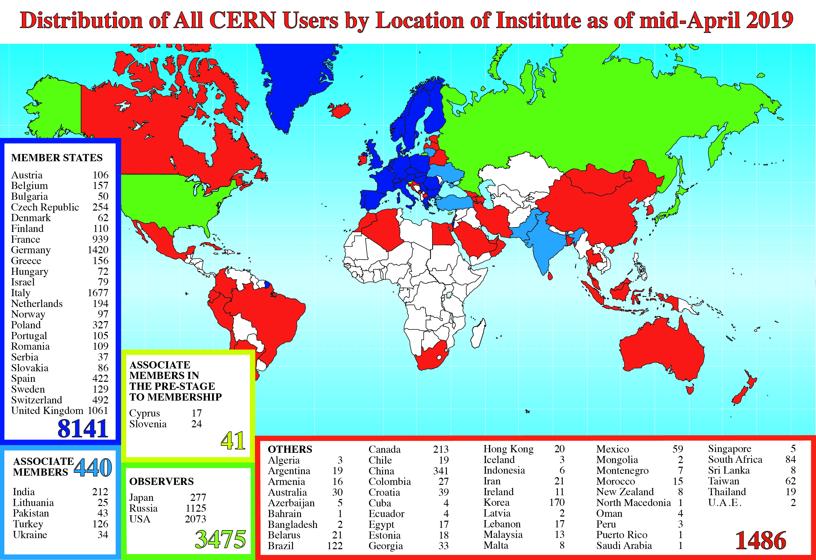
Science is Getting More and More Global
Notes:
7
7

Slide 8
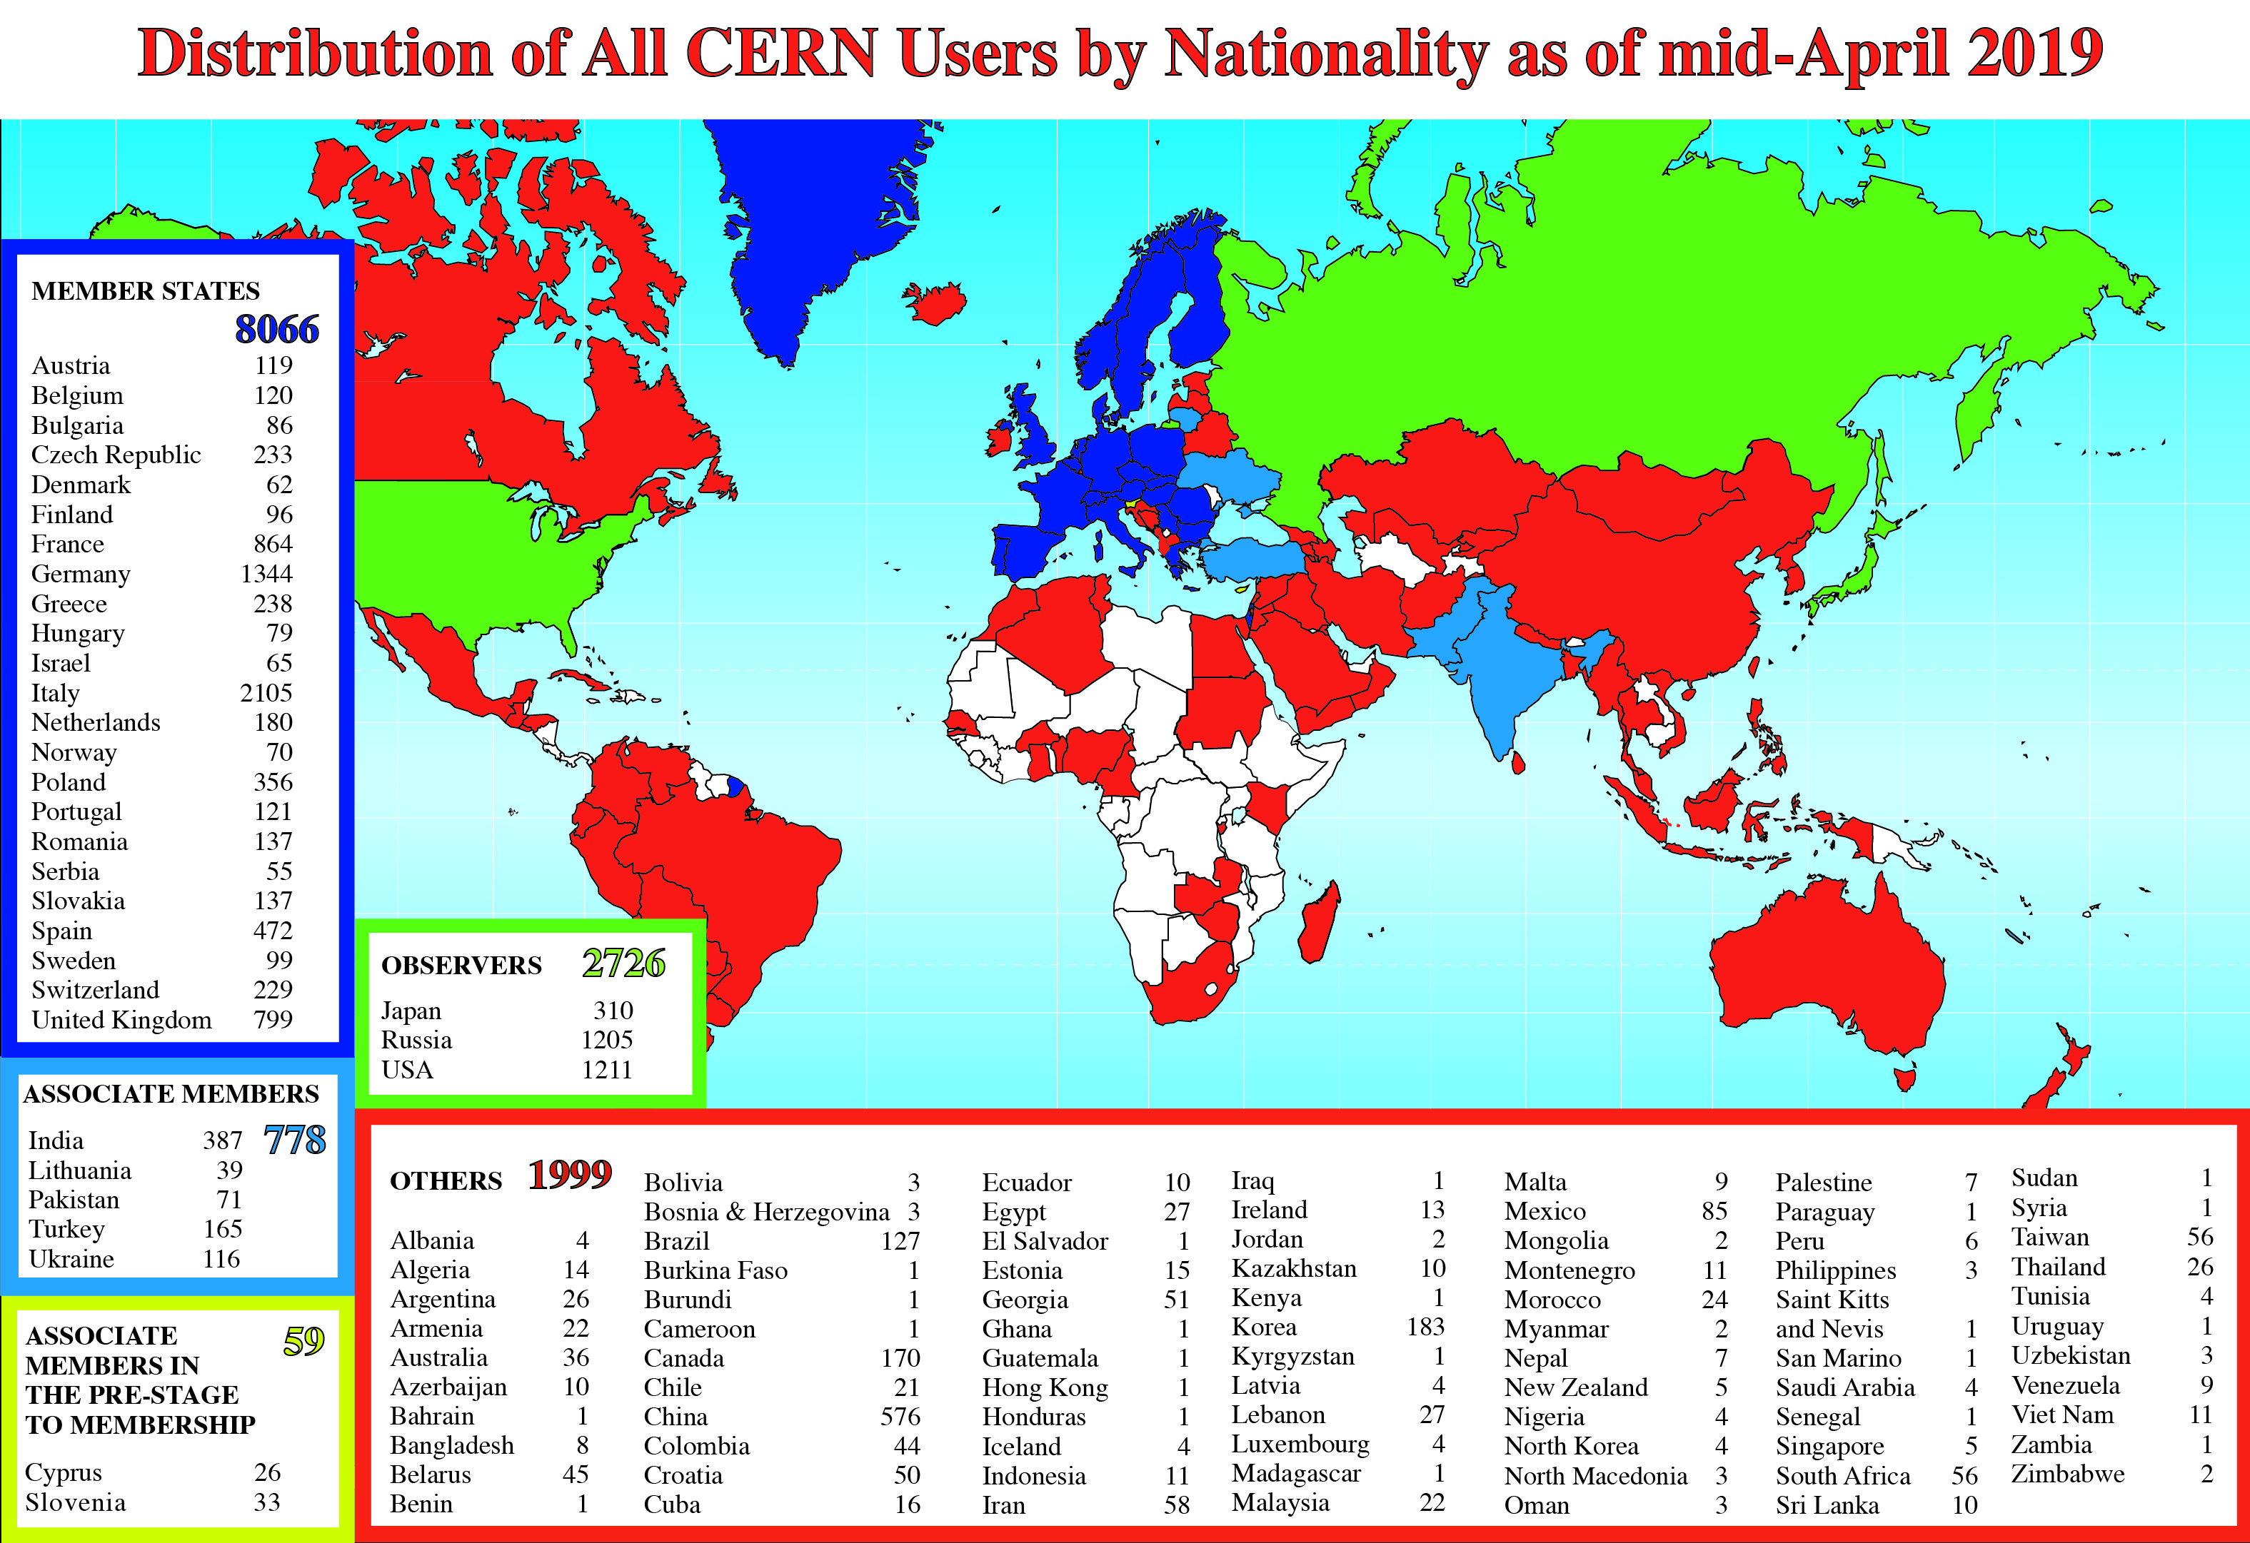
Science is Getting More and More Global
Notes:
8
8

Slide 9
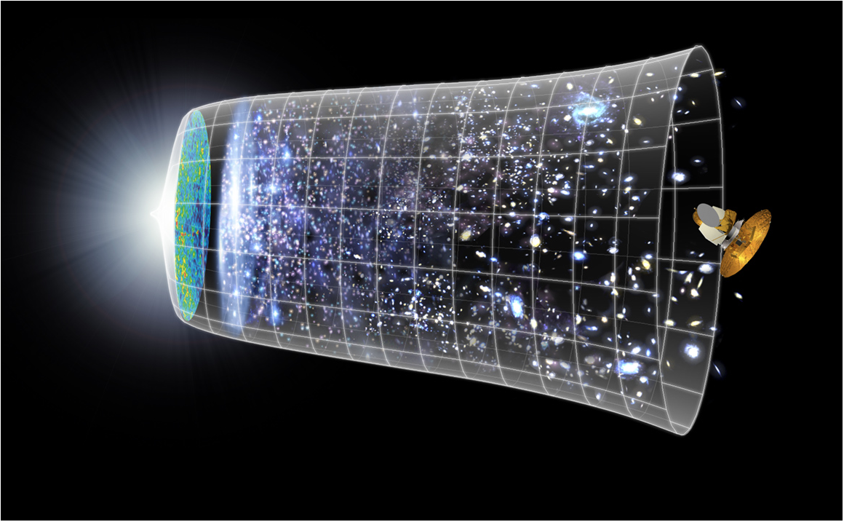
Our Scientific Challenge
To understand the very first moments of our Universe after the Big Bang
Big Bang
WMAP
13.8 Billion Years
Today
10²⁸ cm

Slide 10
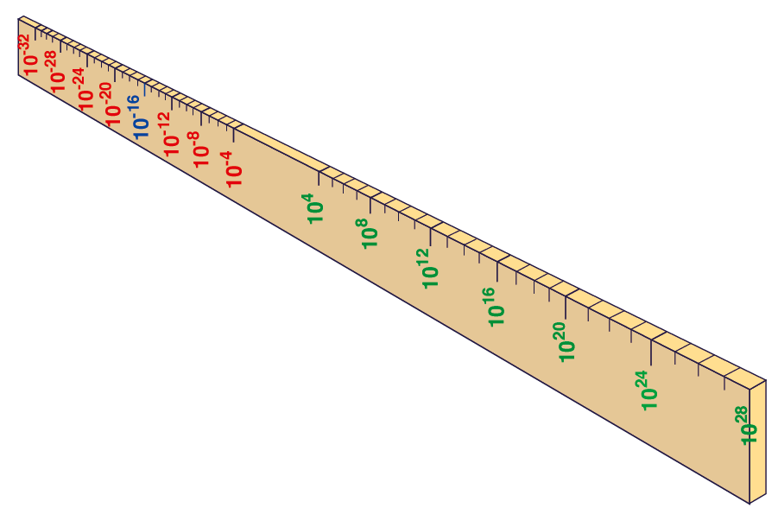
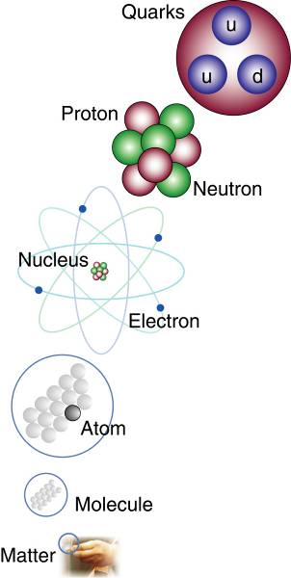
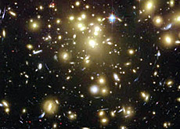
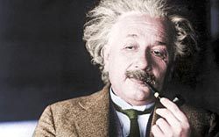


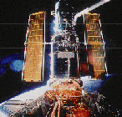
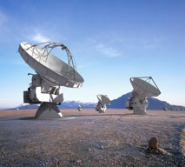

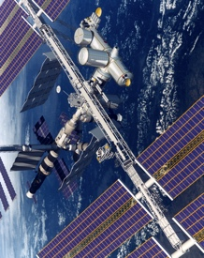
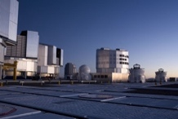
Big Bang
Proton
Atom
Radius of Earth
Earth to Sun
Radius of Galaxies
Universe
LHC
Super-Microscope
Hubble
ALMA
cm
Reproducing conditions
Looking back
AMS
VLT
Notes:
10
60 Grössenordnungen

Slide 11
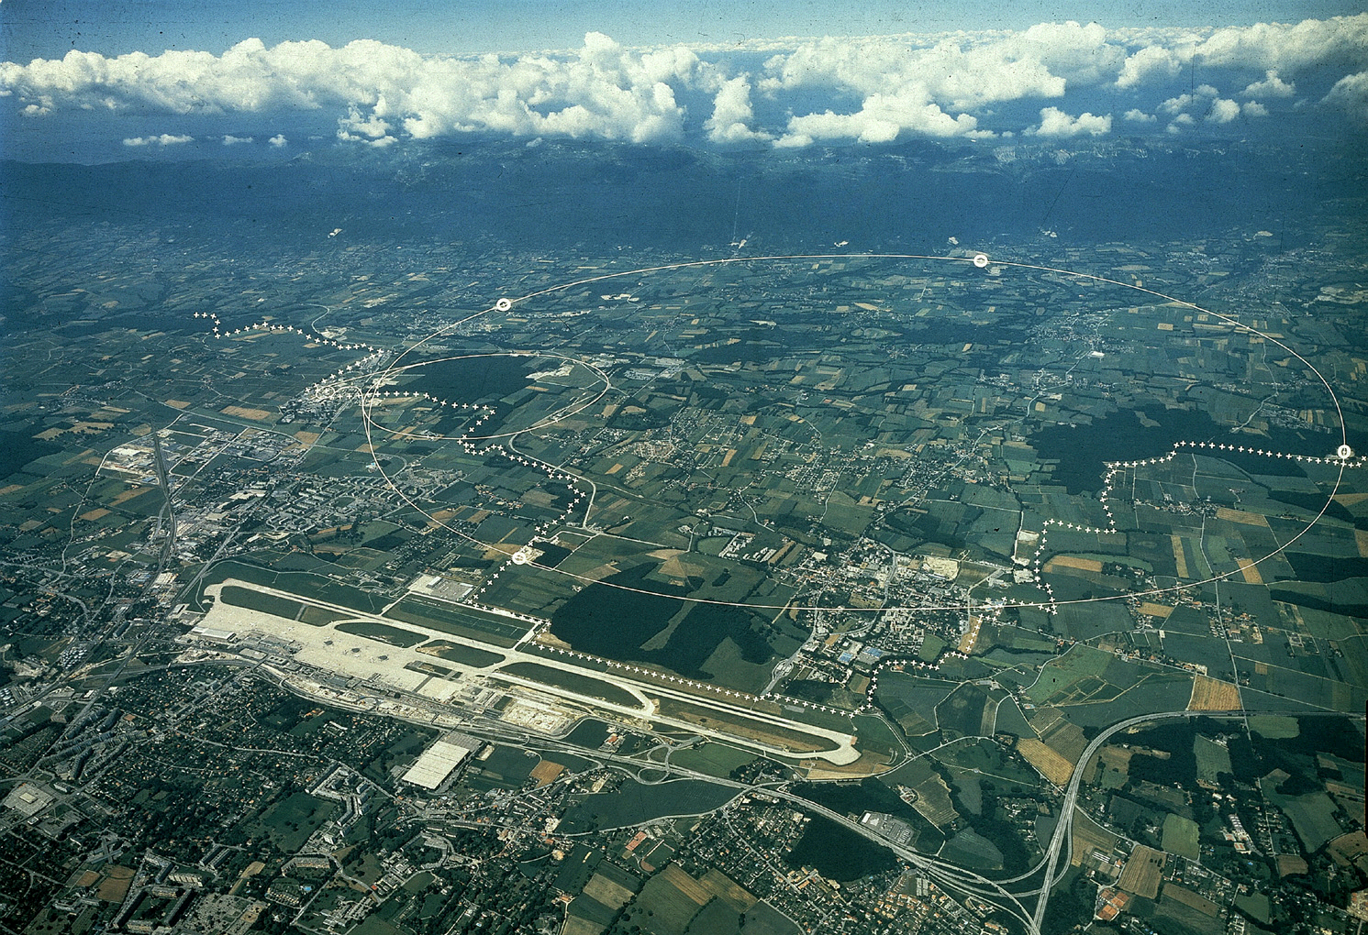
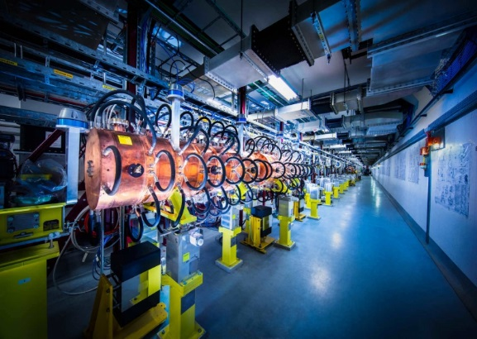
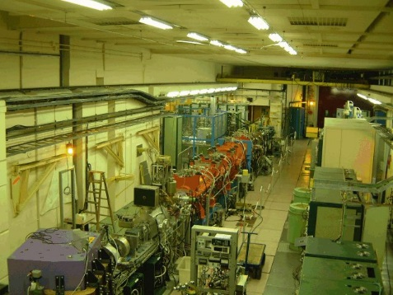
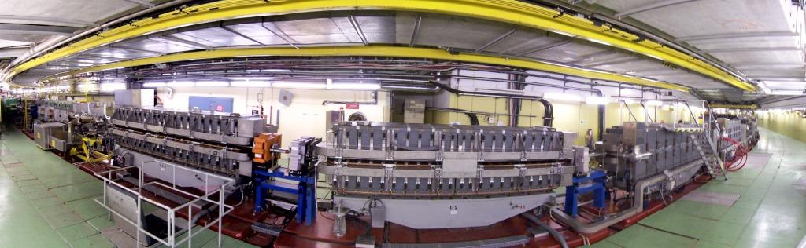
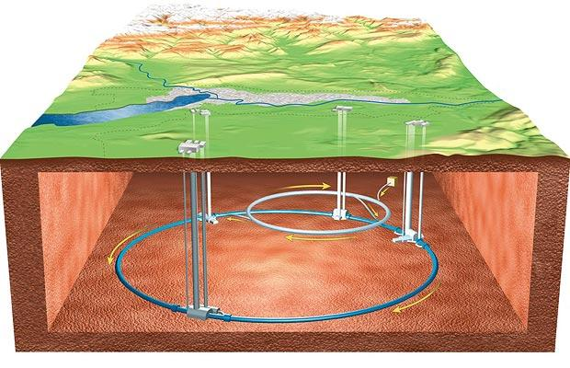
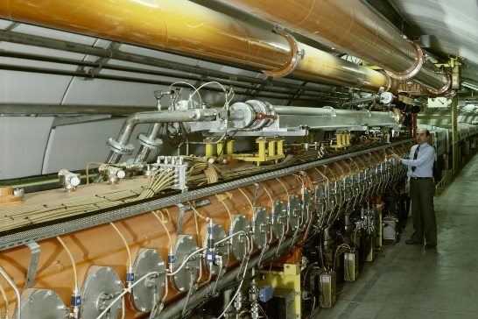
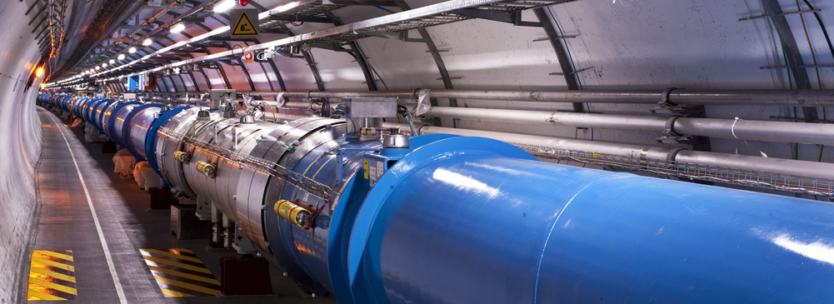
The Biggest Particle Accelerators Complex in the World
PS complex
France
Switzerland
SPS
LHC
Geneva airport
Notes:
11
11

Slide 12
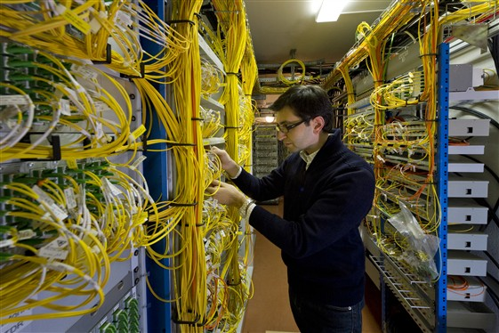

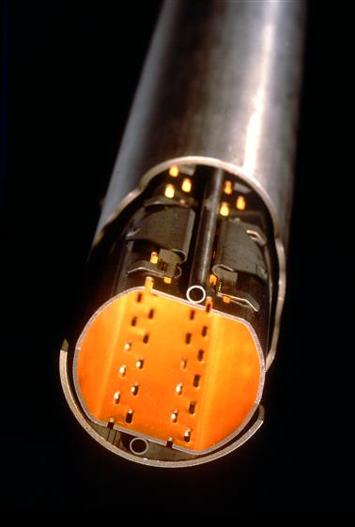
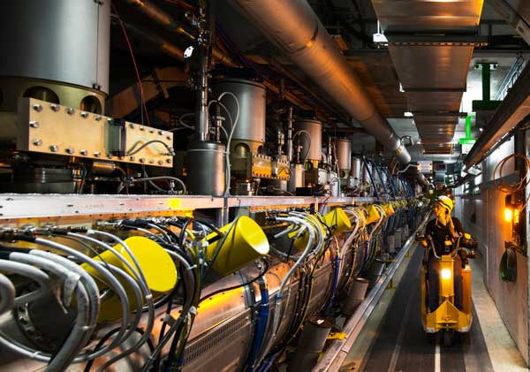
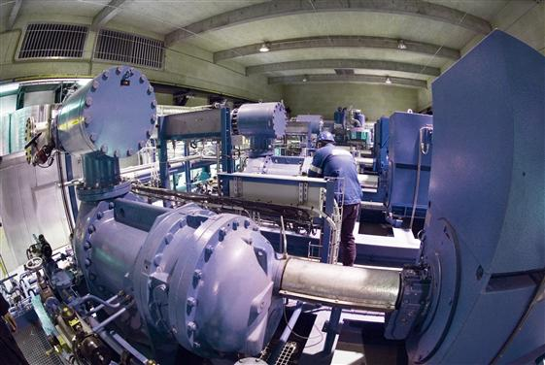
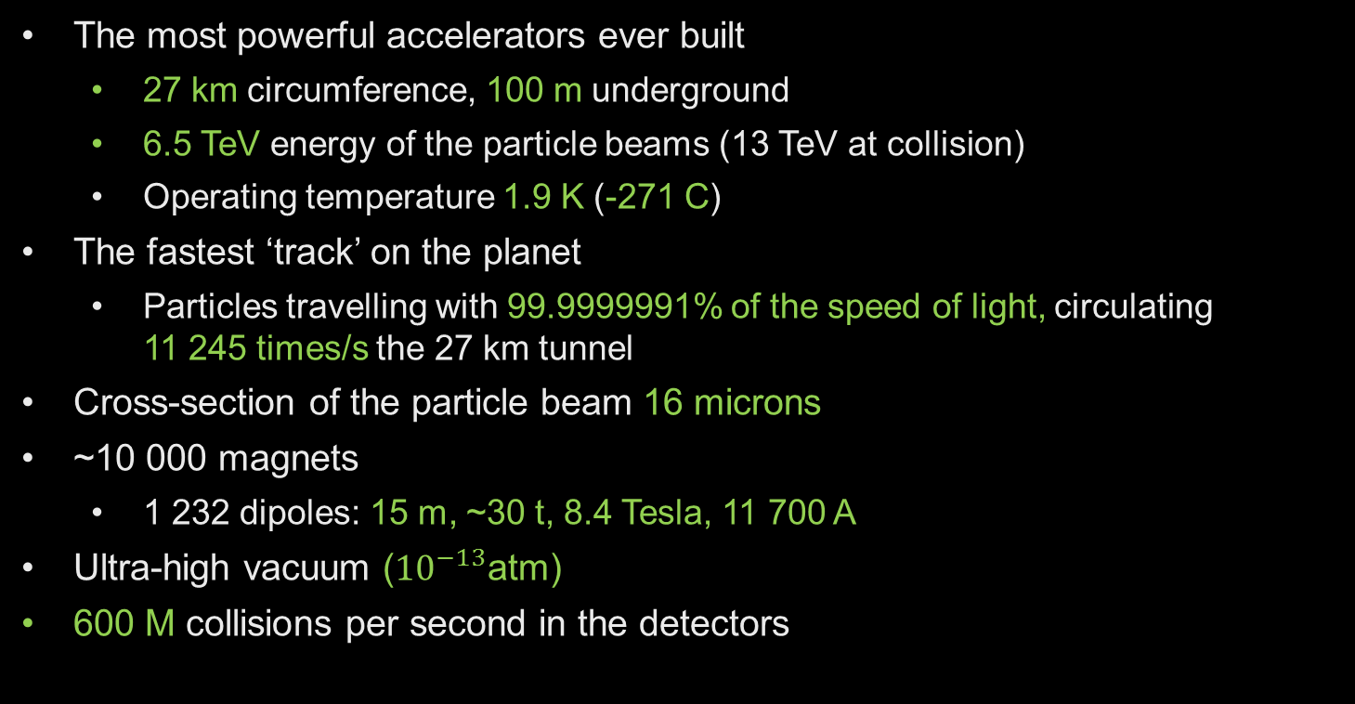
The Large Hadron Collider (LHC)
The most powerful accelerators ever built
  27 km circumference, 100 m underground
  6.5 TeV energy of the particle beams (13 TeV at collision)
  Operating temperature 1.9 K (-271 C)
The fastest ‘track’ on the planet
  Particles travelling with 99.9999991% of the speed of light, circulating
  11 245 times/s the 27 km tunnel
Cross-section of the particle beam 16 microns
~10 000 magnets
  1 232 dipoles: 15 m, ~30 t, 8.4 Tesla, 11 700 A
Ultra-high vacuum (${10}^{−13}$atm)
600 M collisions per second in the detectors

Slide 13
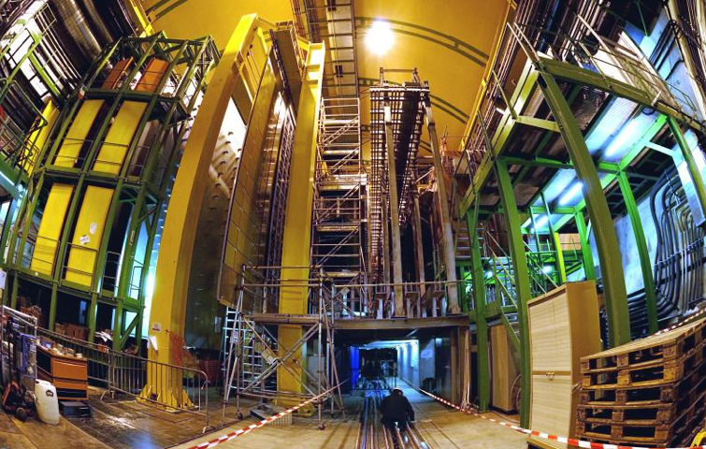


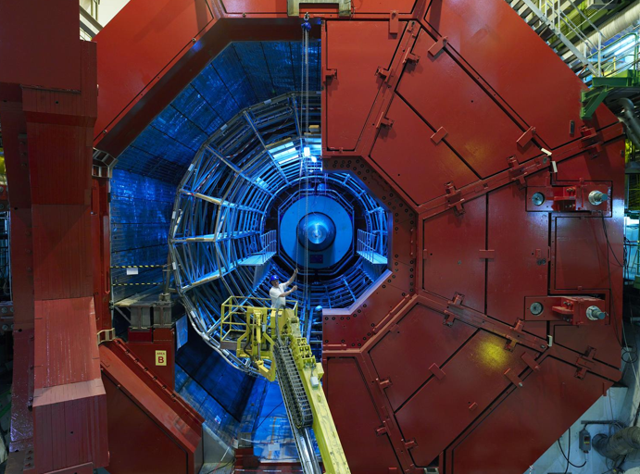

2010: a New Era in Fundamental Science
LHCb
CMS
ATLAS
Exploration of a new energy frontier
in p-p and Pb-Pb collisions
ALICE
LHC ring:
27 km circumference
Notes:
13

Slide 14
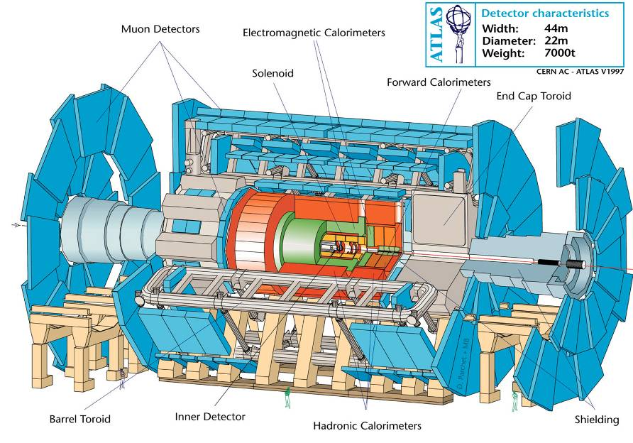
ATLAS (A Toroidal LHC ApparatuS)

Slide 15
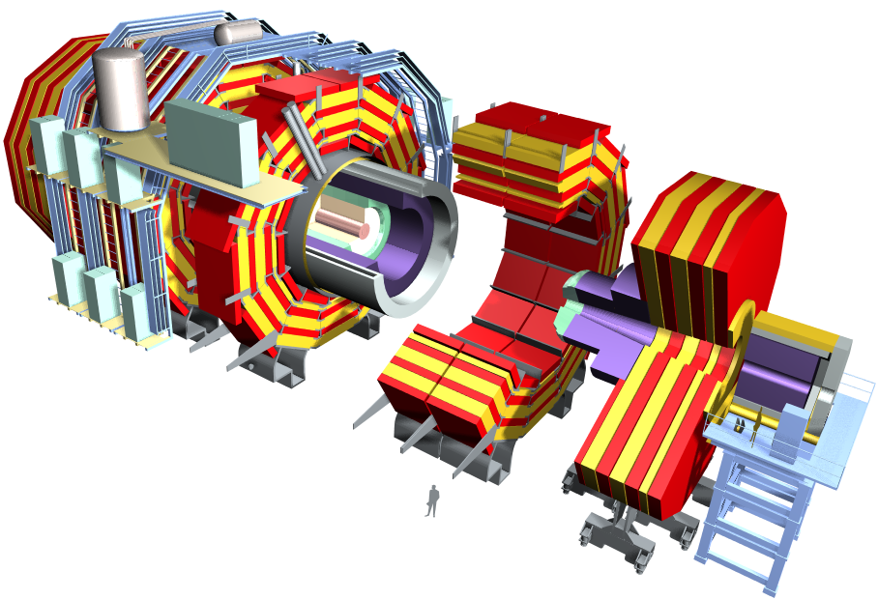
CMS (Compact Muon Solenoid)
Weight: 14,000 t
Diameter: 15 m
Length : 21.6 m
Magnetic field : 4 Tesla

Slide 16
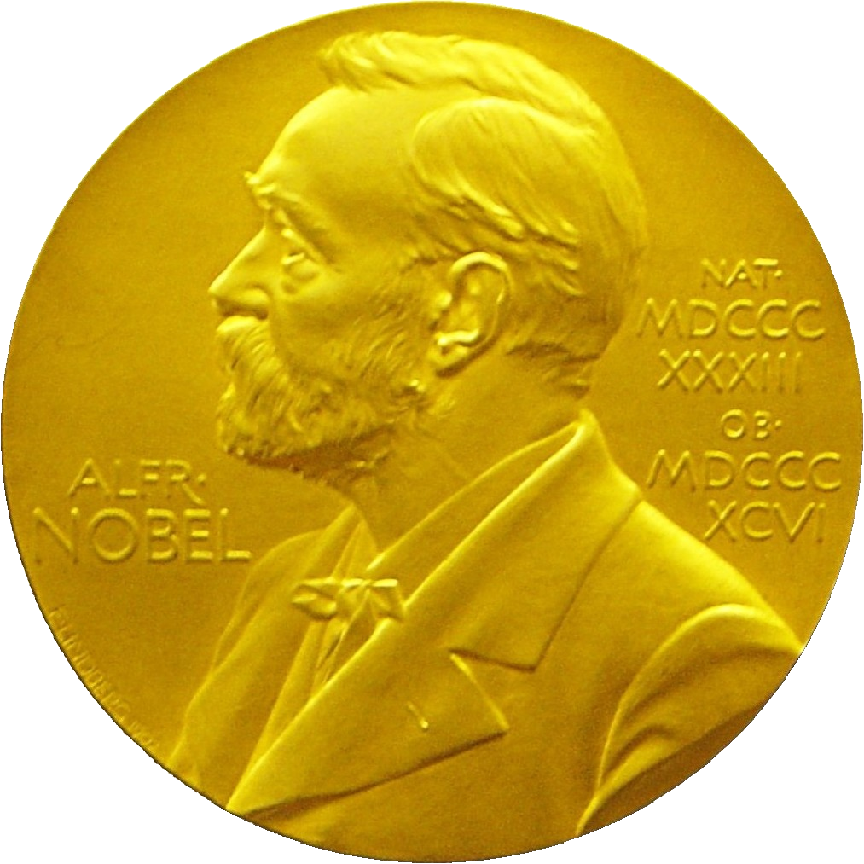
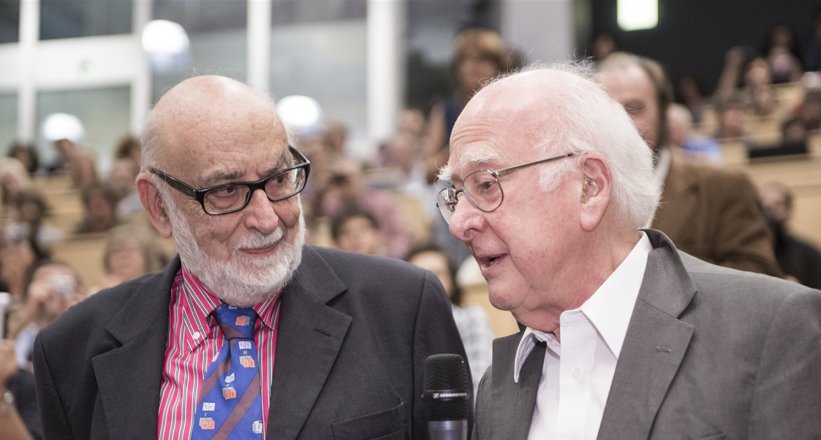
Discovery 2012, Nobel Prize in Physics 2013
The Nobel Prize in Physics 2013 was awarded jointly to François Englert and Peter W. Higgs "for the theoretical discovery of a mechanism that contributes to our understanding of the origin of mass of subatomic particles, and which recently was confirmed through the discovery of the predicted fundamental particle, by the ATLAS and CMS experiments at CERN's Large Hadron Collider”.

Slide 17
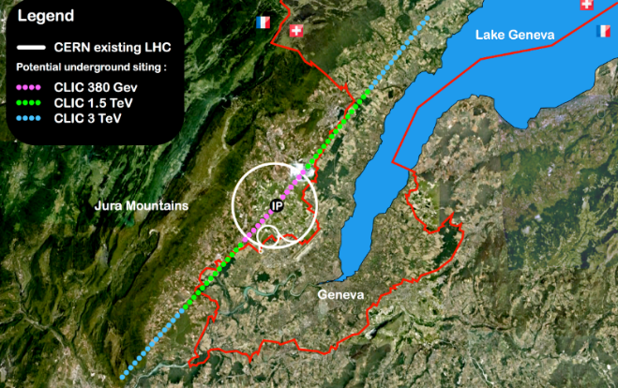

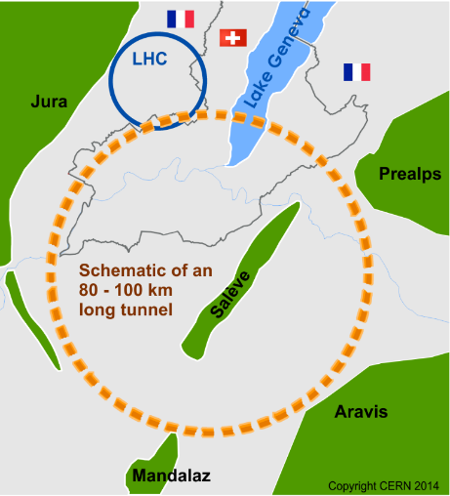

Future of Particle Physics Research
High Luminosity LHC until 2035
Ten times more collisions than
the original design
Studies in progress:
Compact Linear Collider (CLIC)
Linear e⁺e⁻ collider √s up to 3 TeV
Future Circular Collider (FCC)
New technology magnets →
100 TeV pp collisions in 100km ring
e⁺e⁻ collider (FCC-ee) as 1st step?
European Strategy for Particle Physics
Preparing next update in 2020

Slide 18
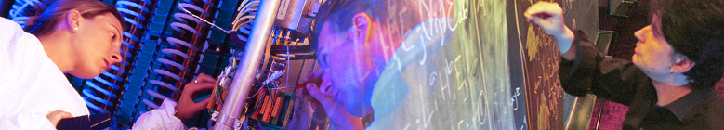

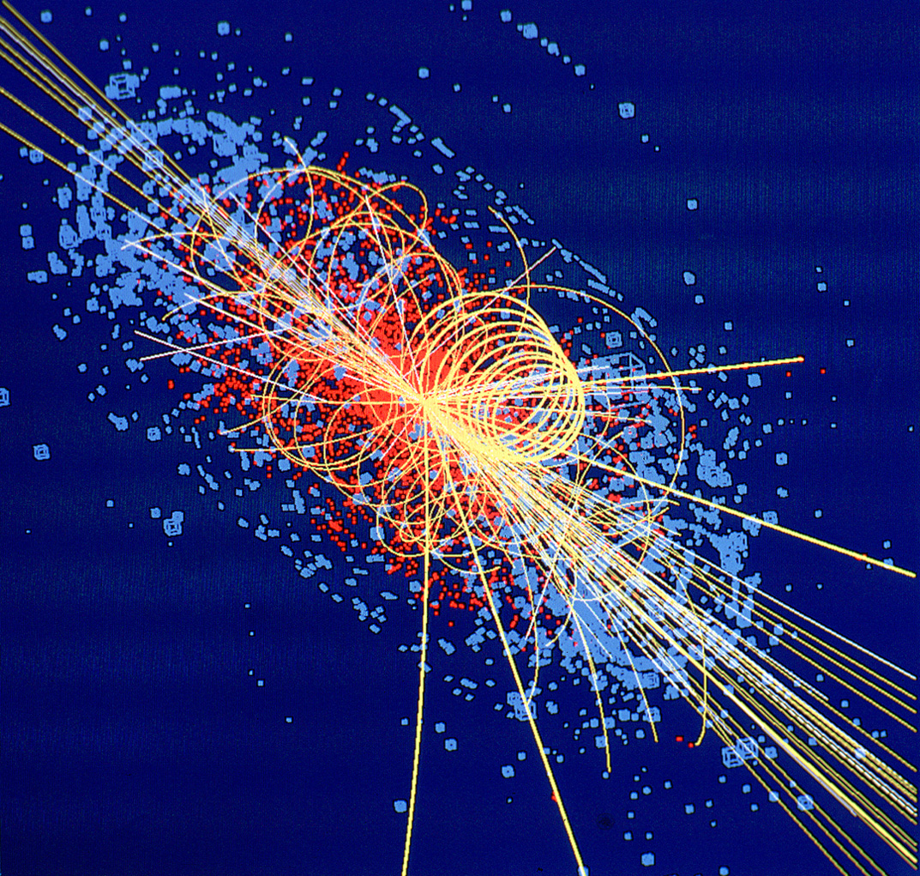
CERN: Particle Physics and Innovation
Interfacing between fundamental science and key technological developments
CERN Technologies and Innovation
Accelerating particle beams
Detecting particles
Large-scale computing (Grid)
Notes:
18

Slide 19
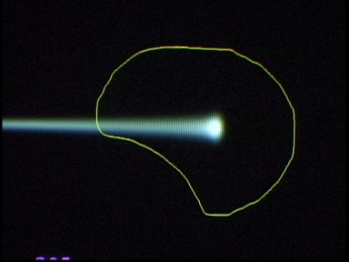
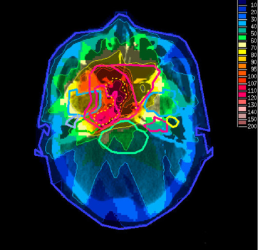
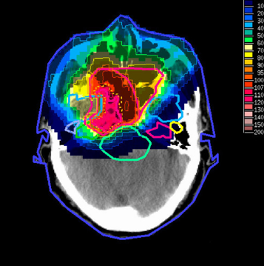
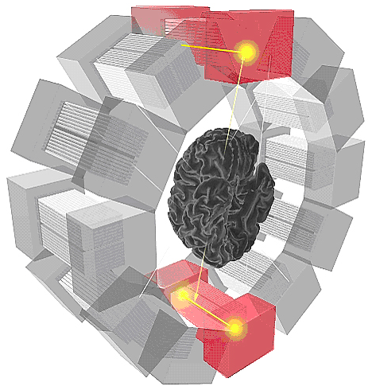
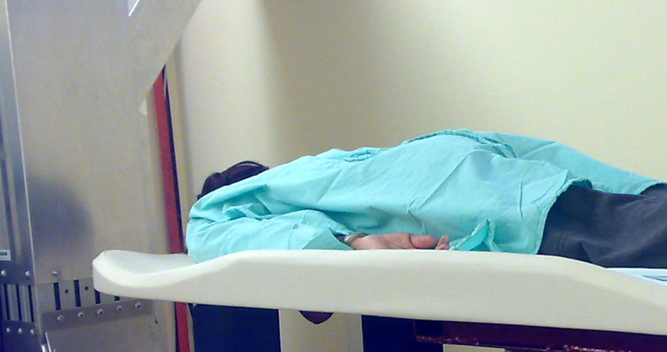
Medical Application as an Example of Particle Physics Spin-off
Combining Physics, ICT, Biology and Medicine to fight cancer
Hadron Therapy
Tumour Target
Leadership in Ion Beam Therapy now in Europe and Japan
Protons
light ions
Accelerating particle beams
~30’000 accelerators worldwide
~17’000 used for medicine
X-ray
protons
>100’000 patients treated worldwide (45 facilities)
>50’000 patients treated in Europe (14 facilities)
Imaging
PET Scanner
Clinical trial in Portugal, France and Italy for new breast imaging system (ClearPEM)
Detecting particles
Notes:
19

Slide 20
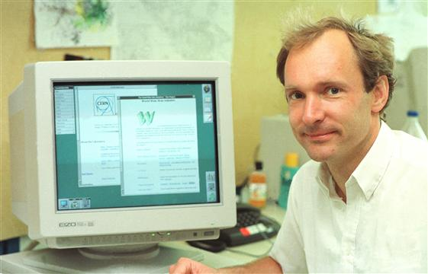



CERN, where the WEB was born
The
Birthplace
of the
WORLD WIDE WEB
20

Slide 21



The Worldwide LHC Computing GRID
WLCG: International collaboration to distribute and analyse LHC data
Integrates computer centres worldwide that provide computing and storage resource into a single infrastructure accessible by all LHC physicists
>170 sites in 42 countries
750k CPU cores
Tier-2: simulation,
end-user analysis
800 PB of storage
Tier-1: permanent storage, reprocessing,
analysis
> 2 million jobs/day
35 GB/s global transfers
21
Tier-0 (CERN): data recording, reconstruction and distribution

Slide 22




CERN Education Activities
Scientists at CERN
Academic Training Programme
Asia-Europe-Pacific School of High-Energy Physics
Fukuoka, Japan, 2012
Puri, India, 2014
2016 Beijing, China
2018 Quy Nhon, Vietnam
Latin American School of High-Energy Physics
Ibarra, Ecuador, 2015
San Juan del Rio, Mexico, 2017
Córdoba, Argentina 2019
Young Researchers
CERN School of High Energy Physics
CERN School of Computing
CERN Accelerator School
CERN
School of Physics
Italy, June-July 2018
Undergraduates
Summer Students
Programme
CERN Teacher Schools
International and National Programmes
Public visitors
135 thousand per year

Slide 23


CERN Teacher Programme

Slide 24





High School Students Outreach
CERN school visits
S’Cool Lab workshops
S’Cool Lab summer camp
  http://scool.web.cern.ch/content/scool-lab-summer-camp
High School Students Internship programme
Beamline for Schools competition
  Team competition – winning team 10 days stay at CERN
  http://cern.ch/bl4s
Educational materials: http://home.cern/students-educators

Slide 25


Summer Students 2018
Education & Collaboration

Slide 26
Accelerating Science and Innovation
Thank You!
Notes:
26

Slide 27








Questions
Zornitsa.Zaharieva@cern.ch

Slide 28
Age Distribution of Scientists at CERN
27
Today:
>3000 PhD students
in LHC experiments
65
They do not all stay at CERN: where do they go?

