Slide 1
EPRCS First Documents Publication Feedback
S. Prodon
Notes:
Sylvie Prodon from the RPC team. I was in charge of the coordination of the preparation and publication of the MTP 2019 document. I will give you the user’s feed-back on the first use of EPRCS for this document.

Slide 2
MTP 2019 Document
Medium-Term Plan for the period 2020-2024 and Draft Budget of the Organization for the sixty-sixth financial year 2020
2 versions published:
  In May for feedback by the Scientific Policy Committee
  In June for approval by the Council
“Living” document with the strategy and most of the data updated at the last minute
 | May version | June version
Nb figures (table or chart) | 12 | 20
Nb data tables | 26 | 26
Nb pages | 126 | 140
Notes:
A quick word on the MTP 2019 document. This document presents the CERN medium-term plan for the period 2020-2024 and the draft budget for 2020.
It is published in two versions: the first version in May for feedback from the Scientific Policy Committee and a 2nd more detailed version in June for approval by the Council.
As you can see in this plot the MTP is a long document of about 140 pages, with 20 figures (either tables or charts) and 26 data tables by activity.
It is a really «living» document with changes of strategy and the underlying budget data up to the last minute.

Slide 3
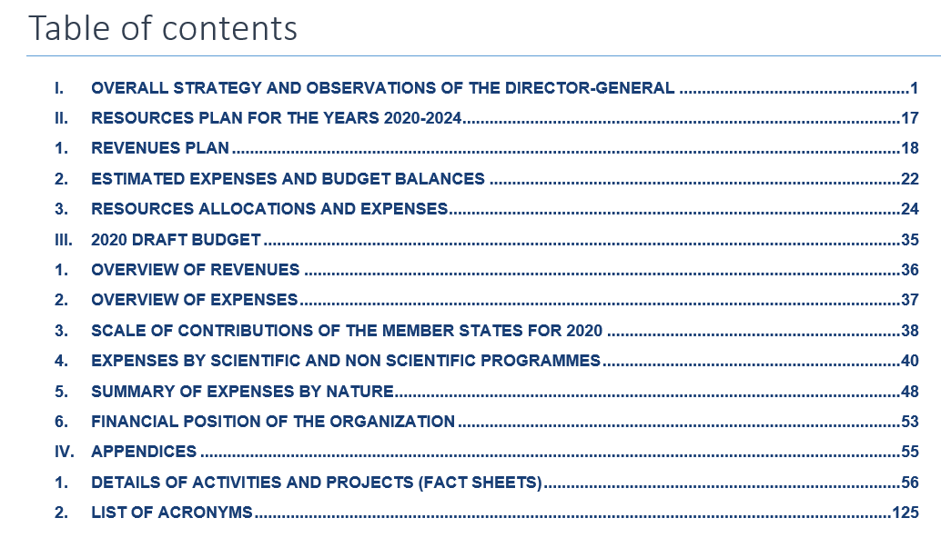
MTP 2019 Document
Introduction and strategy prepared by the Director General
Budget figures & their comments prepared by RPC team
26 factsheets by activity:
Goal / risks / targets prepared by departments & project leaders
Data tables prepared by RPC team
Notes:
From the table of content of the MTP document, the main stakeholders involved are:
The Director General who writes the introduction and the overall strategy (around 15 pages)
The RPC team that prepares the budget figures and their comments
26 factsheets by activity with the goal / risks / targets prepared by the departments and projects leaders & the data tables extracted by the RPC team

Slide 4
EPRCS Usage for MTP 2019
Managed in EPRCS
Production of the document (split into 57 doclets)
Integration of 46 Excel-based tables/figures
Versioning
Review process
Managed outside EPRCS
Gathering of goal / risks / targets for 26 factsheets by activity prepared by departments & project leaders ➔ SharePoint, then downloaded into EPRCS
Director General contribution ➔ Word document (dedicated doclet for the introduction)
English proof-reading ➔ Word document
Final table of content ➔ Word document
Notes:
The first decision was to define the activities managed in EPRCS and outside EPRCS.
We decided to use EPRCS for: the production of the document itself, through 57 doclets; the integration of the 46 tables/figures from Excel into Word; the full versioning of the document; the review process.
Some other activities were managed outside EPRCS: the gathering of the goal / risks / targets for the 26 activities from departments & project leaders was done through SharePoint, then downloaded into EPRCS. The Director General contribution was done directly in the Word document, but a doclet was indeed reserved for her contribution in the introduction. The English proof-reading was also done in the Word document. And the table of content had to be corrected in the Word document.

Slide 5



EPRCS Feedback
Getting started
Web interface | Some actions intuitive (e.g. check-in / check-out) | Structured user training needed | Personalised quick user guide: Installation EPRCS & SmartView Doclet management Check-in / check-out Excel tables integration Style management Breaks management
SmartView | Very intuitive and easy to use | Slow-down the applications If check-out not done, no information that on read only mode &“save” button in Word functional | Improve the speed of the applications with SmartView Alert when trying to save in a read only mode
Notes:
In the next slides I will give you a feed-back on what went well, what was difficult and painful and what could be improved.
Getting started with the application, for the Web interface, some actions wer quite intuitive like the check-in and the check-out. But a proper structured user training was needed. In addition, it would be good to have a personalised quick user guide with basic information on the installation of EPRCS & SmartView, doclet management, check-in/check-out principles, excel tables integration, style and breaks management.
SmartView is very intuitive and easy to use, but it really slow-down the applications. This is something really to improve. The second issue we encountered, when the check-out was not done, is that we had no information that we were working in a read-only mode and the «save» button was indeed functional. As a result some modifications/changes were lost. This should be improved, in particular if we want to involve more stakeholders in the process.

Slide 6
EPRCS Feedback
Style and formatting
Document style | Style set for the entire document including number formatting | Users shall master the style function in Word Style can easily be “polluted” (e.g. various user sources) | Bullets style not to change whether track changes are activated or not Alert at download if other styles than the master
Table of content | Automatic table of content based on style set | Updated manually in Word document | Restart at 1 functionality on the headers
Breaks | Doclets assembly in the document: continuously or with a page break | Users shall master the break function in Word (page break vs section break), otherwise blank pages are created | More intuitive break management (e.g. font set at 1pt)
Document preview |  | Differences between EPRCS preview, PDF in EPRCS and Word document | Harmonise the different views
Notes:
We indeed spent a lot of time in the style and formatting.
For the style, the application of a style set for the entire document including the number formatting was a feature really appreciated. But before starting it is important to make sure that the users fully master the style function in Word. In addition, the style can be easily «polluted», especially in case of text coming from various sources. A few improvements would help in this area: correct the bug that makes the bullets different whether the track changes is activated or not, and put some alerts if some styles different from the master one are used.
We had an issue with the table of content that was impossible to solve within EPRCS, and that led to some manual corrections in Word. It would therefore be good to have restart at 1 functionality on the headers.
Working with breaks was very time consuming. It is indeed a good feature to be able to assemble the doclets in the document either continuously or with a page break. But you really have to make sure that the users fully master the break functions in Word, otherwise blank pages are created. In our case the difficulty is that we alternate between one column pages for tables and two columns pages for comments, and we sometimes had to be creative with font set to 1 point when no other solution was possible.
The document preview was also quite disturbing with some differences between the EPRCS preview, the PDF in EPRCS and the Word document. It took us some time to realise that these views were different and that only the Word document was trustful.

Slide 7
EPRCS Feedback
Excel integration
Excel integration | Automatic update of all data | Links not supported ➔ need to upload each time the excel file Reformatting of Excel tables time consuming Formatting issues (superscript, multiple formats in same cell, hidden columns, page breaks) | Support links Improve formatting integration (e.g. autofit table in a text box)
Notes:
The Excel integration was a big advantage for us. As I told you in the beginning of my presentation we had a lot of last minutes changes in the MTP and it was really a relieve to have only to upload the Excel source and that all the data tables are automatically updated.
It is only a pity that links are not supported and that we had to re-upload the Excel source files each time there is a change.
The reformatting of the Excel tables to fit into the Word text box was really time consuming, but it is only once and will be OK for next year.
We also faced a lot of formatting issues like the superscripts, the multiple formats in the same cell, hidden columns & page breaks) that required a lot of time to find the adequate solution. Excel integration is really a plus in EPRCS but would need features such as to support links or to improve the formatting integration like for instance an autofit table in a text box.

Slide 8
EPRCS Feedback
Other functionalities
Document structure in EPRCS | Hierarchy, folders, sub-folders, access rights, add doclets | Time consuming the 1st time to prepare all the doclets
Single sign-on | Efficient for users
Multi-users editing | Granularity at level of doclet Useful to share work
Versioning | Automatic and useful
Data quality checks |  | Need to open various doclets in case of “Replace all” | “Replace all” functionality
Review process | Transparent comment management for the full document | Some reviewers would need track changes function in addition to comments (e.g. DG, English proof-reading) | Review with track changes for the full document
Notes:
Regarding the other functionalities in EPRCS, the document structure in EPRCS is very practical and flexible with hierarchy, folders, sub-folders, access right and easy addition of doclets. But the split of the document into doclets (57 in our case) is time consuming, but it is done once and the structure will be used for next year’s MTP.
The single sign-on with our CERN login was indeed very practical.
The multi-users editing is also a plus of the EPRCS, with the granularity at the level of the doclet, and very useful to share the works between the team.
The versioning is automatic and useful. We indeed had to go back to previous versions of some doclets.
Some data quality checks were indeed very painful in EPRCS. We have a few words/expressions need to be consistent across the document, and we had to make the changes doclet by doclet. A “Replace all” functionality would be highly appreciated.
Which concerns the review process, we finally did not use it much. It is indeed a very transparent comment management tool for the full document. But in our case some reviewers like the Director General or the English proof-reader would also need to directly change the text of the full document in a track changes mode. We would need a review mode that allows track changes for the full document.

Slide 9
Summary
EPRCS used for the MTP 2019 document
Teething problems time consuming: style implementation, breaks, Excel table formatting
Some functionalities useful and appreciated: multi-users, versioning, Excel data update, review process
Still some improvements: Excel integration (links & formatting), quick user guide, functionalities applicable to full document (e.g. replace all, track changes in review process), speed for SmartView
Notes:
In summary, we have used EPRCS for the production of the MTP 2019 document.
Some teething problems were time consuming like the style implementation, the breaks management and the Excel table formatting. But hopefully they are not recurrent and will probably not occur next year.
Some functionalities were very useful and appreciated: the multi-users to share work, the versioning, the Excel data update and the review process.
Some improvements are still needed in order to fully profit from EPRCS: the Excel integration (links and formatting), a quick user guide, some functionalities applicable to the full document (replace all, track changes in the review process) and the speed for SmartView.

