Slide 1

HL-LHC WP9 Cryogenics, an introduction for this Functional analysis
S. Claudet, 09May’19
(HiLumi – CRG internal review)

Slide 2
Goal of this mini series of meetings
For the HiLumi cryogenics at P1/P5, we have now completed the series of expected heat loads, flow diagrams and preliminary sizing of the QXL headers (QXL: Cryoline for HiLumi). With specificities due to Nb3Sn magnets and higher pulsed heat loads than for LHC, we would like to consolidate our approach with your help.
Our goal is to evaluate possible operation modes, control techniques, instrumentation for measurements (range, accuracy) and actuators, propose alternative schemes if advantageous and justified
We believe it is now time to present the status of our studies to a larger audience in the cryo group, and get feedback from experienced colleagues in functional analysis and control techniques. As validated at pilotage last autumn and following similar work recently done for QXL sizing, we would propose to start a small series of meetings on this topic.
The concerned cooling loops would be for users: 11T, IT+D1, D2, sc links, CC
We could consider: introduction and presentation of reference so far, then parametric studies done so far for all headers with comments/discussion, then further studies that could allow to update and consolidate the baseline.
The final deliverable should be a joint recommendation to go from P&F_Diagrams to P&I_Diagrams, instrumentation main characteristics and control techniques envisaged.
The reference documentation so far:
- Preliminary heat loads estimates: EDMS-1610730
- Process & Flow Diagrams and typical QXL cross sections will be presented
- Functional requirements for heat extraction, CERN-ACC-Note-2019 being finalised
For the organisation of these meetings, we will prepare ad-hoc indico sites, call for meeting and prepare executive minutes of meetings
Participants:
- HL-Cryo: Marco Spitoni, Michele Sisti, Emmanuel Monneret, Krzysztof Brodzinski, Antono Perin, Rob van Weelderen, Serge Claudet
- CRG: Benjamin Bradu, Krzysztof Brodzinski, Laurent Delprat, Gérard Ferlin, Vanessa Gahier, Udo Wagner, Marco Pezzetti
- Convenors: Michele Sisti, Serge Claudet
Thursdays 10h30-12h.
To be complete, this series will be complemented with another one: global instrumentation and control architecture.
Circuits, Actuators, Sensors,
Control Technics
! Dynamics ! - ! Radiation !

Slide 3
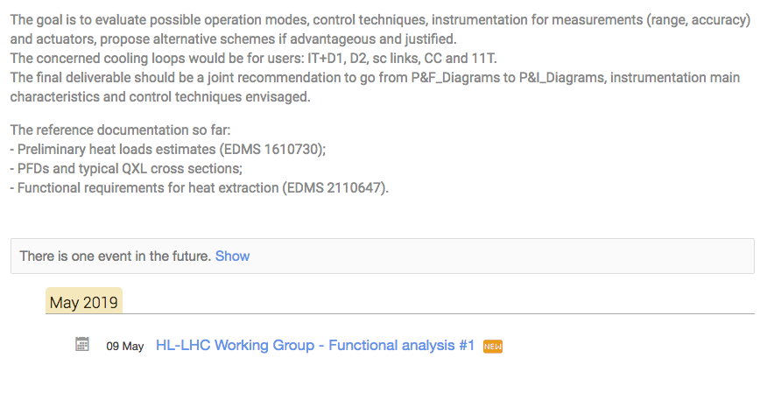
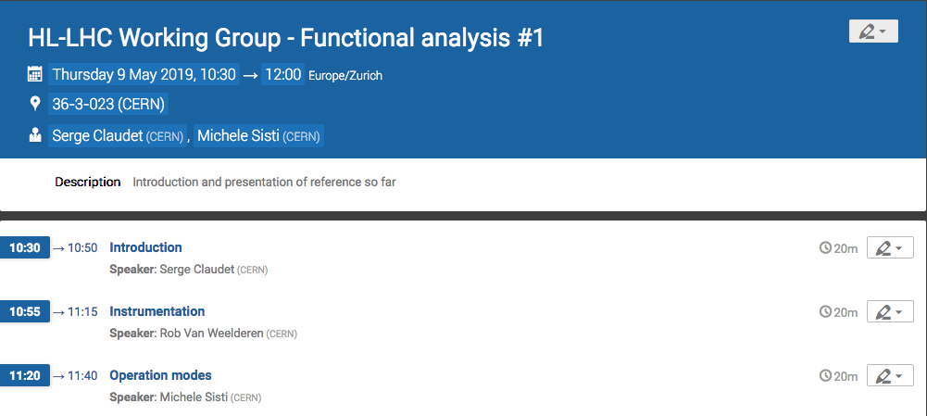
Agenda
Next meeting to be defined at the end, depending on needs and outcome of this meeting

Slide 4
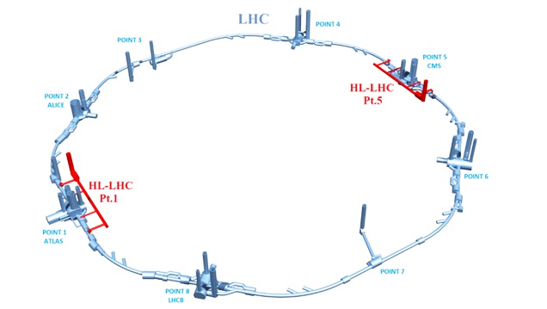
P1/P5 Cryogenic architecture
18 kW equivalent at 4.5 K, including 3 kW at 1.8 K
Warm compressor station
SHE
QSVB
GHe storage tanks
Surface piping
SHM
QSCG
QSAG
Dryer
QSP
Surface cold box
SLN
SD
SLN
Liquid Nitrogen tank(s)
Quench tank
QSDQ
QSRG
QSDN
Surface
QPP
QPLG
Vertical transfer line
Shaft
Underground
US
Cold compressors box
QURCG
DFHX
DFHM
(existing)
DFBL
UR
UL
QUIG
DSHX
DSHM
LHC tunnel
Interconnection box
DSL
Q1
Q2a
Q2b
Q3
CP
D1
D2
CC
Very limited impact identified for QXL headers
CC
Q4
Q5
Q6
QRP
QXL
HRL

Slide 5
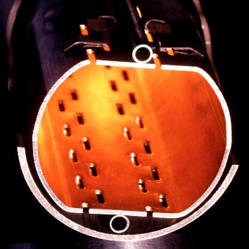
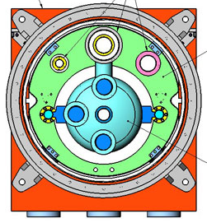
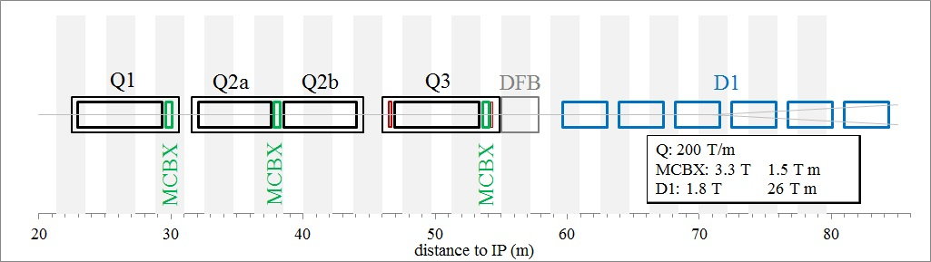
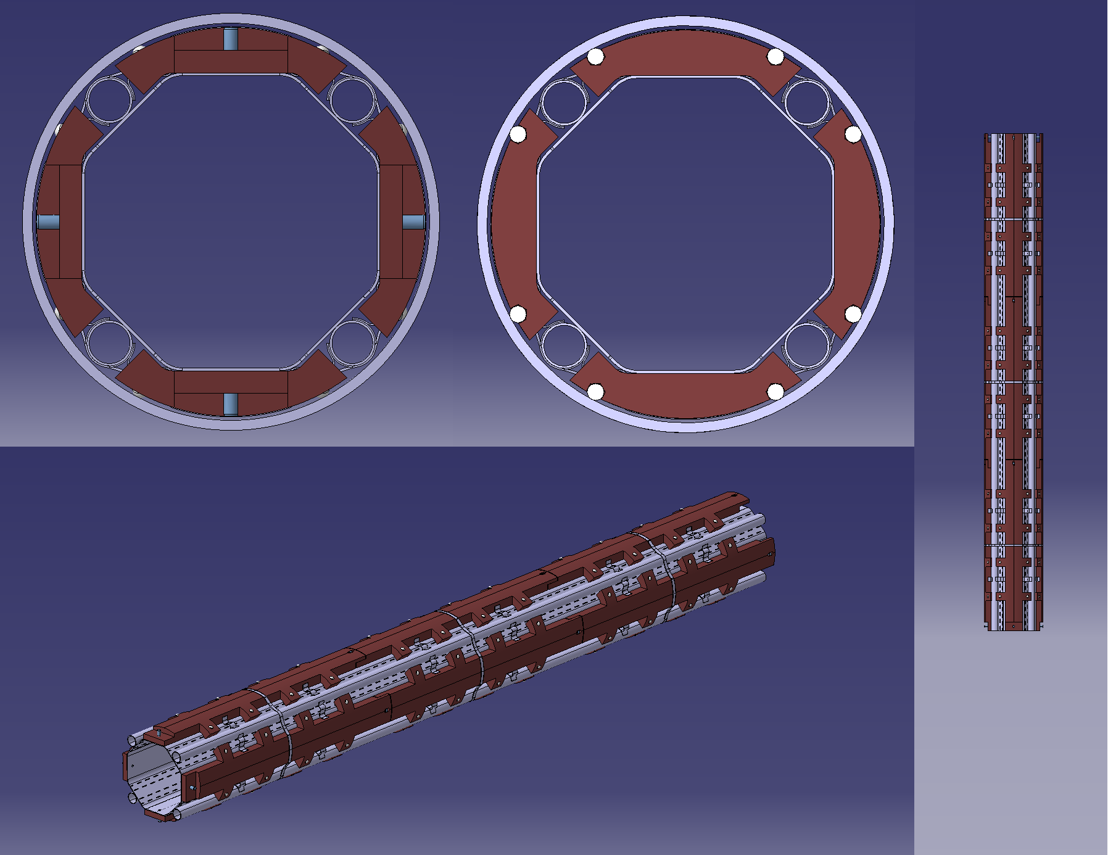
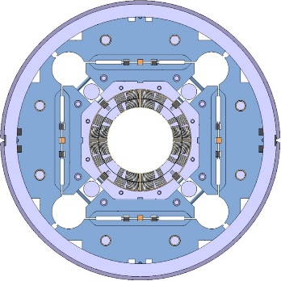
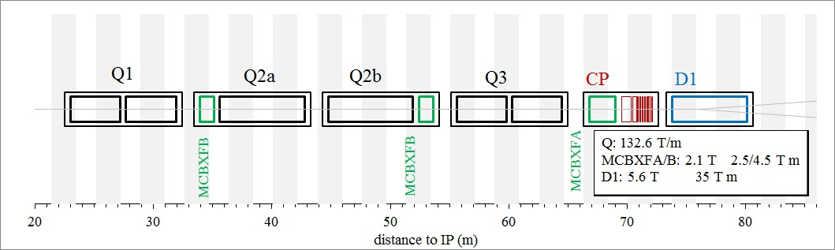

Inner Triplets Cooling (LHC vs HL-LHC)
Beam Screen
Cold Mass
Assembly (IT.R5)
Nb-Ti + single cooling channel at 1.8K
cryostat
LHC
CERN
Fermilab
Nb-3Sn + double cooling channel at 1.8K
Tungsten shielding
cryostat
HL-LHC
Notes:
5

Slide 6
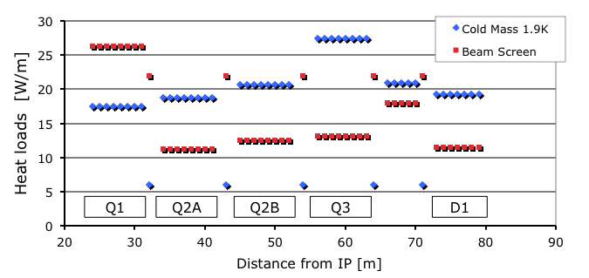
HL-LHC: heat loads on triplets
Based on data from F. Cerutti at 4th HiLumi annual meeting at KEK
Highly “luminosity driven”

Slide 7
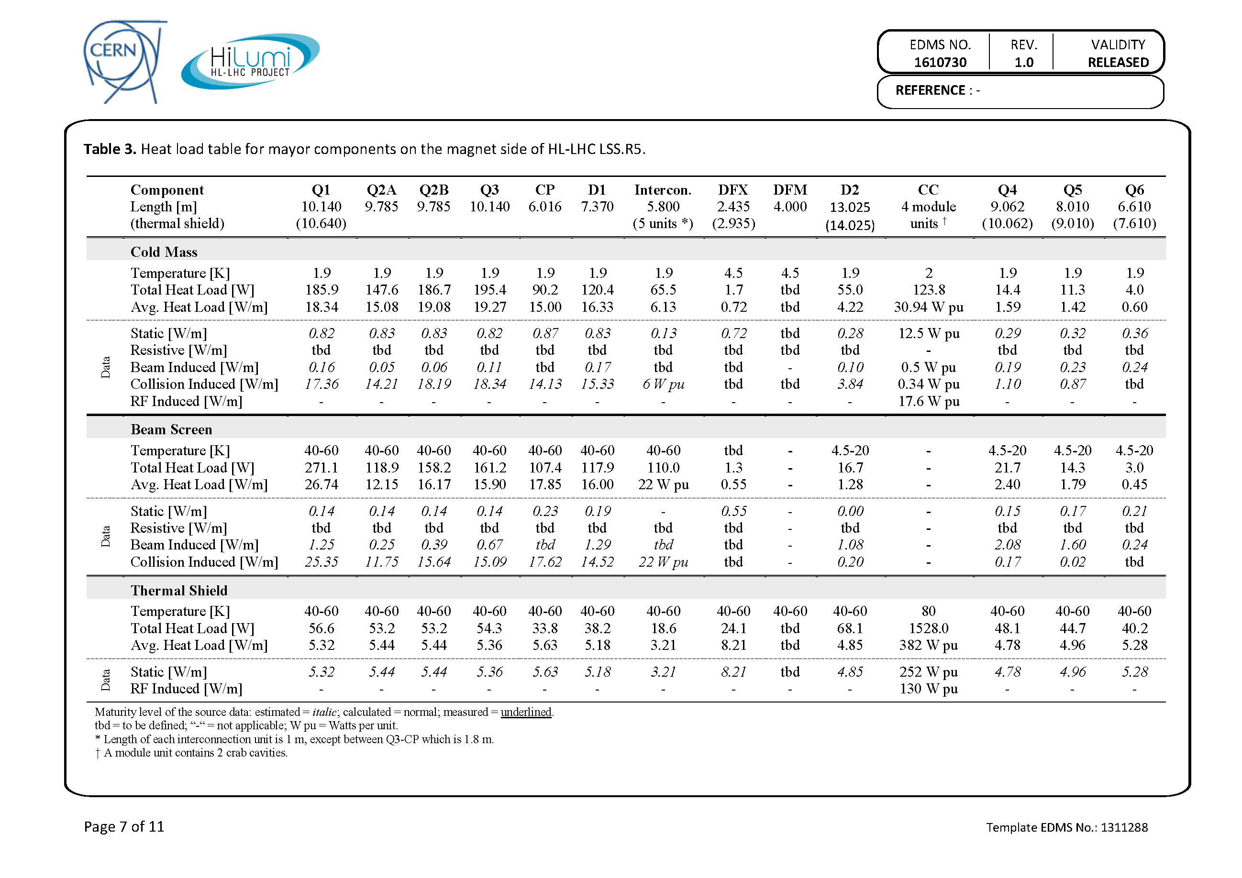
1st Evaluation of Heat Loads
1000 W
1200 W

Slide 8
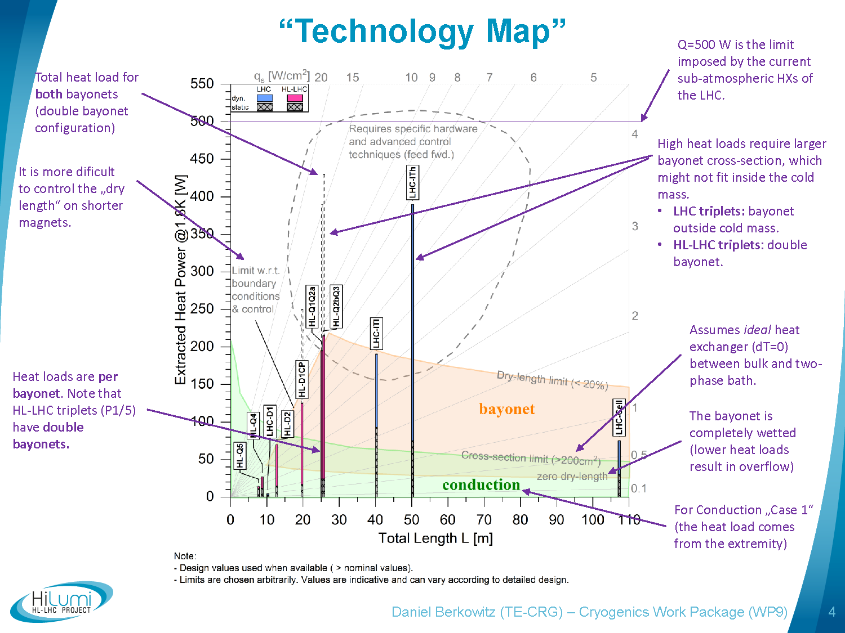
(slope dependent)

Slide 9
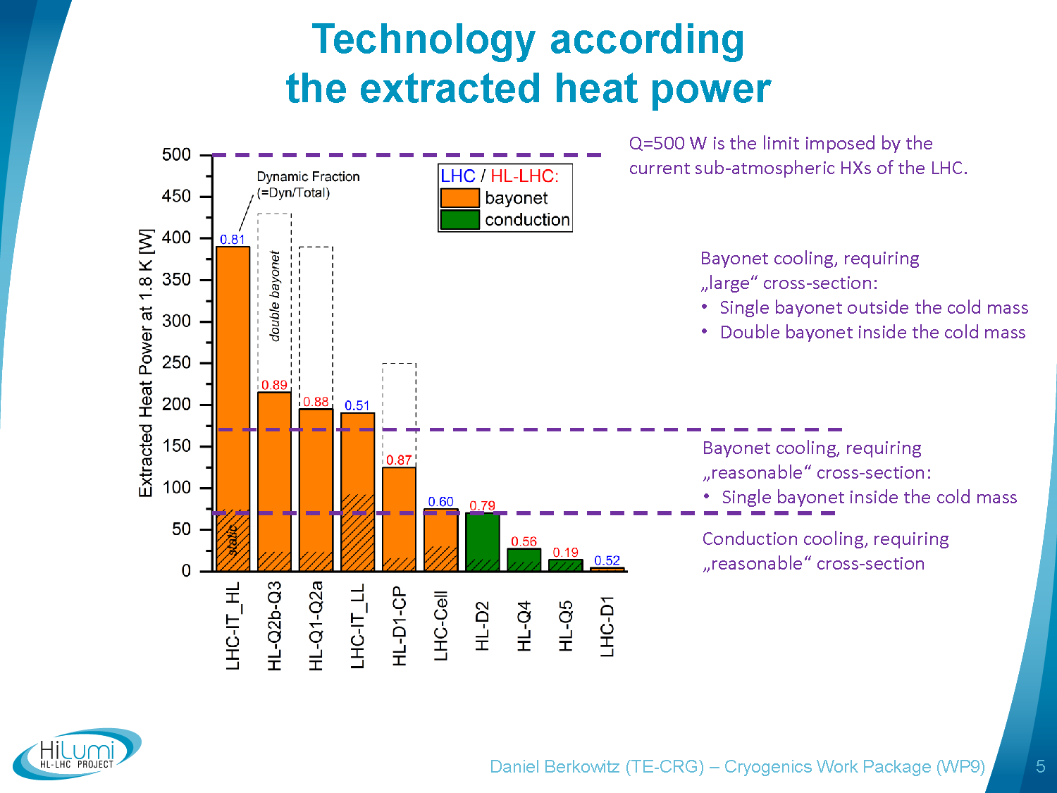

Slide 10
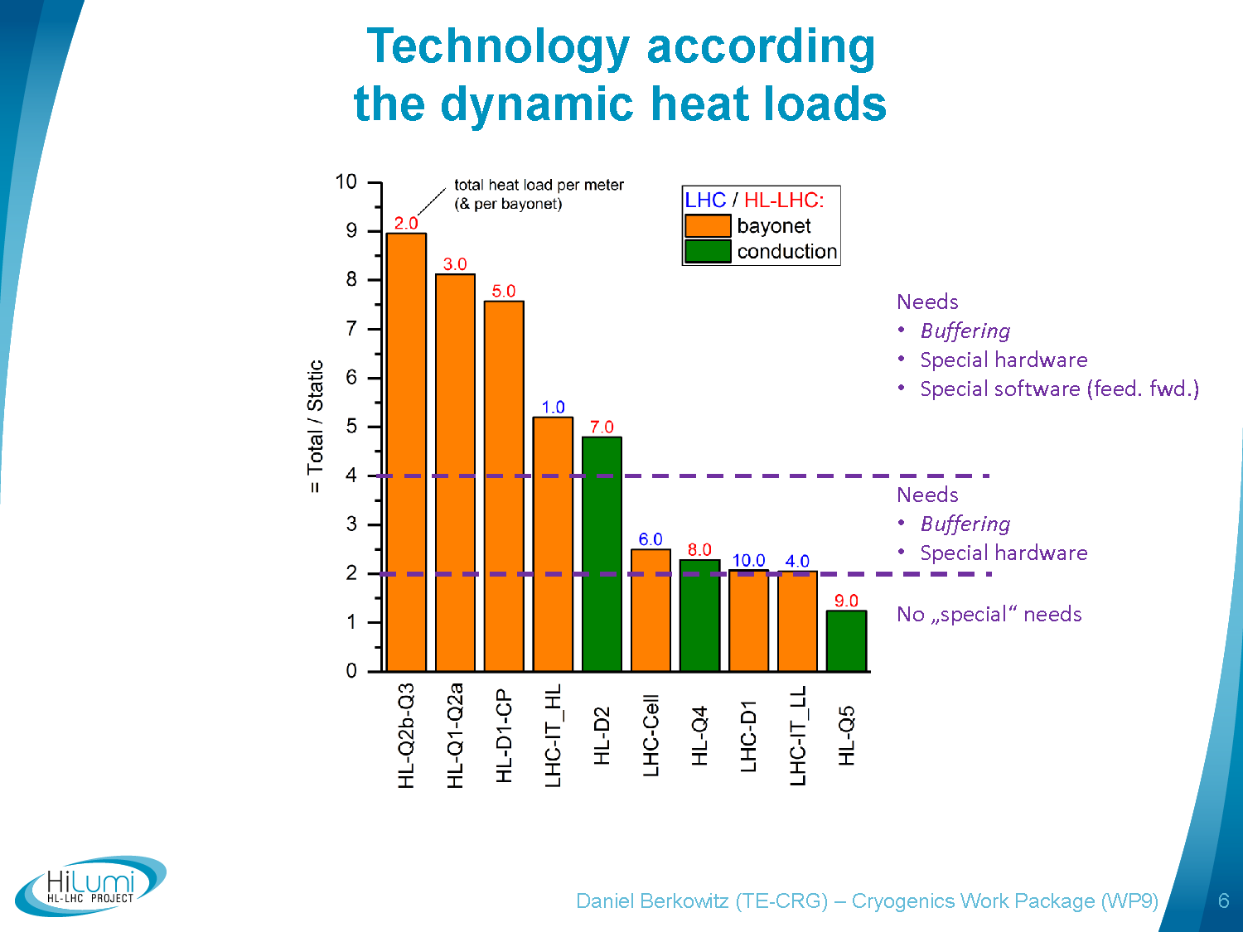
Consideration during LHC design phase: (driven by Cold Compressors dynamic)
(pre-load?)
Advanced controls, Feed forward
Classic (PID) tuning

Slide 11
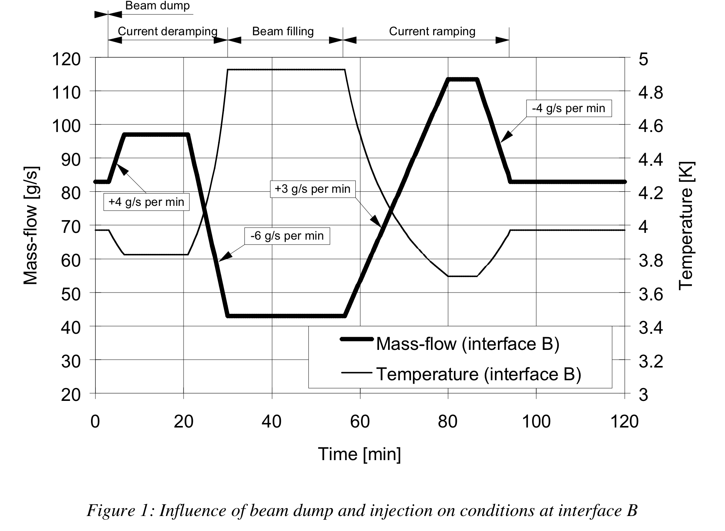
Introduction to dynamic effects, main parameters
IT-2545/LHC/LHC, 1.8K Units
Magnet ramping effect covered by margin in total capacity
Installed mode
(~150% Nom)
He buffering
Maximum flow
Flow acceleration
Nominal
(mode)
x2
Injection
(~Static losses)

Slide 12
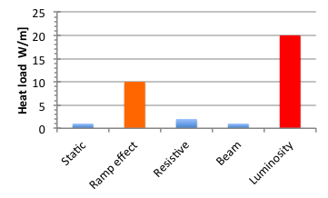
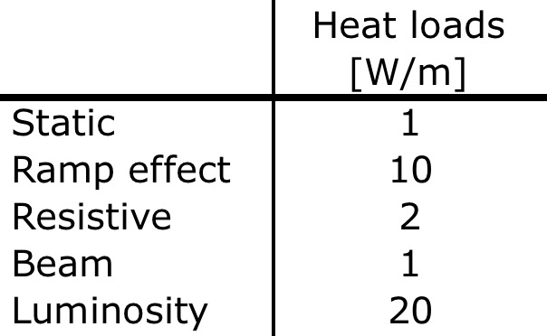
Introduction to heat loads per origin
Qualitative illustration (with not too bad orders of magnitude)
Magnet
Beam
?
=> This will deserve specific strategy

Slide 13
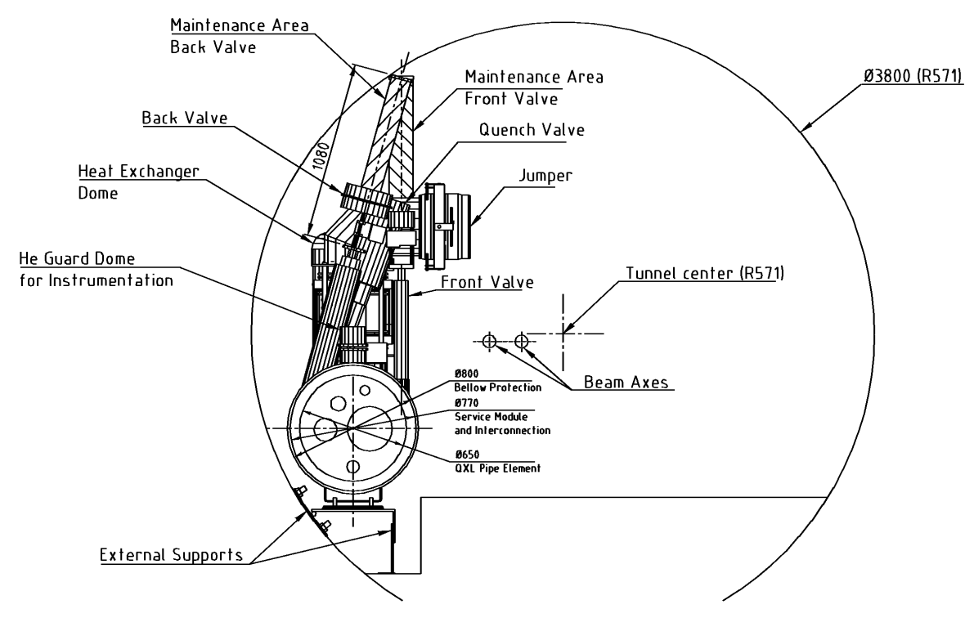
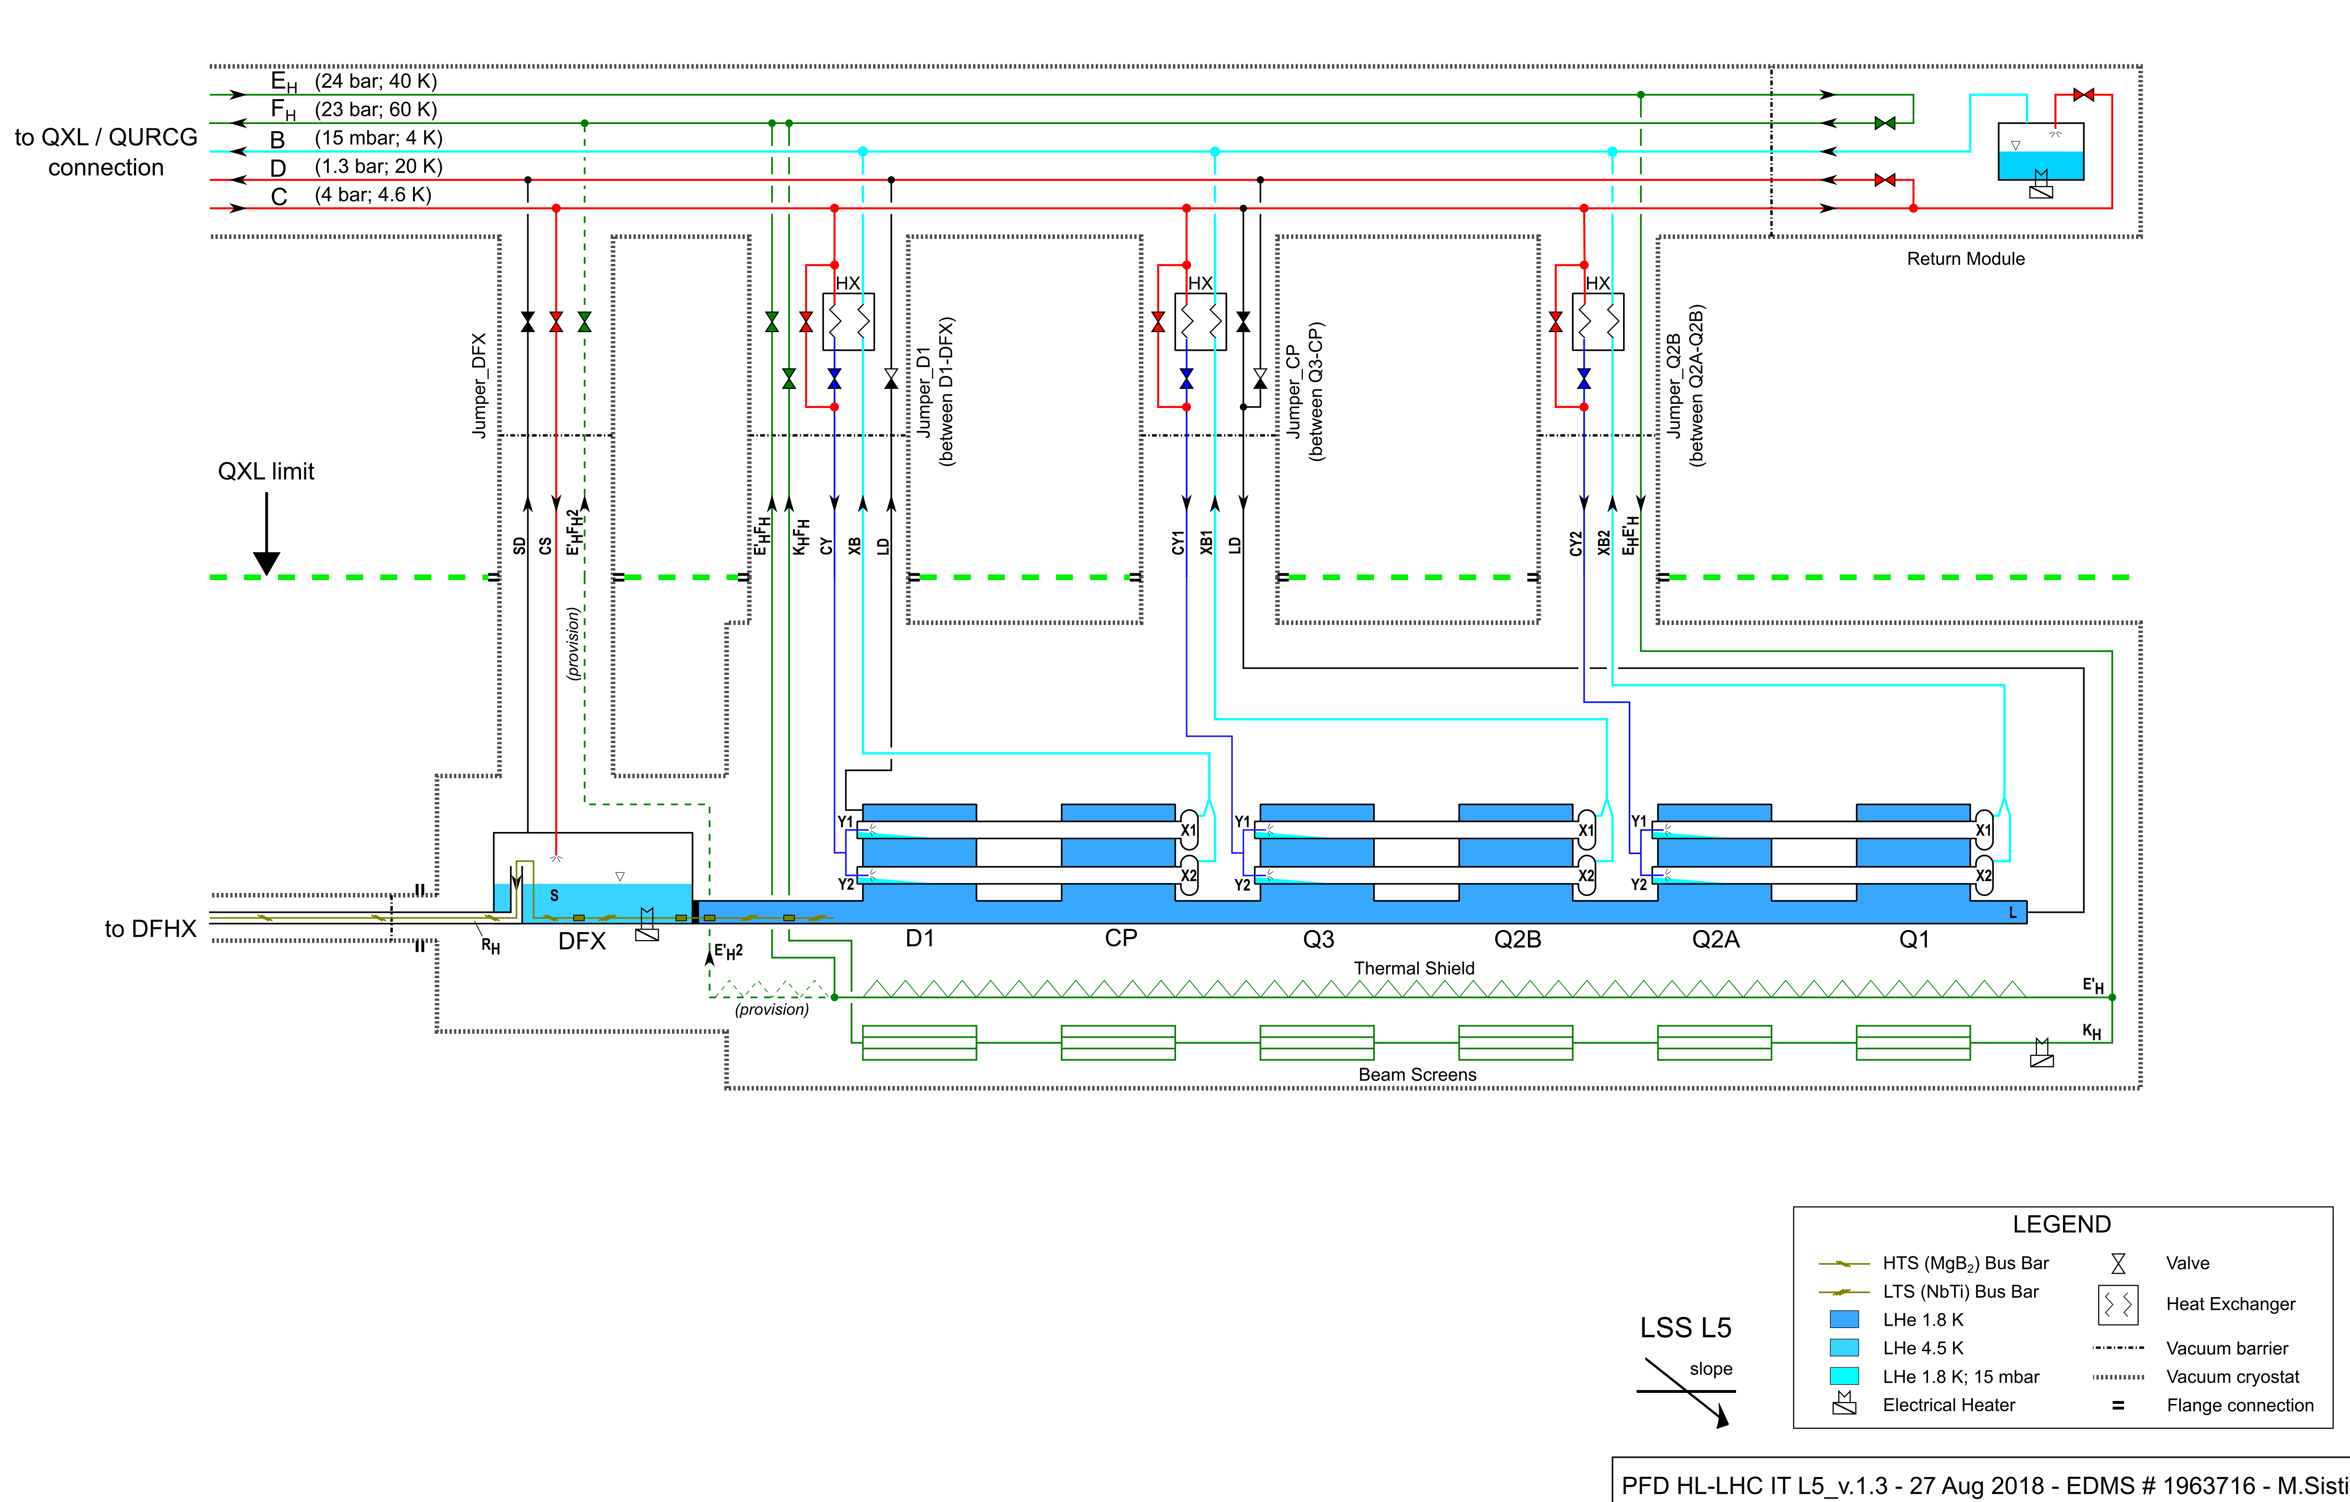
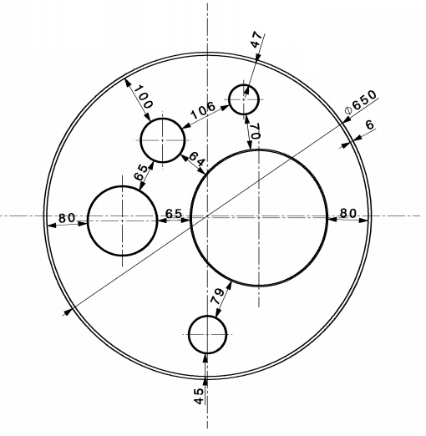
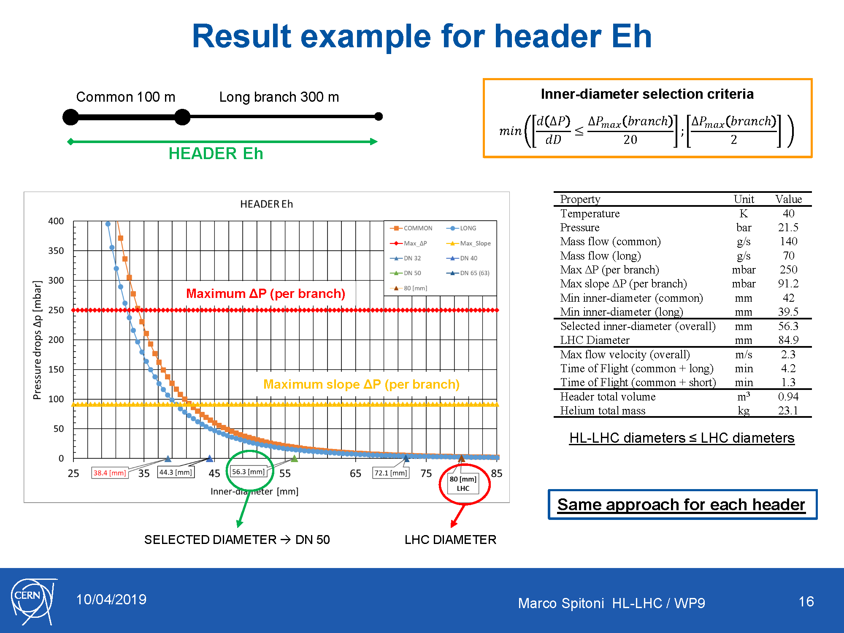
WG1, QXL headers
Typical Tunnel cross section
Inner Triplet flow scheme
QXL
Typical QXL cross section
Users
Eh
C
Header Eh → Supply of thermal shield and beam screen (IT only)
Header Fh → Return of header Eh
Header C → Supply of supercritical He
Header B → Return of superfluid He (very low pressure)
Header D → Return from DFX-DFM, beam screen (D2, CC, SAMs)
Various modes:
- Nominal
- Reduced capacity
- Cool-down
- Quench
- Other transients
D
B
Fh
Marco Spitoni HL-LHC / WP9
13

Slide 14
WG2, Summary results
Thermal shield
(Eh - Fh)
Header B
Header C
Header D
LHC
(mm)
80 - 80
267
100
150
Not yet started
Directly affects
QXL vacuum jacket
Study started
Maximum increase
→ to be investigated
Higher
DN
DN 300 @ caverns?
(damping reasons)
DN 100/125 ?
(damping reasons)
DN 200 @ LSS_
(quench buffer)
Baseline HL-LHC
(DN)
50 - 65
250
80
125
Lower
DN
DN 40 - DN 50
(ΔP reasons)
DN 200 @ LSS_
(encumbrance)
DN 65
(conservative)
Could be decreased
(ok for ΔP)
(not ok quench)
No changes for the time being
DN 50
(ΔP reasons)
On-going work on damping effects for C (close to a baseline) and B (not much hope with “short” QXL w.r.t QRL 180m3)
Marco Spitoni HL-LHC / WP9
14

Slide 15
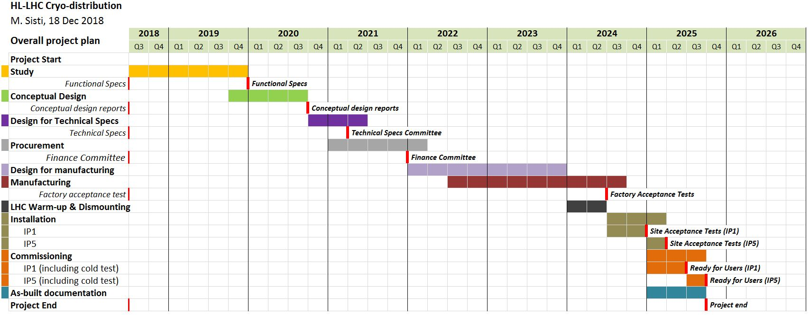
Project plans Refrigeration-Distribution
+
-

Slide 16
Complements (if needed)

Slide 17
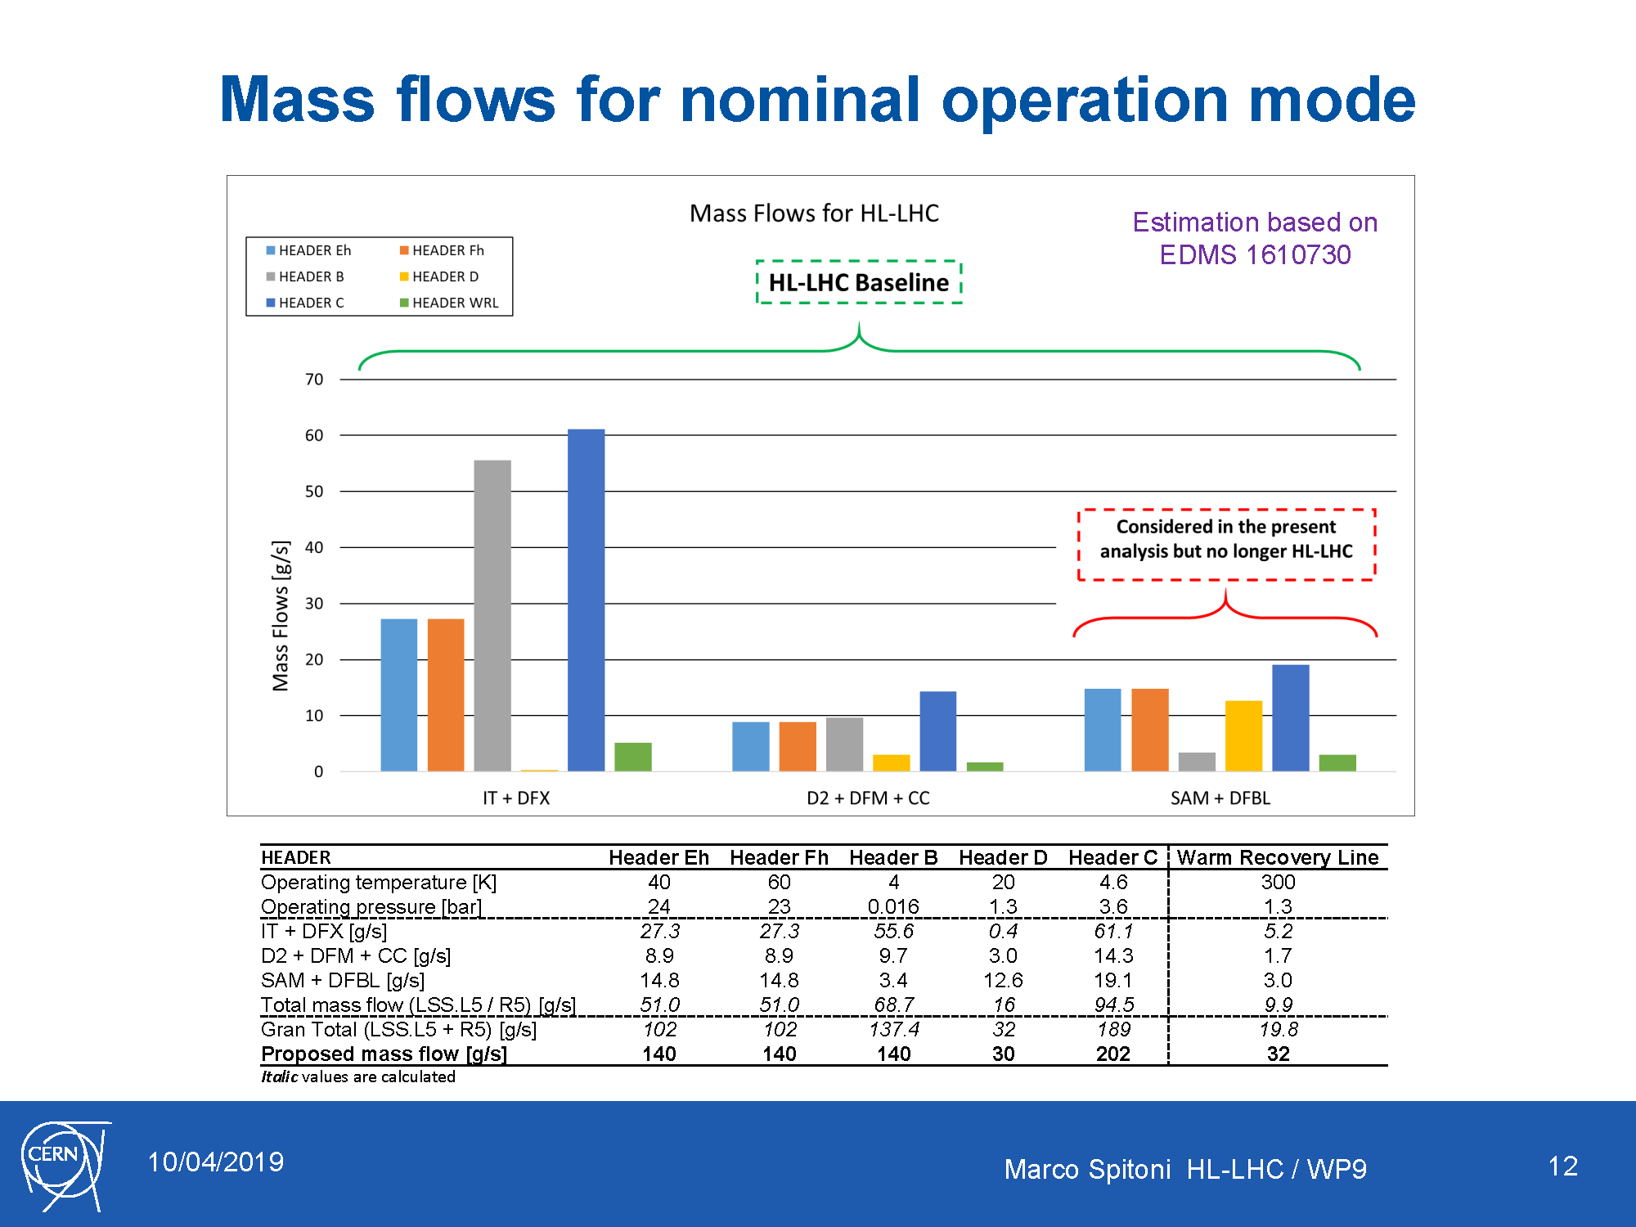

Slide 18
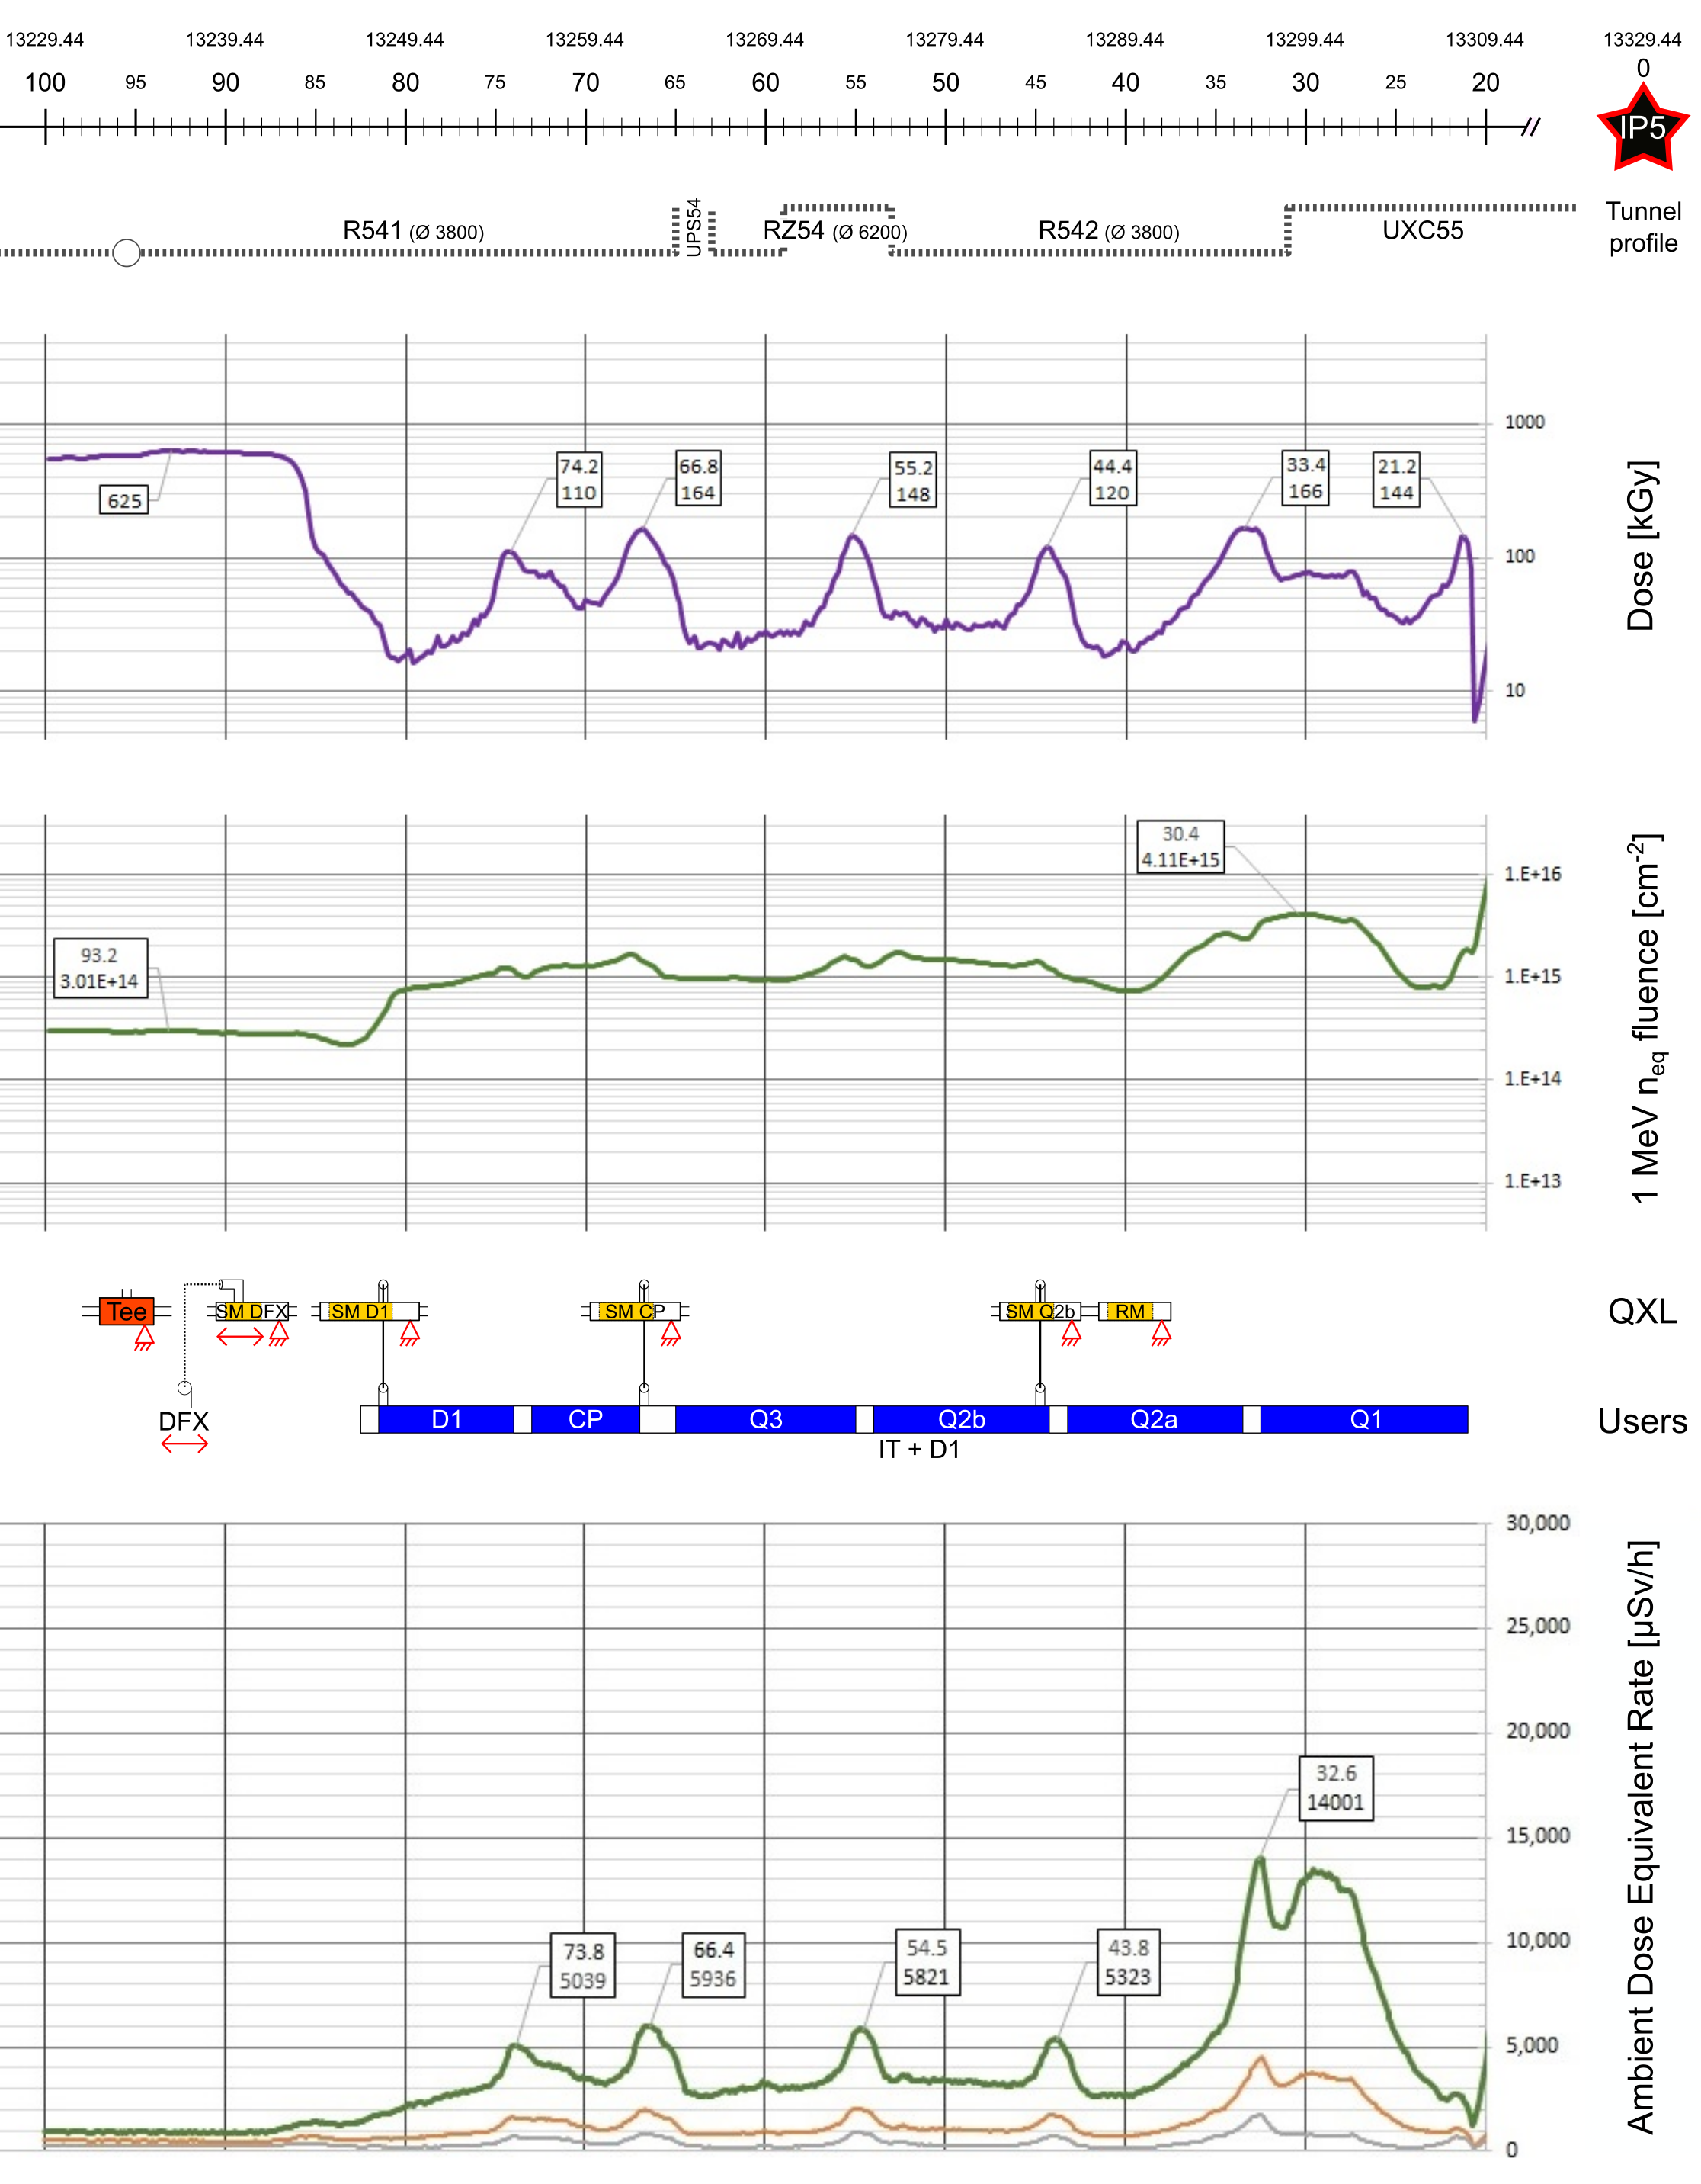
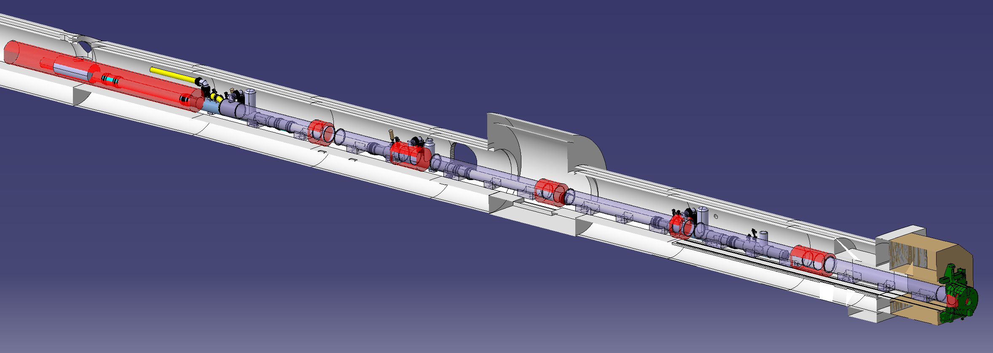
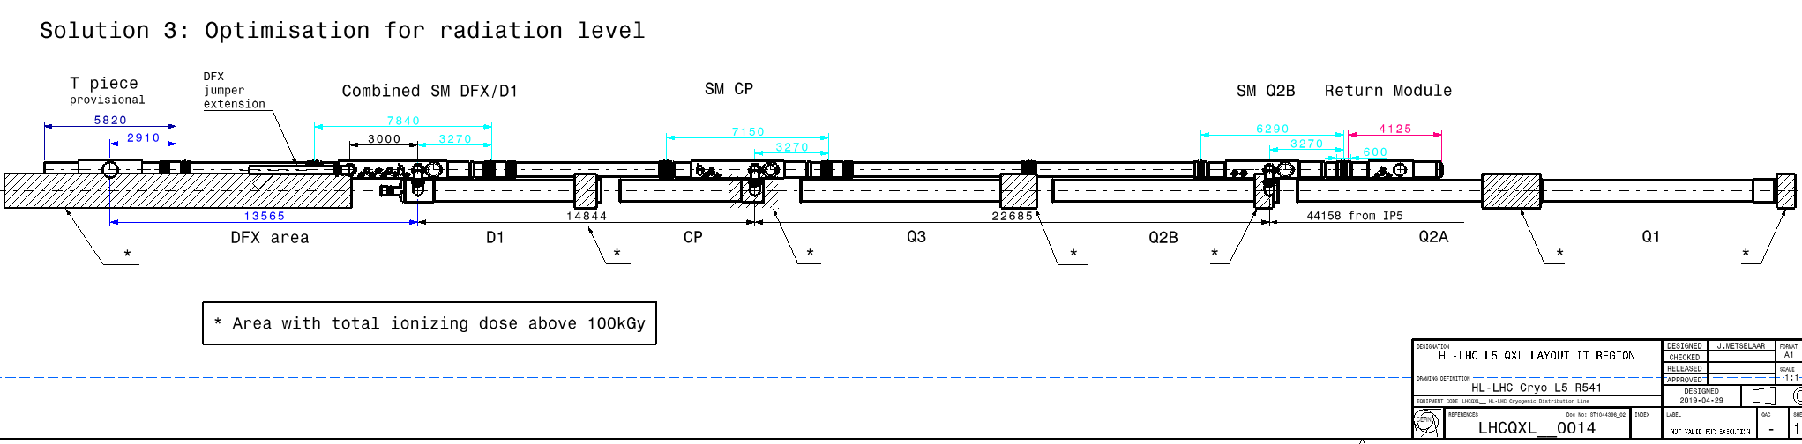
QXL Cryoline integration

Slide 19
HL-LHC refrigeration capacity at Points 1 & 5
About 18kW eq. @ 4.5K, including 3kW @ 1.8K
Temperature level | Cooling circuit | Specific heat load [W/m] (Static) | Capacity* / Point |  | Dynamic range
40-60 K | IT beam screen | 16 (0) | 3.2 kW | 13 kW | ~1.3
 | Thermal shield | 6 (6) | 3.6 kW
 | Crab cavity | - | 6 kW
20-300 K | Current lead & SC link | - | 40 g/s | 40 g/s | ~2
4.5-20 K | MS beam screen | 2 (0.1) | 0.1 kW | 0.1 kW | ~20
1.9 – 2 K | Cold-mass (1.9 K) | 14 (0.35) | 2.6 kW | 3 kW | ~10
 | Crab-cavity (2 K) | - | 0.4 kW
*: Including uncertainty and design capacity factor
Preliminary global values

Slide 20
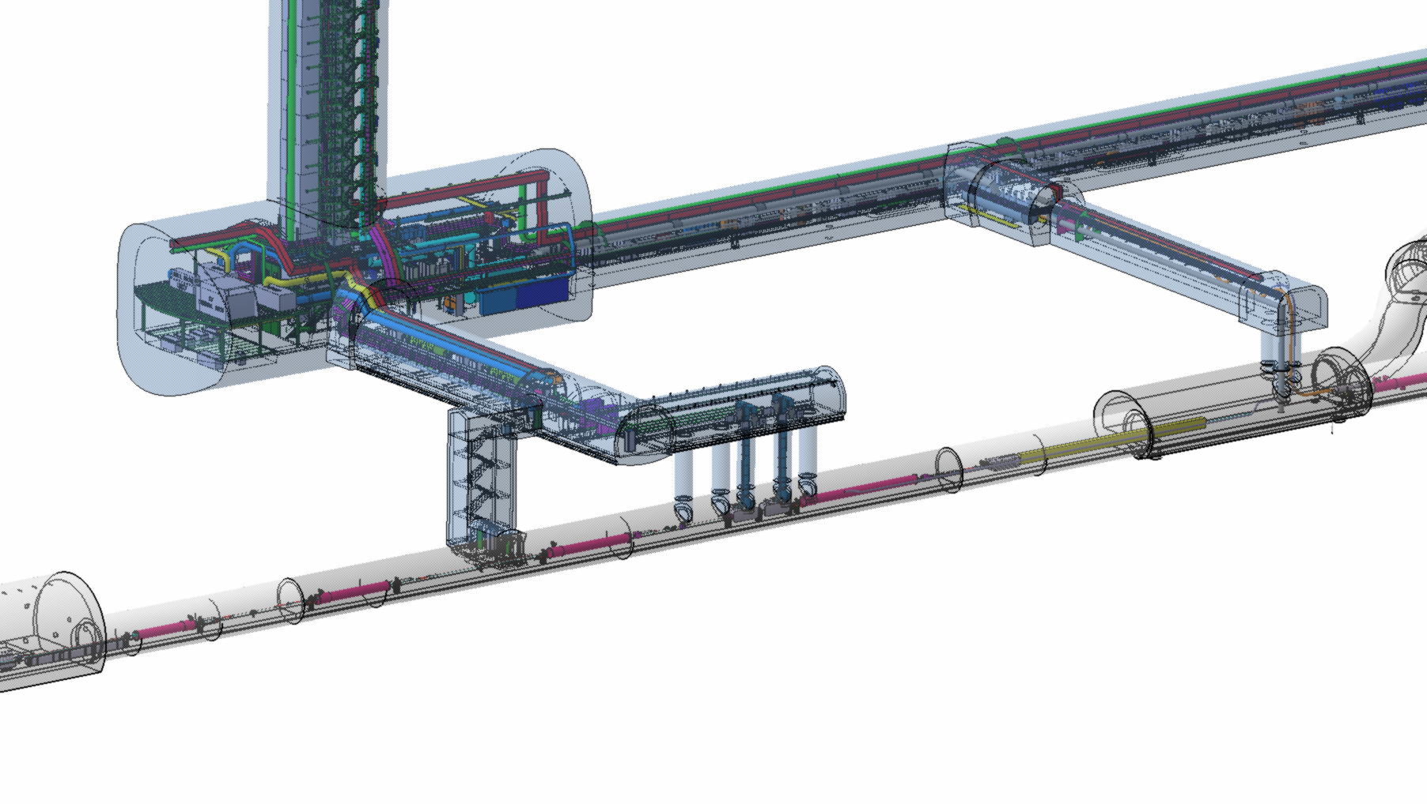
Cooling P1/P5 SAM’s
View from integration views DB
Return Module
Return Module
D2
QXL
QRL
Q4
Q5
Access / safety / sectorisation ?
Powering from existing RR & DFBL, corresponding cooling of DFBL and SAM’s to be with same origin
(QRL or QXL but not mixed)
Q4 and Q5 possibly with remote alignment, compatible with QRL ?
3D models to be implemented and then integrated (Q2-2018 for CRG)
Q6
NEW Jan’18
HL
Q4-Q5 could remain at 4.5K (already the case for Q6),
and moved towards the arc by 10-11m
LHC
Present limit for QRL/QXL

Slide 21
Possible modes and implications, as identified so far for HiLumi
Decreasing requirements in cooling capacity
HL
Ultimate Luminosity (HL)
Nominal Luminosity (HL)
Nominal Luminosity (LHC)
Low Luminosity / Intensity
. Powering conditions to 7TeV, (maybe pilots or few bunches)
Injection stand-by (He preservation in magnets, ELQA, maybe pilots or few bunches at injection)
Magnets @20K
=> The maximum reasonably possible
WRL
Bonus (only 1st year)
Junction Module QRL-QXL
Desired (1 wk)
Mandatory (few wks)
LHC
=> Junction Module and bridge between WRL’s recommended
=> Corresponding cooling capacities and impact on size/cost/volume to be further investigated

