Slide 1

HL-LHC
WP9 Cryogenics, an introduction for this Controls & Instrumentation Architecture wg
S. Claudet, 16May’19
(HiLumi – CRG internal review)

Slide 2
Goal of this mini series of meetings
For the HiLumi cryogenics at P1/P5, we have now completed the series of expected heat loads, flow diagrams and preliminary sizing of the QXL headers (QXL: Cryoline for HiLumi). We would like to complement this work with a similar one for controls.
Our goal is to evaluate possible control architectures, interfaces with existing ones, and typical needs for racks and cables
As validated at pilotage last autumn and following similar work recently done for QXL sizing, we would propose to start a small series of meetings on this topic with specialised and experienced collegues in the group.
We could consider: introduction and presentation of reference so far for HiLumi cryogenics from our side, and LHC controls architecture from your side.
Discussion, studies for possible scheme for instrumentation and controls of HiLumi cryogenics.
A summary document with schemes and list should be the final deliverable.
For the organisation of these meetings, we will prepare ad-hoc indico sites, call for meeting and prepare executive minutes of meetings
Participants:
- HL-Cryo: Marco Spitoni, Michele Sisti, Emmanuel Monneret, Krzysztof Brodzinski, Serge Claudet
- CRG: Nikolaos Trikoupis, Juan Casas-Cubillos, Czeslaw Fluder, Marco Pezzetti, Benjamin Bradu
- Convenors: Michele Sisti, Serge Claudet
We would propose to use the slot on Thursdays 10h30-12h, tentatively and if nobody objects, we could start May 16th.
Looking forward to meeting you and getting your feedback!
Wg2: Functional Analysis
Circuits, Actuators, Sensors,
Control Technics
! Dynamics ! - ! Radiation !
Wg1: Cryoline QXL sizing
Done

Slide 3
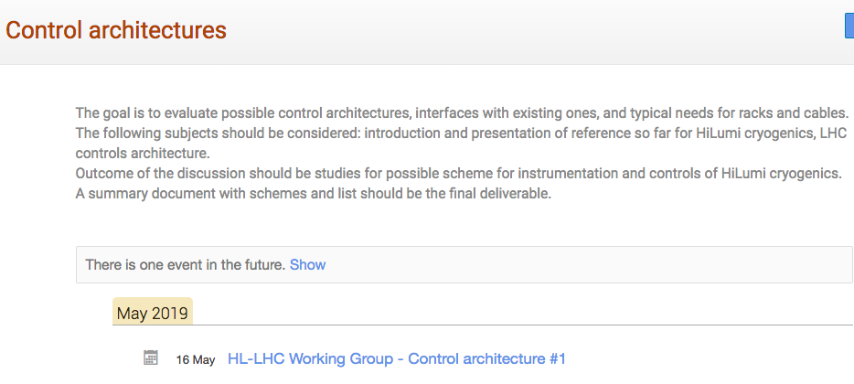
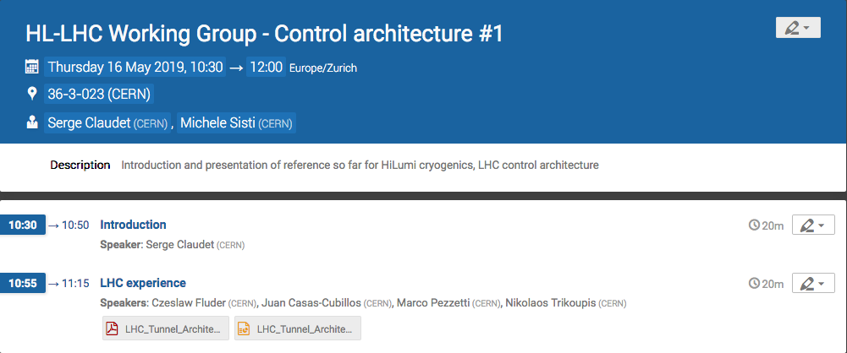
Agenda
Next meeting to be defined at the end, depending on needs and outcome of this meeting
https://indico.cern.ch/category/10932/

Slide 4
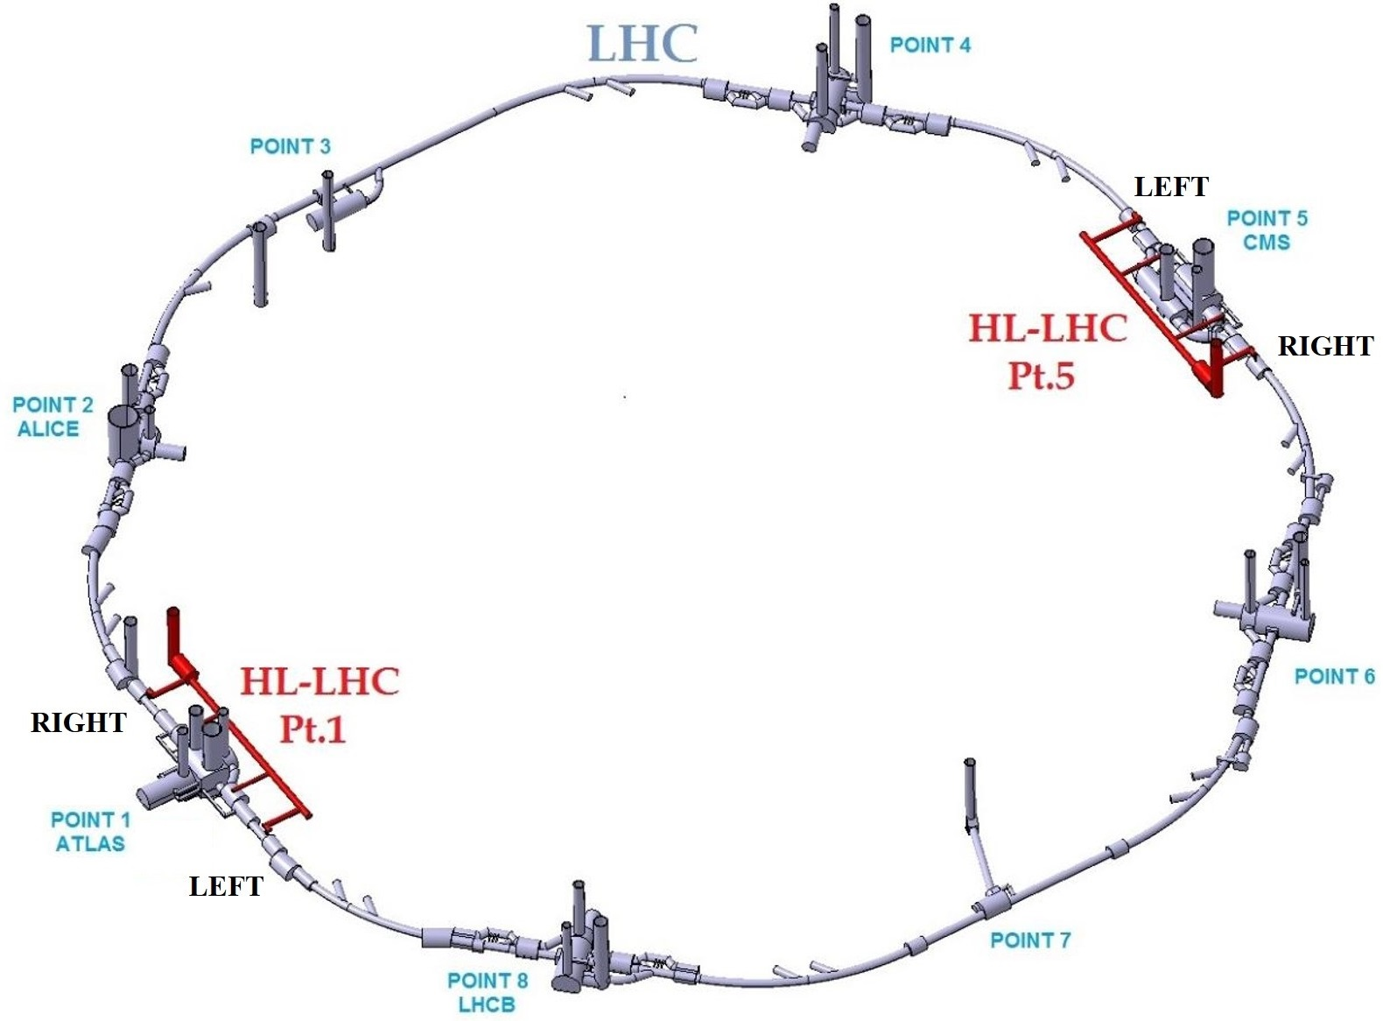
High Luminosity Large Hadron Collider (HL-LHC)
Main objective → Higher collision rate
By increasing the number of bunches
By decreasing the bunch’s size
Main consequences
New accelerator components
Higher beam induced heat loads
Inner Triplet (@ 1.9K)
300 W → 1000 W
15 g/s → 50 g/s
No way that the existing cryo-plants could deliver the additional capacity being 3.3 km away (both sides)
Peak luminosity → $5∙{10}^{34}{cm}^{−2}s^{−1}$
Integrated luminosity → $250 {fb}^{−1}(year)$
Two new refrigerators at
P1 ad P5
(higher heat load)
10/04/2019
4

Slide 5
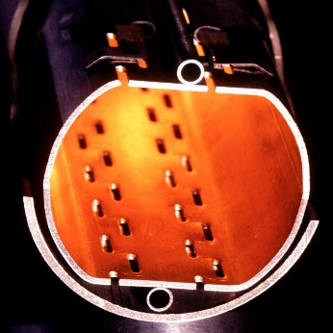
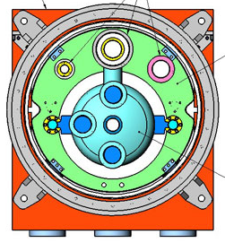
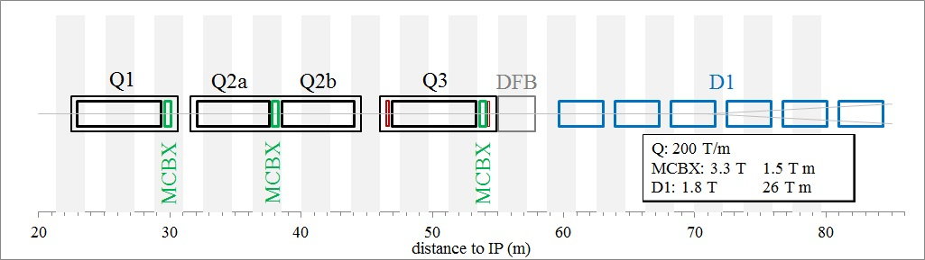
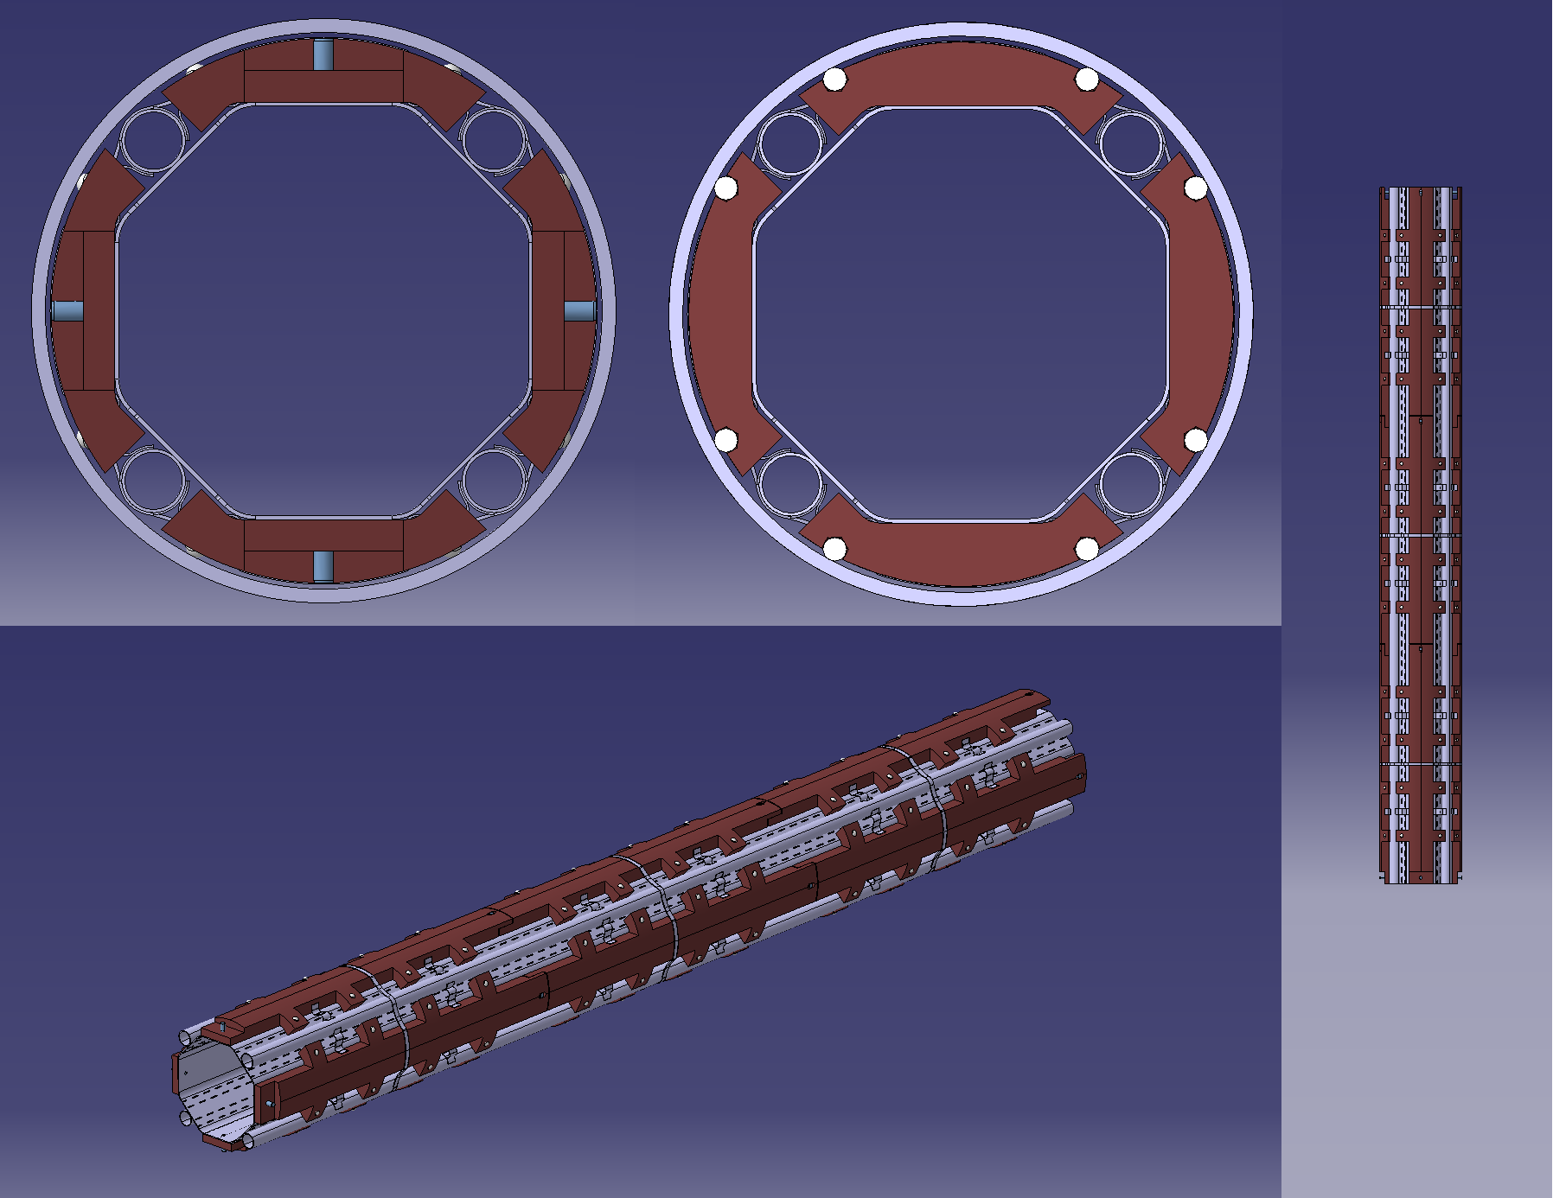
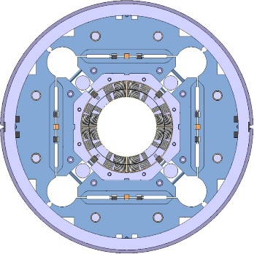
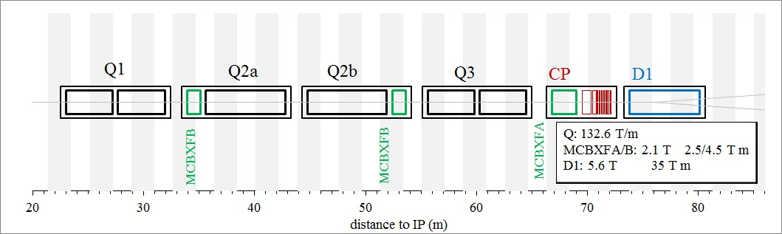

Inner Triplets Cooling (LHC vs HL-LHC)
Beam Screen
Cold Mass
Assembly (IT.R5)
Nb-Ti + single cooling channel at 1.8K
cryostat
LHC
CERN
Fermilab
Nb-3Sn + double cooling channel at 1.8K
Tungsten shielding
cryostat
HL-LHC
Notes:
5

Slide 6
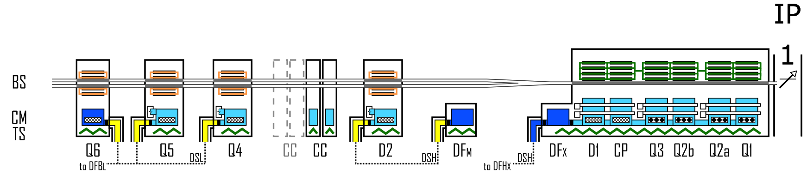
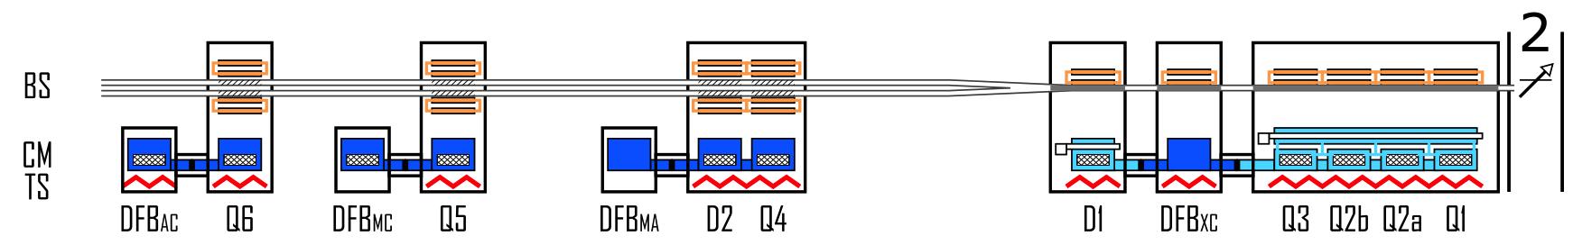
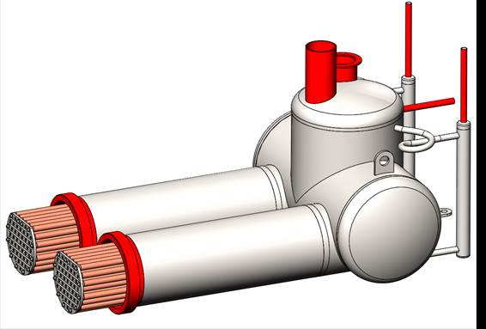
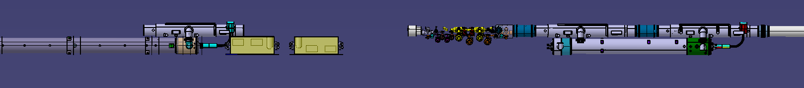
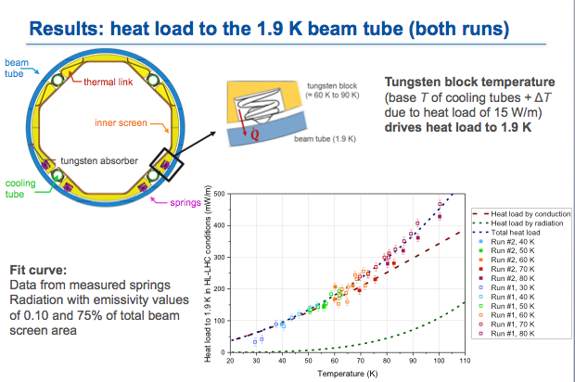
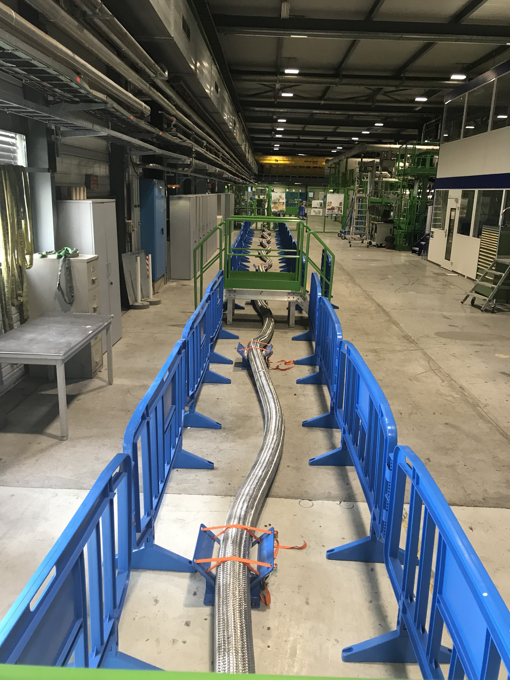
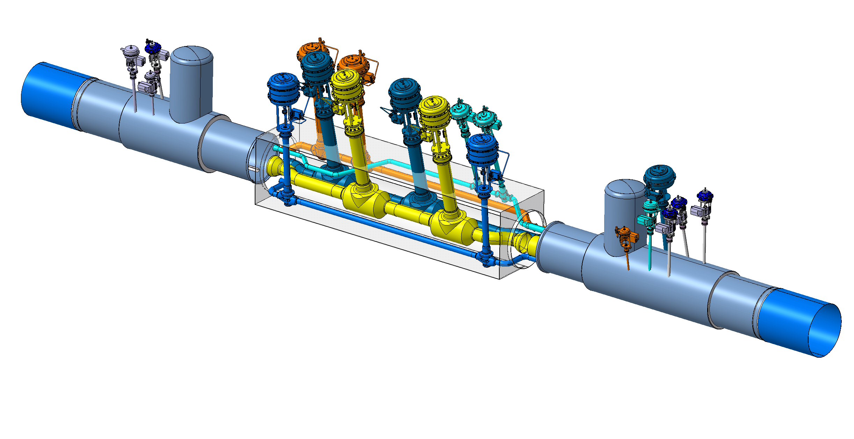
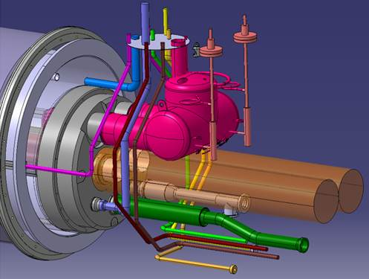
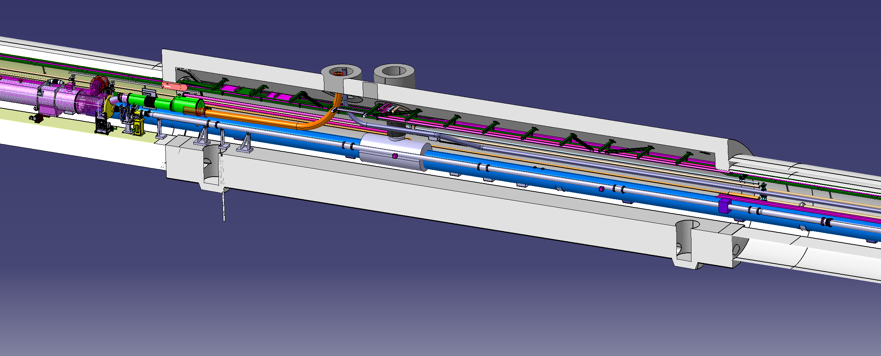
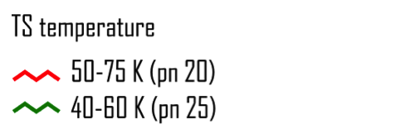
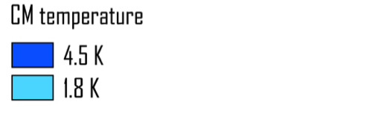
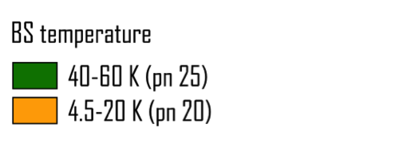
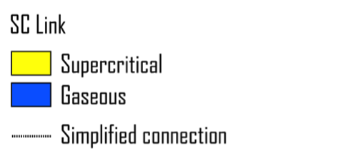
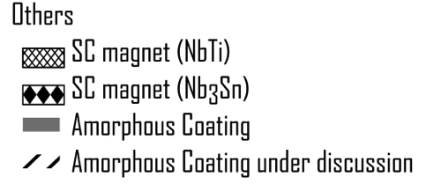
INTERFACES identification and definition
A large variety of cold masses, beam-screens and sc-links
Specific study done
=> Will be kept with arc/QRL
Heat extraction
Close to validate technical choices in order to finalise design
SC Link = 60 m
Thermal behaviour of tungsten beam-screen validated at Cryolab,
now looking for off-design modes
3D models for Cryo started this year!
D2 cooling heat exchanger collaboration with CEA-SBT
Un-shielded cryostats validated
D.Berkowitz for HL-LHC WP9 – Nov17 – EDMS 1865871 v.0.9.

Slide 7
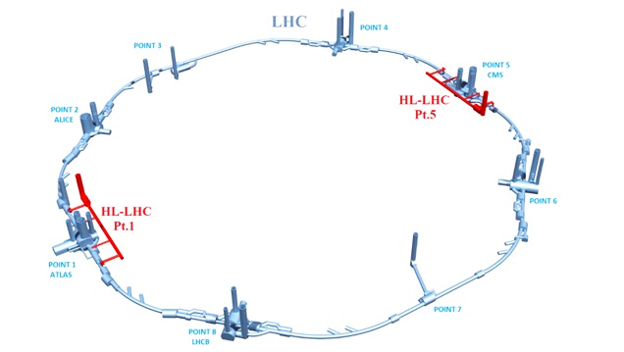
P1/P5 Cryogenic architecture
18 kW equivalent at 4.5 K, including 3 kW at 1.8 K
Warm compressor station
SHE
QSVB
GHe storage tanks
Surface piping
SHM
QSCG
QSAG
Dryer
QSP
Surface cold box
SLN
SD
SLN
Liquid Nitrogen tank(s)
Quench tank
QSDQ
QSRG
QSDN
Surface
QPP
QPLG
Vertical transfer line
Shaft
Underground
US
Cold compressors box
QURCG
DFHX
DFHM
(existing)
DFBL
UR
UL
QUIG
DSHX
DSHM
LHC tunnel
Interconnection box
DSL
Q1
Q2a
Q2b
Q3
CP
D1
D2
CC
Very limited impact identified for QXL headers
CC
Q4
Q5
Q6
QRP
QXL
HRL

Slide 8
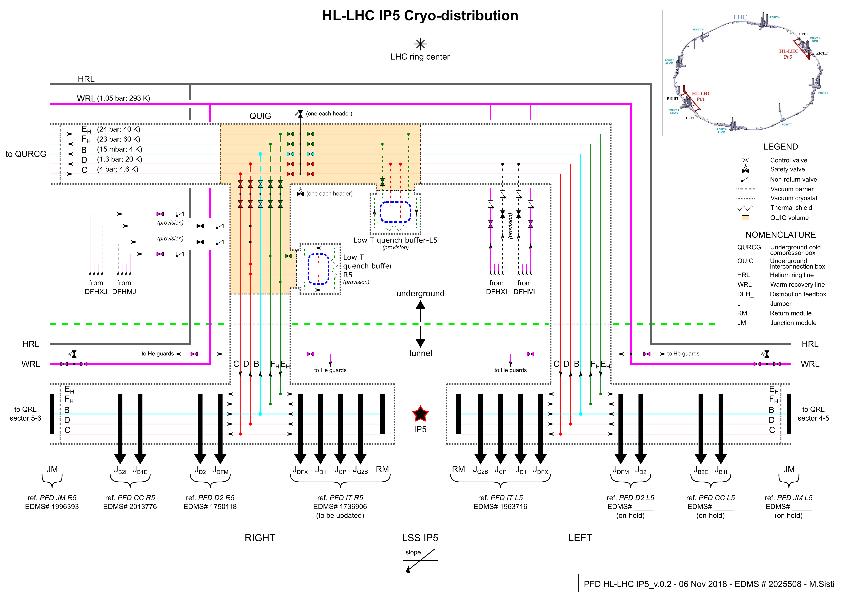
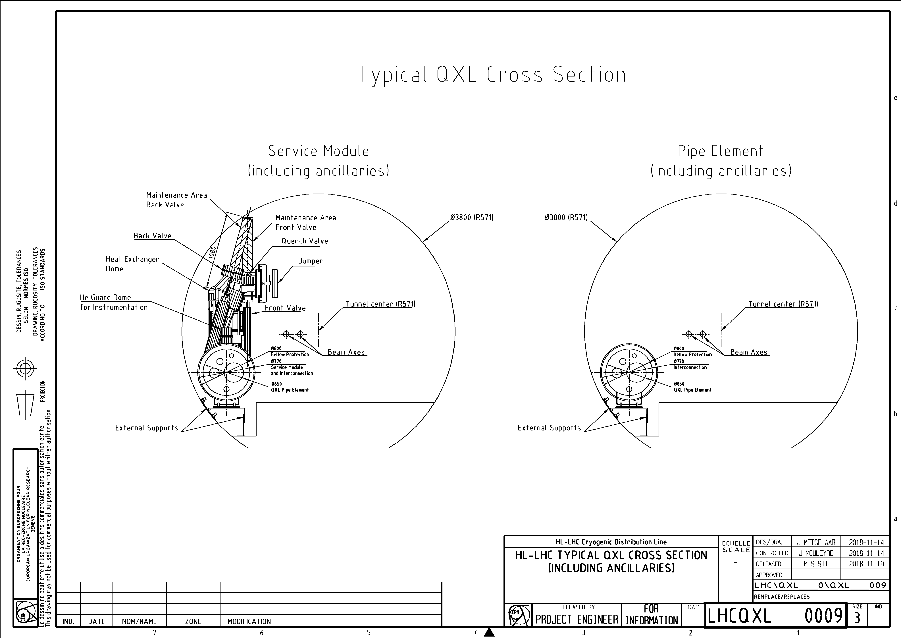
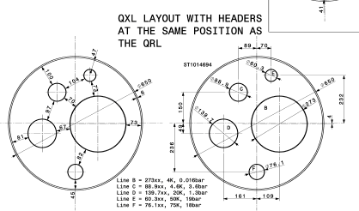
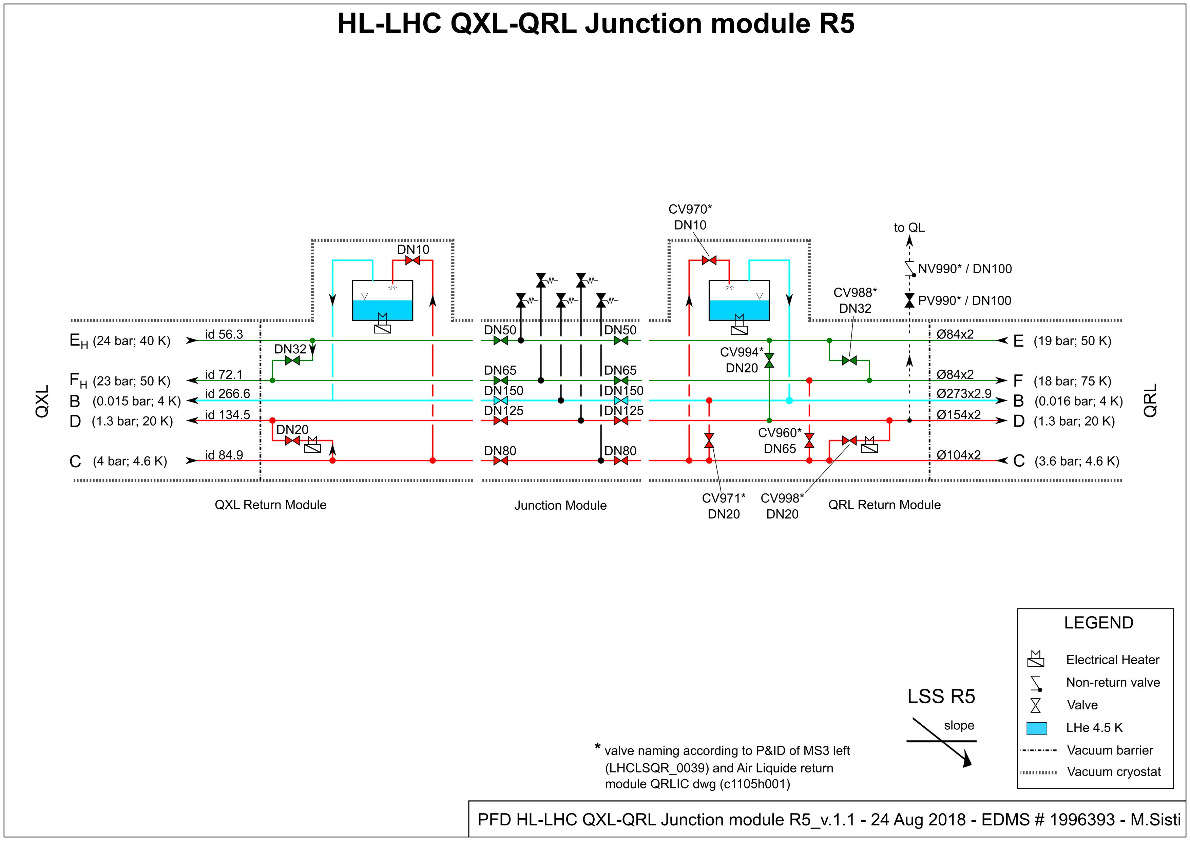
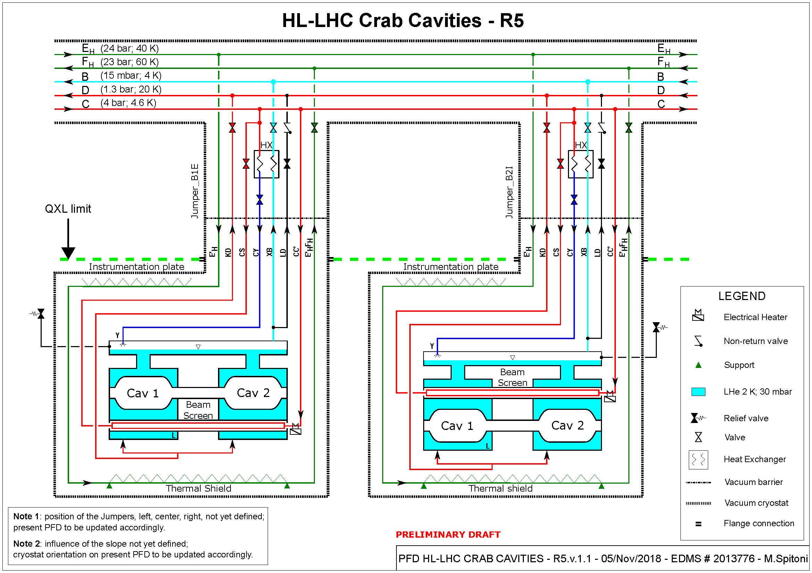
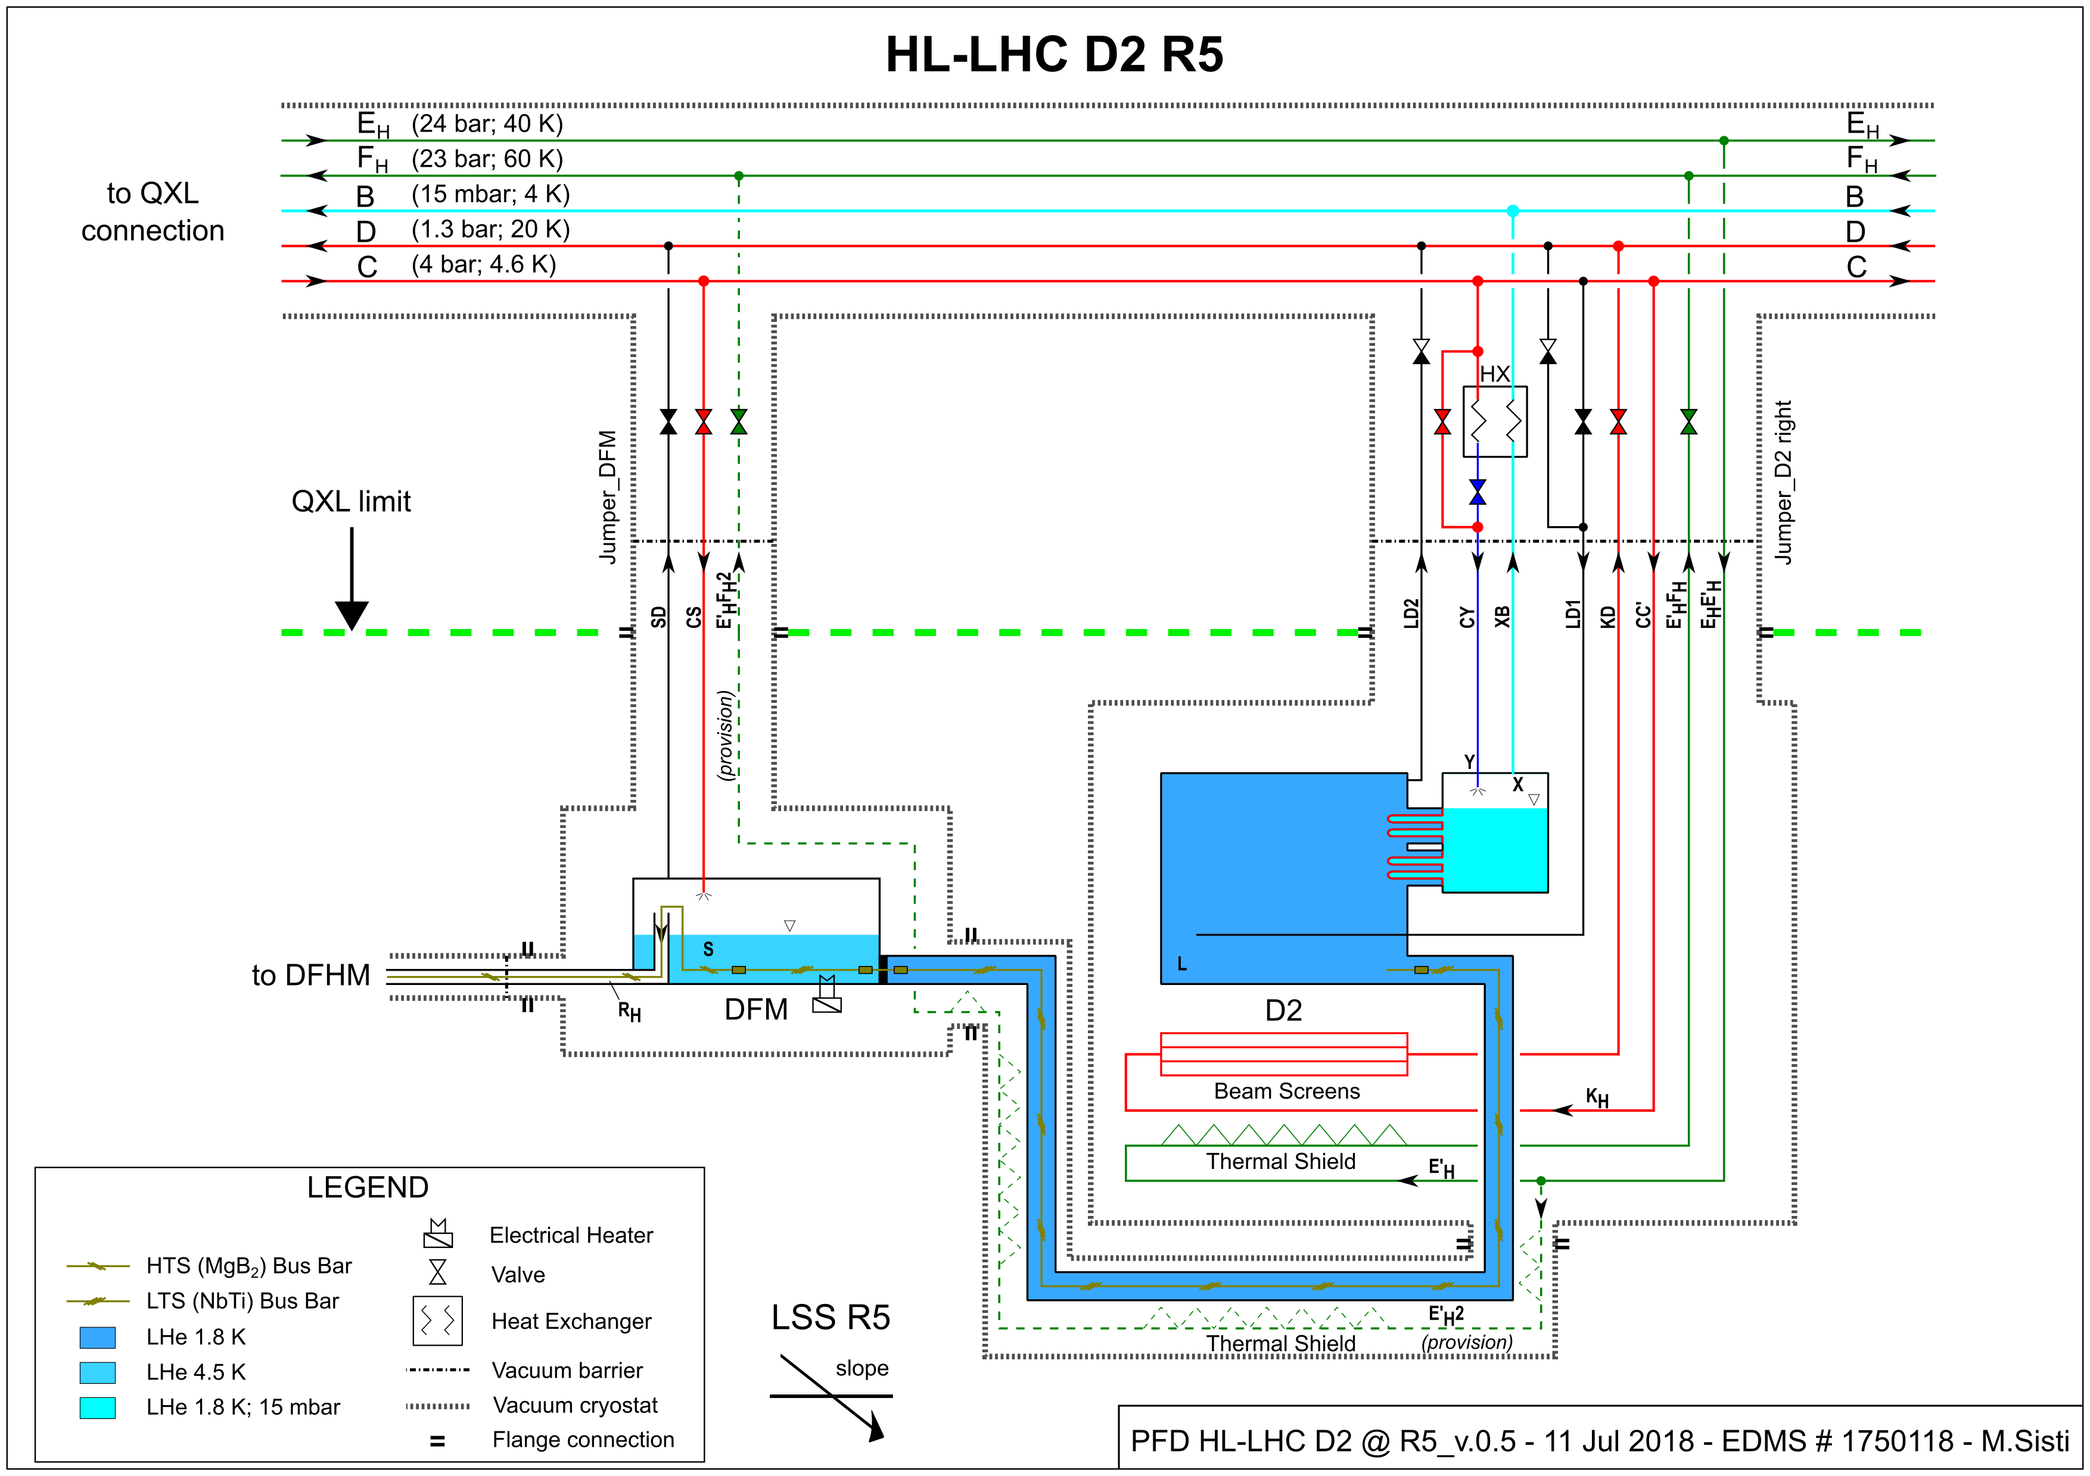
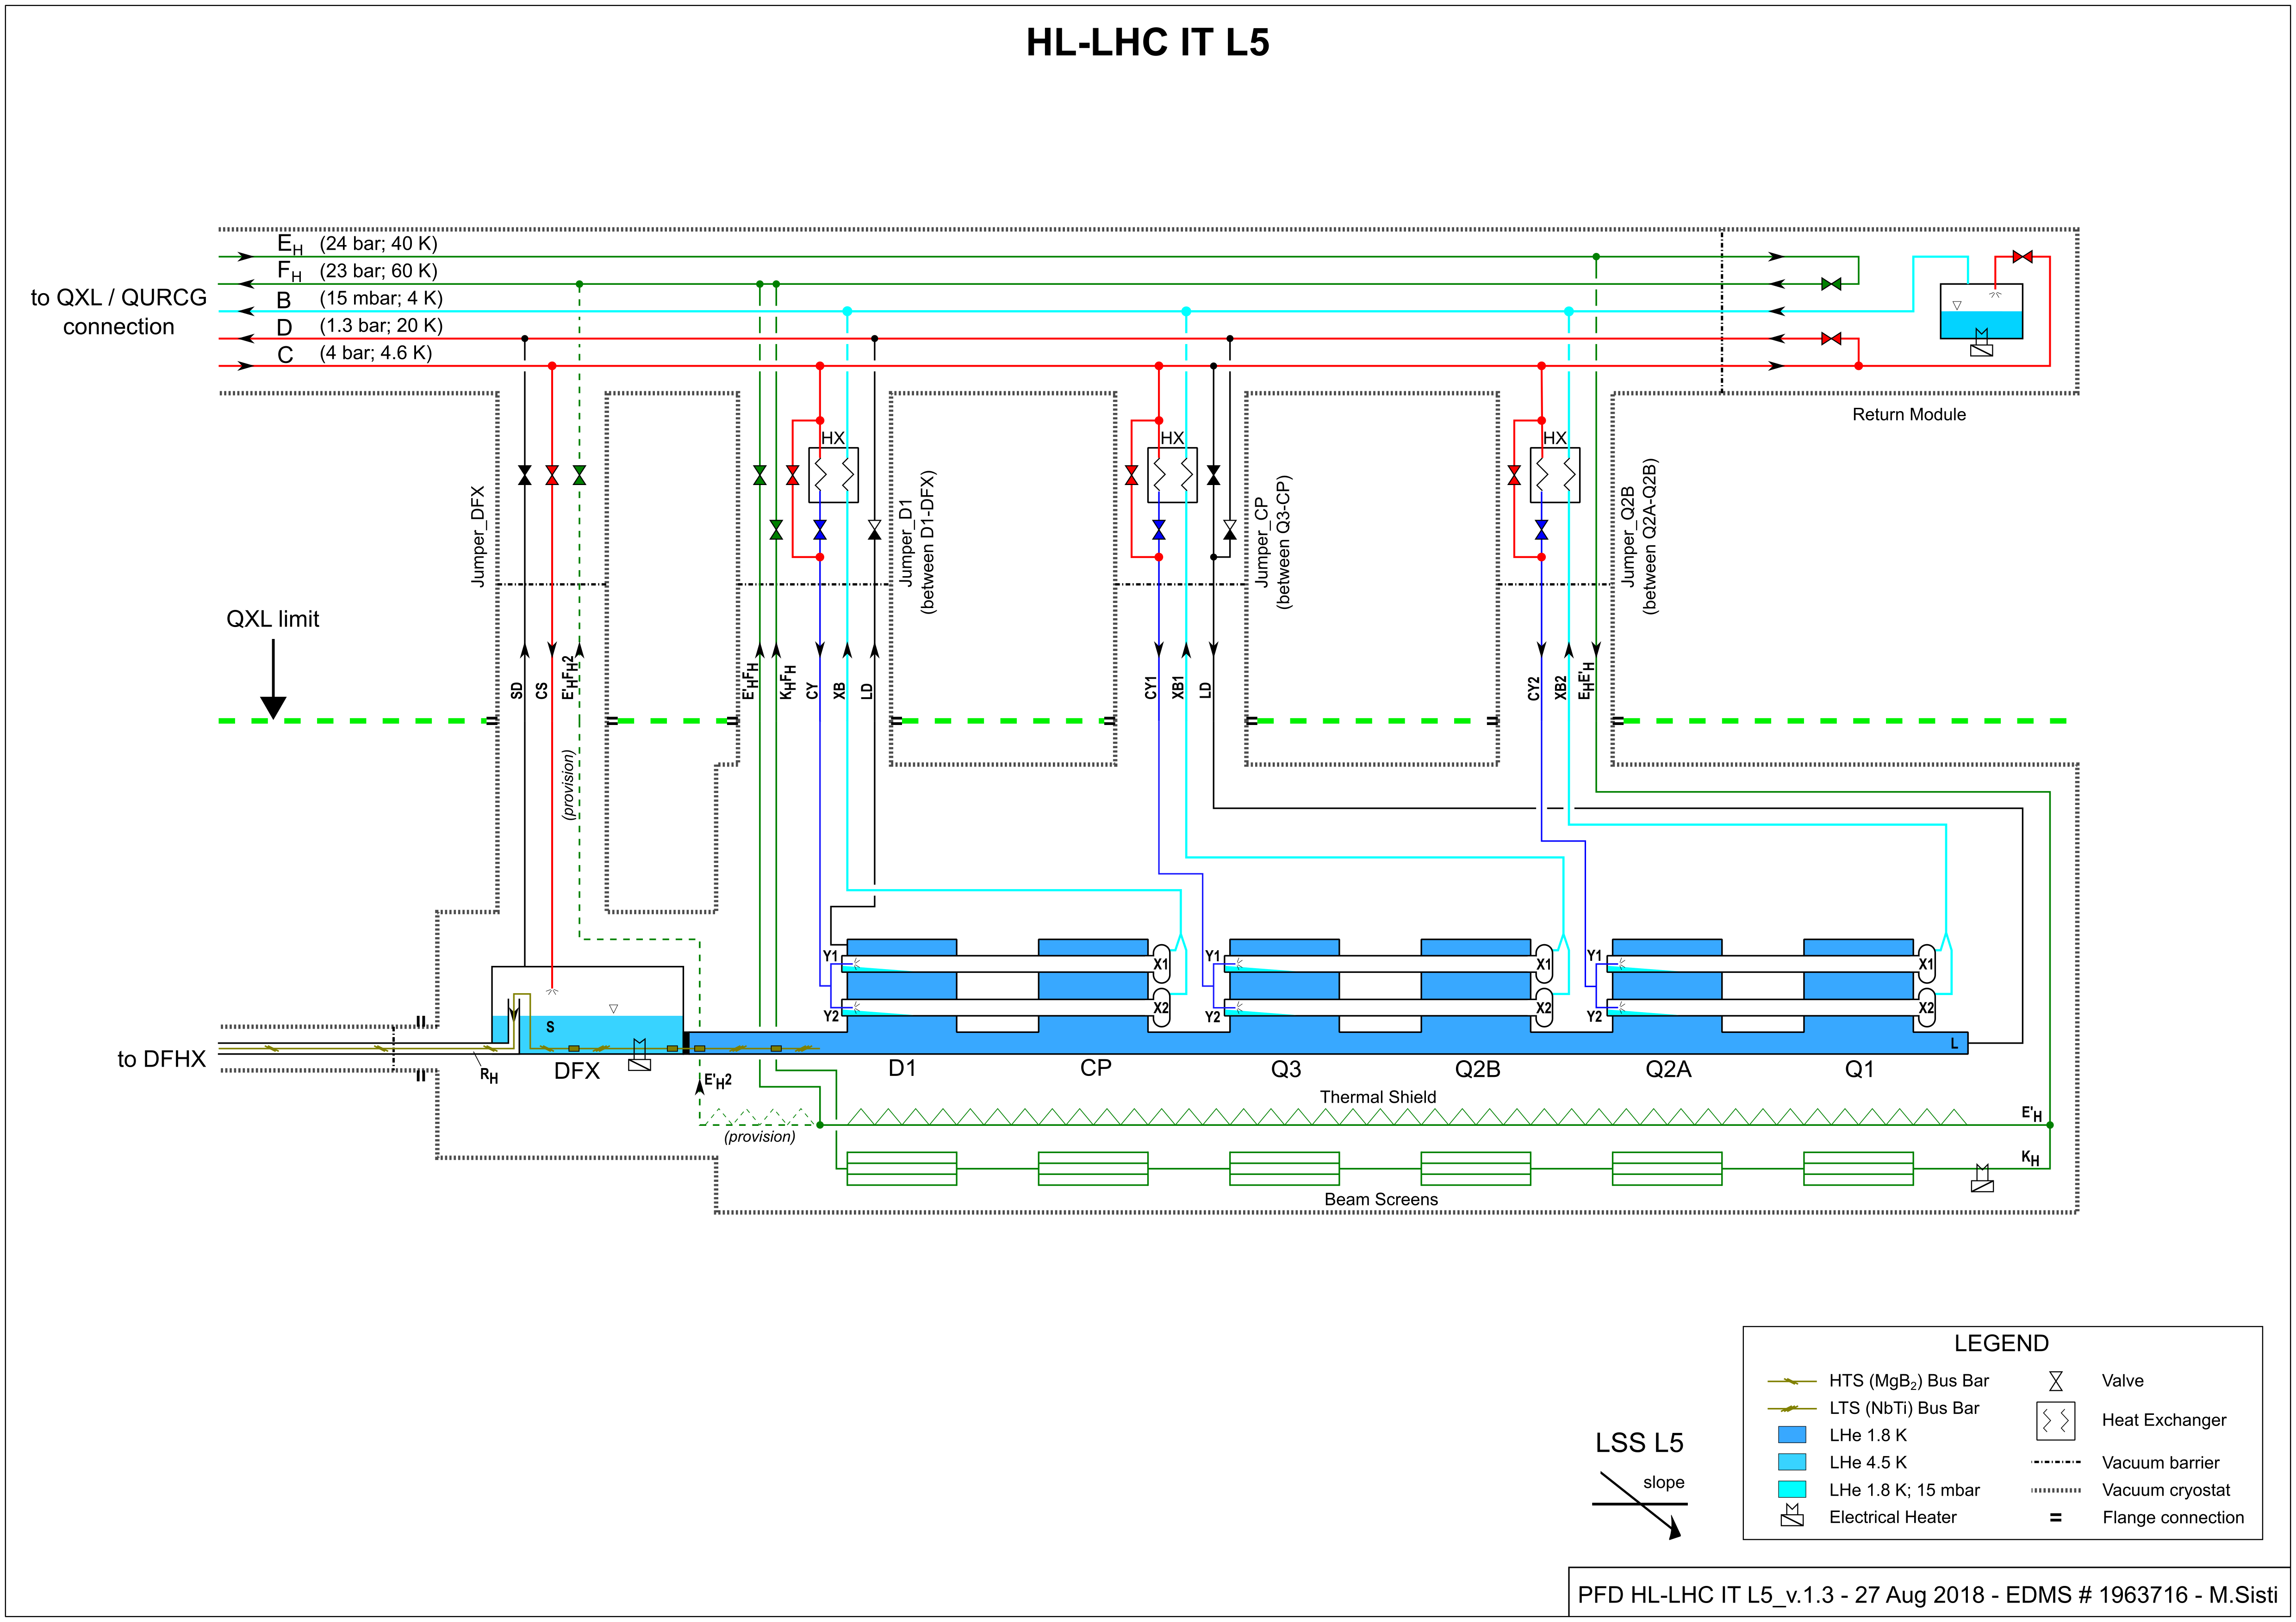
Cryo-distribution reference
CC
D2
QRL-QXL
IT-D1
Reference established, to be optimised considering project requirements and CRG expertise

Slide 9
Junction module QRL-QXL
Work on-going
3.5 m
4.0 m
4.5 m
It should fit within 12m

Slide 10
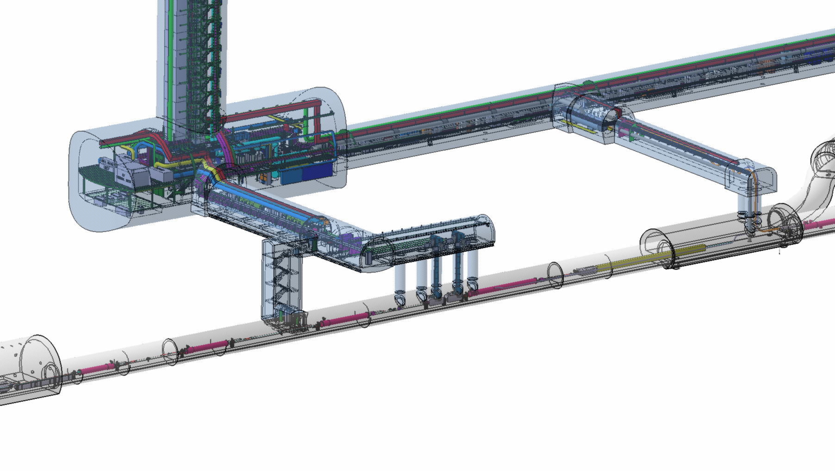
Cooling P1/P5 SAM’s
View from integration views DB
Return Module
Return Module
D2
QXL
QRL
Q4
Q5
Access / safety / sectorisation ?
Powering from existing RR & DFBL, corresponding cooling of DFBL and SAM’s to be with same origin
(QRL or QXL but not mixed)
Q4 and Q5 possibly with remote alignment, compatible with QRL ?
3D models to be implemented and then integrated (Q2-2018 for CRG)
Q6
NEW Jan’18
HL
Q4-Q5 could remain at 4.5K (already the case for Q6),
and moved towards the arc by 10-11m
LHC
Present limit for QRL/QXL

Slide 11
Possible modes and implications, as identified so far for HiLumi
Decreasing requirements in cooling capacity
HL
Ultimate Luminosity (HL)
Nominal Luminosity (HL)
Nominal Luminosity (LHC)
Low Luminosity / Intensity
. Powering conditions to 7TeV, (maybe pilots or few bunches)
Injection stand-by (He preservation in magnets, ELQA, maybe pilots or few bunches at injection)
Magnets @20K
=> The maximum reasonably possible
WRL
Bonus (only 1st year)
Junction Module QRL-QXL
Desired (1 wk)
Mandatory (few wks)
LHC
=> Junction Module and bridge between WRL’s recommended
=> Corresponding cooling capacities and impact on size/cost/volume to be further investigated

Slide 12
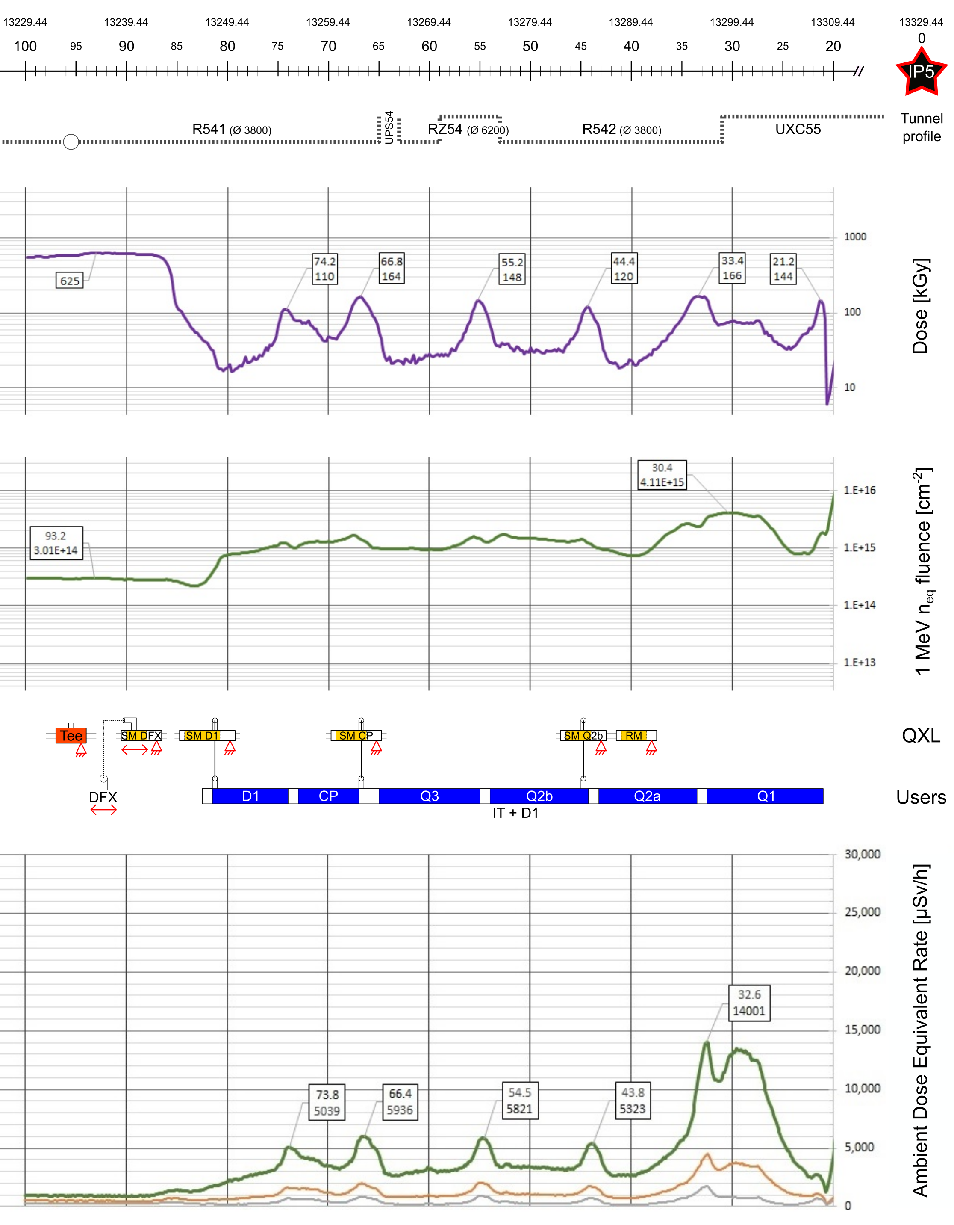
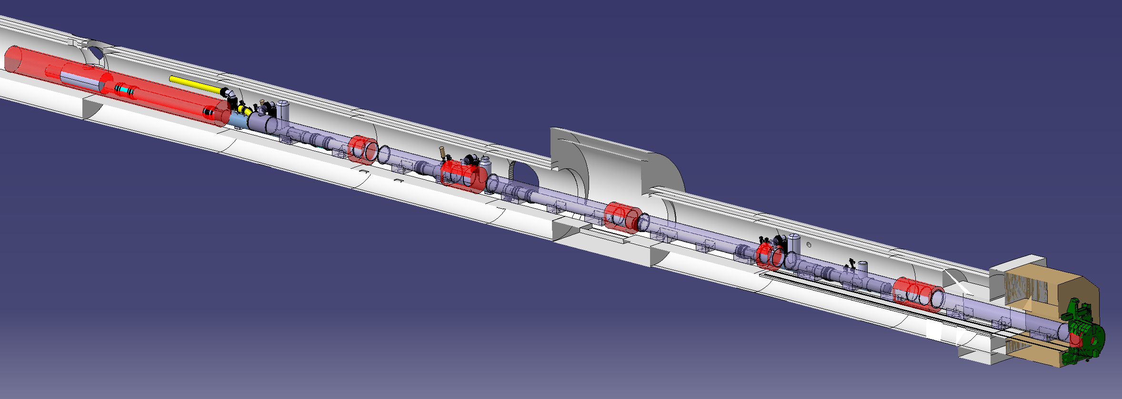
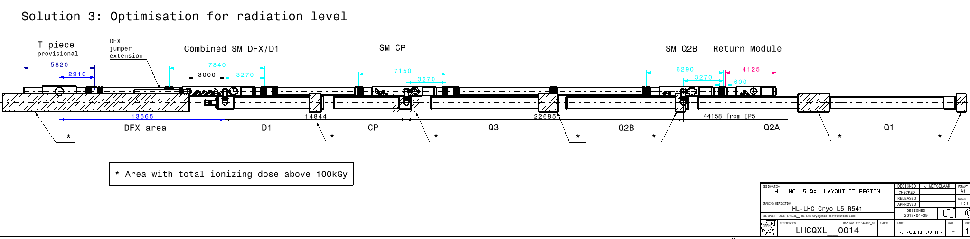
QXL Cryoline integration

Slide 13
HL-LHC refrigeration capacity at Points 1 & 5
About 18kW eq. @ 4.5K, including 3kW @ 1.8K
Temperature level | Cooling circuit | Specific heat load [W/m] (Static) | Capacity* / Point |  | Dynamic range
40-60 K | IT beam screen | 16 (0) | 3.2 kW | 13 kW | ~1.3
 | Thermal shield | 6 (6) | 3.6 kW
 | Crab cavity | - | 6 kW
20-300 K | Current lead & SC link | - | 40 g/s | 40 g/s | ~2
4.5-20 K | MS beam screen | 2 (0.1) | 0.1 kW | 0.1 kW | ~20
1.9 – 2 K | Cold-mass (1.9 K) | 14 (0.35) | 2.6 kW | 3 kW | ~10
 | Crab-cavity (2 K) | - | 0.4 kW
*: Including uncertainty and design capacity factor
Preliminary global values

Slide 14
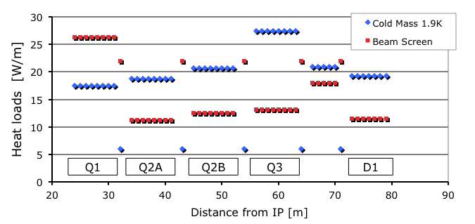
HL-LHC: heat loads on triplets
Based on data from F. Cerutti at 4th HiLumi annual meeting at KEK
Highly “luminosity driven”
LHC_Triplets_P1/P5
LHC_ARC_Cells

Slide 15
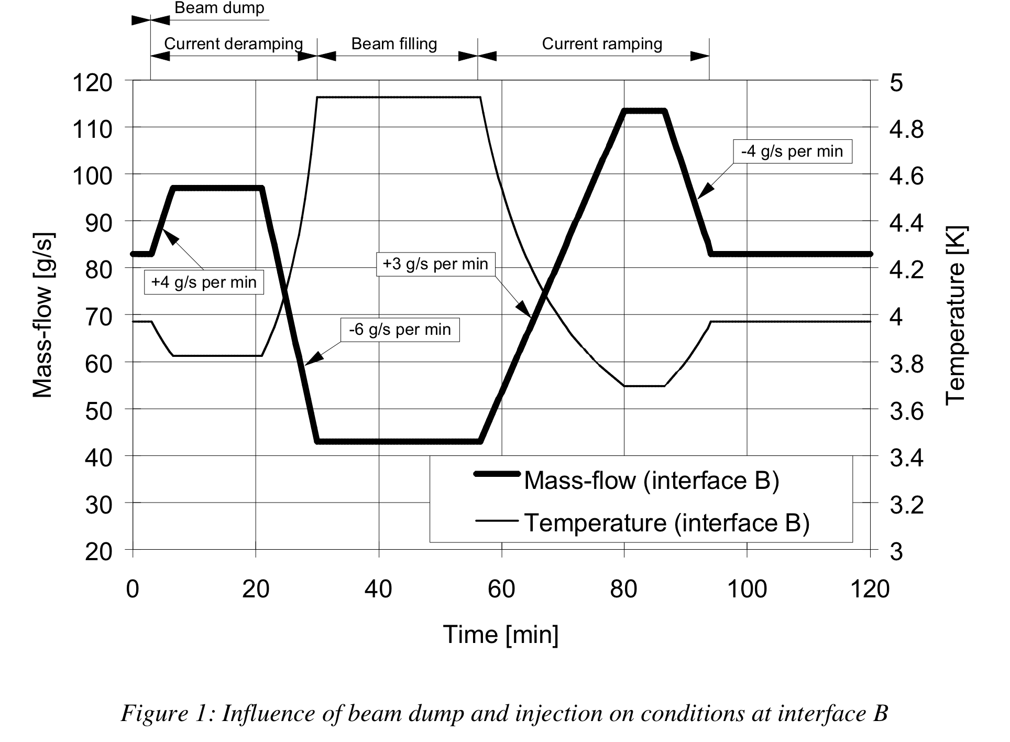
Introduction to dynamic effects, main parameters
IT-2545/LHC/LHC, 1.8K Units
Magnet ramping effect covered by margin in total capacity
Installed mode
(~150% Nom)
He buffering
Maximum flow
Flow acceleration
Nominal
(mode)
x2
Injection
(~Static losses)

Slide 16
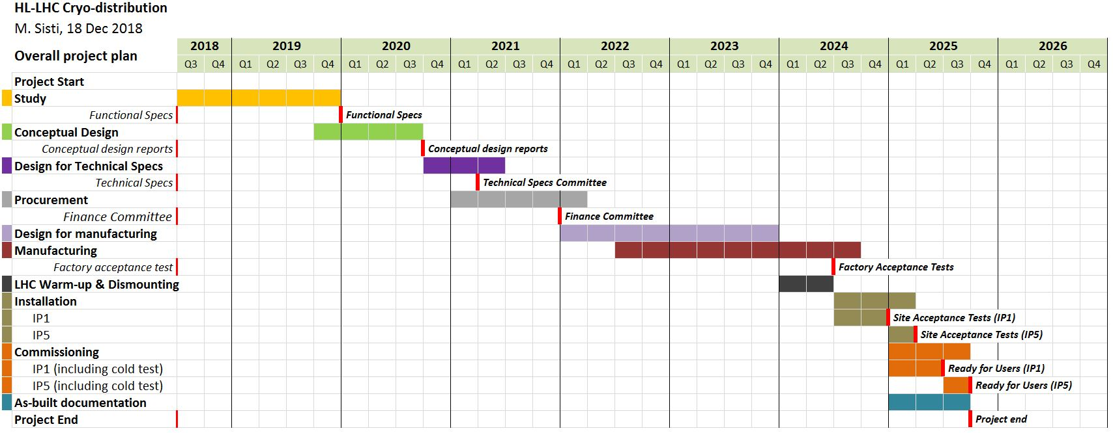
Project plans Refrigeration-Distribution
+
-
From WP-Central vision to project engineer ownership
without change for important milestones
Soon ready to discuss LS3 (ready to install, P1 w.r.t P5)

Slide 17
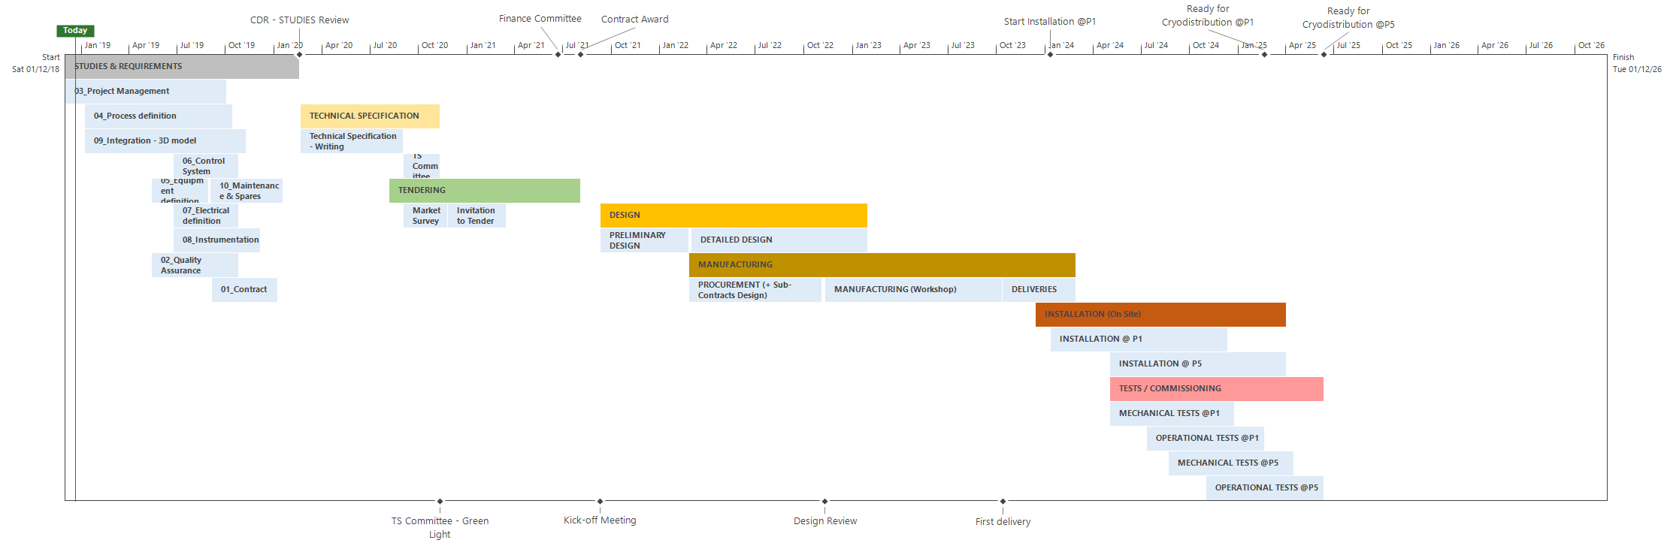
Project plans Refrigeration-Distribution
Prepared by E. Monneret
-
!
-
!
-
To be operated for QXL tests at cold, and LSS commissioning
From WP-Central vision to project engineer ownership
With moderate anticipation for tendering
Possible to anticipate delivery in 2023 (surface),
it would require to freeze heat loads at the end of 2019 (why not)

Slide 18
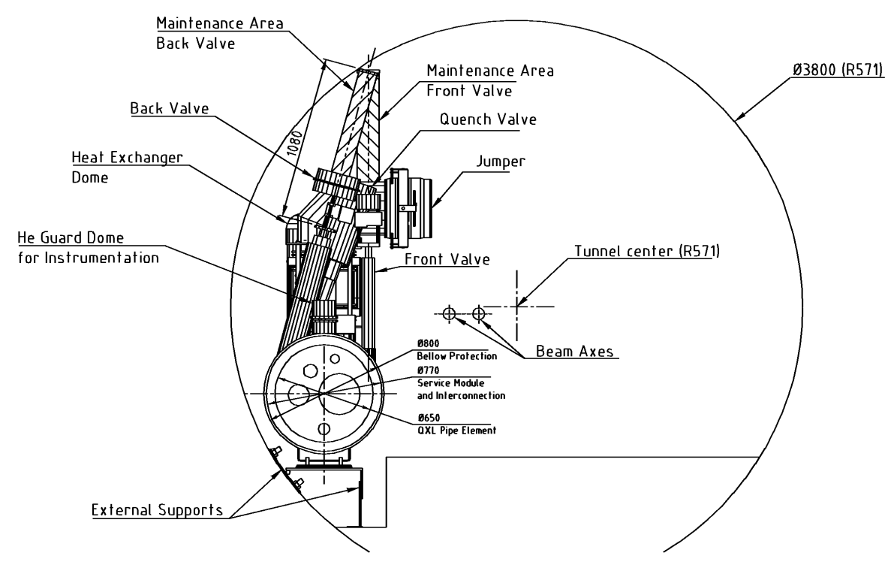
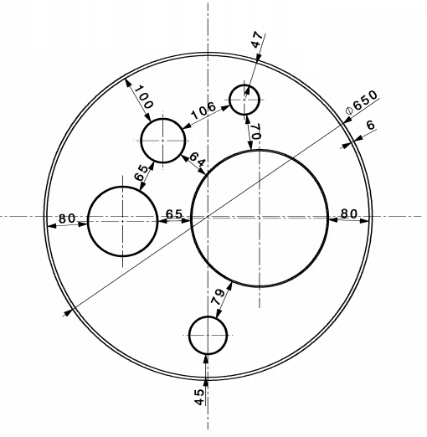
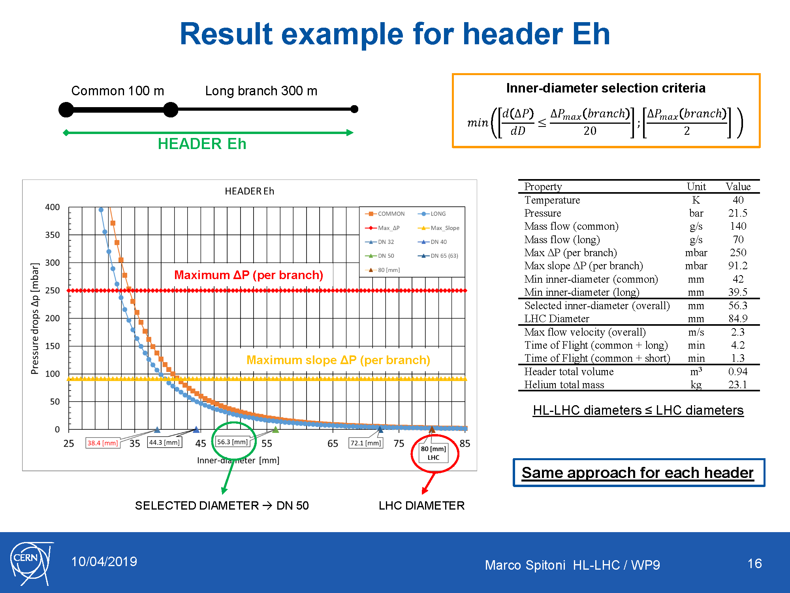
WG1, QXL headers – WG2, Functional Analysis
Typical Tunnel cross section
Inner Triplet flow scheme
QXL
Typical QXL cross section
Users
Eh
C
Header Eh → Supply of thermal shield and beam screen (IT only)
Header Fh → Return of header Eh
Header C → Supply of supercritical He
Header B → Return of superfluid He (very low pressure)
Header D → Return from DFX-DFM, beam screen (D2, CC, SAMs)
Various modes:
- Nominal
- Reduced capacity
- Cool-down
- Quench
- Other transients
D
B
Fh
Marco Spitoni HL-LHC / WP9
18

Slide 19
Goal of this mini series of meetings
For the HiLumi cryogenics at P1/P5, we have now completed the series of expected heat loads, flow diagrams and preliminary sizing of the QXL headers (QXL: Cryoline for HiLumi). We would like to complement this work with a similar one for controls.
Our goal is to evaluate possible control architectures, interfaces with existing ones,
and typical needs for racks and cables
As validated at pilotage last autumn and following similar work recently done for QXL sizing, we would propose to start a small series of meetings on this topic with specialised and experienced collegues in the group.
We could consider: introduction and presentation of reference so far for HiLumi cryogenics from our side, and LHC controls architecture from your side.
Discussion, studies for possible scheme for instrumentation and controls of HiLumi cryogenics.
A summary document with schemes and list should be the final deliverable.
For the organisation of these meetings, we will prepare ad-hoc indico sites, call for meeting and prepare executive minutes of meetings
Participants:
- HL-Cryo: Marco Spitoni, Michele Sisti, Emmanuel Monneret, Krzysztof Brodzinski, Serge Claudet
- CRG: Nikolaos Trikoupis, Juan Casas-Cubillos, Czeslaw Fluder, Marco Pezzetti, Benjamin Bradu
- Convenors: Michele Sisti, Serge Claudet
We would propose to use the slot on Thursdays 10h30-12h, tentatively and if nobody objects, we could start May 16th.
Looking forward to meeting you and getting your feedback!
WG3

Slide 20
Complements
(if needed)

Slide 21
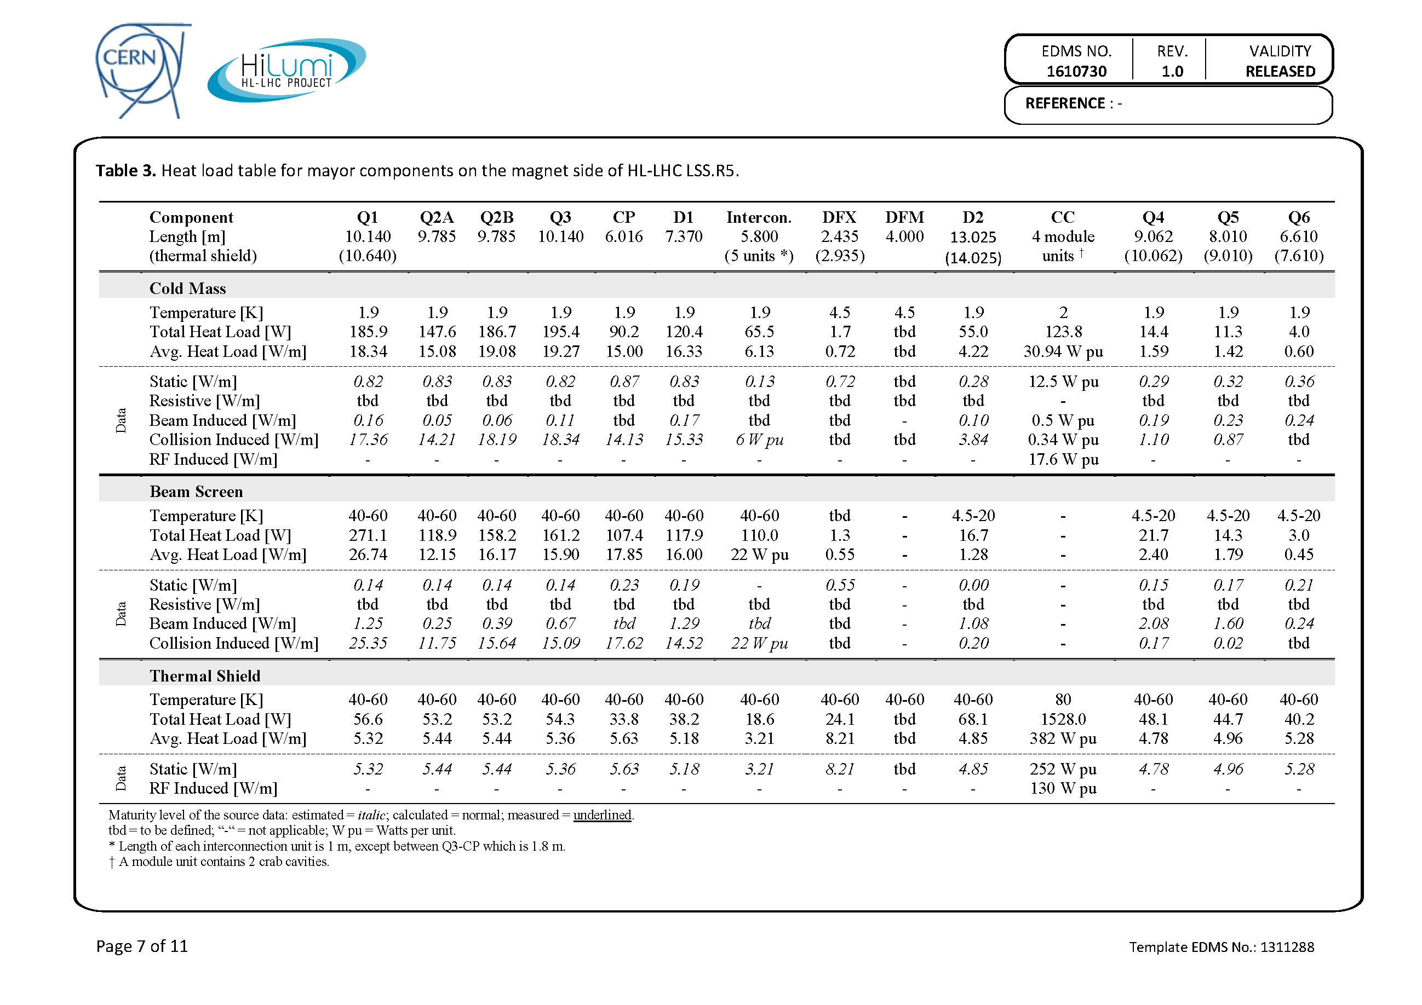
1st Evaluation of Heat Loads
1000 W
1200 W

Slide 22
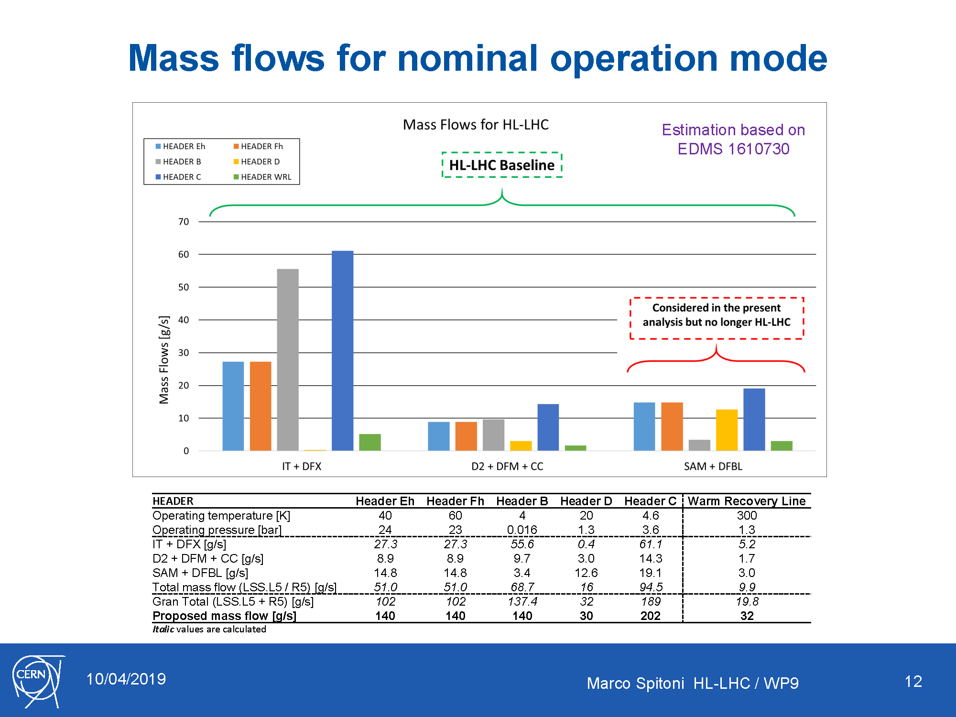

Slide 23
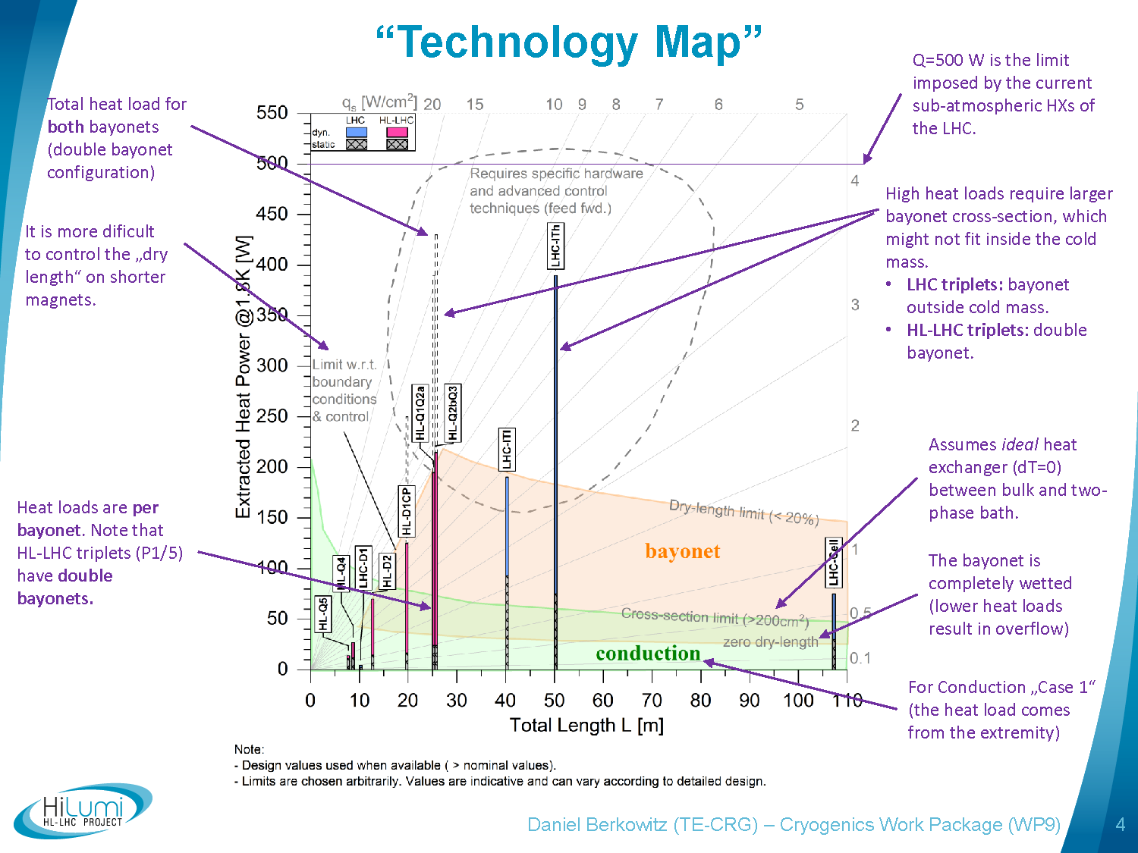
(slope dependent)

Slide 24
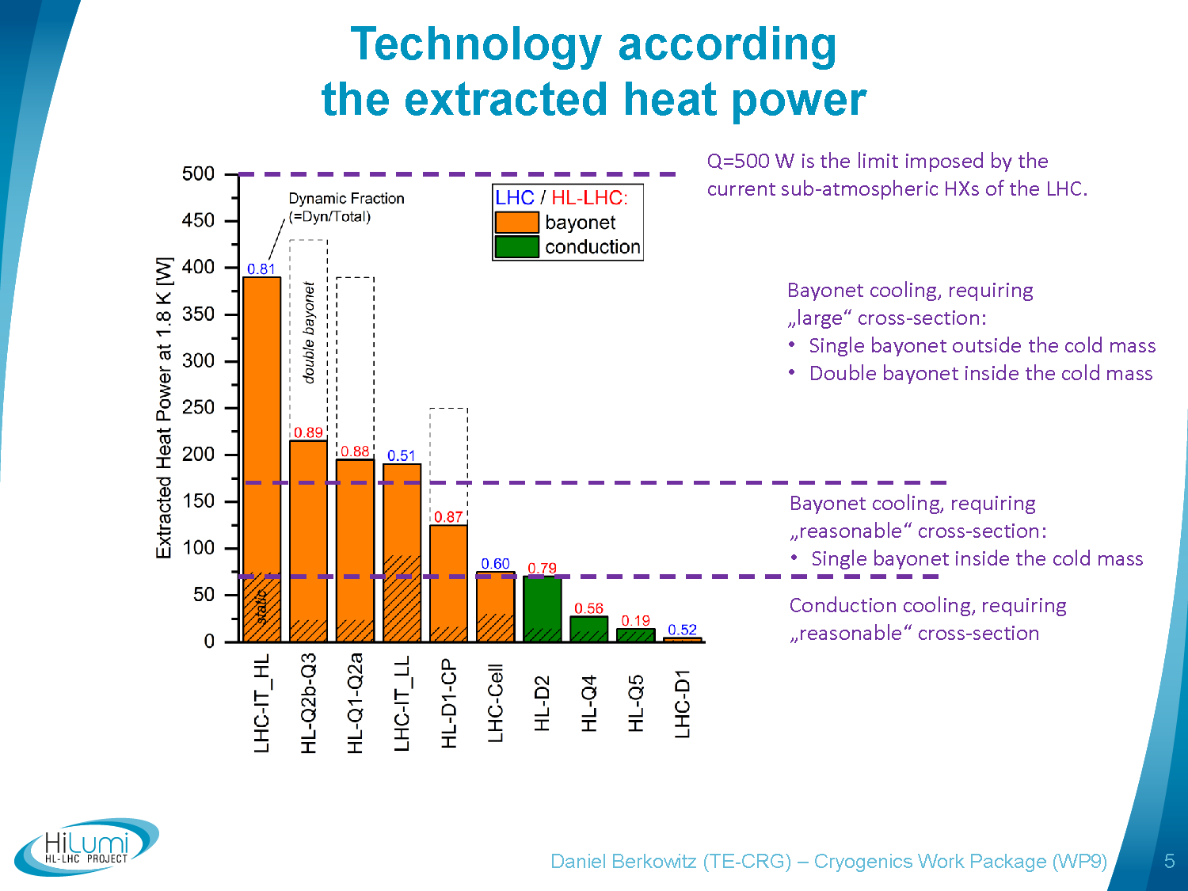

Slide 25
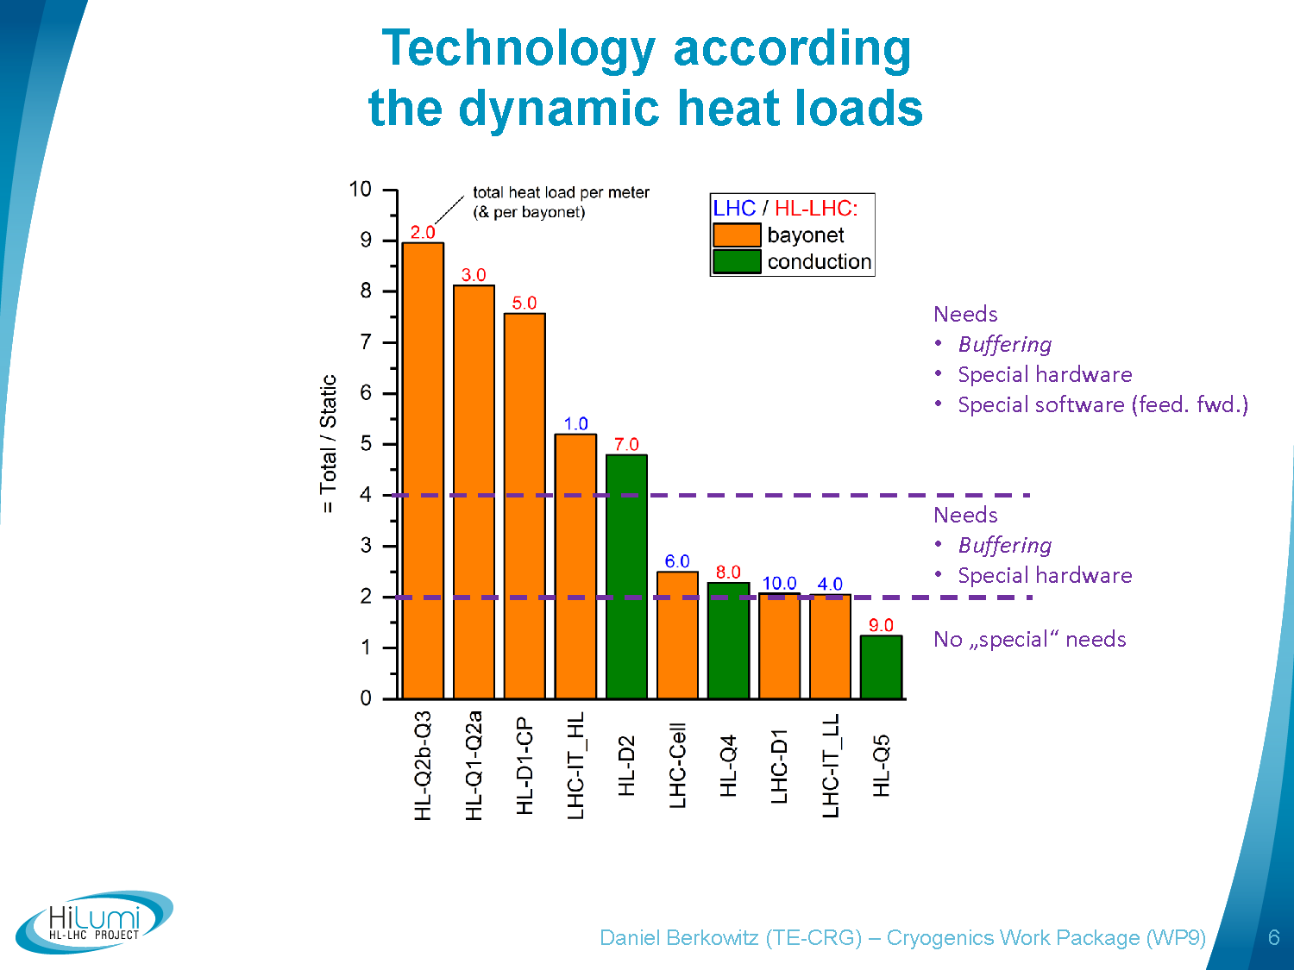
Consideration during LHC design phase: (driven by Cold Compressors dynamic)
(pre-load?)
Advanced controls, Feed forward
Classic (PID) tuning

Slide 26
WG2, Summary results
Thermal shield
(Eh - Fh)
Header B
Header C
Header D
LHC
(mm)
80 - 80
267
100
150
Not yet started
Directly affects
QXL vacuum jacket
Study started
Maximum increase
→ to be investigated
Higher
DN
DN 300 @ caverns?
(damping reasons)
DN 100/125 ?
(damping reasons)
DN 200 @ LSS_
(quench buffer)
Baseline HL-LHC
(DN)
50 - 65
250
80
125
Lower
DN
DN 40 - DN 50
(ΔP reasons)
DN 200 @ LSS_
(encumbrance)
DN 65
(conservative)
Could be decreased
(ok for ΔP)
(not ok quench)
No changes for the time being
DN 50
(ΔP reasons)
On-going work on damping effects for C (close to a baseline) and B (not much hope with “short” QXL w.r.t QRL 180m3)
Marco Spitoni HL-LHC / WP9
26

Slide 27
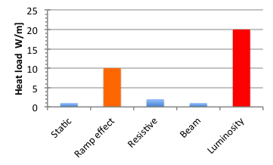
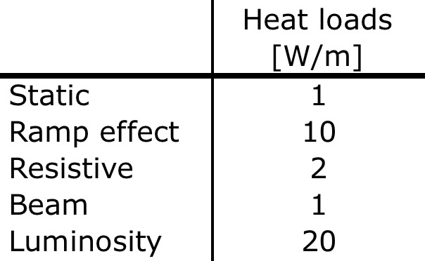
Introduction to heat loads per origin
Qualitative illustration (with not too bad orders of magnitude)
Magnet
Beam
?
=> This will deserve specific strategy

