Slide 1
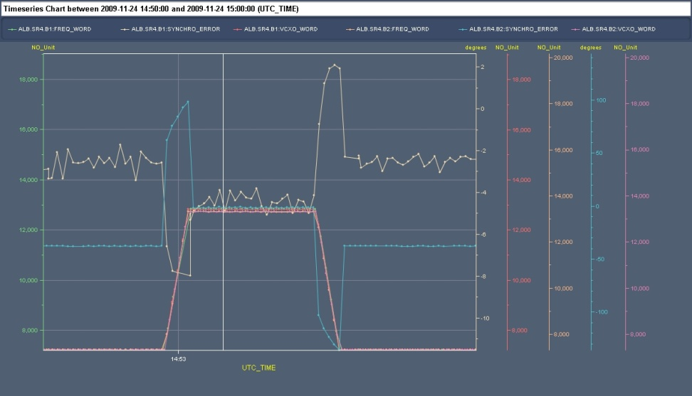
Synchronisation problems
Coarse frequency program reference for ring 2
  want to use ring 1 reference when rings locked together
  using wrong reference can make synchro loop unlock on a large trim
  → FGC and sequencer mods to allow use of ring1 reference for both rings
Phase loop problem with beam & RF off
  at injection gives random phase -> phase loop kicks synchro loop out of sync
  same when switching RF off with beam (e.g. for debunching)
  added threshold in firmware -> switching RF off disables phase loop
Beam control Clock generators
  resync of 40MHz sampling clock had been forgotten from synchro initialisation sequence
  used for sampling in beam phase module
  come up with random phase if not properly resynced
  → added resync of 40 MHz to f_{rev}
Installed diagnostics (TDC measurements)
  on BC1 crates (f_{rev} master vs f_{rev} prog)
  in Synchro system between f_{rev} prog 1 and 2
Synchro loop error (blue) during 855Hz trim
(ns)
Resynchronisation
Injection
Synchro loop unlocking at injection
Notes:
Run the sequencer!

Slide 2
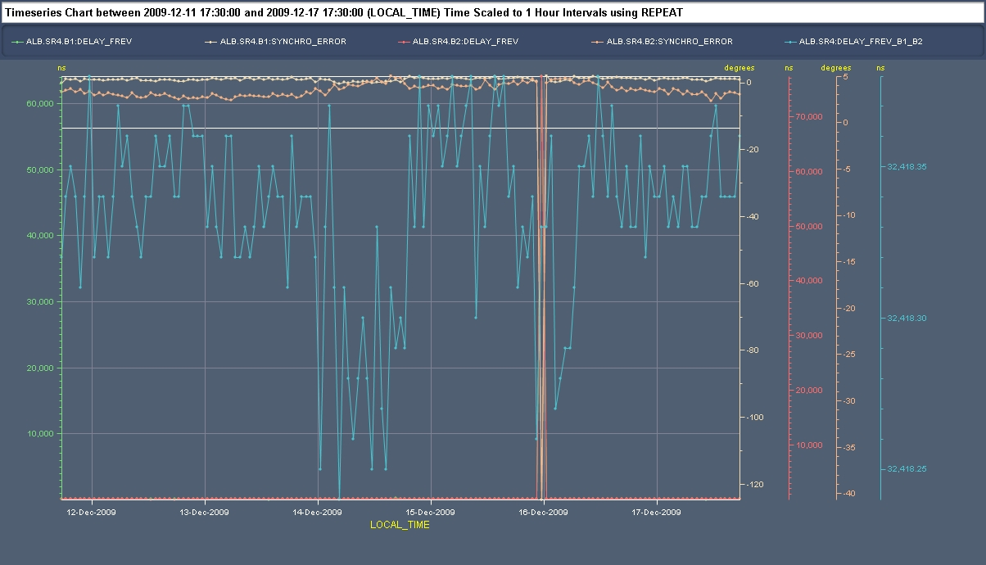

Slide 3
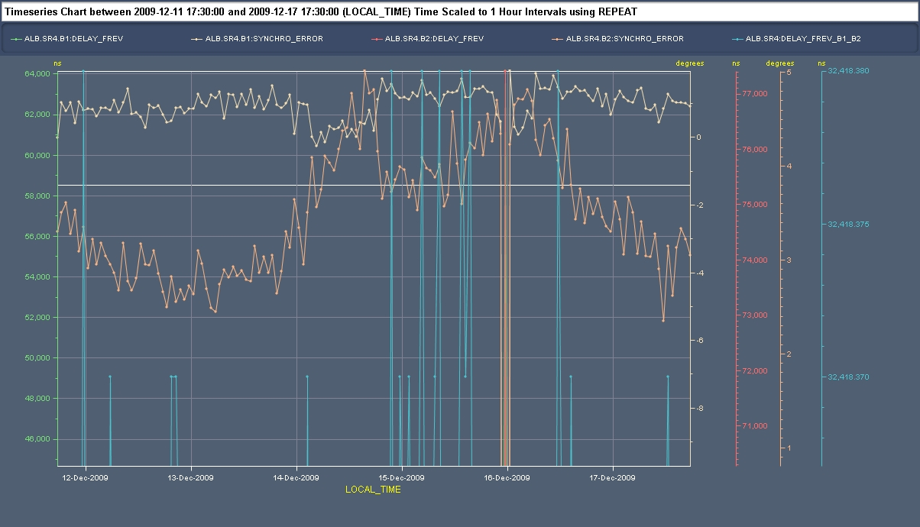

Slide 4
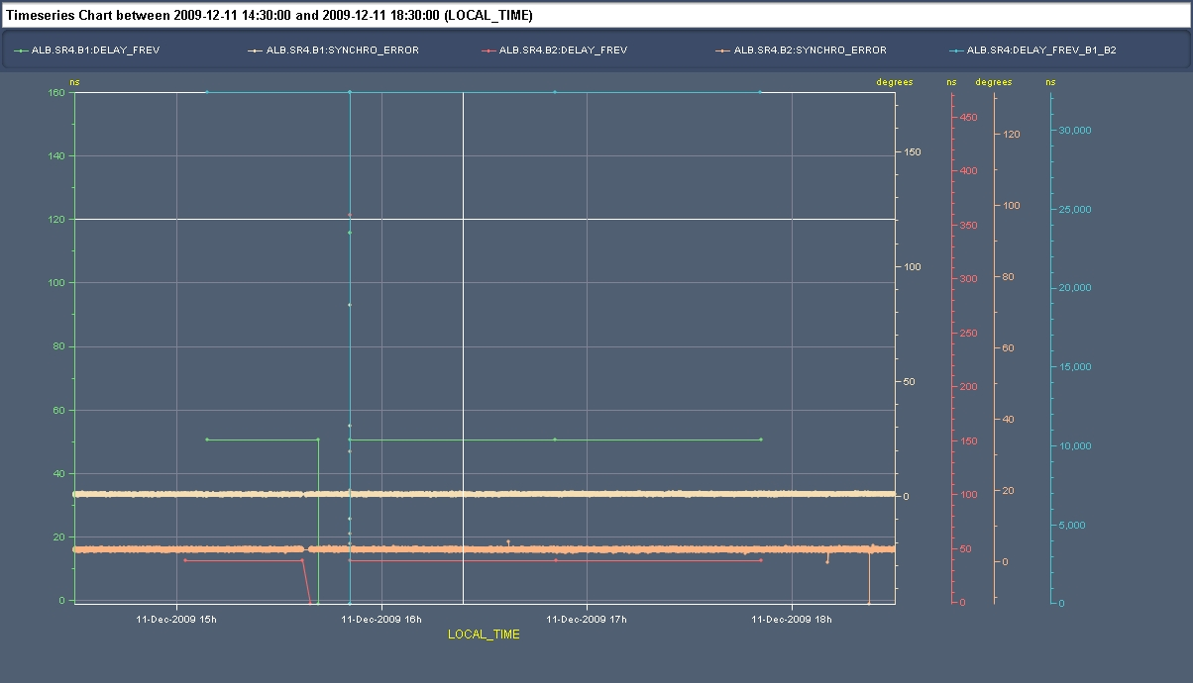

Slide 5
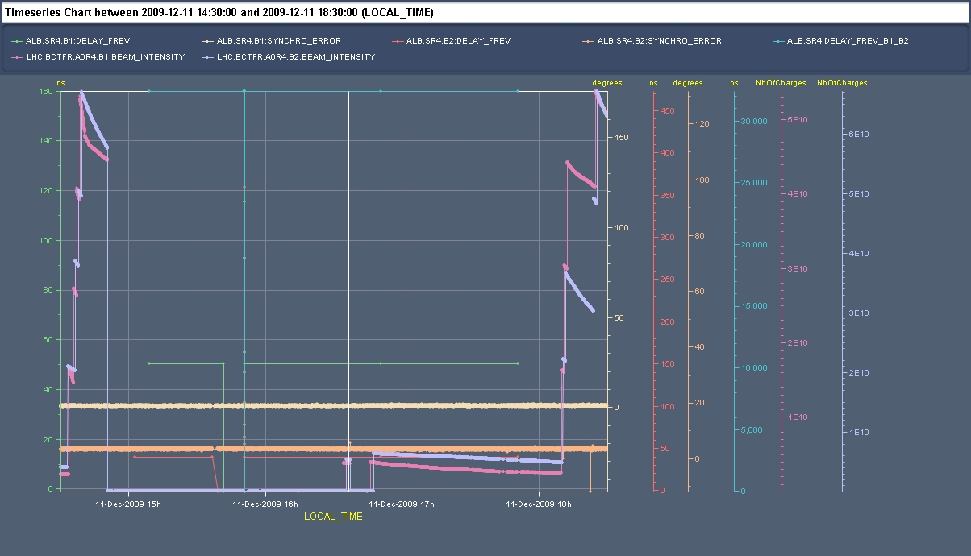

Slide 6
