Slide 1
Design, implementation and performance results of the GeantV prototype
Andrei Gheata for the GeantV R&D team
Draft_v2

Slide 2
1. Introduction, context, motivation
Why?

Slide 3

Context
Hardware: hitting walls
  power, ILP, memory access – limiting scaling up scalar code performance
    -> multi/many cores with SIMD pipelines, accelerators
LHC requirements++: Run3->HL
  Simulation still a bottleneck in many workflows
  demand for simulated samples ~luminosity
Application requirements: simulation is hard to optimize
  Very complex stepping per track
  Large code, sequential OO design from early C++ adoption era (deep stacks, virtual calls)
  Small number of instruction per cycle
CMS estimated CPU needs for HL-LHC (source: CWP)
Notes:
The hardware was hitting strong walls since ~2005 for scaling up the scalar performance. The community requirements were scaling up with the increase of luminosity, and simulation does not escape the rule. The simulation application is very complex and not optimized for modern architectures.

Slide 4
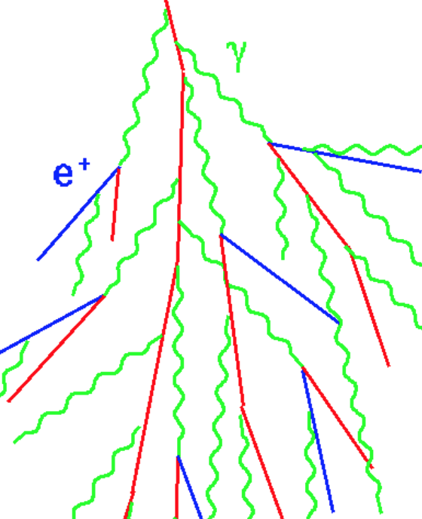
Application morphology: stepping
2. Transportation (multi-branching intensive computation)
query geometry
propagate in field to reach selected step
Cross boundary
Charged particle in field
3. MSC step correction (intensive FP)
Sample interaction length (memory lookup)
4. Continuous processes (ioni)
5. Sample discrete process + at rest (stochastic branching, memory lookup, computation)
– generate new tracks
6. Stepping actions (user callbacks)
The stages can make a pipeline, but each stage is large and complex (10²-10⁴⁺ LOC, deep stacks, stochastic decision tree)
Track state gets changed after every stage -> strong data binding between functional parts
Notes:
The application morphology is very important to understand the complexity and try to optimize

Slide 5
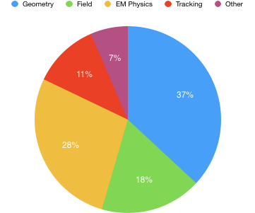
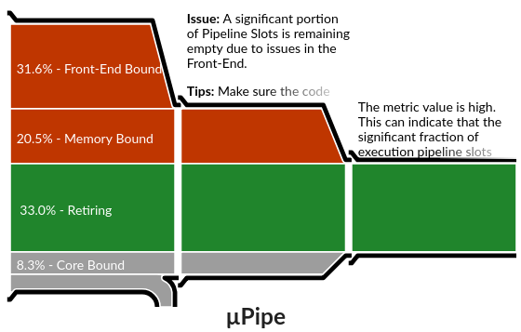
Motivations: locality & vectorization
Get rid of those…
Geant4, CMS benchmark (described later)
Front-end bound
~6% bad speculation
Vtune Microarchitecture analysis
Xeon®CPU E5-2630 v3@2.4 GHz
How the application works…
How the hardware behaves…
The profiling numbers are not absolute (application dependent)
- Useful to get insight on what happens in a complex setup
Shrink some cycles used here…
Notes:
Getting some profiling insight in a complex application already gives hints on where to optimize.
FEB: fetching code from memory and decoding into muOps
MB: load/store for data
Retiring: useful instruction executed
Core bound: CPU pipelines overloaded, unbalanced computation
Bad speculation: mostly branch prediction
Getting rid of most of the red (locality) and shrinking cycles the green (vectorization) by a sizeable factor can bring factors in speedup.

Slide 6
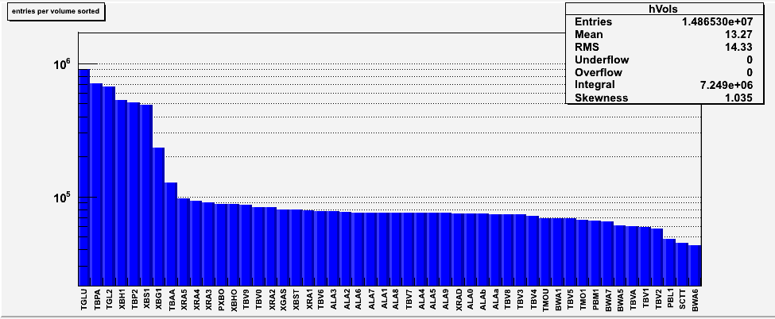
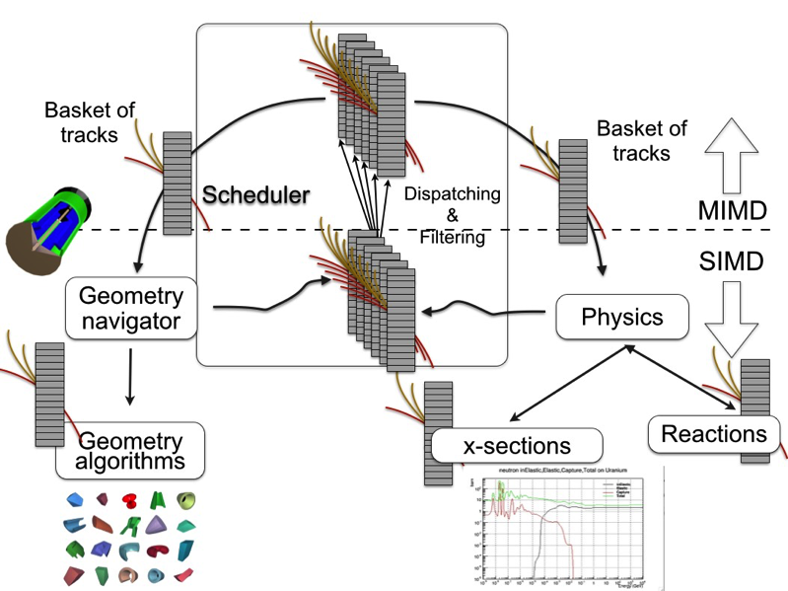
GeantV
50 per cent of the time spent in 50/7100 volumes
Initial observations
  There is large potential for locality in simulation
  Locality opens up parallelism
Initial ideas
  Grouping tracks doing same work...
  … and make the work vectorizable on tracks
  Gather tracks from more events to increase populations
Initial goals
  Primary: Large CPU speedup per single core for full sim
    increased locality and vectorization, usage of larger % of the hardware
  Secondary: new opportunities for accelerators -> GPU model?
  “Prototype with 2000 lines” (2013)
Extracted from early talks of Rene…
…and Federico
Notes:
- Started from the observation that there is large potential for locality, and some ideas on how to do it. The goal was not well defined, but optimistic.

Slide 7
Initial challenge : vectorizing the outer loop?
Model feature parallelism
(e.g. surfaces of a polyhedron)
Algorithm(Data &, ModelState& m)
Data
loop ( m.feature[i] )
{ FLOPS(Data, m.feature[i]) }
loop ( m.feature[i] )
{ FLOPS(Data, m.feature[i]) }
Very few algorithms with natural inner loops
loop ( m.feature[i] )
{ FLOPS(Data, m.feature[i]) }
loop ( m.feature[i] )
{ FLOPS(Data, m.feature[i]) }
Data feature parallelism
(e.g. multiple tracks)
Data
Algorithm(vector<Data*> &)
A new programming model?
Data
Data
Data
loop ( Data[i].feature )
{ FLOPS(Data[i].feature) }
Needs track-parallel environment
Modifying the workflow involves more copy overhead, since m.feature may be const data vector while data[i].feature needs to be gathered -> vector FLOPS need to worth it
Notes:
The main initial challenge was to figure out a programming model exposing the parallelism of the outer loops over tracks

Slide 8
2. Concepts, design considerations
Can it be done? To the blackboard…
Notes:
So step 2: can it be done?

Slide 9
Data processing oriented design
b
Work
Bundle data for same work type -> make it look more like pipeline
  Need more tracks doing the same work -> “basket”
  Tracks will need to be regrouped -> state fully contained in track
    Reentrant methods with tracks/baskets as arguments -> API change
Enable data locality
  Tracks in baskets need to be nearby in physical memory -> basket = SOA
May need to reinforce basket populations
  Allow several (mixed) events in flight -> event slots
  Data indexed by slot number [0…nslots]
… concurrently
  Shared basket data structure with atomic synchronization -> extra complexity
yyyy
zzzz
tttt
…
xxxx
Notes:
Many design choices derived directly from gathering track data for the same work type

Slide 10
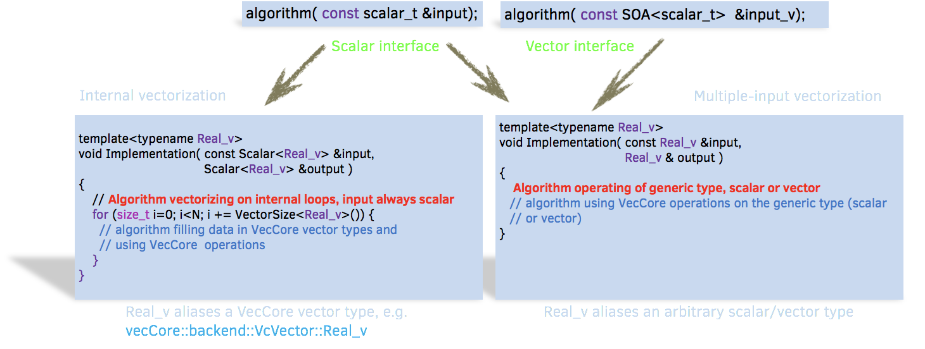
Code design: vector interfaces
Reusing code -> templated kernels for scalar/vector data types, working also on accelerators
A foundation enabling scalar/vector flows to coexist
Techniques to enforcing short vectorization -> independent on compiler
Started with geometry -> VecGeom
Transforming naturally vectorizable scalar algorithms to use explicit vectorization
Single kernel for scalar/vector code
Notes:
The code and API had to be redesigned as well, since compiler support for vectorization was very limited

Slide 11
Concurrency design: track-level parallelism
Tested different concurrency models: single kernel thread model (worker) vs. TBB-base attempts
Event server + event slots: thought as a necessity…
  More data for same work, data indexed by slot number
Track parallelism: try to find the optimum
  Be able to share state data, but exchange the minimum
Towards functional programming style: percolating all state (task data & tracks) through interfaces, making functions fully re-entrant
  Helpful for cutting down the Amdahl
Support for externally-driven parallelism
  What are HEP concurrent frameworks happy with?
Notes:
We tested different concurrency models to minimize overheads. The concept of event slots was intrinsic to multi-event handling. We tried to find gradually a compromise for the track parallelism, sharing less and less tracks. Functional programming was essential for cutting down the Amdahl

Slide 12
Prototyping revealed unforeseen problems
Track populations executing different kernels are not uniform
  Putting one basket per logical volume requires lots of tracks to trigger basket processing on a threshold
Exhausting tracks from in-flight event slots implies at some point flushing partial baskets into scalar executors
  Inefficient, but necessary to refill the workload and finish event transport
Concurrent track gathering in general track SOA creates bottlenecks
  Scaling problems, but also useless data copying
Boosting both instructions and data
locality in simulation has a price:
  Copy the state from sparse locations
Just illustrating scheduling issues here
Track block (contiguous)
Basket (SOA)
Different colors = different threads
Notes:
Several unforeseen problems were due to the specific workflow

Slide 13
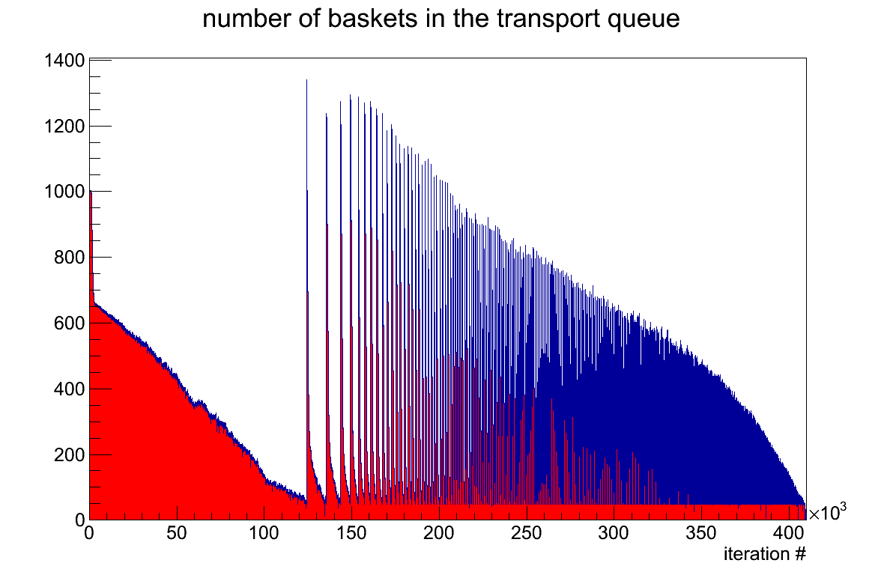
About 2000 lines, one year later…
A lot of good signs and hopes
  Geometry components showing good vectorization
Revealed how complex the problem really was…
  …and how reality can be different from blackboard drawings
Dealing with extra complexity and seeking solutions since then
  Moving gradually from a toy example with geometry only to the full complexity of an LHC experiment simulation
Initial events injection
Sparse regime
More and more frequent garbage collections (drink the glass empty…)
Less tracks per basket
Optimal regime
Constant basket content
Depletion regime
Continuous garbage collection
New events needed
Force flushing some events
Garbage collection threshold
Notes:
After ~2K lines, we ended up with a prototype, but this exercise revealed the real complexity of the problem

Slide 14
Going complex: algorithm-oriented design
Stepping loop
Stage
Basket
Geometry
Stage
Select appropriate handler
Select(Track*)
LinearPropagator
(scalar)
scalar
Algorithm1
(scalar)
Track*
Stage
Basket
Propagation
Stage
gather
scatter
FieldPropagator
(vectorized)
AOS
SOA
Algorithm2
(vector)
AOS
Stage
Basket
Physics
Stage
std::vector<Track*>
Vector basket
FieldTrack_v &
AOS
Stage
Basket
other stages…
scalar/vector flow in stages
2 types of baskets (copy what is needed)
Stack-like approach
Less work sharing
GeantTrack *
Secondaries
#10
Secondaries
#1
Primaries
#0
Event server
Prioritized particle stack
…
consume showers first
Notes:
On the path to dealing with the full complexity, we enabled a model based on specialized processing stages handling baskets of track pointers and dispatching them to lower level algorithms via handlers supporting both scalar/vector dispatch, basketizing only required input data into SOA baskets

Slide 15
3. Implementation: the components
How?

Slide 16
VecCore – SIMD Abstraction Library
Get()
Set()
Simple API abstracting common SIMD operations in a generic way
Evolution of “backends” from VecGeom
  Abstraction across scalar and vector types
  Used by VecGeom and ROOT besides GeantV
Multiple backends support
  Relies on Vc + other backends for the implementation
Multiple platform support
  x86/CUDA, but also ARM, PPC64 with scalar backend
Multiple OS:
  Windows, Mac, and Linux
Foundation layer for GPU
Gather()
Scatter()
Blend()
MaskedAssign()
mask
https://github.com/root-project/veccore
Notes:
One of the foundation components derived from VecGeom development was VecCore. This is an Abstraction library supporting SIMD operations, but most importantly an abstraction across scalar/vector types.

Slide 17
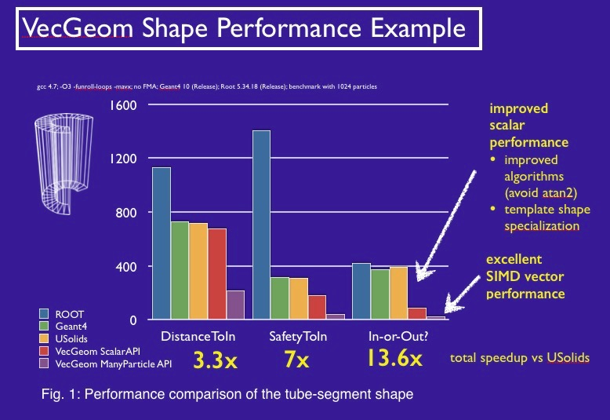
VecGeom – vectorized geometry library
Workhorse for implementing the main project ideas:
  Multi-architecture support, scalar/vector workflows
  Multi-level vectorization (optimization structures + shape algorithms)
Performance-driven development
  best algorithms inspired from GeantV/ROOT/USolids
  Production-level quality
  Unit-tests showing excellent performance figures
Remaining problem: dispatching efficiently to lower level algorithms
  Cannot group by boxes/tubes/…, but only by logical volumes
  Volume navigation has to talk to several daughters -> work divergence
Notes:
VecGeom was really the workhorse for the main ideas. The development was performance driven.

Slide 18
VecGeom: a new programming model
gitlab.cern.ch/VecGeom/VecGeom
Cacheable
(Specialized navigation)
vectorized
vectorized
(scalar mode)
vectorized
Notes:
VecGeom is not only a geometry library but also a model for programing in a similar manner a scalar, vector or GPU workflow

Slide 19
VecMath: vectorization support for math utilities
github.com/root-project/vecmath
Library needed for common vectorized algorithms, math, vector- aware types (Vector3D, SOA3D, AOS3D, …)
  So far only: PRNG implementations, fast math functions (vectorized)
Idea: extending the library to provide common vectorization support
  Migrate existing common components from VecGeom & GeantV, add extra general-interest utilities
VectorFlow: A way to express outer loop vectorization in a general way in a scalar workflow
  Templated abstraction based on the concepts of ‘work’ and ‘flow’ inspired by GeantV
  Extracted as independent library, not part of VecMath
Notes:
We gradually extracted common vectorization utilities with a scope larger than VecCore in VecMath. The basketized workflow of GeantV was abstracted out based on templates and extracted in the VectorFlow library.

Slide 20
GeantV EM physics models
particle | processes | models(s)
 |  | GeantV | Geant4 defaults
e⁻ | ionisation | Møller[100eV-100TeV] | Møller[100eV-100TeV]
 | bremsstrahlung | Seltzer-Berger [1keV-1GeV] | Seltzer-Berger [1keV-1GeV]
 |  | Tsai (Bethe-Heitler) w. LPM. [1GeV-100TeV] | Tsai (Bethe-Heitler) w. LPM. [1GeV-100TeV]
 | Coulomb sc. | GS MSC model [100eV-100TeV] | Urban MSC model [100eV-100TeV]
 |  |  | Mixed model [100MeV-100TeV]
e⁺ | ionisation | Bhabha [100eV-100TeV] | Bhabha [100eV-100TeV]
 | bremsstrahlung | Seltzer-Berger [1keV-1GeV] | Seltzer-Berger [1keV-1GeV]
 |  | Tsai (Bethe-Heitler) w. LPM. [1GeV-100TeV] | Tsai (Bethe-Heitler) w. LPM. [1GeV-100TeV]
 | Coulomb sc. | GS MSC model [100eV-100TeV] | Urban MSC model [100eV-100TeV]
 |  |  | Mixed model [100MeV-100TeV]
 | annihilation | -Heitler (2𝛾) [0-100TeV] | Heitler (2𝛾) [0-100TeV]
𝛾 | photoelectric | Sauter-Gavrila + EPICS2014 [1eV-100TeV] | Sauter-Gavrila + EPICS2014 [1eV-100TeV]
 | incoherent sc. | Klein-Nishina⁺ [100eV-100TeV] | Klein-Nishina⁺ [100eV-100TeV]
 | e⁺e⁻ pair production | Bethe-Heitler⁺ [100eV-100TeV] | Bethe-Heitler⁺ [100eV-100TeV]
 |  | Bethe-Heitler⁺ w. LPM [80GeV-100TeV] | Bethe-Heitler⁺ w. LPM [80GeV-100TeV]
 | coherent sc | - | Livermore
+ | energy loss fluct. | - | Urban
GeantV physics list used also in Geant4 for comparisons
Notes:
The models are not a port from Geant4, but code derived from theoretical models. Geant4 implementation was checked for consistency and fixed wherever needed. The implementations in GeantV/Geant4 are very different due to framework constraints, but also sampling methods (rejection vs. tables) and vectorization.

Slide 21
Vectorized EM physics models
Rewritten models describing nearly complete EM physics (except energy loss fluctuations)
  More compact implementations, simplified interfaces
  Support for multiple physics list
  Several features went back also in Geant4, so the physics Geant4/GeantV can be numerically compatible
All the models are multi-particle vectorized
  Most important work was done to vectorize the common services: sampling algorithms (alias, table), track rotation/boost
  Many challenges: unpredictable recursions, memory access, code complexity
  Final state EM speedup: between 1.5-3 on Haswell, 2-4 on Skylake with AVX2
Most efficient implementation for a model depends on many factors
  Energy, material composition
  Precalculated tables or accept/reject
  The full performance study is not complete
Notes:
The models were re-written in a more compact form with simplified interfaces, but numerically compatible with G4 ones. All models are vectorized, starting from the common services.

Slide 22
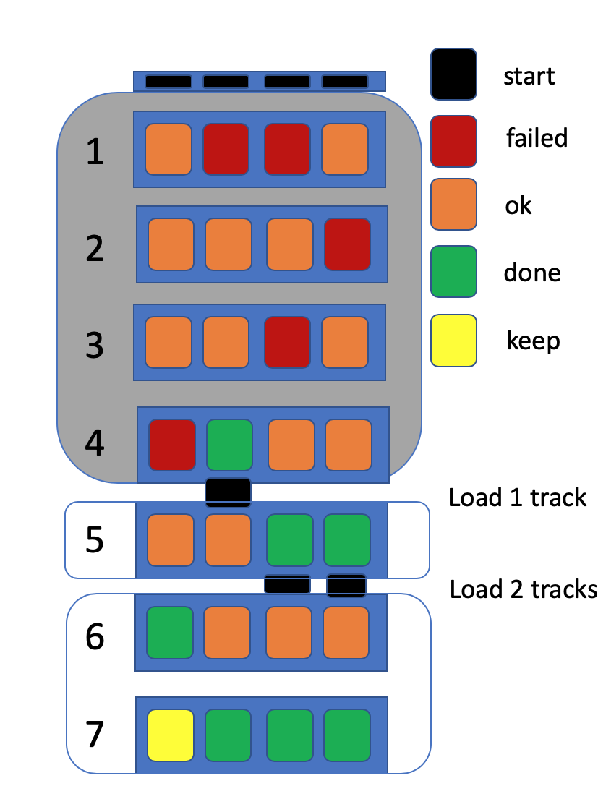
Integration of motion in Field
Integration takes about 18% CPU time in ‘scalar’ GeantV
Vectorized over tracks
  Driver, RK stepper, equation, field interpolation
Lower level classes ‘simply’ vectorizable
  Implementation templated on Field/Equation types
Top level ‘Driver’ fully rewritten
  checks good step and end of integration, reloads vector lanes with new work
No more tracks
Notes:
The integration in field vectorization was one of the important studied carried on during the R&D, due to its importance. All the components were redesigned and rewritten compared to the G4 implementation.
Started from GSoC 2014 G4 project
Memory size increase – only field was basketised in this benchmark on MacOS High Sierra with Xcode 10.1.

Slide 23
Field Propagation - optimization
Memory size vs basket size
for different event window sizes.
Efficiency and memory use depend strongly on basket size b
  Lanes doing useful work increases from 82% (b=16) to 99.3% (b=1024)
  Memory size increases – by 160MB for b=1024 (16 event window) (why?)
Further refinements possible
  ‘Reordering’ tracks - so long integration moves to basket front (tested – 97.5% util. @ bsz=64)
  Using ‘single’ track code if only 1 track is left.
  Improved load / store.
Unused lanes (fraction) vs basket size
Notes:
One of the components showing efficient basketization was field propagation. Several efficiency studied such as dependency on basket size were done, showing that further refinements and improvements are possible.
Started from GSoC 2014 G4 project
Memory size increase – only field was basketised in this benchmark on MacOS High Sierra with Xcode 10.1.

Slide 24
User interfaces: a compromise
Same callbacks as in Geant4, but dealing with the extra complexity of multiple events and multiple threads
  Data structures: templated approach (users provide their own types)
  Data indexed only by event slot, not thread id
Approach changed from:
  “give me your hit model, I give you factories and tools to handle and store them efficiently concurrently”
    Nice concurrent merging service ending up in ROOT (TBufferMerger)
To:
  “Here are the hooks allowing to allocate your own data and providing per-thread handles”
  “Here is the workflow allowing to score concurrently and merge hit information”
Storing the hits or passing them to digitization is the user business
Notes:
Of course the prototype had to demonstrate that it is usable by user code in the same manner as Geant4. We had to compromise having the same interfaces, but the extra complexity of multiple events/.threads.

Slide 25
User data integration in GeantV callbacks
master
UserApp::
Initialize()
Create/attach user data to task data
UserApp::
FinishRun()
UserApp::
AttachUserData(td)
UserApp::
SteppingActions(td)
Data registration -> get a
handler
TaskData *td
Merge run user data (on demand)
Retrieve user data using handler,
score inclusive or per event info
UserData<T>
UserApp::
AttachUserData(td)
UserApp::
SteppingActions(td)
UserApp::
FinishEvent(event)
TDManager
TaskData *td
Merge event user data providing handler to a service (on demand)
workers
UserData<T>
UserApp::
AttachUserData(td)
UserApp::
SteppingActions(td)
TaskData *td
  Example data models making use of event slots coming with the library
data per run
UserData<T>
data per event
ScoringData
[0..nslots]
vector<DataPerEvent>
Requirements for user hit types:
Data::Merge(int event_slot, const Data &other )
Data::Clear(int event_slot)
Notes:
To demonstrate how user scoring data can be integrated, we provided a simple example showing the requirements on the data and the integration in GeantV callbacks.

Slide 26
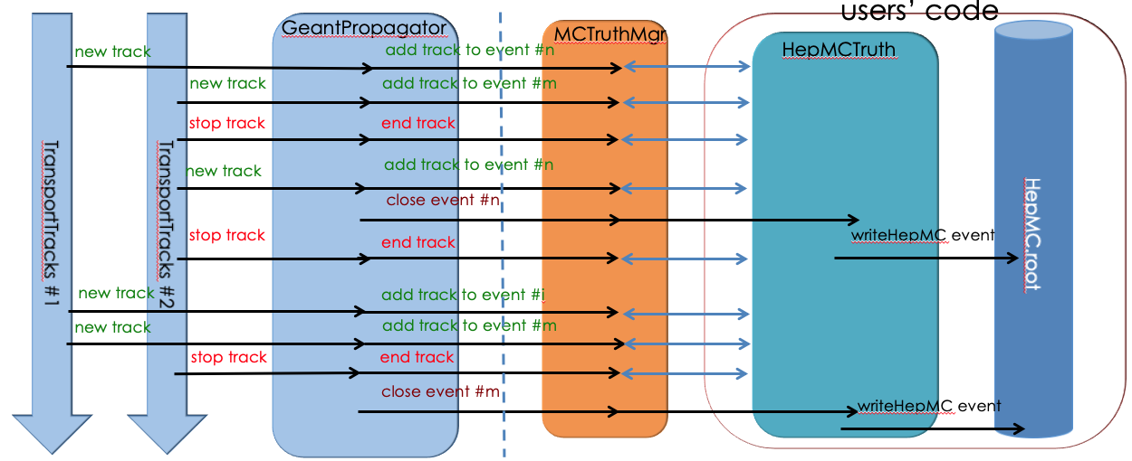
MC truth: keeping track of kinematics
Problem: we need to store the particle history necessary to understand the given event (process)
  there is no single solution that would cover all use cases
  functionality is provided as a user-hook allowing concrete user implementations
interface (MCTruthMgr) implemented in the prototype
  receives (concurrent) notifications from transport threads about: adding/ending particles, events finishing
  delegates processing of particles history to concrete MC truth implementation
Light coupling to transport
  minimal ‘disturbance’ to transport threads
  maximal flexibility of implementing custom particle history handlers
concrete example implementation provided based on HepMC3
  See backup slides for more details
Notes:
For understanding the compatibility of GeantV approach with MC truth recording, we developed a model based on a Mctruth manager + user filter allowing to start/stop recording based on stepping information.

Slide 27
4. Integration with experiment frameworks
Easy to use?

Slide 28


GeantV Integration in CMSSW
Integration testing of GeantV w/ CMSSW has several goals:
  Demonstrate benefits of co-development between R&D team & experiments
  Exercise capabilities of CMSSW framework to interface with external processing (ExternalWork mechanism) and handle track-level parallelization in detector simulation
  Measure any potential CPU penalties or gains when running GeantV in CMSSW
  Estimate cost of adapting to new interfaces and eventually migrating to new (and potentially backward-incompatible) tools such as GeantV
    Thinking forward to HPC/GPU solutions
Not planning to migrate CMS simulation to GeantV
  This is an R&D exercise
Notes:
There is no plan to migrate the simulation of CMS to GeantV, but there were several targets explored: co-development benefits, CMSSW interfacing capability with ExternalWork mechanism, ….

Slide 29
Overview of the integration exercise
Exercise and debug features of GeantV and CMSSW
  Run GeantV using CMSSW ExternalWork feature:
    Asynchronous, non-blocking, task-based processing
  Resolved impedance mismatch between original GV scheduler and CMSSW
Template wrappers for Sensitive detectors (SD) and scoring
  Ensure exact same SD code used for Geant4 & GeantV
  Minimize overhead (no branching or virtual table)
  Handle that each event processed in multiple threads, mixed in with other events (i.e. merge at end of each event processing)
Performance results and conclusions discussed in separate sections
Notes:
The integration exercise led to improvements on both sides, solving impedance mismatches in terms of parallelism and user interfaces. The templated wrappers allowe running the exact same scoring code with minimal overhead.

Slide 30
5. Performance results
Is it efficient?

Slide 31
Benchmarks
Set of application examples to demonstrate functionality and/or measure performance
  Simple setups: simplified layered calorimeter
  Complex setup with general non-experiment specific stepping actions: CMS
    Full geometry and production cuts
    Shooting electrons to fire EM physics
    Allowing to tune internal GeantV parameters
    GeantV and Geant4 applications mapped 1 to 1 (geometry, physics lists, gun, cuts)
Set of CPU platforms
  Different architectures, CPU, cache configurations
  Performance results given mostly for the CMS benchmark
Notes:
We provided a small set of application examples to measure and optimize the performance. We tested on several CPU platforms, and some components were also unit tested on GPU

Slide 32
Checking physics performance (1)
Per-mil agreement for all observables in most cases
Notes:
Results are in most cases agreeing at per mil level, like in the layered calorimeter example.

Slide 33
Checking physics performance (2)
Some ~1% systematics visible in magnetic field
  Known issue due to difference in tracking/boundary crossing between GeantV and Geant4
Notes:
There is in case of magnetic field some %-level systematics, mostly understood due to differences in the stepping and boundary crossing in the 2 cases.

Slide 34
CMS example comparisons
Configuration details: GeantV vs. Geant4 10.04.p03
  FullCMS geometry (cms.gdml)
  No field/Map-based magnetic
  field
  GeantV-defined physics lists
  Input: 10 jobs x 1000 e+ each
Jobs run on single-thread,
scalar mode
Observables:
  number of secondaries
  track length
Good matching within percent
level
  statistics to be improved
Geant4: blue
GeantV: non-blue
e⁻
Neutrals
𝛾
e⁺
Charged
Notes:
These plots show the matching level for observables such as number of secondaries and track length.

Slide 35
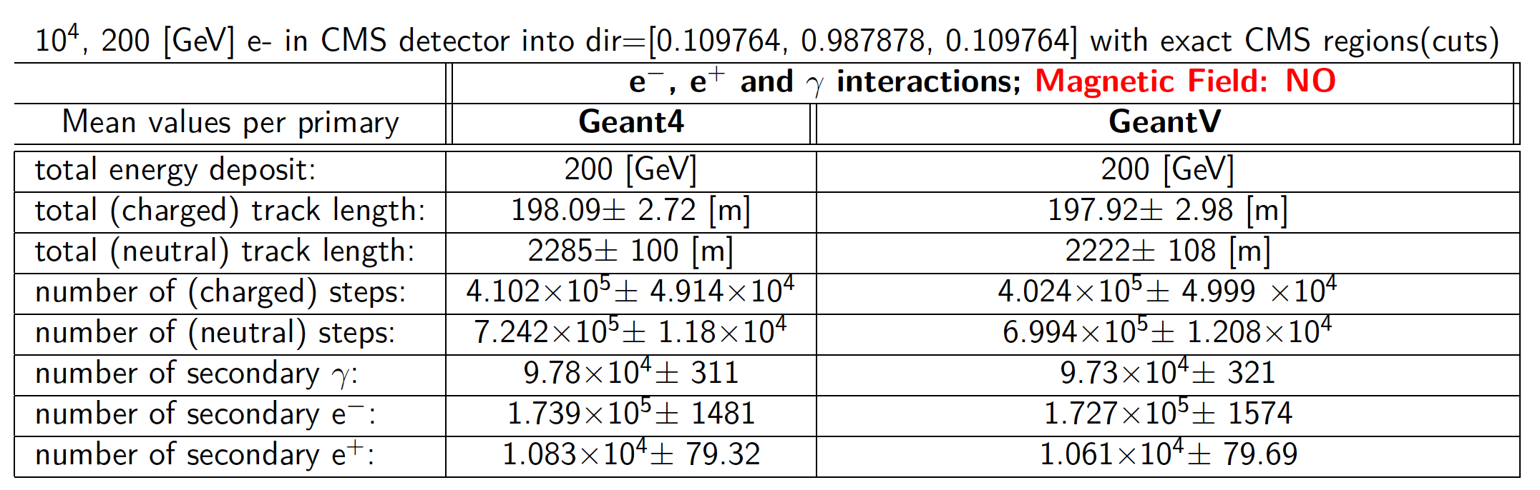
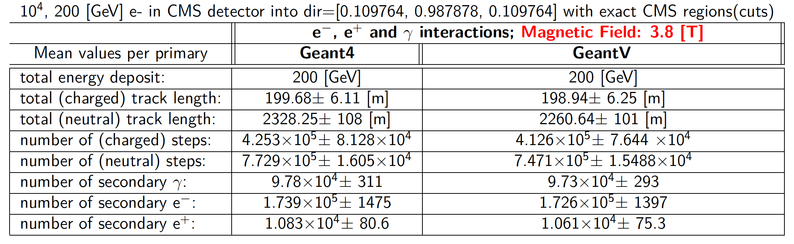
CMS example: stepping observables
B = 0
Good matching for all observables
B = 3.8 T
Notes:
More detailed comparisons were done in both field and w/o field for many other observables, showing good matching

Slide 36
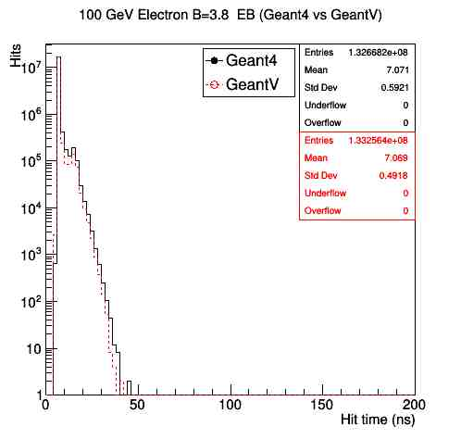
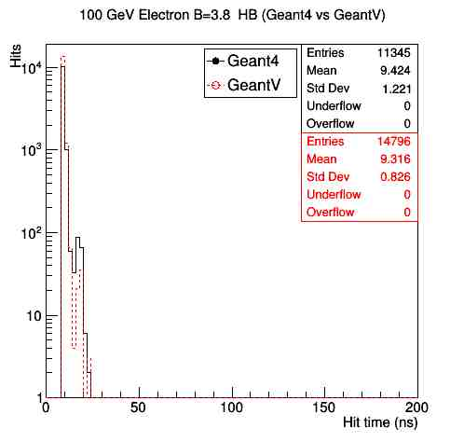
Physics validation in CMSSW simulation test
Geant4 10.4p2 w/ VecGeom v0.5 (scalar) vs
GeantV pre-beta-7 w/ VecGeom v1.1
  All CMS-specific G4 optimizations disabled
  Same production cuts (default 1mm)
  Single thread (reproducible pRNG sequences)
Roughly the same distributions
with no magnetic field
Small difference in the physics results
in the presence of constant B-field
Hit Time for 100 GeV e- (B=3.8)
Notes:
To make sure that they run the same simulation, the integration test in CMSSW was checking also the hit information, showing also good matching modulo the small field effects described before.

Slide 37
Basketizing: efficiency, vectorization, overhead per stage
gather
scatter
AOS
SOA
Stage
AOS
Several execution modes to measure stage performance
  Scalar mode (no baskets): T_{scalar}
  Vector mode (fill baskets and call vector algorithm): T_{vector}
  Basket “emulation” mode* (fill baskets and call scalar algorithm in loop): T_{BE}
  Scalar dispatch mode⁺ (execute full stepping loop with single particle): T_{SD} -> measure impact of improved GeantV code
Measure efficiency & overhead for basketization relative to total run time
  Overhead: B_{o} = (T_{BE} – T_{scalar}) / T_{scalar}
  Observed efficiency: B_{e} = (T_{scalar} – T_{vector}) / T_{scalar}
  Vectorization efficiency: B_{v} = B_{e} + B_{o}
scalar
scalar
vect
scalar
Scalar_b
scalar
* BE mode hard to measure for some stages (e.g. physics) missing emulation of scalar scatter of internal SOA basket
+ emulating Geant4 stepping but with GeantV data model
Notes:
An important study based on the CMS benchmark was done for basketization efficiency. To measure how efficient is to vectorize globally in the context of changing the workflow and doing gather/scatter, we introduced few complementary modes.

Slide 38
Results: basketizing efficiency
Fractions of total scalar execution time
Xeon®CPU E5-2630 v3@2.4 GHz ,16 core
2x32KB L1/core, 256KB L2, 20MB L3
CMS application benchmark
  100 GeV isotropic e⁻
  100 primaries, 16 event slots
  Field type: CMS map
  1 thread, performance mode
Bad vectorization efficiency overall
  Up to 10-12% depending on platform
  Large overhead, sometimes bigger than vectorization
    Dispatching to many small basketizers (geometry) not effective
Good use cases: field and MSC
  larger % FLOP
Stage | % total | B_{e} | B_{o} | B_{v}
Field | 14.4% | 5.0% | 2.0% | 7.0%
Phys⁺ | 9.4% | 0.3% | 1.4% | 1.7%
Geom* | 12.3% | -3.3% | 3.7% | 0.4%
MSC^{x} | 8.6% | 1.8% | 0.2% | 2.0%
FPMº | 32.4% | 5.8% | 1.5% | 7.3%
+ Only post step sampling of physics models
* Only querying distance to boundary and safety
x Only MSC position/direction correction calculation
o Best configuration for vectorization (Field /Physics/MSC)
Measurement errors < 0.5%
Notes:
The results for the basketizing efficiencies and overheads per simulation stage are presented in the table. To note that efficiency is in some cases ~equal to the overhead, but can be also negative in case of geometry. The good cases are field propagation and MSC, while the best combined case shows up to 5-10% of the total time gain. We see clearly how expensive is to gather data even for a subset of ~50-100 volumes, while dispatching vectors to low level algorithms is very difficult. A global conclusion is that overall vectorization is much lower than expected.

Slide 39
Basketizing overheads dependence on architecture
Geant4 (10.4.p03) vs. GeantV (beta)
10 GeV electron x 1000 events (1-thread, 10 measurements), 16 event slots
CPU | OS | gcc | SIMD | Cache L1 | Cache L2 | Cache L3 | B_{o} _{(field)} | B_{o} _{(physics)} | B_{o} _{(geometry)} | B_{o} _{(MSC)} | B_{o} _{(FPM)}
Intel i7 2.5GHz | Ubuntu 16.04 | 5.4.0 | AVX2 | 4x32 KB I 4x32 KB D | 4x256 KB | 8 MB | 2% ± 1% | 2% ± 1% | 6% ± 1% | 0% ± 1% | 3% ± 1%
Intel Core i7-4510U 2GHz | Ubuntu 16.04 | 5.4.0 | AVX | 2x32 KB I 2x32 KB D | 2x256 KB | 4 MB | -1% ± 7% | -3% ± 7% | 12% ± 9% | -4% ± 8% | 2% ± 8%
AMD A10- 7700k | Fedora Workstation 29 | 8.2.1 | AVX | 2x96 KB I 4x16 KB D | 2 x 2 MB | - | 15% ± 1% | 4% ± 1% | 15% ± 1% | 1% ± 1% | 13% ± 1%
Intel Celeron 1000M 1.8GHz | Fedora Workstation 29 | 8.3.1 | SSE4 | 2x32 KB I 2x32 KB D | 2x256 KB | 2 MB | 9% ± 1% | 5% ± 1% | 9% ± 1% | -1% ± 1% | 9% ± 1%
Intel Centrino2 | Fedora Workstation 29 | 8.2.1 | AVX | - | 4 MB | - | 6% ± 1% | 3 ± 1% | 13% ± 1% | -1% ± 1% | 7% ± 1%
11AMD e-300 | Ubuntu 18.10 | 8.2.0 | SSE2 | 2x32 KB I 2x32 KB D | 2x512 KB | - | 1% ± 1% | 3% ± 1% | -3% ± 1% | -2% ± 1% | In process
Overhead seems to largely increase for smaller (data) cache size
Notes:
Measuring the dependency of the copy overheads with the platform/architecture, we see a very large variation. It seems that the overhead largely increases for small L1 cache size.

Slide 40
“Basketizing”: benefits vs. costs
gather
scatter
AOS
SOA
Algorithm
(vector)
AOS
Costs (coming from initial scalar approach):
  Workflow redesign, interface redesign, data structure re-engineering
  Copy overheads: data regrouping, gather/scatter
  Filling baskets concurrently -> additional overheads due to contention
  Algorithm vectorization effort
Benefits:
  Improved instruction locality
  Data locality would improve if re-basketizing could be done only with collocated tracks
  SIMD instructions: making use of important % of the silicon for more algorithms
  Code more compact/efficient and accelerator-ready
Efficient basketization needs reasonable FLOPS workload
  Algorithm vectorization can be inefficient for the same reasons as loop vectorization…
    Branching, early returns, complexity
Notes:
An analysis of basketization benefits versus costs has the following conclusion: efficient basketization needs a reasonable FLOPS workload. On the other hand, the more complex the algorithm the more difficult to vectorize.

Slide 41
Performance summary table: Geant4 vs. GeantV
Geant4 (10.4.p03) vs. GeantV (beta)
10 GeV electron x 1000 events (1-thread, 10 measurements)
strk (single track mode): emulation of Geant4 style tracking
,
Summary of speed-ups for different architectures
CPU | OS | gcc | SIMD | Cache L1 | Cache L2 | Cache L3 | GV [sec] | G4/GV | strk/GV0 | Vector Gain
Intel i7 2.5GHz | Ubuntu 16.04 | 5.4.0 | AVX2 | 126KB | 1MB | 8 MB | 941 ± 5 | 1.41 ± 0.04 | 1.02 ± 0.02 | 1.09 ± 0.01
Intel Core i7-4510U 2GHz | Ubuntu 16.04 | 5.4.0 | AVX | 128KB | 512KB | 4 MB | 1,303 ± 3 | 1.09 ± 0.01 | 0.95 ± 0.07 | 1.09 ± 0.08
AMD A10- 7700k | Fedora Workstation 29 | 8.2.1 | AVX | 2x96 KB I 4x16 KB D | 2x2M | - | 1,828 ± 5 | 1.80 ± 0.04 | 1.25 ± 0.03 | 1.01 ± 0.01
Intel Celeron 1000M 1.8GHz | Fedora Workstation 29 | 8.3.1 | SSE4 | 64KB | 512KB | 2 MB | 2,769 ± 10 | 1.03 ± 0.01 | 1.11 ± 0.01 | 0.84 ± 0.01
Intel Centrino2 | Fedora Workstation 29 | 8.2.1 | AVX | - | 2x2 MB | - | 2,592 ± 2 | 1.92 ± 0.01 | 1.24 ± 0.01 | 1.01 ± 0.01
11AMD e-300 | Ubuntu 18.10 | 8.2.0 | SSE2 | 64KB | 1 MB | - | Not Vc compatible | Not Vc compatible | in process | Not Vc compatible
CPU performance of G4/GV varies significantly over different platforms
Notes:
Looking globally at the performance G4/GV we see again globally a large variation across CPUs, so the important question is where the gain is coming from.

Slide 42
Some observations and open questions
Vectorization efficiency largely impacted by the basketizing overheads
  Removing the overheads would give about same efficiency everywhere
Single track mode emulating Geant4-like stepping shows loss of performance only on systems with poor caching. Possible reason:
  More compact code fitting cache on modern CPUs
Wildly varying performance ratio GV/G4 depending on architecture, cache configuration
  Coming from Geant4 being frontend-bound?
  Cache size/architecture, but also memory latency/throughput?
Notes:
There are few open questions like: why is stage caching not so important in the performance (<10% effect)? There are few possible speculations. Also, the ratio G4/GV varies too much, and we gradually understood that this comes mainly from Geant4 being frontend bound

Slide 43
CPU Benchmark on the Fermilab Wilson Cluster
Benchmark
  GeantV (pre-beta-7) vs. Geant4 (10.5)
  The standalone Geant4/GeantV application using a CMS gdml with a CMS field map
  10 × 10 GeV e−/event, 1000 events
  measurements on quiet batch nodes (error < 1%)
CPU Time in [sec] and performance comparisons between GeantV and Geant4
  CPU performance widely varies on different processors
  marginal gain by SIMD vectorization (maximum ∼ 10%)
  Processor: SIMD-CPU[GHz]-Cache[MB]
What is the source of gain (~1.4-2.1) in Geant4/GeantV?
Processor | GeantV | GeantV-vec | Geant4 | G4/GV | G4/GV-vec
SSE4-2.3-15 | 4457 | 4333 | 6627 | 1.49 | 1.53
AVX-2.0-15 | 2621 | 2331 | 4938 | 1.88 | 2.12
AVX2-2.4-35 | 1628 | 1530 | 2182 | 1.34 | 1.43
AVX2-2.5-28 | 1186 | 1275 | 1875 | 1.58 | 1.47
Notes:
We have done a large set of performance profiling tests on the FNAL cluster, looking at global figures, but also performance counters.

Slide 44
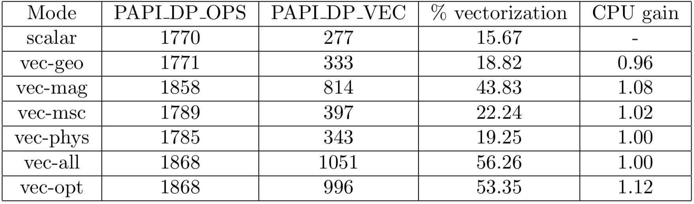
Vector Instruction and Gain (AVX)
% of vectorization = (PAPI_DP_VEC)/(PAPI_DP_OPS)
  PAPI DP VEC = Double precision vector/SIMD instructions
  PAPI DP OPS = Floating point (double precision) operations
PAPI (performance API) hardware counters in [1 Billion]
% of vectorization is high, but gain is small
  Vectorization comes with the price of too many data moves
Notes:
So we started looking at different aspects of performance in order to understand better the source of different gains. Looking at the percent of vectorized instructions, we noticed a large % of vectorization, but with a modest gain, showing that vectorization comes with the price of too many data moves.

Slide 45
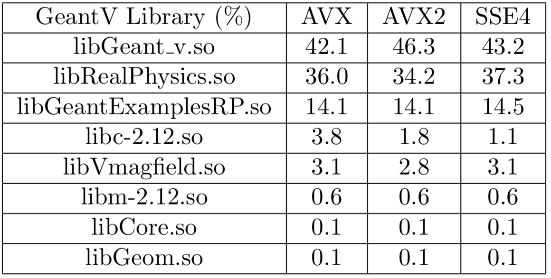
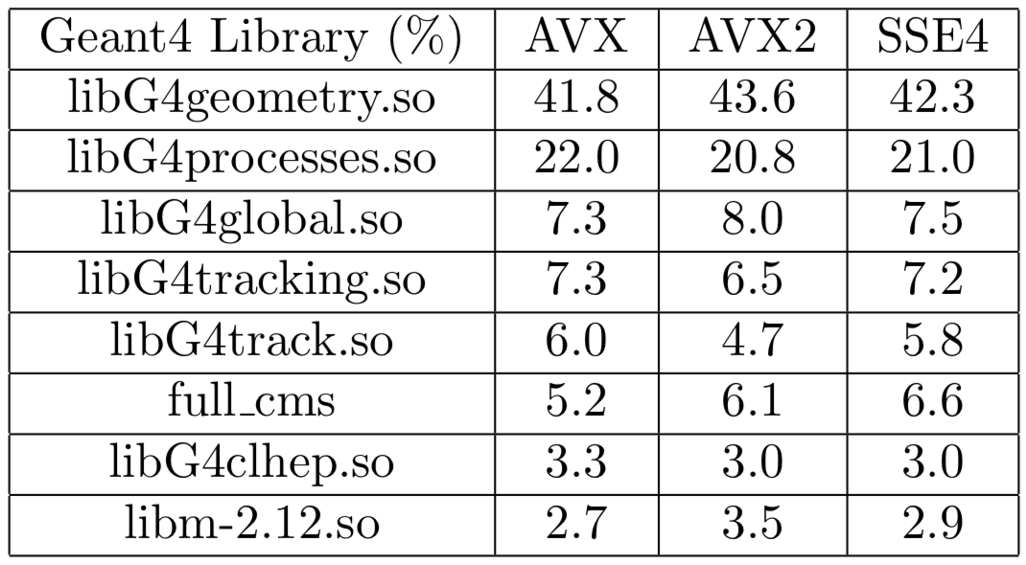
Performance Comparison: Geant4 vs. GeantV libraries
Exclusive time (%) of big libraries
There are not much variations in the percent of time over different processors (CPUs/Cache Size)
The performance difference between Geant4 and GeantV is a global effect (i.e., not driven by a single module or a set of functions)
Notes:
Looking at the fraction of the total time spent in different components, we noticed that there is no there is no big variation across processors, so the gain is a global effect not driven by a single module.

Slide 46
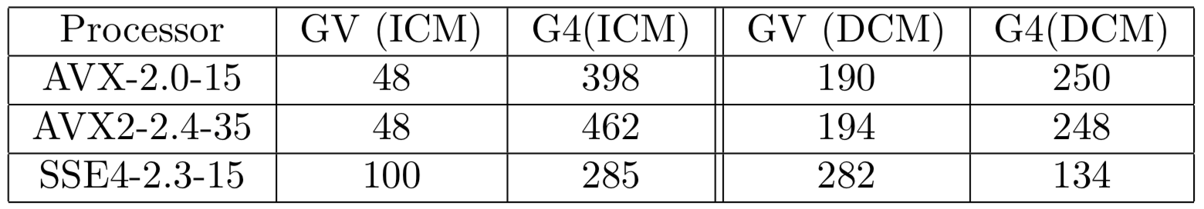
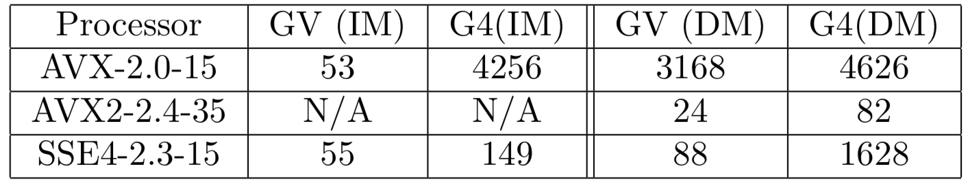
Performance Comparison: L1 Cache and TLB Misses
L1 cache miss: in [Billion] counters
  ICM (DCM) = Instruction (data) cache miss
  GeantV shows significantly less ICM, quite similar DCM
TLB (translation lookaside buffer) miss: in [1M] counters
  cache for page tables which map addresses between virtual and physical memory
  GeantV show much less TLB misses (code page tables more compact fitting TLB)
Notes:
Looking at the usage of caches, we see that GeantV shows significantly less ICM, while the DCM are comparable or sometimes higher. A pathology in case of G4 shows up for the usage of the TLB, showing that the cache of address mapping to the physical memory is regularly missed.

Slide 47
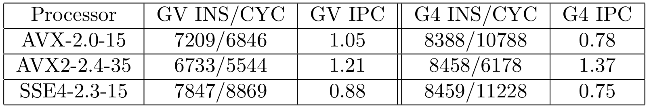
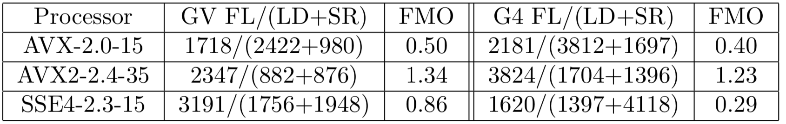
Performance Comparison: IPC and FMO
IPC = Instruction(INS)/Cycle(CYC) : Good Balance with Minimal Stall
  IPC variation across CPUs relatively smaller in GeantV compared to Geant4
    For Geant4, INS is nearly constant, but CYC widely varies
FMO = FL/(LD+SR) : CPU Utilization
  FL (Floating point instruction), LD (load), SR (store) in [1B] counters
  GeantV shows the better FMO in all tested platforms (less LD+SR)
Notes:
Looking at the CPU utilization, we see a good balance with minimall stall for GeantV, with better floating per memory ops.

Slide 48
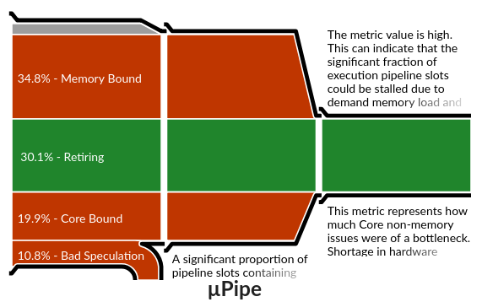
Application profiles from VTune microarchitecture analysis – CMS benchmark
Geant4
Can this be improved?
GeantV
Frontend & memory bound
Core & memory bound
Large, not understood
Xeon®CPU E5-2630 v3@2.4 GHz
Notes:
The microarchitecture analysis shows the bottlenecks in the processor pipeline converting processor instructions into register microops and executing them. The picture compatible with the previous observations, showing that while the Geant4 application is frontend and memory bound, the GeantV one is Core and memory bound. This means that we managed to deal much better with fetching the instructions, but we still violate the data caches, and the CPU pipelines are not well balanced. There is a fair amount of bad speculation also (bad branch prediction) that needs to be understood.

Slide 49
Performance tests for CMSSW integration exercise
Settings:
  GeantV pre-beta-7+ (63468c9b)
    Enabled: vectorized multiple scattering, field (not physics)
  Disable output
Machines:
  FermiCloud VM w/
    Intel(R) Xeon(R) CPU E5-2660 v2 @ 2.20GHz, 4096 KB cache, sse4.2 (Sandy Bridge EP)
  CERN OpenLab w/
    Intel(R) Xeon(R) CPU E5-2683 v3 @ 2.00GHz, 35840 KB cache, 28 cores, sse4.2 (Haswell)
Standalone GV/G4 test: 2.1x (Sandy Bridge), 1.6x (Haswell) speedup
CMSSW GV/G4 test: 2.6× (Sandy Bridge), 1.7x (Haswell) speedup with single thread
  Cache size impact clearly visible
  G4 has better scaling w/ # threads than GV (~20%@16 threads effect, see backup)
Notes:
Performance tests were done also for the CMSSW integrated example, showing also a good speedup when the application output is disabled, with better scaling however of G4, so a decrease of ~20% of the gain for 15 threads.

Slide 50
Concurrency: Strong scaling
Not just Amdahl, but also basket efficiency loss due to more flushes (scalar mode)
Acceptable efficiency, but far from perfect (~80% for 16 threads)
  Price to pay for concurrent services, track stealing
  Hard to improve w/o fully binding events to threads
Do we need to exchange tracks between threads?
  Buffer of events bound to threads, using more memory…
Notes:
Looking at concurrency strong scaling, we notice an acceptable efficiency, but not ideal, due to both Amdahl and loss of basket efficiency due to more frequent flushes with many threads. This brings up a question about the parallelism model: could we keep events bound to threads, with the price of extra memory

Slide 51
Memory efficiency
Larger memory footprint than Geant4 (~3x)
  Expected to improve for large #nthreads (no study yet)
  Depending on number of buffered events
Memory efficiency
  Scaling with number of tracks in flight (see also backup)
  Price to pay: decrease of memory access coherency -> data cache misses increasing with #nthreads
Track block (contiguous)
Dead track (hole)
New track
Basket (pointers to tracks)
Notes:
Even though it has a larger memory footprint due to more tracks in flight, GV has good memory efficiency with # threads. There is however a price to pay by losing gradually the memory localitydue to handling of track pointers in the baskets.

Slide 52
Topology awareness
GeantV
run manager
CMS example, 8 threads on XEON®E5-2630, 2x8 cores
NUMA discovery service
(libhwloc)
Propagator
Propagator
(…)
Scheduler
Scheduler
node
socket
socket
socket
~9% gain
CPU
CPU
Basketizer
Basketizer
memory
Thread binding to cores by policy
  Compact/scatter over NUMA domains
  Multiple propagators/schedulers
Track block allocator NUMA aware
  Blocks owned by threads
Measurable NUMA effect (~10%)
  Scatter 8 threads over 2 NUMA domains (SYS) versus compact (4 threads per domain)
  pointing to data cache misses
Notes:
We also studied topology awareness in terms of binding propagators and track allocators to NUMA nodes and observed a 10% effect.

Slide 53
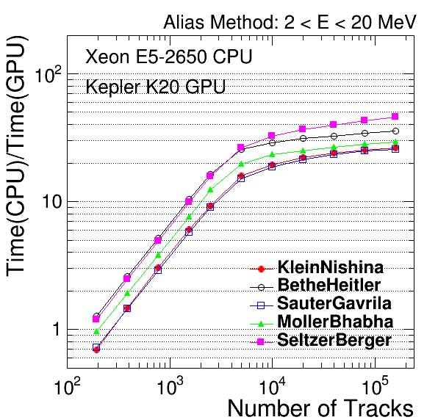
Accelerators: integration with the “basket” model
Portability: CUDA as a backend
  Model not finalized (asynchronous exchange host/device)
GPU baskets and performance
  CPU Intel Xeon E5 (1 core @2.6GHz)
  NVidia K20 GPU (2096 cores @0.7GHz)
  EM models (sampling final states)
  Performance (including transfer host->device) vs. number of tracks
  Potential of x30 on GPU, but requires
  10⁴ tracks per process
Lessons:
  Portability is feasible, but does not come for free
  efficiency comes with very large baskets, which are difficult to maintain
Host-device transfer included
Notes:
The accelerators integration model with the basketized approach of GeantV was not finalized. The tests that were done were model tests measuring speedup for different basket size. It is clear that good efficiency comes with the price of very large baskets (10000) which are unsustainable from the CPU flow.

Slide 54
6. Lessons learnt
How could it be done better?

Slide 55
Concurrency “lessons”
The more thread-local, then the data flow is better
  Keep tracks in the same thread, with minimum stealing
  Avoid high contention on common data containers
    Concurrent basketizing has high price, baskets w/ high populations must be thread local
A multi-threaded, multi-basketized flow becomes inefficient on event tails
  Partial baskets have to be flushed in scalar mode to sustain the data flow
Track-level parallelism is the path to instruction-level parallelism
  cuts event tails, but has large price
  Multiple events in flight, but owned by a thread - is it a good compromise?

Slide 56
Conclusions from CMSSW integration
CMS studies met ~all goals laid out
  Co-development led to improvements and bug fixes in GeantV to facilitate experiments’ use
  One of the first projects to exercise CMSSW ExternalWork feature
  Physics validation & CPU measurements show very positive results
  Path to adapt interfaces efficiently is laid out
Demonstrator to test major elements of GeantV-CMSSW integration is ready
  1.7x to 2.6× speedup in CMSSW application depending on CPU/cache
  More efficient use of CPU caches in GV seems to translate in improved performance within CMSSW
  The CMS simulation group thanks the GeantV R&D team for providing support to this integration exercise and making it a successful co-development endeavor. ​

Slide 57
Main lessons from physics vectorization
There is no generic solution to achieve speedup
  The best approach is often a compromise
    E.g. choosing sampling method to be used, depending on scalar/vector, but also on energy or material composition
Complex code can be also vectorized, but it has to have a sufficient hotspot to be worth it
  There are “important” and ”less important” models depending on the simulation, ranging from < 1% to 4-5% of the total time
Compactness and more efficient data access actually brings much more benefits than vectorization for “small” hotspots

Slide 58
More open questions…
Benchmarked/concluded from CMS only, what about other setups?
  ATLAS, LHCb, ALICE, upgrades, …
Still not fully understanding all sources of performance increase of GeantV
  Would need extra time/resources/expertise
Sharing tracks opens up fine grain parallelism, but extra communication hinders on performance: what is the best trade-off?
How to improve both instruction and data locality, is it even possible?
  Can data load/store be substantially reduced?
  Needs rethinking the data model and access patterns

Slide 59
Main lessons (1)
Main factors in the speedup seem to include
  Better cache use (single track mode shows performance decrease for small caches)
  Tighter code (e.g., less classes, indirections and branching)
Vectorization’s impact (much) smaller than hoped for
  Small fraction of the code has been vectorized or is run in vector mode effectively
  Overhead of basketization cost similar to vector gain for “small” modules
  Basketization can bring benefits for FP hotspots (e.g. magnetic field, multiple scattering)
Basketization cost in
  Either extra memory copy (using collection of tracks)
  Or lower memory access coherency (using collection of pointers)

Slide 60
Main lessons (2)
Geometry navigation not (yet?) vectorized and introduces a bottleneck (Amdahl)
  Mainly due to the end-of-event track collection/gathering from the ‘rarely’ used volumes​
  Should decrease for larger track multiplicities
  But no guarantee that these volumes internally vectorize
Code/Algorithm needs to be designed from the ground up for vectorization for best results
  Compact code, compact data fitting caches and being reused
Actual upper limit on potential vectorization gains are still to be fully understood
  including whether different approaches and trade-offs in the physics code implementation could bring extra computing performance
  Including AVX512 that was not tested due to not working backends

Slide 61
Conclusions (1)
Innovative and disruptive R&D allowing to investigate novel technologies and approaches to simulation
  Allowed to improve performance-critical code in the simulation chain
  Still more room for improvement
Showed the significant impact of good CPU cache behavior (and the challenge of measuring this effect)
  Further research warranted to see if this can be exploited even further
Basketization gains overshadowed by associated costs mainly due to data copy/management overheads.
  Nonetheless might still benefit other workflows (e.g. pipelines)
  Balance might be different under different conditions (e.g. larger multiplicities)

Slide 62
Conclusions (2)
Amdahl's law applies to vectorization too :(
Lessons learned will be useful for GPU architecture investigations
GeantV allowed to venture into interesting and ambitious R&D paths and set new expectations for the future, both in terms of potential gains and the cost of achieving them

Slide 63
Thank you!
Thanks to all the GeantV collaborators contributing to different parts of this R&D

Slide 64
Backup slides
More detailed info about the different topics

Slide 65
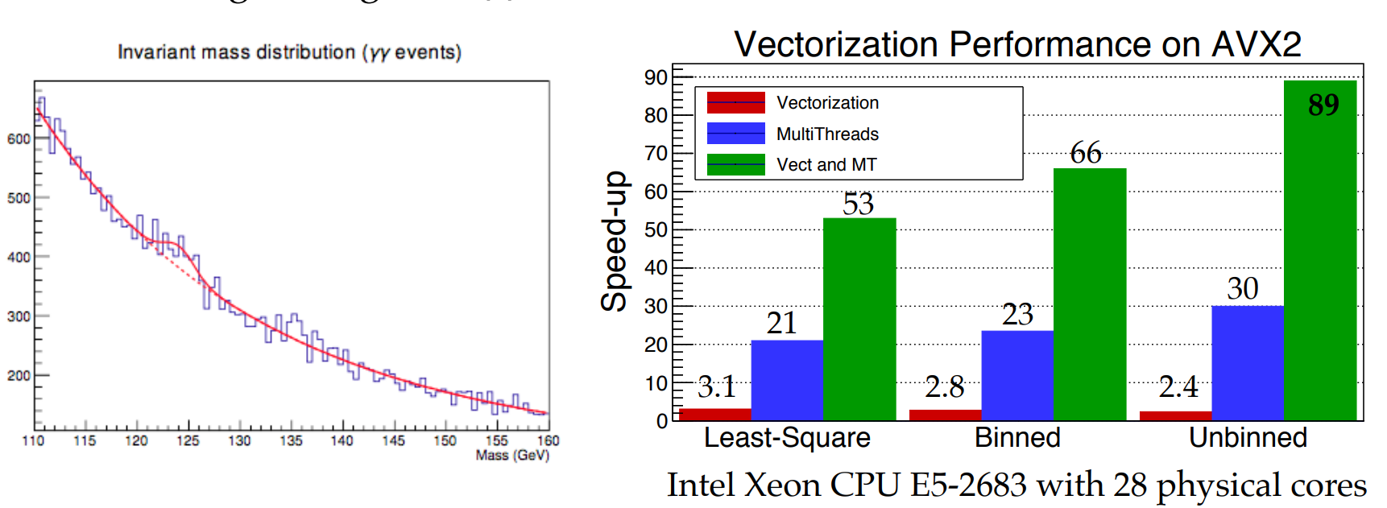
Why use SIMD Vectorization?
SIMD vectorization is already essential for high performance on modern Intel® processors, and its relative importance is expected
to increase, especially on hardware geared towards HPC, such as Xeon Phi™ and Skylake Xeon™ processors.
Vectorization of ROOT Mathematical Libraries — CHEP 2018, Sofia, Bulgaria
Reference: https://indico.cern.ch/event/587955/contributions/2938041/attachments/1683418/2706263/Vectorization_chep2018.pdf

Slide 66
SIMD Programming Models
Auto-vectorization
OpenMP 4.1
Compiler Pragmas
SIMD Library
Compiler Intrinsics
Assembly
float a[N], b[N], c[N];
for (int i = 0; i < N; i++)
a[i] = b[i] * c[i];
float a[N], b[N], c[N];
#pragma omp simd
#pragma ivdep
for (int i = 0; i < N; i++)
a[i] = b[i] * c[i];
#include <Vc/Vc>
Vc::SimdArray<float, N> a, b, c;
a = b * c;
#include <x86intrin.h>
__m256 a, b, c;
a = _mm256_mul_ps(b, c);
asm volatile(“vmulps %ymm1, %ymm0”);

Slide 67
Why did we need VecCore?
Unreliable performance with auto-vectorization
  https://godbolt.org/g/bjQzbA (change int to bool)
  https://godbolt.org/g/R6fXAw (change -O1 to -O3)
Compiler intrinsics are not an ideal interface
  Limited to C name mangling, so portability is an issue
Libraries do not work well across all architectures
  UME::SIMD is best on KNL, but Vc is better for Skylake
  ARM support only in UME::SIMD, but poor performance
Portable solution for when no library is available
  For example, on PowerPC

Slide 68
VecCore API
namespace vecCore {
template <typename T> struct TypeTraits;
template <typename T> using Mask = typename TypeTraits<T>::MaskType;
template <typename T> using Index = typename TypeTraits<T>::IndexType;
template <typename T> using Scalar = typename TypeTraits<T>::ScalarType;
// Vector Size
template <typename T> constexpr size_t VectorSize();
// Get/Set
template <typename T> Scalar<T> Get(const T &v, size_t i);
template <typename T> void Set(T &v, size_t i, Scalar<T> const val);
// Load/Store
template <typename T> void Load(T &v, Scalar<T> const *ptr);
template <typename T> void Store(T const &v, Scalar<T> *ptr);
// Gather/Scatter
template <typename T, typename S = Scalar<T>>
T Gather(S const *ptr, Index<T> const &idx);
template <typename T, typename S = Scalar<T>>
void Scatter(T const &v, S *ptr, Index<T> const &idx);
// Masking/Blending
template <typename M> bool MaskFull(M const &mask);
template <typename M> bool MaskEmpty(M const &mask);
template <typename T>
void MaskedAssign(T &dst, const Mask<T> &mask, const T &src);
template <typename T>
T Blend(const Mask<T> &mask, const T &src1, const T &src2);
} // namespace vecCore
Get()
Set()
Gather()
Scatter()
Blend()
MaskedAssign()
mask

Slide 69
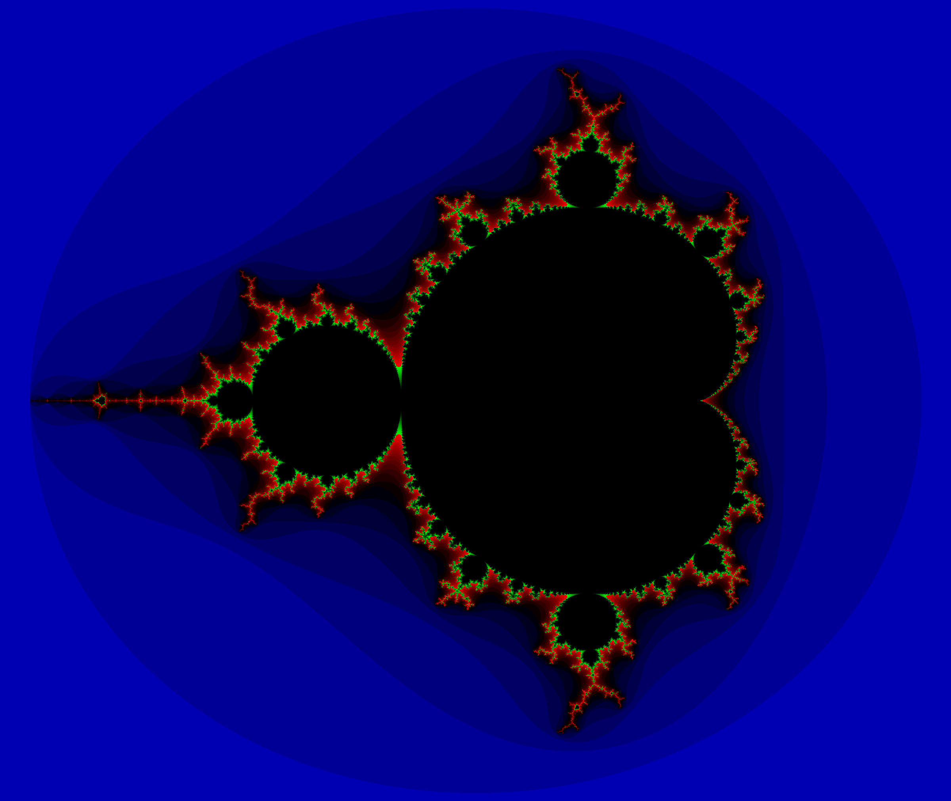
VecCore Example: Mandelbrot Set
Iterate
f(z) = z² + c
N times and check if z diverges
Example included in VecCore
Example SIMD implementations using intrinsics:
https://github.com/skeeto/mandel-simd
Shows speedup of 5.8x with AVX

Slide 70
VecCore Example: Mandelbrot Set
Scalar Implementation
template<typename T>
void mandelbrot(T xmin, T xmax, size_t nx,
T ymin, T ymax, size_t ny,
size_t max_iter,
unsigned char *image)
{
T dx = (xmax - xmin) / T(nx);
T dy = (ymax - ymin) / T(ny);
for (size_t i = 0; i < nx; ++i) {
for (size_t j = 0; j < ny; ++j) {
size_t k = 0;
T x = xmin + T(i) * dx, cr = x, zr = x;
T y = ymin + T(j) * dy, ci = y, zi = y;
do {
x = zr*zr - zi*zi + cr;
y = 2.0 * zr*zi + ci;
zr = x;
zi = y;
} while (++k < max_iter &&
(zr*zr+zi*zi < 4.0));
image[ny*i+j] = k;
}
}
}
Iterate
f(z) = z² + c
N times and check if z diverges
Example included in VecCore

Slide 71
VecCore Example: Mandelbrot Set
VecCore Implementation
template<typename T>
void mandelbrot_v(Scalar<T> xmin, Scalar<T> xmax, size_t nx,
Scalar<T> ymin, Scalar<T> ymax, size_t ny,
Scalar<Index<T>> max_iter,
unsigned char *image)
{
T iota;
for (size_t i = 0; i < VectorSize<T>(); ++i)
Set<T>(iota, i, i);
T dx = T(xmax - xmin) / T(nx);
T dy = T(ymax - ymin) / T(ny), dyv = iota * dy;
for (size_t i = 0; i < nx; ++i) {
for (size_t j = 0; j < ny; j += VectorSize<T>()) {
Scalar<Index<T>> k{0};
T x = xmin + T(i) * dx, cr = x, zr = x;
T y = ymin + T(j) * dy + dyv, ci = y, zi = y;
Index<T> kv{0};
Mask<T> m{true};
do {
x = zr*zr - zi*zi + cr;
y = T(2.0) * zr*zi + ci;
MaskedAssign<T>(zr, m, x);
MaskedAssign<T>(zi, m, y);
MaskedAssign<Index<T>>(kv, m, ++k);
m = zr*zr + zi*zi < T(4.0);
} while (k < max_iter && !MaskEmpty(m));
for (size_t k = 0; k < VectorSize<T>(); ++k)
image[ny*i+j+k] = (unsigned char) Get(kv, k);
}
}
}
Iterate
f(z) = z² + c
N times and check if z diverges
Example included in VecCore

Slide 72
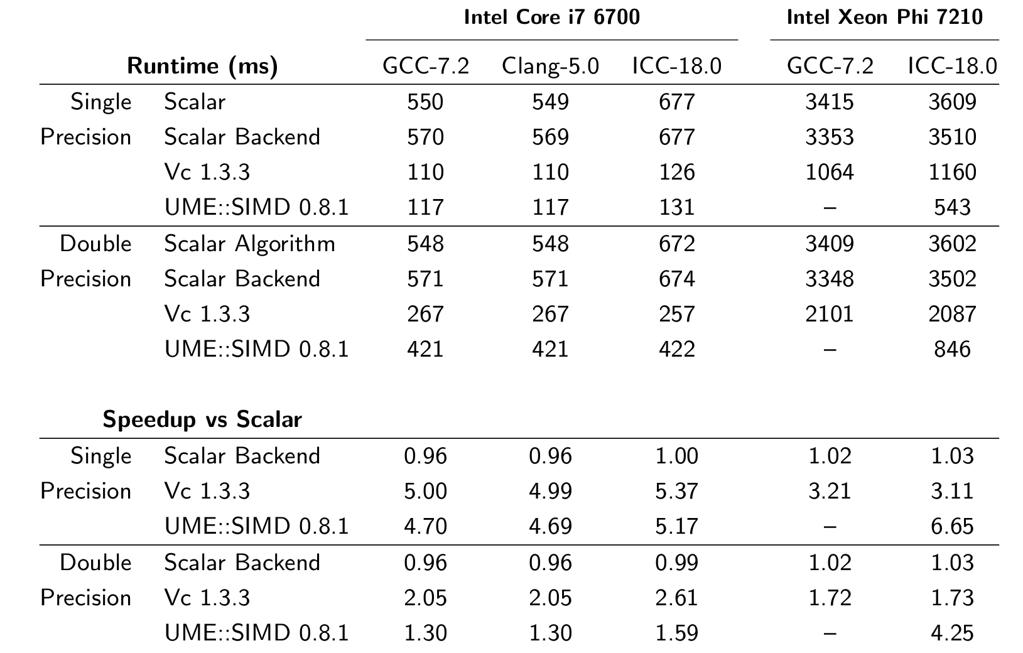
Performance of Mandelbrot Set
Note: “Scalar” above has SSE2 enabled, single precision time with SSE2 disabled with GCC-7.2 is 764ms.
Reference: https://indico.cern.ch/event/567550/papers/2700128/files/6152-veccore-v2.pdf

Slide 73
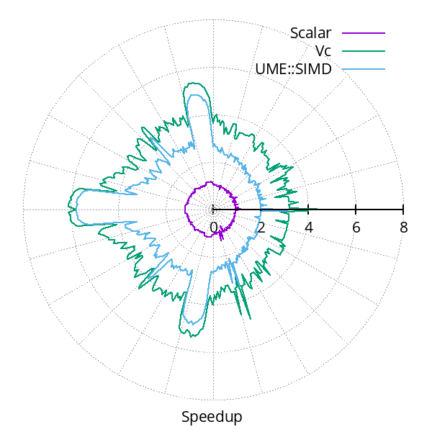
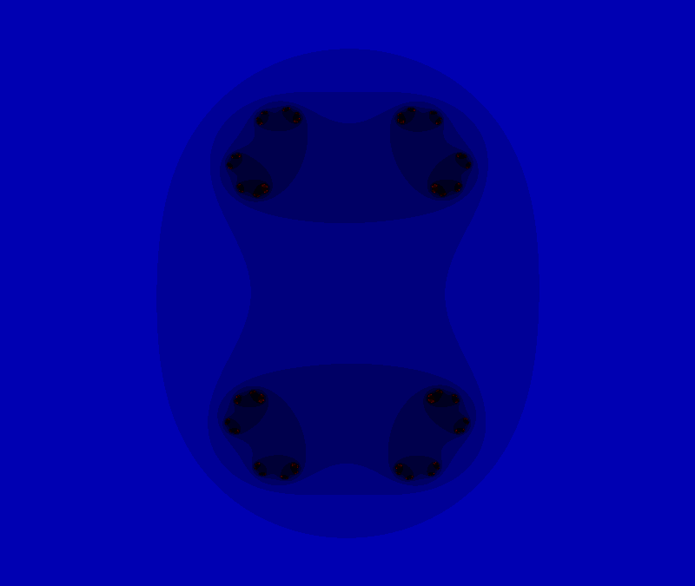
Effect of branching on SIMD performance
Iterate f(z) = z² + c, where
c = 0.7885 e^{iα} and α ∈ [0, 2π]
Julia Set

Slide 74
Code Sample: VecGeom Box
Box Implementation of DistanceToIn()
template <typename Real_v>
void DistanceToIn(UnplacedStruct_t const &box, Vector3D<Real_v> const &point,
Vector3D<Real_v> const &direction, Real_v const &stepMax, Real_v &dist)
{
const Vector3D<Real_v> invDir(Real_v(1.0) / NonZero(direction[0]),
Real_v(1.0) / NonZero(direction[1]),
Real_v(1.0) / NonZero(direction[2]));
const Real_v distIn = Max((-Sign(invDir[0]) * box.fDimensions[0] - point[0]) * invDir[0],
(-Sign(invDir[1]) * box.fDimensions[1] - point[1]) * invDir[1],
(-Sign(invDir[2]) * box.fDimensions[2] - point[2]) * invDir[2]);
const Real_v distOut = Min((Sign(invDir[0]) * box.fDimensions[0] - point[0]) * invDir[0],
(Sign(invDir[1]) * box.fDimensions[1] - point[1]) * invDir[1],
(Sign(invDir[2]) * box.fDimensions[2] - point[2]) * invDir[2]);
dist = Blend(distIn >= distOut || distOut <= Real_v(kTolerance), Infinity<Real_v>(), distIn);
}

Slide 75
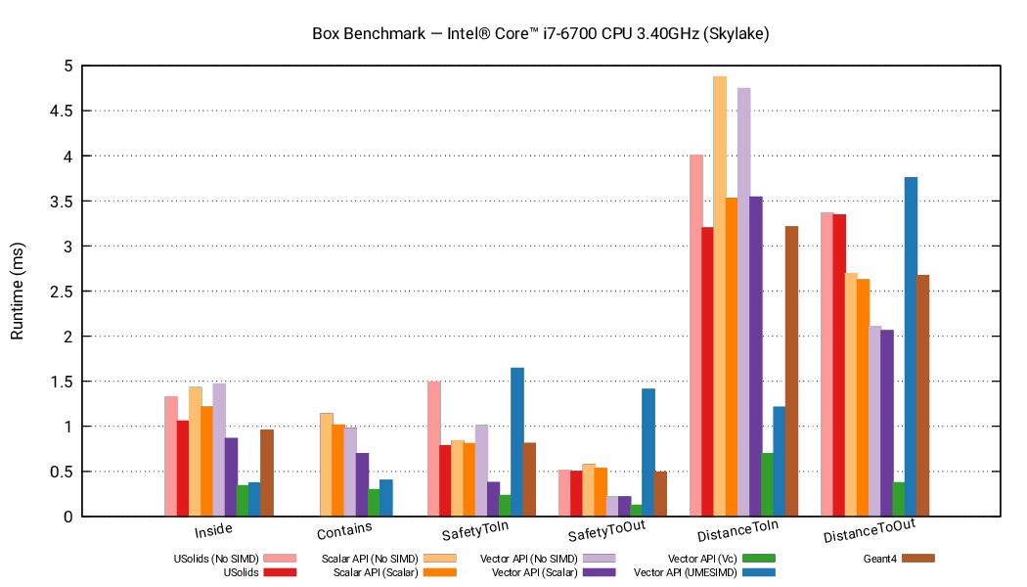
Performance of VecGeom Box Algorithms

Slide 76
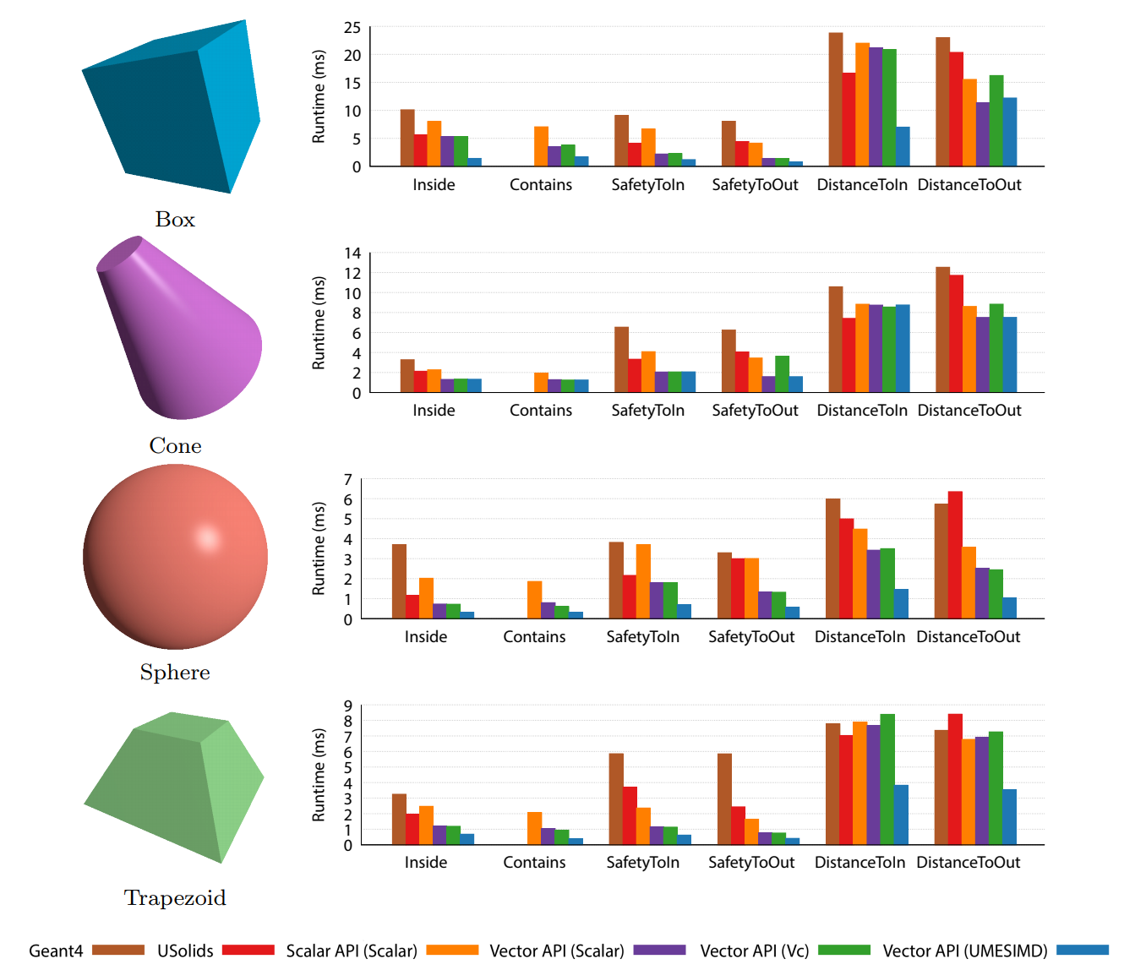
VecGeom Speedups on Knights Landing

Slide 77
Field propagation overview
x₀, p₀
x₁, p₁, Δx, Δp
x₂, p₂, Δx, Δp
Field propagation involves solution of Ordinary Differential Equation
  Typically Runge-Kutta methods are used (as in Geant4)
In GeantV created vectorised Runge-Kutta propagation
  Charged tracks in a basket are sent to the FieldPropagation classes
  Vectorised over tracks
Challenges are
  To use mostly vector operations
  To ensure that all vector lanes are doing useful work
Motion in field requires solving ODE for endpoint x, p after length s
Runge-Kutta step: evaluate B-field, estimate x, p, Δx, Δp
Successful if |Δx| < ε s & |Δp| < ε |p|
Each step of a Runge-Kutta algorithm is easy to vectorise
  But different tracks (vector lanes) can take different number of iterations to finish integration
  The ‘driver’ class which calls the RK ‘stepper’ must play coordinate the work

Slide 78
Vector propagation in Field–v2
start
1
2
3
4
5
6
7
failed
Call # 1
A step can either
  Fail,
  Succeed but not get to the end (“ok”)
  Finish the integration (“done”)
Driver rewritten to use
  Tight loop with all lanes integrating until at n>=threshold reach the end of interval
  Reload lanes with new work.
Profiled with (semi-)realistic RZ field
  Interpolated from sampled CMS field
ok
done
keep
Load 1 track
Call # 2
Load 2 tracks
Call # 3

Slide 79
Performance with baskets for field only
Basket size | 16 | 32 | 64 | 128 | 256 | 512 | 1024
Unused lanes | 0.186 | 0.130 | 0.073 | 0.039 | 0.023 | 0.015 | 0.007
Unused lanes (reordering) | 0.140 | 0.066 | 0.025 | 0.003 | 0.002 | 0.001 | 0.001
Fraction of lanes which have finished integration.
Event window | Tracks/event | Basket sz= 16 | 32 | 64 | 128 | 256 | 512 | 1024
16 | 16 | 3.4 (2) % | 5.6 (2) % | 4.0 (2) % | 4.1 (2) % | 5.2(2) % | 3.6 (2) % | 1.6 (2) %
1 | 16 |  | 4.7 (2) % | 5.0 (2) % | 5.5 (2) % | 6.8(2) % | 7.0 (3) %
1 | 8 reordering | 6.6 (3) % | 5.3 (3) % | 6.9 (3) % | 7.2 (4) % | 7.9(4) % | 8.2 (3) % | 7.3(3) %
Benchmarks on 1 thread of MacBook Pro 2016, 2.6 GHz Core i7 6700HQ (Skylake), 16 GB LPDDR3 2133MHz RAM, with clang from Xcode 10.1.
Baseline is “Basket off” configuration with 16 event window with 16 tracks/event (10 GeV e-).
‘Reordering’ means bringing forward tracks with length / radius(curvature) over threshold (=1.5)

Slide 80
EM Physics
Backup slides

Slide 81
Vectorized EM physics models – Intro
A simulation step, limited by a discrete physics interaction, can be divided into two distinct parts
  Select the physics interaction with the corresponding interaction point:
    Driven by the integrated cross section values of the physics
    Cross section table lookups and interpolations (Memory bounded operations with very little mathematical computations)
  Invoke the interaction (final state sampling):
    Computation of the post-interaction kinematical state of the primary particle
    Generation of possible secondary particles
    Contains significantly more mathematical operations (CPU bounded)
The final state computation includes generation of stochastic variables from their probability distributions determined by the corresponding differential (in energy, angle) cross sections (DCS) of the underlying physics interaction
  Composition-rejection method is typically used in Geant4 to sample from these PDFs

Slide 82














Sampling techniques for the Final State generation
Rejection Sampling:
  Unpredictable n. of loop executions: Exit condition depends on the outcome of the stochastic variable
  Non deterministic behavior for the different tracks filled into the vector register, resulting in undesired divergence and eventually loss of potential computational gain
  Solution: lane refilling
Table Sampling:
  Alias method efficiently generates samples of discrete stochastic variables
  An intermediate discrete random variable is introduced by partitioning the range of the original continuous PDFs into distinct intervals
    new discrete variable is the probability of having the original continuous variable lying in a given interval
  Appropriate partitions of the original variable range and/or variable transformations are used to transform the original PDF to a smooth function, in order to have a linear behavior of the PDF over each discrete interval
Vectorized code
Physics Model Handler
SOA Primary LightTracks
KleinNishina Model
Physics
Stage
Select()
Physics
Model
Handler
Physics Model Handler
MollerBhabha Model
DoItVector()
SeltzerBerger Model
Geant Tracks
Updated SOA Primary LightTracks && Secondary LightTracks
Rejection
Table

Slide 83

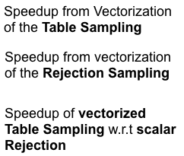
Vectorized EM physics models
[1]
- Architecture: Intel Haswell Core i7-6700HQ, 2.6 GHz
- Instruction Set: AVX2
- Backend: Vc
- Detector: Lead
- #baskets: 256
- Run with GoogleBenchmarks
In KleinNishina model, Rejection Sampling is faster both in scalar and vector mode
In Relativistic Pair model, Table Sampling is faster both in scalar and vector mode
M. Bandieramonte, M. Novak
Speedup of the final state generation of different electromagnetic physics models obtained with SIMD vectorization in case of different sampling algorithms. The results were obtained by using Google Benchmarks on an IntelR Haswell CoreTM i7-6700HQ, 2.6 GHz, with Vc backend and AVX2 instruction set processing 256 tracks.
Notes:
Since the values behind the green and yellow bars share the same denominator, the relation of their heights indicate the speed difference between the scalar implementations of the table and rejection based sampling algorithms. Similarly, since the blue and the yellow bars values share the same numerator, the relation of their heights shows the difference between the speed achievable vectorizing the table or the rejection based sampling algorithm.
Taking for example the Klein-Nishina model [18, 19] for Compton scattering of photons, one can see that the rejection based solution is faster than the sampling table based one since the green bar is higher than the yellow one. This is due to the fact that the computationally simple Klein-Nishina DCS makes possible the composition of a very efficient rejection based final state generation with a very low rejection rate and computational complexity that cannot be beaten by the sampling table based version. On the contrary, the DCS (in total energy transferred to one of the e−/e+ pair) in case of the high-energy model for e−/e+ pair pro- duction [18, 20–22] (RelPair) is significantly more complex compared to the Klein-Nishina DCS for Compton scattering. This results in a computationally more demanding rejection based final state generation compared to the table based one where all such complexities are handled at initialisation time as discussed in Section 4.1. Moreover, further advantage of us- ing sampling table over the composition-rejection can be observed in case of the high-energy bremsstrahlung model (RelBrem), where the computationally expensive nature of the DCS comes together with a higher rejection rate due to the inclusion of the LPM suppression effect [18, 21, 22]. This makes the rejection based algorithm significantly (∼ 4×) slower compared to the sampling table based one. This gain further enhanced up to 8.4 thanks to the efficient vectorization of the sampling table based algorithm. In general, the combined effects of choosing the appropriate sampling algorithm and its vectorization for a given EM physics model provides a speedup factor of 1.8-3.

Slide 84
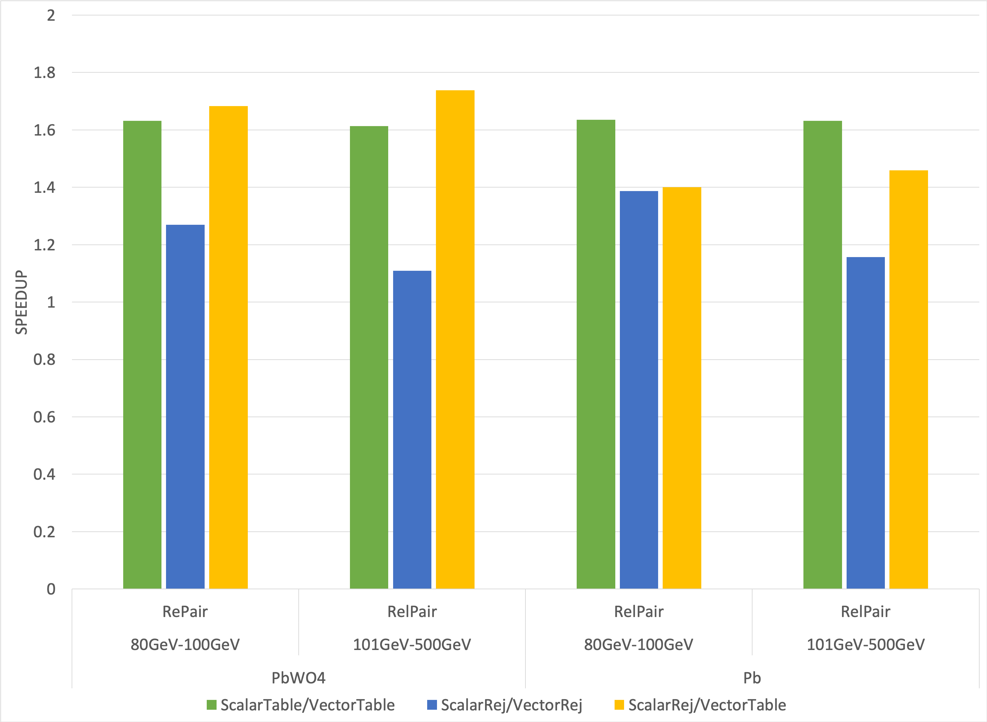
Vectorized EM physics models
[1]
- Architecture: Intel Haswell Core i7-6700HQ, 2.6 GHz
- Instruction Set: AVX2
- Backend: Vc
- Detector: Lead
- #baskets: 256
- Run with GoogleBenchmarks
M. Bandieramonte, M. Novak
Microbenchmark results for final state generation in case of the high energy e−/e+ pair production model under different primary energy (80-100 [GeV] and 101-500 [GeV]) and target material conditions (left: PbWO4, right: Pb).
Specs: Haswell core i7 - AVX - Vc backend
Detector: Pb/PbWO4
Model for Energy Range [80GeV-100TeV]
Vectorized, #baskets: 256
Notes:
The final state generation algorithm of some EM models follows different computational paths depending on some external conditions. For example, some corrections are computed only above a given primary particle energy but not below; or selecting a target atom for the interaction is necessary only in case of materials with multiple elements. These directly trans- late to particular computing paths with different computational complexities favouring one or the other sampling technique within the same model. This is demonstrated in Fig.2, where the benchmark results are shown for the high energy e−/e+ pair production model (RelPair) under different primary energy and target material (Pb or PbWO4) conditions. One can see that the observable speed-up for the rejection based sampling depends on these conditions. At the same time, the table based sampling algorithms do not depend on these conditions, as it was discussed in Section 4.1., showing a constant speedup factor.

Slide 85
Vectorized EM physics models
[1]
- Architecture: Intel Haswell Core i7-6700HQ, 2.6 GHz
- Instruction Set: AVX2
- Backend: Vc
- Detector: Lead
- #baskets: 256
- Run with GoogleBenchmarks
Speedup of the rejection based final state sampling compared to the sampling table based one in case of the Bethe-Heitler e−/e+ pair production model, as a function of the primary γ particle energy.
M. Bandieramonte, M. Novak
Specs: Haswell core i7 - AVX - Vc backend
Detector: Pb/PbWO4
Model for Energy Range [80GeV-100TeV]
Vectorized, #baskets: 256
Notes:
While the sampling table based final state generations have a constant runtime under any external conditions, the efficiency of a given rejection algorithm can change significantly with the primary particle energy. This is illustrated in Fig. 3 where the relative speed of applying these two techniques in case of the Bethe-Heitler e−/e+ pair production model [18, 23] is shown as a function of the primary γ particle energy. It can be seen that the two algorithms perform similarly at lower primary γ particle energies while the rejection algorithm becomes ∼35 % faster at higher γ energies simply due to the smaller rejection rate.

Slide 86
Vectorized EM physics models – lesson learned
Main message: there is no generic solution to achieve speedup
  Final state EM speedup: between 1.5-3 on Haswell, 2-4 on Skylake with AVX2
  We never tested vectorized EM physics with AVX512 (speedup expected to be doubled): lack of person power
The computational diversity of the physics models directly implies a variation of the optimal algorithmic solution as a function of the models.
In addition, the dependence of the underlying physics on some external conditions such as target material composition or primary particle energy introduces further variations
In order to maximize the achievable gain from vectorization it’s necessary to profile all the available final state generation algorithms as a function of:
  The complexity of the underlying DCS
  Target material composition
  Primary particle energy
Due to lack of person power the profiling activity was not completed

Slide 87
MC truth
Backup slides

Slide 88
GeantV kinematics output (MC truth)
handling of MC truth is problematic per se
  which particles to store, how to keep connections, where to connect hits
multithreading adds the complexity
  order of processing of particles is ‘random’
    processing of ‘daughter’ particle may be completed before ‘mother’ particle ‘end of life’
  events need to be ‘put together’ after parallel processing

Slide 89
MC truth
we can’t (and we don’t need) to store all particles
  typically no delta-e, no low-E gamma showers, etc needed
we need to store particles necessary to understand the given event (process)
we need to store particles to associate hits
in all cases, we need to (re)connect particles to have consistent event trees

Slide 90
MC truth handling requirements
no MC truth-handling strategy is perfect, nor complete, but:
  we need to give user a way to decide
transport need to provide/allow
  links between mother and daughter particles
  the possibility to flag particles as ‘to be stored’
  possibility to introduce ‘rules’ what to store
  a way to ‘reconnect’ tracks and hits if some are skipped
    if we don’t store a particle, we need to update the daughter particles to point back to the last stored one in the chain
for the final output we need to have some event record
  for our proof of principle, we can start with HepMC

Slide 91
MC truth handling architecture
light coupling to transport
  minimal ‘disturbance’ to transport threads
  maximal flexibility of implementing custom particle history handlers
interface provided by MCTruthMgr
  receives (concurrent) notifications from transport threads about
    adding (primary or secondary) new particles
    ending particles
    finishing events
  delegates processing of particles history to concrete MC truth implementation

Slide 92
MC truth infrastructure and users code
MCTruthMgr provides interface and underlying infrastructure for particles history
  light-weight transient, intermediate event record
users code:
  decision making (filtering) algorithm
  conversion to users’ event format
concrete example implementation provided based on HepMC3

Slide 93
MC truth call sequence
users’ code
TransportTracks #1
TransportTracks #2
GeantPropagator
MCTruthMgr
HepMC.root
new track
add track to event #n
HepMCTruth
new track
add track to event #m
stop track
end track
new track
add track to event #n
close event #n
stop track
end track
writeHepMC event
new track
add track to event #i
new track
add track to event #m
stop track
end track
close event #m
writeHepMC event
93

Slide 94
MC truth output status
GeantV MC truth manager provides handles to deal with particles history
  allows ‘physics’ studies
  first implementation, further iterations possible to look in detail at performance
example implementation based on HepMC3 provided
further performance testing/improvements in highly concurrent environment to be studied

Slide 95
Vectorized EM physics
Backup slides

Slide 96
Vectorized EM physics models – Intro
A simulation step, limited by a discrete physics interaction, can be divided into two distinct parts
  Select the physics interaction with the corresponding interaction point:
    Driven by the integrated cross section values of the physics
    Cross section table lookups and interpolations (Memory bounded operations with very little mathematical computations)
  Invoke the interaction (final state sampling):
    Computation of the post-interaction kinematical state of the primary particle
    Generation of possible secondary particles
    Contains significantly more mathematical operations (CPU bounded)
The final state computation includes generation of stochastic variables from their probability distributions determined by the corresponding differential (in energy, angle) cross sections (DCS) of the underlying physics interaction
  Composition-rejection method is typically used in Geant4 to sample from these PDFs

Slide 97
Sampling techniques for the Final State generation
Rejection Sampling:
  Unpredictable n. of loop executions: Exit condition depends on the outcome of the stochastic variable
  Non deterministic behavior for the different tracks filled into the vector register, resulting in undesired divergence and eventually loss of potential computational gain
  Solution: lane refilling
Table Sampling:
  Alias method efficiently generates samples of discrete stochastic variables
  An intermediate discrete random variable is introduced by partitioning the range of the original continuous PDFs into distinct intervals
    new discrete variable is the probability of having the original continuous variable lying in a given interval
  Appropriate partitions of the original variable range and/or variable transformations are used to transform the original PDF to a smooth function, in order to have a linear behavior of the PDF over each discrete interval
Vectorized code
Physics Model Handler
SOA Primary LightTracks
KleinNishina Model
Physics
Stage
Select()
Physics
Model
Handler
Physics Model Handler
MollerBhabha Model
DoItVector()
SeltzerBerger Model
Geant Tracks
Updated SOA Primary LightTracks && Secondary LightTracks
Rejection
Table

Slide 98
Vectorized EM physics models
[1]
- Architecture: Intel Haswell Core i7-6700HQ, 2.6 GHz
- Instruction Set: AVX2
- Backend: Vc
- Detector: Lead
- #baskets: 256
- Run with GoogleBenchmarks
In KleinNishina model, Rejection Sampling is faster both in scalar and vector mode
In Relativistic Pair model, Table Sampling is faster both in scalar and vector mode
M. Bandieramonte, M. Novak
Speedup of the final state generation of different electromagnetic physics models obtained with SIMD vectorization in case of different sampling algorithms. The results were obtained by using Google Benchmarks on an IntelR Haswell CoreTM i7-6700HQ, 2.6 GHz, with Vc backend and AVX2 instruction set processing 256 tracks.
Notes:
Since the values behind the green and yellow bars share the same denominator, the relation of their heights indicate the speed difference between the scalar implementations of the table and rejection based sampling algorithms. Similarly, since the blue and the yellow bars values share the same numerator, the relation of their heights shows the difference between the speed achievable vectorizing the table or the rejection based sampling algorithm.
Taking for example the Klein-Nishina model [18, 19] for Compton scattering of photons, one can see that the rejection based solution is faster than the sampling table based one since the green bar is higher than the yellow one. This is due to the fact that the computationally simple Klein-Nishina DCS makes possible the composition of a very efficient rejection based final state generation with a very low rejection rate and computational complexity that cannot be beaten by the sampling table based version. On the contrary, the DCS (in total energy transferred to one of the e−/e+ pair) in case of the high-energy model for e−/e+ pair pro- duction [18, 20–22] (RelPair) is significantly more complex compared to the Klein-Nishina DCS for Compton scattering. This results in a computationally more demanding rejection based final state generation compared to the table based one where all such complexities are handled at initialisation time as discussed in Section 4.1. Moreover, further advantage of us- ing sampling table over the composition-rejection can be observed in case of the high-energy bremsstrahlung model (RelBrem), where the computationally expensive nature of the DCS comes together with a higher rejection rate due to the inclusion of the LPM suppression effect [18, 21, 22]. This makes the rejection based algorithm significantly (∼ 4×) slower compared to the sampling table based one. This gain further enhanced up to 8.4 thanks to the efficient vectorization of the sampling table based algorithm. In general, the combined effects of choosing the appropriate sampling algorithm and its vectorization for a given EM physics model provides a speedup factor of 1.8-3.

Slide 99
Vectorized EM physics models
[1]
- Architecture: Intel Haswell Core i7-6700HQ, 2.6 GHz
- Instruction Set: AVX2
- Backend: Vc
- Detector: Lead
- #baskets: 256
- Run with GoogleBenchmarks
M. Bandieramonte, M. Novak
Microbenchmark results for final state generation in case of the high energy e−/e+ pair production model under different primary energy (80-100 [GeV] and 101-500 [GeV]) and target material conditions (left: PbWO4, right: Pb).
Specs: Haswell core i7 - AVX - Vc backend
Detector: Pb/PbWO4
Model for Energy Range [80GeV-100TeV]
Vectorized, #baskets: 256
Notes:
The final state generation algorithm of some EM models follows different computational paths depending on some external conditions. For example, some corrections are computed only above a given primary particle energy but not below; or selecting a target atom for the interaction is necessary only in case of materials with multiple elements. These directly trans- late to particular computing paths with different computational complexities favouring one or the other sampling technique within the same model. This is demonstrated in Fig.2, where the benchmark results are shown for the high energy e−/e+ pair production model (RelPair) under different primary energy and target material (Pb or PbWO4) conditions. One can see that the observable speed-up for the rejection based sampling depends on these conditions. At the same time, the table based sampling algorithms do not depend on these conditions, as it was discussed in Section 4.1., showing a constant speedup factor.

Slide 100
Vectorized EM physics models
[1]
- Architecture: Intel Haswell Core i7-6700HQ, 2.6 GHz
- Instruction Set: AVX2
- Backend: Vc
- Detector: Lead
- #baskets: 256
- Run with GoogleBenchmarks
Speedup of the rejection based final state sampling compared to the sampling table based one in case of the Bethe-Heitler e−/e+ pair production model, as a function of the primary γ particle energy.
M. Bandieramonte, M. Novak
Specs: Haswell core i7 - AVX - Vc backend
Detector: Pb/PbWO4
Model for Energy Range [80GeV-100TeV]
Vectorized, #baskets: 256
Notes:
While the sampling table based final state generations have a constant runtime under any external conditions, the efficiency of a given rejection algorithm can change significantly with the primary particle energy. This is illustrated in Fig. 3 where the relative speed of applying these two techniques in case of the Bethe-Heitler e−/e+ pair production model [18, 23] is shown as a function of the primary γ particle energy. It can be seen that the two algorithms perform similarly at lower primary γ particle energies while the rejection algorithm becomes ∼35 % faster at higher γ energies simply due to the smaller rejection rate.

Slide 101
Vectorized EM physics models – lesson learned
Main message: there is no generic solution to achieve speedup
  Final state EM speedup: between 1.5-3 on Haswell, 2-4 on Skylake with AVX2
  We never tested vectorized EM physics with AVX512 (speedup expected to be doubled): lack of person power
The computational diversity of the physics models directly implies a variation of the optimal algorithmic solution as a function of the models.
In addition, the dependence of the underlying physics on some external conditions such as target material composition or primary particle energy introduces further variations
In order to maximize the achievable gain from vectorization it’s necessary to profile all the available final state generation algorithms as a function of:
  The complexity of the underlying DCS
  Target material composition
  Primary particle energy
Due to lack of person power the profiling activity was not completed

Slide 102
5. Performance results
Backup slides

Slide 103
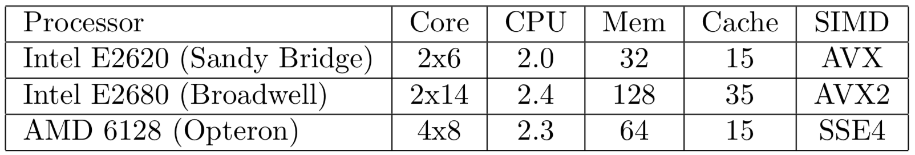
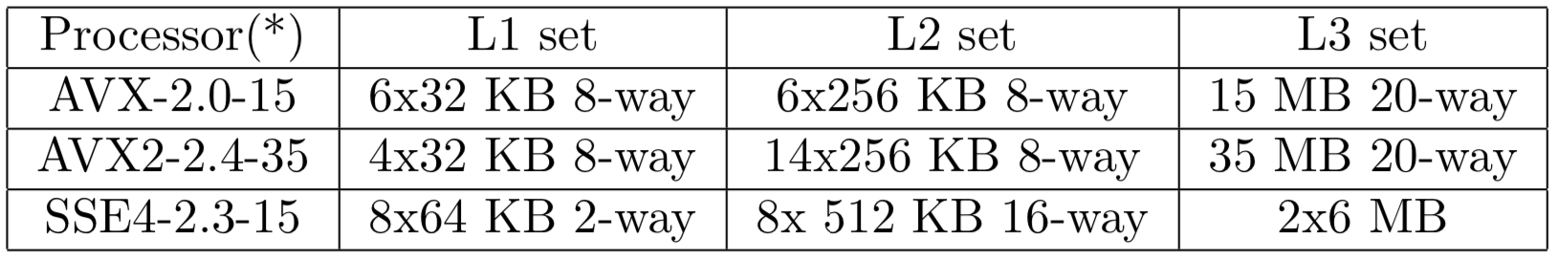
Performance Comparisons: Tested Platforms
Process-Cores-CPU[GHz]-Memory[GB]-Cache[MB]-SIMD
Cache size
  * Processor Convention: SIMD-CPU-Cache

Slide 104
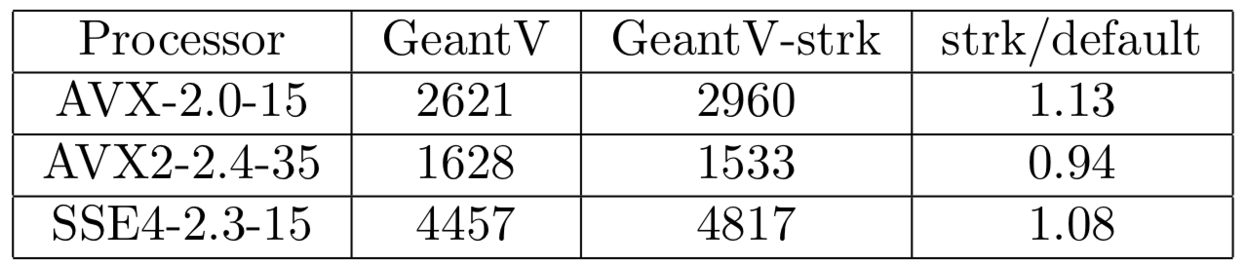
Locality
Single track mode (strk)
  Emulate Geant4 style tracking
  A meaure of locality: GeantV (strk)/GeantV(default)
CPU Time in [sec] and their ratios
  The data locality does not explain the performance difference between Geant4 and GeantV (scalar)

Slide 105
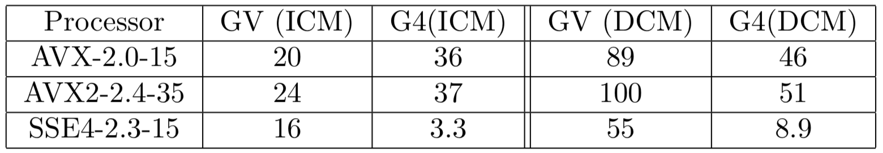
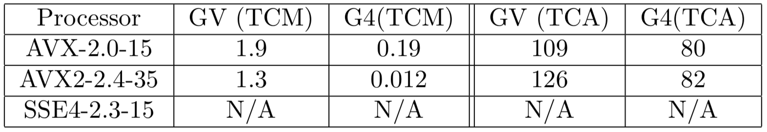
Hardware Counters: L2 Cache and L3 Cache
L2 cache miss (~12 cycles): in [Billion] counters
  ICM (DCM) = Instruction (data) cache miss
  GeantV has less ICM and Geant4 has less DCM (AVX/AVX2)
L3 cache miss (~38 cycles): in [1B] counters
  TCM (TCA): Total Cache Miss (Access)

Slide 106
Performance summary table (go to backup)
Normalized performance factor with respect to the Intel i7 2.5GHz taking into account the clock speed
CPU | OS | gcc | SIMD | Cache | GV | G4 [sec]
Intel i7 2.5GHz | Ubuntu 16.04 | 5.4.0 | AVX2 | 8 MB | 1 ± 0.01 | 1 ± 0.03
Intel Core i7-4510U 2GHz | Ubuntu 16.04 | 5.4.0 | AVX | 4MB | 1.39 ± 0.01 | 0.98 ± 0.01
AMD A10- 7700k | Fedora Workstation 29 | 8.2.1 | AVX | 4 MB | 1.94 ± 0.01 | 2.48 ± 0.02
Intel R 1.8GHz | Fedora Workstation 29 | 8.3.1 | SSE4 | 2 MB | 2.95 ± 0.01 | 2.15 ± 0.01
Intel Centrino 2 | Fedora Workstation 29 | 8.2.1 | AVX± | 4 MB | 2,76 ± 0.01 | 3.75 ± 0.02
11AMD e-300 | Ubuntu 18.10 | 8.2.0 | SSE2 | 1 MB | Not Vc compatible | 13.32 ± 0.01
Geant4 fluctuates more than GeantV over different tested platforms

Slide 107
Integration with experimental frameworks
Backup slides

Slide 108
Status of GeantV Integration in CMSSW
Kevin Pedro, Sunanda Banerjee
(FNAL)
October 4, 2019

Slide 109
Introduction
Integration testing of GeantV w/ CMSSW has several goals:
Demonstrate benefits of co-development between R&D team & experiments
Exercise capabilities of CMSSW framework to interface with external processing (ExternalWork mechanism) and handle track-level parallelization in detector simulation
Measure any potential CPU penalties when running GeantV in CMSSW
Estimate cost of adapting to new interfaces and eventually migrating to new (and potentially backward-incompatible) tools such as GeantV
Thinking forward to HPC/GPU solutions
Not planning to migrate CMS simulation to GeantV
This is an R&D exercise

Slide 110
GeantV Integration Tests in CMSSW
Repositories: install-geant, SimGVCore
Generate events in CMSSW framework, convert HepMC to GeantV format
Build CMSSW geometry natively and pass to GeantV engine (using TGeo)
Using constant magnetic field, limited EM-only physics list
Calorimeter scoring adapted
Run GeantV using CMSSW ExternalWork feature:
Asynchronous, non-blocking, task-based processing
Output in CMS format, immediately suitable for digitization etc.
External processing
GeantV
Event data
Callback
CMSSW thread
acquire()
(other work)
produce()

Slide 111
Geant4 vs. GeantV Scoring
Sensitive detectors (SD) and scoring trickiest to adapt
Necessary to test “full chain” (simulation → digitization → reconstruction)
Significantly more complicated than Geant4 MT
Duplicate SD objects per event per thread, then aggregate
→ 4 streams, 4 threads = 16 SD objects
GeantV TaskData supports this approach
Use template wrappers to unify interfaces and operations
Ensure exact same SD code used for Geant4 & GeantV
Minimize overhead (no branching or virtual table)
Particles
Hits
SD
Particles
Hits
SD
SD
Event
SD
Event
Geant4
SD
SD
?
Particles
GeantV
Particles
Hits
SD
SD
Event
Geant4
SD
SD
SD
Event
SD
Geant4 shares memory, but each event processed in separate thread
Each event processed in multiple threads, mixed in with other events

Slide 112
GeantV Data Aggregation
RunManager
UserApplication
A
threads
B
TaskData
DataPerThread
TaskData
DataPerThread
TaskDataHandle
1
2
events
1
2
Event
ScoringCache
ScoringClass
ScoringClass
ScoringClass
ScoringClass
merge
Each ScoringClass object has instance of CaloSteppingAction
Some additional memory overhead from duplicated class members
Attempt to minimize this by storing volume maps in magic static struct
Merged ScoringClass output copied to cache attached to Event object
GeantV may consider event finished before CMSSW has written output
→ copy to cache, then immediately clear ScoringClass objects
(avoid possible race conditions)

Slide 113
Physics Validation
Settings:
Geant4 10.4p2 w/ VecGeom v0.5 (scalar)
GeantV pre-beta-7 w/ VecGeom v1.1
All CMS-specific G4 optimizations disabled
Same production cuts (default 1mm)
Single thread (reproducible pRNG sequences)
Generate 1000 events w/ single electron, E = 100 GeV, η = 1.0, φ = 1.1
Tests: (same generated events used for G4 and GV)
No field (B = 0)
Constant field (B = 3.8 T)
(more in backup)

Slide 114
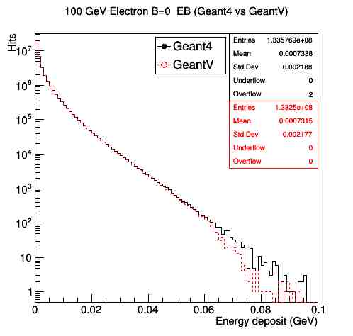
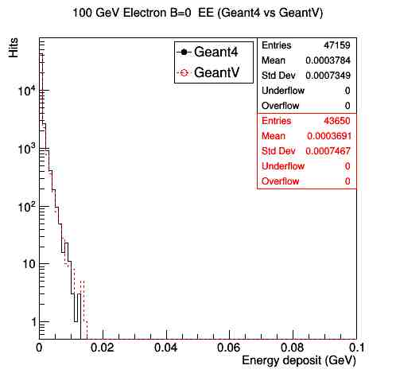
1. Energy Deposits for 100 GeV e- (B=0)
The number of entries differs by 0.3% (7.4%) in EB (EE)
The means differ by 0.2% for EB and 2.5% for EE

Slide 115
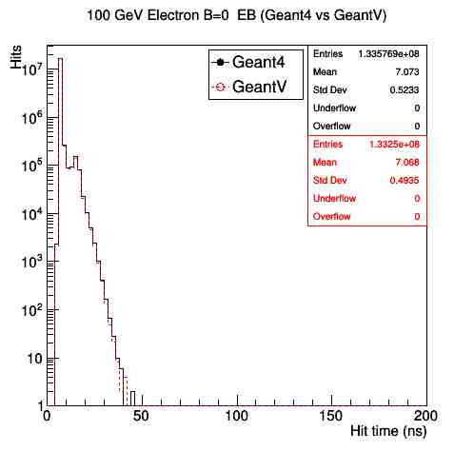
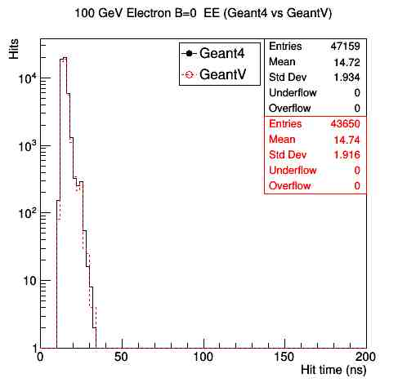
1. Hit Time for 100 GeV e- (B=0)
Means differ by 0.07% for EB and 0.13% for EE
GeantV and Geant4 applications provide roughly the same distributions

Slide 116
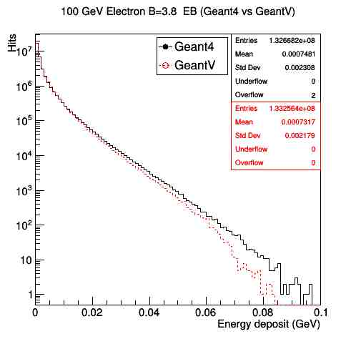
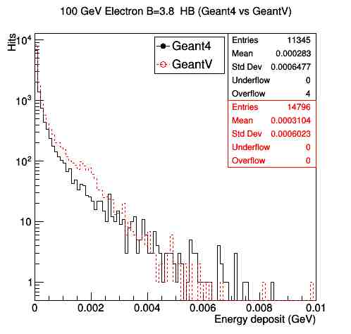
2. Energy Deposits for 100 GeV e- (B=3.8)
The number of entries differ by 0.4% (23.3%) in EB (HB)
The means differ by 2.2% for EB and 8.8% for HB

Slide 117
2. Hit Time for 100 GeV e- (B=3.8)
The means differ by 0.03% for EB and 1.15% for HB
There is a small difference in the physics results of GeantV and Geant4 applications in the presence of B-field

Slide 118
Performance Tests
Settings:
GeantV pre-beta-7+ (63468c9b)
Enabled: vectorized multiple scattering, field (not physics)
Generate 500 events, 2 electrons w/ E = 50 GeV, random directions
Keep # events / thread constant (copy & concat 500 generated events)
Use same generated events in G4 and GV
Keep unused threads busy
Disable output
Machine: FermiCloud VM w/
Intel(R) Xeon(R) CPU E5-2660 v2 @ 2.20GHz, 4096 KB cache
Intel(R) Xeon(R) CPU E5-2683 v3 @ 2.00GHz, 35840 KB cache, 28 cores
sse4.2 instructions
Track wall clock time & memory with CMSSW TimeMemoryInfo tool
Measures VSIZE, RSS per event
Calculate speedup from wall time
(divided by # threads used, since # events / thread is constant)

Slide 119
Characterization
VM CPU has relatively small cache
Known that major component of GeantV speedup arises from smaller library → fewer cache misses
To characterize CMSSW performance results, first run built-in GeantV FullCMS standalone test
Single thread, settings as close to previous slide as possible
(see test script: testStandalone.sh)
NB: different physics list used in standalone vs. CMSSW
Results E5-2660 v2 @ 2.20GHz, 4096 KB cache:
GeantV: RealTime=756.002s CpuTime=753.09s
Geant4: User=1617.36s Real=1618.52s
2.14× speedup (standalone)
Results E5-2683 v3 @ 2.00GHz, 35840 KB cache:
GeantV: RealTime=526.796s CpuTime=526.76s
Geant4: User=842.67s Real=842.76s
1.6× speedup (standalone)

Slide 120
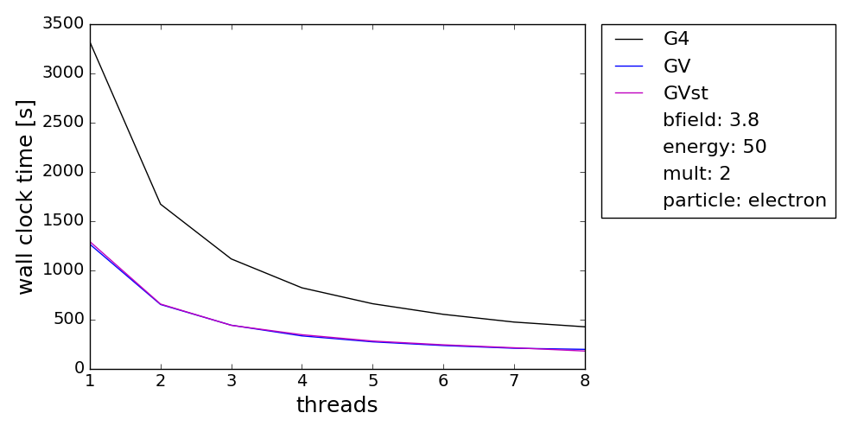
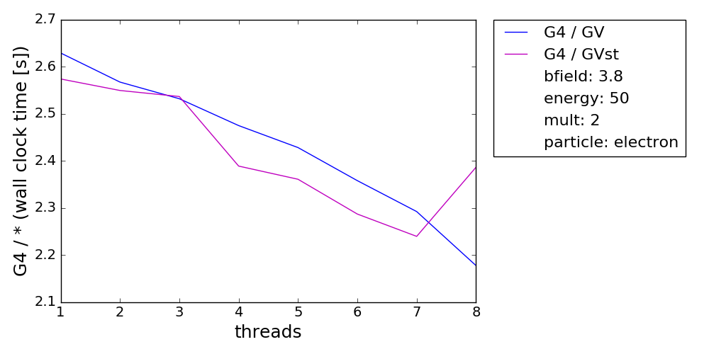
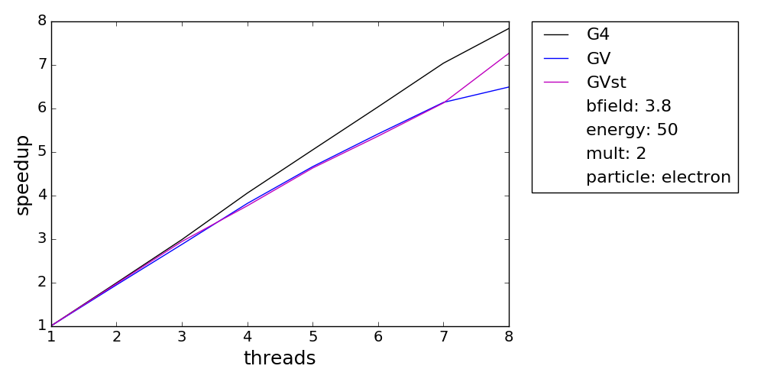
Time Performance E5-2660 v2 @ 2.20GHz
PRELIMINARY
speedup = time(threads=1)/time(threads=N)
GV 2.6× faster than G4 single thread, still ~2.2× faster in MT
GV single track mode similar to basketized
G4 has better scaling w/ # threads than GV

Slide 121
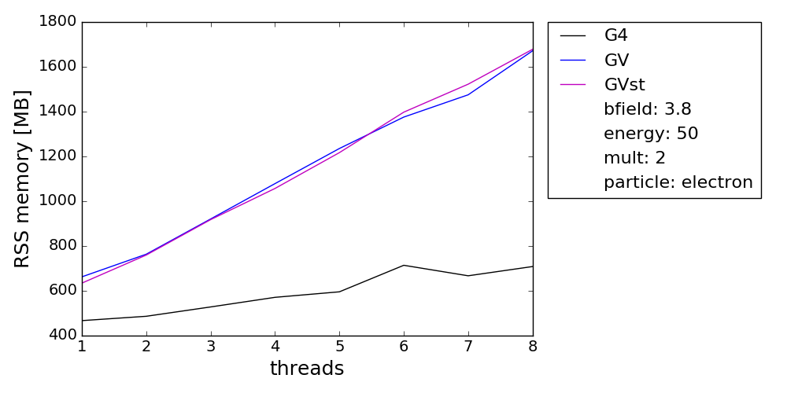
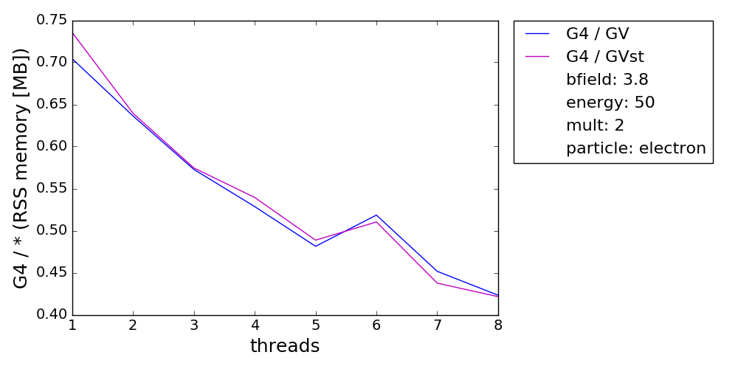
Memory Performance E5-2660 v2 @ 2.20GHz
PRELIMINARY
Memory grows ~linearly w/ # threads (expected)
GV uses more memory than G4 (expected)
Single track mode uses similar memory to basketized

Slide 122
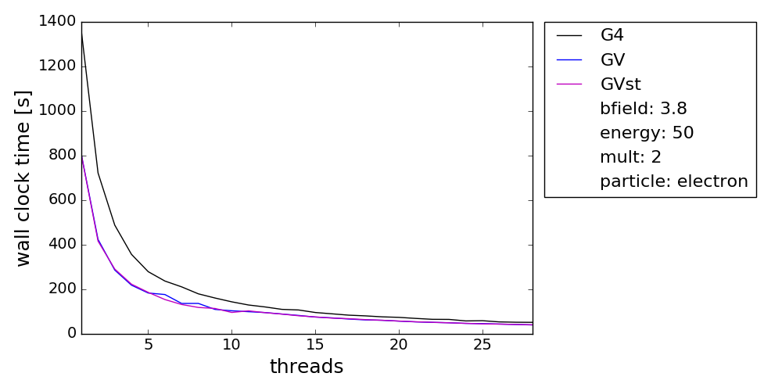
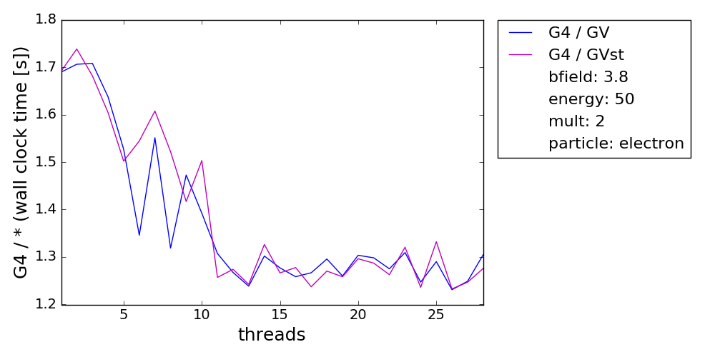

Time Performance E5-2683 v3 @ 2.00GHz
PRELIMINARY
speedup = time(threads=1)/time(threads=N)
GV 1.7× faster than G4 single thread, still ~1.3× faster in MT
GV single track mode similar to basketized
G4 has better scaling w/ # threads than GV

Slide 123


Memory Performance E5-2683 v3 @ 2.00GHz
PRELIMINARY
Memory grows ~linearly w/ # threads (expected)
GV uses more memory than G4 (expected)
Single track mode uses similar memory to basketized

Slide 124
What Would Be Next?
To complete the goals of CMS R&D studies for the paper:
Full magnetic field map
Test on machines w/ different cache sizes
Stretch goals/notes for future similar projects:
Random number generator
Adapt scoring classes for other detectors (beyond calorimeters)
Combine w/ other simulation improvements
Notably Russian Roulette & HF shower library, which give largest gains
If GeantV project were to continue:
Better solution for geometry conversion than TGeo
Sensitive volume/detector functionality
Vectorized hadronic physics
Improve threading, memory management, and ownership models
Decouple event loading & task launching in ExternalLoop mode
Event-wise scoring rather than current thread-wise scoring w/ TaskData

Slide 125

Conclusions
CMS studies met ~all goals laid out
Co-development led to improvements and bug fixes in GeantV to facilitate experiments’ use
One of the first projects to exercise CMSSW ExternalWork feature
Physics validation & CPU measurements show very positive results
Path to adapt interfaces efficiently is laid out:
“Rosetta stone” mostly contained in StepWrapper and VolumeWrapper
Demonstrator to test major elements of GeantV-CMSSW integration is ready
Speedup of 1.7x - 2.6× in CMSSW application
Will finalize results for paper
The CMS simulation group thanks the GeantV R&D team for providing support to this integration exercise and making it a successful co-development endeavor​
Geant4 | GeantV
StepWrapper | StepWrapper
VolumeWrapper | VolumeWrapper

Slide 126
Extras from CMSSW integration exercise

Slide 127
Template Wrappers
Goal: use exact same SD code for Geant4 and GeantV
Problem: totally incompatible APIs
Example: G4Step::GetTotalEnergyDeposit() vs. geant::Track::Edep()
Solution: template wrapper with unified interface
e.g. StepWrapper<T>::getEnergyDeposit()
SD code only calls the wrapper
Wrapper stores pointer to T (minimize overhead)
Current wrappers:
BeginRun
BeginEvent
Step
Volume
EndEvent
EndRun

Slide 128
Traits
Collect Geant4/GeantV-specific types and wrappers into unified Traits class:
struct G4Traits {
typedef G4Step Step;
typedef sim::StepWrapper<Step> StepWrapper;
};
struct GVTraits {
typedef geant::Track Step;
typedef sim::StepWrapper<Step> StepWrapper;
};
Provides standardized typenames to be used by SD class:
template <class Traits> class CaloSteppingActionT : …,
public Observer<const typename Traits::Step *>
{
public:
void update(const Step * step) override { update(StepWrapper(step)); }
private:
// subordinate functions with unified interfaces
void update(const StepWrapper& step);
};

Slide 129
Organization
Old
CaloG4
CaloSteppingAction (.h, .cc)
New
Calo
CaloSteppingActionT (.h, .icc)
Wrappers (.h)
CaloG4
CaloSteppingAction (.h, .cc)
G4 Wrappers (.h), Traits (.h)
CaloGV
CaloSteppingAction (.h, .icc)
GV Wrappers (.h), Traits (.h)
SD interface & implementation in Calo (.icc file), w/ unimplemented wrapper interfaces
G4/GV wrapper specializations in CaloG4/GV, w/ specific instances of templated SD class → isolate dependencies

Slide 130
Scoring Approaches
Two approaches to scoring in CMSSW:
Inherit from G4VSensitiveDetector (Geant4 class)
→ automatically initialized for geometry volumes marked as sensitive
Inherit from SimWatcher (CMSSW standalone class)
→ need to specify names of watched geometry volumes
CaloSteppingAction is a demonstrator class w/ approach 2
Simplified version of ECAL and HCAL scoring
Less dependent on Geant4 interfaces
“Real” SD code uses approach 1
More work to extract Geant4 dependencies will be necessary
Some SD class methods directly from Geant4 (via inheritance)
Need to mock up Geant4-esque interfaces w/ dummy classes for GeantV

Slide 131
More Physics Validation
Generate 1000 events of single electrons at 2, 10 and 50 GeV at a fixed direction and compare GeantV against Geant4 with magnetic field off and on at 3.8 Tesla
Generate 100 events of 50 GeV double electrons at 50 GeV with -3 < η < 3 and 0 < φ < 2π, run in multi-threaded mode (4 threads), B = 0 Tesla
Repeat multi-threaded test with B = 3.8 Tesla

Slide 132



3. Energy Deposit with B = 0
2 GeV Electrons
10 GeV Electrons
50 GeV Electrons
Number of hits is the same for all 3 energies. The differences are at the level of 0.1/0.3/0.2% for 2, 10 and 50 GeV
The means differ by 0.8/0.6/0.4% at the three energies

Slide 133



3. Energy Deposit with B = 3.8
2 GeV Electrons
10 GeV Electrons
50 GeV Electrons
Number of hits is the same for all 3 energies. The differences are at the level of 27.7/6.7/1.3% for 2, 10 and 50 GeV
The means differ by 0.5/1.6/1.7% at the three energies

Slide 134


4. Energy Deposit with B = 0, MT
Events are generated with 50 GeV electrons having random direction within a limited range of η and φ
The agreement is pretty good in the B=0 option for both # of hits as well as in the shape of the distributions for EB and EE

Slide 135


4. Hit Times with B = 0, MT
Hit time distributions are also in good agreement for the B=0 option in EB as well as in EE

Slide 136


5. Energy Deposit with B = 3.8, MT
Same events (50 GeV electrons, random direction within a limited range of η and φ) are simulated in a uniform B-field option of 3.8 Tesla
The agreement is still good for both # of hits as well as in the shape of the distributions for EB and EE

Slide 137


5. Hit Times with B = 3.8, MT
Hit time distributions are also in reasonable agreement for the B = 3.8 Tesla option in EB as well as in EE

Slide 138
CMS Simulation Optimizations
 | Relative CPU usage
Configuration | MinBias | ttbar
No optimizations | 1.00 | 1.00
Static library | 0.95 | 0.93
Production cuts | 0.93 | 0.97
Tracking cut | 0.69 | 0.88
Time cut | 0.95 | 0.97
Shower library | 0.60 | 0.74
Russian roulette | 0.75 | 0.71
FTFP_BERT_EMM | 0.87 | 0.83
VecGeom (scalar) | 0.87 | 0.93
Mag. field step,track | 0.92 | 0.90
All optimizations | 0.16 | 0.24
HF shower library, Russian Roulette have largest impacts
VecGeom, mag. field improvements entered production in past ~year
Enabled by validating and using latest Geant4 versions
Cumulative effects: overall, simulation is 6.2× (4.1×) faster for MinBias (ttbar) vs. default Geant4 settings
CMS full simulation is at least 8× faster than ATLAS

Slide 139
Follow-up R&D directions
Backup slides

Slide 140
Some follow-up directions
Reusable components and ideas for improving existing Geant4
  Extending VecCore, VecMath, VecGeom
  Investigate basketization of few performance-critical components in Geant4
    Started already
Follow-up plans
  Compact specialized libraries as alternative to general stepping approach
  Extraction of basketization generic library, possible basketization of FP-intensive components
  Disentangling state from managers and move towards more functional programing style
    Increase flexibility of functional-based regrouping, enable parallelism opportunities below event level.
  Review the data model and flow in Geant4 to pre-empt extra parallelism and acceleration opportunities

