Slide 1
Circuit Disconnector Boxes
Implementation of our safety first policy
Jean-Paul Burnet
TCC no. 76 2019-05-09

Slide 2
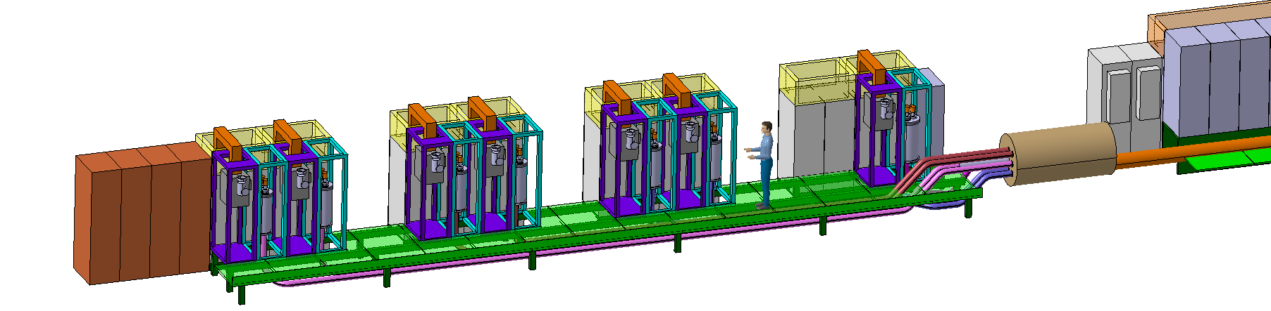
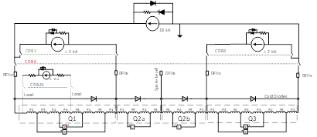
Circuit Disconnector Box recall
The box between power converters and current leads.
Disconnector and earthing system, automation system and panel lock
Notes:
To add the meetings

Slide 3
Safety intervention on electrical system
Any intervention on electrical system should be done with respect to NFC 18-510. (French standard applicable at CERN by safety code C1). ‘article R4544-3 code du travail pour la maîtrise des opérations dans un environnement à risques électriques’.
Any country has similar safety regulations.
Lockout-tagout (LOTO) procedures need to be defined and need to respect 5 steps.
  Disconnect, lock, identify, voltage check and carry earthing & short-circuit.
Reminder:
  Any equipment shall respect IP standard, IEC 60529 `Degrees of protection provided By enclosures’. MCF Meeting # 24, October 2017.
Notes:
To add the meetings

Slide 4
Safety intervention on electrical system
Direct source identification for intervention on 18kA circuit:
  18kA Power converter
  2kA trim converter * 2
  60A k-modulation * 1
  CLIQ system * 6
  IFS box * 10
Indirect source identification for intervention on 18kA circuit (insulation failure):
  All circuits going through the Sclink
  All power converters, QHDS, QPS and CLIQ
More than 100 potential sources!
Complex LOTO procedure before giving work permit.
Notes:
To add the meetings

Slide 5
Safety intervention on electrical systems
The only way to do it is the CDB.
  It can isolate from the sources
  It can earth the circuits
  It respects the IP standard
LOTO is mandatory for people interventions on any part of the system, which concerns:
  Power converters, power cables, water cooling, Current leads, Sclink, Cryo, QPS, QHDS, ELQA…
Moreover, it is safe, fast and easy!
Notes:
To add the meetings

Slide 6
Power converter design safety rules
Since few years, any design of power converter includes the separation and the earthing systems.
Strong support from Electrical safety working group and HSE to deploy these functionalities everywhere!
The non-conformity to electrical standards of magnets is a huge and costly business. LHC isn’t a good example, the electrical standards aren’t respected. The cost for compensatory measures are well above the cost of conform equipment.
Notes:
To add the meetings

Slide 7
CDB technical design
Many meetings
  MCF no. 6 by K. Dahlerup-Petersen
  MCF no. 32 by S. Yammine
  MCF no. 36 by S. Yammine
  TCC no. 53 by S. Yammine
  Special Meeting on warm Cables Cost Saving 2018-09-20 by M. Martino
  8th Annual Meeting 2018 Plenary Talk and Parallel Session by S. Yammine
  TCC no. 64 by M. Martino
No additional risk introduced. Safe operation by automation system with locking, interlock and monitoring.
Strong support from all groups, MSC, MPE, HSE, EPC, EL, ACE
Everybody need it, everybody want it!
Notes:
To add the meetings

Slide 8
Conclusion
The CDB is the best way to respect electrical standards and electrical safety.
CDB needs to be integrated in the HL baseline.
No way to escape!
Notes:
To add the meetings

Slide 9
LHC operation in 2026
All people will thank the discernment of the HL project
to ease their work
and
to assure rapid and safe interventions.
Notes:
To add the meetings

