Slide 1
Charge Sharing Readout
-
Splitting Adapter
for APVs
Hans Henschel, DESY Zeuthen

Slide 2
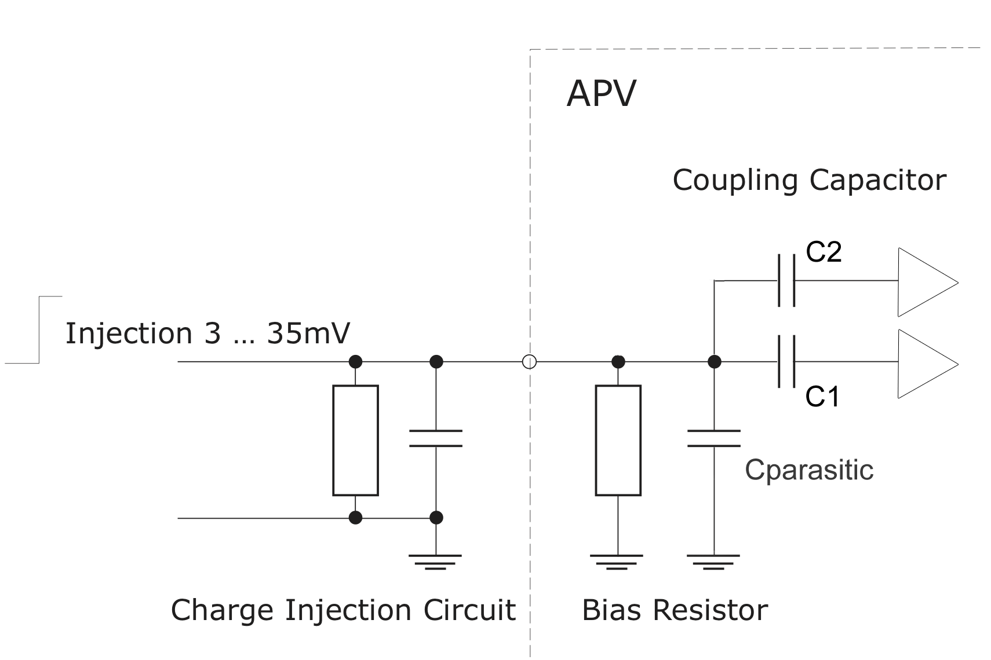
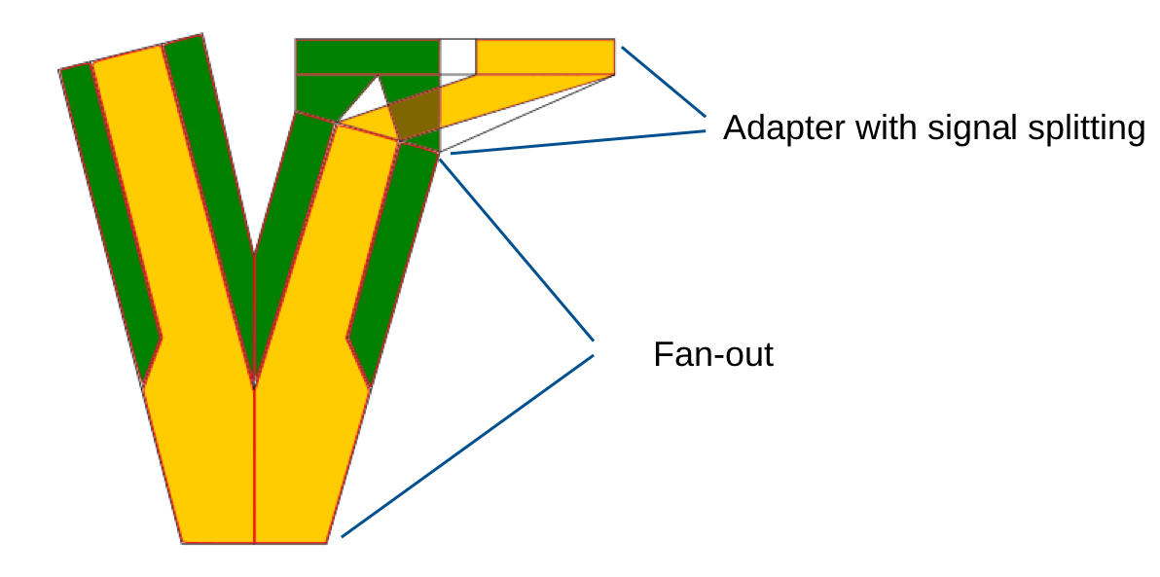

Twin APV adapter
Motivation
• extend the sensitivity range of the APV frontend
• share charge between two APV channels using different
coupling capacitors
(C1 standard: 100pF, C2 modified: 10pF)
• design new fanout or an adapter board
with matching connectors
➨ modify every 2nd channel on APV!
approved?

Slide 3
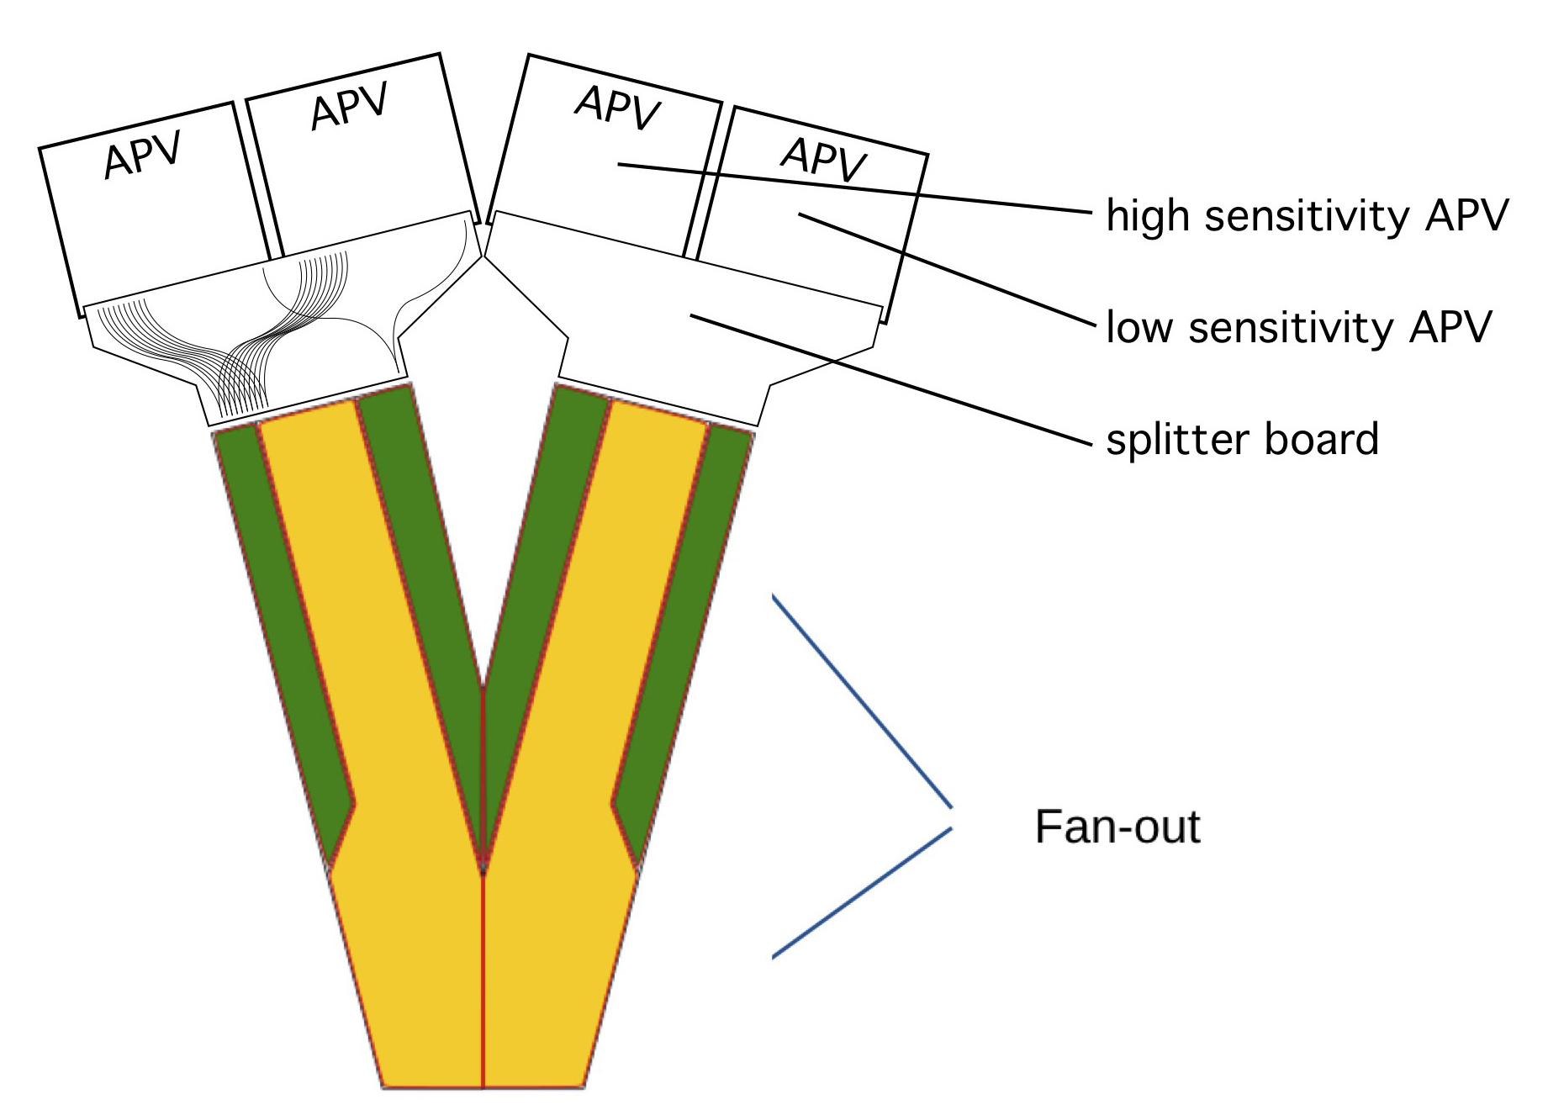
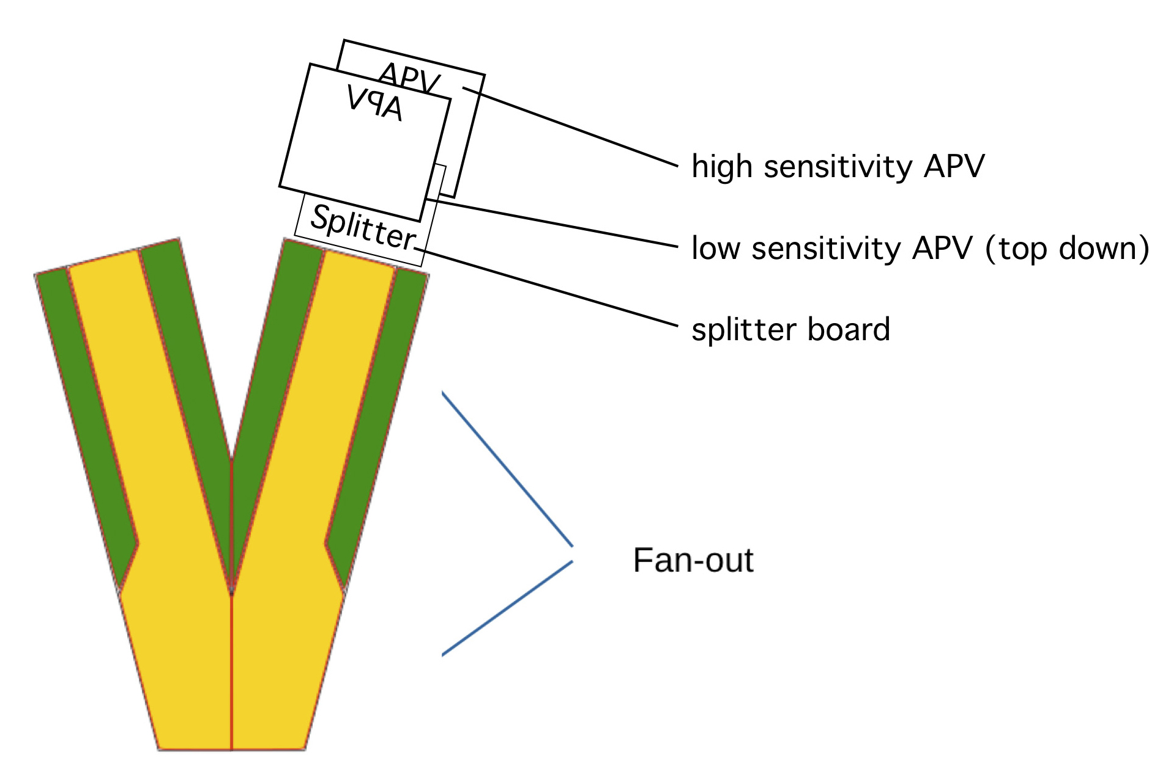
Twin APV adapter
Basic Concepts
• modify a whole APV board (all channels) √
• neighbour APVs or
• stack them (one flipped, preferred!) ➨ less stub line length and easier routing

Slide 4
Twin APV adapter
Geometrical constraints (1)
• consecutive sensor planes: just 3.5mm!
• existing fanout (Panasonic connector): ~9mm
• two flipped APVs: 19mm
• use bulged adapter to place APVs
of two consecutive sensor planes side by side
instead of stacked in a series
➨ no more space needed than now

Slide 5
Twin APV adapter
Versatility considerations
• place connector footprints on both sides
to allow for a single (reversible) design
• which side to solder is a matter of later decision
• place Panasonic as well as Samtec footprints
on fanout bound end
(Samtec has less height, therefore at the very end)
• place a hole for a carrying rod

Slide 6
Twin APV adapter
Geometrical constraints (2)
• Given fanout angle results in a required minimum adapter length (150mm) ➨ too much?

Slide 7
Twin APV adapter
Status
• APVs
20 pcs. to modify arrived in Zeuthen
will be put into the workshop next week ➨ modifications still possible! (10pF?)
• Twin Adapter
pcb design just started ➨ modifications still possible!
manufacturing and soldering due
Panasonic connectors available @ CERN store
➨ have to be ordered and sent to Zeuthen!
Samtec connectors: few free samples delivered

Slide 8
Thank you for your
attention!
Looking forward for a fruitful discussion.

