Slide 1
FCAL Workshop DESY 2019
Closeout
Wolfgang Lohmann

Slide 2
Statistics
19 presentations,
2 General
1 CEPC
4 LUXE
Hardware: 6
Software and simulations 6

Slide 3
general
FLC projects
CALICE
LCTPC
Silicon tracker
FCAL
LUXE
Ties, DESY, projects
Karsten, ILC

Slide 4
CEPC
Hongbo
LumiCal and forward design

Slide 5
LUXE
Marina, Matthew, Sasha
Currently studies ongoing to optimize the design, estimate performance, study background etc.
CDR in summer 2020

Slide 6
Hardware
Aleksandr, Angel, Anton, Jakub, Konrad, Hans, Mirek,
FLAME is alive
DAQ designed
APV adapters under work
Absorber plates prepared
ASIC for GaAs in progress
New GaAs sensors for February test-beam considered

Slide 7
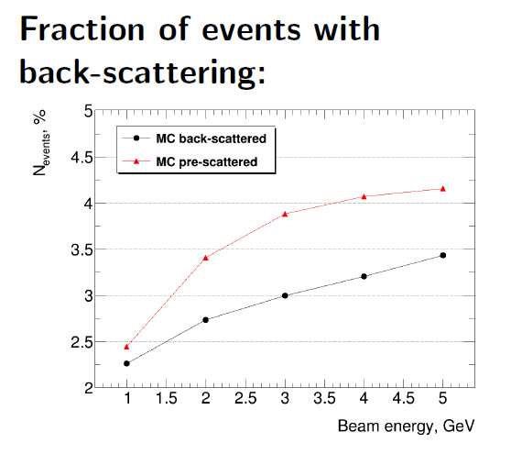
Software
Andre, Bohdan, Georgios, Ivan, Mykyta, Zhanna
Bias in the polar angle due to beam-beam effect at Fccee→has impact on the LEP mesurements of the numbers of neutrinos
There are still test-beam data from 2016 to be analysed!

Slide 8
closeout
Lets thank:
Sergey for the preparation of the workshop,
Andrea, Ibtisam for giving first class support
DESY for hosting
All the speakers for presentations of excellent results
Enjoy Hamburg! Have a nice return jurney!

