Slide 1


Technical Report for the INTC and ISCC Meetings 4th February 2010
Richard Catherall EN-STI-RBS

Slide 2
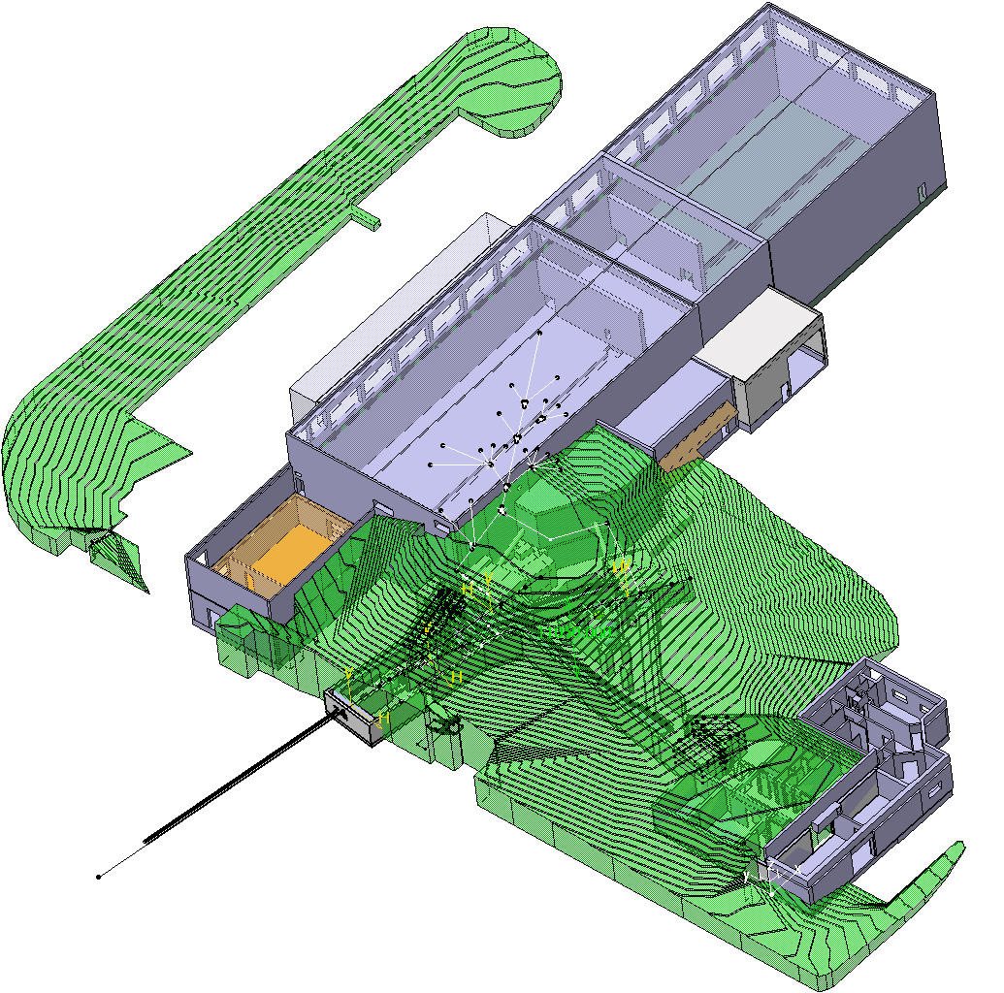
Outline
Shutdown Work
  Vacuum Controls Consolidation
  REX
  RILIS
  Experimental Hall
Front End #6 exchange
  Phases 0.5 - 3
  Boris tube insulator exchange
News from support groups
HIE- ISOLDE
  Status

Slide 3
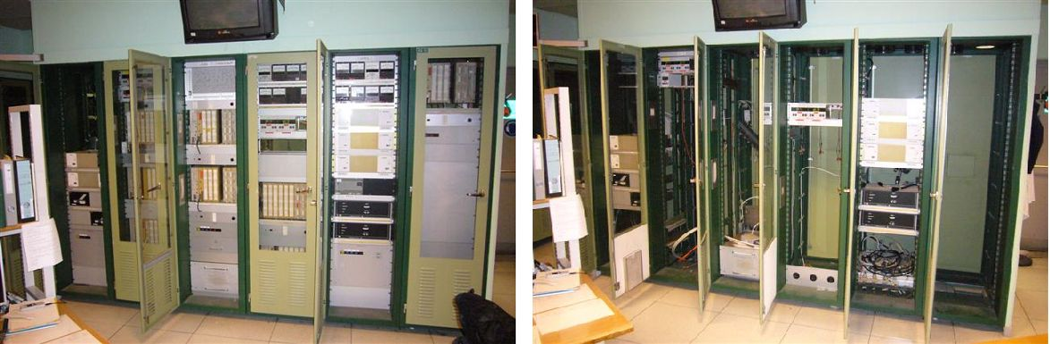
Vacuum Controls Consolidation
Good progress being made and on schedule
Removal of old cables completed
Installation and connections of new cables nearly completed
New chassis currently being installed
Verifications done in parallel on FE#6 test stand
Removal of venting equipment from HRS separator zone
Replacement of all vacuum gauges nearly complete
Before
After

Slide 4
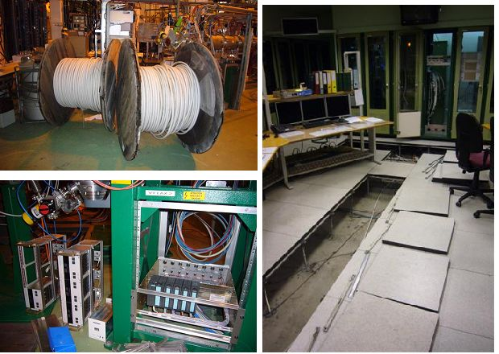
Vacuum Controls Consolidation

Slide 5
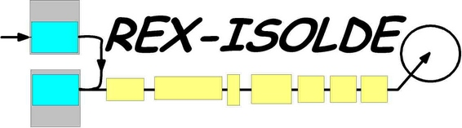
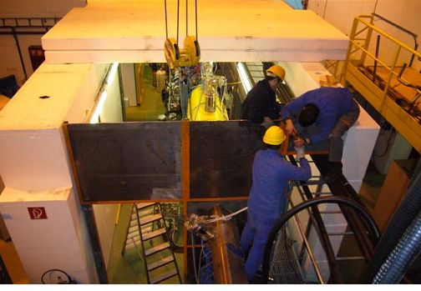
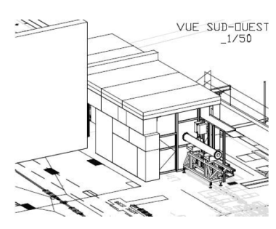
Shielding end caps currently being put in place.
RF to be started tomorrow for x-ray measurements and validation
Interlocks remain to be installed

Slide 6
Vacuum.
  There are leaks on sectors 6 and 7, most likely due to the DBs windows.
  New windows are being made for all linac DBs. They will be installed in March.
  IHS vacuum modification. The cryo-pump and intermediate chamber have been removed and the turbo pump reinstalled on the cavity
  Investigations to be done to improve the overall vacuum
Water cooling installation in the RF room is finished.
  Pressure tests have been done.
  Everything is ready for the installation of heat exchangers.
REXTRAP, BTS and the local ion source will be restarted for Witch in the second half of February…infrastructure permitting
The new BI control system is in place control software is being finished, tests and debugging are ongoing.
New steerer magnets
  The magnets will be delivered end of February. Installation beginning of March.
  Power supplies, cabling and supports are ready.
  A dedicated interlock rack will be added for these magnets.

Slide 7
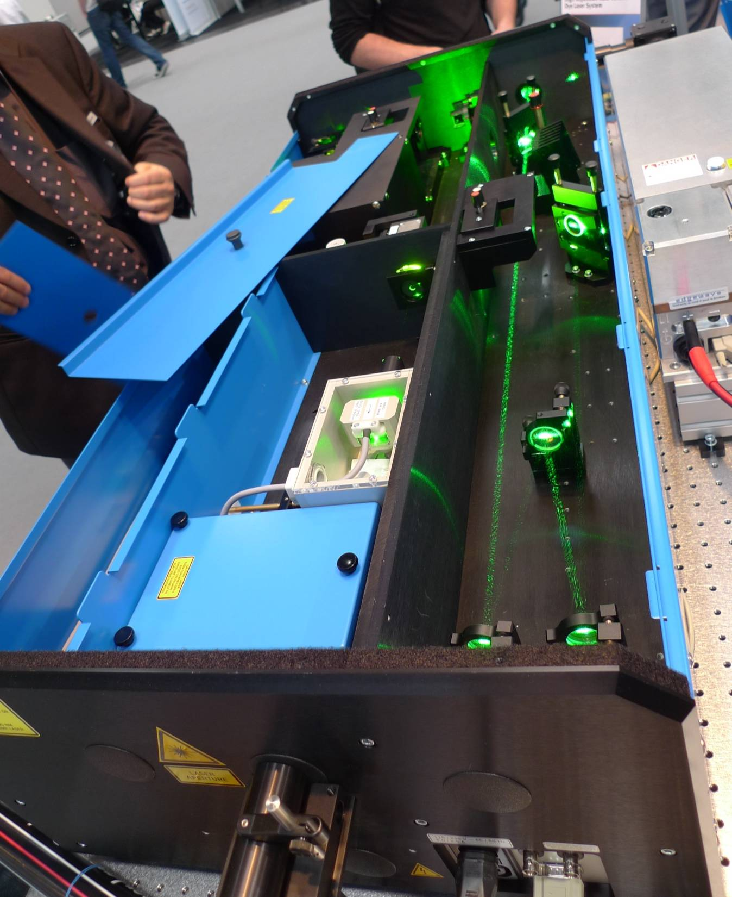
RILIS
Received the 2 new dye lasers from Sirah.
February:
  Receipt of a new narrow band dye laser and installation /testing during February.
  Install and test the Sirah dye lasers with both Nd:YAG (green + UV) and CVL pumping (just to measure any efficiency differences between YAG/CVL).
March:
  Remove CVL laser system, increase optical table size and change laser layout to allow space for the two large Sirah Dye lasers and the future Nd:YAG and Ti:Sa laser system (which is in construction and will be installed in various stages throughout the year).
Syrah Dye Laser Potential benefits:
Greater efficiency and stability.
Higher UV power and better beam quality.
Enable UV pumping to provide beams in the 380 – 540 nm range.

Slide 8
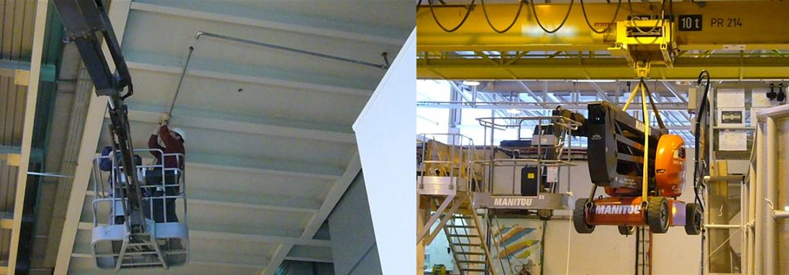
Experimental Hall
Water in the Experimental Hall!!
Due to condensation during the summer months
Collection reinforced
Excess water diverted to drains

Slide 9
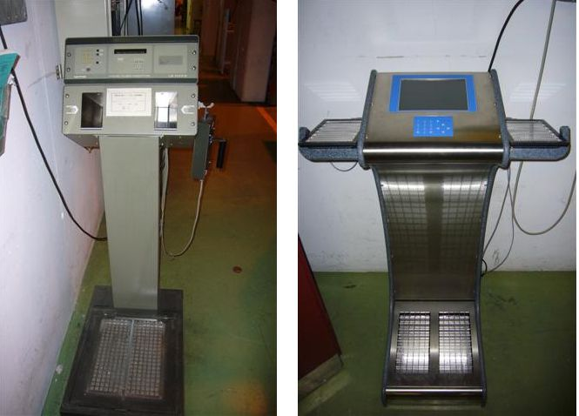
Experimental Hall
New Hand Foot monitors
Readings can be logged/monitored over technical network

Slide 10
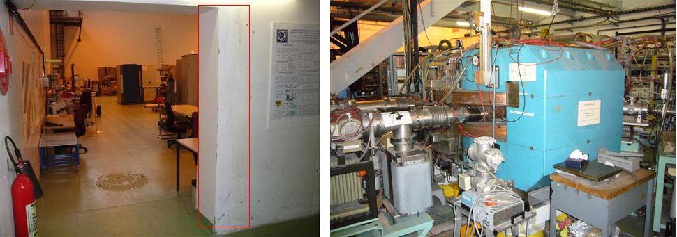
Experimental hall
Opening of the passage between old and new hall foreseen in near future.
Study required due to platform support
Mistral magnet to be removed end of February

Slide 11
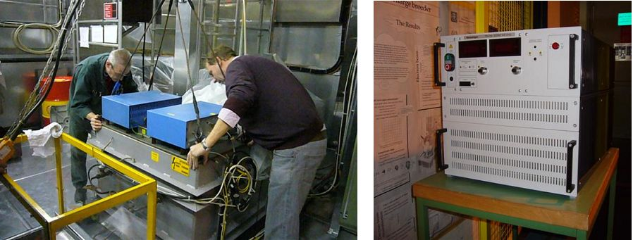
Experimental Hall
Astec 60kV repaired and has replaced the spare Heinzinger supply.
HT room cleaned and protected in view of scheduled Boris tube work

Slide 12
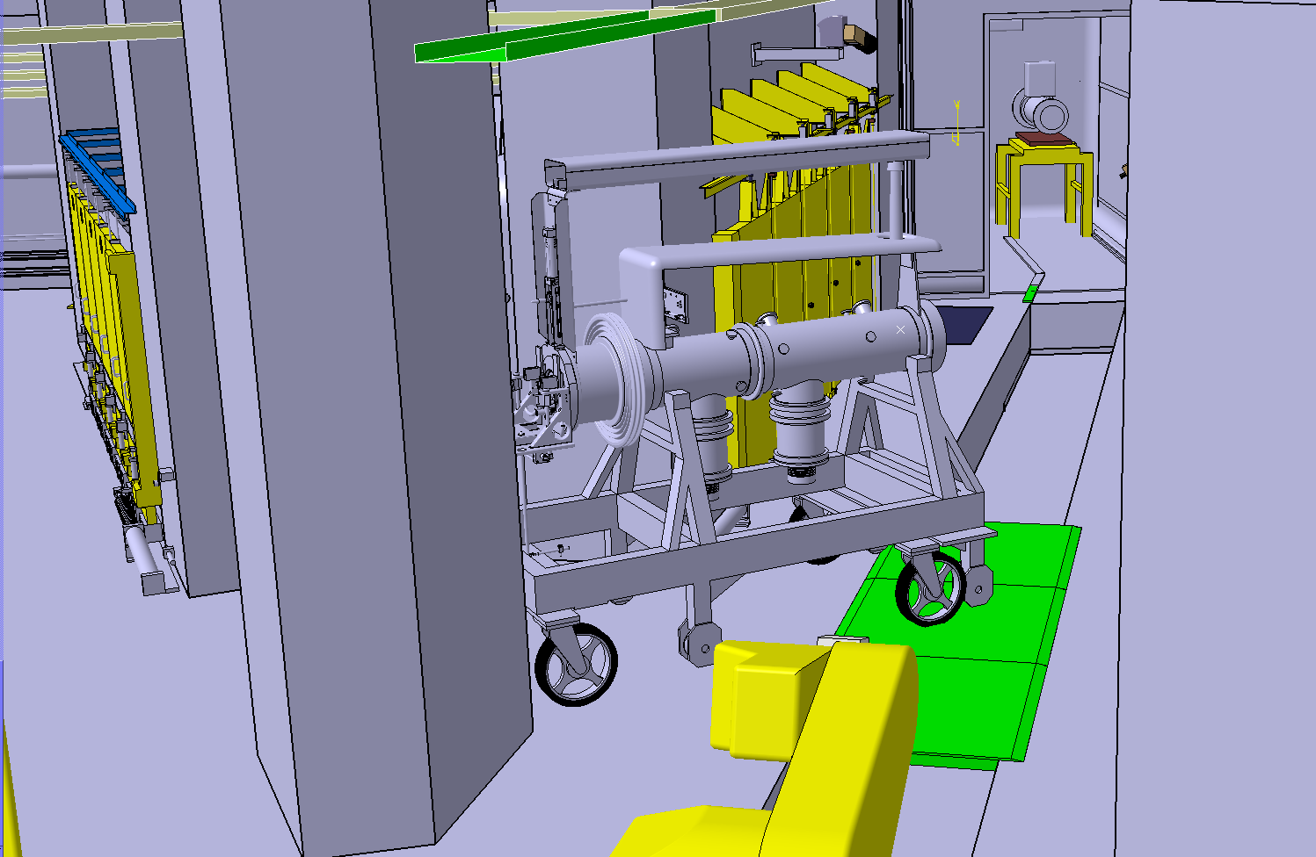
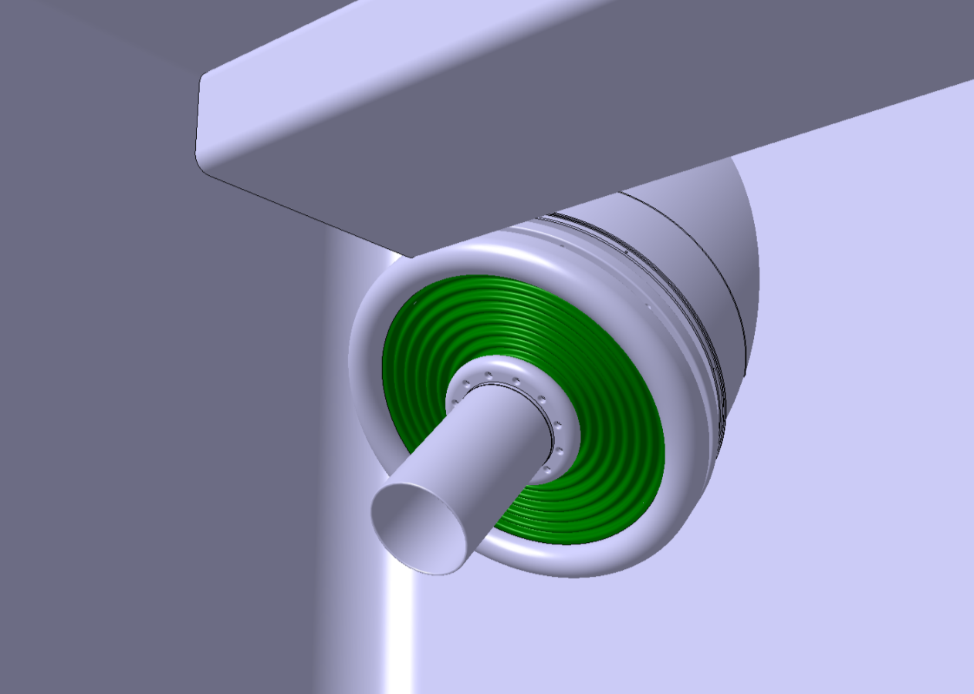
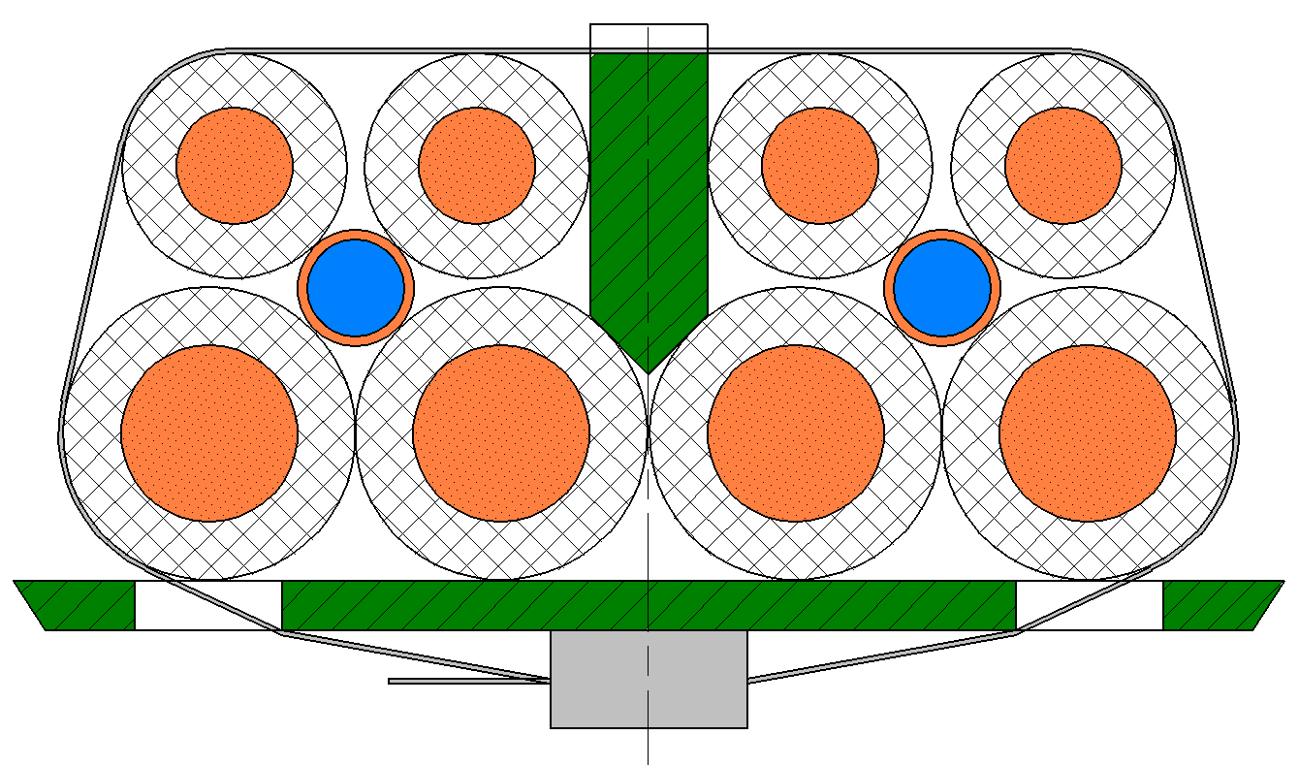
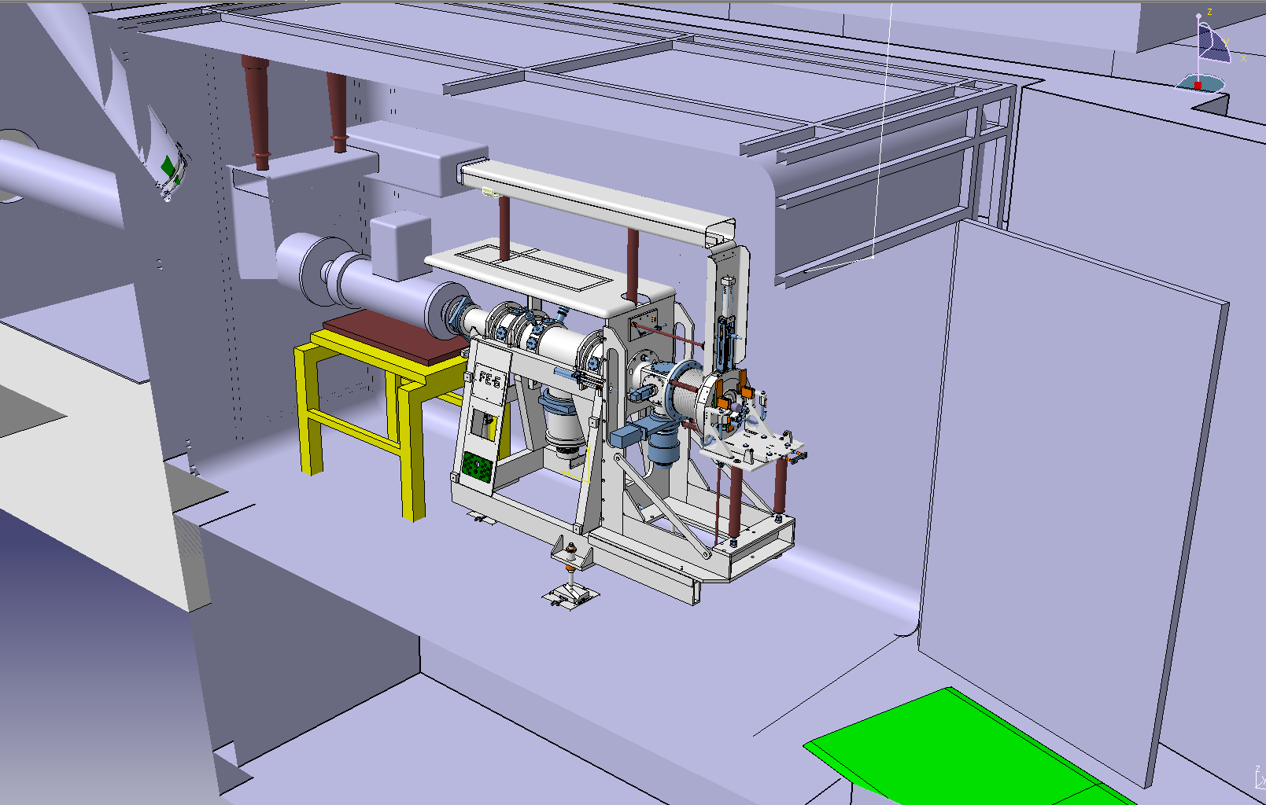
Front End #6 exchange
Phase 1 - Removal of FE#3
    13th – 15th January
Phase 2 - Removal of Boris tube cables and insulator exchange
    18th – 22nd January
Phase 3 - Cabling of BT and ground elements
    25th January – 12th February
Phase 4 - Installation of FE#6, alignment
    15th – 19th February
Phase 5 - Coupling, vacuum and electrical
    22nd – 24th February
Phase 6 - Tests, mechanical, vacuum, power
    3rd March ->
Key dates
  Cold check out 5th April
  Off-line run – 19th April
  Protons to ISOLDE – 26th April
Warning: Planning subject to change according to progress on both FE installation and vacuum controls upgrade progress!!
Still on schedule

Slide 13
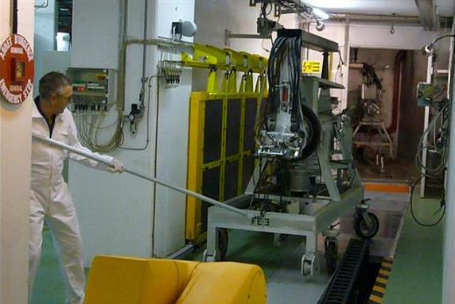
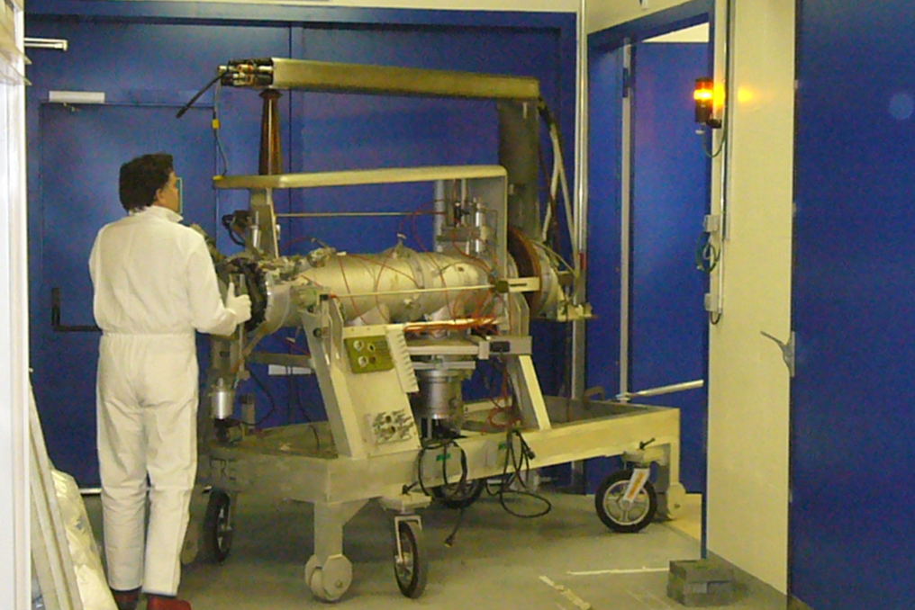
Front End #6 Exchange
Phase 0.5 – Removal of old target successful
  Cause: gripping of clamps
  Collective dose slightly higher than estimated.
Phase 1 – Removal of FE # 3 successful
  Collective dose lower than ALARA dose estimate despite last minute modifications

Slide 14
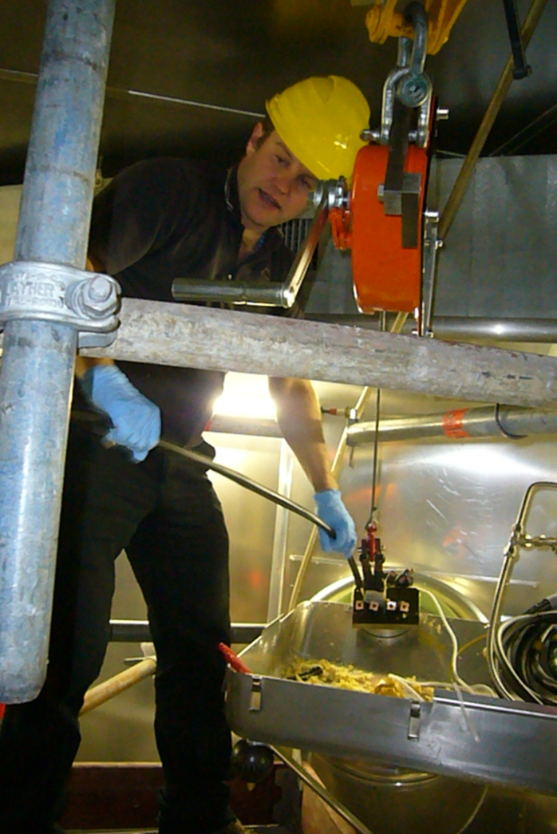
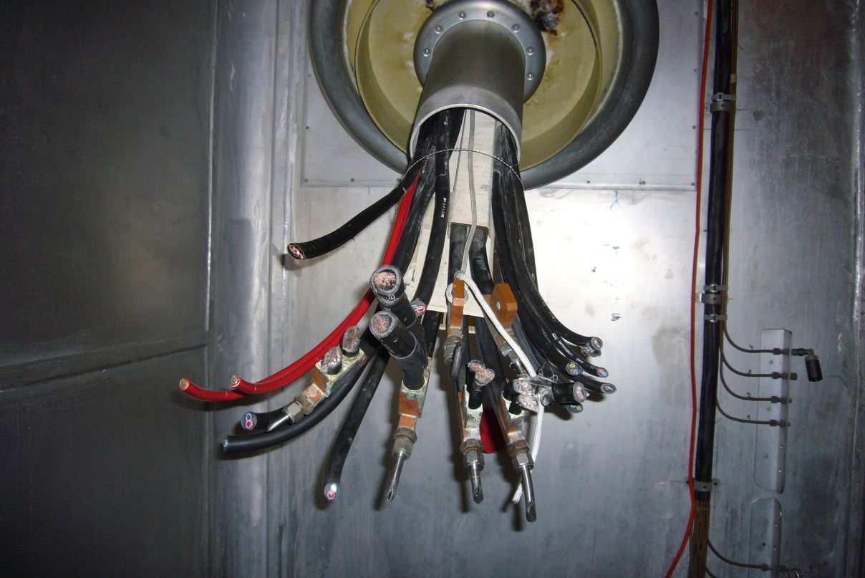
Phase 2 cable removal
Smaller cables pulled from HT room
Thicker cables lowered and cut in target area

Slide 15
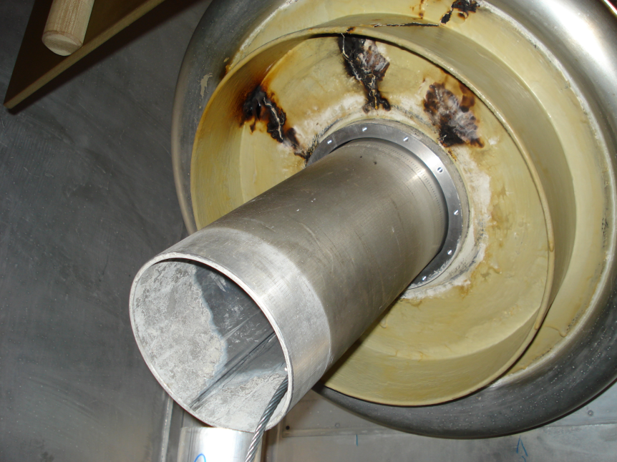
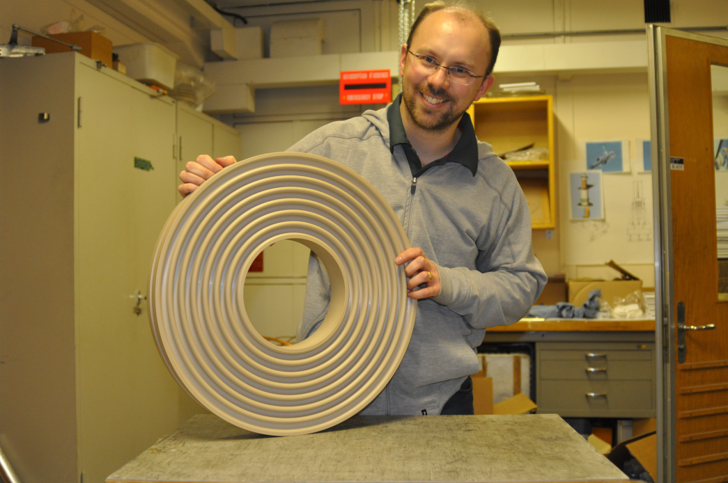
Phase 2 Boris Tube Insulator Exchange
Tracking across the insulator
Breakdown of polymer coating done in 2007
Delay in the installation of new insulator
  First batch damaged during delivery
  Second batch revealed incompatibility between araldite and surface coating
  Third batch in PEEK arrived last Tuesday and was successfully installed yesterday
  No overall delay as phase 3 cabling was brought forward

Slide 16
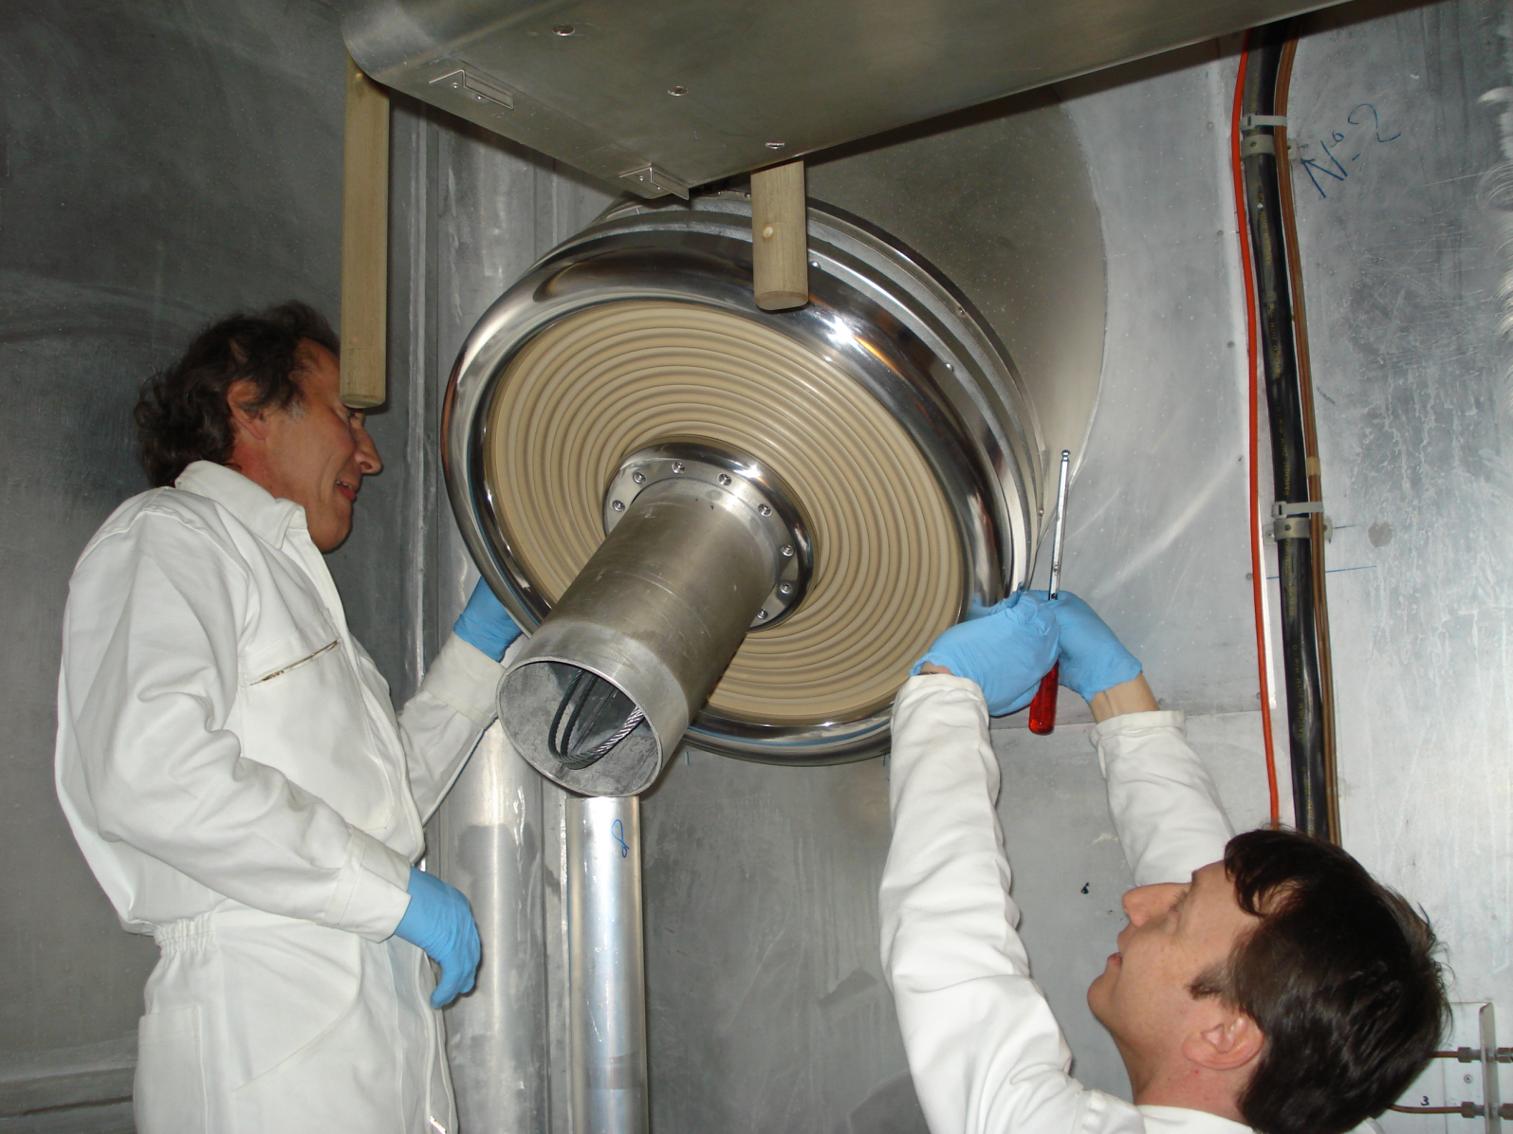
Phase 2 – completed!!
3rd February 2010

Slide 17
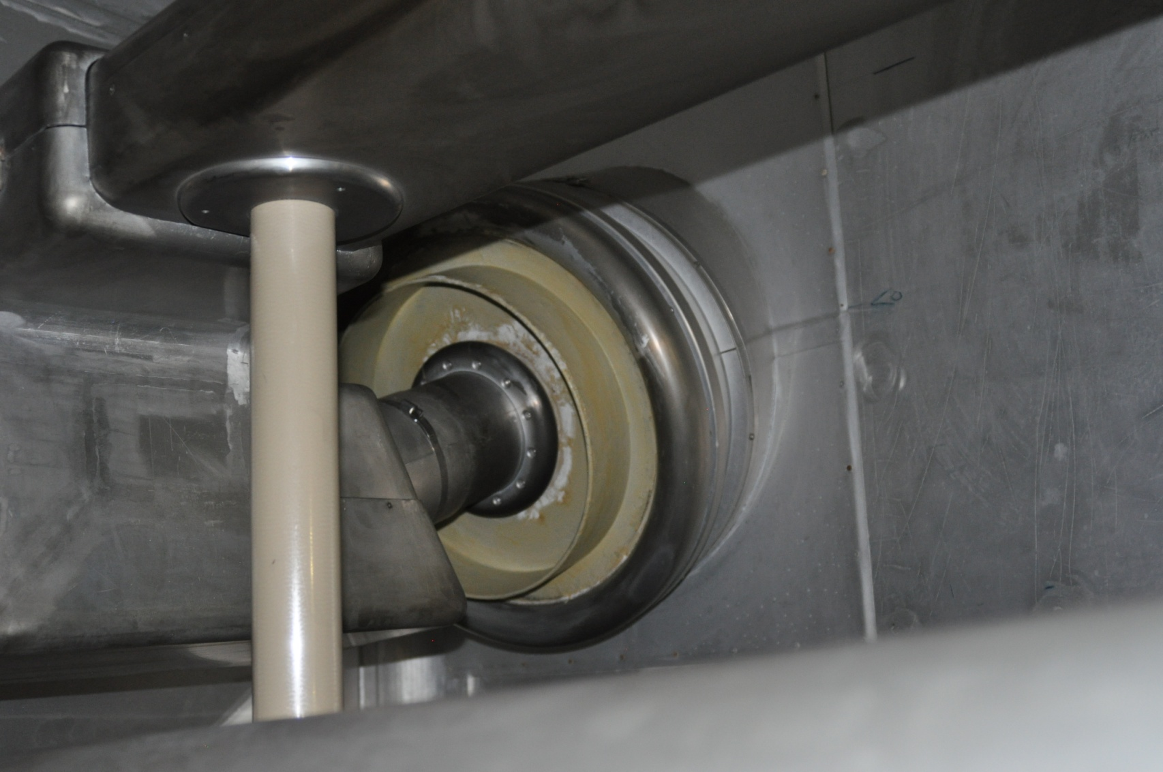
GPS Boris tube insulator

Slide 18
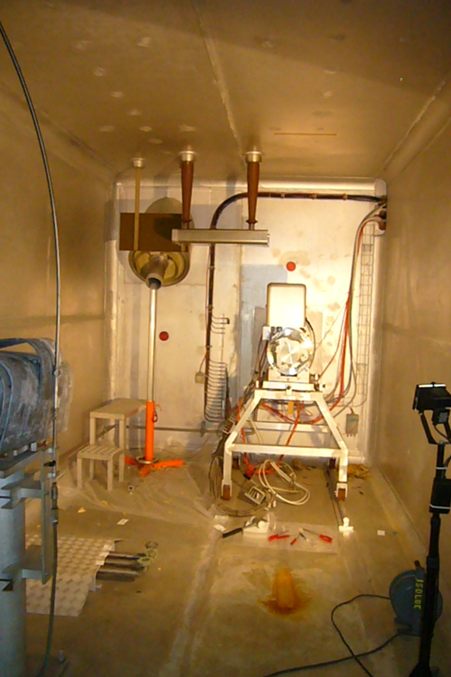
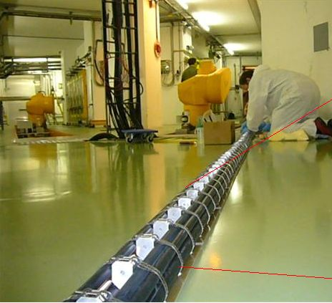
Phase 3 Cabling
Preparation of new power cables for Boris tube
Faraday cage status
Non HT cabling progressing well

Slide 19
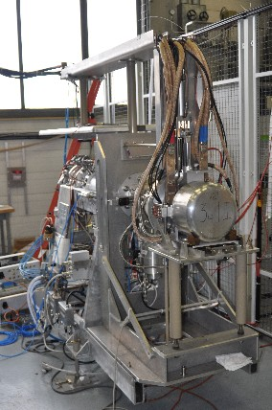
Front End #6
Final commissioning
  Stable beam to be done this week
  Faraday cup to be tested
  Testing of new vacuum control system and interlocks
Vacuum tested
  Requires re-orientation of vacuum equipment
Modifications
  Addition of a 9-pin connector on coupling table.
    Increases possibilities of connections within target unit
  Addition of micro-switches on linear potentiometers

Slide 20
News from Support Groups
SC-RP
  Supplementary RP technician for shutdown period… an excellent initiative
EN-STI
  Target area upgrade project being launched.
    Budget allocated
    Initial contact with EN-HE for robot replacement
    Hiring of 2 Fellows for project
  Posts
    Safety Engineer within EN-STI-RBS…A-P. Bernardes
    Pekka Suominen EN-STI-RBS starts as from March (3 years)
    Peter Valko EN-STI-RBS starts mid February (6 months)
    Slovak student EN-STI-LP starts mid February (6 months)
    Opening of post for Laser Physicist in EN-STI-LP
    Progress being made on the safety file for ISOLDE by M. Picard ..also following ALARA document for FE exchange
    E. Brard EN-STI-RBS starts 1st April (5 months)
BE-OP, EN-CV, BE-ABP, TE-VSC, TE-EPC, EN-EL, TE-ABT….
  Support for shutdown work and Front end exchange

Slide 21


HIE-ISOLDE Project:
Planning & Resources
Overview
  HIE-ISOLDE Planning
  Resource Loaded Schedule
  CATHI Proposal (Marie-Curie ITN3)
  Project Management Structure
  R&D Activities and Outlook
Y. Kadi (EN-HDO)
and the HIE-ISOLDE Project team

Slide 22
HIE-ISOLDE Schedule (1/3)
The HIE-ISOLDE project concentrates on the construction of the SC LINAC and associated infrastructure in order to upgrade the energy of the post-accelerated radioactive ion beams to 5.5 MeV/u in 2013 and 10 MeV/u by 2014/2015
The design study for the intensity upgrade, also part of HIE-ISOLDE, starts in 2011/2012, and addresses the technical feasibility and cost estimate for operating the facility at 10 kW once LINAC4 and PS Booster are online. The 30 kW option (SPL beam) will be studied at a later stage

Slide 23
HIE-ISOLDE Schedule (2/3)
Energy Upgrade
Stage-1: 5.5 MeV/u SC Linac (2013)
  New service buildings (CV, electrical systems, …) ->
  Cryogenics station (Cold box, compressors, control systems) ->
  SC linac (2 cryomodules, 10 β_{high} cavities, 2 solenoids and 10 RF stations) ->
Stage-2: 10 MeV/u SC Linac (2014/2015)
  SC linac (4 cryomodules, 10 β_{high} + 12 β_{low} cavities, 6 solenoids and 22 RF stations) ->
  New transfer line ->

Slide 24
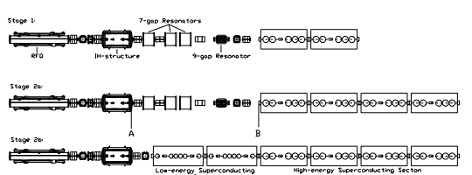
SC Linac Layout staged installation
1.2 MeV/u
3
MeV/u
5.5 MeV/u
8
MeV/u
10 MeV/u

Slide 25
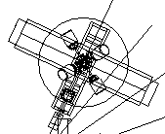
New Transfer Line
HEBT3
HEBT2
HEBT1

Slide 26
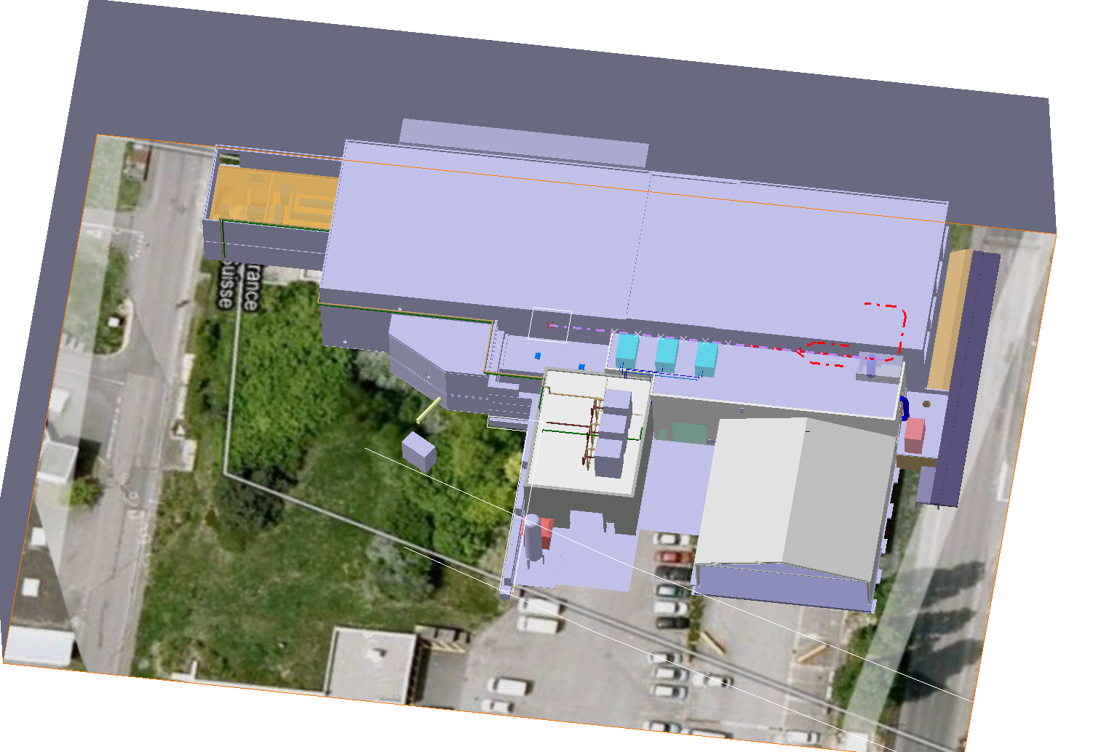
HIE-ISOLDE Layout

Slide 27
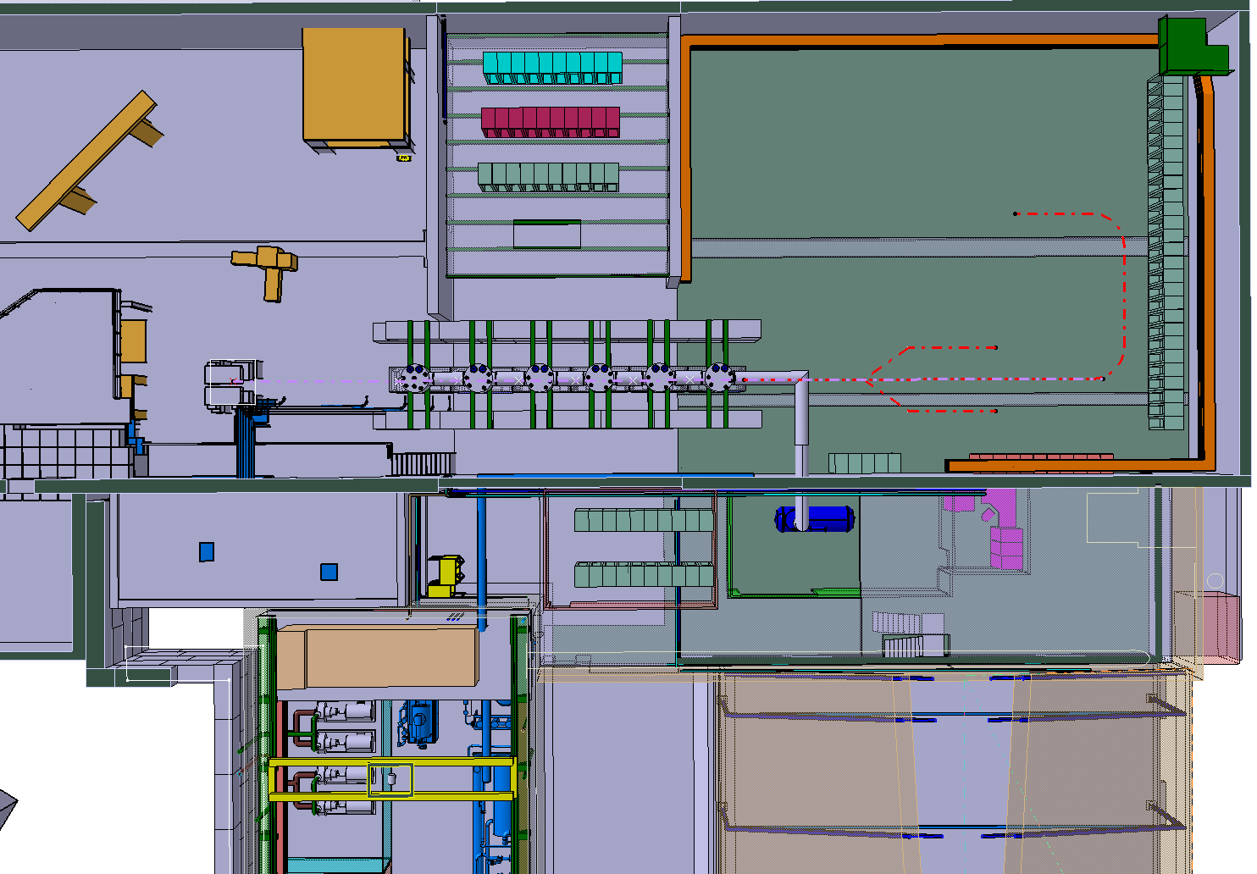
HIE-ISOLDE Layout

Slide 28
Research Training Themes Addressed by the CATHI Proposal
(56 FTE over 4 years)
Y. Kadi HIE-ISOLDE Proposal, IEFC, August 21, 2009

Slide 29
List of Participants
Y. Kadi HIE-ISOLDE Proposal, IEFC, August 21, 2009

Slide 30
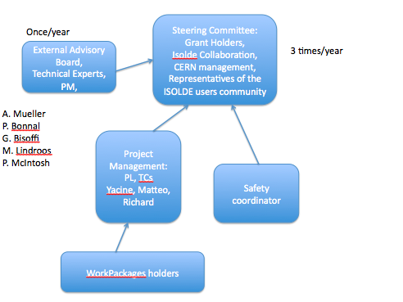
Project Breakdown Structure Overview

Slide 31
Outlook
Cavity prototype completed. Tests scheduled @ TRIUMF by March 2010
Cryomodule conceptual design completed, will start detailed design as soon as manpower is available
Preparation of test bench at CERN of QWR resonators (new test cryostat is planned to be ready by Feb/Mar 2010)
Complete Cavity configuration test @ SM18 is planned by the end of 2010.
M. Pasini SRF09 Berlin, 20-25.09 2009

Slide 32
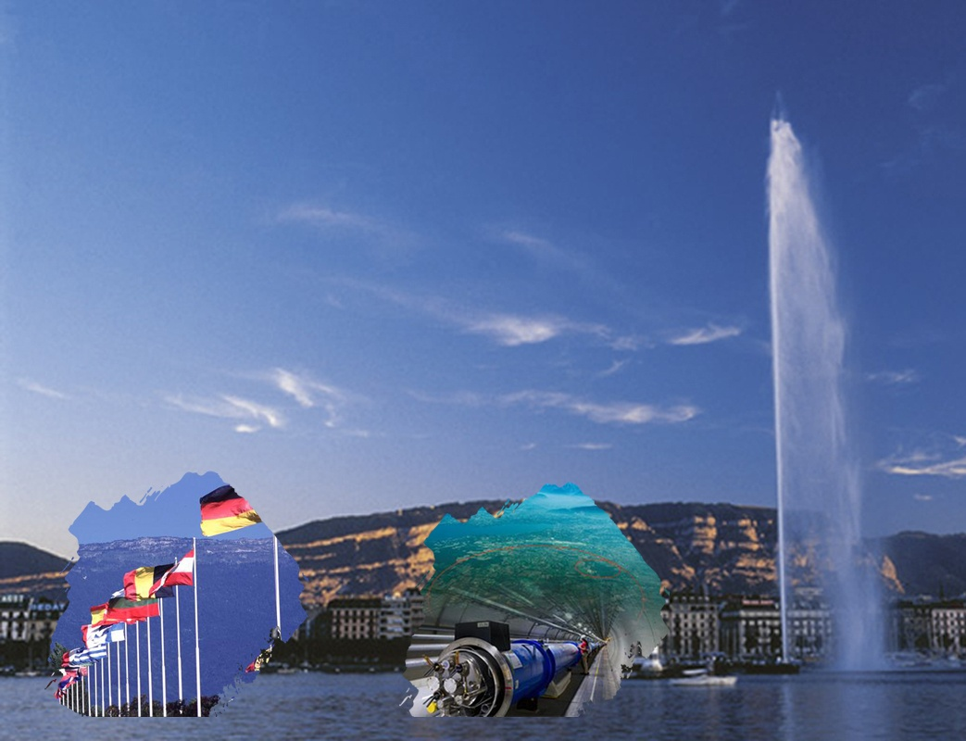


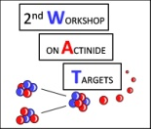



International Joint Workshop
CERN, Geneva,
Switzerland
40^{èmes} Journées des Actinides
27th March - 30th March 2010
2nd Workshop on Actinide Targets
30th March – 1st April 2010
LOCAL ORGANISING COMMITTEE
    R. Catherall
    K. Johnston
    T. Stora
    V. Vlachoudis
TOPICS
Nuclear fuel cycle, environment
Inorganic, organometallic chemistry
Theory, electronic structure
Materials science, nanomaterials
Strongly correlated behaviours;
superconductivity, quantum criticality
Actinide production
Actinide handling
Radiation protection
Fission products & radioactive ion
beam yields
SCIENTIFIC COMMITTEE
  A. Gonçalves
  L. Havela
  D. Kaczorowski
  A. C. Morton
  A. Ferrari
  E. Chiaveri
  T. Otto
  F. Wastin
Website: www.cern.ch/wat-jda2010
Contact: wat-jda2010@cern.ch
Poster: L. Catherall

