Slide 1
Coulomb excitation of ¹¹⁶Te: a study of collectivity above the Z=50 shell gap
Tuomas Grahn
University of Jyväskylä
INTC meeting 4.2.2010

Slide 2
Outline
Physics background
Proposed experiment
Beamtime request

Slide 3
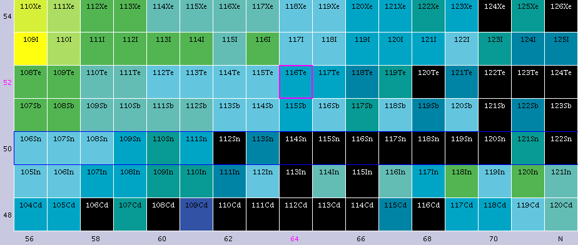
Physics background
In neutron-deficient nuclei around the Z=50 shell gap many unusual phenomena have been observed.
Recently measured transition probabilities in Sn nuclei deviate from the seniority scheme.
ISOLDE is one of the leading laboratories for such studies.
N=66
Z=50

Slide 4
Physics background
The 2⁺ and 4⁺ states minimise their energies at the neutron mid shell.
Consequently, transition probabilities increase towards the mid shell.
Level energies in Xe, Te and I nuclei may indicate a sudden onset of collectivity when approaching N=50 shell closure

Slide 5
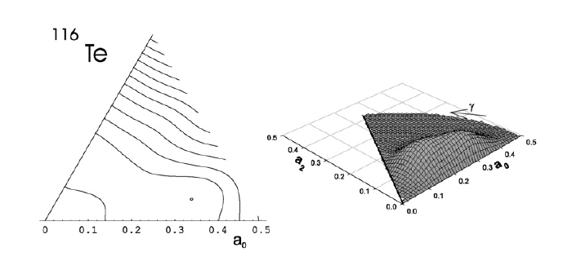
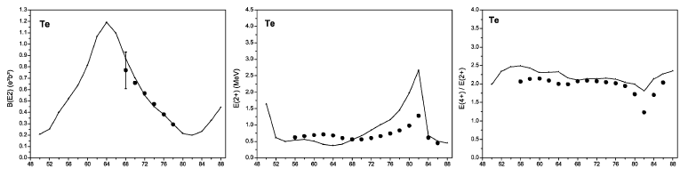
Physics background
Microscopic configuration mixing approach with Gogny D1S interaction
J. Libert et al. Nucl. Phys. A 786 (2007) 47

Slide 6
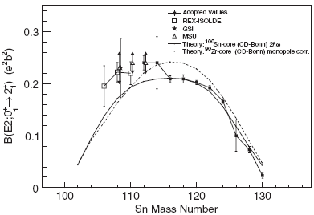
Physics background
B(E2; 0⁺ → 2⁺) values for the neutron-deficient Sn nuclei have been measured at ISOLDE.
Deviations from the generalised seniority scheme when approaching N=Z=50 shell gap.
What happens in the neutron-deficient Te nuclei?
A. Ekström et al., PRL 101 (2008) 012502

Slide 7
Proposed experiment
Objectives of the proposed study:
  To probe collectivity and wave functions around the neutron mid shell at N=66 by measuring the B(E2;0⁺ → 2⁺) value in ¹¹⁶Te.
  To initiate beam and target developments for more neutron-deficient Te beams.

Slide 8
Proposed experiment
While ¹¹⁶Te can be produced using the ZrO₂ primary ISOLDE target and the hot plasma ion source through spallation of 1.5 mass% hafnium impurities [U. Köster et al., NIM B 204 (2003) 303] better options are likely to exist.
HfO₂ or CeO₂ primary targets are likely to be more suitable for the production of the neutron-deficient Te beams.
Therefore, 3 shifts of beam time is requested for the target & yield test prior the Coulomb excitation run.
Nevertheless, objectives of the present proposal can be achieved with ¹¹⁶Te beam produced with the ZrO₂ target.

Slide 9
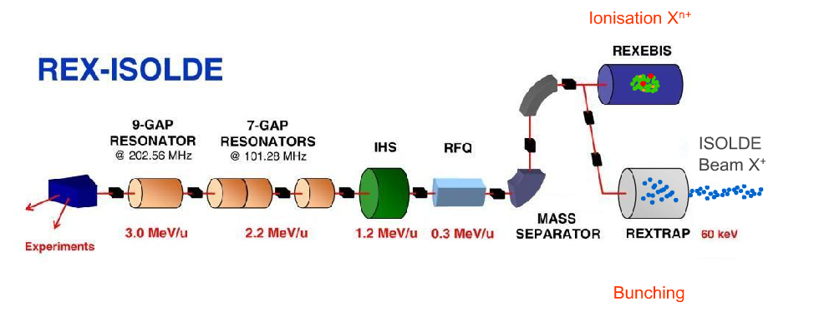
Proposed experiment
The mass separated ¹¹⁶Te beam will be charge bred in REX-EBIS in order to obtain required charge state for the REX linear accelerator.
Post-accelerated (E=2.95 Mev/u) ¹¹⁶Te beam will be Coulomb excited with a 2 mg/cm² ⁵⁸Ni target.
Coulomb excitation γ-ray yield will be recorded with the MINIBALL γ-ray spectrometer.

Slide 10
Proposed experiment
Coulomb excitation events can be distinguished by detecting both the target and projectile nuclei in the MINIBALL CD Si detector.
Particle-particle-γ coincidences required.
2.95 MeV/u ¹¹⁶Te beam on the 2 mg/cm² ⁵⁸Ni target.

Slide 11
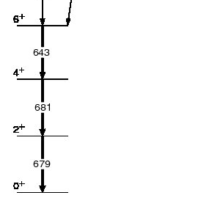
Proposed experiment
Reported ISOLDE primary yield for ¹¹⁶Te: 10⁶/μC
Assumptions: 1% REX transmission efficiency, 10% MINIBALL efficiency @ ~600 keV, transition matrix element 0.39 e²b².
A yield estimate using the Coulomb excitation code GOSIA ⇒ 170 γ-ray events for the 0⁺_{g.s.} → 2⁺ transition in ¹¹⁶Te per an 8 hour shift.
Partial level scheme of ¹¹⁶Te

Slide 12
Beam time request
3 shifts are requested for the target development and the yield measurement.
Further 3 shifts are requested for the REX set up.
9 shifts are requested for the Coulomb excitation of ¹¹⁶Te.
  ~1500 γ-ray events for the 0⁺ → 2⁺ transition in ¹¹⁶Te
  ~140 γ-ray events for the 0⁺ → 2⁺ transition in ⁵⁸Ni (target excitations)
In total, 15 shifts are requested.

Slide 13
Collaboration
CERN-ISOLDE (J. Pakarinen, F. Wenander)
KTH Stockholm (T. Bäck, B. Cederwall, A. Johnson)
KU Leuven (N. Bree, I.G. Darby, J. Diriken, M. Huyse, P. Van Duppen)
STFC Daresbury Laboratory (D. O’Donnell, J. Simpson)
University of Jyväskylä (T. Grahn, R. Julin, P. Rahkila, M. Sandzelius)
University of Liverpool (P.A. Butler, L.P. Gaffney, T. Grahn, D.T. Joss, R.D. Page, E.S. Paul, M. Scheck)
University of Lund (J. Cederkäll, A. Ekström, C. Fahlander)
University of the West of Scotland (B. Hadinia, J.F. Smith)
University of York (D.G. Jenkins, B.S. Nara Singh, R. Wadsworth)

