Slide 1

Deep Inelastic Scattering
The way to unravel the secrets of nucleons
E.C. Aschenauer
BNL

Slide 2
Elementary Particles
Protons, neutrons and electrons (p,n,e) build all the atoms.
Proton and neutrons make up 99.9% of the visible mass in the universe.
Dozens of new particles were discovered in the past century.
Strong interaction: strength can be 100 times the electromagnetic one
  leptons (e,m,n,..): not involved in strong interaction
  hadrons [mesons(p,K,…) and baryons (p,n,…)]: involved in strong interaction
Electron Scattering
Quarks and Gluons: QCD

Slide 3
Cool Facts about QCD and Nuclei
Did you know that … ?
If an atom was the size of a football field, the (atomic) nucleus would be about the size of a football.
Despite its tiny dimensions, the nucleus accounts for 99.9% of an atom’s mass.
Protons and neutrons swirl in a heavy atomic nucleus with speeds of up to some ¾ of c.
More commonly, their speed is some ¼
the speed of light.
The reason is because they are
“strong-forced” to reside in a small
space.
Quarks (and gluons) are “confined”
to the even smaller space inside
protons and neutrons. Because of
this, they swirl around with the
speed of light.

Slide 4
Cool Facts about QCD and Nuclei
The strong force is so strong, that you can never find one quark alone (this is called “confinement”).
When pried even a little apart, quarks experience ten tons of force pulling them together again.
Quarks and gluons jiggle around at nearly light-speed, and extra gluons and quark/anti-quark pairs pop into existence one moment to disappear the next.
This flurry of activity, fueled by the energy of the gluons, generates nearly all the mass of protons and neutrons, and thus ultimately of all the matter we see.
Even the QCD “vacuum” is not truly empty. Long-distance gluonic fluctuations are an integral part. Quarks have small mass themselves, but attain an effective larger mass due to the fact that they attract these gluonic fluctuations around them.
Nuclear physicists are trying to answer how basic properties like mass, shape, and spin come about from the flood of gluons, quark/anti-quark pairs (the “sea”), and a few ever-present quarks.

Slide 5
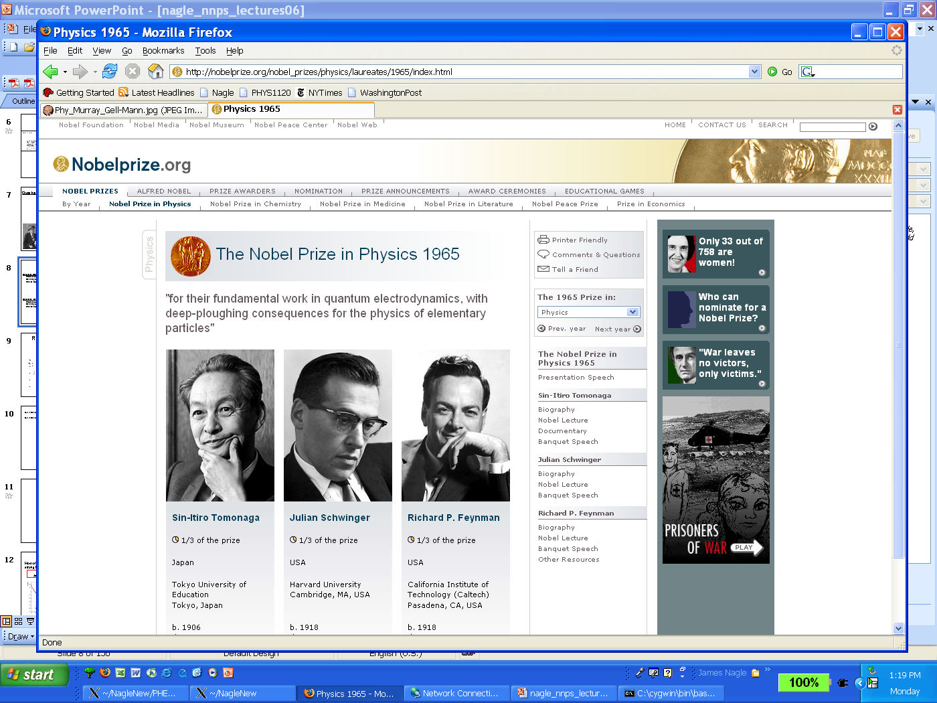
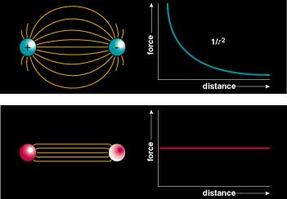
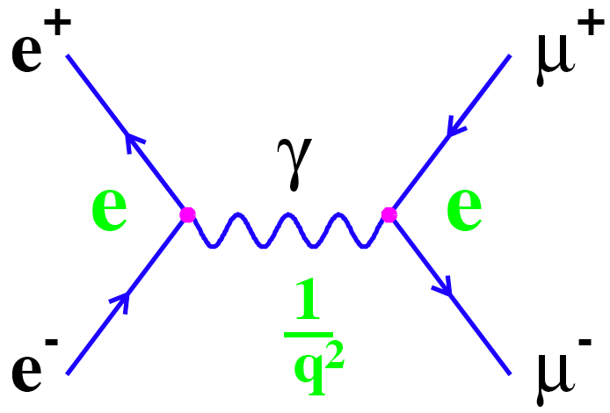
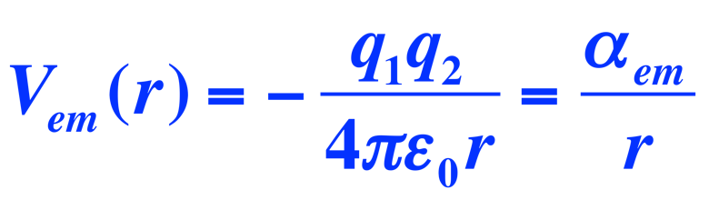
A reminder of Quantum Electro-Dynamics (QED)
Theory of electromagnetic interactions
Exchange particles (photons) do not carry electric charge
Flux is not confined: V(r) ~ 1/r, F(r) ~ 1/r²
Feynman Diagram:
e⁺e⁻ annihilation
√α
√α
Coupling constant (α): Interaction Strength
In QED: αem = 1/137

Slide 6
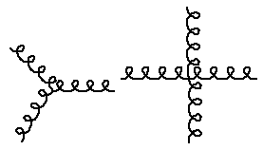
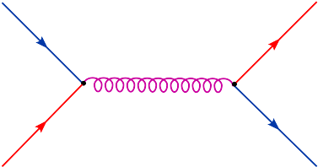
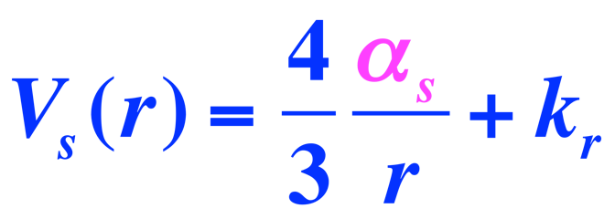
Quantum Chromo-Dynamics (QCD) - 1973
Theory of strong (nuclear) interactions
Three colour charges: red, green and blue
Exchange particles (gluons) carry colour charge and can self-interact
Flux is confined: V(r) ~ r, F(r) ~ constant
q
q
√α
√α
q
g
q
~1/r at short range
αs = strong coupling constant ≈ 0.3
gluons can self-interact - more vertices are allowed
long range force ~ r

Slide 7
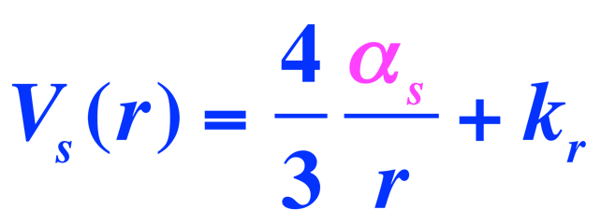

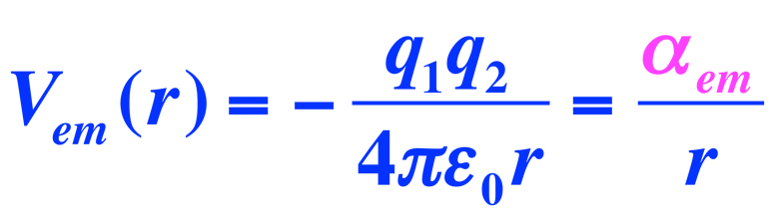
QED vs QCD
Potentials:
  →long range aspect of Vs(r) leads to quark confinement and the existence of nucleons
 | QED | QCD
Charges | electric (2) | colour (3)
gauge bosons | γ | g
charged? | no | yes
coupling strength | αem = e²/4π ≈ 1/137 | αs ~ 0.3

Slide 8
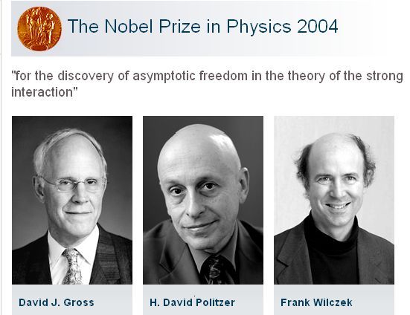
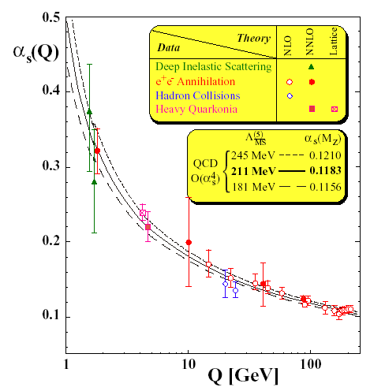
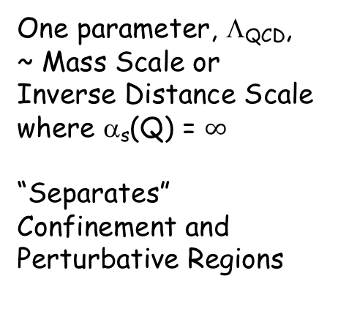
Features of Quantum Chromo-Dynamics
Confinement
Nucleons
Q < Λ
α_{s}(Q) > 1
Constituent
Quarks
Q > Λ
α_{s}(Q) large
Asymptotically
free Quarks
Q >> Λ
α_{s}(Q) small
One parameter, Λ_{QCD}, ~ Mass Scale or Inverse Distance Scale where α_{s}(Q) = $∞$
“Separates” Confinement and Perturbative Regions
q
g
q
0.2 fm 0.02 fm 0.002 fm

Slide 9
QCD evolved from a Lagrangian with the property of asymptotic freedom to a sophisticated tool for the calculation of high energy processes.
R.K. Ellis Nuovo Cimento 39C(2016)355

Slide 10
Consequence: scattering experiments become more popular
at existing facilities and new ones get built

Slide 11
Deep Inelastic Scattering ep → eX (1969)
E_{e} = 1.5 … 20 GeV
Θ = 6º … 26º
Q² = 1 … 7 GeV²
Resolution: ~ 1/Q ~ 10⁻¹⁶ m
F₂(Q²,ν) → F₂(x)
pointlike scattering centers
inside the proton
x = momentum fraction carried by quarks
Friedman, Kendall, Taylor

Slide 12
The Quark Parton Model
F₂(ep)=x[e_{u}²(u+ubar) + e_{d}²(d+dbar)]
F₂(en)=x[e_{d}²(u+ubar) + e_{u}²(d+dbar)]
q = q_{v}+q_{s} (Weisskopf)
If u_{s} = ubar = d_{s} = dbar
→ F₂(ep) - F₂(en) = x[e_{u}²u_{v} - e_{d}²d_{v}]
e_{u}=2/3 e_{d}=1/3
till today u_{v} is better known than d_{v}
→ F₂(eN) / F₂(νN) = ½(e_{u}² + e_{d}²)
SLAC/GGM: 0.29 ± 0.05 (1974)

Slide 14
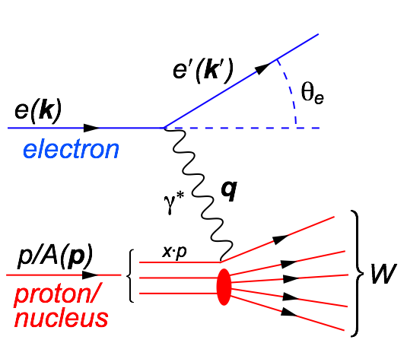
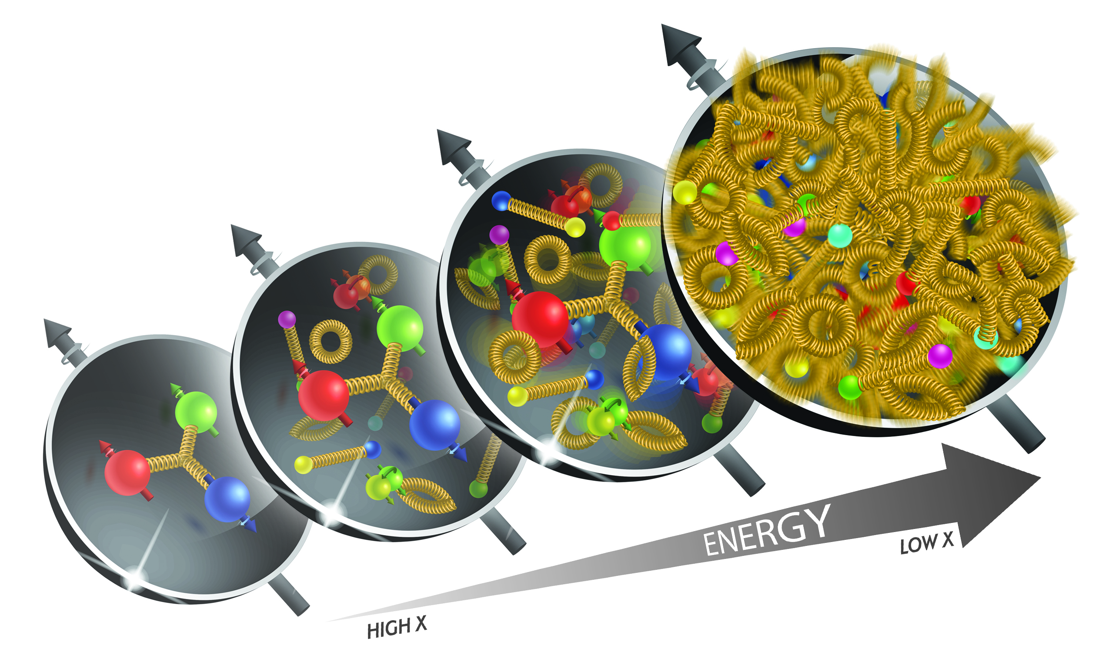
Deep Inelastic Scattering
Kinematics:
Measure of resolution power
Measure of inelasticity
Measure of momentum fraction of struck quark
center-of-mass energy of electron-hadron system
DIS:
As a probe, electron beams
provide unmatched precision
of the electromagnetic
interaction
Direct, model independent,
determination of kinematics
of physics processes

Slide 15
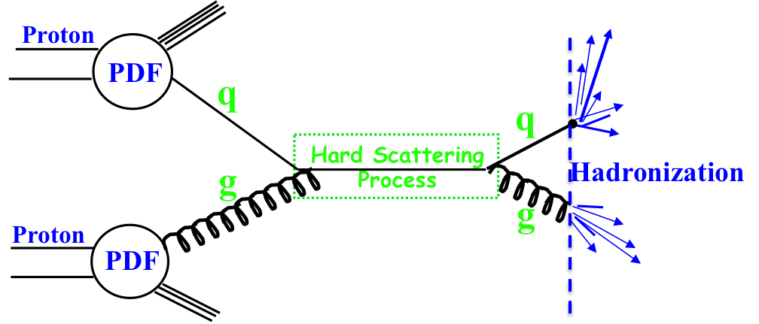
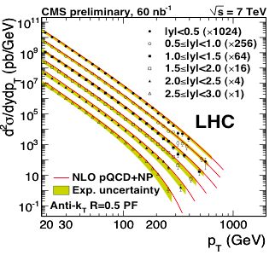

Why do we need different probes
Complementarity
QCD has two concepts which lay its foundation
factorization and universality
To tests these concepts and separate interaction dependent phenomena from
intrinsic nuclear properties
different complementary probes are critical
Probes: high precision data from ep, pp, e+e-
Factorization
Universality
Example: Measure PDFs at HERA at √s=0.3 TeV:
Predict pp and measurements at √s=0.2, 1.96 & 7 TeV
$$p\overline{p}$$
(un)polarized cross section ~
PDF ⊗ hard-scattering ⊗ Hadronization
hard-scattering : calculable in QCD
PDFs and Hadronization: need to be determined experimentaly

Slide 16
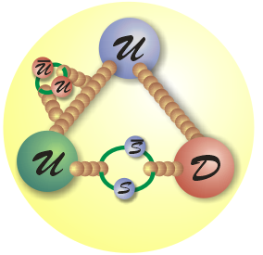
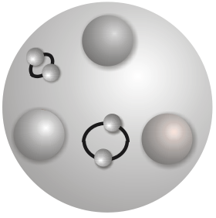
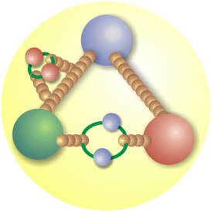
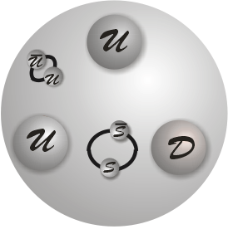
To fully understand proton structure
Need complementary high statistics data
to separate interaction dependent phenomena from intrinsic properties
UNIVERSALITY
to rigorously tested
the validity and limits of factorization and different evolutions
pp & pA ←→ ep & eA
EM interaction
Photon
Sensitive to electric charge
→ flavor
pp: DY
ep: DIS, SIDIS
Strong interaction
Gluon
Sensitive to color charge
→ gluon
jets, single hadrons, direct photon
jets, charm
Weak Interaction
Weak Bosons
Sensitive to weak charge
→ flavor & helicity
W and Z prod’n
high Q² DIS

Slide 17
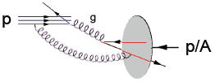
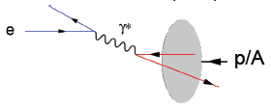
Different Processes
Hadron-Hadron:
Ultra-Peripheral Collisions:
probe has complex structure
no simple access to parton kinematics:
η → x; p_{t}² → Q² → x-Q²
strongly correlated
Gluons can be accessed directly → qg & gg
  gluon fragmentation
Electron-Hadron:
Photon induced process
no simple access to parton kinematics:
η → x; M²→ Q² can only be
varied by VM
access to initial state
Point-like probe → resolution
High precision & access to partonic kinematics through scattered lepton
→ x_{B}, Q²
    initial and final state effects can be cleanly disentangled
      inclusive measurements of Structure functions only sensitive to initial state
Notes:
details in backup
picture much more schematic / carton

Slide 18
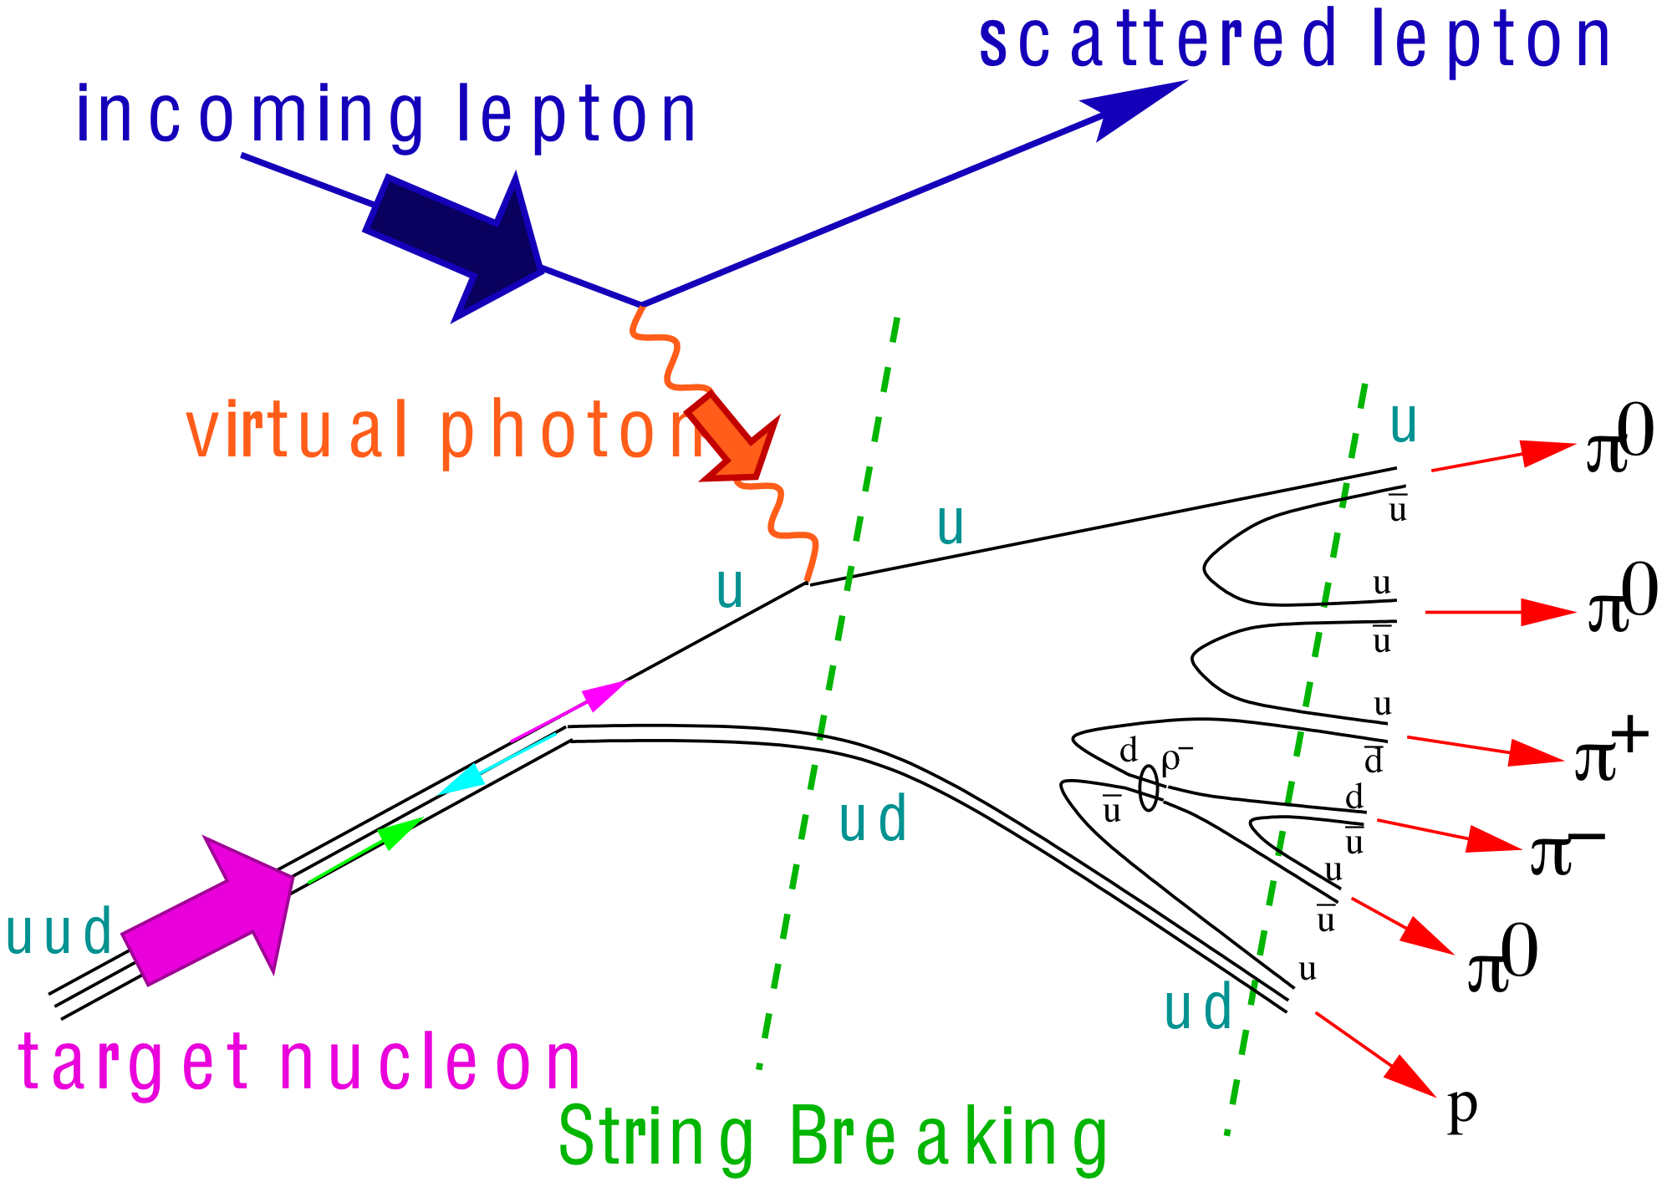
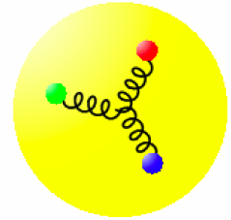
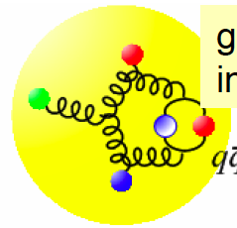
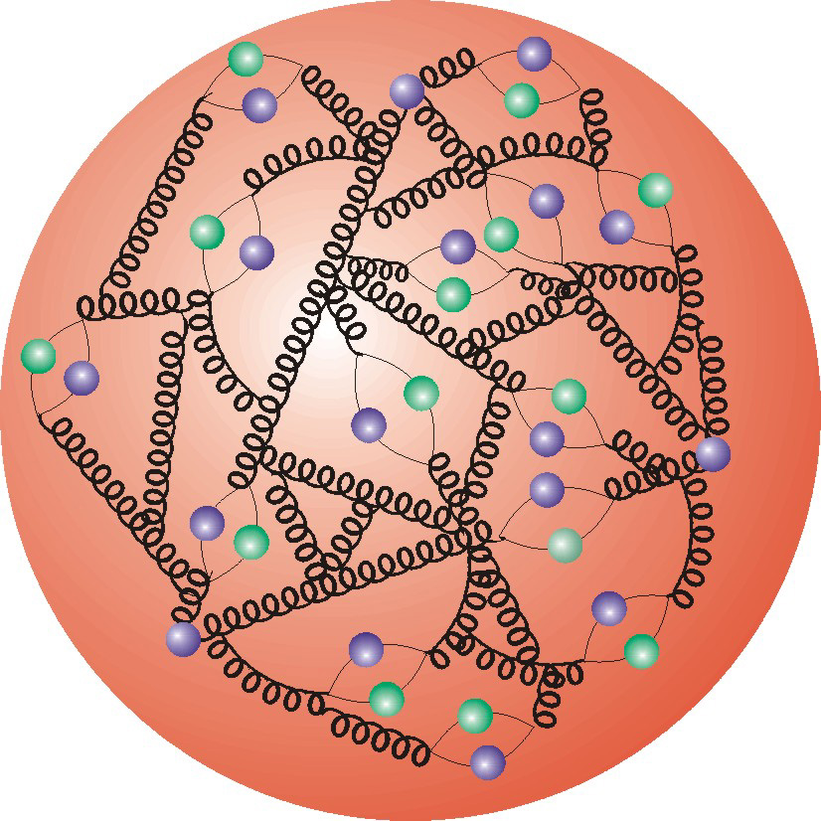
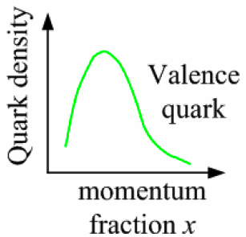
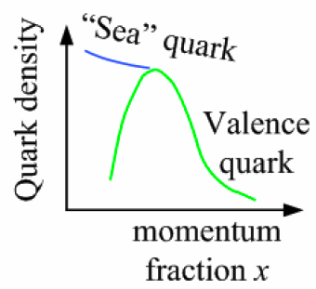
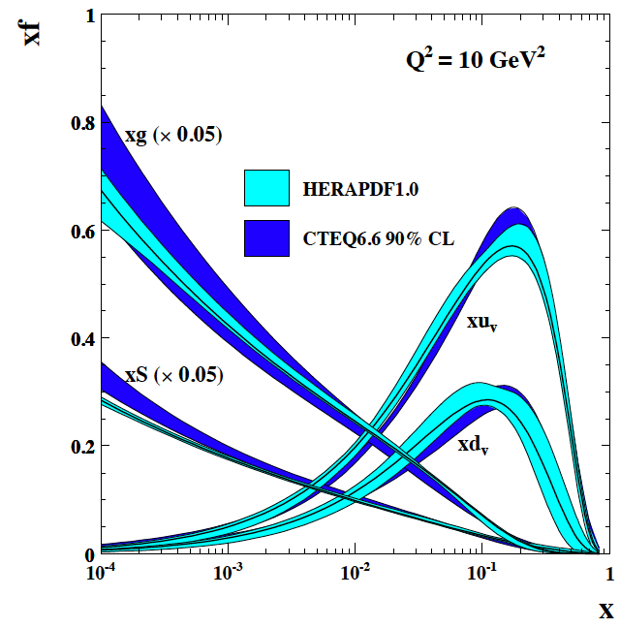
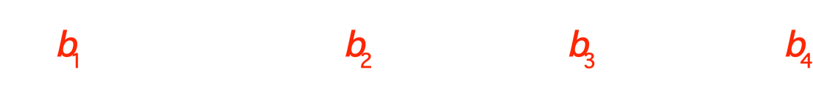
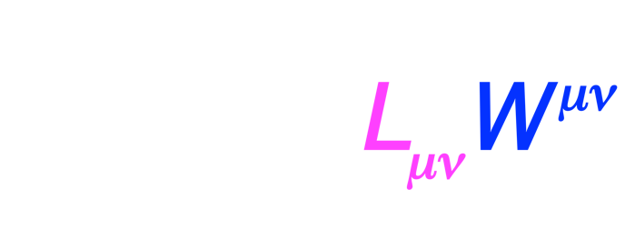
Deep Inelastic Scattering
Gluon splits
into quarks
Quark splits
into gluon splits into quarks …
10⁻¹⁶m
DF
FF
10⁻¹⁹m
√s
cross section:
Spin 1

Slide 19
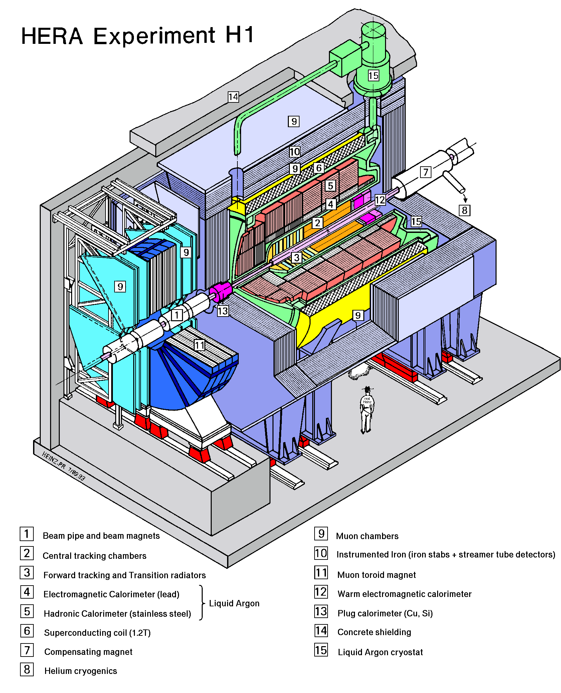
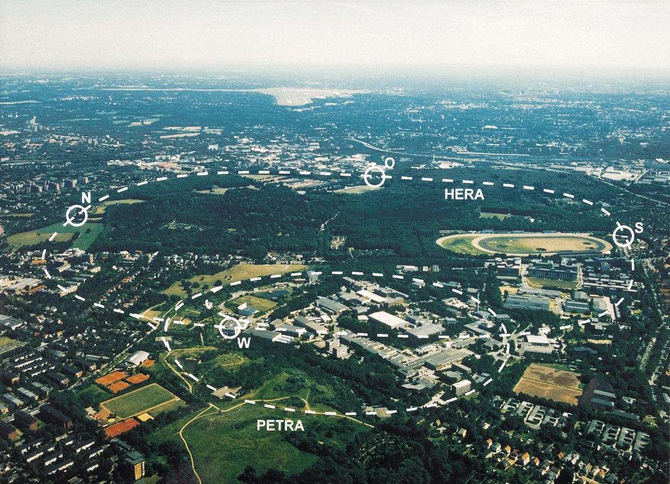
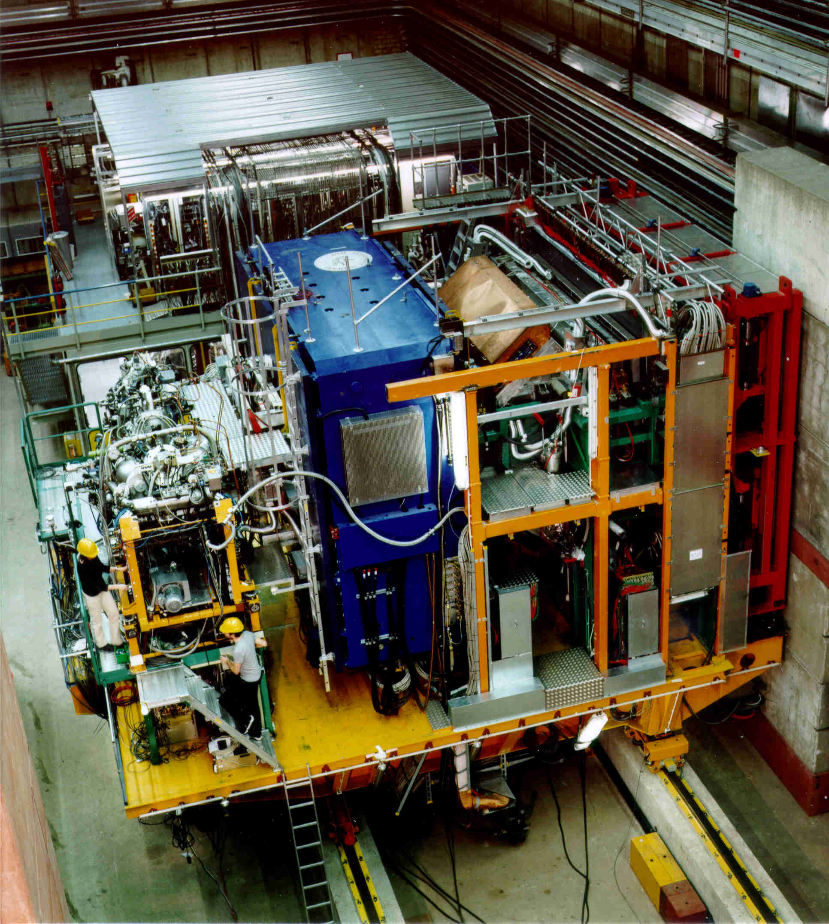




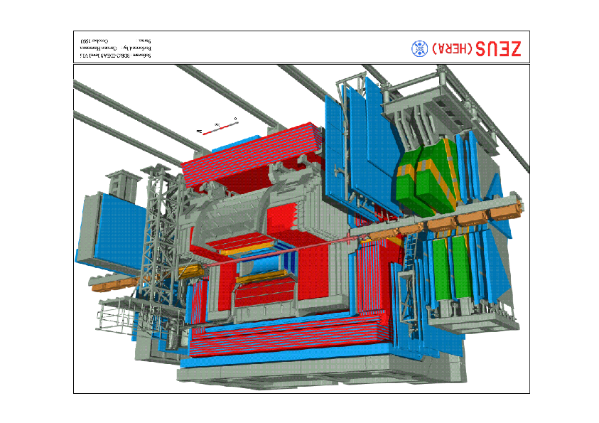
HERA @ DESY
Situation for F₂ before
HERA: e⁺/e⁻ (27GeV) - proton (920 GeV) collider
√s = 314GeV → 10⁻¹⁸m
HERA-e self-polarizing due to Sokolov-Ternov effect

Slide 20
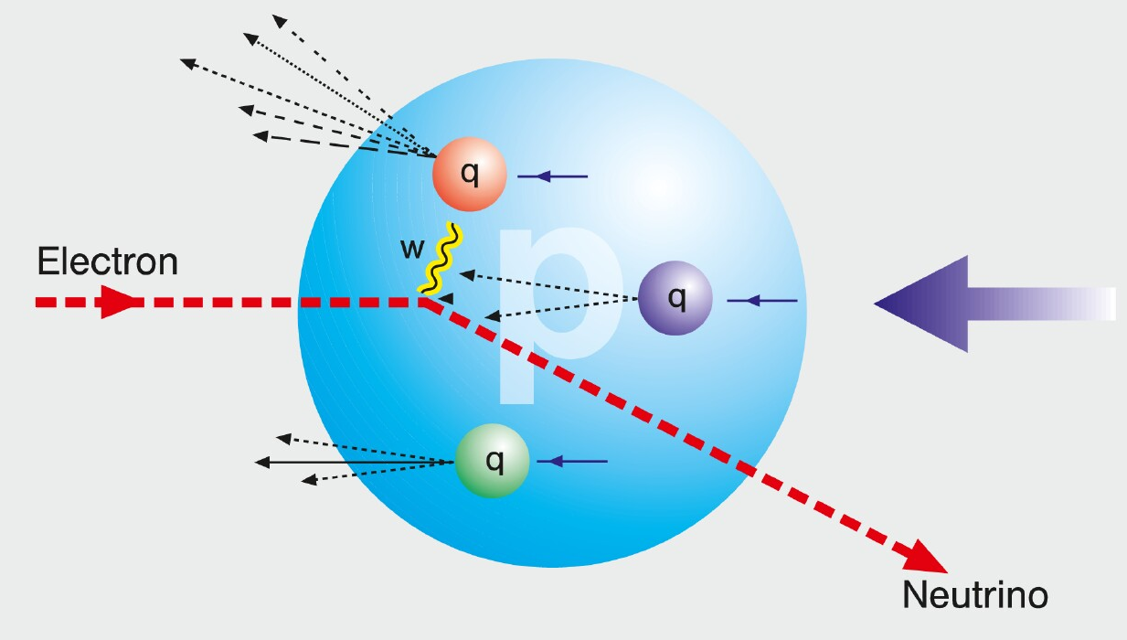
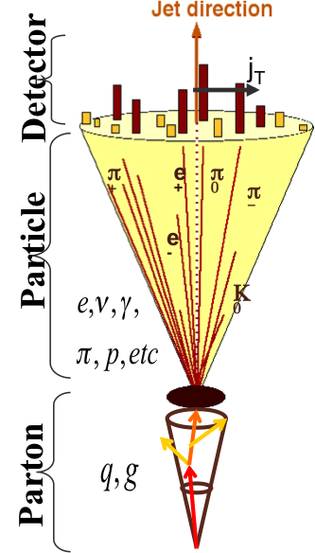
HOW TO ACCESS PARTONS IN DIS
SIDIS:
Detect scattered lepton (DIS) in coincidence with identified hadrons (SIDIS)
one can measure the correlation between different
hadrons as fct. of p_{t}, z, η
needs fragmentation functions to correlate
hadron type with parton
→ Detector: PID over a wide range of η and p
Charge Current:
W-exchange: direct access to the quark flavor
no FF – complementary to SIDIS
→ Detector: large rapidity coverage and large √s
Jets:
best observable to access parton kinematics
tag partons through the sub-processes and
jet substructure
di-jets: relative p_{t} → correlated to k_{t}
tag on PGF
→ Detector: large rapidity coverage and PID

Slide 21
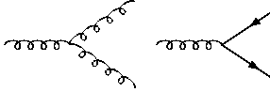
How to access Gluons in DIS
Gluons manifest themselves through
the behavior of the cross section as function of x and Q²
quark+anti-quark
momentum distributions
gluon momentum
distribution
without gluons the cross section depends only on x, no dependence on Q² → F₂(x)
Bjorken scaling
BUT:
Observe strong rise of cross section
with both x and Q²
Because of gluon initiated processes
Cross Section
Scaling violation
Gluon Distribution:
dσ(x,Q²)/dlnQ²
Resolution (Q² / GeV²)

Slide 22
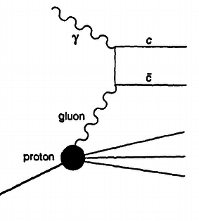
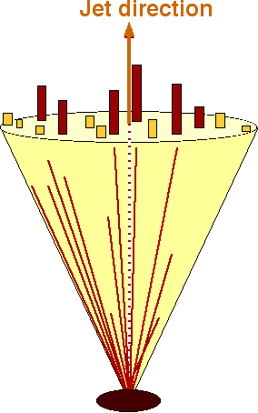
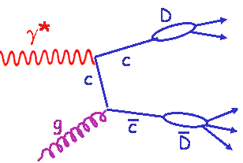
How to access Gluons in DIS
Gluons manifest themselves through
the scaling violation of the cross section as function of x and Q²
dF2(x,Q²)/dlnQ² → G(x,Q²)
Directly through the measurement of F_{L}
Through tagging of the photon gluon fusion process
  Di-jets
  charm production
quark+anti-quark
momentum distributions
gluon momentum
distribution
All these process need a wide coverage in x and Q²

Slide 23
How to access Gluons in DIS
Several different complementary channels to access gluons
Scaling Violation
all x-Q² x_{g} = x_{Bj}
only limited by detector acceptance
Scaling Violation | F_{L}
all x-Q² x_{g} = x_{Bj} | only accessible if y is large x_{g} = x_{Bj}
only limited by detector acceptance | need several beam energies
 |  | Photon Gluon Fusion
Scaling Violation | F_{L} | Di-jets
all x-Q² x_{g} = x_{Bj} | only accessible if y is large x_{g} = x_{Bj} | wide coverage in x_{Bj}-Q² x_{g} =x_{Bj}(1+M²/Q²⁾ > x_{Bj}
only limited by detector acceptance | need several beam energies | need a wide acceptance detector
 |  | Photon Gluon Fusion
Scaling Violation | F_{L} | Di-jets | Charm
all x-Q² x_{g} = x_{Bj} | only accessible if y is large x_{g} = x_{Bj} | wide coverage in x_{Bj}-Q² x_{g} =x_{Bj}(1+M²/Q²) > x_{Bj} | same coverage in x_{Bj}-Q² as incl. F₂ x_{g} ≳x_{Bj}
only limited by detector acceptance | need several beam energies | need a wide acceptance detector | needs excellent m-vertex detector and particle ID

Slide 24
How do gluons manifest themselves in DIS
What can data at low √s teach us
The gluon distribution function as
extracted from the E665 data with
Q² > 1 GeV² at a √s = 31 GeV
Lack of kinematic coverage
and lever arm limits the accuracy
→ raise with decreasing x strongly
overestimated
Cross Section
parton density
Resolution (Q² / GeV²)

Slide 25
How do gluons manifest themselves in DIS
What can data at high √s teach us
The raise of the cross section as
fct. of Q² at low x directly
reflected in gluon distribution
Cross Section
parton density
Resolution (Q² / GeV²)

Slide 26
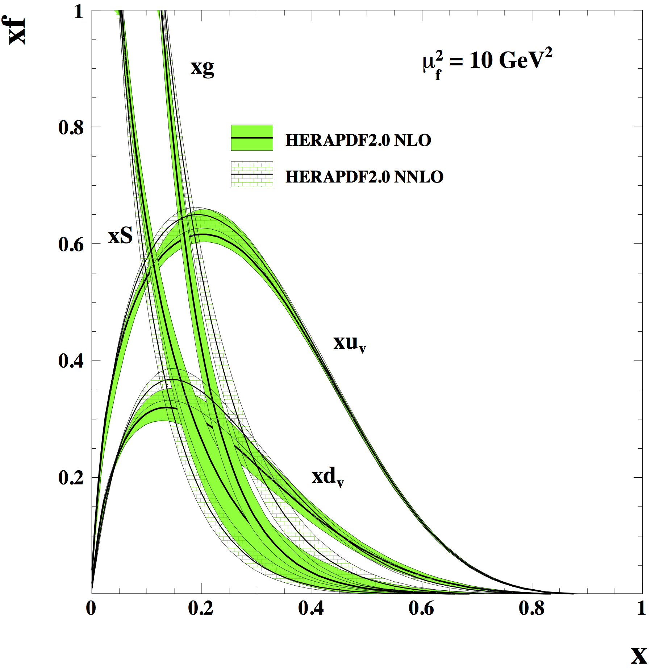
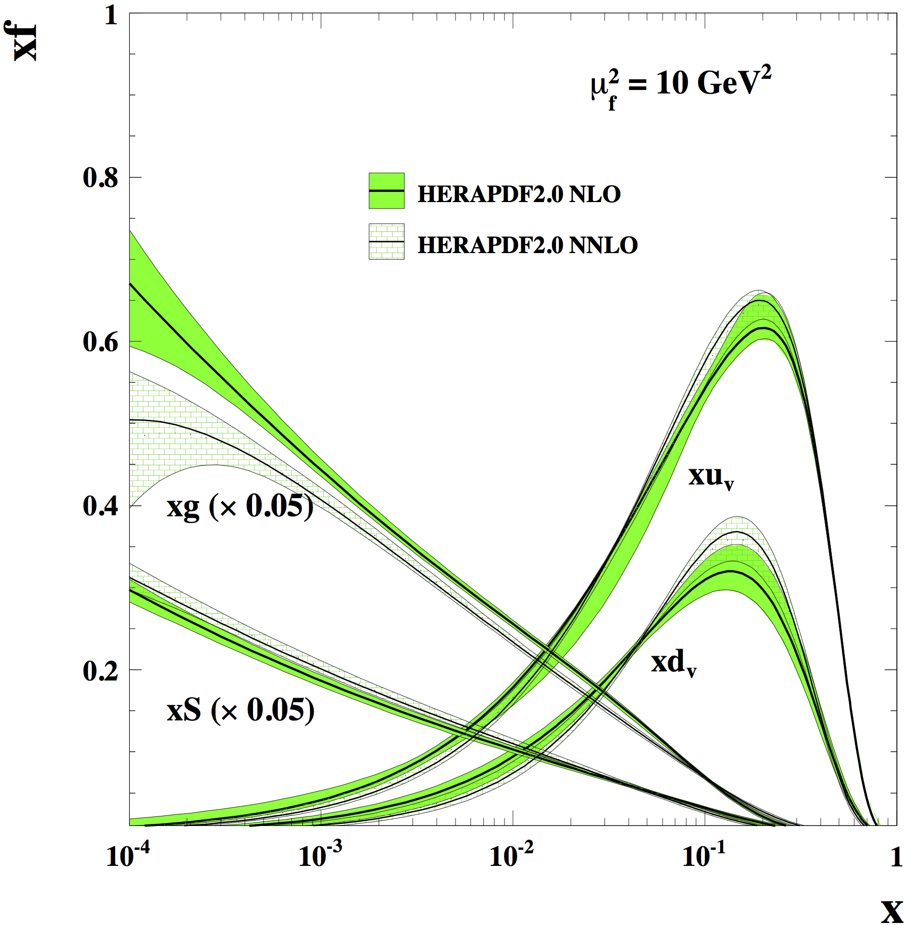
HERA’s big Discovery
Nucleons consist of an ocean of gluons and sea of quarks
arXiv:1506.06042

Slide 27


Slide 28
What is next? The EIC
What is the EIC:
A high luminosity (10³³ – 10³⁴ cm⁻²s⁻¹) polarized electron proton / ion collider
with √s_{ep} = 20 – 140 GeV
Why an EIC:
Revolutionize our view of nucleon structure and the glue!
a very diverse physics program impacting
nuclear, heavy ion and high energy physics
What is new/different:
Hera: factor 100 to 1000 higher luminosity
both electrons and protons / light nuclei polarized
nuclear beams: d to U
Fixed Target Facilities i.e.:
at minimum > 2 decades increase in kinematic coverage in x and Q²
Documents on EIC:
Physics: arXiv: 1212.1701 and arXiv:1708.01527
Summary on JLEIC & eRHIC accelerator designs: http://icfa-bd.kek.jp/Newsletter74.pdf

Slide 29
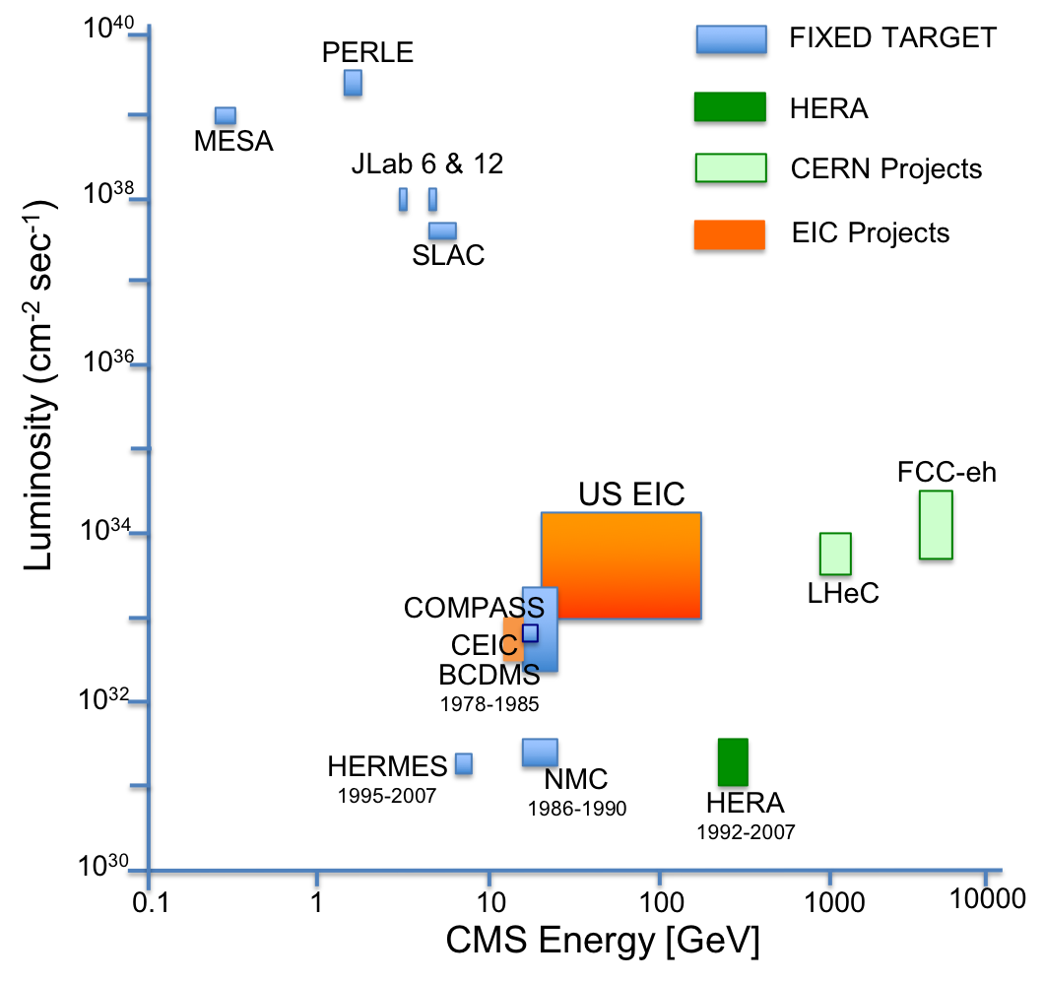
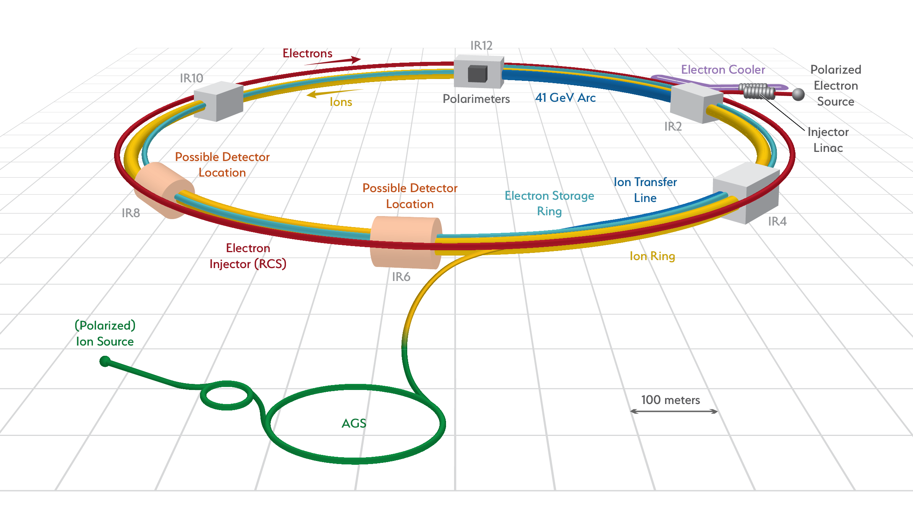
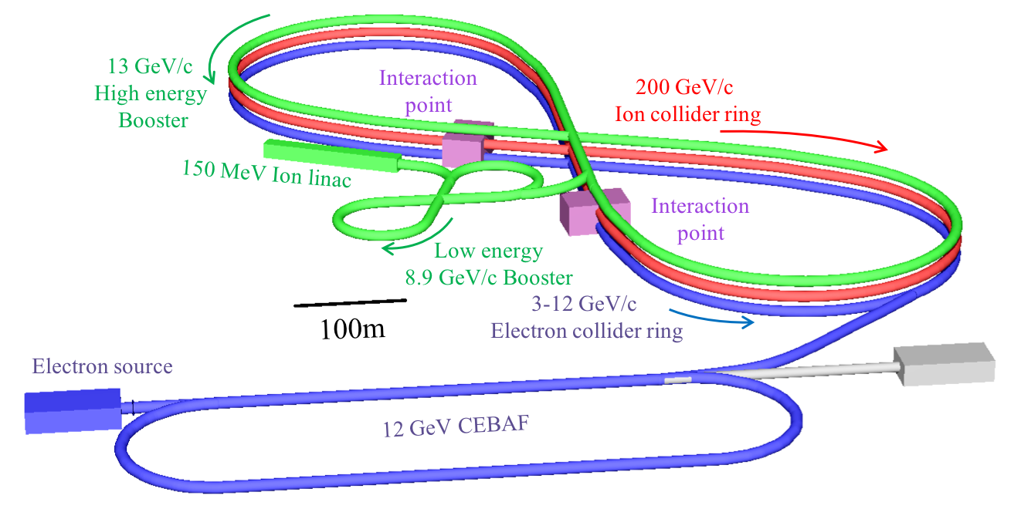
EIC Accelerator Designs
US-EIC:
polarization, ion species together with its luminosity and √s coverage makes it a completely unique machine world wide.
Two realization plans
Requirements from Physics:
High Luminosity: 10³³-10³⁴ cm⁻²s⁻¹
Variable center of mass energies from 20− 100 GeV, upgradable to 140 GeV
Electrons and protons/light nuclei highly polarized (70%)
Ion beams from deuteron to the heaviest nuclei (d to U)
Possibilities of having more than one interaction region with room for a wide acceptance detector with good PID (e/h & π, K, p)
large acceptance for small angle scattered particles along the beam line
eRHIC
JLEIC

Slide 30
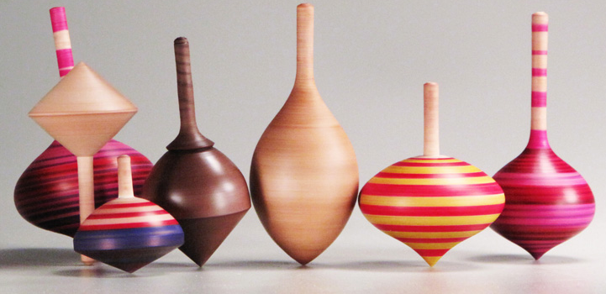
SPIN: Fundamental Quantum Number
SPIN is one of the fundamental properties of matter
all elementary particles, but the Higgs carry spin
Studying Spin revealed many surprises in physics
→ proton anomalous magnetic moment → substructure
cannot be explained by a static picture
of the proton
Proton Spin:
It is more than the number ½ ! It is the interplay between
the intrinsic properties and interactions of quarks and gluons
If we do not understand the proton spin in QCD,
we do not fully understand QCD !
need a polarized collider to have full access
to the proton dynamics

Slide 31
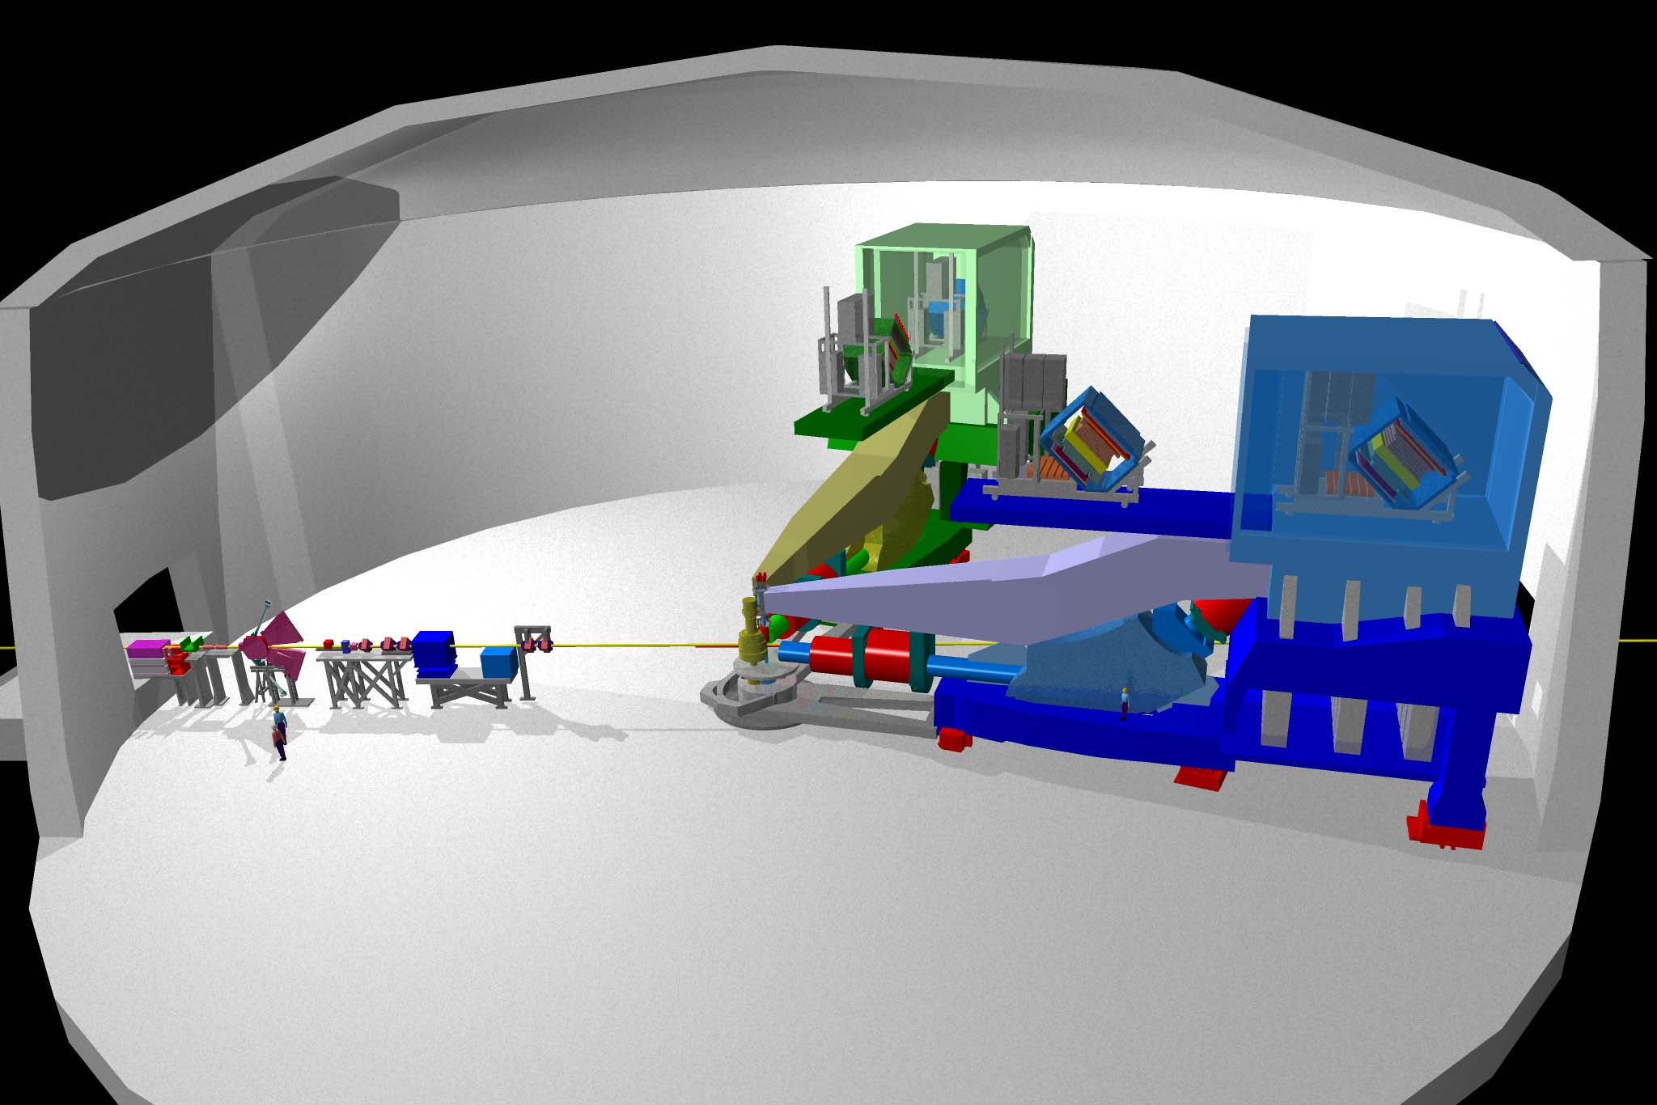

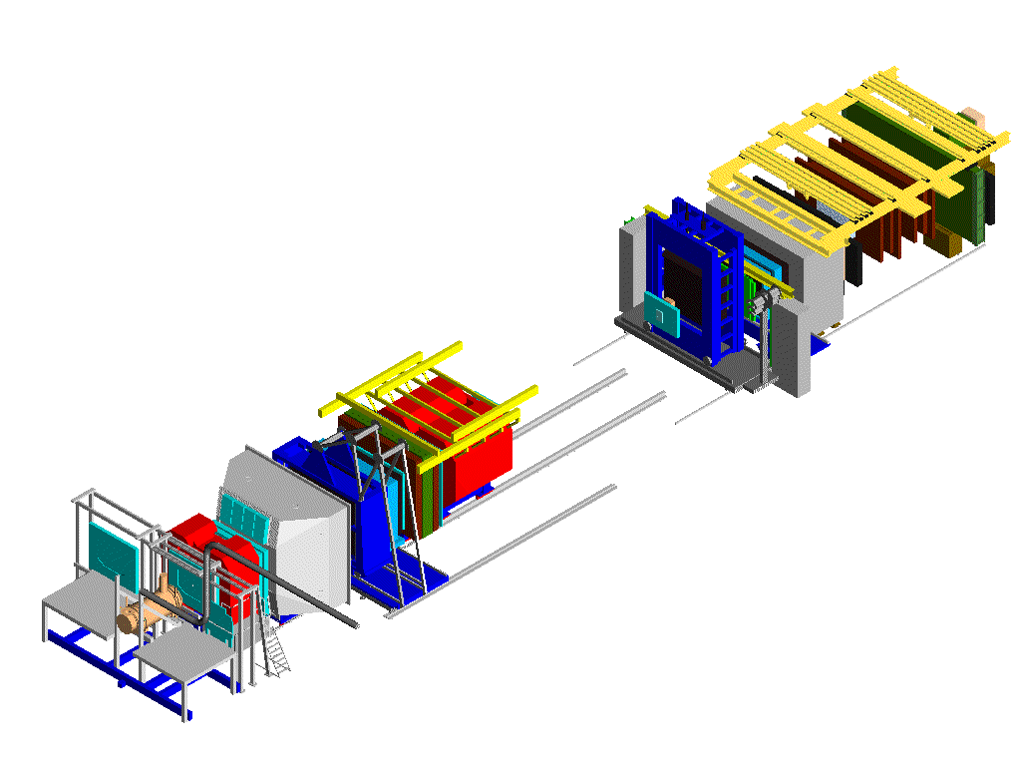
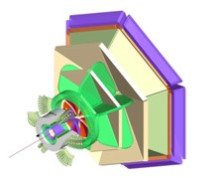





The contemporary “spin” experiments
Trigger-hodoscopes
Hall A
Hall B
μ−Filter
ECal & HCal
50 m
SM2
Two high-resolution spectrometers
& large installations
RICH
Large acceptance spect. electron/photon beams
SM1
MWPC
Beam: ≤12 GeV e⁻; 85% polarization
Target: polarized targets 3He, 6LiD, NH3
several unpolarised targets
Hall-D: for spectroscopy 9GeV tagged polarised photons & a 4π detector
Hall C
Straws
⁶LiD Target
Gems
Drift chambers
Beam: 27.5 GeV e±; <50>% polarization
Target: polarized gas targets H, D, <85%> He³ <50%> polarization
unpolarised gas targets H₂ to Xenon
Lumi: pol: 5x10³¹ cm⁻²/s⁻¹; unpol: 3x10³²⁻³³ cm⁻²/s⁻¹
Data taking finished June 2007
160 GeV μ
Micromegas
Beam: 160 GeV μ: 80% polarization
Target: ⁶LiD: 50% polarization (2002-2006)
NH₃: 80% polarisation (2007)
Lumi: 5x10³² cm⁻²s⁻¹
2010 & 2011: longitudinal and transverse NH₃
SciFi
Silicon
Super high momentum spectrometer,
high luminosity and forward angles

Slide 32





The Spin of the Proton
What is Spin? Google….
revolve quickly and repeatedly around one's own axis,
twist and turn so as to give an intended interpretation,
"The President's spokesmen had to spin the story to make it less embarrassing”
Wikipedia: In quantum mechanics and particle physics, spin is an intrinsic form of angular momentum carried by elementary particles, composite particles (hadrons), and atomic nuclei
Proton spins are used to image the structure and function of the human body using the technique of magnetic resonance imaging.
Paul C. Lauterbur
Sir Peter Mansfield
Nobel Prize 2003:
for their discoveries concerning magnetic resonance imaging

Slide 33


What composes the Spin of the Proton
ΔG
L_{g,q}
Σ_{q}Δq
The Holy Grail
The Spin Sum Rule
total
quark
spin
gluon
spin
angular
momentum
“Helicity sum rule”
Can quarks and gluons explain all the spin?
→ what is the role of gluons?
→ what is the role of sea quarks?
How much orbital angular momentum is needed?

Slide 34
Why should we care?
Spin ideal tool to understand the dynamics of sea quarks and gluons inside the hadron
Despite decades of QCD – Spin one of the least understood quantities
Consequence very few models, but several physics pictures, which can be tested
with high precision data
the pion/kaon cloud model
→ rooted in deeper concepts → chiral symmetry
→ generated q-qbar pairs (sea quarks) at small(ish)-x are predicted to be unpolarized
→ gluons if generated from sea quarks unpolarised → spatial imaging
→ a high precision measurement of the flavor separated polarized quark and gluon
distributions as fct. of x is a stringent way to test.
the chiral quark-soliton model
→ sea quarks are generated from a "Dirac sea" with a rich dynamical
structure but excludes gluons at its starting scale
→ sea quarks are polarized → asymmetry
→ a high precision measurement of the flavor separated polarized quark
as fct. of x is a stringent way to test
stringent test of lattice calculations
→ the relative importance of lattice graphs
→ probe quark is connected to the proton wave function or
is created from the 'gluon soup' inside the proton

Slide 35

How and What do we measure

Slide 36











How to measure Quark Polarizations
$$\vec{S_{γ∗}}+\overset{⃖}{S_{N}}=1/2$$
$$\vec{S_{γ∗}}+ \vec{S_{N}}=3/2$$
$$\overset{⃖}{S_{N}}=\overset{⃖}{S_{q}}$$
$$\vec{S_{N}}=−\vec{S_{q}}$$
$$σ_{1/2}\sim q^{+}(x)$$
$$σ_{3/2}\sim q^{−}(x)$$
Virtual photon γ* can only couple to quarks of opposite helicity
Select q⁺(x) or q⁻(x) by changing the orientation of
target nucleon spin or helicity of incident lepton beam
$$Δq=q^{+}−q^{−}$$
Asymmetry definition:
inclusive DIS: only e’ info used
semi-inclusive DIS: e’+h info used

Slide 37



How to go from Asymmetries to Structure Functions
Combine p and d to get n:
or ³He
Compass: hep-ex/0609038
Hermes: hep-ex/0609039

Slide 38
present vs EIC kinematic coverage
likewise for Q²
EIC extends x coverage
by ~2 decades

Slide 39

Why is separating quark flavors important?
Why is separating quark flavors important?
nuclear structure is encoded in parton distribution functions
understand dynamics of the quark-antiquark fluctuations
flavor asymmetry in the light quark sea in the proton
unpolarized: ubar < dbar Helicity: Δubar > Δdbar TMDs: ?????
shape of polarized sea-quark PDFs critical for quark contribution to spin
ΔΣ does not converge at low x
due to current constrains put in the fits
strangeness was identified to be one of the least known quantities
  both unpolarized and polarized
from
SIDIS
K-data
SIDIS
data
indirect
from
inclusive
DIS-data
1st moment
constrained
by 3F-D

Slide 40

Data from Deep Inelastic scattering
Correlation between detected hadron and struck q_{f}
“Flavor – Separation”
Inclusive DIS:
Semi-inclusive DIS:
incl.
π⁺
K⁺
Polarised Quark Densities:
u-quarks polarised in the
spin direction of the proton
d-quarks polarised opposite
to the spin direction of
the proton
sea-quarks still pretty
unknown
PLB 693 (2010) 227–235
π –
K⁻

Slide 41


What We Know right now: ΔG
DIS:
DIS +
RHIC ≤2009
Data till 2009 included
in fits:
DIS +
RHIC ≤2015
arXiv:1404.4293
First time a significant
non-zero Dg(x)
all data till 2015
factor 2 reduced
uncertainties
at x ~ 10⁻³
RHIC:

Slide 42




Q²-Dependence
high Q²
very fast evolution
in RHIC kinematics
medium Q²
low Q²

Slide 43
What forms the Spin of the Proton
Remember:
total
quark spin
gluon
spin
angular
momentum
⟼
⟼
data
data
1/2 -
Gluon
-
Quarks
=
orbital angular
momentum
40%
30%

Slide 44

g₁^{p} the way to find the Spin
To determine the contribution of quarks and gluons to the spin of the proton, one needs to measure the cross section difference g₁ as function of x and Q²
cross section:
The current knowledge about g₁
as function of x at Q²=10 GeV²
-
g₁ ~
pQCD scaling violations
M.Stratmann, R. Sassot, ECA: arXiv:1206.6014 & 1509.06489

Slide 45


scaling violations at small x
rough small-x approximation to Q²-evolution:
spread in Δg(x,Q²) translates into
spread of scaling violations for g₁(x,Q²)
need x-bins with a least two Q² values to compute derivative (limits x reach somewhat)
smallest x bins require 20 x 250 GeV
⟼ √s < 70 GeV
error bars for moderate 10fb⁻¹ per c.m.s. energy; bands parameterize current DSSV+ uncertainties

Slide 46
What forms the Spin of the Proton
The polarized SF g₁(x,Q²) as
measured by EIC for low to high √s
The polarized SF g₁(x,Q²) as
measured by EIC for low √s
Only with the center-of-mass energies
available at EIC the different contributions
to the spin of the proton can be disentangled
arXiv:1509.06489
PRD 92, 094030

Slide 47
Where does the Spin of the proton hide
total
quark
spin
“Helicity sum rule:”
gluon
spin
angular
momentum
1/2 -
-
orbital angular
momentum
Gluon
Quarks
=

Slide 48
The spin Sum rules
Jaffe-Manohar:
defined in A⁺=0 gauge
Δq and Δg
→ density interpretation
Ji:
through GPDs

Slide 49

on
TMDs and GPS

Slide 50


