Slide 1
Equipment Integration PSB
LIU Commissioning Coordination Committee
17th May 2019
J.F. Comblin, G.P. Di Giovanni, B. Mikulec

Slide 2
A PSB LIU Upgrade Snapshot
Upgrade
  New injection and extraction energies
  New H⁻ injection schema: Stripping foil, transverse & longitudinal painting, beta-beating correction
  New RF system (Finemet) and LLRF control
  POPS-B control: beta-beating corrections, special trims, etc, etc
  B-Train
  Transverse Feedback
  New Extraction Kicker control
Instrumentation
  H⁰/H⁻
  TbT BPMs
  Diamond BLMs
  Matching Monitors
  Wire scanners
  Tune/Quadrupolar PU
Operation
  Cycle generation and tune control
  Interlock: BIS, External Conditions, SIS
  Synchronisation adjustment of equipment (distribution, injection, extraction, recombination)
  Operational applications

Slide 3
New PSB Injection
TE-ABT equipment
BE-RF equipment
TE-EPC equipment
By-ring correction of magnetic
field at injection (injection during
ramping B-field)
Correction of vertical beta-beating
introduced by BSW magnets (+
working point)
Produce bump during injection;
chicane fall after 5 ms to nominal
orbit
Transverse phase-space painting and
fast beam removal from stripping foil
Defines length of Linac4 pulse
Produces 1.5 us holes betw. rings to avoid
losses during distributor rise-time;
chopping pattern for loss-free beam-to-
bucket transfer; longitudinal painting
Distributes beam slices of flexible
length into 4 PSB rings
Linac4 RF: Ramping of last 2 PIMS cavities for longitudinal painting + debuncher
PSB RF: To align RF buckets per ring to
Linac4 beam slice arrival
PSB
Injection
Pre-Chopper
Chopper
Distributor
Linac4 and PSB RF
Injection Kicker
Injection Chicane Bumpers
Bdl
Q-strips
(QDE3/14)

Slide 4
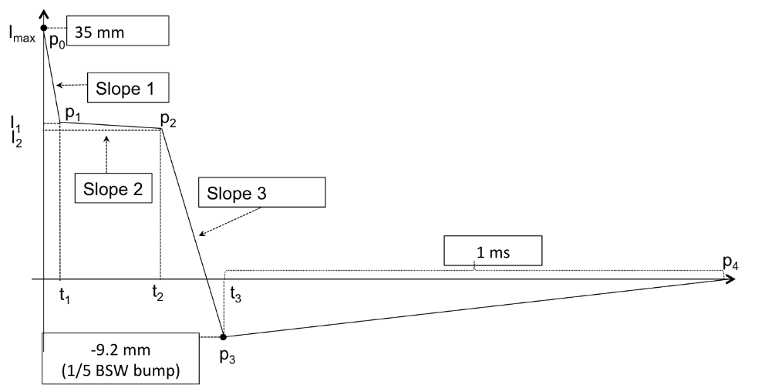
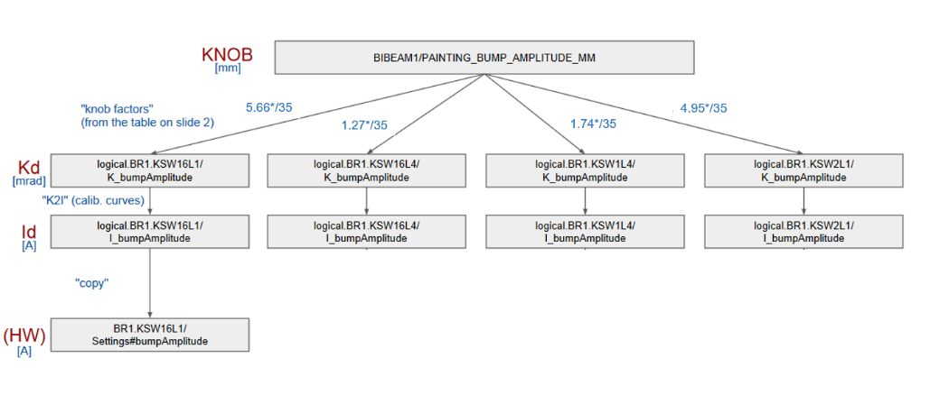
Transverse Painting
Description:
  Four slow kickers (KSW), installed in each ring of the PSB, will be used
  to perform the transverse painting of the injected beam based on the
  desired intensity, emittance and beam distribution for each PSB user.
-35 mm
Status:
  Functional specification, EDMS 2117053 under approval.
  Editable points of a multi-linear function, control bump height (mm).
  Current for each KSW depends on tune.
Resources and Planning:
  Readiness mock-up for SW development within the next weeks (ABT).
  Incorporate KSW control in PSB Cruise Control (OP).
  List all interlocks covered by the BIS in an official EDMS document (ABT with OP assistance).
  To finalise: LSA implementation of scale factors which are
  tune-dependent. Makerule? (ABT/Setting Management/OP).
Notes:
The KSW painting bump will decay, in a controlled way, until injection is accomplished. A multiple-linear waveform is chosen for the KSW generators. The ultimate goal is that, after the commissioning period, predefined and optimised waveforms for each user will be available to be played during the regular PSB operation

Slide 5
BSW
Description:
  The chicane bump stays constant at 46 mm during injection and
  then decays to zero in 5 ms.
  Short rectangular magnets with a max. deflection of 66 mrad.
Status:
  Challenging to reach the specified precision (±50 ppm at flat-top), especially for a pulse as long as 150 μs.
  Communication issues to increase the repeatability of signals transmission slowed down the testing process. Issues recently fixed.
Resources and Planning:
  EPC currently exploring couple of solutions:
    Standard online regulation in the FGC3 pushed to the limit while maintaining repeatability.
    Integration of ILC (Iterative Learning Control), tuning the current reference function from cycle to cycle in order to obtain excellent performances in a few cycles.
  EPC to provide the maximum precision currently reachable of the flat-top and ramping down of the BSW to ABT/ABP, who will simulate the effect.
  To finalise: Best compromise for the first ~2 years of run 3 (then a new FGC3.2 should resolve all these issues).
Notes:
In order to satisfy the stringent geometry constrain, short rectangular magnets with a maximum deflection of 66 mrad are required and introduce focusing errors in the vertical plan.
Implementation of all regulation loops in a lower level board (not in FGC3). This implies using a faster regulation board, not designed to guarantee high precision on manipulated signals.
Pros: a 3rd possibility if the first 2 are not acceptable...
Cons: Precision is lower than solutions with FGC3, this has to be evaluated via lab. testing / not a standard approach / could be difficult to properly implement a "random" ramp-down start.

Slide 6
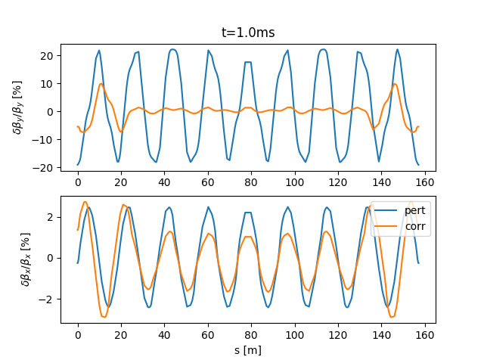
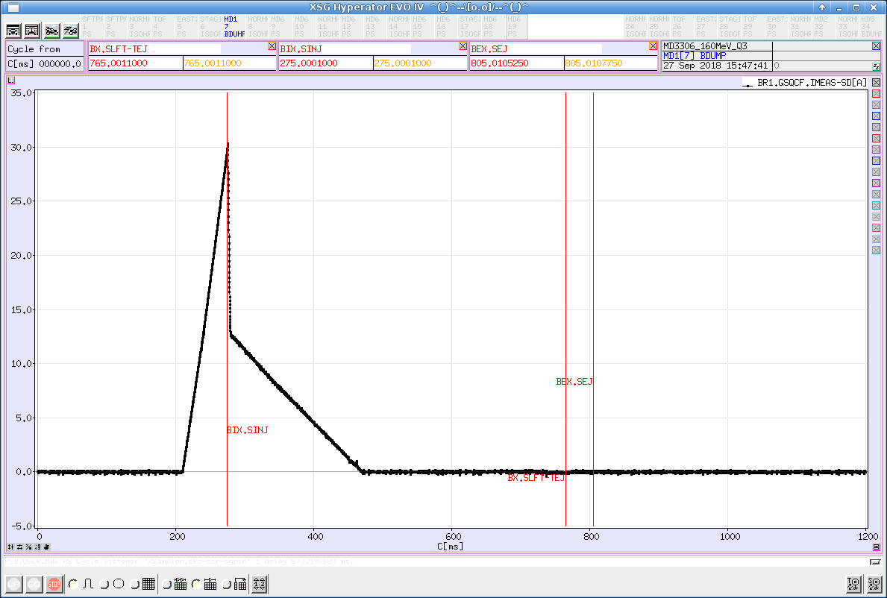
Q-Strips
Description:
  PPM tune control at injection.
  Vertical beta beating introduced by edge effects and eddy currents during the fall of the chicane (lasting 5 ms).
  Two additional trims are foreseen on top of the standard quadrupoles of cells 3 and 14 to compensate the induced beta beating.
Status:
  One power converter successfully tested in 2018 (EPC/OP).
  Control done via KNOBS.
  LSA implementation of fast correction on top of the tune correction done and tested in 2018.
S [m]
Beta-beat correction
Resources and Planning:
  To be implemented: Procedure for loading predefined
  tune-dependent correction functions in the hardware (ABP/OP). Makerule?
  To be implemented: Inclusion in new tune control.
Tune control
Notes:
First of all, in order to satisfy the stringent geometry constrain, short rectangular magnets with a
maximum deflection of 66 mrad are required and introduce focusing errors in the vertical plan

Slide 7
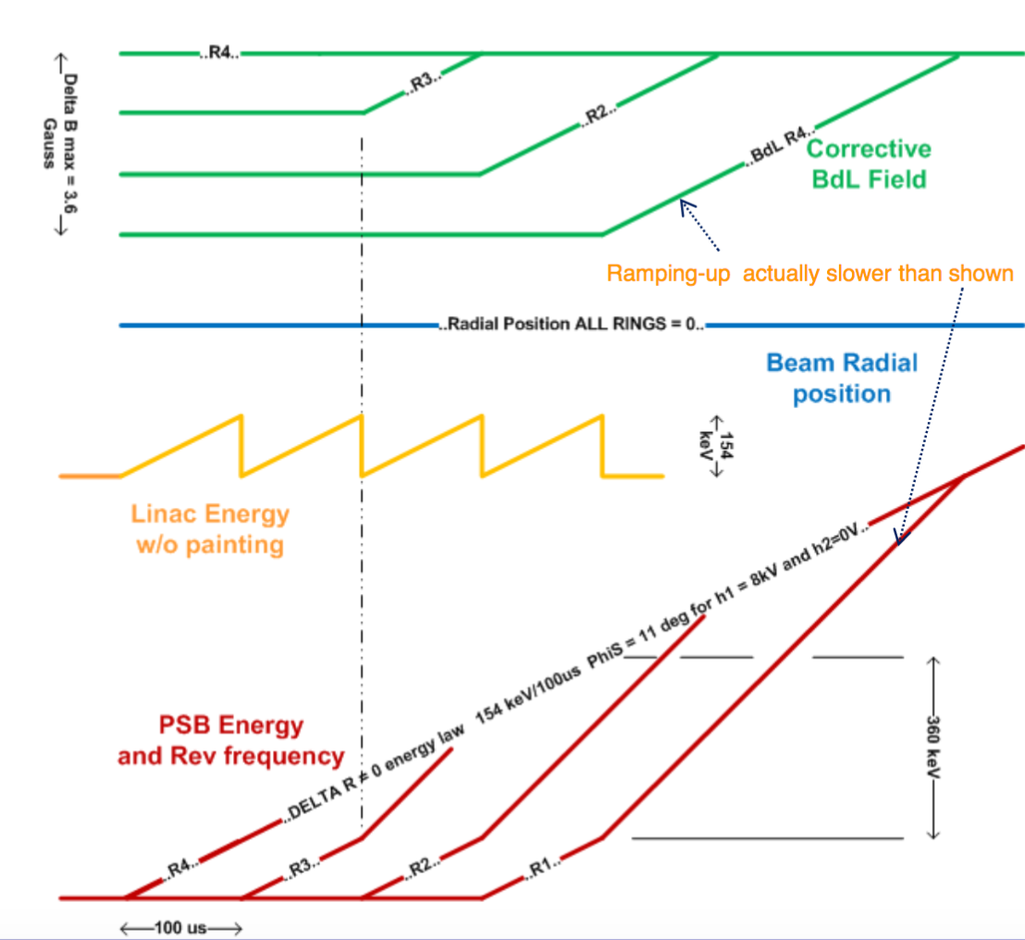
Bdl
Description:
  Additional windings to the main bending electrically connected in series.
  Pre-LS2, the Bdl were used for equalising the energy across rings
  Post-LS2, the Bdl will ALSO be used to correct the B-field such that each ring sees the same B-field at injection → need to pulse TWICE during the cycle.
Status:
  Active discussion within LIU Beam Dynamics WG (ABP/ABT/RF) to evaluate staged approach and inject on flat bottom (and not on a ramp) to ease the commissioning.
  RF prepared a new magnetic cycle with flat bottom injection
    Currently it would require the extension of the PSB cycle by 5-10 ms.
    RF is working on preparing a flat-bottom cycle fitting in the current cycle.
Resources and Planning:
  Ongoing simulation based on the new magnetic cycle (ABP/ABT/RF).
  EPC/CO working on the control side to allow acquisition values at two different times in the cycle.
  A makerule has to be implemented to split the injection and extraction controls (EPC/Setting Management/OP).

Slide 8
Magnetic Cycle and B-Train
Description:
  New magnetic cycle for 2.0 and 1.4 GeV operation with POPS-B (compatible with its limitation).
  New B-Train to allow separate control of inner/outer rings.
Status:
  RF prepared the new magnetic cycles since a while already.
    Used for the successful tests of POPS-B in December 2018.
    In light of the recent discussions, RF prepared a new magnetic cycle with flat bottom injection. Performance under testing with simulation.
  New firestorm B-Train reliability run successfully carried out in 2018 for about 6 months.
Resources and Planning:
  RF may need to refine the magnetic cycle based on latest simulation results.
  MSC-MM and OP finalising the details of the B-Train implementation, e.g. calibration procedures, alarm raising, etc, etc.

Slide 9
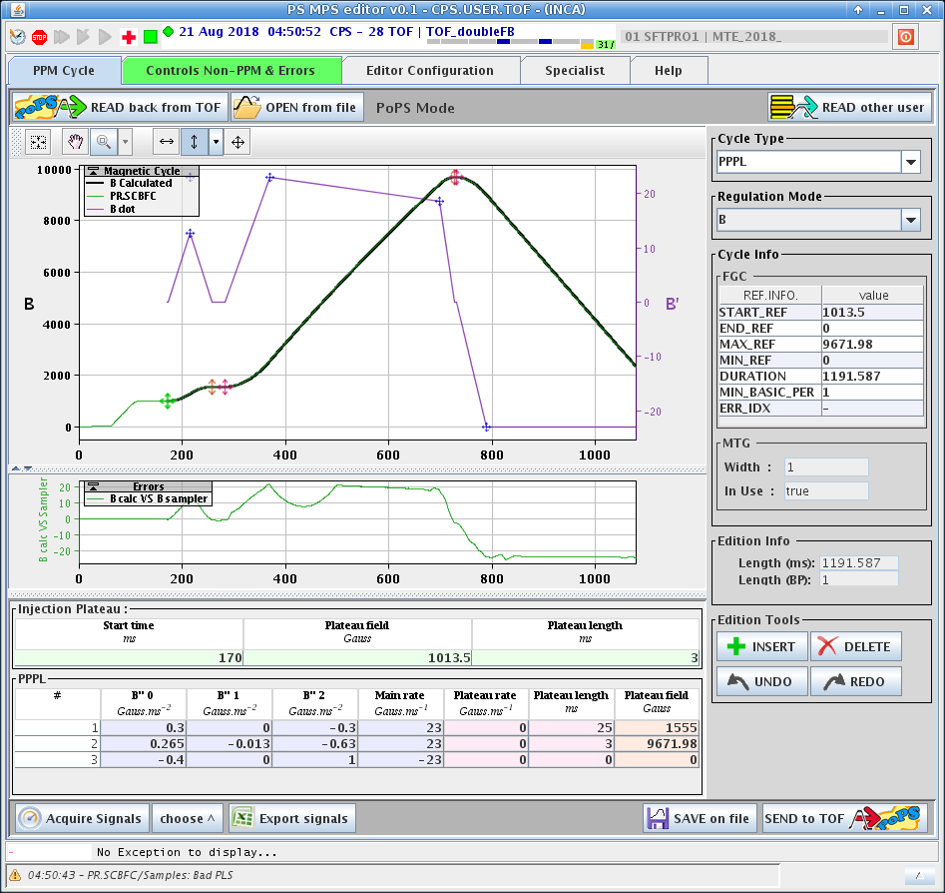
POPS-B
Description:
  Increase to 2 GeV energy → an equal increase in the power requested by the main PC.
  Need to build a new, more powerful Main Power Supply, called POPS-B,
  splitting the chain for inner/outer rings and include all additional special trims.
Status:
  Successful test of the main power supplies in December 2018 pulsing the magnet at 2.0 GeV.
    B-field sent via function editor and based on the baseline 2.0 GeV cycle.
  OP is exploring two complementary approaches for the control:
    1. Control via a cycle editor and makerules which will handle BOTH POPS-B and old MPS limitations.
    2. Replicate POPS control, using PPPL functions:
      Can we fit the new PSB magnetic cycles with one or more PPPL?
      In this case we must keep the old MPS control working.
Resources and Planning:
  Regular meetings to discuss the progress.
  By June 2018 agree on the control implementation.
  By the end of the year EPC/MSC/EL/OP finalise a procedure in case of switch to old MPS.
Notes:
Say test in HW commissioning and catastrophic scenario

Slide 10
Extraction Kicker
Description:
  Eradicate the old GM control → New control.
  In addition allow advancing extraction for optics matching at injection, i.e. extract the beam not later than
  100 turns to avoid burning the grids of the matching monitor.
Resources and Planning:
  Application needed as the new control is not compatible with KNOBS.

Slide 11
Extraction Kicker
Description:
  Eradicate the old GM control → New control.
  In addition allow advancing extraction for optics matching at injection, i.e. extract the beam not later than
  100 turns to avoid burning the grids of the matching monitor.
Resources and Planning:
  Application needed as the new control is not compatible with KNOBS.
Matching Monitor
Description:
  Standard grid to measure optics parameters at PSB injection. Only in Ring3.
Resources and Planning:
  Application will be based on current Linac4 SEM grid application. Work not yet started.
  To define: any additional post-processing for matching (ABT experience on PS analysis), if needed.

Slide 12
BI Devices Integration
H⁰/H⁻ Monitor:
  OP developer allocated. Work not yet started.
  Display of H⁰/H⁻ signal for the 4 rings over a variable period of time.
  Display thresholds for degraded performance and stripping foil failure.
Wirescanner:
  OP developer allocated. Work not yet started.
  Same application for PSB and PS. In PSB we will also maintain the old WS equipment and application.
  Automatic logging for LHC quality tracking.
  Deconvolution with tomogram, if needed.
Diamond BLM:
  OP developer allocated, if an application is needed.
  Waiting for summer as decision point to know if BI could provide an acquisition system + FESA.
Tune/Chroma Measurement:
  By the end of the year, BI plans to renew the FESA for tune/quadrupolar/chroma measurement.
  The development could realistically start only next year.

Slide 13
Others (I)
LLRF:
  The LLRF will move to a 5 motherboard system, including brand new FW to control and drive the Finemet hardware.
  New FESA classes, knobs, low level synoptic, OASIS & sampler signals will be deployed to control the RF system for each ring, including the spare low level crate maintained in parallel on ring 4.
  Distributed cavity approach via software to be readied for start of commissioning, so all 3 cavities can be programmed with the required proportion of each harmonic used.
Transverse FeedBack:
  Commissioning of the new damping system in 2018:
    Managed to systematically accelerate the highest intense beam in the PSB.
  Did NOT commission additional features like transverse blow-up
  Old system still kept as a backup:
    Due to GM eradication, OP developed a new inspector-based application to control the old TFB system using its updated control.
  KNOBS are currently the baseline solution for controlling the new TFB.
    If time and resources allow, OP/RF may develop a dedicated application.

Slide 14
Others (II)
Tomoscope:
  Current FORTRAN-based implementation of tomography would work just as fine post-LS2.
  Because of maintenance considerations, RF is looking into re-writing the tomographic algorithm in C++.
Tune Control:
  Discussion started with ABP in 2018 about using MADX simulation as input for the turning the knobs for the tune.
  Effect of QSTRIPs and BDL to be added to the linear optics.
  Only initial discussions done so far.
YASP:
  Successful tests of the PSB-PS transfer + 1st turn in PS.
  ABT+ABP to provide new optics for the injection in the PSB and extraction to PS.
  Include the steering to ISOLDE if possible. New optics model available.
Interlock:
  SIS implementation of new permits and adaptation old permits → OP developer allocated.
  BIS monitoring: Plan to test Jorg’s application during LBE run. To be implemented for the PSB as well.

Slide 15
Others (III)
Ring BPMs:
  Fully integrated in the PSB system. Commissioned last year.
  Critical equipment which needs to work from 1st turn.
Beam distribution:
  KNOBS to define height and angle at distributor entrance and calculate the current of QNO30/40 and DVT30
  Task supported by the Setting Management WG
Injection/Extraction position/angle:
  Implementation of momentum scaling in LSA already done and tested in 2018.
  ABP/ABT to provide new coefficients for the updated optics.
Logging:
  OP to review the signals to be logged in NXCALS.

Slide 16
Others (IV)
Timing Renovation:
  Ongoing activity with RF, OP and CO.
  For the IONs in LBE/LBS, while running the H⁻ beam in the PSB, special tests are planned for Q3/Q4 of 2019.
    In July tests based on simulation.
    In September tests to be done during the LBE run.
    All tests will be carried out with TE-EPC assistance.
Longitudinal Painting:
  Ongoing discussion within RF, ABP, ABT and OP.
  Basic implementation to be tested during the LBE run.
  Simulation (ABP/ABT/RF) to better understand the criticality of longitudinal painting for the production of high intensity beams.
  Based on the outcome of simulation and the LBE line tests, we will judge IF/HOW to integrate the longitudinal painting in the PSB control.

Slide 17
Summary
Presented an overview of the new system to be integrated in the PSB, including adaptation of old system to new controls.
Close follow-up:
  BSW: EPC working on improving precision and repeatability of the system.
  POPS-B: Decision point in June. The integration will follow up.
    Also prepare detailed procedure in case of switch with old MPS.
  New Magnetic Cycle: Investigating with simulation possibility to use a flat-bottom for injection.
    Impact on the priority list and commissioning schedule.
  Extraction kicker: clarify the details of advancing the extraction kicker time for commissioning purposes.
  Tune control.
  Transverse and longitudinal painting.
BE-OP-PSB fully engaged with as many software developers as possible, see next slide.

Slide 18
Software Development BE-OP-PSB
Application | Responsible
LN4 Longitudinal Emittance | Y. Wu
LN4 Transverse Emittance. | T. Bukovics / JF Comblin
Time of Flight | Akroh
Energy Meas. with Beam Loading | JF Comblin
Cruise Control | Akroh
Laser Emittance Measurement | T. Bukovics
S.I.S. | T. Bukovics
Wire Scanner Application | JF Comblin
Diamond BLMs | Y. Wu
Matching Monitor | JF Comblin
H0/H- Monitor | V. Barbet
Extraction Kickers Control | V. Barbet
POPS-B Control | V. Barbet / JF Comblin / JM Nonglaton
Tune Control | V. Barbet / JF Comblin / JM Nonglaton
YASP Configuration | JF Comblin
Review and Update of Logging | Y. Wu
Misc. (Update of app., knobs, W-Sets) | Y. Wu / A. Akroh / JF Comblin / V. Barbet
Total, including LN4 development | 5 programmers (3 experienced + 2 novice)

