Slide 1
Welcome
Willkommen
Welcome

Slide 2
Indico Agenda
Your programme agenda:
https://indico.cern.ch/e/DE-2-HSSIP
Please browse frequently – agenda is subject to change!

Slide 3
Important phone numbers
Your teachers
Jonas Wagner : +41 75 411 20 63 (or 16 20 63)
Sabine Juckelandt : +41 75 411 20 48 (or 16 20 48)
Your programme coordinator at CERN
Sebastian Fabianski (CERN Coordinator) : +41 75 411 6125
The HSSIP team
Stavie Kotsi (Programme Manager): +41 75 411 10 96 (16 10 96)
Sara Musetti (Admin Support) : +41 75 411 75 74 (or 16 75 74)
Email: HSSIP-Admin@cern.ch
Our offices: 33/R-012 and 33/R-020

Slide 4

In case of emergency
Emergencies at CERN:
Use the fixed phones located all over CERN
Fire brigade/Medical emergencies: 74444
Emergencies in Switzerland:
Ambulance: 144
Fire Brigade: 118
Police: 117
European SOS: 112

Slide 5
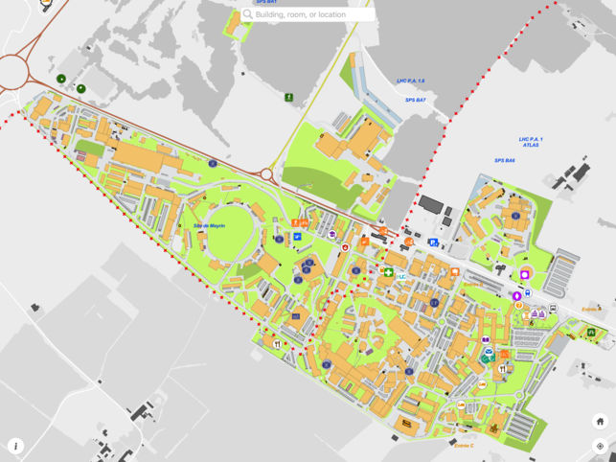

Navigate on the CERN campus
Campus maps:
Printed CERN map
https://maps.cern.ch/
Mobile version of CERN map available
Shuttle Service: http://smb-dep.web.cern.ch/en/ShuttleService
No 1: Meyrin
No 2: Prévessin
Rent a bicycle: http://smb-dep.web.cern.ch/en/Mobility/CERN_bikes_rental
Gate B: open 24/7

Slide 6
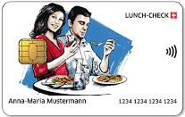


Lunch cards
Opening Hours Restaurant 1
Timetable | Breakfast | Lunch | Dinner
Monday - Friday | 6h30 - 10h30 | 11h30 - 14h15 | 18h00 - 21h30
Weekend & bank holidays | 7h00 - 10h00 | 11h30 - 14h00 | 18h00 - 20h00
Use: Anywhere at Meyrin Site
Prévessin Site
Vending Machines
Daily allowance: 36 CHF
Use like a contactless credit card

Slide 7
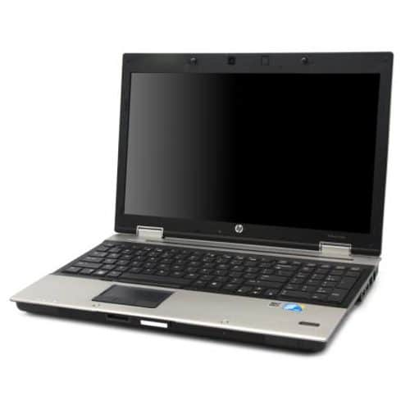


Laptops
Log-in: personal username and password (NICE account)
Are you facing technical problems? - Come to us!
Will be collected at the end of the programme after the final presentation!

Slide 8

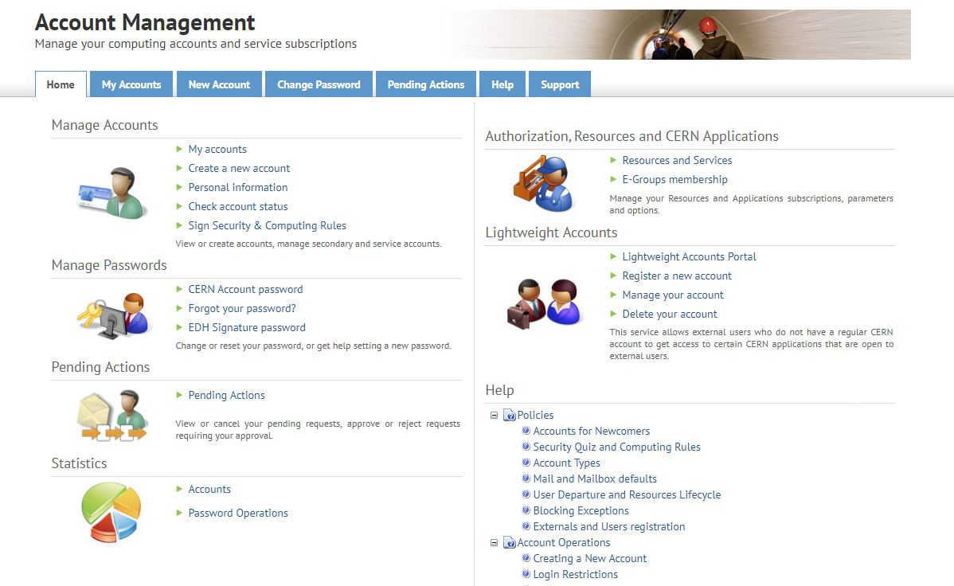
Login for the first time
account.cern.ch/account

Slide 9
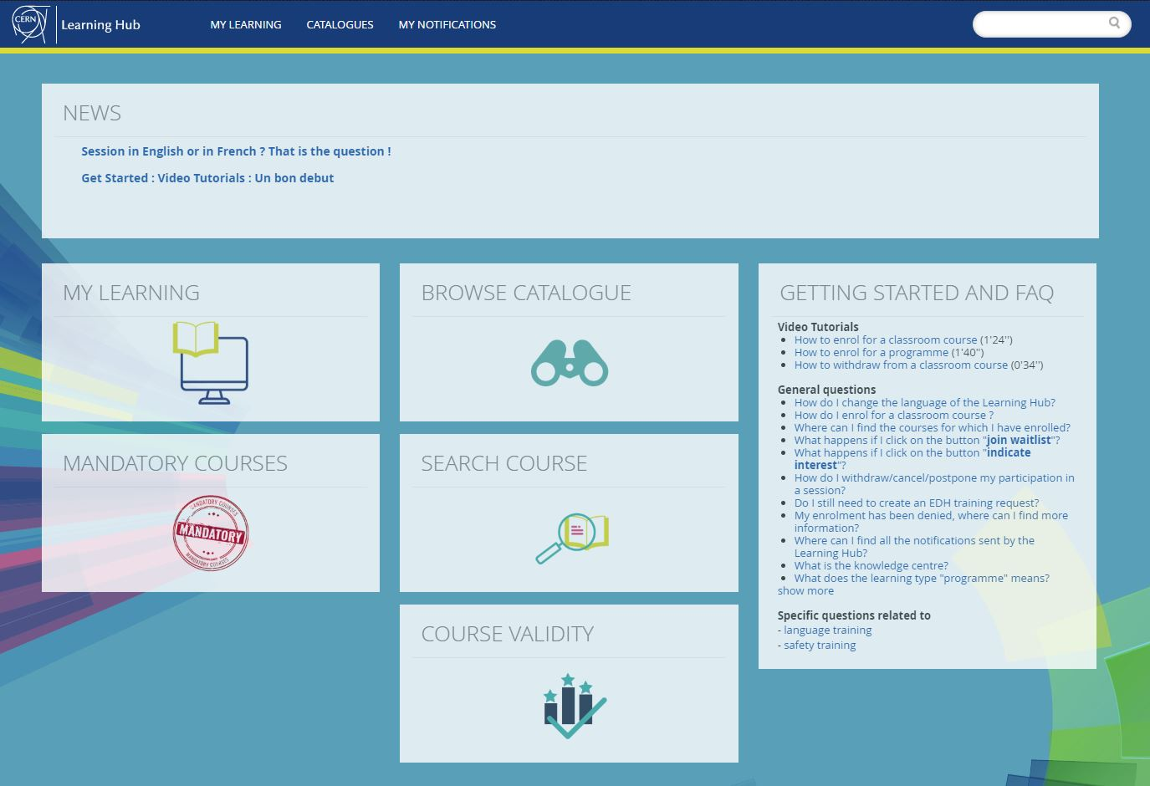

Safety training
DO the Safety Courses
CERN Learning Hub
<learninghub.cern.ch>

Slide 10
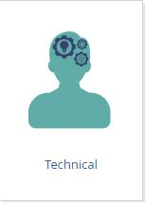

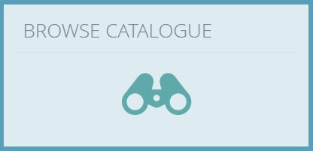


Safety training

Slide 11
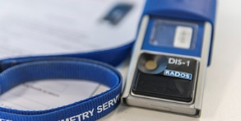
Dosimeters
Wear it while you work
They measure the dose you receive by exposure to ionising radiation
Personal – not transferable!
Required training: Radiation protection – Supervised Area
https://lms.cern.ch/ekp/servlet/ekp?TX=STRUCTUREDCATALOG&CAT=EKP000000488

Slide 12




Visits at CERN

Slide 13
CERN BOX
Upload your pictures here!
https://cernbox.cern.ch/index.php/s/8ALums38W6KzbbV

Slide 14
What’s next?
Registrations – Building 55 – ID / passport needed
Lunch
Group picture – 13h30 – meeting point: UBS bank – main building
CERN treasure hunt – 14h00 – 17h00
Visit to Synchrocyclotron (SC) – 17h00

Slide 15

Enjoy the programme!

