Slide 1
SLS booster emittance exchange
Jonas Kallestrup :: PhD student :: Paul Scherrer Institut
Advanced Low Emittance Rings Technology workshop, 11-07-2019

Slide 2
Outline
Motivation
Emittance redistribution
SLS booster overview
Measurements
  Coupling
  Tune along ramp
  Emittance exchange
Damping effects
Outlook
Summary

Slide 3
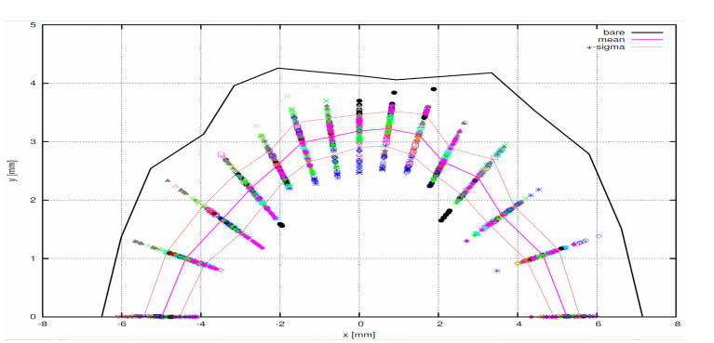
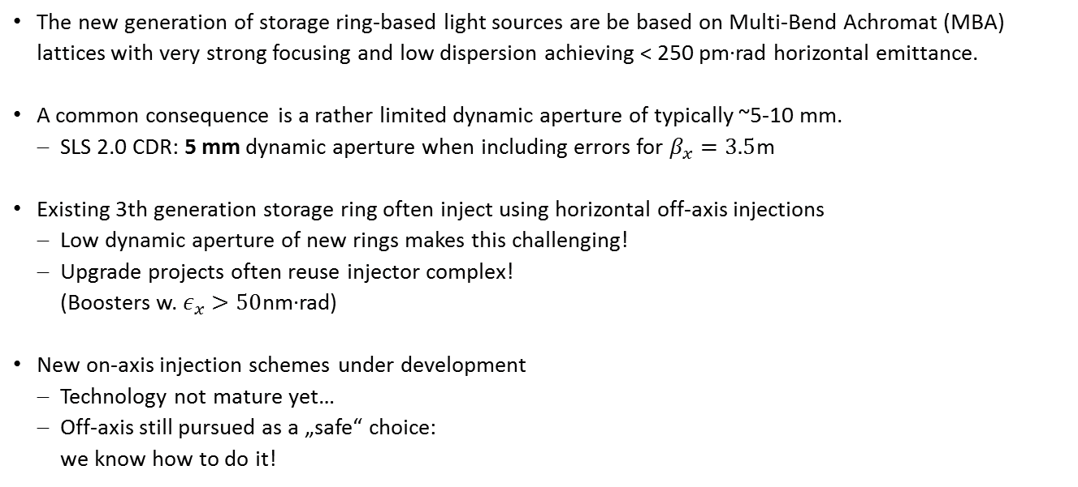
Motivation
The new generation of storage ring-based light sources are be based on Multi-Bend Achromat (MBA) lattices with very strong focusing and low dispersion achieving < 250 pm∙rad horizontal emittance.
A common consequence is a rather limited dynamic aperture of typically ~5-10 mm.
  SLS 2.0 CDR: 5 mm dynamic aperture when including errors for $β_{x}=3.5$m
Existing 3th generation storage ring often inject using horizontal off-axis injections
  Low dynamic aperture of new rings makes this challenging!
  Upgrade projects often reuse injector complex!
  (Boosters w. $ε_{x}>50$nm∙rad)
New on-axis injection schemes under development
  Technology not mature yet…
  Off-axis still pursued as a „safe“ choice:
  we know how to do it!

Slide 4
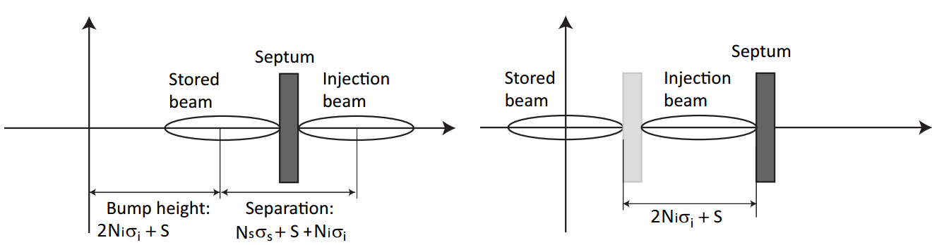
Motivation
Several tricks can be used to improve off-axis injection efficiency or give safety margin
  High-β region for injection
  „Anti-septum“
  See previous talk by M. Aiba
Booster and transfer line initiatives
  Reduction or Redistribution of booster emittances
Bump on
Bump off
Aperture required

Slide 5
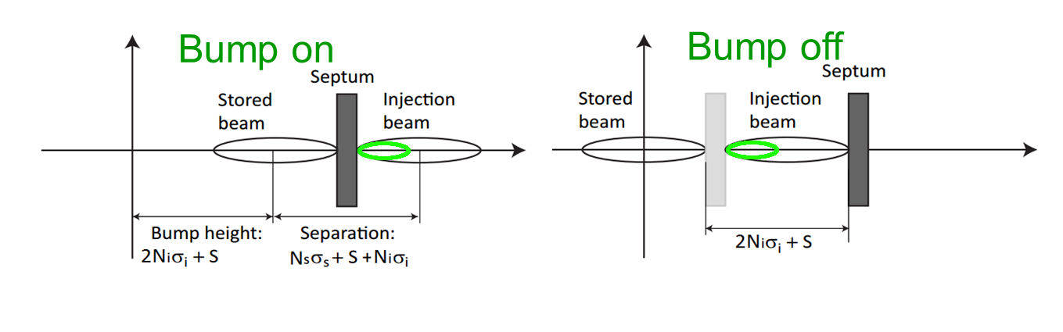
Motivation
Several tricks can be used to improve off-axis injection efficiency or give safety margin
  High-β region for injection
  „Anti-septum“
  See previous talk by M. Aiba
Booster and transfer line initiatives
  Reduction or Redistribution of booster emittances
New aperture required!

Slide 6
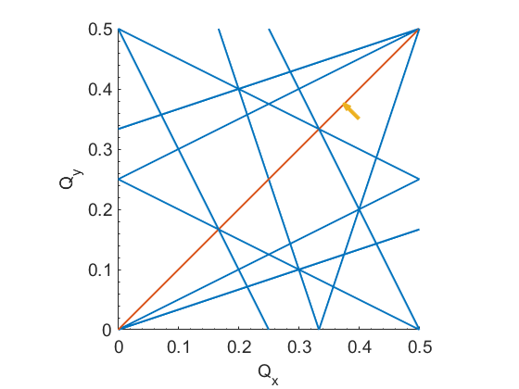
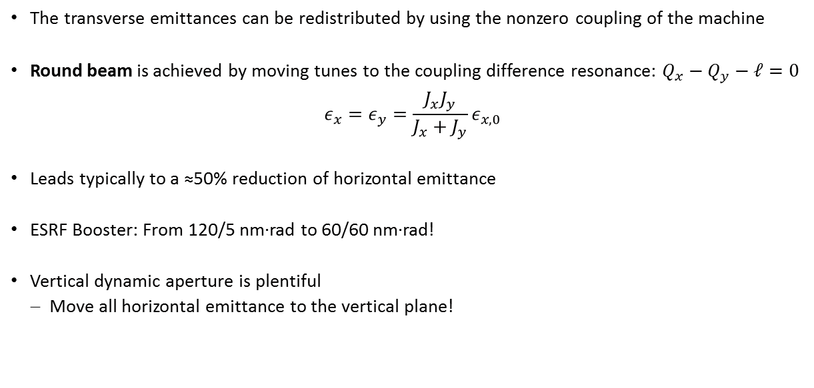
Emittance redistribution: sharing
The transverse emittances can be redistributed by using the nonzero coupling of the machine
Round beam is achieved by moving tunes to the coupling difference resonance: $Q_{x}−Q_{y}−ℓ=0$
$$ε_{x}=ε_{y}=\frac{J_{x}J_{y}}{J_{x}+J_{y}}ε_{x,0}$$
Leads typically to a ≈50% reduction of horizontal emittance
ESRF Booster: From 120/5 nm∙rad to 60/60 nm∙rad!
Vertical dynamic aperture is plentiful
  Move all horizontal emittance to the vertical plane!

Slide 7
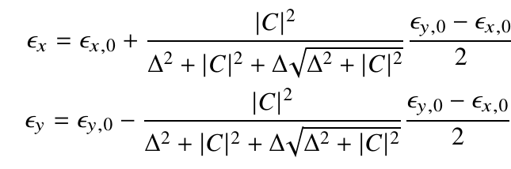
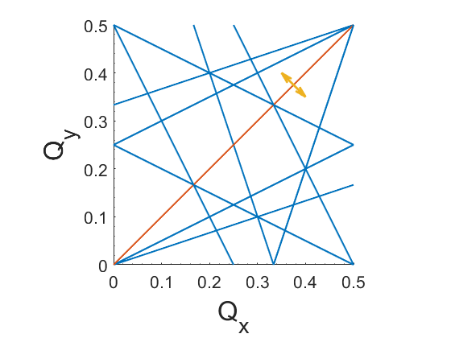
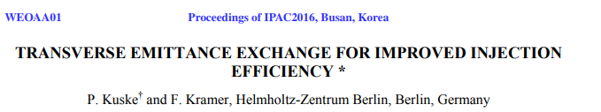
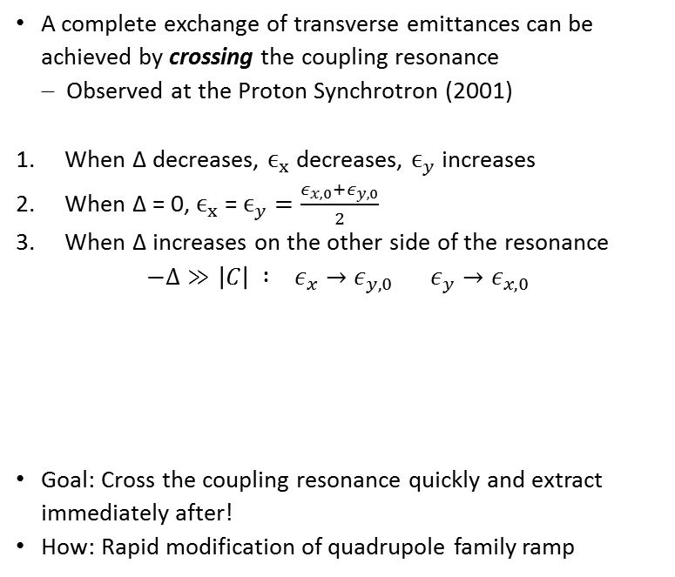

Emittance redistribution: exchange
A complete exchange of transverse emittances can be achieved by crossing the coupling resonance
  Observed at the Proton Synchrotron (2001)
When Δ decreases, $ϵ_{x}$decreases, $ϵ_{y}$increases
When Δ = 0, $ϵ_{x}$= $ϵ_{y}=\frac{ε_{x,0}+ε_{y,0}}{2}$
When Δ increases on the other side of the resonance $−Δ≫\left|C\right| : ε_{x}→ε_{y,0}$ $ε_{y}→ε_{x,0}$
Goal: Cross the coupling resonance quickly and extract immediately after!
How: Rapid modification of quadrupole family ramp
Δ: betatron tune separation $Q_{x}−Q_{y}−ℓ$
|C|: coupling coefficient

Slide 8
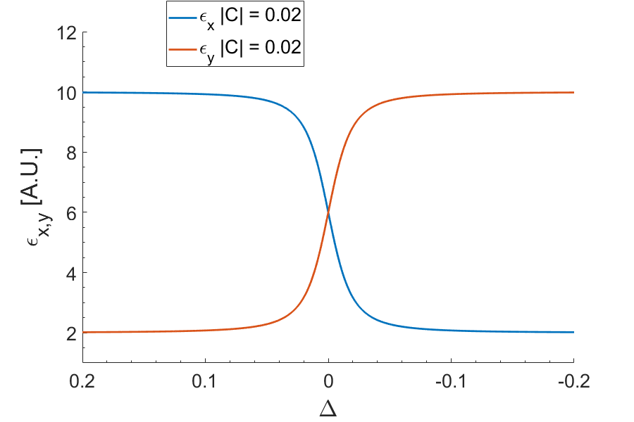
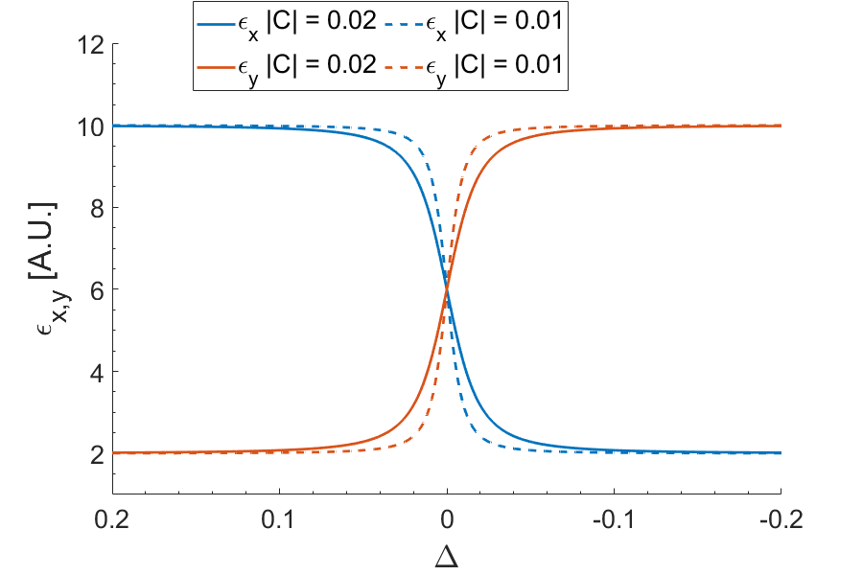
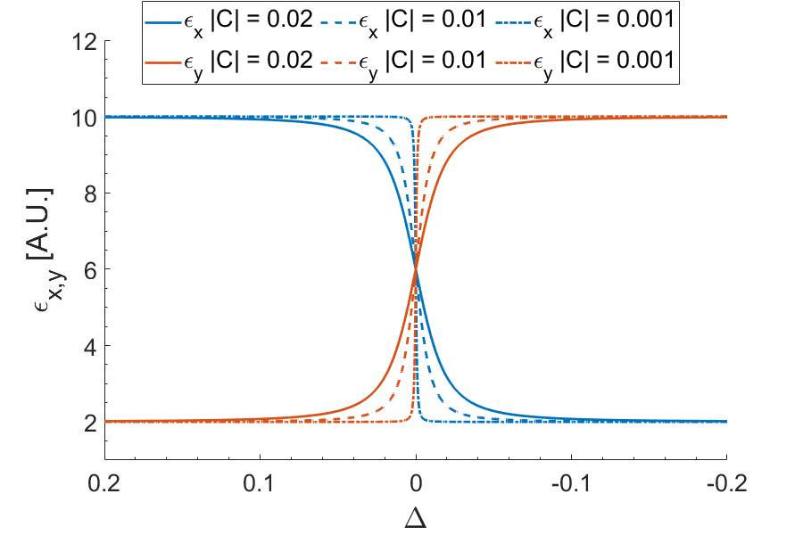
Emittance redistribution: exchange
A complete exchange of transverse emittances can be achieved by crossing the coupling resonance
  Observed at the Proton Synchrotron (2001)
When Δ decreases, $ϵ_{x}$decreases, $ϵ_{y}$increases
When Δ = 0, $ϵ_{x}$= $ϵ_{y}=\frac{ε_{x,0}+ε_{y,0}}{2}$
When Δ increases on the other side of the resonance $−Δ≫\left|C\right| : ε_{x}→ε_{y,0}$ $ε_{y}→ε_{x,0}$
Goal: Cross the coupling resonance quickly and extract immediately after!
How: Rapid modification of quadrupole family ramp
Δ: betatron tune separation $Q_{x}−Q_{y}−ℓ$
|C|: coupling coefficient

Slide 9
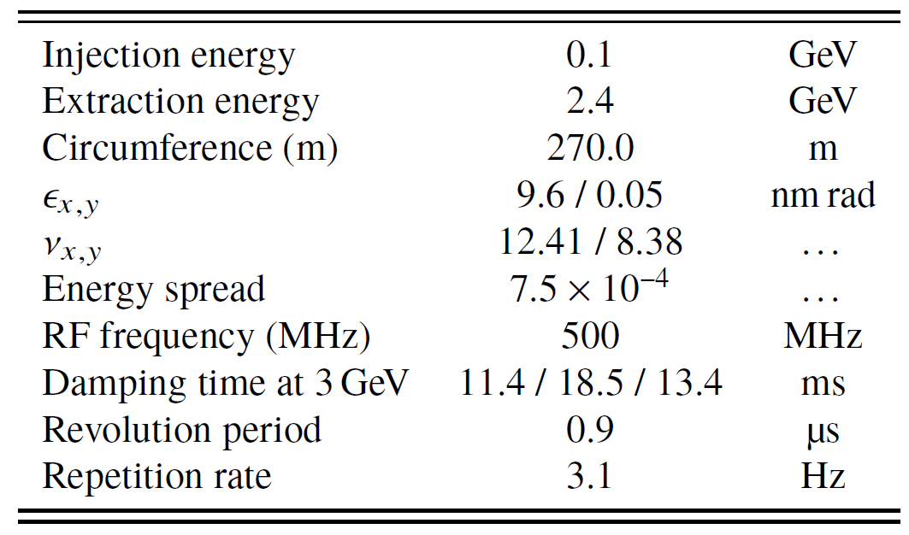
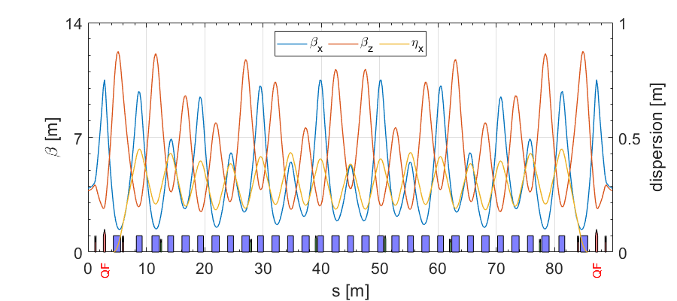
SLS booster: overview
Highlights
First booster built specifically for top-up operation
Mounted on inner wall of Storage Ring tunnel
  ≈ same circumference as SR
Low horizontal emittance
  Vertical emittance probably ~2-3 nm.rad while minimum is 0.05
Tune are relatively close
Digital magnet power supply control
Dipoles with quadrupole + sextupole components
  Quadrupole families for dispersion and tune control
Relatively weak and inexpensive magnets
Extremely flexible and easily controllable!

Slide 10
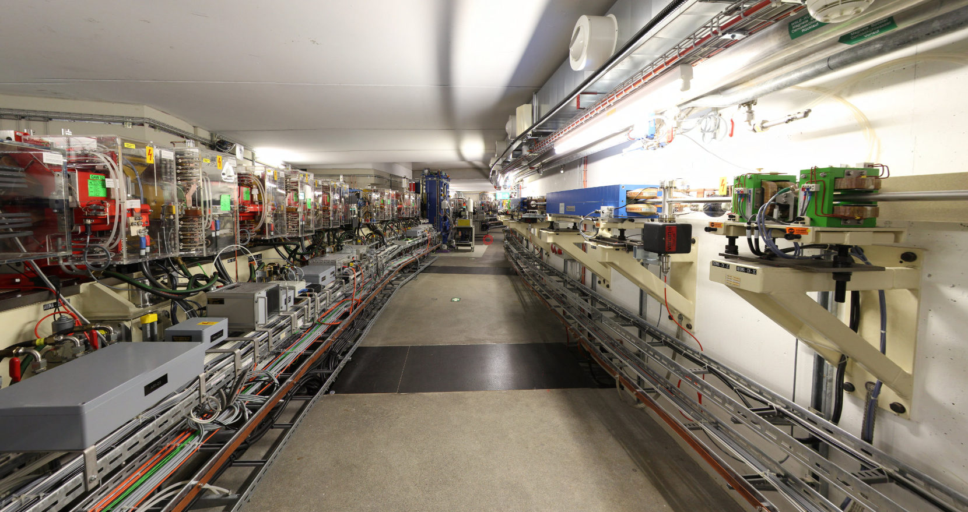
SLS booster: overview

Slide 11
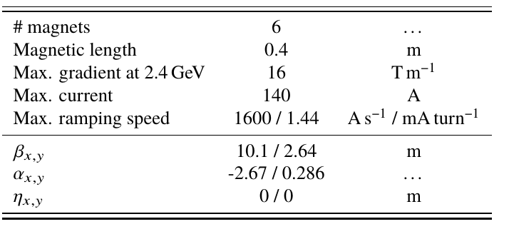
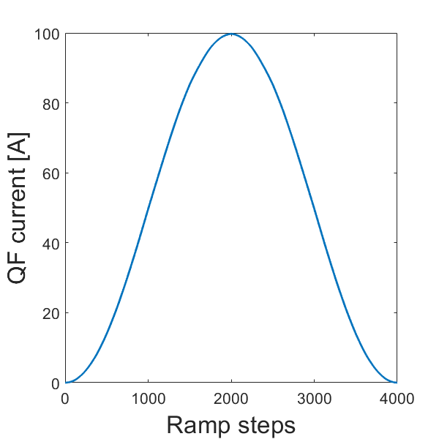
SLS booster: QF family
Digitally controllable in 4000 steps along full ramp
  ≈ 88 turns / step ≈ 79 μs / step.
  Quite nice resolution!
Maximum current: 140 A

Slide 12
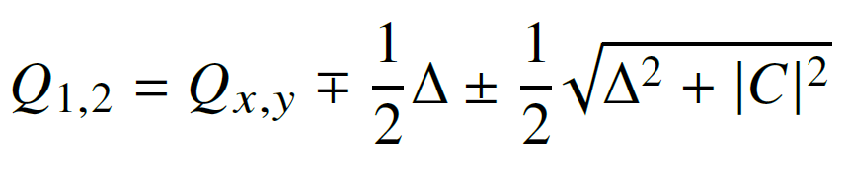
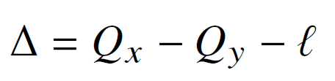
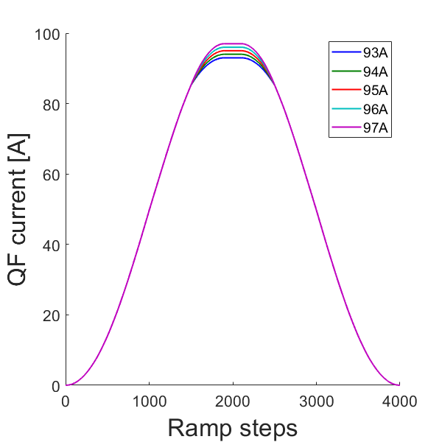
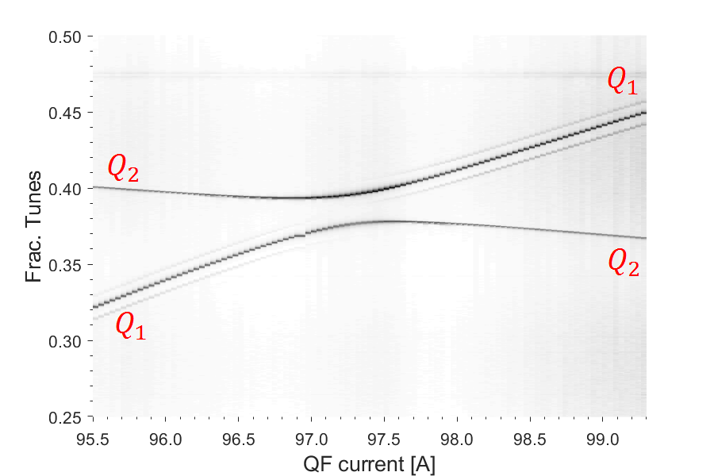
Closest Tune Approach measurements
Coupling is measured using the Closest Tune Approach at the top of the ramp
‘Natural’ coupling is substantial:
  |C| = 0.019
  No need for additional skew quadrupoles
=|C|

Slide 13
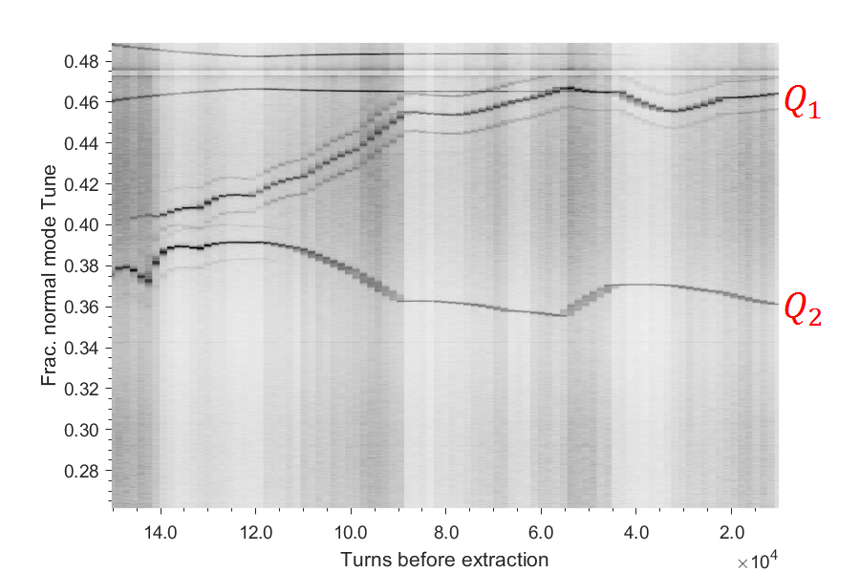

Tune along ramp
Goals:
Cross the coupling resonance quickly to achieve the emittance exchange
Extract beam shortly after to avoid damping
$I_{QF}:98A →95A$
Waterfall plot of FFT of Turn-by-Turn BPM data

Slide 14
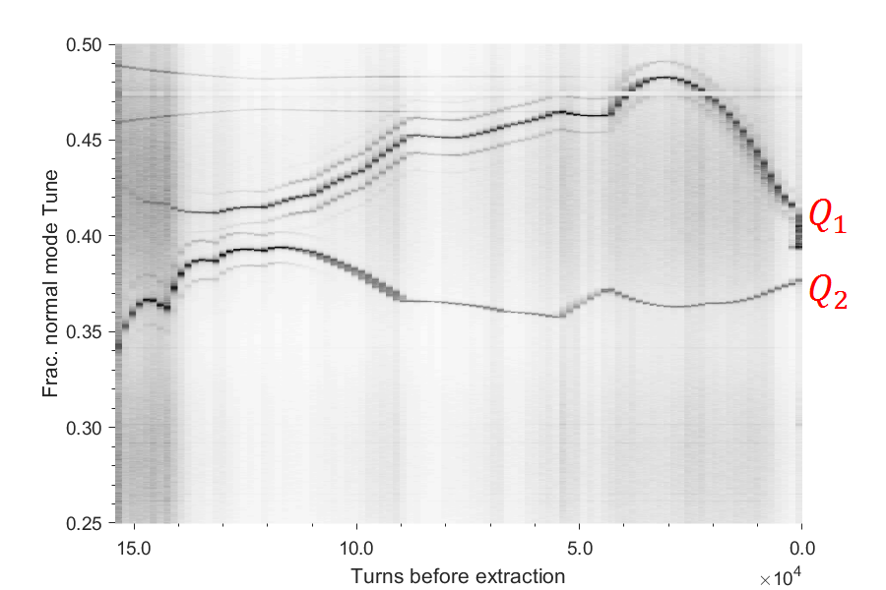
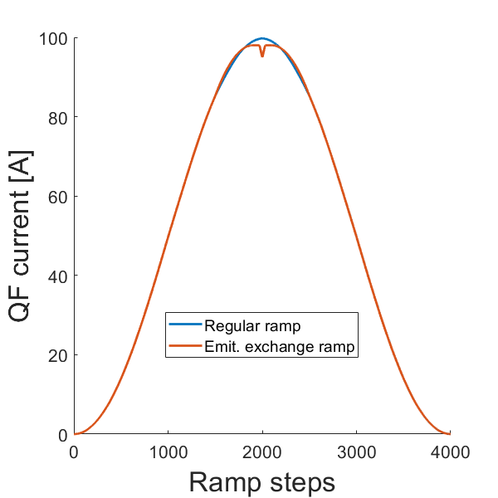
Tune along ramp
Goals:
Cross the coupling resonance quickly to achieve the emittance exchange
Extract beam shortly after to avoid damping
$I_{QF}:98A →95A$
Waterfall plot of FFT of Turn-by-Turn BPM data

Slide 15
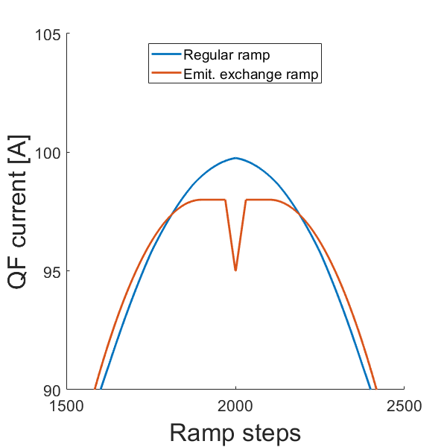
Tune along ramp
Goals:
Cross the coupling resonance quickly to achieve the emittance exchange
Extract beam shortly after to avoid damping
$I_{QF}:98A →95A$
Waterfall plot of FFT of Turn-by-Turn BPM data

Slide 16
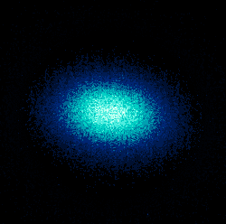
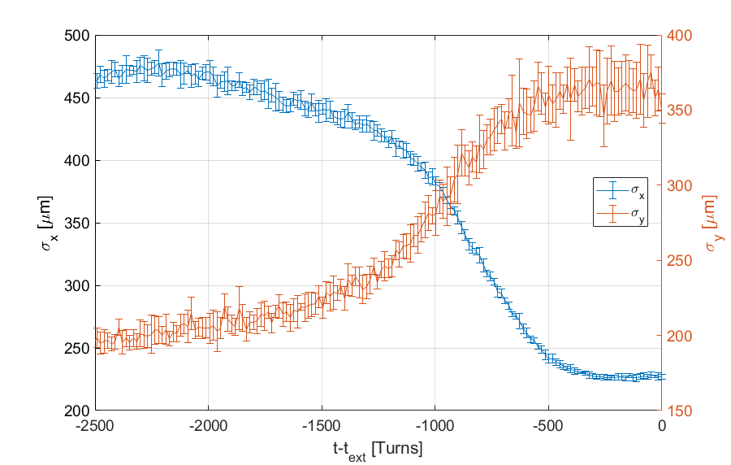
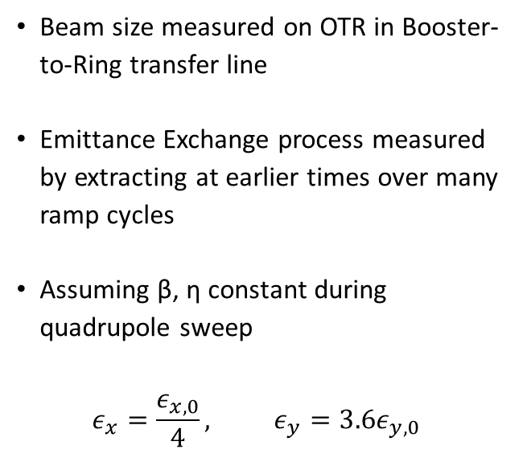
Results
Beam size measured on OTR in Booster-to-Ring transfer line
Emittance Exchange process measured by extracting at earlier times over many ramp cycles
Assuming β, η constant during quadrupole sweep
  $$ε_{x}=\frac{ε_{x,0}}{4}, ε_{y}={3.6ε}_{y,0}$$
Not a “big” change but remember: ${(ε}_{x},ε_{y})≈\left(10, 2.5\right)$ nm∙rad

Slide 17
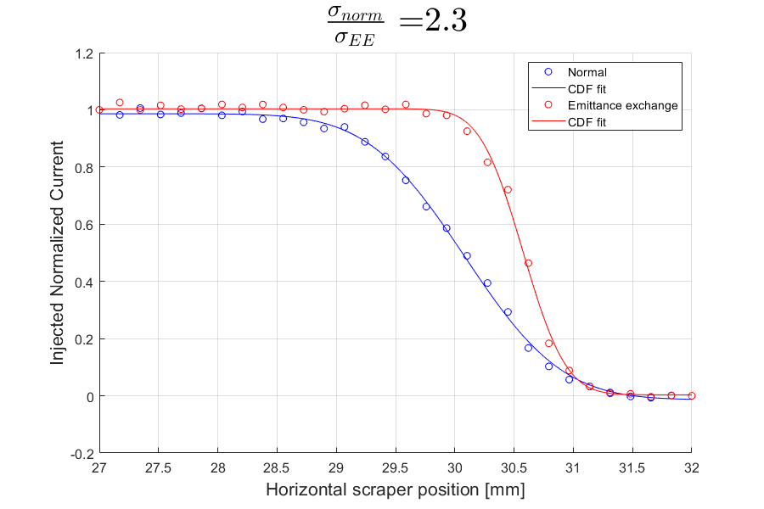
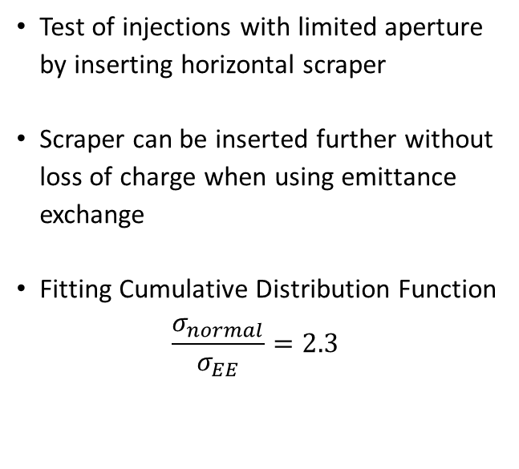
Results
Test of injections with limited aperture by inserting horizontal scraper
Scraper can be inserted further without loss of charge when using emittance exchange
Fitting Cumulative Distribution Function
  $$\frac{σ_{normal}}{σ_{EE}}=2.3$$

Slide 18
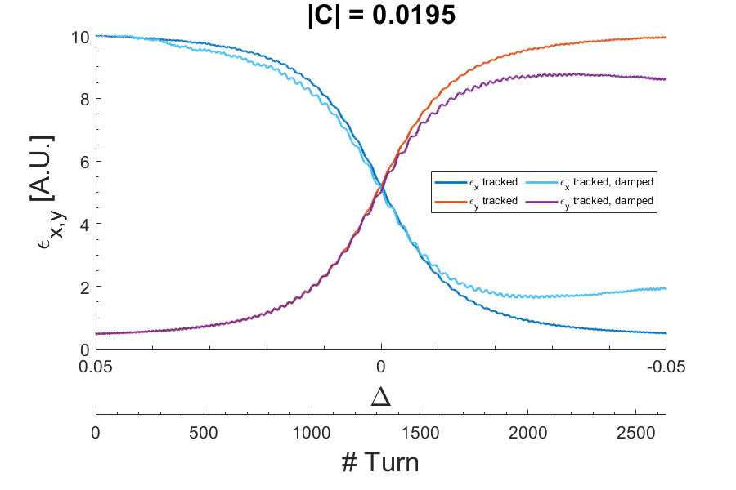
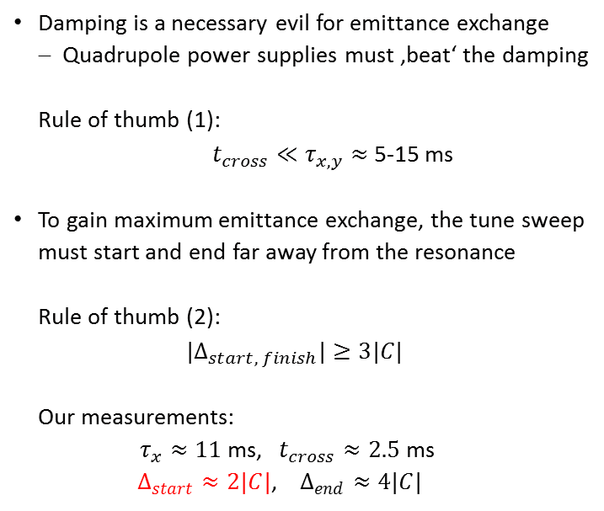
Emittance redistribution: Radiation damping
Damping is a necessary evil for emittance exchange
  Quadrupole power supplies must ‚beat‘ the damping
  Rule of thumb (1):
                $t_{cross}≪τ_{x,y}≈$5-15 ms
To gain maximum emittance exchange, the tune sweep must start and end far away from the resonance
  Rule of thumb (2):
  $${|Δ}_{start, finish}|≥3|C|$$
  Our measurements:
  $τ_{x}≈11$ms, $t_{cross}≈2.5$ ms
          $Δ_{start}≈2|C|$, $Δ_{end}≈4|C|$

Slide 19
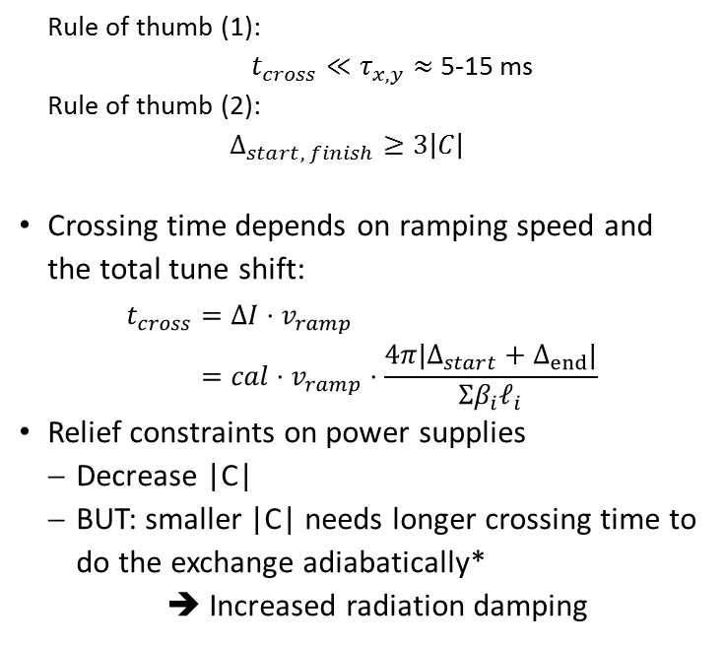
Emittance redistribution: Radiation damping
  Rule of thumb (1):
                $t_{cross}≪τ_{x,y}≈$5-15 ms
  Rule of thumb (2):
  $$Δ_{start, finish}≥3\left|C\right|$$
Crossing time depends on ramping speed and the total tune shift:
$$\begin{aligned}t_{cross}&=ΔI⋅v_{ramp} \\ &=cal⋅v_{ramp}⋅\frac{4π|Δ_{start}+Δ_{end}|}{Σβ_{i}ℓ_{i}}\end{aligned}$$
Relief constraints on power supplies
  Decrease |C|
  BUT: smaller |C| needs longer crossing time to do the exchange adiabatically*
  ➔ Increased radiation damping
* See averaging of single particle emittance in: A. Franchi, E. Métral, R. Tomás, “Emittance sharing and exchange driven by linear betatron coupling in circular accelerators” eq. 20 & 21

Slide 20
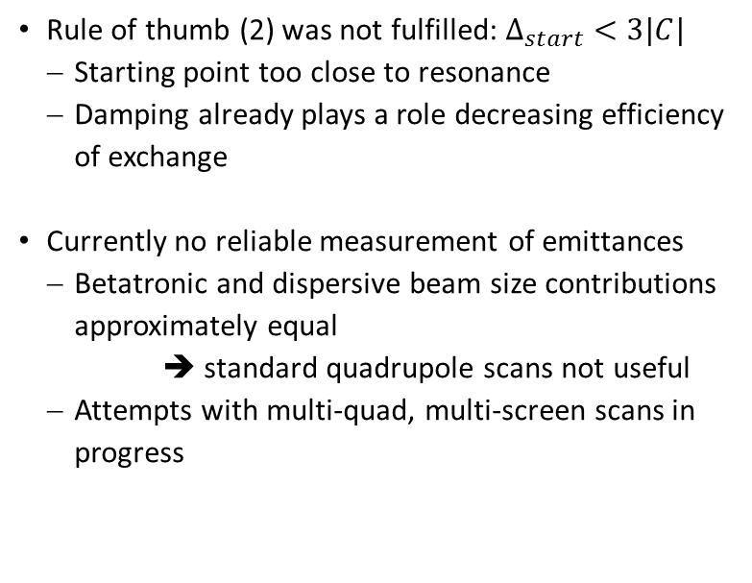
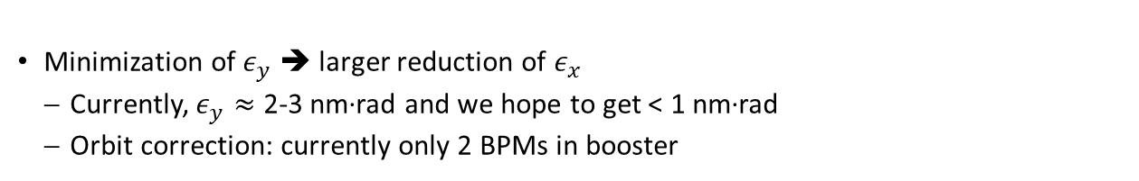
Improvements for future measurements
Rule of thumb (2) was not fulfilled: $Δ_{start}<3|C|$
  Starting point too close to resonance
  Damping already plays a role decreasing efficiency of exchange
Currently no reliable measurement of emittances
  Betatronic and dispersive beam size contributions approximately equal
  ➔ standard quadrupole scans not useful
  Attempts with multi-quad, multi-screen scans in progress
Minimization of $ε_{y}$ ➔ larger reduction of $ε_{x}$
  Currently, $ε_{y}≈$ 2-3 nm∙rad and we hope to get < 1 nm∙rad
  Orbit correction: currently only 2 BPMs in booster

Slide 21
Outlook
Emittance exchange successfully tested: many future and existing facilities might apply this technique depending on their booster and injection scheme
High-emittance (≥ 50 nm) boosters can have a significant relaxation of required horizontal acceptance, since vertical emittance is typically less than 5 nm
  Large emittance does not imply longer crossing times
Easy to implement:
  Does (should) not require modifications of booster or transfer line hardware
  Exploits ‘natural’ coupling of the machine

Slide 22
Summary
Upgrade projects tend to reuse existing injector complex
Small dynamic aperture make off-axis injections challenging
The booster emittance can be redistributed through emittance exchange by coupling resonance crossing before extraction
A factor 4 (3.6) decrease (increase) in horizontal (vertical) emittance achieved in SLS booster
  Close to full exchange!
  Can be useful for other existing and future facilities and (almost) immediately applied

Slide 23
Summary
Thank you for your attention!

Slide 24
Extra slides

Slide 25
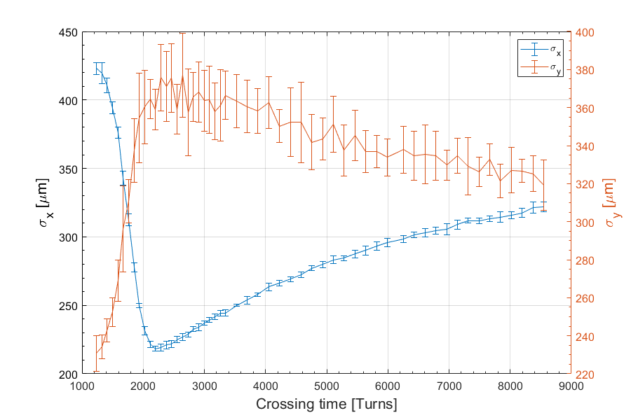

Crossing speed dependency
Best exchange for the crossing $I_{QF}=98A →95A$ with a “crossing time” of ≈2200 turns.
Small machine coupling: Longer crossing time needed
  Radiation damping becomes important
    Additional coupling needed
      Additional skew quadrupole needed
Power supply can’t follow

Slide 26
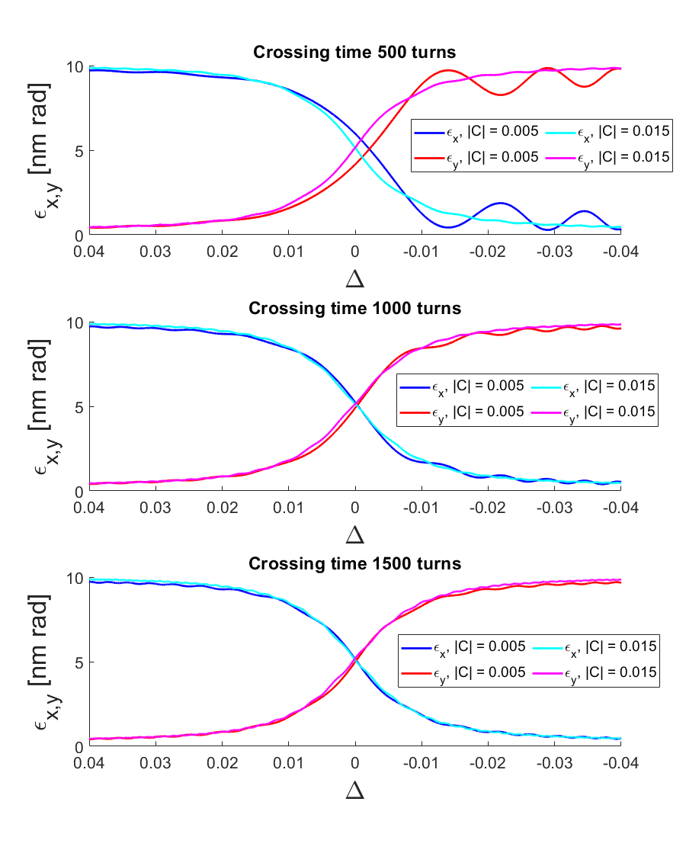
Crossing speed dependency
Consequences of low coupling: mismatch of emittance
  If coupling is small, then a longer crossing time is needed to do a proper emittance exchange without mismatch of the emittance.
  If crossing time is too short, the emittance exchange becomes nonadiabatic.
  If crossing time is too long, radiation damping & quantum excitation will play a role.
  Skew quadrupoles might be needed if coupling is too small.

Slide 27
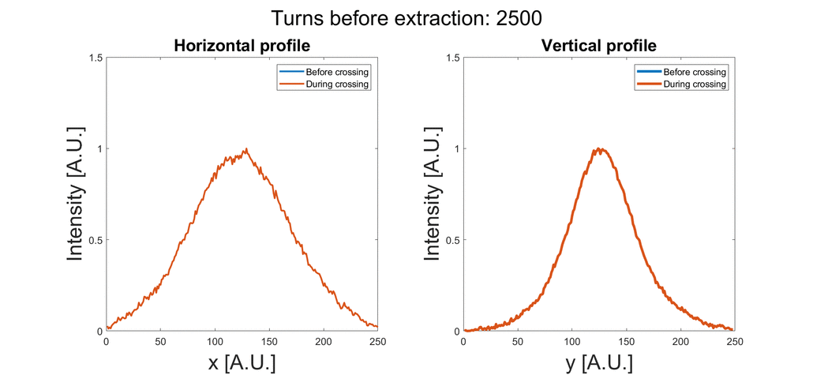

Results
Movie of measured beam profile
  Emittance exchange is not very visible due to large dispersion at OTR monitor
  ($D_{x},D_{y})≈\left(0.1, 0.1\right)$ m measured

