Slide 1
Workshop 17 June 2019
CERN’s Open Source Components for Infor EAM
Lukasz Pater & David Widegren
CERN, Asset & Maintenance Management
June 2019
EDMS 2170647

Slide 2
Agenda
14.00-14.30 | CERN and Infor EAM at CERN : Why Open Source Components were created!
14.30-15.30 | Overview of the Open Source Components What they are and how they can be used
15.30-16.00 | Coffee Break
16.00-17.00 | Technical Overview & QA How these tools can be installed in your environment

Slide 3
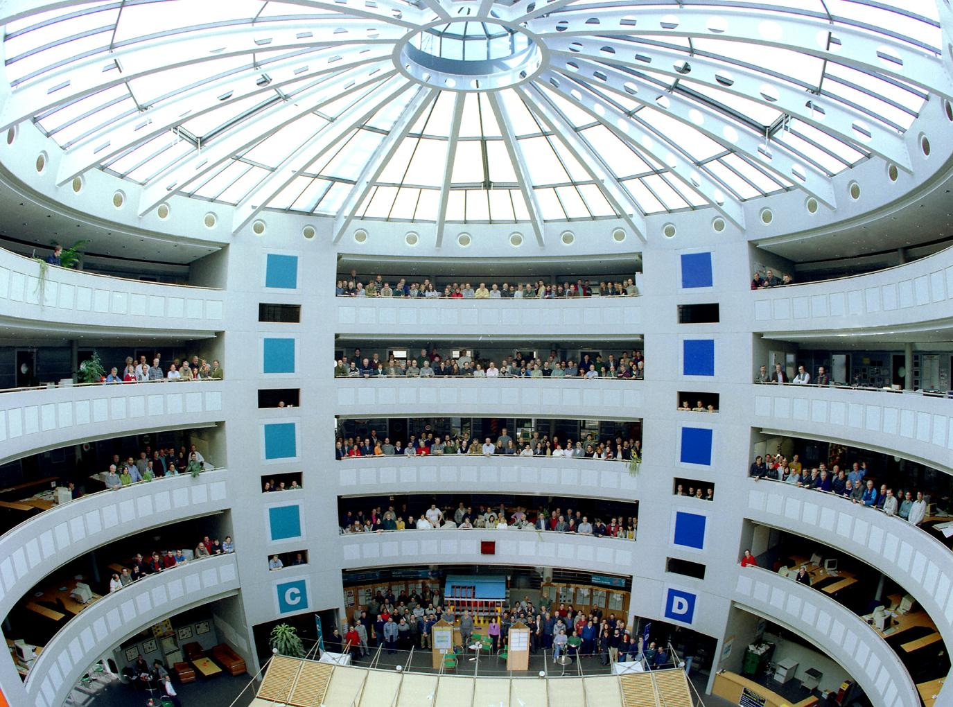
What is CERN?
CERN is the world’s largest research center for particle physics.
23 European member states and over 70 additional collaborating countries.
Our mission is to provide scientists with tools to study the building blocks of matter and the origins of the universe.
How: By building and operating huge particle accelerators.
People: 2.600 staff, 2.500 students & 12.000 visiting scientists.
Annual budget: ~ 1.1 billion CHF

Slide 4
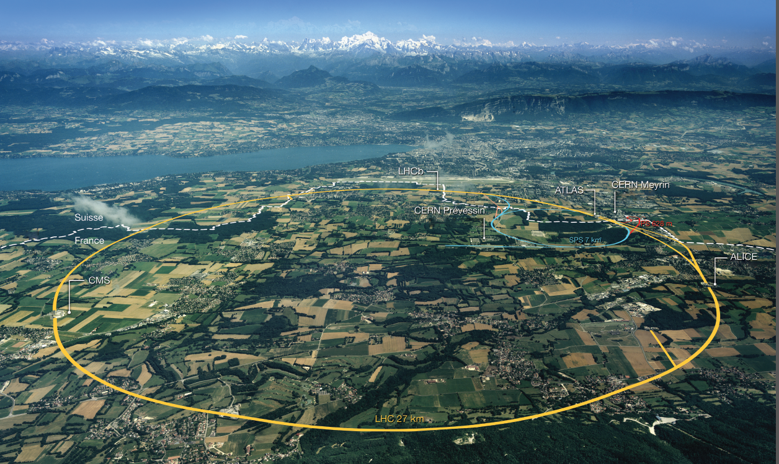
The Large Hadron Collider - LHC

Slide 5
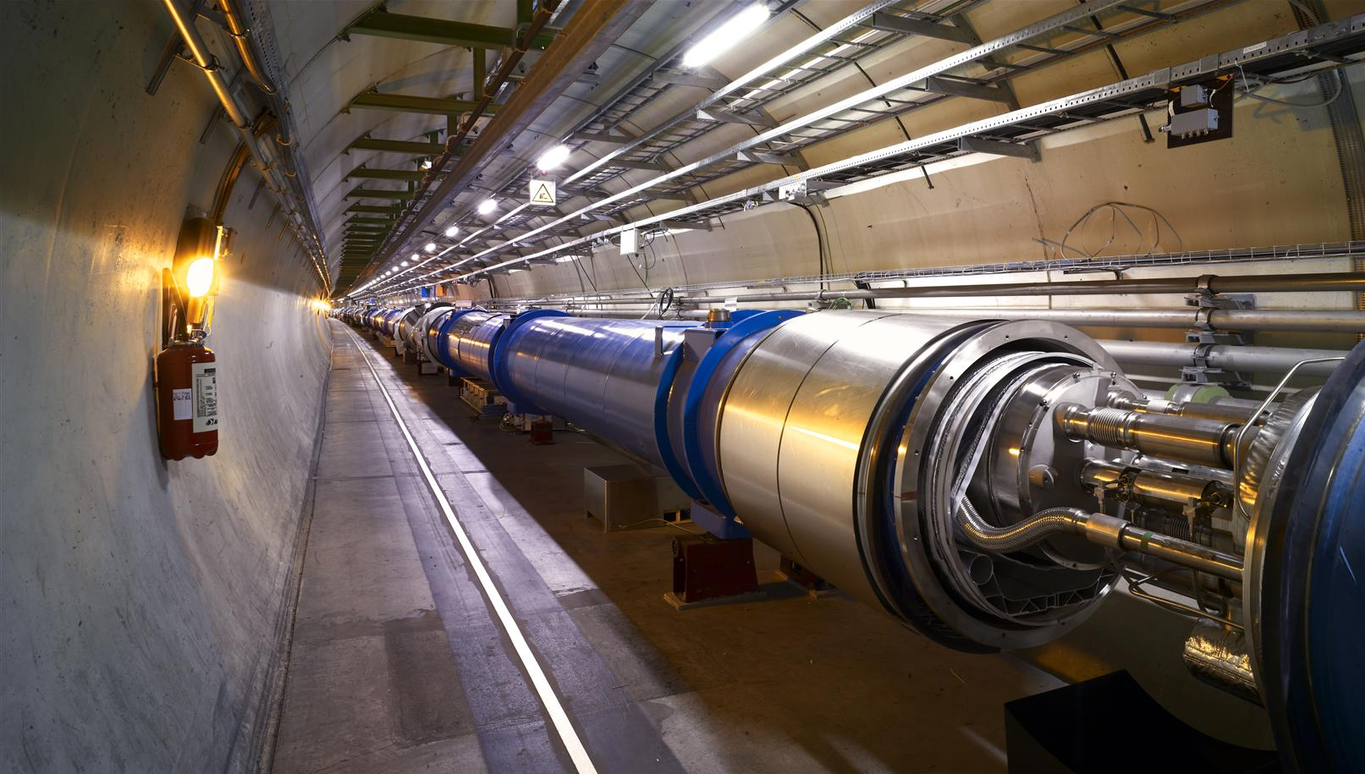
Inside the LHC Tunnel

Slide 6

CMS – 1 of 4 LHC Detectors

Slide 7
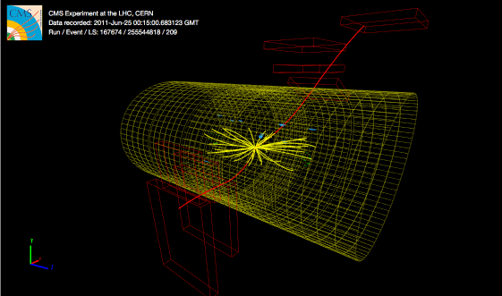
CMS – Particle Collisions

Slide 8

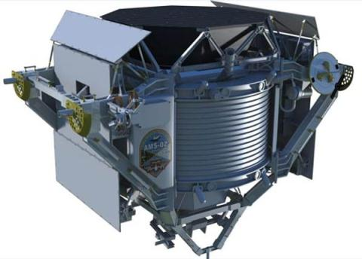
Alpha Magnetic Spectrometer

Slide 9
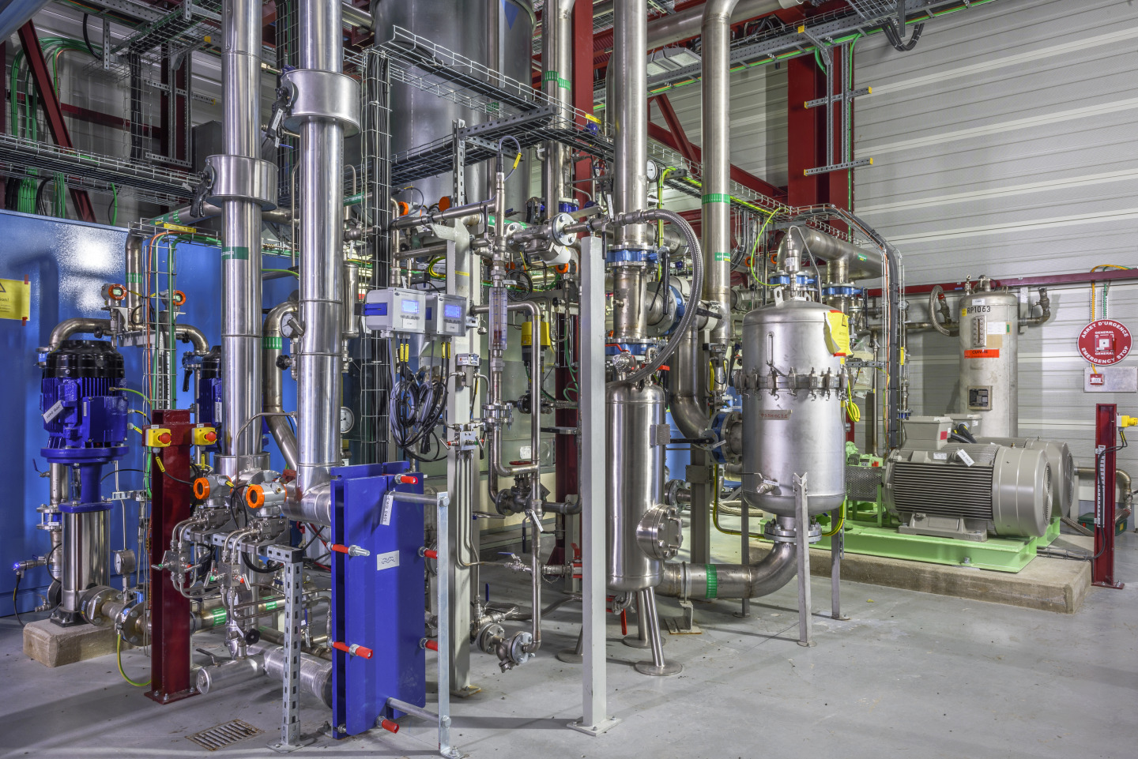
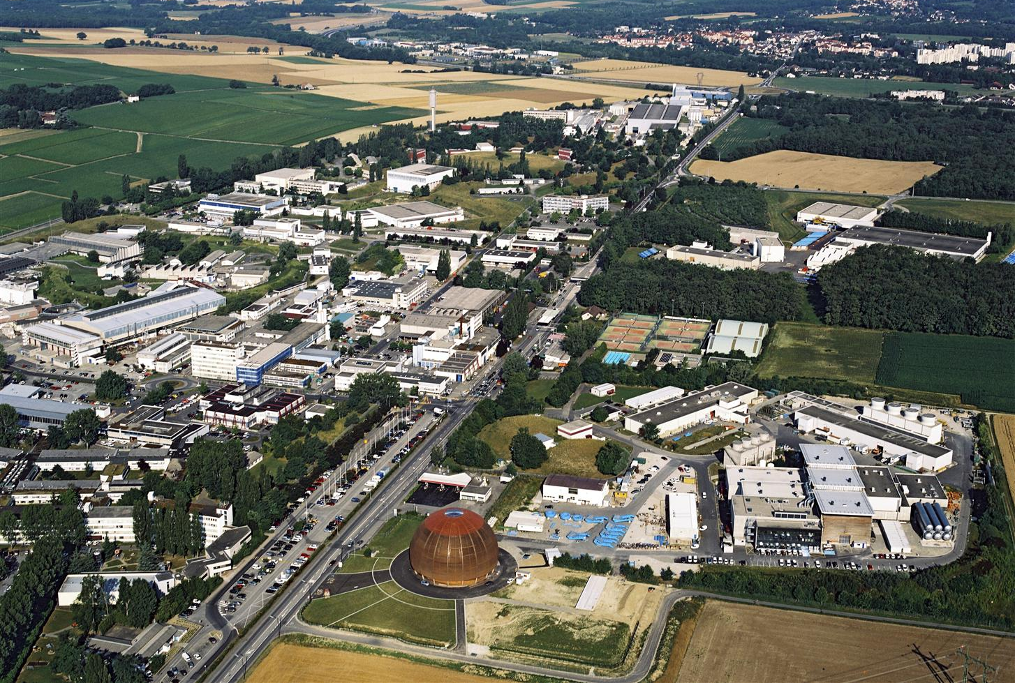

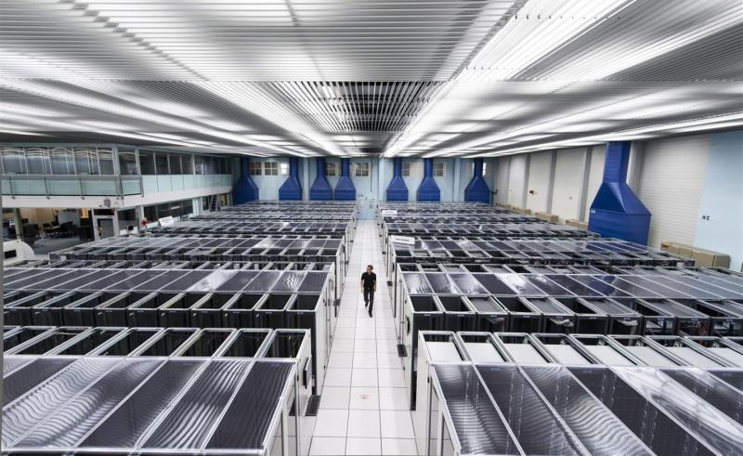
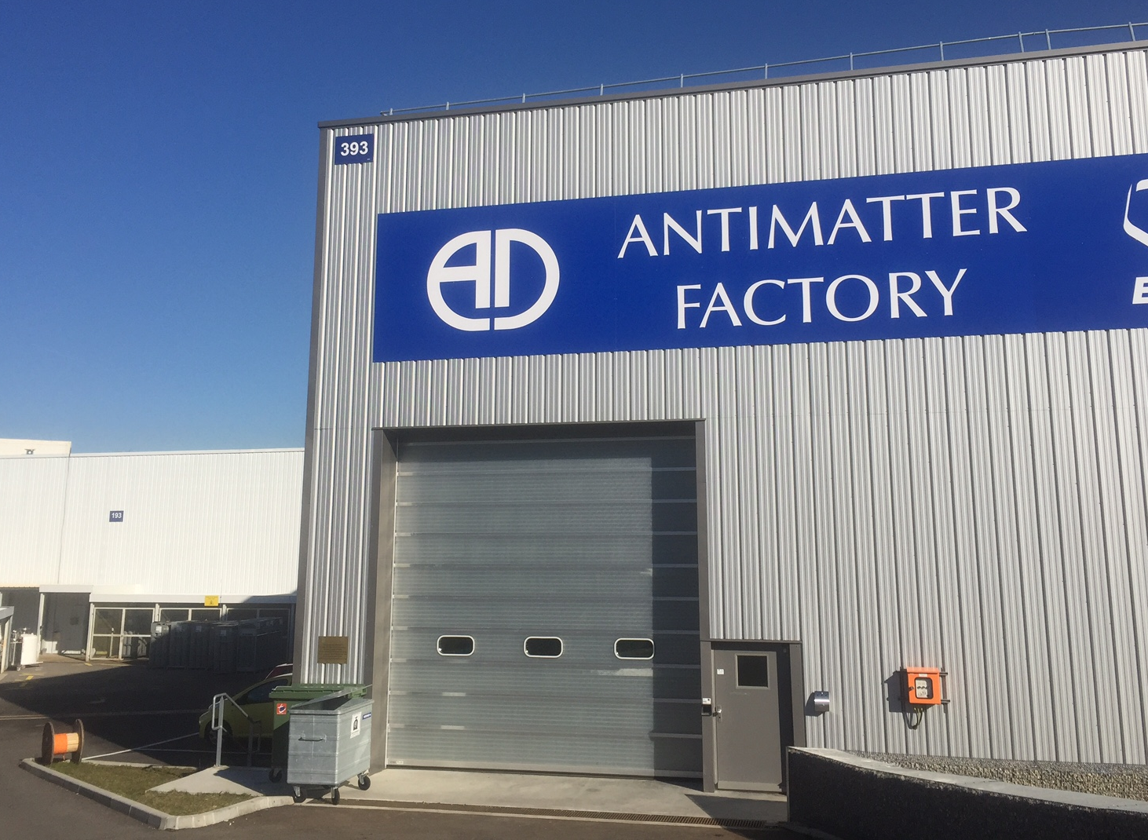
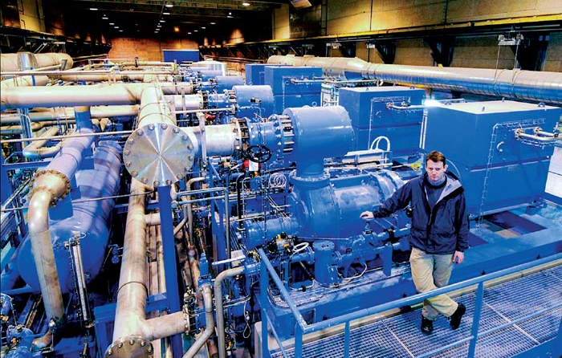
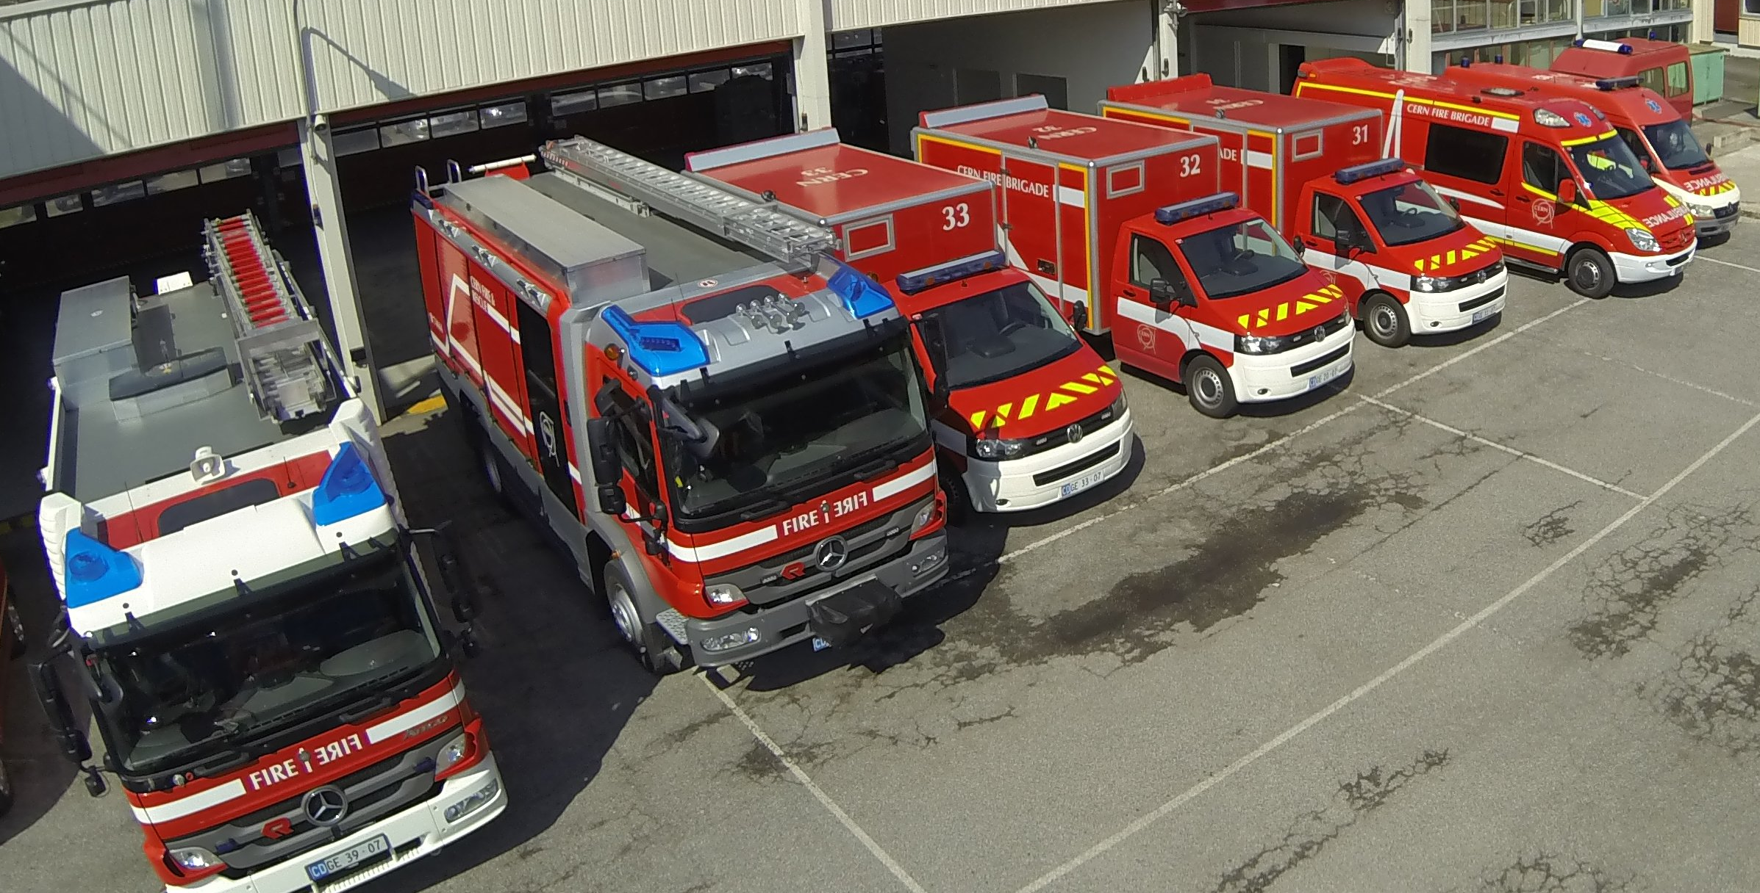


Very wide array of assets…
..and a strategy of a single EAM system to manage them.
  (Close to) Zero modifications of the software.
  Only standard configuration or external add-ons / integrations.

Slide 10
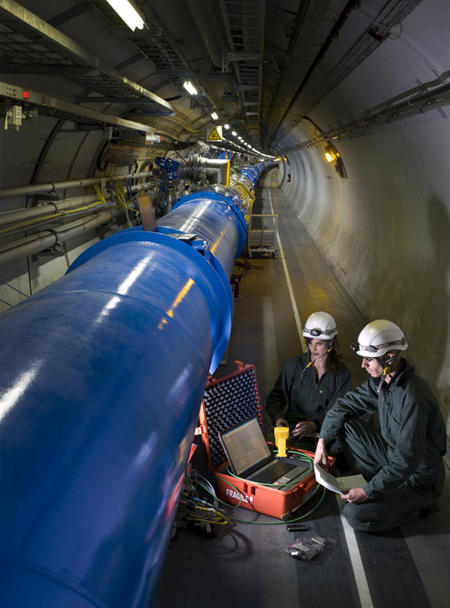
Asset Management at CERN
A large part of our maintenance is outsourced
  Our very wide range of maintenance activities makes outsourcing the only alternative due to cost and personnel constraints.
Outsourced maintenance requires centralized tools for managing knowledge
  Essential with single repository for all assets and their history to keep knowledge at CERN.
  A common tool brings common processes, which in turn brings efficiencies and financial savings.

Slide 11
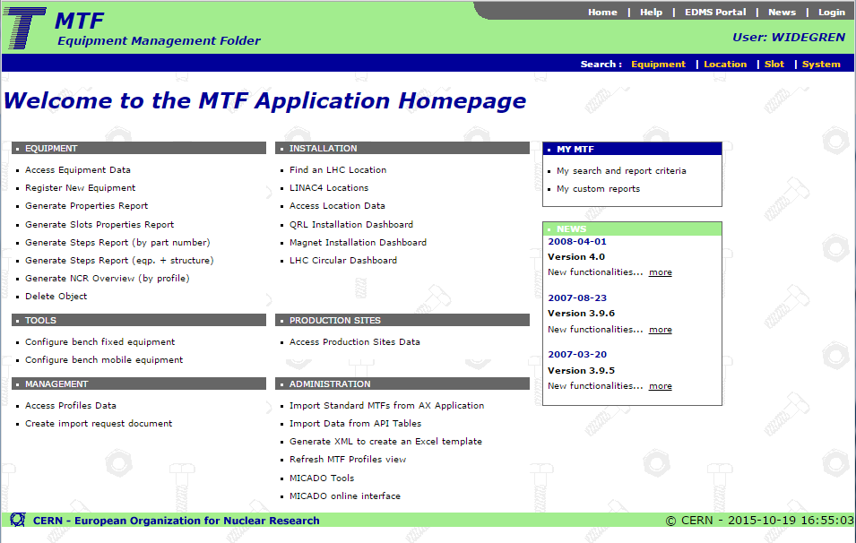
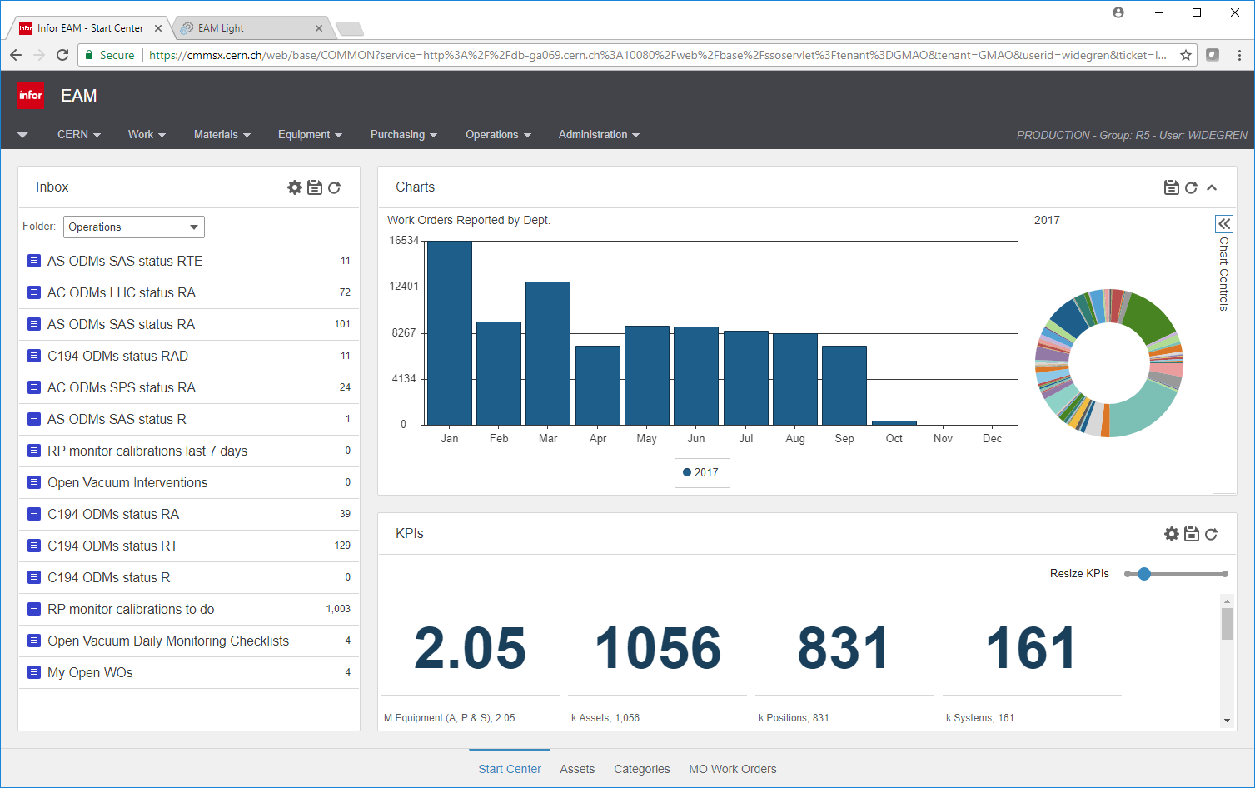
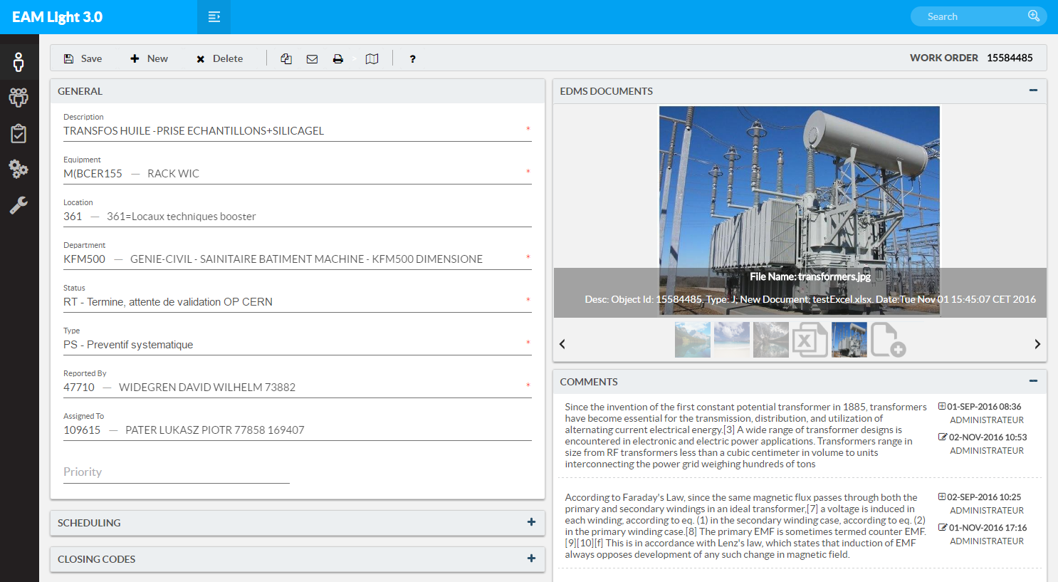
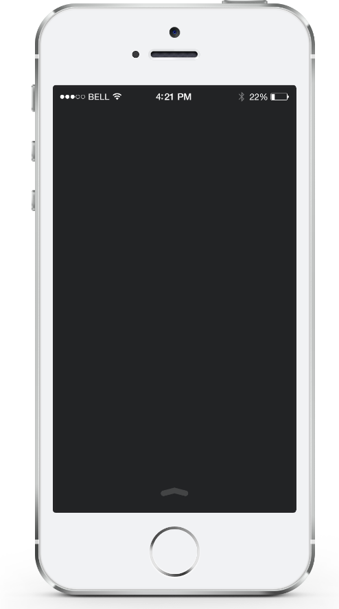

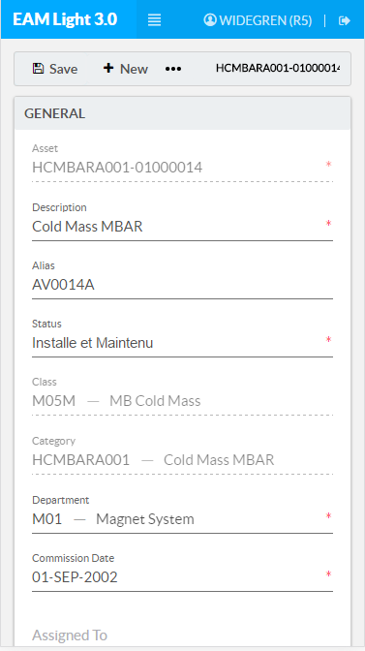
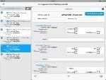
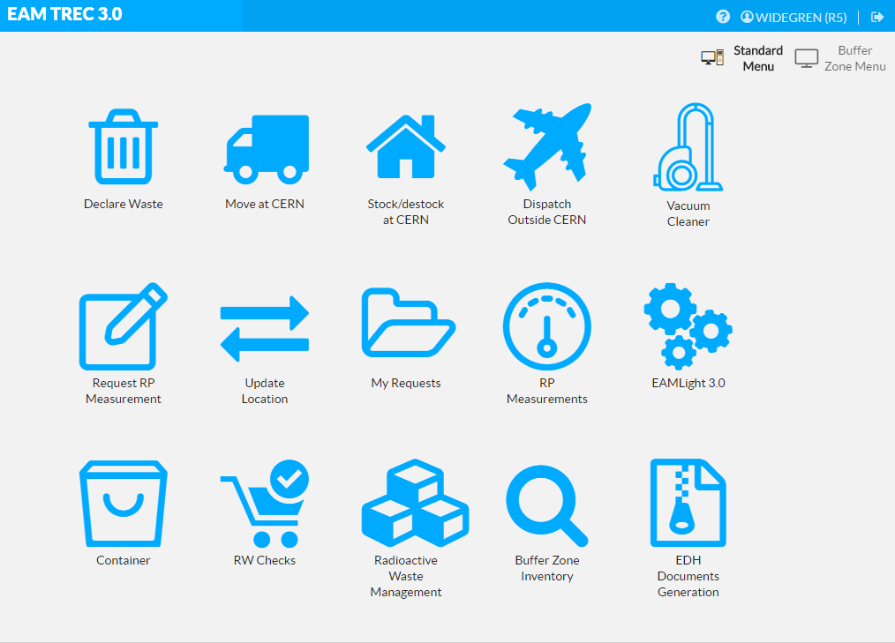

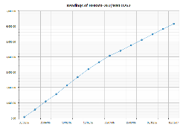
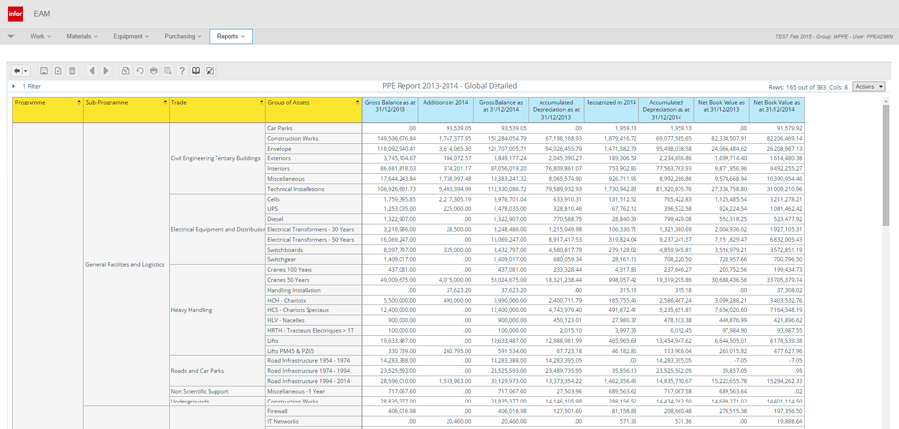
Our Asset Management Platform
Manufacturing &
Installation
Operation &
Maintenance
Disposal & Waste
Management
MTF
Manufacturing & Test Folder
Infor EAM
Enterprise Asset Management
TREC
Radioactive Traceability
Reporting & BI
Business Intelligence / Reports
Financial Depreciation
Plant, Property & Equipment

Slide 12
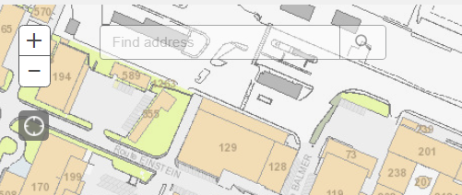
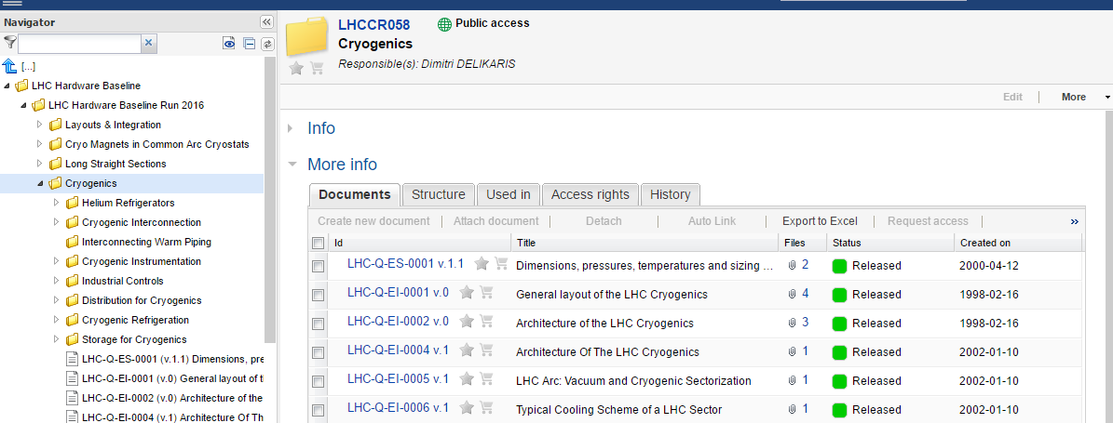
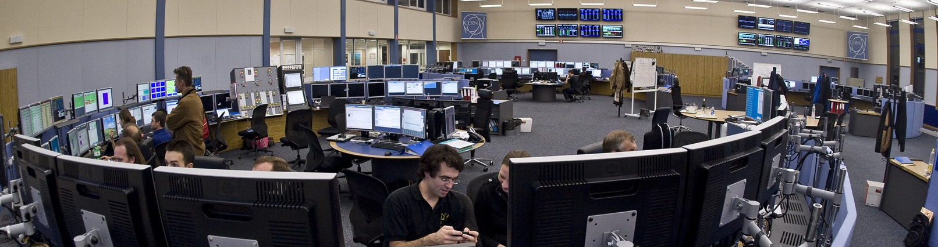
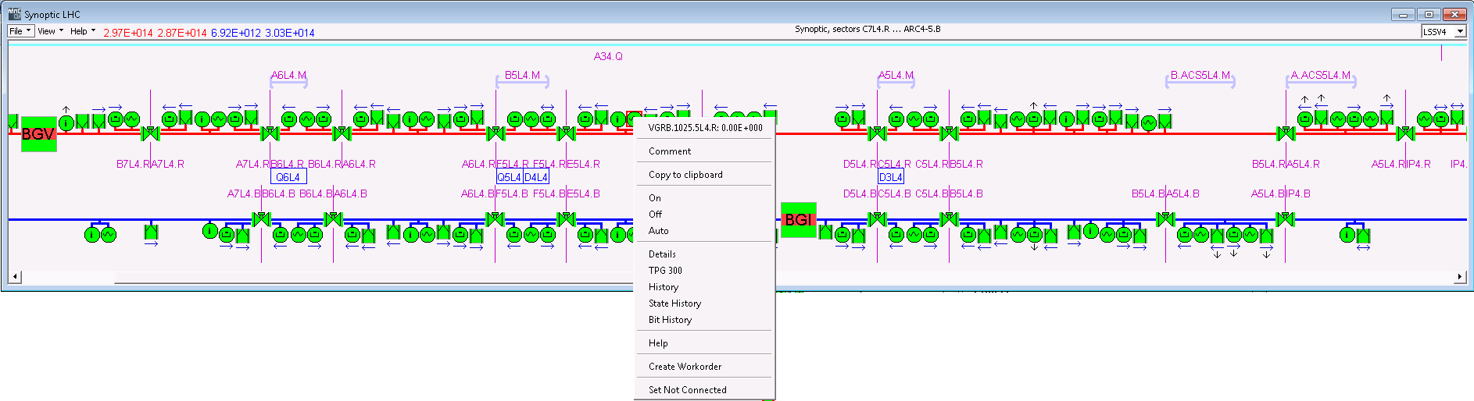
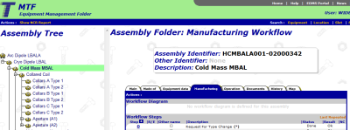
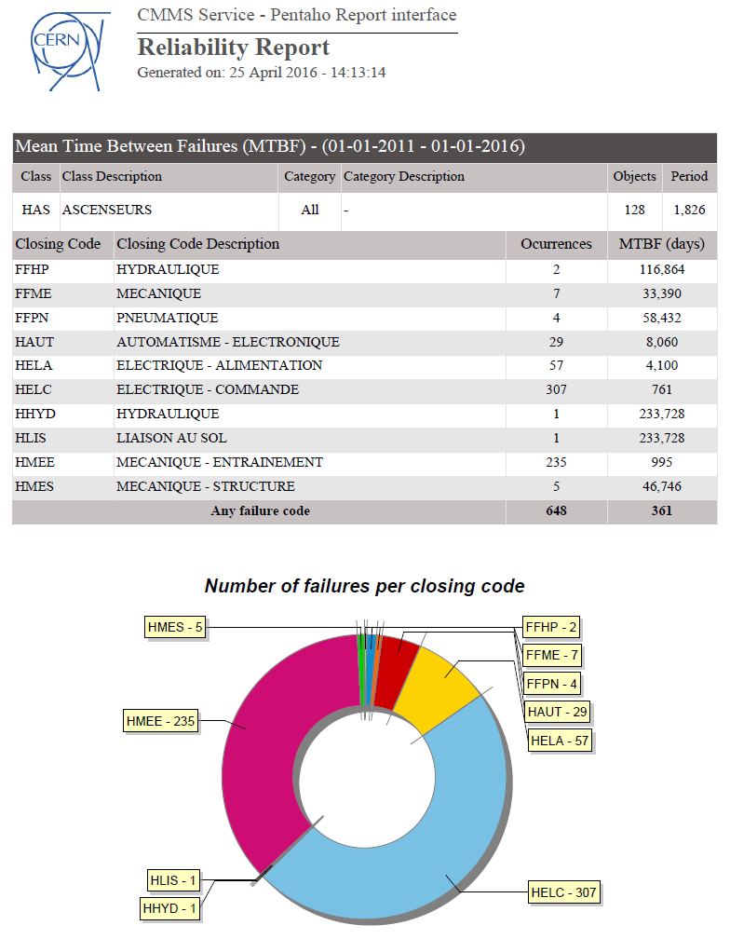
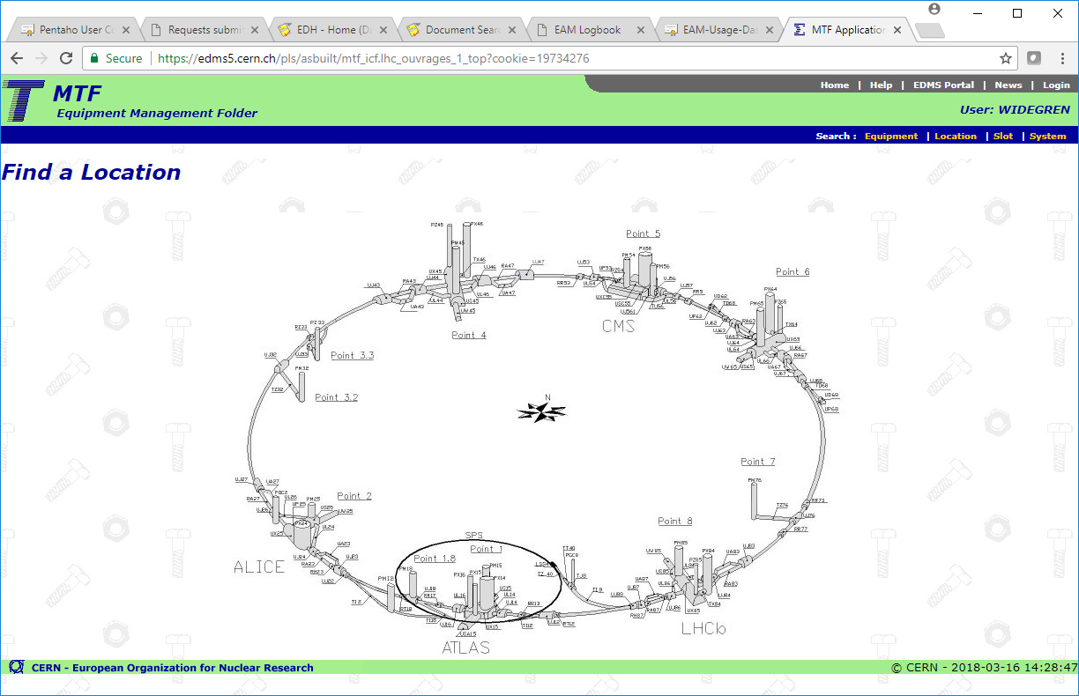

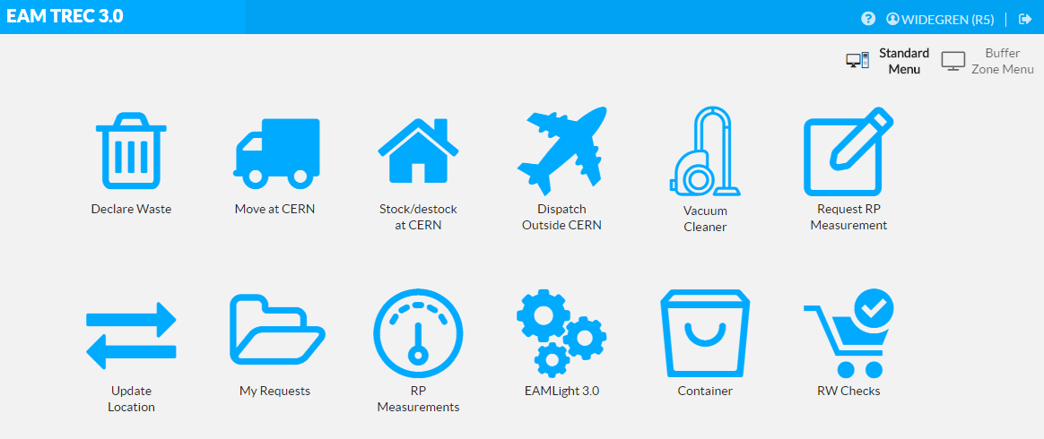
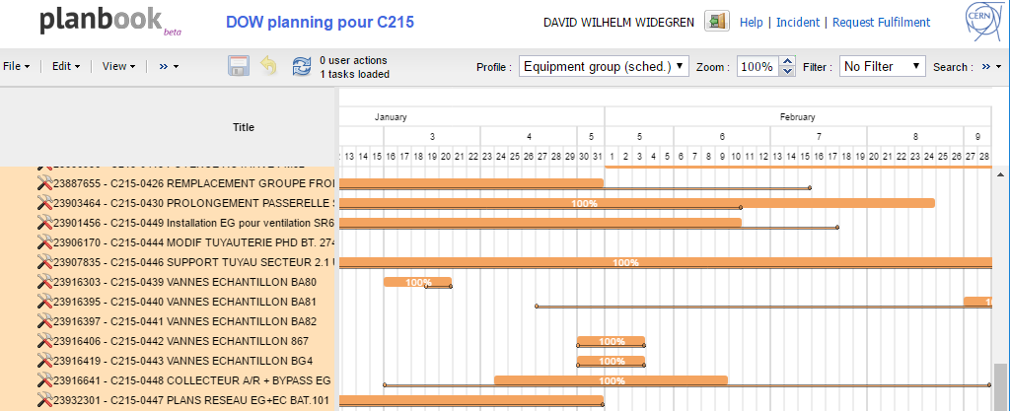

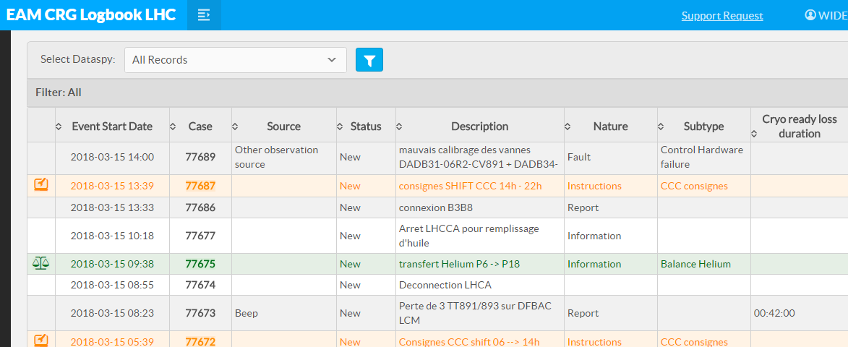
Integrating tools and processes
Control Room & Service Desk
GIS
PLM
SCADA /IIoT
Manufacturing
Reporting / BI
Commissioning
Radioactive Waste
Planning
ERP(s)
Operation Logbooks
Contractor’s CMMS
Accelerator Layout /
Configuration Management
Access / Permit Management

Slide 13
Infor EAM at CERN: In numbers
2.4 M Equipment
>200 k Work Orders / year
5000 Check List Items / day
92 k Part References
1 M Attached Documents
2800 Users

Slide 14
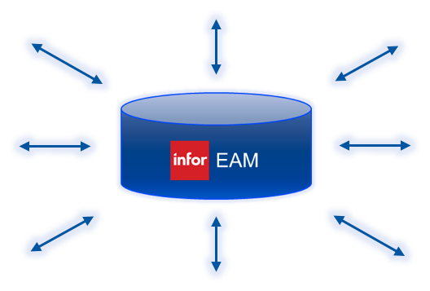
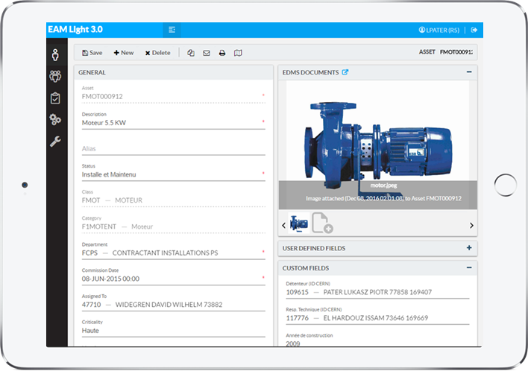
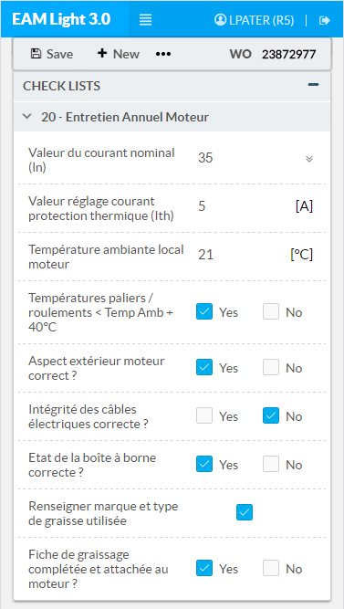
Two of our keys to success
Integrating with other tools
Simplified user interfaces for specific tasks
Using CERN’s EAM Web Services Hub
Using CERN’s EAM Light toolkit.
Now available as Open Source components for Infor EAM!

Slide 15
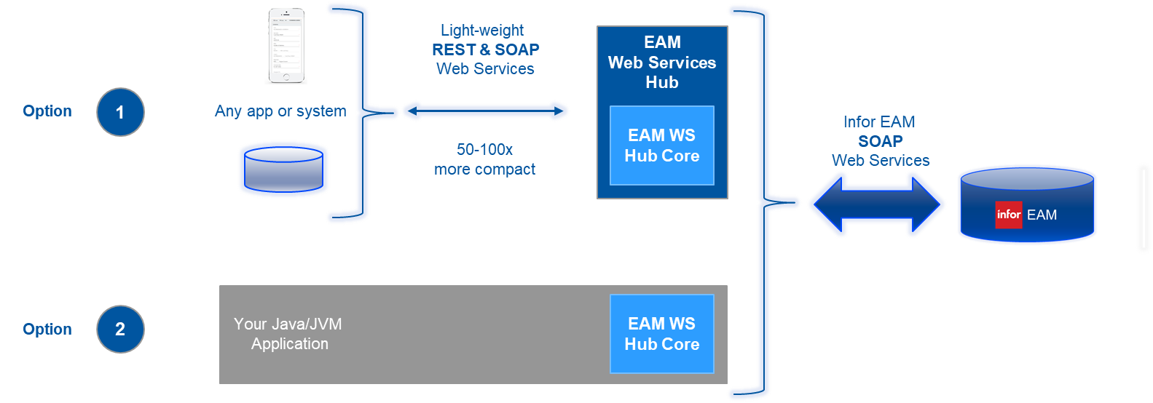
CERN’s EAM Web Service Hub
CERN’s EAM Web Services Hub solves this by providing a simple, developer-friendly and light-weight web services front-end to Infor EAM Web Services.
Allows developers and system integrators to focus on what they want to do. Not on the how.

Slide 16
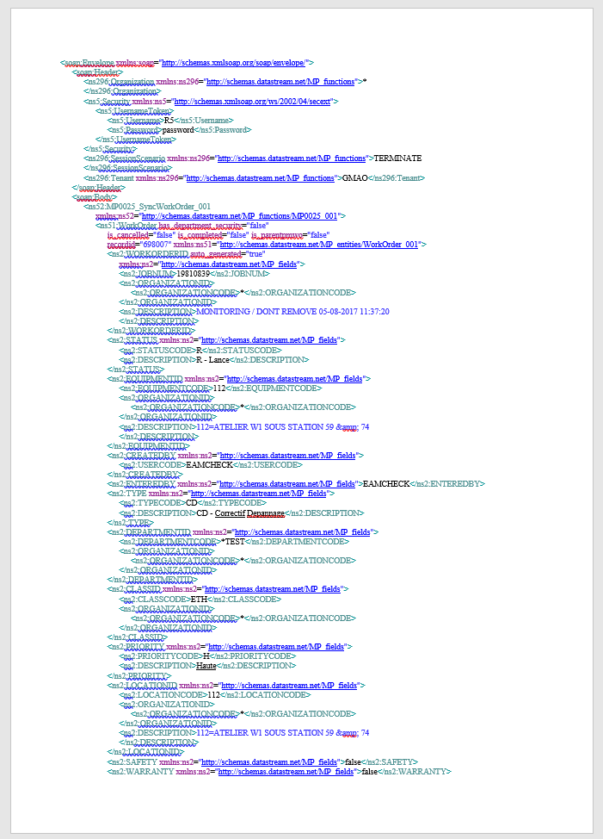
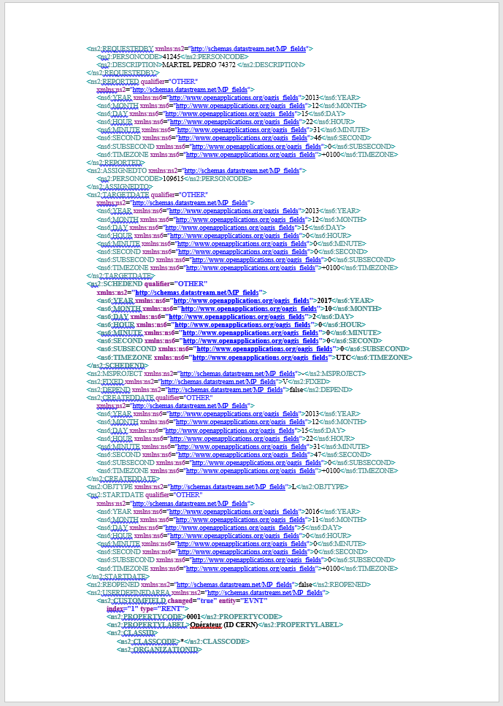
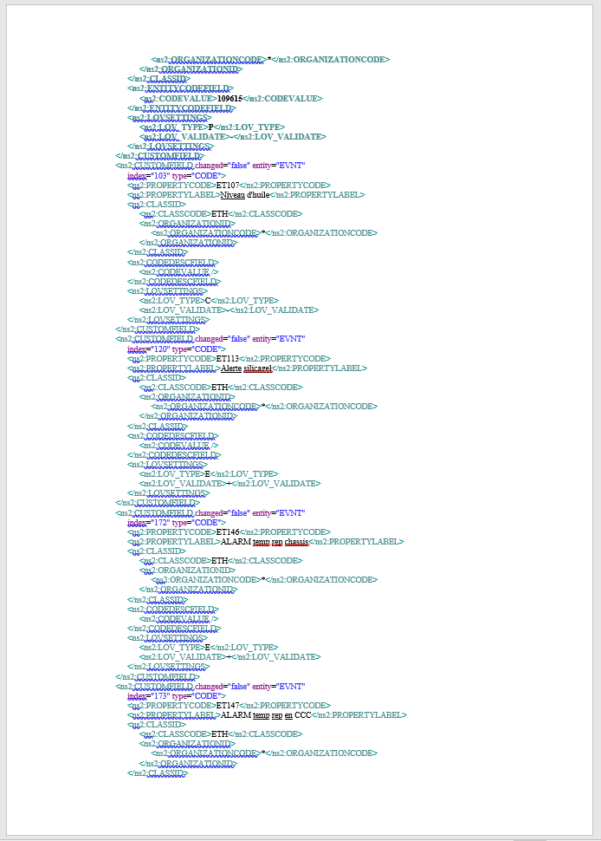
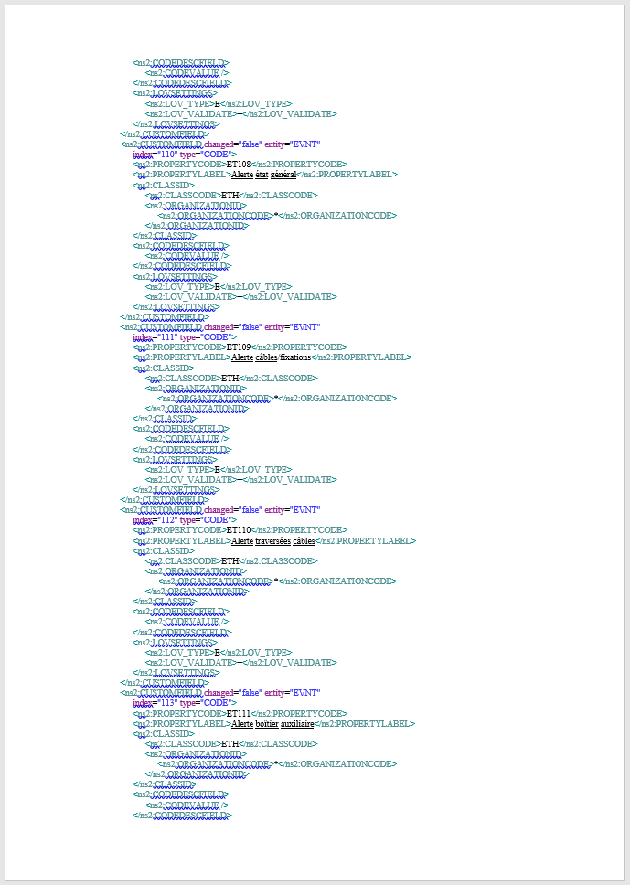
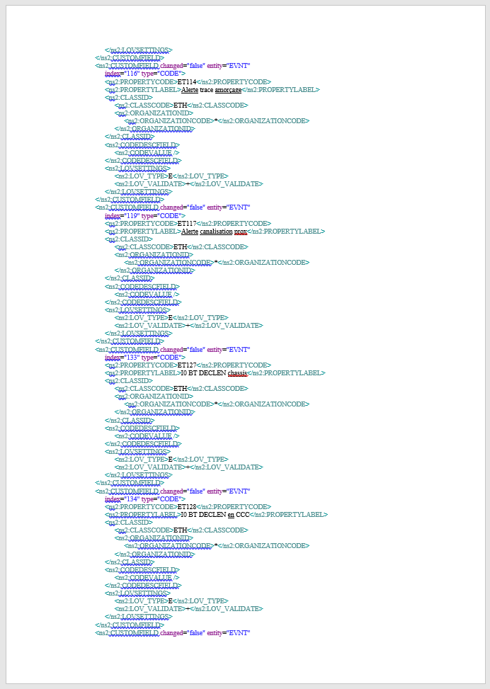
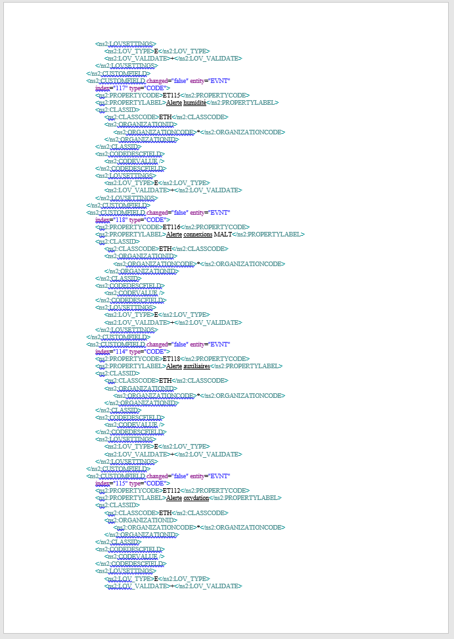
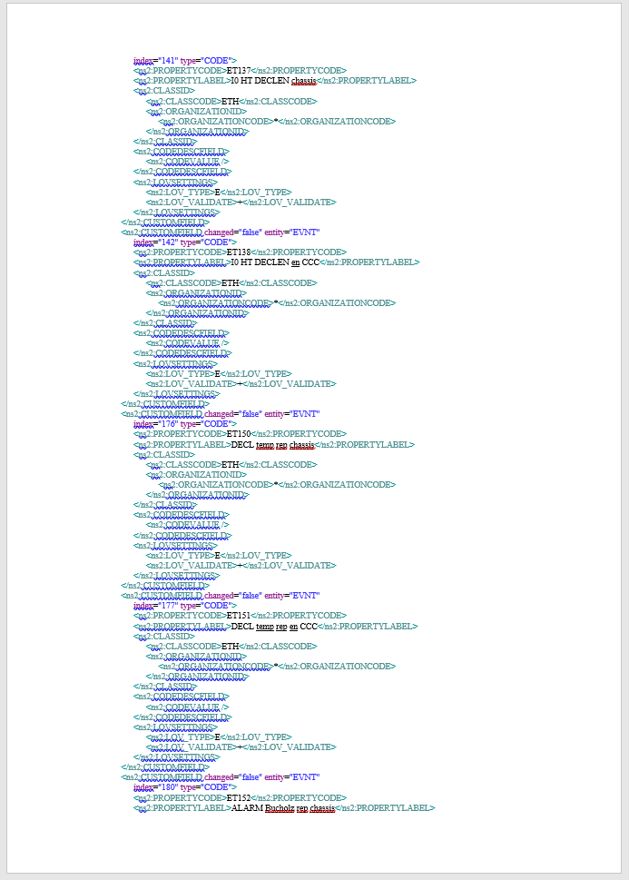
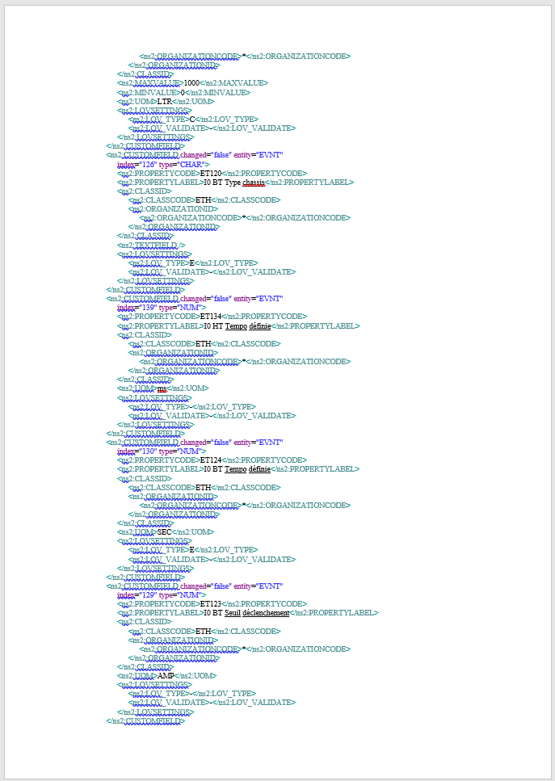
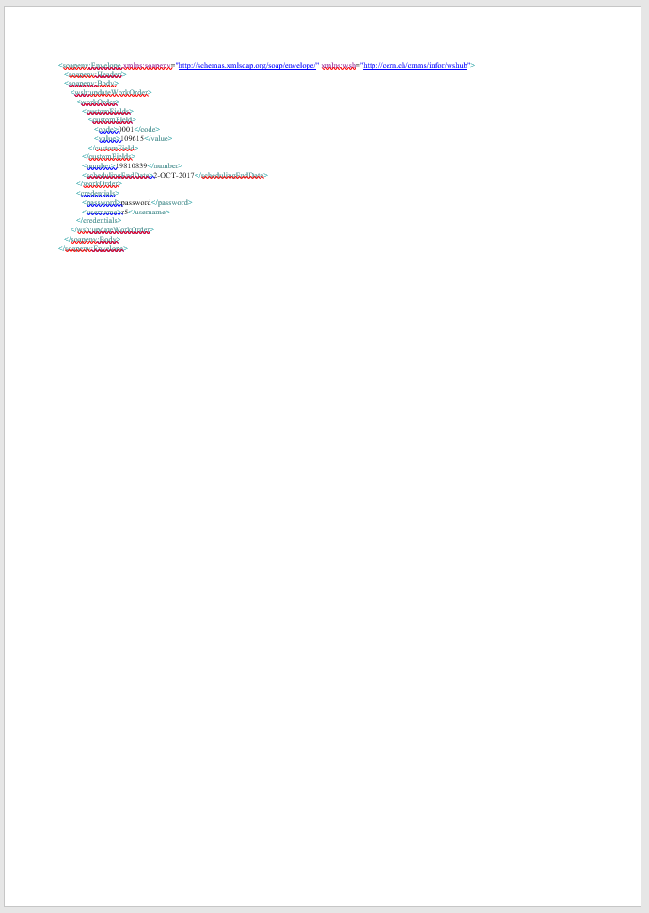
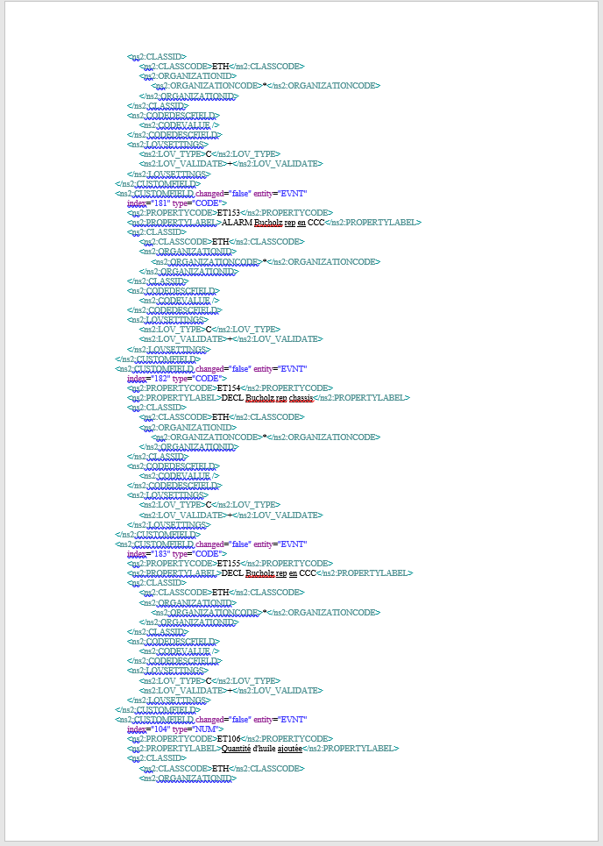
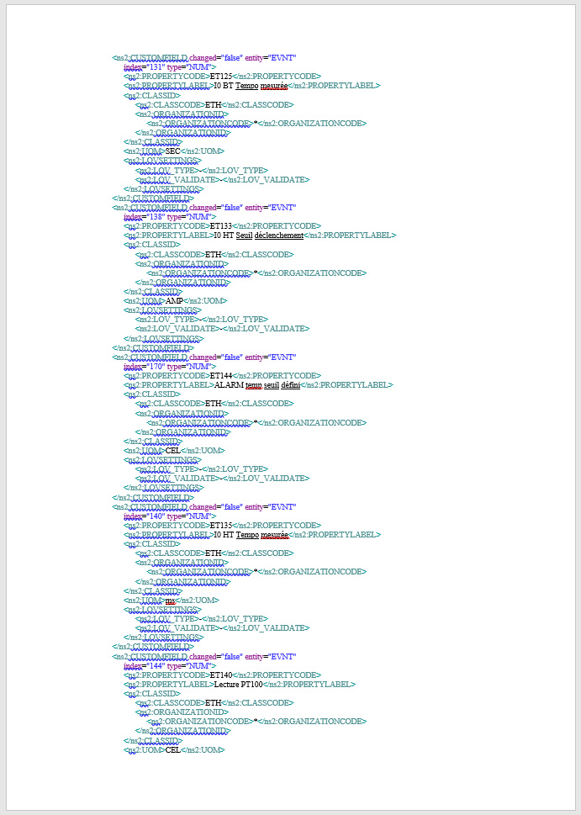
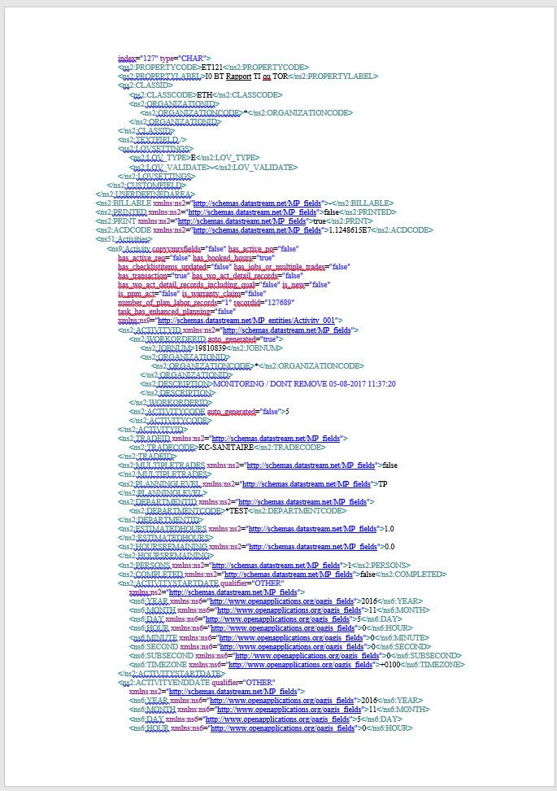
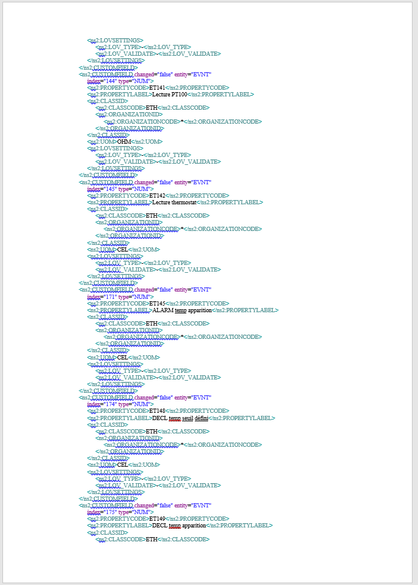
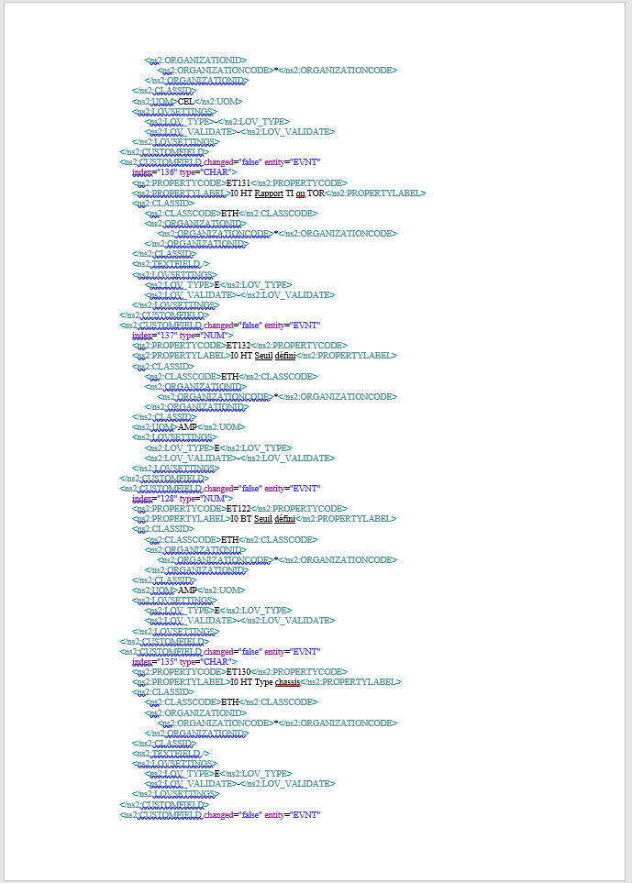
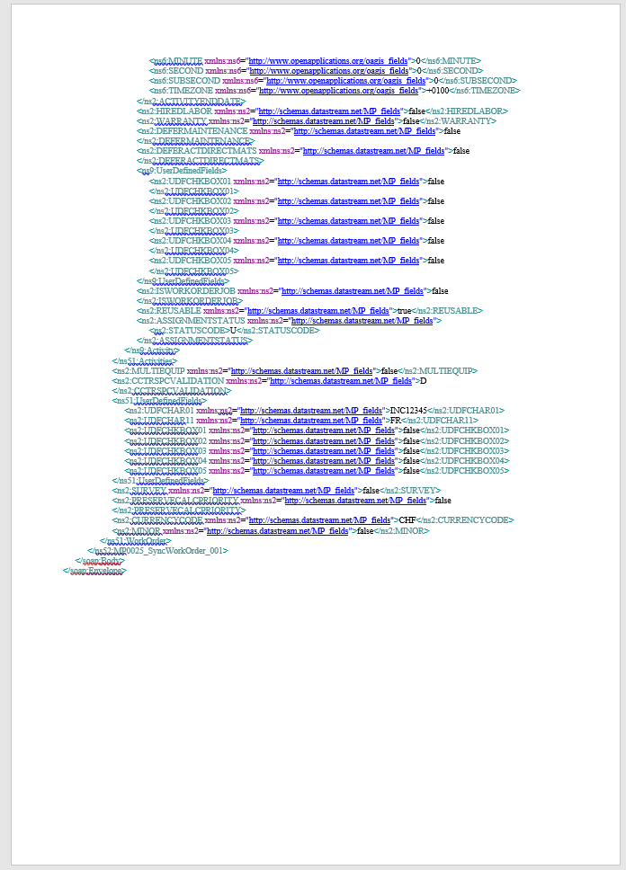
EAM WS Hub: Compact & Fast
CERN’s EAM WS Hub
496 characters XML code
Infor EAM Web Services
35.112 characters XML code
Example: Update of Scheduled End date & a single Custom Field for a Work Order.
Web service call reduced with a factor of 70!
- Easier to develop
- Faster to execute

Slide 17

EAM WS Hub: Simplified
Example:
Update of a Scheduled End Date for a Work Order in Infor EAM:
CERN WS Hub
<SchedEndDate>2-OCT-2017</SchedEndDate>
<ns2:SCHEDEND qualifier="OTHER"
xmlns:ns2="http://schemas.datastream.net/MP_fields">
<ns6:YEAR xmlns:ns6="http://www.openapplications.org/oagis_fields">2017</ns6:YEAR>
<ns6:MONTH xmlns:ns6="http://www.openapplications.org/oagis_fields">10</ns6:MONTH>
<ns6:DAY xmlns:ns6="http://www.openapplications.org/oagis_fields">2</ns6:DAY>
<ns6:HOUR xmlns:ns6="http://www.openapplications.org/oagis_fields">0</ns6:HOUR>
<ns6:MINUTE xmlns:ns6="http://www.openapplications.org/oagis_fields">0</ns6:MINUTE>
<ns6:SECOND xmlns:ns6="http://www.openapplications.org/oagis_fields">0</ns6:SECOND>
<ns6:SUBSECOND xmlns:ns6="http://www.openapplications.org/oagis_fields">0</ns6:SUBSECOND>
<ns6:TIMEZONE xmlns:ns6="http://www.openapplications.org/oagis_fields">UTC</ns6:TIMEZONE>
</ns2:SCHEDEND>
Infor EAM
Web Services

Slide 18




Different profiles - Different needs
Infor EAM
Full / Expert Web Interface
Infor EAM Mobile
Offline/Online Mobile Application
EAM Light
Simplified / Limited Web Interface
  “One size fits all” does not work for users with significantly different needs.
  Simple, configurable and task-targeted user interfaces increase overall efficiency.

Slide 19

Capable Tools – Simple User Interfaces
“If you can't explain it simply,
you don't understand it well enough.”

Slide 20

The need for EAM Light
Infor EAM is a great application packed with functionality and industry best practice.
However not all users need all that functionality - especially not all the time.
EAM Light is a web application that provides a limited sub-set of the most commonly used functions.
The responsive design allows it to be used on both mobile devices as well as desktops.
The purpose is to provide a simple and intuitive tool that can be used with little or no training.

Slide 21


About EAM Light
EAM Light is a complement to Infor EAM.
Experience shows that many users start with EAM Light and continues, once more advanced, with Infor EAM.
EAM Light lowers the initial effort to learn a new tool and has proven to also boost the usage of Infor EAM.
An Infor EAM or Infor EAM connector license is required to use the application.

Slide 22

Available anywhere on any device
The responsive design makes EAM Light efficient to work with on any device with a web browser.

Slide 23
EAM Light: Overview & Navigation

Slide 24

Start Page
A single Google-like search for Equipment, Parts and Work Orders.
No need to know the equipment type in advance.
The search will automatically jump to the corresponding Asset, Position or System screen.
If the user have no access to the main screen, he will automatically be redirected to the clone where he has access.
More advanced searches can be done in the corresponding grid.

Slide 25

Start Page
Gives instant feedback with autocomplete inputting search criteria by hand.
Allows barcode scanning using camera on device or external Bluetooth/cabled scanner.

Slide 26





EAM Light : Menus
Open Work Orders assigned to me.
Open Work Orders assigned to my Department(s).
Work Order menu
Equipment menu
Materials menu
Quick Search

Slide 27

EAM Light : Navigation
Copy/Clone
Send email link
Show on Map
Create new Work Order
Open page in Infor EAM

Slide 28


Easy navigation in structures
Show/Hide Equipment Structure
Show/Hide Main Menu

Slide 29




Examples of main screens
Work Orders
Positions
Assets
Parts
And more…!

Slide 30


Grids with Dataspies & Filters

Slide 31
EAM Light: UI & Navigation
User Interface
Access rights, screen designer settings and alternative language/boiler texts are supported.
Cloned screens & User Defined Fields supported.
Autocomplete functionality wherever suitable
Responsive web design providing full functionality in mobile mode (also on Smartphones).
Navigation & Searching
Quick access to My Work Orders as well as My Teams’ (Departments) Work Orders
Infor EAM dataspies and additional ad-hoc filtering in grids always available from main menu.
Quick search for Equipment, Parts & WOs. Also operating on fields such as alias & serial number.
And more!

Slide 32
EAM Light: Work Orders

Slide 33
Work Order Functionality
Work Orders
Possible to view, create, update and delete WOs.
Both Requested and Scheduled dates supported.
Support for Closing Codes & Closing Comments
Checklists Supported (except new checklist items introduced in 11.4)
Custom Fields and UDFs supported.
Possible to create activities, book labor and issue parts.
Possible to enter Meter readings (if associated).
Possible to navigate to Equipment or to Child Work Orders
And more…

Slide 34


Work Orders

Slide 35



Booking Hours

Slide 36

Adding Activity

Slide 37

Checklists
All types of checklist items supported.
Possibility to enter notes.
Checklists items grouped by activities and/or equipment
(for route work orders).
Available on desktops, laptops, tablets and smartphones.
Can be used both in landscape and portrait mode.
Entered results are automatically pushed to server in order to avoid data loss. (Especially important for long checklists.)

Slide 38


Checklists on tablets…

Slide 39


EAM Light Checklists in action….

Slide 40



Issue Part directly from WO
Easy to indicate Part usage directly from Work Order.
Possible to Issue/Return Parts or Parts tracked by Asset.
Scanning can be done with camera on device.

Slide 41

Work Orders - Demo
Link

Slide 42
EAM Light: Meter Readings

Slide 43

Meter reading from WO

Slide 44

Add-hoc meter reading:
Meter readings:
By scanning Meter code or
By scanning Equipment identifier

Slide 45
EAM Light:
Assets, Positions & Systems

Slide 46

Equipment screens
Assets, Positions and Systems

Slide 47
EAM Light: Parts

Slide 48

Example use case:
Accessing Part information:
Available quantity in stock
Technical information

Slide 49
EAM Light:
Equipment Replacement

Slide 50



Example: Card replacements

Slide 51
EAM Light: Configuration

Slide 52

Easy configurable
Leveraging the power of Screen Designer functionality in Infor EAM!
Text labels can be changed.
Required / Protected / Hidden options supported.
Default values available.
Possible to hide whole regions
As EAM Light supports cloned screens, this open even more possibilities.

Slide 53
Easy URLs to Asset, WOs, Parts, etc…
URLs to any page in EAM Light can be bookmarked, emailed, computed and included in other applications or reports.
Some examples:
Asset: https://cmmsx.cern.ch/SSO/eamlight/asset/PX113601
Position: https://cmmsx.cern.ch/SSO/eamlight/position/UACV1-00083
Work Order: https://cmmsx.cern.ch/SSO/eamlight/workorder/368651
Part: https://cmmsx.cern.ch/SSO/eamlight/part/F834041626

Slide 54


Quick access to functions with URLs
EAM Light pages can be opened using URLs.
Examples:
- Equipment replacement: https://cmmsx.cern.ch/SSO/eamlight/replaceeqp
- Meter readings: https://cmmsx.cern.ch/SSO/eamlight/meterreading
Bookmark these as favorites or create shortcuts
from your desktop, tablet or phone – and you have
basically created a dedicated “app”!
App
App

Slide 55
Integrate with other applications
EAM Light pages can be opened using URLs and also combined with input parameters.
Create Work Order for a specific Asset: https://cmmsx.cern.ch/SSO/eamlight/workorder?&equipmentcode=HCLBAR_000-CR003009
Create a Work Order based on a Standard Work Order:
https://cmmsx.cern.ch/SSO/eamlight/workorder?&standardwo=MM-REQ-SCM01
Such links could for example be used
as buttons/links from other applications.
Create Repair WO

Slide 56

QR Codes for Quick WO Creation
Or to create a Work for the a specifc Asset based on a Standard Work Order:
https://cmmsx.cern.ch/SSO/eamlight/workorder?&equipmentcode=HCLBAR_000-CR003009 &standardwo=MM-REQ-SCM01
And why not generating a QR code label and stick it on to the Asset?
Scanning such a QR code could allow creation of a;
Repair Work Order for the asset
Ad-hoc Checklist Work Order for the asset
Or anything else you might think of….

Slide 57


QR Code examples from CERN
Gas bottle delivery, tracing and inspections are managed with EAM.
This are barcodes available at gas bottle delivery points.
All fields are prefilled except Asset code, which is scanned.

Slide 58


QR Code examples from CERN

Slide 59
Support for cloned screens
Example opening a cloned* Work Order screen to create a WO based on a Standard Work Order:
https://cmmsx.cern.ch/SSO/eamlight/workorder?&standardwo=MM-REQ-SCM01&screen=WSJB29
This can be bookmarked or used to create as a link/button from another application.
*A cloned screen is a copy of a standard Infor EAM screen that the can be modified or simplified.

Slide 60
Demo: “Mobile Checklist App”
Imagine you would like to create a simple Checklist app for your technicians to be used on their smartphones.
Steps:
  Create a specific user group with limited access to the standard Work Order screen (or create a dedicated cloned Work Order screen)
  Modify and remove everything you don’t want to see on the screen for this particular user group.
  Compose and distribute the URL to the technicians.
Congratulations, you have just created a mobile checklist app!

Slide 61
EAM Light Configuration Summary
Highly configurable
Leverages Infor EAM’s powerful configuration possibilities.
If this is not enough, you also have access to the source code.
Web links, shortcuts and QR codes can be parametrized.
Flexible deployment
Fully online with no sync problems.
No client installation.
System configurations are available instantly.
Works on basically all devices with a web browser.

Slide 62
EAM Light: Other applications

Slide 63

EAM Light applications at CERN

Slide 64
How to download & install?

Slide 65


Where to download the software?
Both tools are available on GitHub with instructions for system administrator how to install.
https://github.com/cern-eam/

Slide 66
How to install the software?
Both tools are available as pre-compiled Docker images.
Can be installed with a single command line on any server with Docker installed.
  Example:
To modify the software, you need to download the Java source code and compile it yourself.
EAM Web Services Hub can be used on:
A Cloud or On-Premise installation.
An Oracle or SQL Server installation.
Any server Operation System supporting Docker.
EAM Light can be used on:
A Cloud* or On-Premise installation
An Oracle or SQL Server installation.
Any server Operation System supporting Docker.

Slide 67
Licenses
All modules of CERN’s Open Source Software are published under GNU GPL v3 License.
Please contact us for potential dual licensing if this license type is not meeting your needs!
Email: eam-service@cern.ch

Slide 68



More information about the tools
A dedicated web site with more information and presentations is also available.
https://cern.ch/eam-opensource

Slide 69
EAM Web Services Hub and EAM Light – Technical Overview
David Widegren & Lukasz Pater
CERN, Asset & Maintenance Management
June 2019

Slide 70
Agenda
EAM Web Services Hub
Docker
EAM Light
  Frontend Setup
  Backend Setup
  Production Setup
  Future Developments
A lot of demos ☺

Slide 71
EAM WS Hub / Overall architecture
EAM WS Hub
Dockerized Java EE web application providing REST and SOAP Web Services façade to Infor EAM
EAM WS Hub Core
Java library that provides all core functionalities of EAM WS Hub used by EAM WSHub
EAM WS Hub
EAM WS Hub Core

Slide 72
Docker
Provides a uniformed wrapper around a software package
«Build, Ship and Run Any App, Anywhere»
Similar to shipping containers: The container is always the same, regardless of the contents and thus fits on all trucks, cranes, ships, ...

Slide 73
EAM WS Hub / Setup
Create the .env file
  INFOR_WS_URL=https://infor/axis/services/EWSConnector
  INFOR_TENANT=GMAO
Run the docker image
  docker run -p 8082:8082 --env-file .env
  cerneam/eam-wshub
WSHUB BACKEND
PORT: 8081

Slide 74
EAM Light / Overall Architecture
EAM Light Frontend
Dockerized ReactJS web application providing the core functionality of Infor EAM Extended
EAM Light Backend
Dockerized Java EE web application providing REST façade for EAM Light Frontend
EAM WSHub Core
Java library that provides all core functionalities of EAM WS Hub used by EAM Light Backend
EAMLIGHT FRONTEND
EAMLIGHT BACKEND
EAM WSHUB CORE

Slide 75
EAM Light Setup
EAMLIGHT BACKEND
PORT: 8081
EAMLIGHT FRONTEND
PORT: 8080

Slide 76
EAM Light / Frontend Setup
Download the sources
  git clone https://github.com/cern-eam/eam-light-frontend.git
Change REACT_APP_BACKEND in the Dockerfile
Build the docker image
  docker build . -t eam-light-frontend
Run the built image
  docker run -p 8080:8080 eam-light-frontend
EAMLIGHT FRONTEND
PORT: 8080

Slide 77
EAM Light / Backend Setup
Create the .env file
  EAMLIGHT_INFOR_WS_URL=https://infor/axis/services/EWSConnector
  EAMLIGHT_INFOR_TENANT=GMAO
  EAMLIGHT_ADMIN_USER=R5
  EAMLIGHT_ADMIN_PASSWORD=
  EAMLIGHT_INFOR_ORGANIZATION=*
Run the docker image
  docker run -p 8081:8081 --env-file .env
  cerneam/eam-light-backend
EAMLIGHT BACKEND
PORT: 8081

Slide 78
EAM Light / Production Setup
EAMLIGHT BACKEND
PORT: 8081
EAMLIGHT PROXY
/apis/rest -> BACKEND:8081
/ … / … -> FRONTEND:8080
EAMLIGHT FRONTEND
PORT: 8080

Slide 79

Status and Future Developments
Detach Meter Readings from DB
Detach Equipment Tree from DB
Detach Equipment Replacement from DB
Fetch Layout Information with the WS
Use Infor Session Authentication(?)
Offline mode(?)

Slide 80
Questions?
If you have questions or feedback later, please contact: eam-service@cern.ch

