Slide 1

Gamma Factory Workshop
A. Martens (LAL) on behalf of
LAL group
w/ help from Sylvie Teulet
w/ support from P2I dept of Université Paris Saclay

Slide 2
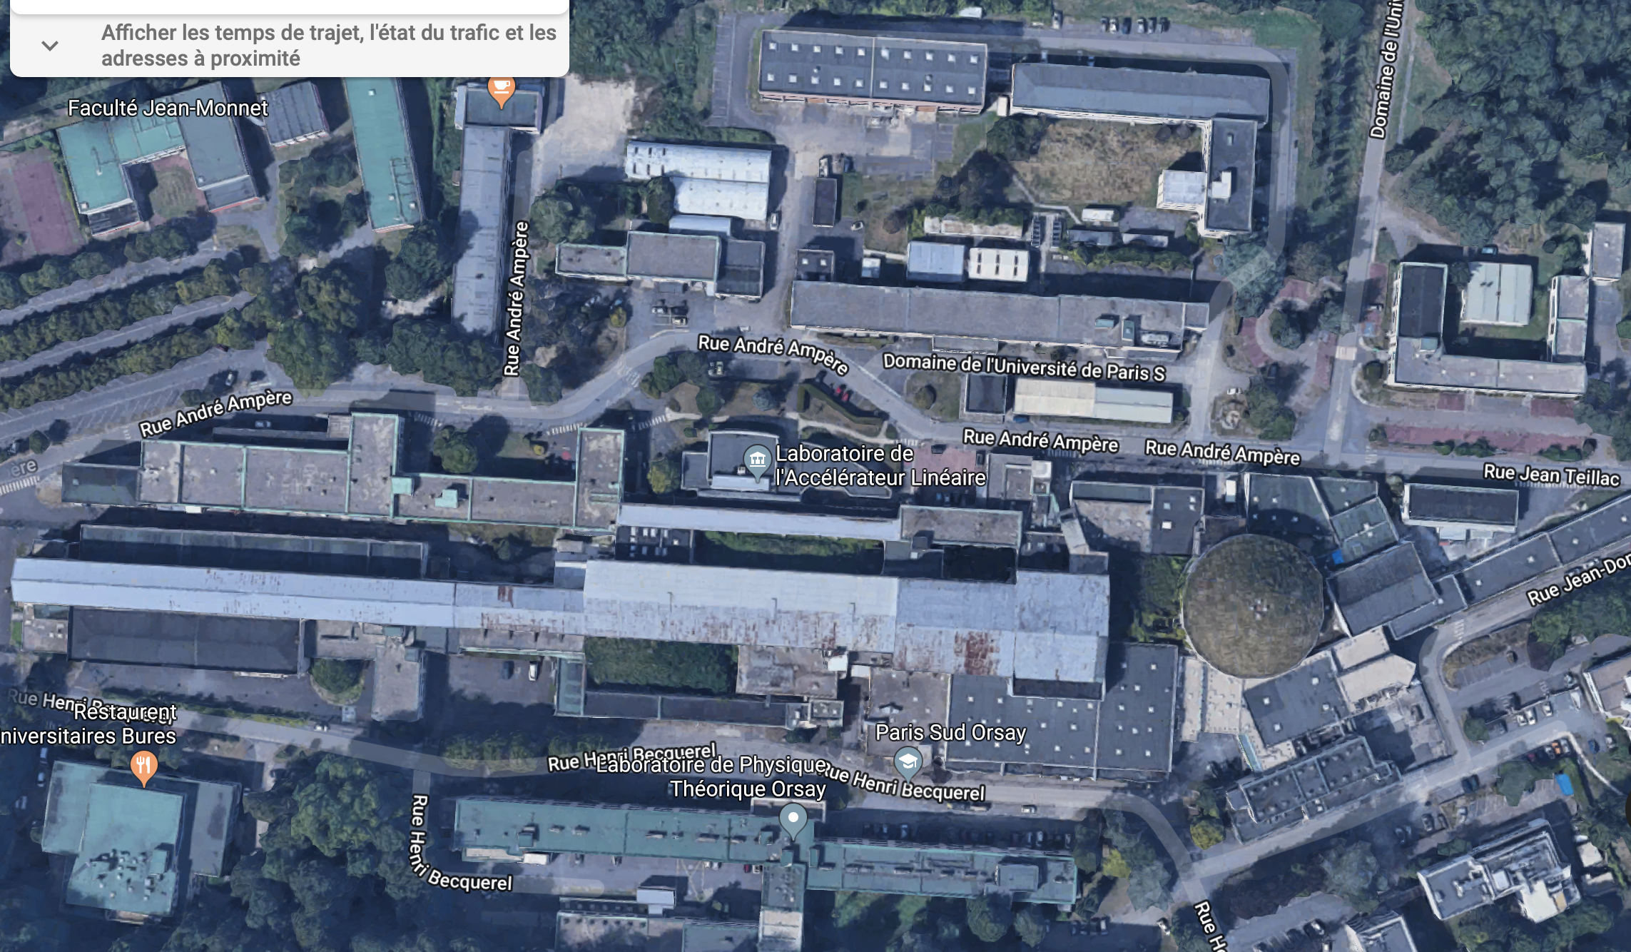
Meeting room + misc
208, meeting room, 1rst floor
Tuesday and Wednesday lunch
ThomX, visit on Wednesday (maybe)

Slide 3
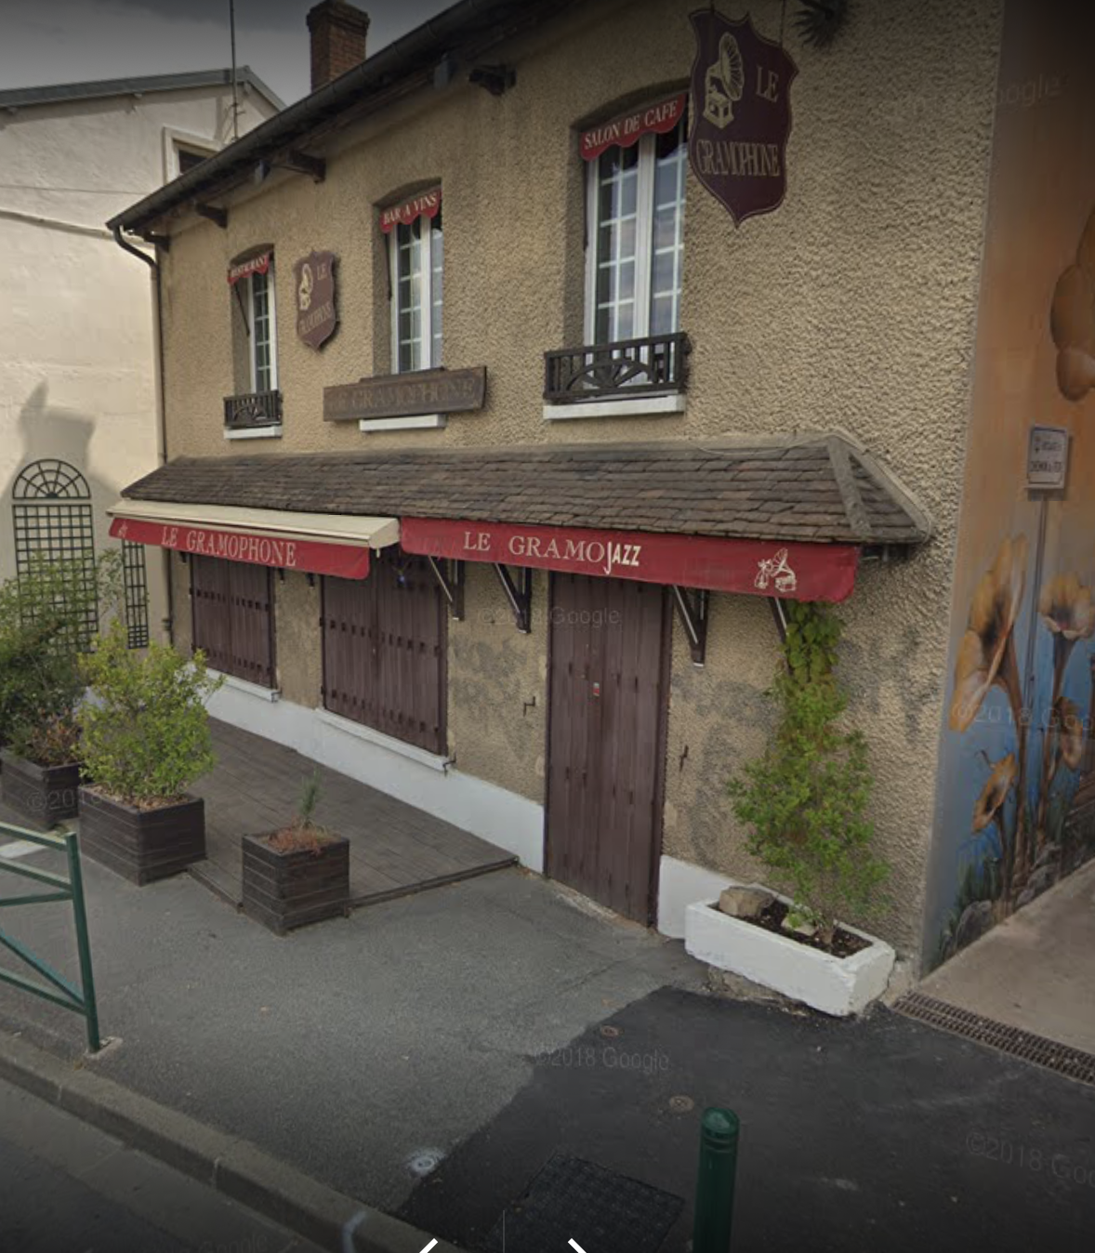
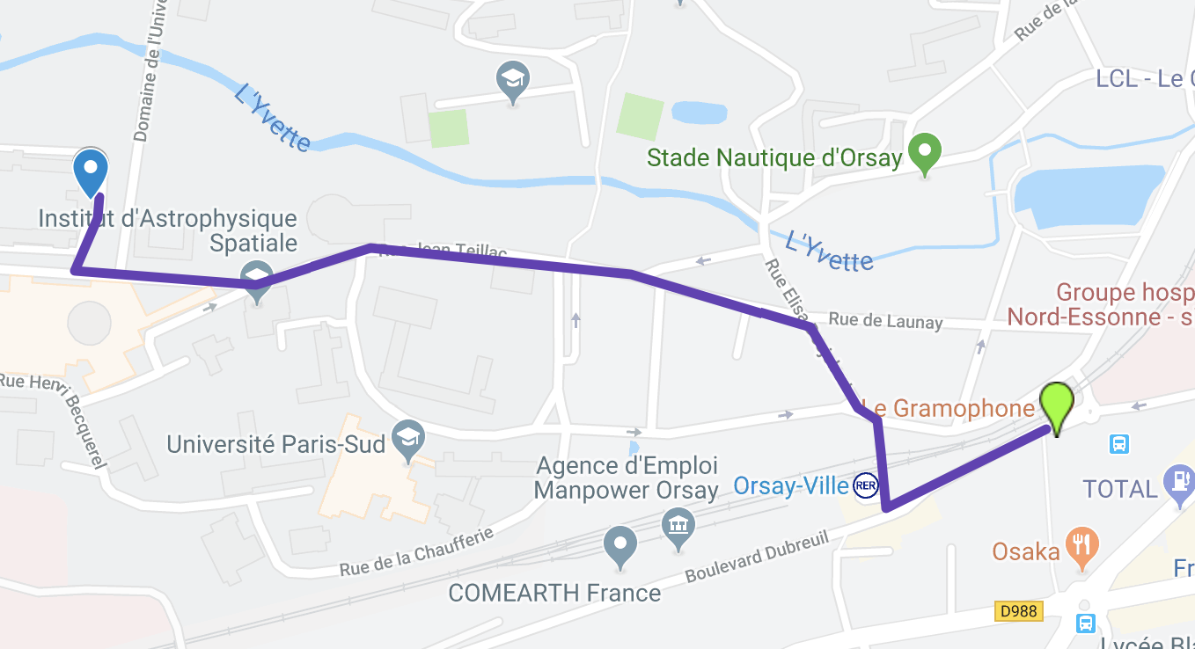
Monday dinner (Gramophone)

Slide 4
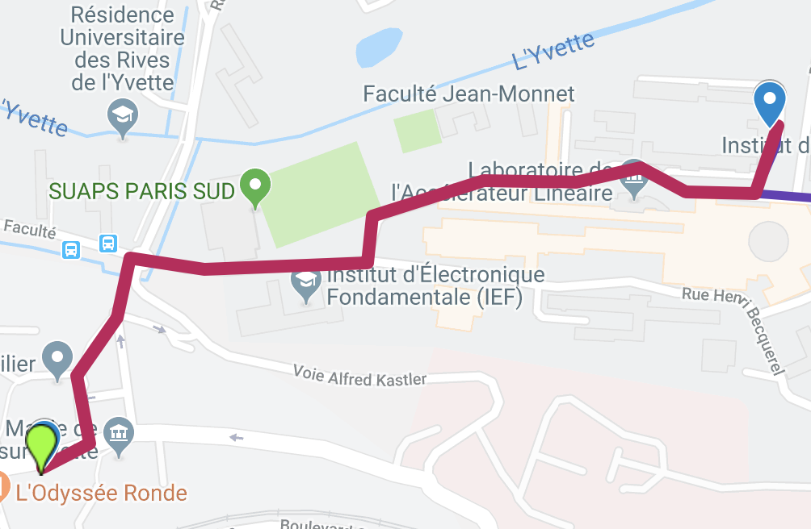
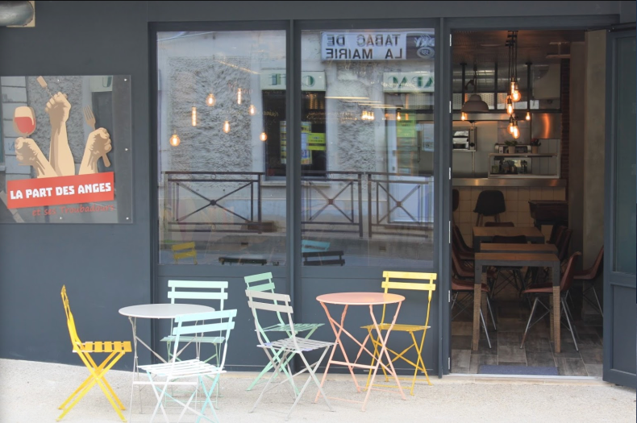
Tuesday dinner (La part des anges)

