Slide 2
LSS621 Layout and apertures
Gamma Factory meeting on the Proof of Principle
LAL, Paris, 3-5 June 2019
Y. Dutheil, B. Goddard, F. Velotti

Slide 3
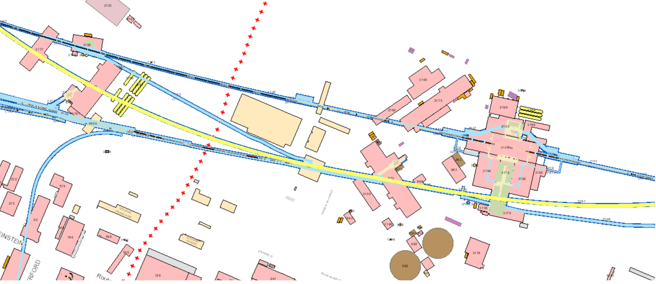
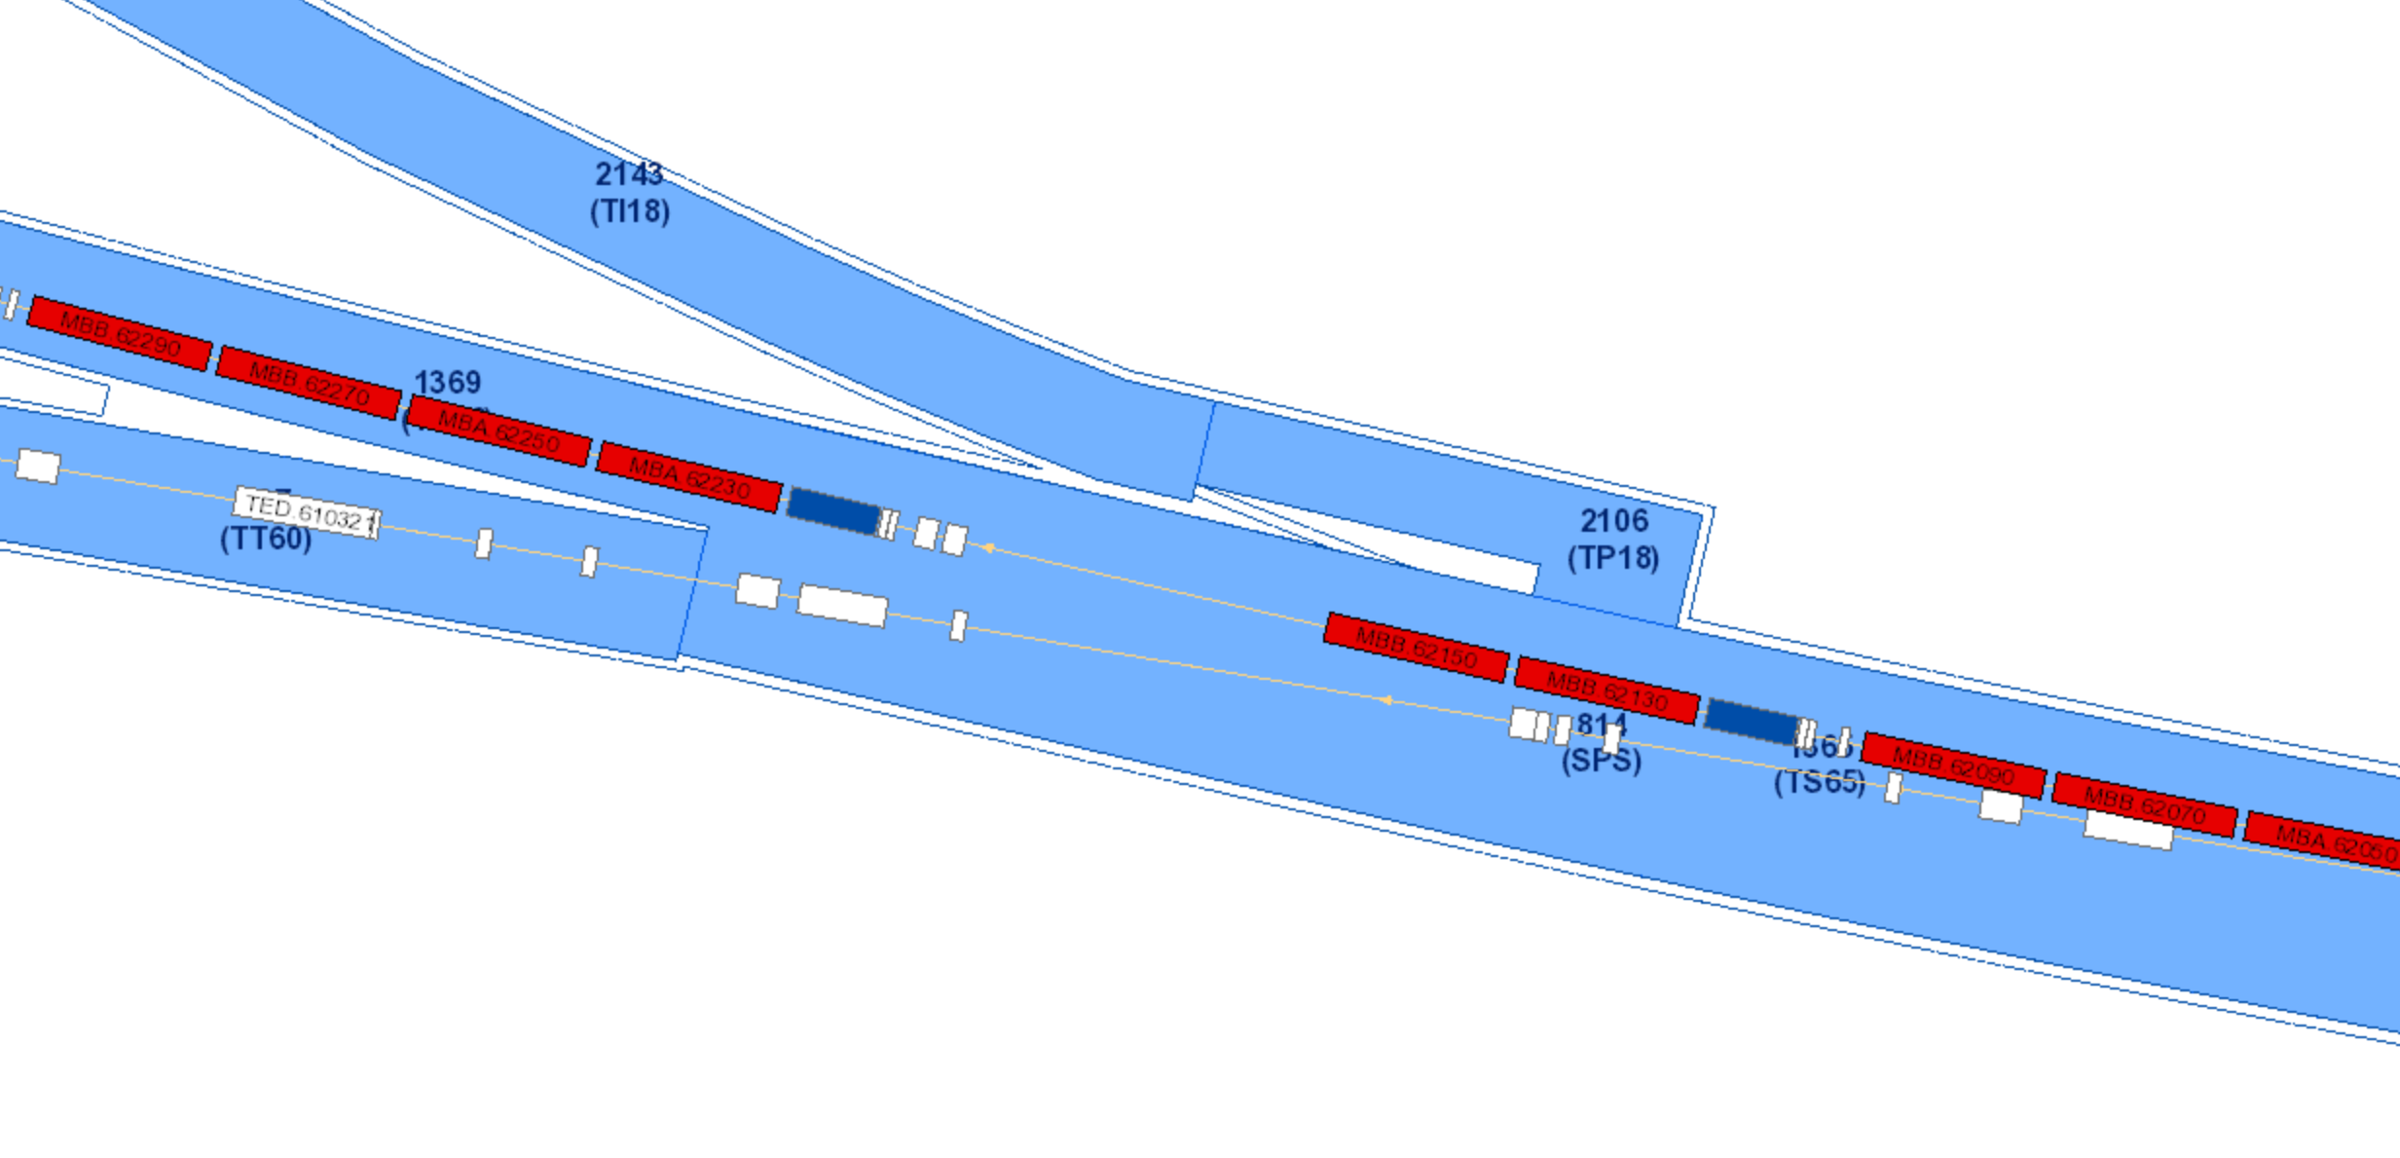
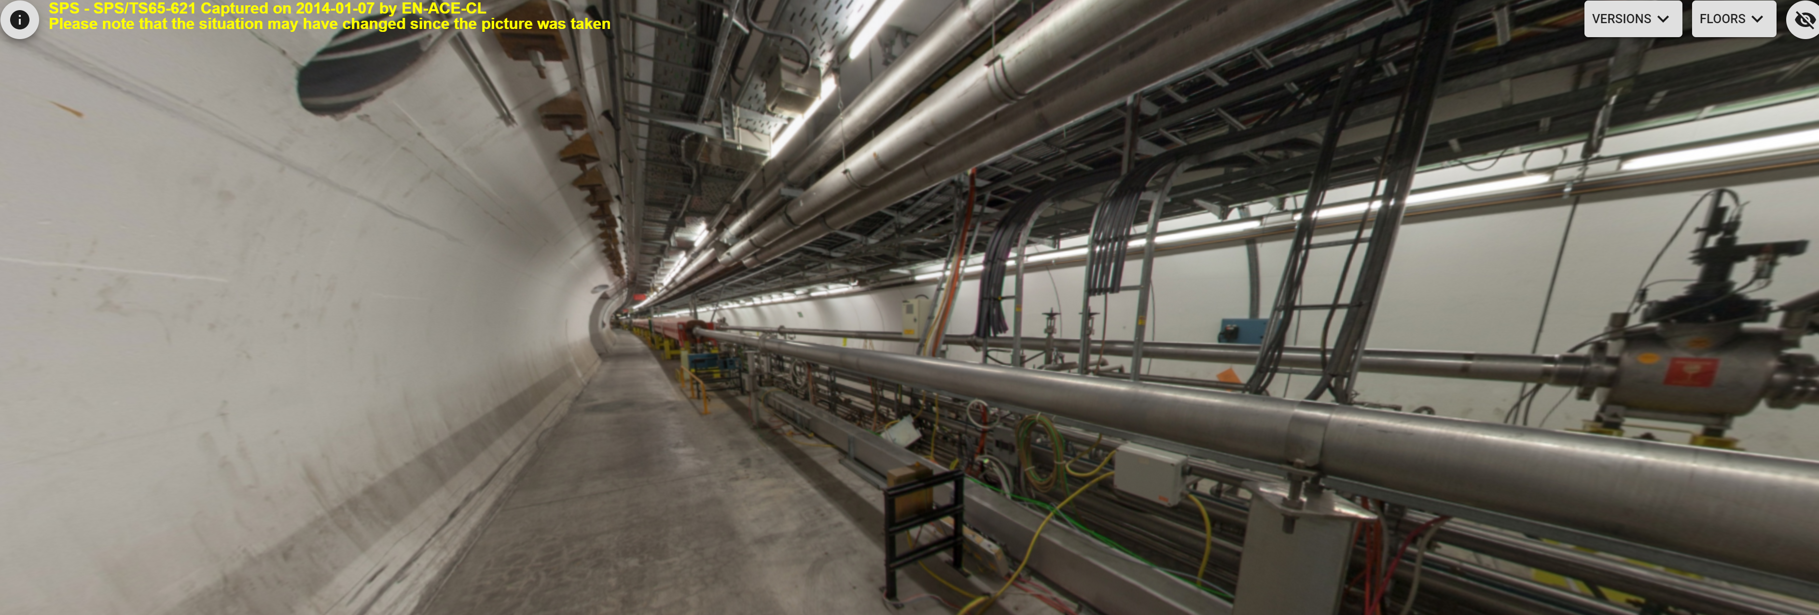
Real space location
LHC ring
ATLAS
SPS ring
Wall penetration
Cavity

Slide 4
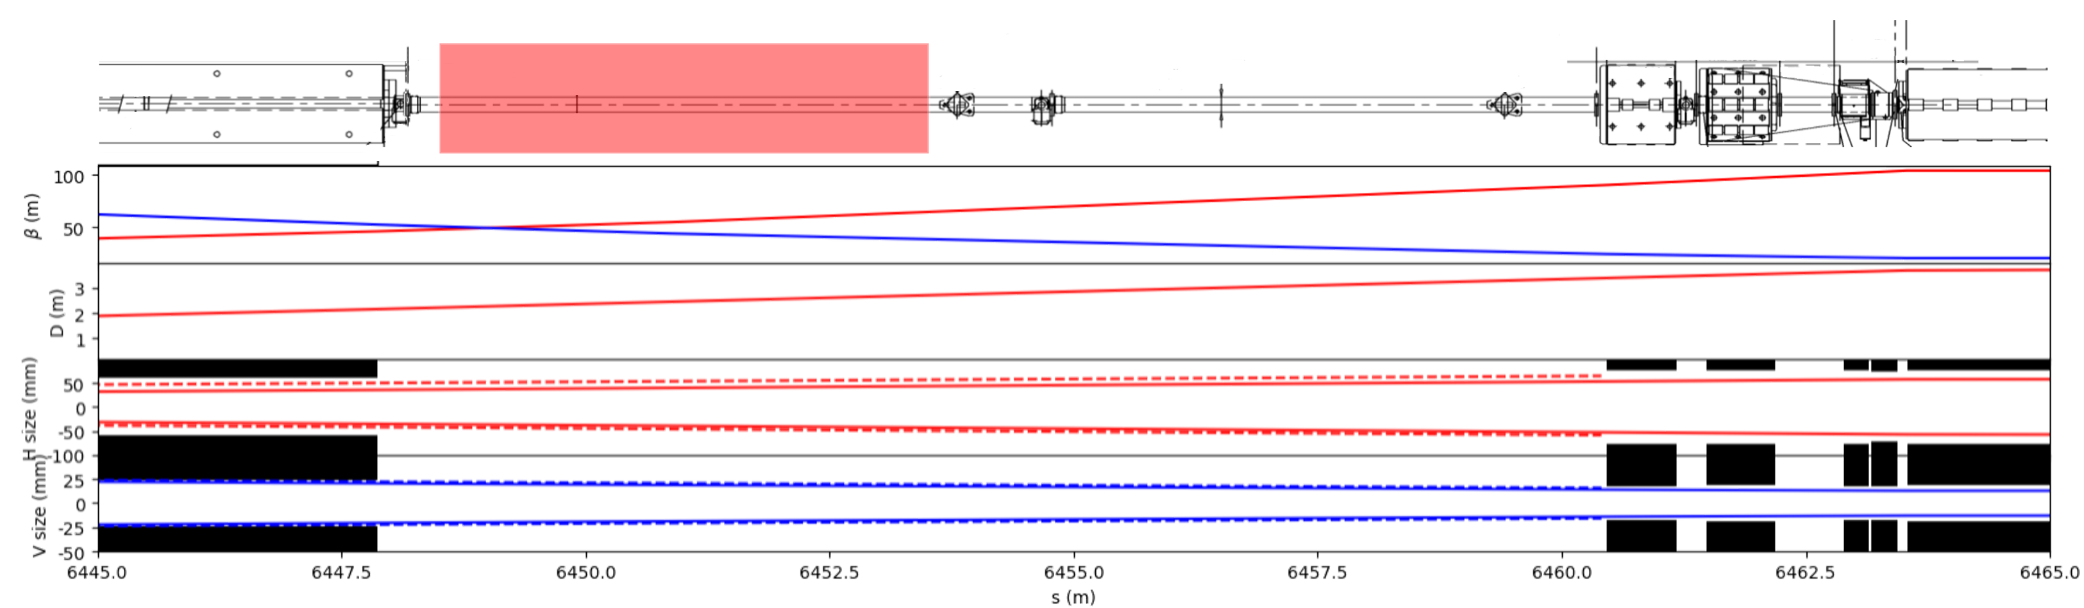
-2
IR
2
4
6
8
s from IR (m)
Cavity shields
Considering detector position 7m downstream the interaction point is conservative.
Possible to go further.
120x50mm
120x50mm
@7m
Forward photon cone
120x50mm
60x25mrad
420x175mm
60x25mrad

Slide 5
-2
IR
2
4
6
8
10
12
s from IR (m)
Forward photon cone
@9m
@11.5m
Detector @11.5 m possible but very little space between stay-clear region and photon cone
120x50mm
60x25mrad
540x175mm
60x225mrad
138x52mm
12x4.5mrad
Dipole corrector @~10m
Octupole @~11m
Magnet apertures
200x45mm
20x4.5mrad
134x134mm
12x12mrad

Slide 6
Conclusion
Detector below the IR is only constrained by the stay clear region (~50x120mm)
Forward detector has other constrains
  Optimal location depends on simulated flux
  A position ~7m downstream from the IR can be considered for now as it leaves some margin if the cavity needs to be moved
  Detectors after the two magnets (dipole corrector MPSH and octupole LOF) may not be relevant due to the limited space between the stay-clear region and the photon cone passing trough those two magnets.

Slide 7
Thank you

