Slide 2
Photon detection concept(s) -
T. Lefevre on behalf on the BI group

Slide 3
Outline
Conclusion from CERN Meeting
Taking into account recent simulations from the new interaction zone
  What changes ?
Can we make a plan of a realistic detection system with the present resources ?
  Consideration on Budget, Schedule, Resources

Slide 4
Diagnostics for GF-OP – Conclusions from March
Beam position monitors around the laser cavity
  Button beam-position monitors (BPMW) are installed on either side of the laser cavity using the CERN DOROS acquisition system providing orbit data (integrated over 1ms) with micron resolution
Challenging monitors
  Need a replacement chamber for Photon X-ray monitor
  Challenging visible light monitor
    Very few photons
    If doable (depending on background light) it will require a high sensitivity (and expensive) camera and integration time of several seconds
  At least two possible technology choices for X-ray monitor
    Scintillation or Pixel detector ?
    Going to more realistic detector study (simulations of realistic design size /shape, including background from beam losses in BDsim?)

Slide 5
Recent simulations from Camilla’talk
Beam imaging system using emitted photons in visible range
These are the photons hitting the detection plane !

Slide 6
Recent simulations from Camilla’talk
Beam imaging system using emitted photons in visible range
Camera
lens
viewport
PSI
laser
Only a fraction of those photons will be detected by the camera
Maybe one or two photons per bunch crossing !

Slide 7
Recent simulations from Camilla’talk
Beam imaging system using emitted photons in visible range
  SR background for ions expected to be negligible in the visible range
  Suppressing Background light at the level of few photons per turn is challenging
    Requiring a perfect light tight detection system
  Background will also come from the laser photons – this limitation should be removed using laser notch filter
My personal feeling is that this is quite challenging
A viewport can be foreseen on the laser cavity vacuum chamber to investigate background light
But I would not count on this detector to tune the experiment

Slide 8
X-ray photon from Camilla’s talk

Slide 9
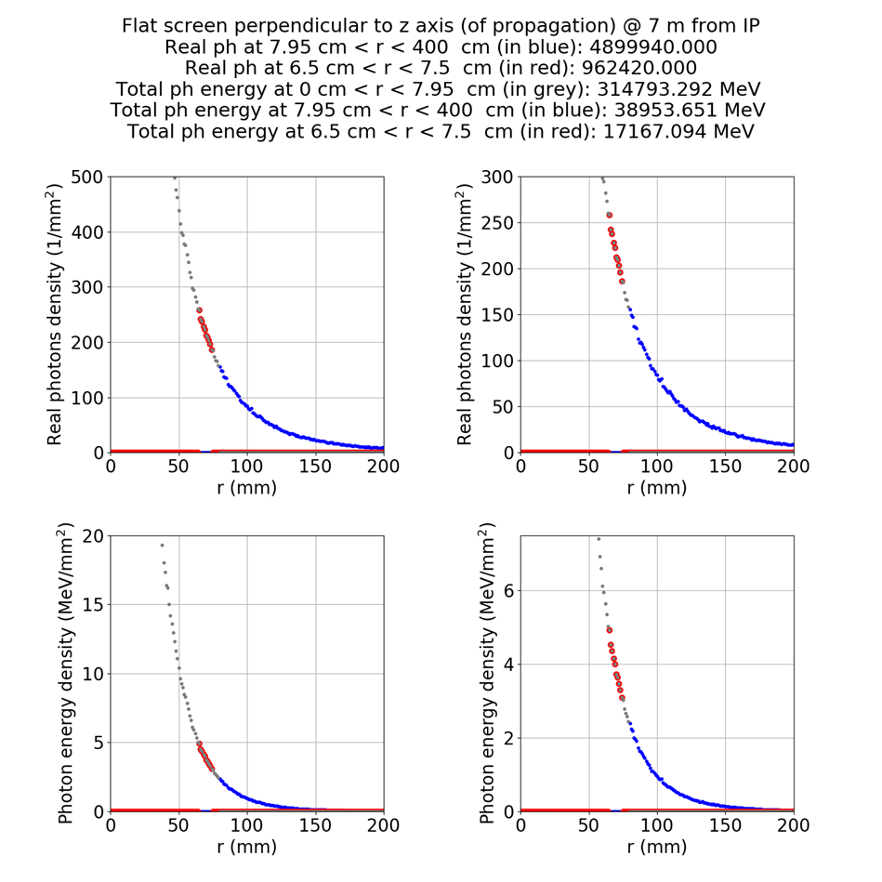
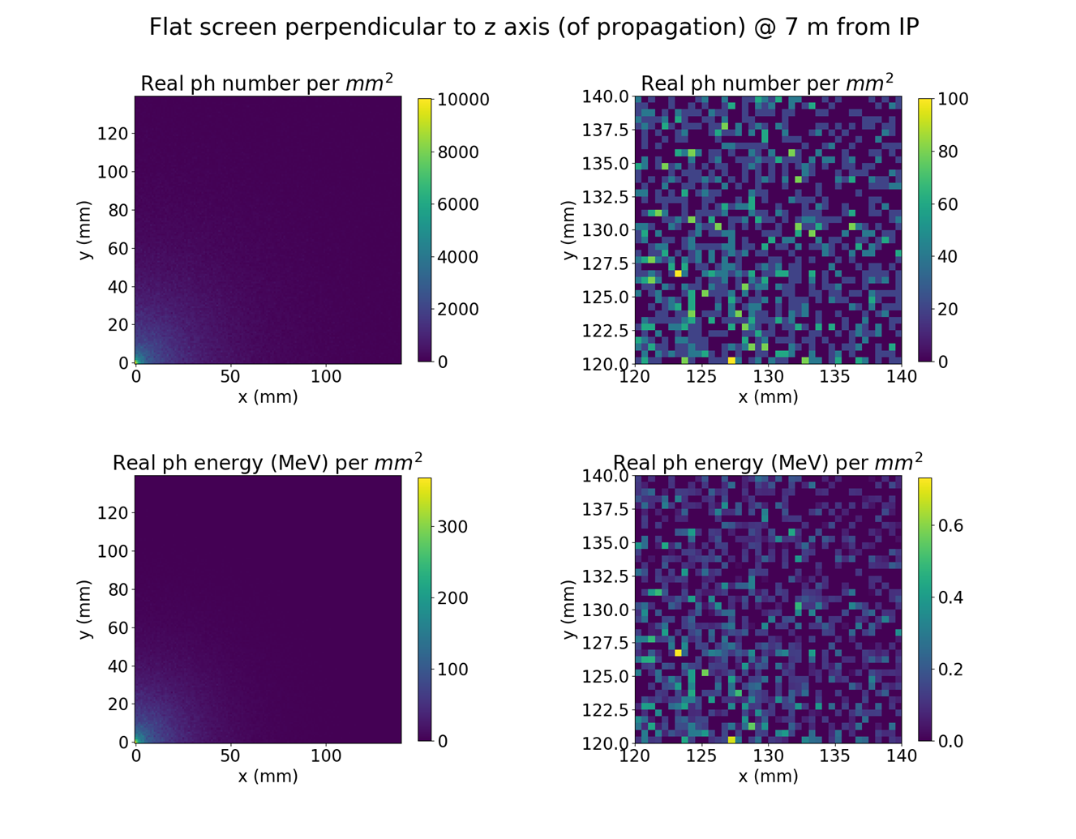
X-ray photon from Camilla’s talk

Slide 10
X-ray photon from Camilla’s talk
Large photon fluxes of 200-250/mm²
Question is more on the detector technology choice ?
  Semiconductor vs Scintillator
  Performance vs Simplicity/Robustness/Cost
    Semiconductor can provide some energy resolution, is it required for the PoP ?
    Semiconductor are great candidate for an outside vacuum detection system (not possible on SPS)
    Scintillating screen or scintillator coupled to PMT could work

Slide 11
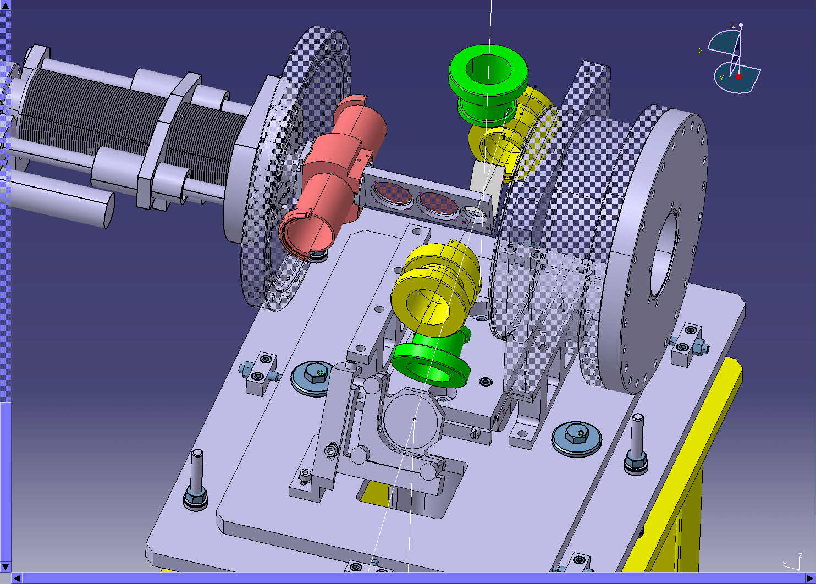
X-ray photon from Camilla’s talk
Simple scintillator design can be done with very limited resources
Refurbishing a CERN BTV system (screen + camera)
  BTV can have a replacement chamber
  It comes with CERN standard control and acquisition system
  Normal scintillating/OTR screen to be replaced by an adequate ring scintillator screen (several option for the screen material and easy to change the screen shape if needed)
  Would need some mechanical design/integration but no real development (possibly reusing existing equipment ?)

Slide 12
Conclusions
Keep two BPMs in the laser cavity
Do not count on visible photons detection system in the laser cavity
Looking for the most pragmatic approach and simpler design of scintillating screen reusing on a BTV system
If more resource/manpower is found, we could do better !!

Slide 13
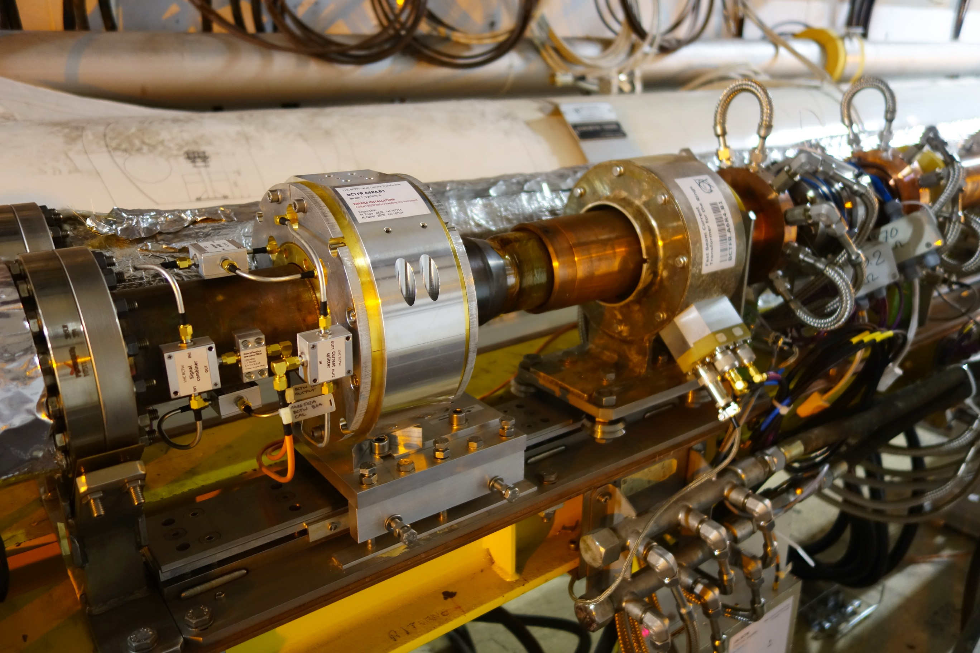
Beam diagnostics for GF-OP
Measuring longitudinal beam cooling
  Several monitors available in SPS with sub-ns resolution (BQM, WCT or HT-monitor)
    Bandwidth up to 3GHz
  Bunch-by-bunch, turn-by-turn longitudinal beam profile possible
  Need to check if the current read-out system is adequate for our need - how many measurements per second are needed ?

Slide 14
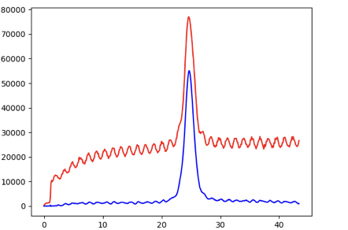
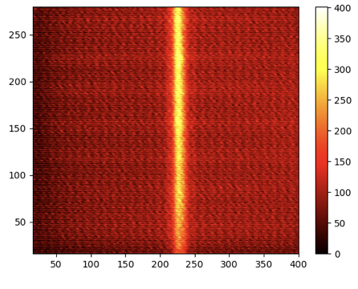
Beam diagnostics for GF-OP
Measuring transverse beam size
  Not enough SR for ions for BSRT
  Wire scanner – risk of stripping ?
  Beam gas ionization profile monitor
Raw data
Background
subtracted
Very clean profile after background subtraction
Smallest intensity that can be detected in a single cycle = ~10e10 p
Open questions and future investigations
  Do we need gas injections ? Sensitivity with single ion bunches ?

Slide 15
X-ray photon Diagnostics for GF-OP
Example on SPS using Pixel detector – Timepix3
https://medipix.web.cern.ch/technology-chip/timepix3-chip
http://bgi-web.web.cern.ch/bgi-web/
CMOS : 256x256 pixels (55umx55um)
Rad-hard read-out electronic system
Operational on PS since 2017

Slide 16
X-ray photon Diagnostics for GF-OP
Example on SPS using Pixel detector – Timepix3

Slide 17
Beam diagnostics for GF-OP
X-ray detection system using lead loaded plastic scintillator
PMT
Existing design (2001)
System sensitivity to be checked (10⁴ photons/pulse)
1st detector
Signal + background
2nd detector
background
3eV
Translation stage
& Bellow
X-ray
22keV
In-air
In-vacuum
Light guide
X-ray
22keV
ions
Aluminized Plastic scintillator

Slide 18
Thank you

