Slide 2
Photon detectors functional specifications
Gamma Factory meeting on the Proof of Principle
LAL, Paris, 3-5 June 2019
Y. Dutheil, B. Goddard, F. Velotti

Slide 3
Photon detection system considerations
Needed for finding and demonstrating the excitation of the circulating ions
Requirements
  Measurement of 10⁻⁴ of the maximum flux with 10ms (500 turns)
Constraints
  Mechanical integration/design compatible with proton operation (Impedance)
  Aperture preserves the stay-clear region
  Radiation resilience
  Background suppression if sensitive to beam losses

Slide 4
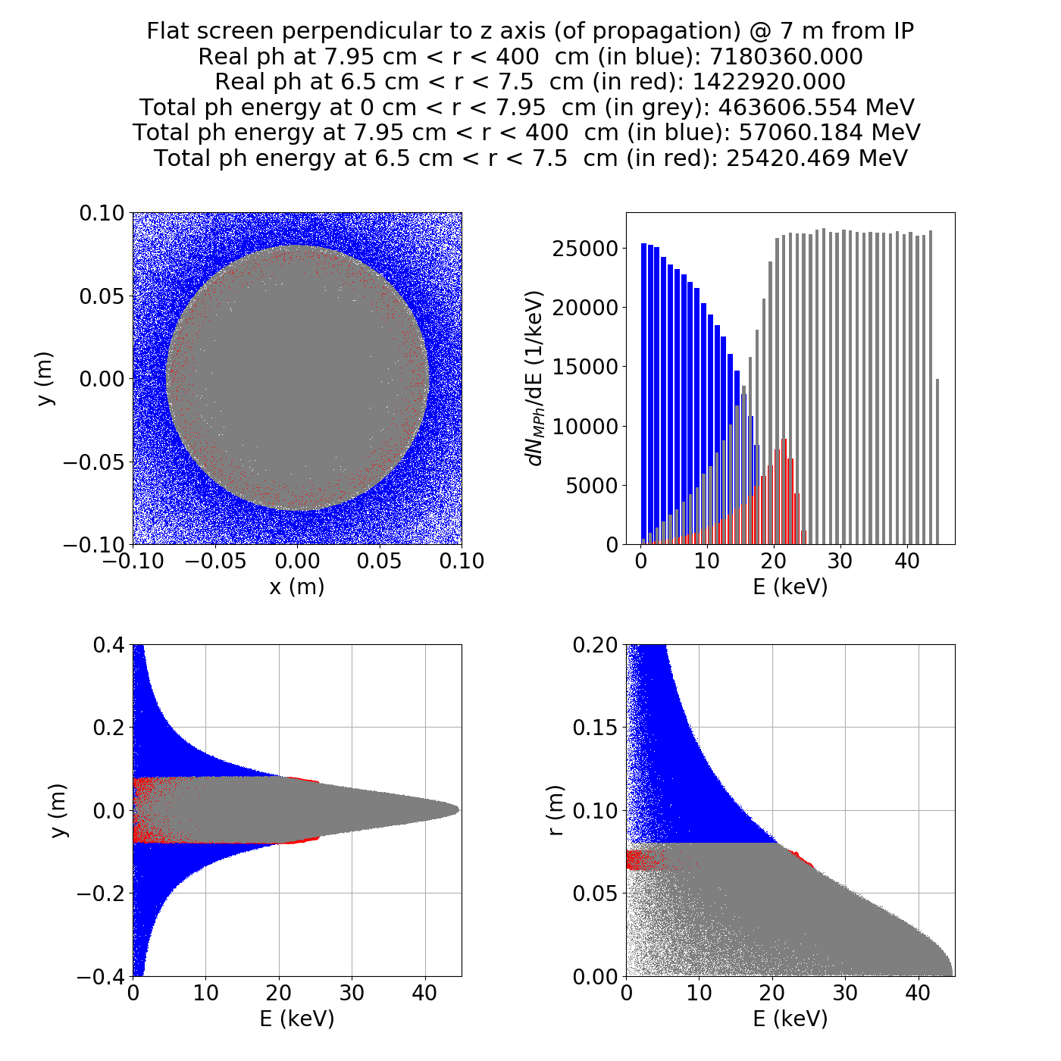
Detector Xrays : Forward detector, C.Curatolo
Ring detector
  7m downstream of the IR, inner radius 65mm and 10mm thick, ~4000mm²
  5sigma below resonance 1.3E5 photons or 33 photons/ mm²
  2sigma below resonance 1E6 photons or 250 photons/mm²
  On resonance, 1.4E6 photons or 350 photons/ mm²
  Range required from 0.035 to 350 photons/mm²
Numbers per bunch crossing, SPS revolution
frequency ~43kHz
Photon energy up to ~35keV
Flux can be changed and placing detectors at
different radius could effectively increase the dynamic range
At resonance
C. Curatolo : https://indico.cern.ch/event/819820/contributions/3427122/

Slide 5
Detector visible : Below IR, C. Curatolo
Detector
  Square 80x80mm 30mm above/below
  Using photons between 1.7 and 3.2eV
  Flux optimized with detector downstream the interaction by ~10cm
Flux
  Up to ~10 photons per crossings (at 2sigma below resonance) and per crossing
  Scales up to ~15 photons for on-resonance and per crossing (12/8 factor)
  With revolution frequency of 43kHz and 10 bunches
  Around up to 6.5E6 photons per second
C. Curatolo : https://indico.cern.ch/event/819820/contributions/3427122/

Slide 6
Conclusion
2 detector positions were identified and photon flux quantified from C. Curatolo simulations
Next steps :
  Agree on detector technologies considering the photon characteristics
  Possibly iterate on the detector positions
  Cross-check simulations with Alexey’s on the chosen geometry
  Write everything on the YR

Slide 7
Thank you

