Slide 1



Monte Carlo generators for the modelling of multijet processes in ATLAS at 13 TeV
Evelin Meoni
(Università della Calabria & INFN)
on behalf of the ATLAS Collaboration

Slide 2
Introduction
Why is MC modelling of paramount importance at LHC?
In cross-section measurements, MC used to unfold detector level results correcting for efficiencies, resolutions and
acceptances and used to correct fixed-order calculations for non-perturbative effects in order to allow comparisons
with data
In precision measurements of SM parameters, MC used to build templates of the sensitive observables
In measurements and searches, estimation of backgrounds often fully MC-based (small background) or based on
a mixture of MC and data-driven techniques
MC used to assess signal and background systematics
Our ability to constrain and discover New Physics depends on having reliable MC predictions with well understood systematic uncertainties!

Slide 3
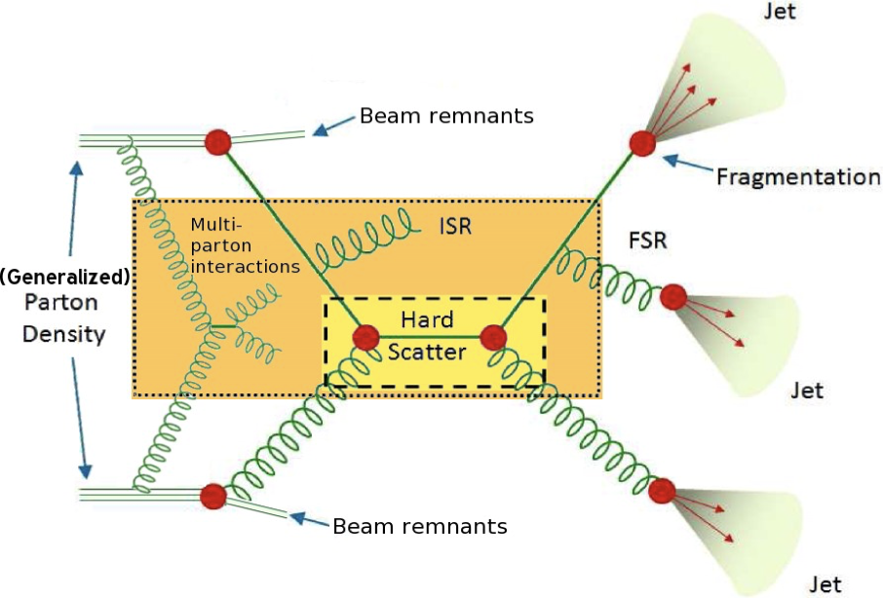
MCs
Description of pp collisions in MC via “factorisation”:
Hard Scattering (& Resonance decay) via Matrix Element
Initial and State Radiation via Parton Shower (PS)
Parton density via PDFs
Underlying Event (UE): everything in a pp collisions expect
the hard scattering via phenomenological models
- Multi-Parton Interactions (MPI): additional parton-parton
scatterings between other partons from the same protons
- Beam remnants
Fragmentation and Hadronisation via non-perturbative
models of color-singlet parton systems
Why does MC modelling of jet processes play a leading role in this effort?
LHC is a jet factory, processes involving jets are crucial inputs for the understanding of basic physics modelling features

Slide 4
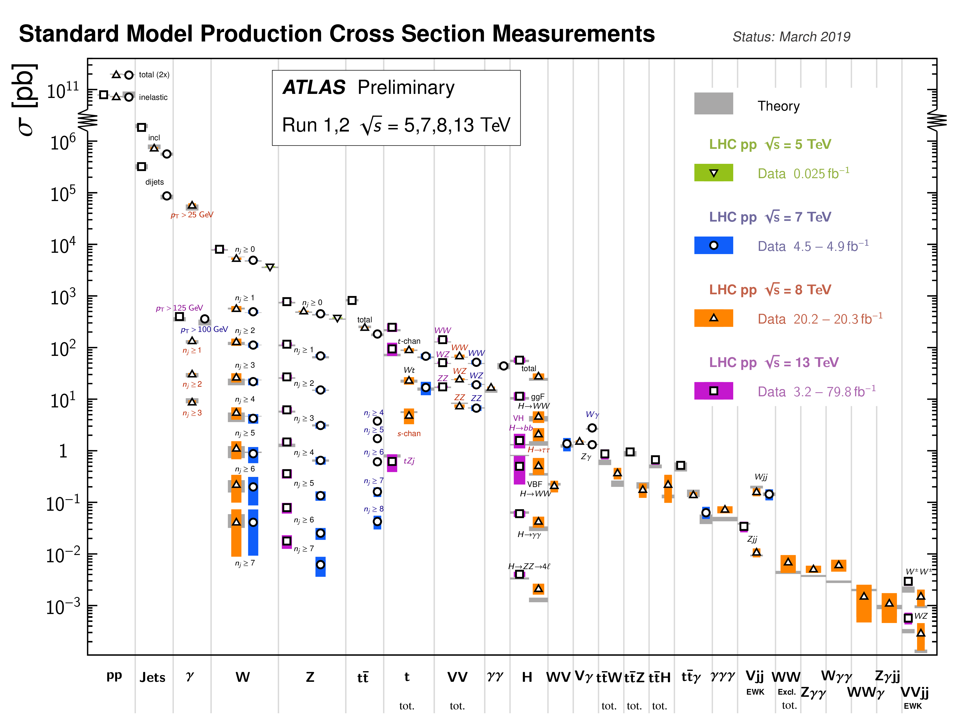
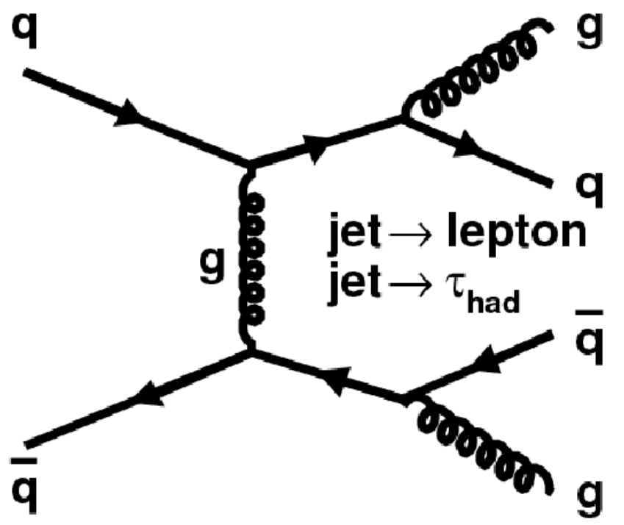
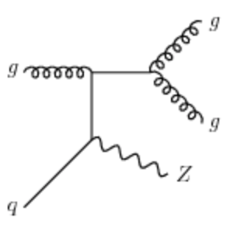
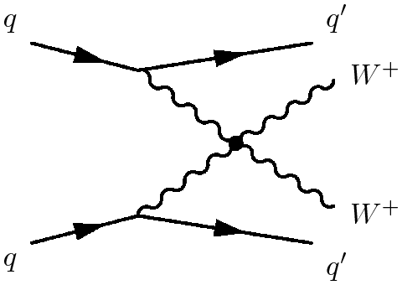
Outline
Talk on MC modelling of Multijets & X+jets!
Multijets
ATL-PHYS-PUB-2019-017
JHEP 05 (2018) 195
WW+jets (VBS)
ATL-PHYS-PUB-2019-004
ATLAS-CONF-2018-030
Z+jets
ATL-PHYS-PUB-2017-006
Eur. Phys. J. C77 (2017) 361

Slide 5
Multijet MC configuration
Detailed study performed recently on several MC configurations simulating inclusive jet production:
MC | ME order | PDFs of ME | PS & UE & Had Models | PS &UE tunes
Pythia 8.230 | LO 2→2 | NNPDF23LO | p_{T}-ordered PS Lund string model for Had | A14 tune
Sherpa 2.2.5 | LO 2→2 | CT14NNLO | p_{T}-ordered PS (CSS Sherpa) Sherpa AHADIC model for Had (based on Cluster Fragm) | Sherpa tune (CT10)
 |  |  | p_{T}-ordered PS (CSS Sherpa) Lund string model for Had (Pythia6.4)
MadGraph+Pythia8 (MadGraph5_aMC@NLO 2.3.3.1) | LO up to 4 part | NNPDF30NLO | PS&Had: Pythia 8.212 | A14 tune (NNPDF23LO)
Powheg+Pythia8 (Powheg-Box V2) | NLO dijets | NNPDF30NLO | PS&Had: Pythia 8.230 | A14 tune (NNPDF23LO)
Herwig 7.1.3 | NLO dijets | MMHT2014NLO | Angular ordered PS Cluster model for Had | Dedicated tune
 |  |  | Dipole PS Cluster model for Had | Dedicate tune
Explored impact of different aspects:
QCD orders of ME (LO vs NLO)
PS models (p_{T} ordered vs angular ordered)
Factorisation and Hadronisation models (Lund vs cluster models)

Slide 6
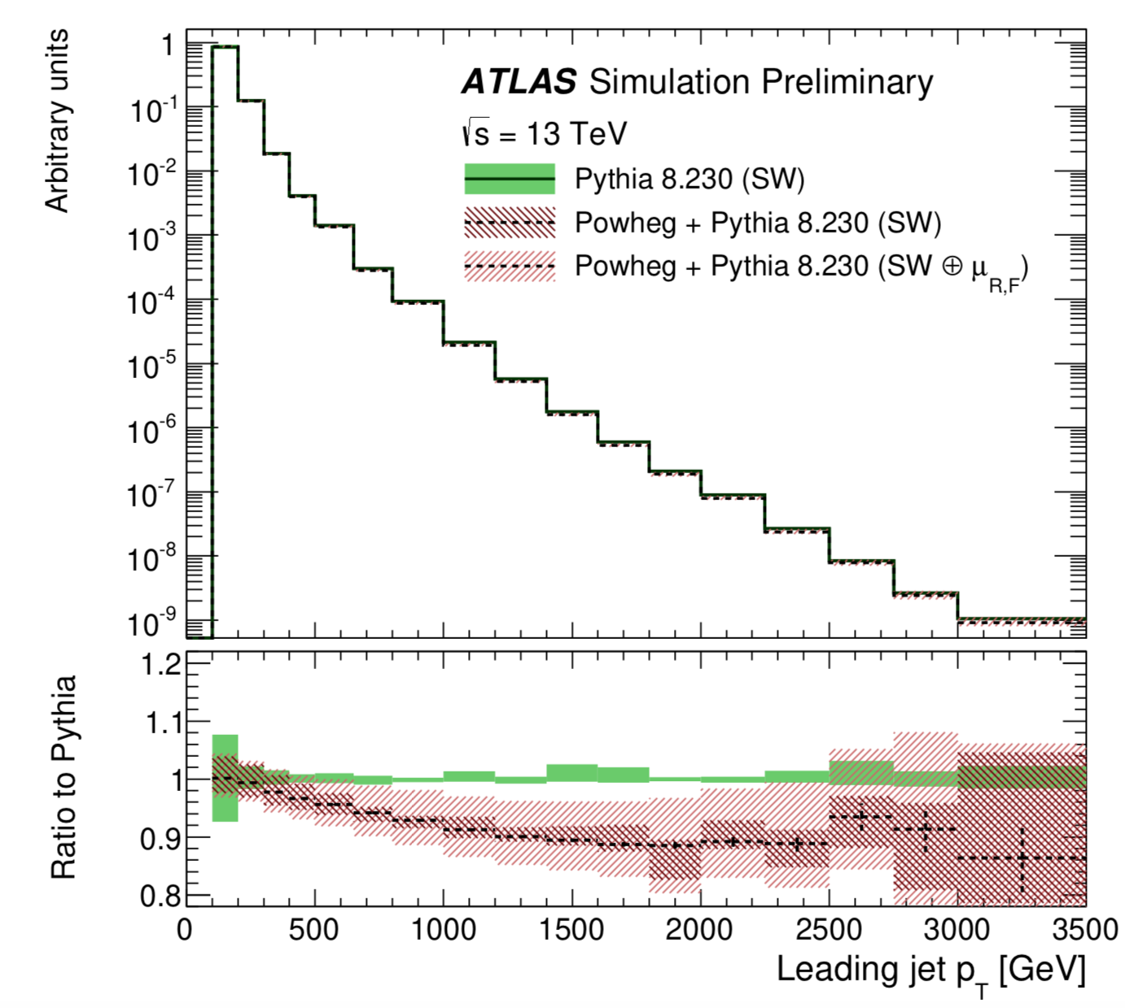
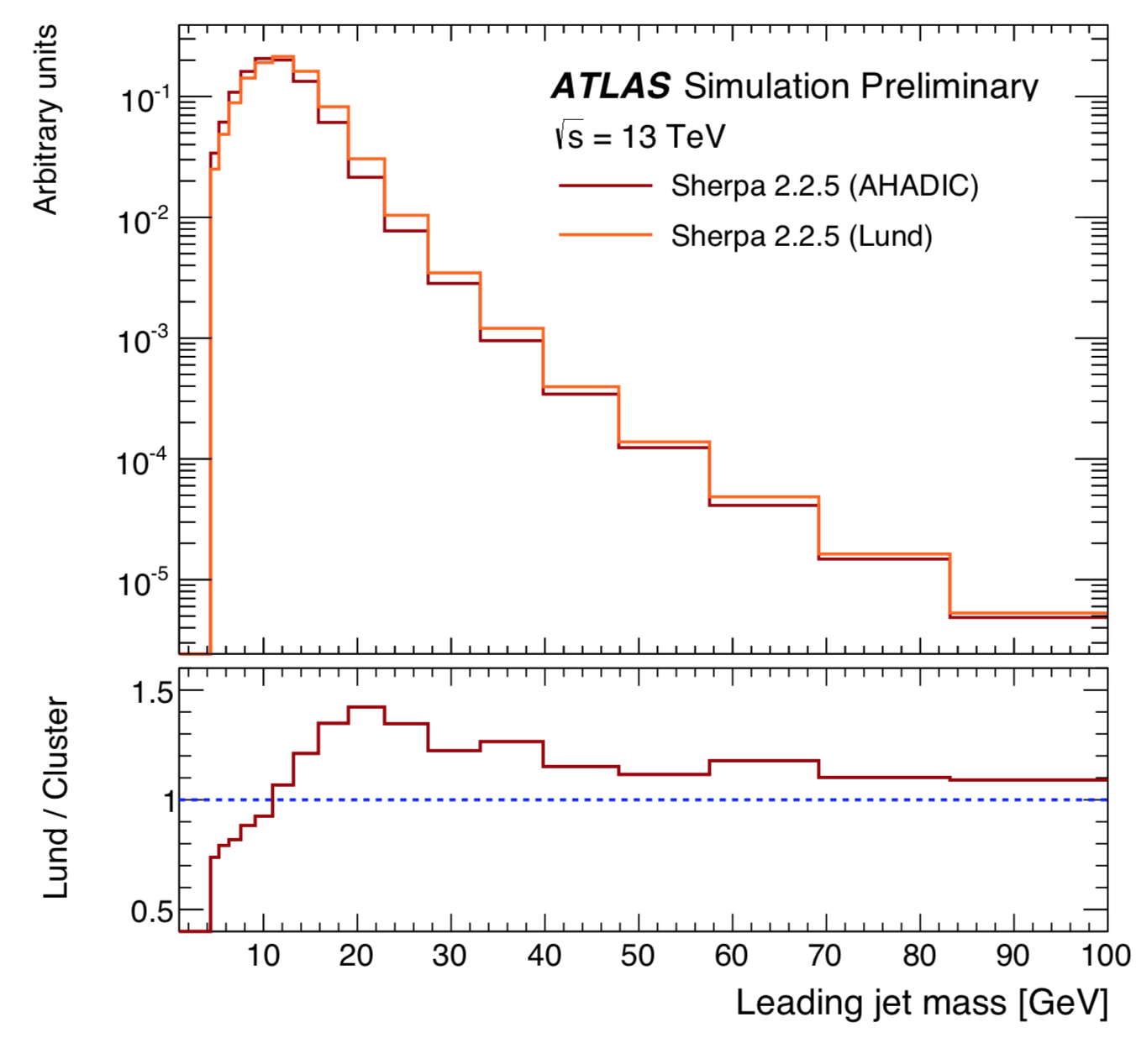
Multijet MC configuration
ME order impact:
Large uncertainty at low p_{T} in LO Pythia8 (PS unc only), PDFs uncertainties play a role at
higher p_{T} in NLO Powheg+Pythia8 (PS+scale+PDF unc)
- employed per-event weight functionality newly implemented in both MCs
Hadronisation model impact:
Impact of 2 hadronization models in Sherpa reaches the level of 45% at low jet mass
MC | ME order | PDFs of ME | PS & UE & Hadr Models | PS &UE tunes
Pythia 8.230 | LO 2→2 | NNPDF23LO | p_{T}-ordered PS Lund model for Had | ATLAS A14
Powheg+Pythia8 | NLO | NNPDF30NLO | PS: Pythia 8.230 | A14 tune
MC | ME order | PDFs of ME | PS & UE & Hadr Models
Sherpa 2.2.5 | LO 2→2 | CT14NNLO | p_{T}-ordered PS (CSS Sherpa) Sherpa AHADIC model for Had based on Cluster Fragm
 |  |  | p_{T}-ordered PS (CSS Sherpa) Lund model for Had with Pythia6.4

Slide 7
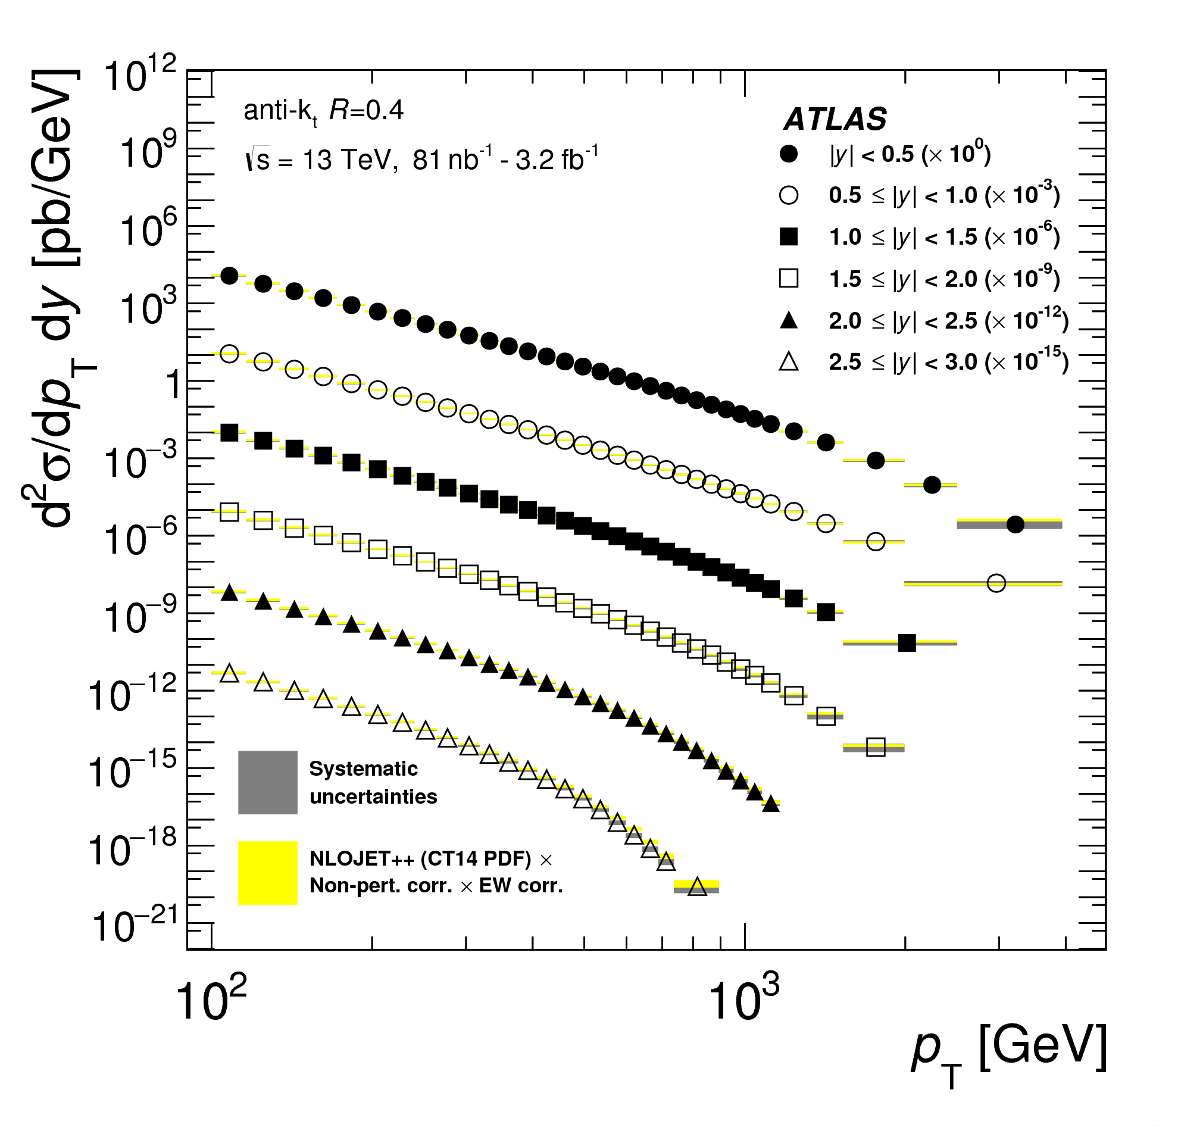
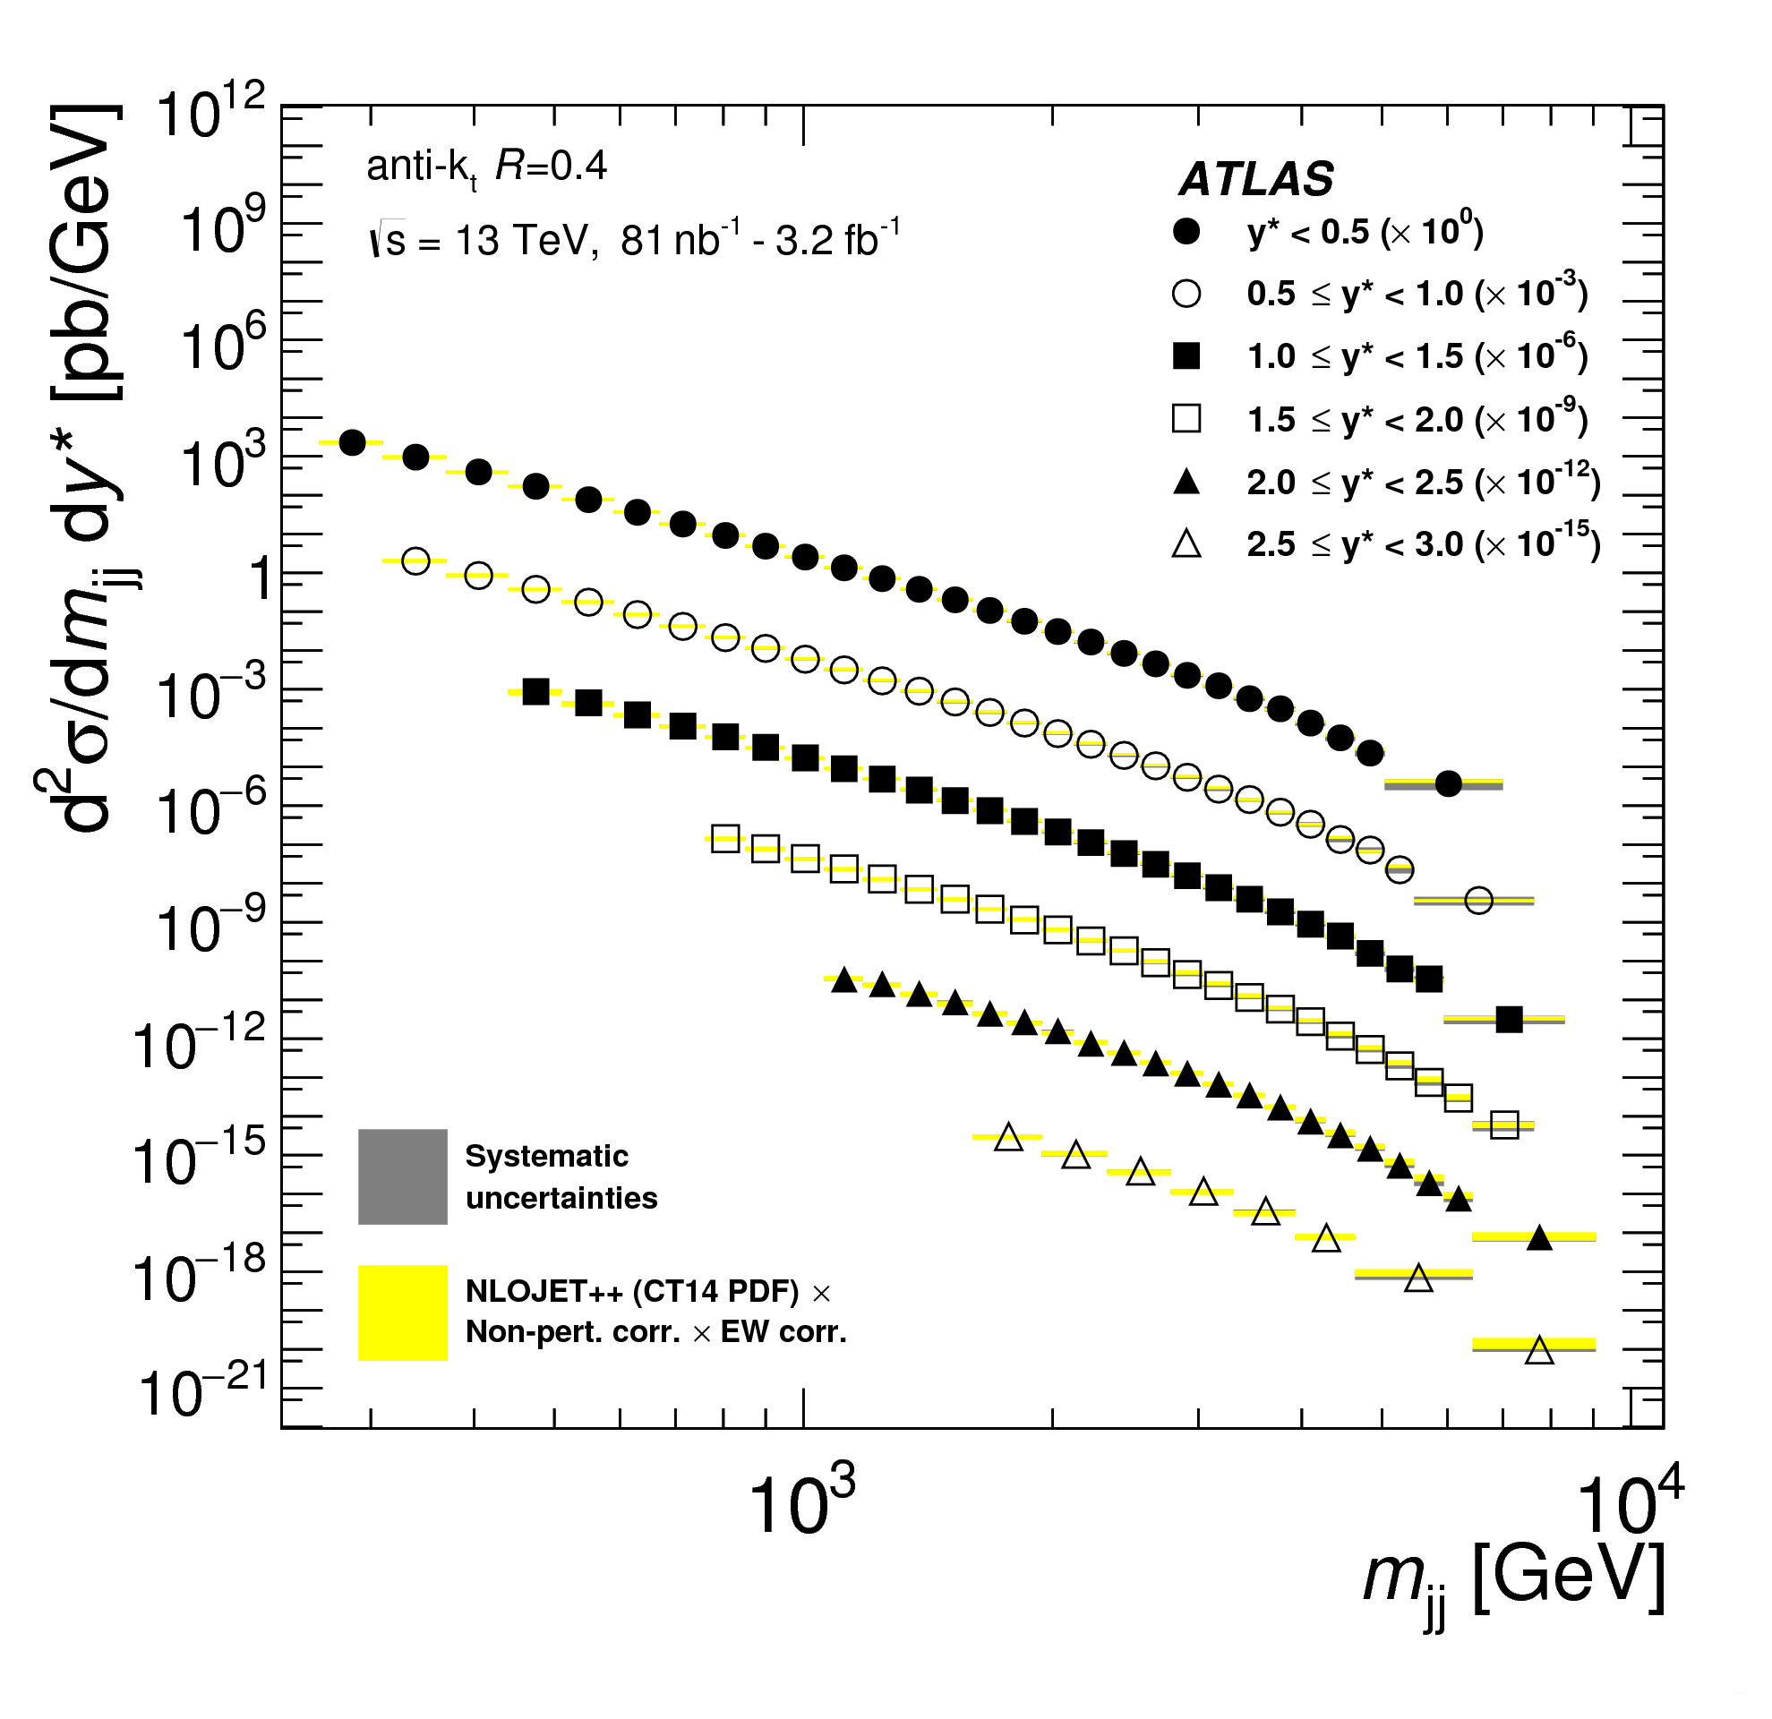
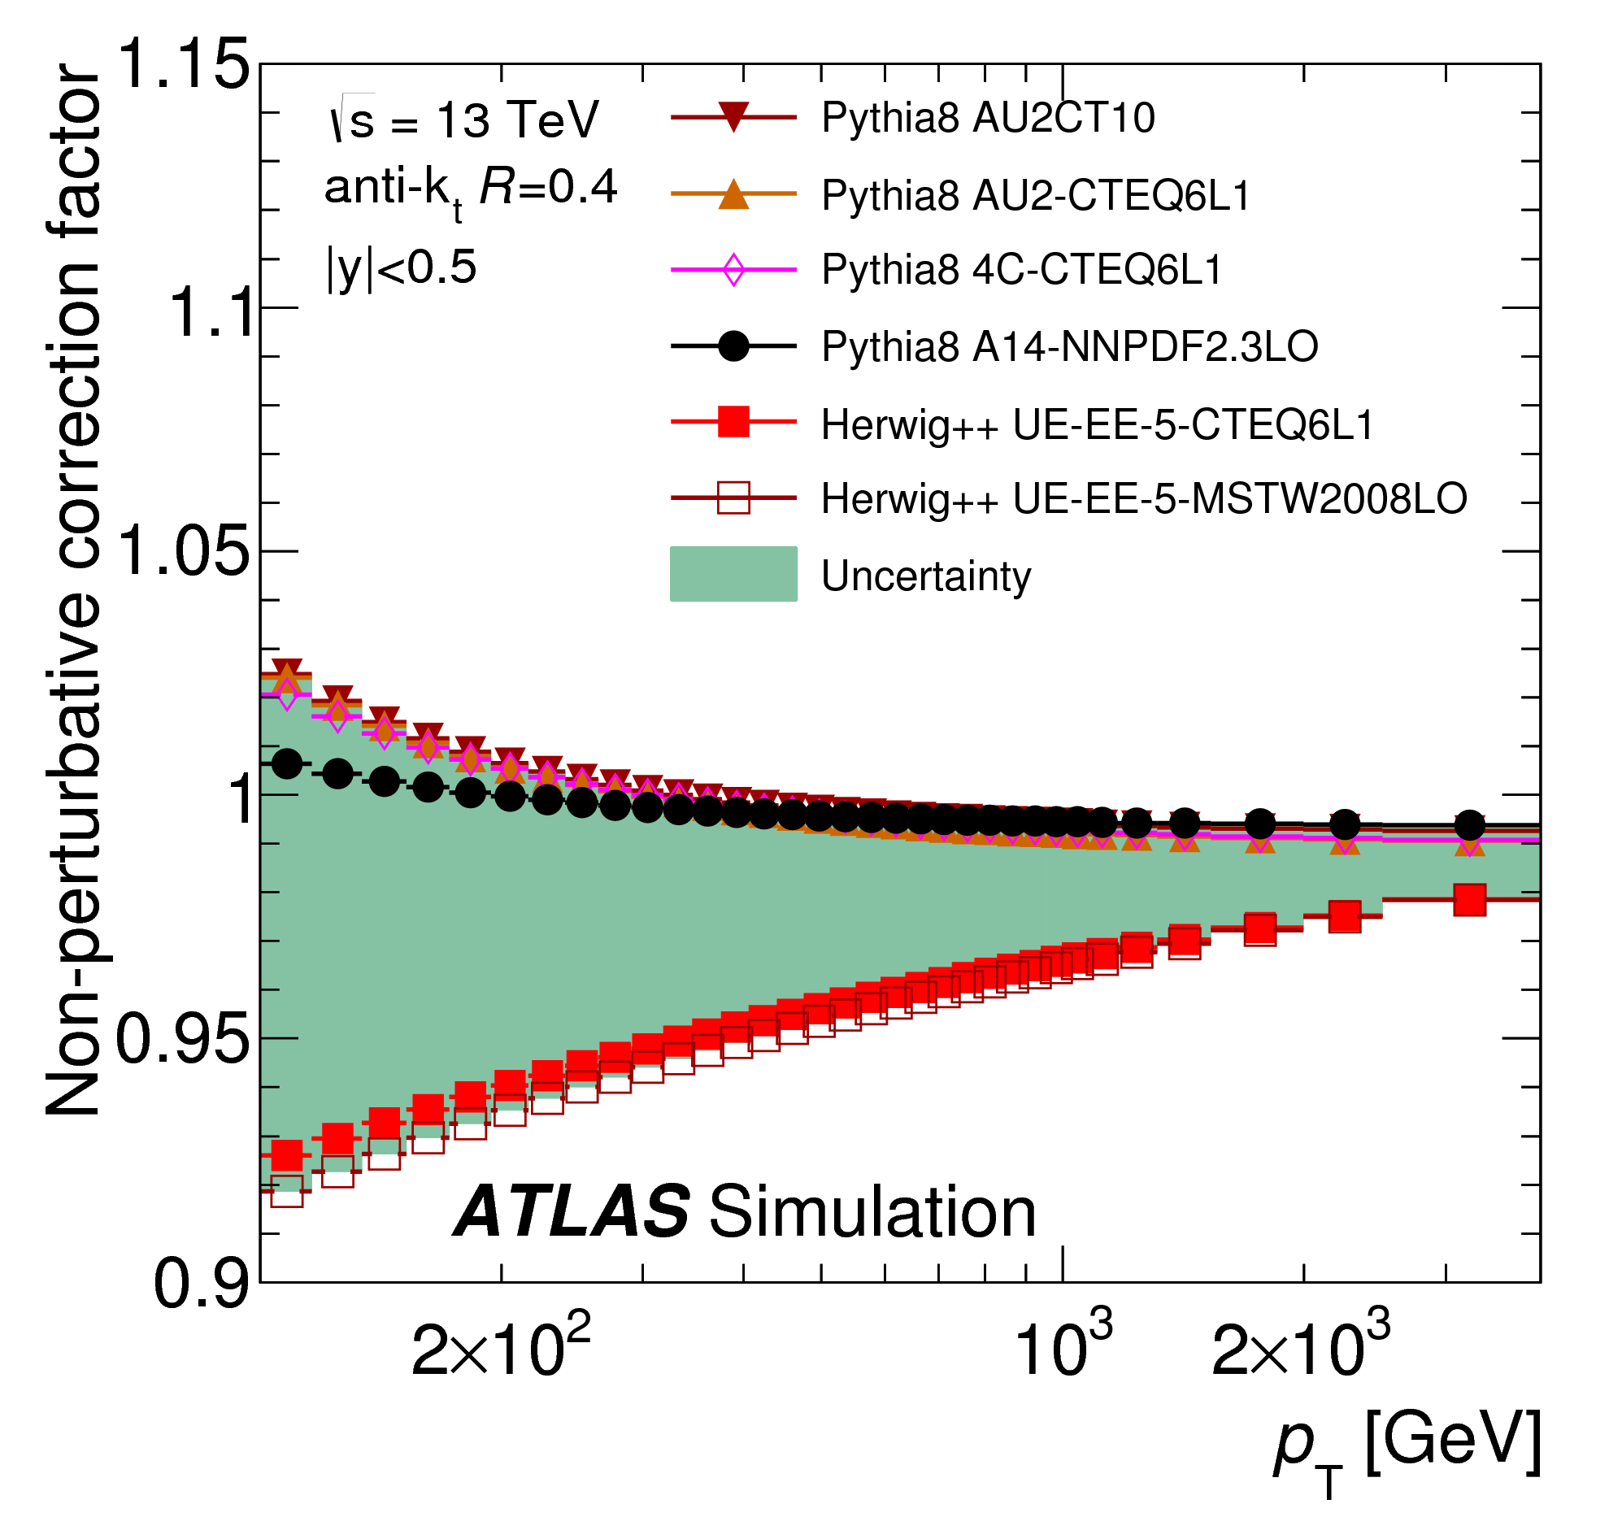
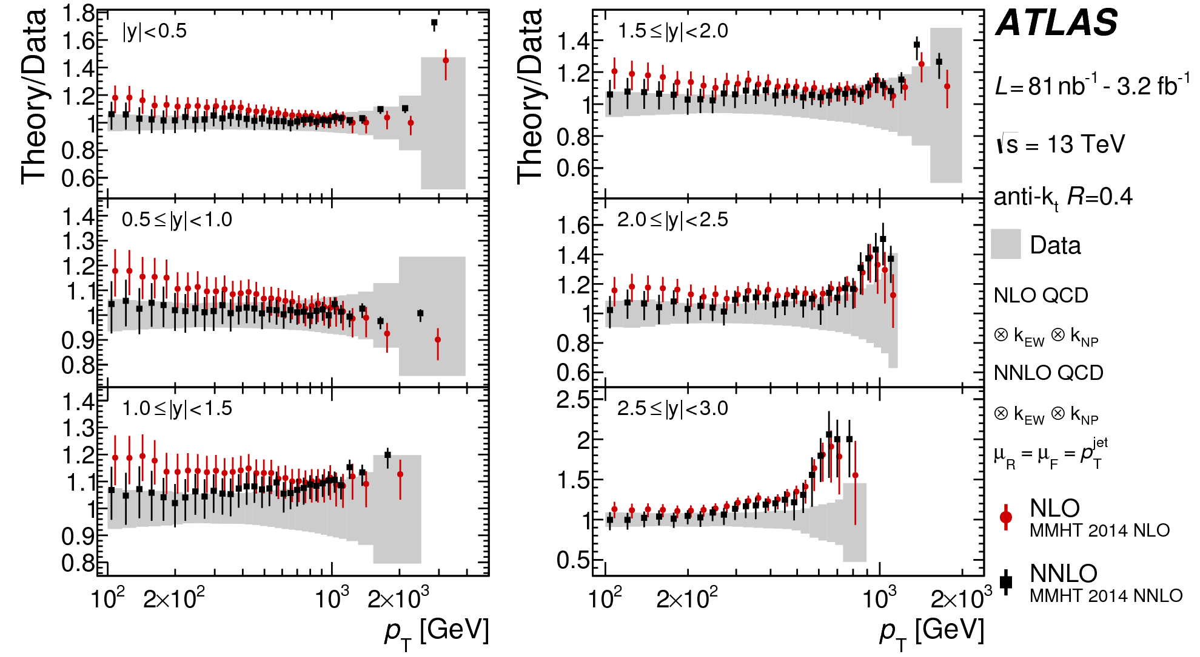
Inclusive jet cross-section
JHEP 05(2018) 195
First ATLAS measurement of inclusive jet and dijet
cross-section @13 TeV: p_{T} measured up to 3.5 TeV
and m_{jj} up to 9 TeV
Fair agreement of NLO prediction (corrected for
non-perturbative and EW effects) with data
No significative difference between NLO
and NNLO when p_{T} is used as QCD scale
More info in the talk of
C. Young (Wednesday)

Slide 8
Inclusive jet cross-section
Central rapidities
Forward rapidities
Predictions normalised to data
Shape comparison
NLO Herwig7 with angular-ordered PS provides the best description of the data for all rapidity ranges,
LO Sherpa matches very well the data for forward rapidities
PS model impact:
Different PS models in Herwig7 (angular-ordered PS vs dipole PS) give small differences in the description
of the data

Slide 9
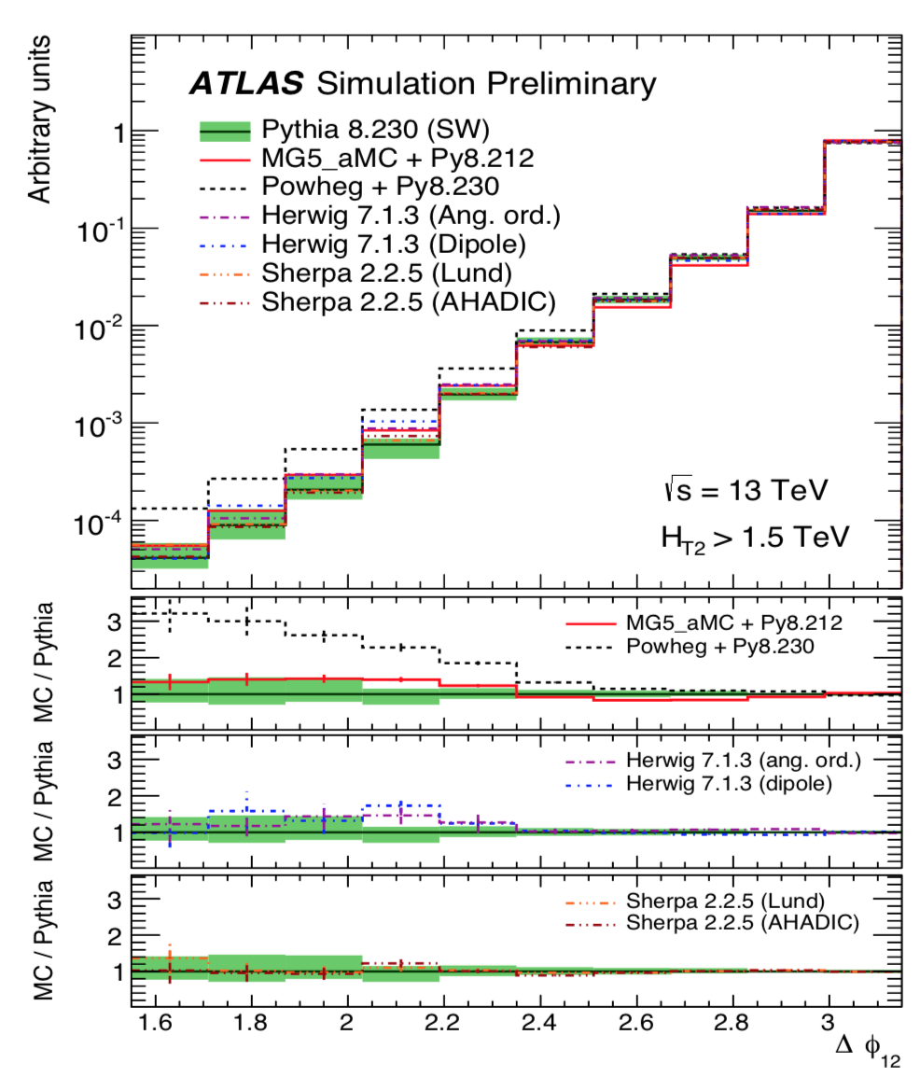
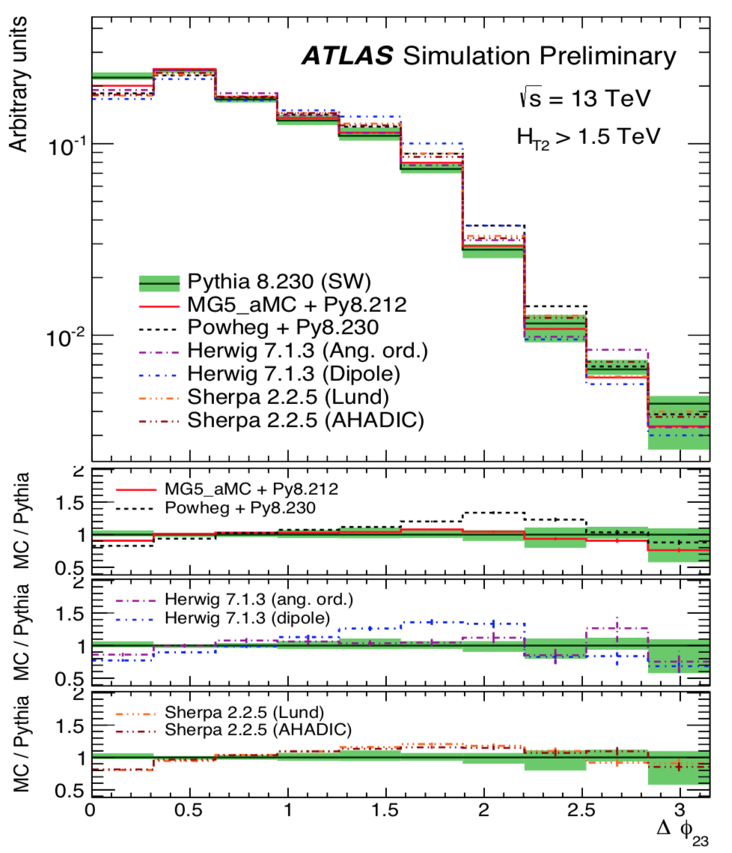
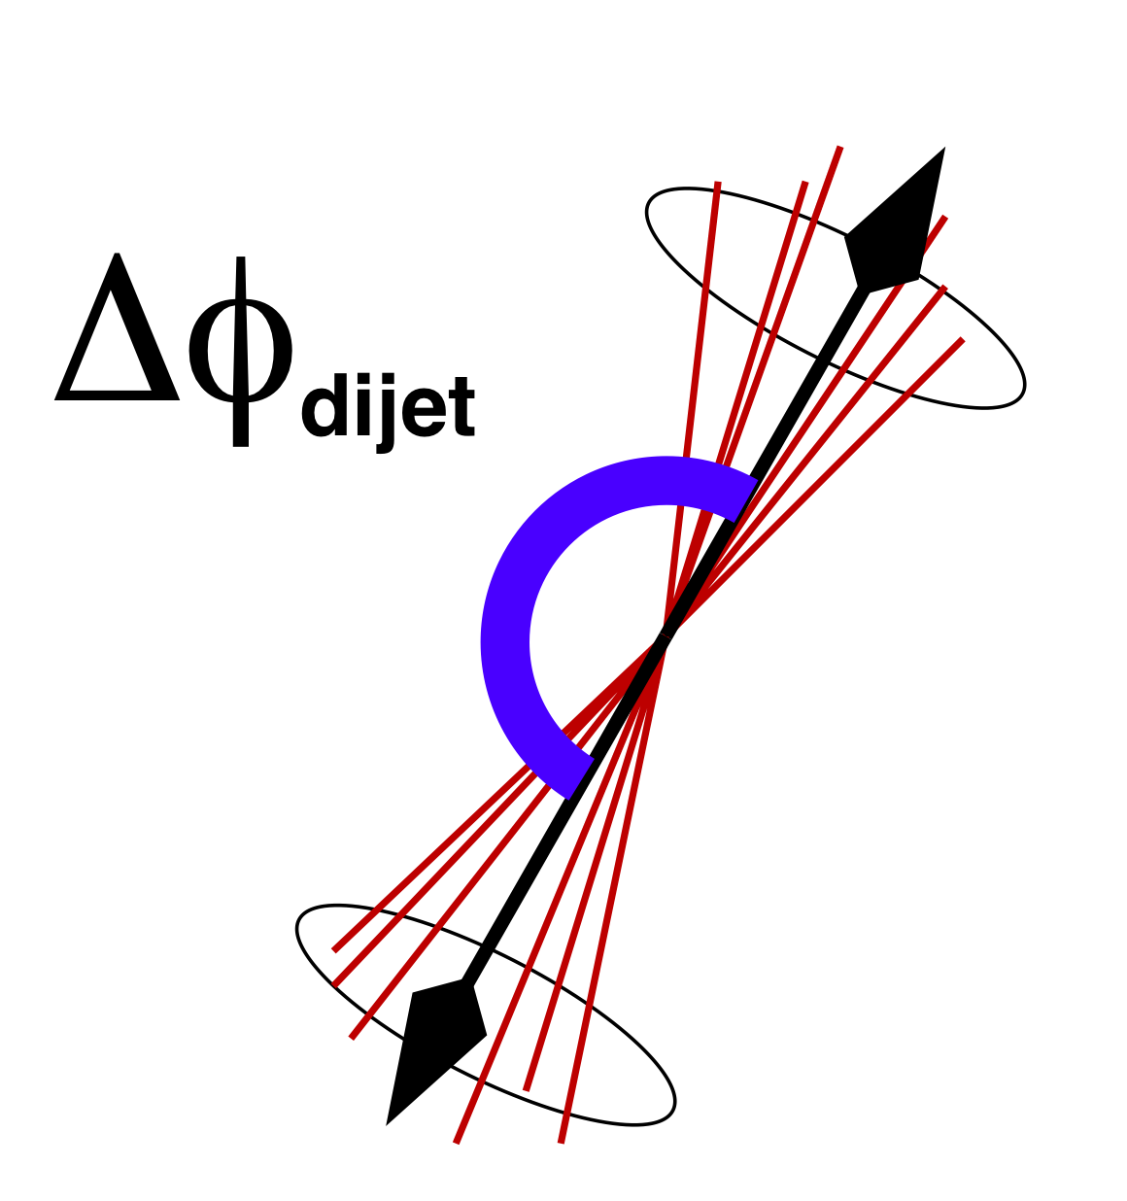
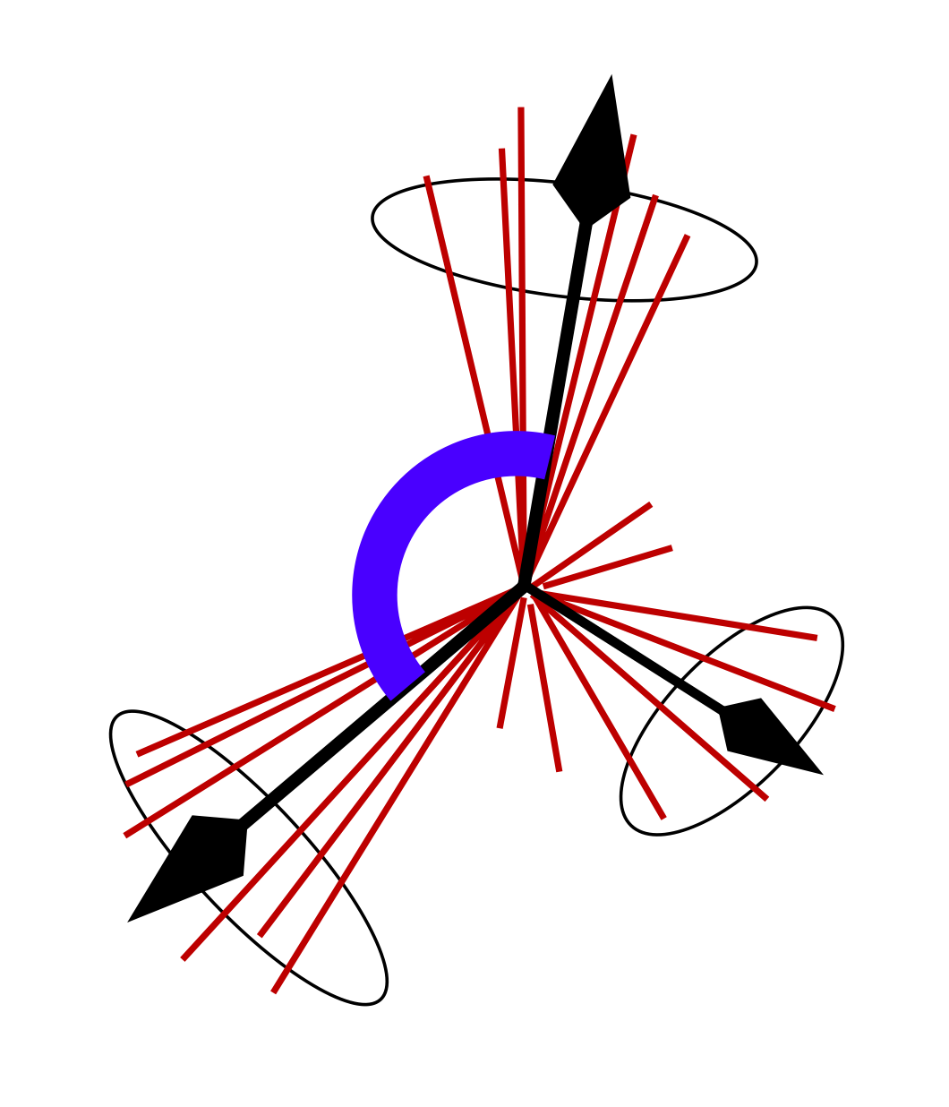
Multijet Event Topology
Azimuthal decorrelation between leading jets allows to test additional radiation emission:
3rd jets from PS in Pythia8 and Sherpa (LO 2→2), from ME in MadGraph+Pythia8 (LO up to 4p), Herwig and Powheg+Pyhia8 (NLO)
∆φ₁₂
∆φ₂₃
Δφ= π (pure dijet)
Δφ small
(extra jets)
anti-k_{t} R=0.4 jets with p_{T}>100 GeV |η|<2.5
and H_{T2} = p_{T1} + p_{T2} >1.5TeV
Sherpa and MadGraph+Pythia8 give a similar
description as the one of Pythia8.
Powheg+Pythia8 shows a much stronger decorrelation
∆φ₂₃ sensitive to the color coherence:
Powheg+Pythia8 and Herwig7 with dipole PS
show the larger differences with respect to Pythia8

Slide 10
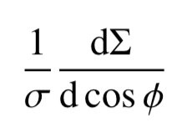
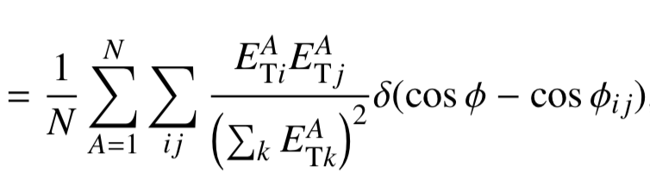
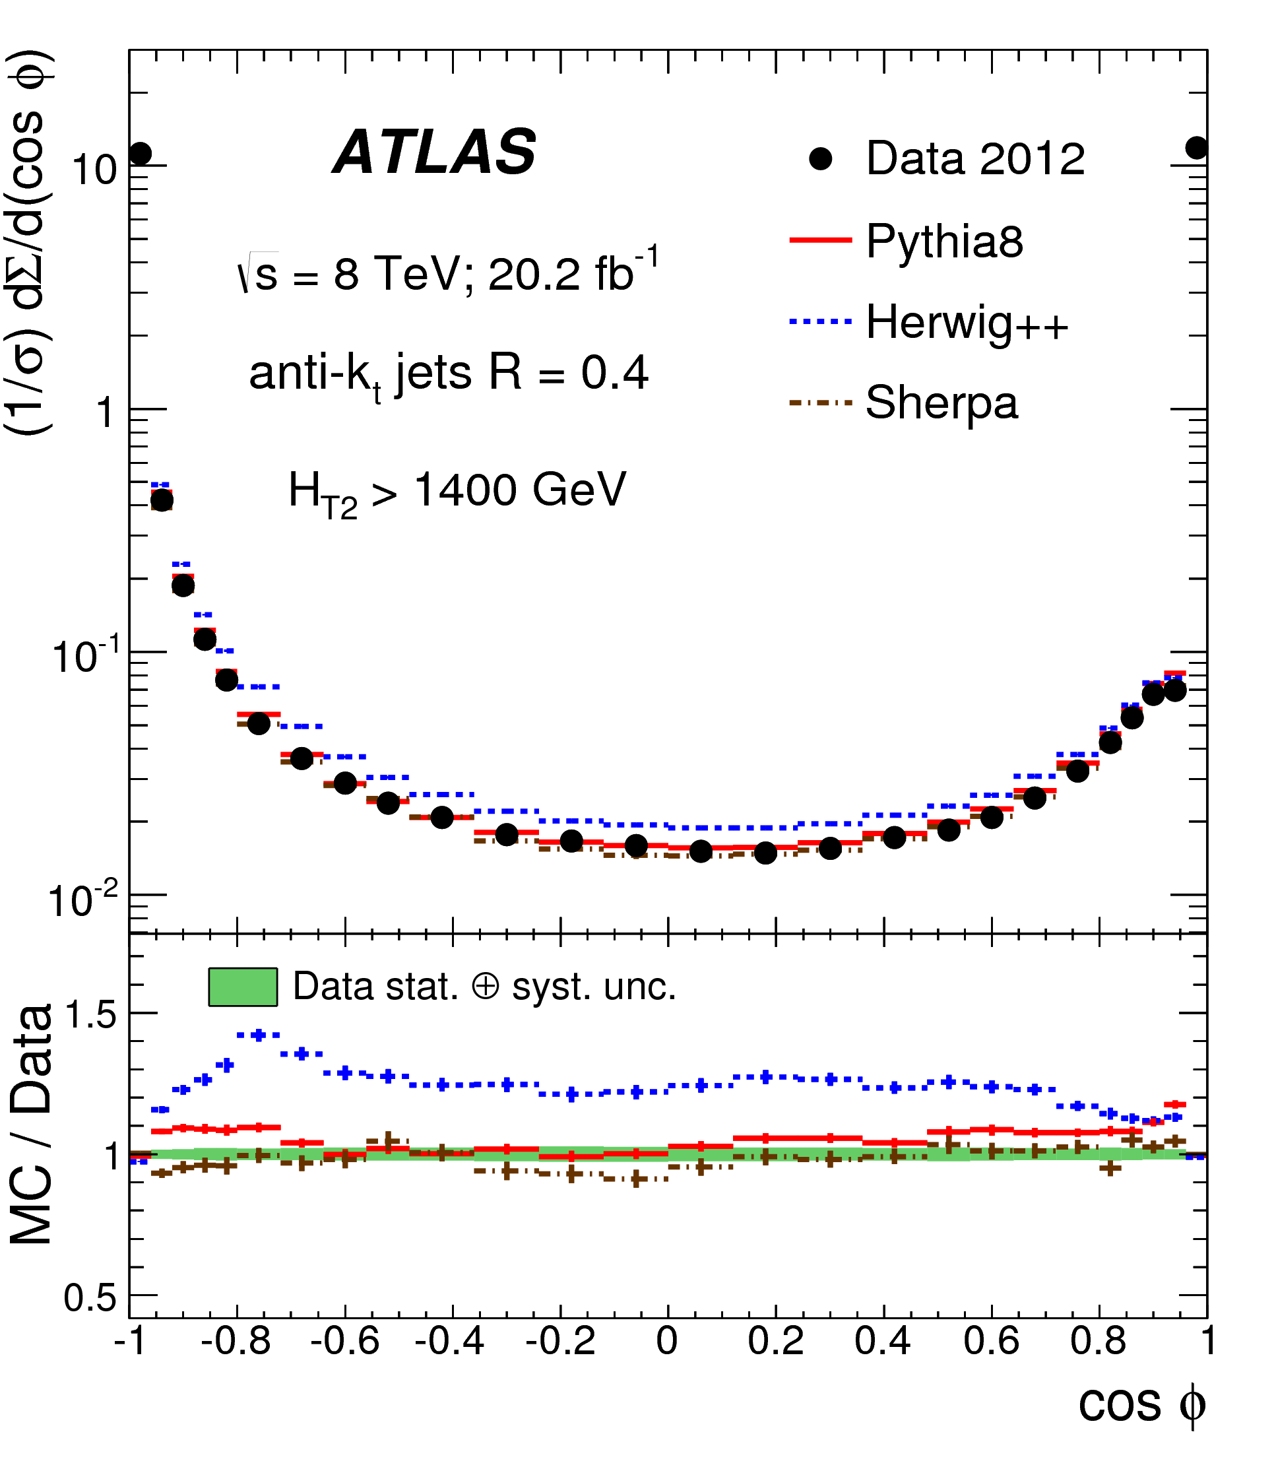
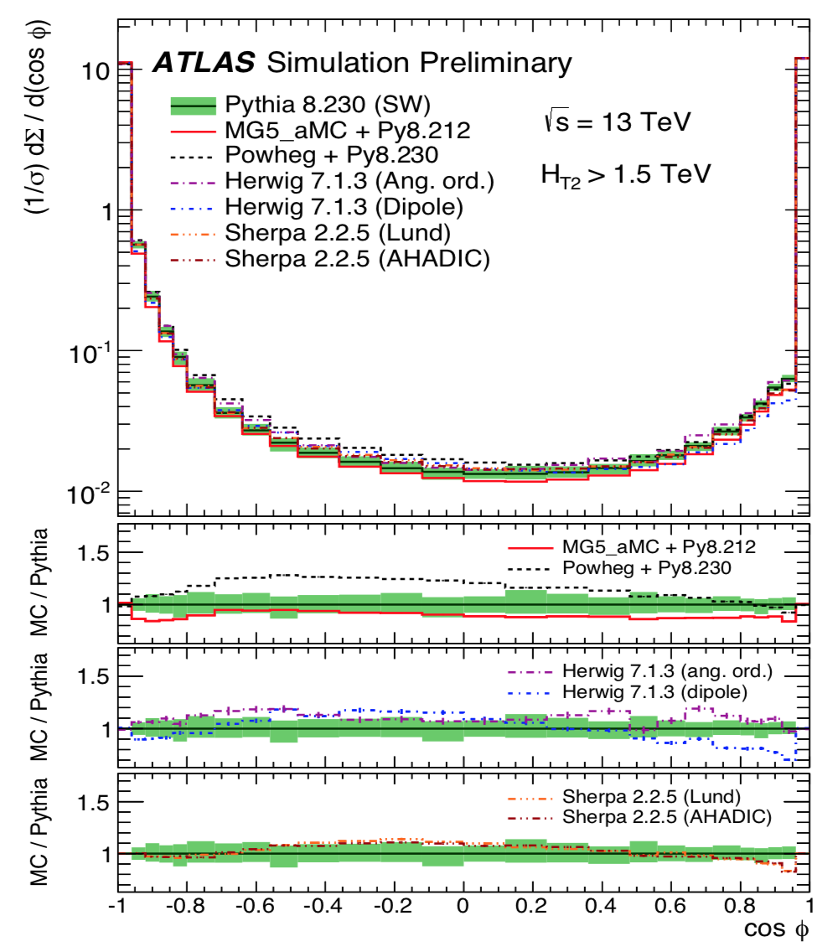
Multijet Event Shape
Event shapes sensitive to hard gluon radiation
Transverse Energy-Energy Correlation (TEEC) = transverse energy-weighted distribution of azimuthal difference between jet pairs
TEEC used to get α_{s} at various Q-scale
Eur. Phys. J. 77 (2017) 872
Data-MC@8TeV:
Pythia8 (LO 2→2) and Sherpa 1.4 (LO up to 3 p)
sufficient to provide a good description of the
data, much better than LO Herwig with
angular-ordered PS (v2.5.1)
Latest MC@13TeV
MadGraph+Pythia8 (LO up to 4 p) shows
less activity in the central region than Pythia8,
all other MCs predict slightly more large-angle
radiation
anti-k_{t} R=0.4 jets with p_{T}>100 GeV |η|<2.5 and H_{T2} = p_{T1} + p_{T2} >1.5TeV

Slide 11
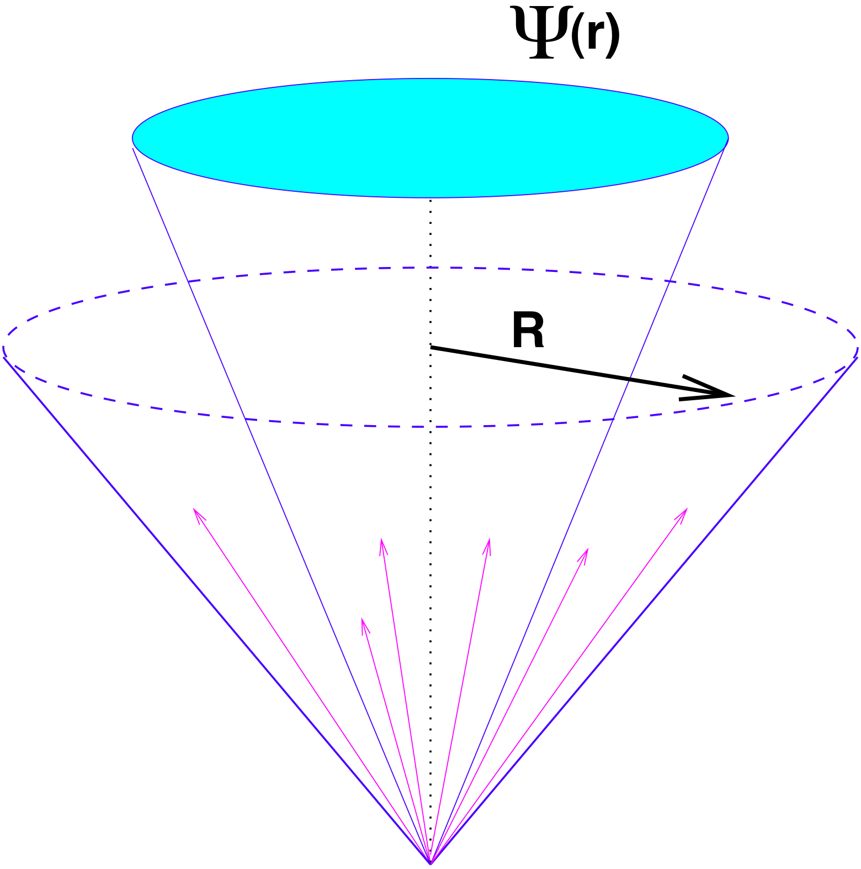
Multijet Jet Shape
Jet shapes sensitive to soft radiation
Integral Jet Shape Ψ(r) = fraction of
jet p_{T} inside a cone of radius r
Fraction of the jet p_{T} outside a cone of 0.2
as a function of the jet p_{T}
Radiation around the original parton becomes more collimated when increasing the jet p_{T}
anti-k_{t} R=0.4 jets with p_{T}>100 GeV |η|<2.5
Pythia8 (p_{T} ordered PS) and Herwig7 show significant differences: dipole PS predicts systematically narrower jets than
Pythia8, while the angular-ordered PS gives wider energy distributions inside the jet cone.

Slide 12
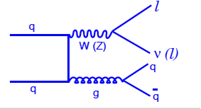
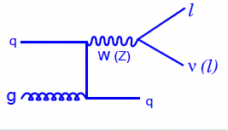
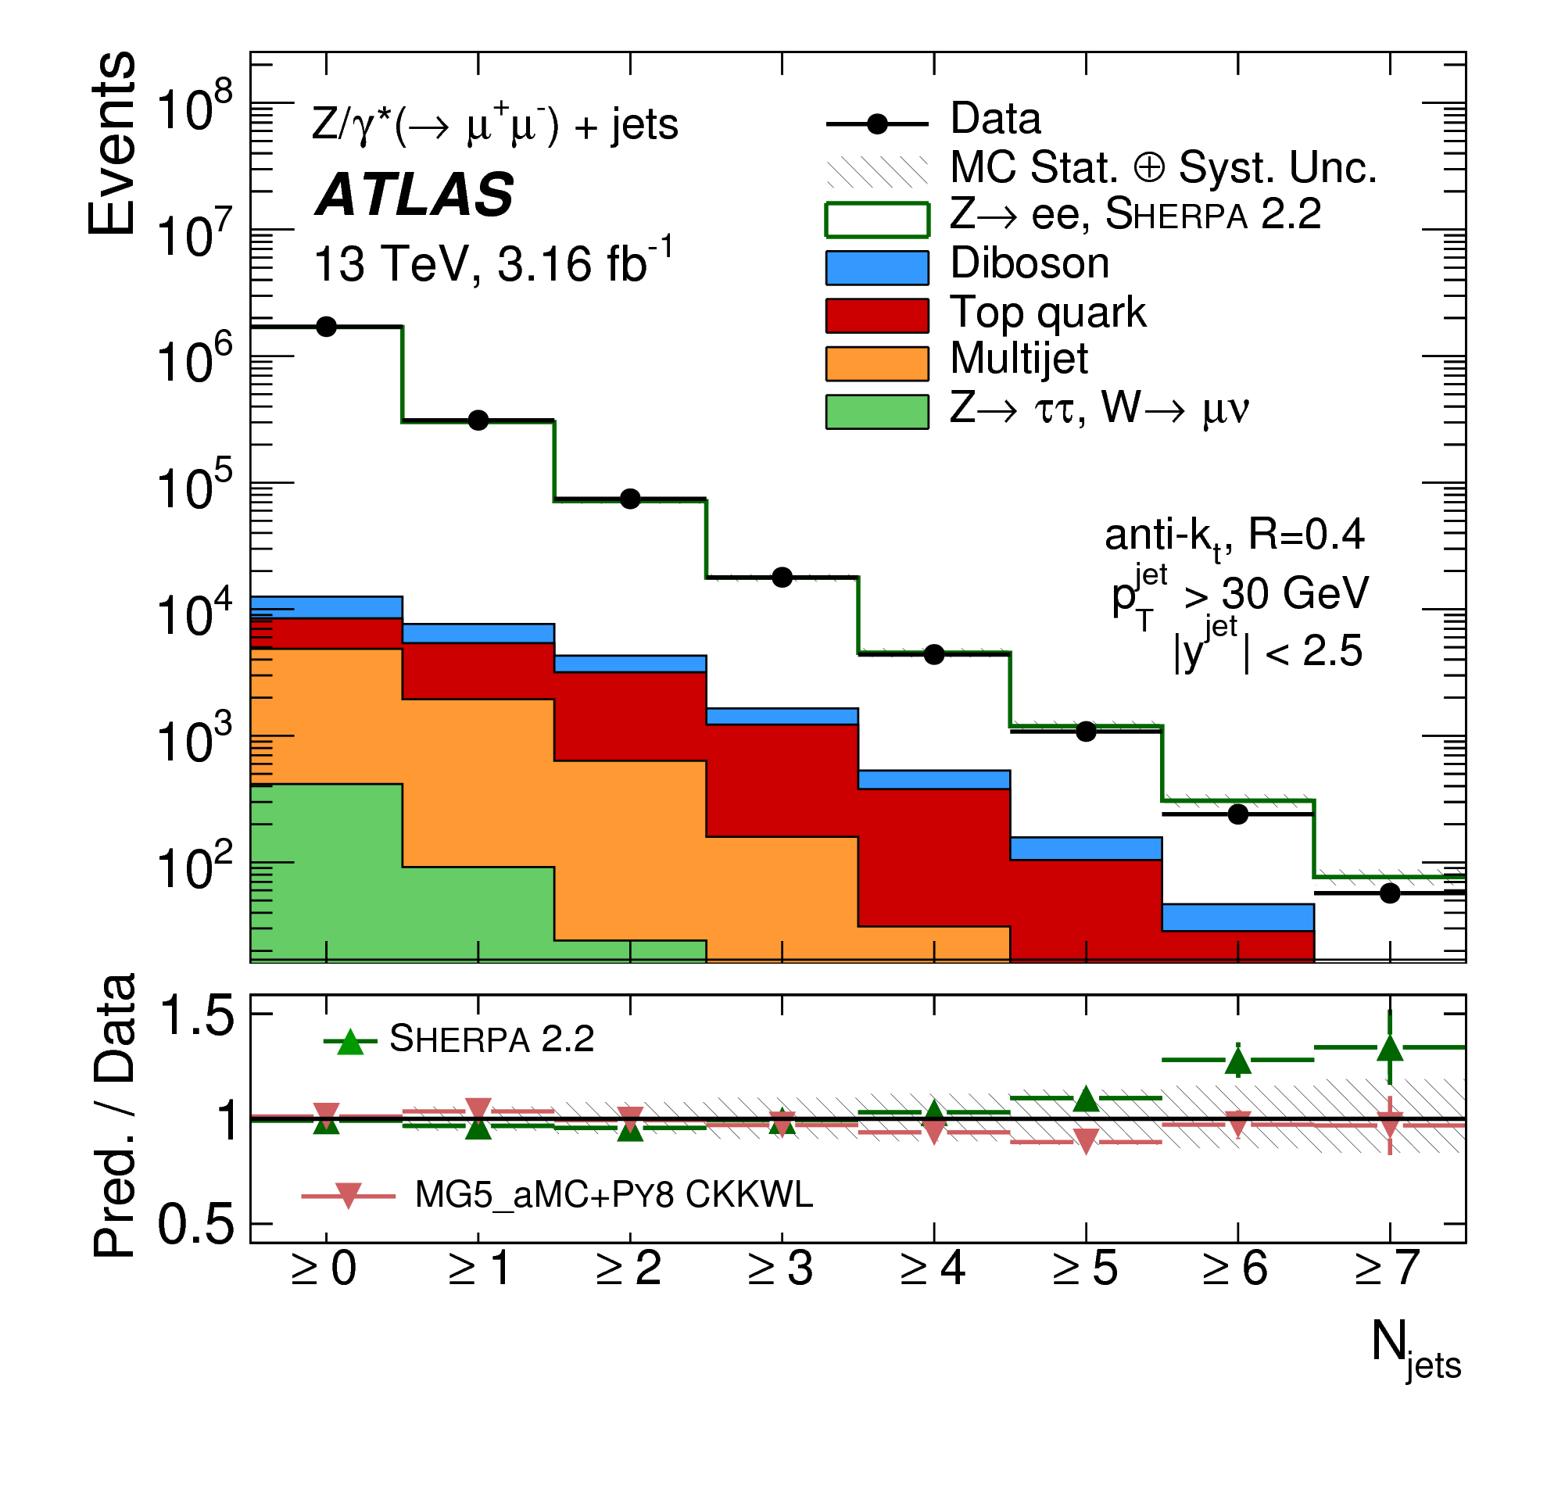
Z+jets
Look at leptonic decays Z→μμ/ee (very clear probe)
Kinematic region with high efficiencies,
good detector performances and low backgrounds
Comparisons : Data unfolded – MCs
Data unfolded – Fixed order calculations corrected for non perturbative effects
Eur. Phys. J. C77 (2017) 361
Leptons: p_{T}>25 GeV, |η|<2.4 (μ) - 2.47 (e)
Z: 71 GeV <m_{ll}<111 GeV
Jets: anti-k_{t} R=0.4, p_{T}>30 GeV, |y|<2.5, ΔR_{lj}>0.4
ATL-PHYS-PUB-2017-006
Eur. Phys. J. C77 (2017) 361
MC | ME order (V+N partons) | PDFs of ME | PS & UE
Sherpa v2.2 | NLO up to 2 p +LO up to 4 p | NNPDF3.0nnlo | PS&UE: Sherpa MEPS@NLO merging
MadGraph CKKW-L (MadGraph5_aMC@NLO v2.2.2) | LO up to 4 p | NNPDF3.0nlo | PS&UE: Pythia v8.186 CKKW-L matching and merging
MadGraph FxFx (MadGraph5_aMC@NLO v2.3.3) | NLO up to 2 p | NNPDF2.3lo | PS&UE: Pythia v8.210 Merging with FxFx prescription
Powheg MiNLO | NLO up to 1 p | CT14nnlo | PS&UE: Pythia v8.186
Alpgen | LO up to 5 p | CTEQ6L1 | PS&UE: Pythia v6.426 MLM matching and merging
Fixed Order Calc | ME order | PDFs
BlackHat+Sherpa | NLO up to 4p | CT14
N_{jetti}NNLO | NNLO | CT14

Slide 13
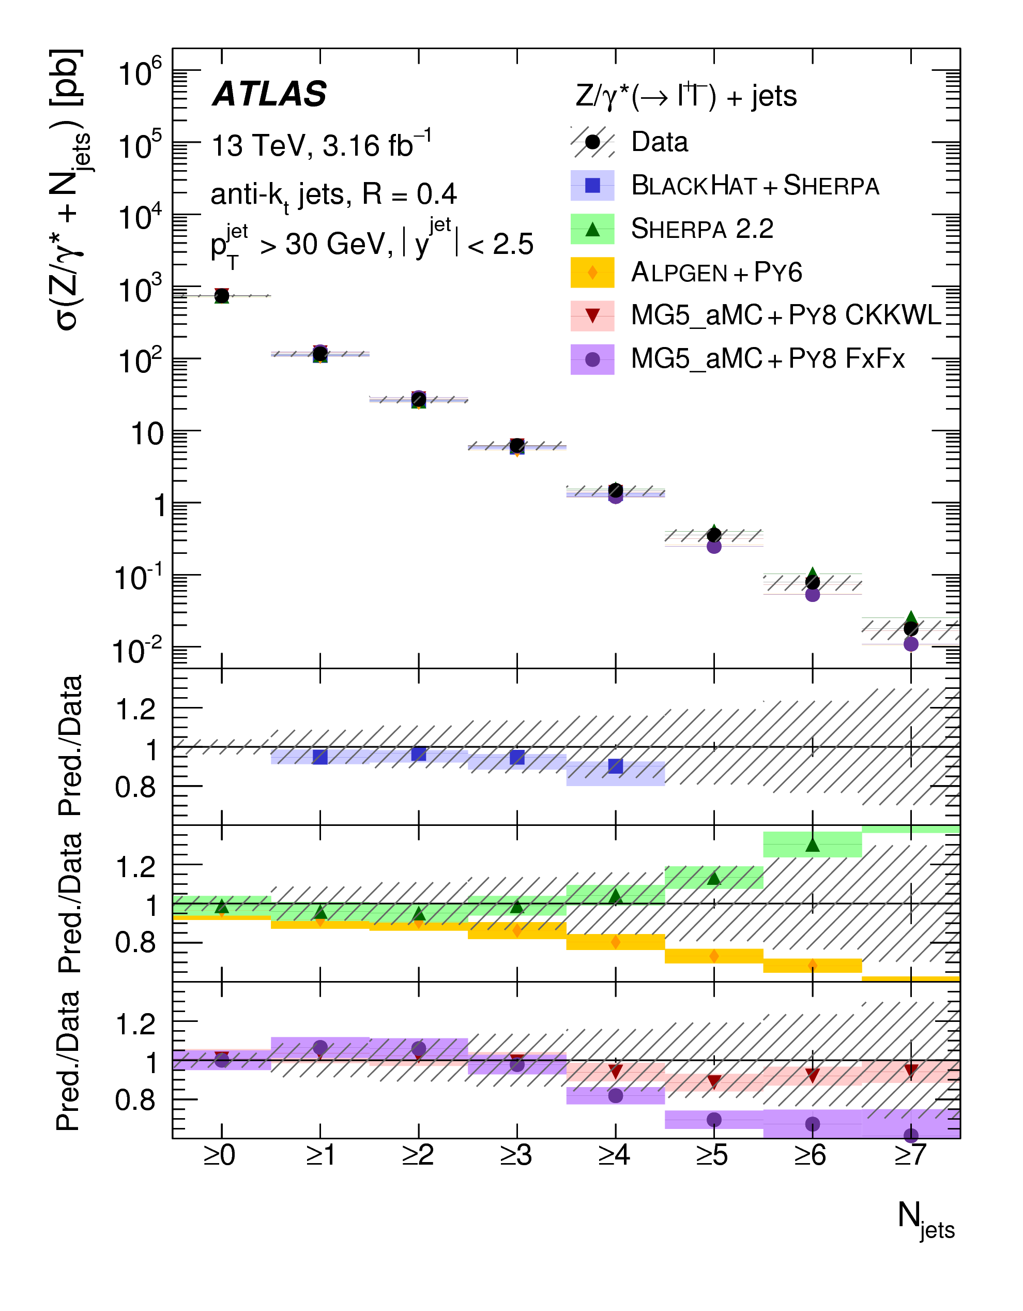
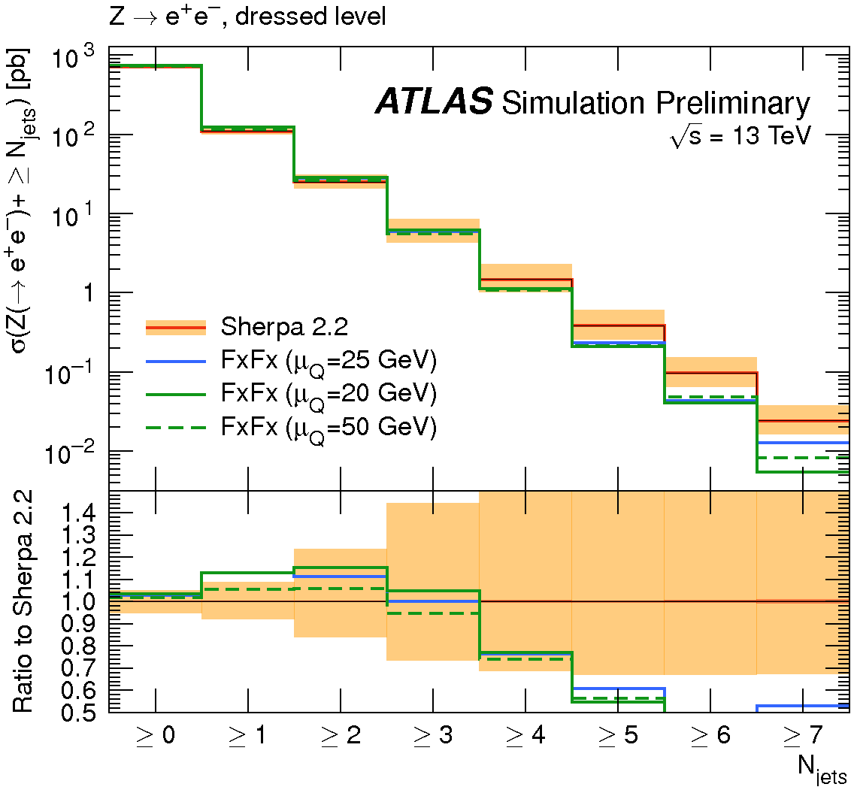
Z+jets: jet multiplicity
Figure of merit of goodness of QCD
predictions and important discriminator
with respect to the background in
Higgs and searches
MadGraph+Pythia8 CKKWL
(LO up to 4p) shows good agreement
with data, while Alpgen (LO up to 5p) ,
Sherpa (NLO up to 2 and LO up to 4p)
and NLO MadGraph+Pythia8 FxFx
(NLO up to 2 p) show a systematic
trend deviating from data at high jet
multiplicities
Eur. Phys. J. C77 (2017) 361
What about MC uncertainty?
Sherpa uncertainty band (PDF +scale+
statistical unc) quite large at high jet multiplicity
ATL-PHYS-PUB-2017-006

Slide 14

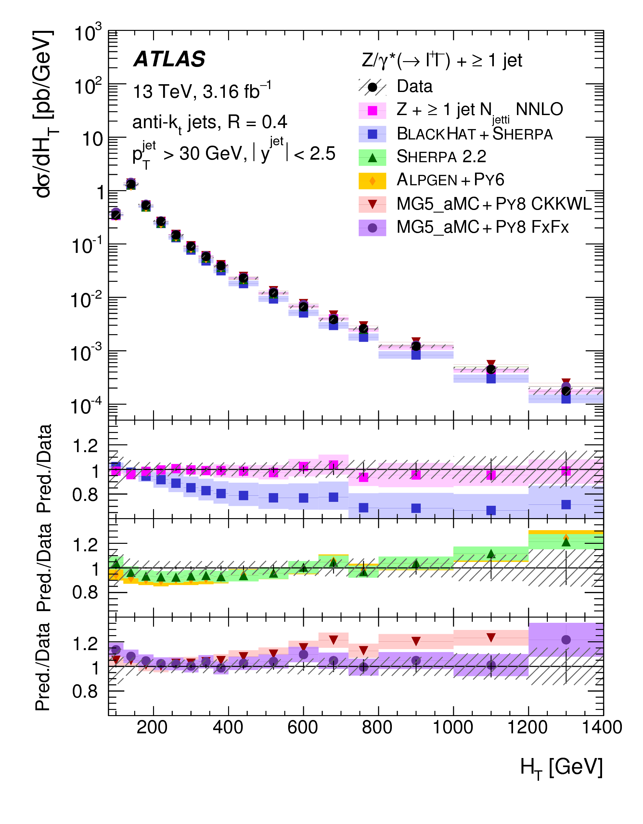
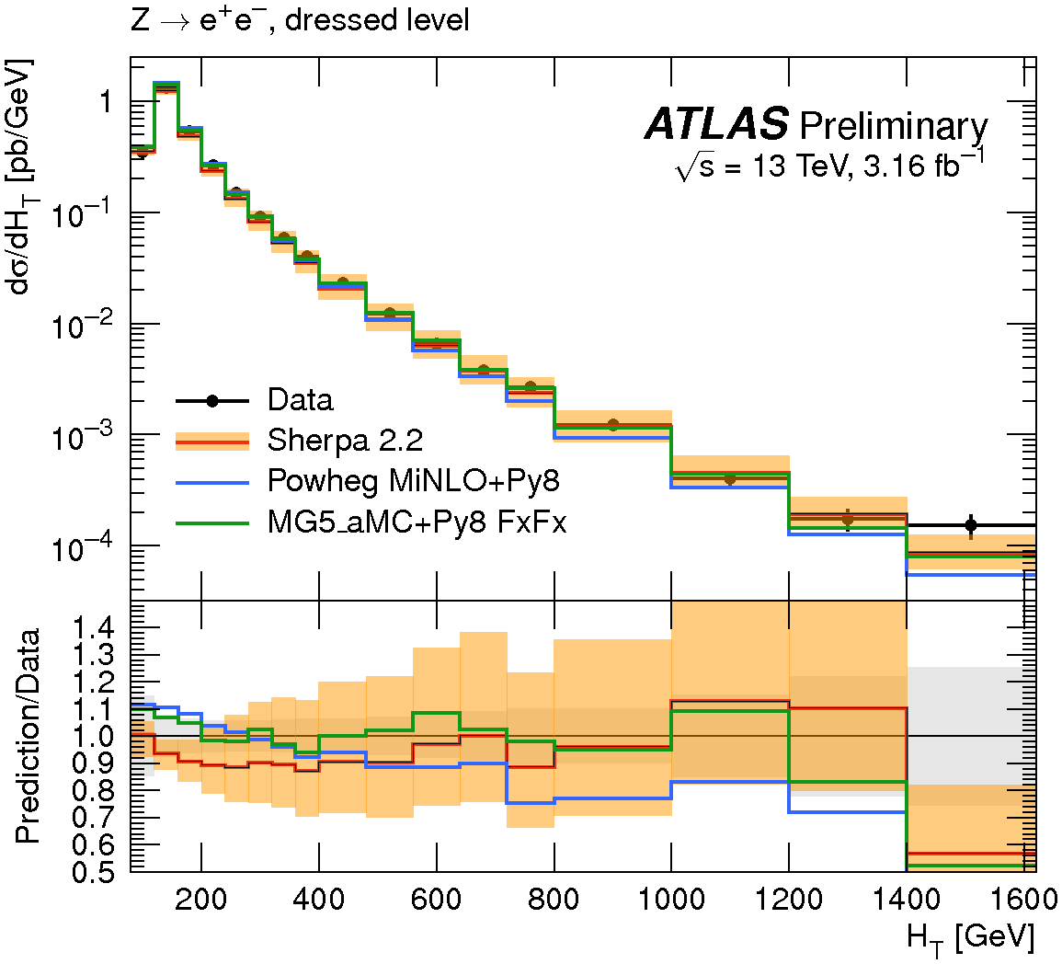
Z+jets: H_{T}
Important for searches: signal topologies
with large jet activity (discriminant with
respect to SM background)
NLO calculations from BlackHat+Sherpa
underestimate data
N_{jetti}NNLO recovers agreement by
adding higher orders in pQCD
LO MadGraph+Pythia8 CKKWL
over-predicts large H_{T}
Eur. Phys. J. C77 (2017) 361
What about MC uncertainty?
From 5% up to 50% using Sherpa (NLO up 2p
and LO up to 4)
Other NLO MCs contained within Sherpa uncertainty band, expect at low H_{T}
ATL-PHYS-PUB-2017-006

Slide 15
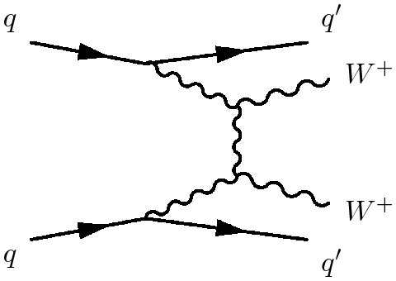
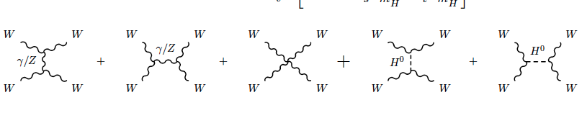
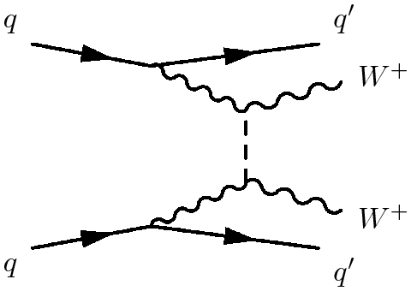
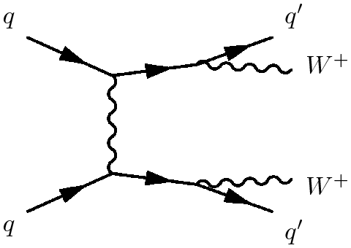
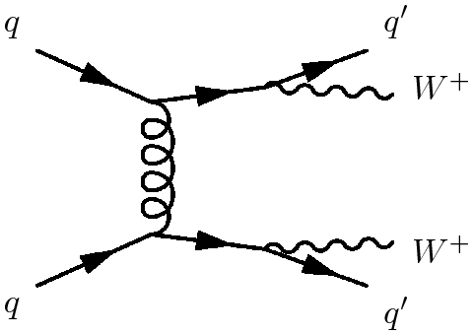
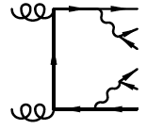
W±W±+jets
Final states sensitive to Vector Boson Scattering (VBS) allow to:
-Test the electroweak breaking symmetry (Higgs contribution)
- Study triple and quadratic gauge coupling
More info in the talk
of Francesco Conventi
(Tuesday)
EW processes:
H⁰
Self-interactions
Higgs contributions
Non resonant
QCD processes:
In W±W±jj (same sign) production
some diagrams do not contribute:
smaller cross-section than W⁺W⁻ jj (opposite sign),
but also large suppression of QCD processes
→ Golden channel to study VBS

Slide 16
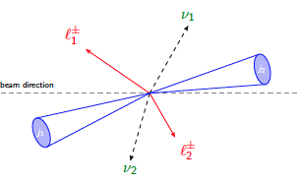
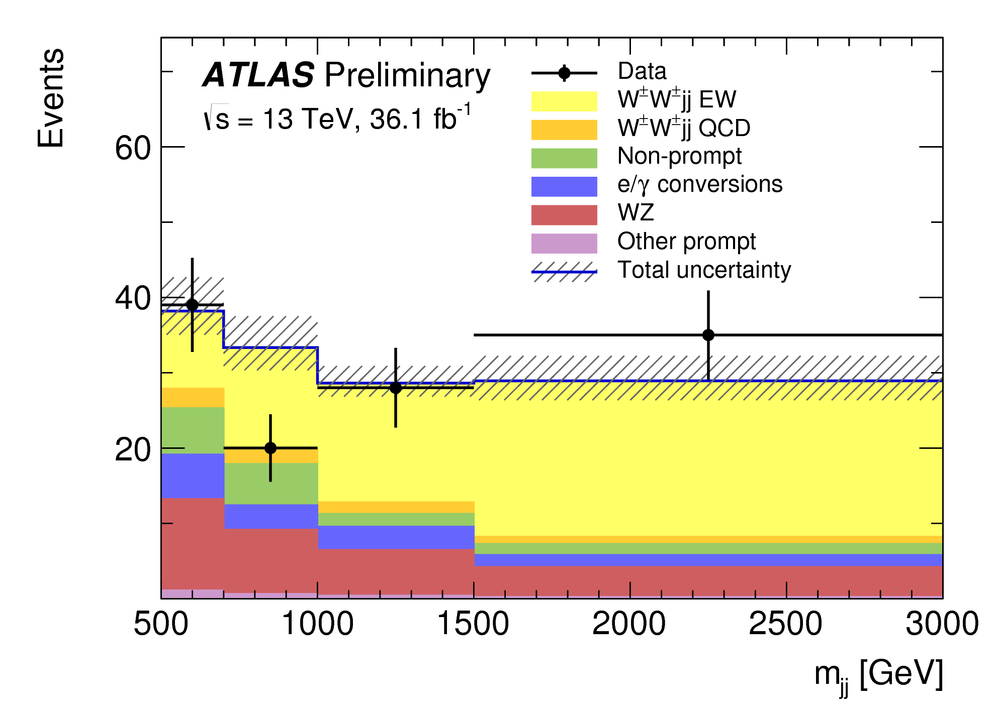
W±W±+jets: measurement
Fiducial phase-space of cross-section measurement:
2 isolated same-sign leptons (e±e±,μ±μ±,e±μ±)
central and p_{T} > 27 GeV, m_{ll}>20 GeV, ∆R_{ll} > 0.3
Missing E_{T} > 30 GeV
>=2 jets with p_{T}^{j1} > 65 GeV , p_{T}^{j2} >35 GeV, ∆R_{lj} > 0.3
|Δy_{jj}|>2
m_{jj}> 500 GeV
Detector level selection very close to fiducial phase-space plus
additional cuts to further reject background
EW signal extracted with fit on m_{jj} distribution
Observation of EW W±W±+jets by ATLAS@13 TeV
background-only hypothesis rejected with an
observed significance of 6.9σ
More info in the talk
of Francesco Conventi
(Tuesday)
ATLAS-CONF-2018-030
M_{jj} distribution after fit

Slide 17
W ± W ± +jets: MC configuration
Detailed study performed recently on several MC configurations - electroweak same-sign WWjj production
Tested impact on different ME orders and PS schemes
ATL-PHYS-PUB-2019-004
MC | ME order | PDFs of ME | PS & UE &Hadr Models
MadGraph (MadGraph5_aMC@NLO 2.6.2) | LO | NNPDF30nlo | Pythia8
 | NLO
 | LO |  | Pythia 8, Dipole Recoil
 | LO |  | Herwig7
 | NLO
Powheg | NLO | NNPDF30nlo | Pythia8
 |  |  | Pythia 8, Dipole Recoil
 |  |  | Herwig7
 |  |  | Herwig7, Dipole Shower
Sherpa | LO (2 samples with different scales) | NNPDF30nnlo | Sherpa PS
 | LO up to 1 additional parton

Slide 18
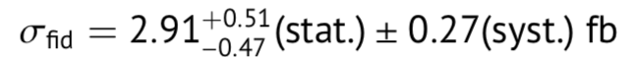
W±W±+jets: cross-section
MC
ATL-PHYS-PUB-2019-004
Powheg (NLO) and all MadGraph (LO and NLO)
configurations agree within 10% while
Sherpa (LO and LO up to 1 additional p) predicts lower
cross-sections
Difference of NLO calculations (MadGraph and Powheg)
of ∼10%, larger than their own ±2% uncertainty
(scale+PDF+ statistical unc), absence of the s-channel
diagrams in the Powheg configuration
Impact of changes in the PS (Pythia8 vs Herwig7)
is at most of 5%
ATLAS-CONF-2018-030
Data
Data in agreement with Powheg and MadGraph and about 1σ higher than Sherpa

Slide 19
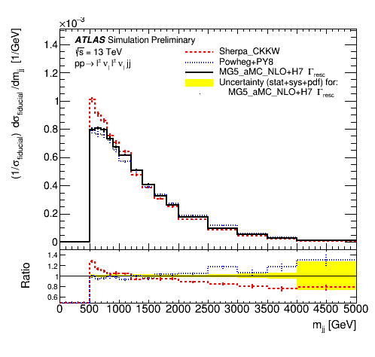
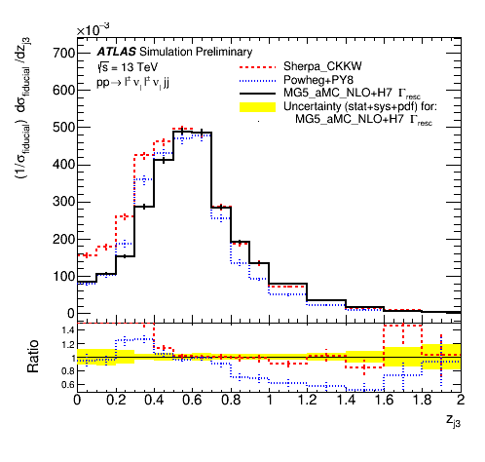
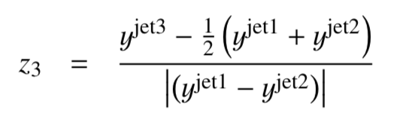
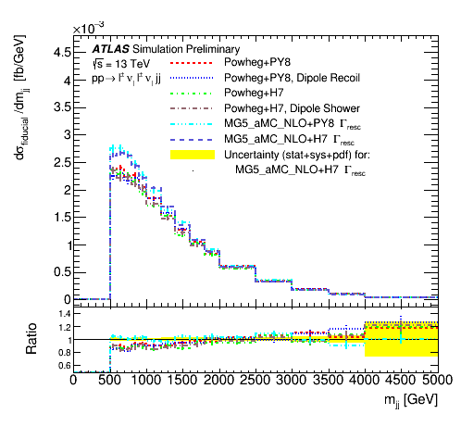
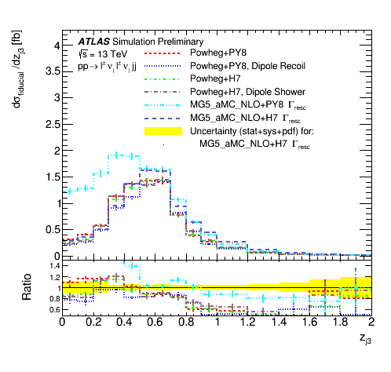
W±W±+jets: differential distributions
ATL-PHYS-PUB-2019-004
NLO MCs (Powheg and Madgraph)
produce harder m_{jj} spectra than LO MCs (Sherpa)
Differences between Sherpa and Powheg
up to 40% at high m_{jj}
Zeppenfeld variable of 3rd jet
found important difference among generators
Impact on PS choice studied for NLO Powheg
and Madgraph:
small effects for m_{jj}, while large effects for z_{j3}

Slide 20
Conclusions
Good MC modelling is central for producing high-profile physics results at LHC
ATLAS Collaboration is investing a huge effort in studying several MC configurations for several physics processes,
testing impact of several aspects: ME+PS matching , PS modelling, hadronisation modelling,
with the aim of identifying a baseline MC modelling as-good-as-possible and with a reasonable uncertainty
Best approach to push on new improvements on MC market (all our publications come with a Rivet routines to
facilitate comparison of our measurements with latest MC setups)
Shown today 3 cases focused on jet modelling: multijets, V+jets in QCD domain and VV+jets in EW-dominated regions
In general found good agreement data-MC and among different MCs in intermediate phase-space regions,
while in some cases important differences found in extreme phase-space regions (i.e. high m_{jj} and H_{T}) or in cases
dominated by additional radiation (i.e. modelling of z_{j3} or high jet multiplicity)

Slide 21
BACKUP

Slide 22

Multijet MC configuration
MC | ME order | PS & UE &Hadr Models | PDFs of ME | μ_{R} μ_{F} | PS&MPI tunes
Pythia 8.230 | LO 2→2 | p_{T}-ordered PS Lund model for Hadr | NNPDF23LO |  | A14 tune
MG5_aMC@NLO+Pythia8 (MadGraph5_aMC@NLO 2.3.3.1) | LO up to 4 part | PS&Hadr: Pythia8.212 Merging with CKKW-L prescriptions, merging scale=30 GeV | NNPDF30NLO | m_{T} of 2→2 process | ATLAS A14 (NNPDF23LO)
Herwig 7.1.3 | NLO dijets (Matchbox) | Angular-ordered PS Matching with MC@NLO-like algorithm Cluster model for Had | MMHT2014NLO | p_{T} leading jet | Dedicated tune
 |  | Dipole PS Matching with MC@NLO-like algorithm Cluster model for Had |  | p_{T} leading jet | Dedicated tune
Sherpa 2.2.5 | LO 2→2 | p_{T}-ordered PS with CSS Sherpa Sherpa AHADIC model for Hadr based on cluster fragm | CT14NNLO |  | Dedicate tune CT10 for MPI
 |  | p_{T}-ordered PS with CSS Sherpa Lund model for had with Pythia6.4
Powheg-Box V2 r3480 | NLO dijets | PS&MPI: Pythia 8.230 | NNPDF30NLO | p_{T} of Born configuration | A14 tune (NNPDF23LO)

Slide 23
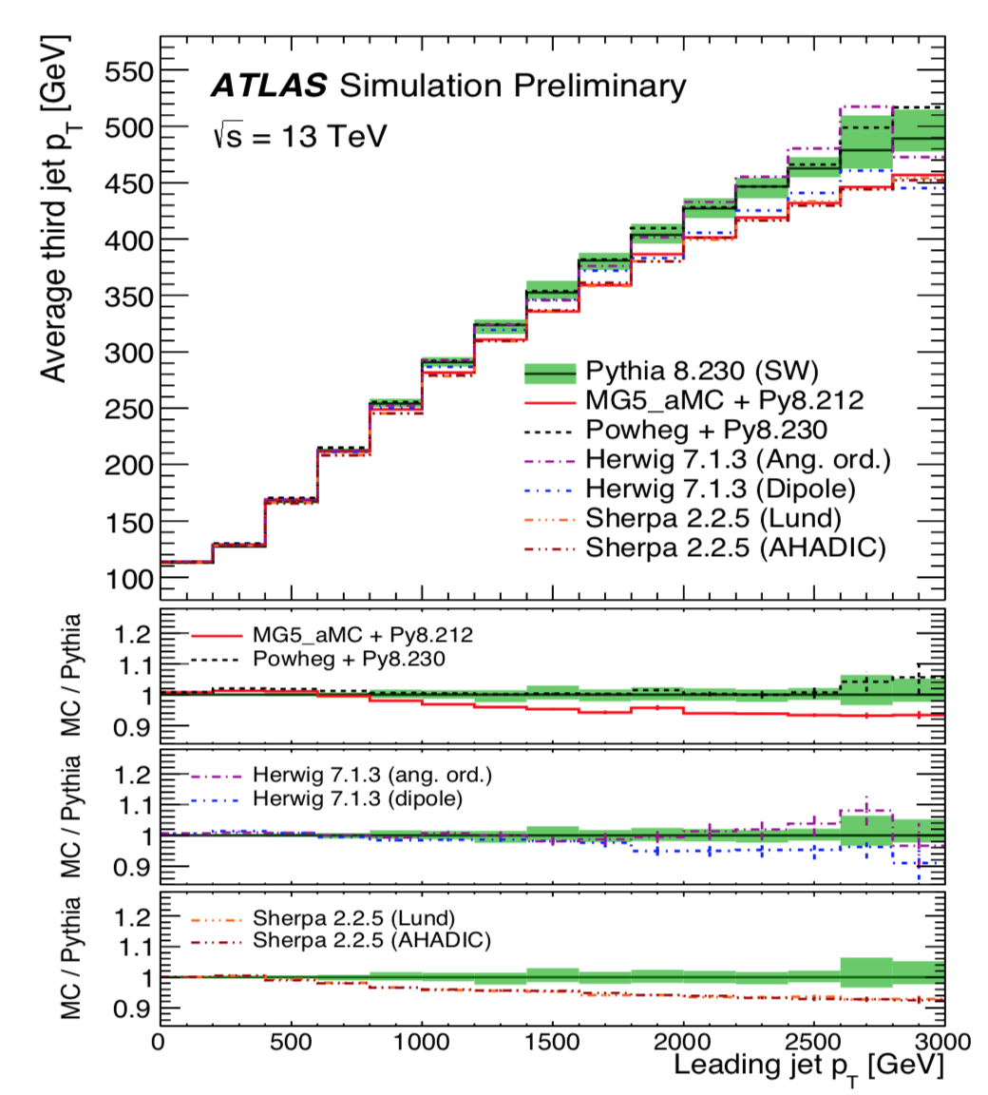
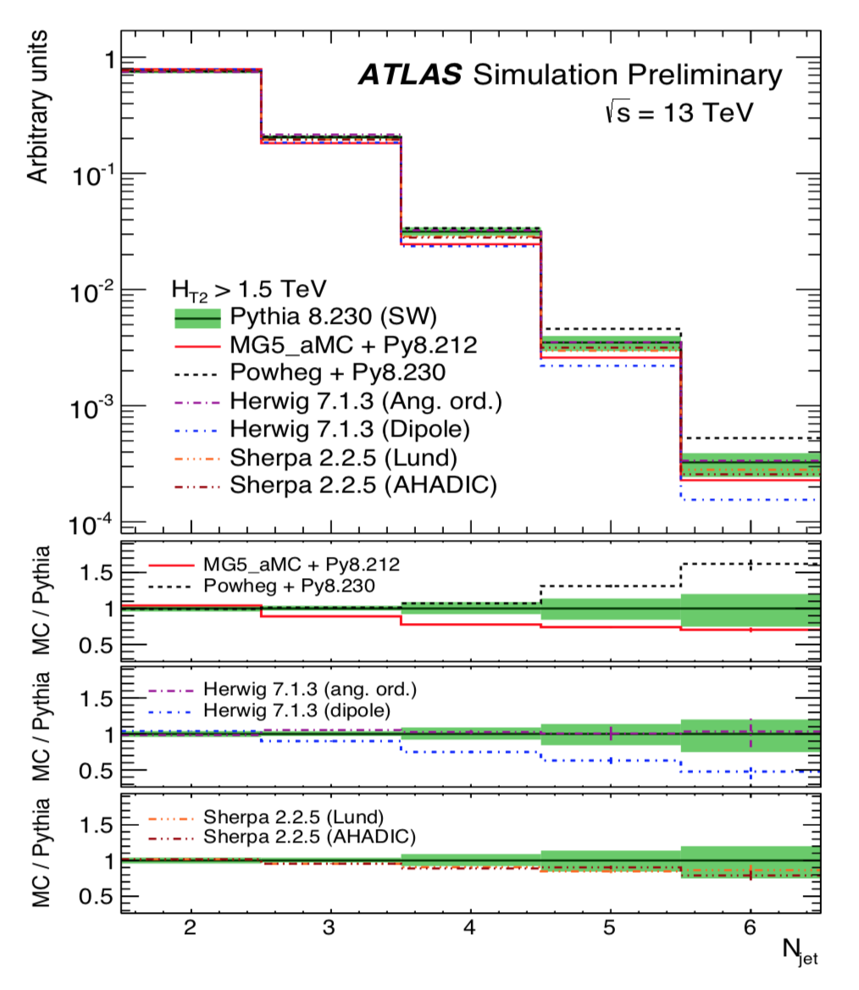
Multijet Event Topology
3rd jets from PS in Pythia8 and Sherpa (LO 2→2), from ME in Madgraph+Pythia8 (LO up to 4p), Herwig and Powheg+Pyhia8 (NLO)
anti-k_{t} R=0.4 jets with p_{T}>100 GeV |η|<2.5
and H_{T2} = p_{T1} + p_{T2} >1.5TeV
Herwig7 with dipole PS predicts a smaller N_{jet} than Pythia8,
angular-ordered PS and Sherpa in agreement with Pythia8
within PS unc. MadGraph+Pythia8 in the middle between
Pythia8 and Herwig7 dipole PS. Powheg predicts larger N_{jet}
MadGraph+Pythia8 and Sherpa predict softer emissions
than Pythia8

Slide 24
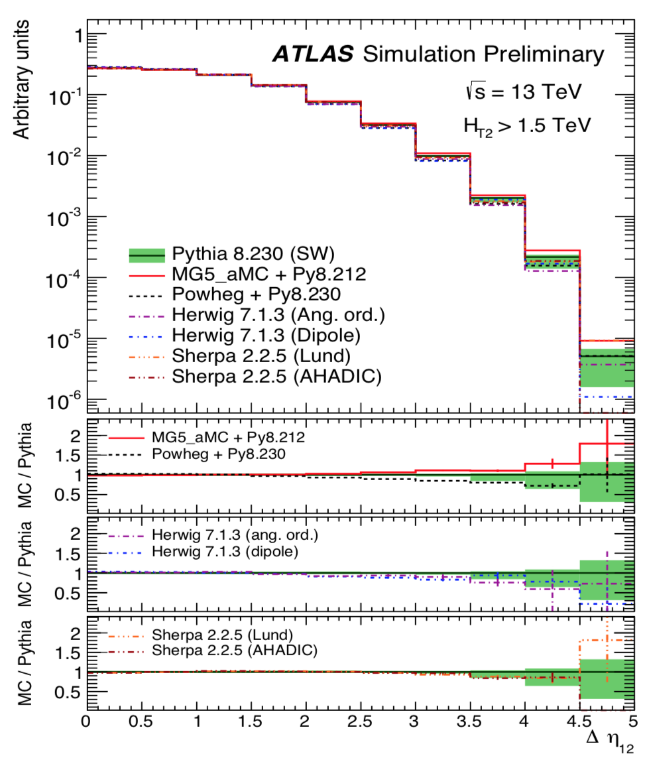
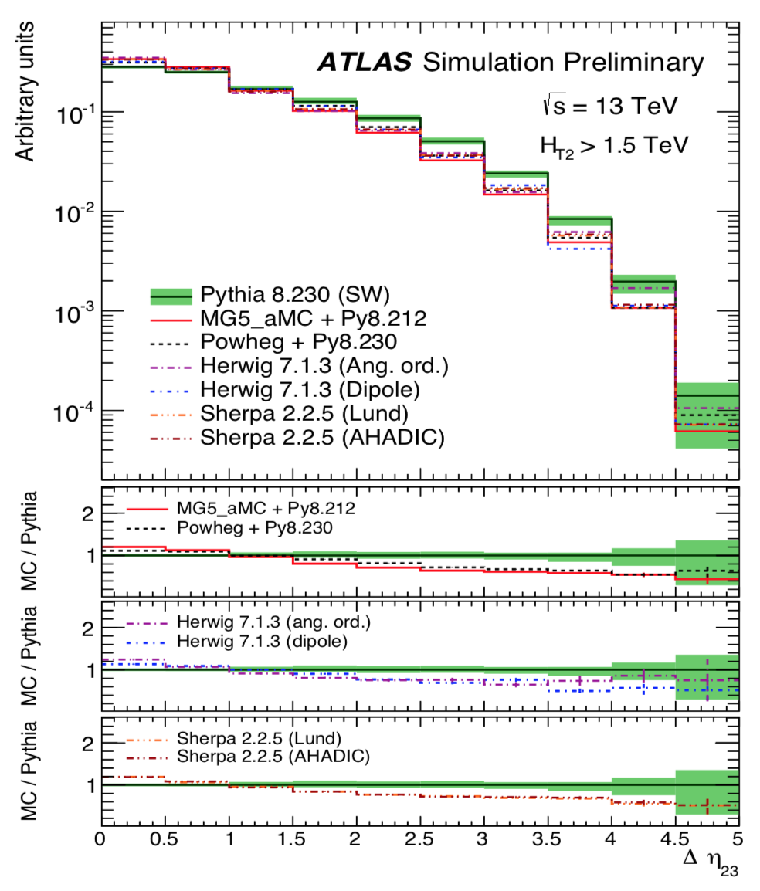
Multijet Event Topology
anti-k_{t} R=0.4 jets with p_{T}>100 GeV |η|<2.5
All MCs show a quite similar behaviour
∆η₂₃ shows significant differences among generators:
Pythia8 predicts systematically larger ∆η₂₃ than others, differences of up to 50%.

Slide 25
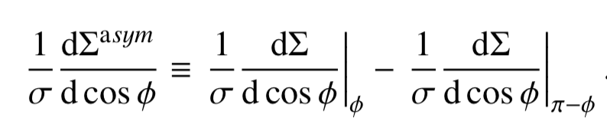
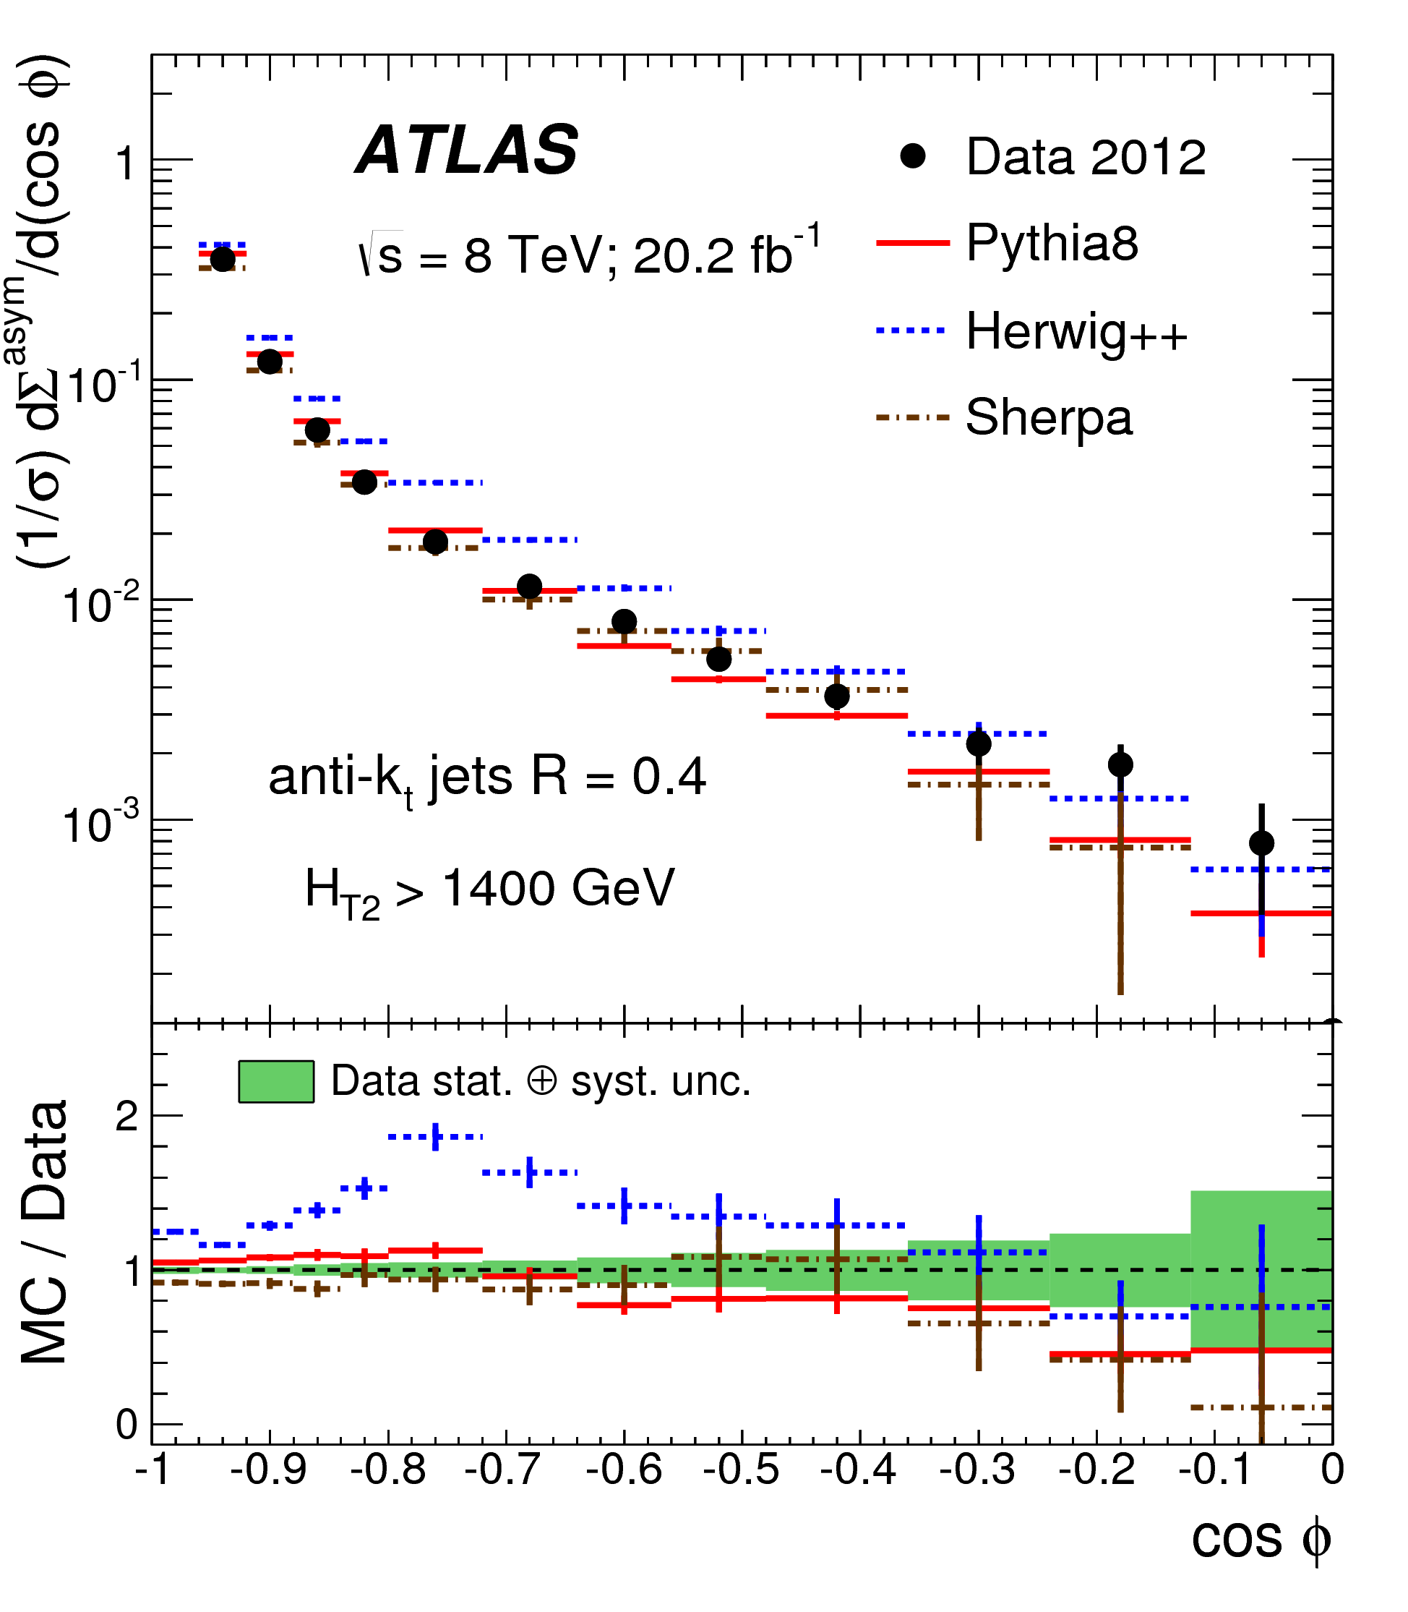
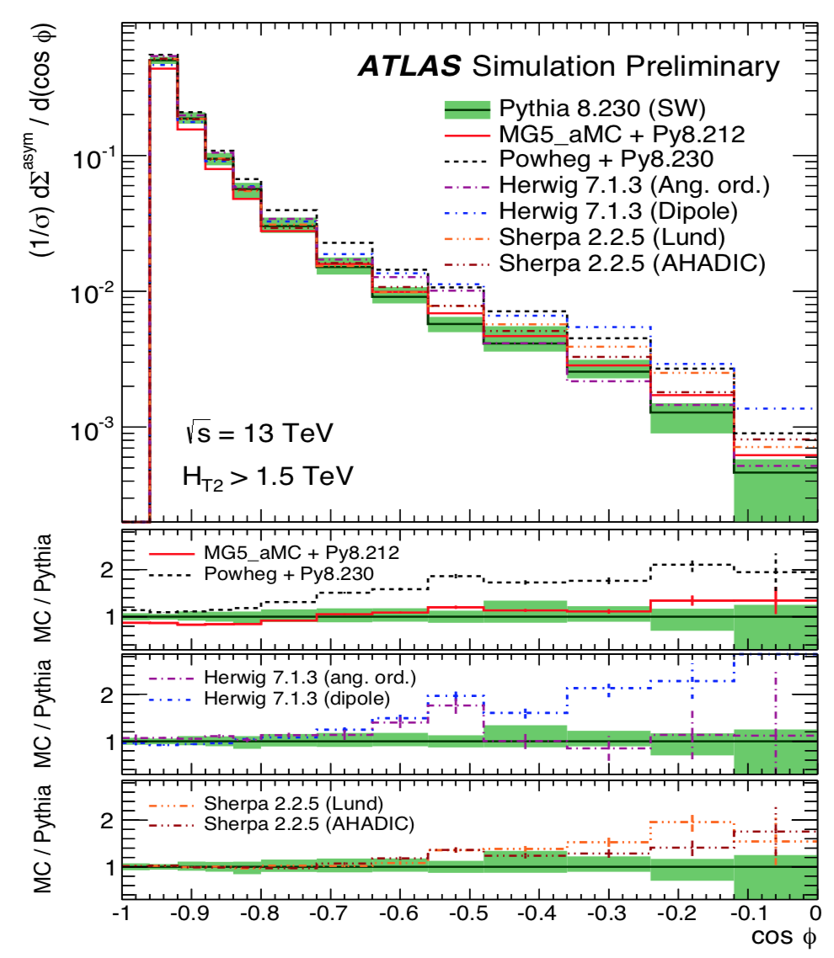
Multijet Event Shape
Event shapes sensitive to hard gluon radiation
Transverse Energy-Energy Correlation (TEEC) = transverse
energy-weighted distribution of azimuthal difference between jet pairs
Asymmetry between the forward and backward part of TEEC (ATEEC)
TEEC and ATEEC used to get α_{s} at various Q-scale
Eur. Phys. J. 77 (2017) 872
Data-MC@8TeV:
Pythia8 (LO 2→2) and Sherpa 1.4 (LO up to 3 p) sufficient to provide
a good description of the data, much better than LO Herwig with
angular-ordered PS (v2.5.1)
Latest MC@13TeV
Herwig7 (NLO), Powheg+Pythia8 (NLO) and Sherpa (LO 2→2)
predict more large-angle radiation than Pythia8 (LO 2→2),
MadGraph+Pythia8 (LO up to 4 p) shows less activity in the
central region
anti-k_{t} R=0.4 jets with p_{T}>100 GeV |η|<2.5 and H_{T2} = p_{T1} + p_{T2} >1.5TeV

Slide 26
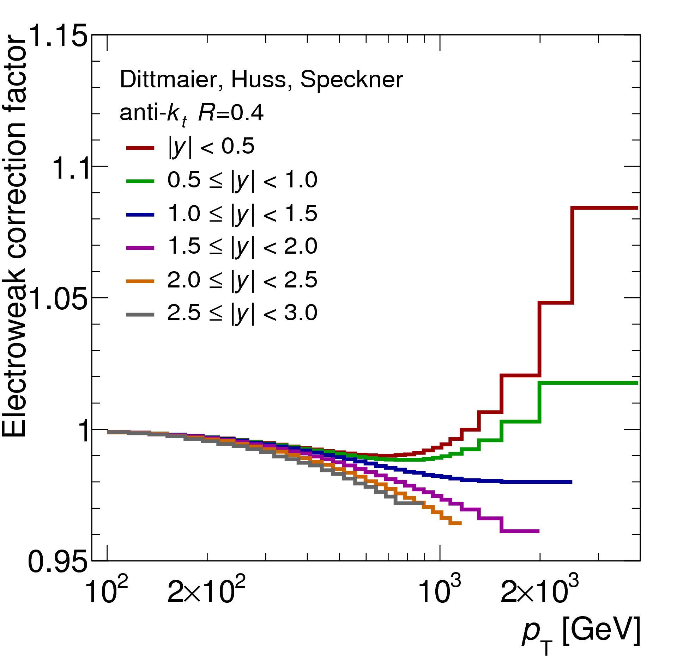
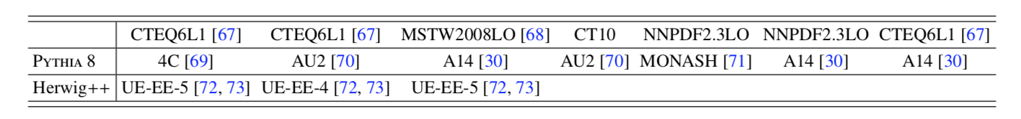
Inclusive jet cross-section
Default

Slide 27
Z+jets
MC | ME order (V+N partons) | PDFs of ME | PS & UE | PS &UE tunes
Sherpa v2.2 | NLO up to 2 p +LO up to 4 p | NNPDF3.0nnlo | PS&UE: Sherpa MEPS@NLO merging Matching scale= 20 GeV | Dedicated Sherpa tune
MadGraph CKKW-L (MadGraph5_aMC@NLO v2.2.2) | LO up to 4 p | NNPDF3.0nlo | PS&UE: Pythia v8.186 CKKW-L matching and merging Merging scale= 30 GeV | A14 tune (NNPDF23lo)
MadGraph FxFx (MadGraph5_aMC@NLO v2.3.3) | NLO up to 2 p | NNPDF2.3lo | PS&UE: Pythia v8.210 Merging with FxFx prescription Merging scale = 25 GeV | A14 tune (NNPDF2.3lo)
Powheg MiNLO | NLO up to 1 p | CT14nnlo | PS&UE: Pythia v8.186 | AZNLO tune (CTEQ6 L1)
Alpgen | LO up to 5 p | CTEQ6L1 | PS&UE: Pythia v6.426 MLM matching and merging Matching scale= 20 GeV | Perugia2011C

Slide 28


Z+jets: m_{jj}
Eur. Phys. J. C77 (2017) 361
Quite good modelling at low values,
in the high mass range
LO MadGraph+Pythia8 CKKWL
predicts an harder m_{jj}
Similar trend also for NLO Sherpa
exploring up to very high mass
range and up to large rapidity
separation
Phys Lett B 775 (2017) 206
Events with at least 2 jets with
p_{T}>55, 45 GeV |y|<4.4 M_{jj}>250 GeV
and at least 1 additional jet in the gap

Slide 29


Z+jets: m_{jj}
Events with at least 2 jets
with p_{T}>55, 45 GeV |y|<4.4
M_{jj}>250 GeV and
at least 1 additional jet in
Detector level
Particle level
Sherpa uncertainty band shown

Slide 30


W ± W ± +jets
Example of missing processes in Powheg:

Slide 31
W±W±+jets: cross-section
MC
ATL-PHYS-PUB-2019-004
Powheg (NLO) and all MadGraph (LO and NLO)
configurations agree within 10% while
Sherpa (LO and LO up to 1 additional p.) predicts lower
cross-sections.
Sherpa LO: central emission excess from PS due to not optimal color flow setup; Sherpa LO up to 1 add. part. (CKKW): fixed central emission, but cross-section reduction from suppression of spuriously large Sudakov factors
Difference of NLO calculations (MadGraph and Powheg)
of ∼10%, larger than their own ±2% uncertainty
(scale+PDF+ statistical unc), absence of the s-channel
diagrams in the Powheg configuration.
Impact of changes in the PS (Pythia8 vs Herwig7)
is at most of 5%.
Data includes W±W±jj electroweak plus interference with
W±W±jj strong , predictions not include interference with the
strong production (+6%) and NLO EW corrections (-16%)
ATLAS-CONF-2018-030
Data
Data in agreement with Powheg and MadGraph and about 1σ higher than Sherpa

Slide 32


W ± W ± +jets: Δy_{jj}
Sherpa predicts a slightly narrower ∆y_{jj} distribution difference up to 20% around ∆y _{j j} = 2.0 (fiducial cut)

Slide 33

W±W±jj: Signal & Background
Further background reduction (applied only at detector level):
additional leptons veto events → reduce background with prompt leptons
Z veto in ee final state → reduce Z+jets background from charge mis-ID
veto events containing b-jets → reduce ttbar
Non-prompt lepton backgrounds (W+jets, ttbar (semi-leptonic), dijet)
with data-driven technique in control region with a 50-90% uncertainty,
dominant one pre-fit
Electron charge mis-identification & prompt photon conversions:
- Electron charge mis-ID (Z+jets, W⁺W⁻, ttbar (di-leptonic))
with data-driven technique
- Prompt photon conversion: Wγ from MC with normalization from
control region
Prompt backgrounds:
WZ from MC with normalization from a trilepton control region
strong W±W±jj subtracted as background.
A total of 122 candidate events is observed for
a background expectation of 78 ± 15 events before the fit
ATLAS-CONF-2018-030
Signal
(34%)
WZ (27%)
WWjj strong (6%)
Non prompt
(19%)
e/γ conv
(11%)
Other (prompt)
Expected Signal and background
composition before fit
33

Slide 34

W±W±jj: the observation
ATLAS-CONF-2018-030
Analysis performed in six channels:
e⁺e⁺, μ⁺μ⁺, e⁺μ⁺ and e⁻e⁻, μ⁻μ⁻, e⁻μ⁻
Signal extracted in a binned fit to m_{jj} distributions
(4 bins) in signal region (m_{jj} > 500GeV) and
control regions (200 < m_{jj} < 500GeV)
dominated by WZ and non-prompt lepton background
The background-only hypothesis is rejected
with an observedsignificance of 6.9σ
Measured signal strength parameter:

