Slide 1
FASER, WP1 report
Francisco Sanchez Galan & Liam Dougherty
16 May 2019
FASER LS2 work coordination meeting

Slide 2
Work done 1 to 16 May
Visits with CV (LHC), EN-EL (ENP/FC)
VIC EN-EL-EIC
On-site interventions related to lowering cable trays
Gangway manufacturing (pending small modifications, HSE in the loop )
SAS quotes received, ONET retained.
EDMS structure

Slide 3
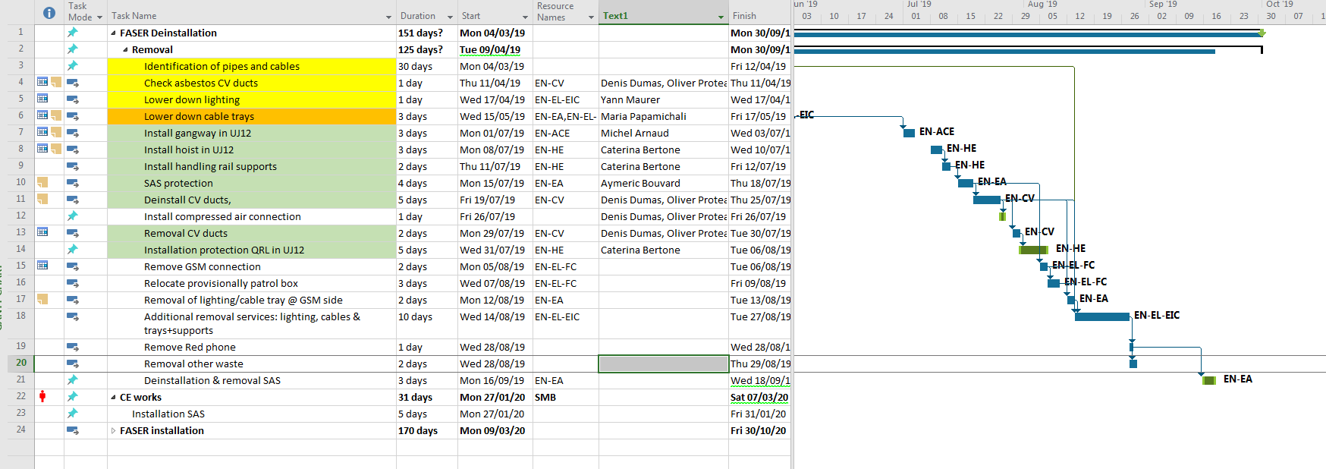
Planning consolidation
BASELINE: avoid coactivity
SAS installation date tbc. Current proposal assuming uncertainty about installation of gangway
Proposal: Start EN-HE 8 july (agreed with Caterina). 8/7: occupation du tunnel pendant toute la journée en heures ouvrables
Proposal start CV work 22 july
~1 month contingency

Slide 4
To do
Cable tray related activities planning inside TI12 ongoing
Coordination with CE (SAS)
Coordination EN-HE/SMB (loads for handling rails)

