Slide 1

The FASER Experiment project structure
EN-ACE-PLM

Slide 2
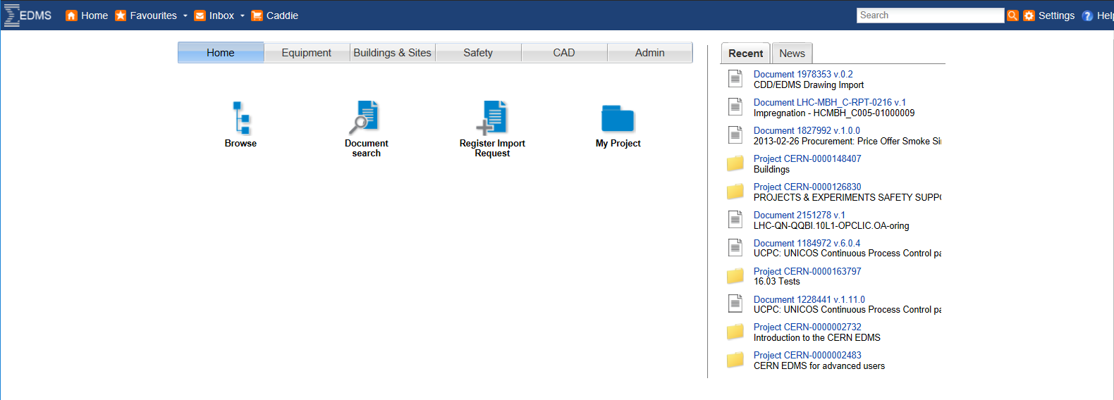
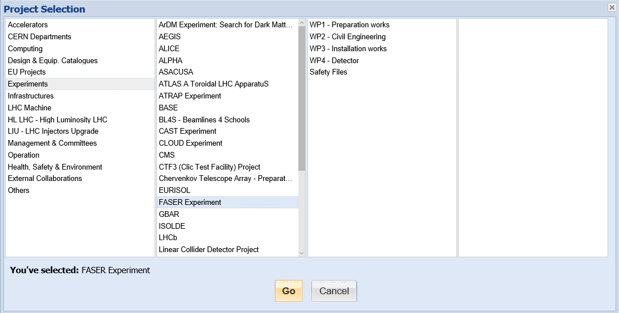
How to access the FASER Experiment node

Slide 3
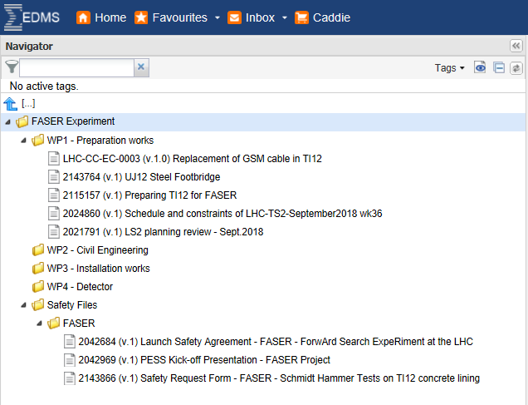
Main configuration aspects
Access derived from the following e-group:
faser-ls2-works-coord
Release Procedures:
  DOC-OWNER
  DOC-PE
Approvers:
  BOYD JAMIE
  SANCHEZ GALAN FRANCISCO
  DOUGHERTY LIAM ANDREW
  GALL JONATHAN NATHANIEL
  PETERSEN BRIAN
  ANDREINI MARCO
Document visibility
CERN Internal when the document is in Released status

Slide 4
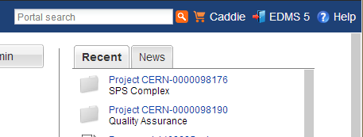
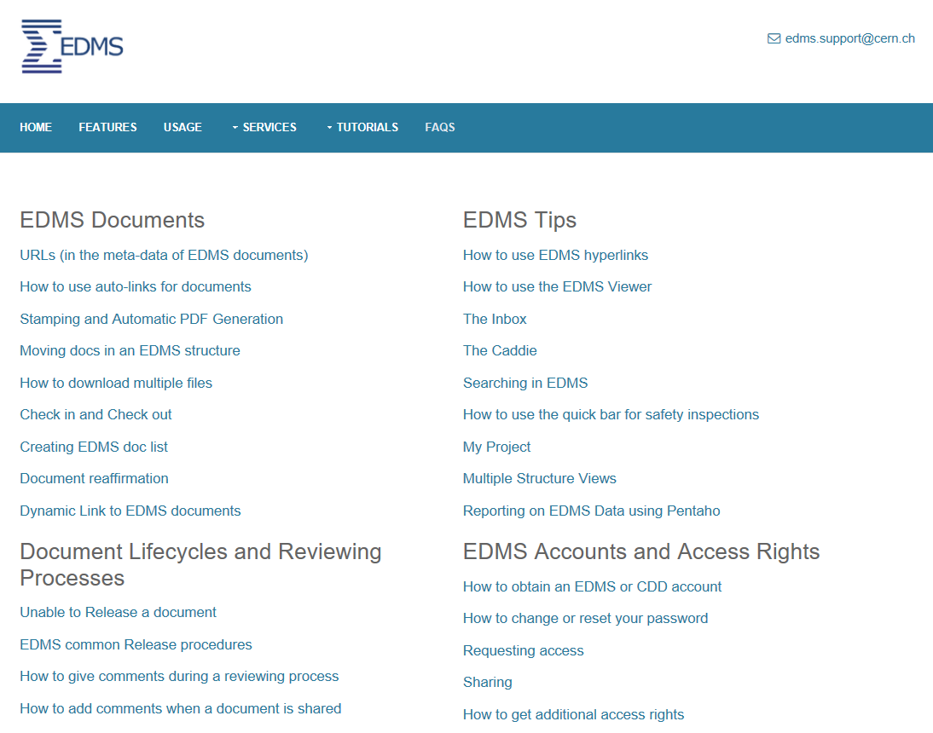
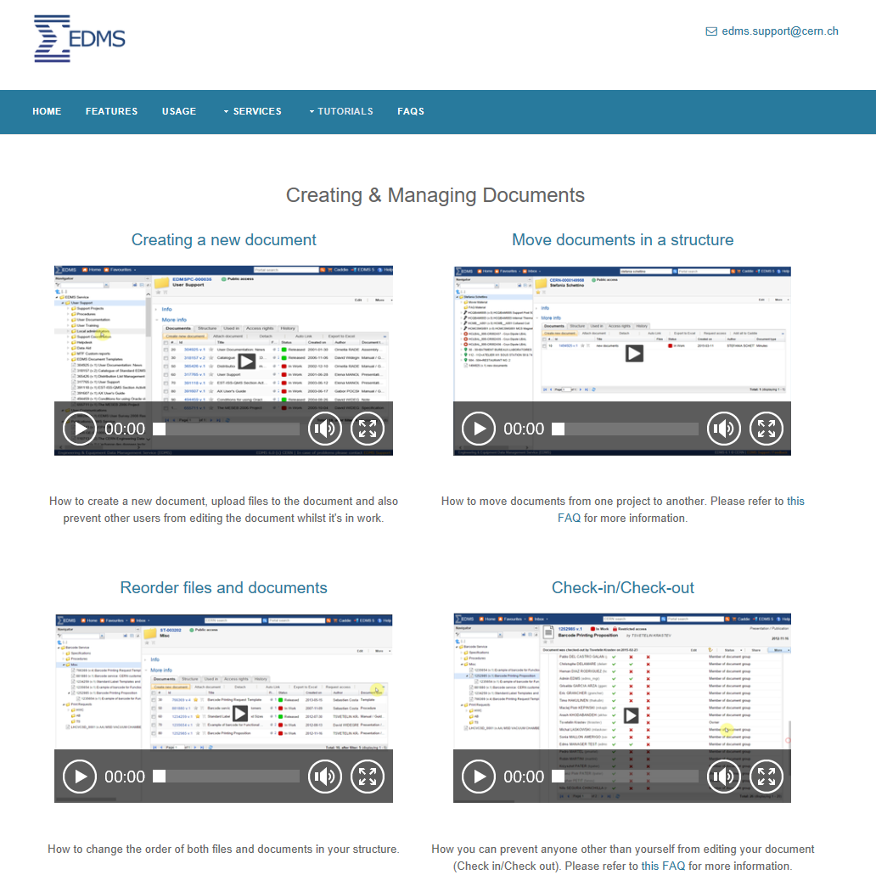
EDMS documentation and FAQs
A set of Guidelines, Tutorials, Registration Forms and useful information is available through the EDMS Service Site. You can access it through the ‘Help’ link from any EDMS page.
https://edms-service.web.cern.ch/edms-service/faq/EDMS/pages/index.html

Slide 5
Support Organization
Central Support
  EDMS.Support@cern.ch
  Hotline 77777
  Training
  Consultancy
  Support
Local Support
  EDMS Local Administrators
  (management of users, access groups, structures, contexts and roles)
Local admin.
EDMS Support
EDMS Course

