Slide 1

Integration procedure DFX vertical part in the Tunnel
R. Betemps, Y. Yang, M. Amparo

Slide 2
Summary
Integration of the DFX in the Tunnel
Tunnel space and working area
DFX unit.
SC link (DSH) with the splice box
Integration process.

Slide 3
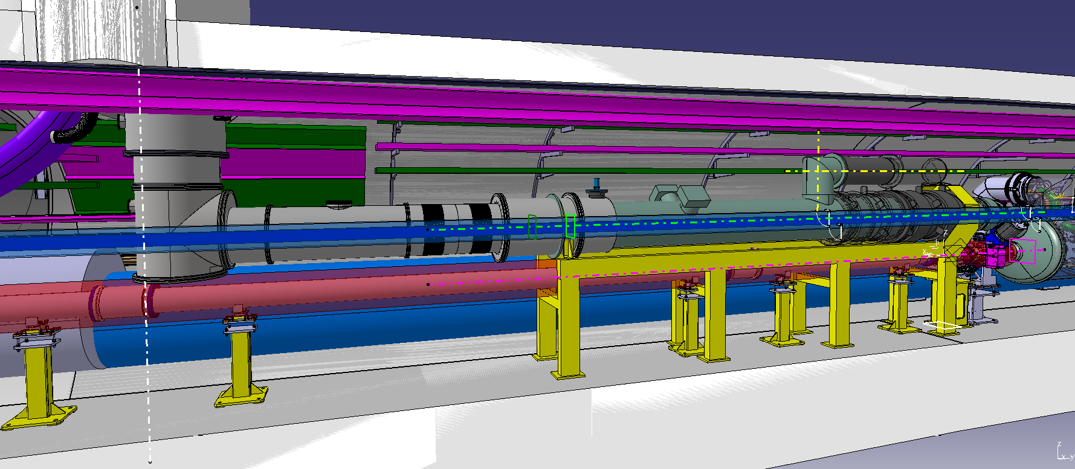
Integration of the DFX in the Tunnel
Reference document for integration EDMS XXXXX
We considerer for the image the point 5L (more critical)

Slide 4
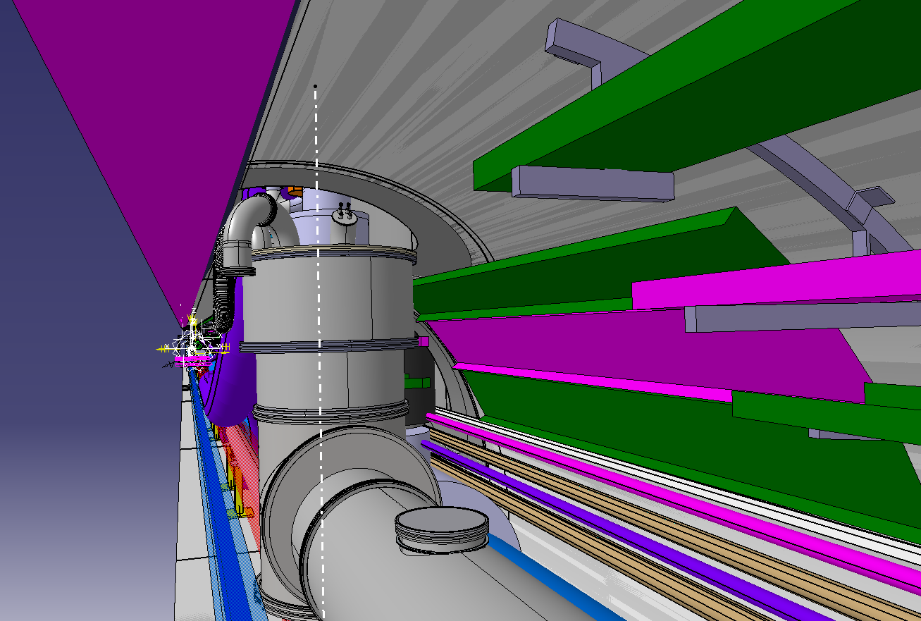
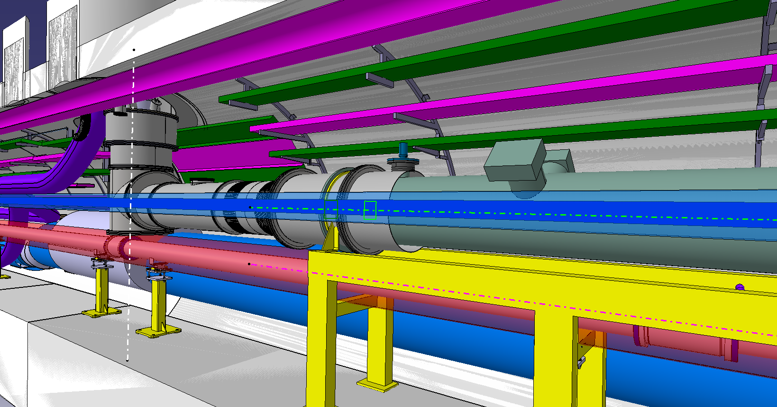
Integration of the DFX in the Tunnel

Slide 5
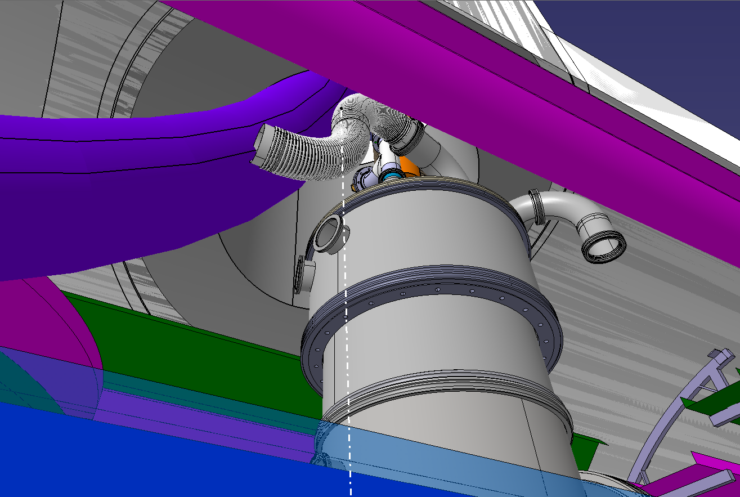
Integration of the DFX in the Tunnel

Slide 6
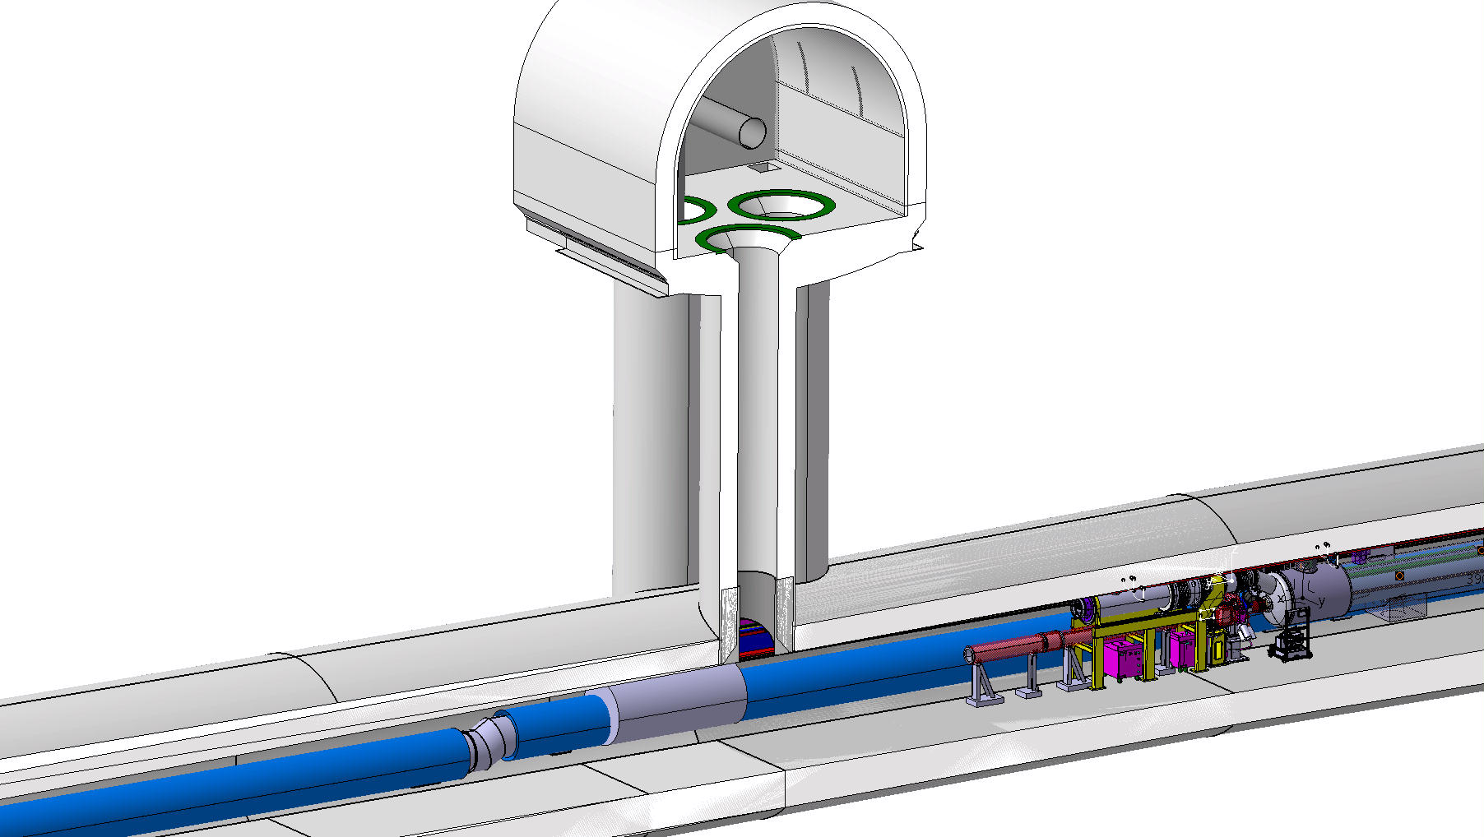
Tunnel view for installation
Not beam pipe
Free space below the final position

Slide 7
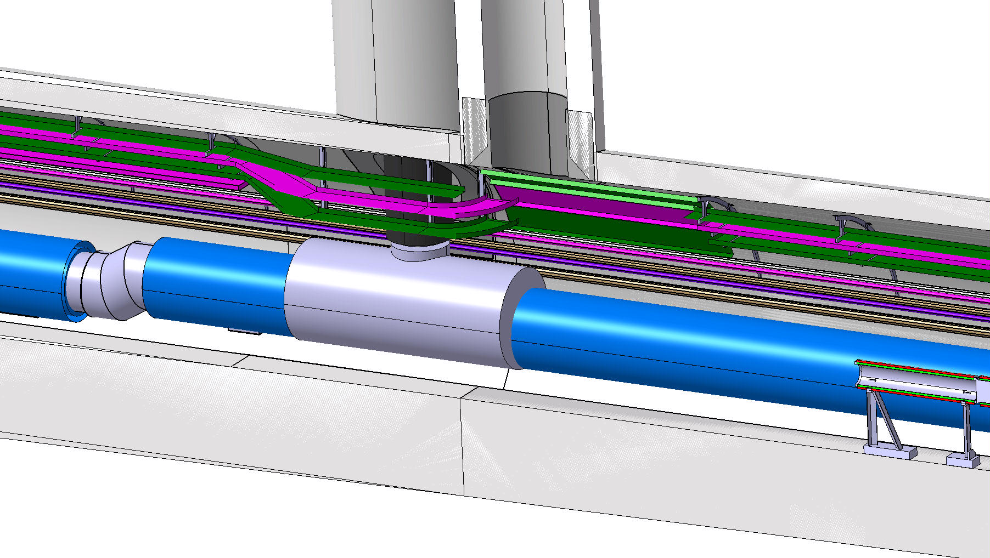
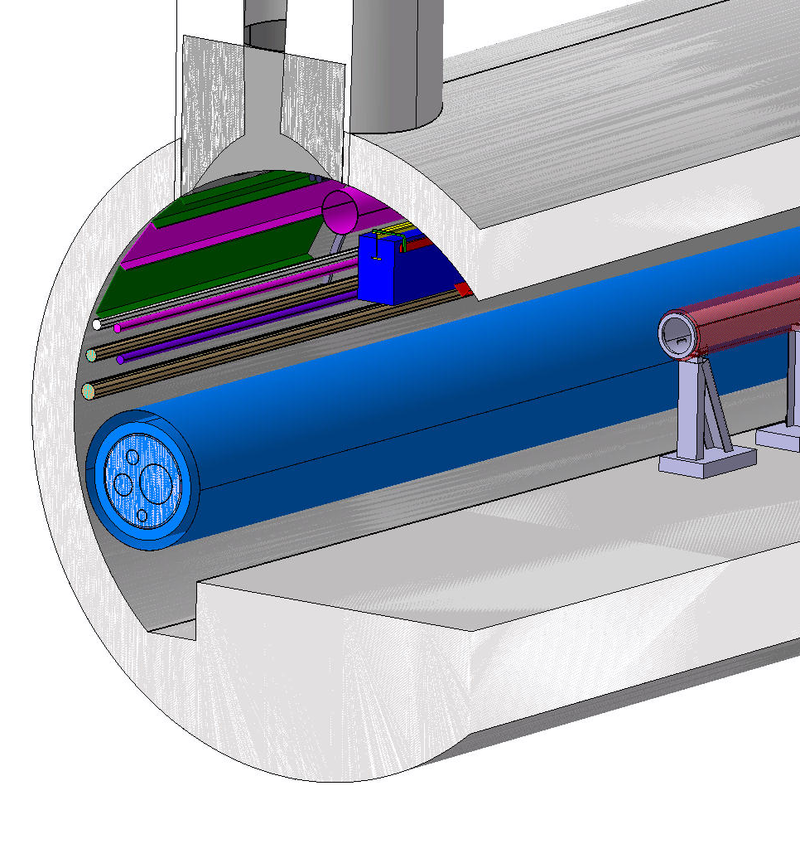
Tunnel view for installation

Slide 8
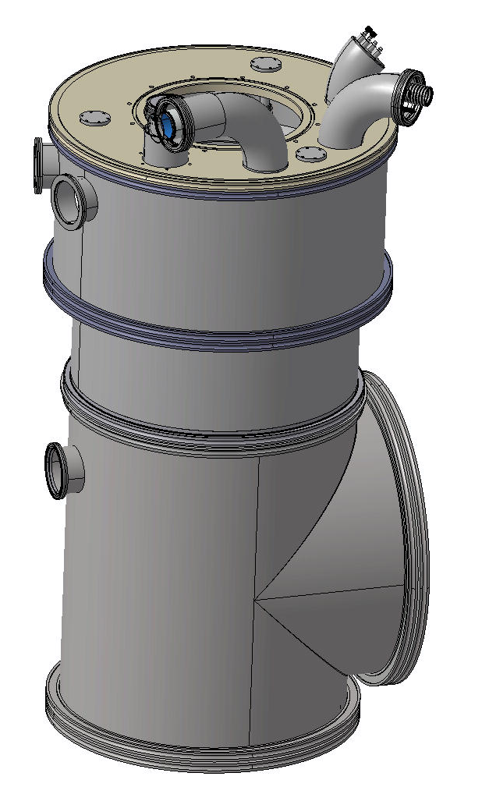
DFX unit
2 sub unit for the DFX
Vertical
Dimensions : 800 x 800 X1750
Horizontal
Dimensions :

Slide 9
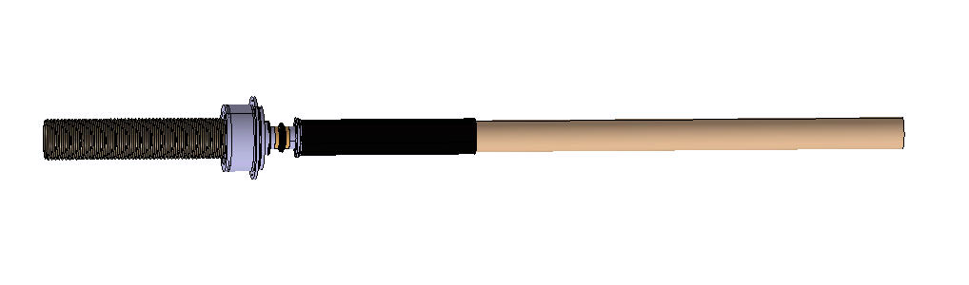
SC link (DSH) with the splice box
End of the SC link DSHx :

Slide 10
Integration process vertical unit
Top Flange in position
DFX preparation (vertical unit)
SC link (DSHx) in assembling position
Welding & welding check
Move SC link DSHx & DFX in final position
Welding of the accessory
Close the vacuum chamber and adjust the fixation to the top flange
Bend the NbTi busbar

Slide 11
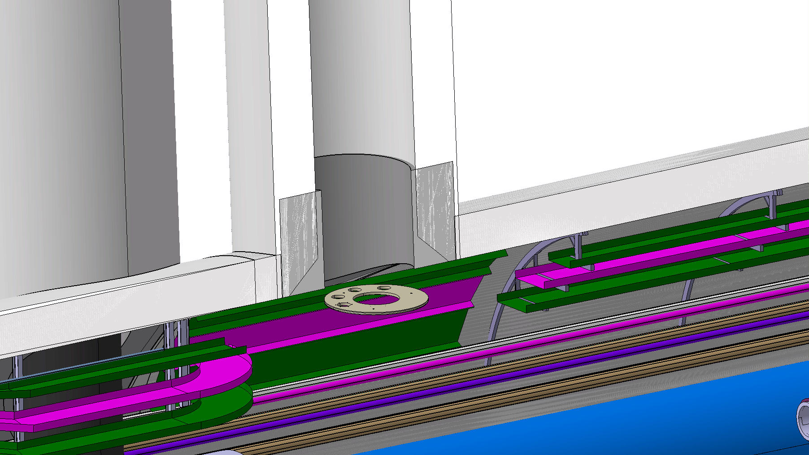
Top Flange in position

Slide 12
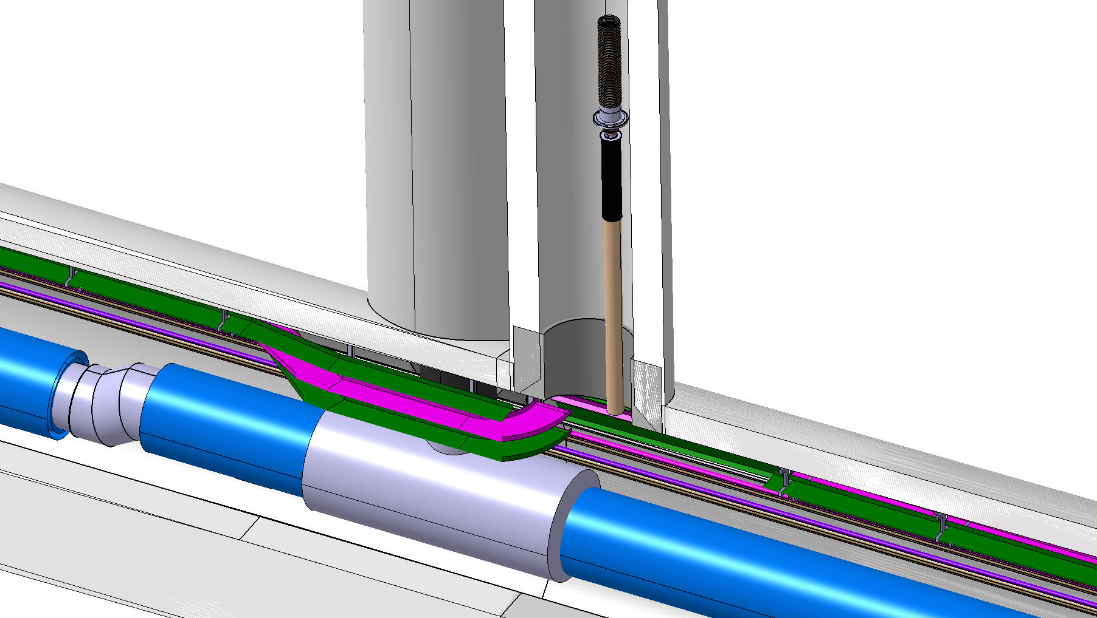
DFX preparation (vertical unit)

Slide 13
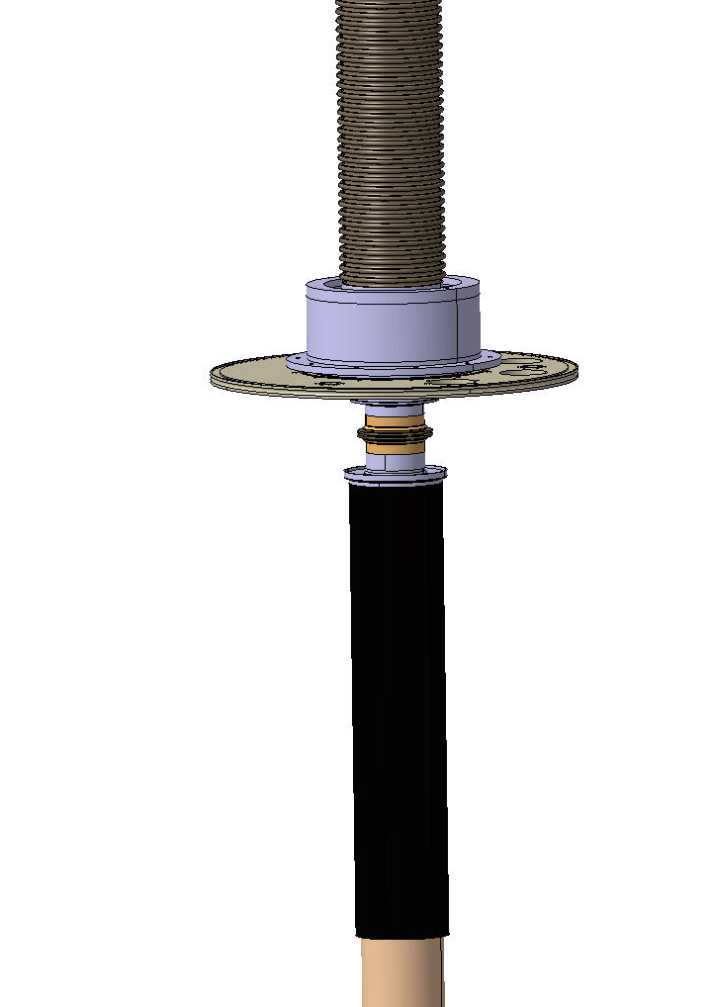
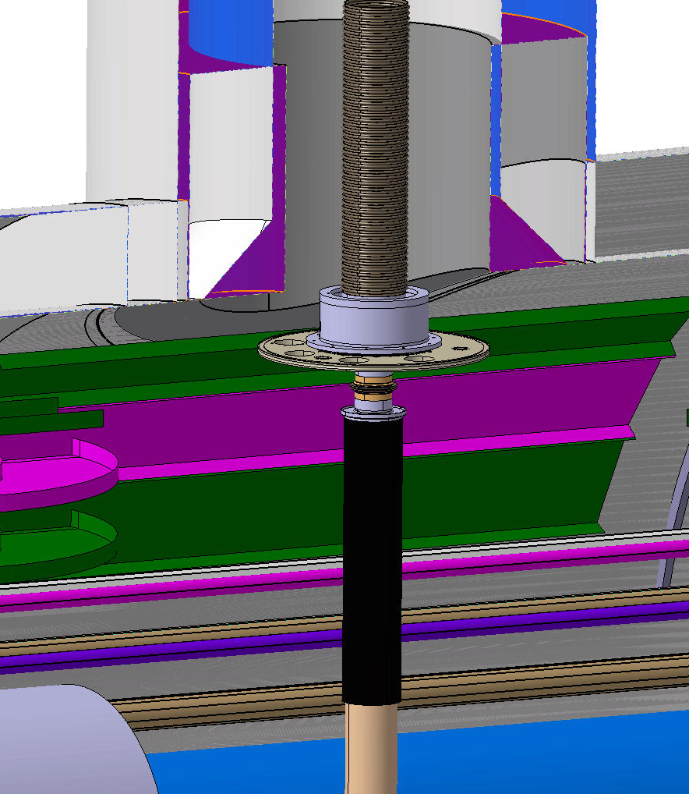
SC link (DSHx) in assembling position

Slide 14
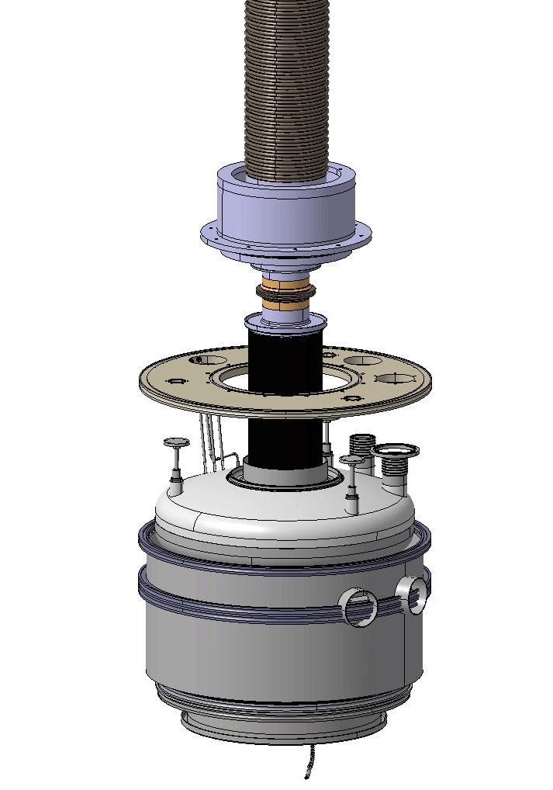
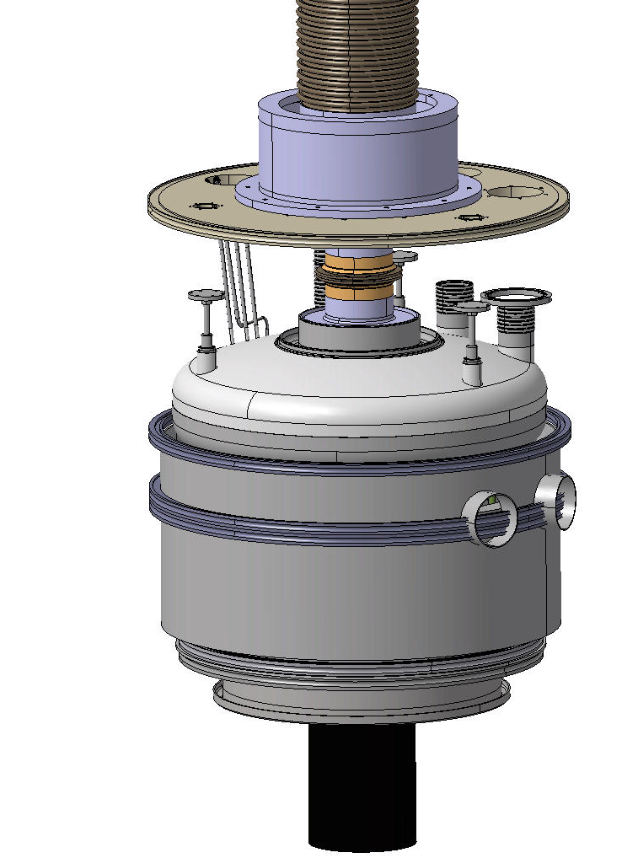
Welding & welding check

Slide 15
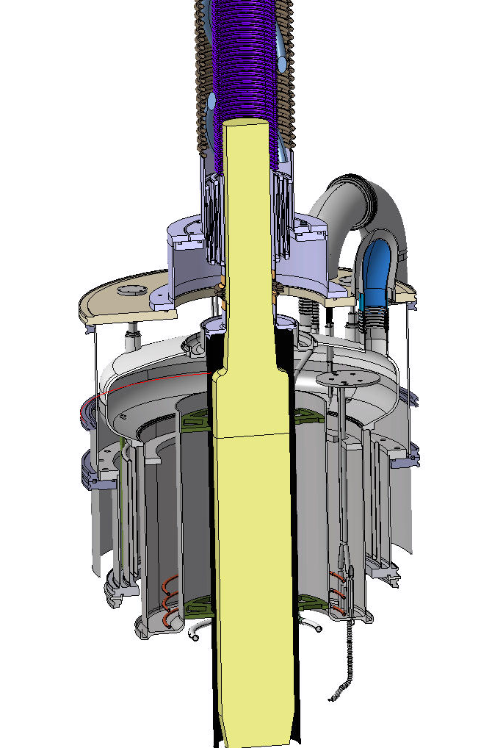
Move SC link DSHx & DFX in final position

Slide 16
Welding of the accessory

Slide 17
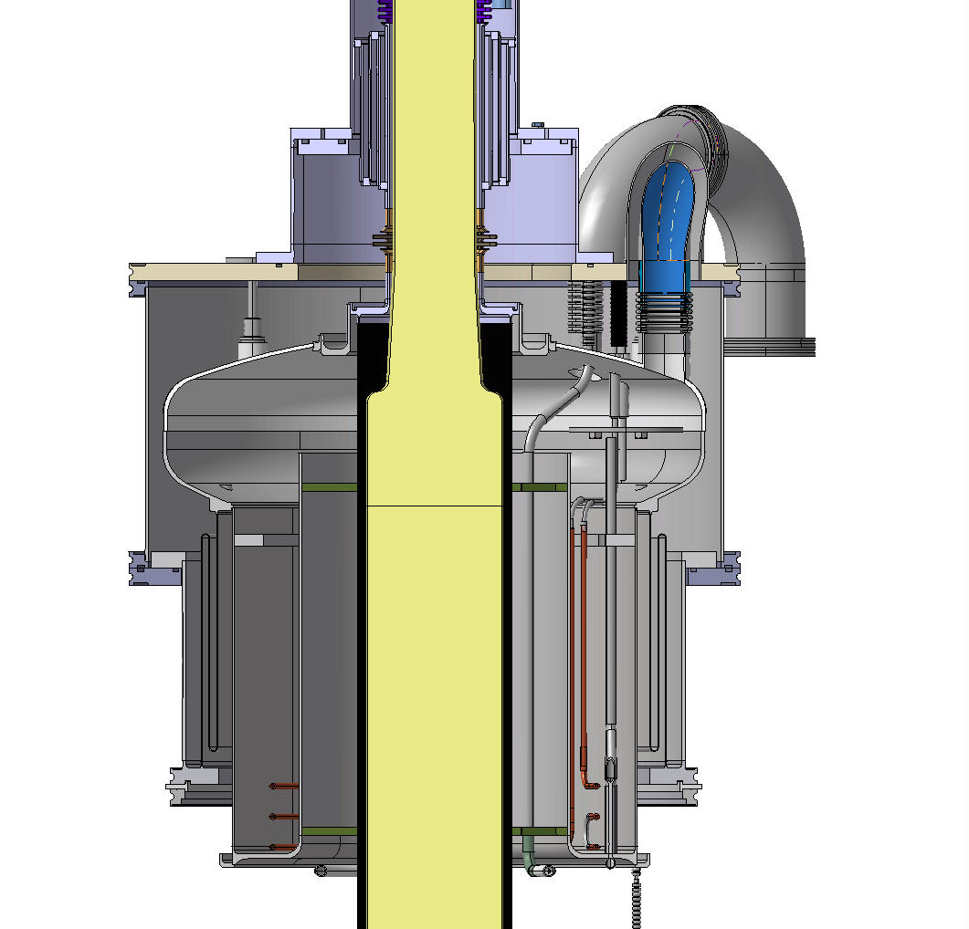
Close the vacuum chamber and adjust the fixation to the top flange

Slide 18
Bend the NbTi busbar

Slide 19
Thank you

