Slide 1

MgB2 / NbTi splices access
Remove the NbTi /NbTi Splices
Remove the horizontal section
Open the vacuum chamber
Remove / cut/ disassembled
all cryogenic and instrumentation
Cut the weld
Move the SC link down
GHe flow
disassembled
SC-Link
Cut weld
disassembled
Open
MgB₂/NbTi Splices
D1 Plug
NbTi bus-bar
NbTi/NbTi Splices
LHe
1

Slide 2
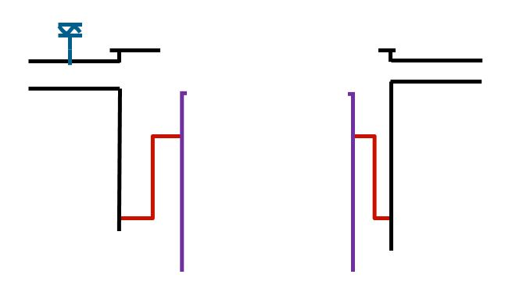
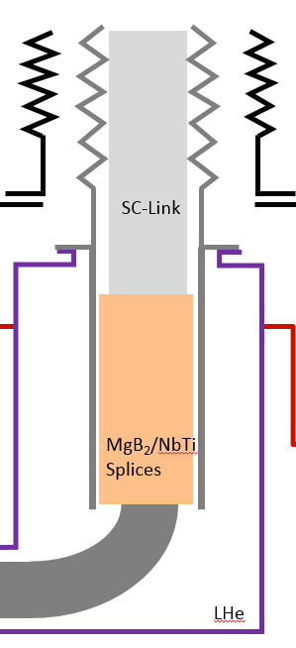
MgB2 / NbTi splices access
access to the splices MgB2/NbTi
is possible.

Slide 3
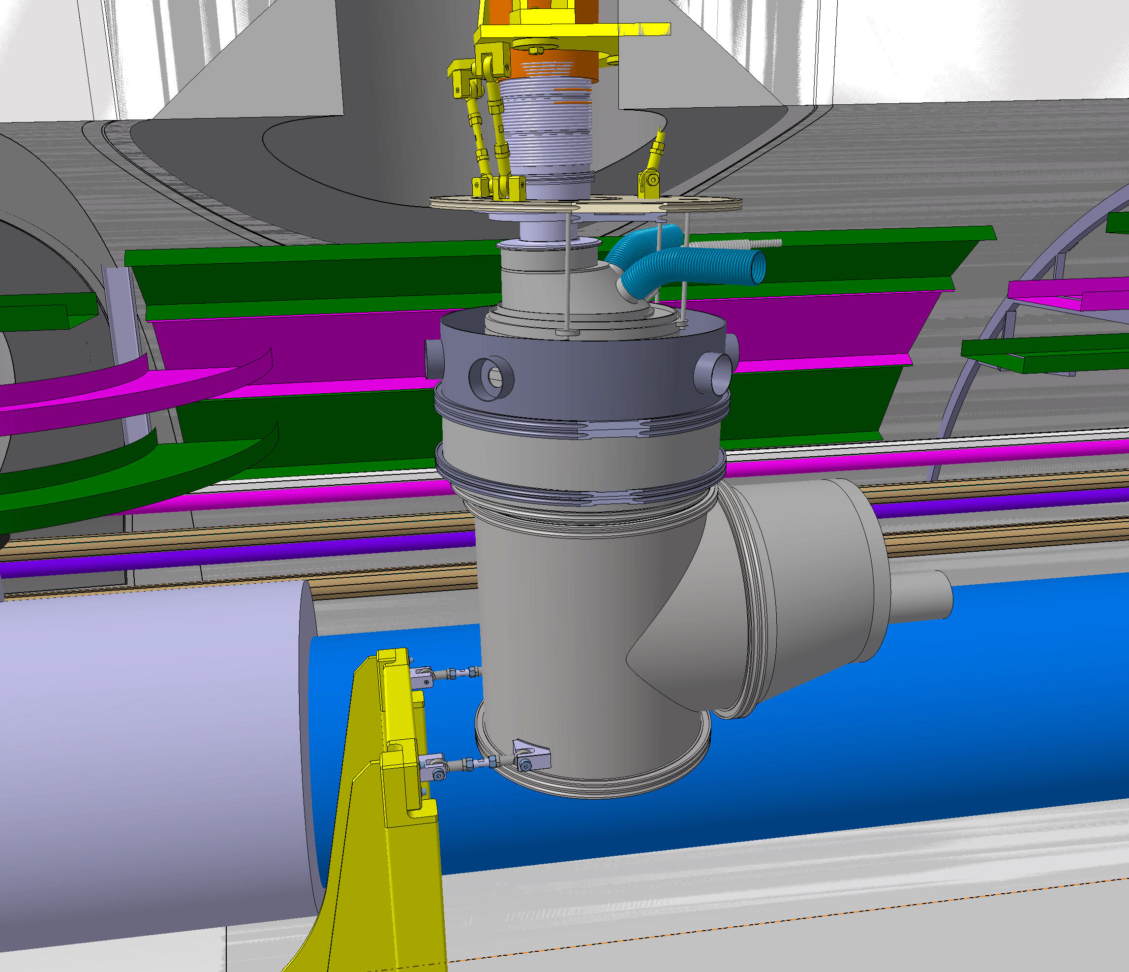
MgB2 / NbTi splices access
Remove the NbTi /NbTi Splices
Remove the horizontal section
Open the vacuum chamber
Remove / cut/ disassembled
all cryogenics and instrumentations

Slide 4
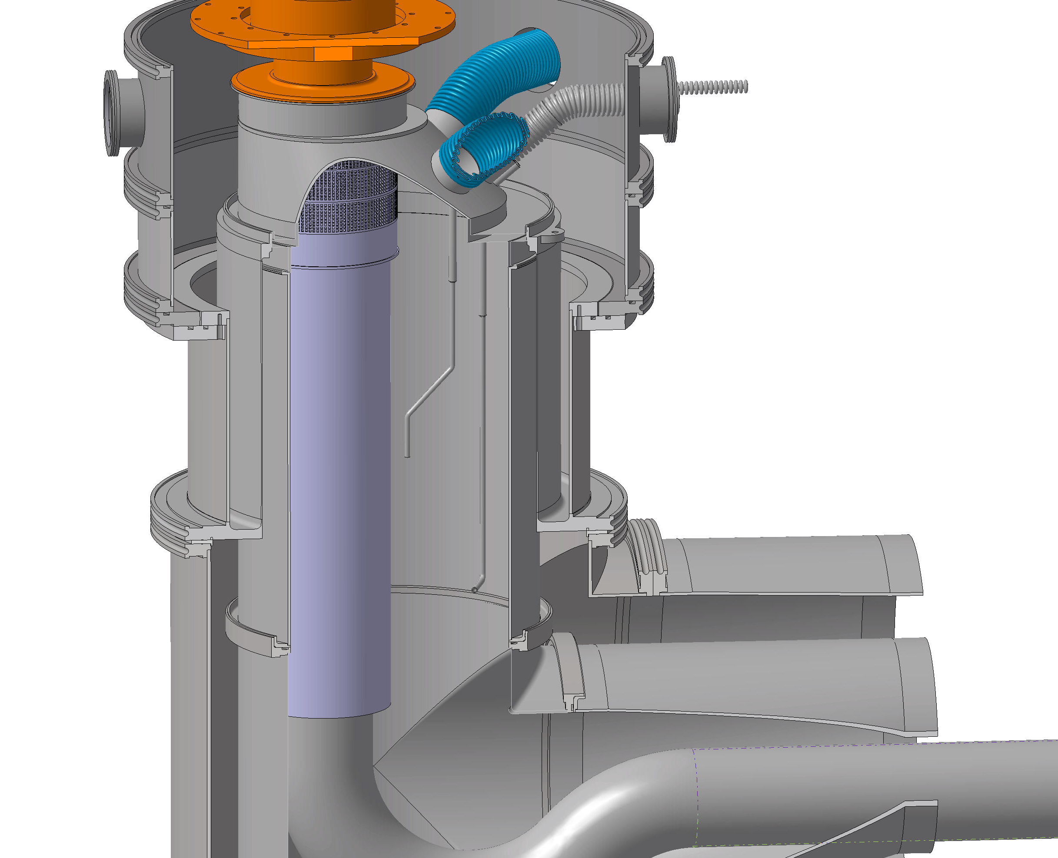
MgB2 / NbTi splices access
Slide the low vacuum chamber
Cut the welds top and down

Slide 5
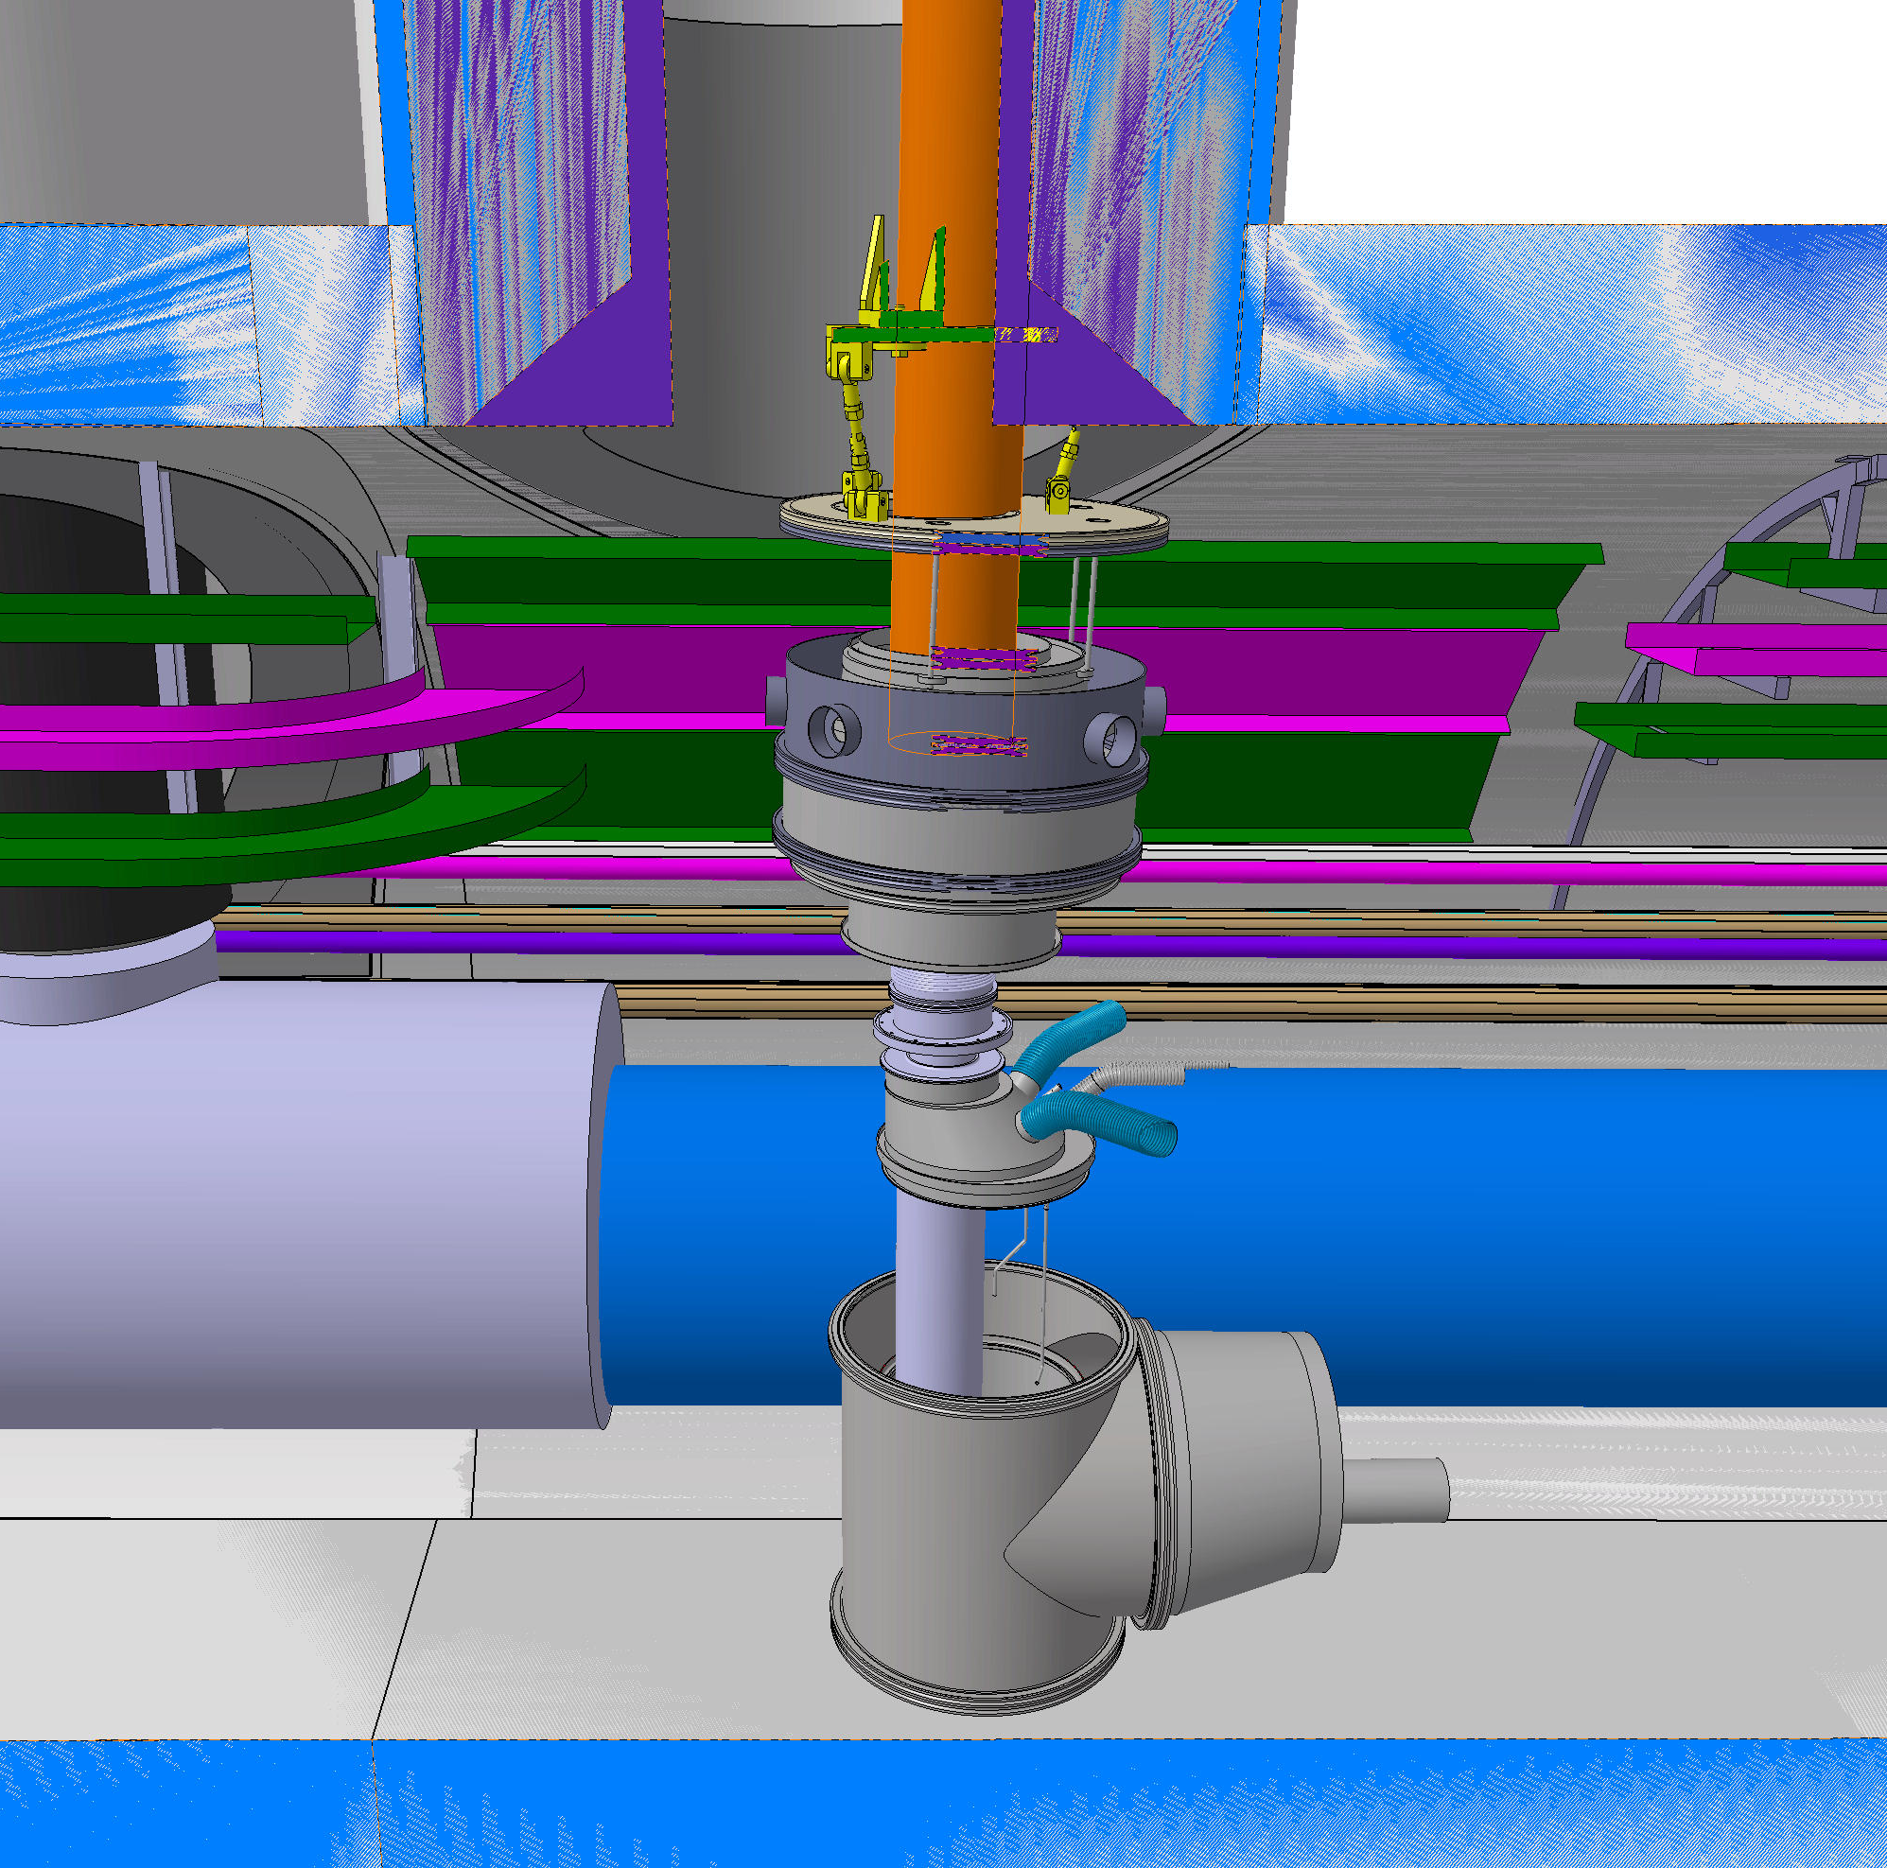
MgB2 / NbTi splices access
Move down the SC link through the DFX
an access to the splices MgB2/NbTi
is possible.

