Slide 1



(Small) Systems at
Weak and Strong Coupling
W. A. Horowitz
University of Cape Town
November 11, 2019
Kolbé and WAH, PRC100 (2019) [1511.09313]
Mogliacci, Kolbé, WAH, arXiv:1807.07871
Kitazawa, Mogliacci, Kolbé, WAH, PRD99 (2019) [1904.00241]
Barnard and WAH, accepted PRC [1706.09217]

Slide 2
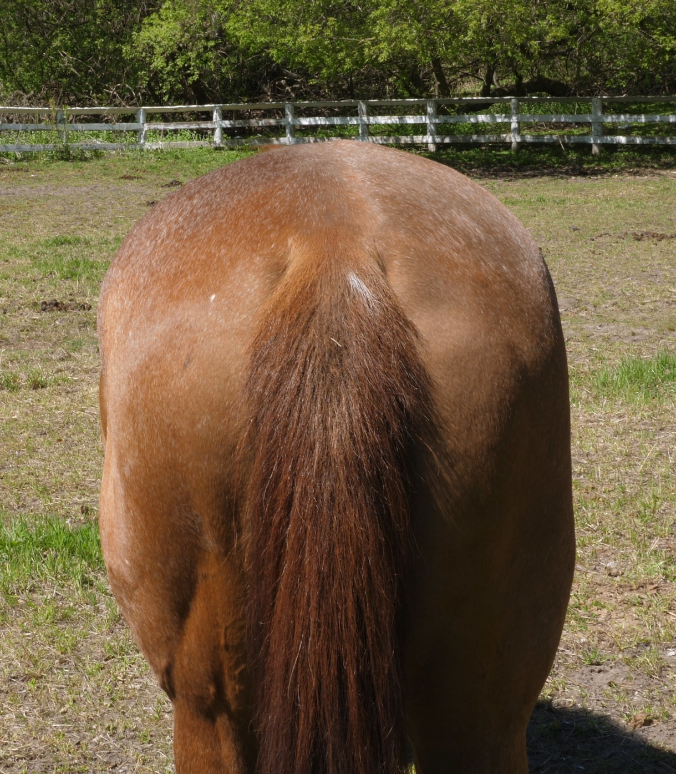
Outline
Talk about Miklos’ three favorite things:
  Jet Tomography
  AdS/CFT
  Horse’s Asses

Slide 3
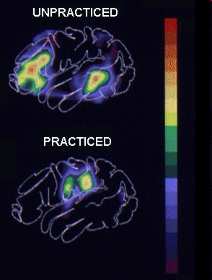
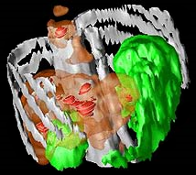
Why High-p_{T} Jets?
Tomography in medicine
One can learn a lot from a single probe…
and even more with multiple probes
SPECT-CT Scan uses internal γ photons and external X-rays
PET Scan
http://www.fas.org/irp/imint/docs/rst/Intro/Part2_26d.html
Notes:
Shown at my PhD defense, August 28, 2008. “dress with tie and jacket. no bare feet please.”

Slide 4
Asymptotic Analytic pQCD
Jackson: ΔE_{el} << ΔE_{rad} as E➞∞
Elastic E-loss:
dp_{T}/dt ~ -T² log(p_{T}/M_{Q})
Radiative E-loss, in expected deep LPM regime:
dp_{T}/dt ~ -L T³ log(p_{T}/M_{Q})
  Compare to Bethe-Heitler dp_{T}/dt ~ -(T³/M²)p_{T}

Slide 5
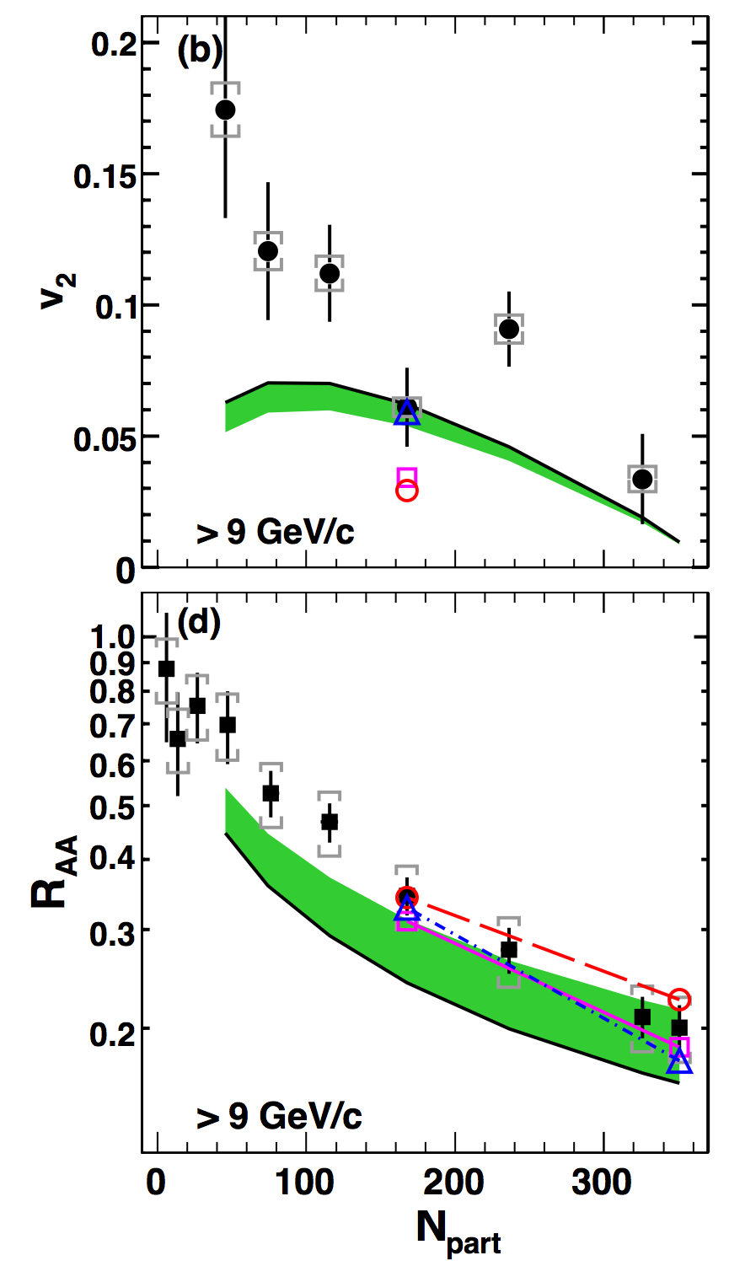
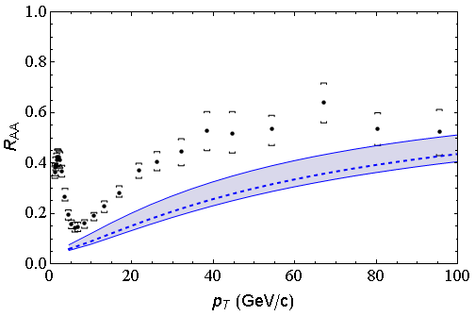
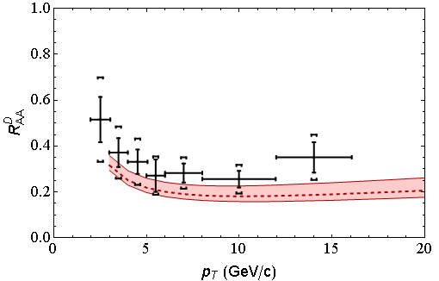
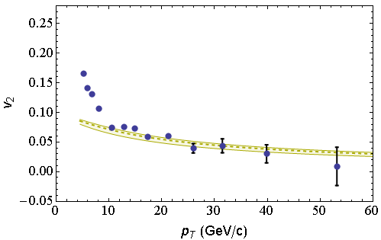
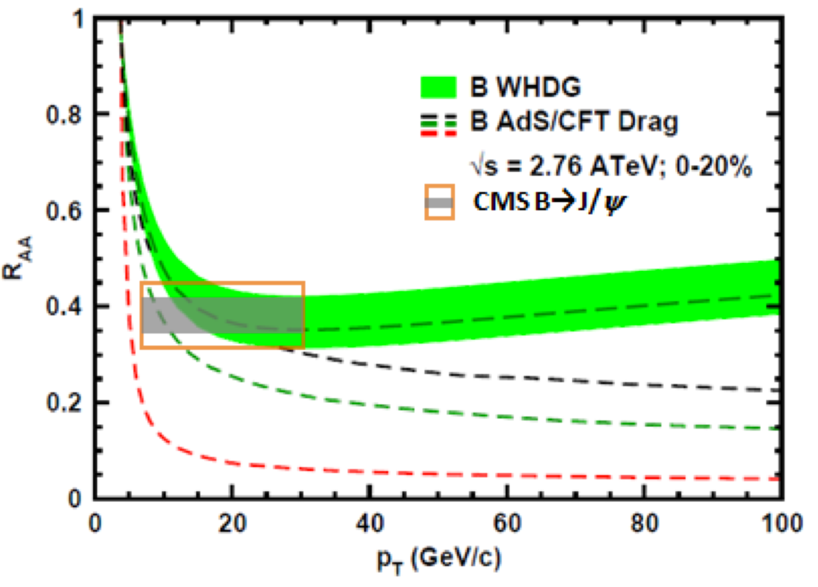
WHDG Successes
Rad + El, realistic geom AA; 540+ citations
LHC
CMS h± 0-5%
WHDG π⁰
LHC
ALICE D
WHDG D
RHIC
RHIC
LHC
CMS h± 40-50%
WHDG π⁰
LHC
CMS, Eur.Phys.J. C72 (2012)
CMS, PRL109 (2012)
ALICE, JHEP1209 (2012) 112
CMS, JHEP 1205 (2012) 063
PHENIX PRL105 (2010)

Slide 6
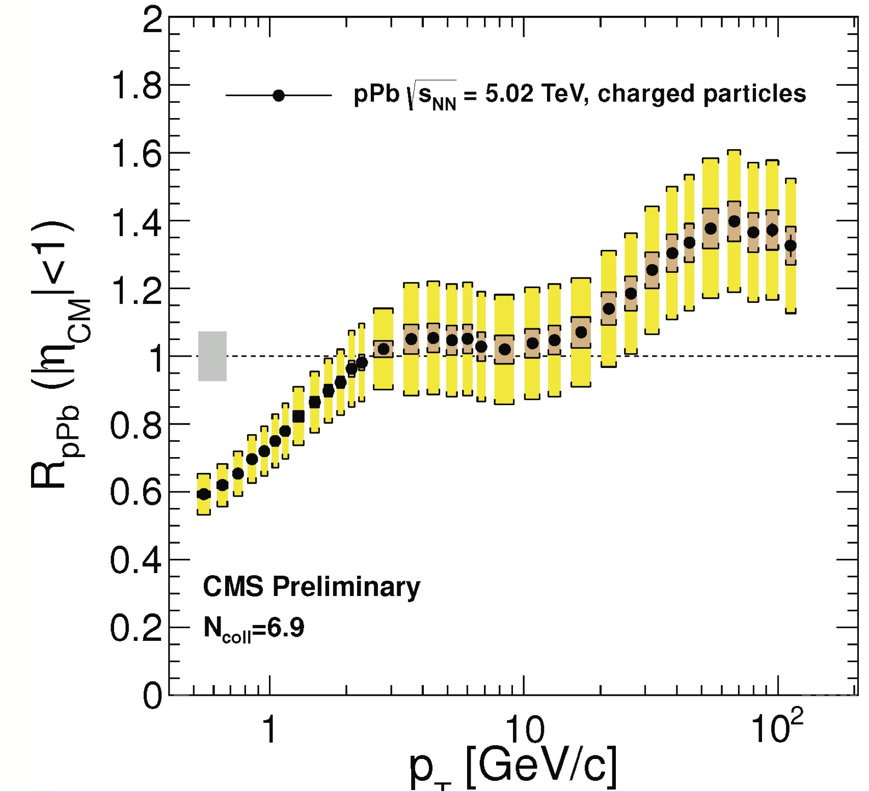
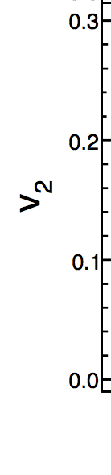
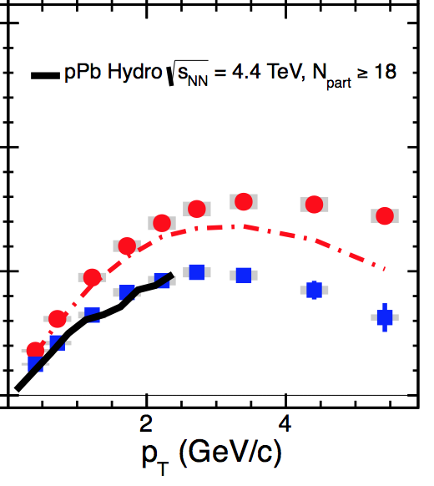
Small System Challenge to pQCD
Collectivity/hydro in pA
R_{pA} > 1 Enhancement
CMS,
PLB724 (2013)
HP2013
Notes:
RpPb shown for the first time at HP2013 in Cape Town

Slide 7
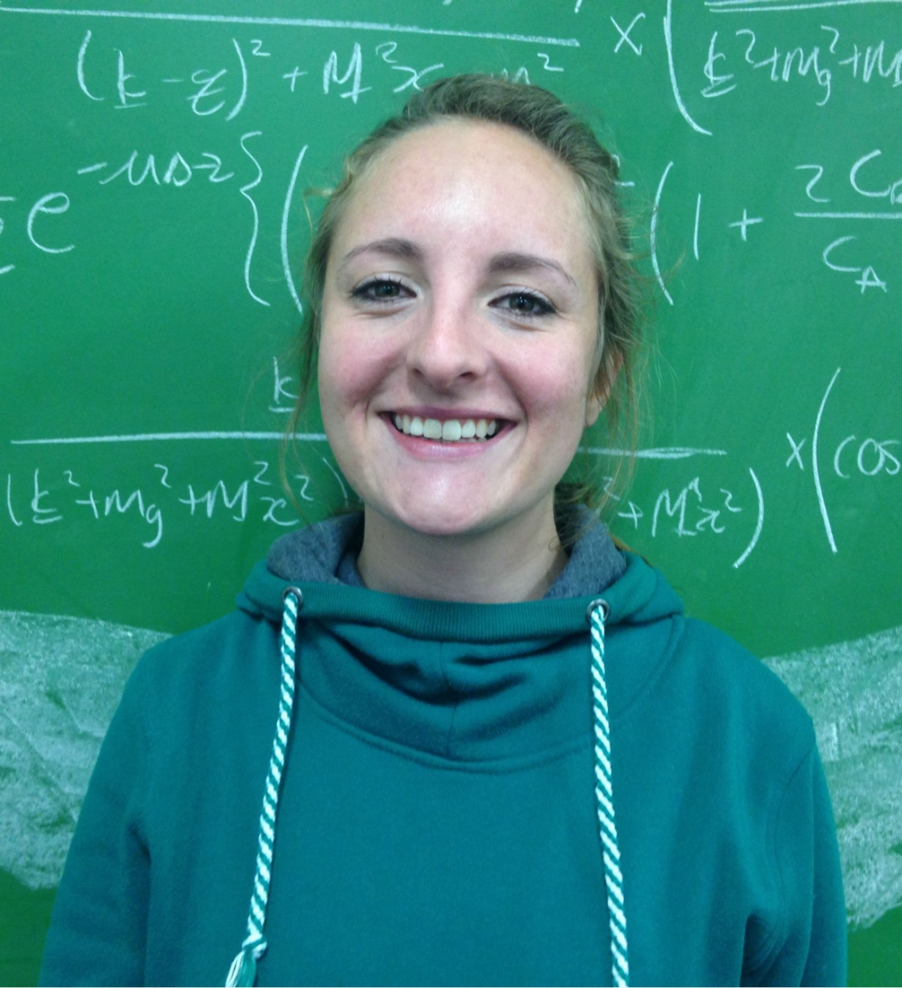
pQCD E-Loss in pA
Take seriously E-loss in small systems
Wish to apply DGLV to small systems
  However, DGLV assumes an ordering of scales: 1/μ_{Debye} << λ_{mfp} << τ_{form} << L_{pathlength}
Desire: derive the 1/L corrections to DGLV
1st order in opacity
  Requires reevaluation of all 11 diagrams, no longer neglecting certain poles originating from the Yukawa scattering potential
  MSc project for Isobel Kolbé

Slide 8
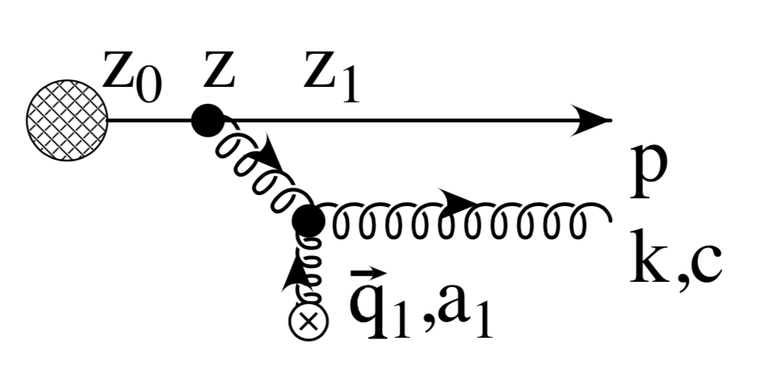
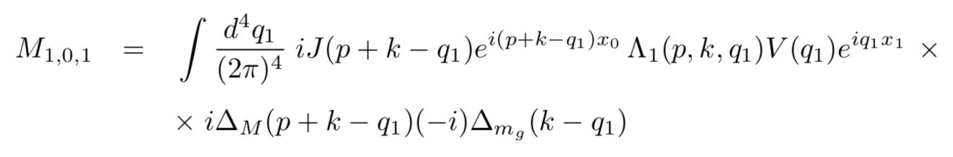

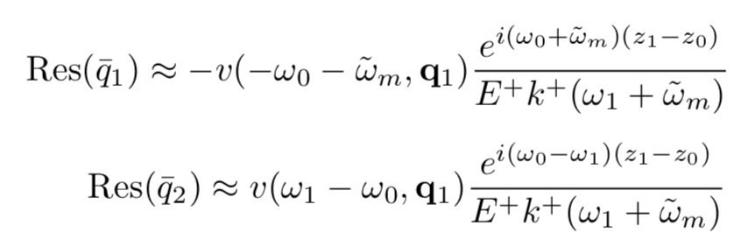
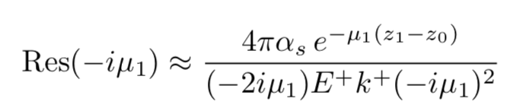
Neglected Poles

Slide 9
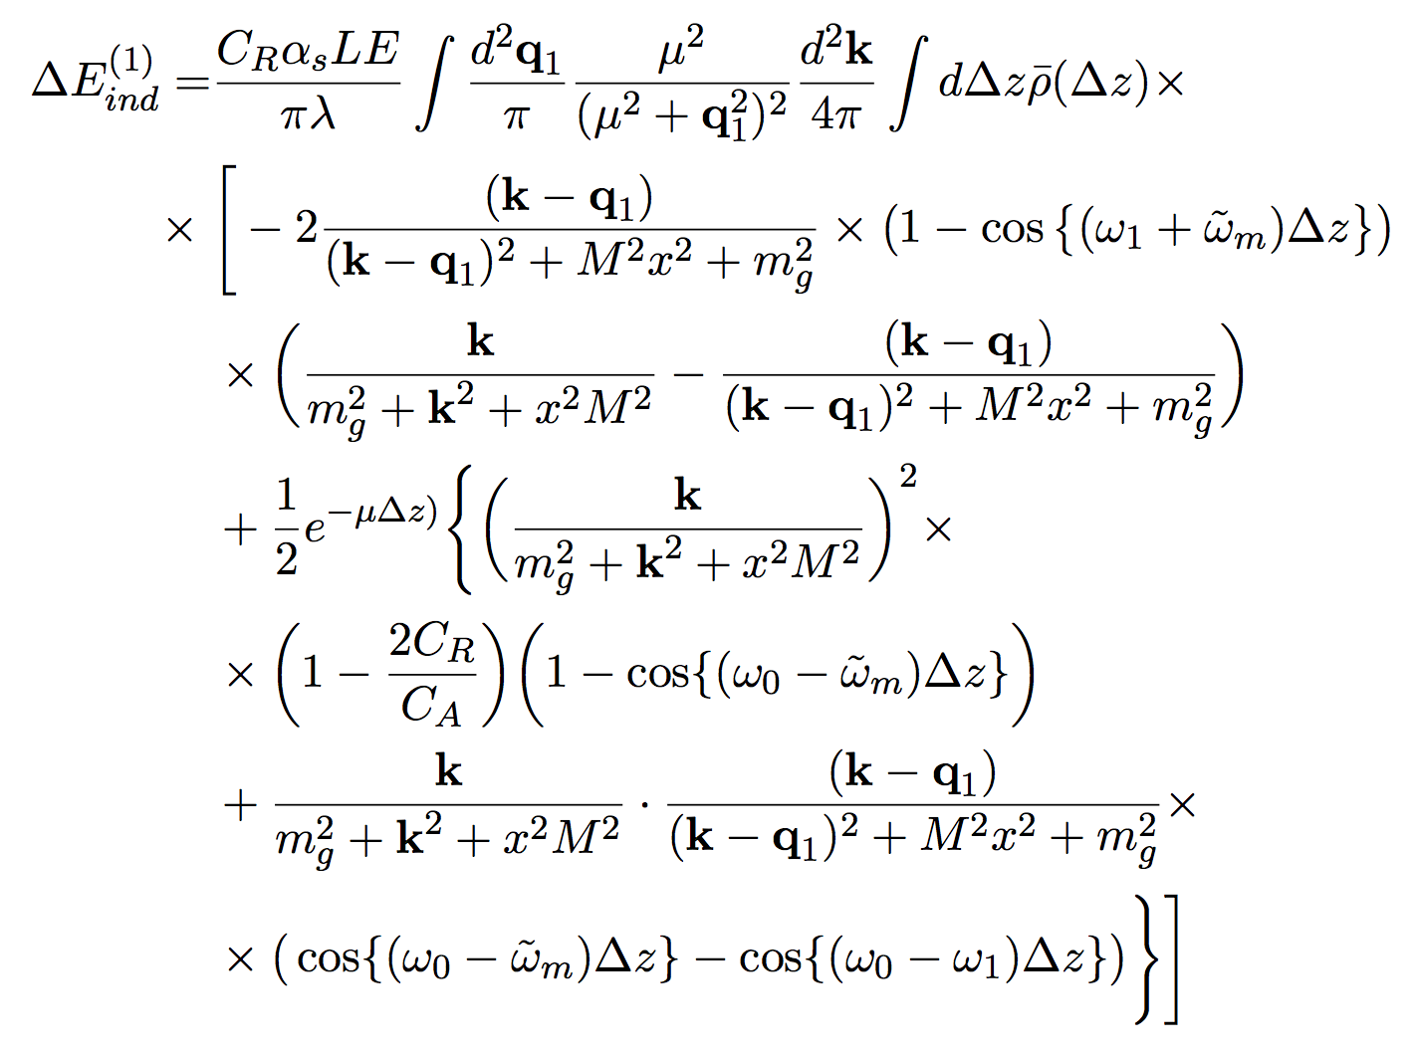
Summed, Squared Result
DGLV
“Small L”
Correction

Slide 10
Analyzing the Short Path Correction
Correction:
  –> 0 as Δz –> 0 (destructive interference)
  –> 0 as μ –> ∞
  (all paths are long)
  breaks color triviality

Slide 11
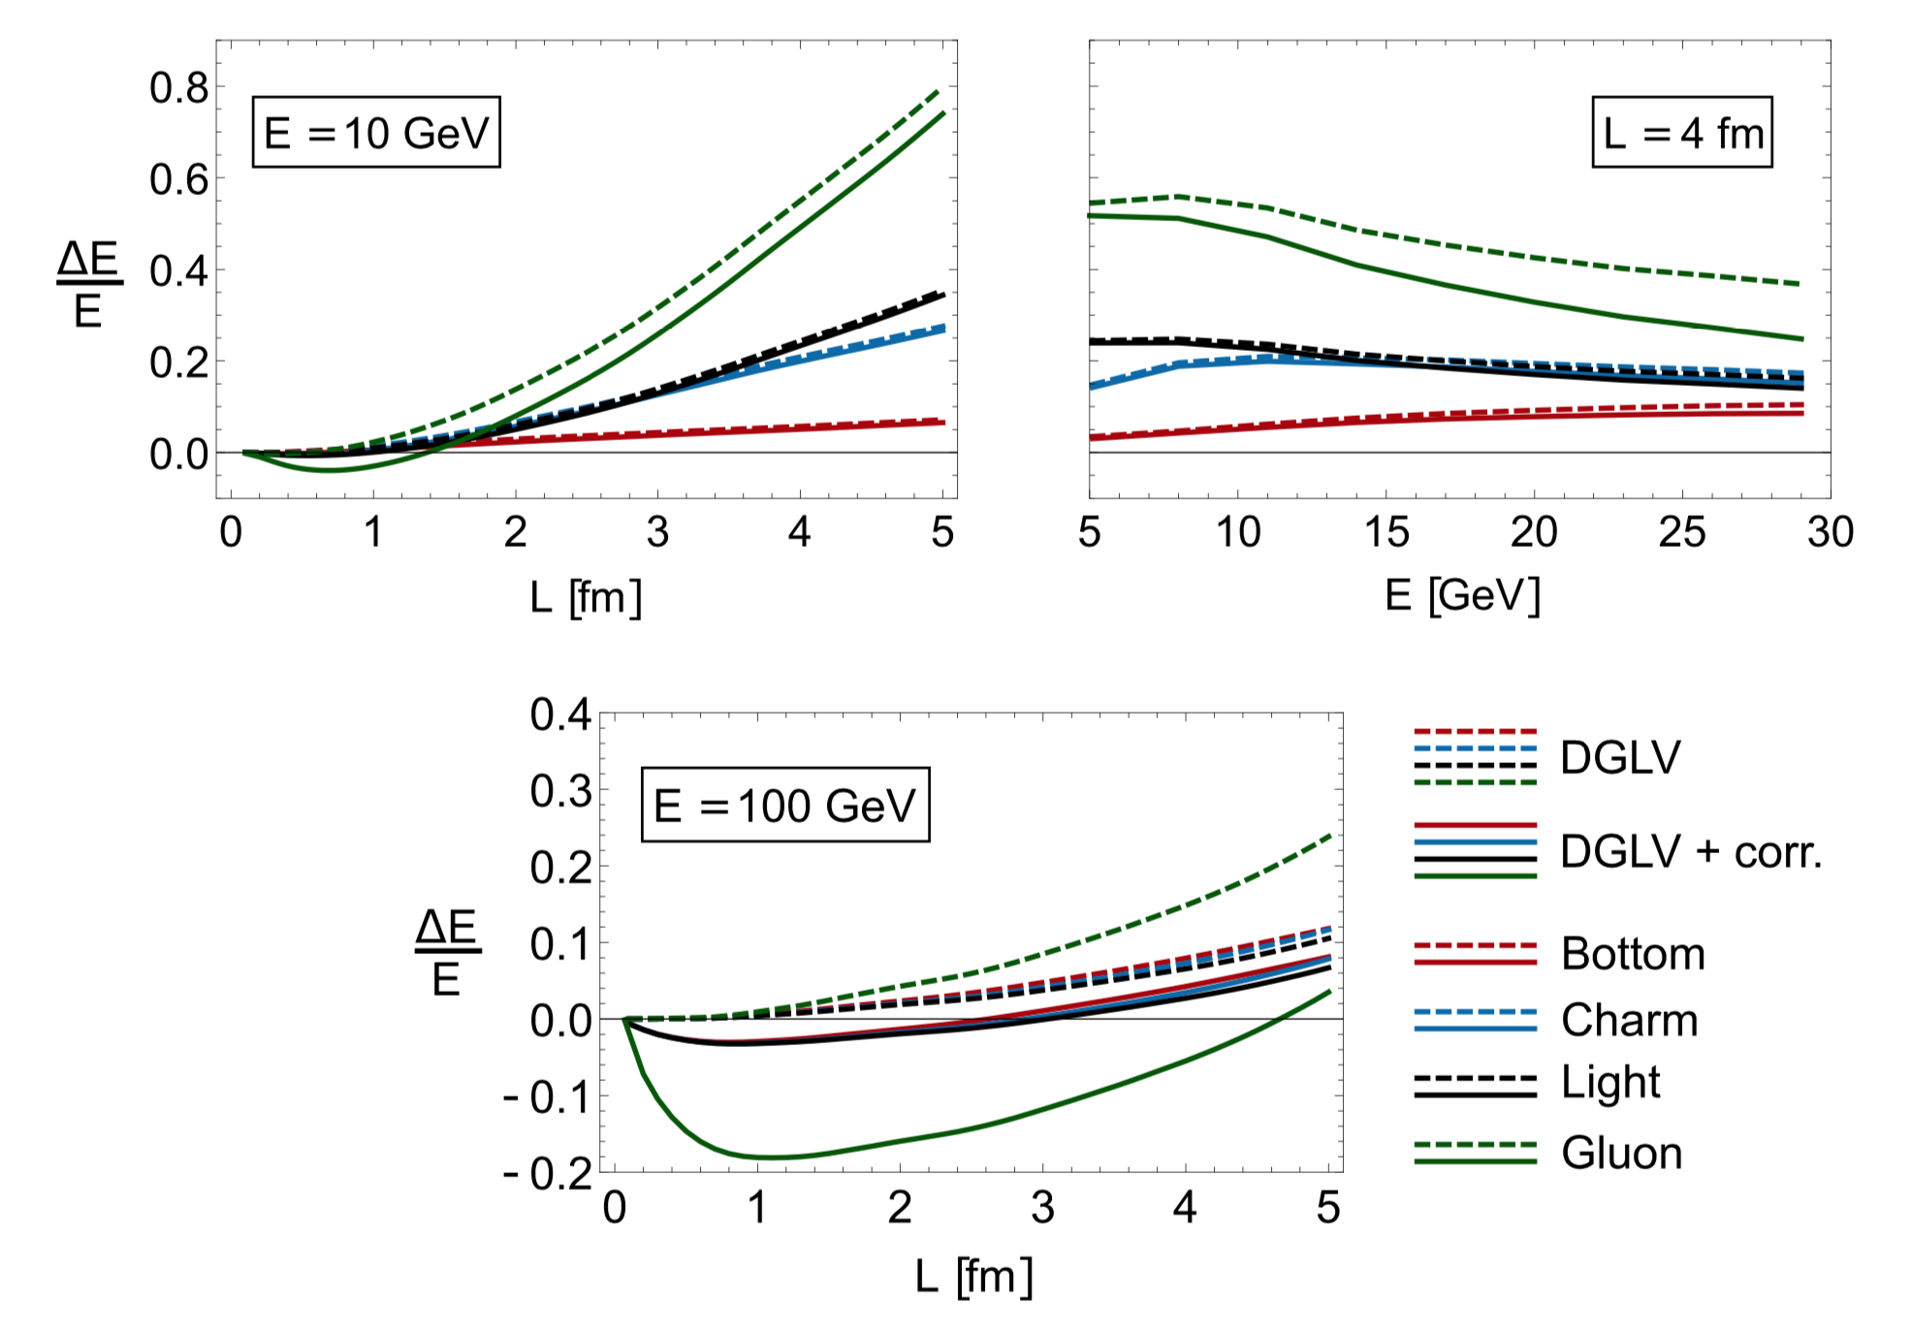
Numerical Investigation of Corr
Kolbé and WAH, PRC100 (2019)
    Surprise 1: Correction leads to reduction in E-loss
    Surprise 2: Affects all pathlengths L
      Due to integrating over all distances to scattering Δz in [0,L]
    Surprise 3: Correction grows with p_{T}
    Need to think more carefully re small systems?

Slide 12
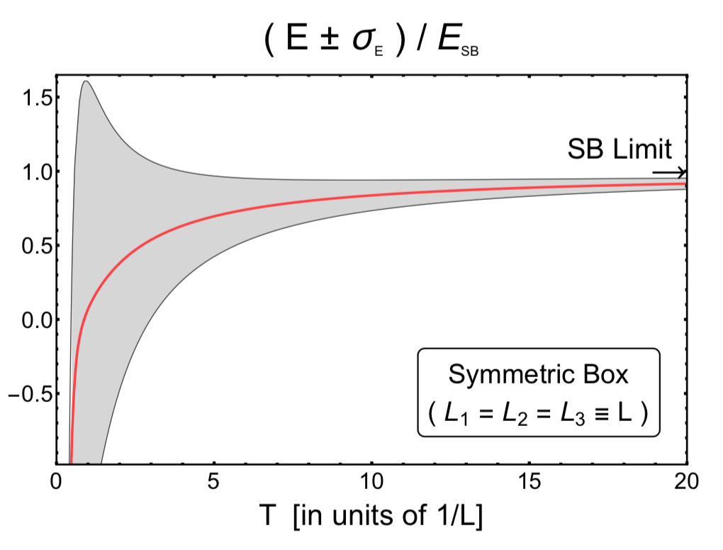
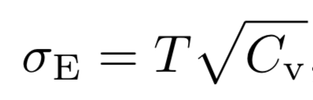
Thermal Fields in Finite L
How is Debye screening affected by finite size?
Warm up: how are thermo props changed by finite L?
  Use non-int. scalar FT w Dirichlet BC
Mogliacci, Kolbé, WAH, 1807.07871

Slide 13
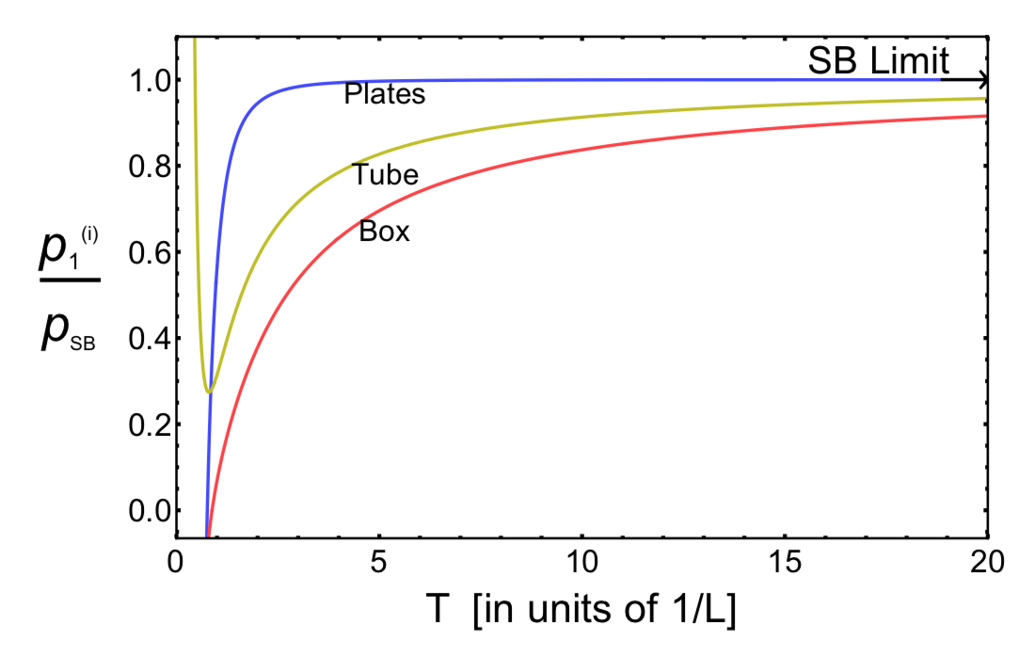
Significant Finite L Corrections
Mogliacci, Kolbé, WAH, 1807.07871
  ~40% corrections to p for T*L ~ 4, relevant for pp collisions with T ~ 400 MeV
  ~10% corrections for T*L ~ 20, relevant for AA with T ~ 400 MeV

Slide 14
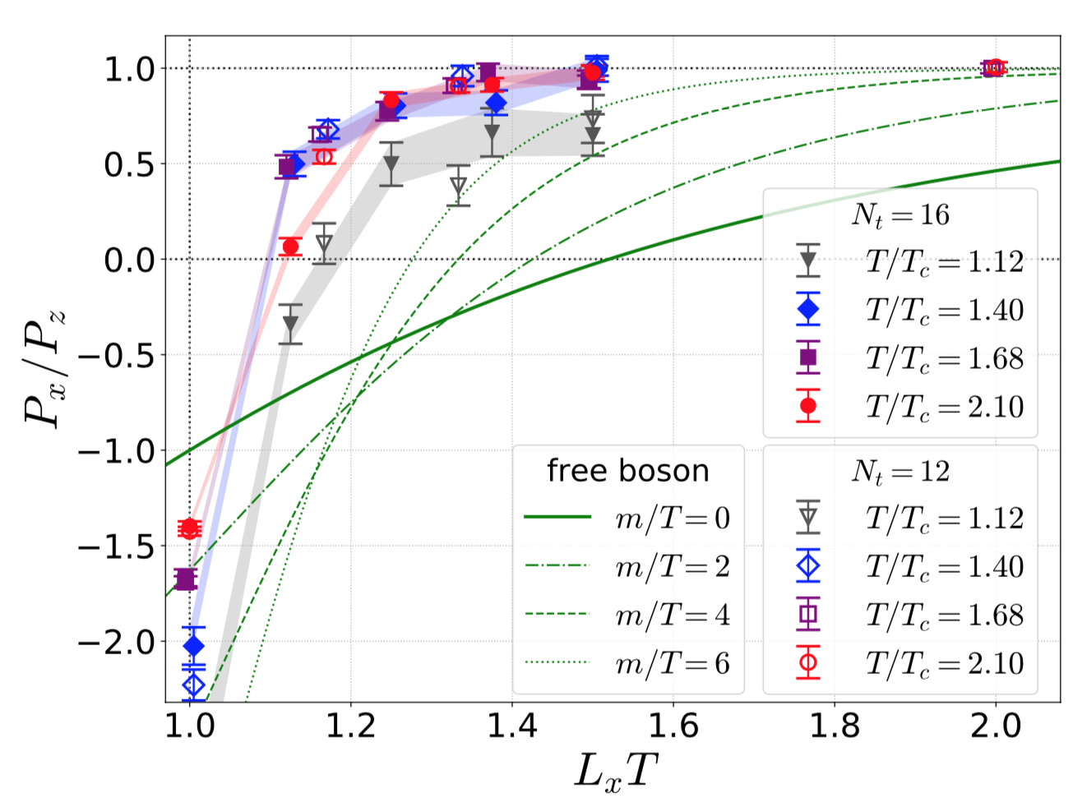
Compare to Lattice
Quenched SU(3) YM with PBC
  L_{y}, L_{z} large; L_{x}T ~ 1
Lattice less affected
than massive free
bosons
  Even for m = 6 * T!
    Large finite size
    corrections to m_{D}?
    Full interactions not
    captured by effective m_{D}?
    Important non-perturbative interactions?
Kitazawa, Mogliacci, Kolbé, WAH, PRD99 (2019)

Slide 15
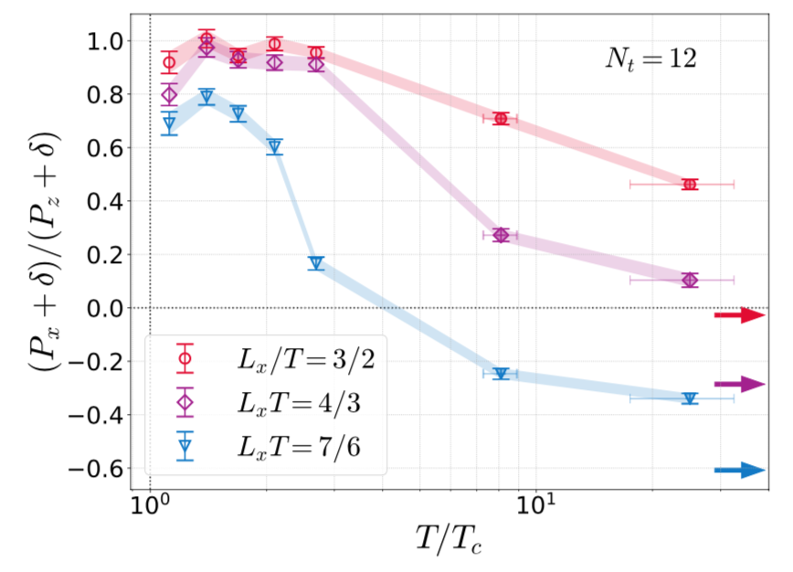
Lattice Approach to SB Limit
Going to high-T difficult
  Lattice spacing decreases; large lattice required
Examine clever ratio to avoid difficulties
  Δ = ε – p_{x} – 2p_{z}; δ = Δ/4
Kitazawa, Mogliacci, Kolbé, WAH, PRD99 (2019)

Slide 16
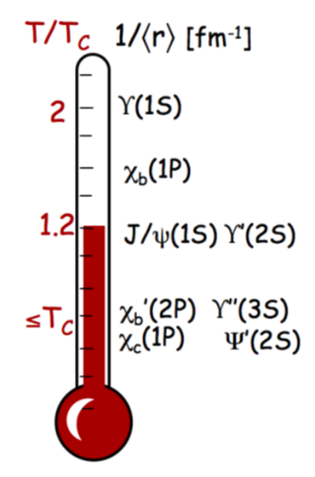
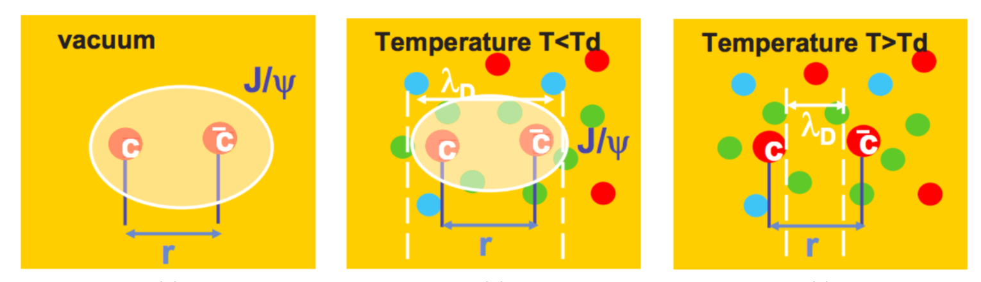
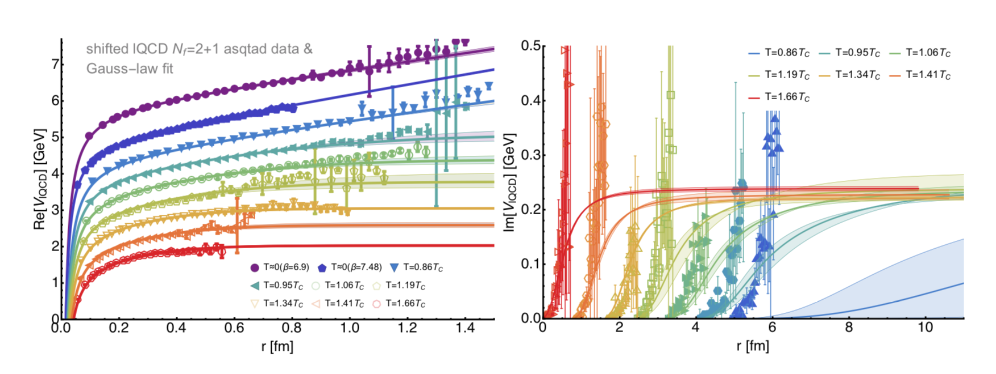
What about Quarkonia?
Another probe of QGP physics:
A Mocsy, EPJC61 (2009)
R Arnaldi, EPJ Web Conf. 7, 02004 (2010)
Krouppa, Rothkopf, Strickland, PRD97 (2018)

Slide 17

From AdS to Data
Follow Krouppa, Ryblewski, Strickland PRC92 (2015):
  QGP dynamics => Heavy quark potential V(r)
  V(r) => E_{bind}
  R_{AA} ~ < exp[-L Im(E_{bind})] >_{geometry}
Exciting because potential (!) to see hot wind screening: L_{AdS} ~ (1-v²)^{1/4}
  Liu, Rajagopal, Wiedemann,
  PRL98 (2007)
Nadia Barnard

Slide 18
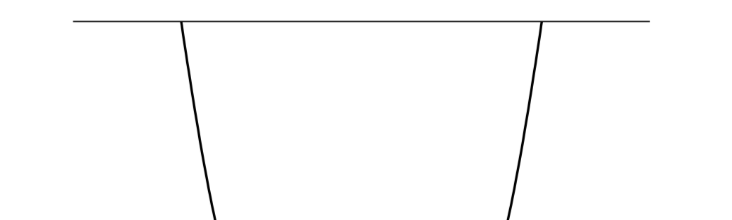
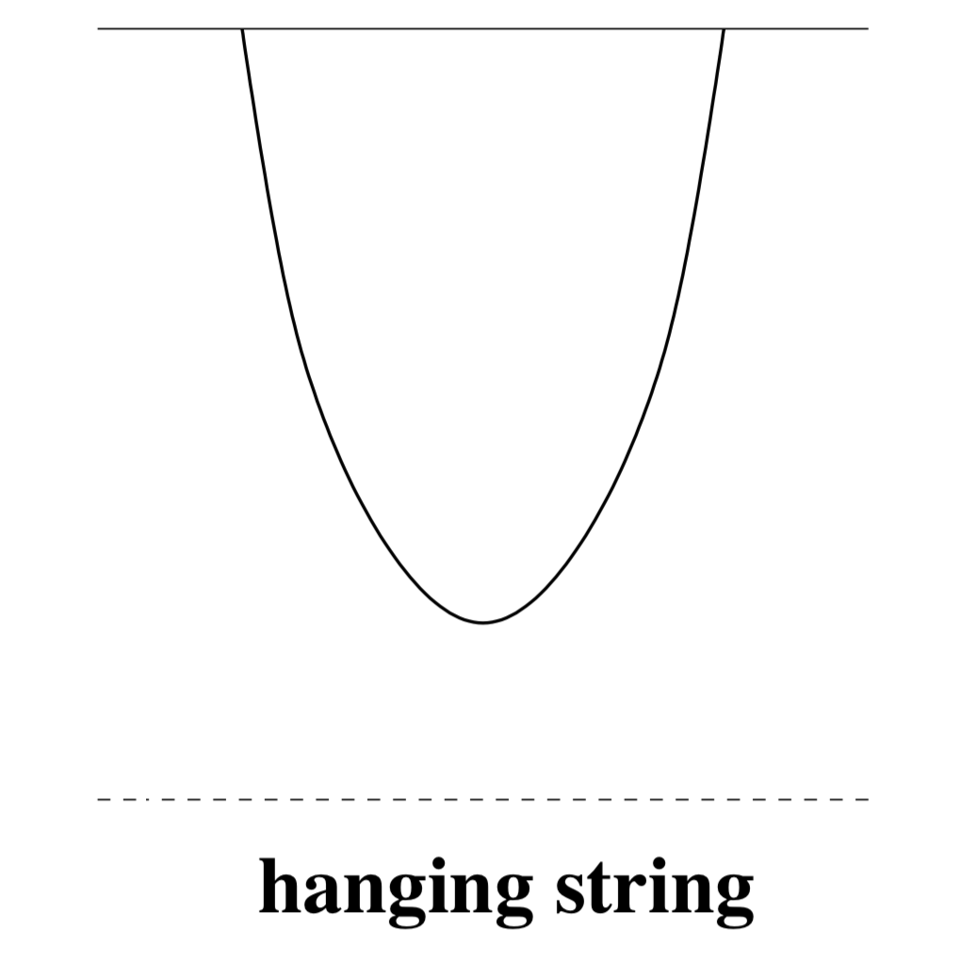
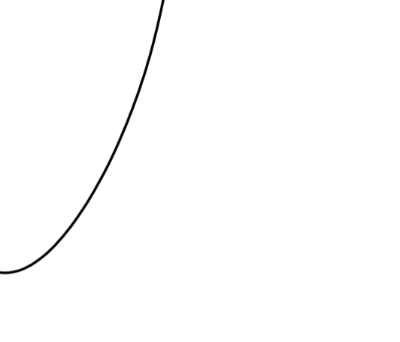


AdS HQ Potential
r
t
$$\overset{⃑}{x}$$
4D
Minkowski
z: 5th dimension
String worldsheet
Black hole horizon ⬄
Hawking temperature T
𝛿S_{NG} = 0 => EOM => worldsheet shape
Worldsheet shape => E(r) => V(r)

Slide 19
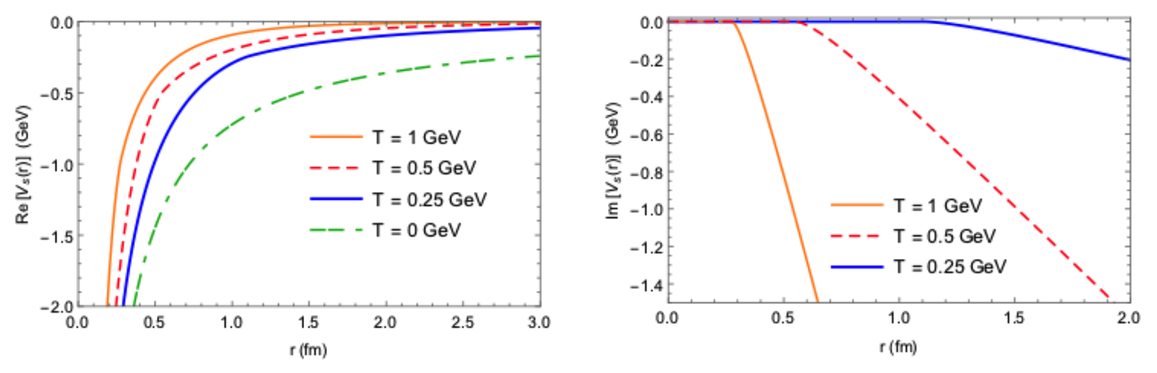
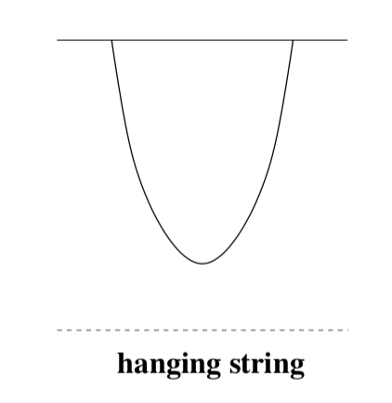
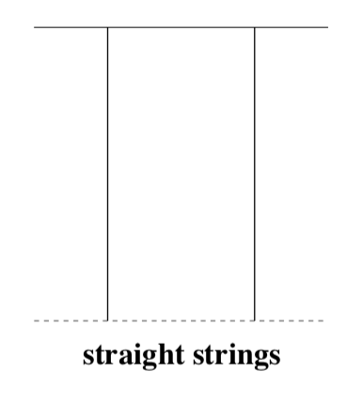

Static AdS QQbar V(r) for $Υ$
Following Albacete, Kovchegov, and Taliotis, PRD78 (2008):
Coulomb-like 1/r
Energetically favorable
configuration:
1/N_{c}² suppressed
string breaking
N. N. Barnard and WAH, arXiv:1706.09217

Slide 20
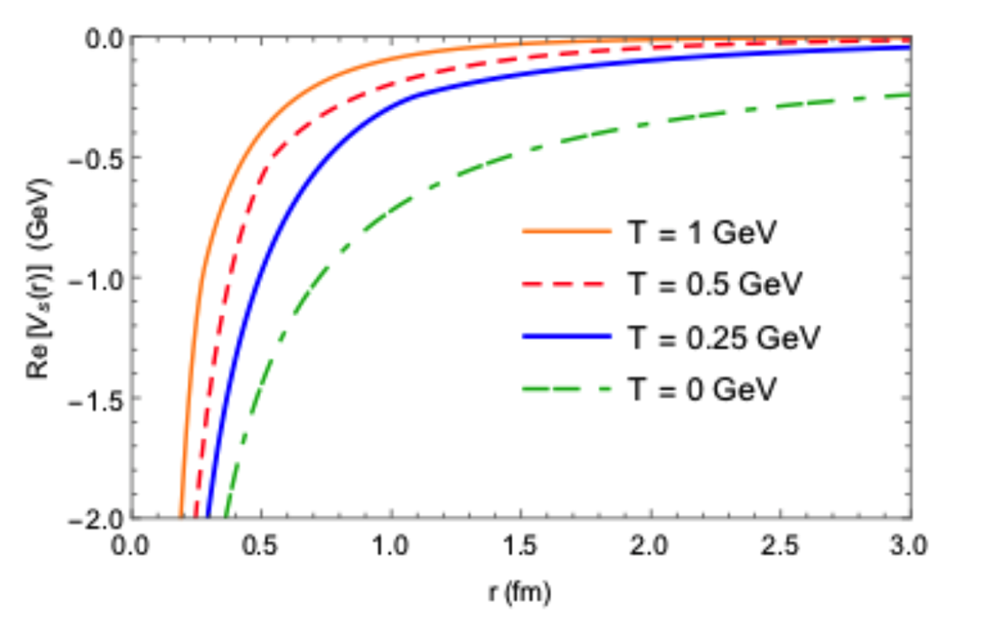
Comparison to pQCD: Real Part
AdS: Albacete et al., PRB78 (2008)
pQCD: HTL from Margotta et al., PRD83 (2011)
N N Barnard and WAH, arXiv:1706.09217
Very similar shapes
  NB: constant vertical offset irrelevant for E_{bind}

Slide 21
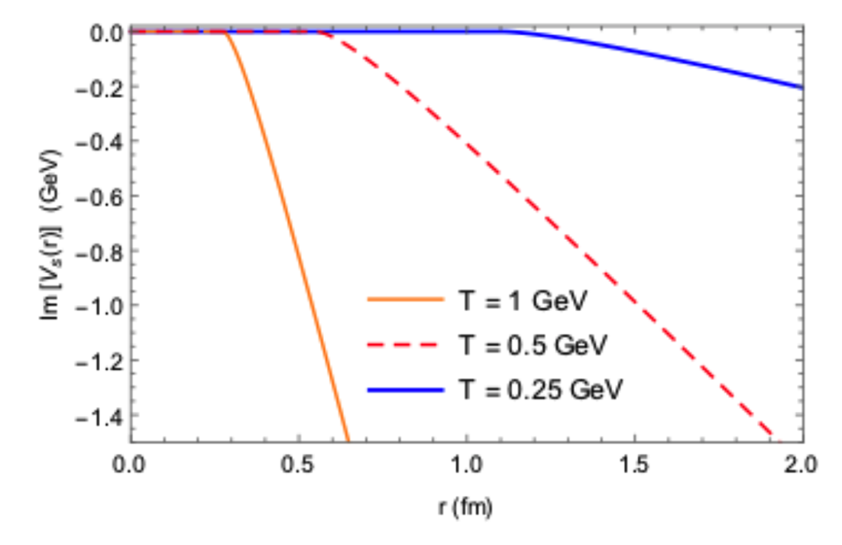
Comparison to pQCD: Im Part
AdS: Albacete et al., PRB78 (2008)
pQCD: HTL from Margotta et al., PRD83 (2011)
N N Barnard and WAH, arXiv:1706.09217
AdS Im(V) grows with r
pQCD Im(V) asymptotes with r

Slide 22
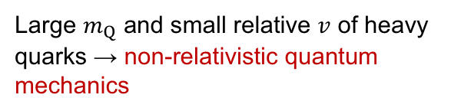
Compute E_{bind}: Find Ground State
NRTDSWE
Large $m_{Q}$ and small relative $v$ of heavy quarks → non-relativistic quantum mechanics
Real time evolution operator of wave function ~
Wick rotation
Imaginary time evolution operator ~
At large τ, only ground state wave function survives

Slide 23
Computing E_{bind}
From ψ₀ to E_{bind}:
  E_{bind} = <ψ₀|H|ψ₀> − Re[V(r = ∞)]
Independent check on E_{bind}:
  Use Complex Ritz Variational Method
    For complex potentials, complex ground state energy E is a stationary state when wavefunction parameters are varied
    cf E is minimum for real V(r) and usual Ritz

Slide 24
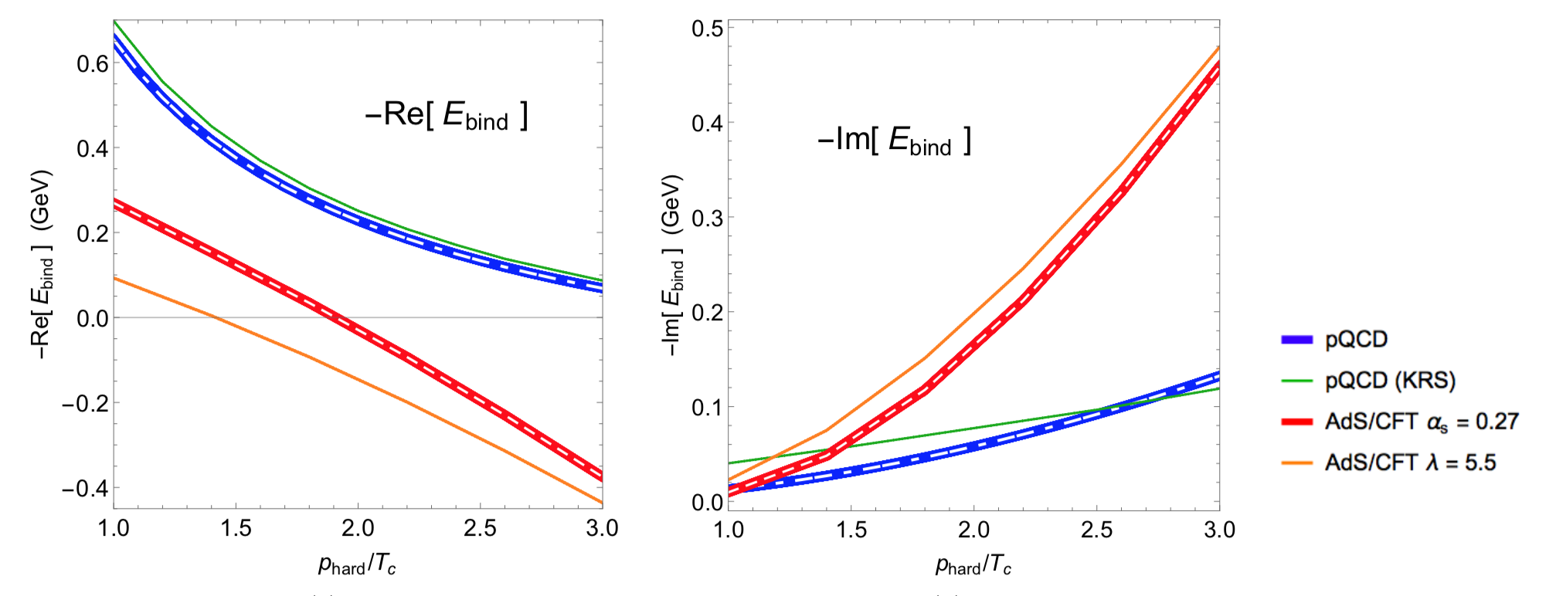
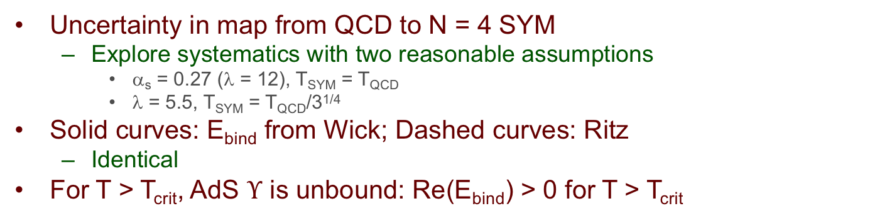
pQCD and AdS Binding Energies
p_{hard} = T
N N Barnard and WAH, arXiv:1706.09217
Uncertainty in map from QCD to N = 4 SYM
  Explore systematics with two reasonable assumptions
    α_{s} = 0.27 (λ = 12), T_{SYM} = T_{QCD}
    λ = 5.5, T_{SYM} = T_{QCD}/3^{1/4}
Solid curves: E_{bind} from Wick; Dashed curves: Ritz
  Identical
For T > T_{crit}, AdS $Υ$ is unbound: Re(E_{bind}) > 0 for T > T_{crit}

Slide 25
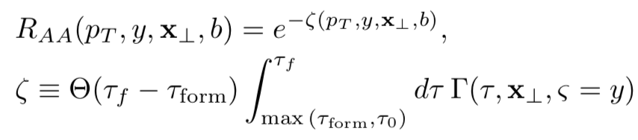
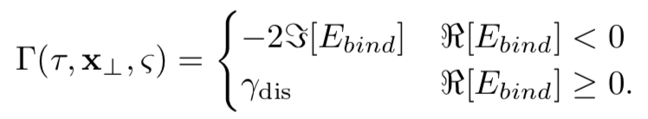
Modelling R_{AA}
Follow Krouppa et al.:
  Relatively naive dN/dp_{T} ~ 1/E⁴
Bjorken expanding optical Glauber medium:
  T ~ (ρ_{part}/τ)^{1/3}
  Cf Krouppa’s aHydro

Slide 26
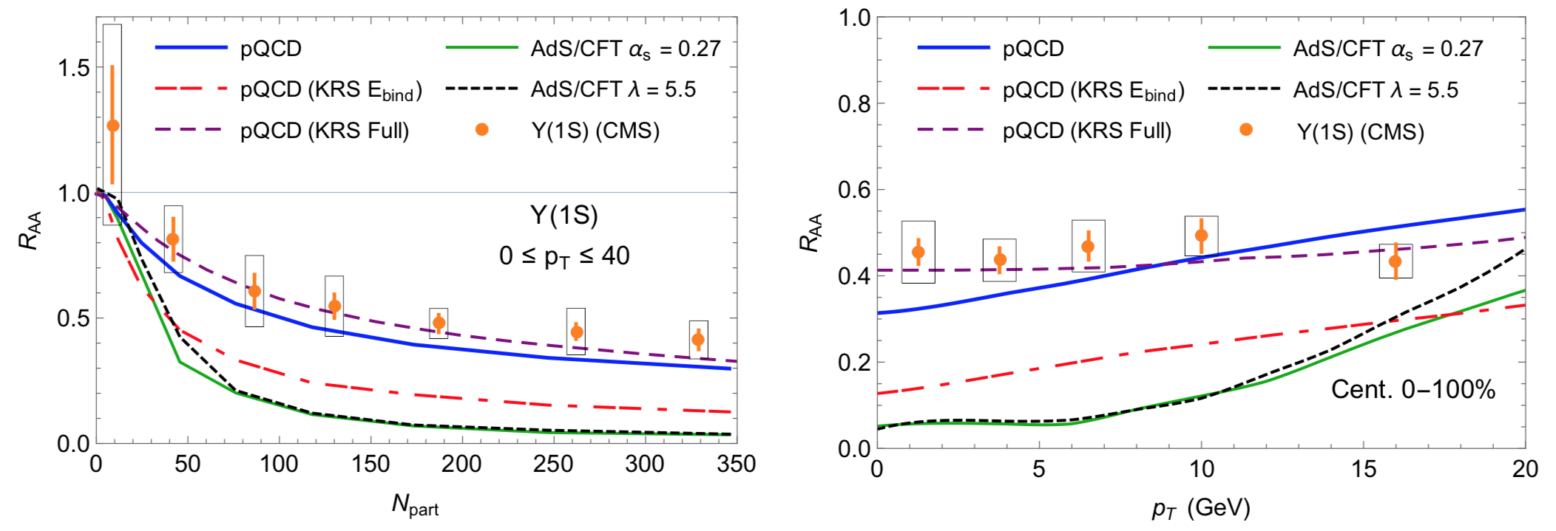
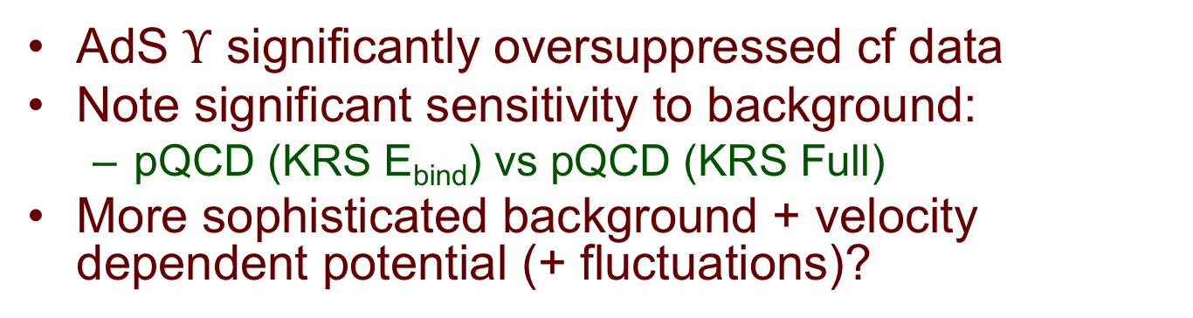
Quarkonia Suppression
N N Barnard and WAH, arXiv:1706.09217
AdS $Υ$ significantly oversuppressed cf data
Note significant sensitivity to background:
  pQCD (KRS E_{bind}) vs pQCD (KRS Full)
More sophisticated background + velocity dependent potential (+ fluctuations)?

Slide 27
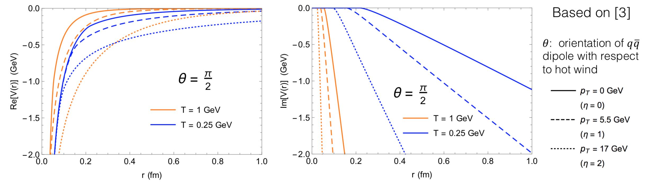
Include Velocity Dependence
V(r) from Noronha et al.
  Im[V(r,v)] < Im[V(r,v = 0)]
Barnard, QM19 Poster

Slide 28
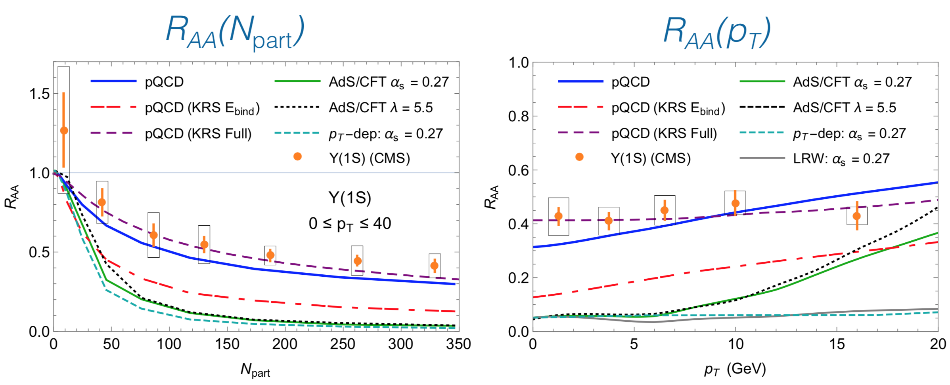
R_{AA} with V(r,v)
Barnard, QM19 Poster
V(r, v != 0) => much larger suppression
  (1-v²)^{1/4} * R_{AA}(p_{T} = 0) almost perfect match to full

Slide 29
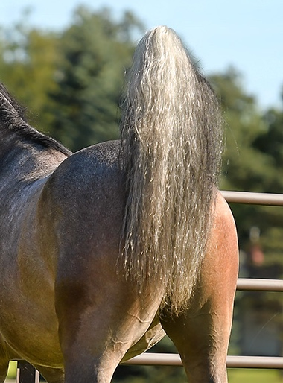
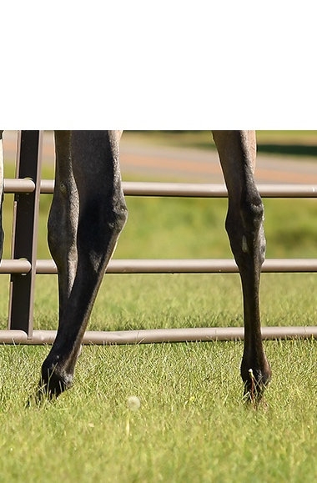
Discussion
How do we merge
pictures?
Strongly coupled
medium fluid
Spindly, weakly coupled
pQCD hard probes

Slide 30
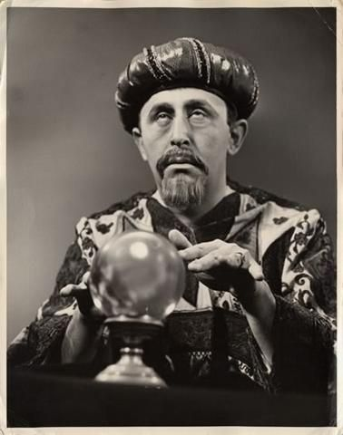
Outlook
If I were to prognosticate…
  Need NLO E loss w/ running coupling scale to connect strongly coupled ~T with weakly coupled p_{T}

Slide 31
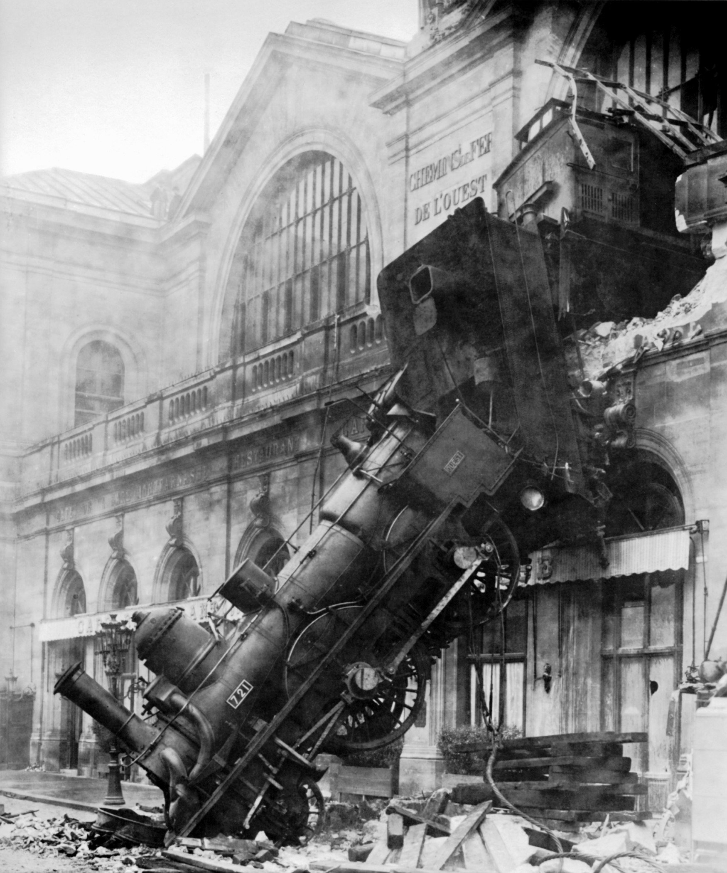
But then there’s data…
High p_{T} v₂ in pPb!!!
Everyone

Slide 32
Conclusions
Above ~15 GeV pQCD describes AA jet tomo well
AdS overssuppresses bottomonia
Small system corrections to E loss grow w E
Large small system corr for free thermal
Lattice SU(3) shows small corr
So much interesting work to do!

Slide 33
A Note of Thanks
To the community for its support
  POETIC; HP; QM (?)
To JPB (and Edmond)
  Physics discussions
To Larry (and Raju)
  Support with visits, and of SA students
To Miklos (and Gyorgi)
  Socially, including me in your lives
  Physics: way of thinking, thick skin, joie de vivre, love of physics, wonderful life

Slide 34
MGs’ Continuing Influence: SA Students
2800+ Engineers
13+1 MSc’s
  On to PhD’s at Oxford, UCSB, OSU, Milan, Durham, …
2+1 Academic Grandbabies (PhD’s)
  Andri Rasoanaivo
    Permanent Faculty
    Ecole Normale Supérieure Antananarivo, Madagascar
  Isobel Kolbé
    Postdoc
    iThemba LABS/BNL/INT
    Back to SA as faculty…
Notes:
Engineers: quantity, not quality (like nucleons used in HI collisions?); if a bridge collapses in SA…

Slide 35

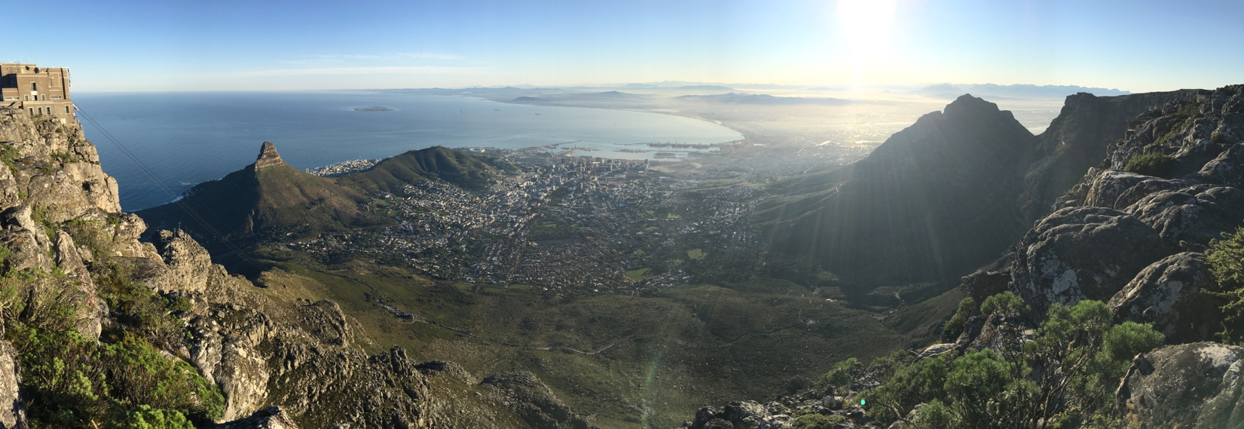
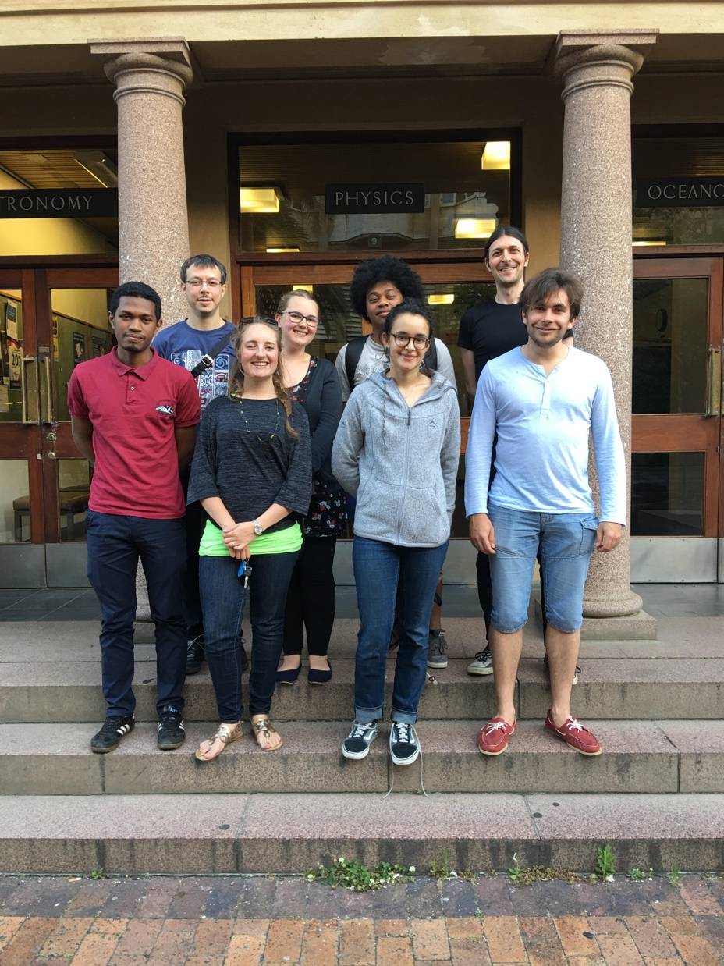
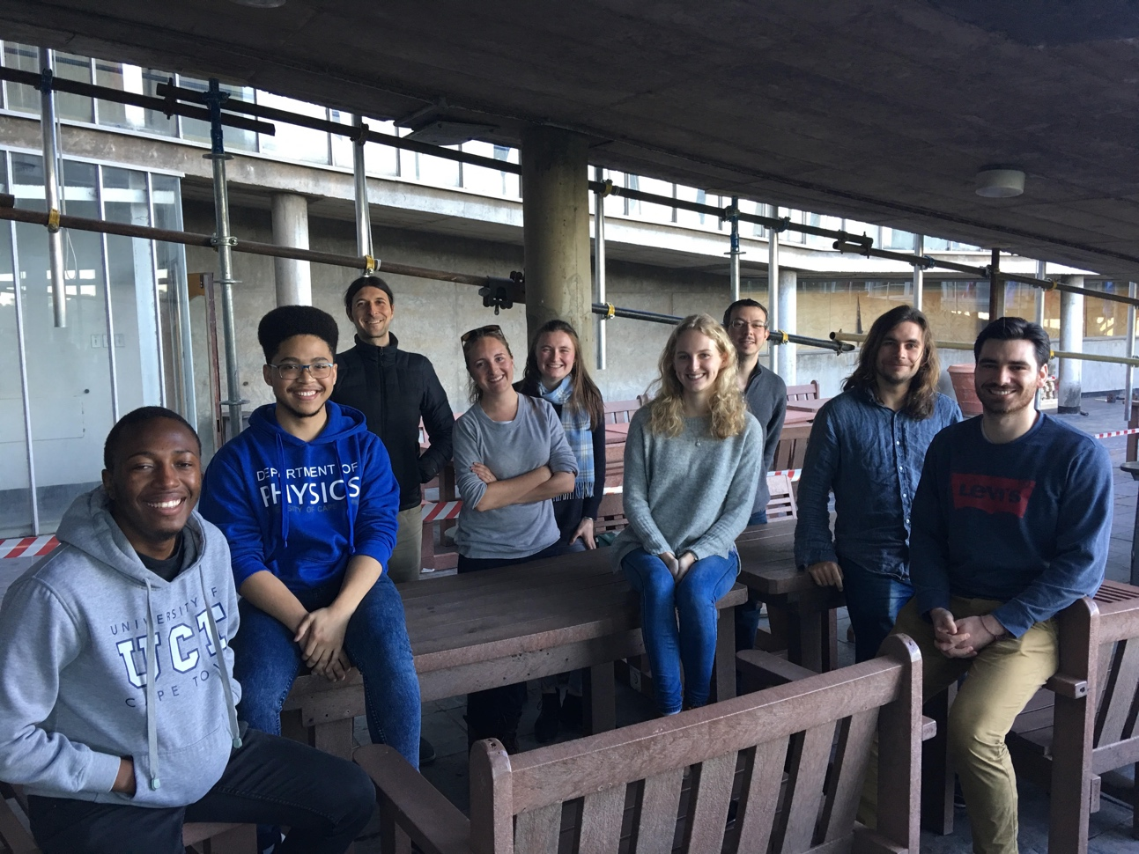
Miklos’ Continuing Influence
A

Slide 37
New Quarkonia Work
Use AdS/CFT to predict quarkonia suppression
Worldsheet shape => E(r) => V(r)
r
4D
Minkowski
z: 5th dimension
String worldsheet
Black hole horizon ⬄
Hawking temperature T

Slide 38
Static AdS QQbar V(r) for Υ
Following Albacete, Kovchegov, and Taliotis, PRD78 (2008):
Coulomb-like 1/r
Energetically favorable
configuration:
1/N_{c}² suppressed
string breaking
N. N. Barnard and WAH, arXiv:1706.09217

Slide 39
Comparison to pQCD: Real Part
AdS: Albacete et al., PRB78 (2008)
pQCD: HTL from Margotta et al., PRD83 (2011)
N N Barnard and WAH, arXiv:1706.09217
Very similar shapes
  NB: constant vertical offset irrelevant for E_{bind}

Slide 40
Comparison to pQCD: Im Part
AdS: Albacete et al., PRB78 (2008)
pQCD: HTL from Margotta et al., PRD83 (2011)
N N Barnard and WAH, arXiv:1706.09217
AdS Im(V) grows with r
pQCD Im(V) asymptotes with r

Slide 41
pQCD and AdS Binding Energies
p_{hard} = T
N N Barnard and WAH, arXiv:1706.09217
Uncertainty in map from QCD to N = 4 SYM
  Explore systematics with two reasonable assumptions
    α_{s} = 0.27 (λ = 12), T_{SYM} = T_{QCD}
    λ = 5.5, T_{SYM} = T_{QCD}/3^{1/4}
Solid curves: E_{bind} from Wick; Dashed curves: Ritz
  Identical
For T > T_{crit}, AdS $Υ$ is unbound: Re(E_{bind}) > 0 for T > T_{crit}

Slide 42
Quarkonia Suppression
N N Barnard and WAH, arXiv:1706.09217
AdS $Υ$ significantly oversuppressed cf data
Note significant sensitivity to background:
  pQCD (KRS E_{bind}) vs pQCD (KRS Full)
More sophisticated background + velocity dependent potential (+ fluctuations)?

Slide 43


Small System Challenge Remains
Collectivity/hydro in pA
R_{pA} > 1 Enhancement
Mäntysaari et al., PLB772 (2017)
Loizides QM2019

Slide 44

High-p_{T} v₂ and No Suppression!?!
Loizides QM2019

Slide 45




Amplitude Evaluation
Assuming τ_{form} >> 1/μ_{Debye},
  =>
  =>

Slide 46

Simplifying Assumptions
Enormous simplification from standard
  Long formation time approximation:
  1/μ_{Debye} << τ_{form} ~ xE/(k_{perp})²
Then only 2 diagrams receive non-zero
1/L (all others suppressed):

Slide 47




Seek Direct Probes of QGP
Energy Loss
Quarkonia
Tomography in high energy nuclear physics
p_{T}
, γ, e⁻
φ
Invert attenuation pattern => measure medium properties
R Arnaldi, EPJ Web Conf. 7, 02004 (2010)
Notes:
Plot of left “borrowed” from Miklos circa 2005 (?)

Slide 48

pQCD Rad Picture
Bremsstrahlung Radiation
  Weakly-coupled plasma
    Medium organizes into Debye-screened centers
  T ~ 250 MeV, g(2πT) ~ 2
    μ ~ gT ~ 0.5 GeV
    λ_{mfp} ~ 1/g²T ~ 1 fm
    R_{Au} ~ 6 fm
  1/μ << λ_{mfp} <<τ_{form}<< L
    mult. coh. em.
Gyulassy, Levai, and Vitev, NPB571 (2000)
  LPM
    dp_{T}/dt ~ -LT³ log(p_{T}/M_{q})
  Bethe-Heitler
    dp_{T}/dt ~ -(T³/M_{q}²) p_{T}

Slide 49
Weak Coupling E_{bind}
Compare to Krouppa et al. PRC92 (2015)
  Consistency check on method
Using Krouppa et al. potential V(r), we find
  E_{bind} using Wick method (thick solid)
  E_{bind} using Ritz method (dashed)
  Two methods yield identical results
Cf. Krouppa et al. E_{bind}
(thin solid)
  Modest differences in absolute values, although large relative difference in Im(E_{bind})
N N Barnard and WAH, arXiv:1706.09217

Slide 50
Weak Coupling R_{AA}
Compare to Krouppa et al. PRC92 (2015)
  Consistency check on geometry model
Blue: our E_{bind} and geometry
Red: KRS E_{bind} and our geometry
  Significantly greater suppression from Im(E_{bind})
Purple: KRS reported R_{AA}
  Suppression significantly reduced using aHydro vs. Glauber
N N Barnard and WAH, arXiv:1706.09217

